Slide 1
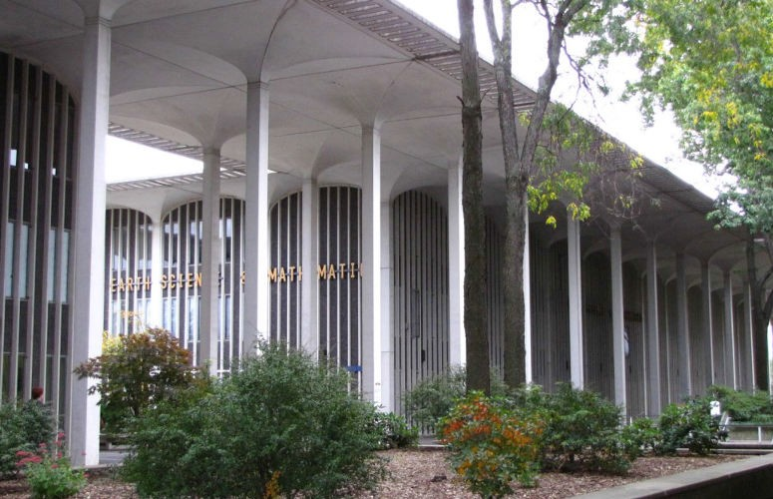
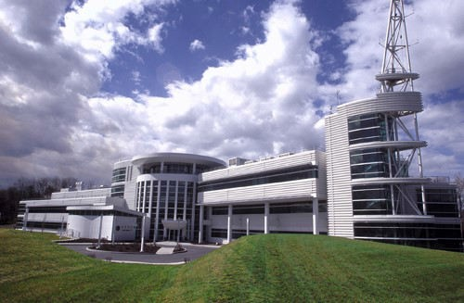
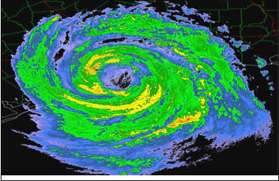
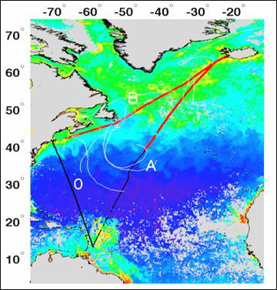




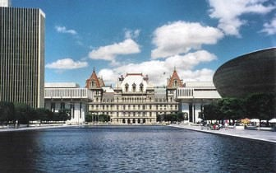
MM..SS.. aanndd PPhh..DD.. DDeeggrreeee PPrrooggrraammss
UNIVERSITY AT ALBANY
ASRC
CCCllliiimmmaaattteee aaannnddd
EEEnnnvvviiirrrooonnnmmmeeennntttaaalll SSSyyysssttteeemmmsss
Faculty supporting the graduate pro-
gram in Atmospheric Sciences are
scientists from the Department of Atmospheric and Environmental Sciences (DAES) and the Atmospheric Sciences Research Center (ASRC).
Synoptic and
Mesoscale Meteorology
The ASRC and the National Weather Service (NWS) local office are both located in the same building, which is within easy walking distance of the DAES. This combination of scientists from two distinct but related institutions gives UAlbany the largest program of education and research in the atmospheric sciences in New York State and one of the largest in the US.
Faculty are funded externally by a variety of agencies such as the National Science Foundation (NSF), the National Aeronautics and Space Administration (NASA), the Environmental Protection Agency (EPA),
the National Oceanic and Atmospheric Administration (NOAA), the Department of Energy (DOE), the Air Force Office for Scientific Research (AFOSR) and the Electric Power Research Institute (EPRI).
The DAES has been particularly successful at mobilizing funds to support collaborations with the NWS through the CSTAR program.
AAAtttmmooosssppphhheeerrriiiccc CCChhheeemmmiiissstttrrryyy aaannnddd
PPPhhhyyysssiiicccsss
Gra d u a te As s is ta n tsh ip s: Fellowships, research assistantships and teaching assistantships are available per calendar year. Tuition scholarships for up to 18 credits per year are offered to all students receiving financial support.
Graduate Applications: Apply through the University Graduate Admissions office. Request an application packet by mail, download materials electronically, or apply online. 518-442-3980 / www.albany.edu/graduate/
For more information: Visit our web pages (www.atmos.albany.edu) or contact Dr. Robert Keesee, Atmospheric Sciences Graduate Program Director:
rgk@atmos.albany.edu
Strategic Location: the City of Albany, the capital of New York State and a short distance from the Berkshires, the Catskills and the Adirondacks.
Re c re atio n : Major ski areas such as Killington, Gore, Hunter, Bromley, Stratton and Mt. Snow are within easy commuting distance.
W ith in Re ac h : Albany is only: 150 miles from New York City, 175 miles from Boston, 225 miles from Montreal. Bus, rail and air terminals are within ten minutes of campus.

