Slide 1


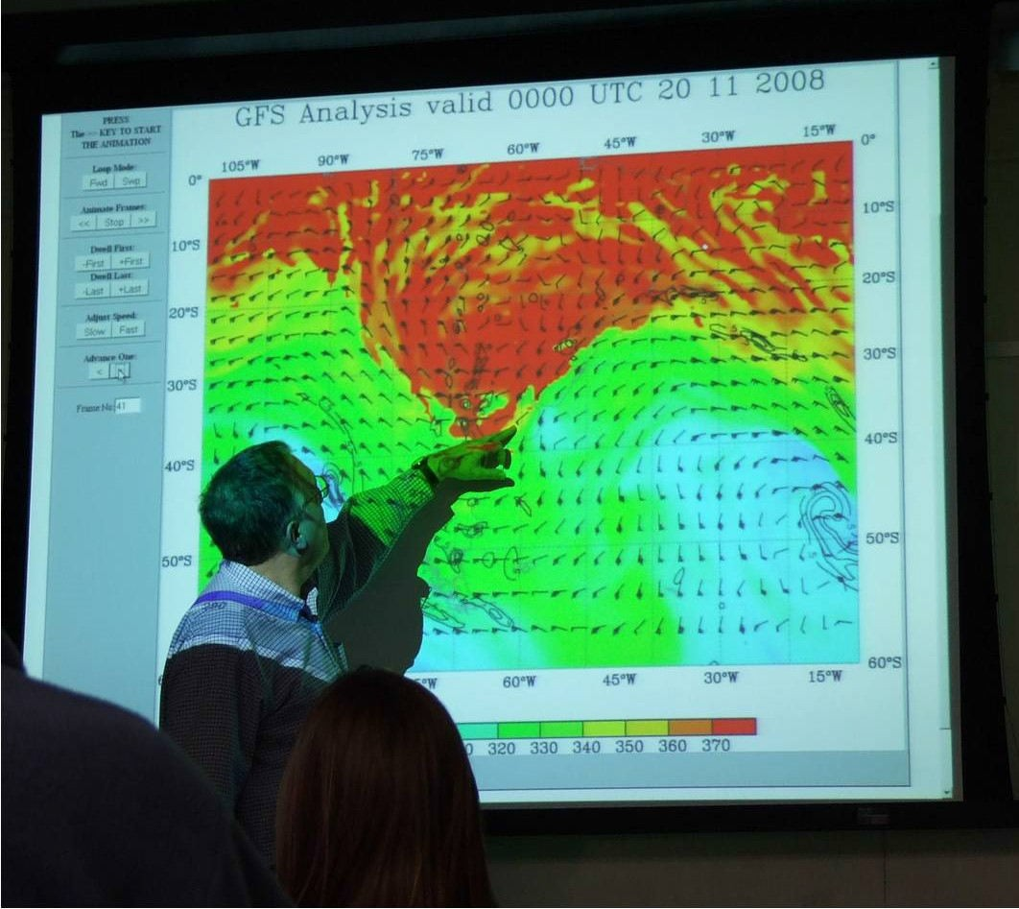
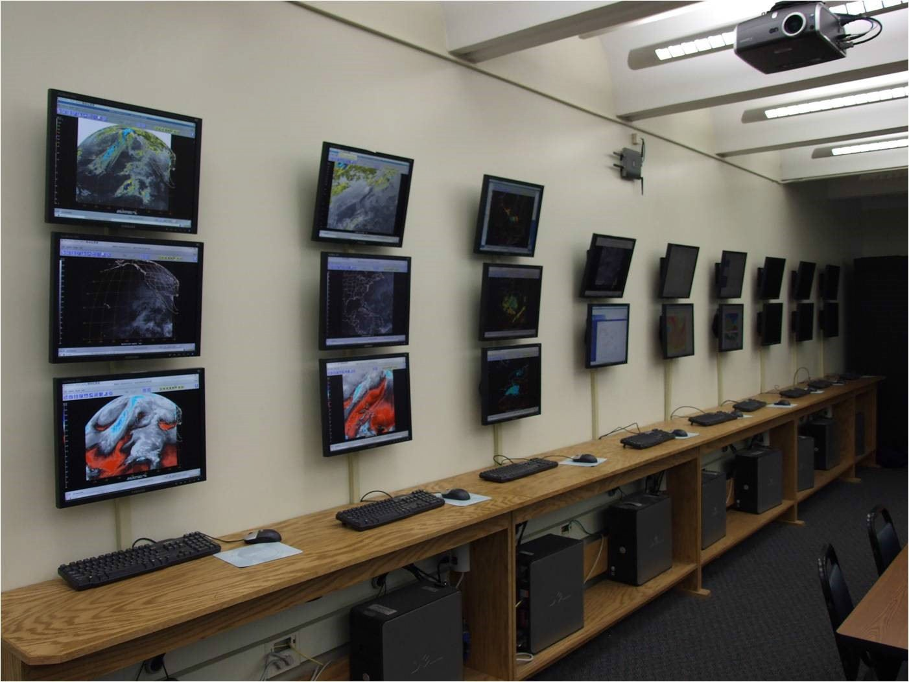
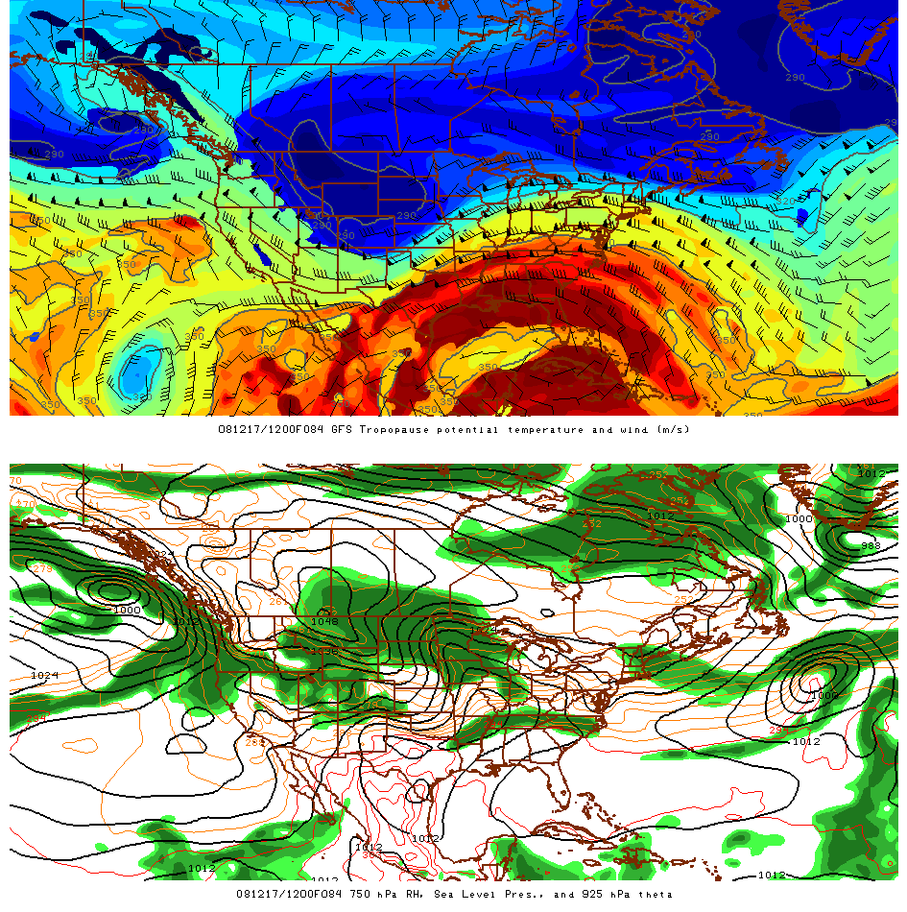
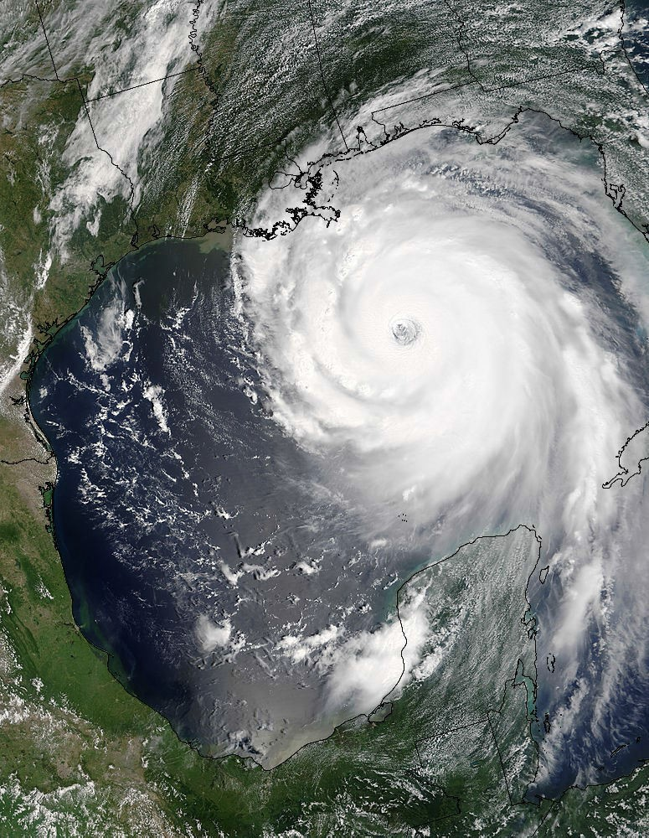
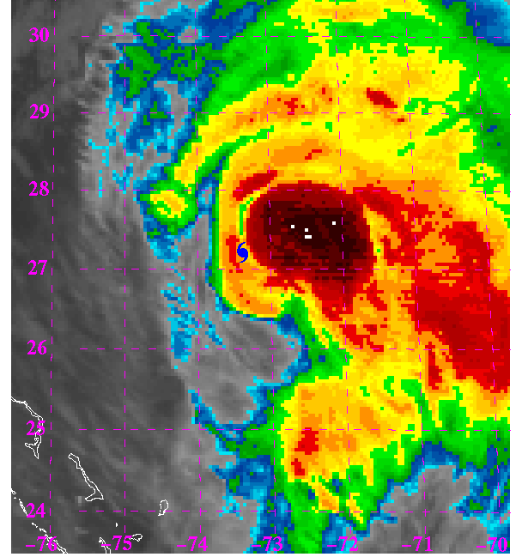
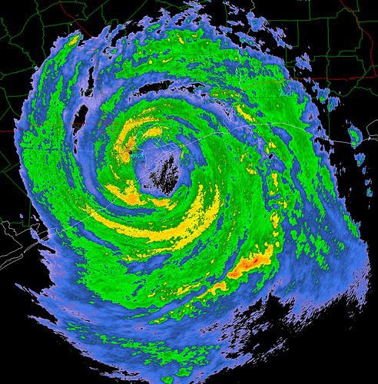
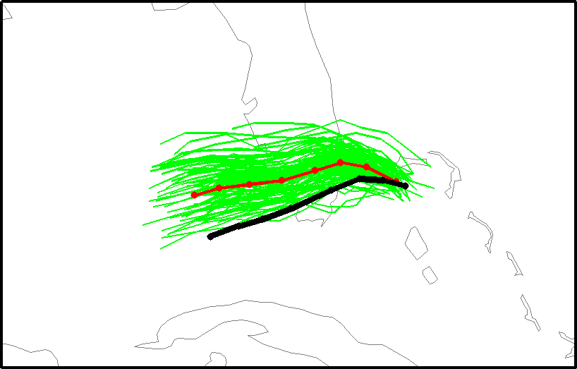
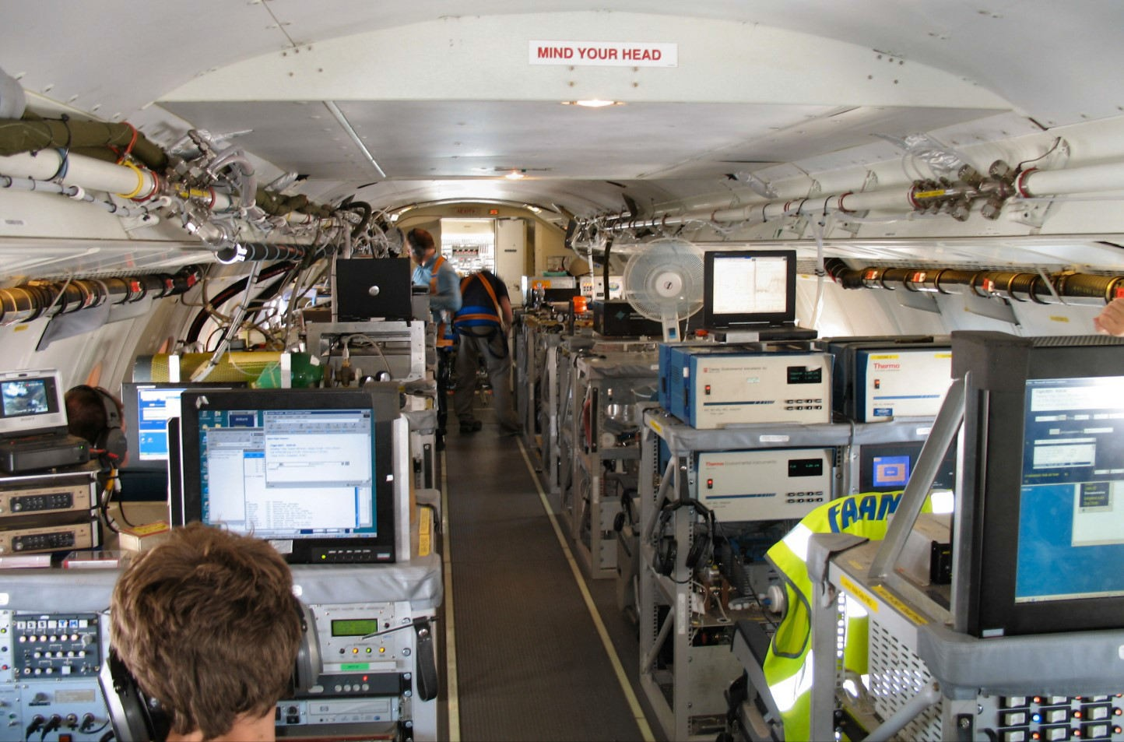
S ynopt i c and Mes os cal e Meteo rol ogy
RE S E ARC H TO P ICS : Extratropical Cyclones, fronts and jet streams
Thunderstorms
Weather analysis and forecasting Synoptic climatology and weather regimes
Hurricanes
Tropical waves and monsoons Predictability and data assimilation
The department has recently benefited from the creation of an electronic map room. This is used for teaching and research purposes. It is also central to the popular map room discussion sessions every Friday afternoon.
Investigation of the nature of mesoscale and synoptic scale weather systems is based on analysis of observations and running state-of-the-art regional models (Bosart, Keyser, Thorncroft).
Visible satellite image of Hurricane Katrina
Ongoing research includes investigation of various phases of hurricane life-cycles including genesis, intensification, electrifica- tion, and mesoscale structures
(Bosart, Molinari, Roundy, Thorncroft).
Radar image of Hurricane Ike
Students often have opportunities to be involved with field campaigns. This picture is taken on board a British research aircraft during a field campaign
in West Africa.
Hurricane Katrina track forecast initialized from a model at 0000 UTC 25 August 2005. Ongoing research is concerned with the predictability of hurricanes (Torn).
FAC ULT Y
Lance F. Bosart, PhD, MIT, 1969. Synoptic and mesoscale meteorology
Daniel Keyser, PhD, Penn State, 1981. Synoptic-dynamic meteorology
John E. Molinari, PhD, Florida State, 1979. Hurricanes and tropical meteorology, lightning in tropical disturbances
Paul E. Roundy, PhD, Penn State University, 2003. Tropical atmosphere & ocean; impacts on global weather and climate
Chris Thorncroft, Department Chair, PhD, Univ. of Reading, UK, 1989, Tropical Meteorology, tropical waves and the West African monsoon
Ryan Torn, PhD, University of Washington, 2007. Predictability, data assimilation, synoptic and mesoscale meteorology

Slide 2


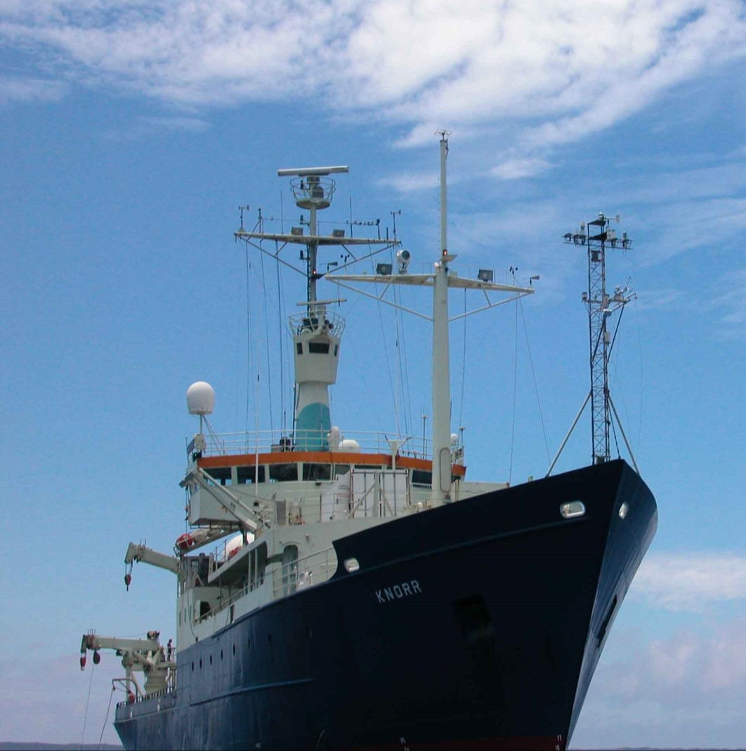
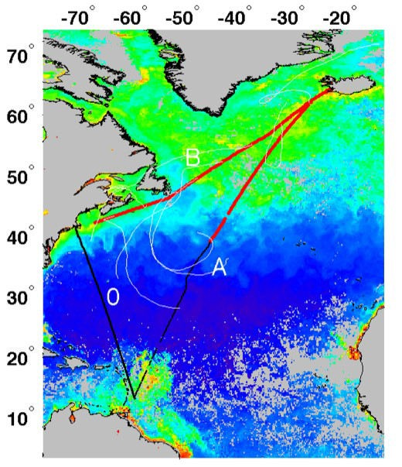
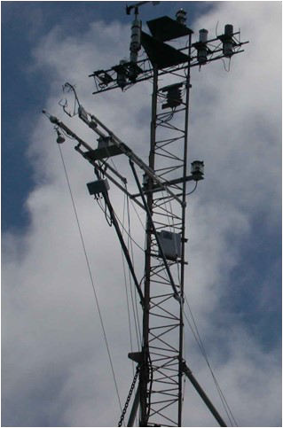
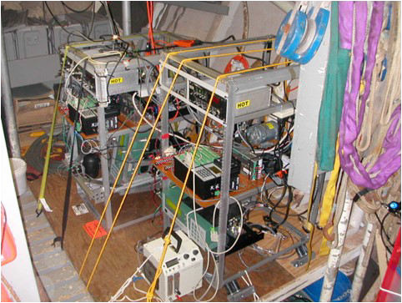
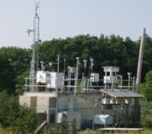
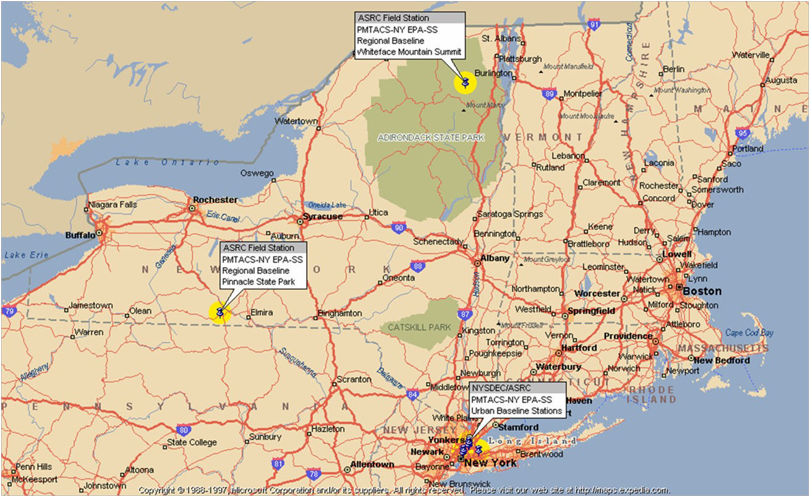
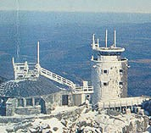
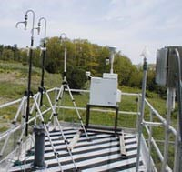
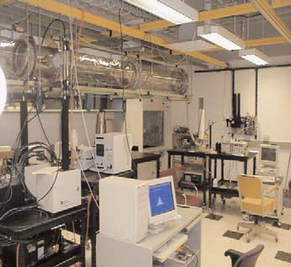
A tmos pheric Chemis tr y and P hys i cs
RE S E ARC H TO P ICS :
Experimental and theoretical studies in chemical kinetics and atmospheric chemical mechanisms Spectroscopic instrumentation development and applications
Experimental determination of photochemical parameters
Field measurement of particulate matter and trace gas species Exploration of regional and global chemical cycles
Modeling of atmospheric transport, transformation and deposition of chemical constituents Modeling of atmospheric chemistry-climate interactions
Physics of aerosols and aerosol instrumentation; boundary-layer transfer processes Atmospheric radiation; remote sensing; cloud and fog microphysics
Formation of precipitation
The research vessel R/V Knorr was used to make direct air/sea gas exchange measurements of carbon dioxide and dimethylsulfide during 3 cruises in spring and summer 2007 in the North Atlantic. The data are being used to study processes controlling gas exchange between the ocean and atmosphere. (Miller)
Pinnacle State Park
Whiteface Mountain Observatory
ASRC Research Facilities
Whiteface Mountain, Pinnacle State Park and Queens College Field Stations
  Aerosol Generation, Calibration and Slow Flow Reactor
    Mobile Measurement Van
      Computation Facilities
Roof of the Recreational Van at Pinnacle State Park
Aerosol Laboratory
F ACULTY
Kenneth L. Demerjian, PhD, Ohio State, 1973. Atmospheric chemistry
David R. Fitzjarrald, PhD, Ohio State, 1973. Atmospheric chemistry, air pollution
Lee Harrison, PhD, Washington-Seattle, 1982. Aerosol physics, atmospheric radiation
Vincent P. Idone, PhD, Univ. at Albany, 1982. Atmospheric electricity
Robert G. Keesee, PhD, Colorado, 1979. Atmospheric chemistry and aerosols
G. Garland Lala, PhD, Univ. at Albany, 1972. Cloud and precipitation physics
Scott D. Miller, PhD, UC-Irvine, 1998. Micrometeorology, air-sea interaction
James J. Schwab, PhD, Harvard, 1983. Atmospheric chemistry, field measurement of gases and particles
Christopher J. Walcek, PhD, UCLA, 1983. Cloud physics, cloud chemistry
Wei-Chyung Wang, D.E.S., Columbia, 1973. Atmospheric radiation and climate modeling
Fangqun Yu, PhD, UCLA, 1998. Atmospheric Physics and Chemistry; Aerosol Microphysics

Slide 3
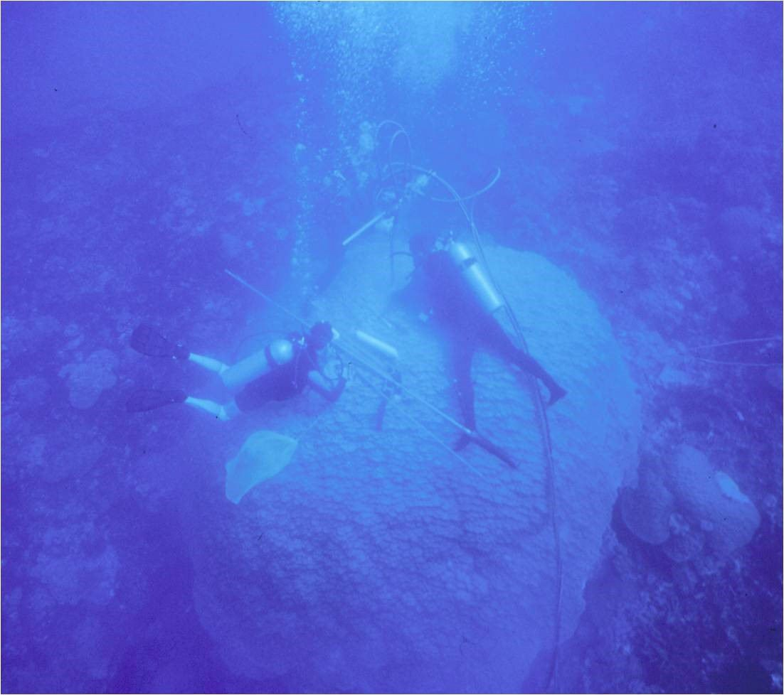
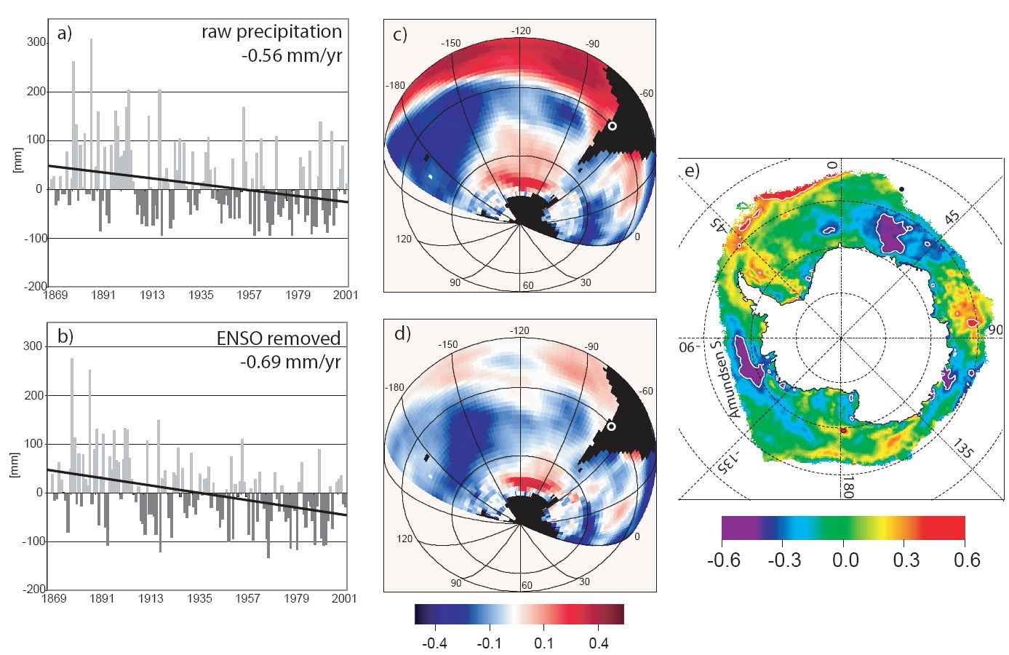
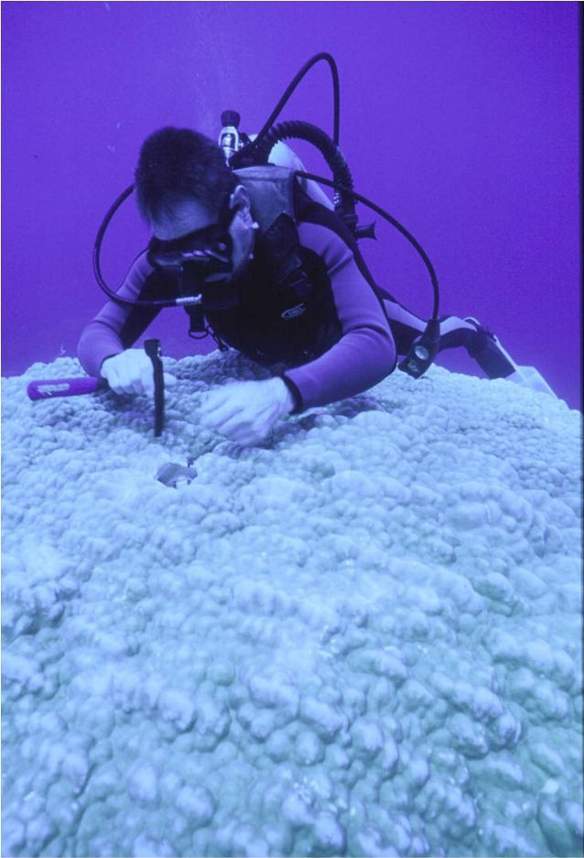
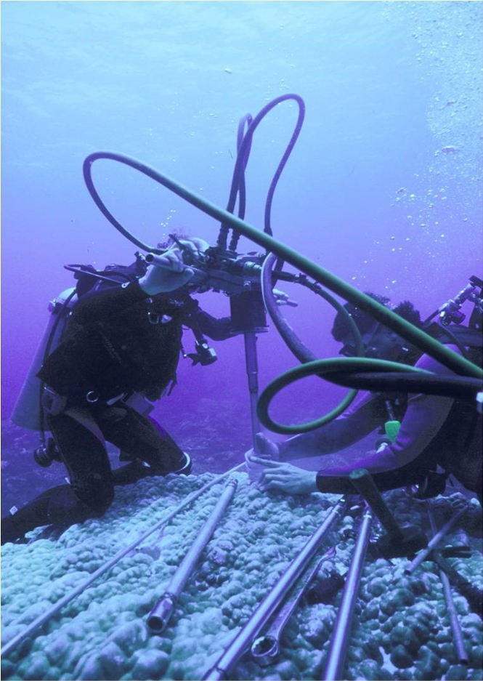
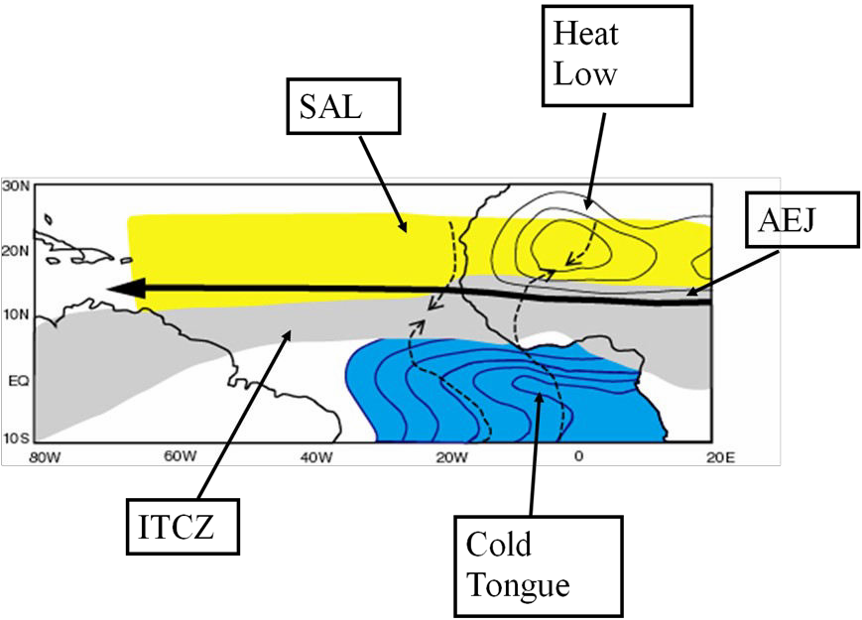
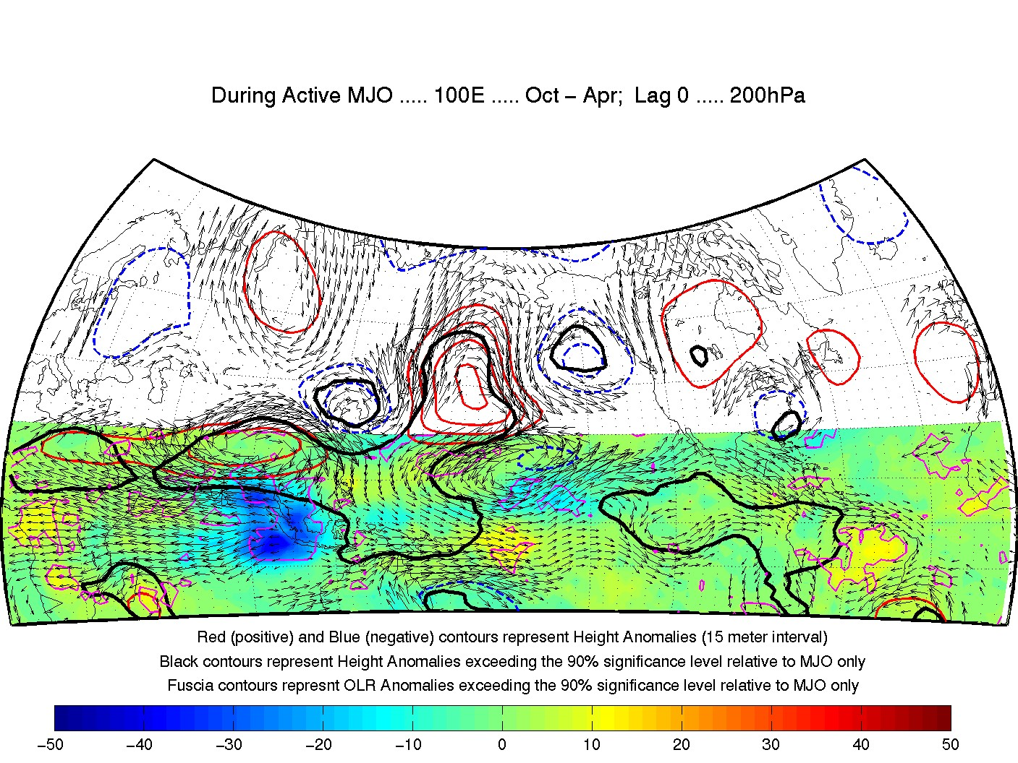

Cl ima te and E nvi ronm ental S ys tem s
RE S E ARC H TO P ICS : Intraseasonal variability
El Niño Southern Oscillation Biogeochemical cycles
Climate modeling and diagnostics
Climate data analysis Climate-chemistry interactions
Earth system history
Paleoclimatology Paleoceanography
Remote sensing of the atmosphere
Cloud-climate interactions
Effects of aerosols on climate Solar radiation measurement Applied solar energy
Natural lighting systems
Applications of solar meteorology to photovoltaic electricity generation
Precipitation in subtropical Chile has been declining over the last 130 years, which is of concern given the low precipitation, high economic activity and large population. Interannu- al variability of precipitation is primarily controlled by ENSO, but this study shows that the negative trend is not related to tropical Pacific forcing and that recent El Niño activity actu- ally helped to alleviate the drought. Instead changes in high-latitude SST and sea-ice con- centration may be the main driver for the observed secular drying trend
(Vuille & Milana, 2007, Geophys. Res. Lett. 34, L23703).
Dr. Linsley and his students sample and geochemically analyze massive corals to reconstruct climate in the Pacific at
near-monthly resolution over the last 400 years. To date, this
research is focused on decadal-scale and interannual variability in sea surface salinity and temperature in the southwest Pacific. A large Porites lutea colony in Fiji is being cored and the core holes plugged when finished.
Figure shows key features of the West African Monsoon system. Ongoing research aims to shed new light on how the land, atmosphere and ocean interact and to ultimately understand how these interactions influence the variability of the monsoon at interannual and longer timescales. The impact of West African Monsoon var- iability on hurricane varia- bility is also
investigated (Thorncroft).
Composite 200 hPa heights and
winds
associated with
the Madden-Julian
Oscillation
MJO
F ACULTY
John W. Delano, PhD, SUNY Stony Brook, 1977. Igneous and sedimentary geochemistry
William S. F. Kidd, PhD, Cambridge, 1974. Tectonics and structural geology
Braddock K. Linsley, PhD, New Mexico, 1990. Environmental geochemistry and climate change
Scott D. Miller, PhD, UC-Irvine, 1998. Micrometeorology, air-sea interaction
Qilong Min, PhD, Alaska-Fairbanks, 1993, Radiative transfer, remote sensing
Richard R. Perez, PhD, Univ. at Albany, 1983. Solar energy applications
Paul E. Roundy, PhD, Penn State University, 2003. Tropical atmosphere & ocean; impacts on global weather and climate
Chris Thorncroft, Department Chair, PhD, Univ. of Reading, UK, 1989, Variability of the West African monsoon
Mathias Vuille, PhD, University of Bern, 1995. Tropical climate change, tropical glacier-climate interactions.
Wei-Chyung Wang, D.E.S., Columbia, 1973. Atmospheric radiation and climate modeling

Slide 4














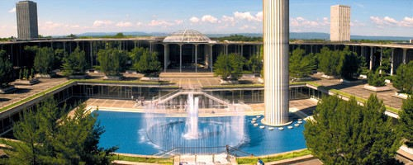
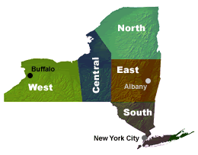
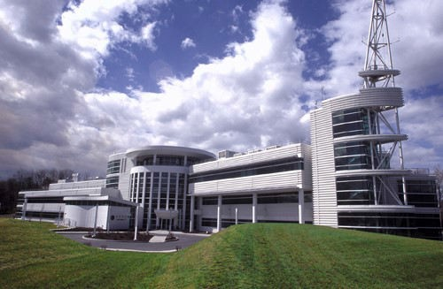
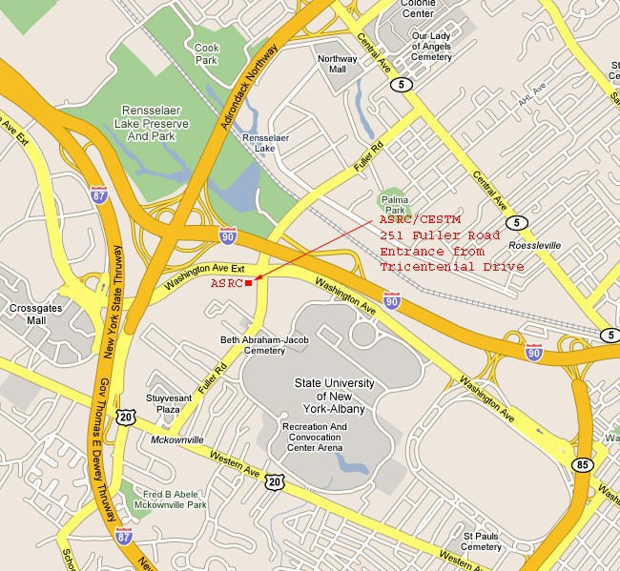
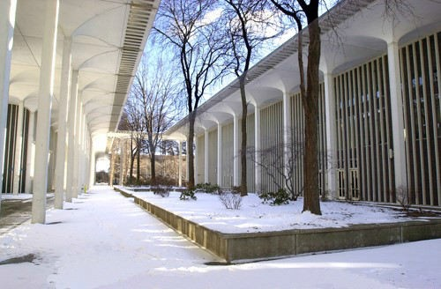
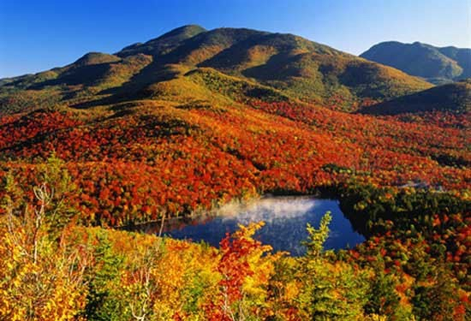
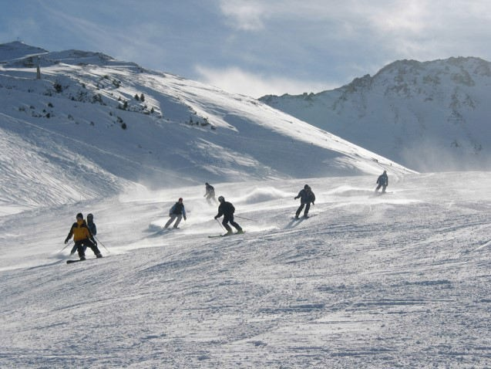
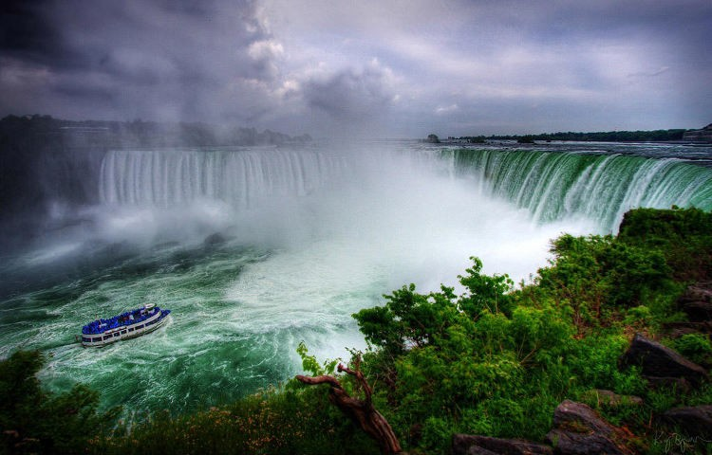
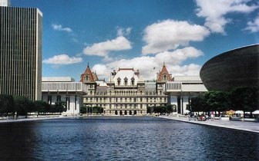
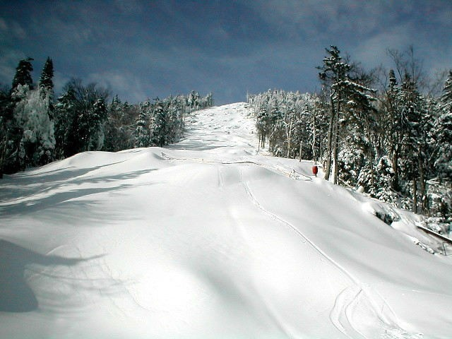
The University at Albany is an internationally recognized public research institution located in the state capital of New York.
Established in 1844 and designated a university in 1962, UAlbany puts the world within reach for nearly 18,000
students at the gr adu at e and u nd er gr adu at e levels.
Faculty supporting the graduate program in Atmospheric Sciences in the University at Albany are scientists from the Department of Atmospheric and Environmental Sciences (DAES) and the Atmospheric Sciences Research Center (ASRC). The ASRC and the local office of the National Weather Service (NWS) are both located in the same building, which is within easy walking distance of the DEAS. This combination of scientists from two distinct but related institutions gives the University at Albany the largest program of education and research in the atmospheric sciences in New York State and one of the largest in the US.
The current group of scientists cover a broad range of research interests in the atmospheric and environmental sciences that is organized under three broad headings: Synoptic and Mesoscale Meteorology, Climate and Environmental Systems, and Atmospheric Chemistry and Physics. Students may combine these areas or propose interdisciplinary research with other departments, such as Mathematics, Physics, Chemistry, Nanoscience, Geography, Environmental Health Sciences, and Public Affairs. The Department of Environmental Health Sciences located at the Wadsworth Center, in particular, has several faculty members with research interests in atmospheric and environmental chemistry.
Faculty are funded externally by a variety of agencies such as the National Science Foundation (NSF), the National Aeronautics and Space Administration (NASA), the Environmental Protection Agency (EPA), the National Oceanic and Atmospheric Administration (NOAA), the Department of Energy (DOE), the Air Force Office for Scientific Research (AFOSR) and the Electric Power Research Institute (EPRI). The DAES has been particularly successful at mobilizing funds to support collaborations with the National Weather Service through the CSTAR program.
Atmospheric Sciences Research Center (ASRC)
University at Albany Academic Podium near
the Earth Science Building
Map of UAlbany and ASRC
G radu a te Ass is tant sh ips : Fellowships, research assistantships, and teaching assistantships are available per calendar year. Tuition scholarships for up to 18 credits per year are offered to all students receiving financial support.
G radu a te Ap pl ic at i ons : Apply to the program through the University Graduate Admissions office. 518-442-3980 / www.albany.edu/graduate/ Choose to request an application packet be mailed to you, download the materials electronically, or apply online.
F or m ore inf orm at i on : Please visit our web pages (www.atmos.albany.edu) or contact Dr. Robert Keesee, Atmospheric Sciences Graduate Program Director: rgk@atmos.albany.edu
S tr ategic Location: The University at Albany enjoys a strategic location in the City of Albany. The capital of the State of New York offers something for everyone, the center of a region remarkable for its natural and cultural resources.
The Capital Region includes the cities of Albany, Schenectady and Troy, and has a population of approximately 875,000. Within a short distance are the Berkshires, the Catskills and the Adirondacks, the largest wilderness area east of the Mississippi River.
R ecr eat ion : Major ski areas such as Killington, Gore, Hunter, Bromley, Stratton and Mt. Snow are within easy commuting distance. Saratoga Springs, 25 miles to the north, is internationally known as a sports, concert, and cultural center, and features outstanding thoroughbred and harness racing at Saratoga Race Track.
W ithi n R e a ch: Geographically, the city of Albany is only:
150 miles from New York City
175 miles from Boston
225 miles from Montreal, Canada.
The New York State Thruway and two major interstate highways intersect one mile from the main campus. Bus, rail, and air terminals are all within ten minutes of UAlbany’s campus.

