Slide 1
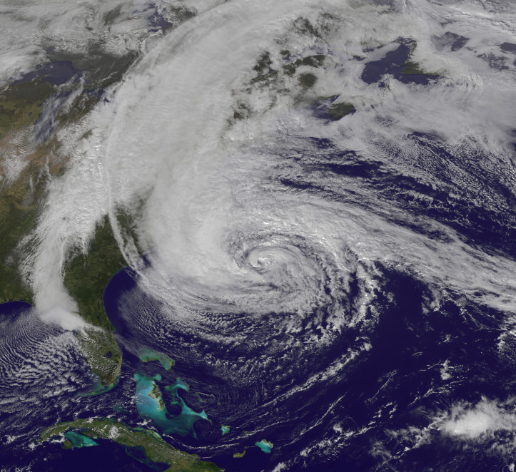
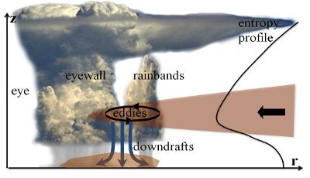
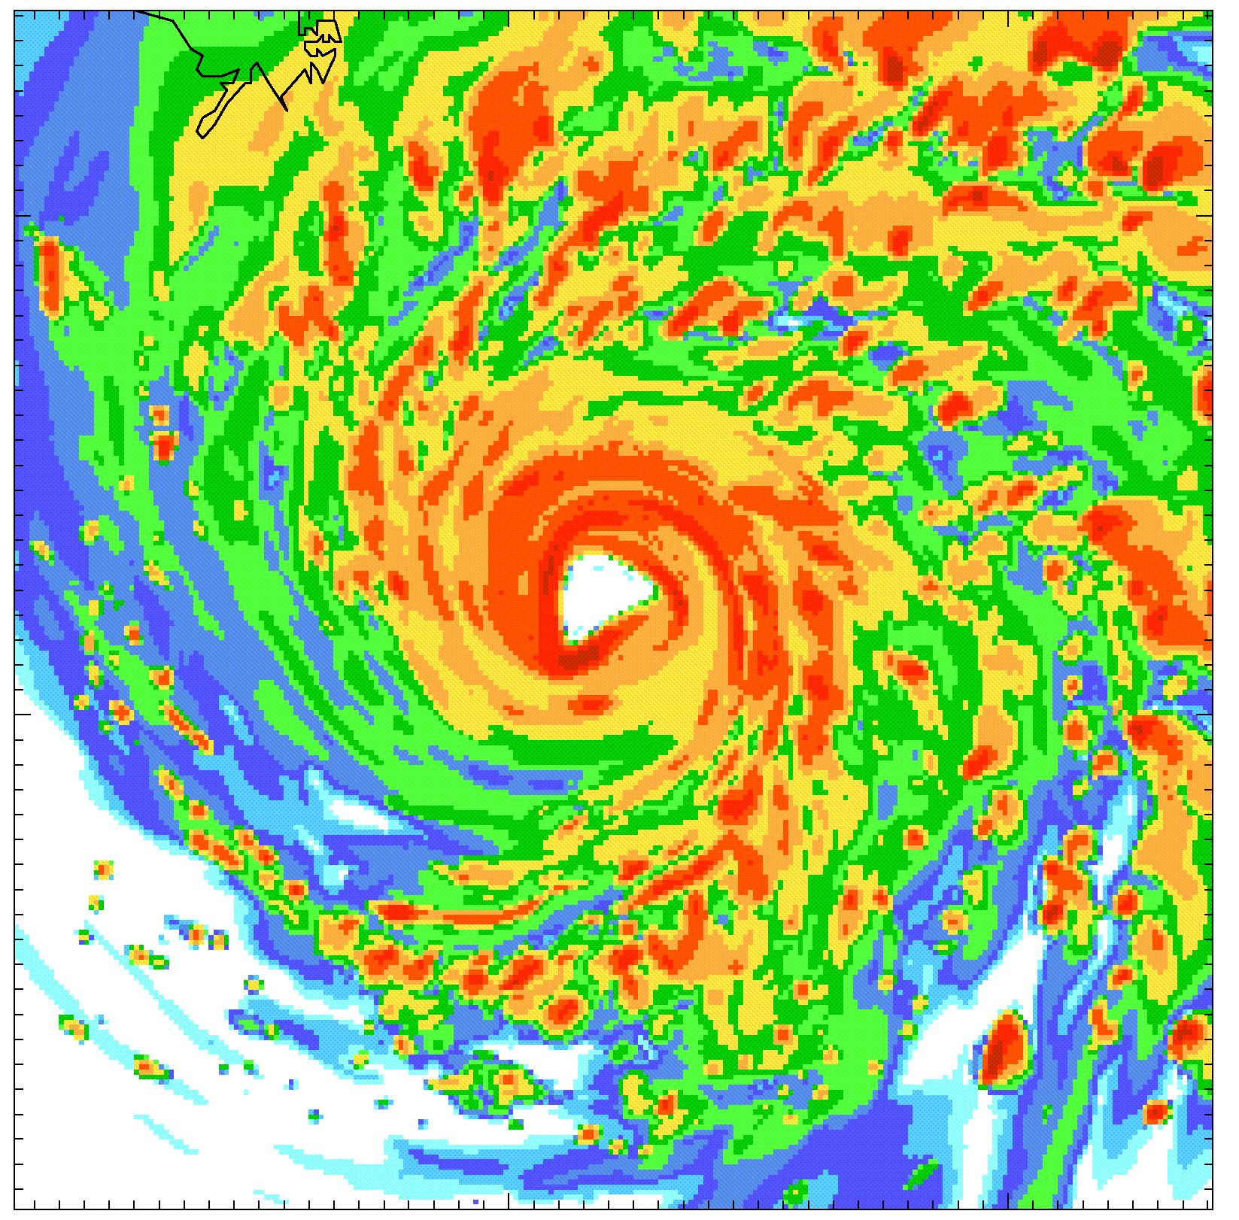
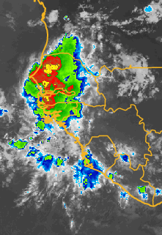
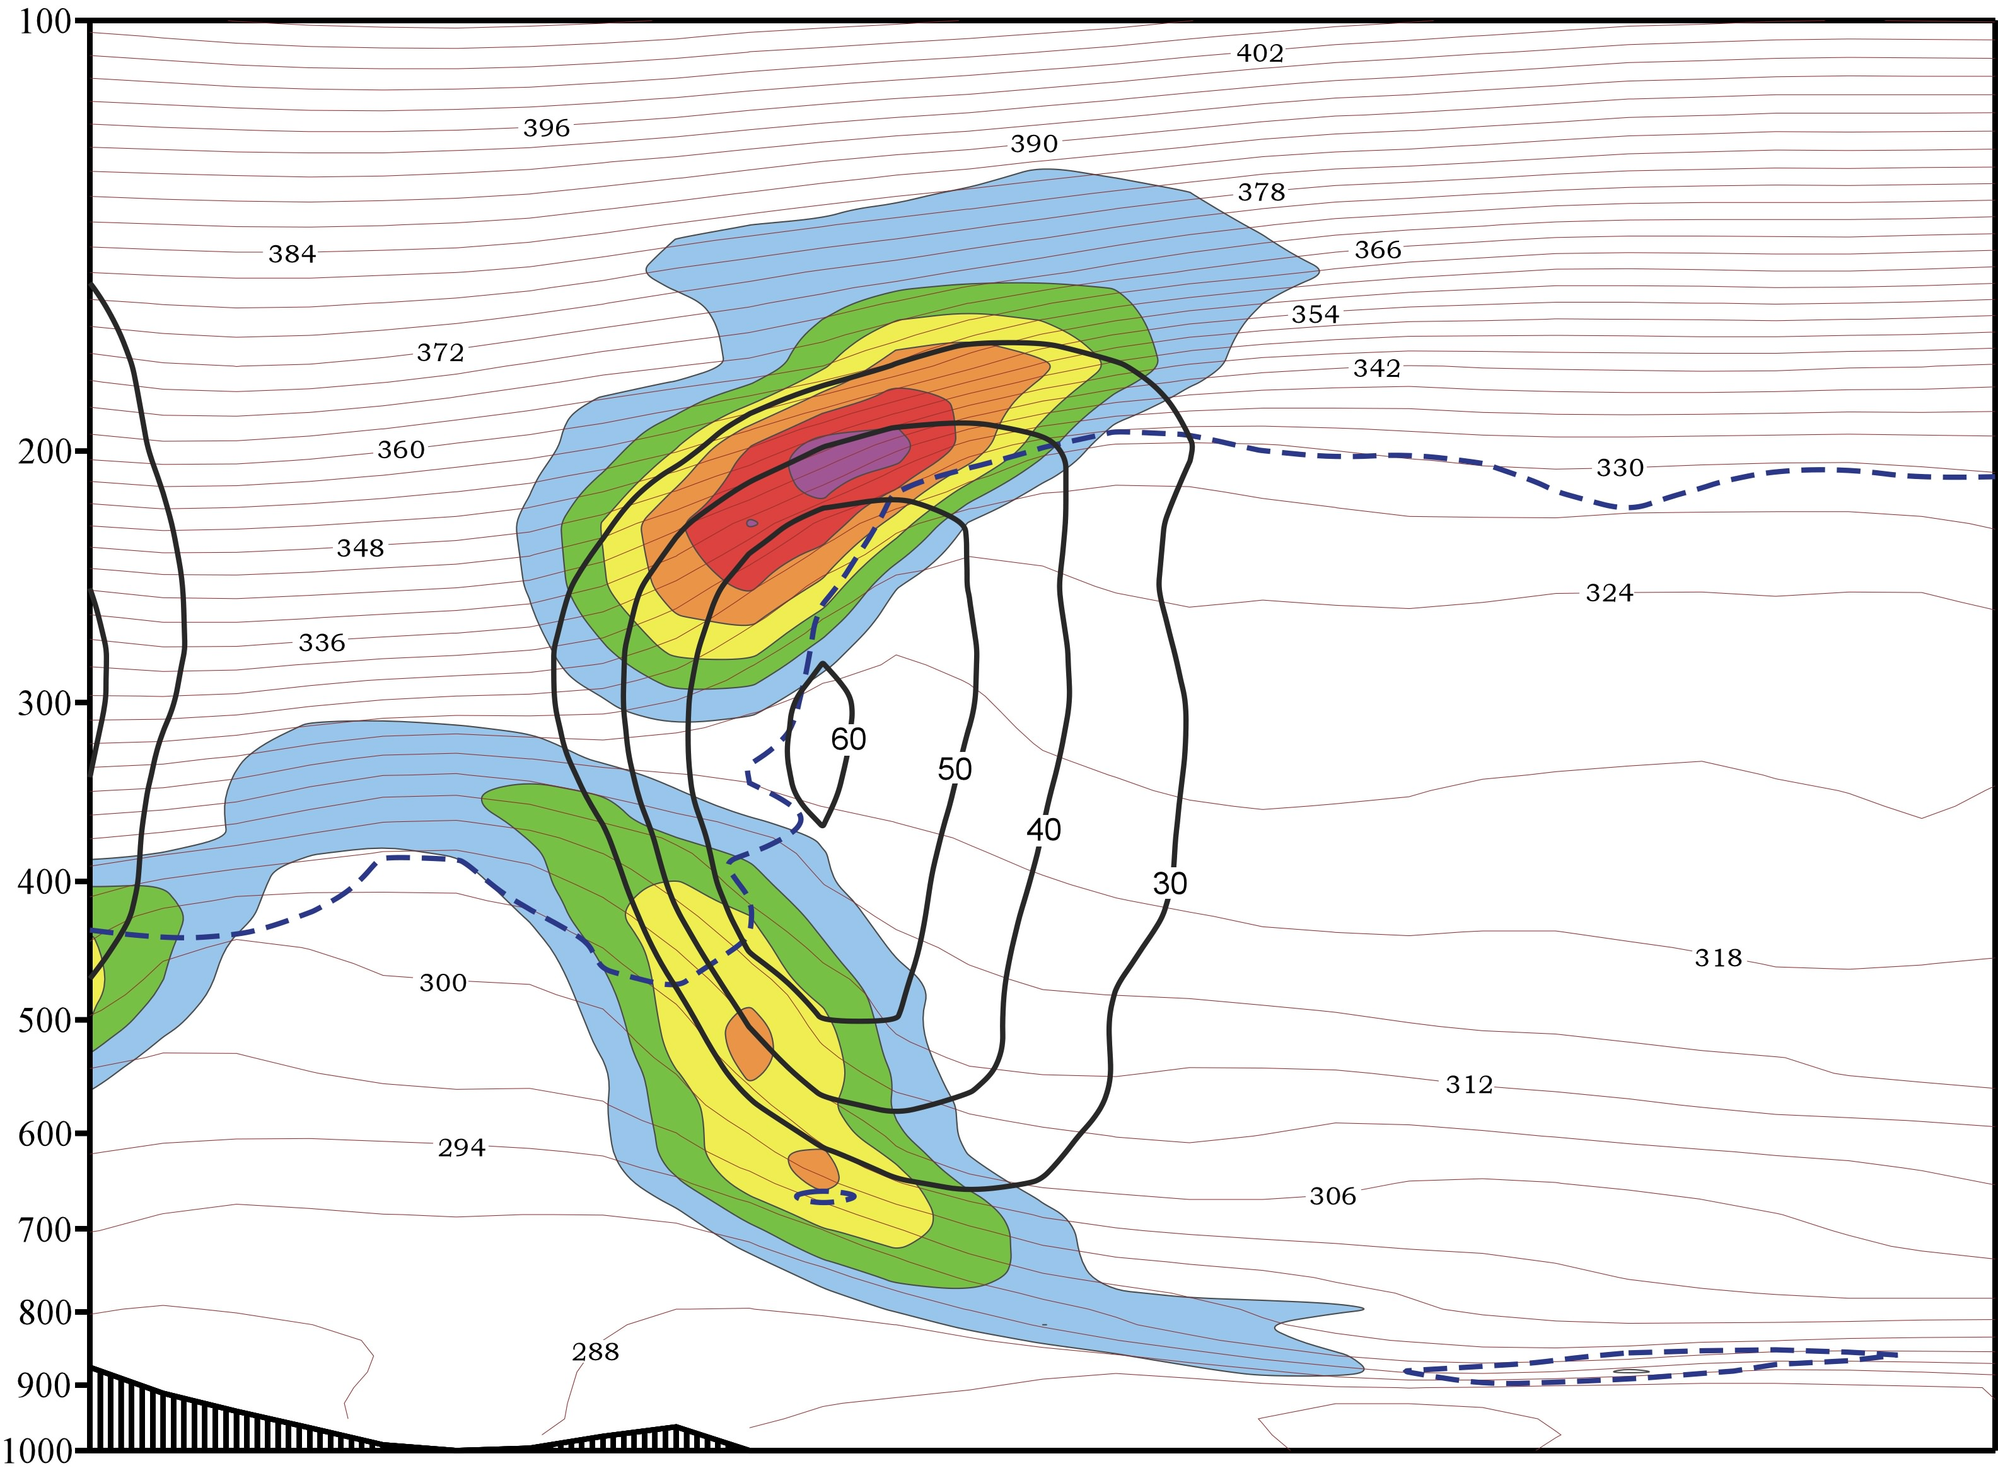
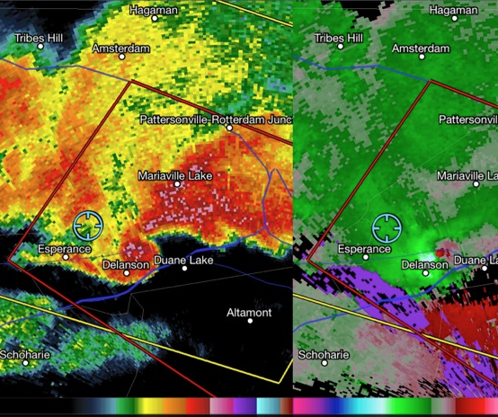
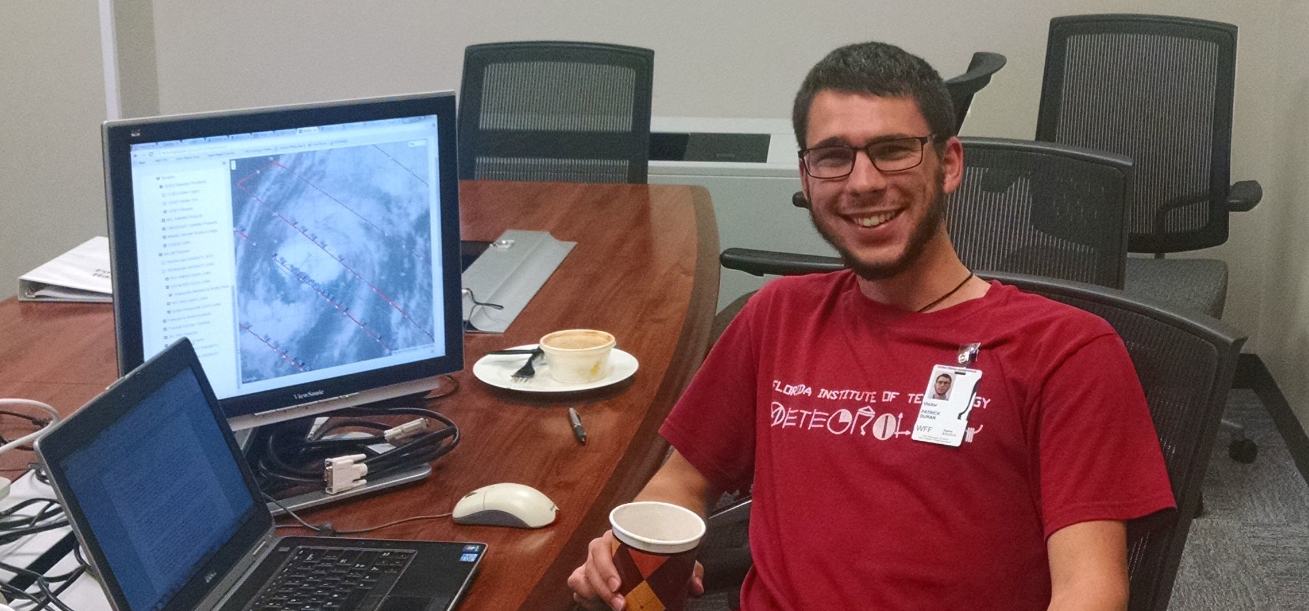
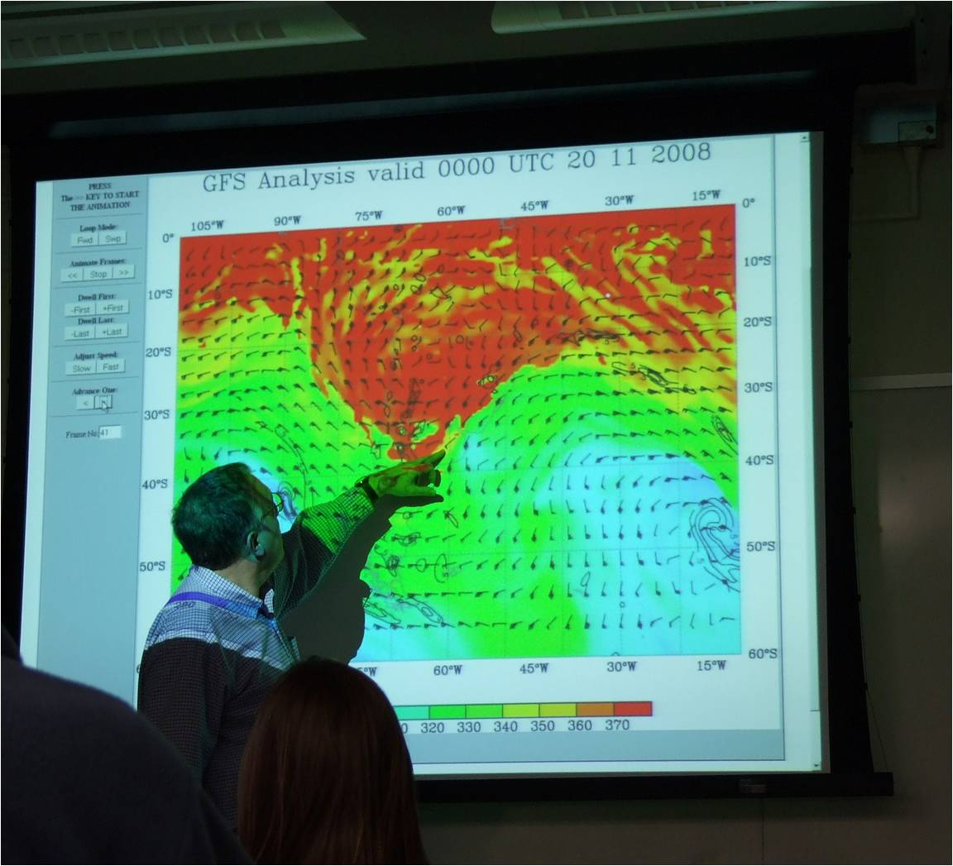
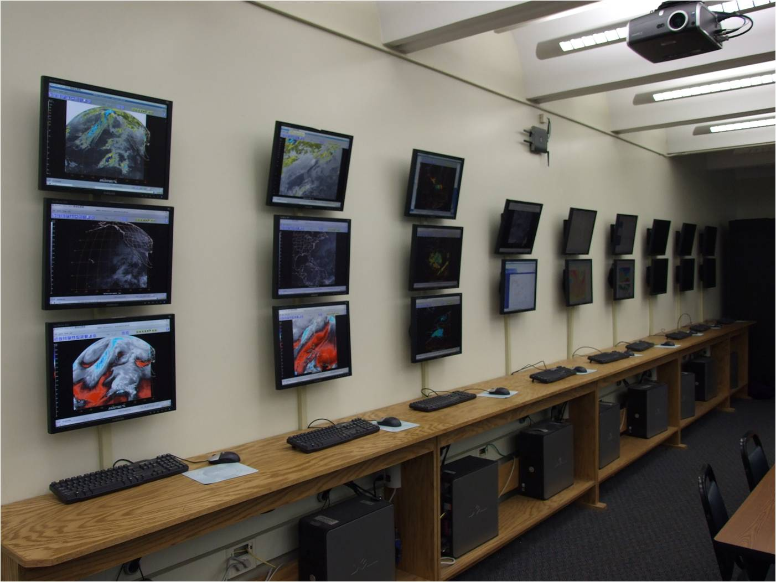
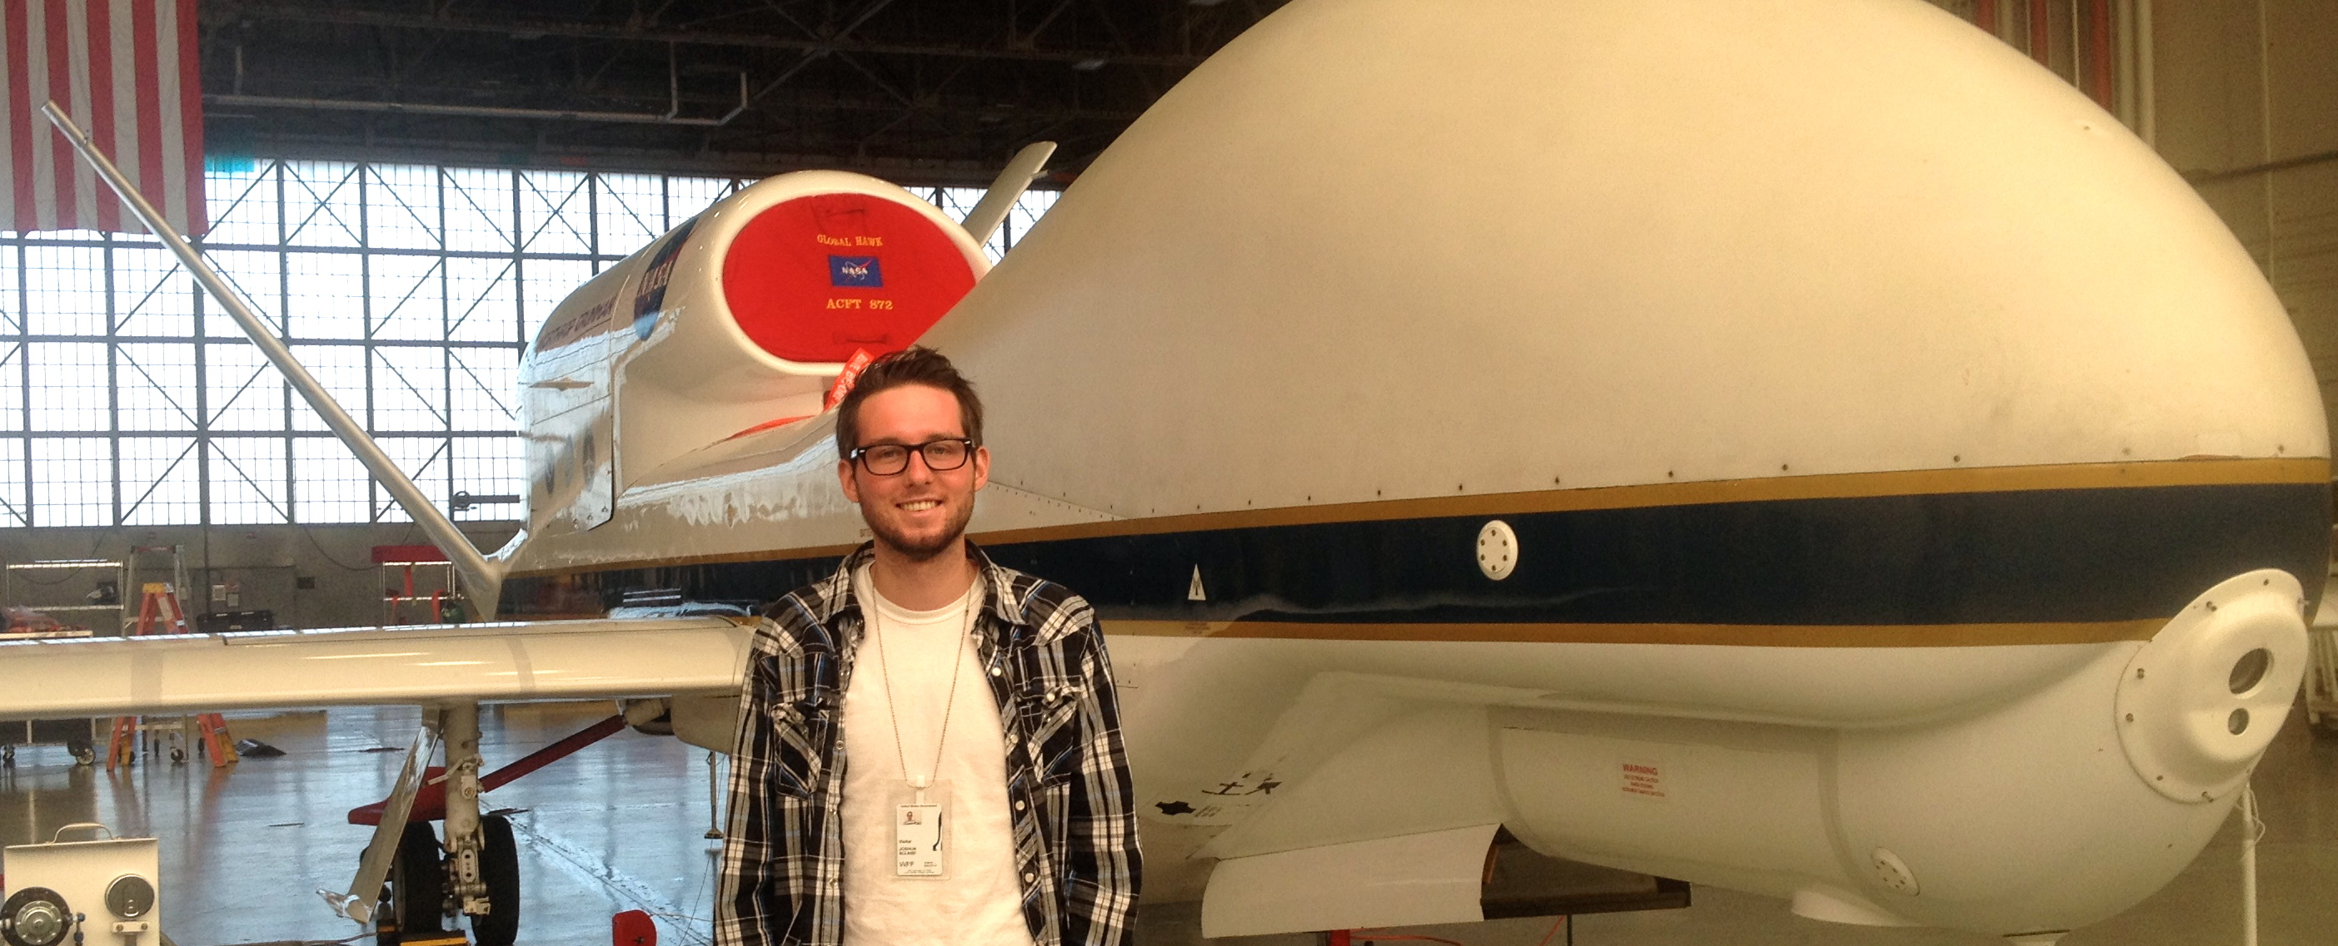
UNIVERSITY AT ALBANY
Synoptic and Mesoscale Meteorology
RESEARCH TOPICS:
Extratropical cyclones, fronts and jet streams • Thunderstorms and thunderstorm climatology Tropical cyclone intensity and structure • Extratropical transition • Tropical transition
Weather—climate interactions • Tropical cyclones and their role in the climate system
Synoptic climatology and weather regimes • Tropical waves and monsoons
Predictability and data assimilation • Mountain meteorology in a changing climate
Synoptic dynamics in stratosphere—troposphere interactions
Bosart/Keyser
Tang
Hurricane Sandy (2012)
Synoptic/tropical/mesoscale groups
Bosart/Keyser
Corbosiero/Molinari
Hurricane eye/eyewall dynamics
Thorncroft
African easterly waves/TC genesis
Lang
Stratosphere—troposphere interactions
Duanesburg, NY EF-3: May 22, 2014
Synoptic/mesoscale/CSTAR groups
Students participate in the HS3
Hurricane Mission campaign
The department a state-of-the-art electronic map room used for teaching and research. It is also central to the popular map room discussion sessions, which occur at least twice per week.
FACULTY
Lance F. Bosart, Distinguished Professor; PhD, MIT, 1969. Synoptic and mesoscale meteorology.
Kristen L. Corbosiero, Assistant Professor; PhD, Univ. at Albany, 2005. Synoptic and tropical meteorology; tropical cyclone structure; applications of lightning data.
Robert Fovell, Professor; PhD, University of Illinois, 1988. Mesoscale meteorology and high-resolution numerical models
Daniel Keyser, Professor; PhD, Penn State, 1981. Synoptic-dynamic meteorology.
Andrea Lang, Assistant Professor; PhD, University of Wisconsin, 2011. Synoptic-dynamic meteorology.
Justin Minder, Assistant Professor; PhD, Univ. of Washington, 2010. Mountain weather and climate, regional climate, mesoscale dynamics, hydrometeorology.
John Molinari, Professor; PhD, Florida State, 1979. Hurricanes and tropical meteorology, lightning in tropical disturbances.
Paul E. Roundy, Associate Professor; PhD, Penn State University, 2003. Tropical atmosphere & ocean; impacts on global weather and climate.
Brian Tang, Assistant Professor; Ph.D., MIT, 2010. Tropical meteorology; mesoscale dynamics; synoptic meteorology; weather-climate interactions.
Chris Thorncroft, Professor, Department Chair; PhD, Univ. of Reading, UK, 1989. Tropical Meteorology; tropical waves and the West African monsoon.
Ryan Torn, Assistant Professor; Ph.D., University of Washington, 2007. Predictability and data assimilation; synoptic and mesoscale meteorology.

Slide 2
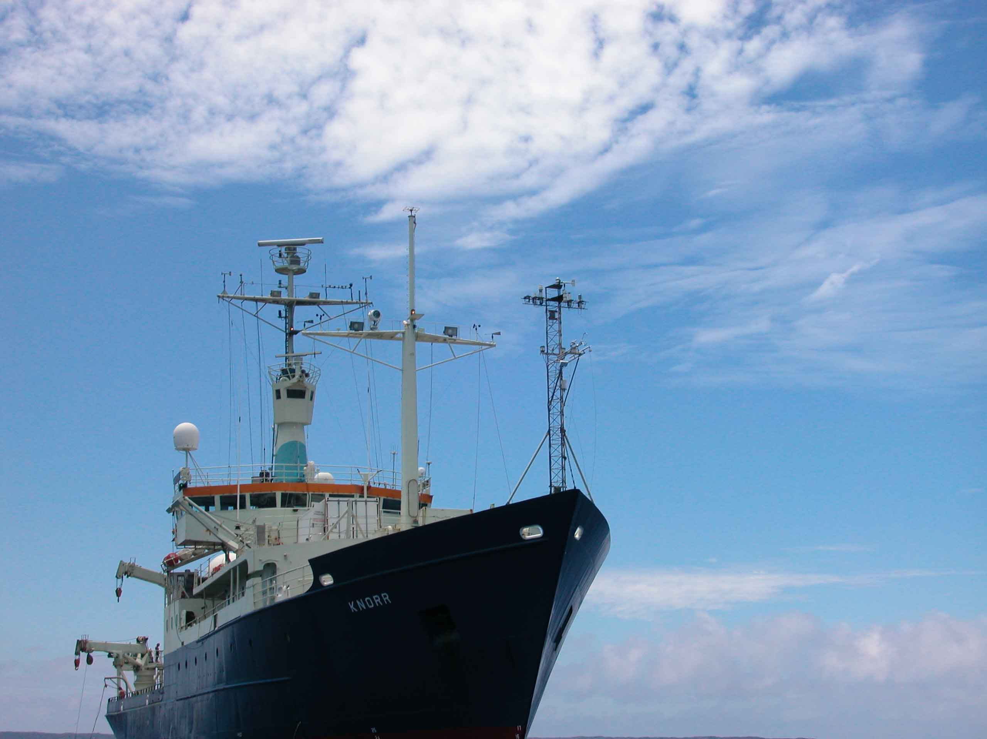
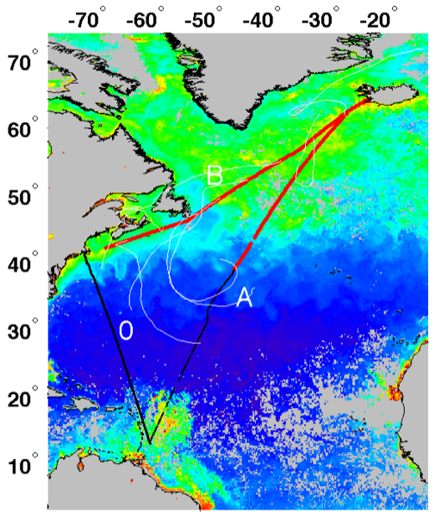
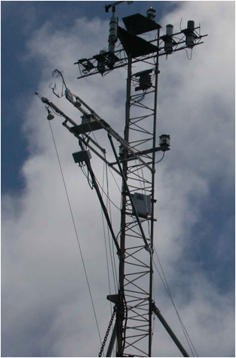
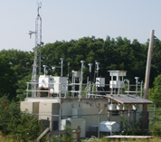
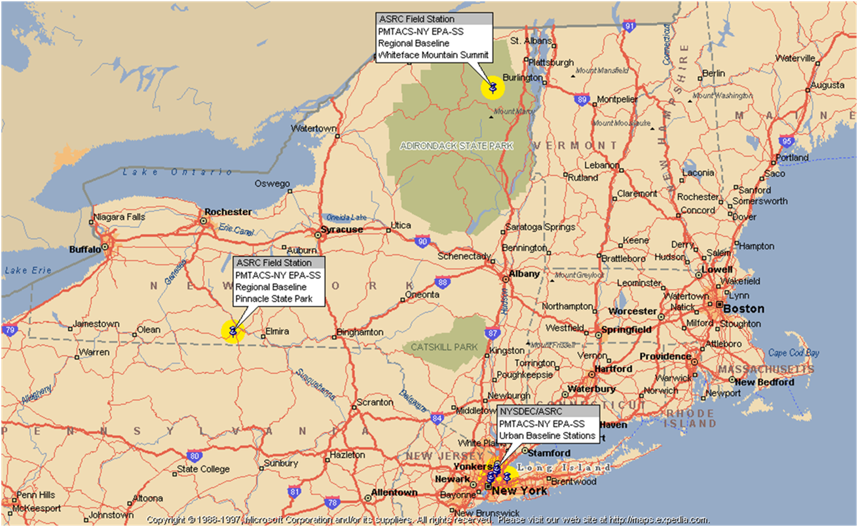
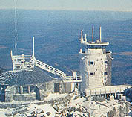
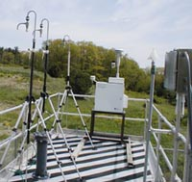
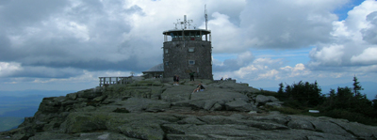
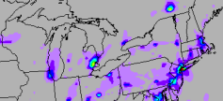
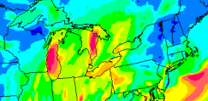
UNIVERSITY AT ALBANY
Atmospheric Chemistry and Physics
RESEARCH TOPICS:
Experimental and theoretical studies in chemical kinetics and atmospheric chemical mechanisms
Spectroscopic instrumentation development and applications
Experimental determination of photochemical parameters
Field measurement of particulate matter and trace gas species
Exploration of regional and global chemical cycles
Modeling of atmospheric transport, transformation and deposition of chemical constituents
Modeling of atmospheric chemistry-climate interactions
Physics of aerosols and aerosol instrumentation
Boundary-layer transfer processes
Atmospheric radiation • Remote sensing
Cloud and fog microphysics • Precipitation formation
The research vessel R/V Knorr was used to make direct/sea gas exchange measurements of carbon dioxide and dimethylsulfide during 3 cruises in spring and summer 2007 in the North Atlantic. The data are being used to study processes controlling gas exchange between the ocean and atmosphere (Miller)
Pinnacle State Park
Observatory
Whiteface Mountain
Observatory
ASRC Research Facilities
Whiteface Mountain, Pinnacle State Park and Queens College Field Stations
Aerosol Generation, Calibration and Slow Flow Reactor
Mobile Measurement Van
Computation Facilities
Roof of the Recreational Van
at Pinnacle State Park
Aerosol Laboratory
Whiteface observatory
FACULTY
Craig R. Ferguson, Research Associate; PhD, Princeton, 2010. Hydrology, remote sensing, climate reconstruction and predictability.
Jeff Freedman, Research Associate; PhD, Univ. at Albany, 2000. Renewable energy and remote sensing.
David R. Fitzjarrald, Research Associate; PhD, Virginia, 1980. Boundary layer meteorology.
Lee Harrison, Research Associate; PhD, University of Washington-Seattle, 1982. Aerosol physics, atmospheric radiation.
Everette Joseph, Director, ASRC; PhD, Univ. at Albany, 1997. Aerosols and remote sensing.
Scott Miller, PhD, Univ. California - Irvine, 1998. Micrometeorology, air-sea interaction.
Justin Minder, Assistant Professor; PhD, Univ. of Washington, 2010. Mountain weather and climate, regional climate, mesoscale dynamics, hydrometeorology.
Richard Perez, PhD, Univ. at Albany, 1983. Solar energy.
James J. Schwab, Research Professor; PhD, Harvard, 1983. Atmospheric chemistry, field measurement of gases and particles.
Kara J. Sulia, PhD, Penn. State, 2013. Ice microphysics.
Chris J. Walcek, Adjunct Faculty; PhD, UCLA, 1983. Cloud physics, cloud chemistry.
Fangqun Yu, Adjunct Faculty; PhD, UCLA, 1998. Atmospheric Physics and chemistry; aerosol microphysics.

Slide 3
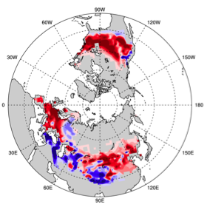
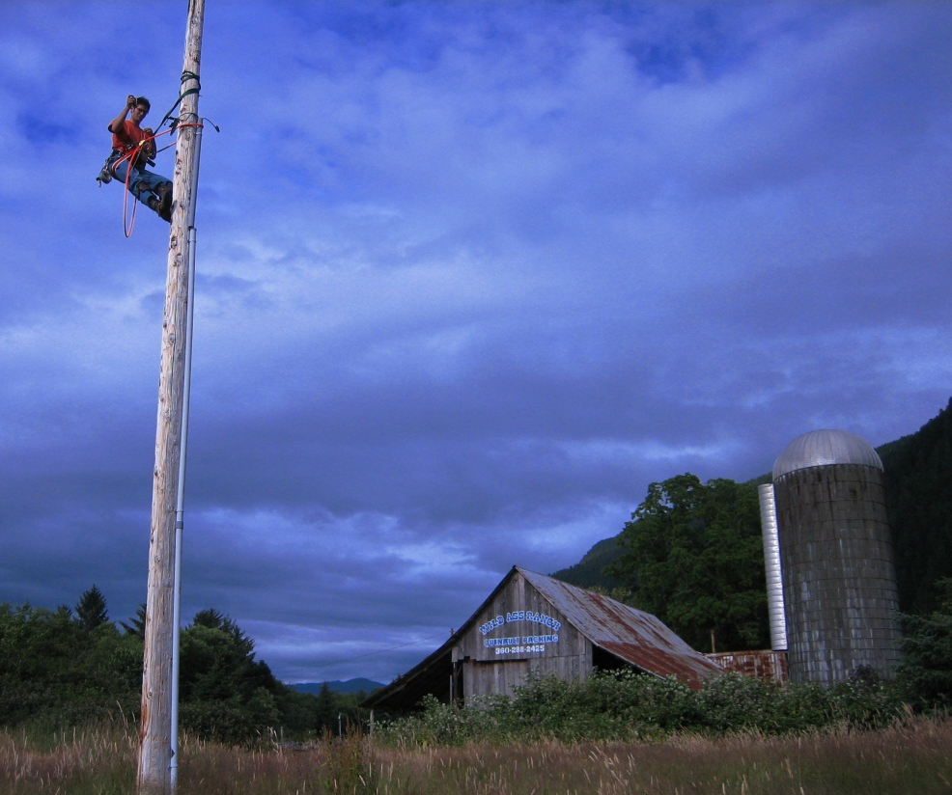
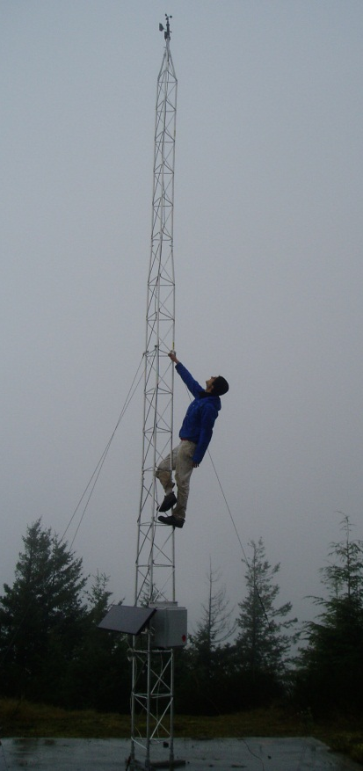
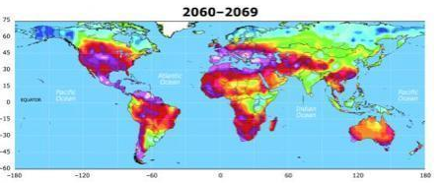
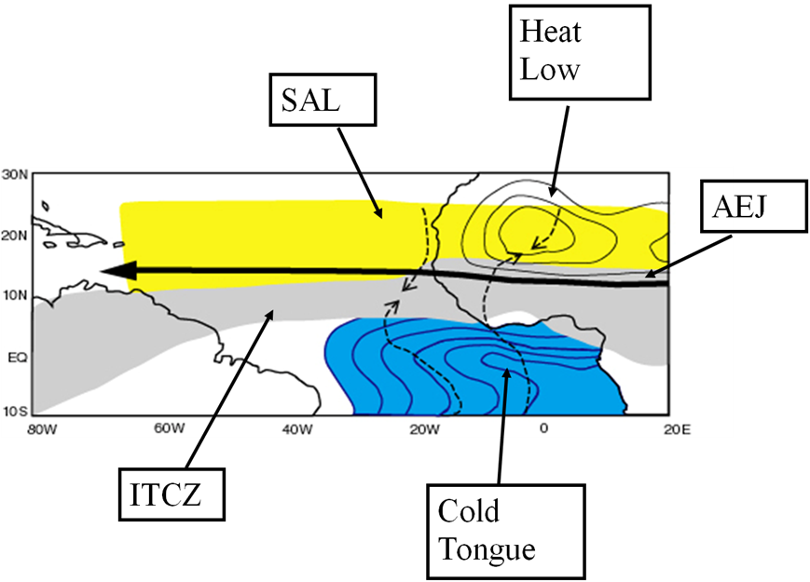
UNIVERSITY AT ALBANY
Climate and Environmental Systems
RESEARCH TOPICS:
Intraseasonal variability • El Niño—Southern Oscillation • Biogeochemical cycles
Climate modeling and diagnostics • Climate data analysis • Paleoclimatology
Climate—chemistry interactions • Paleoceanography
Solar radiation measurement • Applied solar energy
Remote sensing of the atmosphere • Effects of aerosols on climate
Applications of solar meteorology to photovoltaic electricity generation
Atmospheric sounding quality and technology
Climate—cryosphere dynamics • Polar sea ice and midlatitude climate change
The global water cycle • Hydroclimate and drought
Liu
Vuille
Vuille
Minder
Precipitation in subtropical Chile has been declining over the last 130 years, which is of concern given the low precipitation, high economic activity and large population. Interannual variability of precipitation is primarily controlled by ENSO, but this study shows that the negative trend is not related to tropical Pacific forcing and that recent El Niño activity actually helped to alleviate the drought. Instead changes in high-latitude SST and sea-ice concentration may be the main driver for the observed secular drying trend (Vuille).
Dai (drought and climate change)
Key features of the West African Monsoon system. Ongoing research aims to shed new light on how the land, atmosphere and ocean interact and to ultimately understand how these interactions influence the variability of the monsoon at interannual and longer timescales. The impact of West African Monsoon variability on hurricane variability is also
investigated (Thorncroft).
Comprehensive research is performed on the midlatitude response to an active phase of the (MJO)
Madden-Julian
Oscillation (Roundy)
FACULTY
Aiguo Dai, Associate Professor, PhD, Columbia Univ., 1996. Climate variability and climate change; hydroclimate; drought and climate change
Oliver Elison Timm, PhD, Univ. of Kiel, 2003. Paleoclimate modeling, climate dynamics.
Jiping Liu, PhD, Columbia University, 2003. Climate—cryosphere dynamics; application of remote sensing in climate.
Scott Miller, PhD, UC-Irvine, 1998. Micrometeorology; air-sea interaction.
Qilong Min, PhD, Alaska-Fairbanks, 1993. Radiative transfer; remote sensing.
Justin Minder, Assistant Professor; PhD, Univ. of Washington, 2010. Mountain weather and climate; regional climate; mesoscale dynamics; hydrometeorology.
Brian E. J. Rose, Assistant Professor, PhD, MIT, 2010. Theoretical climate dynamics and climate modeling.
Paul E. Roundy, Associate Professor; PhD, Penn State University, 2003. Tropical atmosphere and ocean interaction; impacts on global weather and climate.
Chris Thorncroft, Professor, Department Chair; PhD, Univ. of Reading, UK, 1989. Tropical meteorology; tropical waves and the West African monsoon.
Mathias Vuille, Associate Professor; PhD, Univ. of Bern, Switzerland, 1995. Tropical climate change; tropical glacier-climate interactions.
Junhong (June) Wang, PhD, Columbia University, 1997. The global water cycle; climate change and variability; sounding data quality and technologies
Wei-Chyung Wang, Professor of Applied Sciences; D.E.S., Columbia, 1973. Atmospheric radiation; climate modeling.
Liming Zhou, Associate Professor; PhD, Boston University, 2002. Land surface remote sensing; land—atmosphere interactions.

Slide 4
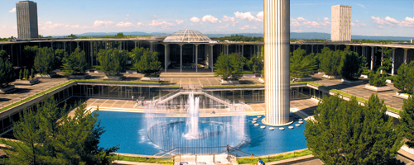
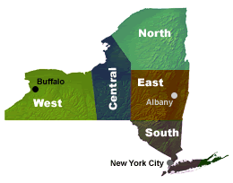
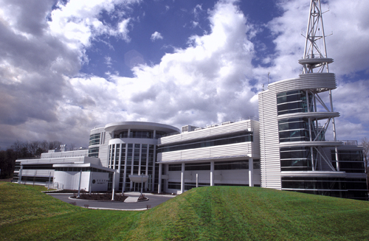
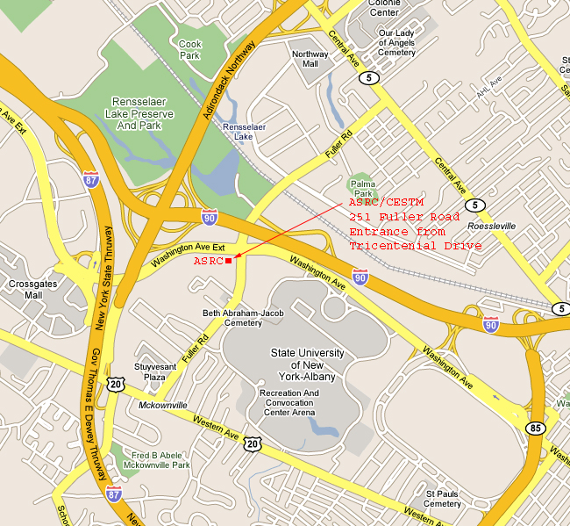
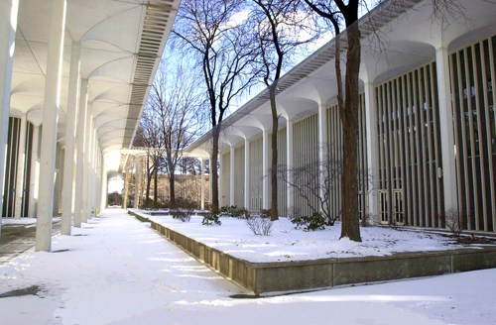
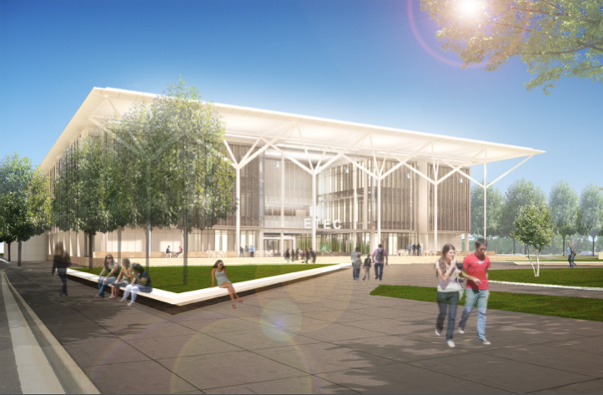
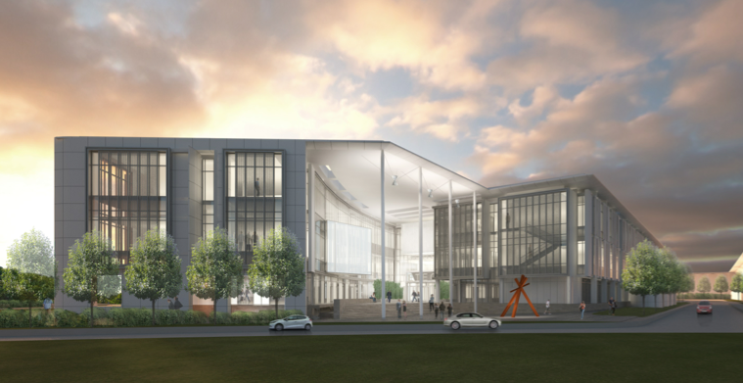
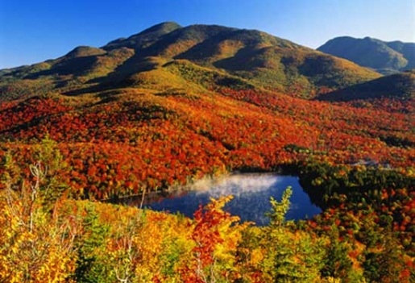
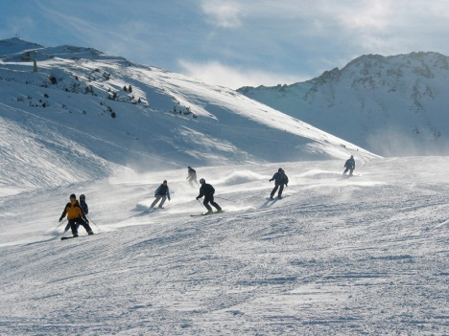
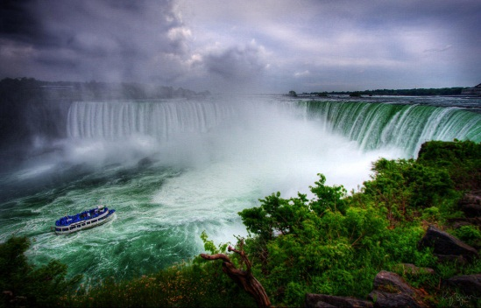

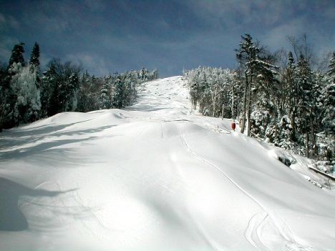
UNIVERSITY AT ALBANY
State University of New York (SUNY)
Department of Atmospheric and Environmental Sciences
M.S. and Ph.D. Degree Programs
The University at Albany is an internationally
recognized public research institution located in the state capital of New York.
Established in 1844 and designated a university in 1962, UAlbany puts the world within reach for nearly 18,000
students at the graduate and undergraduate levels.
Faculty supporting the graduate program in Atmospheric Sciences in the University at Albany are scientists from the Department of Atmospheric and Environmental Sciences (DAES) and the Atmospheric Sciences Research Center (ASRC). The ASRC and the local office of the National Weather Service (NWS) are both located in the same building, which is within easy walking distance of the DAES. This combination of scientists from two distinct but related institutions gives the University at Albany the largest program of education and research in the atmospheric sciences in New York State and one of the largest in the U.S.
The current group of scientists cover a broad range of research interests in the atmospheric and environmental sciences that is organized under three broad headings: Synoptic and Mesoscale Meteorology, Climate and Environmental Systems, and Atmospheric Chemistry and Physics.
Faculty are funded externally by a variety of agencies such as the National Science Foundation (NSF), the National Aeronautics and Space Administration (NASA), the Environmental Protection Agency (EPA), the National Oceanic and Atmospheric Administration (NOAA), the Department of Energy (DOE), the Air Force Office for Scientific Research (AFOSR) and the Electric Power Research Institute (EPRI). DAES also currently supports collaborations with the National Weather Service through the CSTAR program.
Atmospheric Sciences Research Center
(ASRC)
University at Albany
Academic Podium near
the Earth Science Building
Map of UAlbany and ASRC
Architect renderings of our new state-of-the-art building, ETEC, housed by DAES, ASRC, the NWS, and private partnerships
Strategic Location: The University at Albany enjoys a strategic location in the City of Albany. The capital of the State of New York offers something for everyone, the center of a region remarkable for its natural and cultural resources.
The Capital Region includes the cities of Albany, Schenectady, Troy and Saratoga Springs, and has a population of approximately 875,000. Within a short distance are the Berkshires, the Catskills and the Adirondacks, the latter of which is the largest wilderness area east of the Mississippi River.
Recreation: Major ski areas such as Killington, Gore, Hunter, Bromley, Stratton and Mt. Snow are within easy commuting distance.
Saratoga Springs, 25 miles to the north, is internationally known as a sports, concert, and cultural center.
Within Reach: Geographically, the city of Albany is only:
  150 miles from New York City
  175 miles from Boston
  225 miles from Montreal, Canada.
The New York State Thruway and two major interstate highways intersect one mile from the main campus. Bus, rail, and air terminals are all within ten minutes of UAlbany’s campus.

