Slide 1
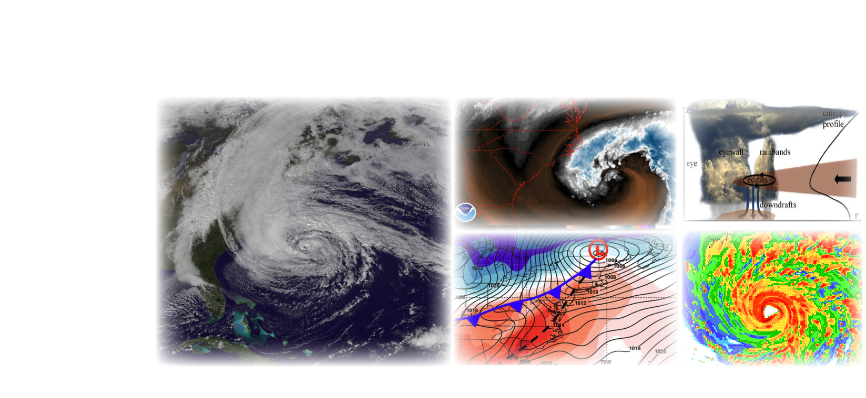
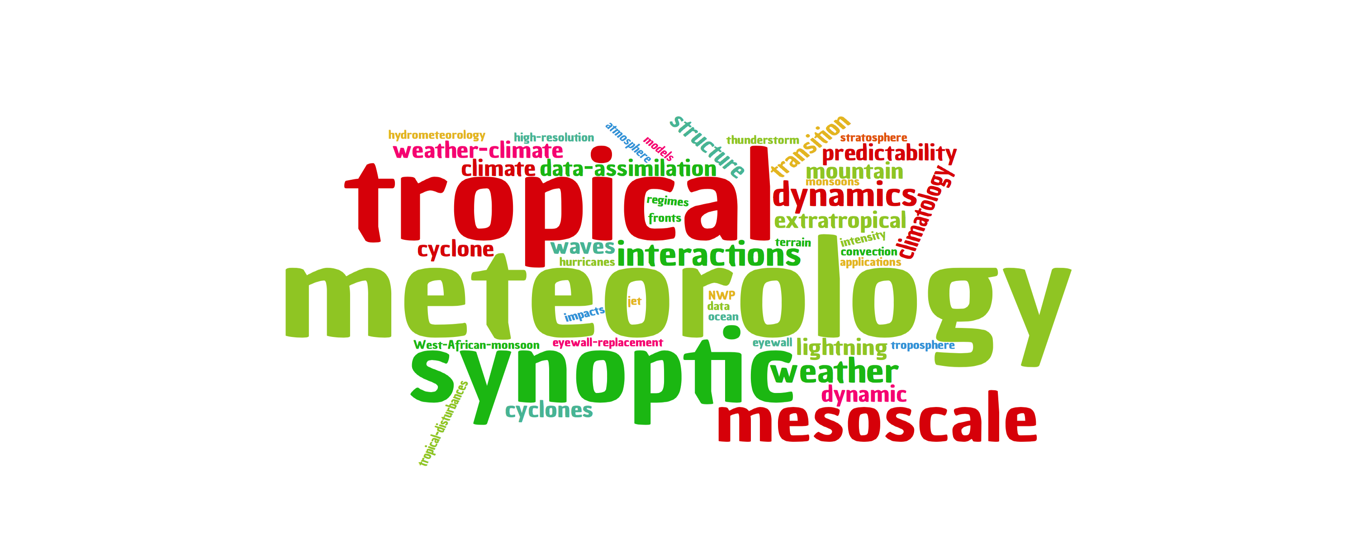
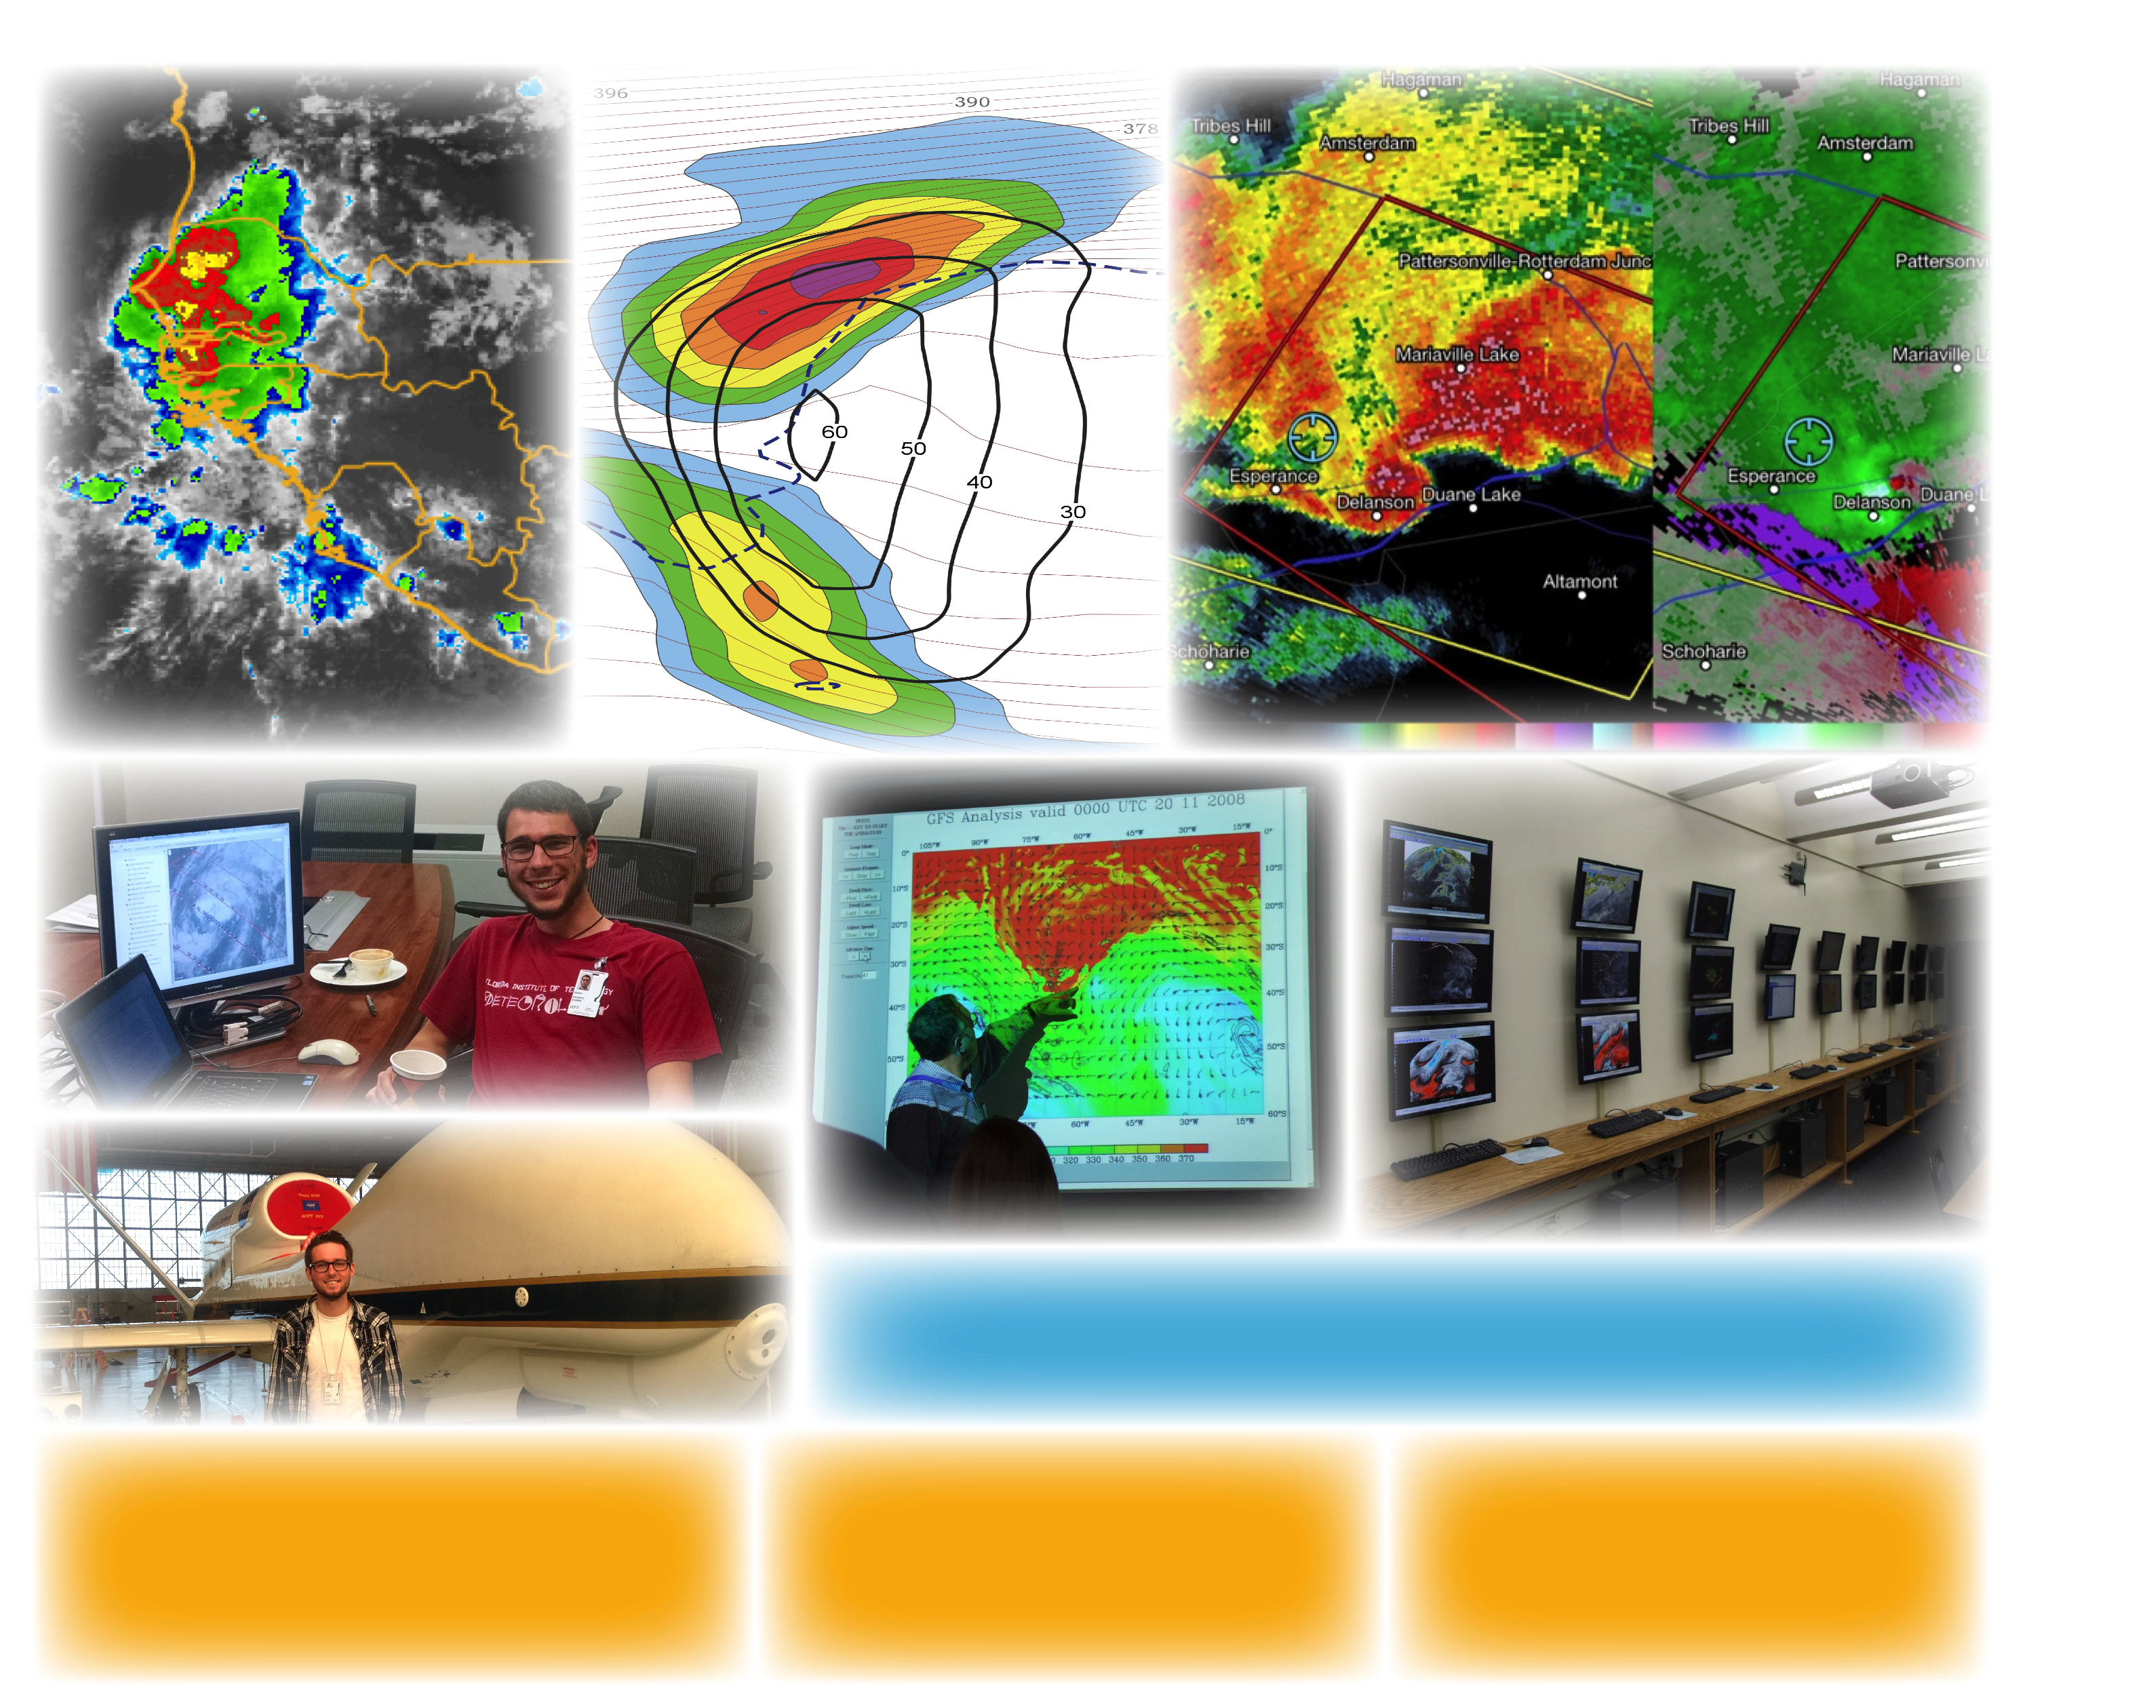
Bosart/Keyser
Tang
Hurricane Sandy (2012)
Synoptic/Tropical/Mesoscale Groups
Bosart/Keyser
Corbosiero/Molinari
Hurricane Eye/Eyewall Dynamics
Thorncroft
African Easterly Wave/ TC Genesis
Lang
Stratosphere-Troposphere Interactions
Duanesburg, NY EF-3, May 22, 2014
Synoptic/Mesoscale/CSTAR Groups
Students participate in the H53
Hurricane Mission Campaign
The department state-of-the-art electronic map room used for
teaching and research. It is also central to the popular map room
discussion sessions, which occur at least twice per week.
Lance F. Bosart, Distinguished Professor
Kristen L. Corbosiero, Assistant Professor
Robert Fovell, Professor
Daniel Keyser, Professor
Andrea Lang, Assistant Professor
Justin Minder, Assistant Professor
John Molinari, Professor
Paul E. Roundy, Associate Professor
Brian Tang, Assistant Professor
Chris Thorncroft, Department Chair
Ryan Torn, Associate Professor

Slide 2
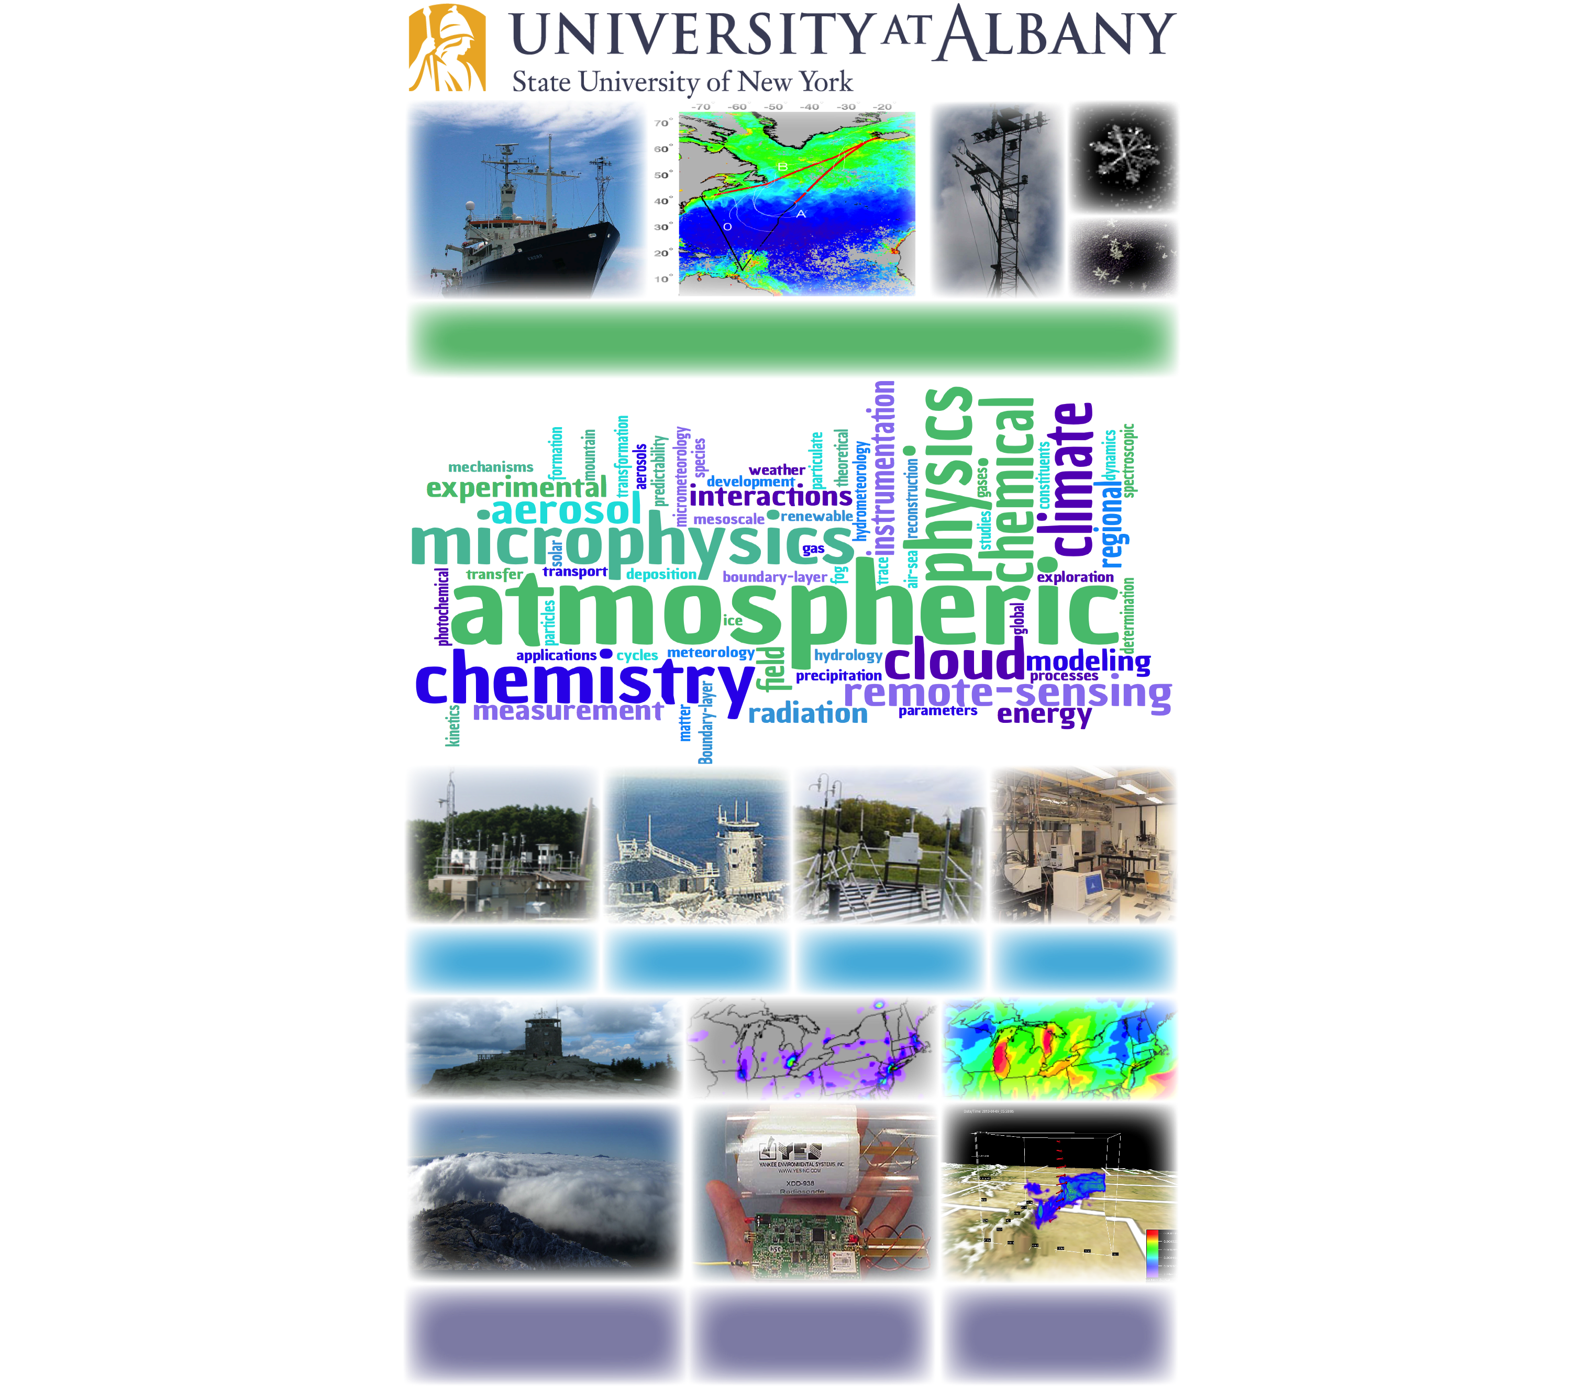
The research vessel R/V Knorr was used to make direct/sea gas exchange measurements of carbon dioxide and
dimethylsulfide during 3 cruises in spring and summer 2007 in the North Atlantic. The data are being used to
study processes controlling gas exchange between the ocean and atmosphere (Miller).
Pinnacle State
Observatory
Whiteface Mountain Observatory
Recreational Can at Pinnacle State Park
Aerosol Laboratory
Whiteface Observatory
Craig R. Ferguson, ASRC Research Associate
David R. Fitzjarrald, ASRC Research Associate
Lee Harrison, ASRC Research Associate
Everette Joseph, ASRC Director
Scott Miller, ASRC Research Associate
Justin Minder, Assistant Professor
James Schwab, ASRC Research Professor
Kara J. Sulia, ASRC Research Associate
Chris Walcek, ASRC Research Professor
Fangqun Yu, ASRC Research Associate

Slide 3
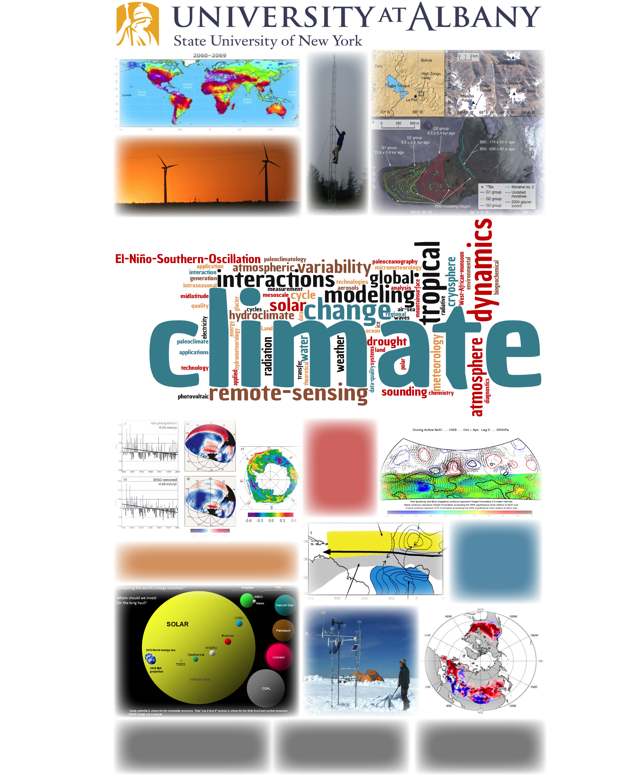
Dai (drought and climate change)
Freedman
Minder
Vuille
Mid-latitude
response
to an active
phase of the
Madden-Julian
Oscillation
(Roundy)
SAL
Heat
Low
Changes in high-latitude SST and sea-ice concentration
may be the main drivers for the observed secular
drying trend in portions of South America (Vuille)
Land-atmosphere-
ocean interactions and
their influence on the
West African Monsoon
system (Thorncroft)
AEJ
ITCZ
Cold
Tongue
Perez
Vuille
Liu
Aiguo Dai, Associate Professor
Oliver Elison Timm, Associate Professor
Jeff Freedman, ASRC Research Associate
Jiping Liu, Assistant Professor
Qilong Min, ASRC Research Associate
Richard Perez, ASRC Research Associate
Brian Rose, Assistant Professor
Mathias Vuille, Associate Professor
Junhong Wang, Research Associate
Wei-Chyung Wang, ASRC Professor
Liming Zhou, Associate Professor

Slide 4
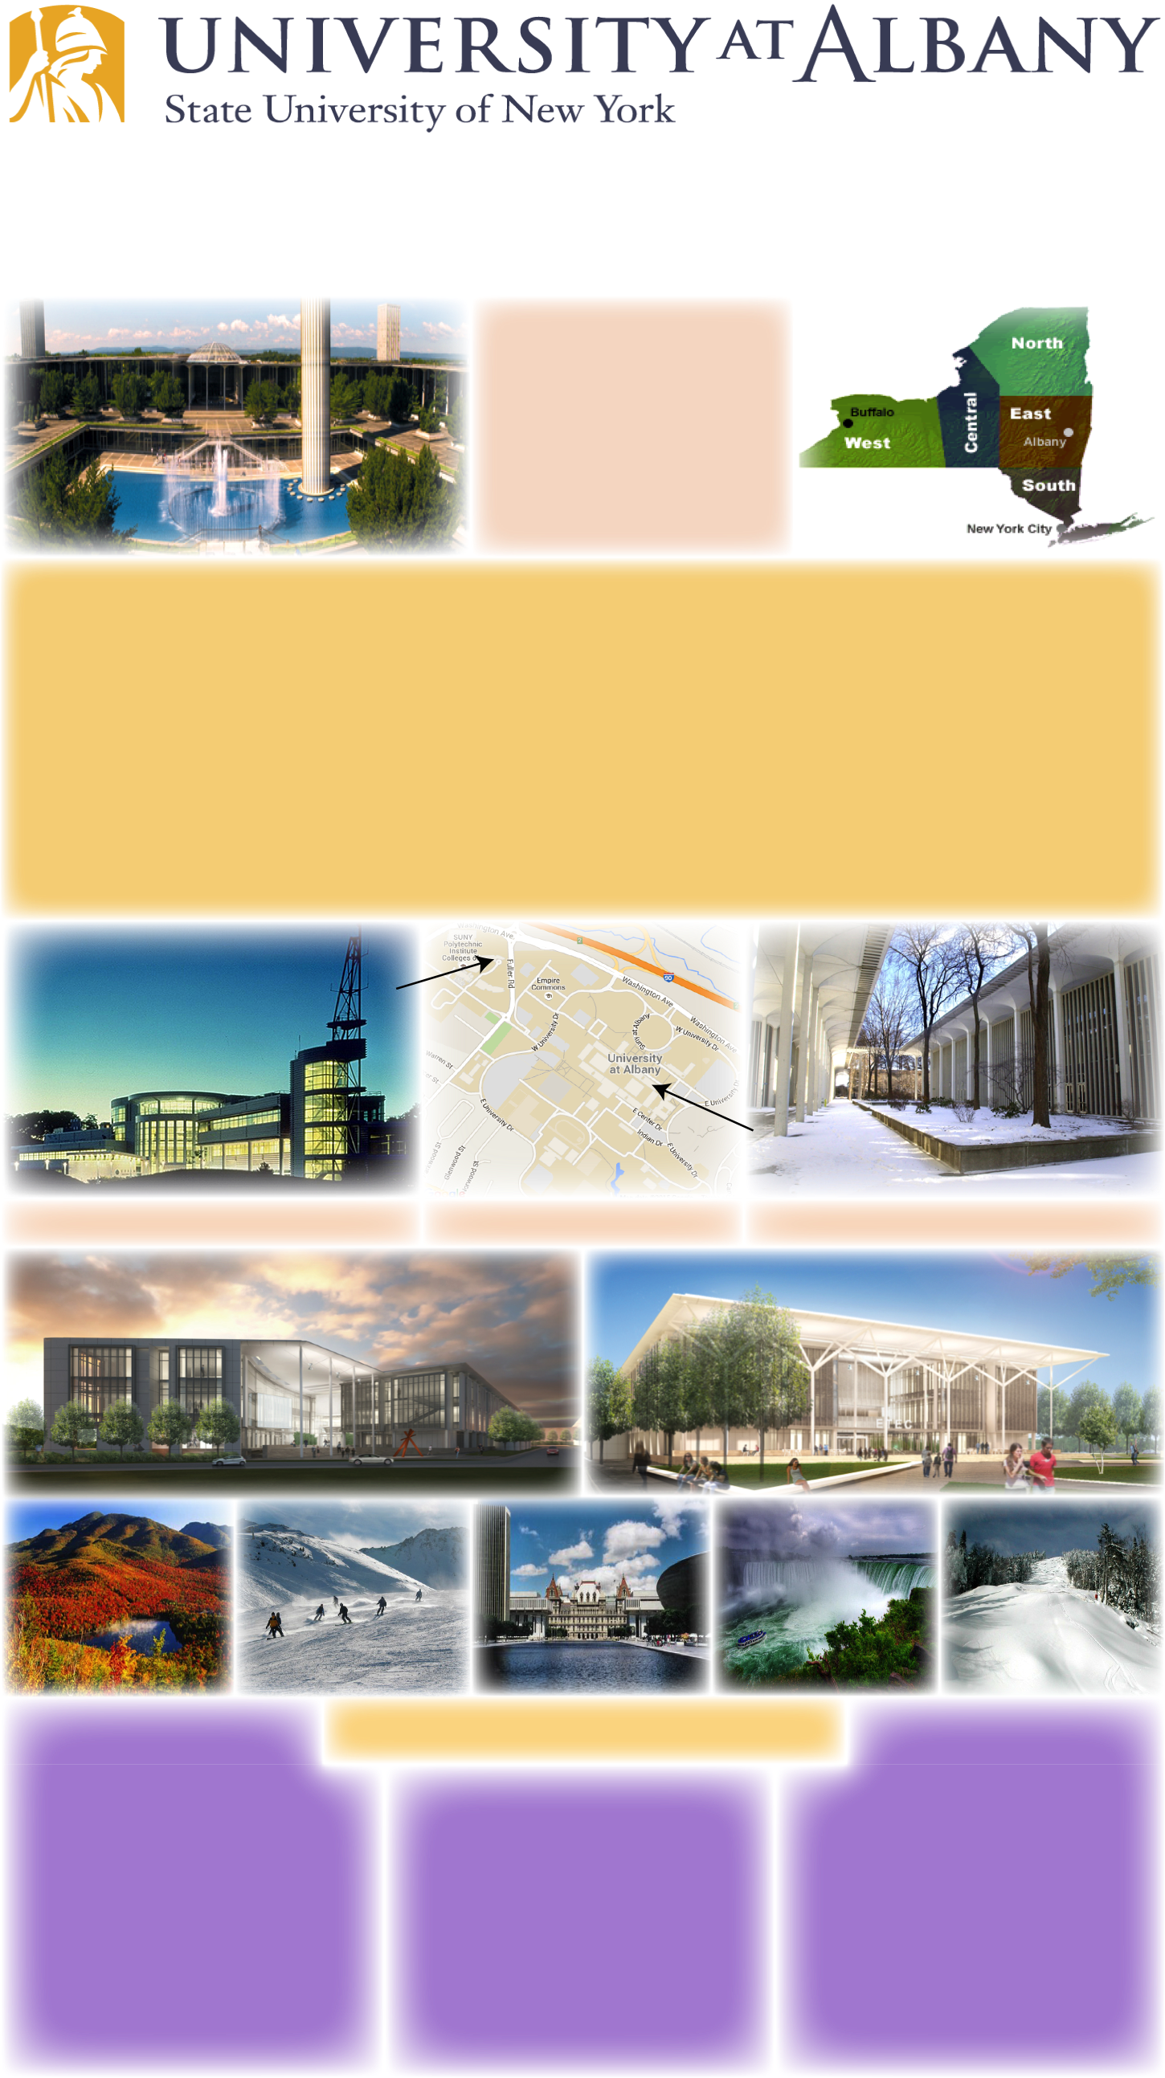
Masters and Doctoral Degree Programs
The Department of Atmospheric and Environmental Sciences and
Atmospheric Sciences Research Center
The University at Albany is an internationally
recognized public research
institution located in the
state capital of New York.
Established in 1844, UAlbany puts the world
within reach for ~20,000
students.
The graduate program in Atmospheric Sciences is supported by faculty from the
Department of Atmospheric and Environmental Sciences (DAES) and the
Atmospheric Sciences Research Center (ASRC).
This combination of scientists from two distinct yet affiliated groups gives UAlbany
the largest program of education and research in the atmospheric sciences
in New York and one of the largest in the US.
The current group of DAES and ASRC scientists cover a broad range of research
interests within: Synoptic and Mesoscale Meteorology, Climate and Environmental
Systems, and Atmospheric Chemistry and Physics.
ATMOSPHERIC SCIENCES RESEARCH CENTER (ASRC)
MAP OF UALBANY AND ASRC
ACADEMIC PODIUM NEAR EARTH SCIENCE BUILDING
Architect renderings of our new state-of-the-art building, ETEC, housing DAES, ASRC, the NWS, and private partnerships.
Recreation
Strategic Location
Within Reach
The Capital Region features a wide range of excellent restaurants, beautiful parks, and history. Several nearby mountain ranges (Adirondacks, Catskills, Berkshires) offer limitless outdoor recreation.
Albany and the surrounding area offers something for everyone and is remarkable for its natural and cultural resources.
150 miles from NYC
175 miles from Boston
225 miles from Montreal
Major interstate highways intersect one mile from campus.

