Slide 1
Tornadoes, rotating thunderstorms, and a look back at the 2024 severe weather season in New York
Ross A. Lazear
Department of Atmospheric and Environmental Sciences
University at Albany, SUNY

Slide 2
Outline
• Tornado climatology
• Rotating thunderstorm ingredients
• Rotating thunderstorms using radar data
• Duanesburg, NY tornado - 22 May 2014
• 2024: New York State’s record-breaking year of tornadoes

Slide 3
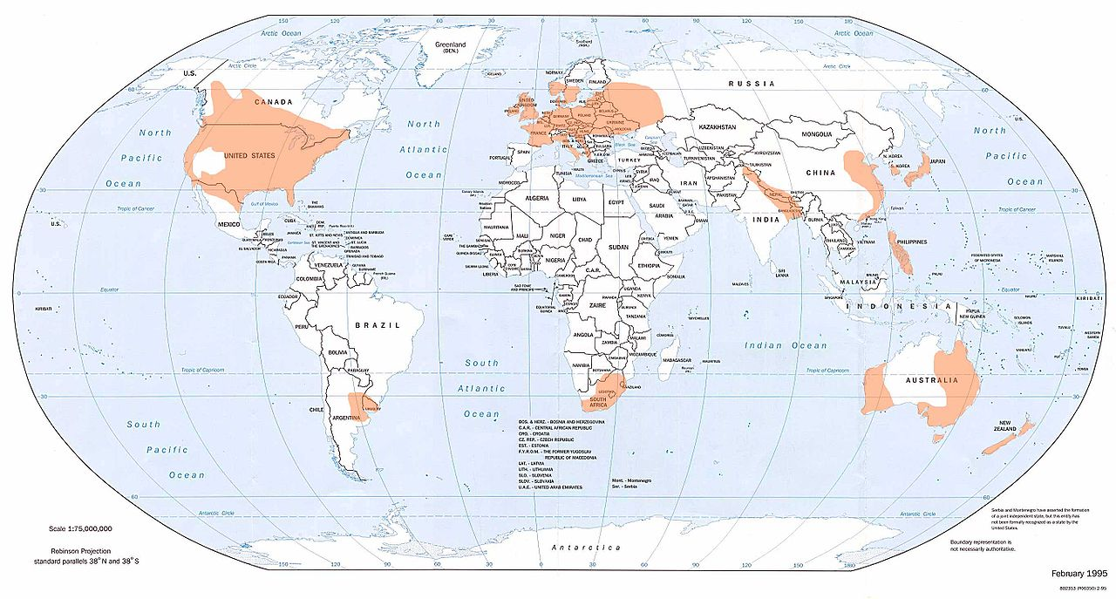
Global Tornado Occurrence
National Climatic Data Center (NCDC)

Slide 4
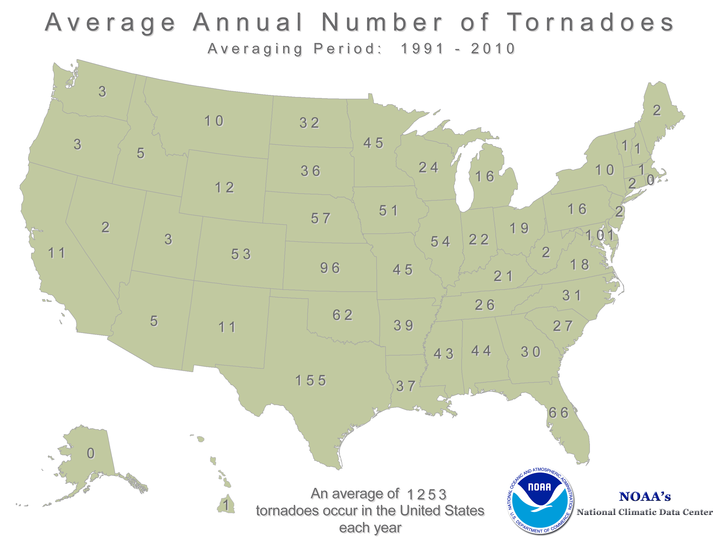

Slide 5
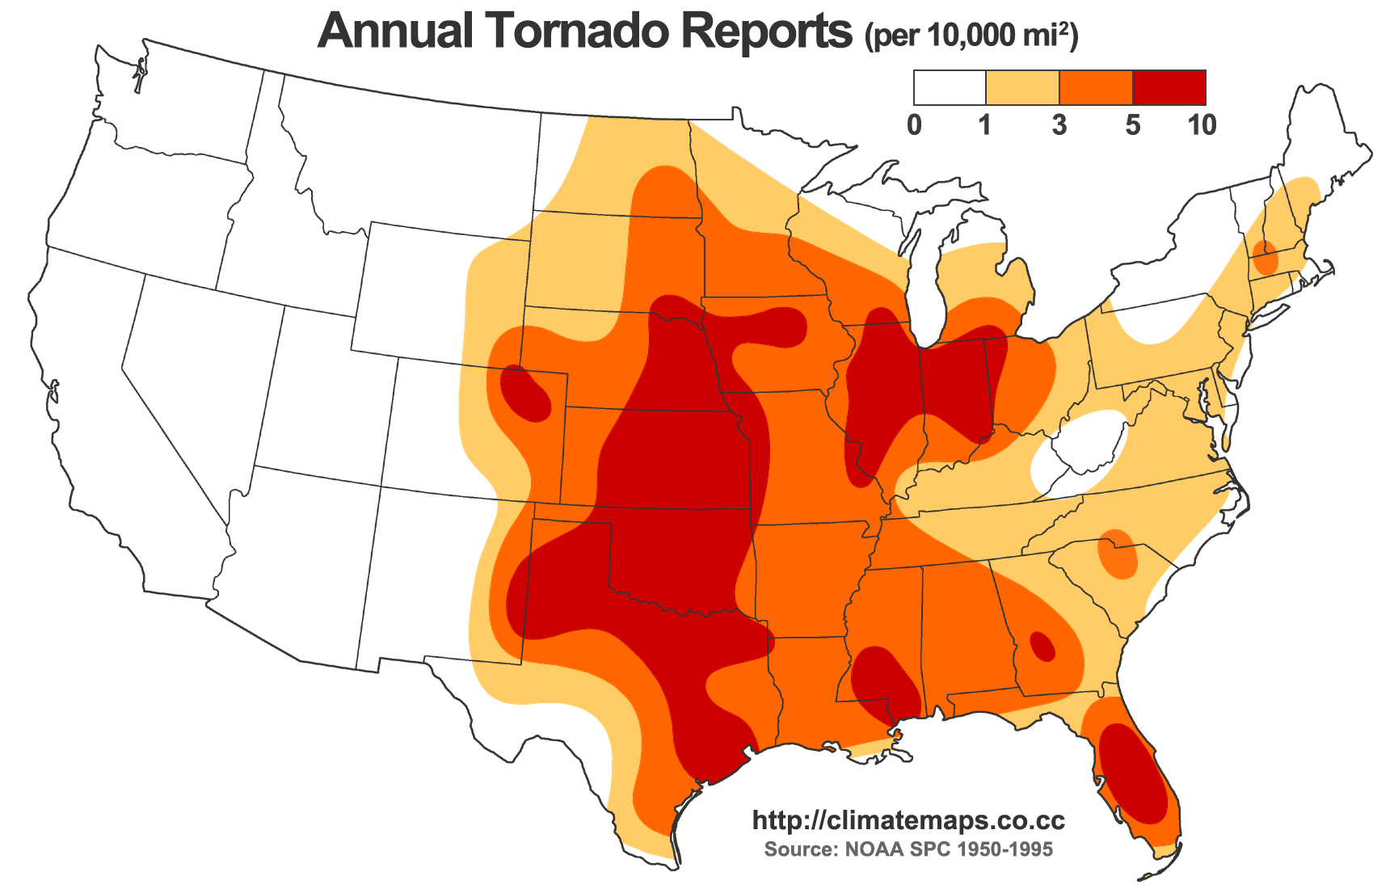

Slide 6
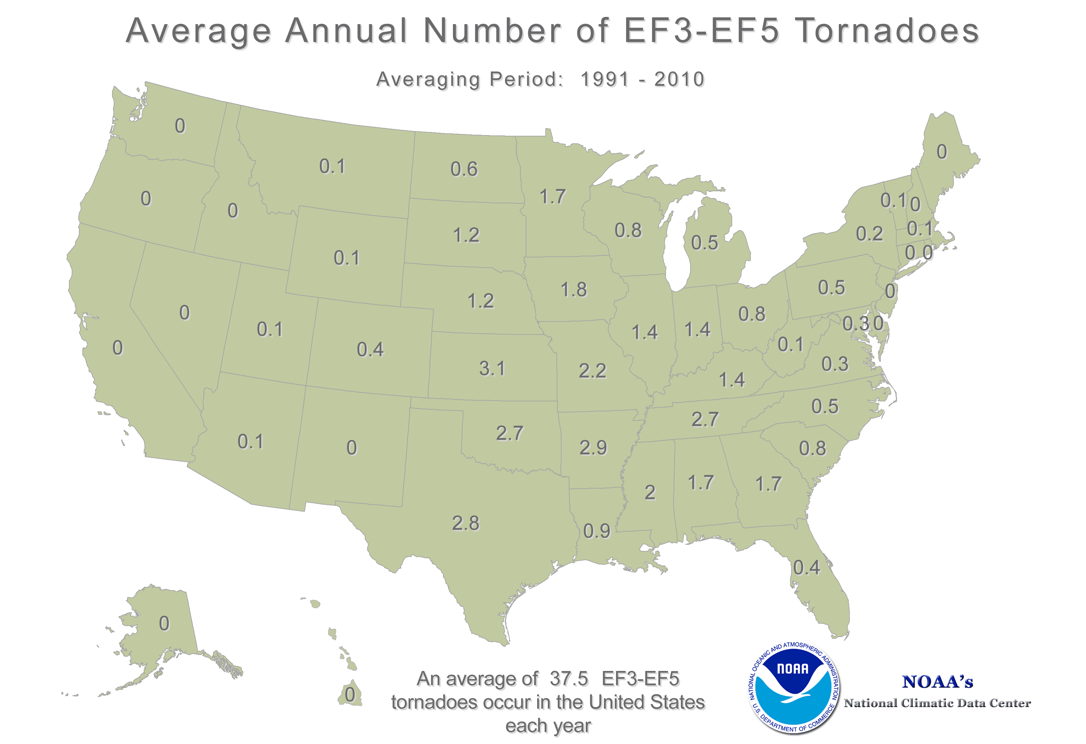

Slide 7
Why “Tornado Alley”?
Perfect combination of . . .
• Warm, moist air at surface
• Cool, dry air aloft (> ~2 km above surface)
-Instability
• Coupled with this is often a change in wind speed and direction with height
-Wind shear
Why are these tornado ingredients, and why are they such a common occurrence in Tornado Alley?

Slide 8
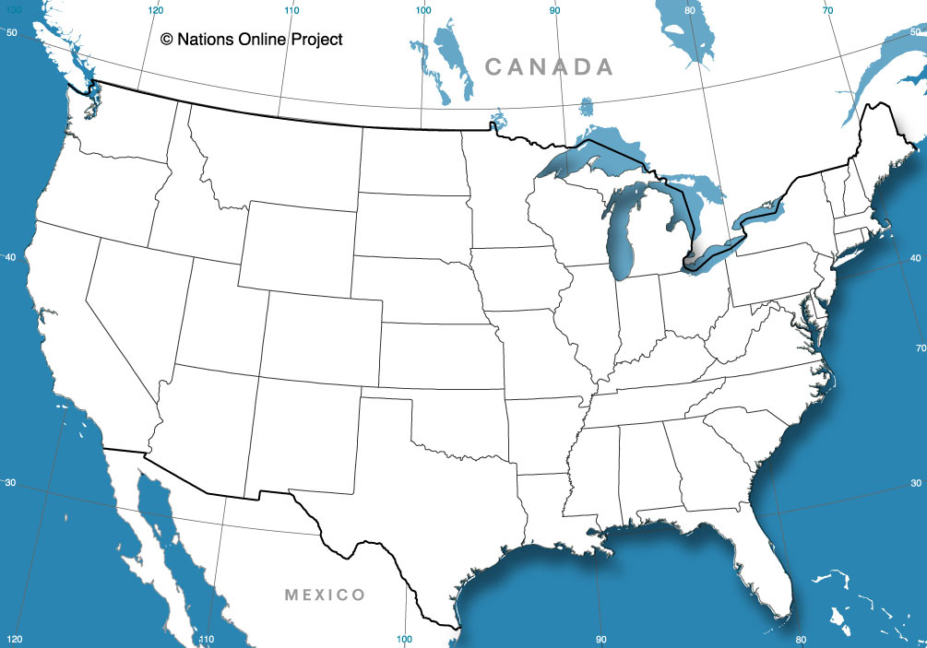
Why “Tornado Alley”?
L

Slide 9
Why “Tornado Alley”?
L

Slide 10
Why “Tornado Alley”?
L
Cold, dry air aloft
Warm, moist air

Slide 11
Why “Tornado Alley”?
-- ~10 km: Top of troposphere
Cold, dry air aloft
L
--1 km
Warm, moist air

Slide 12
Why “Tornado Alley”?
-- ~10 km: Top of troposphere
Cold, dry air aloft
More dense
L
--1 km
Warm, moist air
Less dense

Slide 13

Why “Tornado Alley”?
-- ~10 km: Top of troposphere
Cold, dry air aloft
More dense
--1 km
Warm, moist air
As in the convection tank:
Warm, less dense air rises
Less dense

Slide 14
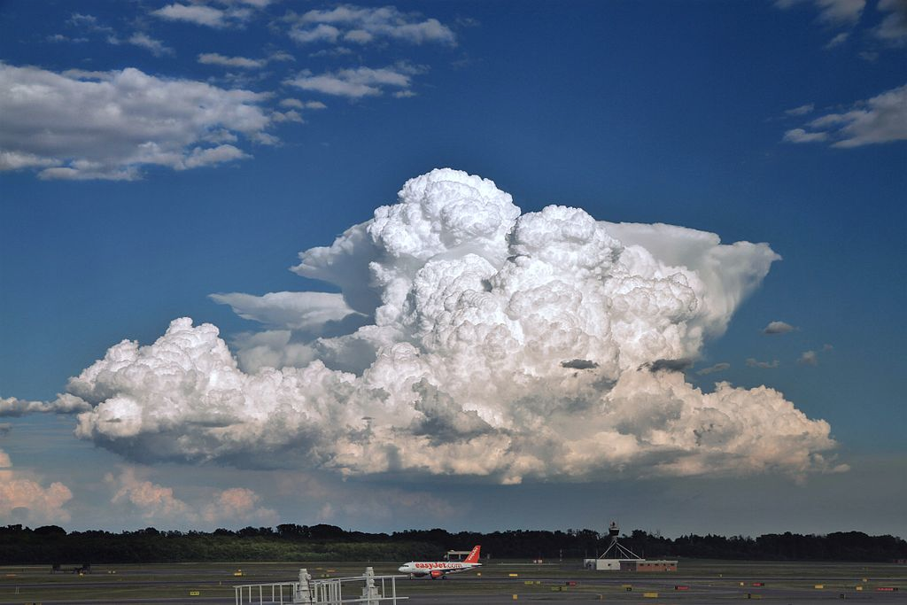
Now we have convection (cumulonimbus).
How do we get ROTATION?

Slide 15
Vertical wind shear
Change in wind speed and direction with height
10 km
5 km
N
Surface
E
S

Slide 16
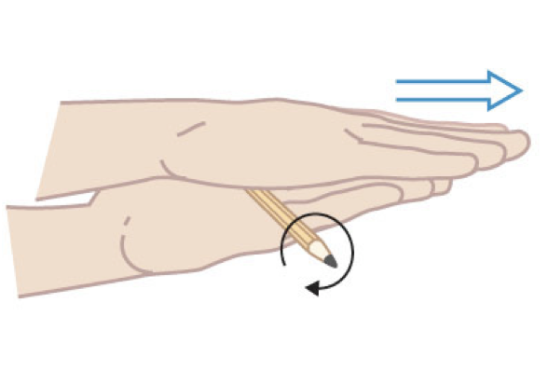
Vertical wind shear
Change in wind speed and direction with height
Wind shear creates a horizontal vortex

Slide 17
Add instability . . .
10 km
5 km
COLD, DRY, MORE DENSE
N
WARM, MOIST, LESS DENSE
Surface
E
S

Slide 18
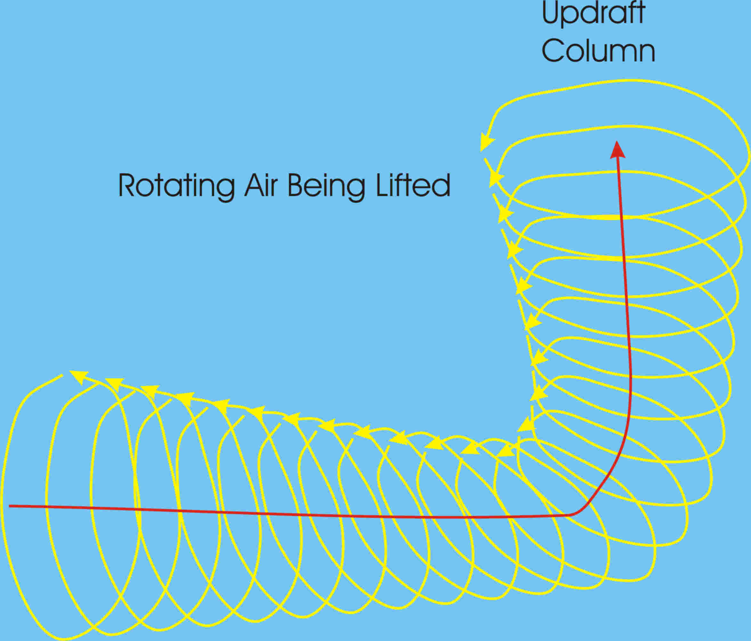
Convective “updraft” plus Vertical wind shear
From MadSciTech.org

Slide 19
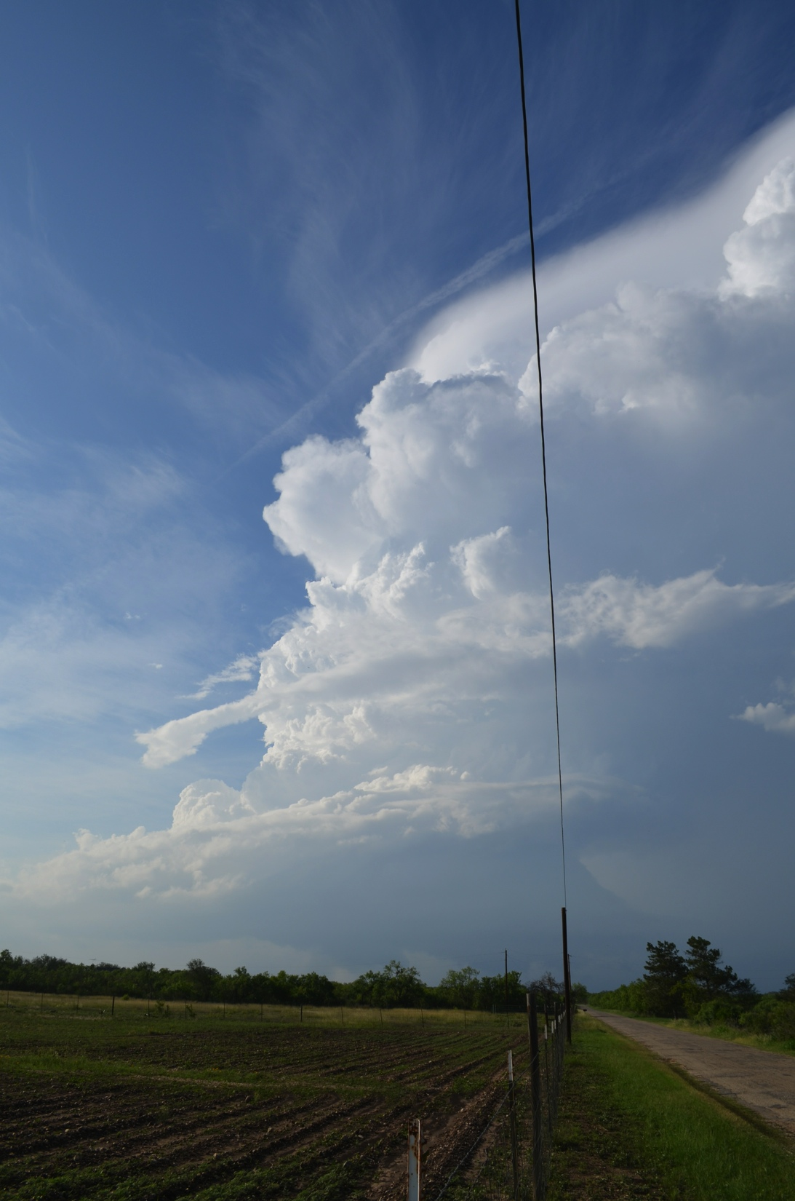
2324 UTC
27 May
2014
CastrovilleTexas

Slide 20
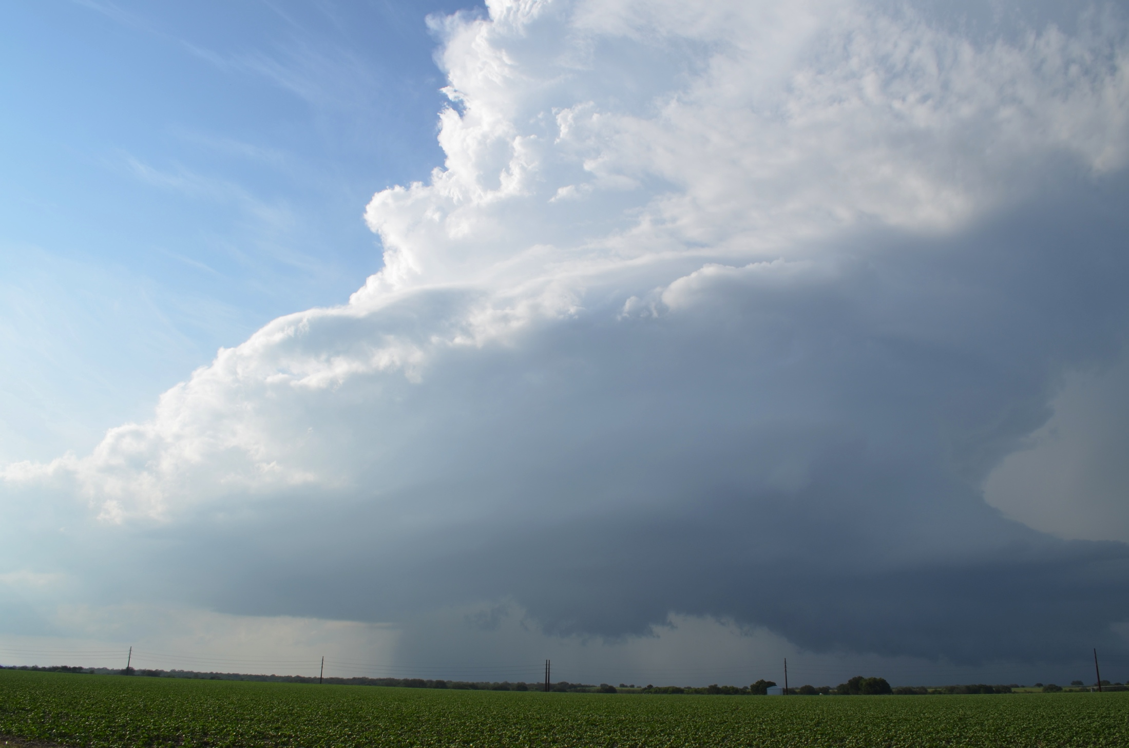
2334 UTC 27 May 2014 – Castroville, Texas

Slide 21
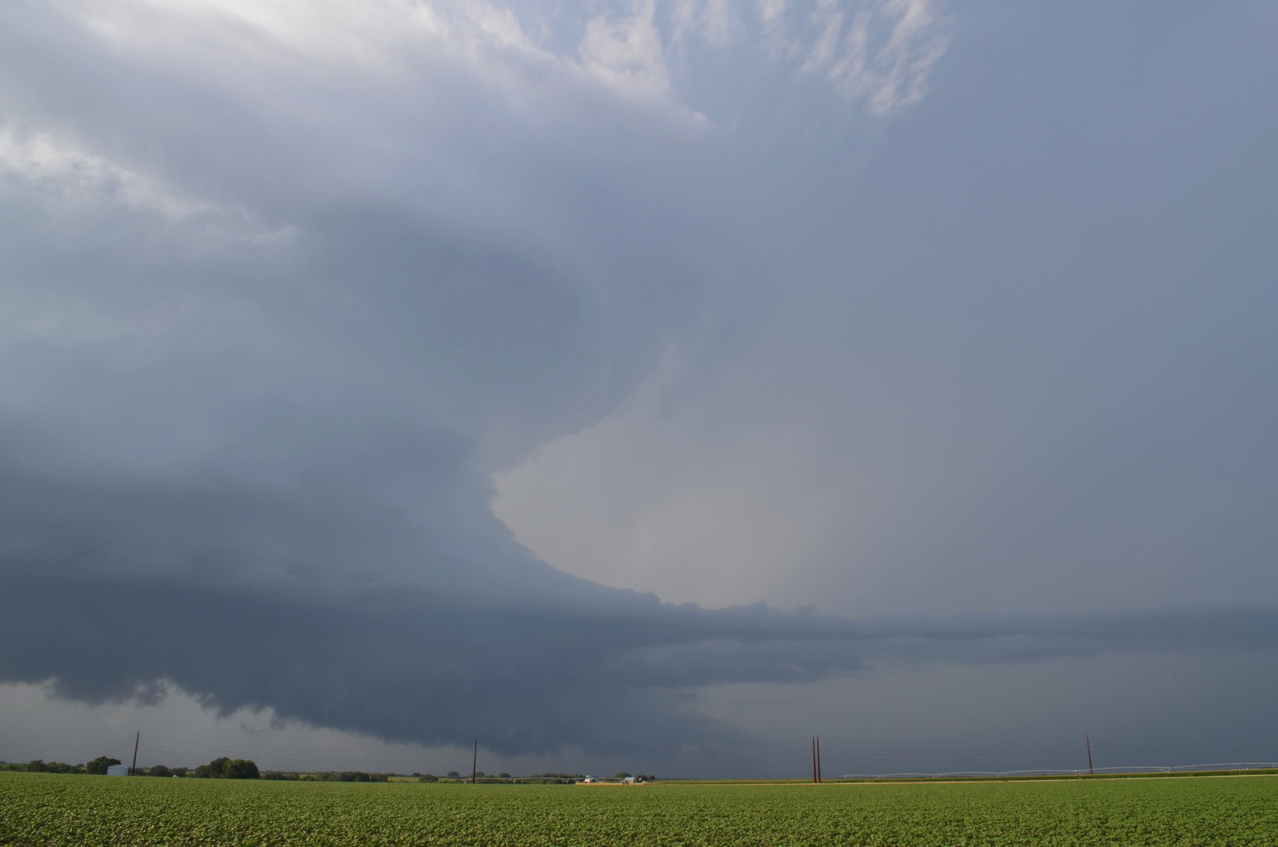
2337 UTC 27 May 2014 – Castroville, Texas

Slide 22
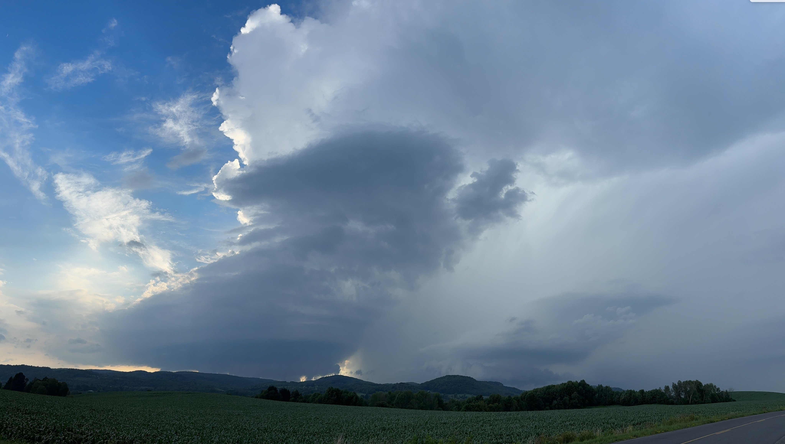
2247 UTC 10 July 2024 – Bridgewater, New York

Slide 23
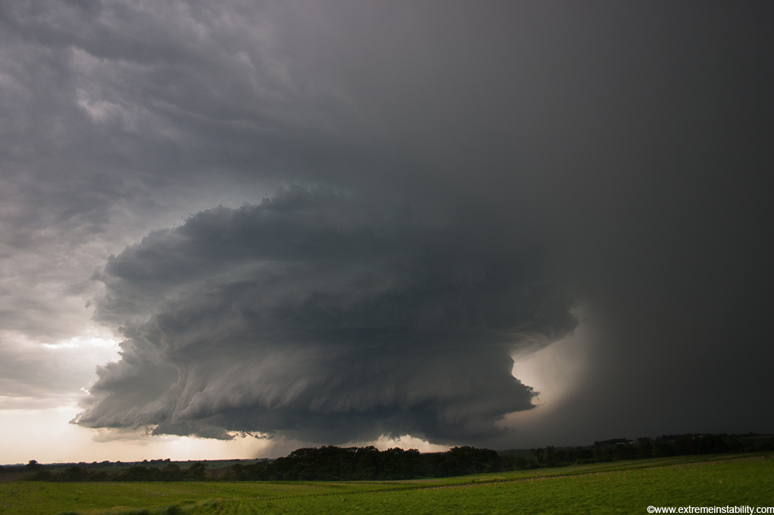
Photo by Mike Hollingshead
June 13, 2004 – Alvo, Nebraska

Slide 24
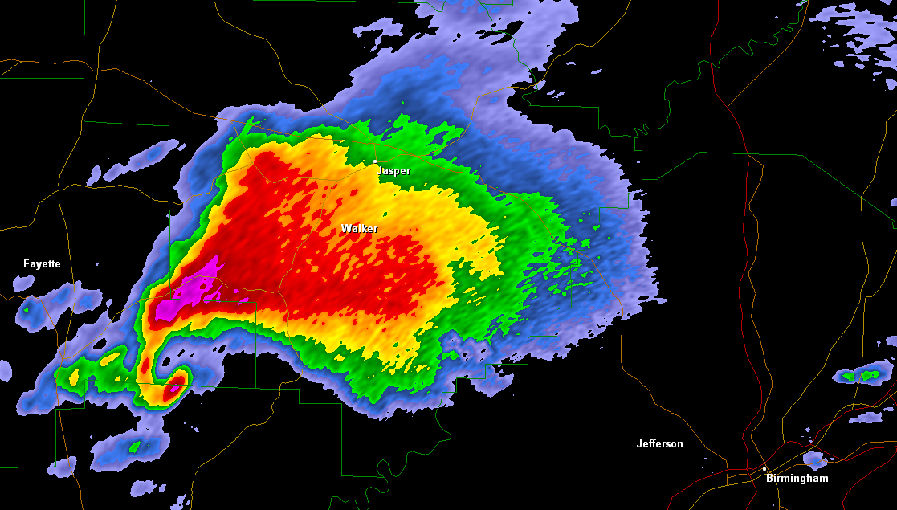
Supercell Thunderstorm
A thunderstorm with a rotating updraft (mesocyclone)
Supercell near Birmingham, AL on April 27, 2011

Slide 25
Supercell Thunderstorm
A thunderstorm with a rotating updraft (mesocyclone)
Hook echo
Supercell near Birmingham, AL on April 27, 2011

Slide 26
Supercell Thunderstorm
A thunderstorm with a rotating updraft (mesocyclone)
Mesocyclone
Supercell near Birmingham, AL on April 27, 2011

Slide 27
Supercell Thunderstorm
A thunderstorm with a rotating updraft (mesocyclone)
Hail shaft
Supercell near Birmingham, AL on April 27, 2011

Slide 28
Supercell Thunderstorm
A thunderstorm with a rotating updraft (mesocyclone)
Warm, moist, inflow
Supercell near Birmingham, AL on April 27, 2011

Slide 29
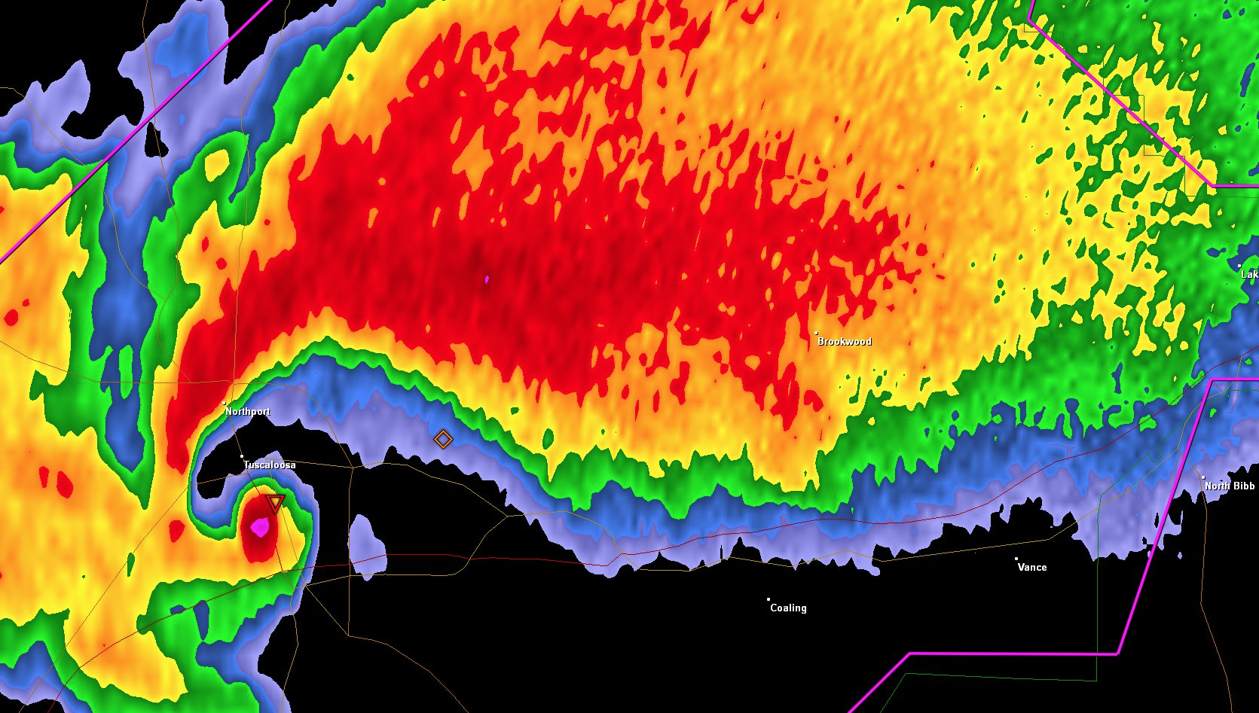
Supercell Thunderstorm
Debris ball
Supercell near Tuscaloosa, AL on April 27, 2011

Slide 30
Supercell Thunderstorm
Vehicle location
Supercell near Tuscaloosa, AL on April 27, 2011

Slide 31
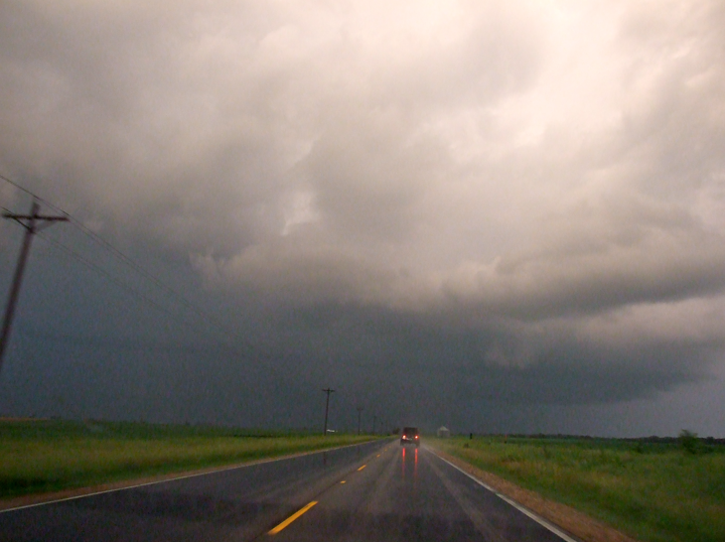
Supercell Thunderstorm
Vehicle location
Photo from storm chase on June 5, 2010 near Magnolia, IL

Slide 32
Supercell Thunderstorm
Vehicle location
Supercell near Tuscaloosa, AL on April 27, 2011

Slide 33
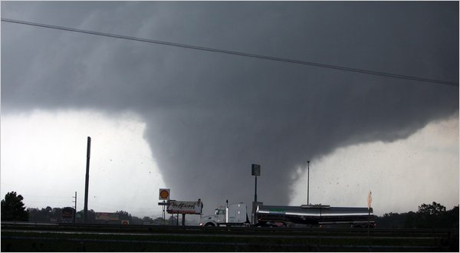
Supercell Thunderstorm
Vehicle location
Photo by Dusty Compton/Tuscaloosa News, 4/27/11

Slide 34
Severe weather outbreak
May 22, 2014
Montgomery and Schenectady County, New York

Slide 35
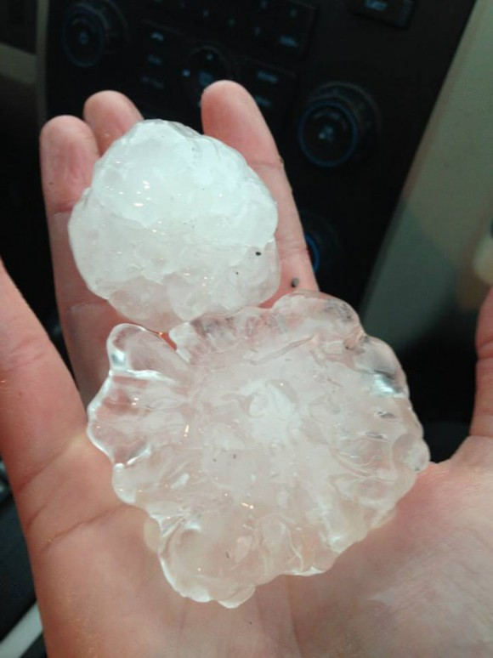
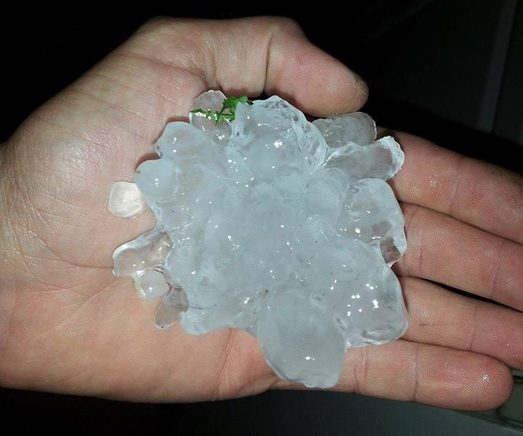
1920 UTC: 4” (10 cm) hailstone in Amsterdam, NY, tying New York state record
Source: CBS

Slide 36
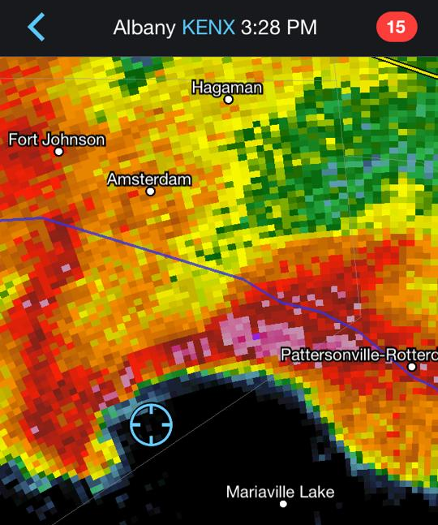
Five minutes prior to tornado touchdown west of Mariaville Lake

Slide 37
AT 351 PM EDT...NATIONAL WEATHER SERVICE DOPPLER RADAR CONTINUED TO INDICATE A TORNADO ON THE GROUND WITH A TORNADIC DEBRIS SIGNATURE JUST SOUTH OF DUANESBURG IN SCHENECTADY COUNTY
Reflectivity
Correlation Coefficient
1951 UTC

Slide 38
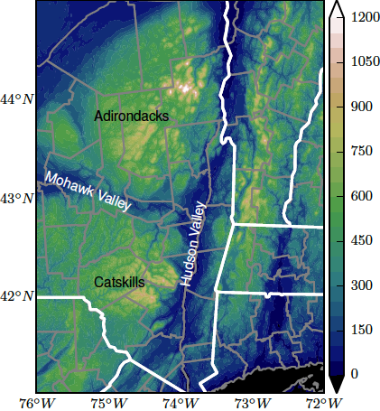
How does local terrain increase the risk for severe weather in valley locations in New York State?

Slide 39
How does local terrain increase the risk for severe weather in valley locations in New York State?
MEAN WIND DIRECTION

Slide 40
How does local terrain increase the risk for severe weather in valley locations in New York State?
VALLEY CHANNELED WIND
MEAN WIND DIRECTION

Slide 41
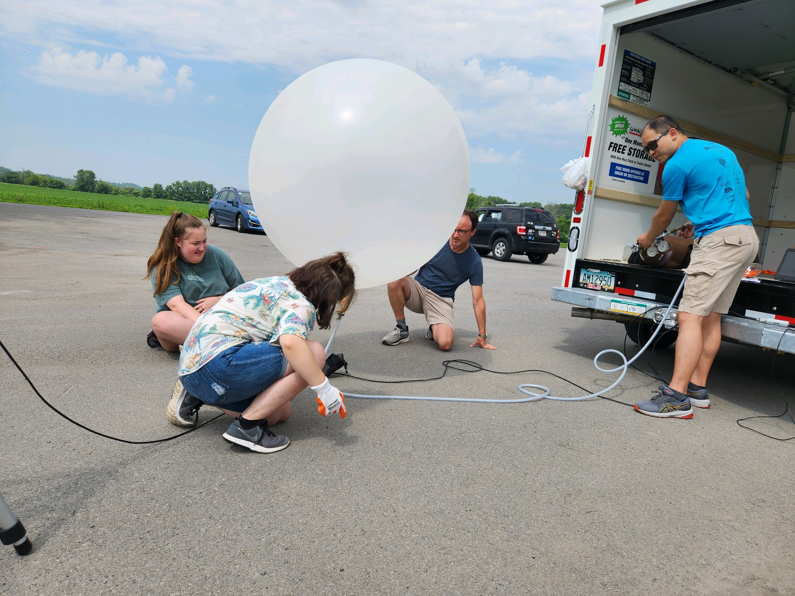
ICECREAM Field Campaign – Summer 2023

Slide 42
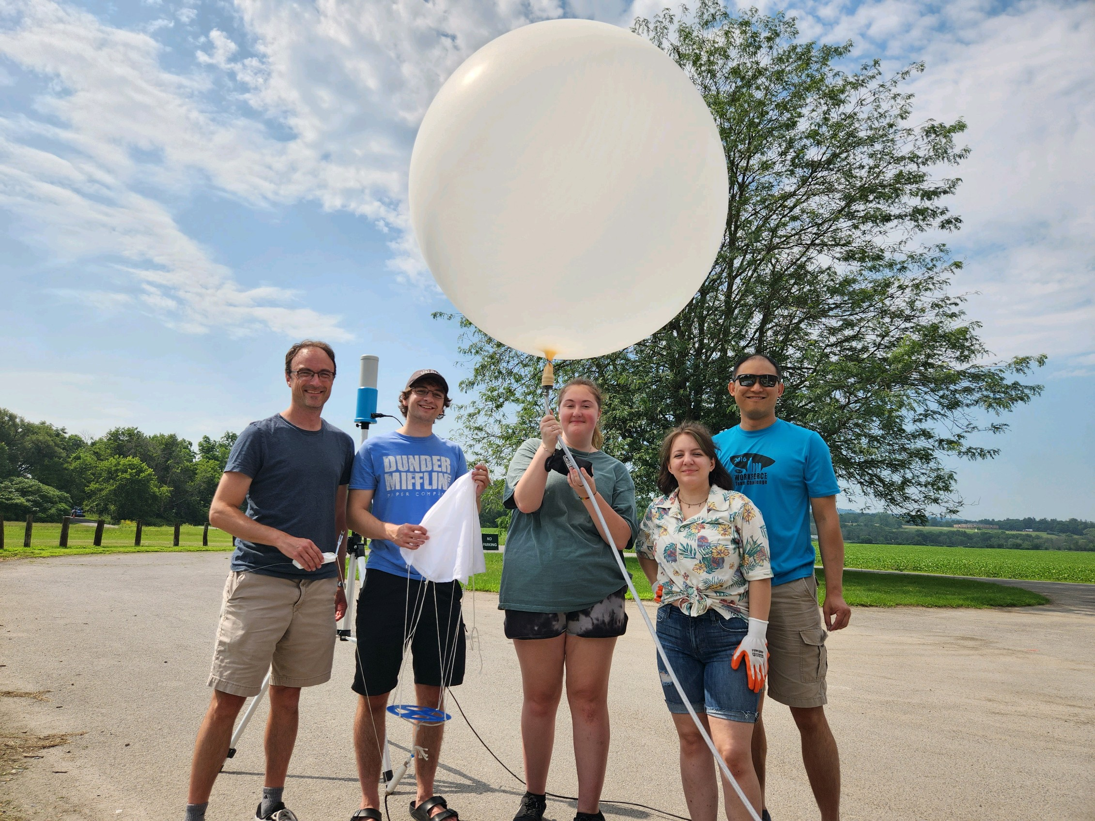

Slide 43
Tornadoes in New York in 2024

Slide 44
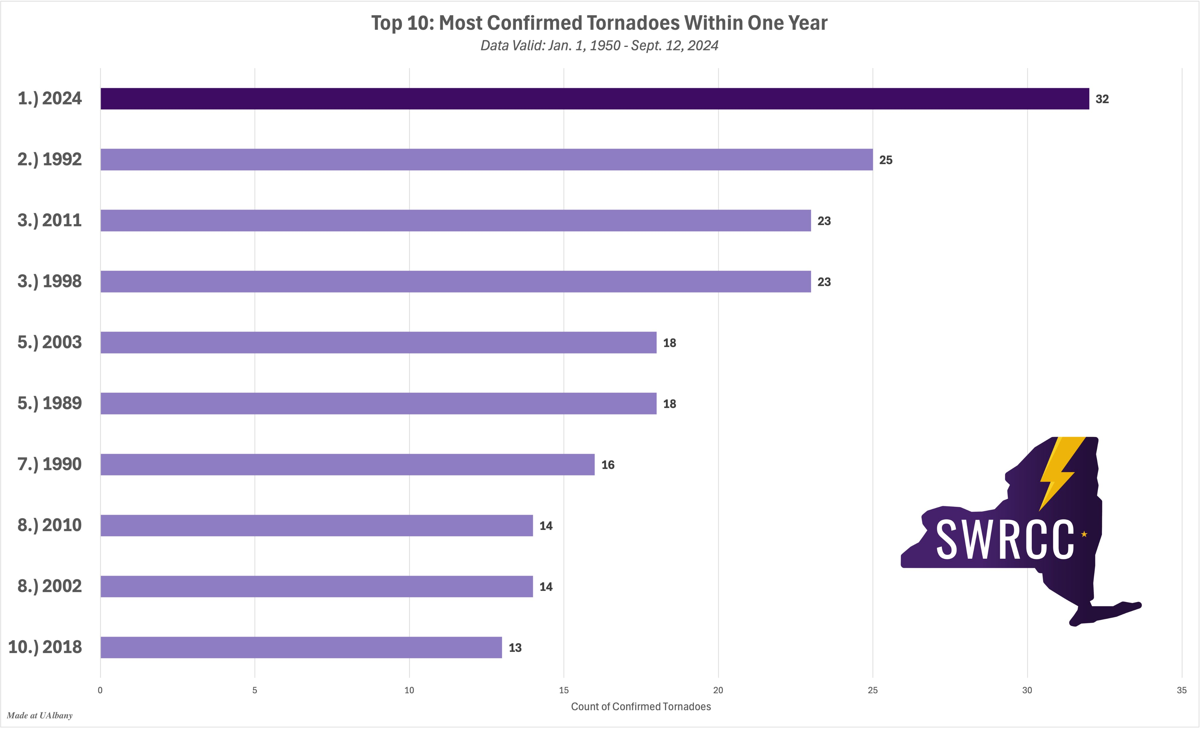
2024 New York State tornadoes

Slide 45
2024 New York State tornadoes
February 28 – Castle Creek
June 22 – West Winfield
July 10 – Arkwright
July 10 – Aurora
July 10 – Darien/Alexander
July 10 – Eden
July 10 – Forestport
July 10 – Redfield
July 10 – Wolcott
July 15 – Canandaigua
July 15 – Lincklaen
July 15 – Pavilion
July 15 – Virgil
July 16 - Canastota
July 16 – Chestertown
July 16 – Great Sacandaga Lake
July 16 – Lee Center
July 16 – Limekiln
July 16 – Ohio
July 16 – Oxbow Lake
July 16 – Rome
July 16 – Wells
July 16 – Wilcox Lake
July 24 – Broadalbin
July 24 – Orwell
August 5 – Buffalo
August 9 – New Paltz
August 11 – Pike Corner
September 9 – Grand Island
September 9 – Pembroke
September 9 – Wirt/Friendship
September 9 – Worth

Slide 46
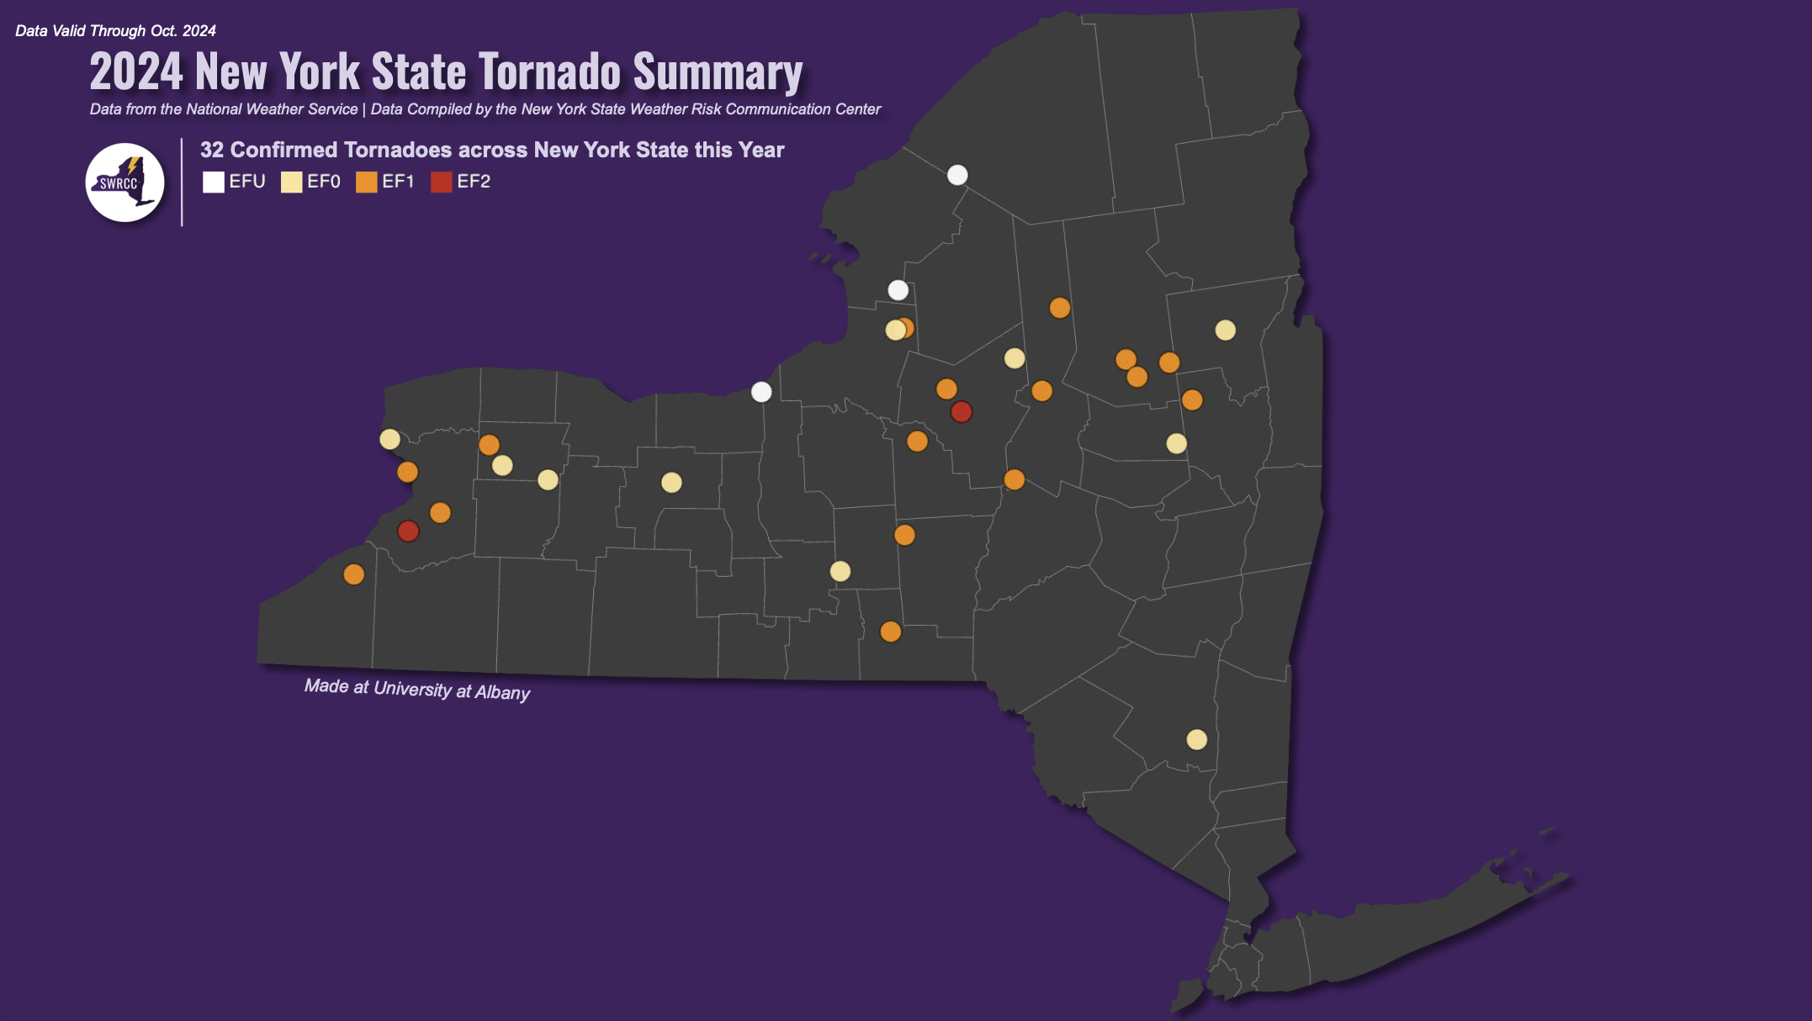
2024 New York State tornadoes
Courtesy of the State Weather Risk Communication Center

Slide 47
2024 New York State tornadoes
February 28 – Castle Creek
June 22 – West Winfield
July 10 – Arkwright
July 10 – Aurora
July 10 – Darien/Alexander
July 10 – Eden
July 10 – Forestport
July 10 – Redfield
July 10 – Wolcott
July 15 – Canandaigua
July 15 – Lincklaen
July 15 – Pavilion
July 15 – Virgil
July 16 - Canastota
July 16 – Chestertown
July 16 – Great Sacandaga Lake
July 16 – Lee Center
July 16 – Limekiln
July 16 – Ohio
July 16 – Oxbow Lake
July 16 – Rome
July 16 – Wells
July 16 – Wilcox Lake
July 24 – Broadalbin
July 24 – Orwell
August 5 – Buffalo
August 9 – New Paltz
August 11 – Pike Corner
September 9 – Grand Island
September 9 – Pembroke
September 9 – Wirt/Friendship
September 9 – Worth

Slide 48
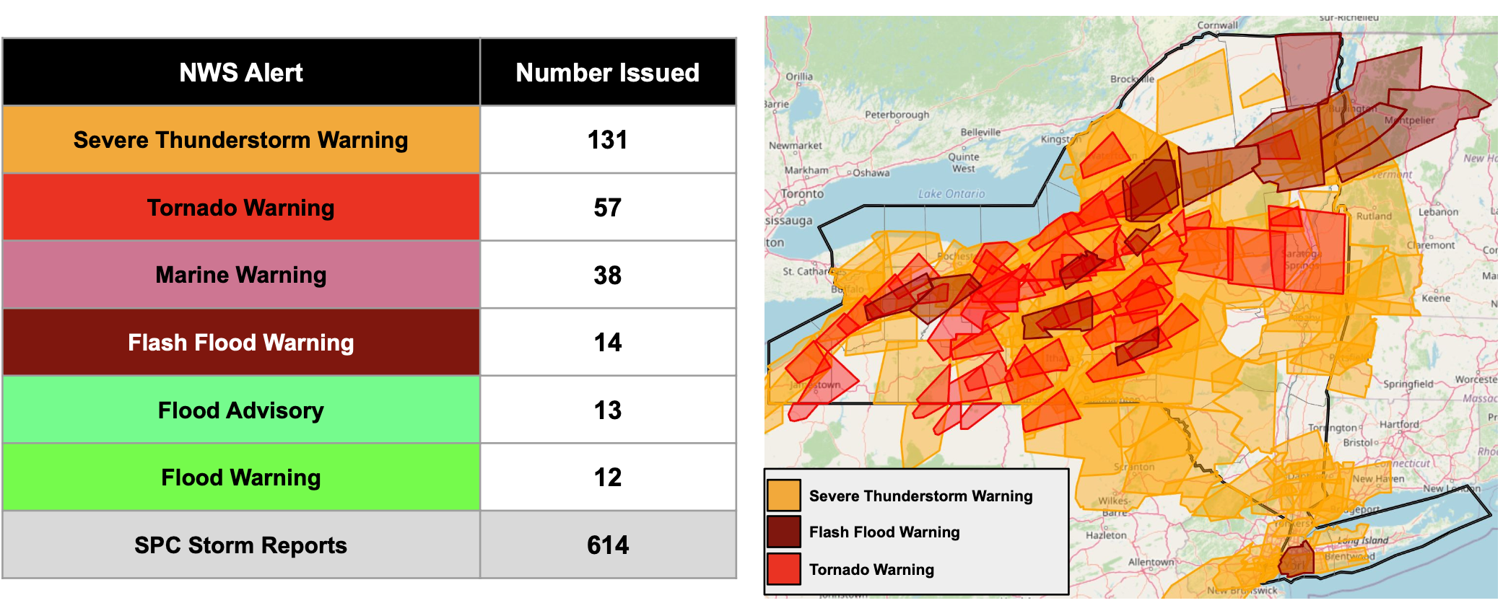
July 10–20 severe weather in NYS
Courtesy of the State Weather Risk Communication Center

Slide 49
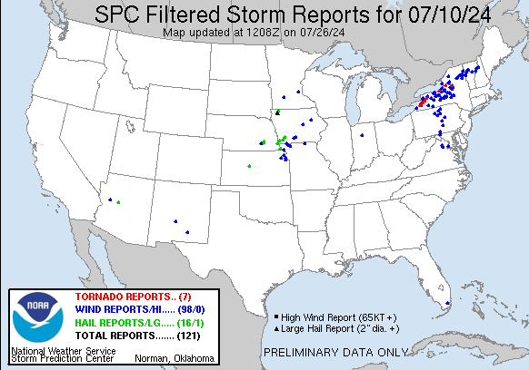
July 10

Slide 50
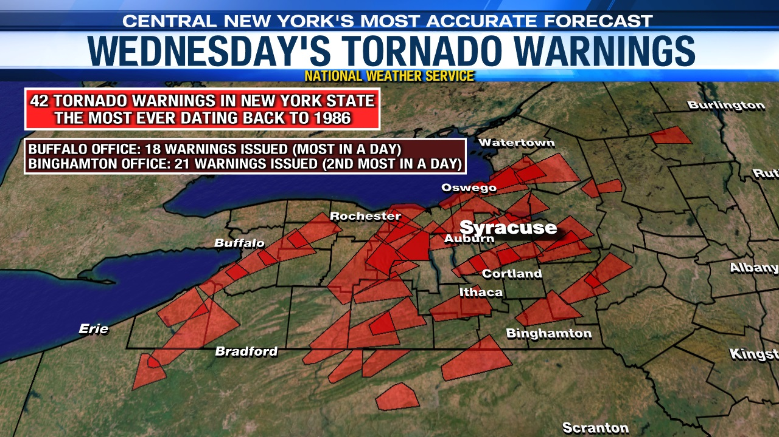
July 10
From localsyr.com

Slide 51
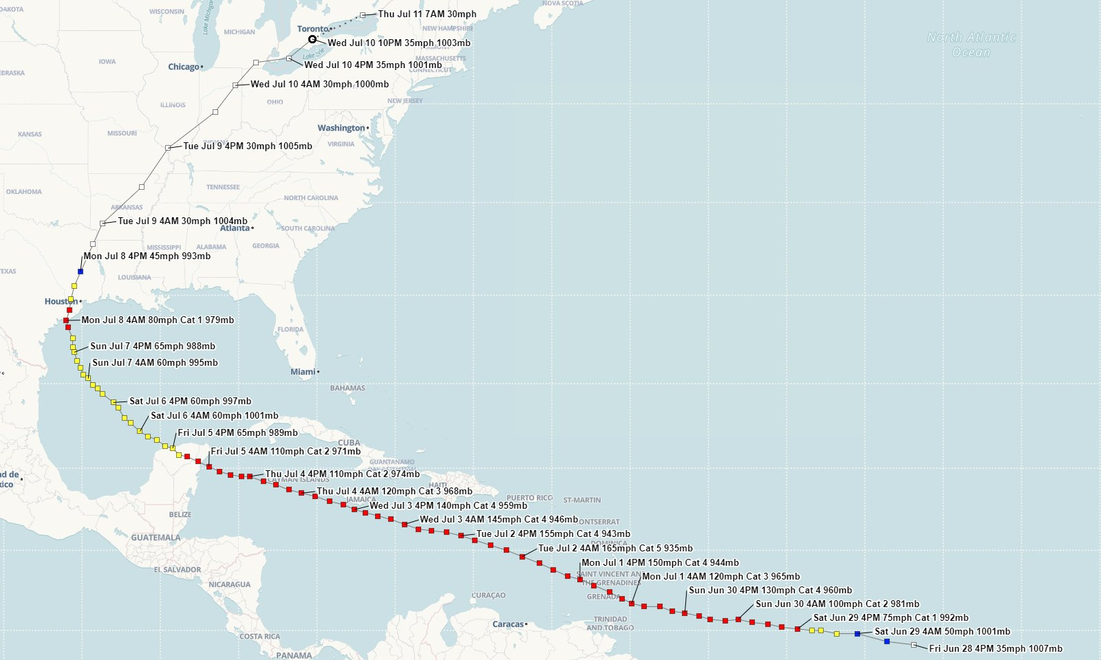
July 10
Hurricane Beryl track map
From NWS Lake Charles, LA

Slide 52
July 10
Storm Prediction Center – 1300 UTC outlook
...Northeastern CONUS... Scattered thunderstorms are expected to develop along/ahead of the cold front , especially near the prefrontal trough (with that activity ultimately evolving upscale into a line. All severe hazards will be possible from relatively discrete convection (including potential for several supercells) from the early-stage, pre-linear regime, and perhaps even in the warm sector to its east. Tornado potential should be relatively maximized near the warm front, where backed near-surface winds will contribute to enlarged low-level hodographs and enhanced storm-relative flow in the boundary layer. The corridor of greatest tornado probabilities is narrow, and may need to be shifted around today as mesoscale trends suggest (especially with regard to warm-frontal position). However, at least marginally favorable low-level shear for embedded supercellular or QLCS mesovortex tornado potential is possible as far south as the western/upper Chesapeake Bay region.
Ample low-level moisture is in place, and will continue over the area, with surface dewpoints commonly in the upper 60s to low 70s along and south of the warm front. This will contribute to low LCL and, in concert with diurnal heating that satellite imagery suggests should be common, will yield peak/preconvective MLCAPE in the 1500-2000 J/kg range ahead of the main convective band. Activity should weaken in and near eastern parts of the "slight" to "marginal" probabilities this evening as it encounters a more-stable boundary layer.

Slide 53
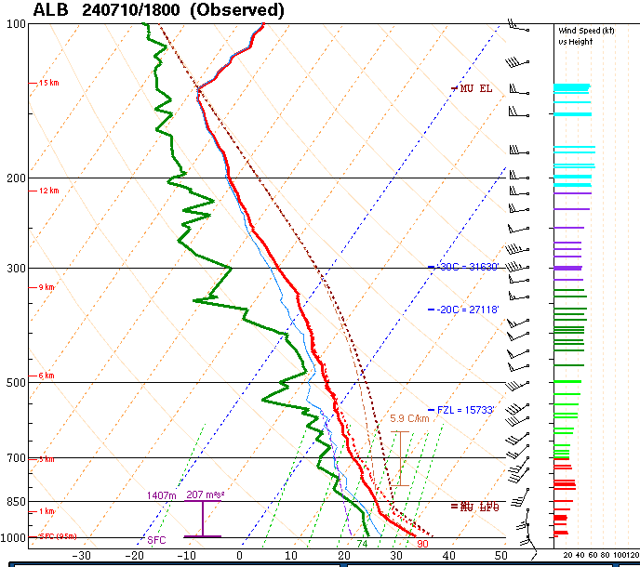
July 10
Albany, NY
Weather balloon
launch
1800 UTC
(early afternoon)

Slide 54
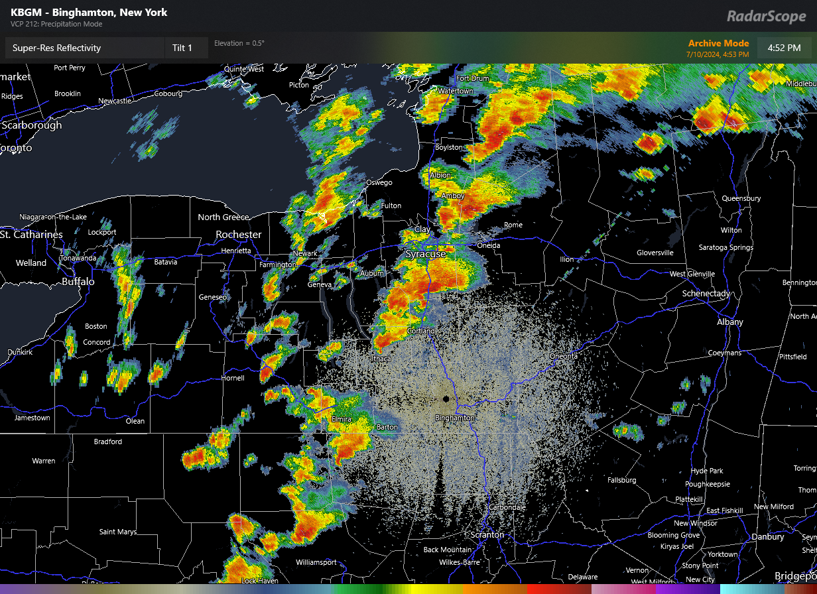
July 10
BGM radar – 1304 UTC
From RadarScope, courtesy of Erik Creighton

Slide 55
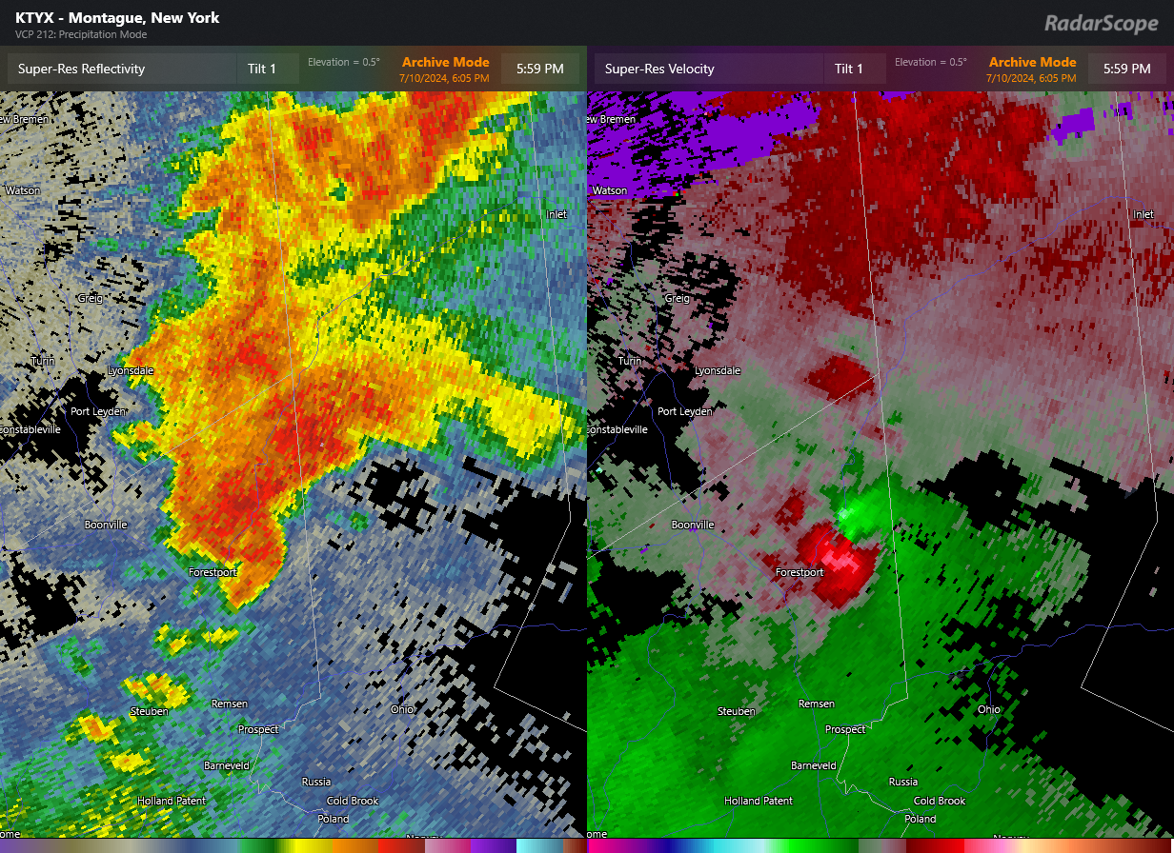
July 10
TYX radar – 1317 UTC
From RadarScope, courtesy of Erik Creighton

Slide 56
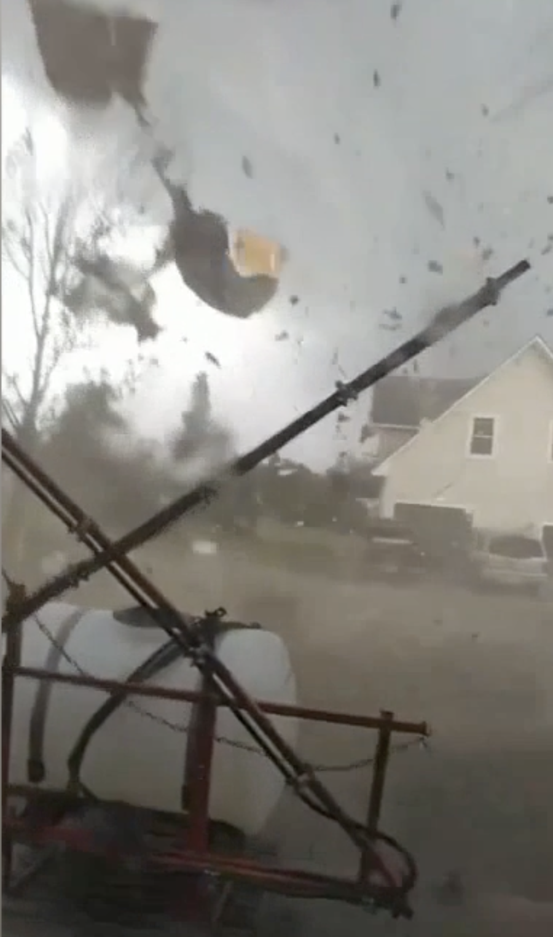
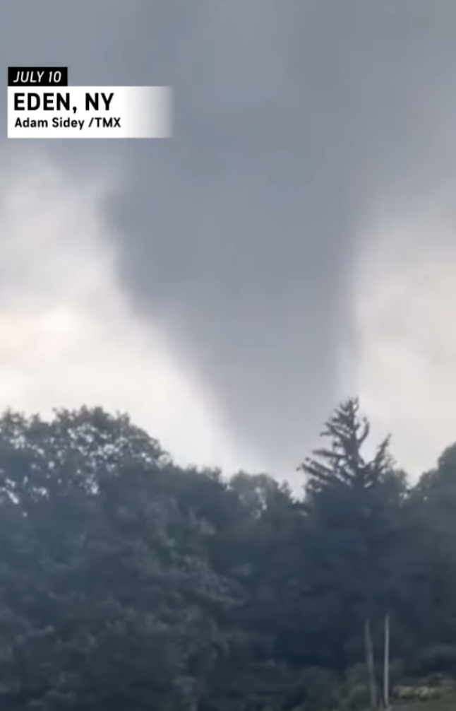
July 10
From FoxWeather
courtesy of Brandon Mead
From AccuWeather
Arkwright, NY
Eden, NY

Slide 57
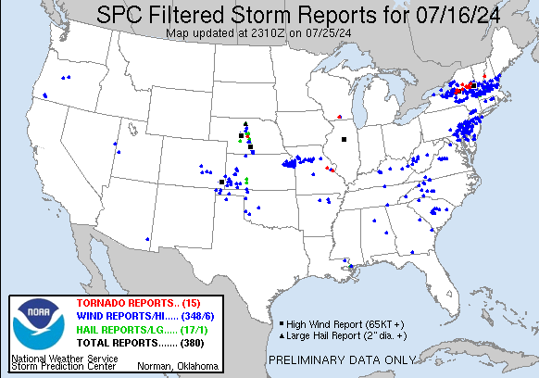
July 16

Slide 58
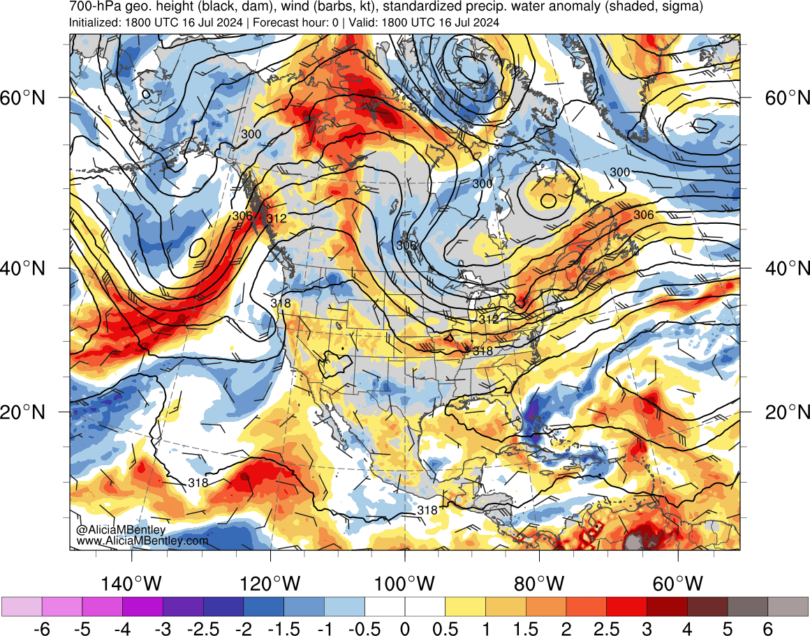
July 16
Anomalously high moisture available

Slide 59
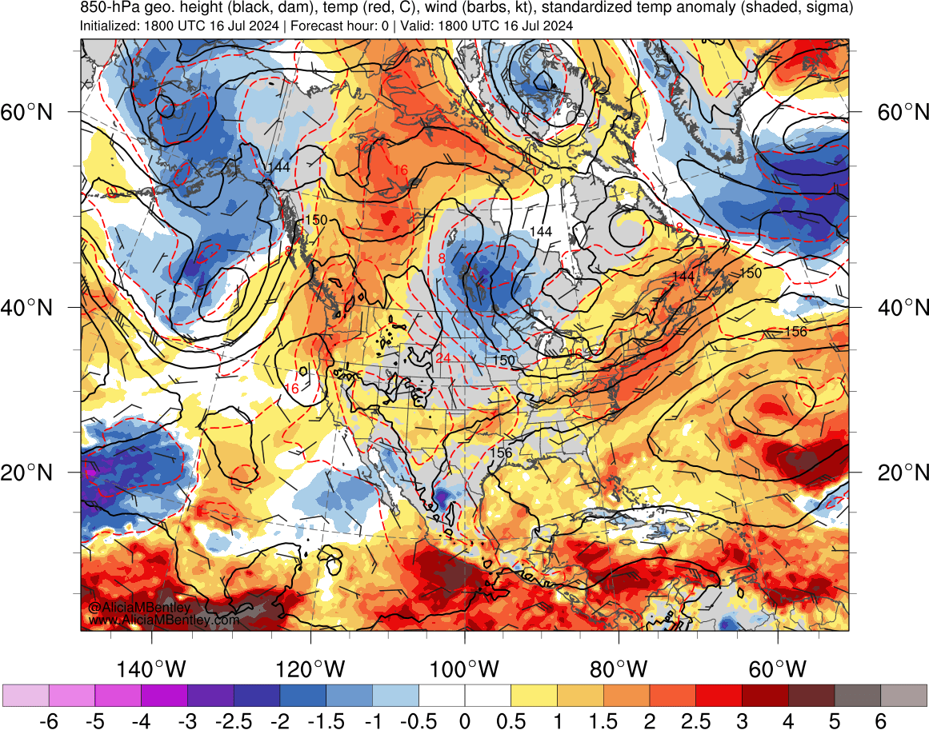
July 16
Anomalously warm temperatures

Slide 60
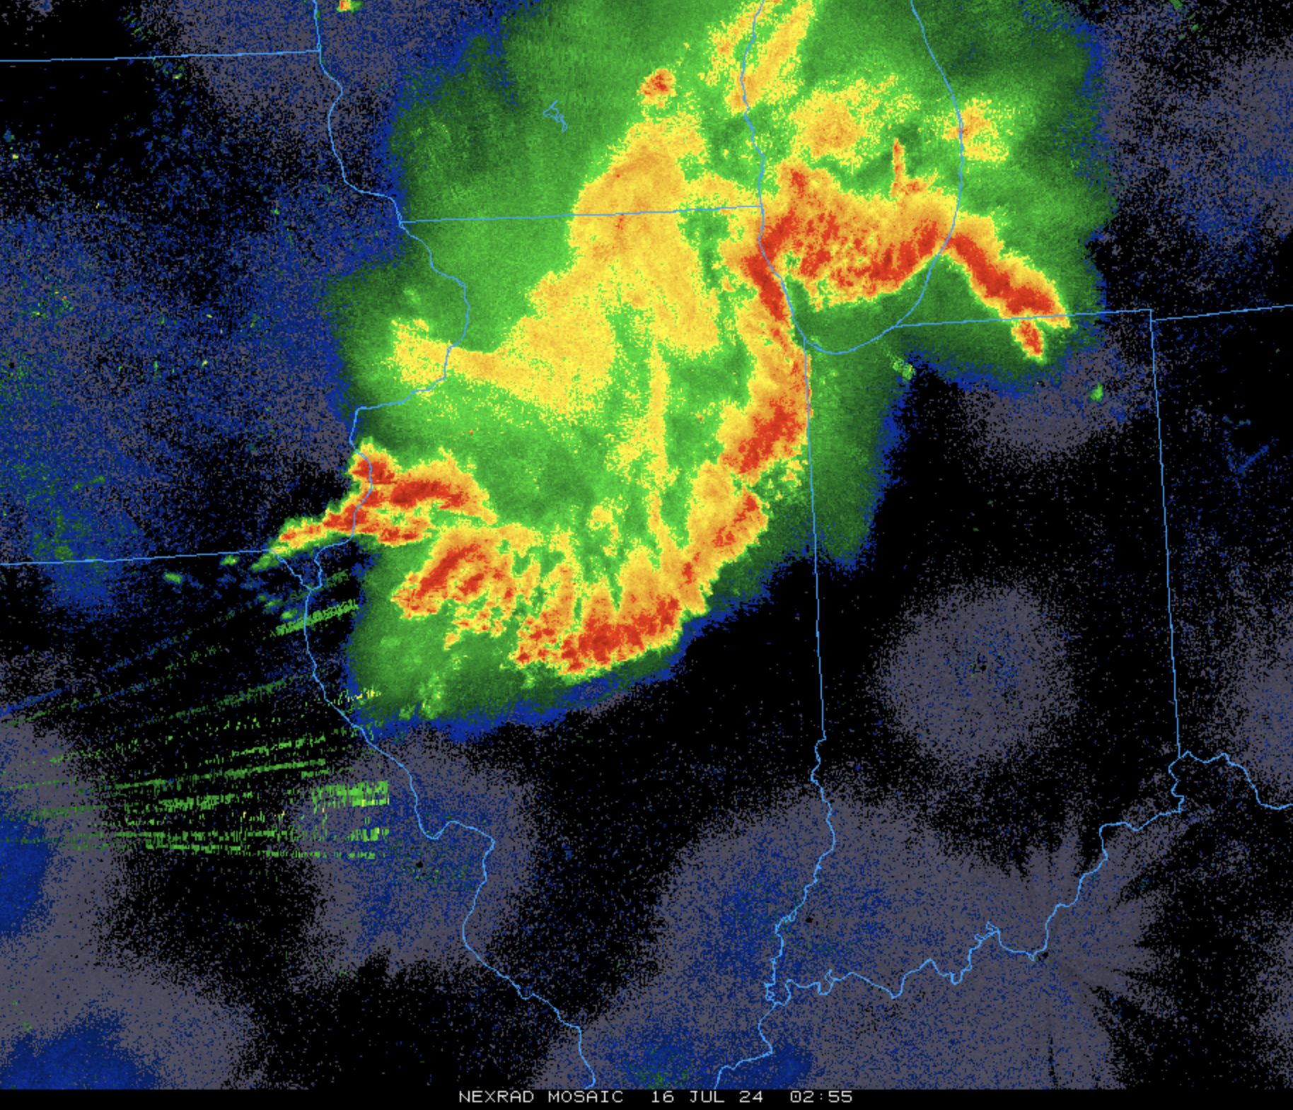
July 16
Image from ral.ucar.edu/weather
Previous evening: Midwest thunderstorm complex

Slide 61
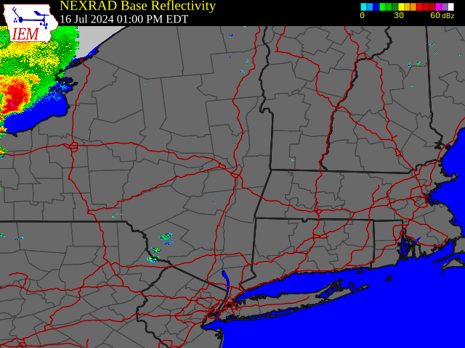
July 16
From NWS–Albany

Slide 62
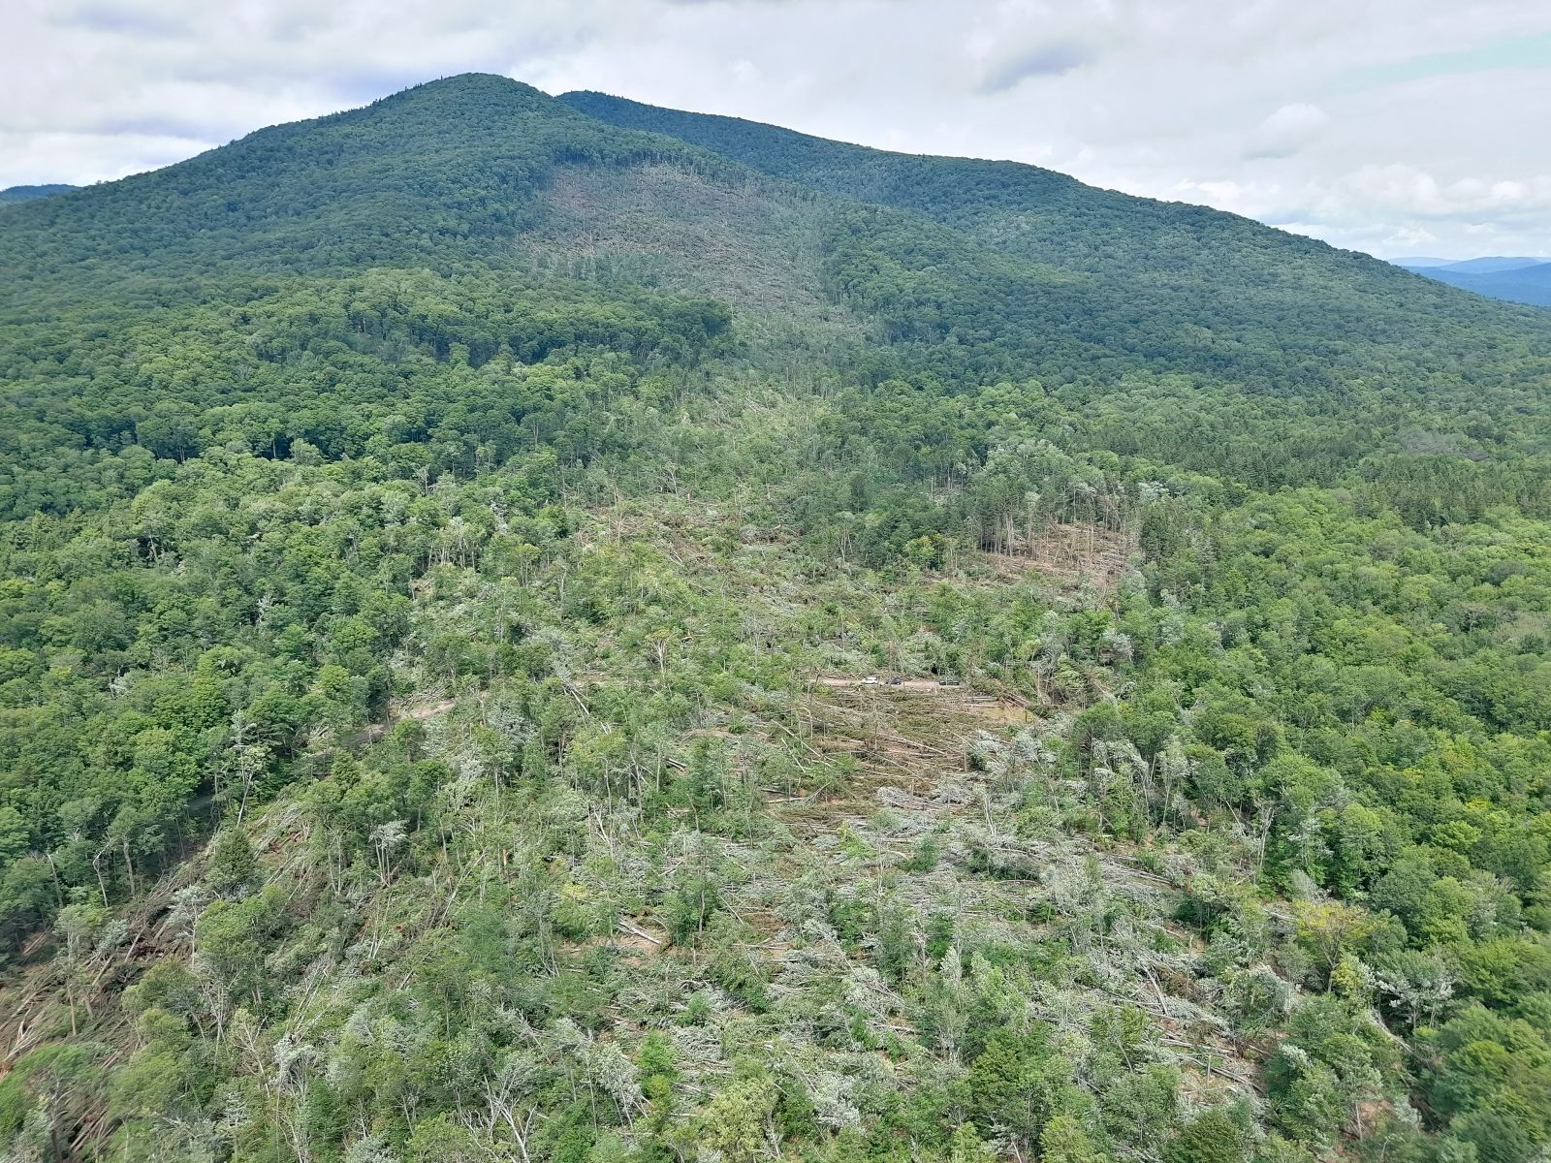
July 16
Oxbow Lake, NY EF-1
From NWS–Albany

Slide 63
Summary
2024 was a record-breaking year, with 32 tornadoes confirmed in New York State
  Max intensity EF-2, Rome
2024 NYS tornadoes were primarily a result of two significant events
  ”Forcing”
  Wind shear
  Instability
  Questions?

