Slide 1
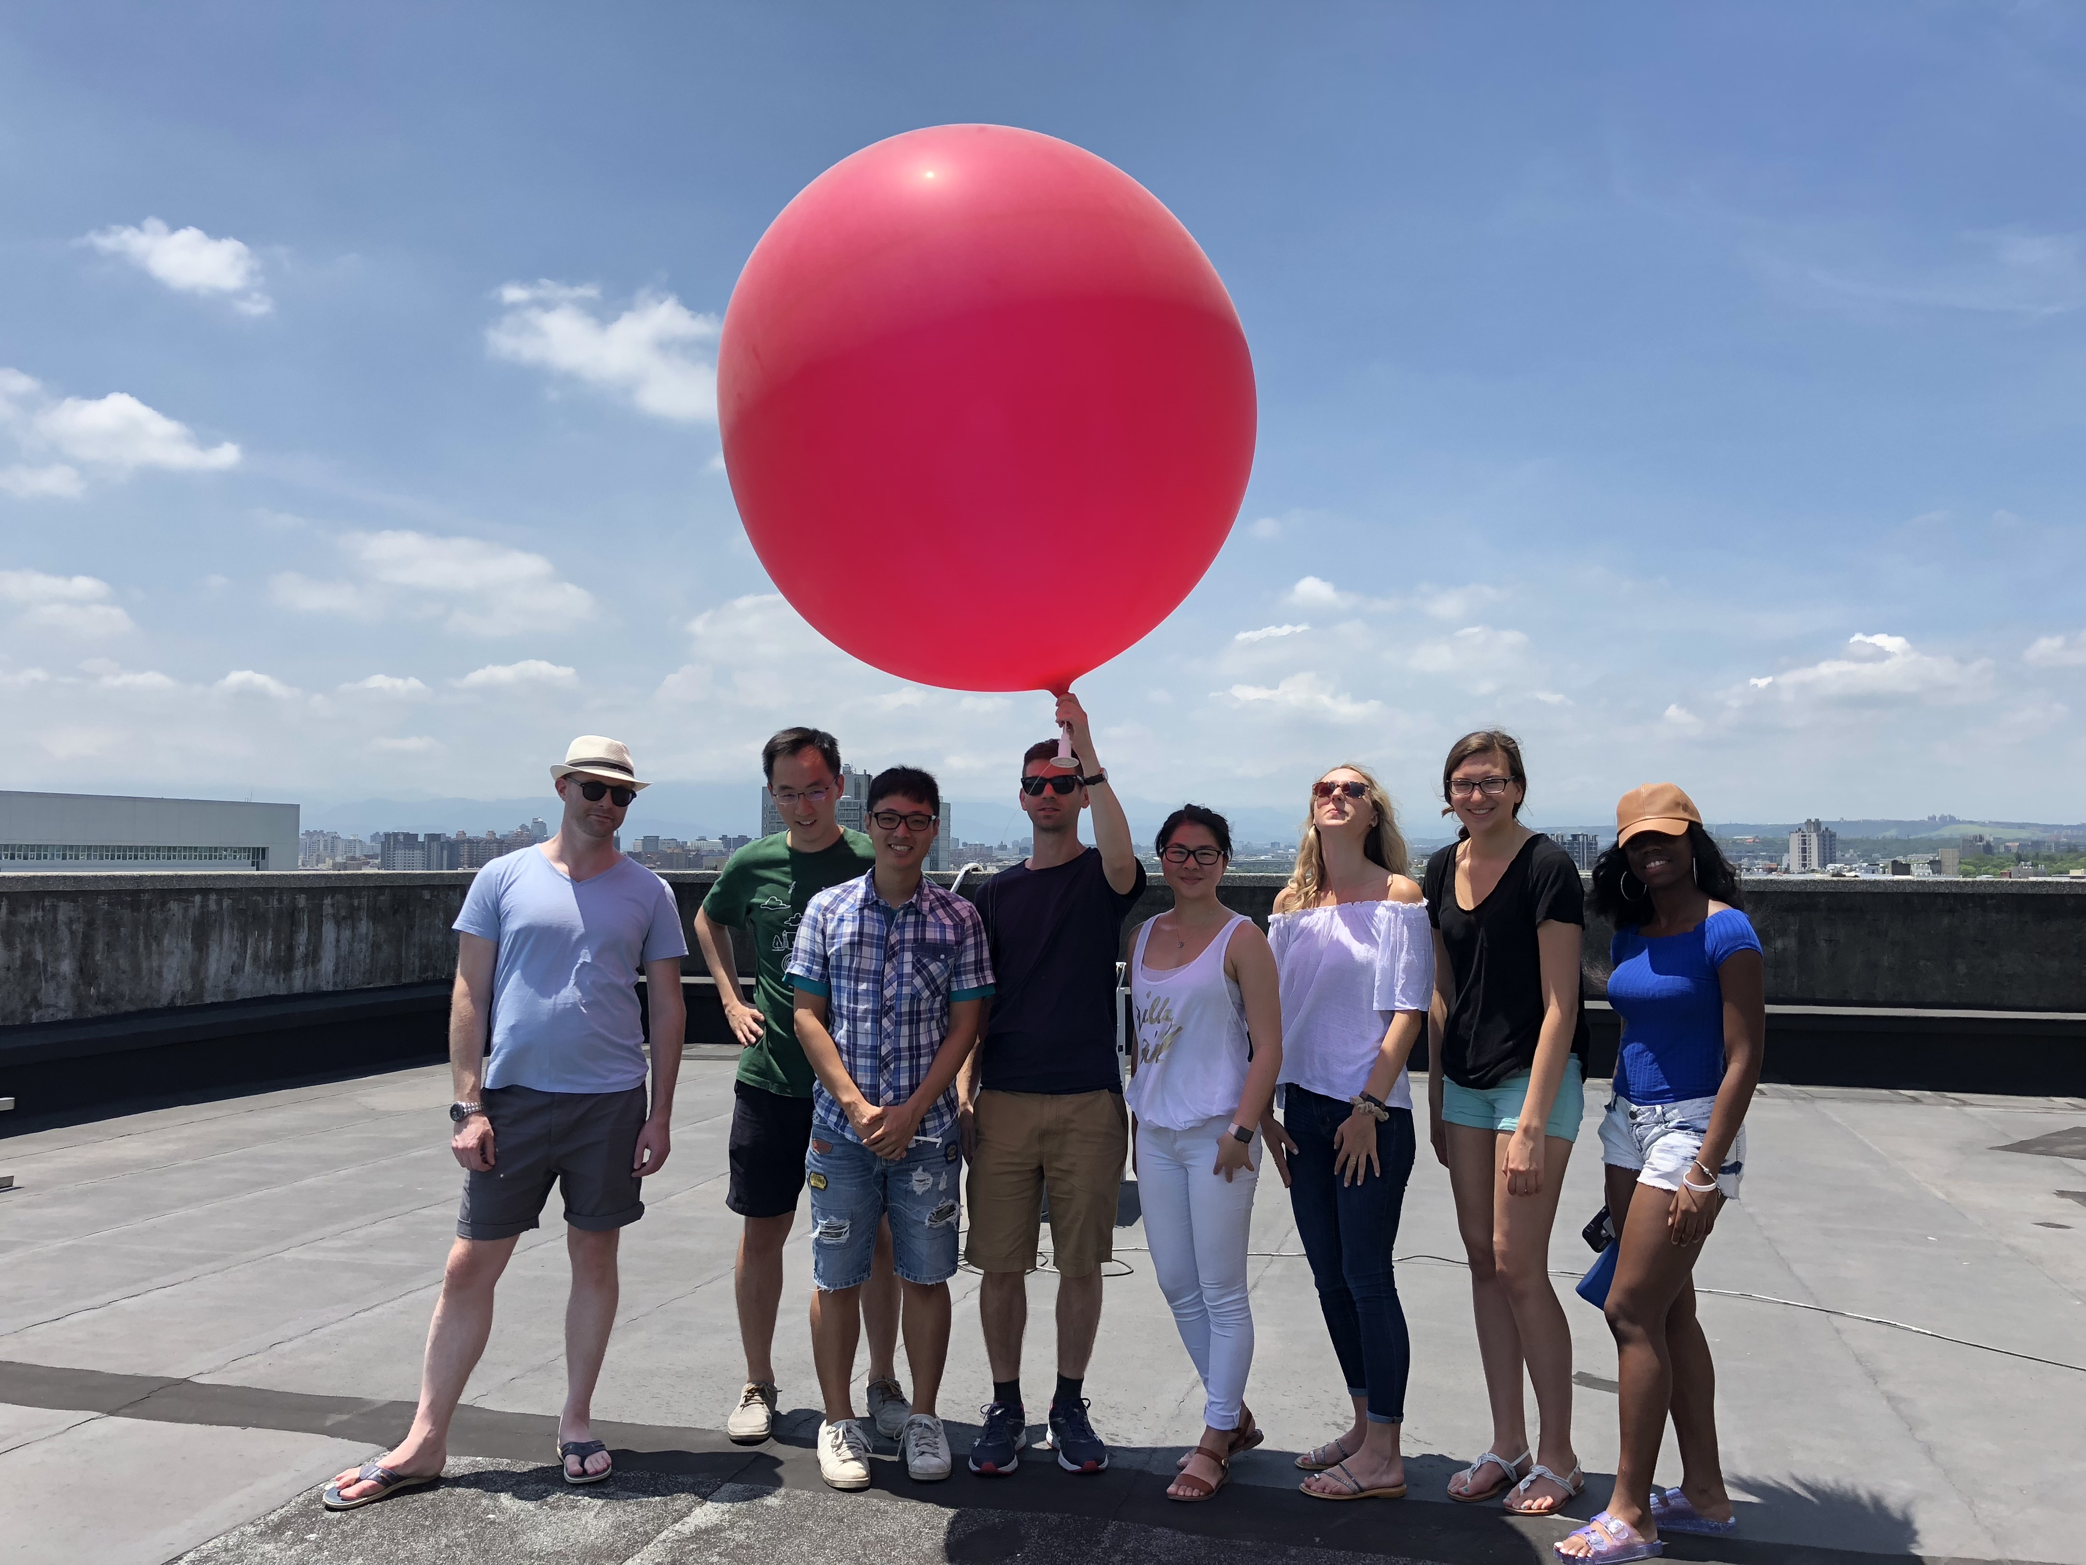
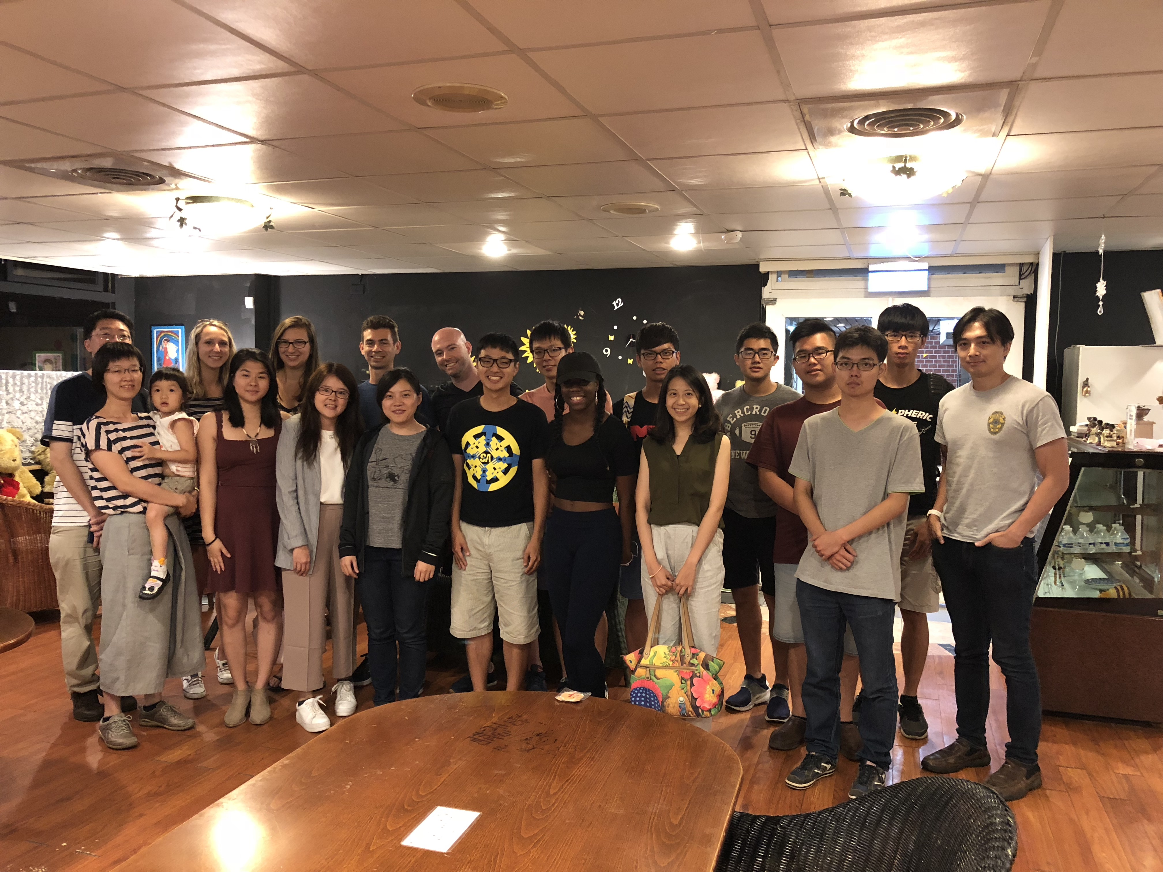
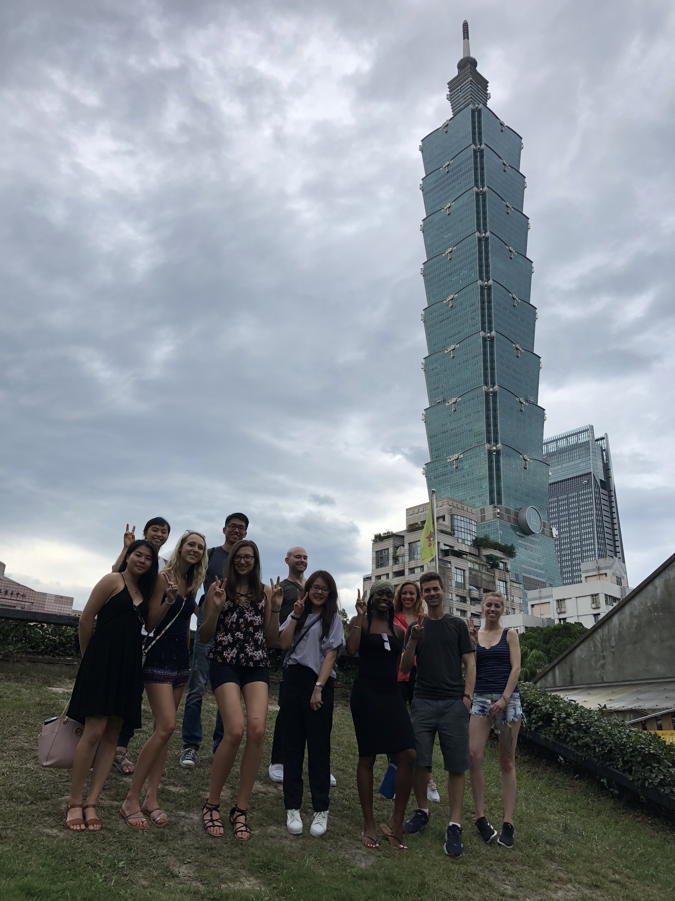
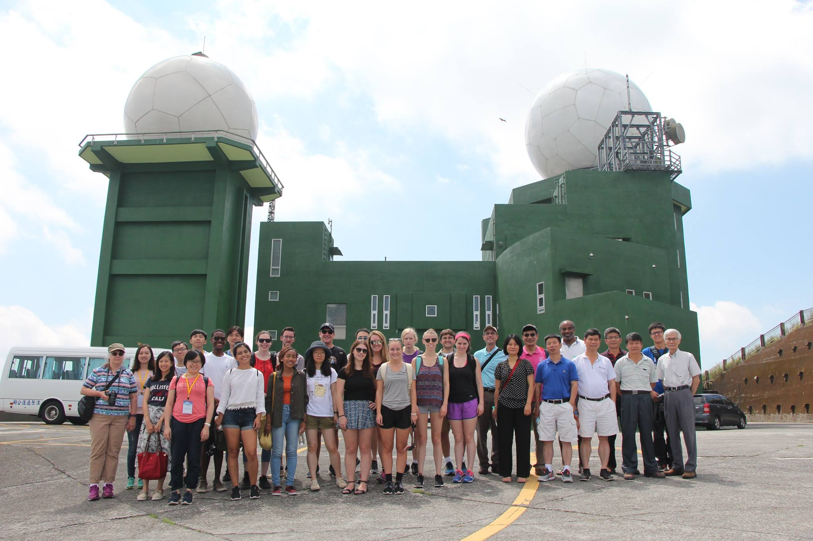
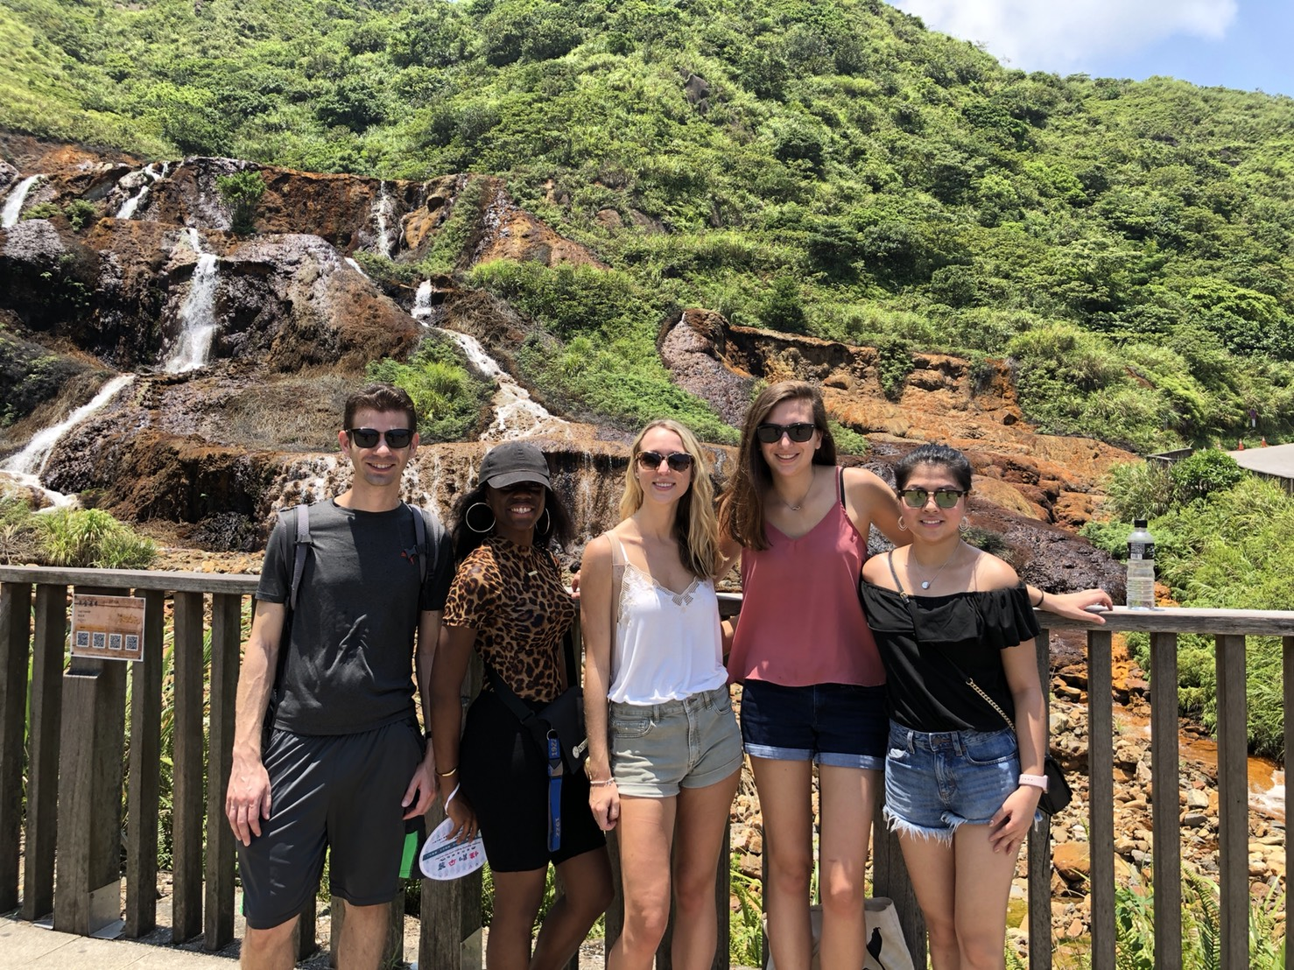
PIRE Summer Program in Taiwan 2019
06/24/2019-08/10/2019

Slide 2
Summer Program Schedule
June 24-August 10, 2019
Date | Agenda
February 25-March 12 | Application
March 24 | Admission Decision
March 31 | Notify PIRE about Your Decision to Accept or Decline
April 1-April 15 | NTU Online Application
April 5 Friday | PIRE Orientation
April 12, 19, 26, and May 3 | Language and Culture Class
April 1-May 10 | Social Activities Connect you with Co-Pis at UAlbany and in Taiwan
May 10-June 20 | Feel free to start your research! Get your research published!!!!

Slide 3
Date | Agenda
June 21 | Fly to Taiwan
June 22 | Arrive in Taiwan and airport pickup by NCU
June 23 | Relax and walk around the campus
June 24-July 2 | National Central University Bring $100-$200 for food.
July 2-August 10 | National Taiwan University
August 5-6 | PIRE Annual Meeting
August 10 | Fly Back to the U.S.

Slide 4
National Central University
June 24- July 2, 2019
Date | Saturday & Sunday | Monday | Tuesday | Wednesday | Thursday | Friday | Saturday& Sunday | Monday
 | 06/22-23 | 06/24 | 06/25 | 06/26 | 06/27 | 06/28 | 06/29-07/01 | 07/02
10 am-12 pm | Airport Pickup & Dorm Check-in | Program Introduction and Orientation | Practical Chinese language for daily life | GPS Application Research Introduction (10 -12 am) Visit NCU Center for Space and Remote Sensing Research ( 1 pm-5 pm) | Field trip to visit CWB, TTFRI, NCDR Academic Sinica | Numerical Modeling and Data assimilation Research | Field trip to 1.Shimen Reservoir and Da-Xi small town 2.Hakka culture visit of Beipu small town 3.Algae reef ecological zone and Coastal air sea interaction observatory Or 1.Chi-Chi Earthquake Museum 2. Sun Moon Lake 3.Chung Tai Chan Monastery 4. Chung Tai World Museum 5. Pu-Li small town | Cloud and aerosol Research with UAV introduction and operation (10 -12 am)
1pm-4 pm |  | Campus tour (1pm-2pm) | Radar Meteorology and Research Introduction (1pm-3 pm) Radar Operation and Observation ( 3 pm-5pm) |  |  | Visit 1.NCU Kunqu Opera Museum 2. NCU arts Center 3. NCU 107 movie theater
 |  | Mesoscale Observation Research Introduction Field trip to NCU Meteorology Observatory |  |  |  |  |  | NCU-SUNY Albany students’ meeting And Bilateral idea exchange activities
5pm-8 pm |  | Welcome dinner | Night Market visit | TaiMall tour |  | dinner and King’s relaxing tour |  | Farewell dinner
Accommodation: NCU guest house

Slide 5
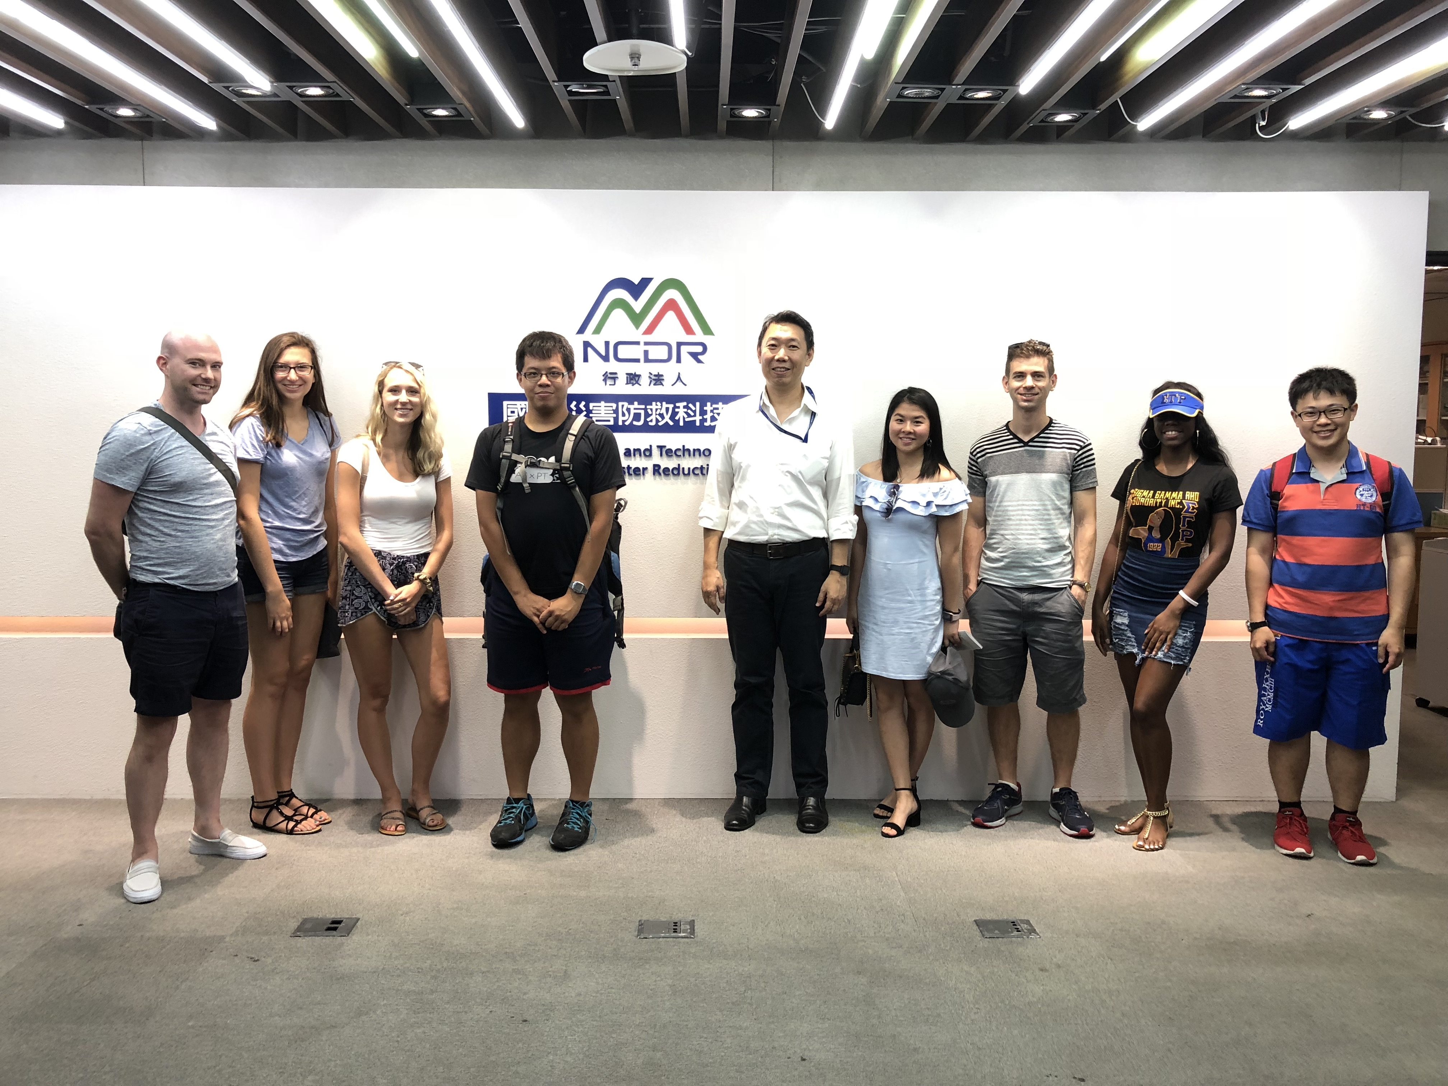
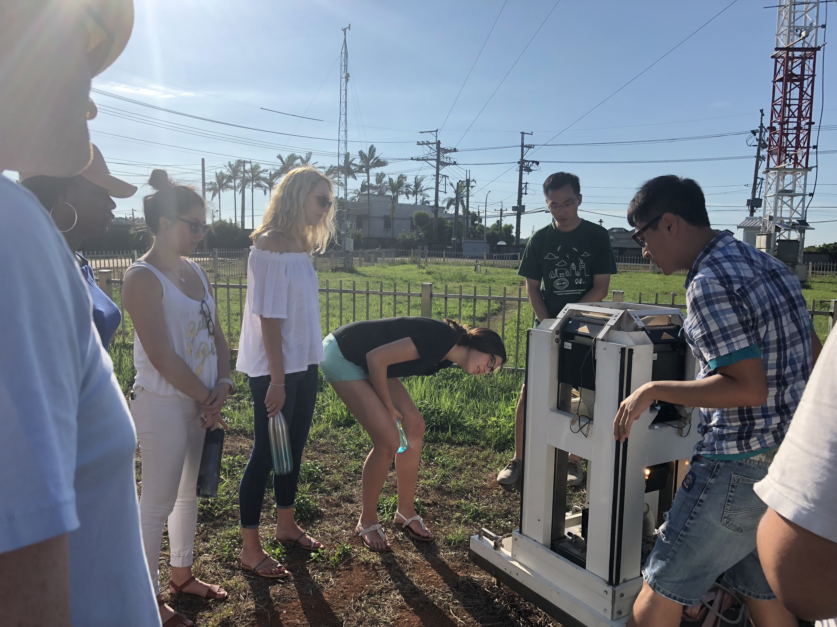
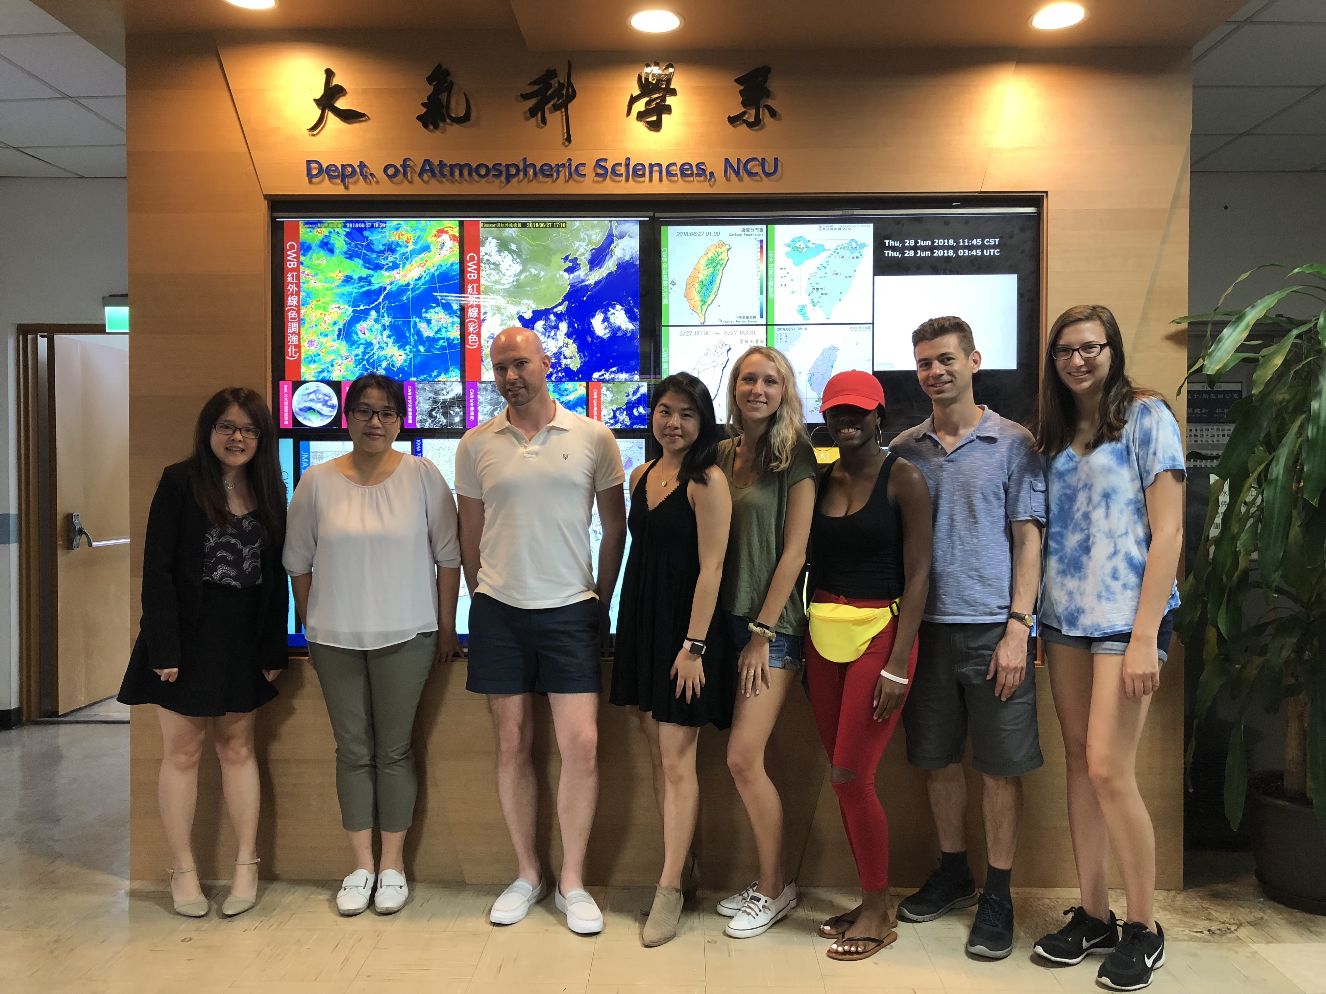
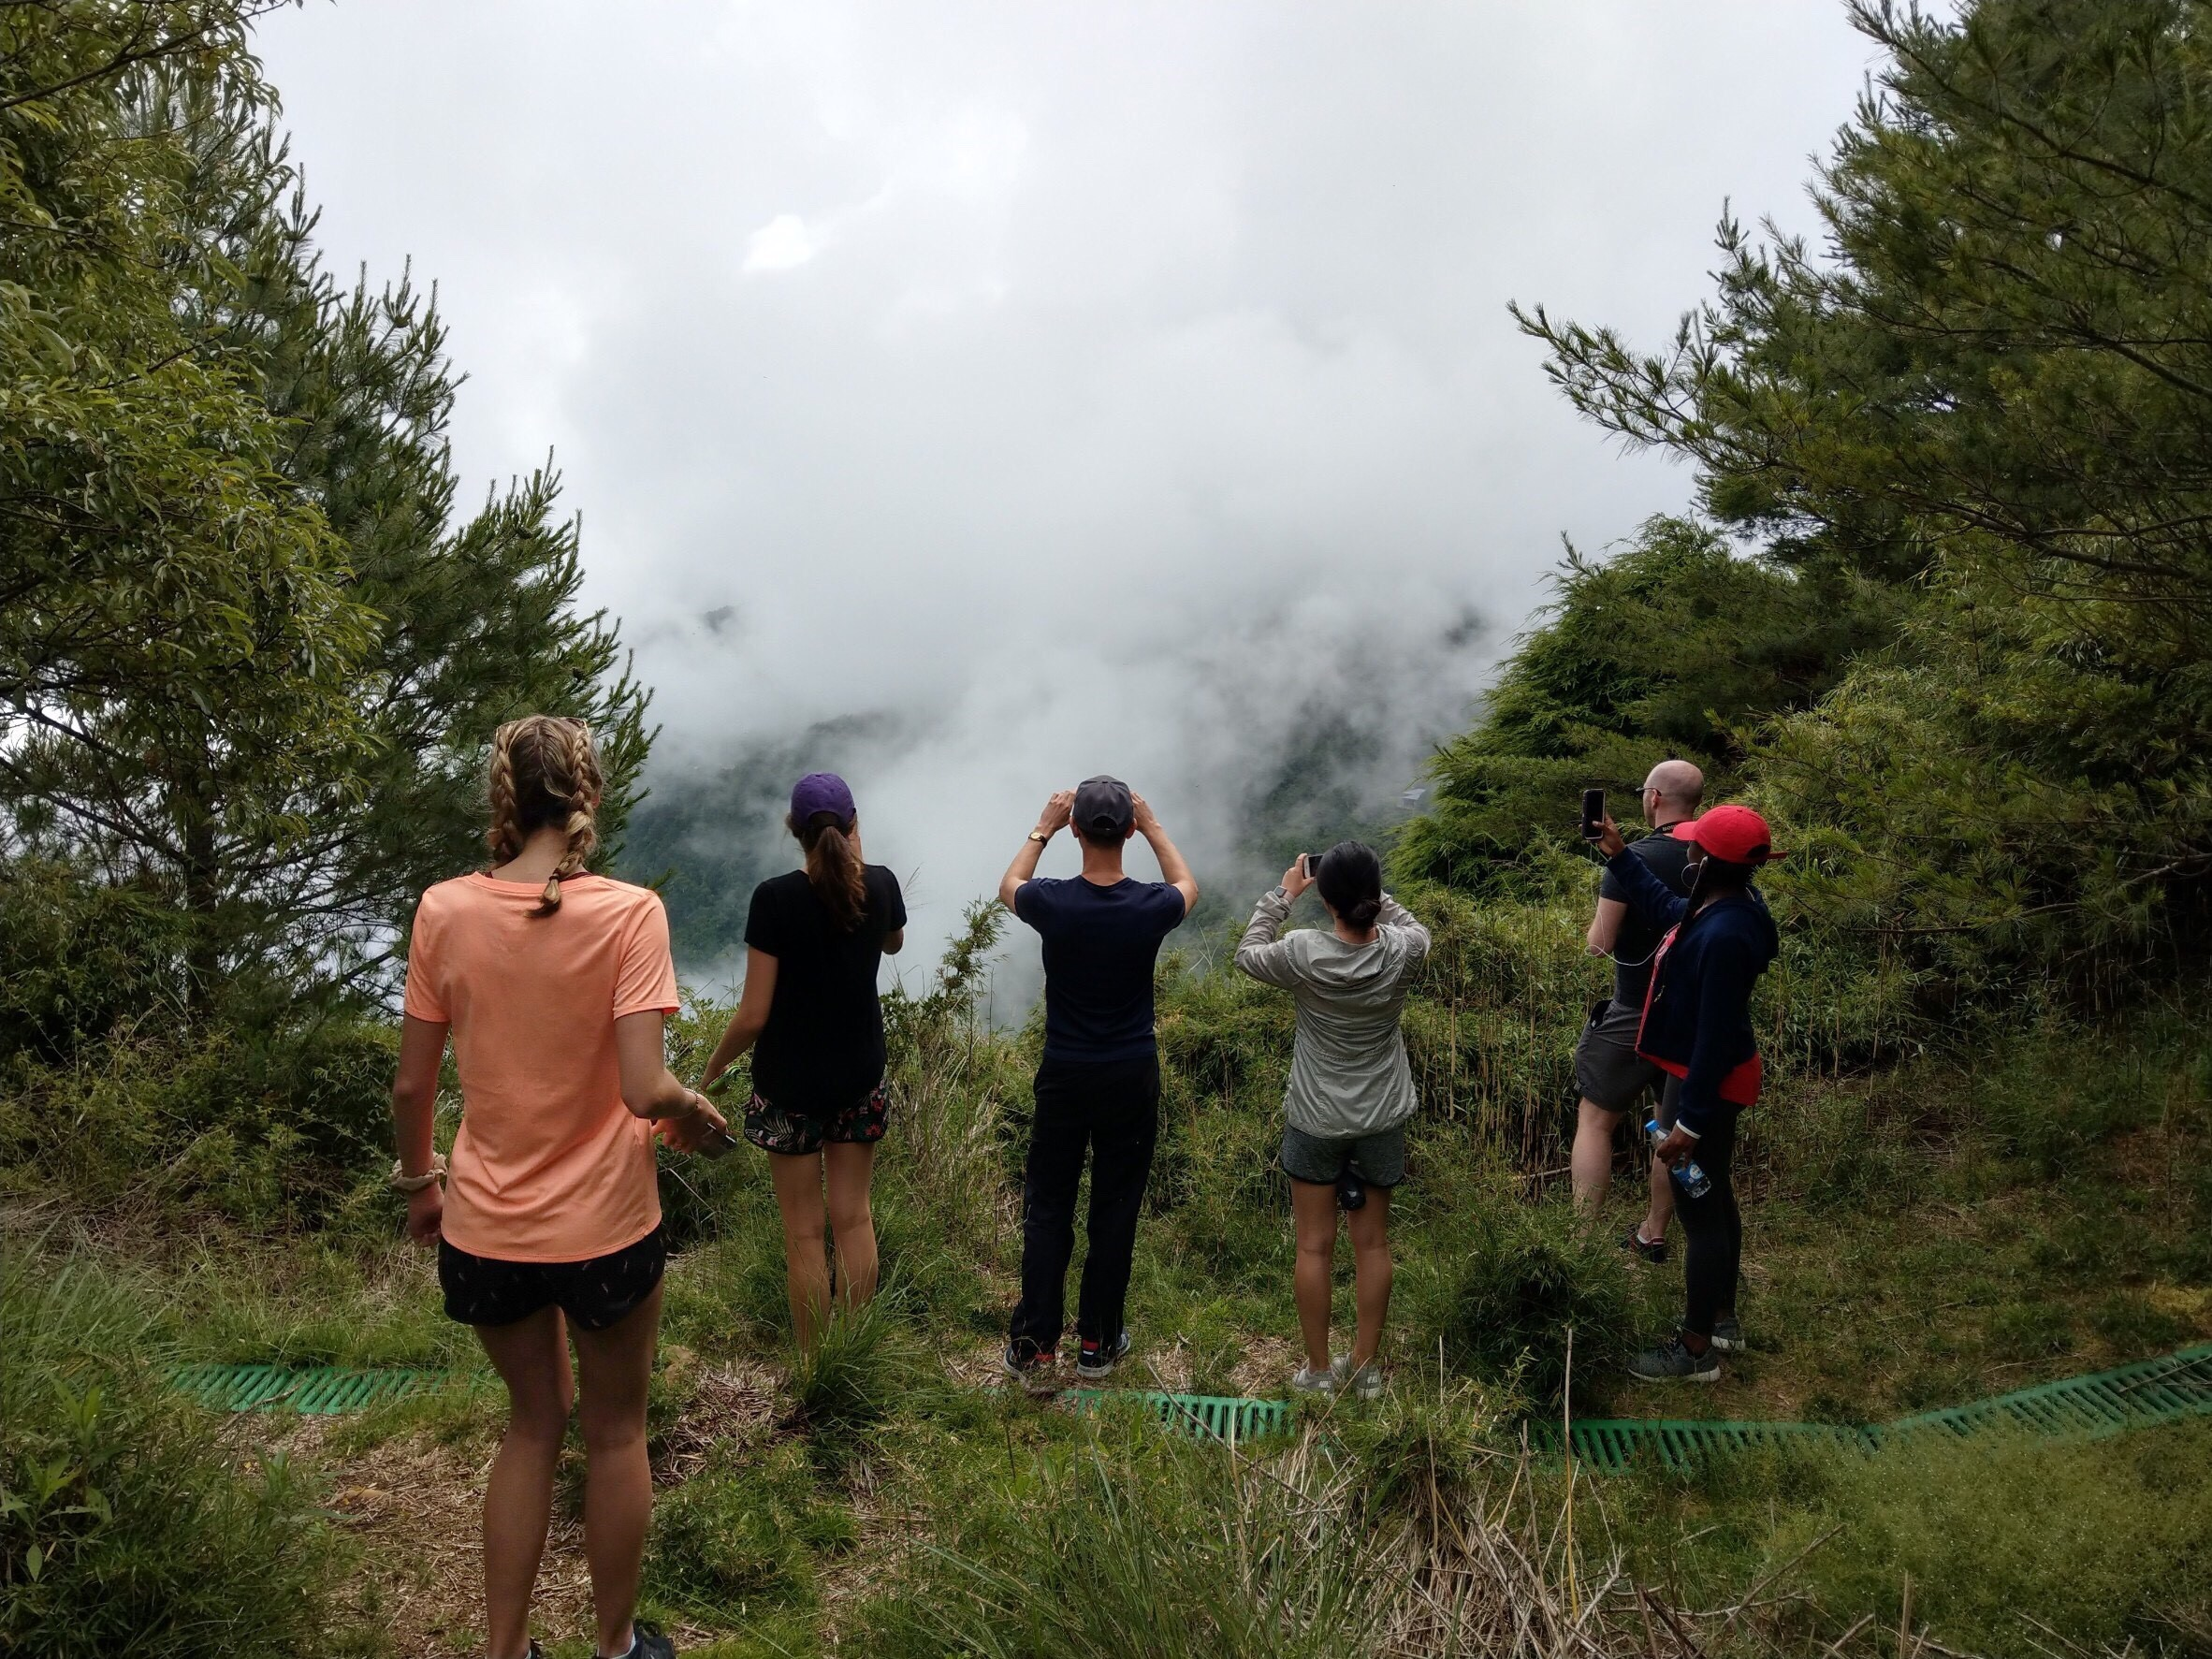
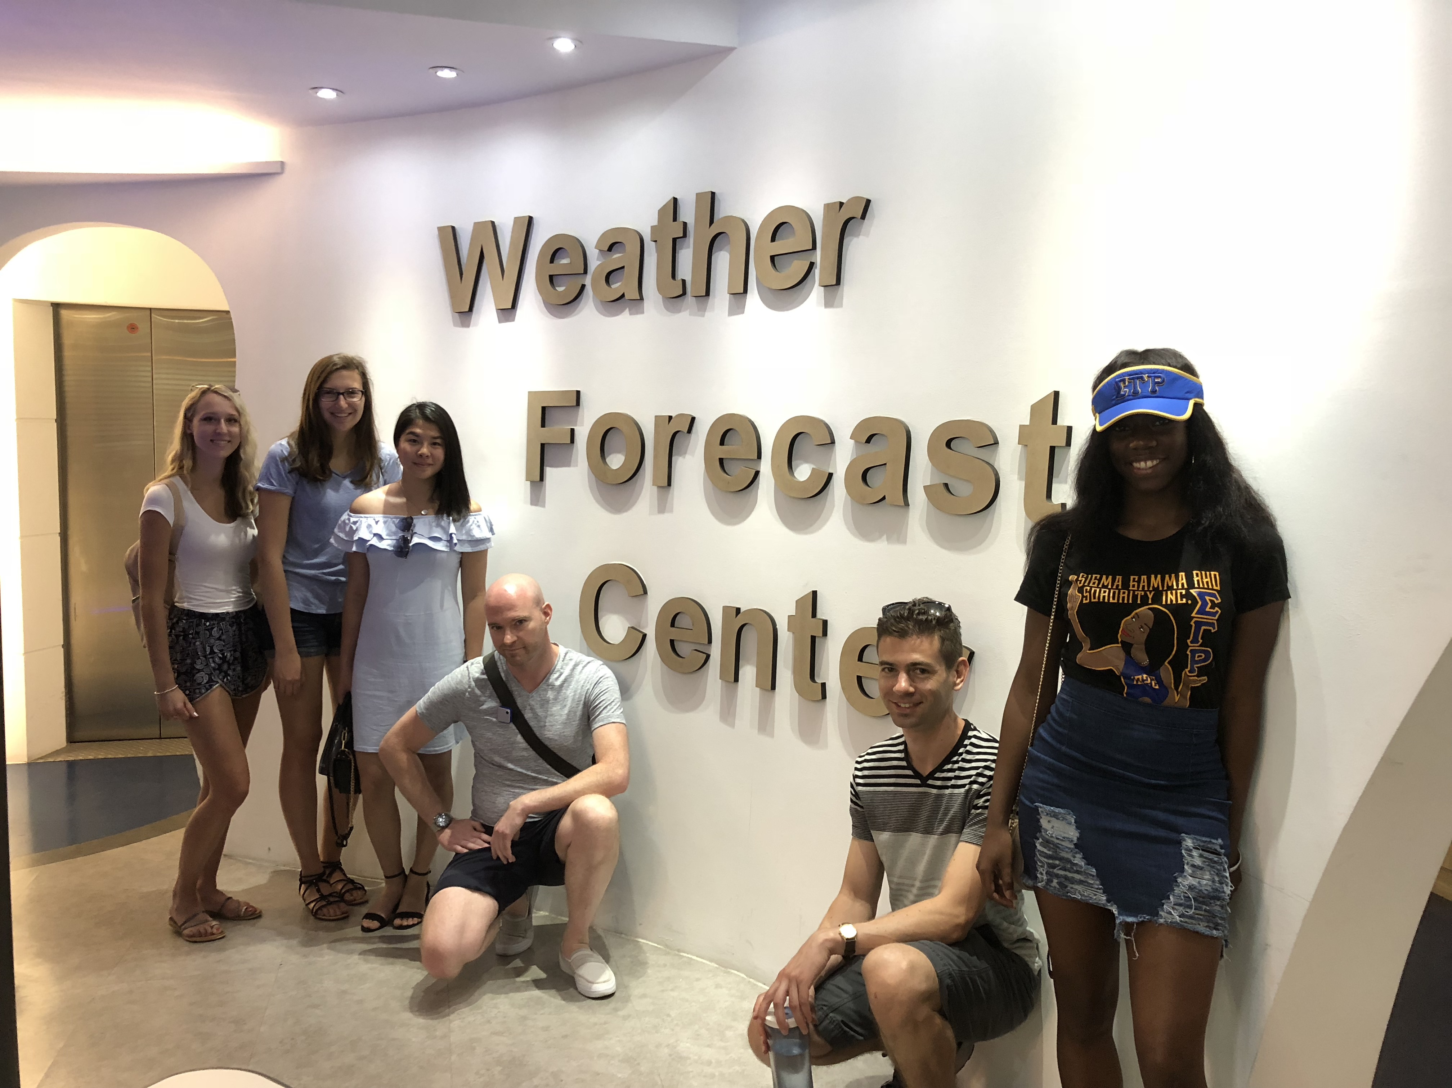
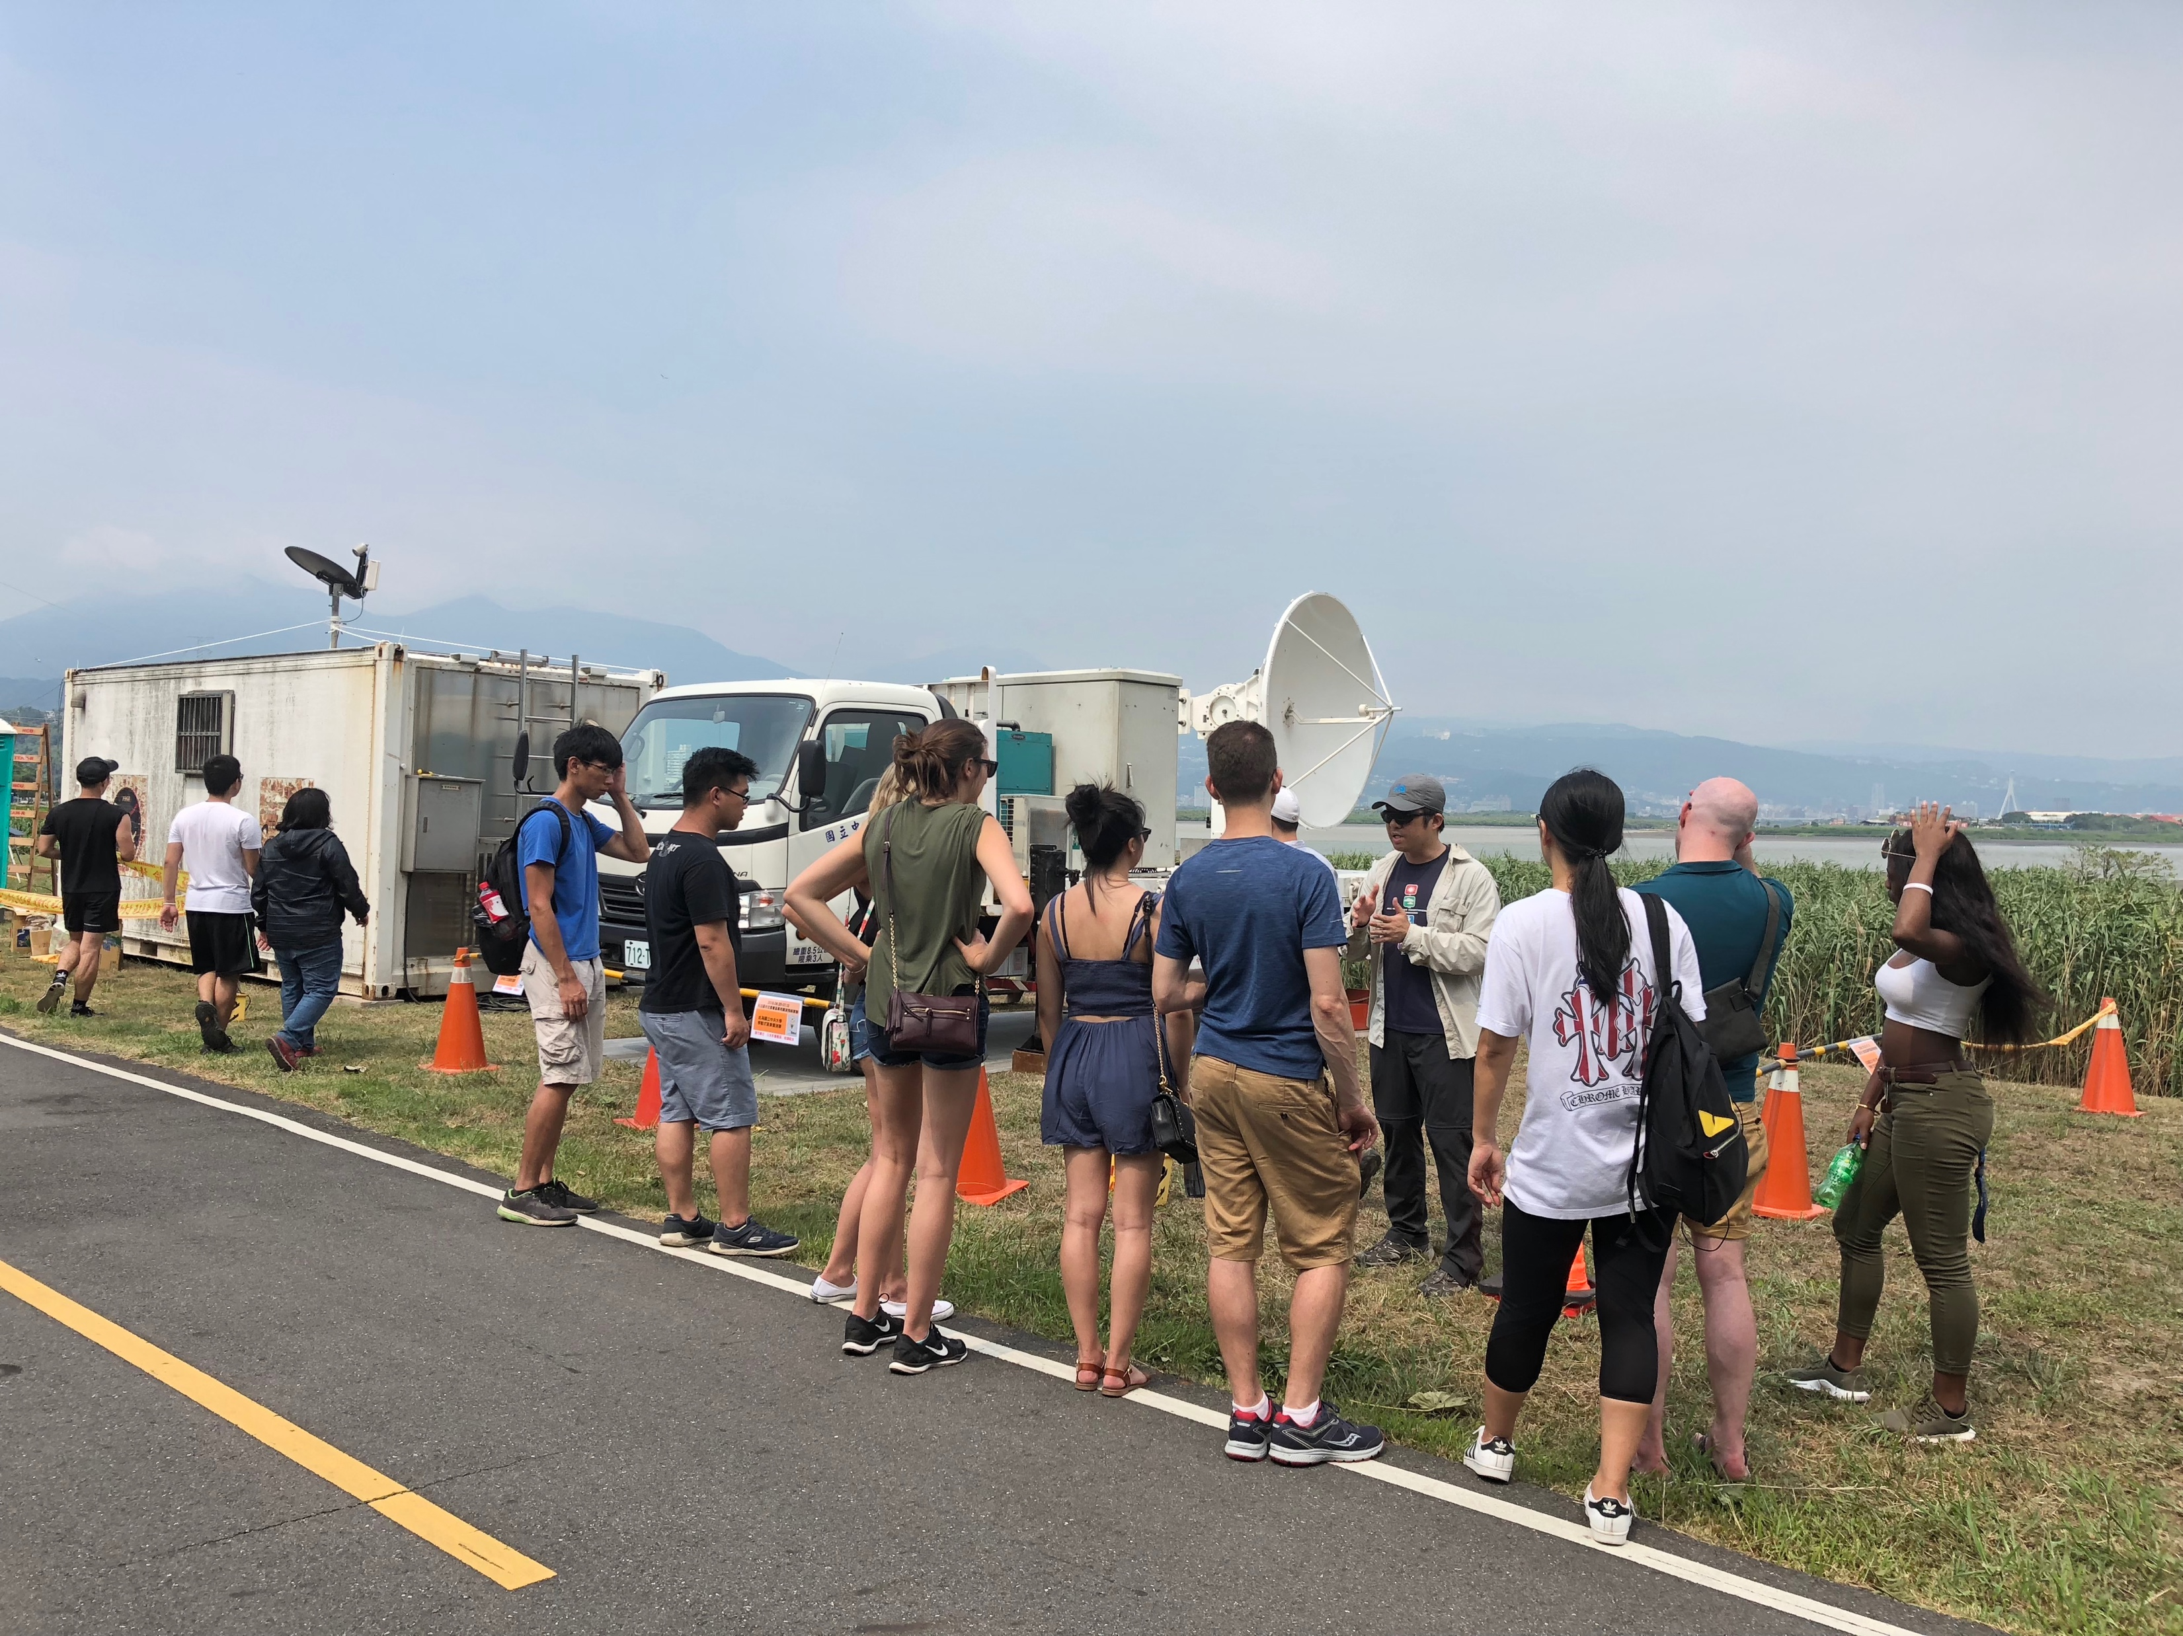
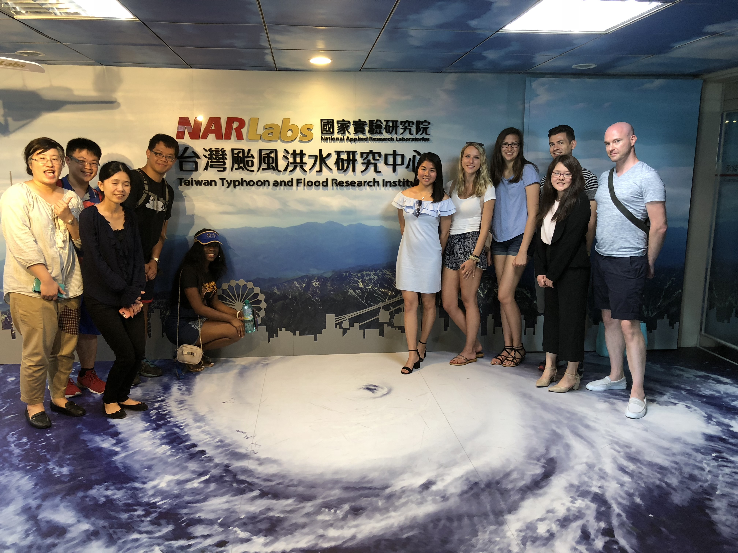

Slide 6
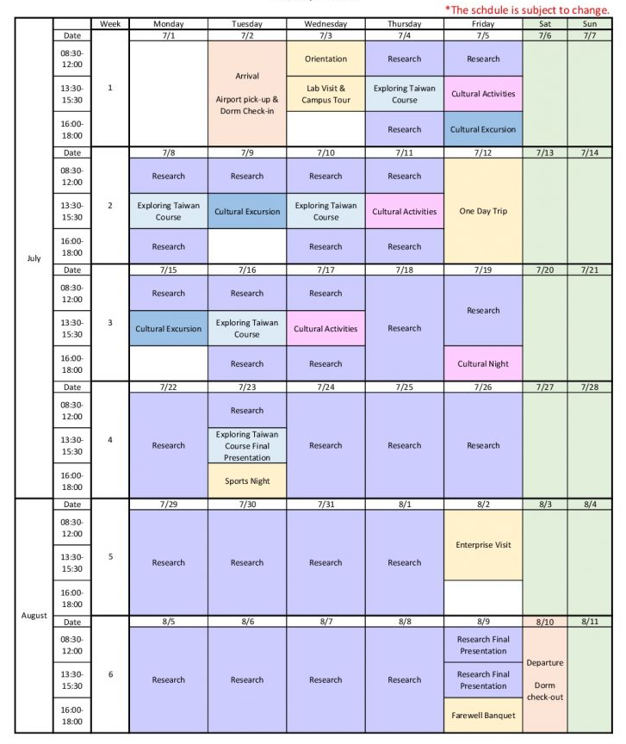
National Taiwan University
July 2
-
August 10, 2019

Slide 7
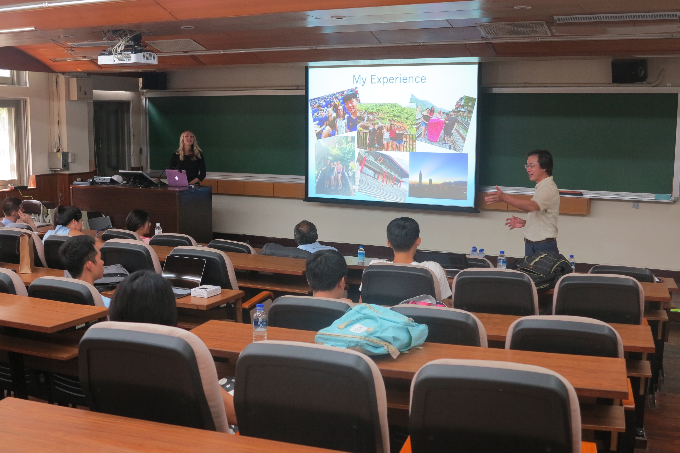
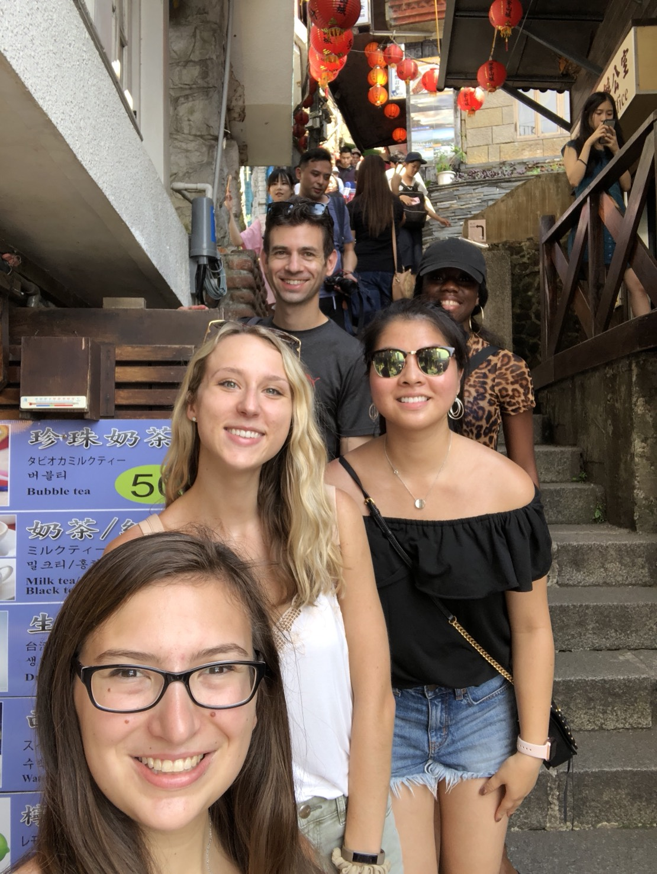
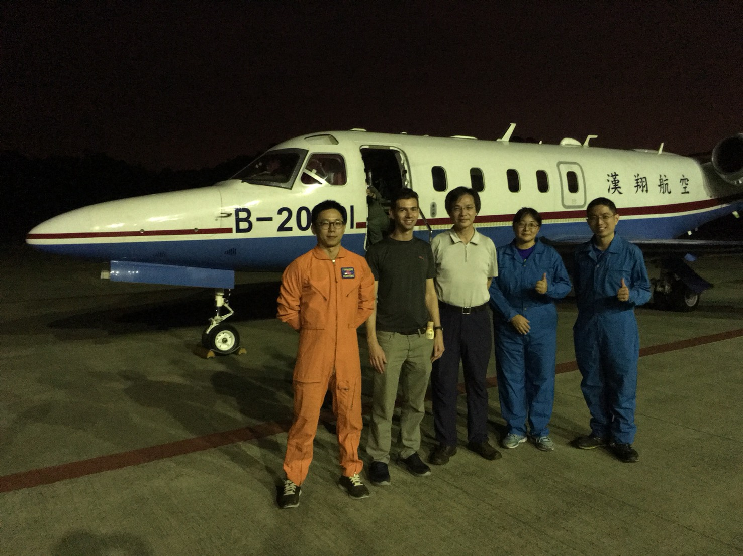
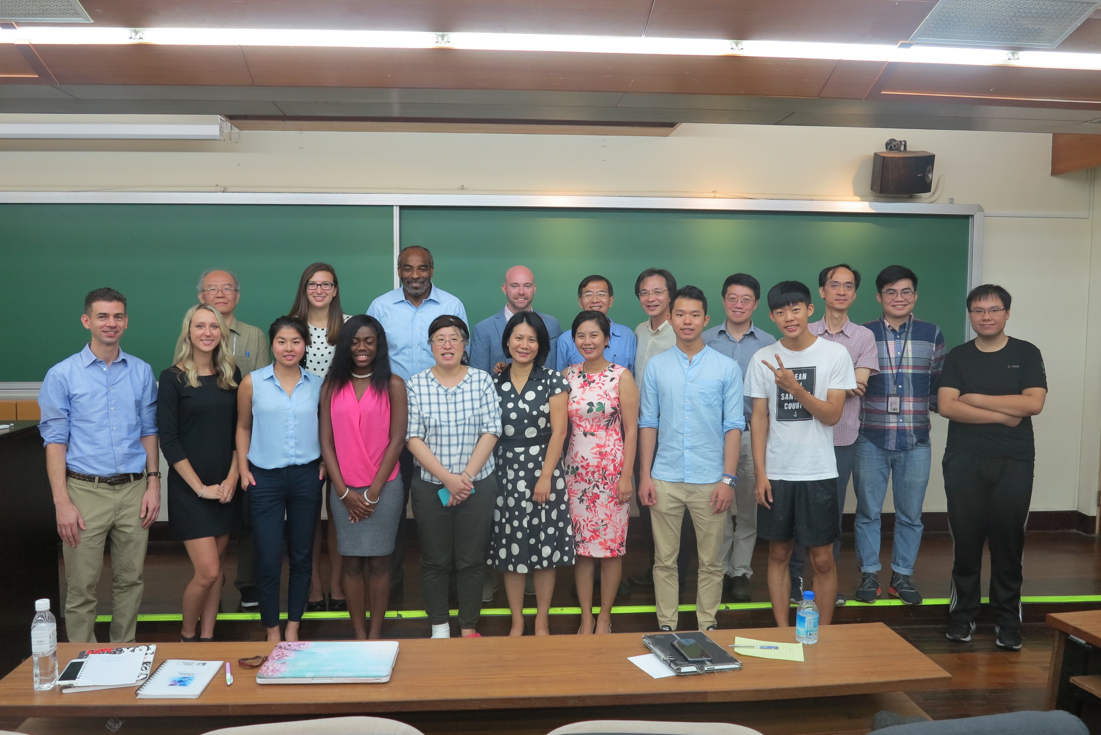
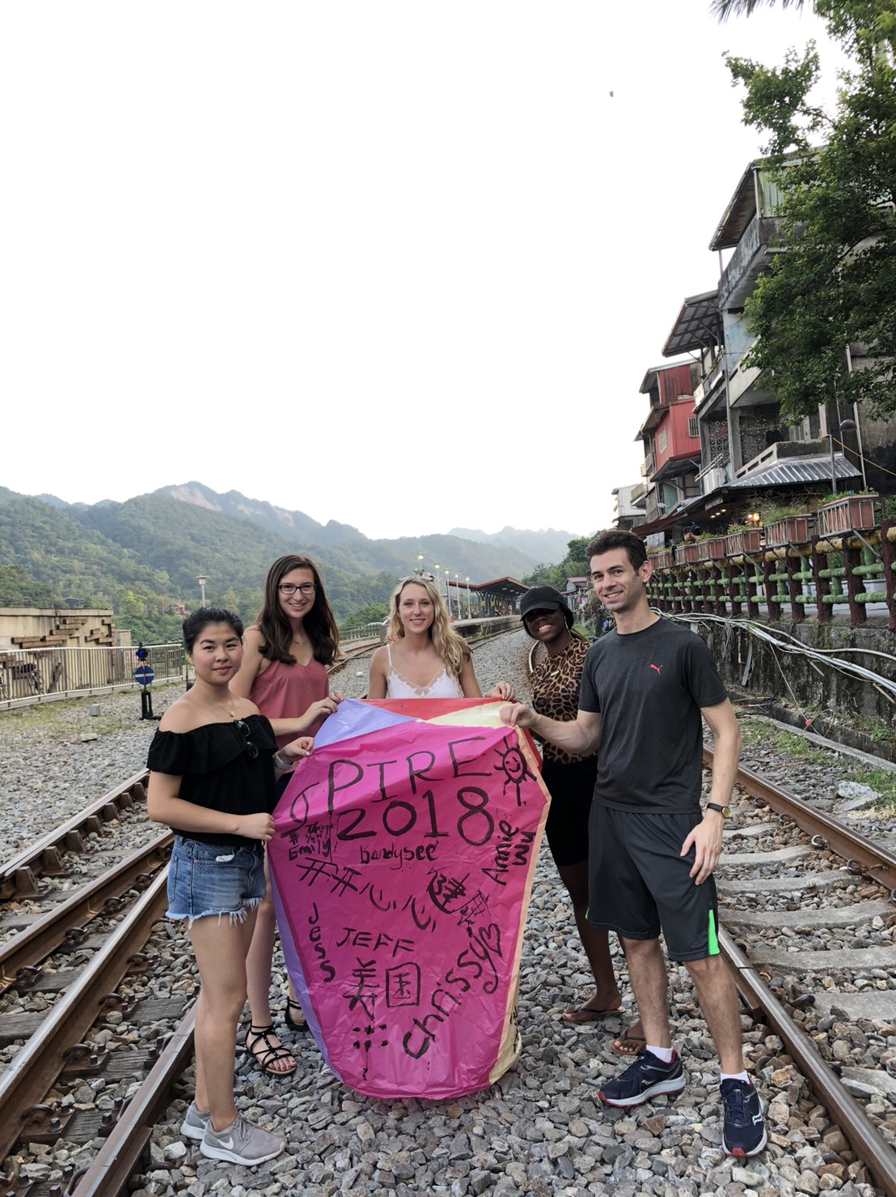
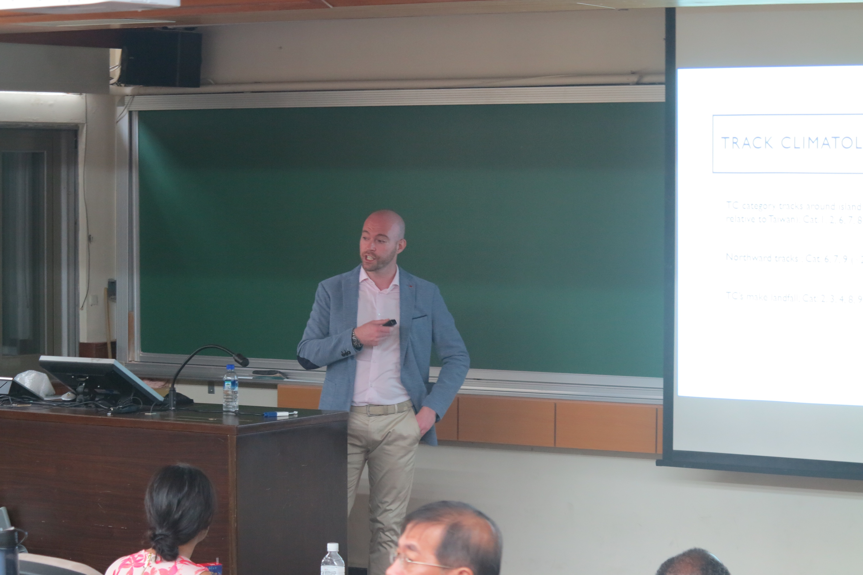

Slide 8
PIRE Funding
Item | Amount (USD)
UAlbany Tuition | Covered by PIRE
NCU One-Week Program | Covered by NCU
NTU Tuition | Covered by PIRE
Airfare | Covered by PIRE
Travel and Health Insurance | COVERED by PIRE
Food and Miscellaneous Expense | $600 travel advance (Please look out for your mail!!)
Deposit $400+$25 Application Fee | Students

Slide 9
PIRE Links
PIRE Online Application
https://abroad.albany.edu/programs/taiwan-pire-research-project-and-cultural-engagement-program/
PIRE Website
http://pire.asrc.albany.edu/
PIRE Facebook
https://www.facebook.com/US-Taiwan-PIRE-Project-1515051001868353/
PIRE Video
https://youtu.be/ra7IGXlpDYg

