Slide 1
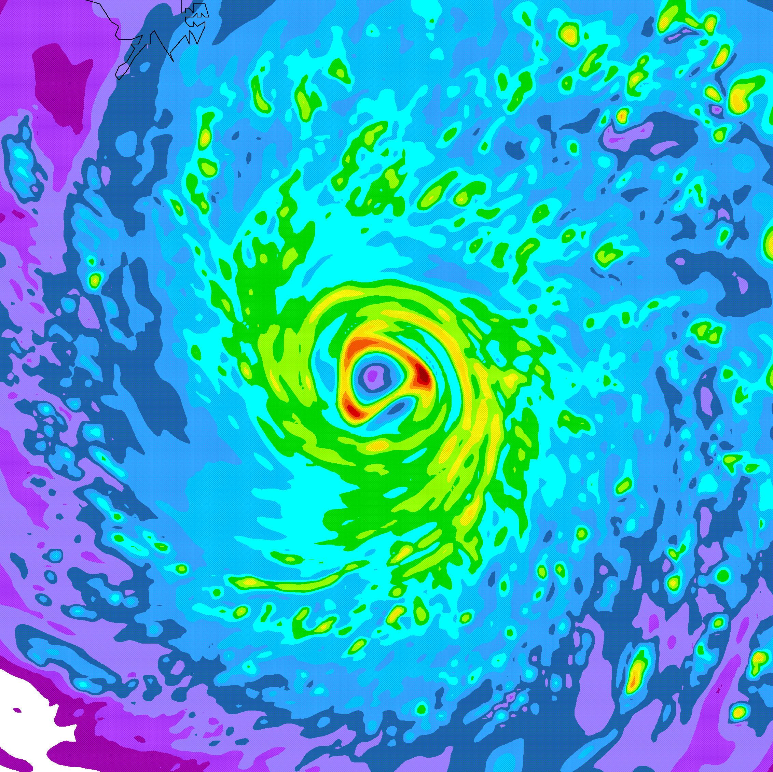
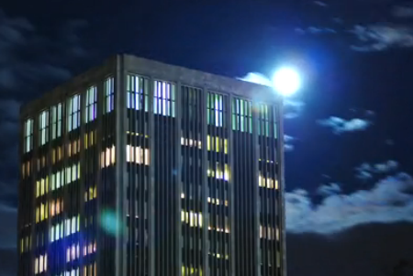
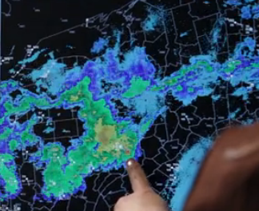
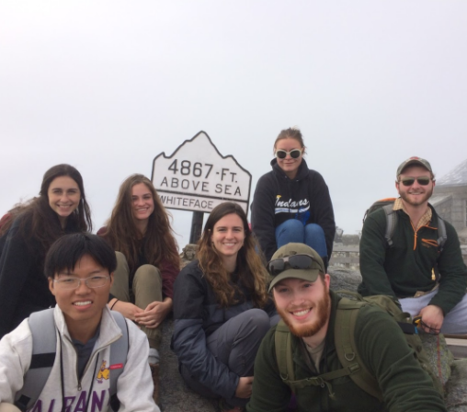
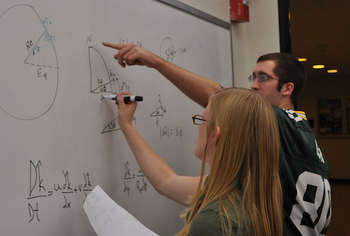
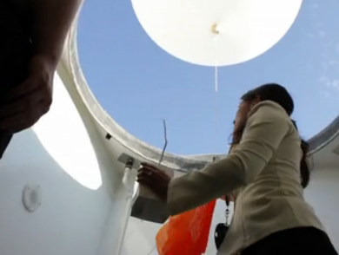
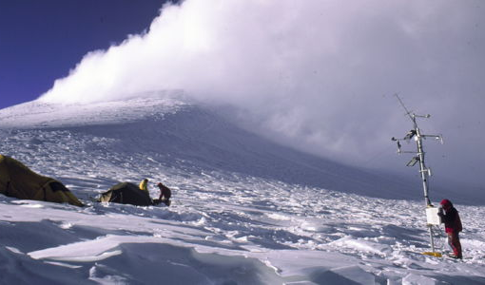
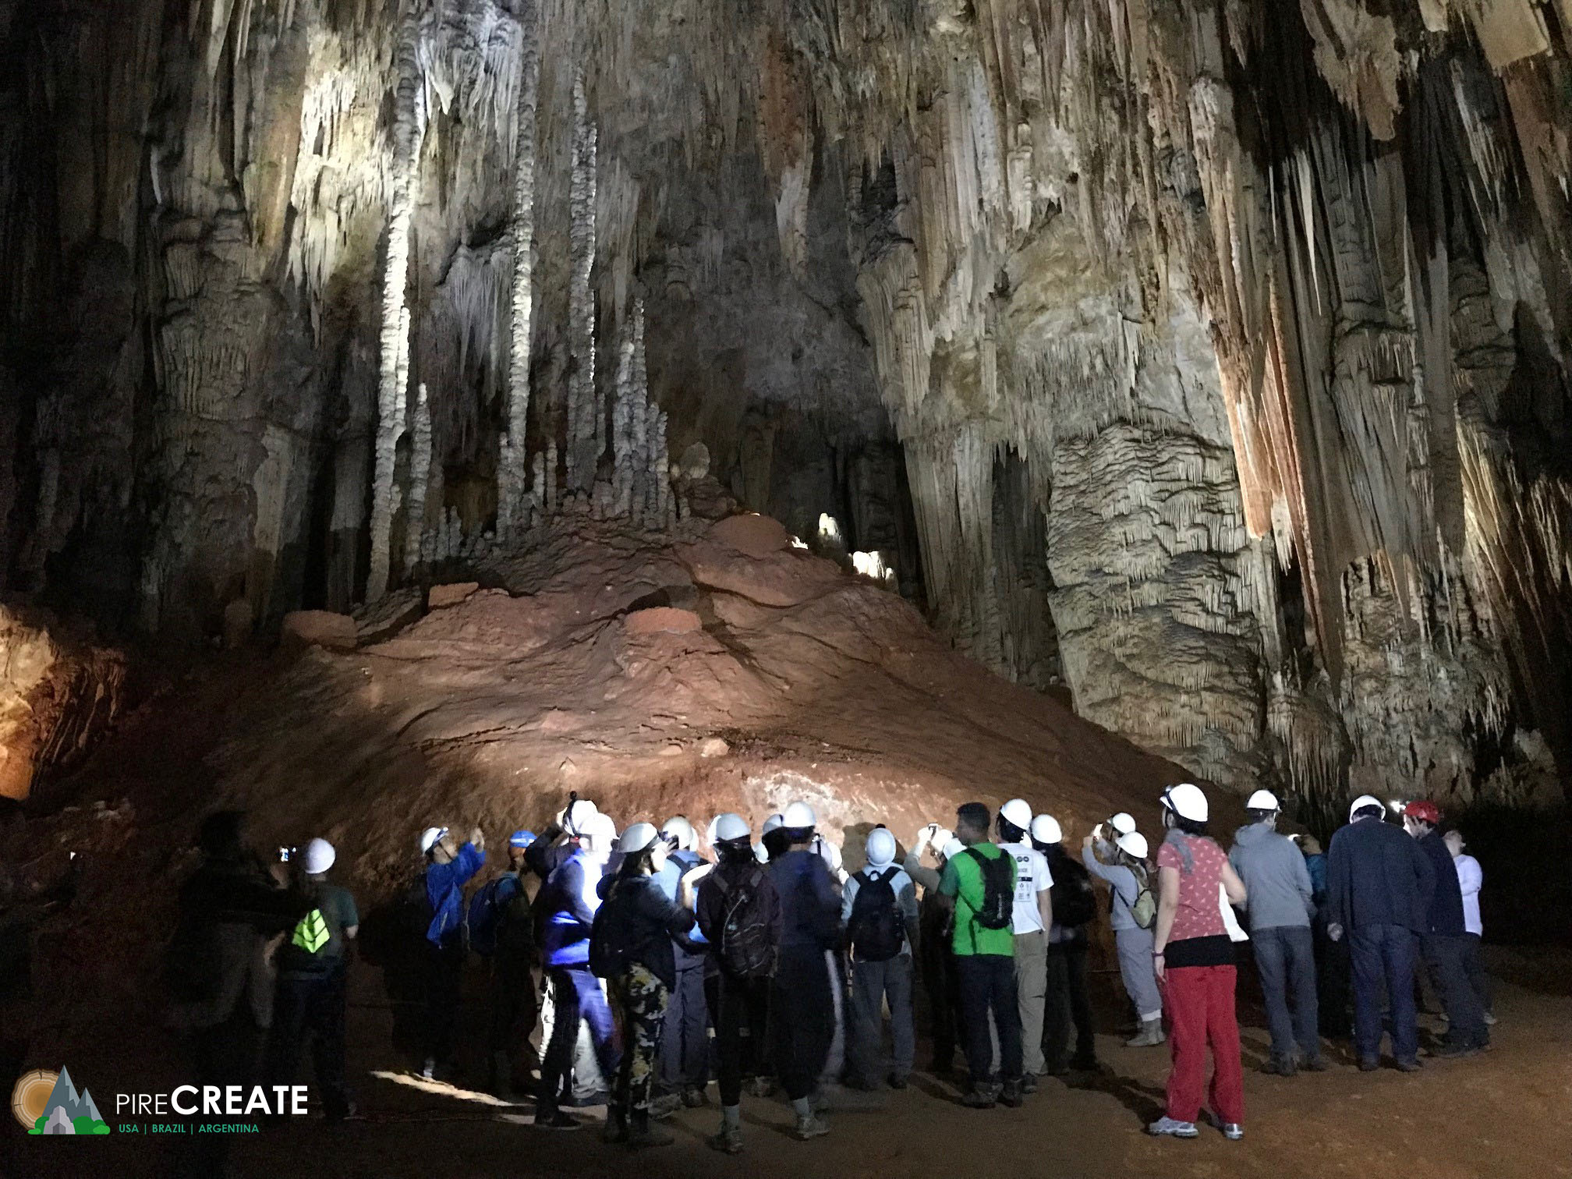
Department of
Atmospheric & Environmental Sciences
DAES
Contact me at:
Ross Lazear
rlazear@albany.edu
Web: http://www.albany.edu/atmos/
Notes:
Intro
Welcome & congrats
Great community. World-class education at state-school cost

Slide 2
16 faculty in DAES
16 faculty in ASRC
B.S. in Atmospheric Sciences Meteorology
B.S. in Environmental Sciences
Notes:
Intro
Welcome & congrats
Great community. World-class education at state-school cost

Slide 3
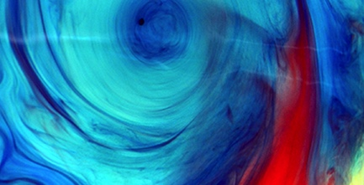
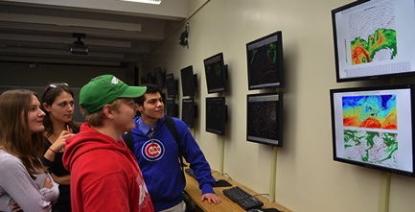
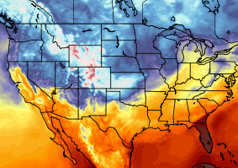
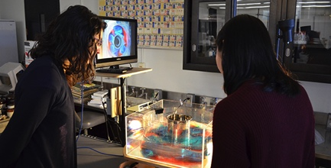
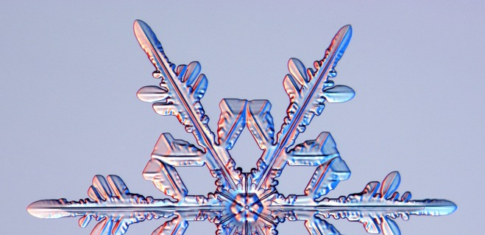
B.S. in Atmospheric Science
Broad foundation in four fundamental areas:
Synoptic
Observations and weather forecasting
Dynamic
Theory and computer modeling
Physical
Clouds and atmospheric chemistry
Climate
Land-ocean-atmosphere processes
Notes:
The bachelor of science degree in atmospheric science prepares our students in 3 fundamental areas: synoptic meteorology(how weather observations are collected, how do we forecast weather in to the future); dynamic meteorology (the physics which govern the atmosphere, how those physics are handled in computer models to make forecasts); physical meteorology (how clouds and precipitation form, how air pollution forms, why the ozone layer exists)

Slide 4
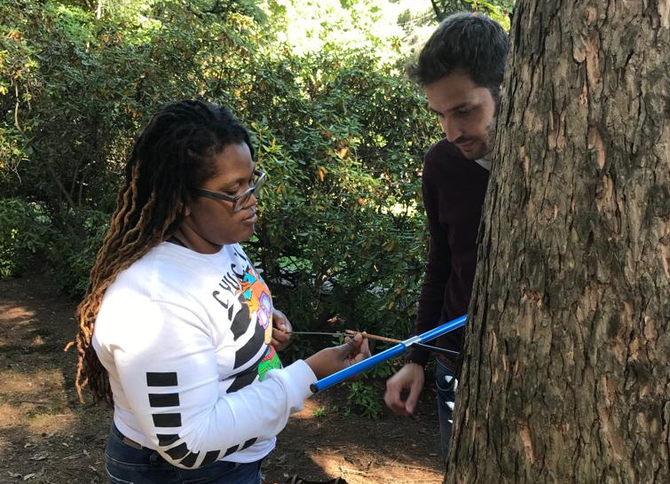
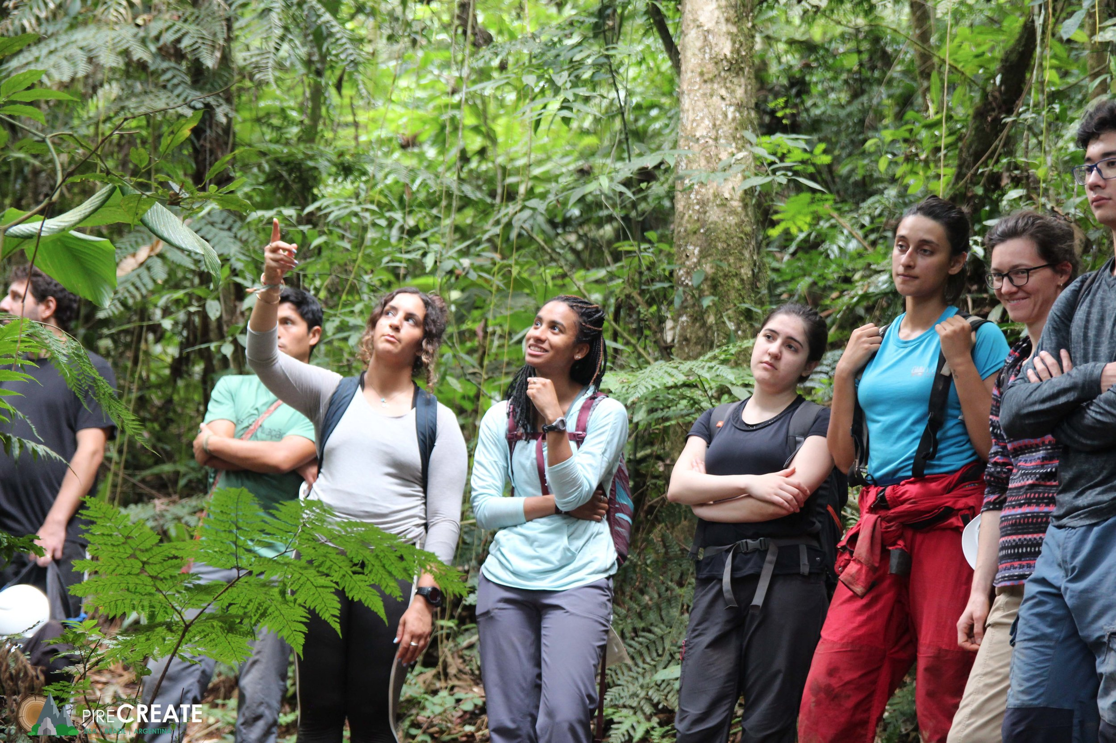
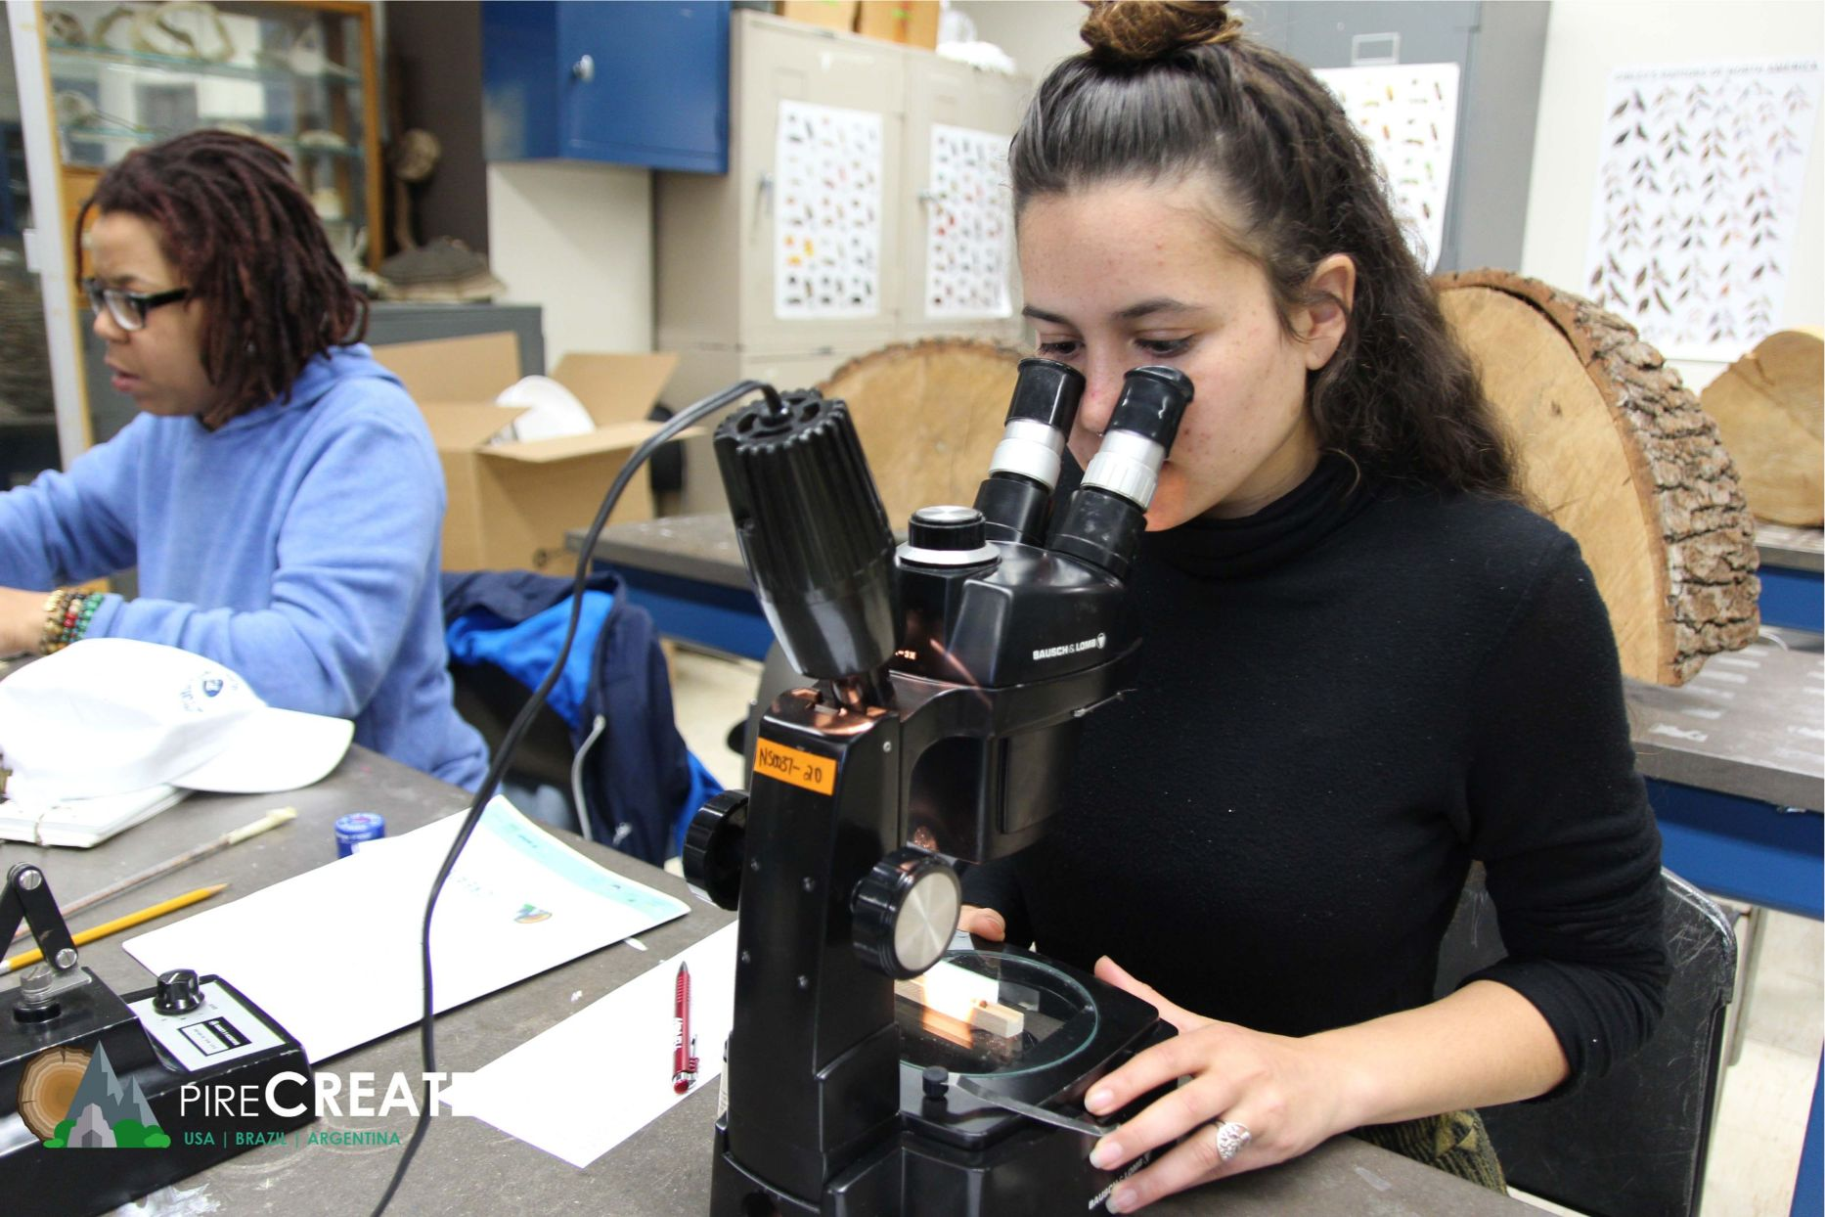
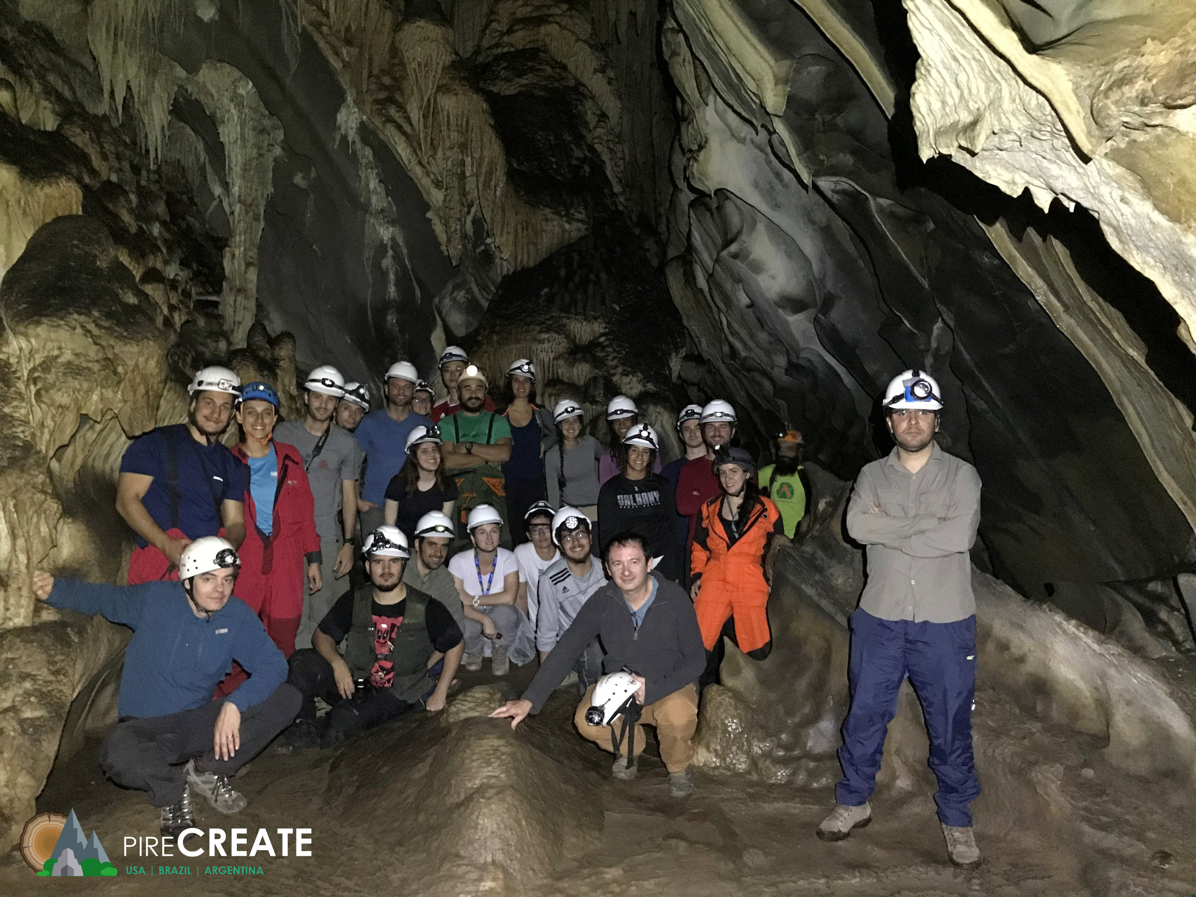
B.S. in Environmental Science
Core environmental fundamentals + four specializations:
Climate Change: long-term variability and change
Ecosystems: ecology, biodiversity, sustainability
Geography: land-use planning, resource management, GIS
Sustainability Science and Policy
Also available:
Sustainability Minor
Geographic information systems (GIS) certificate
Notes:
The bachelor of science degree in environmental science prepares our students in the core environmental issues of how humans interact with the environment around us and the use of natural resources. Our majors choose one of three concentrations: climate (what control variability of Earth’s climate (like El Nino), how climate has changed in the past and how it will change in future); biology (ecology and sustainability, which is becoming an increasingly bigger issue); geography (land-use planning and geographical information systems, how do we plan in a smarter way to minimize costs and impacts to the environment)

Slide 5
B.S. in Atmospheric Science
B.S. in Environmental Science
Key attributes of curriculum:
Firm foundation in science
Firm connections to applications & society
Small class sizes
Professors are available and interested
Professors are active leading researchers
Hands on learning: computing, labs, field
Internship & research opportunities

Slide 6
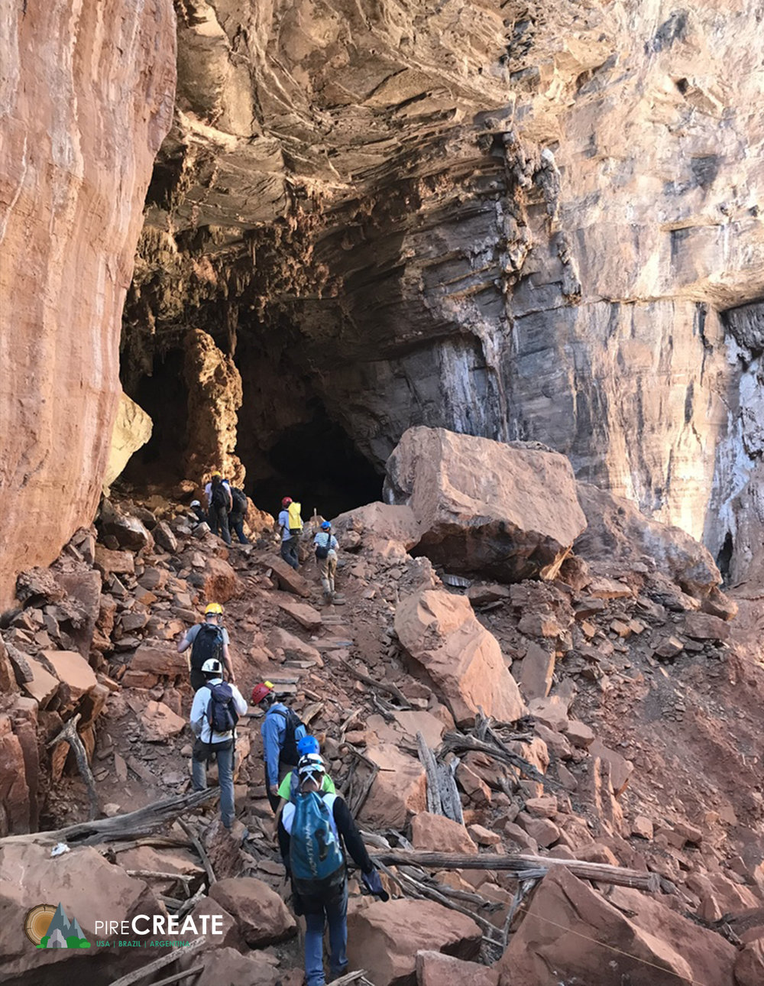
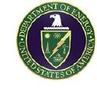
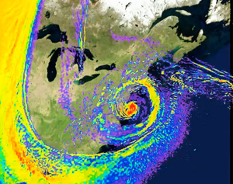
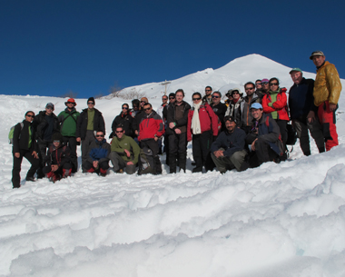
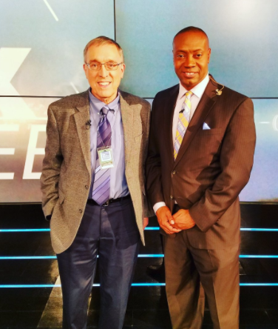
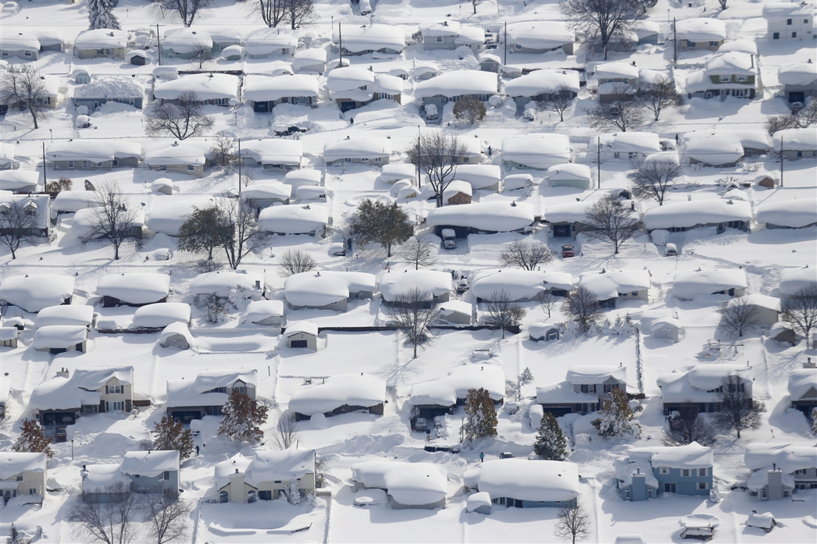
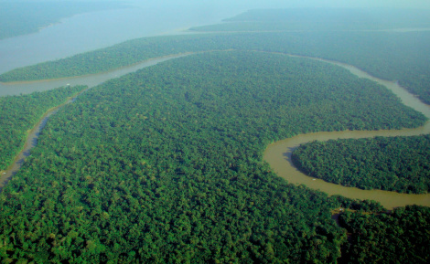
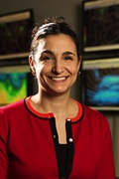
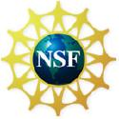
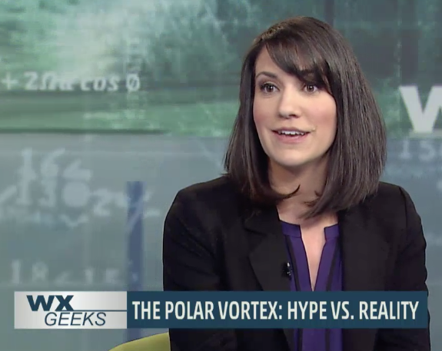
Leaders in atmospheric and environmental research (and teaching!)
20 faculty - $2-4M/yr in research funding
Tree ring & cave research
South American glaciers and climate
The Weather Channel
SANDY
MSNBC
Lake-effect snow
Congo rainforest “browning”
Polar vortex
3 American Meteorology Society teaching award winners on faculty. More than any other department in the US!!
Notes:
Another big asset to the students is that their professors are all leaders in atmospheric and environmental research. This allows for hot off the press, topical items to make it in to the classroom. For instance, this time last year, I was using data from Hurricane Sandy in my own class to challenge students to analyze the system and appreciate how unusual the storm was, using knowledge from the class and previous classes. This also allows us to offer an wide array of unique classes.

Slide 7
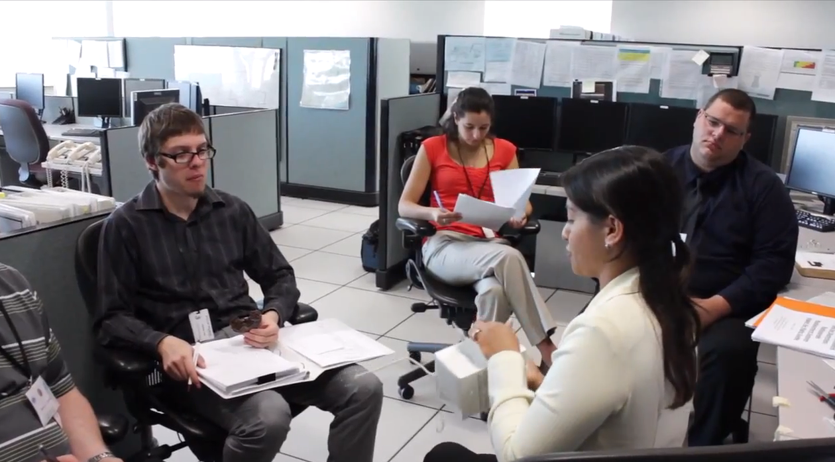
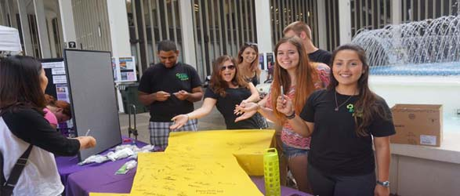
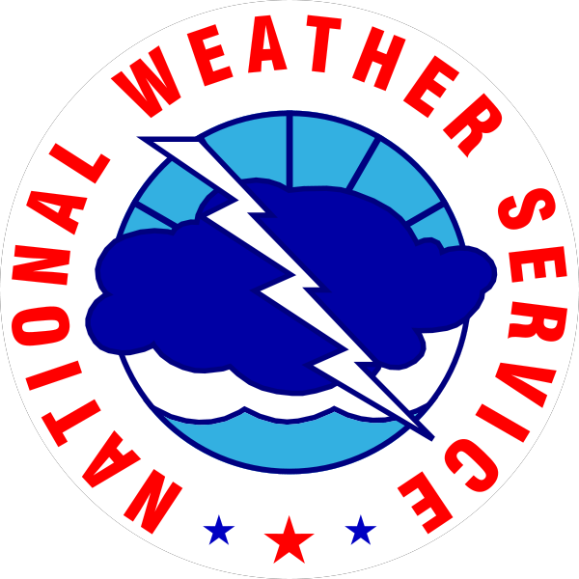
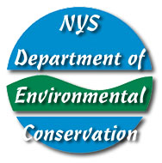
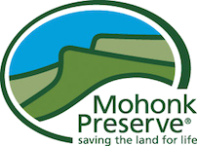
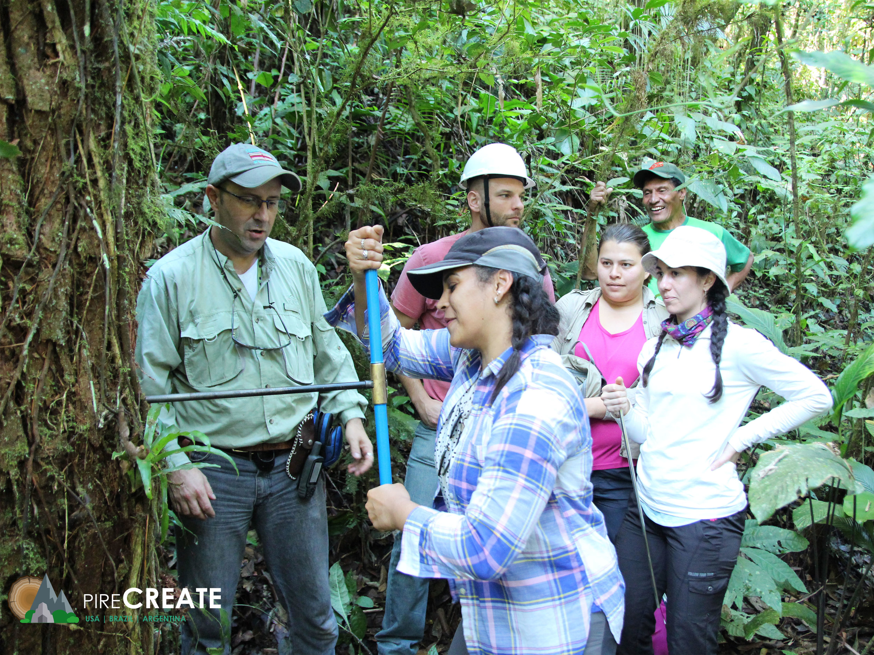
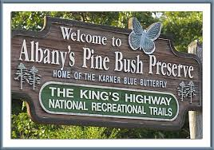
Hands-on research, internships and student involvement
Notes:
This also allows for opportunities from hands-on research and internships. Internships with the National Weather Service, which is located very near campus. Some undergraduates even get to go out into the field. This particular example was from a lightning study, showing one of our recent undergraduates standing by some of the photography equipment.

Slide 8
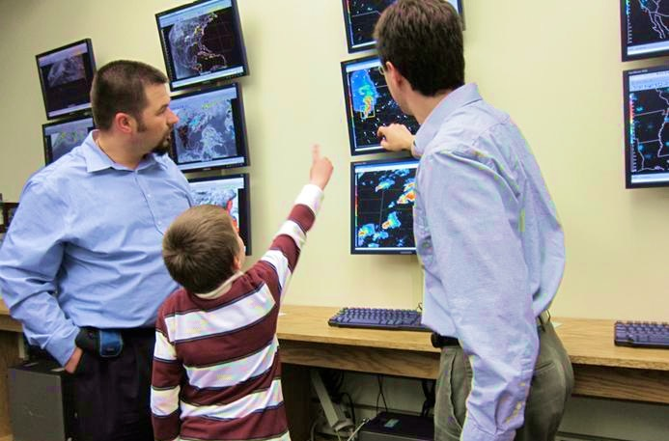
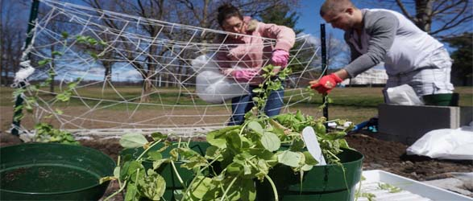
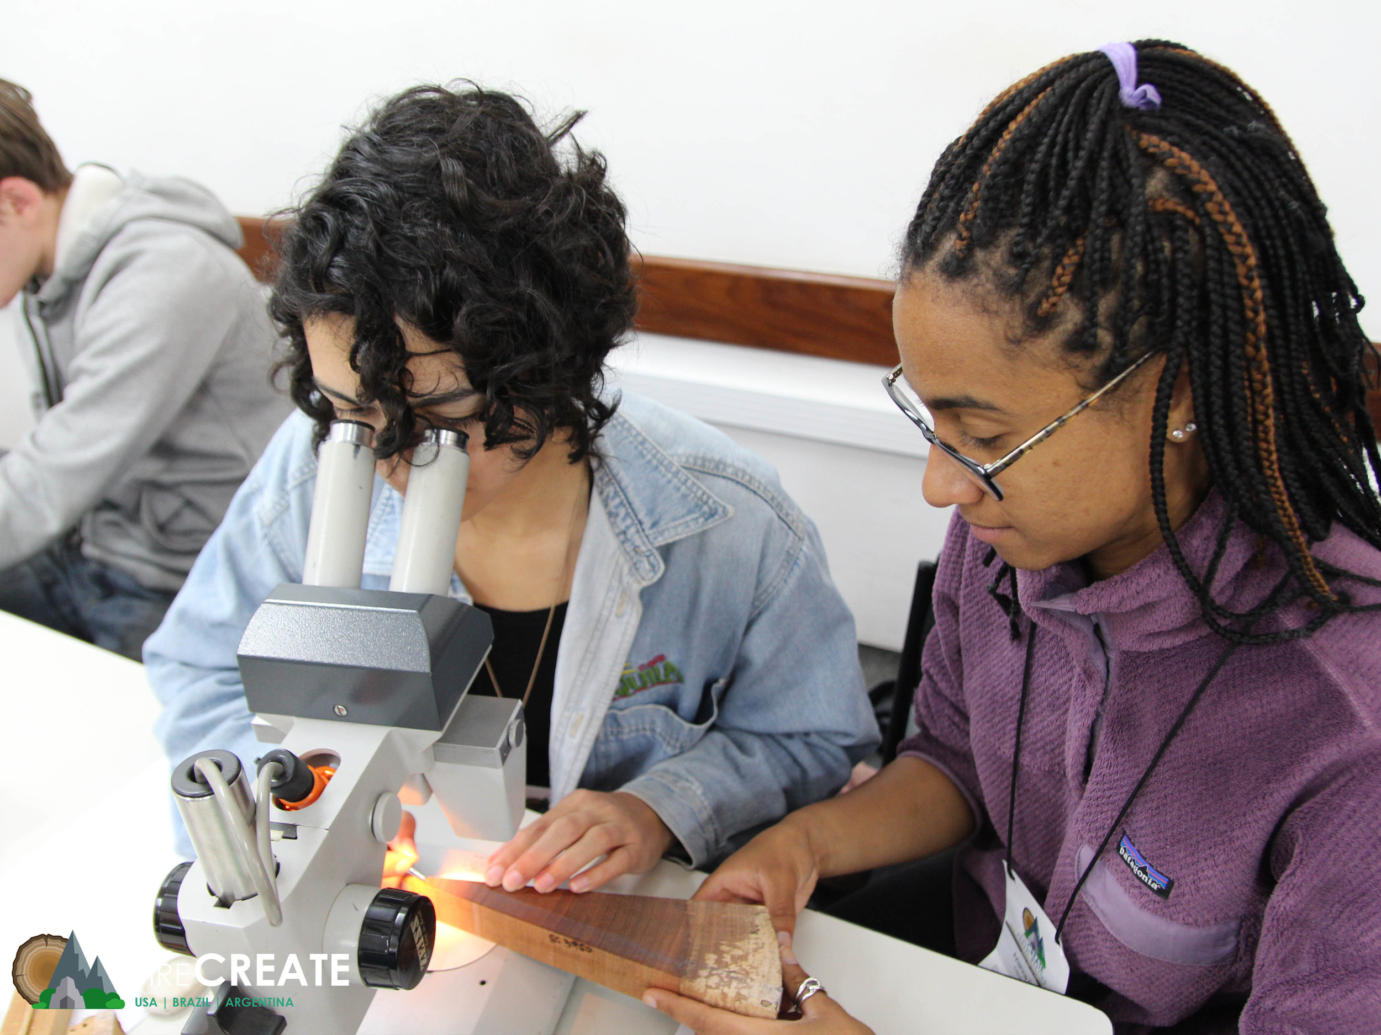
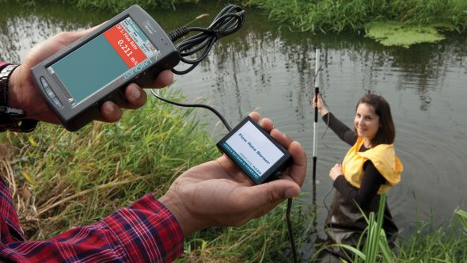
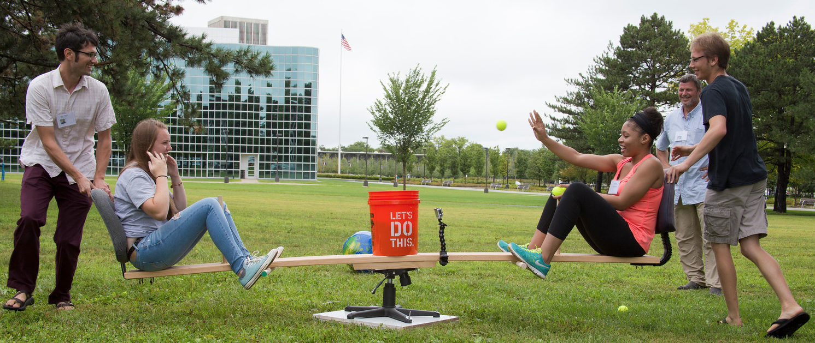
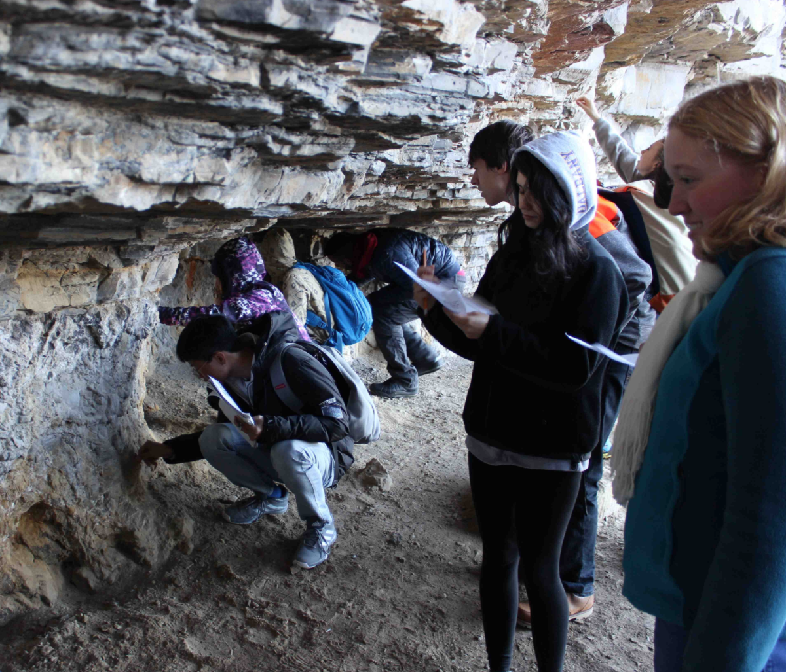
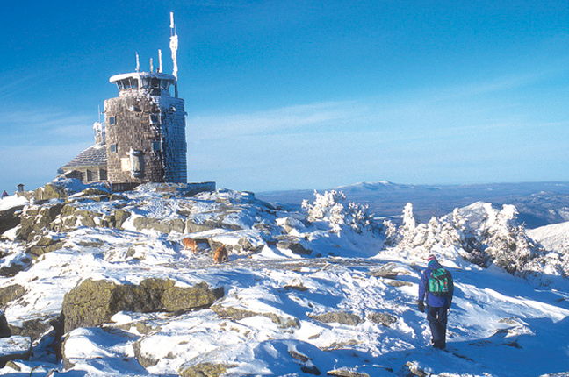
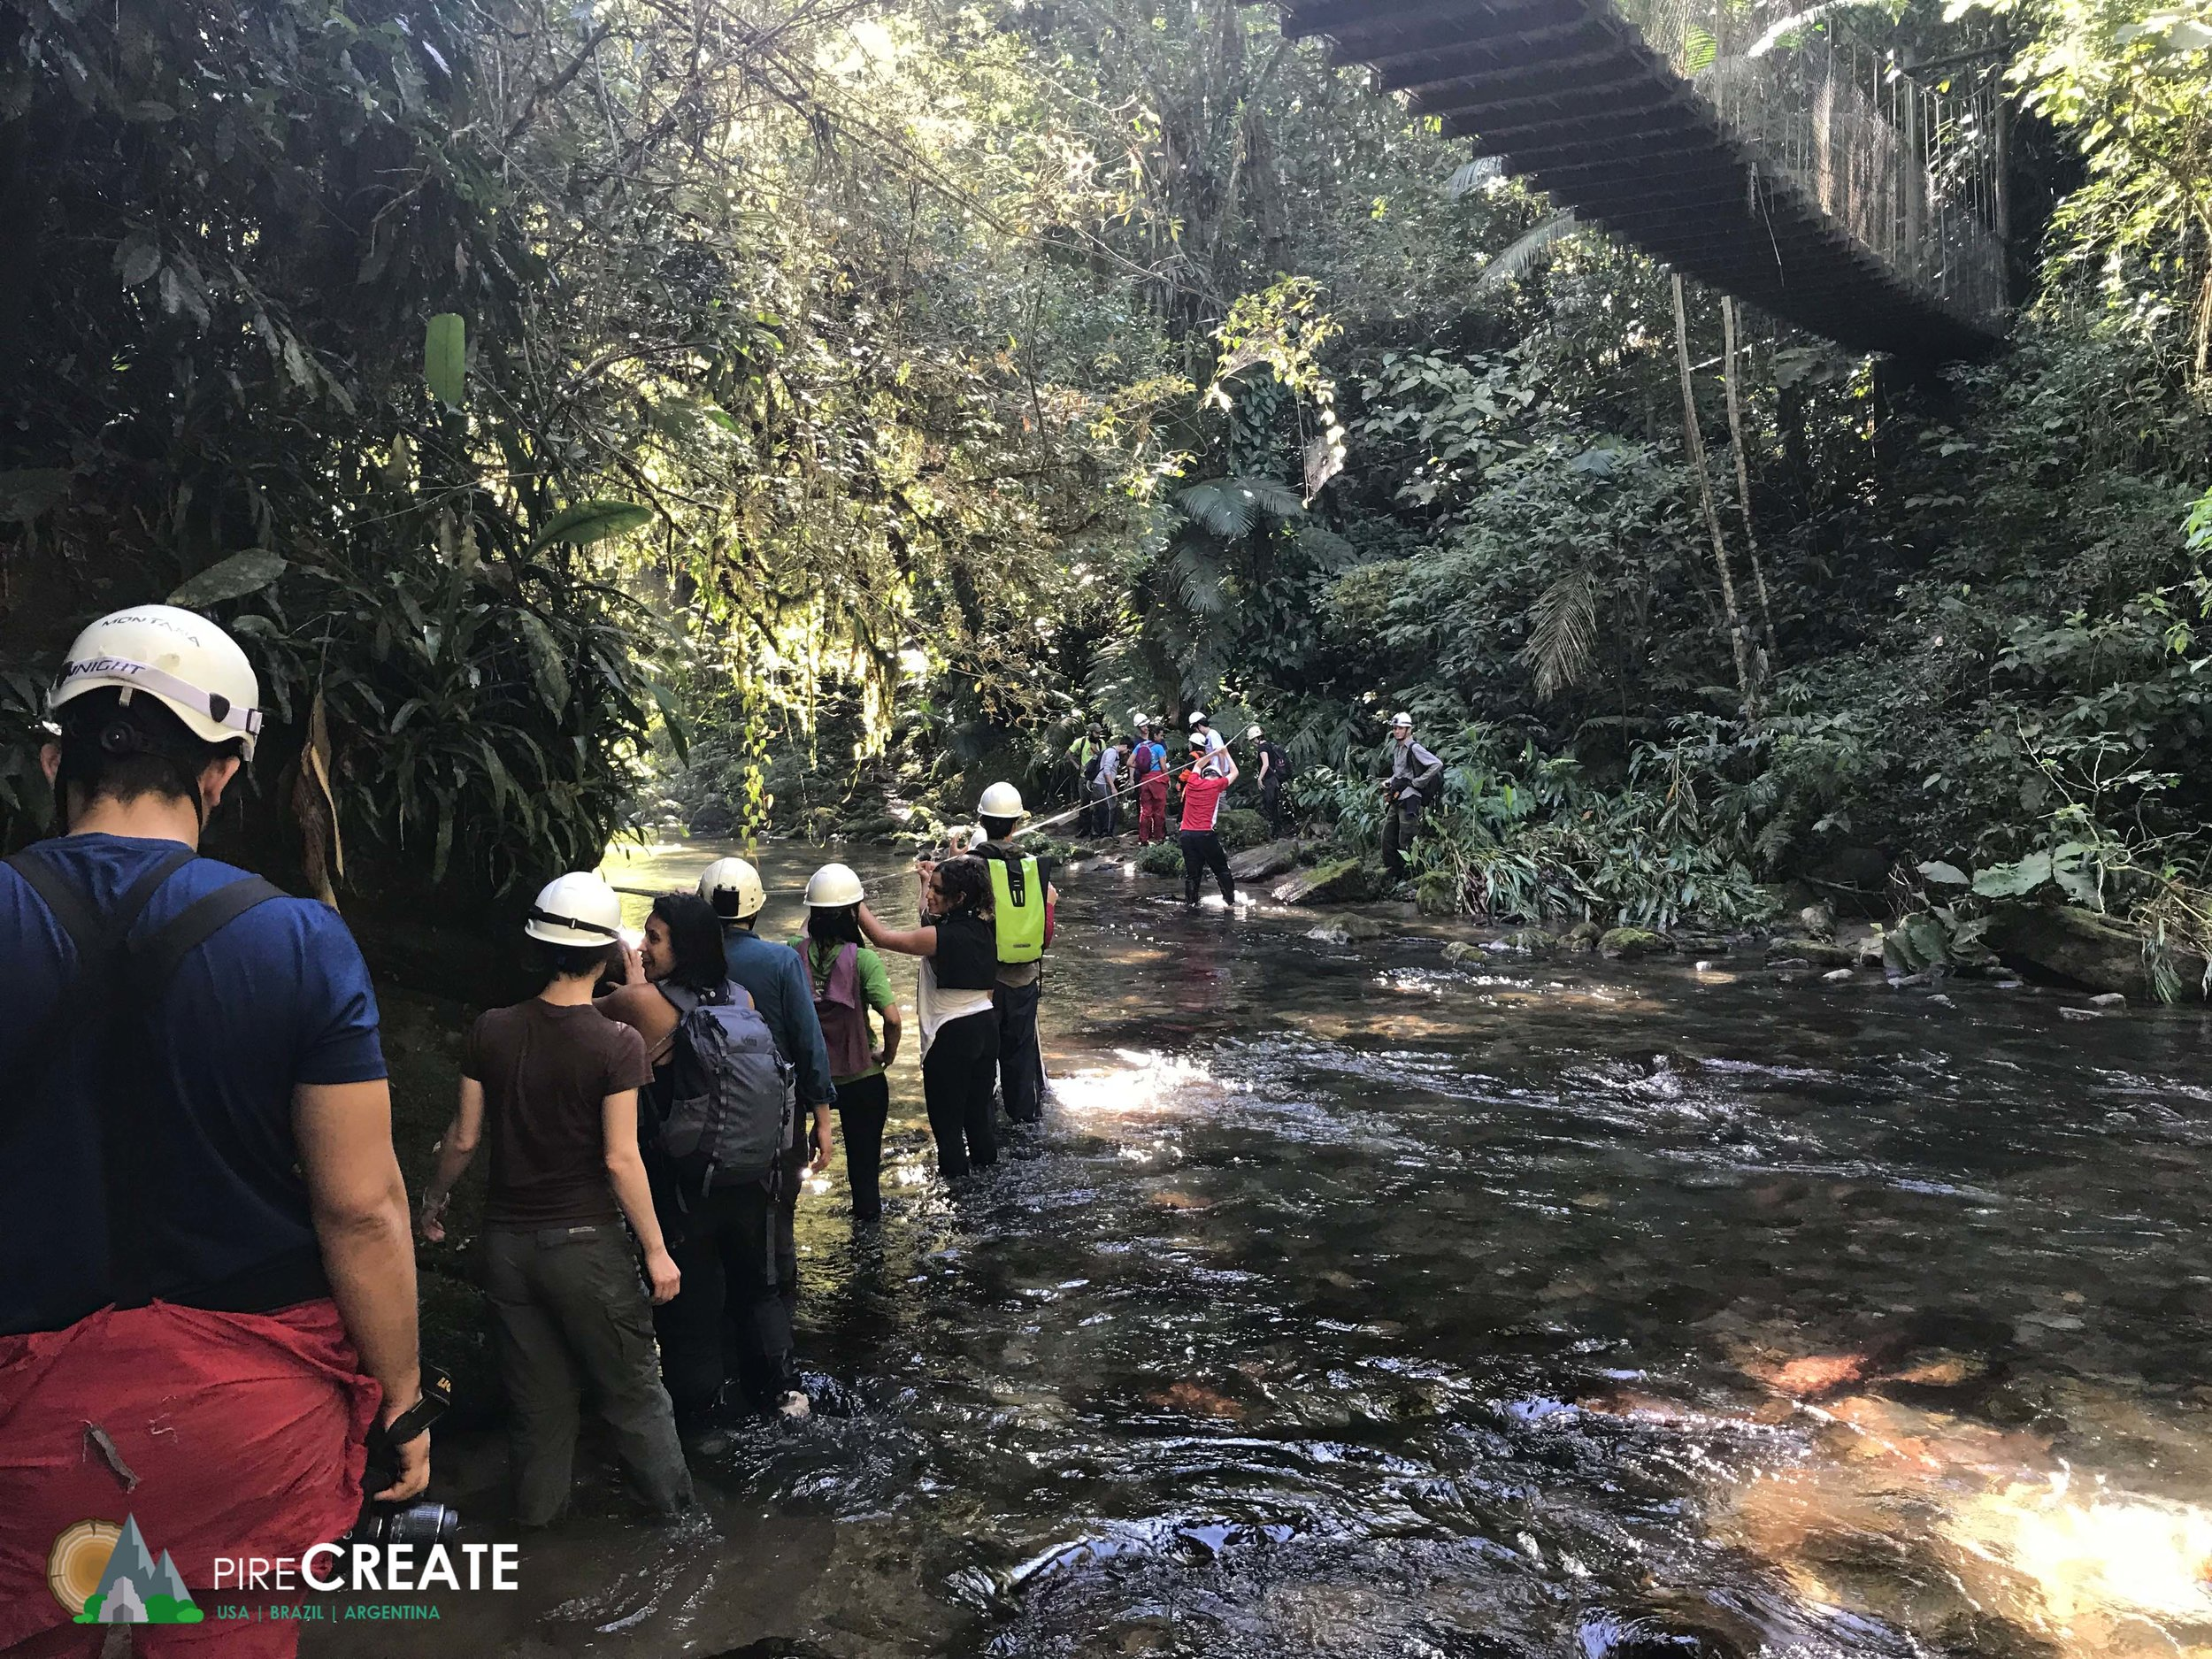
Student Groups
Instrumentation
International Summer schools
Whiteface Mt
observatory
Faculty-led trips abroad
Local Field Trips
Notes:
We have an array of state-of-art resources within the department. The first is our electronic map room, which is an interactive wall of maps that can be displayed from satellite images, to radar, to student-generated products that allow one to analyze the atmosphere and environment. The second is the Whiteface observatory, where real-time measurements of the atmosphere, from its chemistry to clouds is collected for analysis. We just had a group of undergraduates visit the observatory a couple weeks ago.

Slide 9
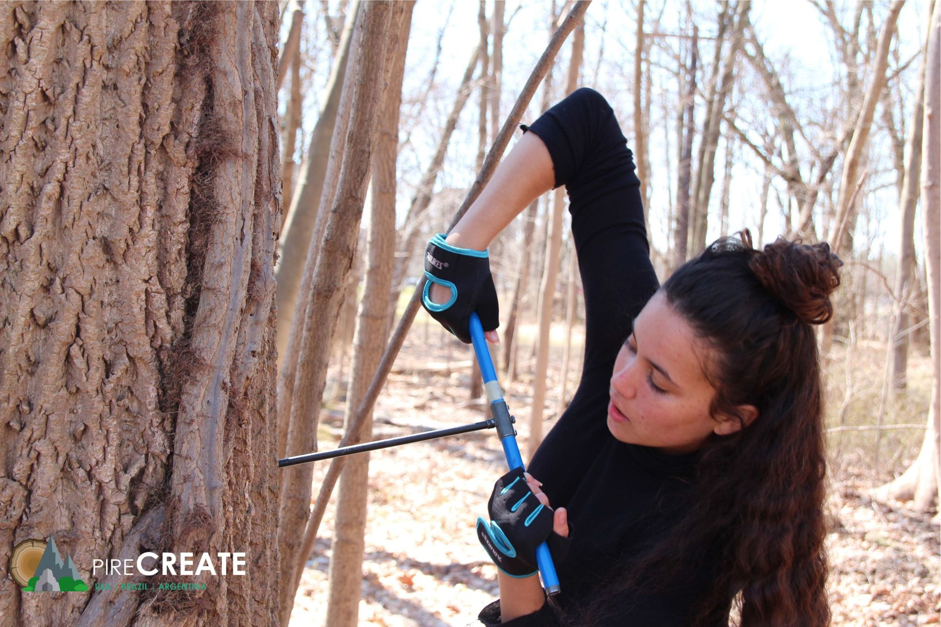
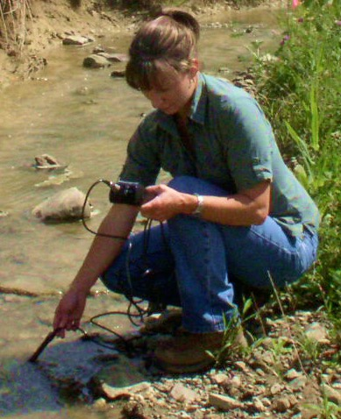
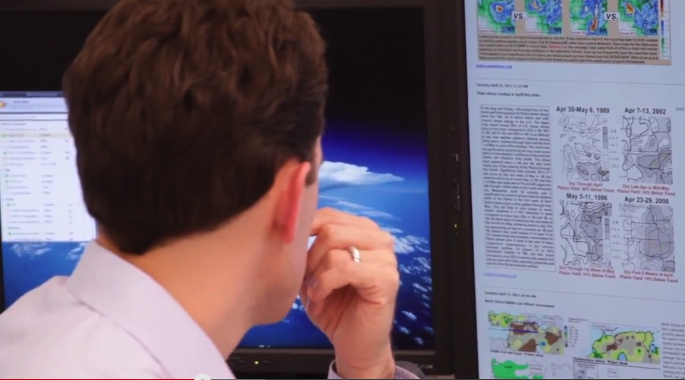
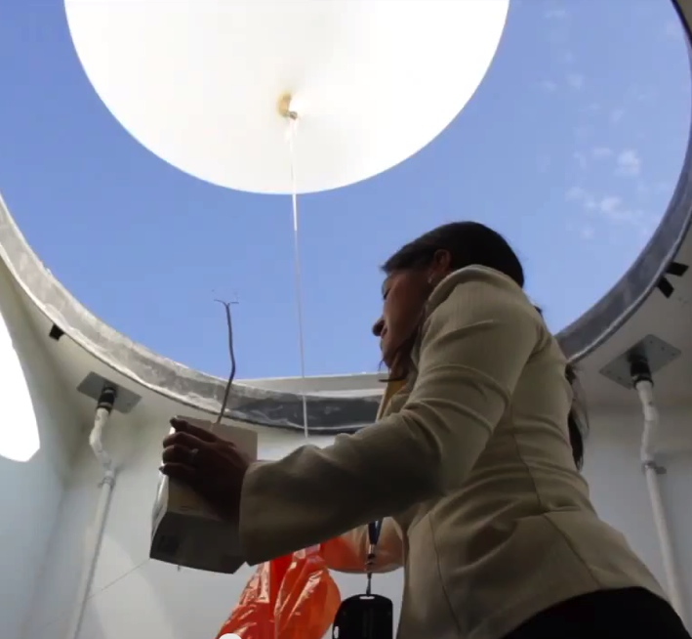
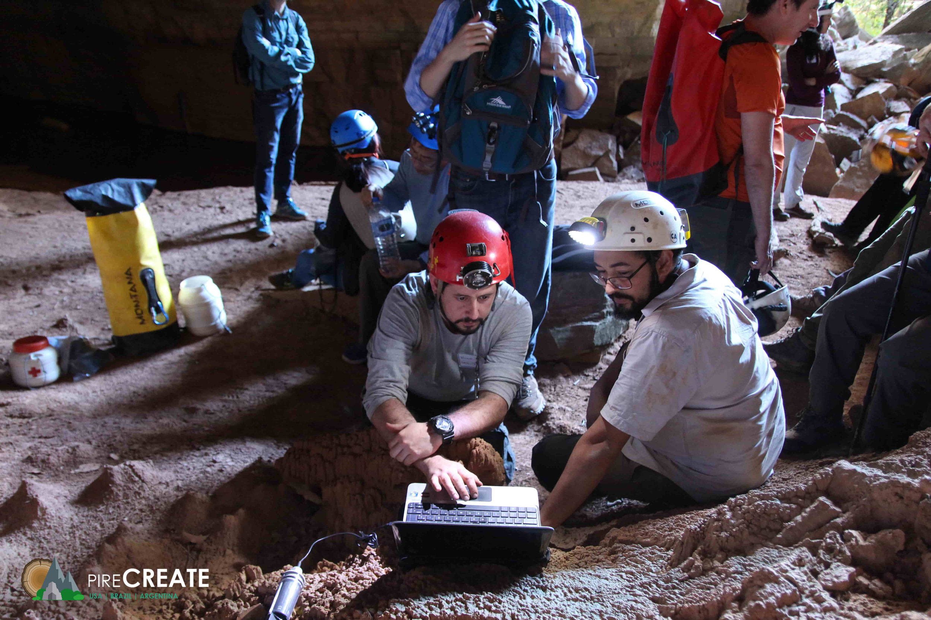
Demand for atmospheric and environmental scientists
in a variety of fields
Academics
Consulting
Economics
Education
Forensics
Government
Insurance
Media
Planning
Research
Transportation
Notes:
What can I do with an atmospheric science of environment science degree and the answer is that there is a demand for atmospheric and environmental scientists in a variety of fields: consulting, insurance, transportation, research, planning, economics, education, media, forensics, and government.

Slide 10
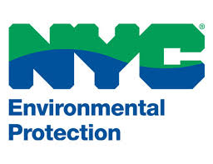
Where some of our recent graduates are now:
Graduate school
National Weather Service
United States Geological Survey
US & NY Environmental Protection
Renewable energy companies
The Weather Channel
New York State Mesonet
Environmental Consulting
Emergency Preparedness
Risk assessment in Insurance/Financial sectors

Slide 11
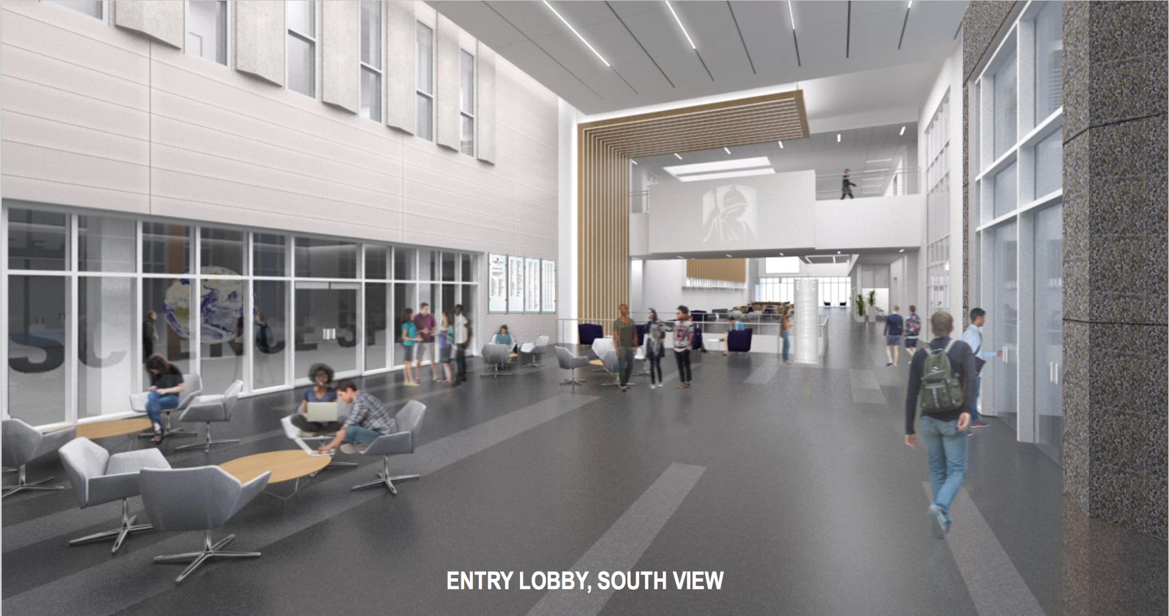

Slide 12
