Slide 1
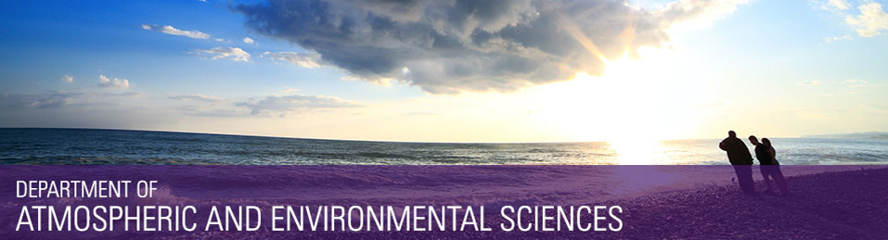
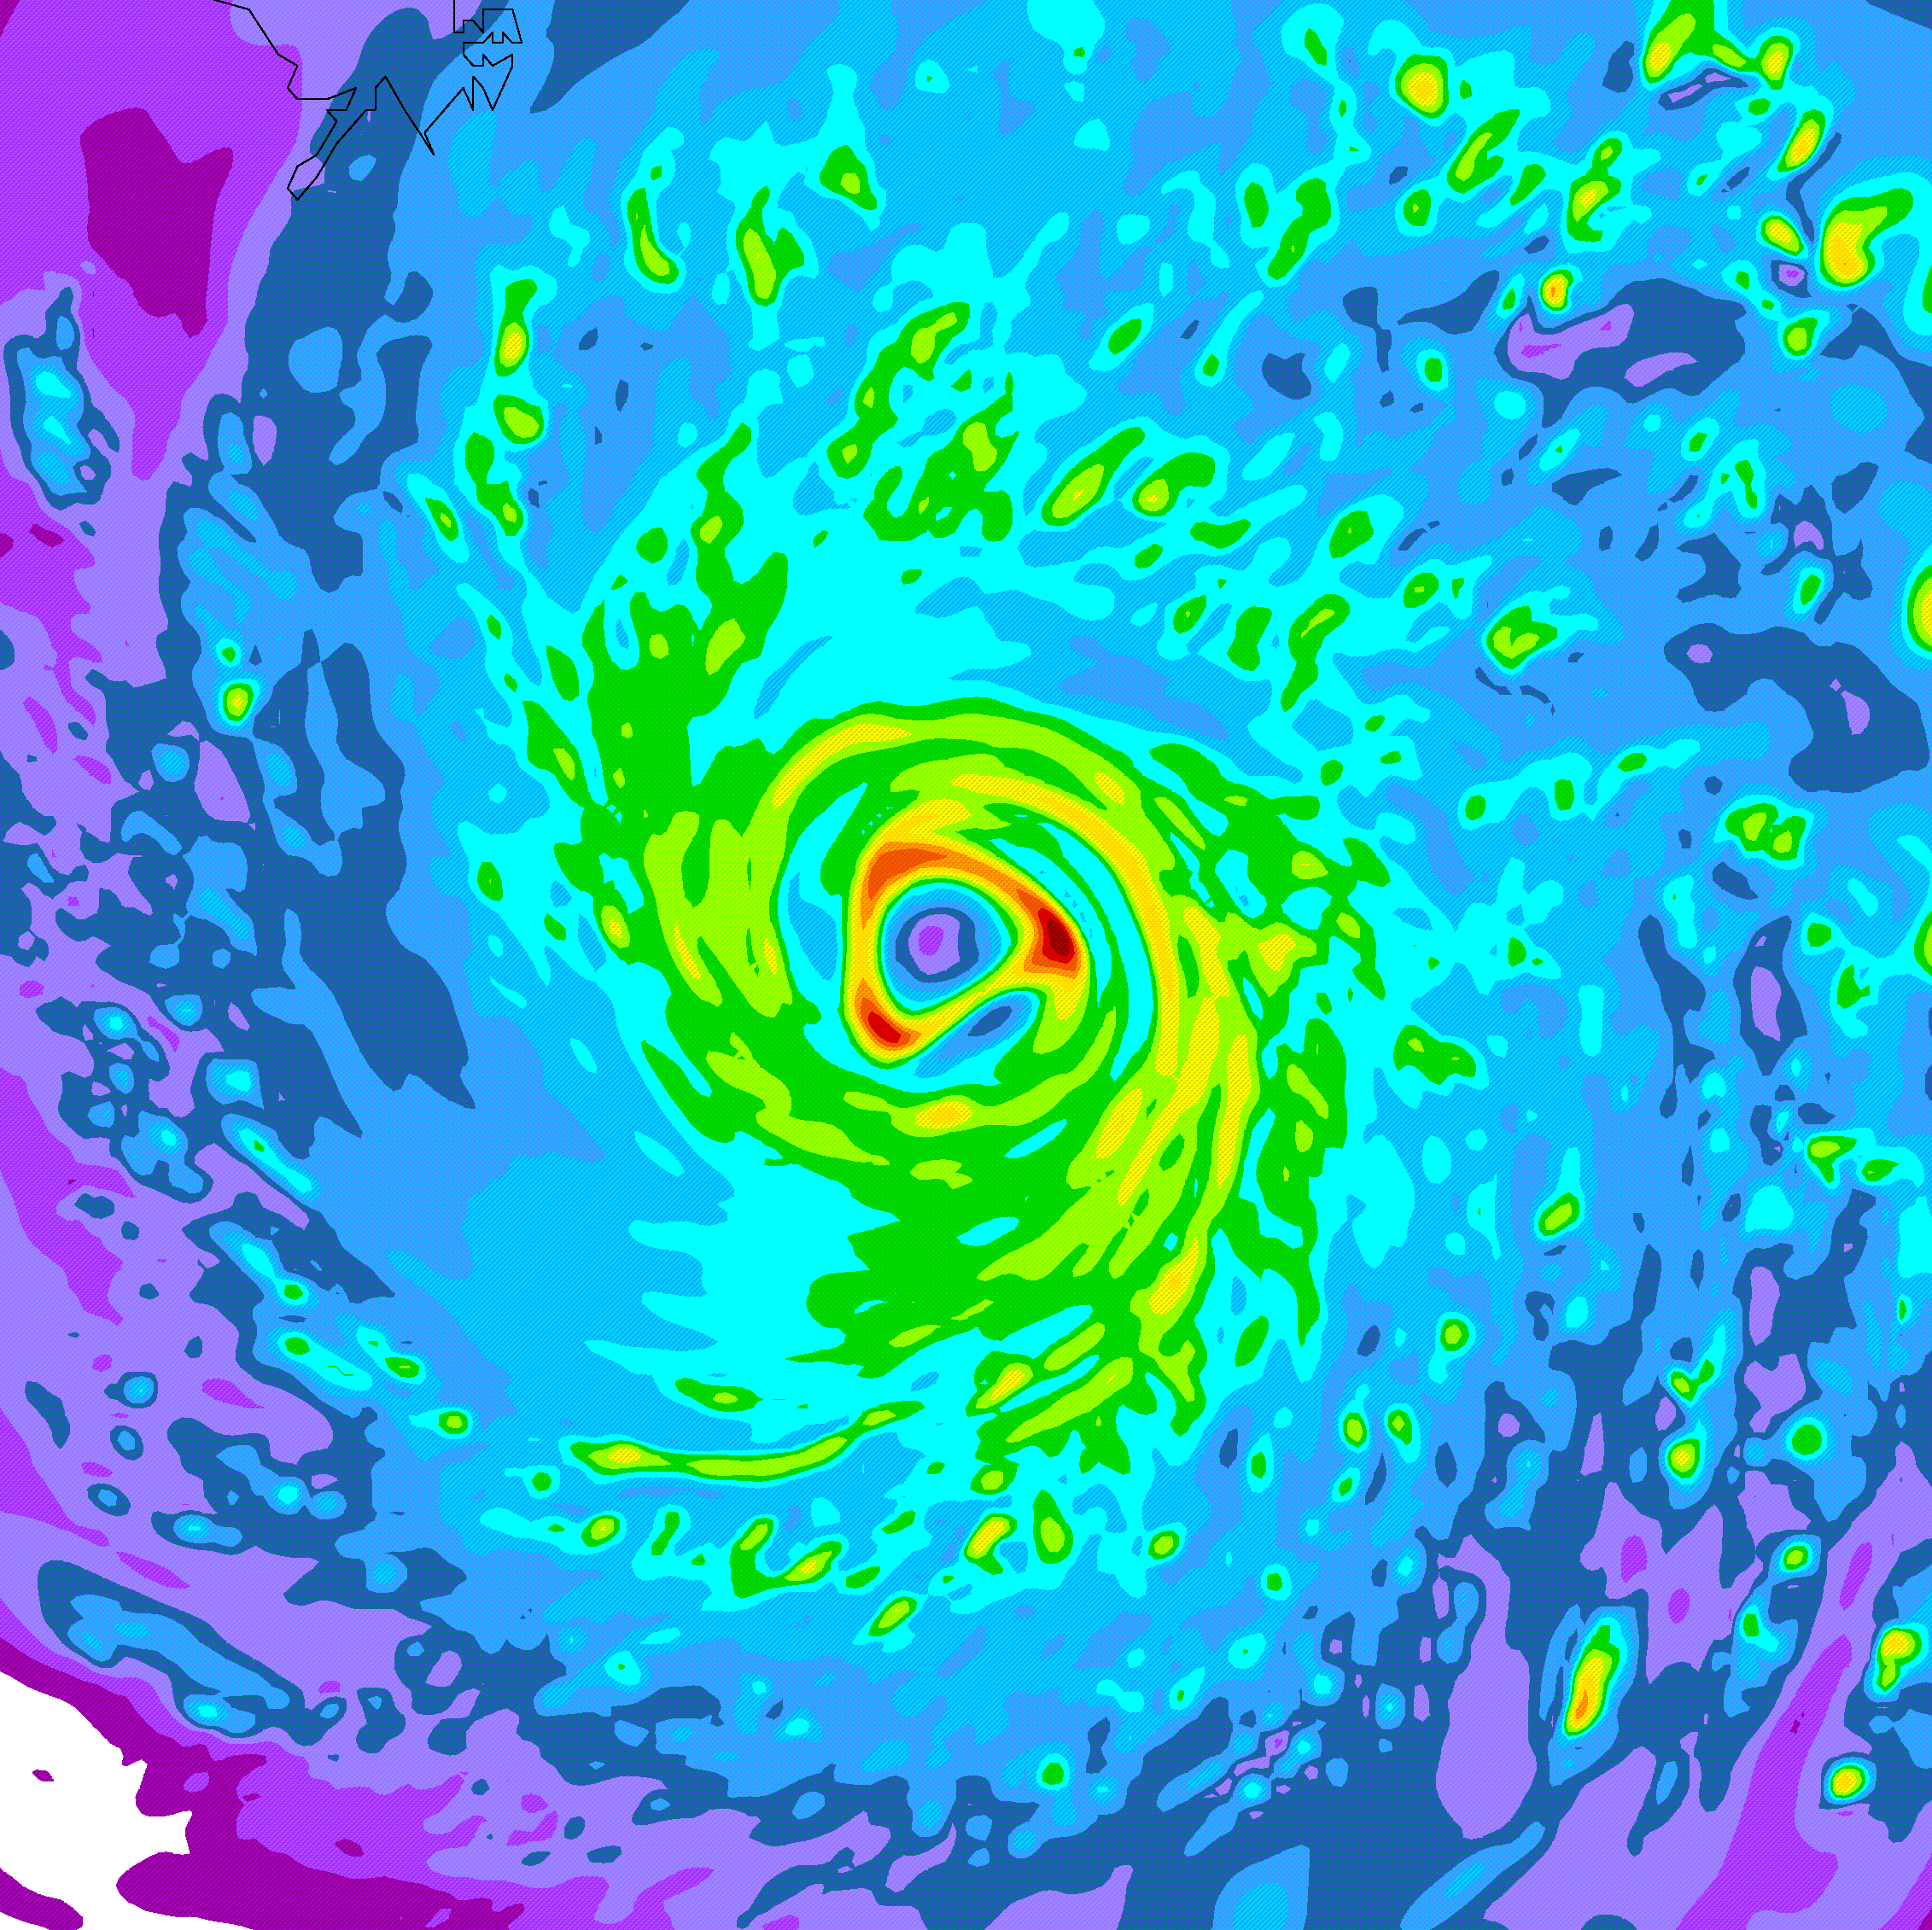
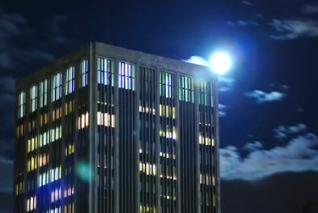
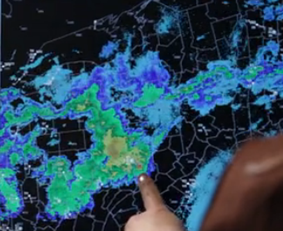

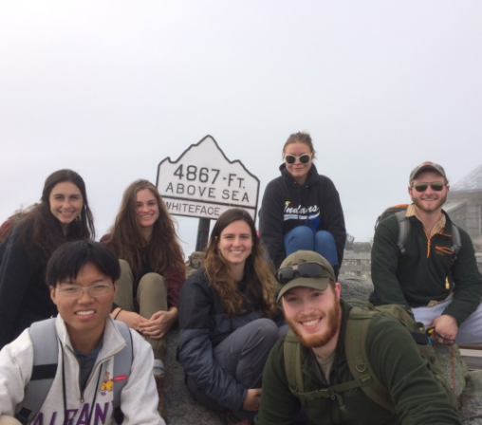
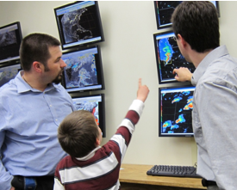
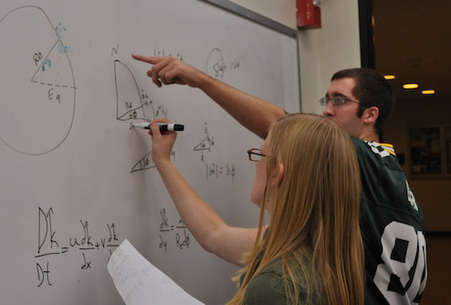
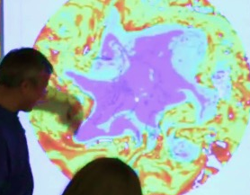
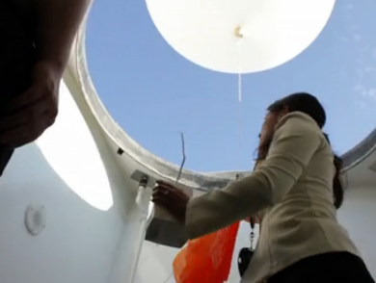
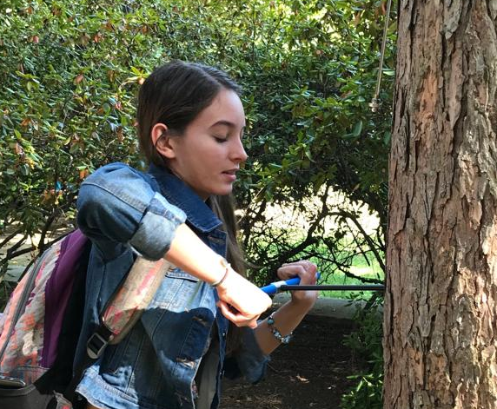
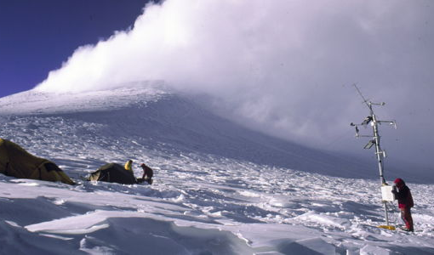
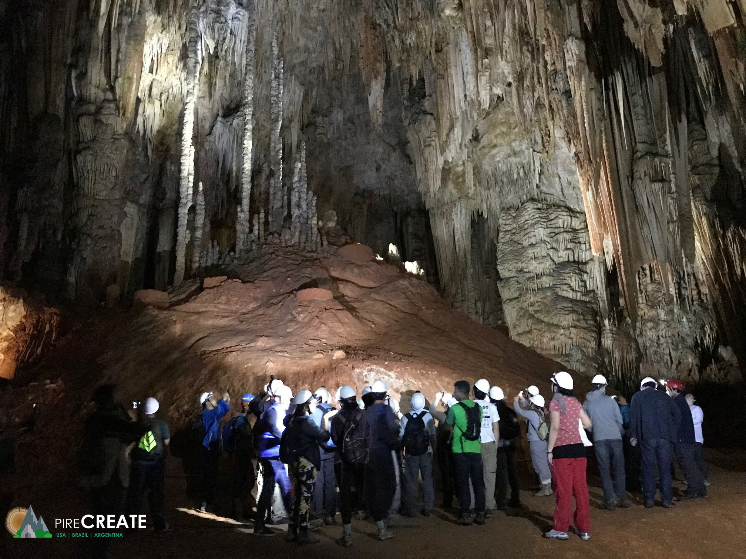


Department of
Atmospheric & Environmental Sciences
DAES
Contact me at:
Ross Lazear
rlazear@albany.edu
Web: http://www.albany.edu/atmos/
Notes:
Intro
Welcome & congrats
Great community. World-class education at state-school cost

Slide 2

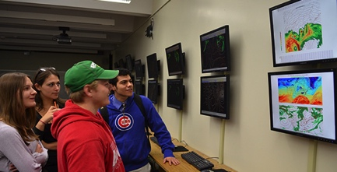
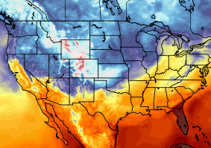
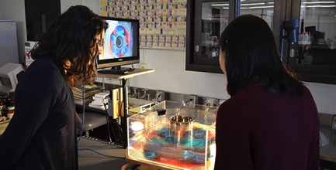
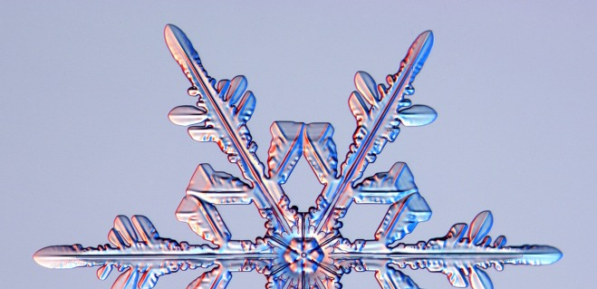
B.S. in Atmospheric Science
Broad foundation in four fundamental areas:
Weather systems and tropical meteorology
  Observations and weather forecasting
Dynamic
  Theory and computer modeling
Physical
  Clouds and atmospheric chemistry
Climate
  Land-ocean-atmosphere processes
Notes:
The bachelor of science degree in atmospheric science prepares our students in 3 fundamental areas: synoptic meteorology(how weather observations are collected, how do we forecast weather in to the future); dynamic meteorology (the physics which govern the atmosphere, how those physics are handled in computer models to make forecasts); physical meteorology (how clouds and precipitation form, how air pollution forms, why the ozone layer exists)

Slide 3
B.S. in Atmospheric Science
Key attributes of curriculum:
  Firm foundation in science
  Firm connections to applications & society
  Small class sizes
  Professors are available and interested
  Professors are active leading researchers
  Hands on learning: computing, labs, field
  Internship & research opportunities

Slide 4
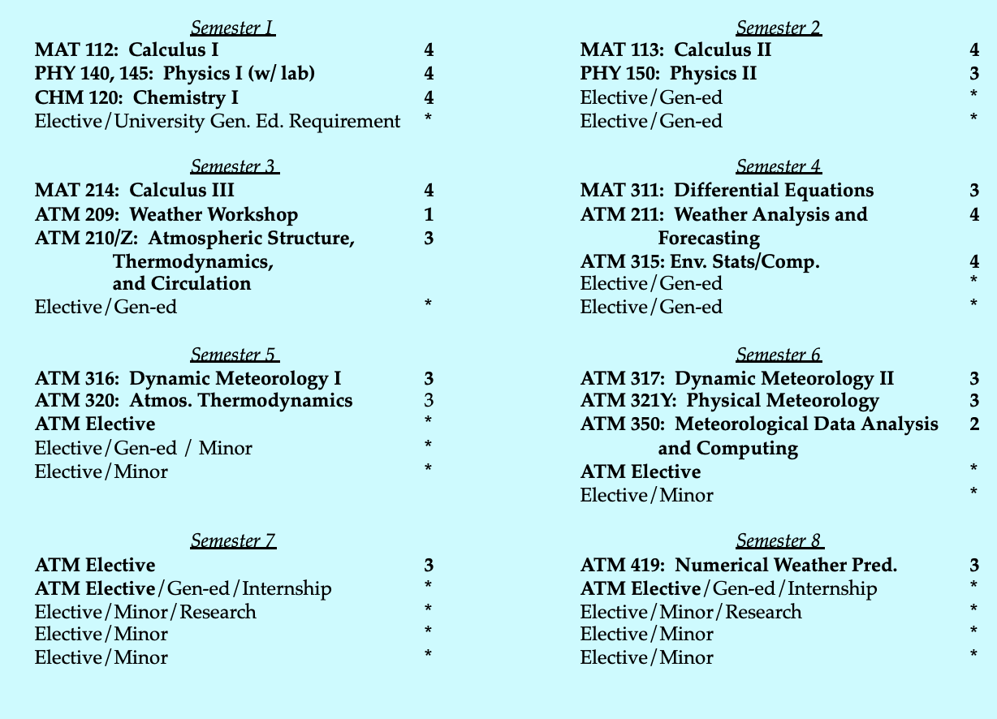
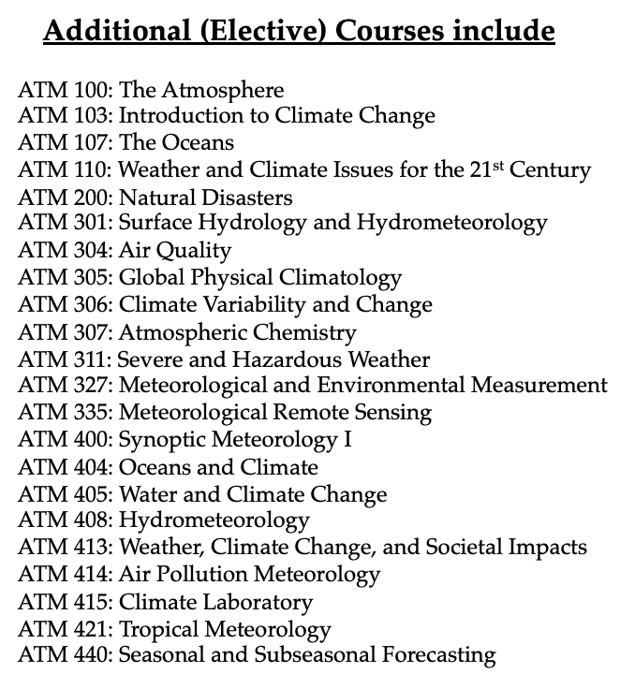
B.S. in Atmospheric Science

Slide 5
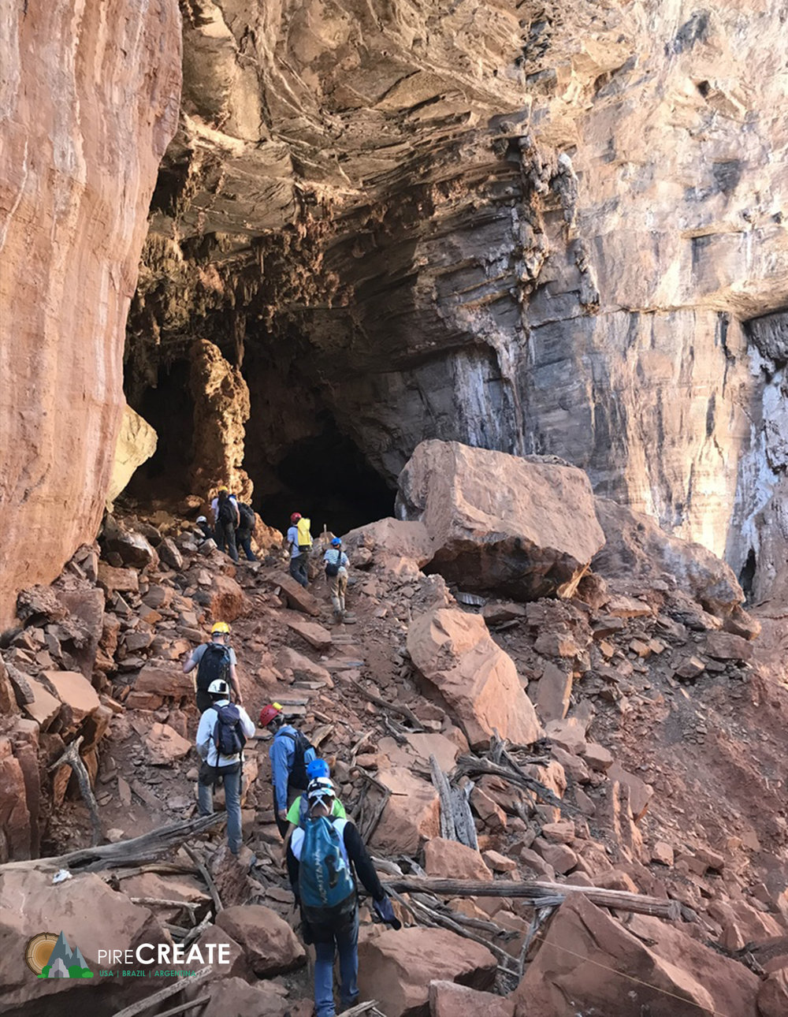

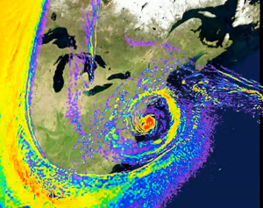
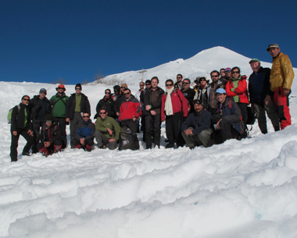


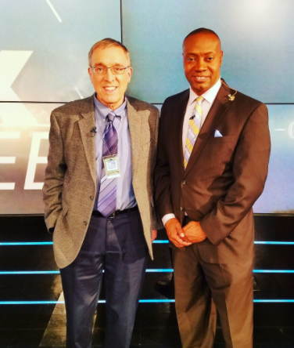
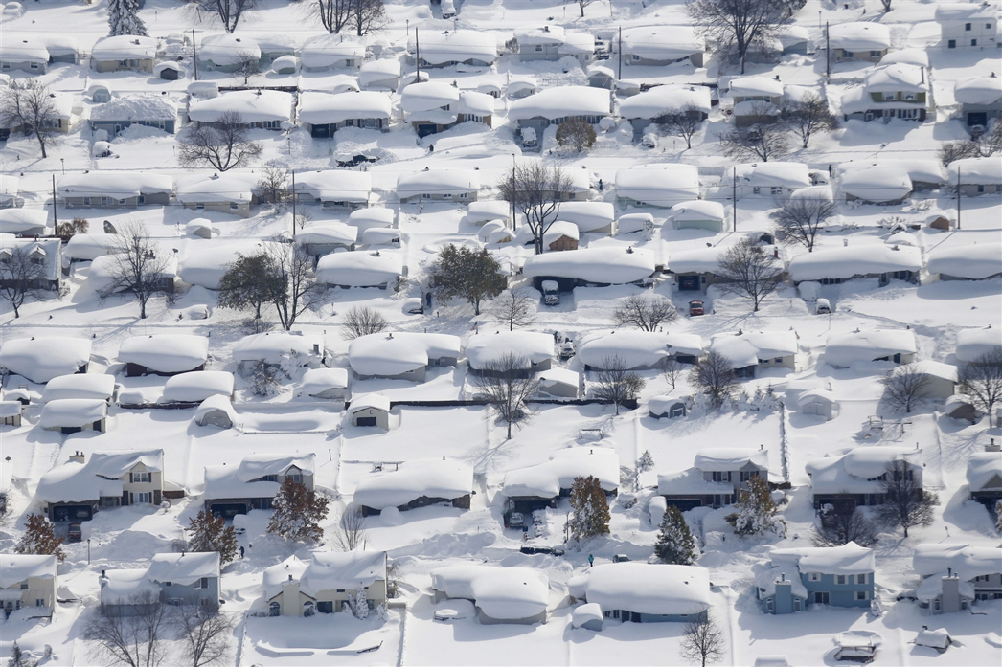
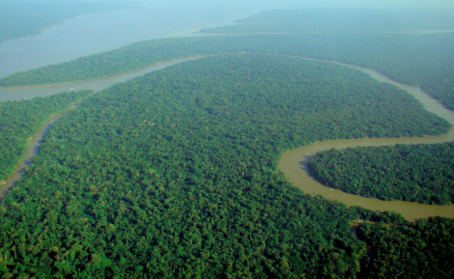
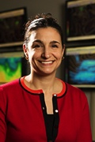

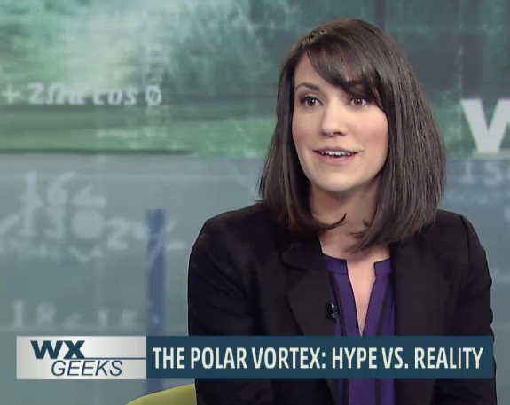
Leaders in atmospheric and environmental research (and teaching!)
20 faculty - $2-4M/yr in research funding
Tree ring & cave research
South American glaciers and climate
The Weather Channel
SANDY
MSNBC
Lake-effect snow
Congo rainforest “browning”
Polar vortex
3 American Meteorology Society teaching award winners on faculty. More than any other department in the US!!
Notes:
Another big asset to the students is that their professors are all leaders in atmospheric and environmental research. This allows for hot off the press, topical items to make it in to the classroom. For instance, this time last year, I was using data from Hurricane Sandy in my own class to challenge students to analyze the system and appreciate how unusual the storm was, using knowledge from the class and previous classes. This also allows us to offer an wide array of unique classes.

Slide 6
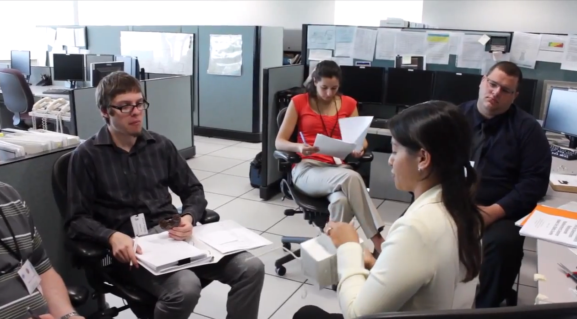

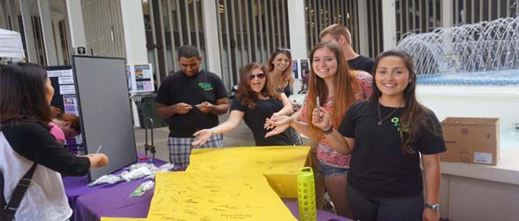


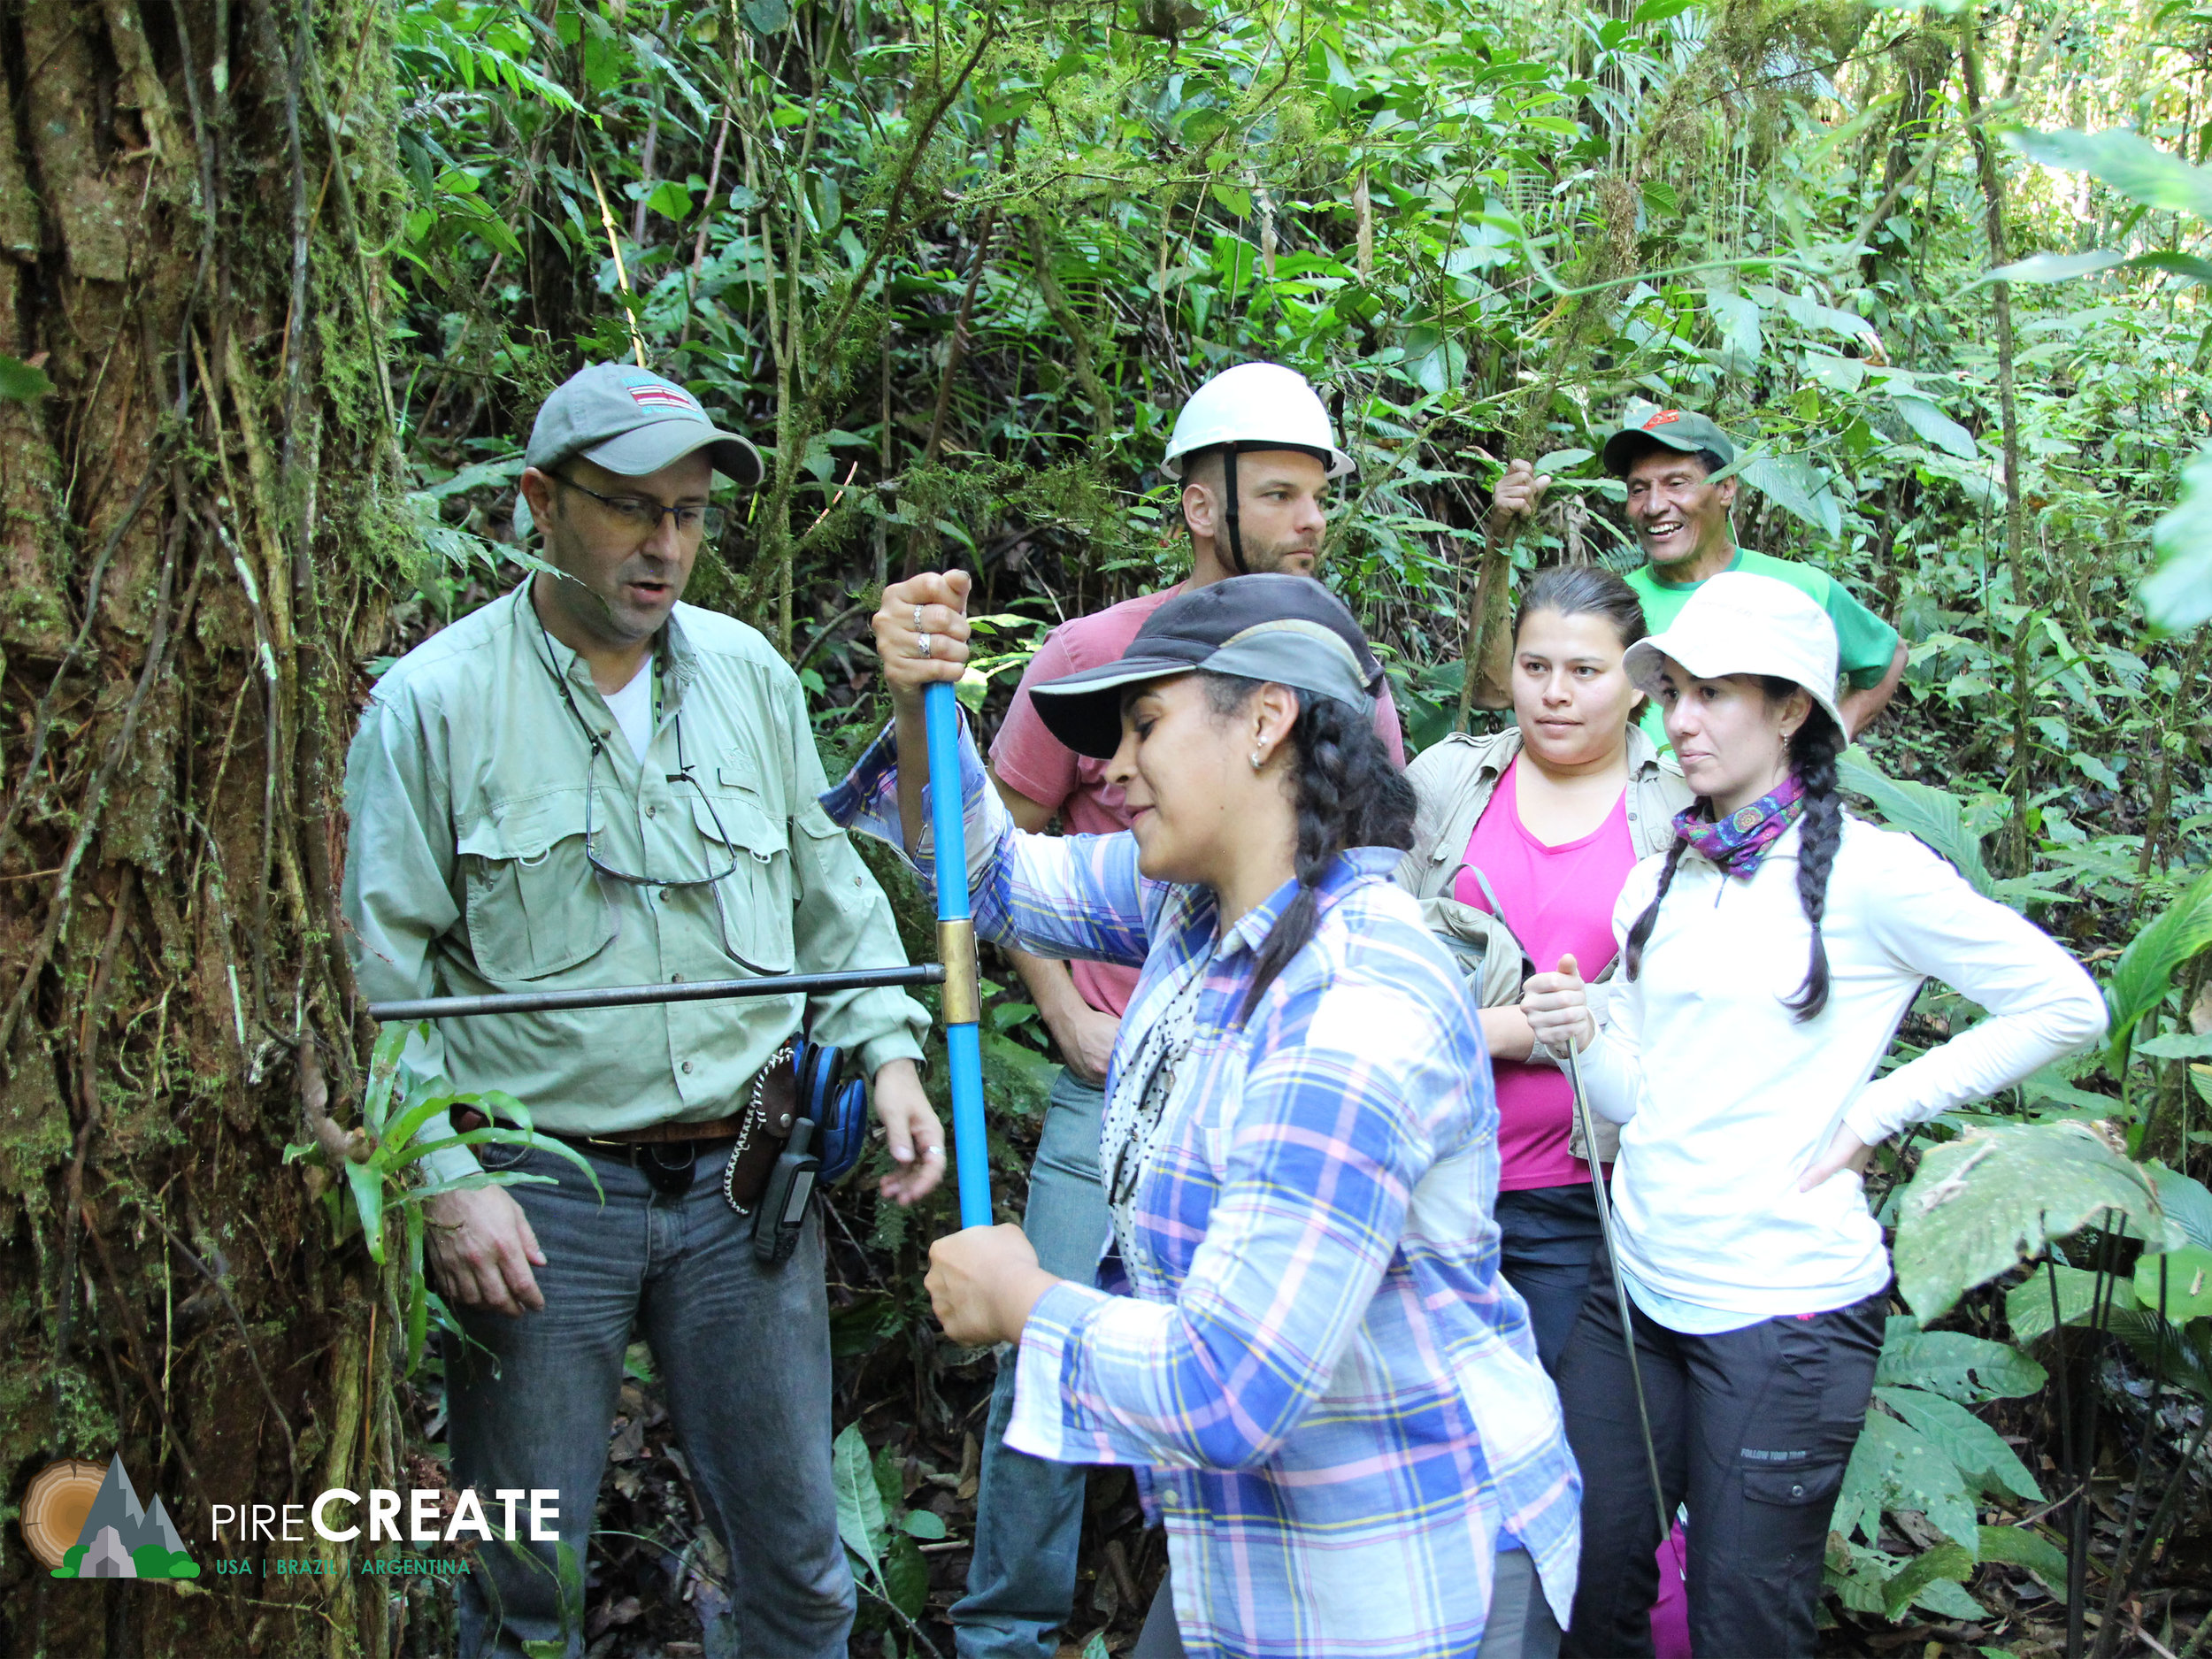
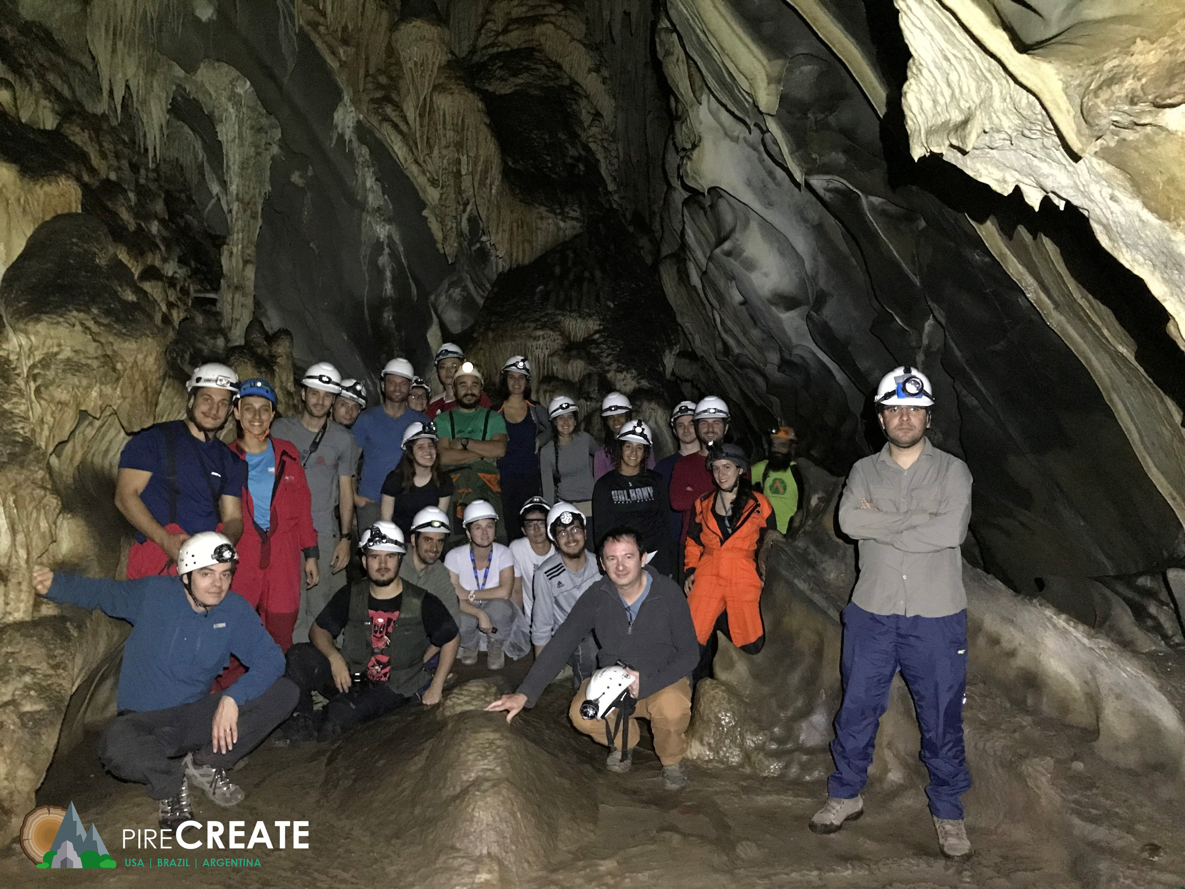
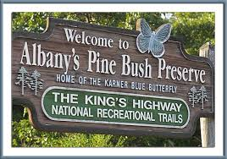



Hands-on research, internships and student involvement
Notes:
This also allows for opportunities from hands-on research and internships. Internships with the National Weather Service, which is located very near campus. Some undergraduates even get to go out into the field. This particular example was from a lightning study, showing one of our recent undergraduates standing by some of the photography equipment.

Slide 7








Where some of our recent graduates are now:
Graduate school
National Weather Service
Renewable energy companies
The Weather Channel
New York State Mesonet
Emergency Preparedness
Risk assessment
TV meteorology

Slide 8
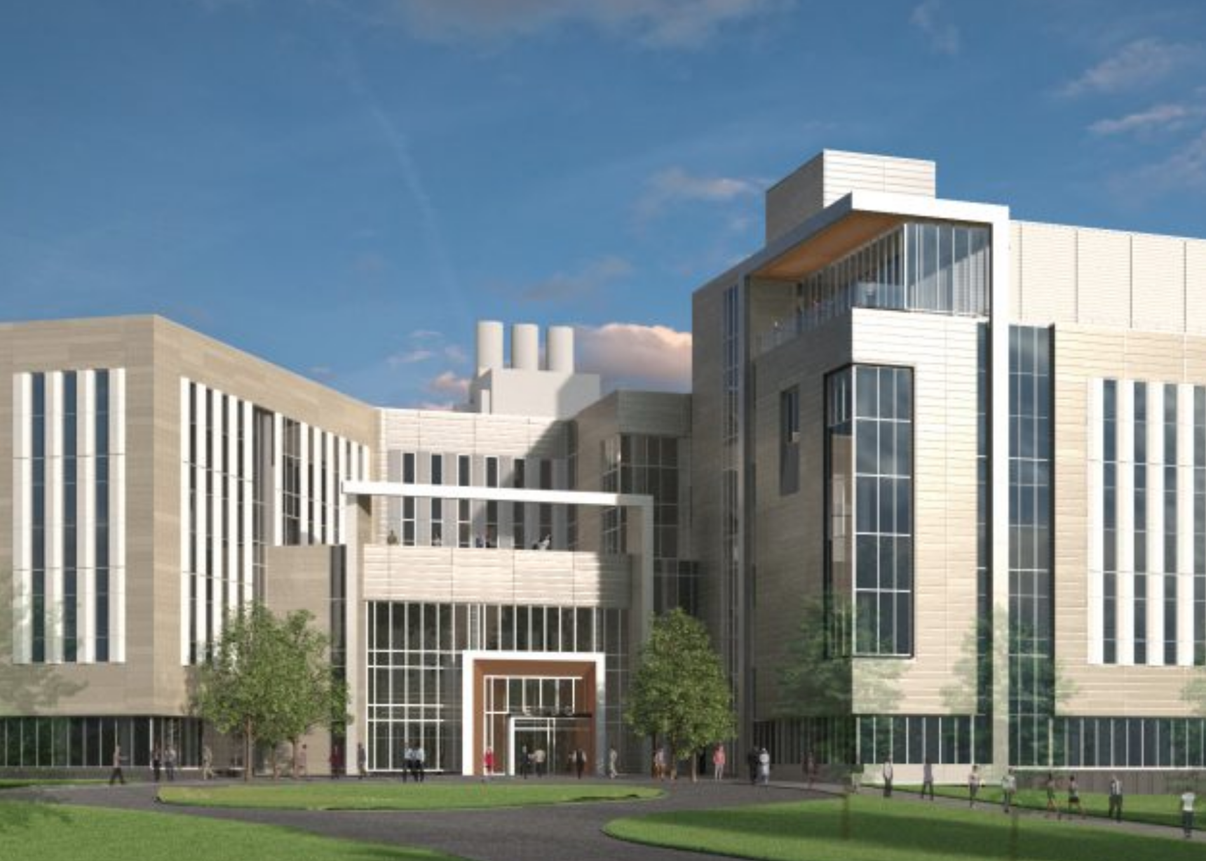

Slide 9
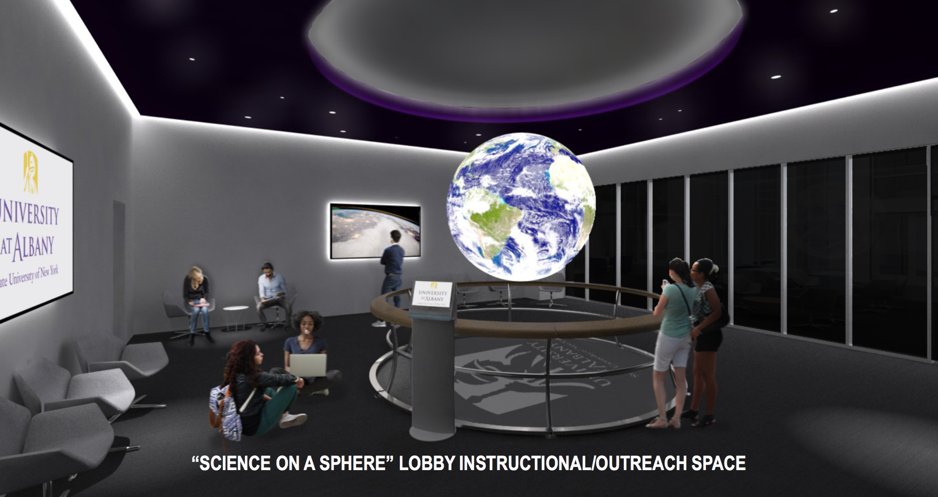

Slide 10
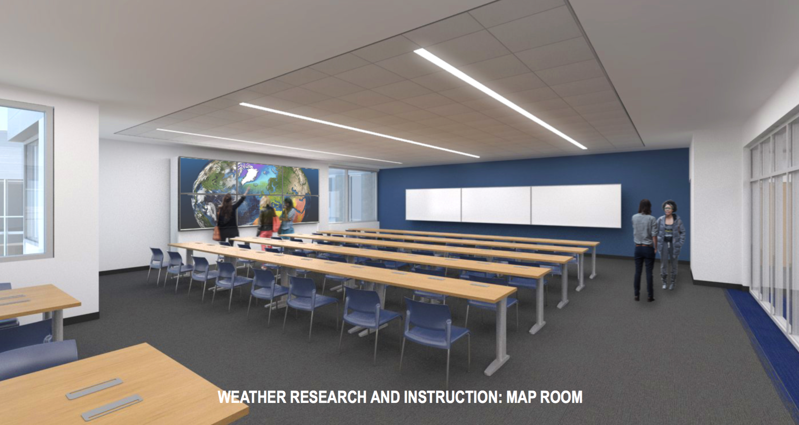

Slide 11
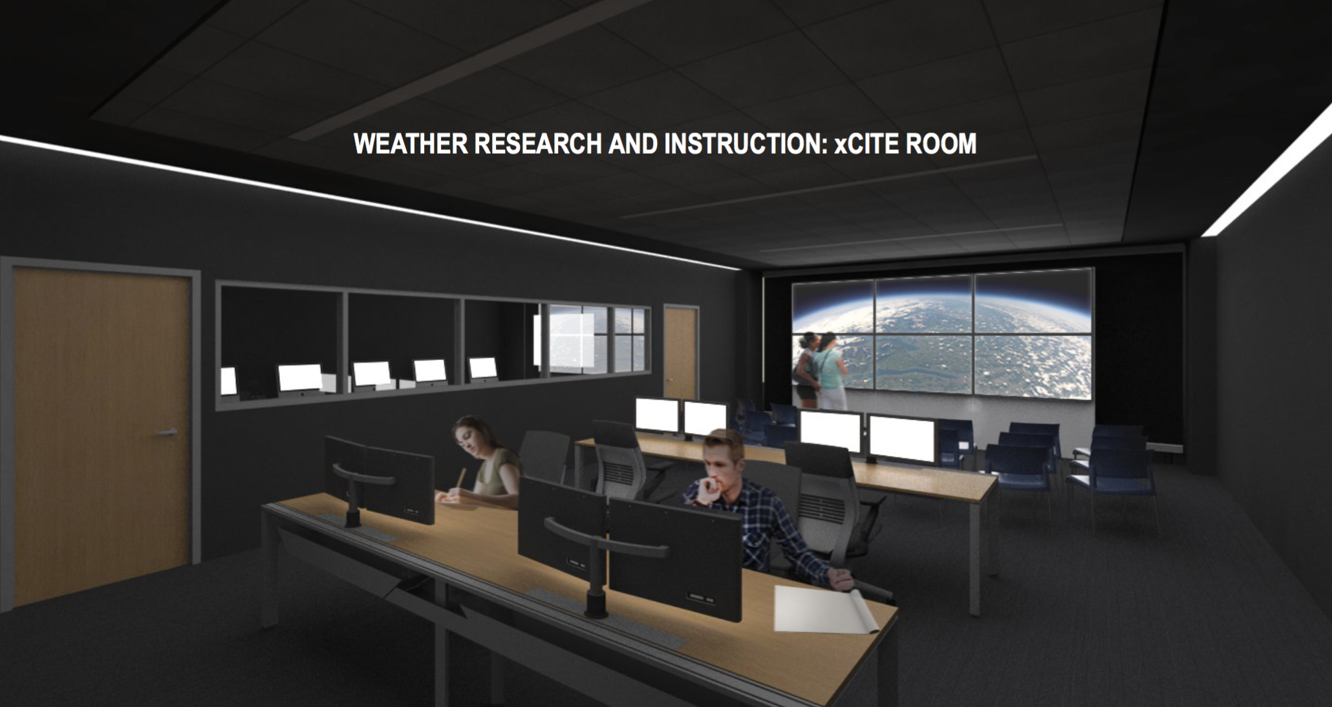

Slide 12
Department of
Atmospheric & Environmental Sciences
DAES
Contact me at:
Ross Lazear
rlazear@albany.edu
Web: http://www.albany.edu/atmos/
Notes:
Intro
Welcome & congrats
Great community. World-class education at state-school cost

