Slide 1
Graduate Fellowships

Slide 2
AMS Graduate Fellowship
(Deadline: 13 January 2017)
Eligibility
  Entering his or her first year of graduate study in the fall of the current year
  Pursuing a related full-time course of study in the atmospheric, oceanic, or hydrologic sciences over a full academic year
  Minimum GPA of 3.25
  U.S. citizen or hold permanent resident status
Award
  $25,000 stipend
  Travel funds to attend the AMS Annual Meeting
Application Requirements
  Completed application form
  Official transcript
  GRE scores
  Three references

Slide 3
National Science Foundation Graduate Research Fellowship
(Deadline: October 24, 2016)
Eligibility
  US citizen, US national, or permanent resident
  Intend to pursue a research-based Master's or Ph.D. program in a NSF-supported field
  Completed no more than twelve months of full-time graduate study (or the equivalent) as of August 1, 2016
Award (36 month tenure for funding)
  Three year annual stipend of $34,000
  $12,000 cost of education allowance per year
  Study abroad opportunities, ability to work with domestic government agencies, and professional development
  Freedom to conduct research at any accredited U.S. institution
Application Requirements
  Completed application form
  Two essays
    Personal statement
    Research proposal
  Un/Official transcript
  Three references
Notes:
Graduate students are limited to only one application to GRFP, submitted either in the first year or the second year of graduate school.

Slide 4

NATIONAL DEFENSE SCIENCE AND ENGINEERING GRADUATE FELLOWSHIP
(Deadline: Dec. 9, 2016 @ 5pm)
Eligibility
  U.S. Citizens or Nationals of the U.S.
  Must receive Bachelor’s by Fall 2017
  Completed less than 2 full-time grad. years
  Must be at U.S. institution of higher ed.
Award (36 month tenure)
  Full Tuition and Fees (not room & board)
  Stipend - $34,000 per year for 3 years
  Health Insurance (up to $1000)
  No additional travel allowance
Application Requirements
  Completed application form
  One essay < 3000 characters (~250 words)
    Research type | specific research question
    Long term goals | interest to DoD
  (Un)Official Undergraduate/Graduate Transcript
  GRE Scores
  Three LORs
Statistics: ~200/+3000 awarded

Slide 5
Undergraduate Research Opportunities

Slide 6
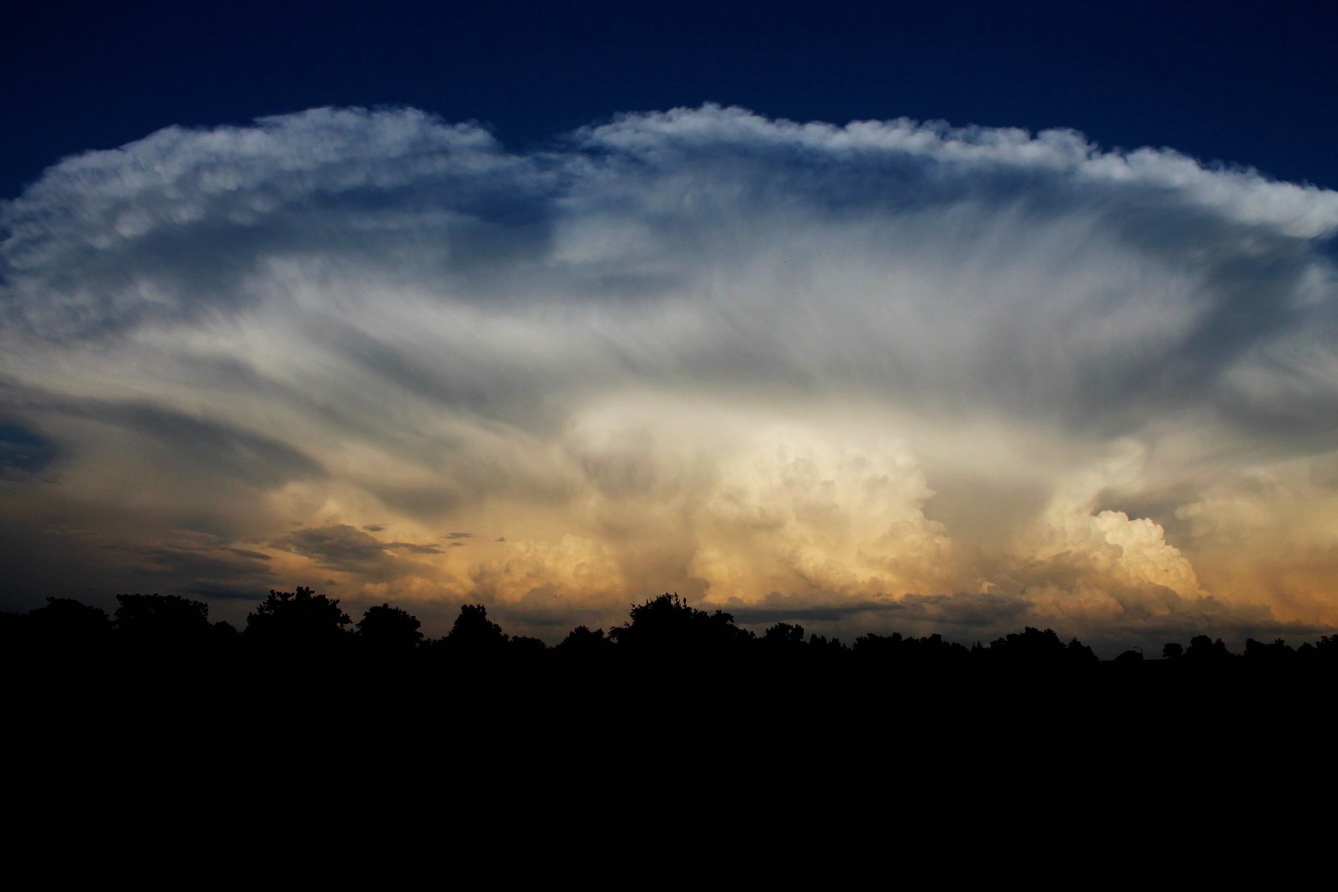

Significant Opportunities in Atmospheric Research & Science (SOARS)
Erin Dougherty
October 6, 2016

Slide 7
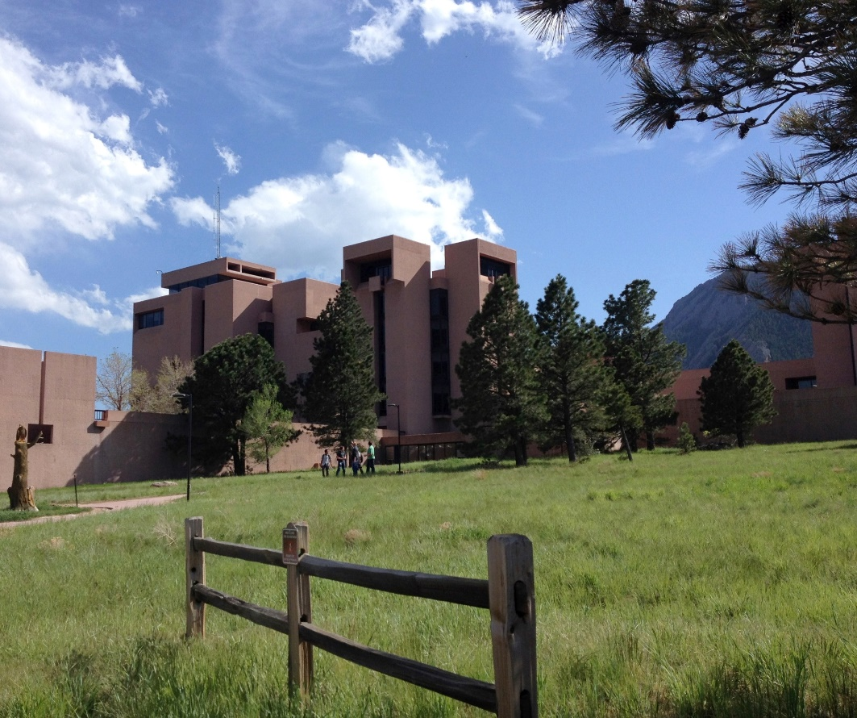
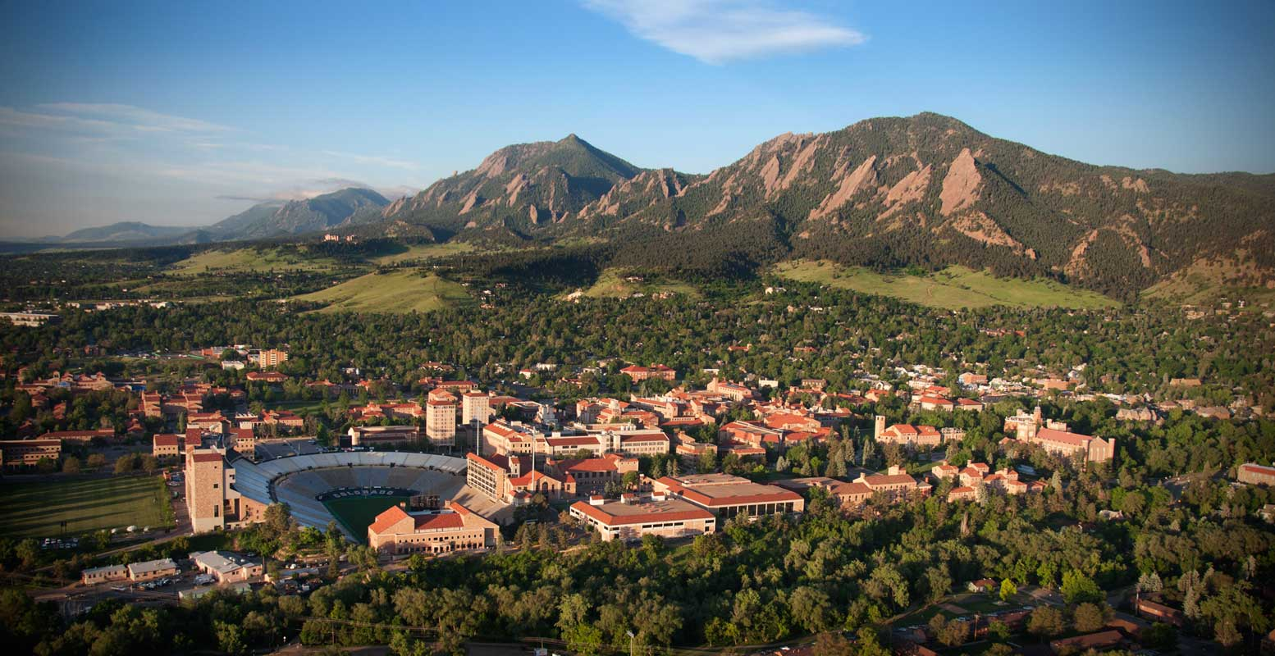
What is SOARS?
A summer research internship at the National Center for Atmospheric Research (NCAR), UC Boulder, or NOAA in Boulder, CO.
Focused on increasing diversity in atmospheric sciences
Undergraduate to graduate bridge program- can participate up to four summers or until you obtain your Master’s
Colorado.edu

Slide 8
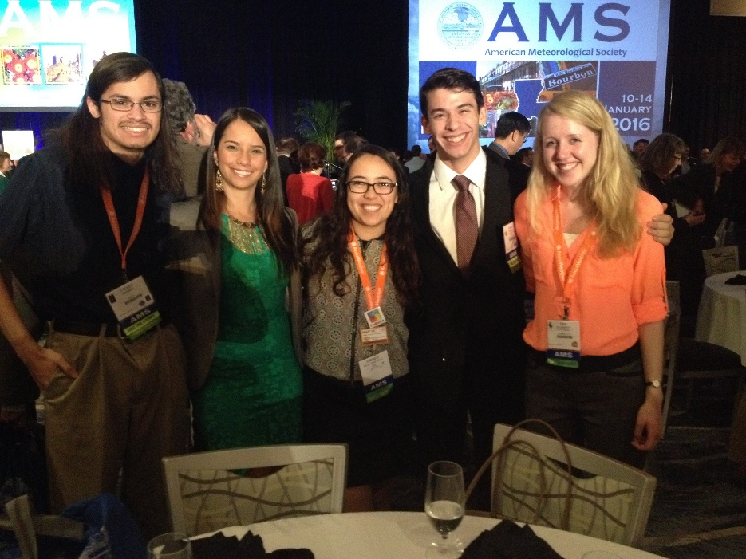
Details
Eligibility:
  Completed 2 years of college (but can’t be graduating senior)
  GPA >3.0
  Majoring in atmospheric science or related fields
  Have U.S. citizen or permanent resident status
Deadline: End of Jan./ Start of Feb.!
Application Requirements:
  Two letters of recommendation
  College transcripts
  SOARS application- basic information and two essays
    1- Academic statement of purpose
    2-SOARS mission and personal journey
Funding:
  Stipend and housing provided
  Travel costs covered
  Conference and school funding available

Slide 9
What Makes SOARS Unique?
Research
Mentoring
Community

Slide 10
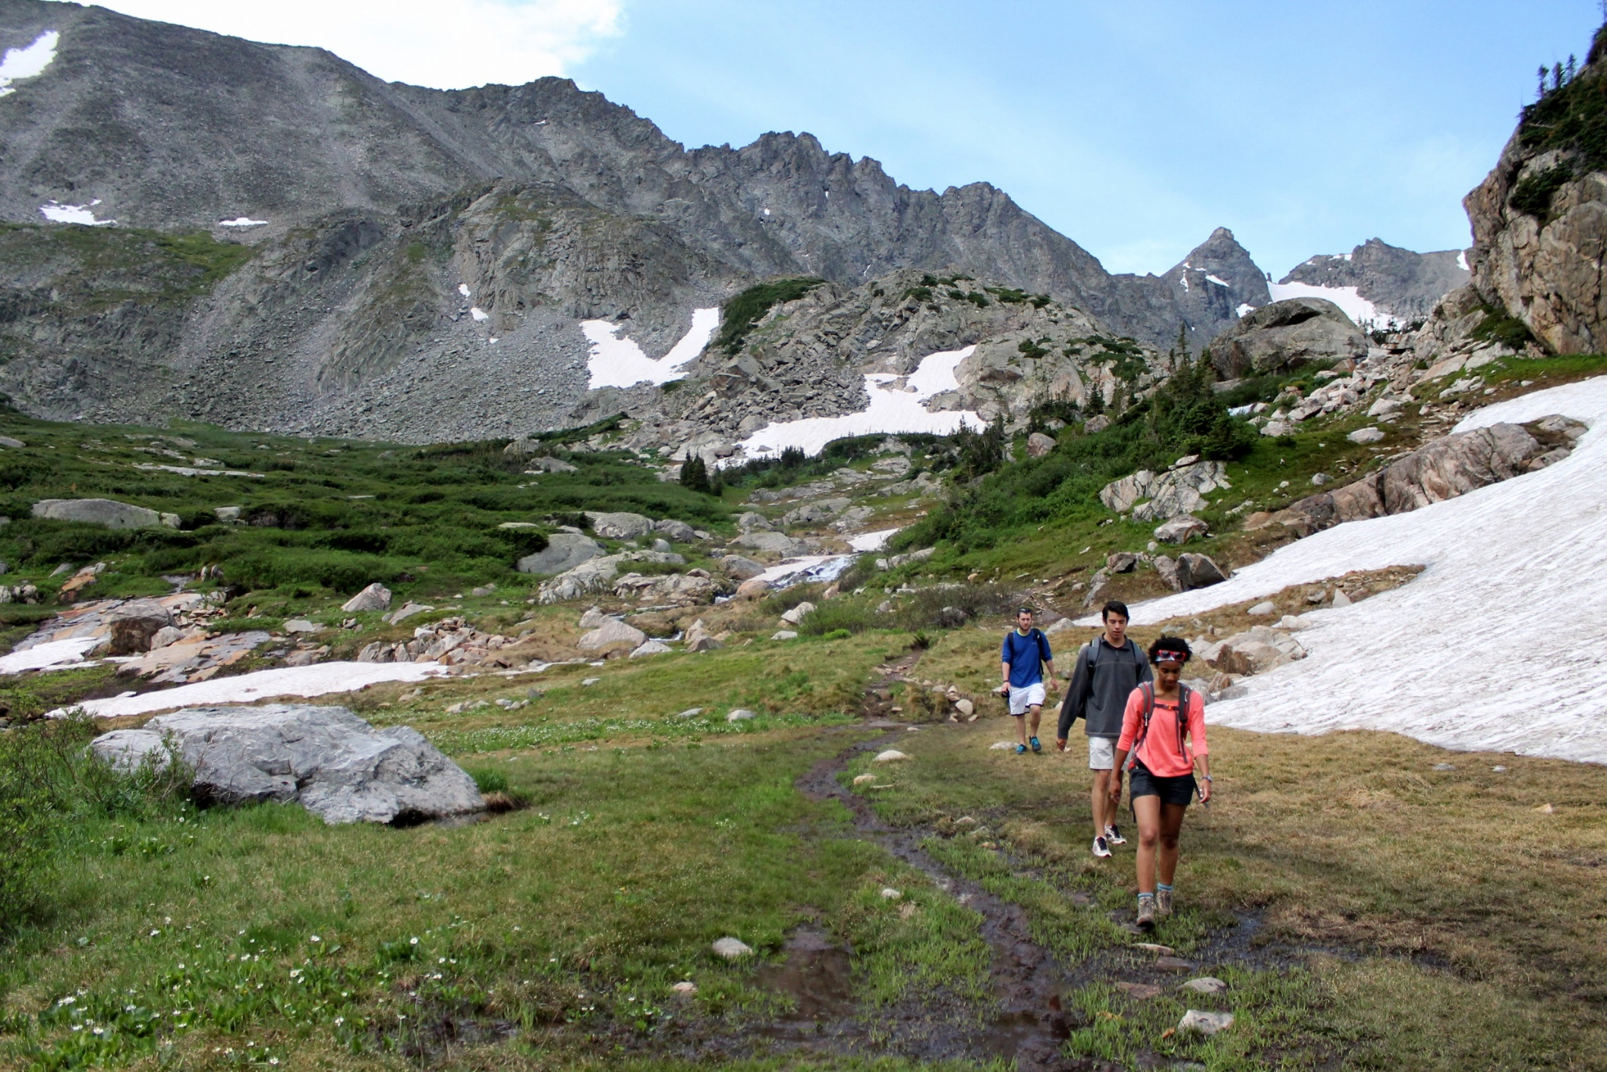
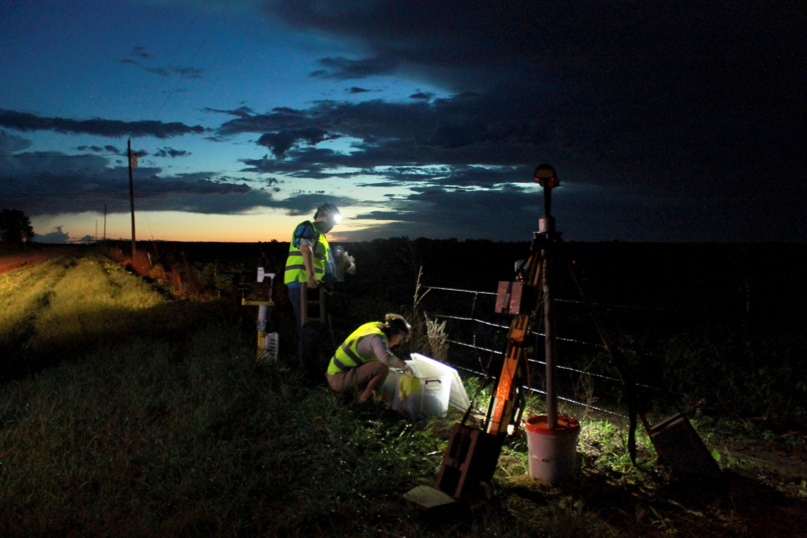
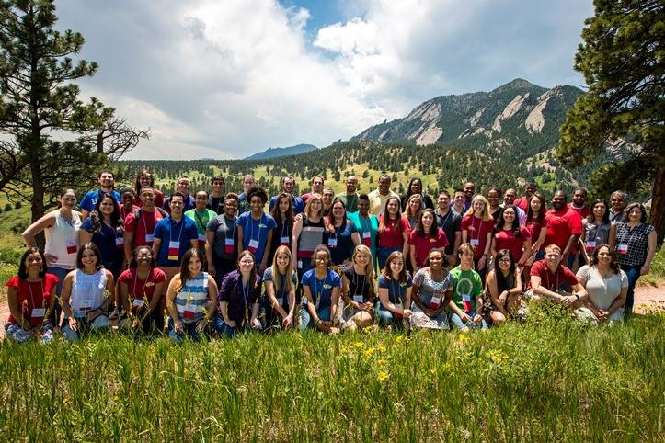
Why SOARS?
Resources:
soars.ucar.edu
“Like” SOARS on Facebook
My email: edougherty2@albany.edu

Slide 11
NOAA Ernest F. Hollings Scholarship
Apply Sophomore year
  Application due at the end of January
Benefits
  Travel to Orientation and Symposium in Silver Spring, Maryland
  Travel for site visit
  $9,500 your Junior and Senior Year
  $700/week paid internship at NOAA Office
  Housing Stipend
  Travel to 2 conferences to present your research
  Feedback on your application

Slide 12
Application Help
Be yourself! They want to know what you want to do and who you are!
Don’t feel like you need to be all science- highlight your extra curriculars
Find a faculty member who can write you a GREAT recommendation letter
Feel free to contact me!
  mehowarth@albany.edu

Slide 13

Weather-Ready Nation (WRN) is a NOAA strategic goal that increases community readiness, resilience, and responsiveness in the face of extreme weather, water, and climate events in order to reduce their impact
  Improving internal products and forecasts
  Increasing external engagement and communication

Slide 14
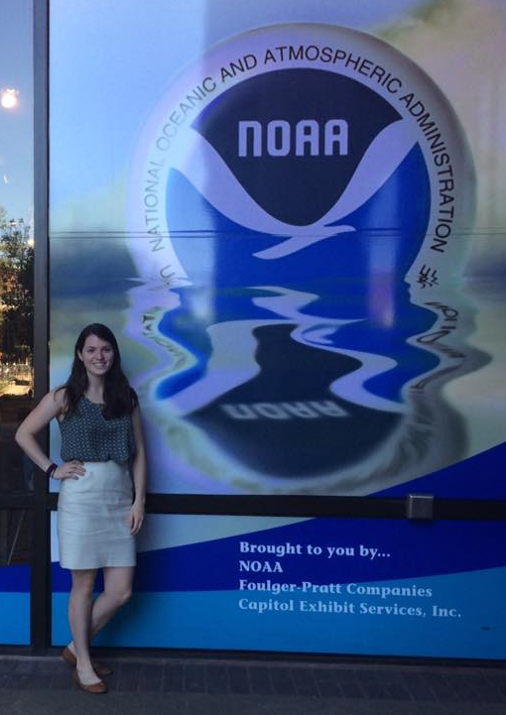
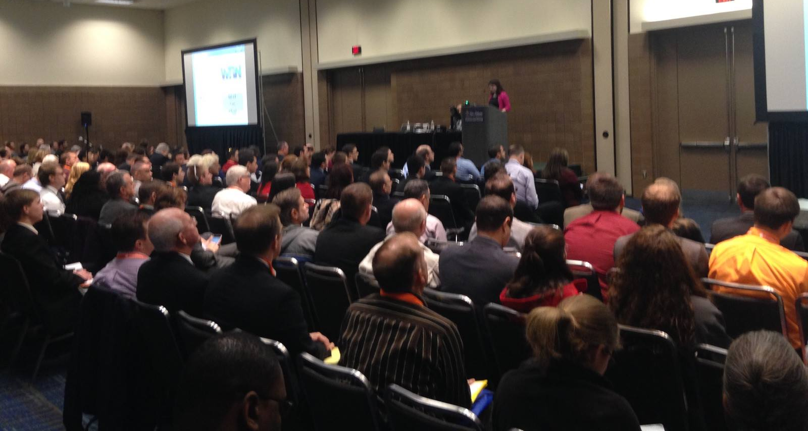
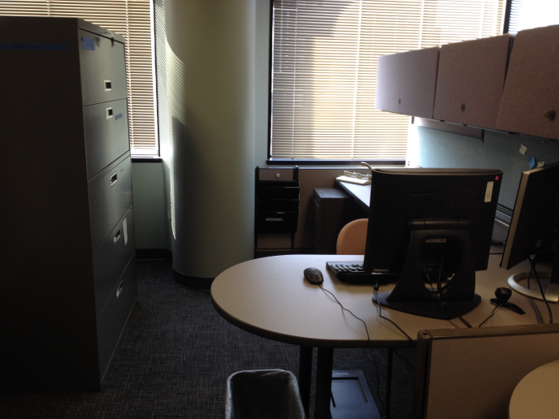
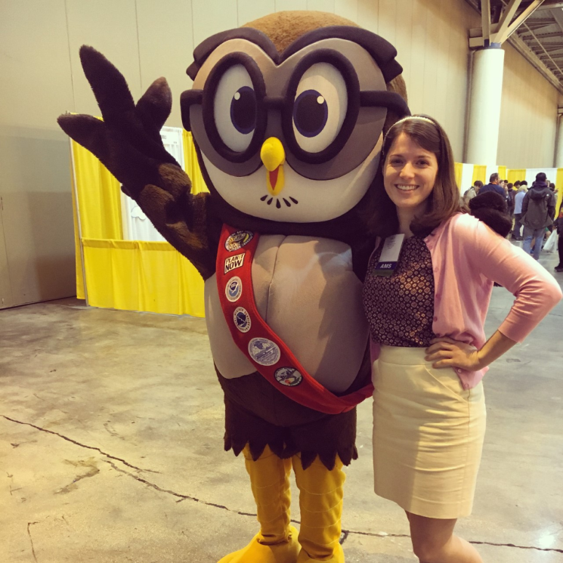
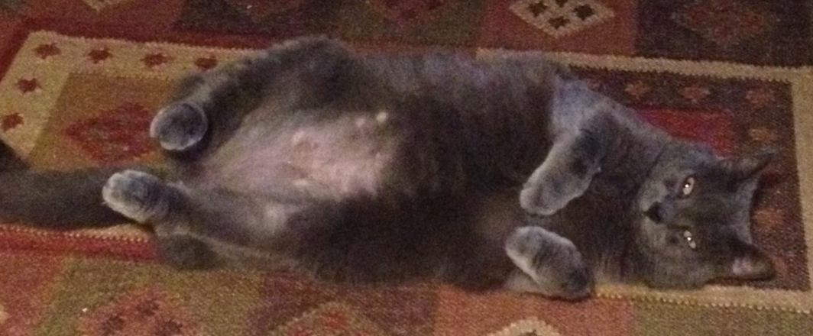

Slide 15


Slide 16
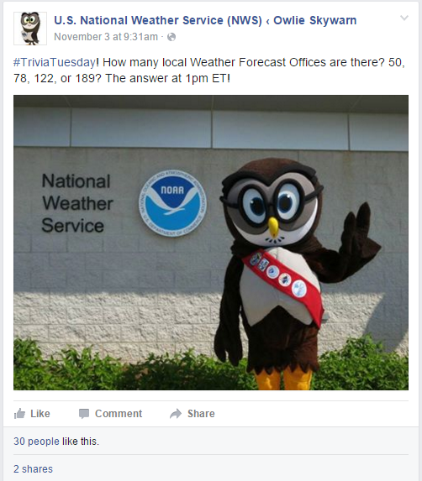
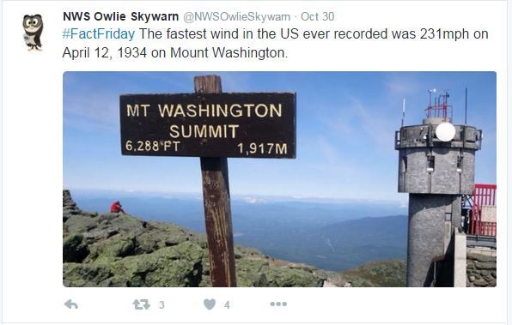
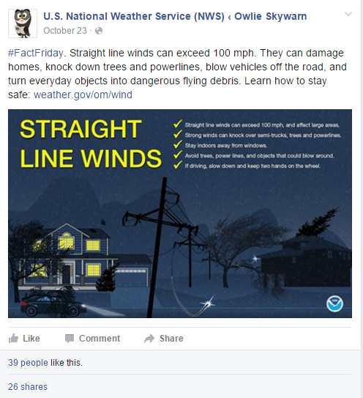
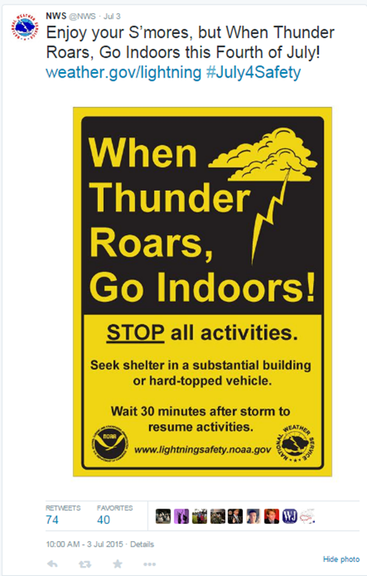
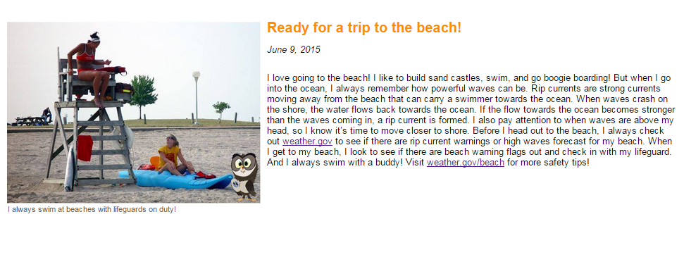

Slide 17
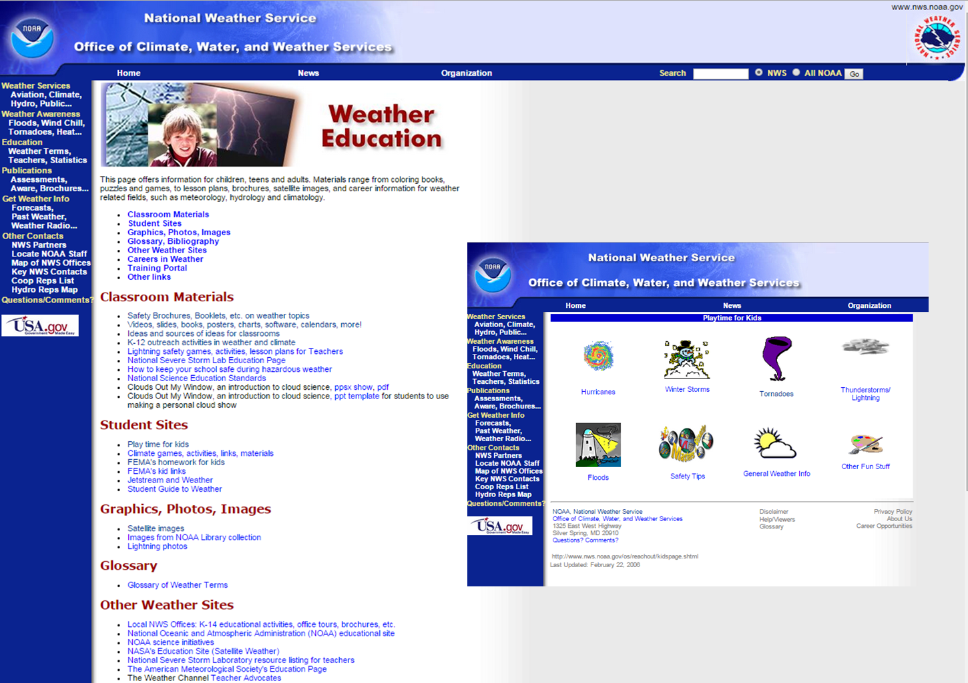

Slide 18


Slide 19


NASA DEVELOP INTERNSHIP
Summer Application Window:
Jan 9 -Feb 17, 2017
Eligibility
  At least 18 years of age
  U.S. citizenship
  Cumulative 3.0 GPA or higher (on 4.0 scale)
  Ability to provide personal transportation to and from the DEVELOP location
  Either currently-enrolled undergraduate or graduate student, individuals who have graduated with a degree within the last two years, or “individuals transitioning to a new career field, who are pursuing further experience in the Earth sciences and remote sensing”
Award
  Stipend – varies by education level (~$2,000 for undergraduate level*)
  Some assistance may be awarded for initial transportation to area
Application Requirements
  Application form
  Formal resume
  Unofficial academic transcripts, including the term before the one to which you are applying. (Official transcript required upon selection)
  2 References (name and contact information; preferably one academic and one professional)
Spring 2017 Term:
  Application Window: August 29 - October 7
  Letters of Recommendation Due: October 21
  Applicant Notifications: November - December
  Term Dates: January 23 – March 31
Summer 2017 Term:
  Application Window: January 9 – February 17
  Letters of Recommendation Due: March 3
  Applicant Notifications: April
  Term Dates: June 5 – August 11

Slide 20
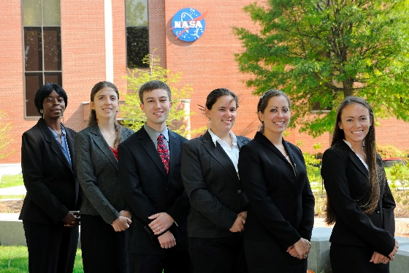
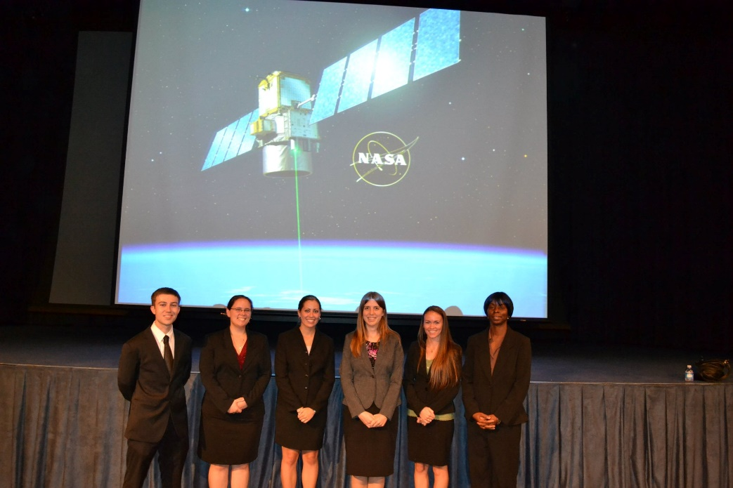
Program Structure and Benefits
“Mission: Integrating NASA Earth observations with society to foster future innovation and cultivate the professionals of tomorrow by addressing diverse environmental issues today.”
Typically a team project; groups range in size from 1-8 people
Project/deliverable-oriented program experience
Professional development workshops (including presentation skills)
In-depth familiarity with NASA remote sensing projects

Slide 21

Some Resources
Sample Spring 2017 Proposals:
Chile Water Resources: Integrating Satellite Precipitation Data into Drought Monitoring for Enhanced Agricultural Management in Chile (NASA Ames Research Center – Moffett Field, CA)
New York Ecological Forecasting: Utilizing NASA Earth Observations to Effectively Track and Predict Prevalence of Lyme and Other Tick-borne Disease at the United States Military Academy (USMA) at West Point and Surrounding West Point Community (NASA Goddard Space Flight Center – Greenbelt, MD)
Glacier National Park Ecological Forecasting II: Utilizing NASA Earth Observations to Correlate Landscape Disturbances to Effects of a Changing Climate across Glacier National Park (NASA Langley Research Center – Hampton, VA)
Alabama Agriculture: Analyzing and Assessing Drought Conditions for Agricultural Crops across Alabama (NASA Marshall Space Flight Center – Huntsville, AL)
Coastal Disasters: Utilizing NASA Earth Observations, NOAA Climate Data Records, and International Space Station Data to Enhance Methods of Measuring and Tracking Cyclones (NOAA National Centers for Environmental Information – Asheville, NC)
Arizona Water Resources: Assessing Tamarisk Invasion Risk in Riparian Areas Using Landsat 8 for Riparian Restoration Efforts (USGS at Colorado State University – Fort Collins, CO)
Costa Rica Water Resources II: Monitoring Drought and Water Balance in the Guanacaste Province to Enhance Decision Making and Response Planning in Costa Rica (University of Georgia – Athens, GA)
Phoenix Health & Air Quality: Utilizing NASA Earth Observations to Reduce the Impact of Extreme Heat on Transit Riders in Phoenix, AZ (Maricopa County Department of Public Health and Arizona State University – Tempe, AZ)
Program Webpage (check out the program sites!)
  http://develop.larc.nasa.gov/about.html
YouTube Page (the media group has a lot of fun)
  https://www.youtube.com/user/NASADEVELOP
Earthzine Poster Presentations (past and current)
  http://earthzine.org/develop/

Slide 22
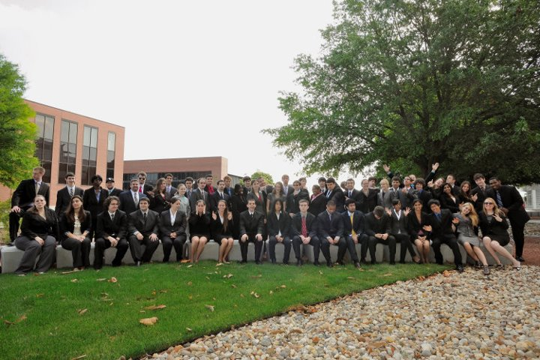
Some Resources
Sample Spring 2017 Proposals:
Chile Water Resources: Integrating Satellite Precipitation Data into Drought Monitoring for Enhanced Agricultural Management in Chile (NASA Ames Research Center – Moffett Field, CA)
New York Ecological Forecasting: Utilizing NASA Earth Observations to Effectively Track and Predict Prevalence of Lyme and Other Tick-borne Disease at the United States Military Academy (USMA) at West Point and Surrounding West Point Community (NASA Goddard Space Flight Center – Greenbelt, MD)
Glacier National Park Ecological Forecasting II: Utilizing NASA Earth Observations to Correlate Landscape Disturbances to Effects of a Changing Climate across Glacier National Park (NASA Langley Research Center – Hampton, VA)
Alabama Agriculture: Analyzing and Assessing Drought Conditions for Agricultural Crops across Alabama (NASA Marshall Space Flight Center – Huntsville, AL)
Coastal Disasters: Utilizing NASA Earth Observations, NOAA Climate Data Records, and International Space Station Data to Enhance Methods of Measuring and Tracking Cyclones (NOAA National Centers for Environmental Information – Asheville, NC)
Arizona Water Resources: Assessing Tamarisk Invasion Risk in Riparian Areas Using Landsat 8 for Riparian Restoration Efforts (USGS at Colorado State University – Fort Collins, CO)
Costa Rica Water Resources II: Monitoring Drought and Water Balance in the Guanacaste Province to Enhance Decision Making and Response Planning in Costa Rica (University of Georgia – Athens, GA)
Phoenix Health & Air Quality: Utilizing NASA Earth Observations to Reduce the Impact of Extreme Heat on Transit Riders in Phoenix, AZ (Maricopa County Department of Public Health and Arizona State University – Tempe, AZ)
Program Webpage (check out the program sites!)
  http://develop.larc.nasa.gov/about.html
YouTube Page (the media group has a lot of fun)
  https://www.youtube.com/user/NASADEVELOP
Earthzine Poster Presentations (past and current)
  http://earthzine.org/develop/

Slide 23
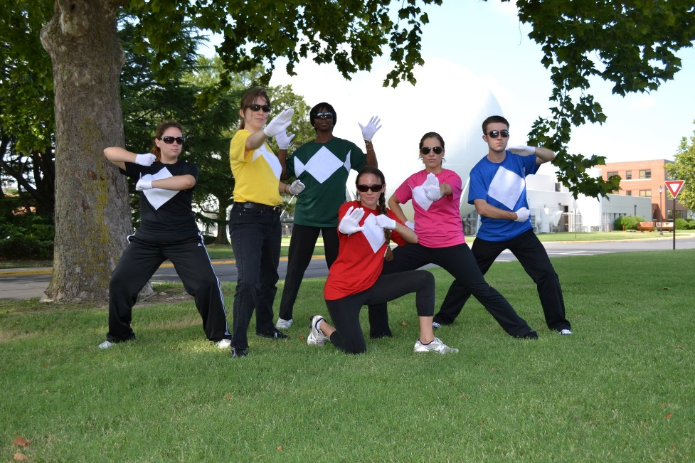
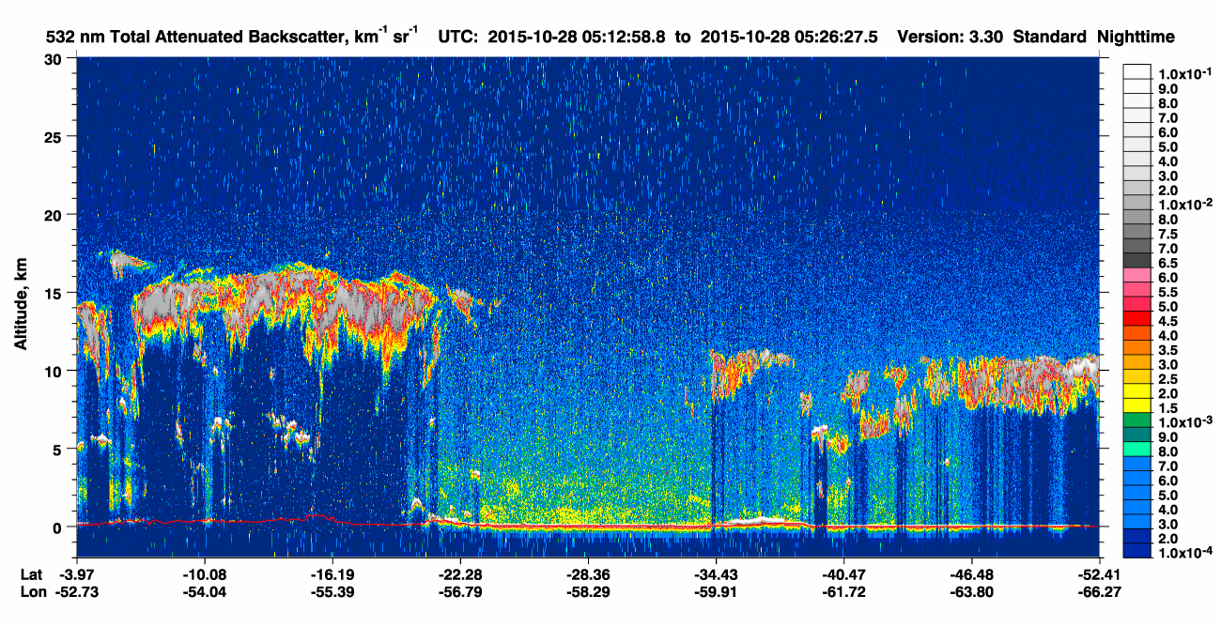
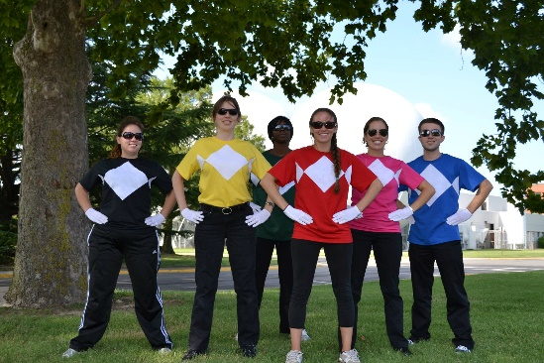
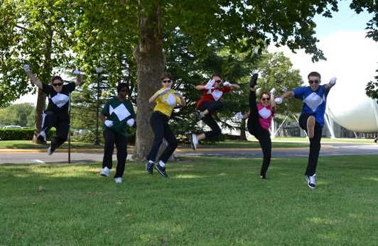
CALIPSO Mission Summer 2011
Synthesized ancient FORTRAN code packages with in-house trajectory modeling (RK4-ish methods) with new code to automatically retrieve CALIPSO particle measurements and compute forward- and back-trajectories
6-member group; two mathematicians, two computer scientists, and two meteorologists
  Were able to share experiences and meet a variety of stretch goals due to our unique backgrounds
Presented at poster session with other groups at the National Office in Washington D.C.
Learned about trajectory modeling, remote sensing, and professional presentations
It’s what got me interested in what I’m doing now as a graduate student!

Slide 24
Hobart and William Smith Colleges
Lauriana Gaudet

Slide 25
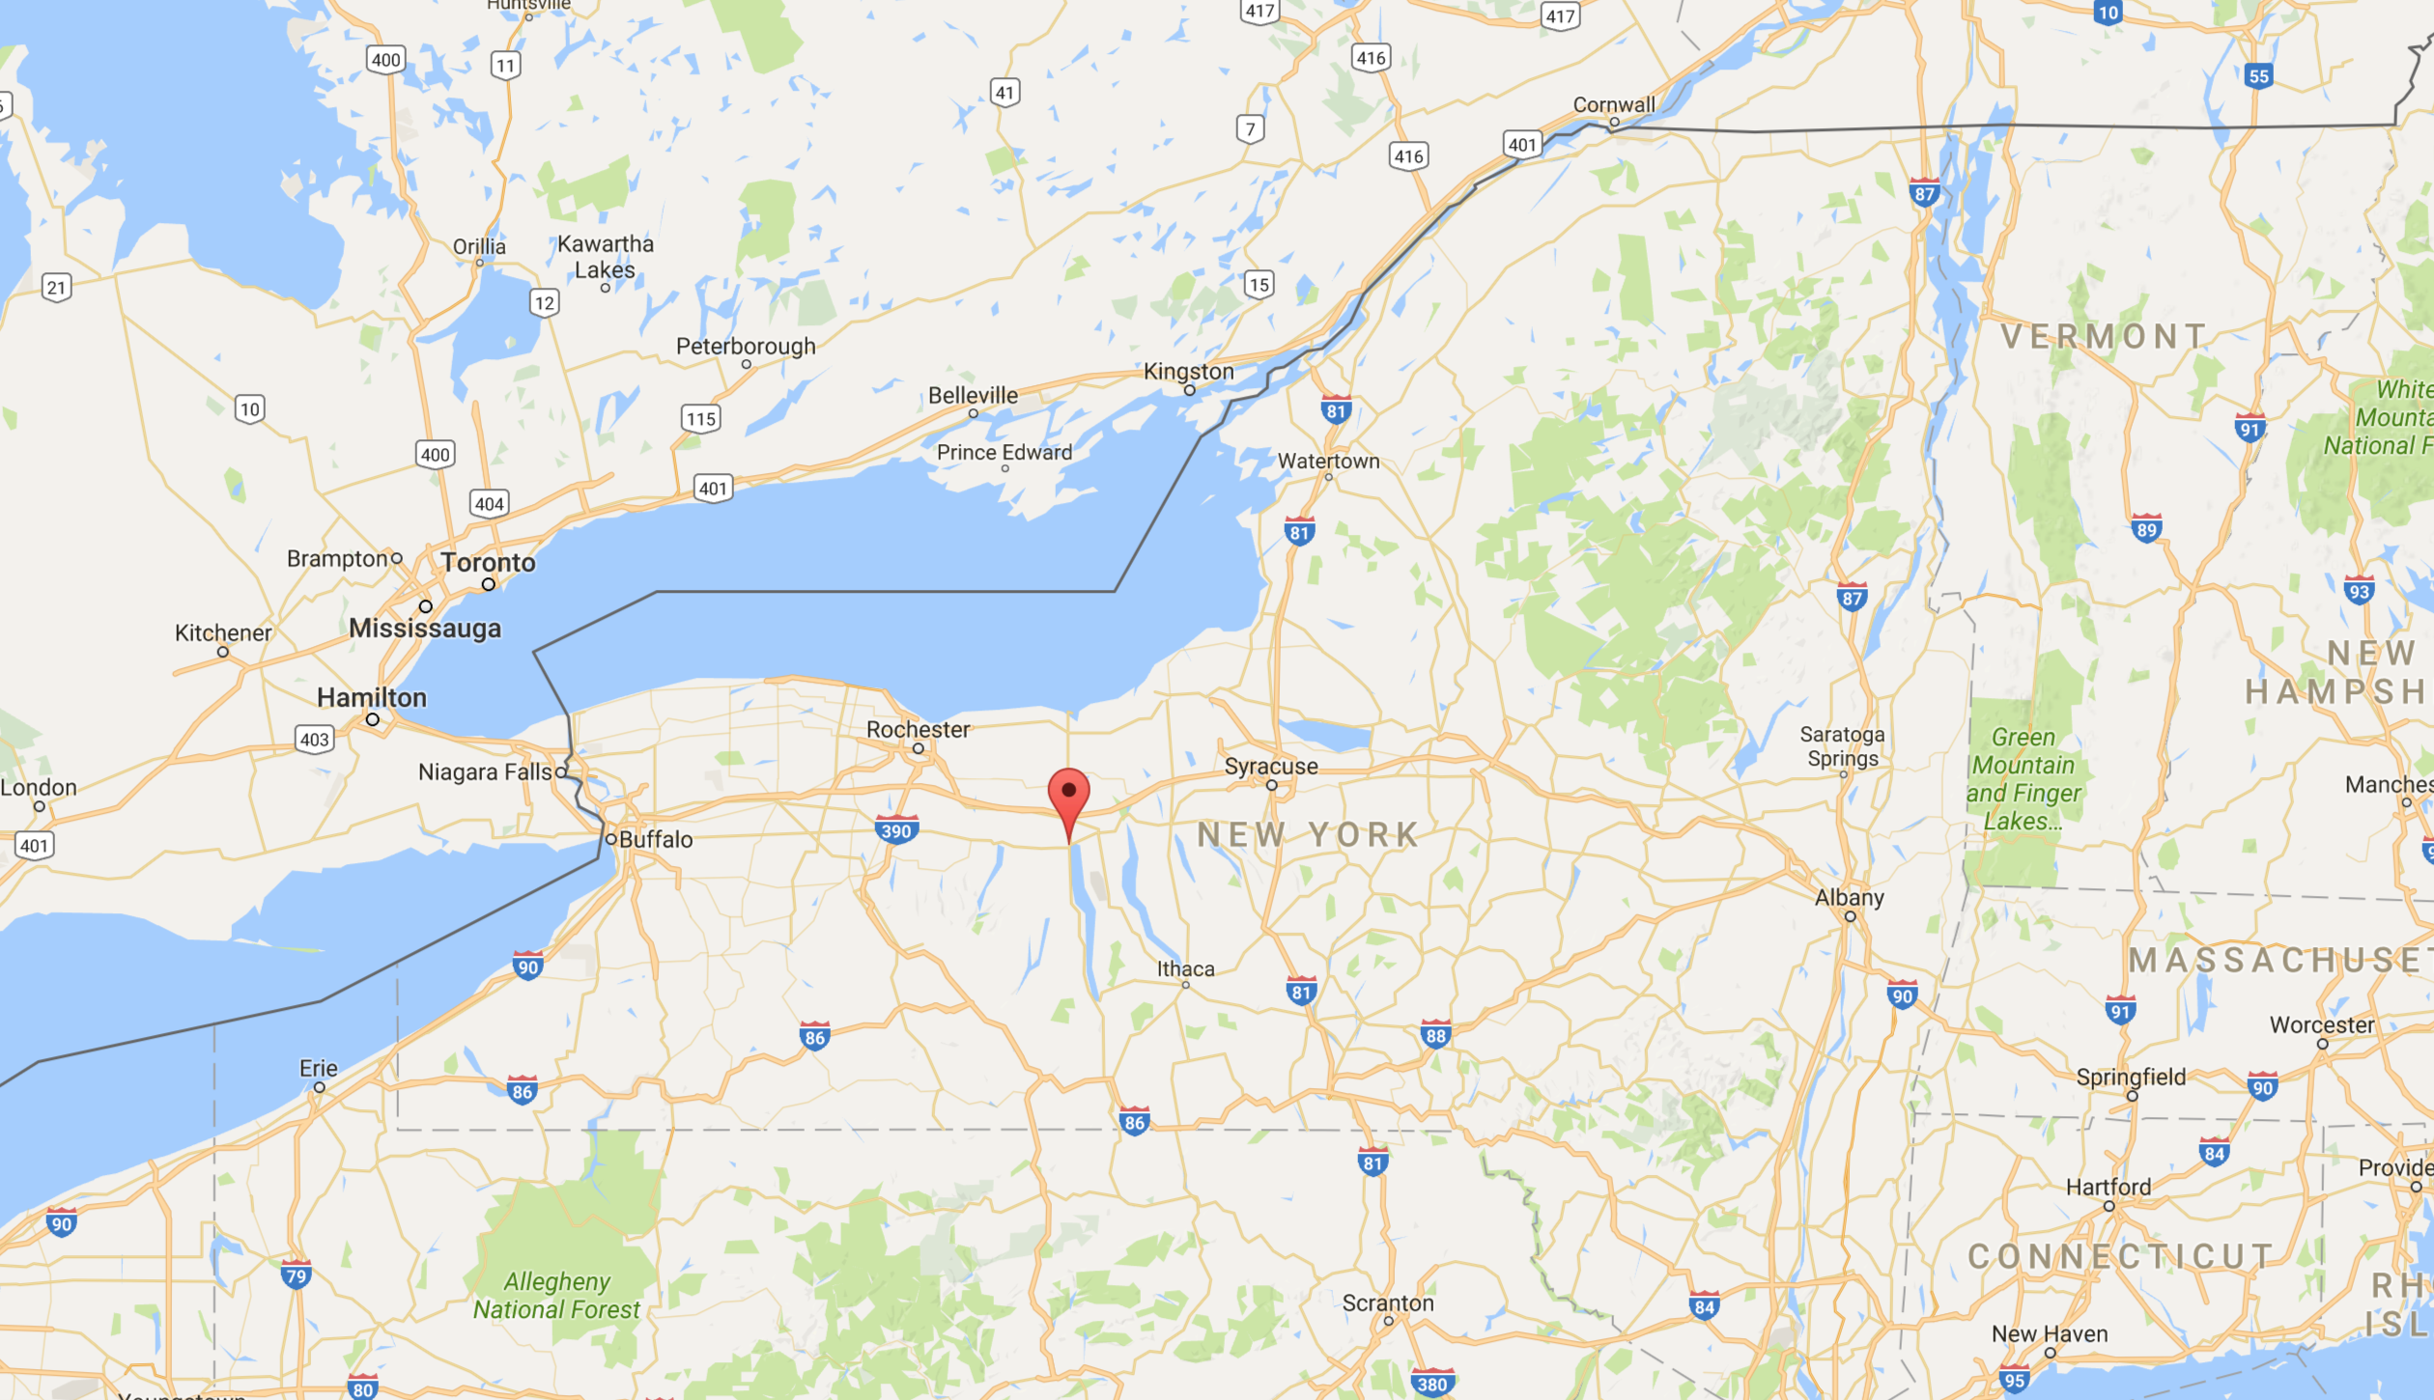
Where is this internship?

Slide 26
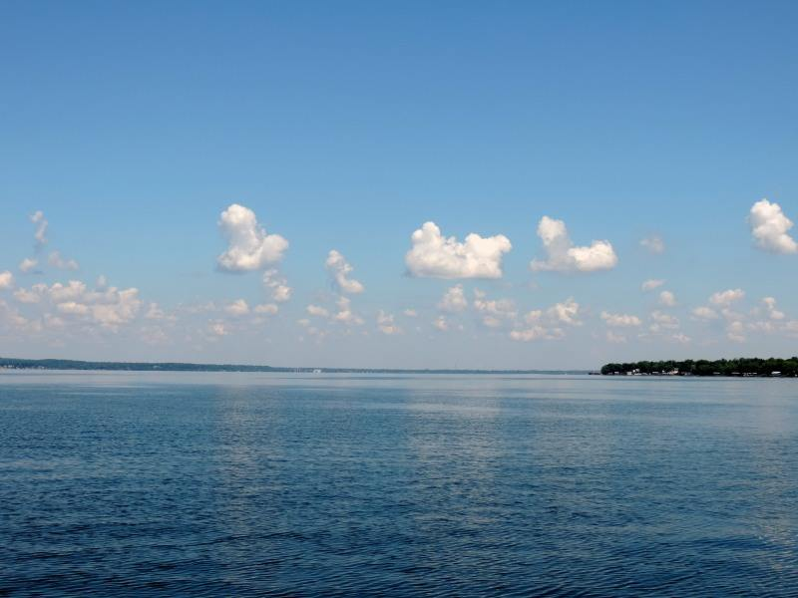
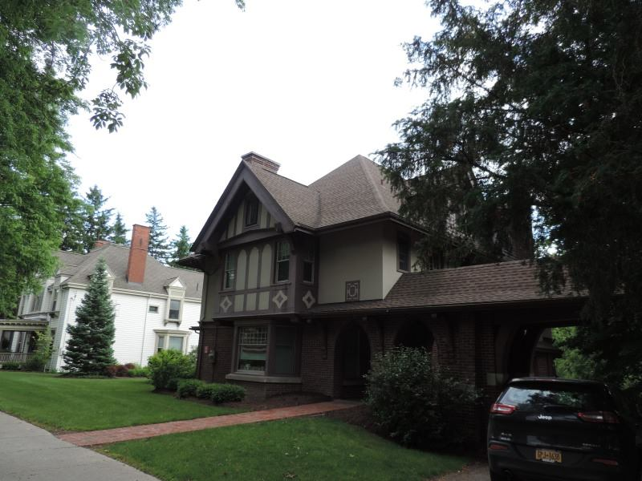
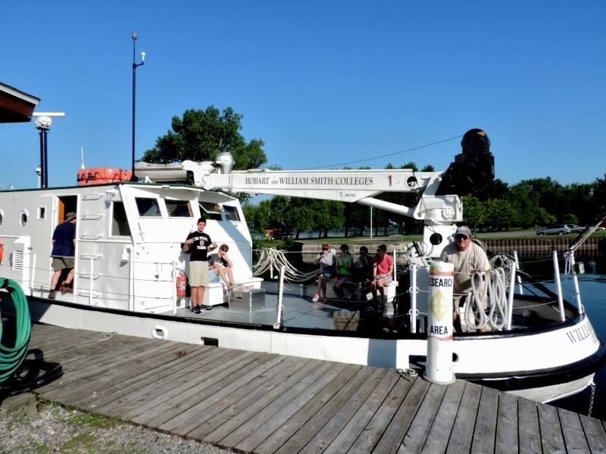

Slide 27
General Questions
Can I apply?
  All undergraduates can apply, including graduating seniors
What kind of funding will I receive?
  Stipend $4,400 for 2 months of research
  Housing on campus
  Travel to/from Geneva
  Conference travel/lodging
What will I be researching?
  Some type of winter weather phenomena (i.e. lake-effect snow processes)

Slide 28
Application Process
Application opens in November/December
  Go to http://people.hws.edu/laird/ to access application materials
  2 references
  Statement of interest
Deadline: Late January/Early February

Slide 29
National Weather Center REU
(Deadline: ~Early February 2017)
Eligibility
Application Requirement
US Citizen or permanent resident
Current 1-3rd year students in a 4 year undergraduate program
Application form
Three short essays
Two references
Official transcript
Award
Stipend: $5000
Some subsistence & travel to/from Norman, OK covered
Housing provided
Up to $1500 funding for traveling to national conference

Slide 30
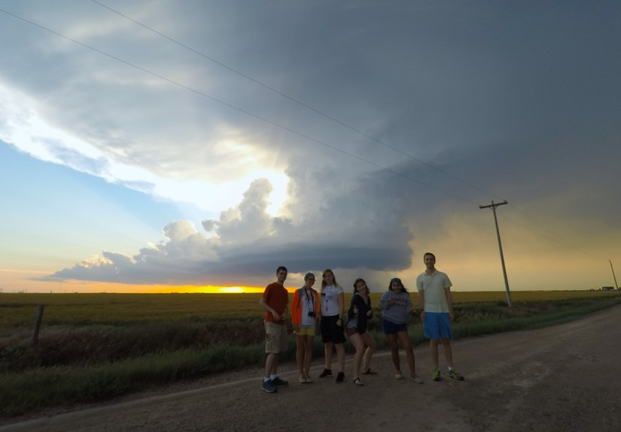
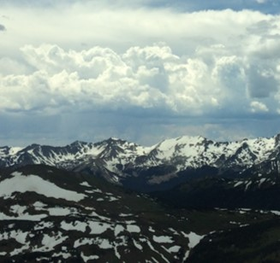
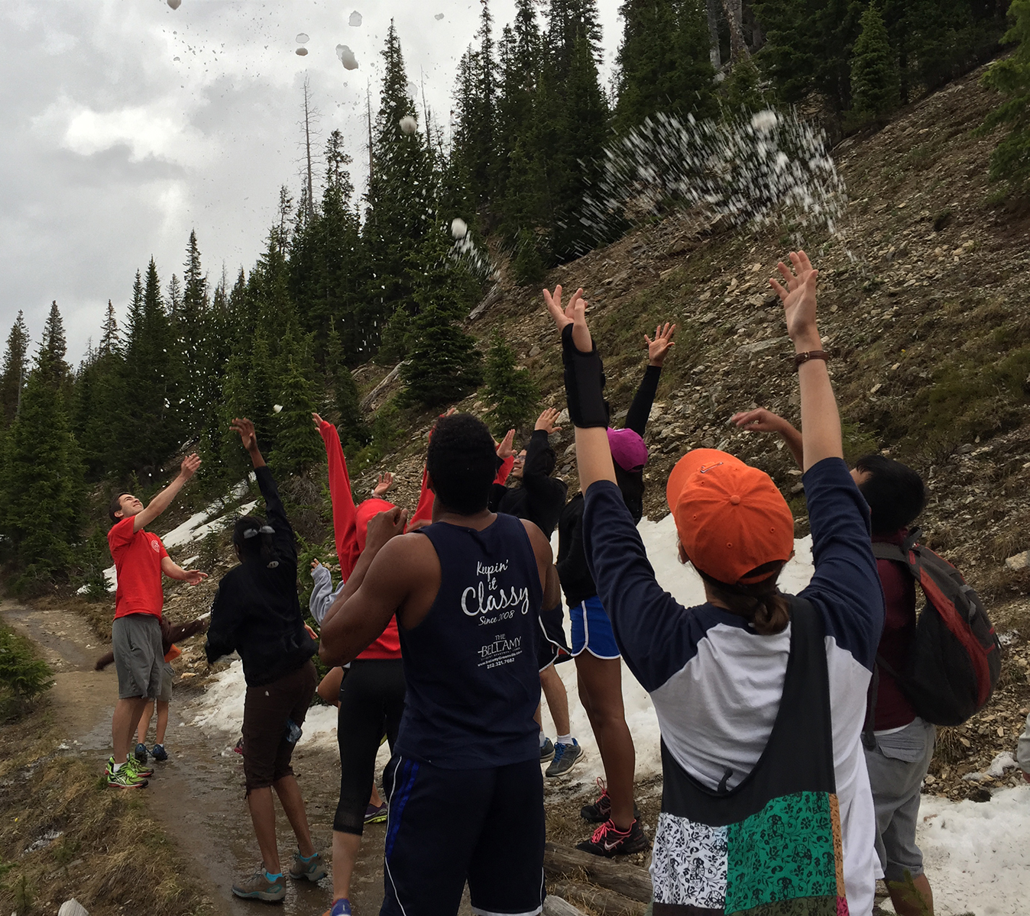
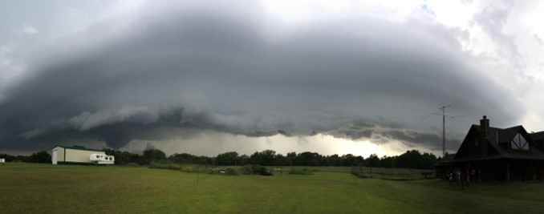
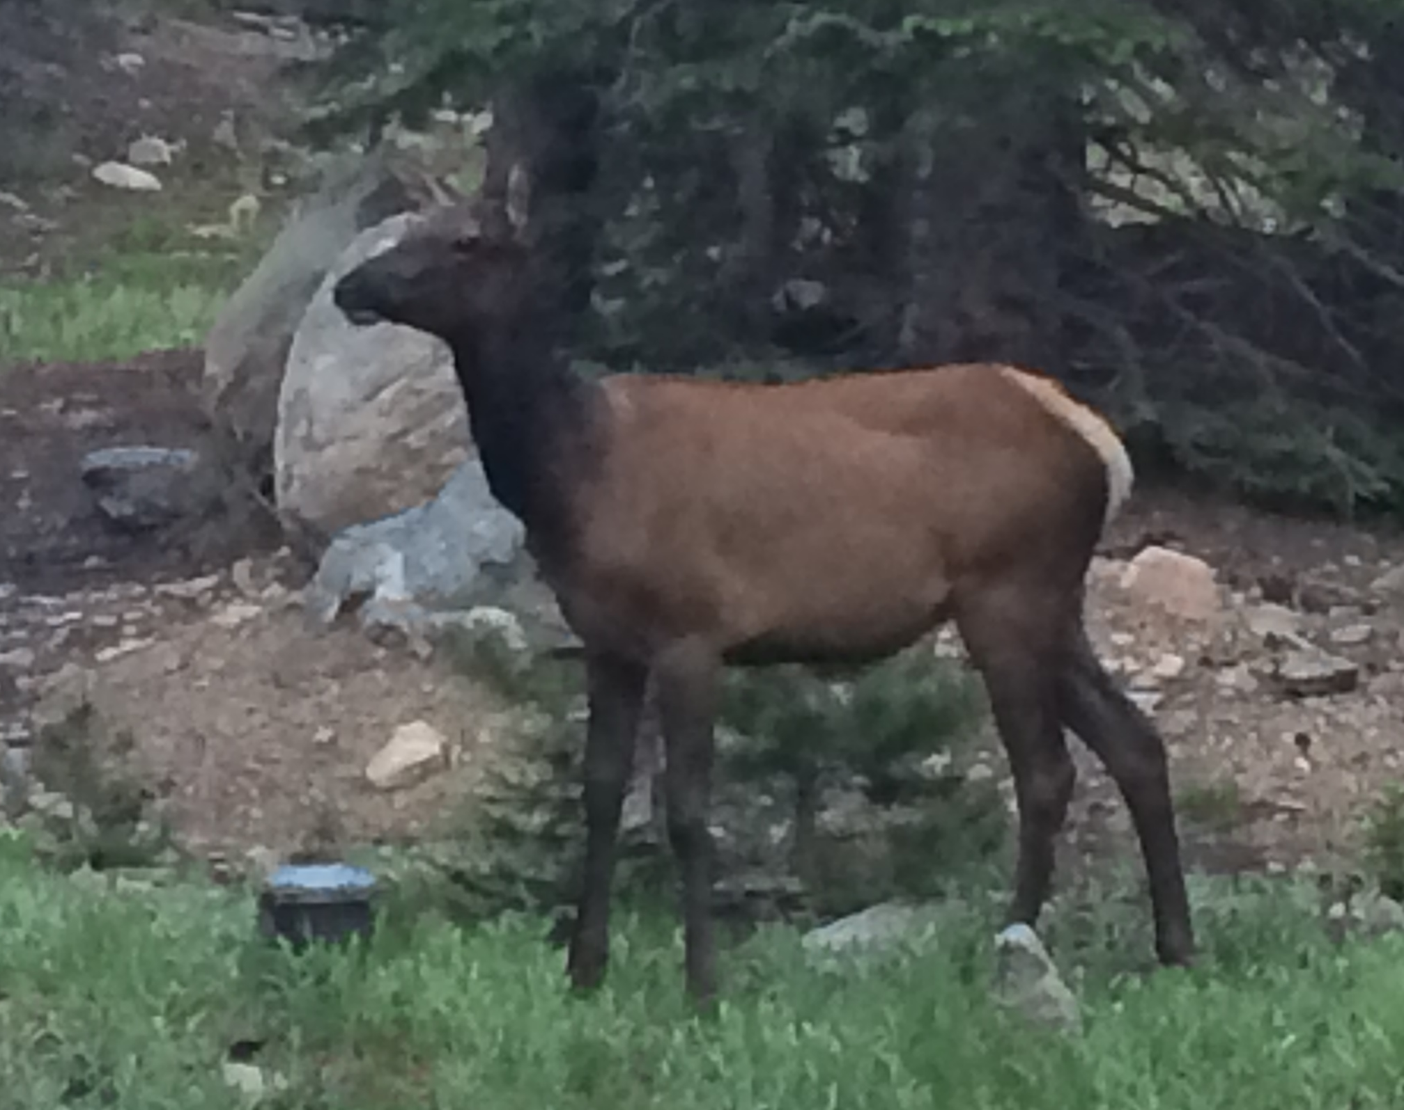
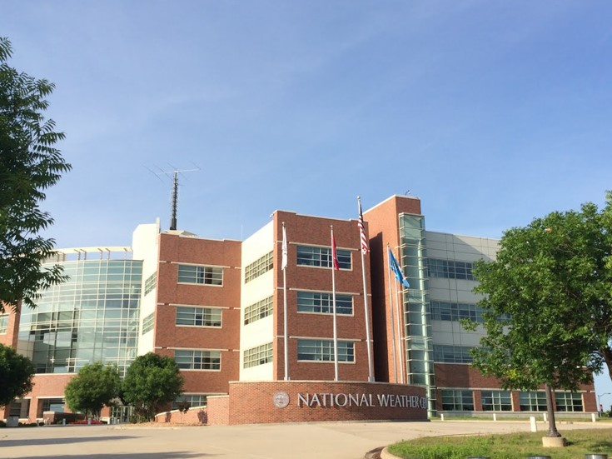
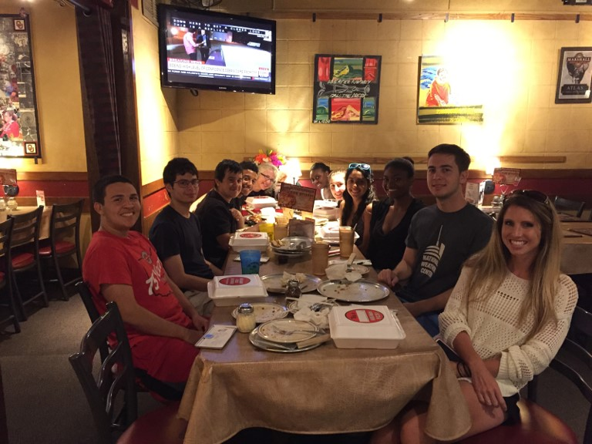
“Superselfie”
Rockies
Snow in June
4th of July “Fireworks”
ELKS!
NWC
Awesome pizza

Slide 31
Scholarships

Slide 32
AMS Senior Named Undergraduate Scholarships
(Deadline: 3 February 2017)
Eligibility
  Junior undergraduate students
  Major in the atmospheric or related sciences
  Cumulative GPA of 3.25
Award
  Varies, but generally between $2,000 and $10,000
  Travel funds to attend the AMS Annual Meeting
Application Requirements
  Completed application form
  Official transcript
  Three references

Slide 33
National Weather Association Scholarships
Lauriana Gaudet

Slide 34
Open Scholarships
The Arthur C. Pike Scholarship in Meteorology
  Eligibility: Any undergraduate going into junior year or higher or graduate student
  Award: $1000 + Free NWA Membership
The NWA Phillips Family Undergraduate Scholarship for Meteorology
  Eligibility: Undergraduates Only
  Award: $1000 + Free NWA Membership
The NWA Bob Glahn Scholarship in Statistical Meteorology
  Eligibility: Undergraduates Only
  Award: $2500 + Free NWA Membership

Slide 35
Other Information
All Deadlines: November 10, 2016
Application Materials:
    Transcripts
    2 recommendations
    Personal essay

Slide 36
National Weather Association Scholarships
(Deadline: varies based on scholarship)
Eligibility
  US citizen, US national, or permanent resident
  Undergraduate and graduate students
  Some scholarships require an interest on a specific topic within meteorology
Award
  Varies, but generally between $1,000 and $2,500
  Free NWA membership
  In my opinion, these scholarships generally have less applicants!
Application Requirements
  Completed application form
  Statement explaining why you are applying for the scholarship
  Un/Official transcript
  Two references

