Slide 1
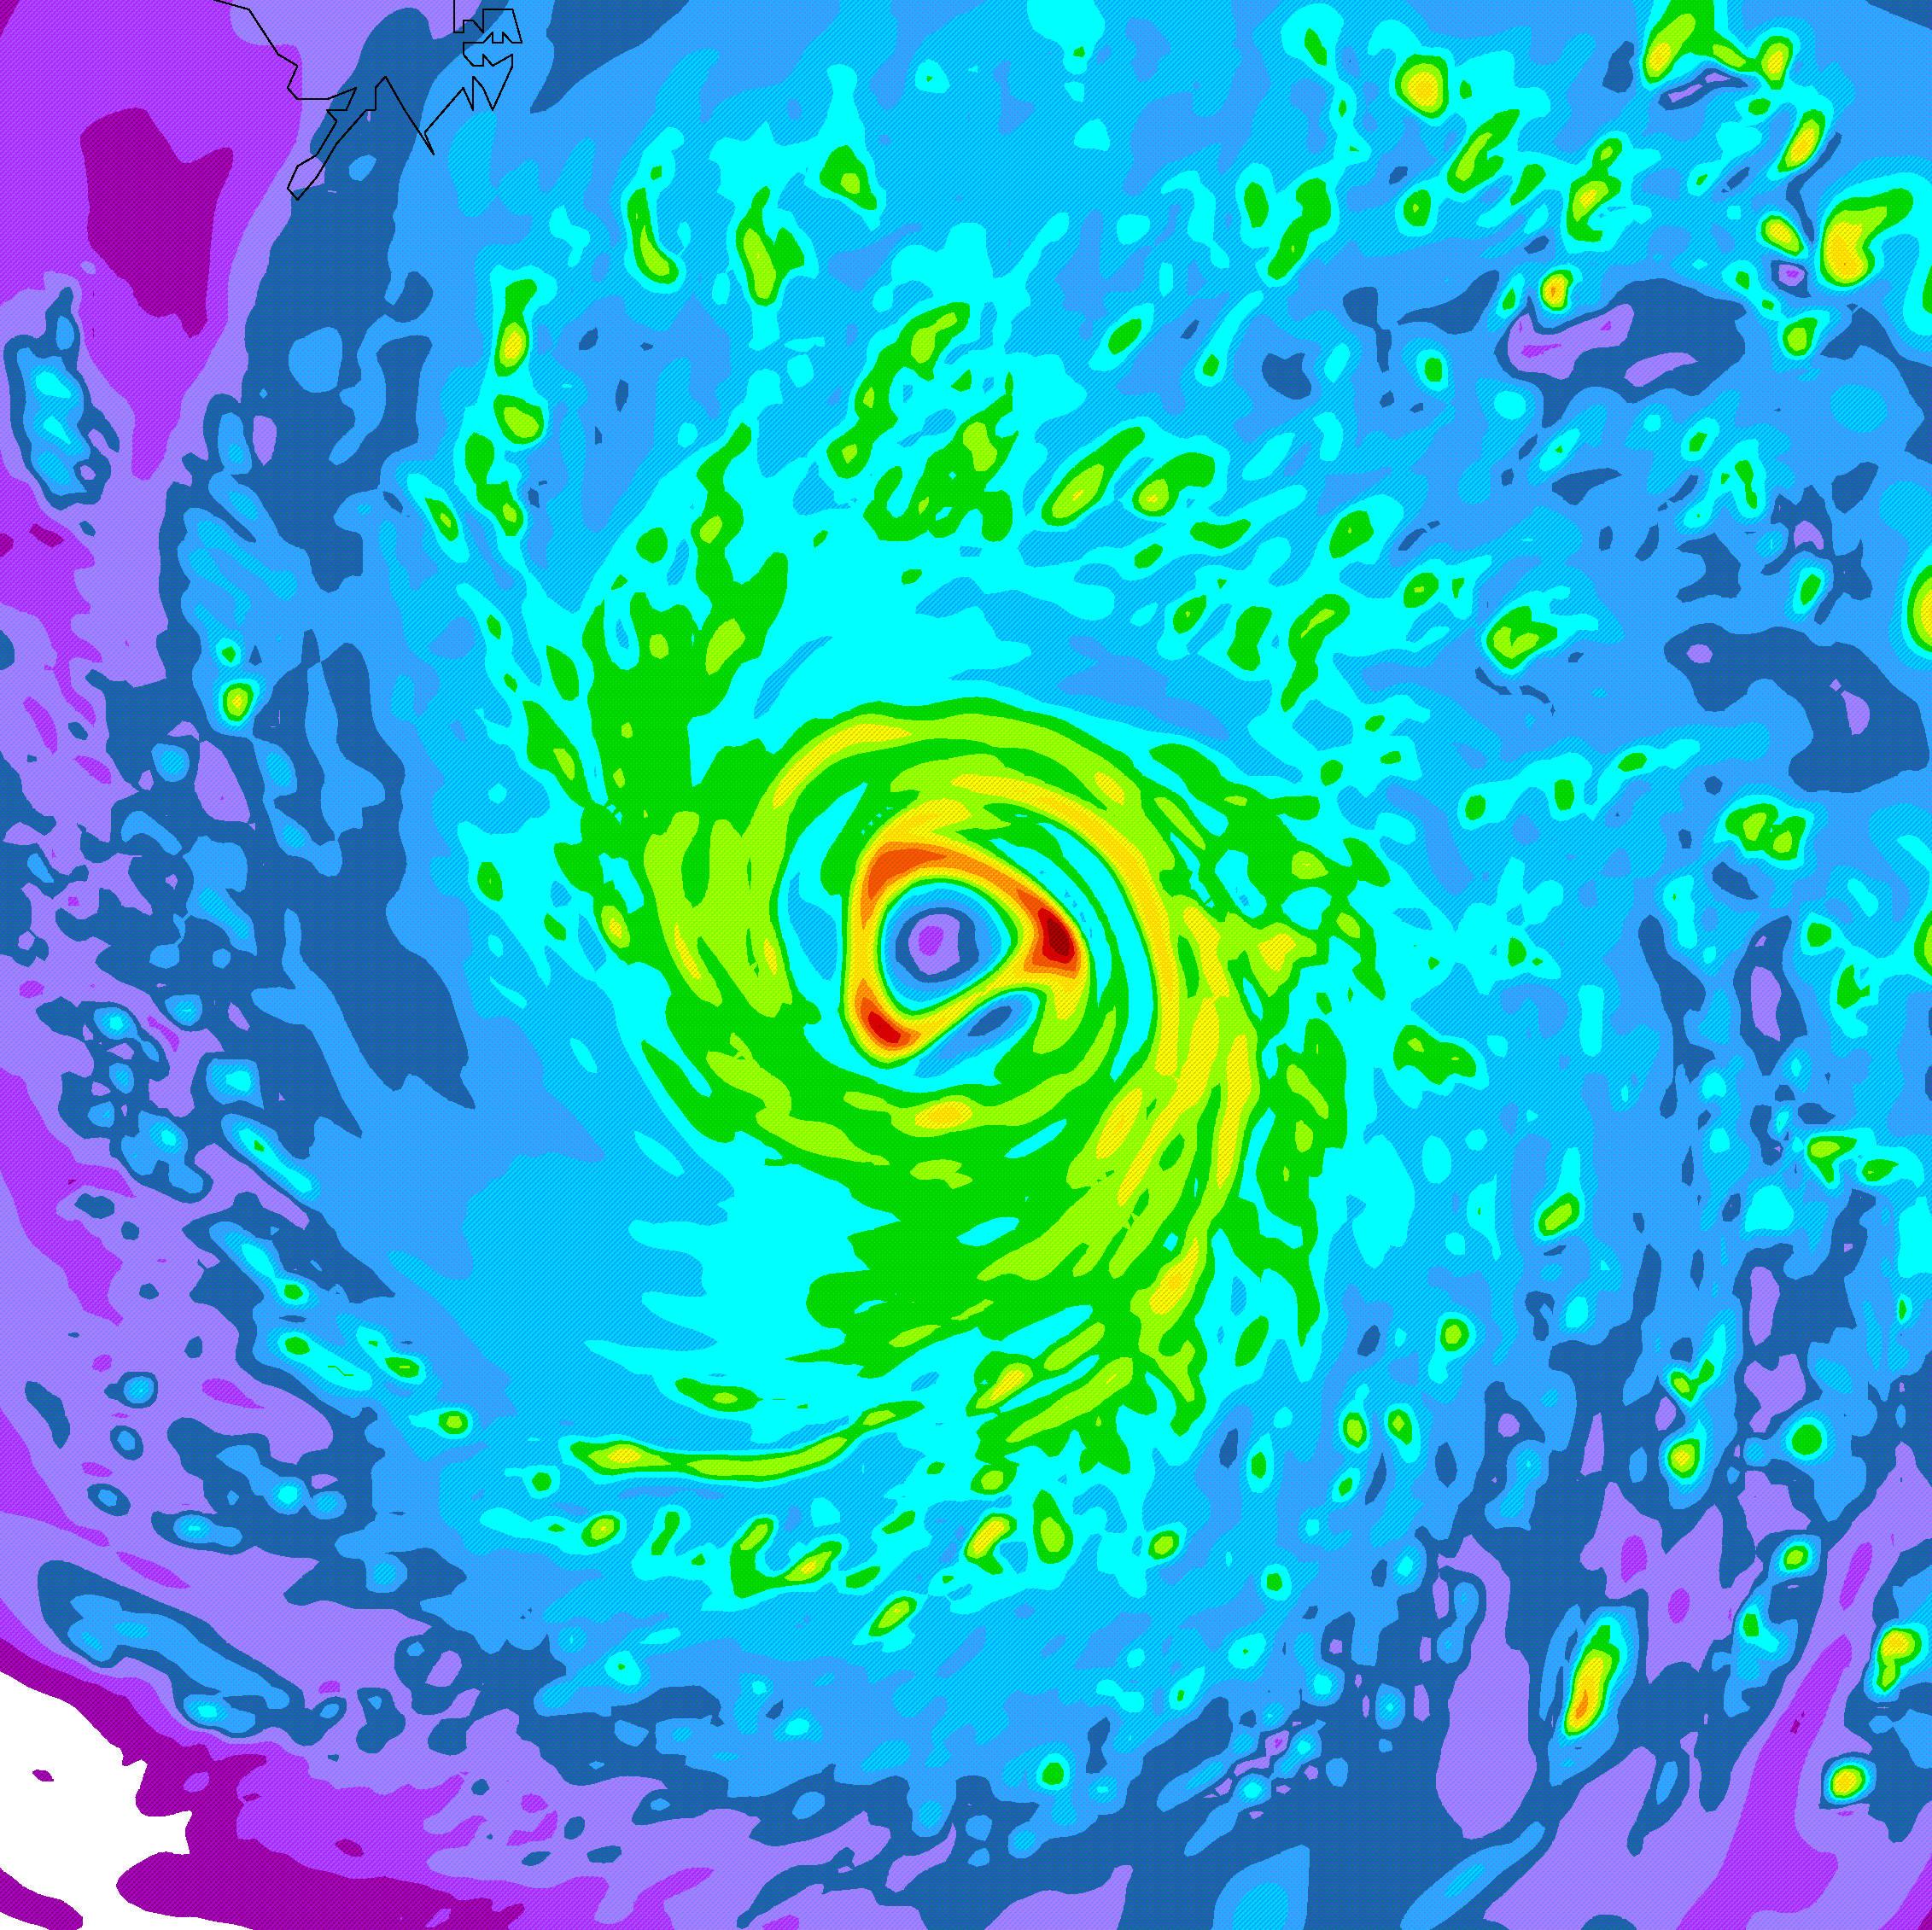
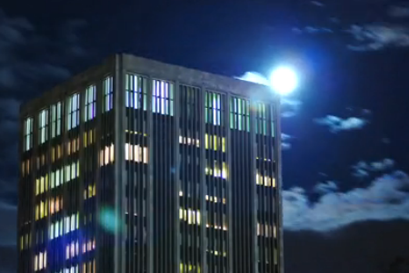
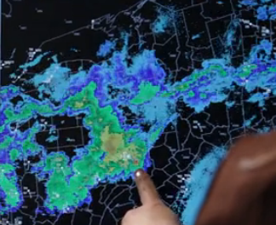
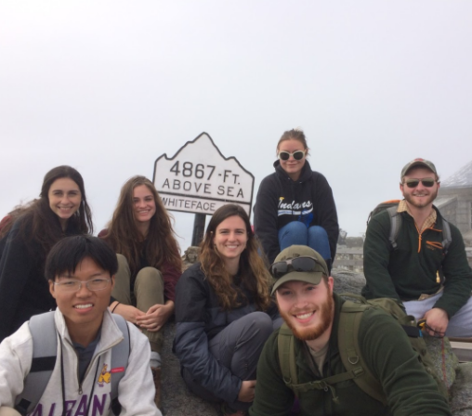
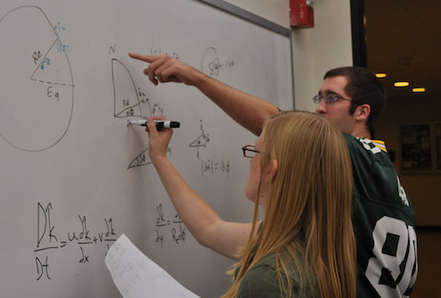
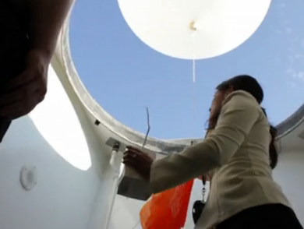
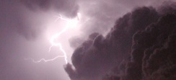
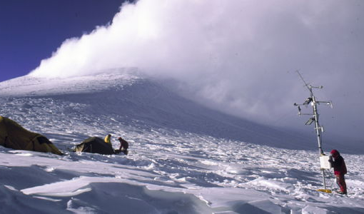
Department of
Atmospheric & Environmental Sciences
DAES
Main Office:
Earth Science (ES) 351
Phone: (518) 442-4556
Web: http://www.albany.edu/atmos/
Notes:
Intro
Welcome & congrats
Great community. World-class education at state-school cost

Slide 2
20 faculty in DAES
16 faculty in ASRC
B.S. in Atmospheric Sciences Meteorology
B.S. in Environmental Sciences
Notes:
Nature of degrees

Slide 3
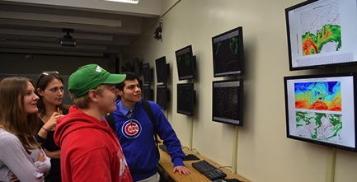
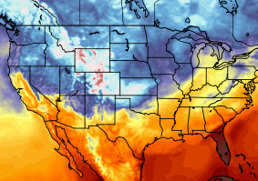
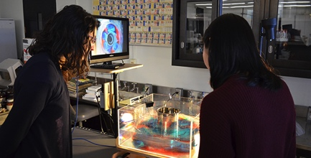
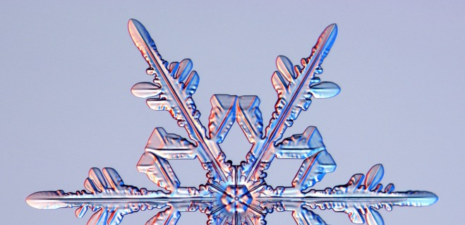
B.S. in Atmospheric Science
Broad foundation in four fundamental areas:
Synoptic
Observations and weather forecasting
Dynamic
Theory and computer modeling
Physical
Clouds and atmospheric chemistry
Climate
Land-ocean-atmosphere processes
Notes:
The bachelor of science degree in atmospheric science prepares our students in 3 fundamental areas: synoptic meteorology(how weather observations are collected, how do we forecast weather in to the future); dynamic meteorology (the physics which govern the atmosphere, how those physics are handled in computer models to make forecasts); physical meteorology (how clouds and precipitation form, how air pollution forms, why the ozone layer exists)

Slide 4
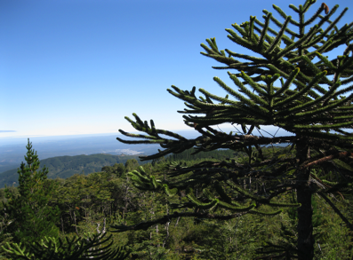
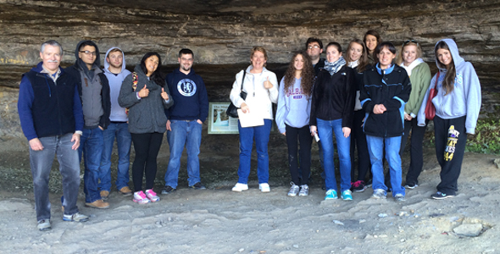
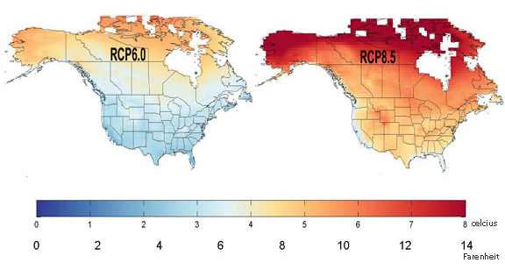
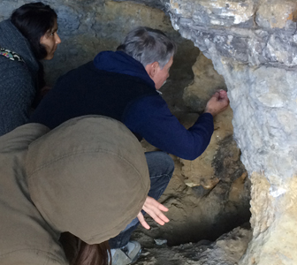
B.S. in Environmental Science
Core environmental fundamentals + four specializations:
Climate Change: long-term variability and change
Ecosystems: ecology, biodiversity, sustainability
Geography: land-use planning, resource management, GIS
Sustainability Science and Policy
Also available:
Sustainability Minor
Geographic information systems (GIS) certificate
Notes:
The bachelor of science degree in environmental science prepares our students in the core environmental issues of how humans interact with the environment around us and the use of natural resources. Our majors choose one of three concentrations: climate (what control variability of Earth’s climate (like El Nino), how climate has changed in the past and how it will change in future); biology (ecology and sustainability, which is becoming an increasingly bigger issue); geography (land-use planning and geographical information systems, how do we plan in a smarter way to minimize costs and impacts to the environment)

Slide 5
B.S. in Atmospheric Science
B.S. in Environmental Science
Key attributes of curriculum:
Firm foundation in science
Firm connections to applications & society
Small class sizes
Professors are available and interested
Professors are active leading researchers
Hands on learning: computing, labs, field
Internship & research opportunities

Slide 6
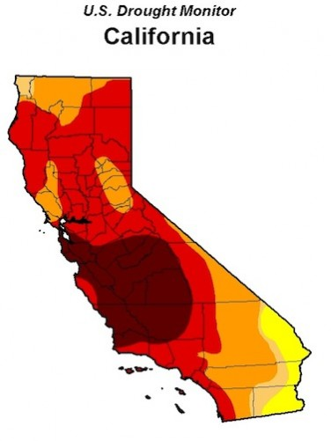
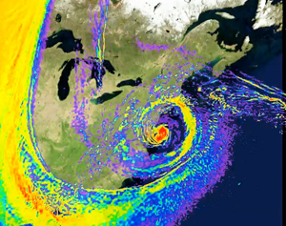
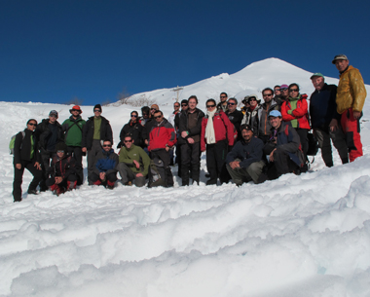
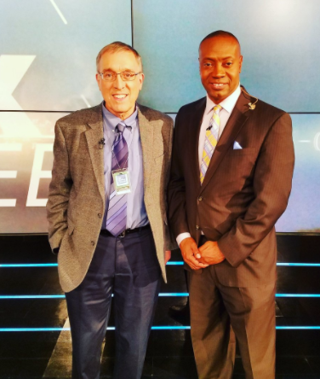
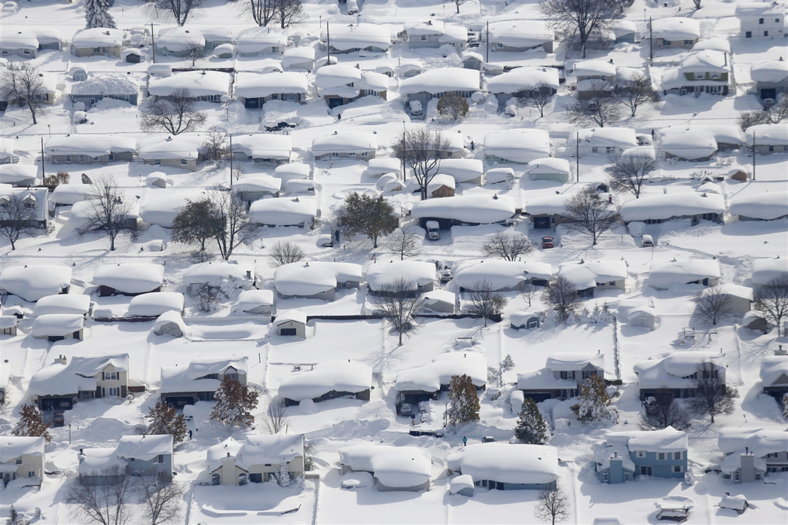
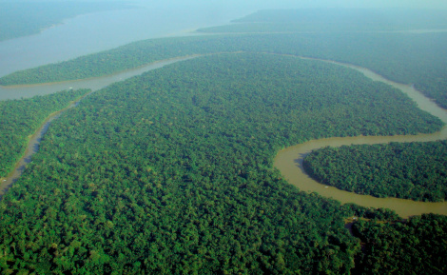
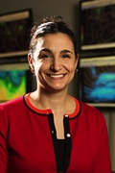
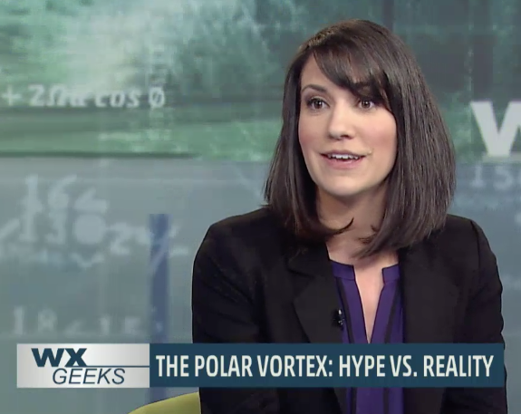
Leaders in atmospheric and environmental research (and teaching!)
20 faculty
$2-4M/yr in research funding
drought
South American glaciers and climate
The Weather Channel
SANDY
MSNBC
Lake-effect snow
Congo rainforest “browning”
Polar vortex
3 American Meteorology Society teaching award winners on faculty. More than any other department in the US!!
Notes:
Another big asset to the students is that their professors are all leaders in atmospheric and environmental research. This allows for hot off the press, topical items to make it in to the classroom. For instance, this time last year, I was using data from Hurricane Sandy in my own class to challenge students to analyze the system and appreciate how unusual the storm was, using knowledge from the class and previous classes. This also allows us to offer an wide array of unique classes.

Slide 7
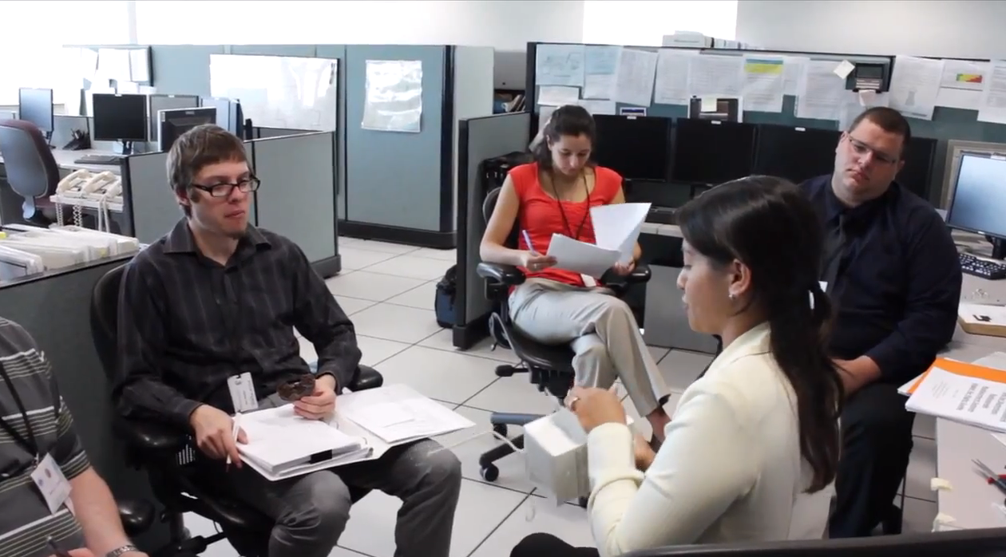
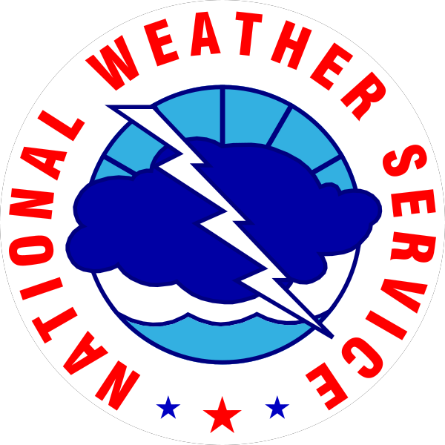
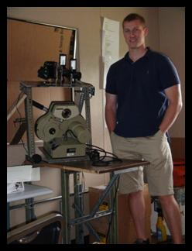
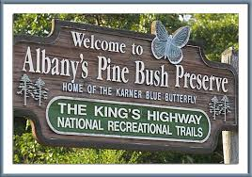
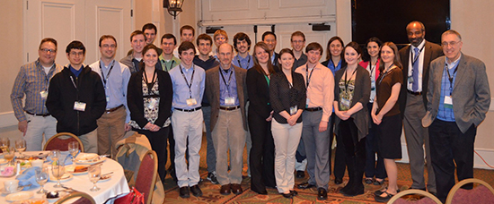
Hands-on research, internships and student involvement
Notes:
This also allows for opportunities from hands-on research and internships. Internships with the National Weather Service, which is located very near campus. Some undergraduates even get to go out into the field. This particular example was from a lightning study, showing one of our recent undergraduates standing by some of the photography equipment.

Slide 8
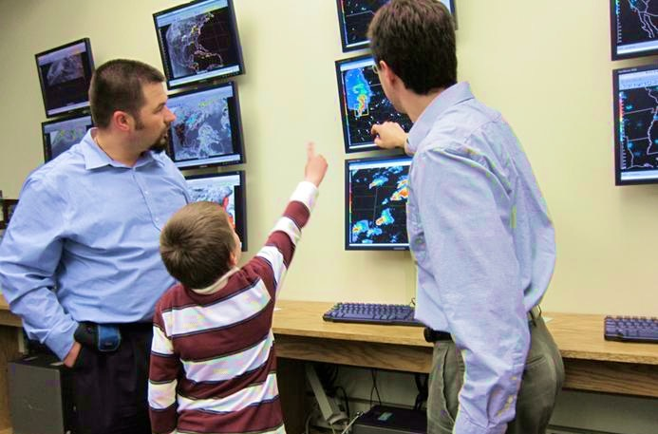
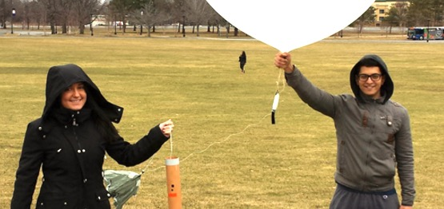
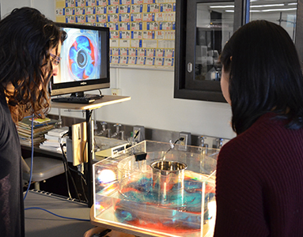
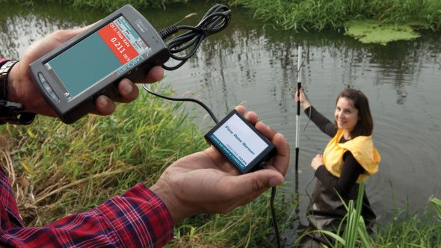
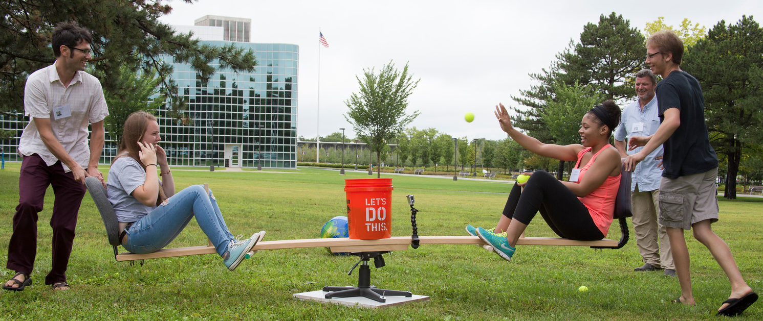
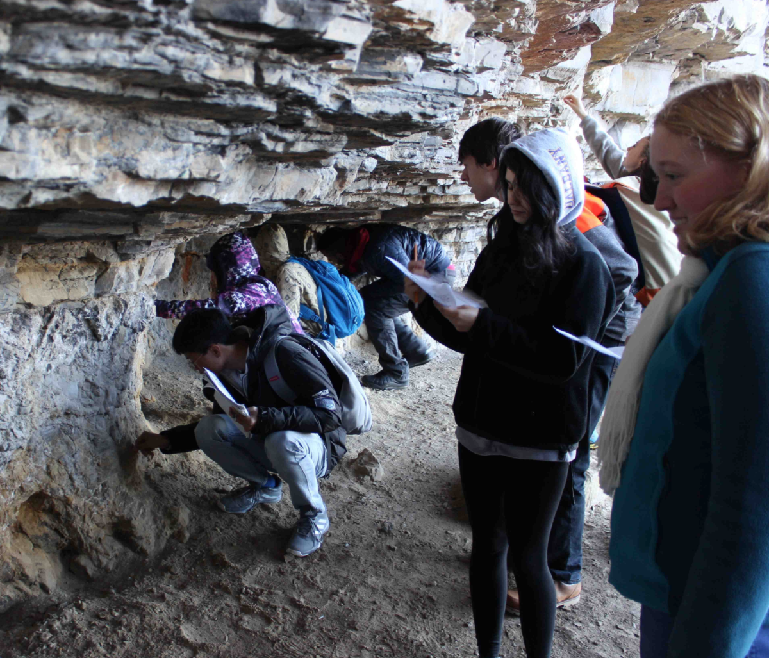
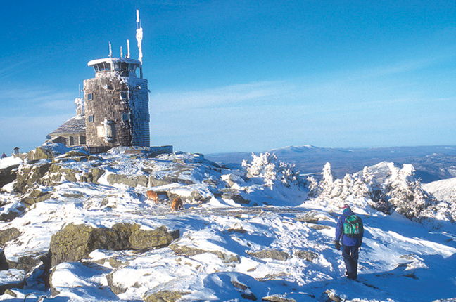
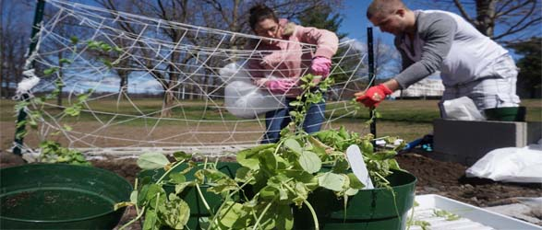
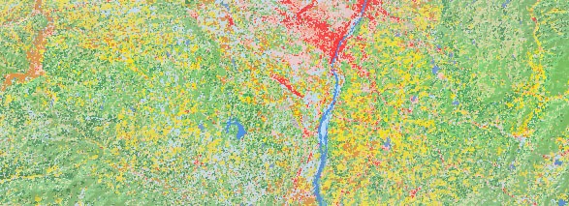
Instrumentation
Fluid dynamics lab
Whiteface Mt
observatory
Student Groups
Field Trips
Environmental Data
Notes:
We have an array of state-of-art resources within the department. The first is our electronic map room, which is an interactive wall of maps that can be displayed from satellite images, to radar, to student-generated products that allow one to analyze the atmosphere and environment. The second is the Whiteface observatory, where real-time measurements of the atmosphere, from its chemistry to clouds is collected for analysis. We just had a group of undergraduates visit the observatory a couple weeks ago.

Slide 9
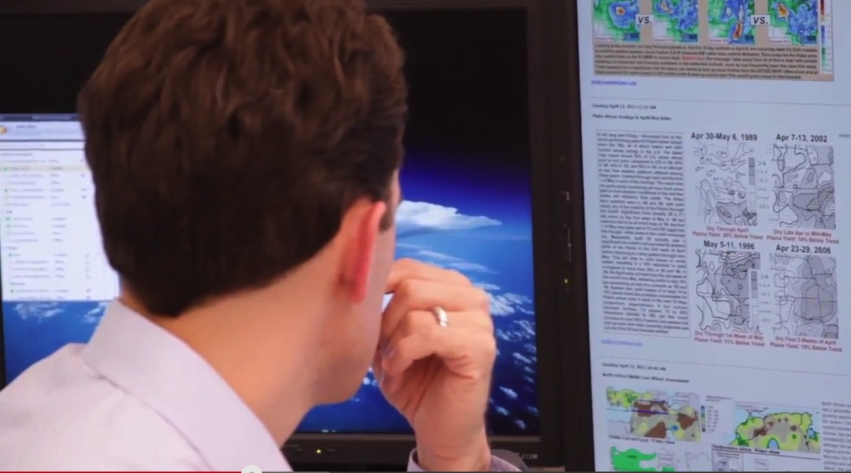
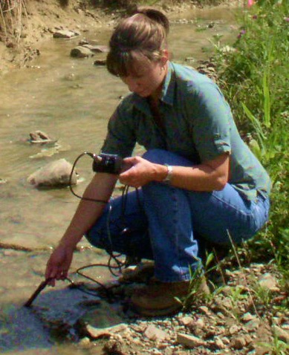
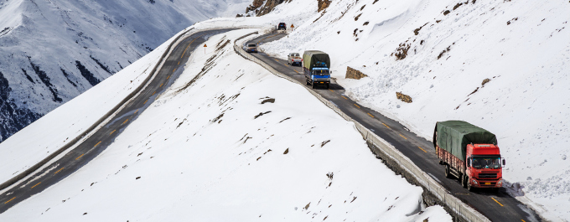
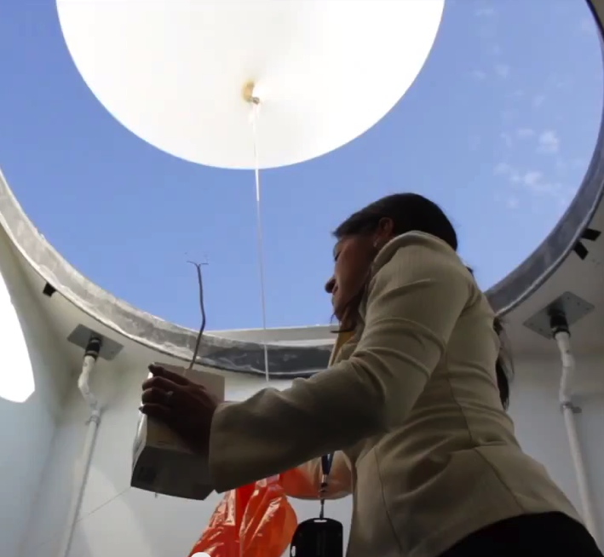
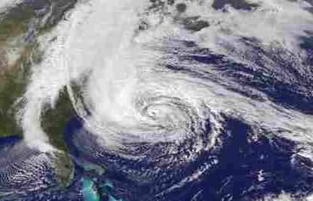
Demand for atmospheric and environmental scientists
in a variety of fields
Academics
Consulting
Economics
Education
Forensics
Government
Insurance
Media
Planning
Research
Transportation
Notes:
What can I do with an atmospheric science of environment science degree and the answer is that there is a demand for atmospheric and environmental scientists in a variety of fields: consulting, insurance, transportation, research, planning, economics, education, media, forensics, and government.

Slide 10
Where some of our recent graduates are now:
Graduate school
National Weather Service
United States Geological Survey
US & NY Environmental Protection
Renewable energy companies
The Weather Channel
New York State Mesonet
Environmental Consulting
Emergency Preparedness
Risk assessment in Insurance/Financial sectors

Slide 11
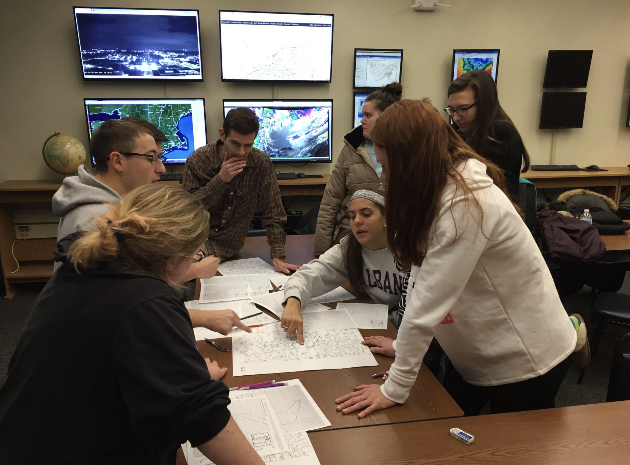

Slide 12
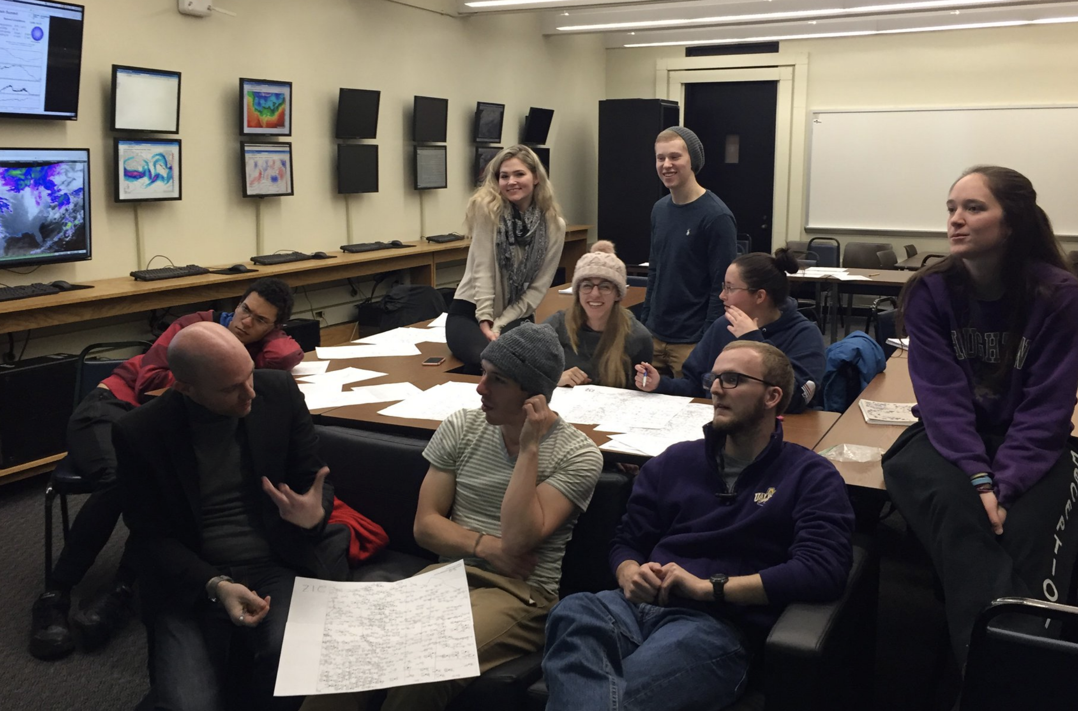

Slide 13
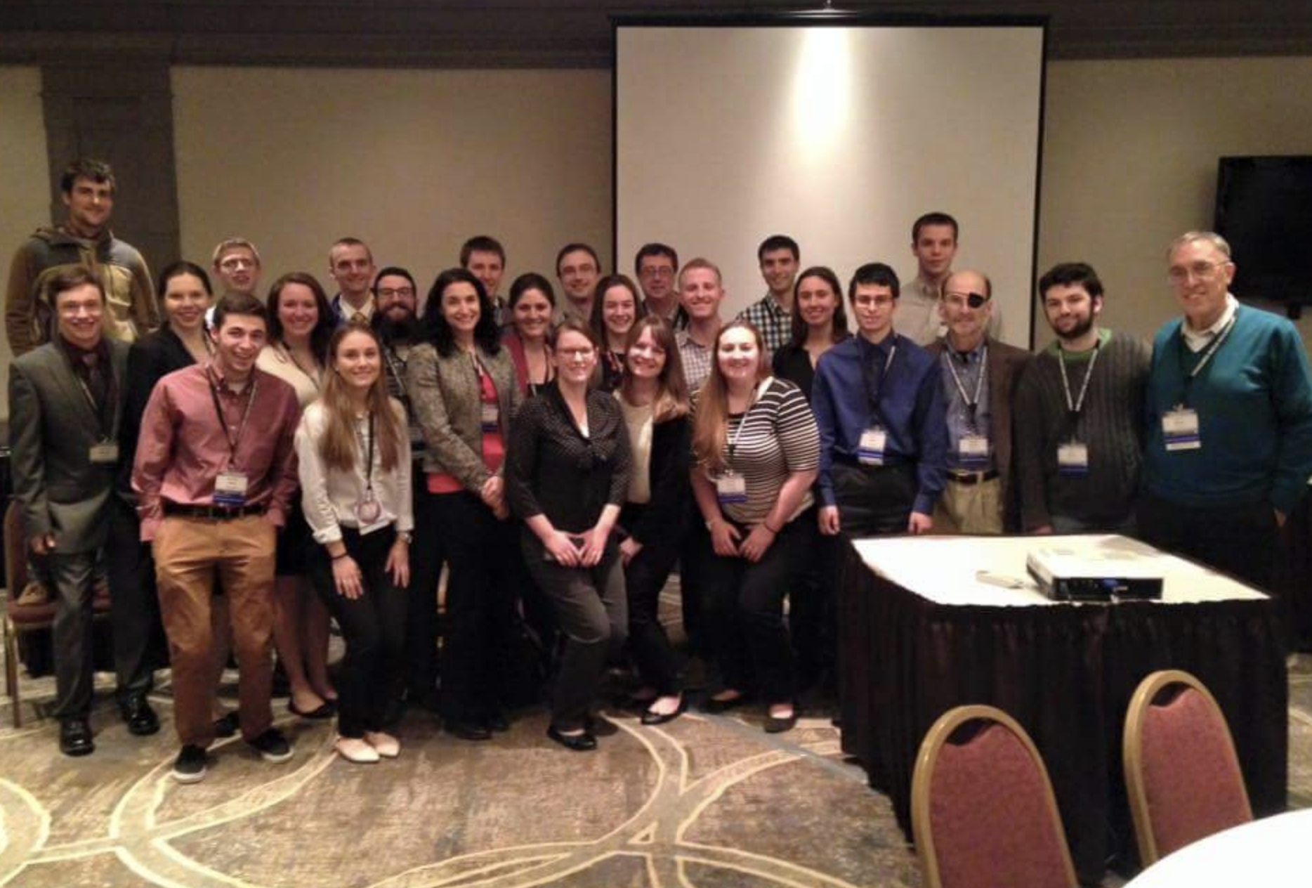

Slide 14
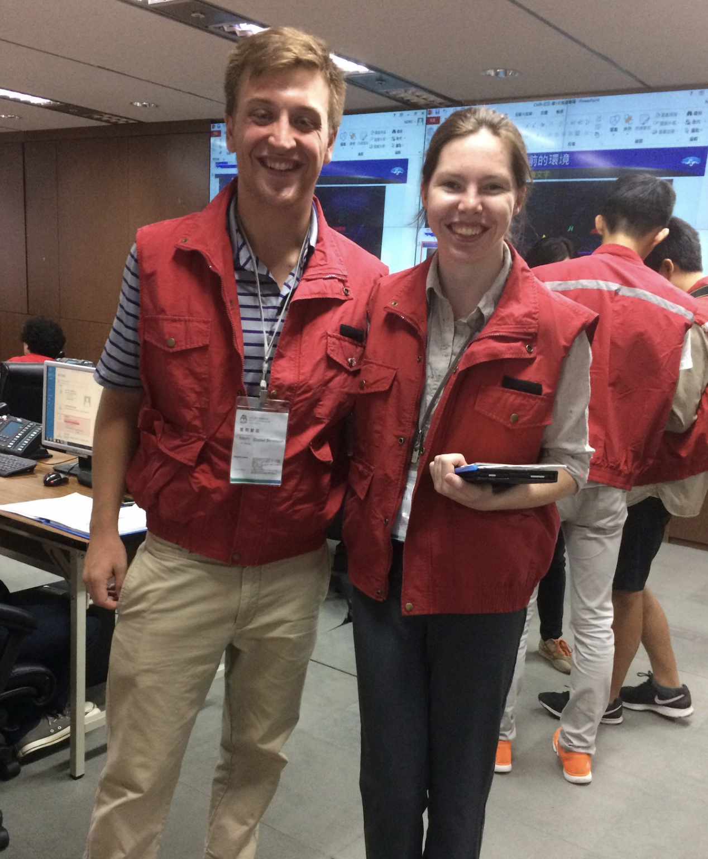

Slide 16
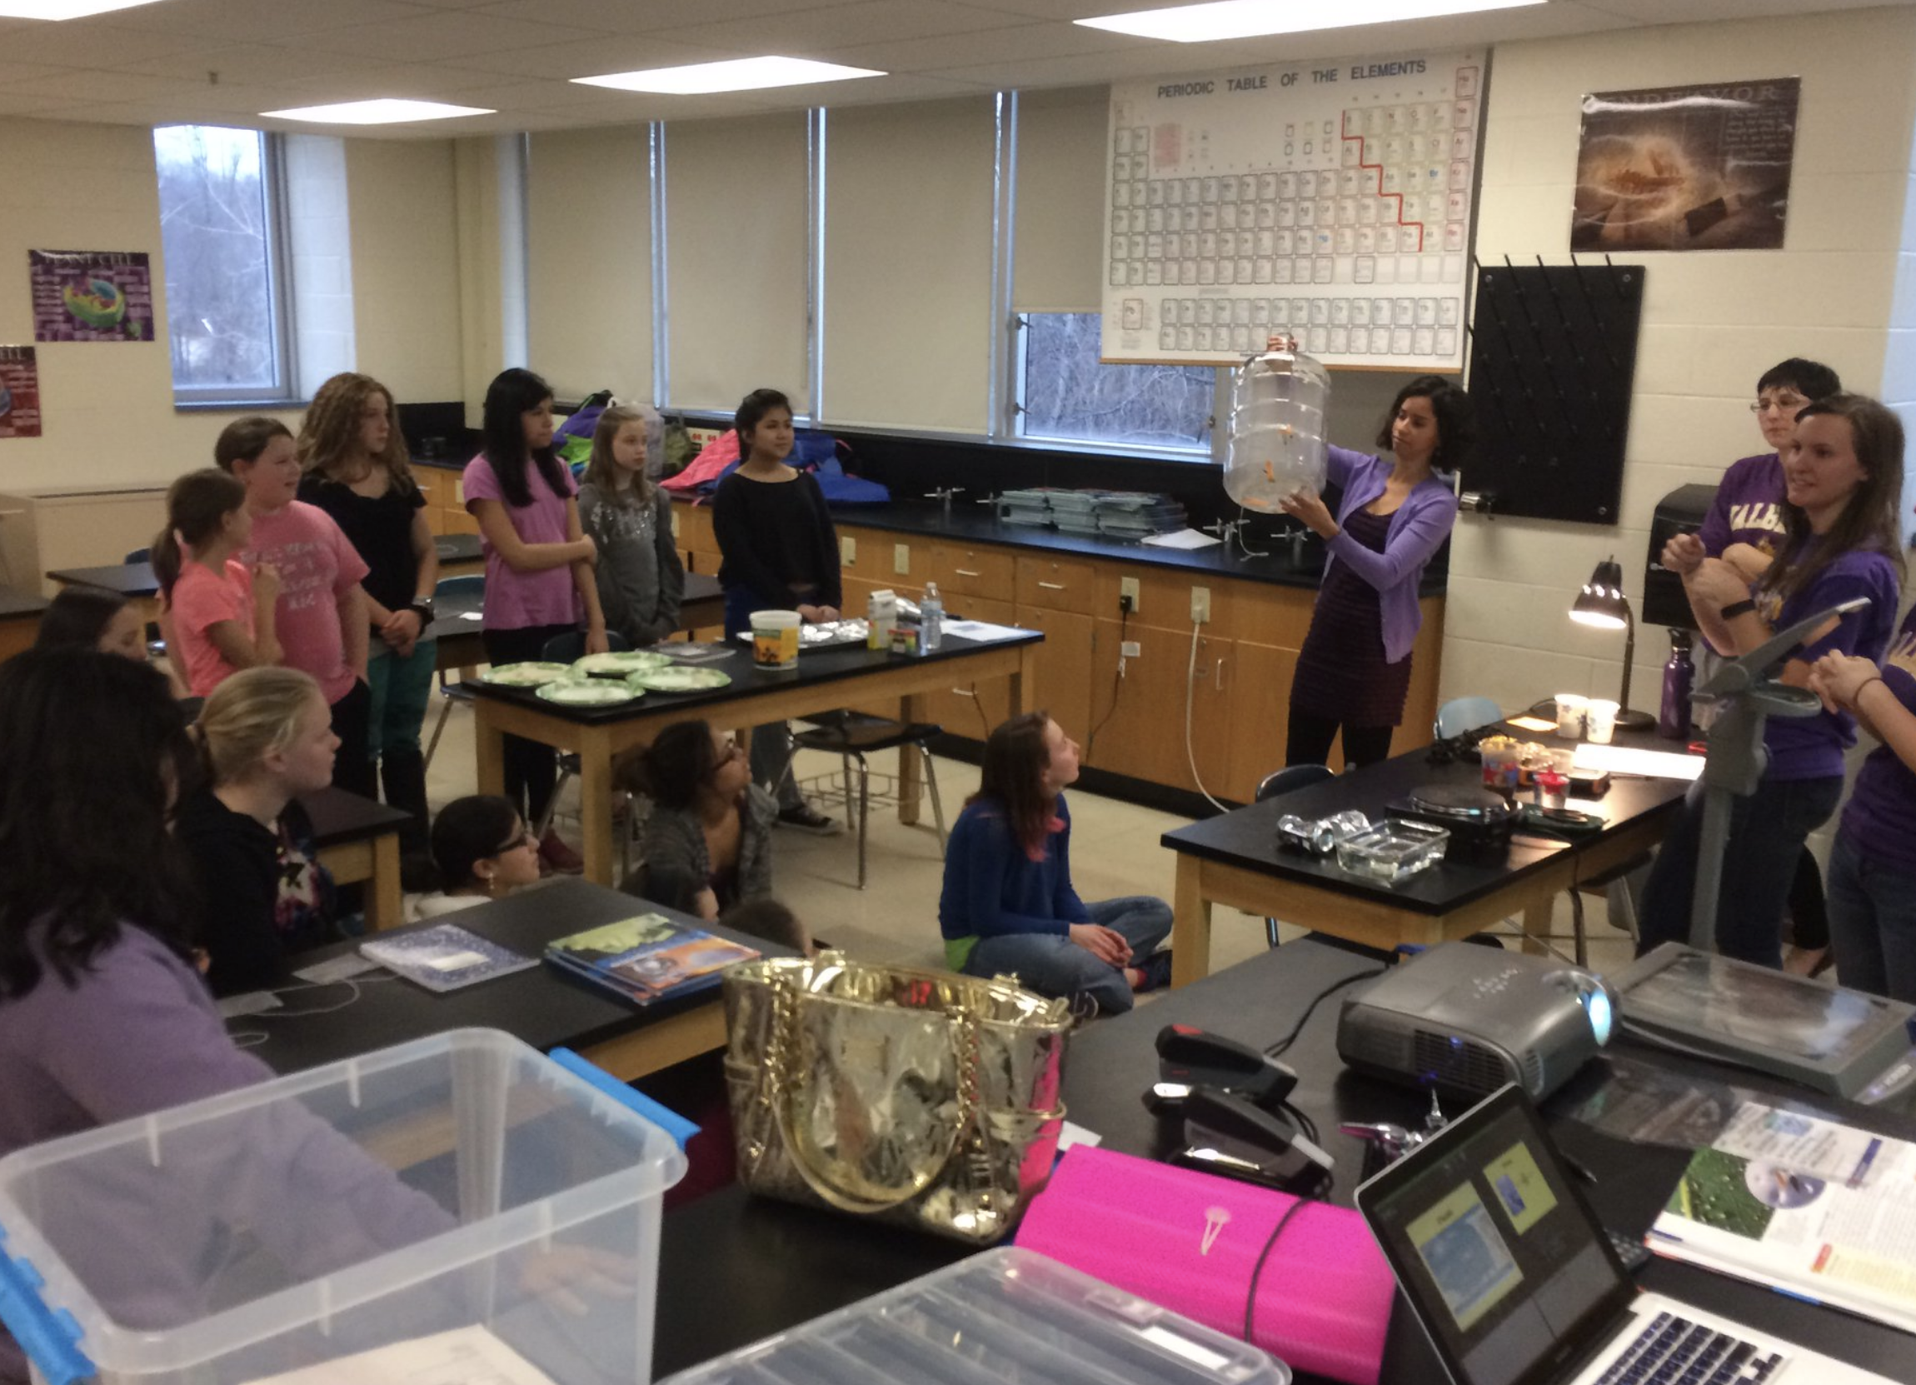

Slide 17
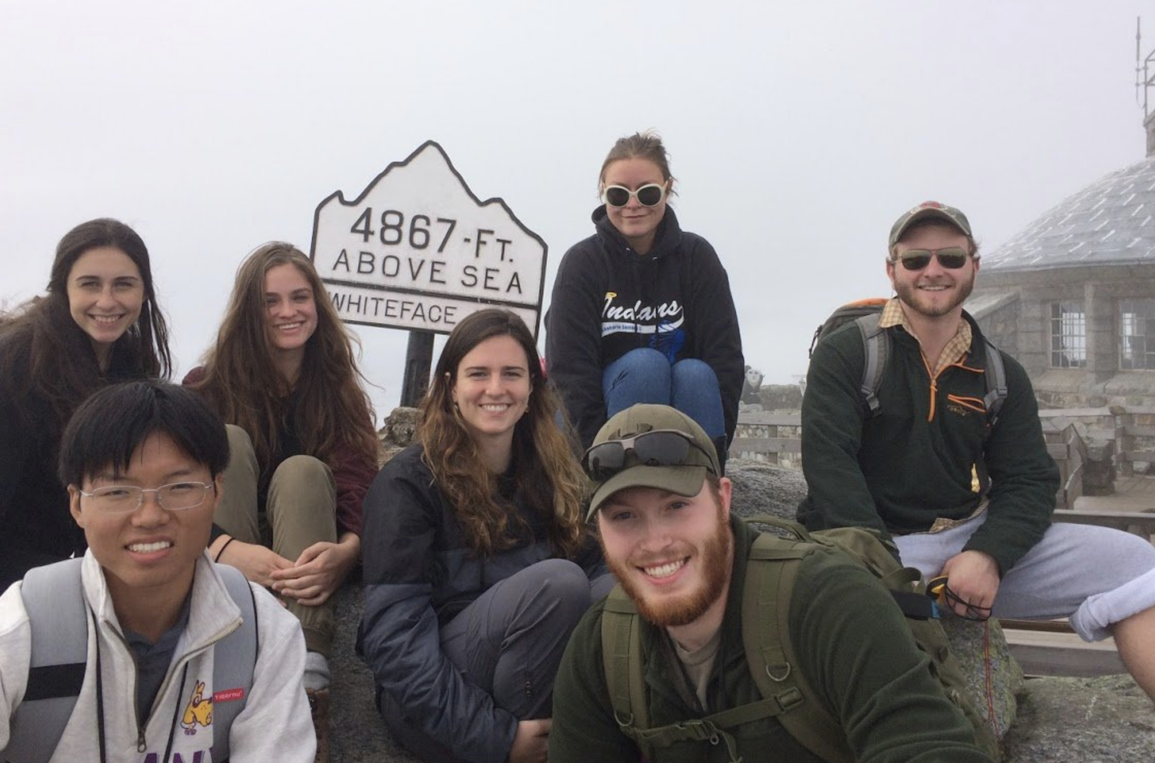

Slide 18
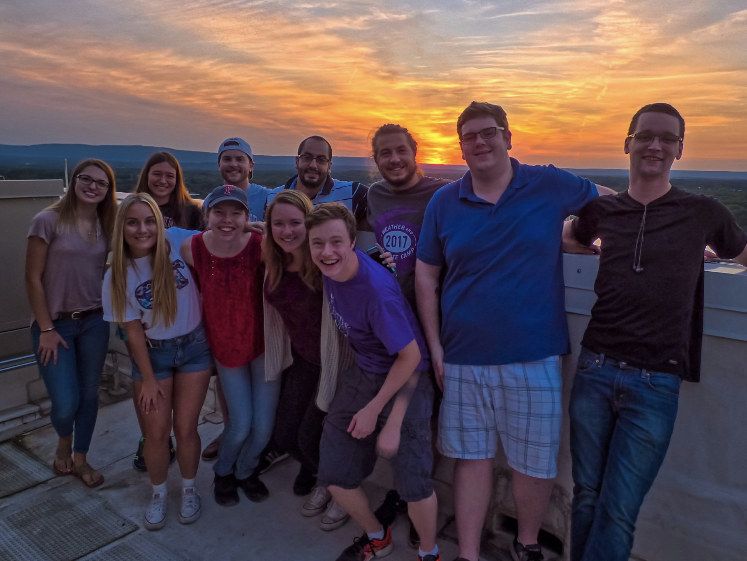

Slide 22
Atmospheric & Environmental Sciences
Affects us all
Dynamic
Interdisciplinary
Impactful
Marketable
Come join us!
University at Albany
Atmospheric and Environmental Sciences
Notes:
In conclusion, why decide to major in atmospheric or environmental science? It’s dynamic: the atmosphere is always changing and always surprising us. It’s electic: you learn some of everything: math, physics, chemistry, biology. It’s challenging: we are here to challenge your students to think and apply themselves so they can succeed in the world to solve challenging problems. It’s impactful: weather and environmental issues are billions of dollars in the GDP. It’s desired: businesses and society desires expertise in this area and job/salary prospects are good as a result

Slide 25
Degree Requirements for the Major in Atmospheric Science
General Program B.S.:
A minimum of 66 credits for the combined major and minor
including: A ATM 209, 210, 211, 316, 317, 320, 350, 418, 425; at least 12 additional credits from A ATM 301 and higher level courses (excluding A ATM 304) and including one of A ATM 311 and 405; A CHM 120 or 130 or T CHM 130; A MAT 111 or 112 or 118 or T MAT 118; A MAT 113 or 119 or T MAT 119; A MAT 214, 311; A PHY 140 or 141 or T PHY 141; A PHY 145; A PHY 150 or 151 or T PHY 151; A PHY 240.
No more than 6 credits from A ATM 490, 497, 498 or 499 may be applied toward the major requirements; further, a maximum of 3 credits from A ATM 490 will apply.

Slide 26
General Program B.S.:
A minimum of 65 credits for the combined major and minor including: A ATM 210, A ATM/A ENV 315, 327, A BIO 120, A CHM 120 or 130 or T CHM 130, A CHM 121 or 131 or T CHM 131, A ENV/A GEO/A GOG 201, A ENV 250, 490, A GEO 221, A MAT 111 or 112 or 118 or T MAT 118, A MAT 113 or 119 or T MAT 119, A PHY 140 or 141 or T PHY 141, A PHY 150 or 151 or T PHY 151; the completion of one of three 21-credit specializations.
Degree Requirements: Environmental Science
Ecosystems Specialization: 22 credits overall. Required courses (10 credits): A BIO 212, 327, 402. Elective courses (12 credits): A ANT 418, 419, A ATM 301, A BIO 308, 311, 321, 329, 343, 427, A ENV 250, 496, A GOG 496/A USP 456, R POS 266, R PAD 366, H SPH 321, H SPH/H EHS 323, H SPH 332. A maximum of 6 credits may be taken from R PAD 366, R POS 266, H SPH 321.
Climate Change Specialization: 21 credits overall. Required courses (12 credits): A ATM 306, 405, A ENV 415, 450. Elective courses (9 credits): A ATM 301, 304, 307, 335, 413, 414, A ENV 496, A MAT 113, R PAD 366, R POS 266, 399, H SPH 321. A maximum of 6 credits may be taken from R PAD 366, R POS 266, 399, H SPH 321.
Geography Specialization: 22 credits overall. Required courses (10 credits): A GOG/A USP 220, A GOG 290, A GOG 496/A USP 456. Elective courses (12 credits): at least 6 credits from A GOG 304, A GOG/A USP 330, A GOG 344, A GOG/A LCS 354, A GOG/A USP 375, A GOG 414, A GOG/A USP 430, 460, A GOG 484, 485; A ATM 301, 405, A ENV/A GEO 250, A ENV 496. (Selecting A GOG 414, 484, and 485 as electives completes the GIS Certificate.)
Sustainability Science and Policy Specialization: 21 credits overall. Required courses (9 credits): A ATM 304, A ENV/A GEO 250, R POS 399. Elective courses (12 credits): A ANT 418, A ATM 405, 413, A BIO 311, A ENV 496, A GOG/A USP 220, A GOG 344, A GOG/A USP 430, 460, A GOG 496 or A USP 456, R PAD 366, R POS 266, H SPH 321, H SPH/H EHS 323, H SPH 332.

