Slide 1
A Python-based Recipe for Weather and Climate
Reanalysis Visualization for the Science-on-a-Sphere
Kevin Tyle
Ross Lazear
Department of Atmospheric and Environmental Sciences
University at Albany
Albany, New York

Slide 2
Outline
• Department of Atmospheric and Environmental Science programs
• ETEC building at the University at Albany
• Programming, data analysis and visualization courses at UAlbany
• Exploration of reanalysis datasets
• Jupyter notebook for global reanalysis data for SOS

Slide 3
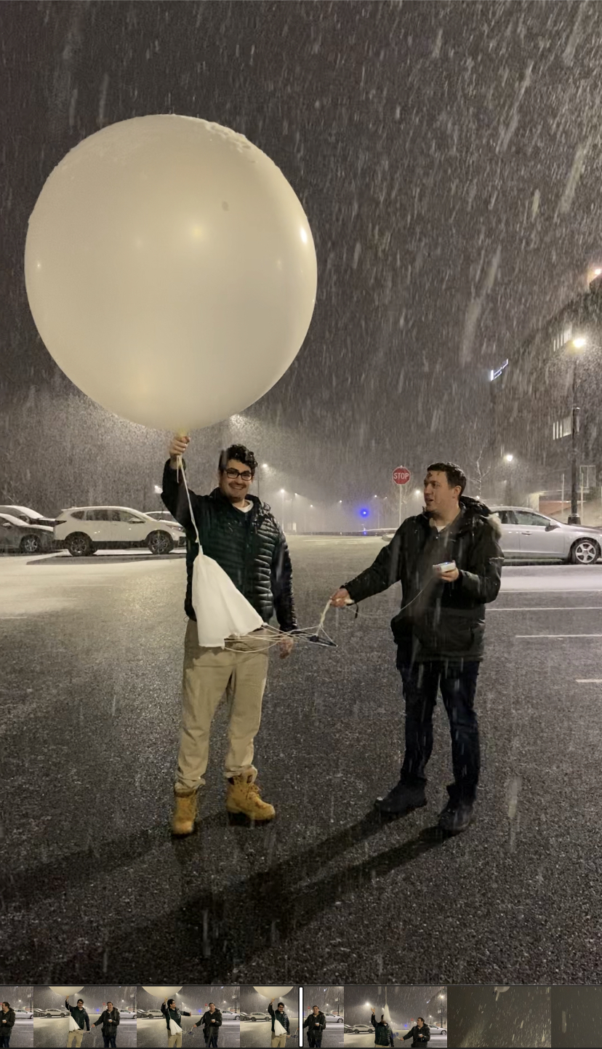
Department of Atmospheric and Environmental Sciences
• Bachelor’s Degrees in
-Atmospheric Science
-Environmental Science
-Climate Science
• Applied MS in Atmospheric Science
• MS in Atmospheric Science
• PhD in Atmospheric Science

Slide 4
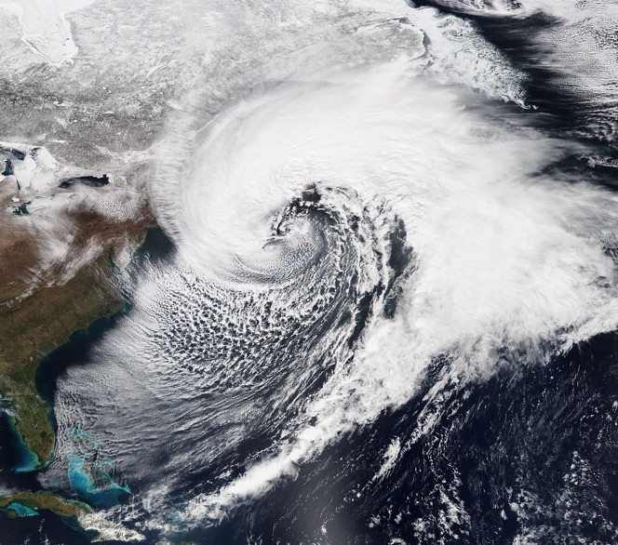
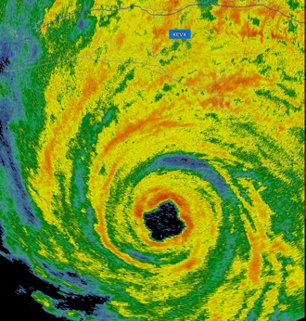
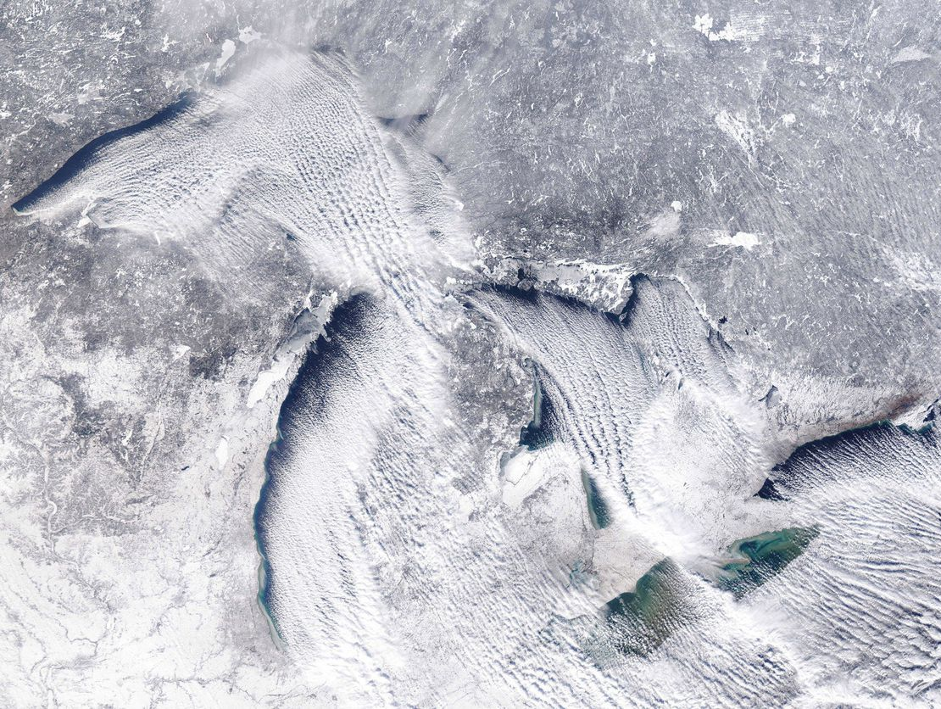
Department of Atmospheric and Environmental Sciences
Synoptic meteorology
Tropical meteorology
Mesoscale meteorology

Slide 5
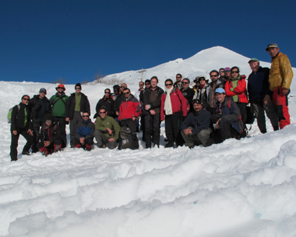
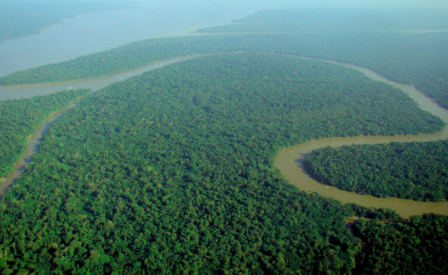
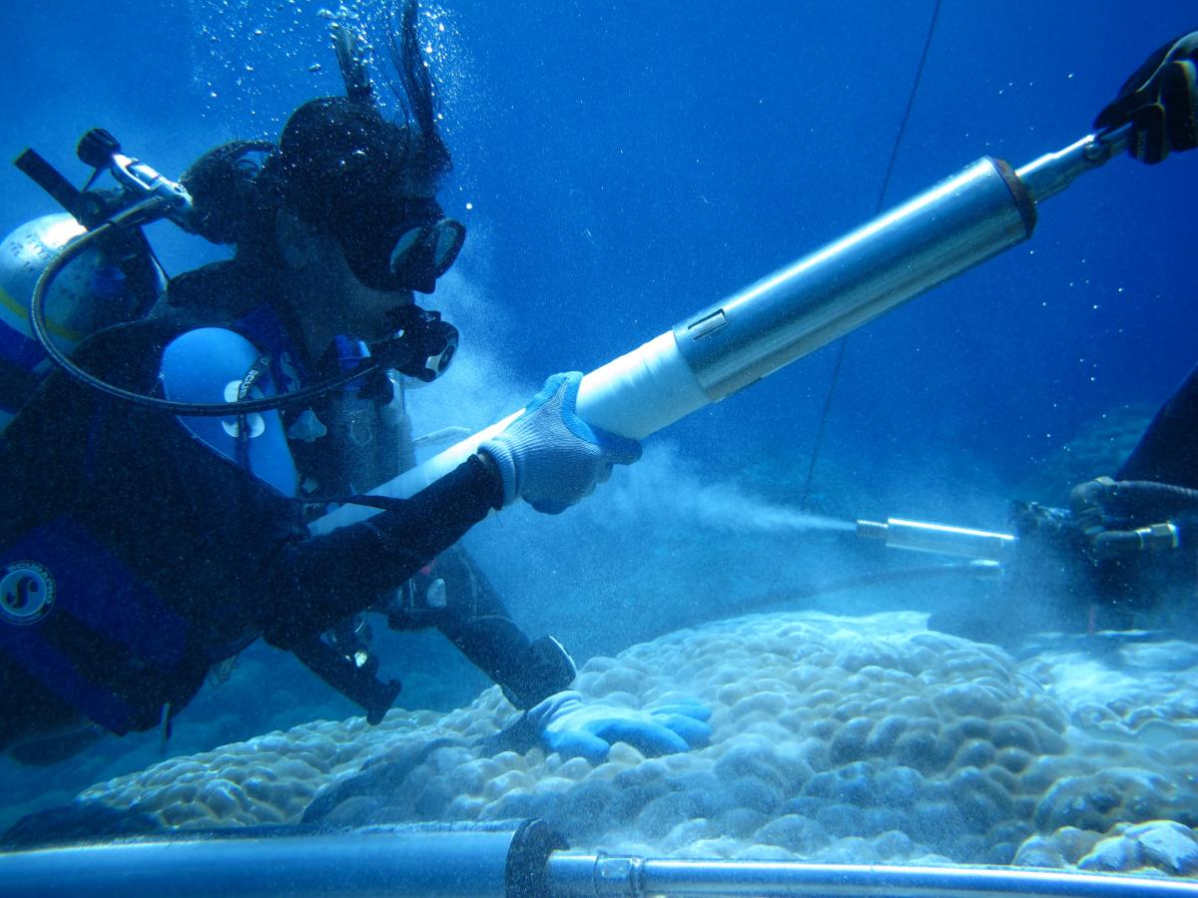
Department of Atmospheric and Environmental Sciences
Paleoclimatology
Climate change and variability
Climate modeling

Slide 6
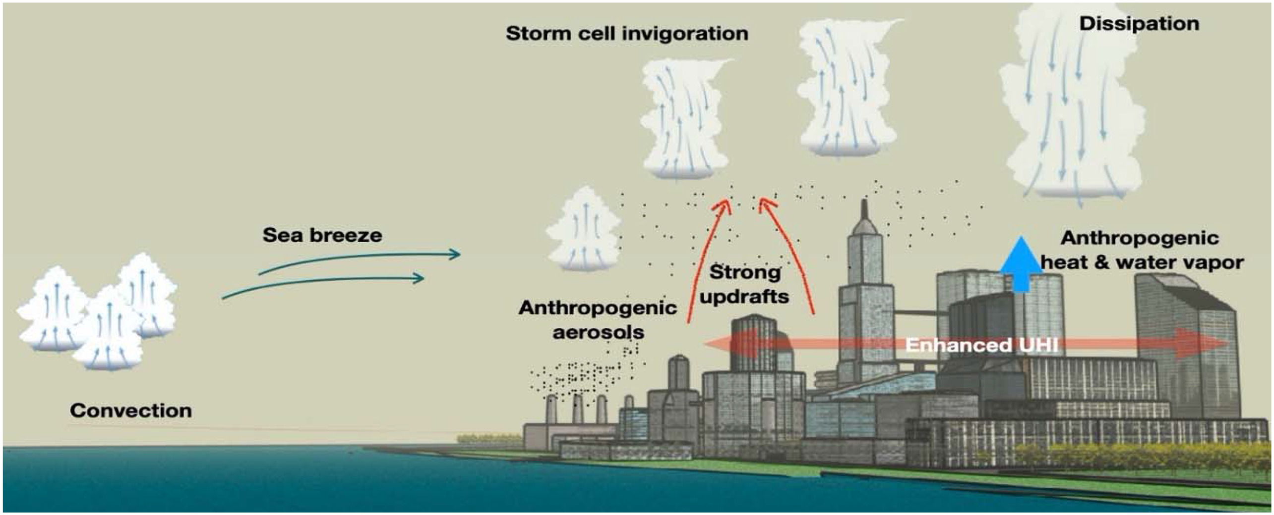
Atmospheric Sciences Research Center
Atmospheric chemistry and air pollution
Boundary layer meteorology
Urban meteorology
Solar and wind energy

Slide 7
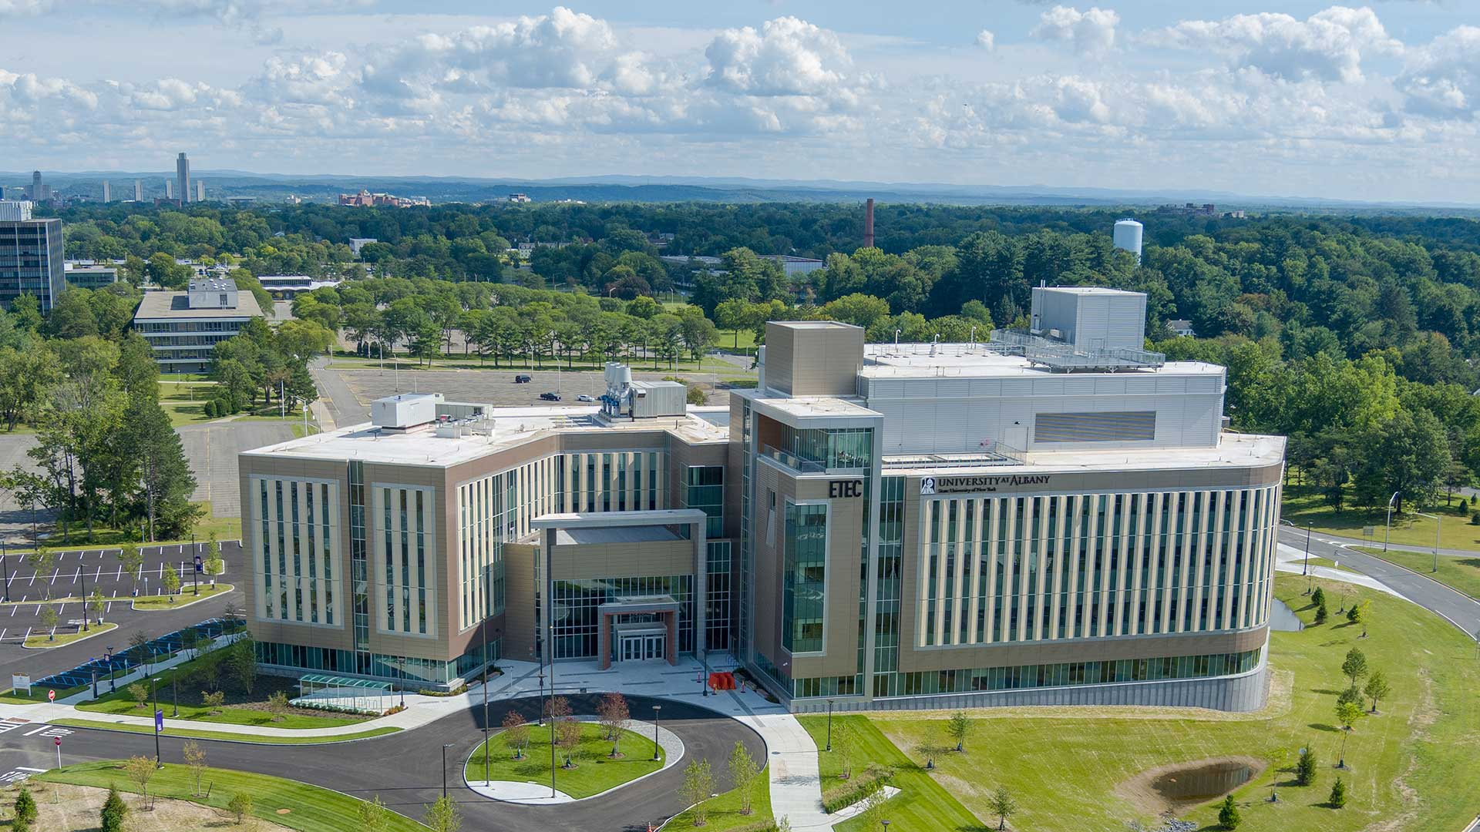
ETEC Building - UAlbany

Slide 8
ETEC Building - UAlbany
• Department of Atmospheric and Environmental Sciences
• Atmospheric Sciences Research Center
• National Weather Service – Albany WFO
• New York State Mesonet
• State Weather Risk Communication Center
• College of Emergency Preparedness, Homeland Security, and Cybersecurity
• Materials Chemistry
• Environmental and Sustainable Engineering

Slide 9
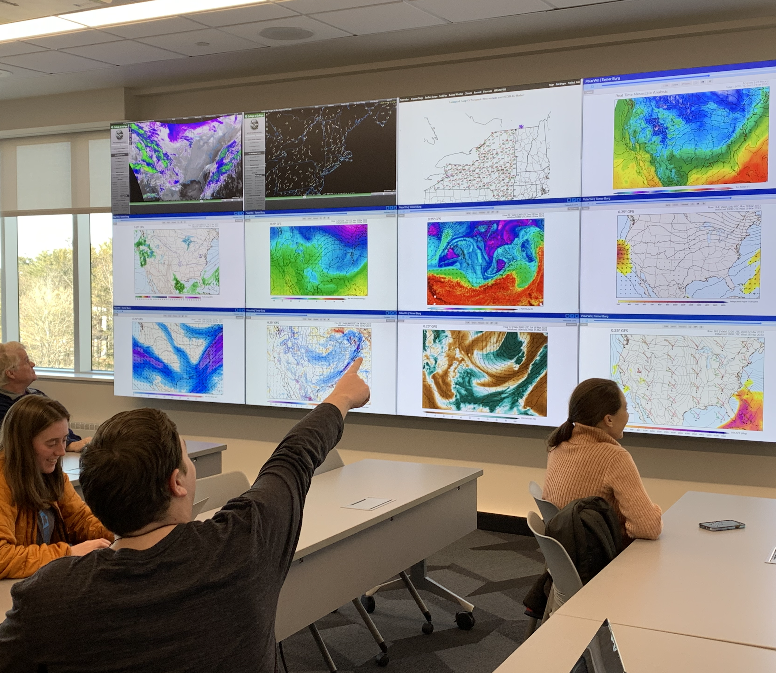
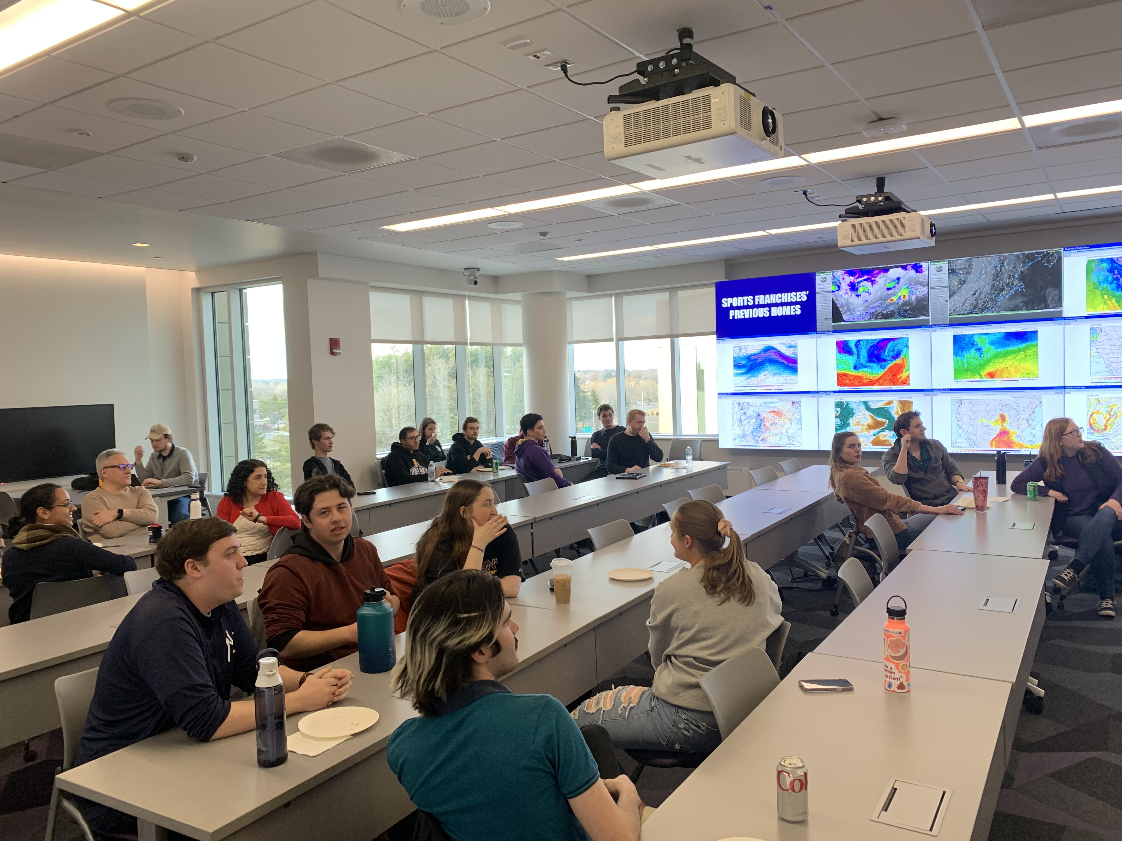
ETEC Building - UAlbany
Weather Map Room

Slide 10
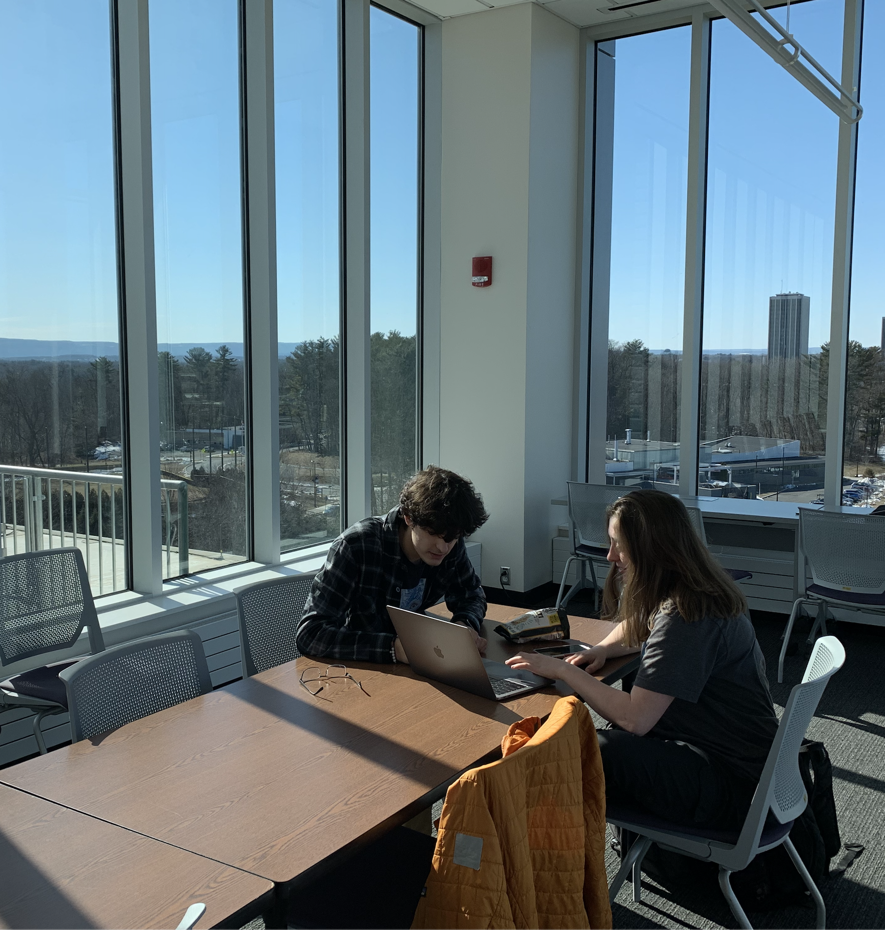

ETEC Building - UAlbany
Views of the Catskills
Weather observation deck

Slide 11
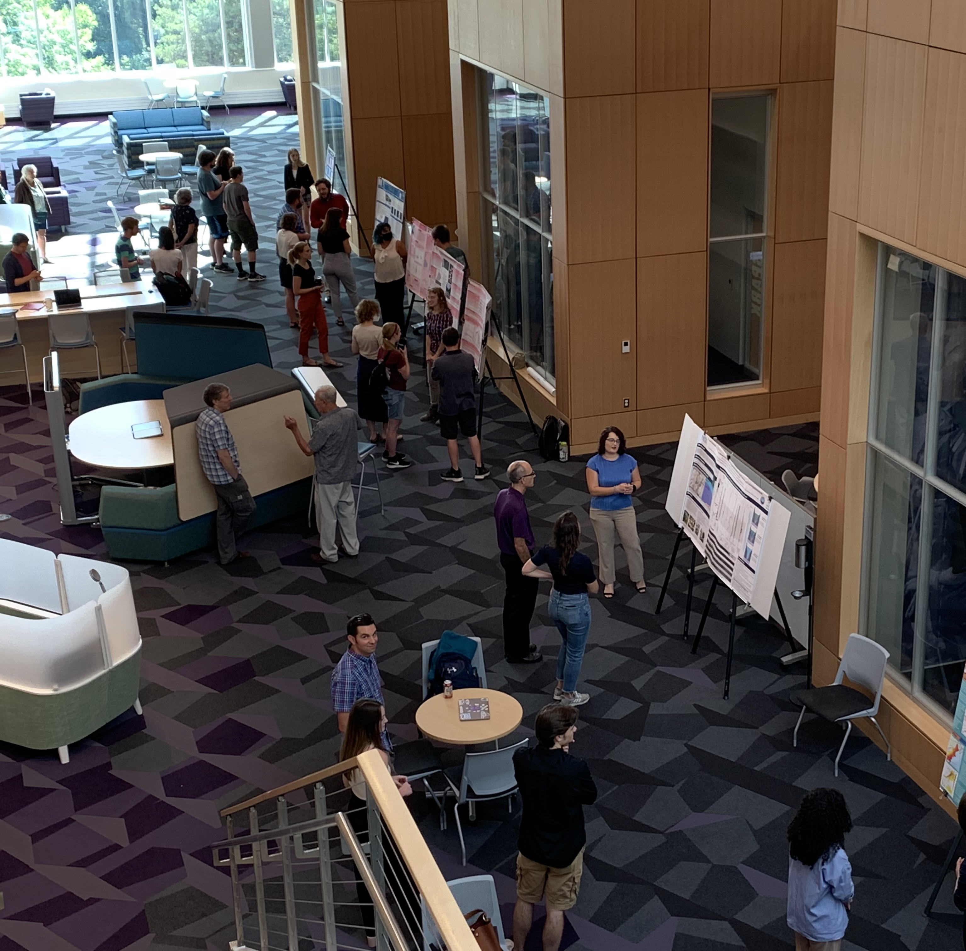
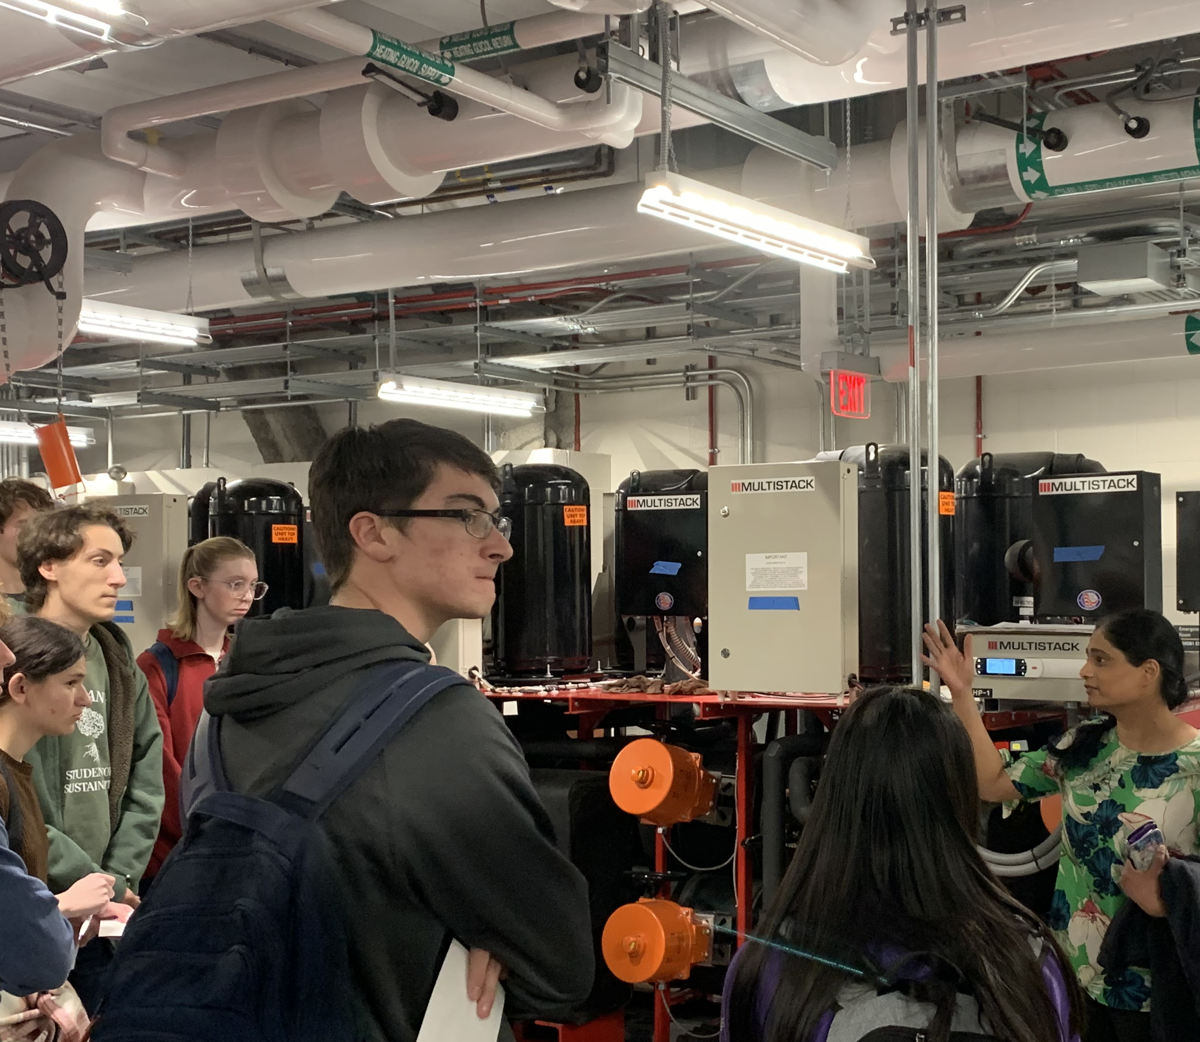
ETEC Building - UAlbany
First-year students touring geothermal system
“Collaboratorium”

Slide 12
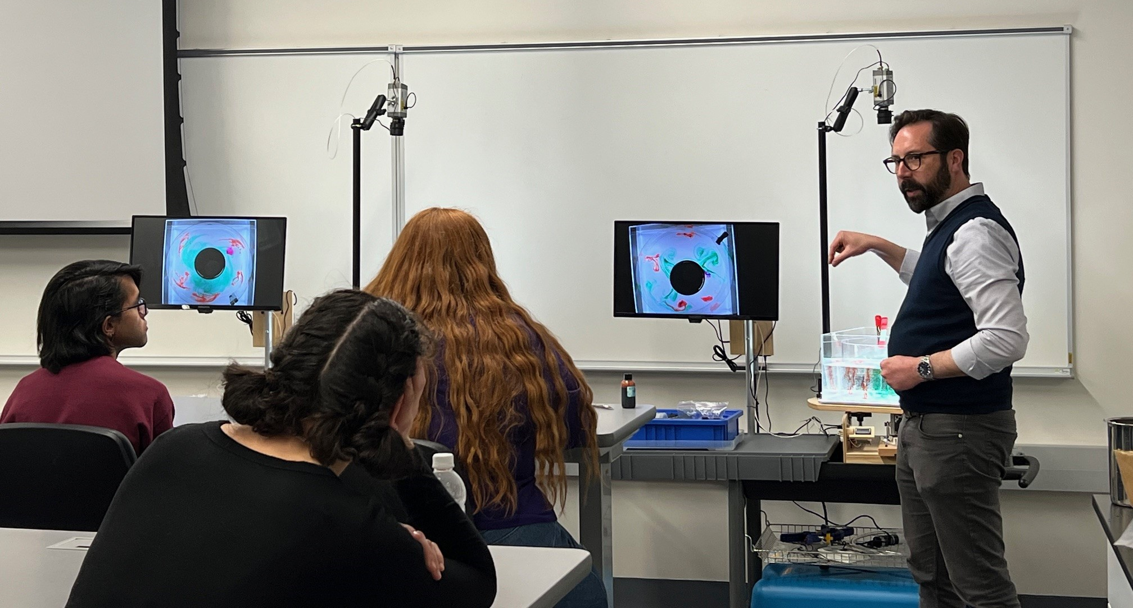
ETEC Building - UAlbany
Fluids Lab

Slide 13
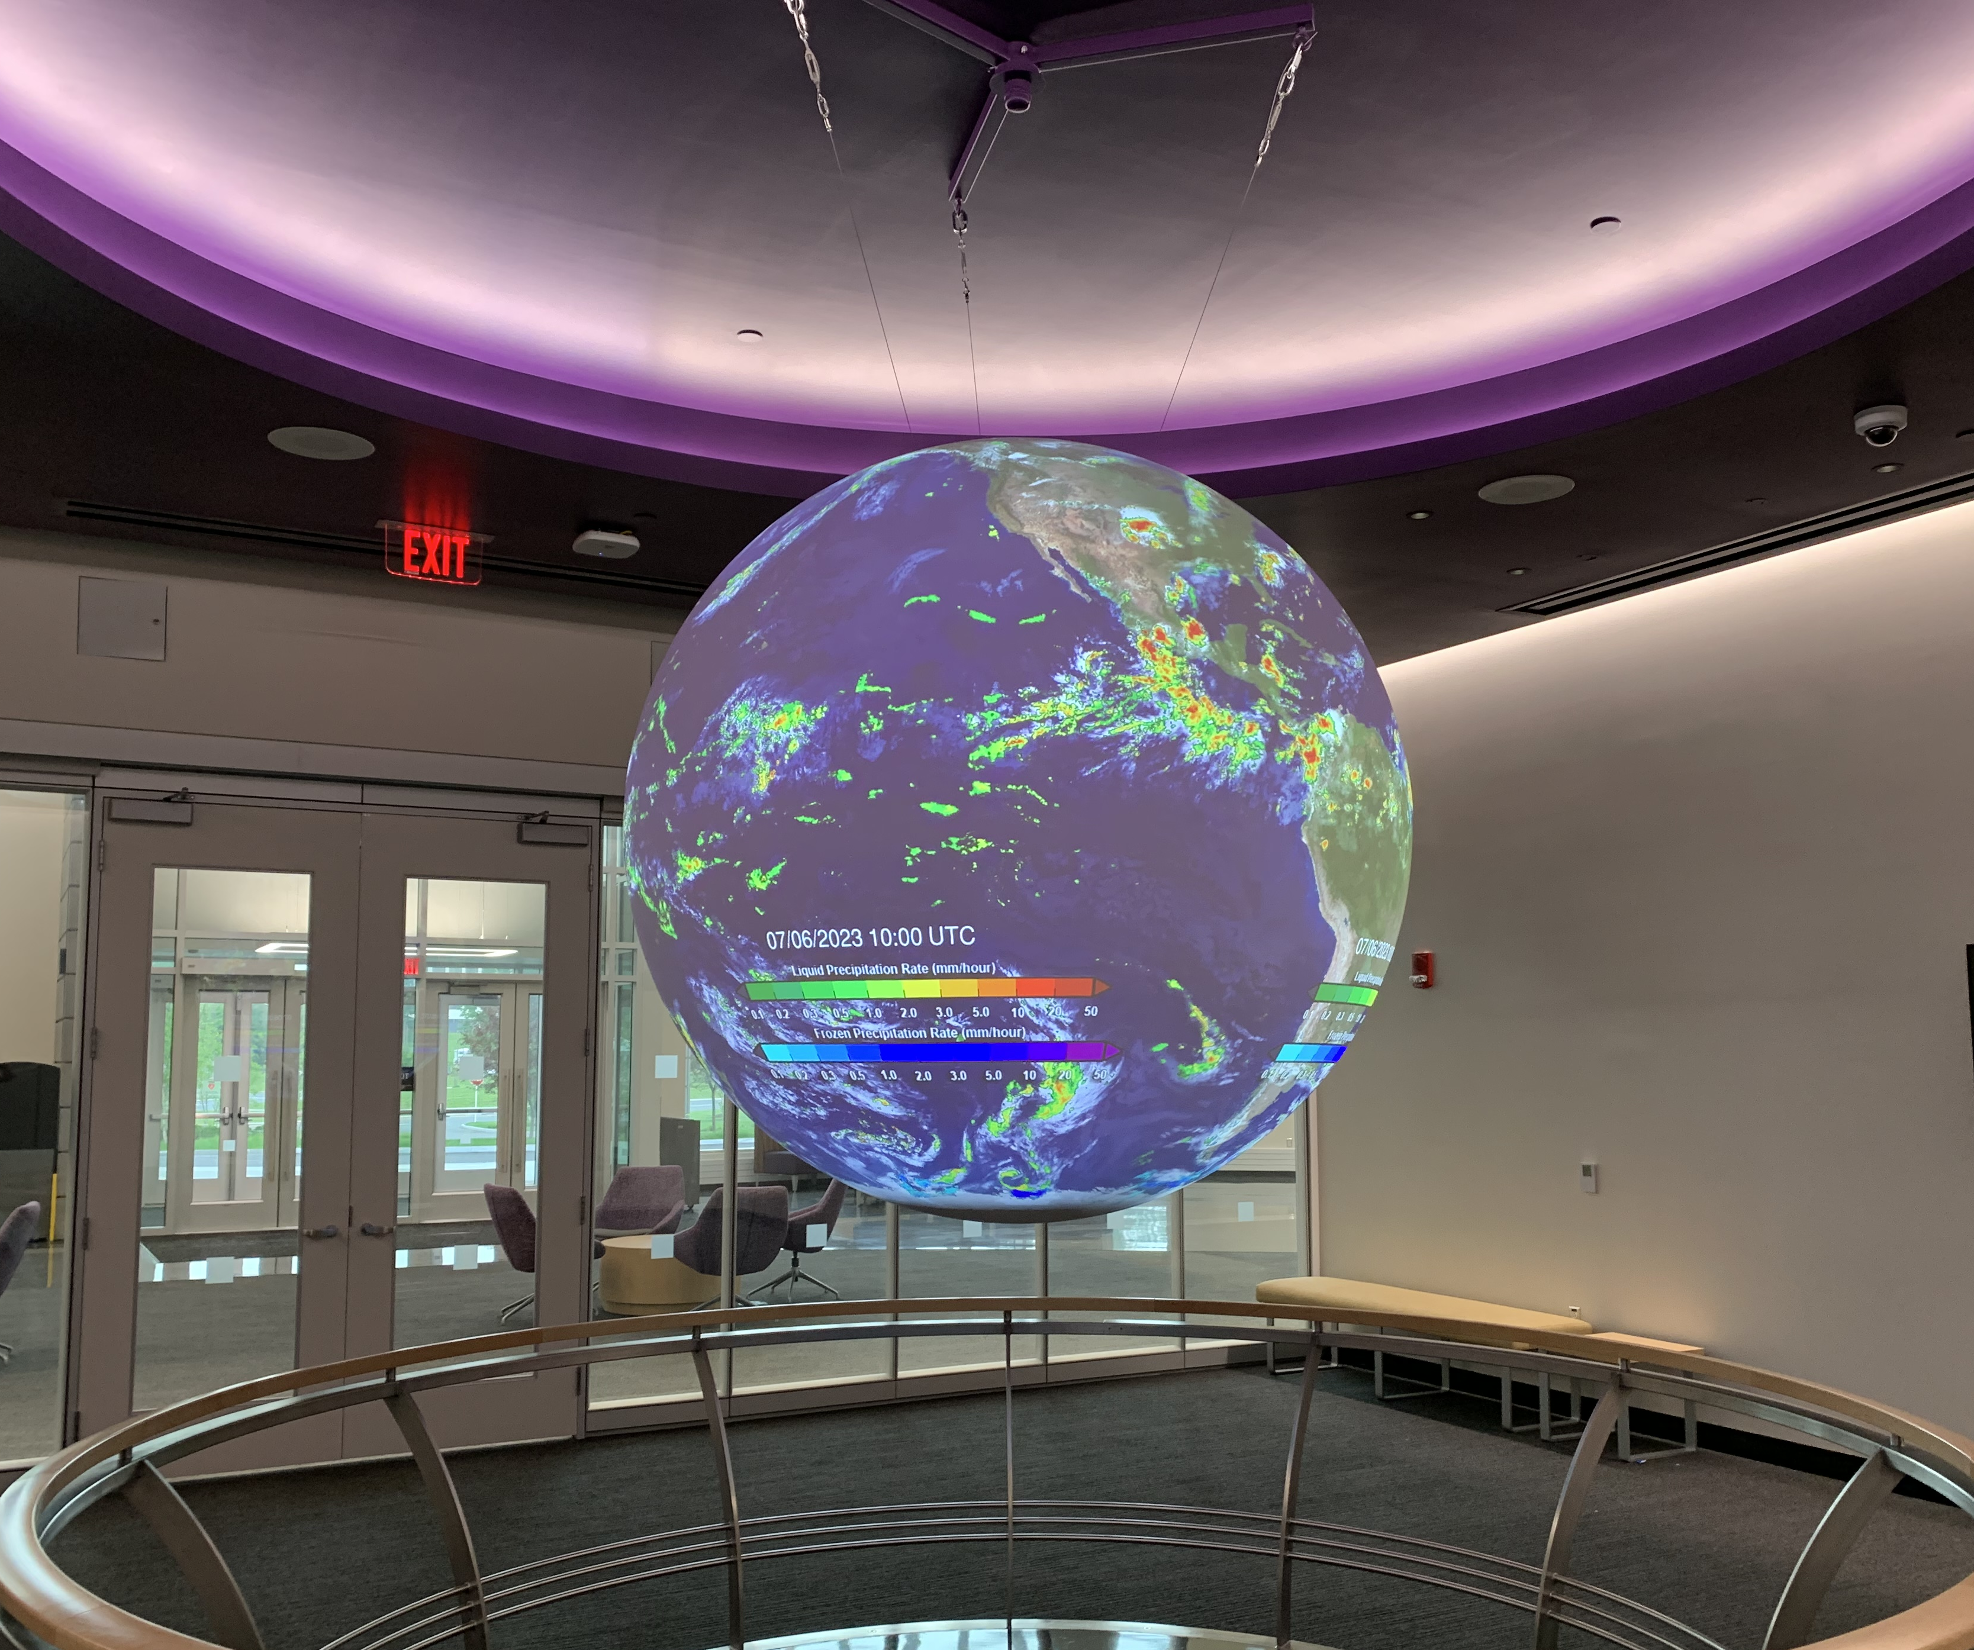
ETEC Building - UAlbany

Slide 14
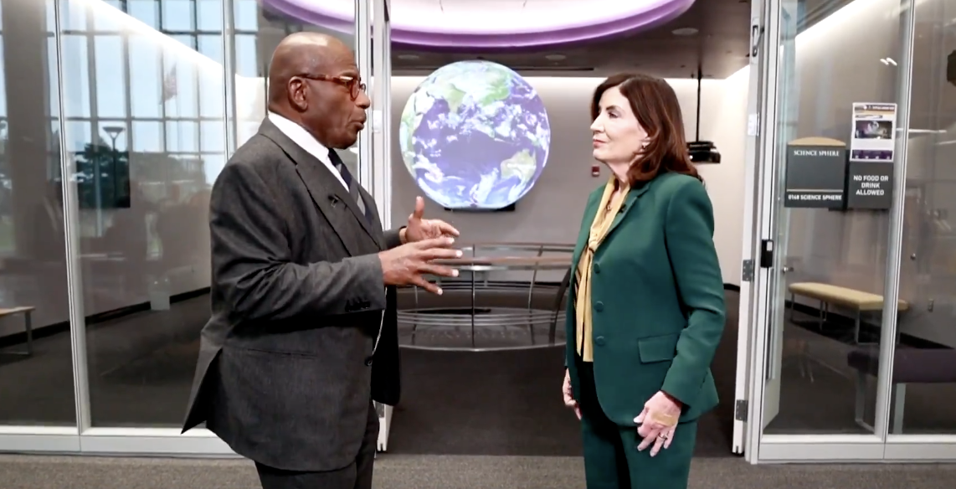
ETEC Building - UAlbany

Slide 15
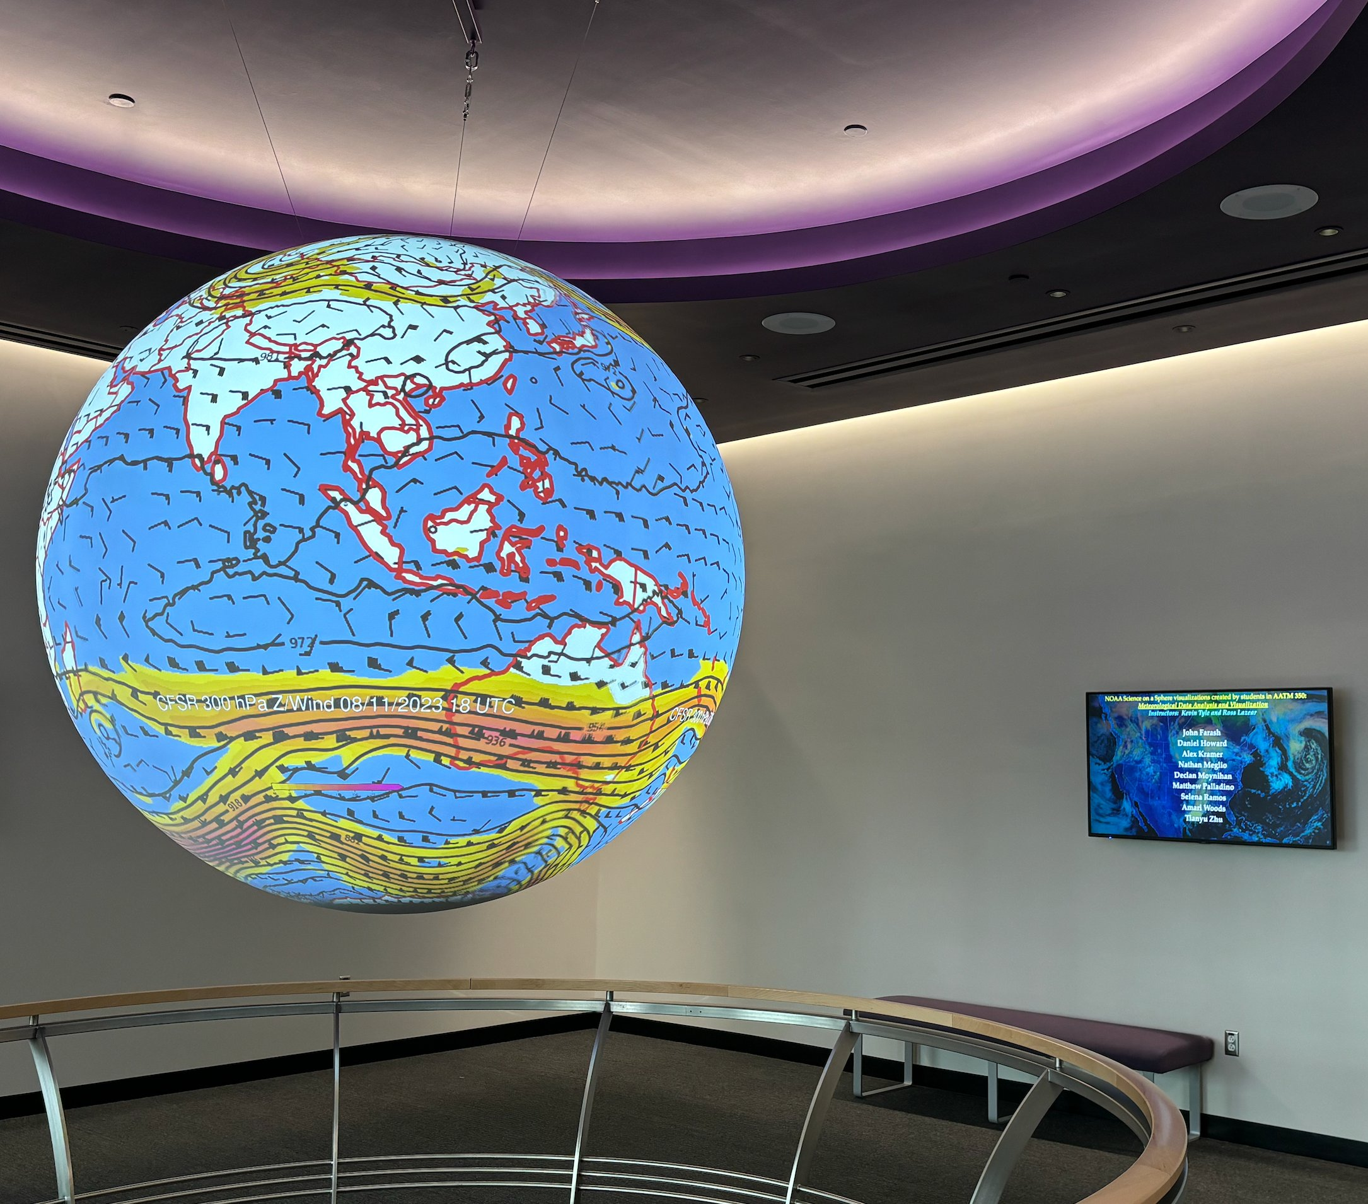
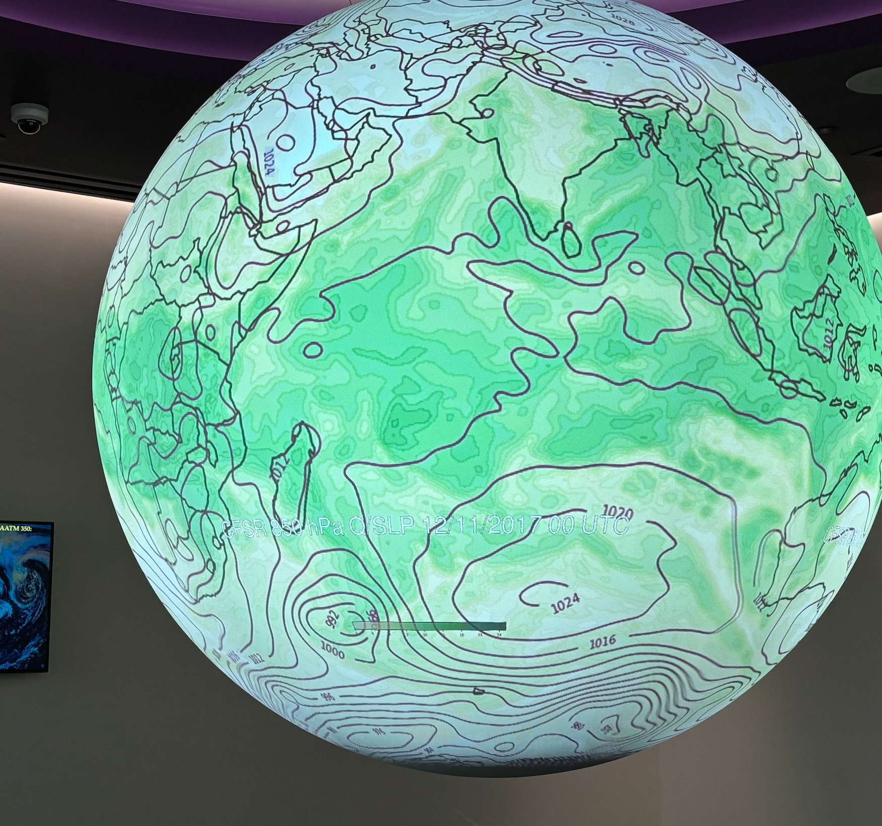
ETEC Building - UAlbany

Slide 16
Programming, Data Analysis and Visualization in DAES
• Programming language: Python
• ATM 350: Meteorological Data Analysis and Visualization
-Junior-year atmospheric science majors
• ATM 433/533: Advanced Geophysical Data Analysis and Visualization
-Senior-year atmospheric science majors and graduate students

Slide 17



ATM 350 – Meteorological Data Analysis and Visualization
• Linux command line and bash shell scripting
• Python using Jupyterlab
• Pangeo software ecosystem
• Final project:
-Weather event case study
-Reanalysis datasets: CFSR, ERA5

Slide 18
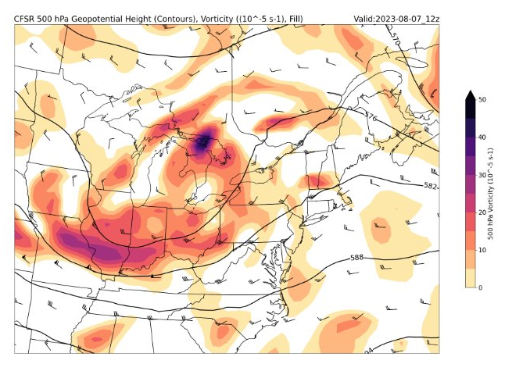


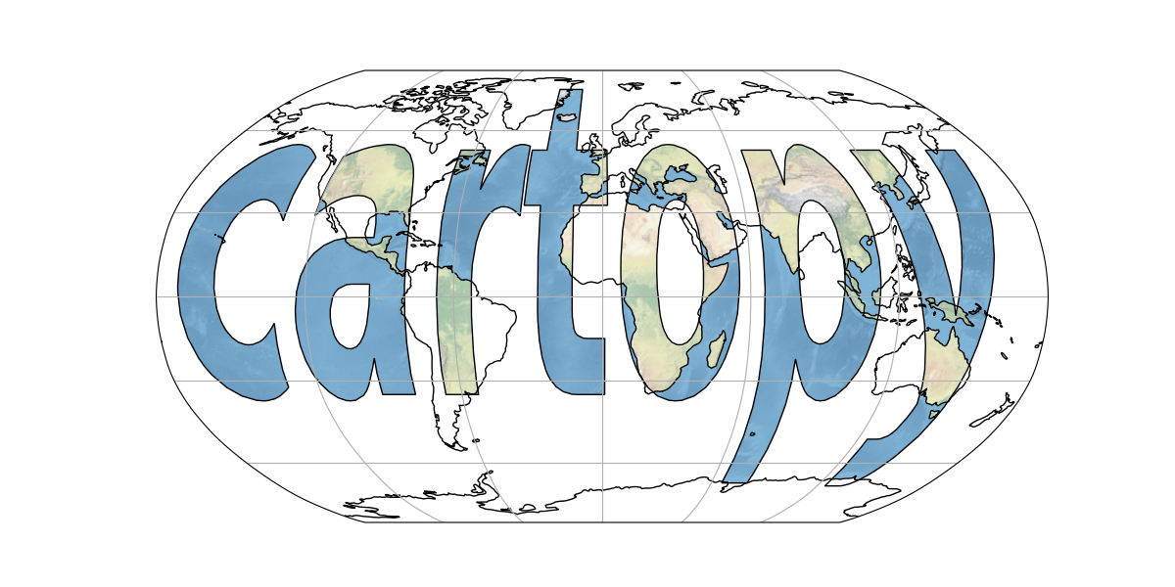

ATM 350 – Meteorological Data Analysis and Visualization
• Reanalysis dataset exploration
- Xarray
- Matplotlib
- Cartopy
- MetPy
Alex Kramer, Class of 2025

Slide 19
Jupyter Notebook “Recipe” for Science on a Sphere
• Data access
• Prototype for a single time
• Test visualization on Cartopy plot and maptoglobe.com
• Create SoS target directory structure
• Loop over times and create the visualizations
• Load on SoS, suggest improvements, re-generate
• Run playlist on UAlbany’s “Showcase Day”

Slide 20
Let’s run through our Jupyter notebook!

Slide 21
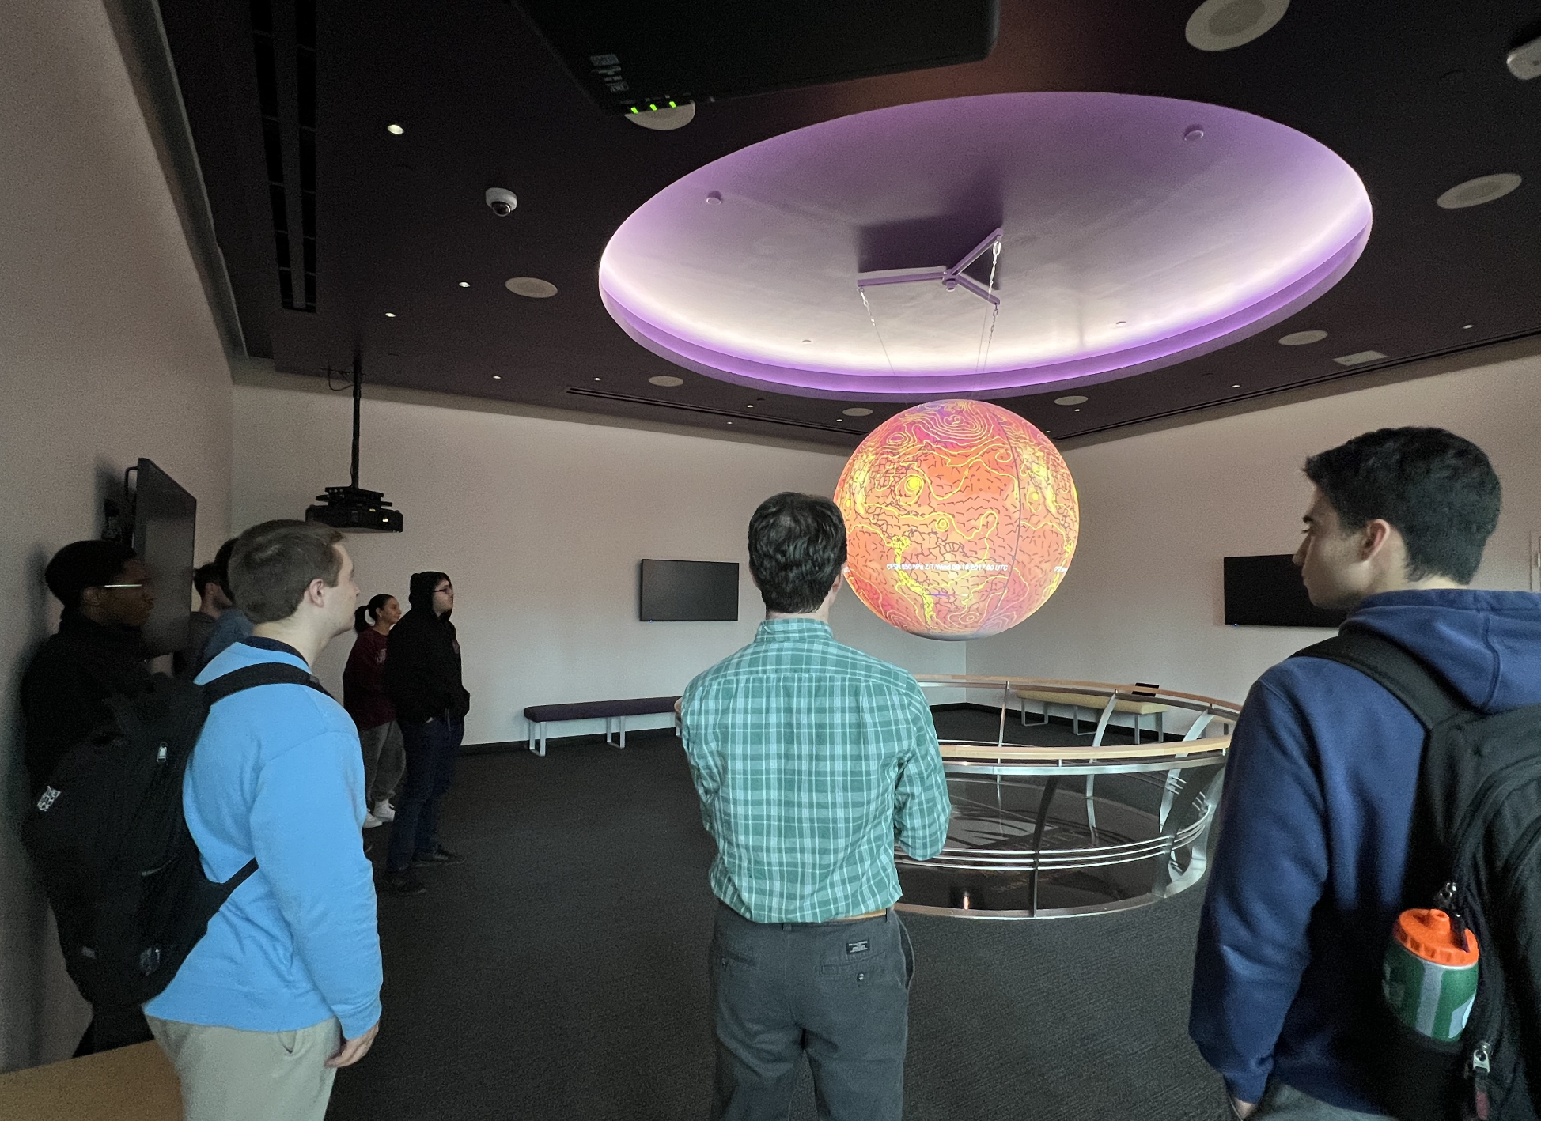

Slide 22
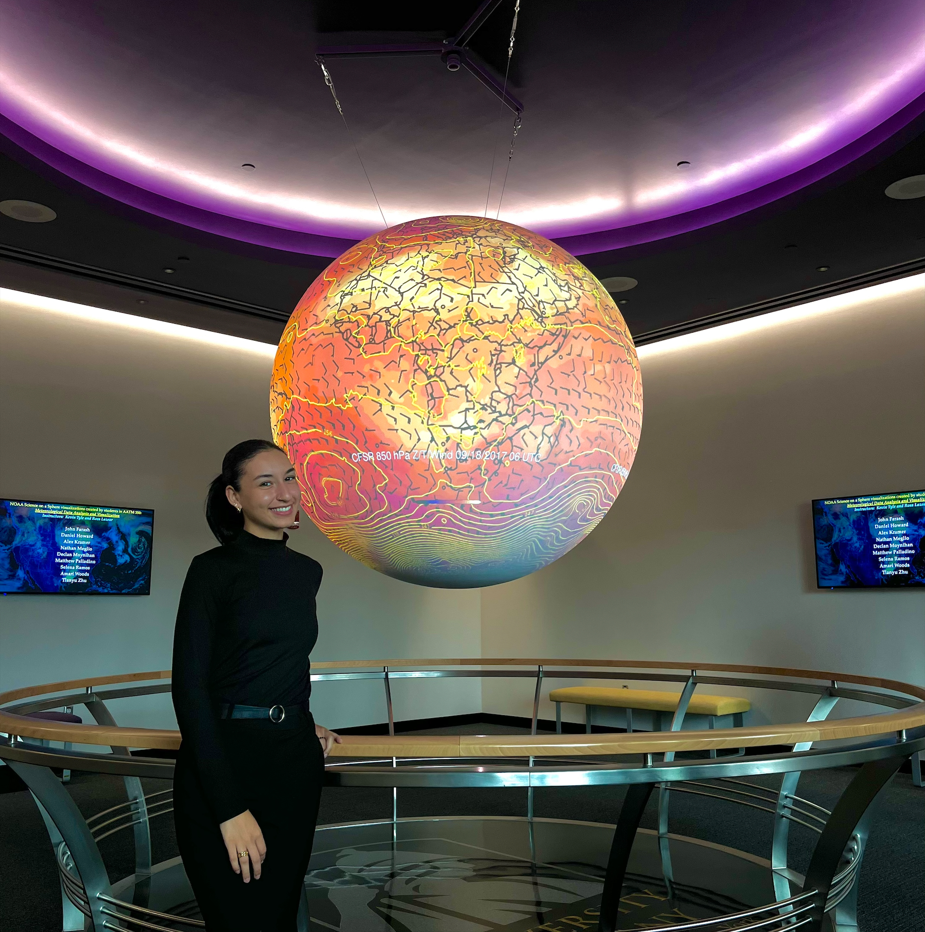
Selena Ramos, Class of 2025

Slide 23
Future work
• Transition from in-house CFSR to cloud-served ERA5
• Use recipe for real-time global NWP output
- Prototype for integrated vapor transport
• GitHub repository

