Slide 1
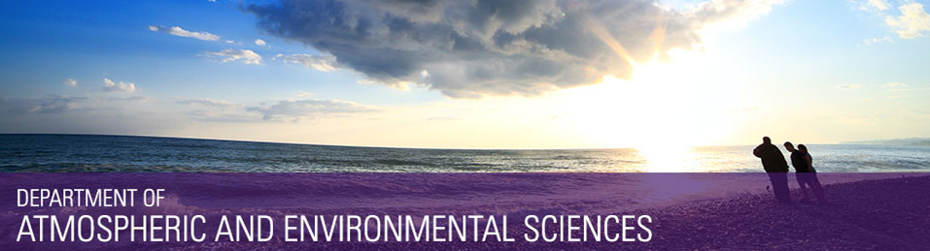
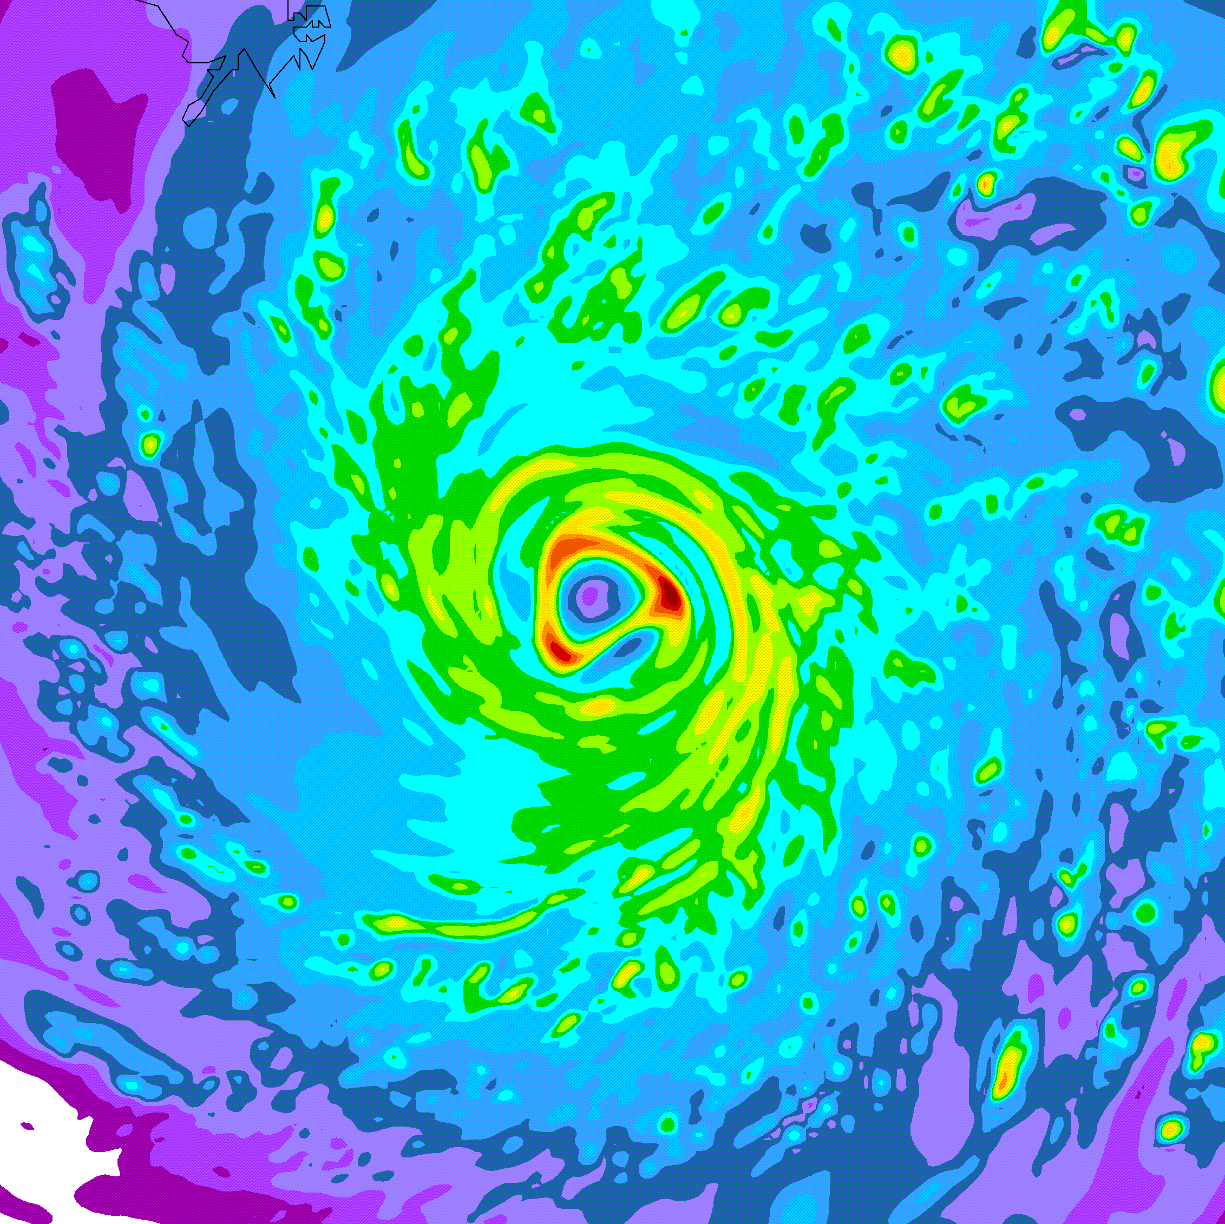
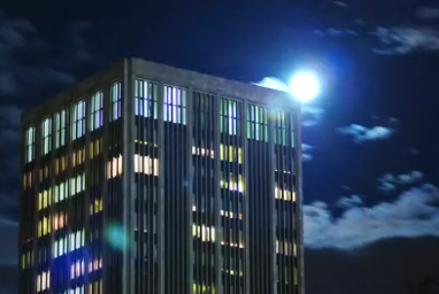
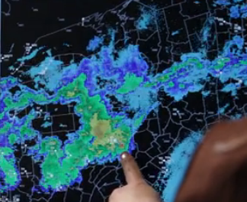

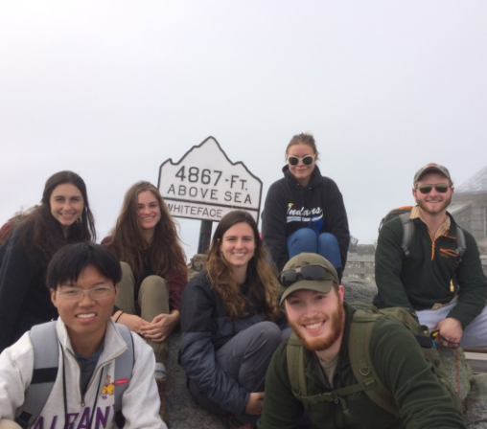
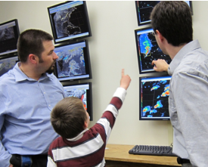
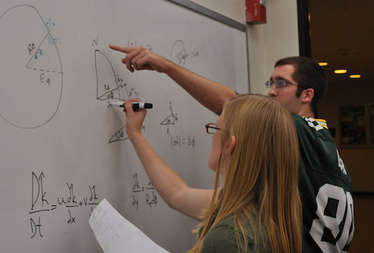
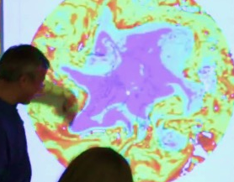
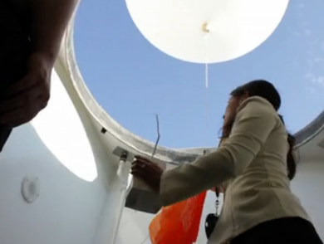
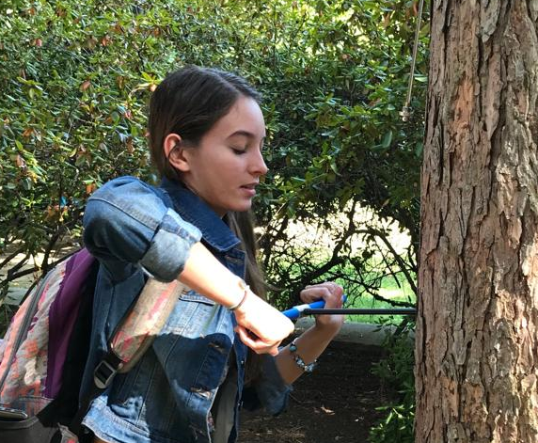
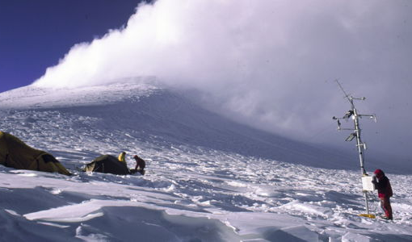
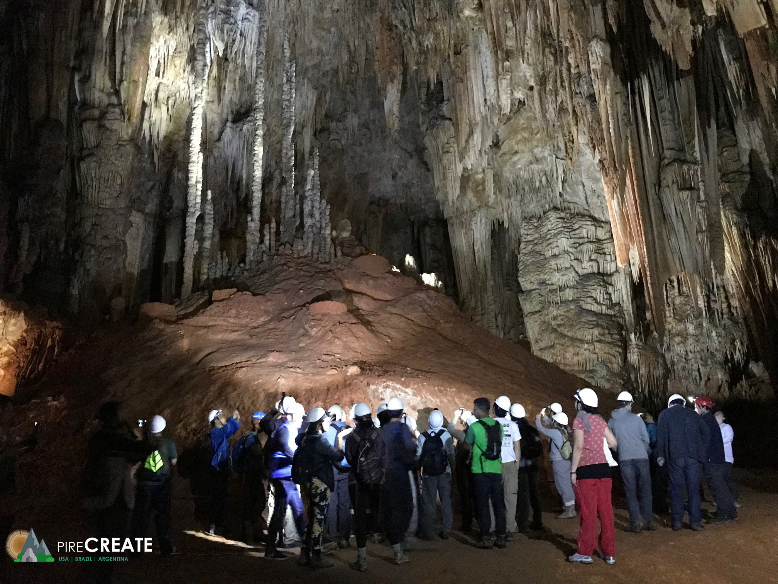


Department of
Atmospheric & Environmental Sciences
Contact me at:
Ross Lazear
rlazear@albany.edu
Web: http://albany.edu/daes/
Notes:
Intro
Welcome & congrats
Great community. World-class education at state-school cost

Slide 2
B.S. in Atmospheric Science
(meteorology and more)
B.S. in Environmental Science
B.S. in Climate Science
(coming soon)
B.A. in Environmental Studies
(coming soon)
Notes:
Intro
Welcome & congrats
Great community. World-class education at state-school cost

Slide 3
World-class teaching and research in:
Weather systems, tropical meteorology, and mesoscale meteorology (mountain weather, thunderstorms)

Slide 4
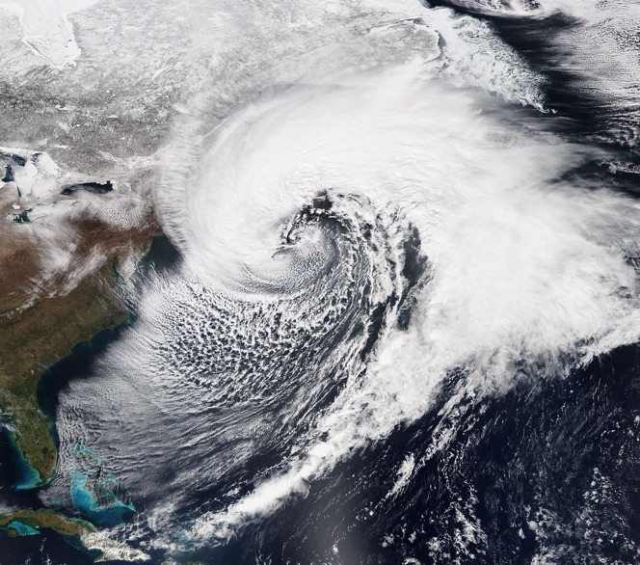
World-class teaching and research in:
Weather systems, tropical meteorology, and mesoscale meteorology (mountain weather, thunderstorms)

Slide 5
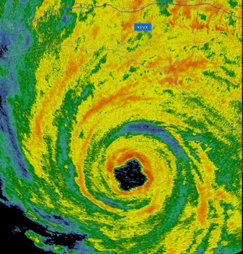
World-class teaching and research in:
Weather systems, tropical meteorology, and mesoscale meteorology (mountain weather, thunderstorms)

Slide 6
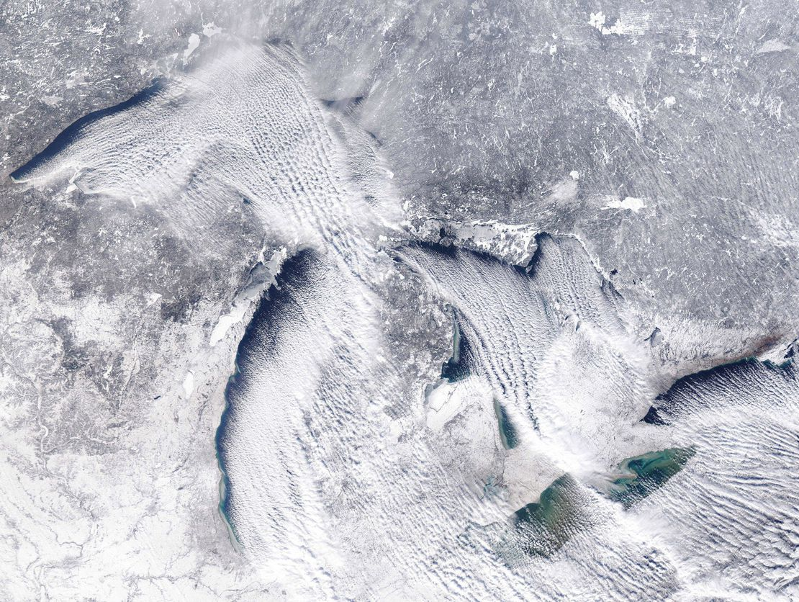
World-class teaching and research in:
Weather systems, tropical meteorology, and mesoscale meteorology (mountain weather, thunderstorms)

Slide 7
World-class teaching and research in:
Climate dynamics, paleoclimate, and environmental systems

Slide 8
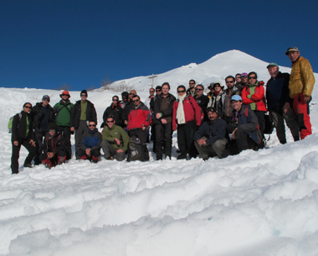
World-class teaching and research in:
Climate dynamics, paleoclimate, and environmental systems

Slide 9
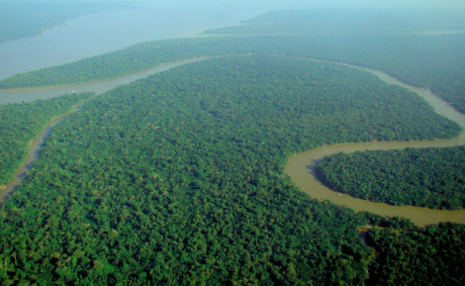
World-class teaching and research in:
Climate dynamics, paleoclimate, and environmental systems

Slide 10
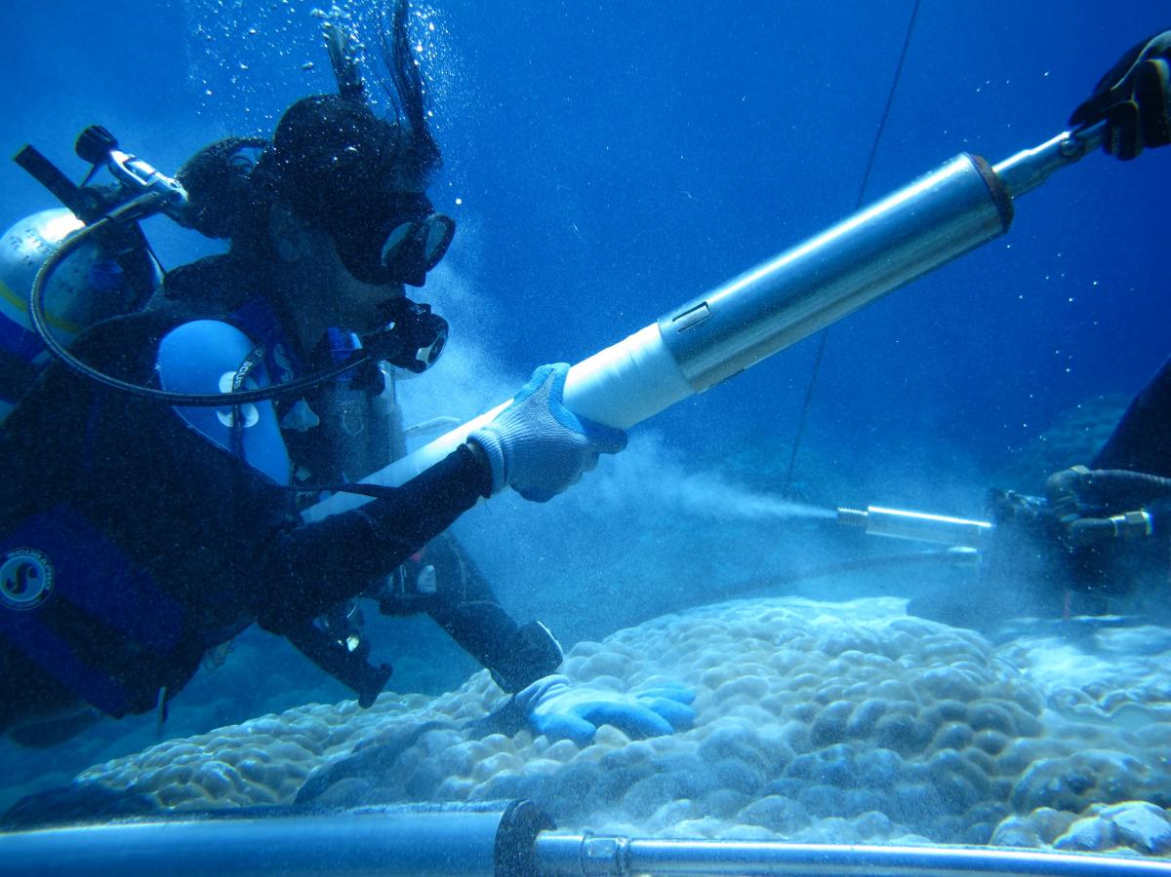
World-class teaching and research in:
Climate dynamics, paleoclimate, and environmental systems

Slide 11
World-class teaching and research in:
Atmospheric chemistry, air quality, and coastal–urban environments

Slide 12
World-class teaching and research in:
Atmospheric chemistry, air quality, and coastal–urban environments

Slide 13
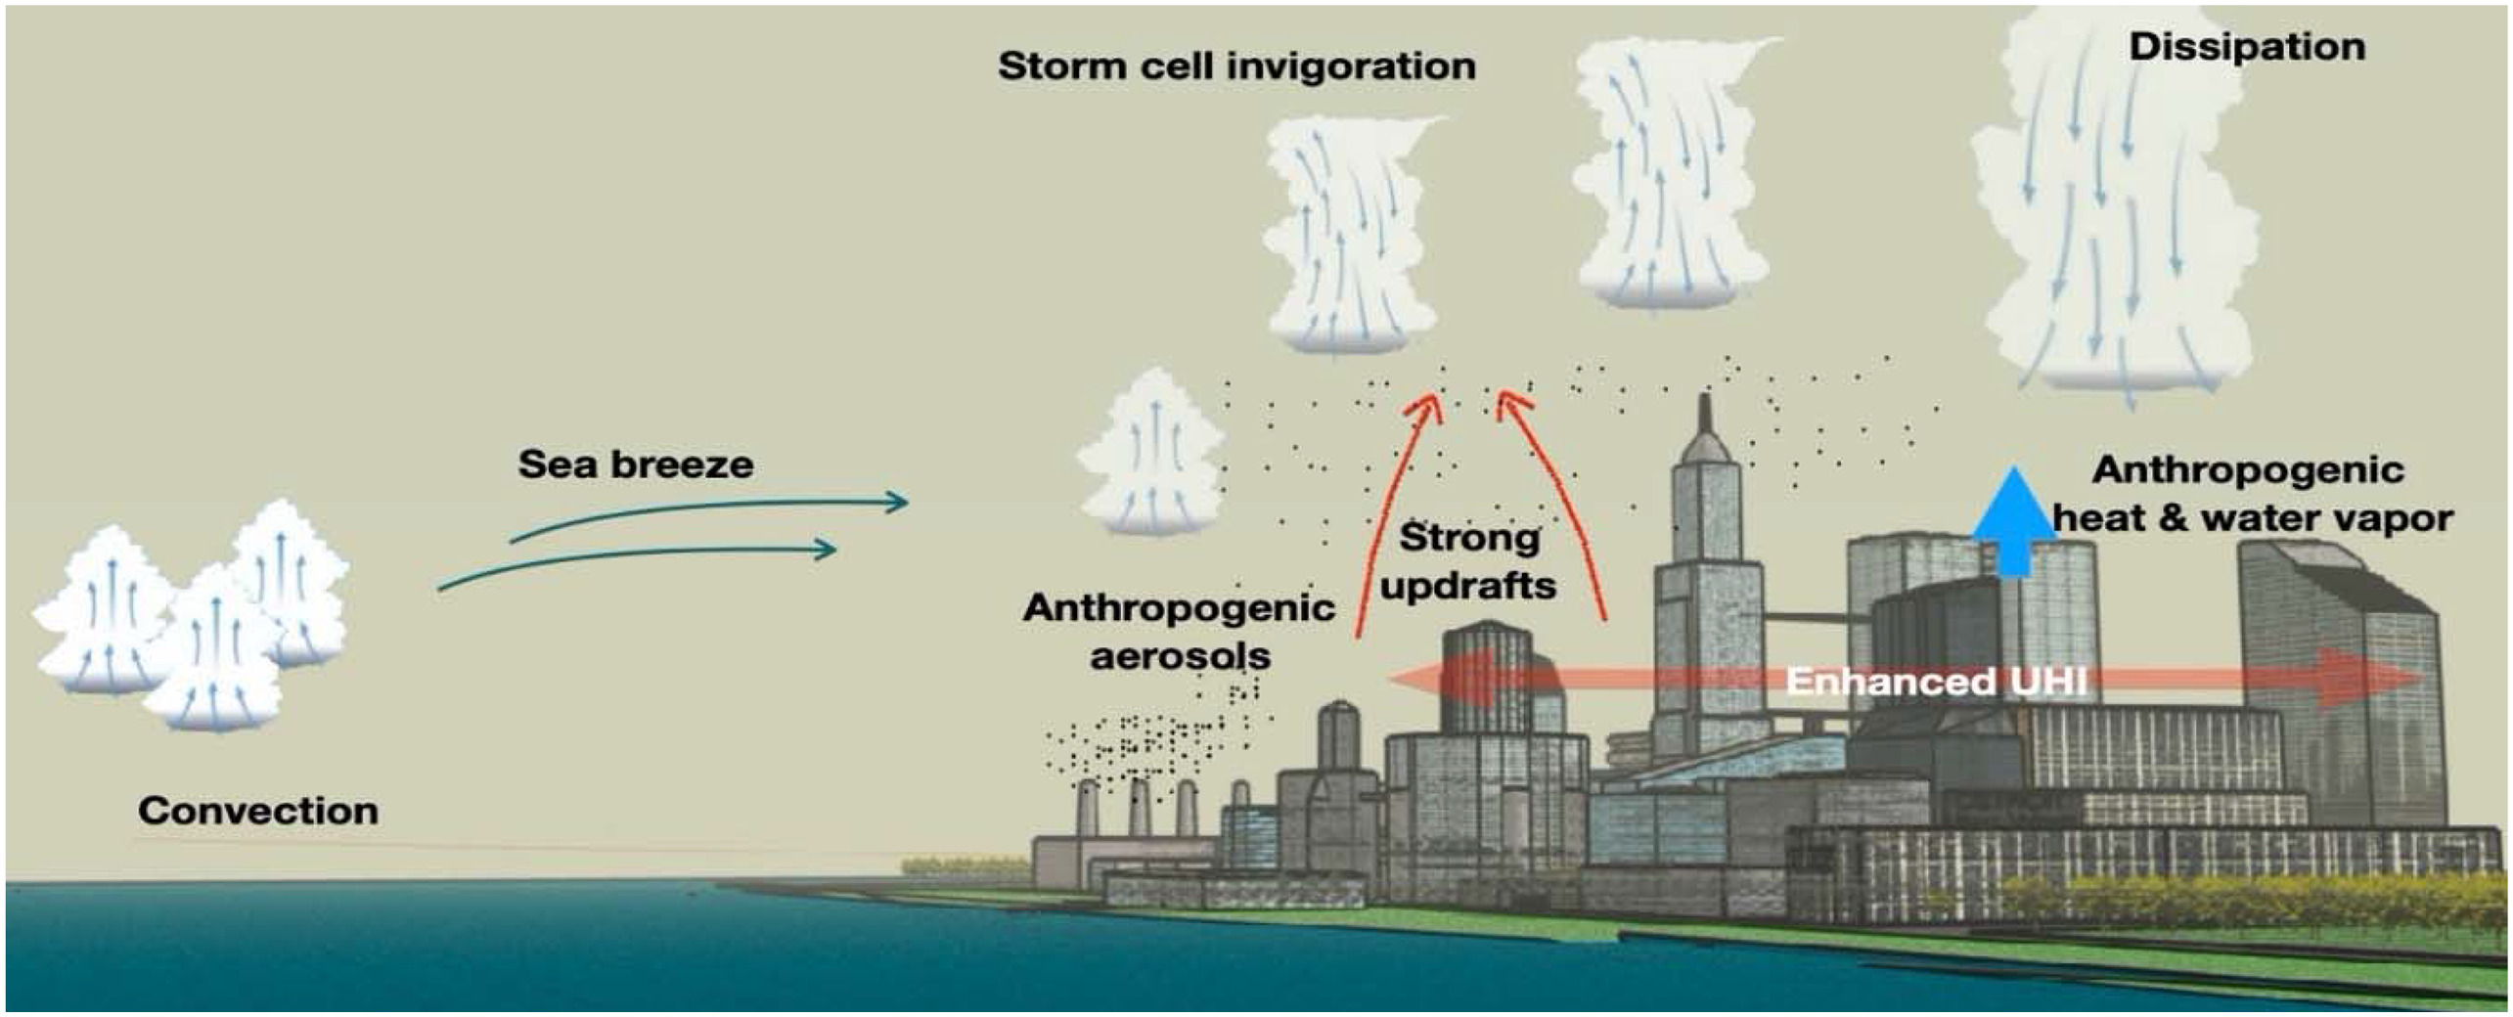
World-class teaching and research in:
Atmospheric chemistry, air quality, and coastal–urban environments

Slide 14
World-class teaching and research in:
Boundary layer meteorology, and air–land–sea interactions

Slide 15
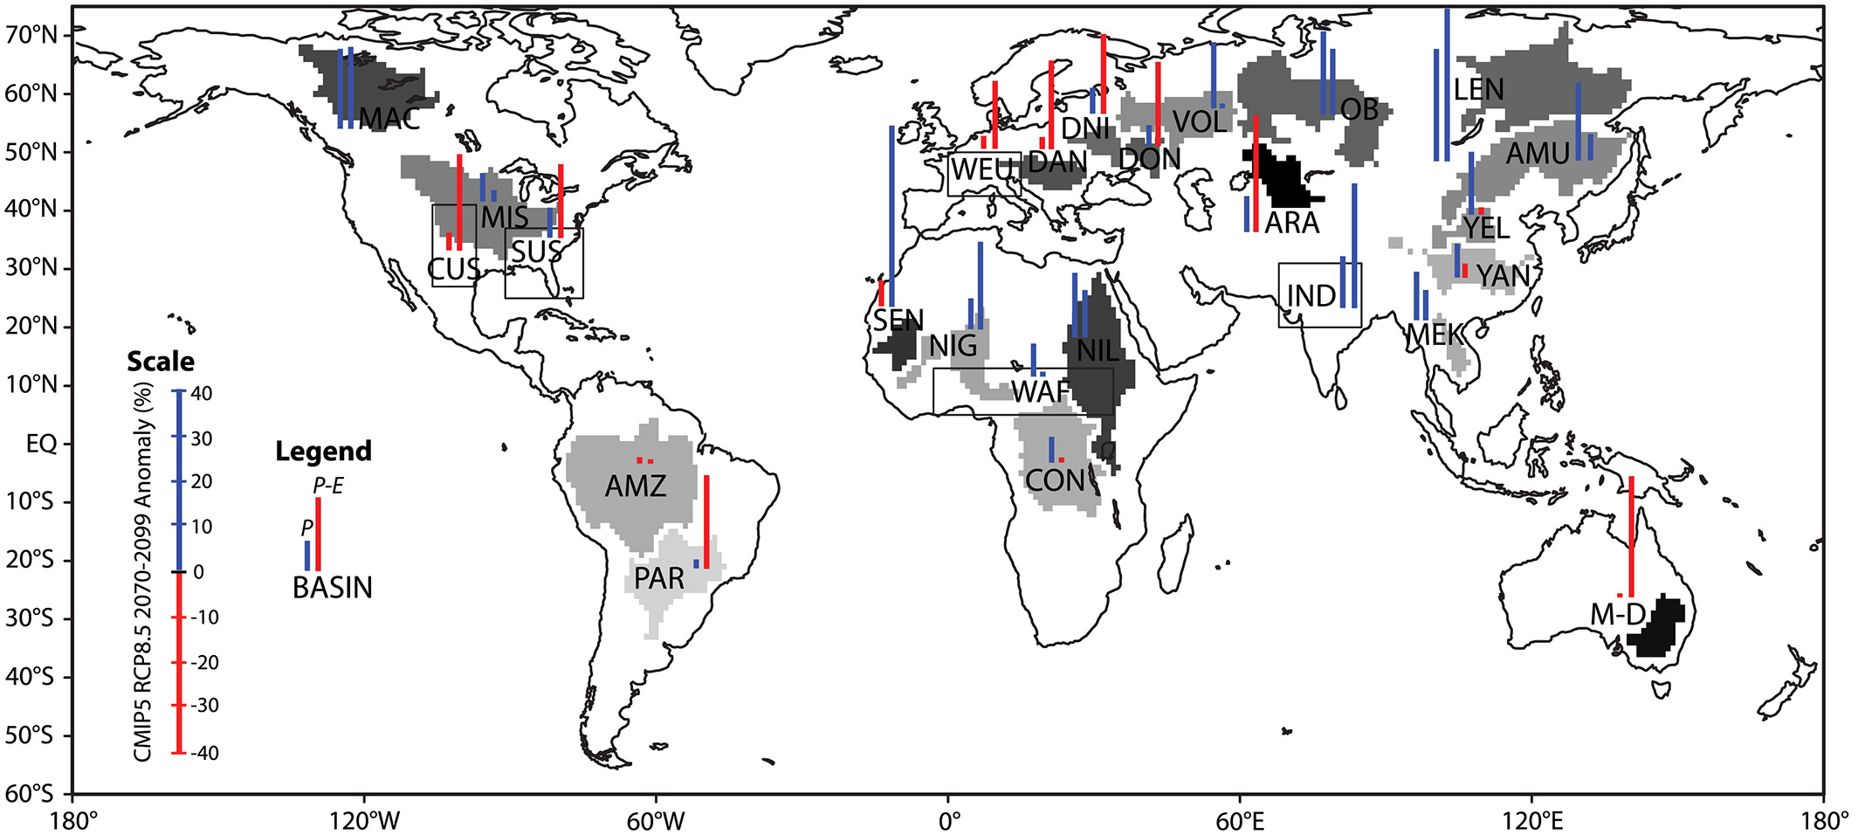
World-class teaching and research in:
Boundary layer meteorology, and air–land–sea interactions

Slide 16
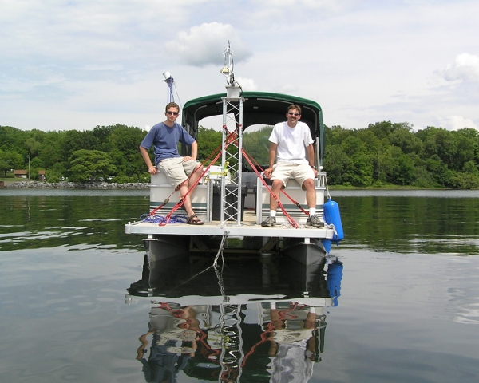
World-class teaching and research in:
Boundary layer meteorology, and air–land–sea interactions

Slide 17
World-class teaching and research in:
Renewable energy

Slide 18
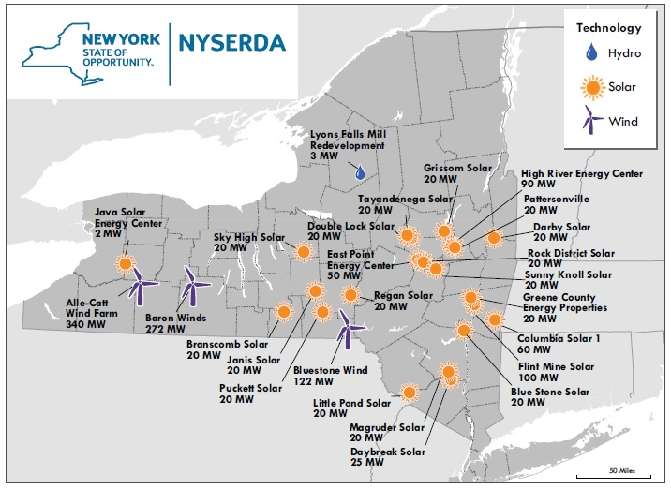
World-class teaching and research in:
Renewable energy

Slide 19
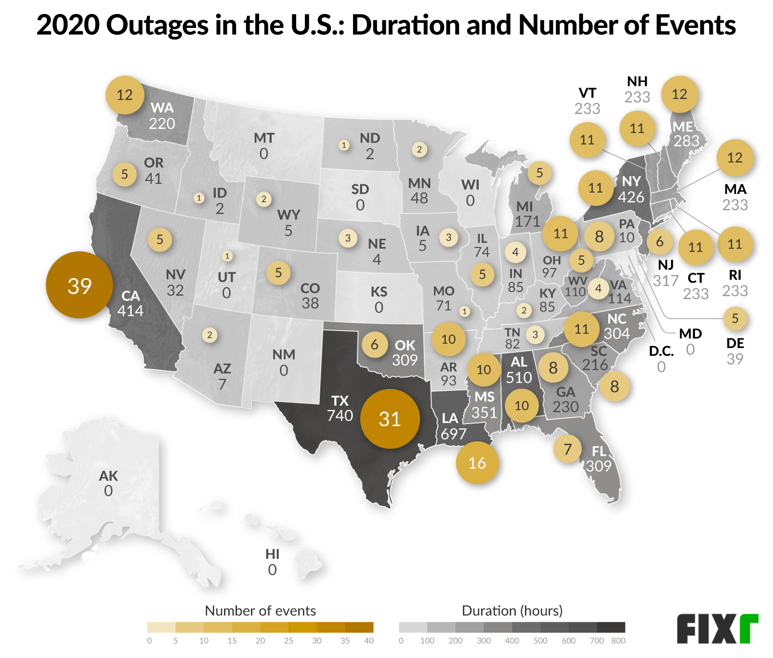
World-class teaching and research in:
Renewable energy

Slide 20
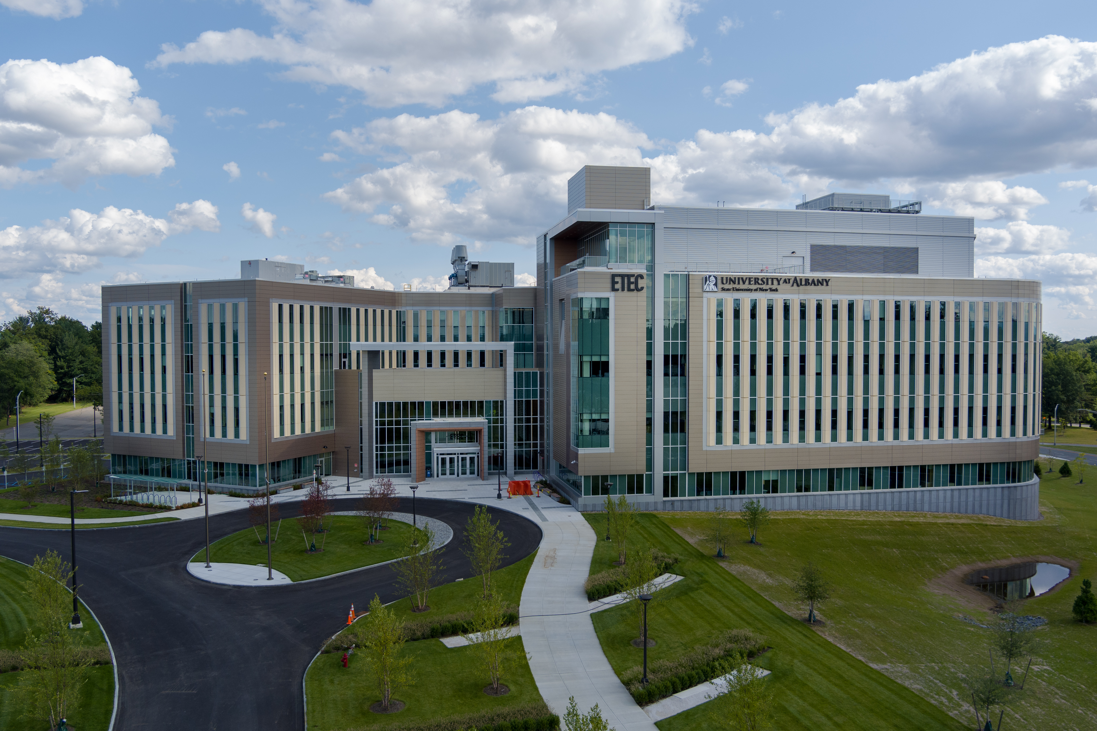
ETEC at UAlbany

Slide 21
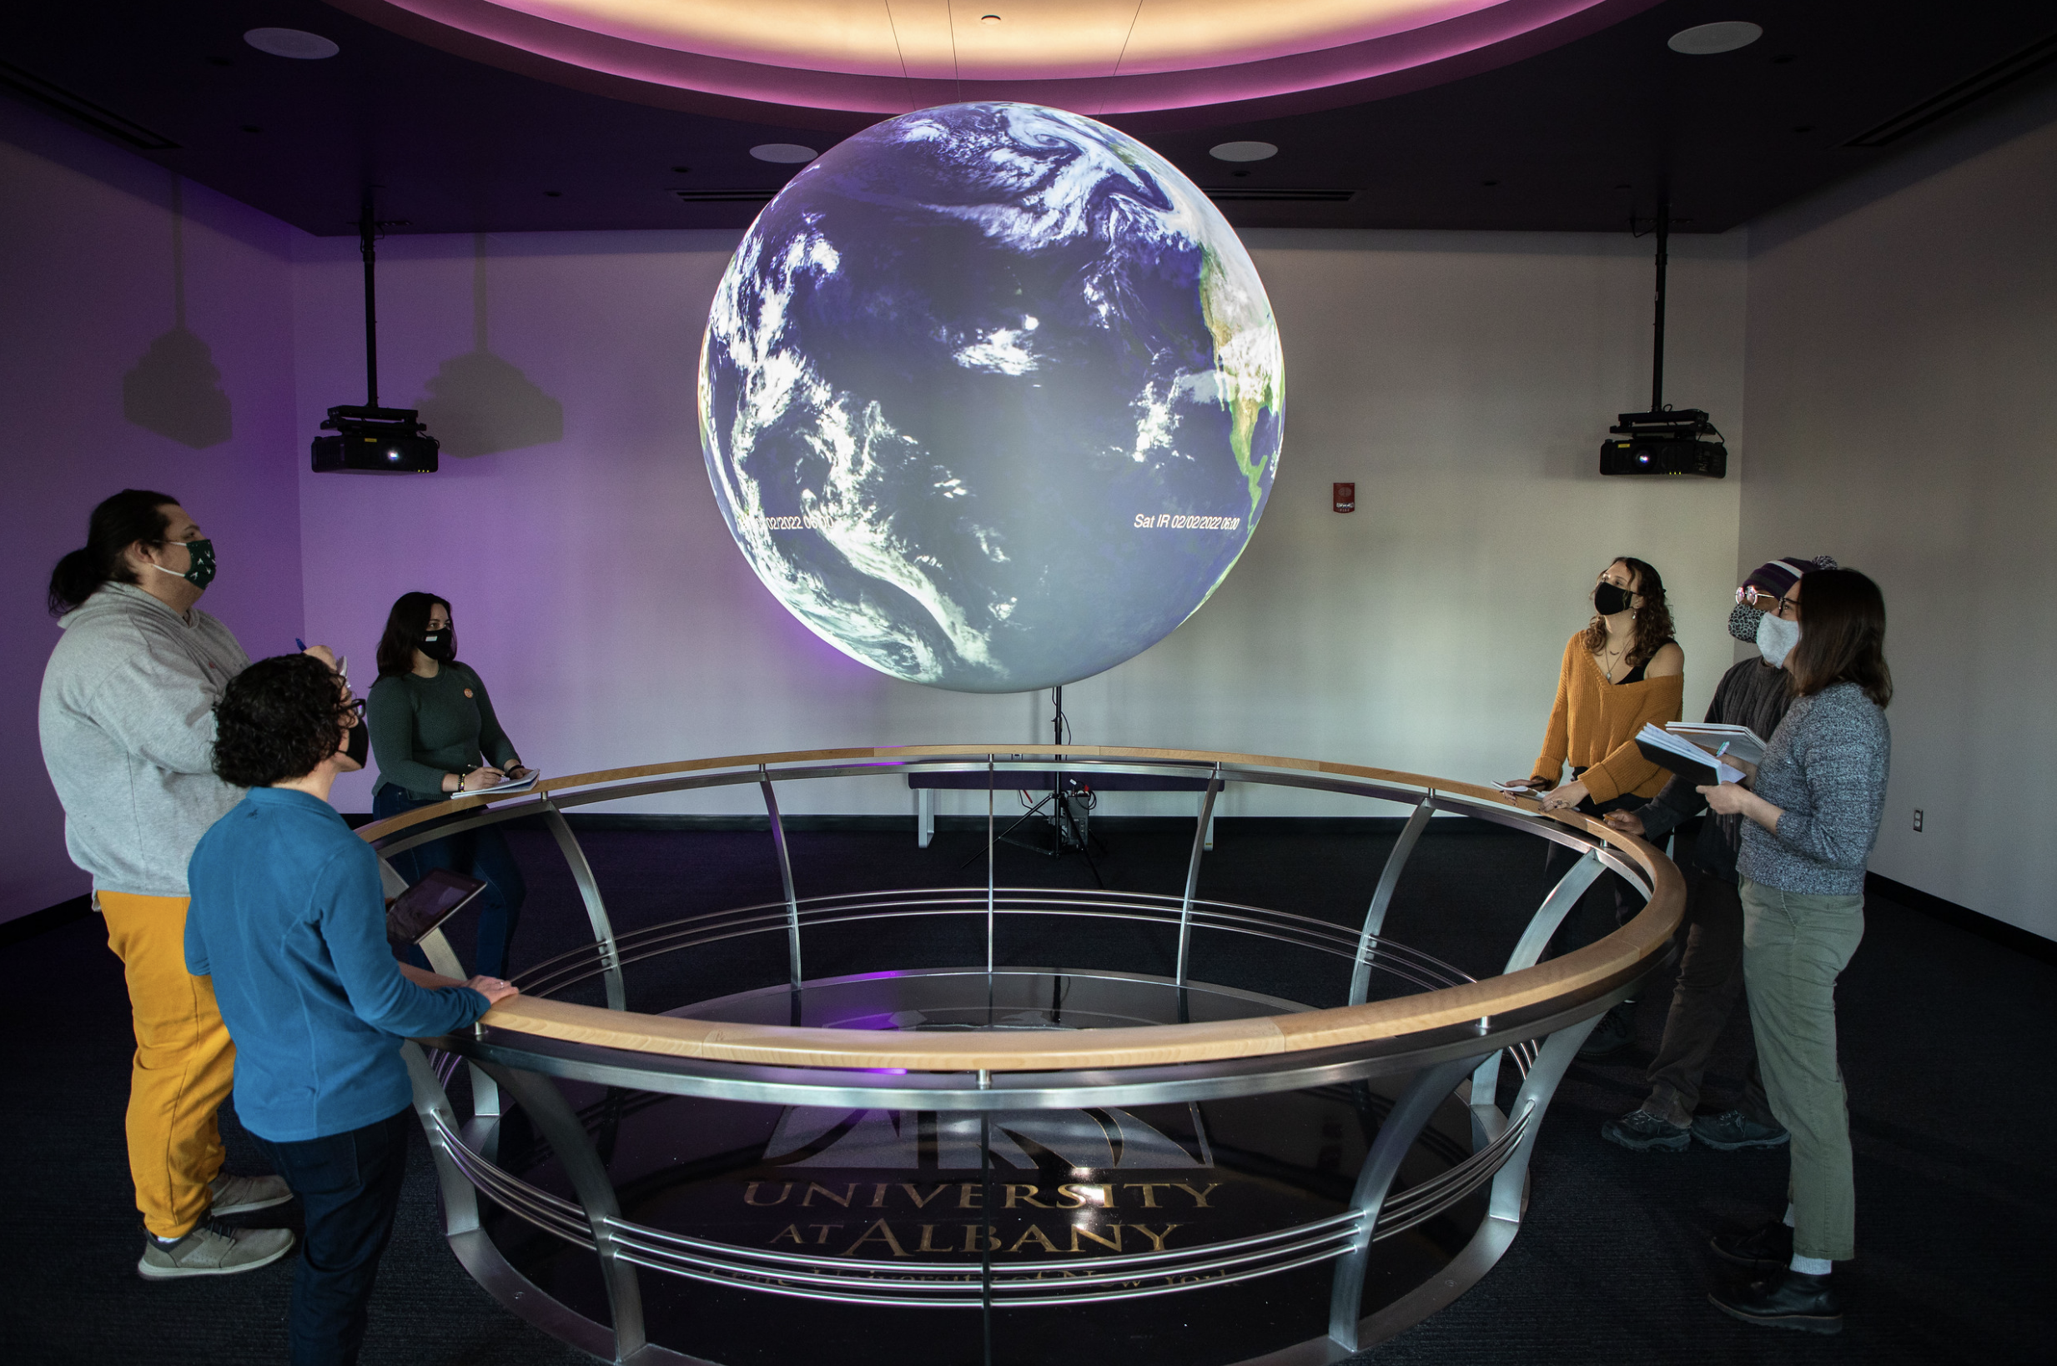
ETEC at UAlbany

Slide 22
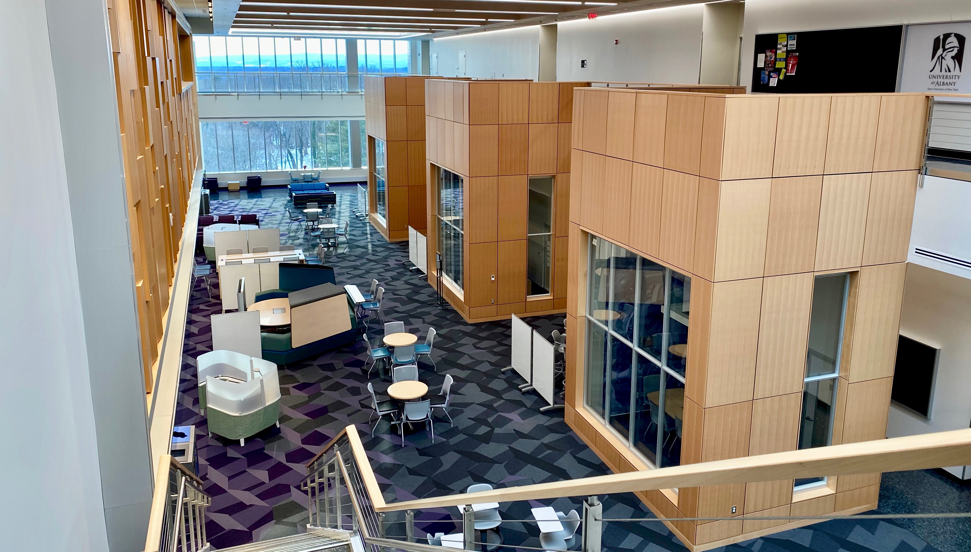
ETEC at UAlbany

Slide 23
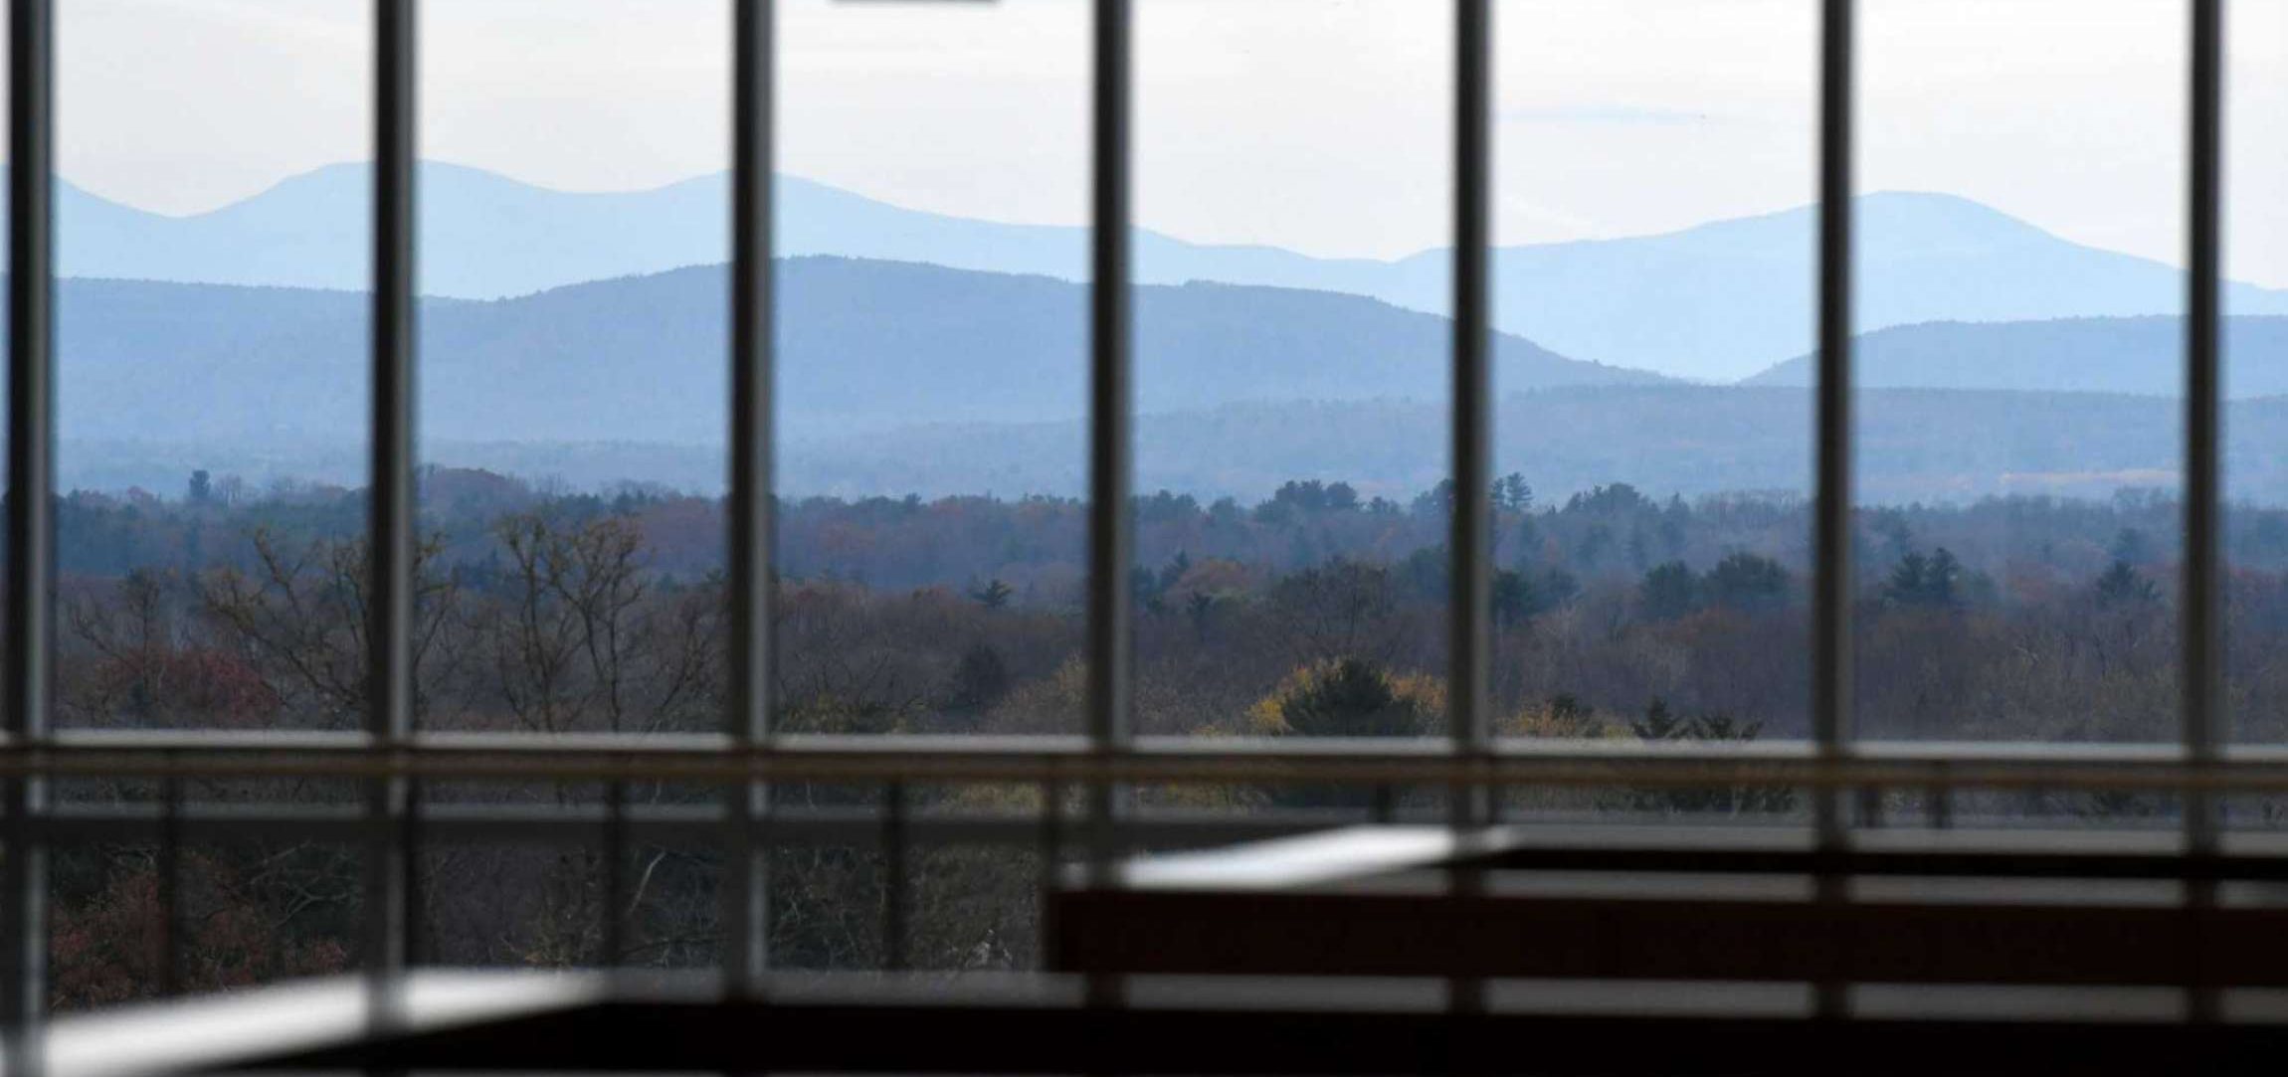
ETEC at UAlbany

Slide 24
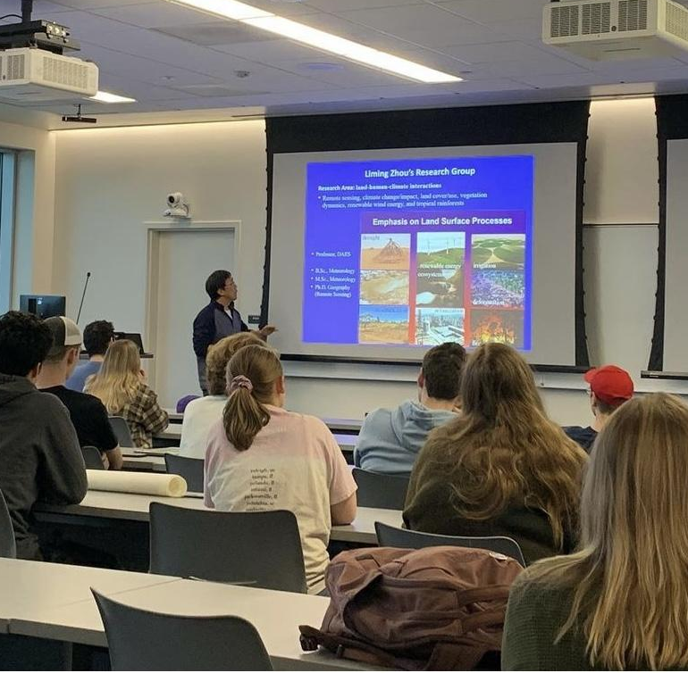
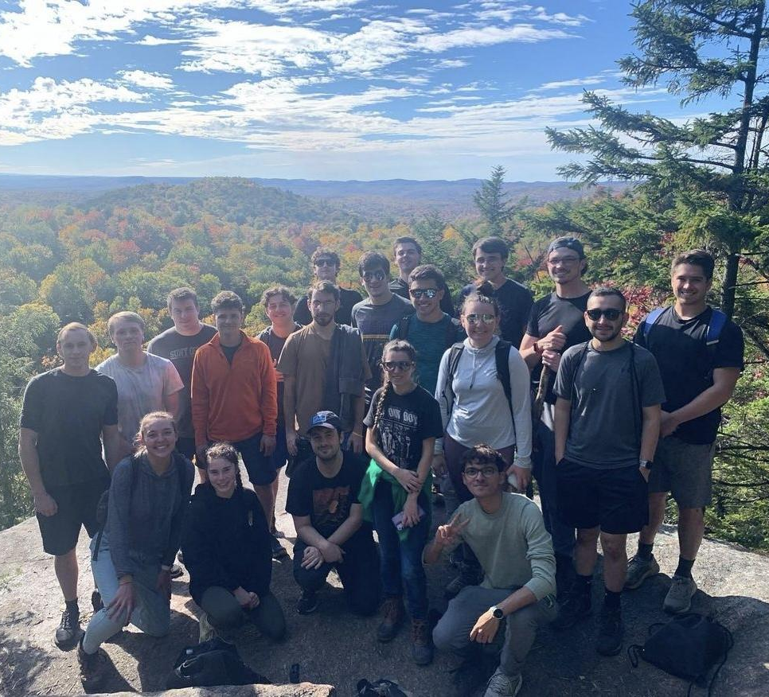
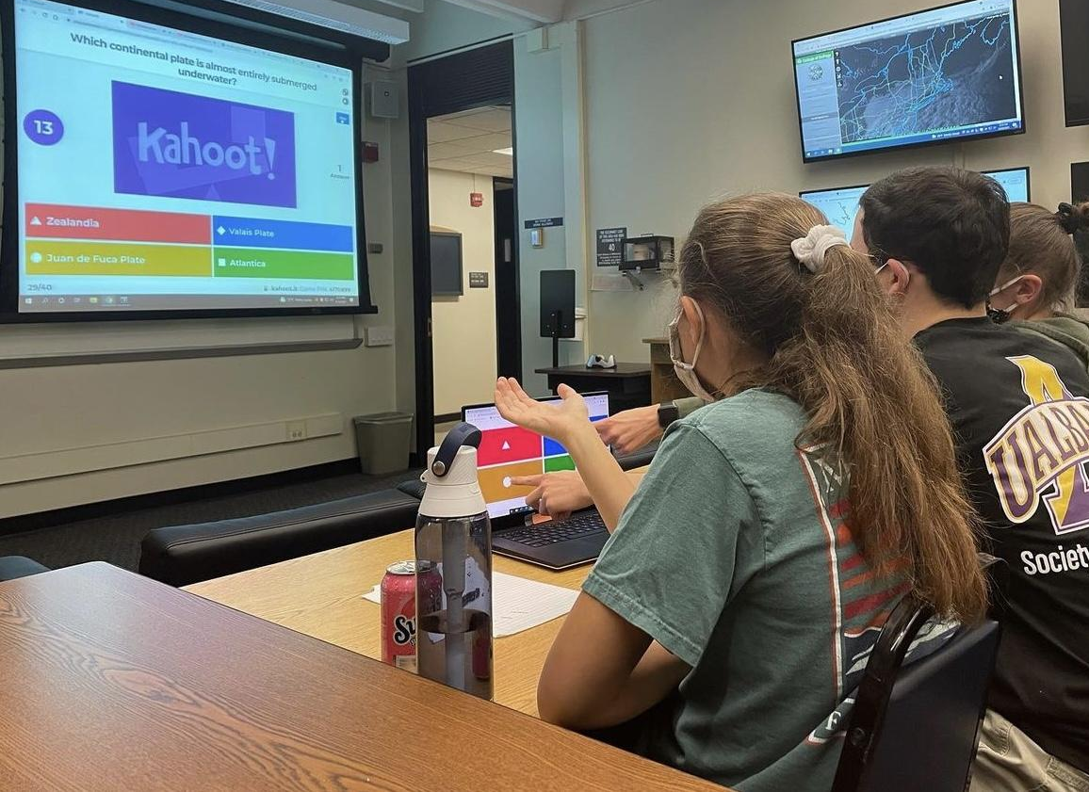

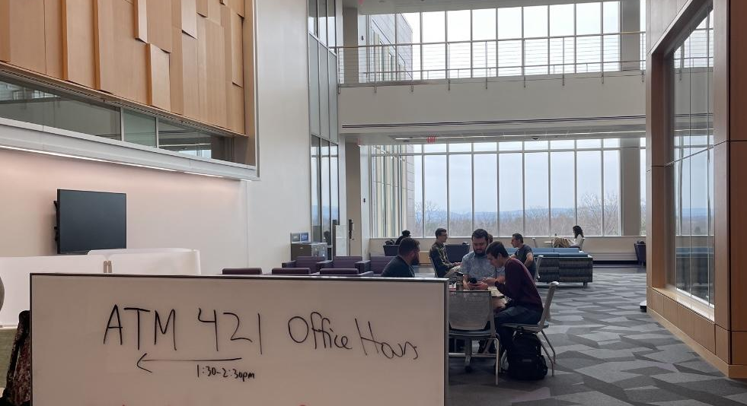
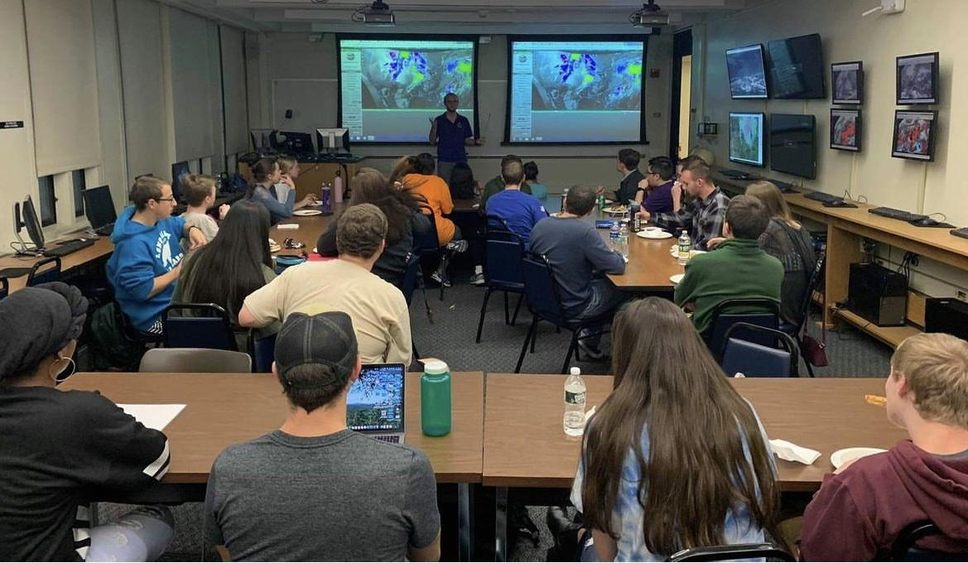
ETEC

Slide 25
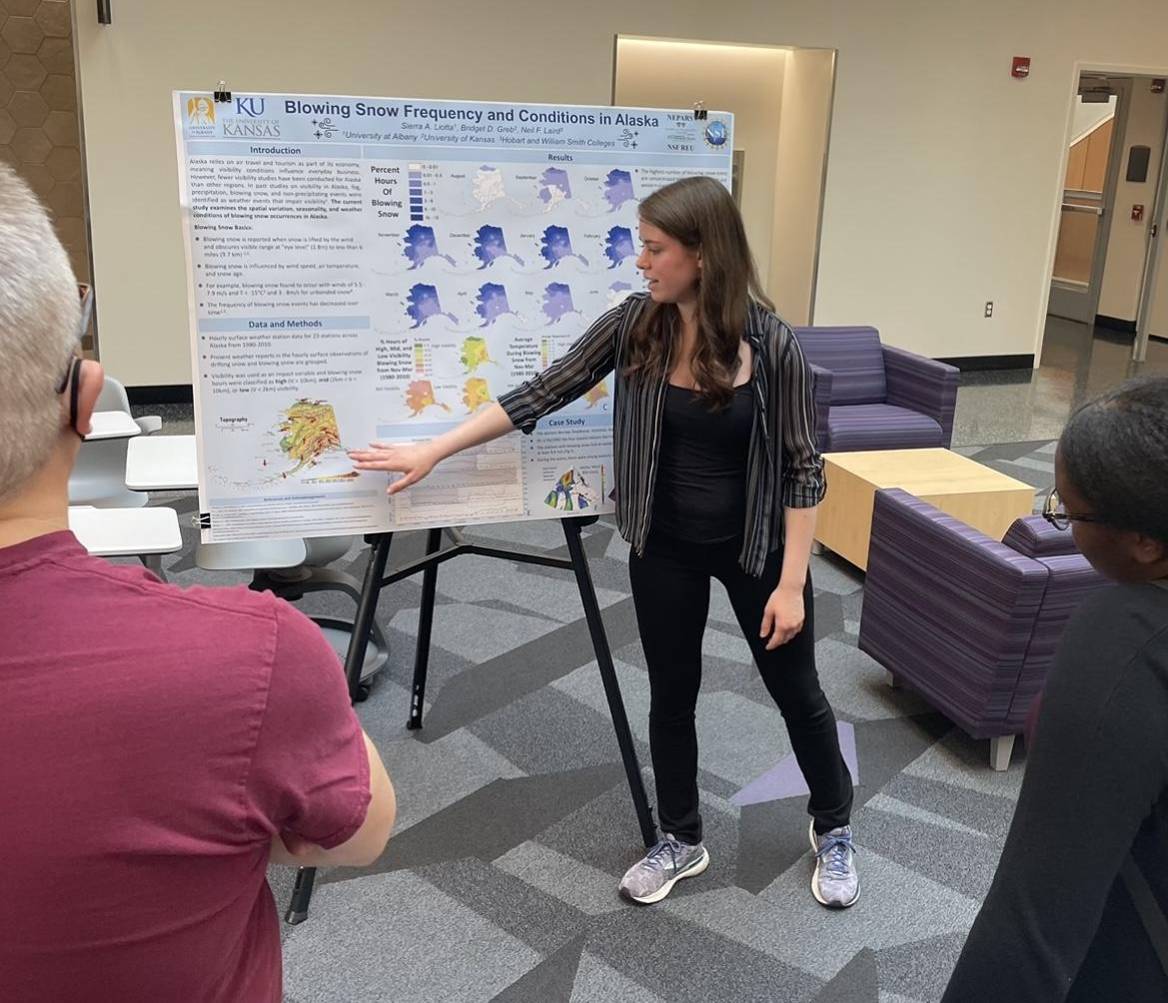
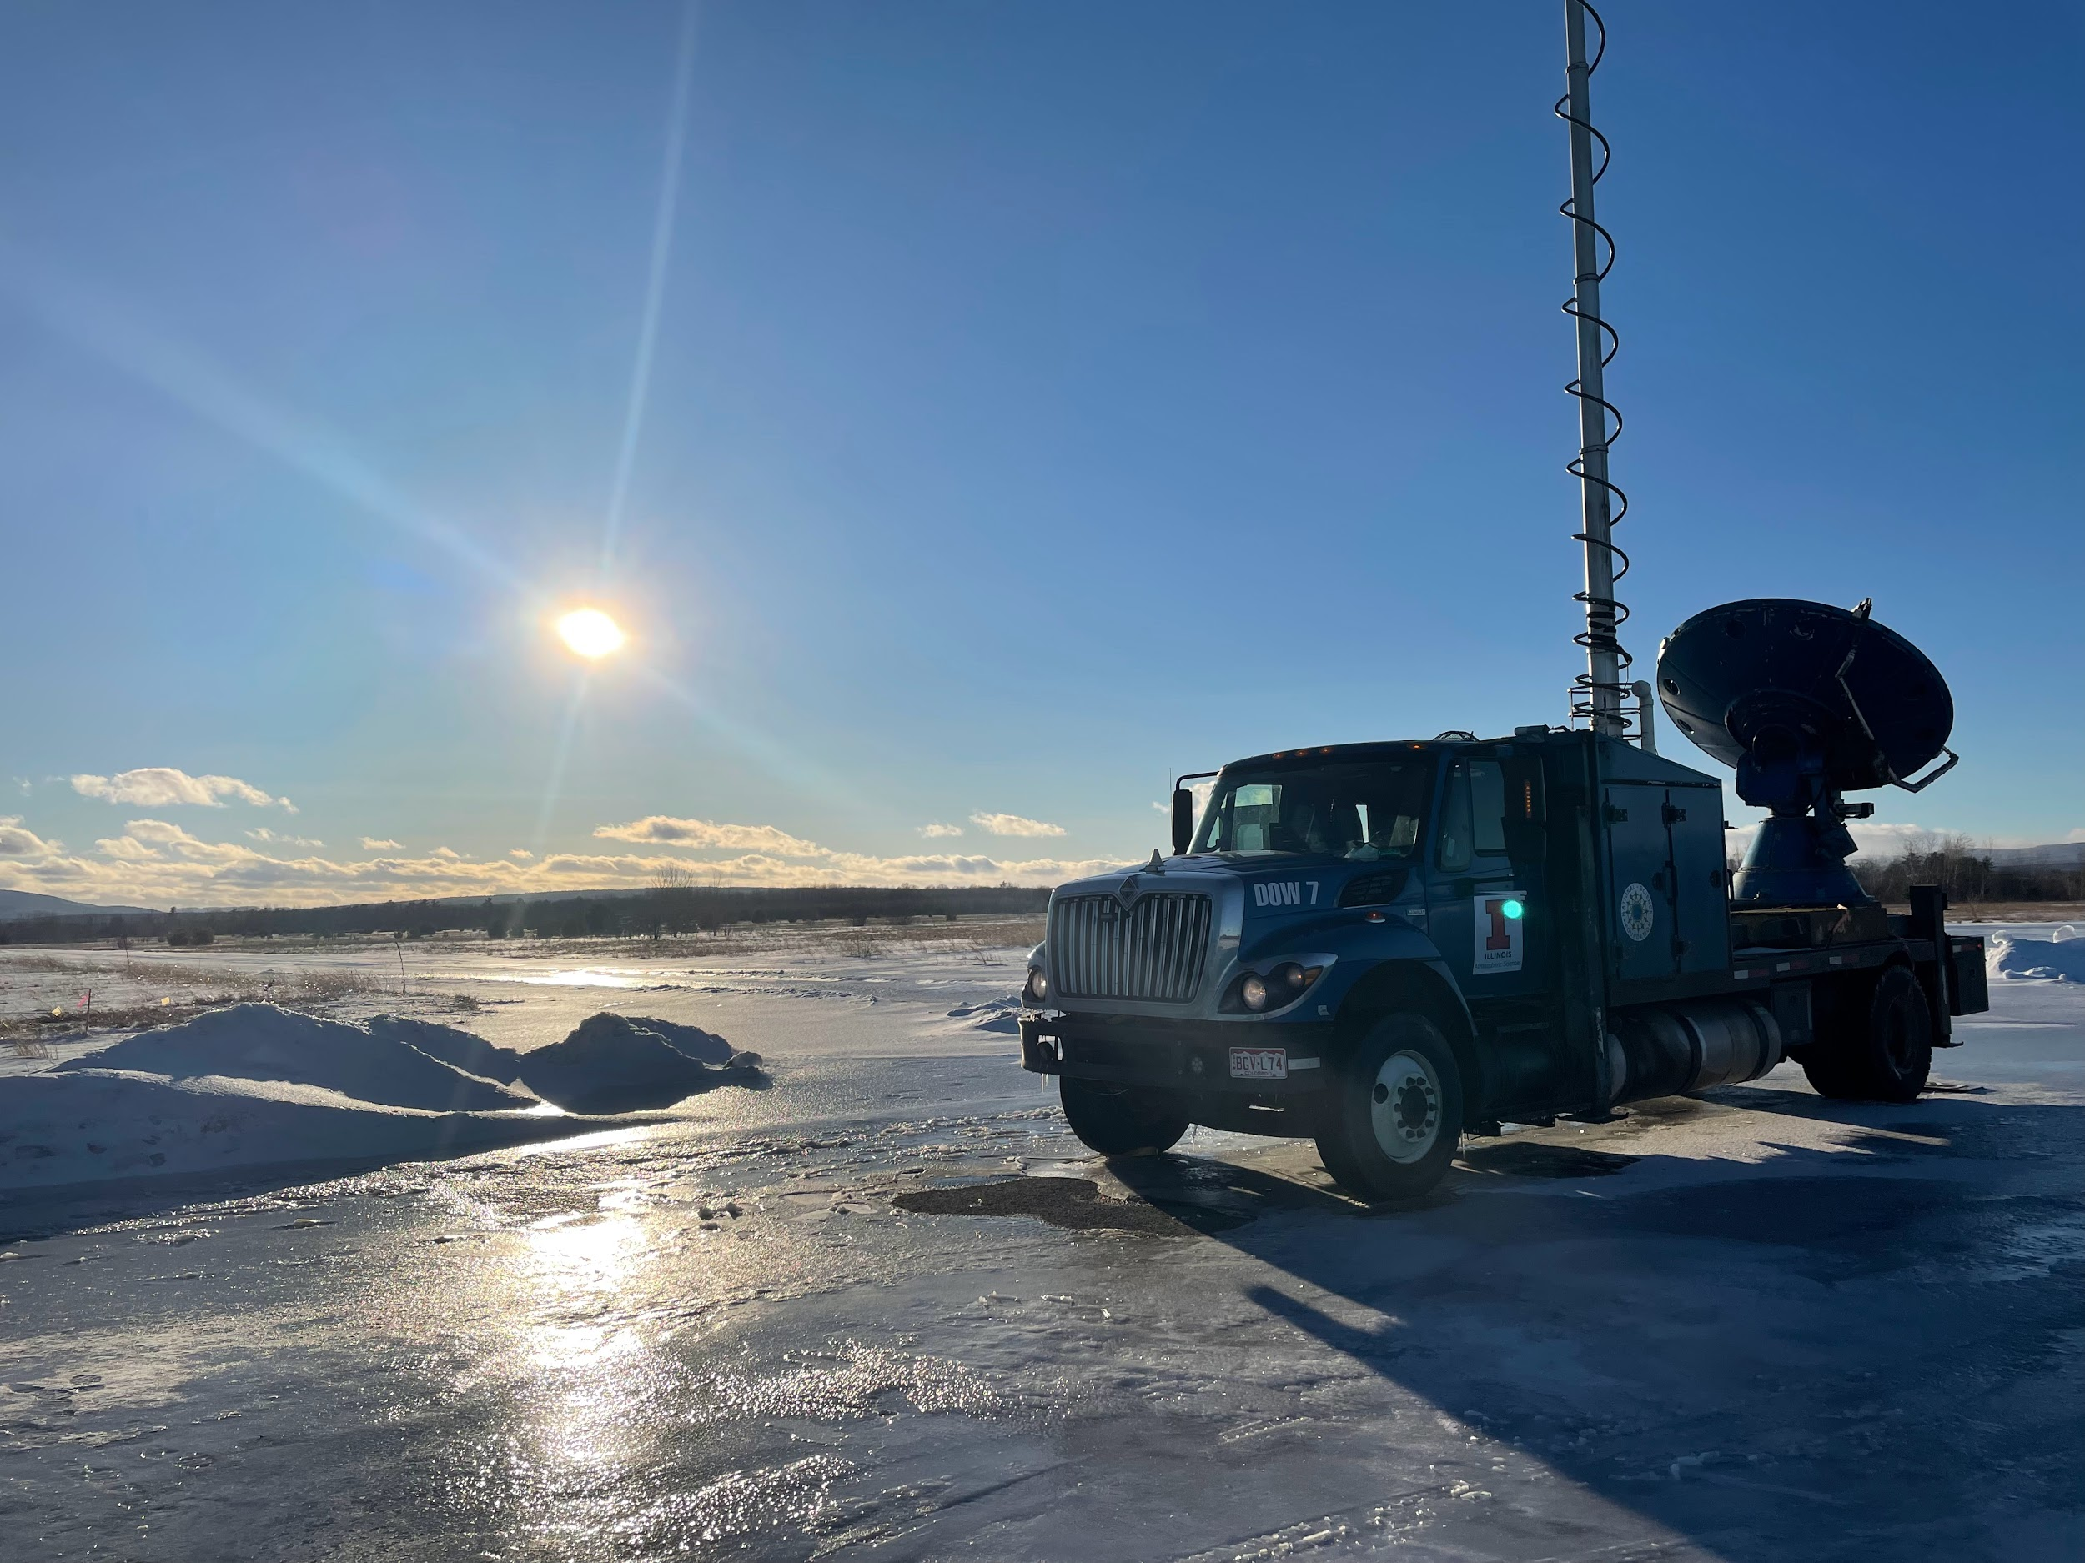
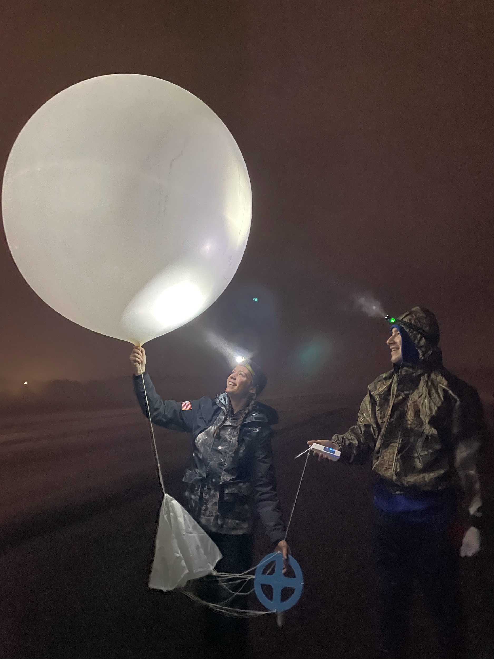
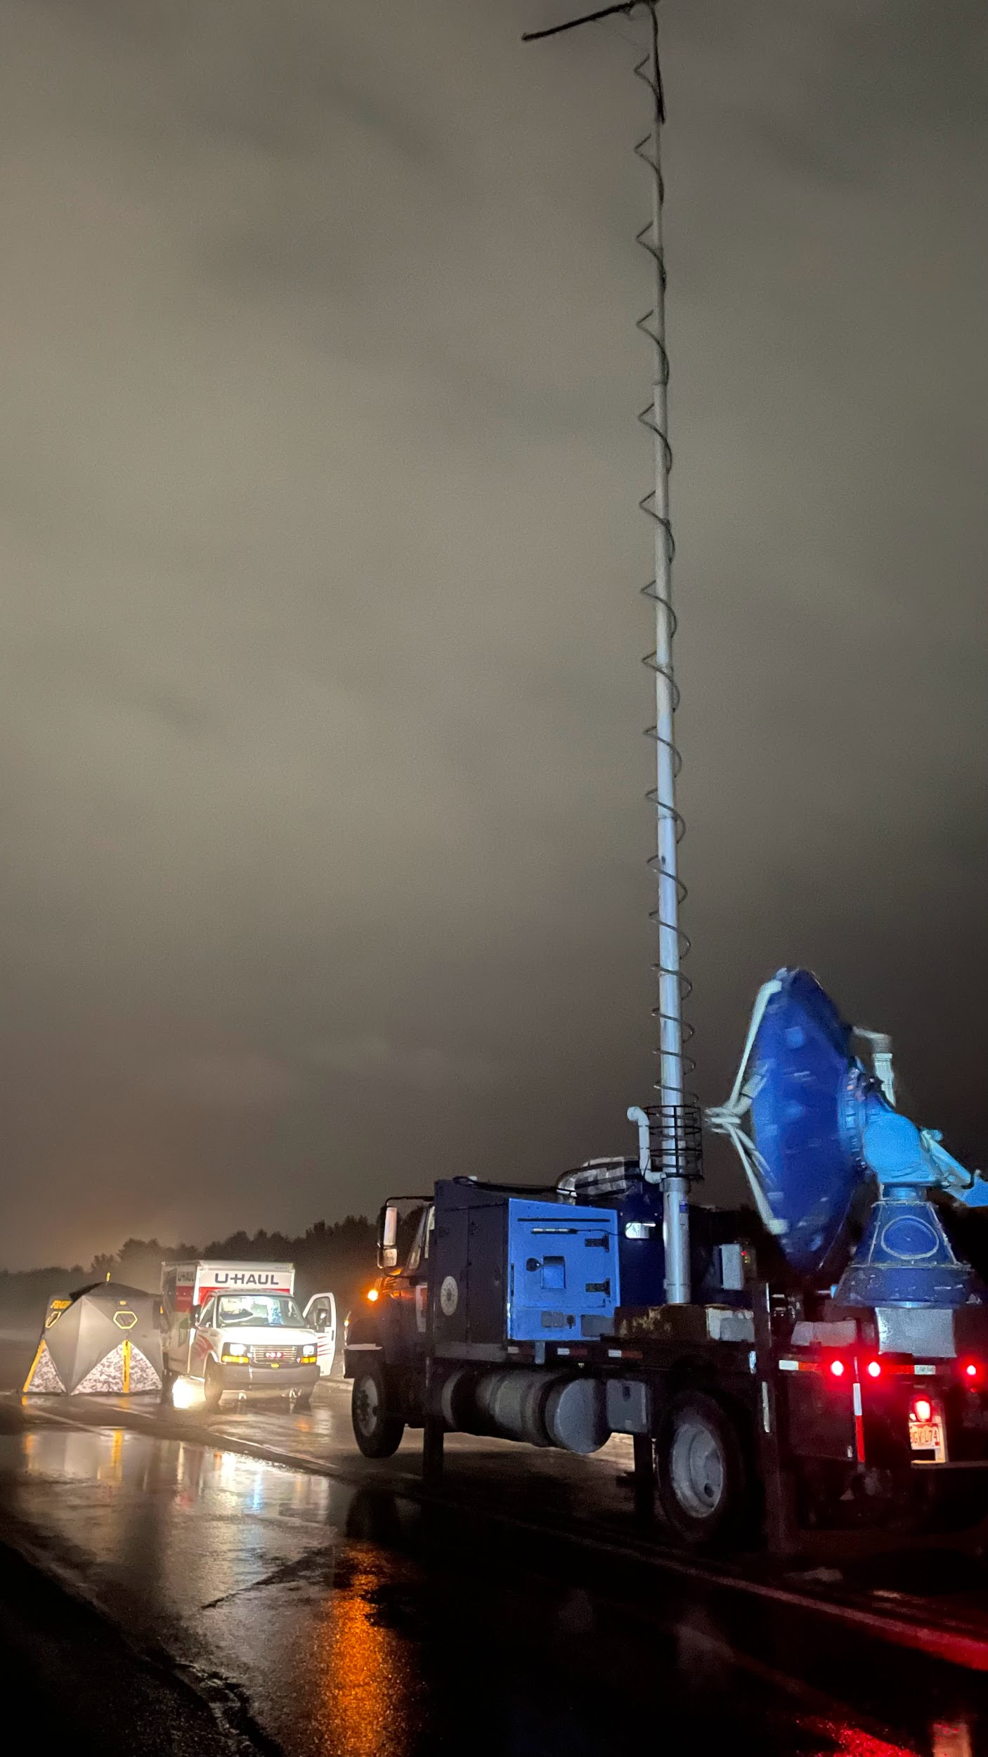
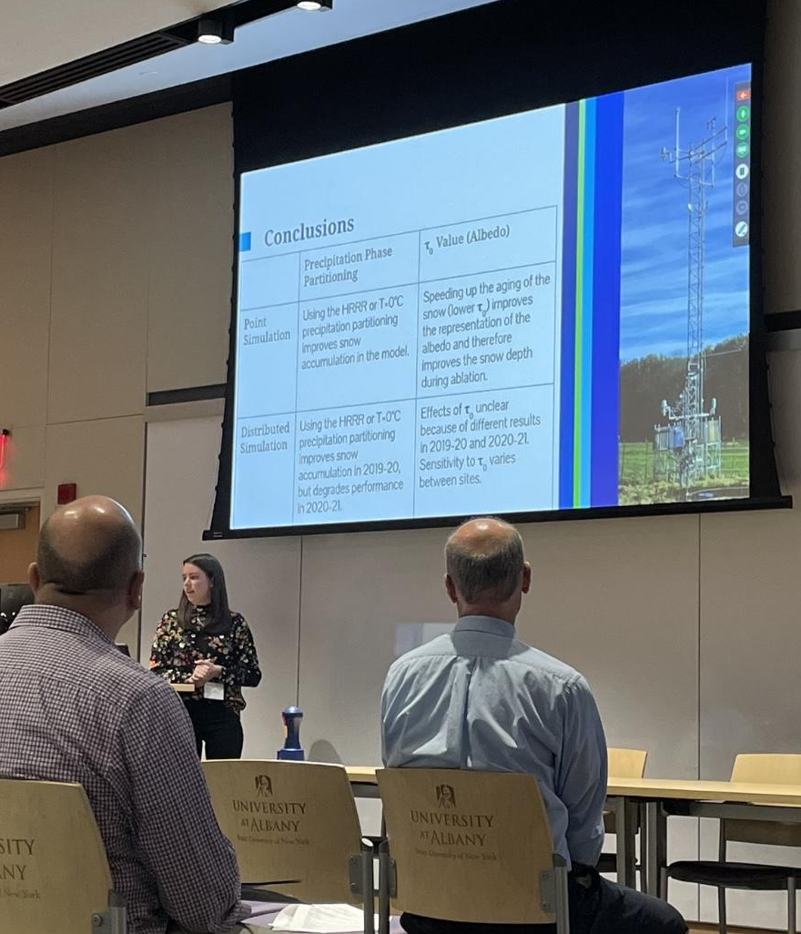


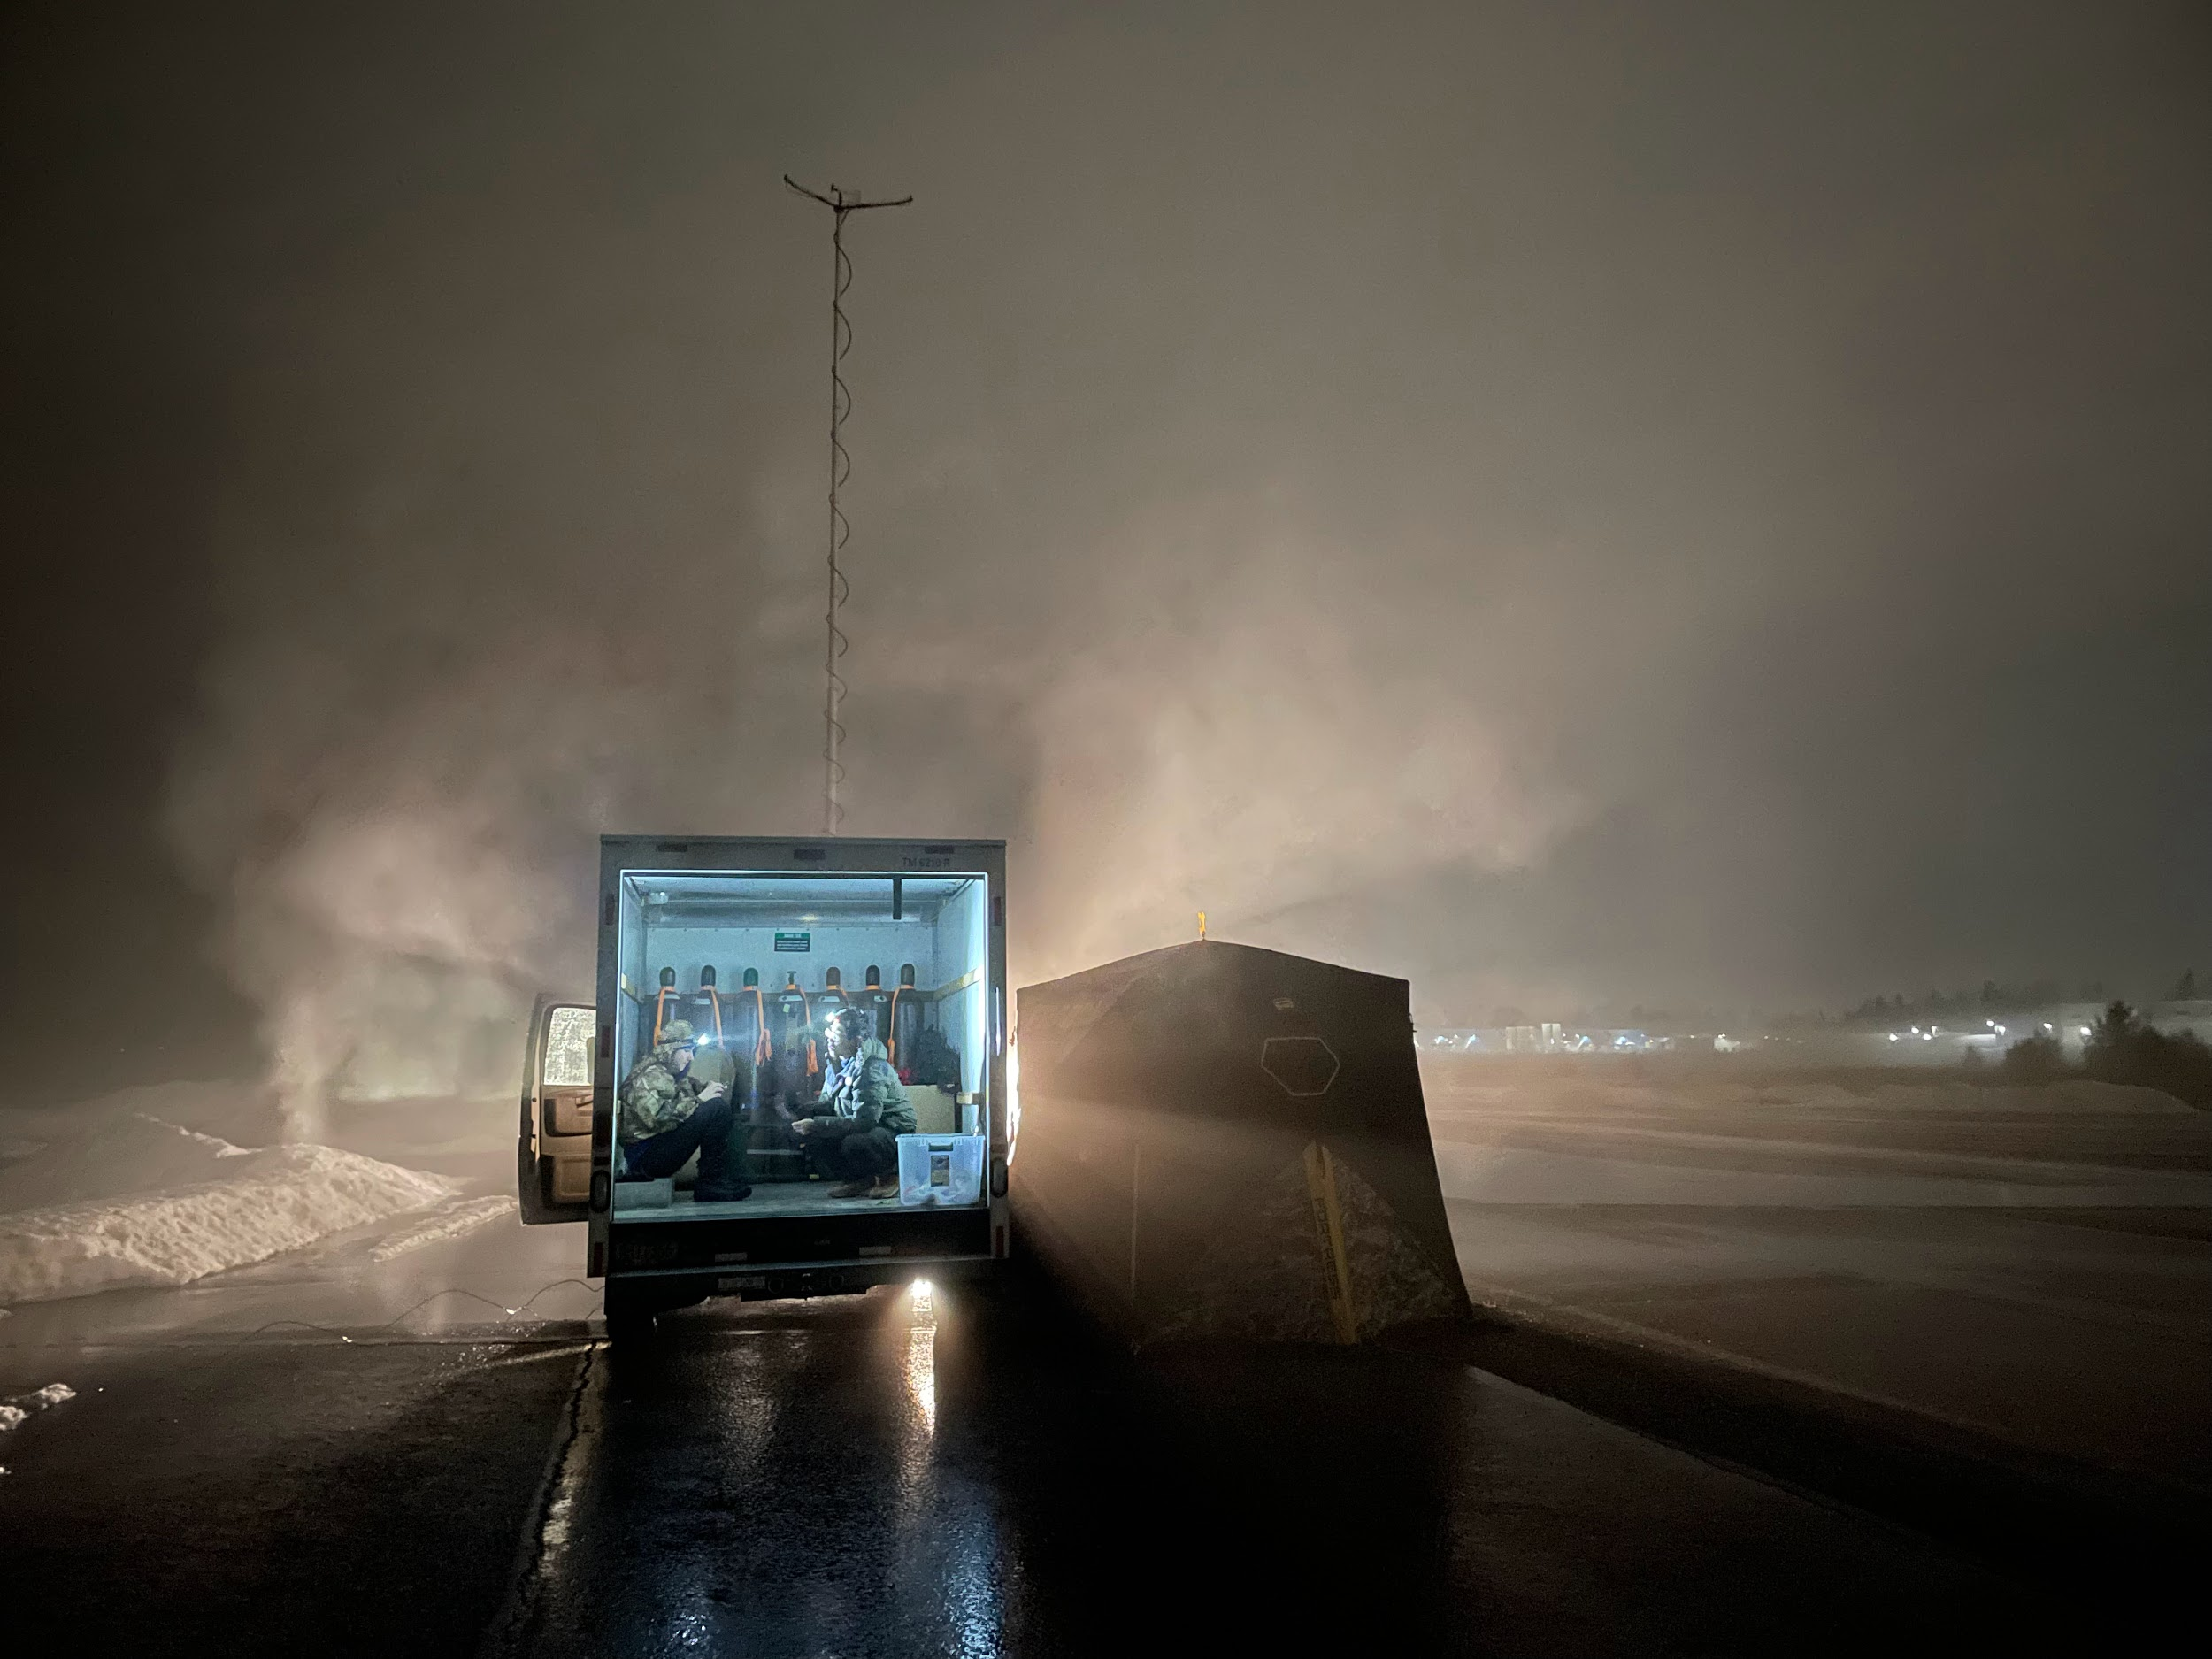
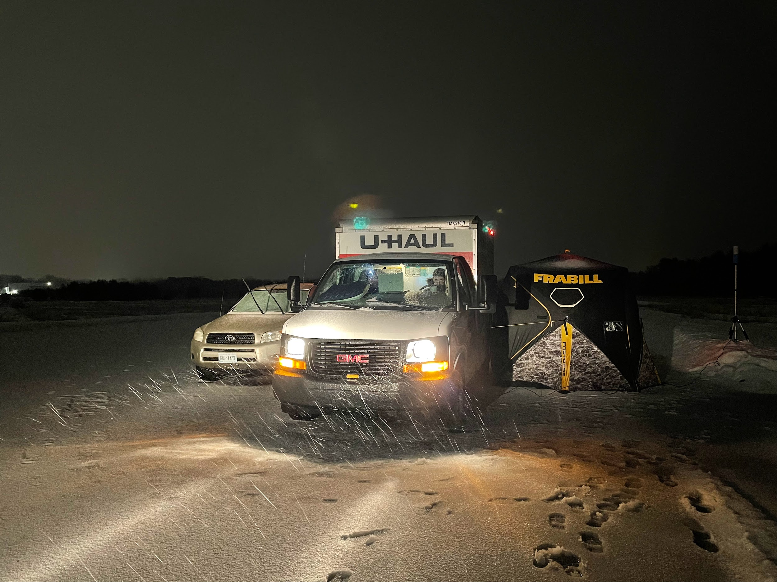
RESEARCH
OPPORTUNITIES

Slide 26
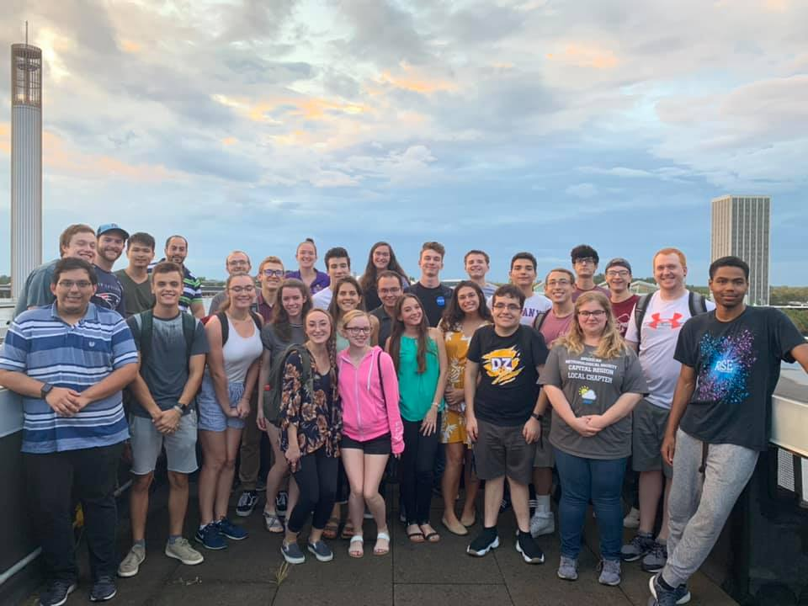
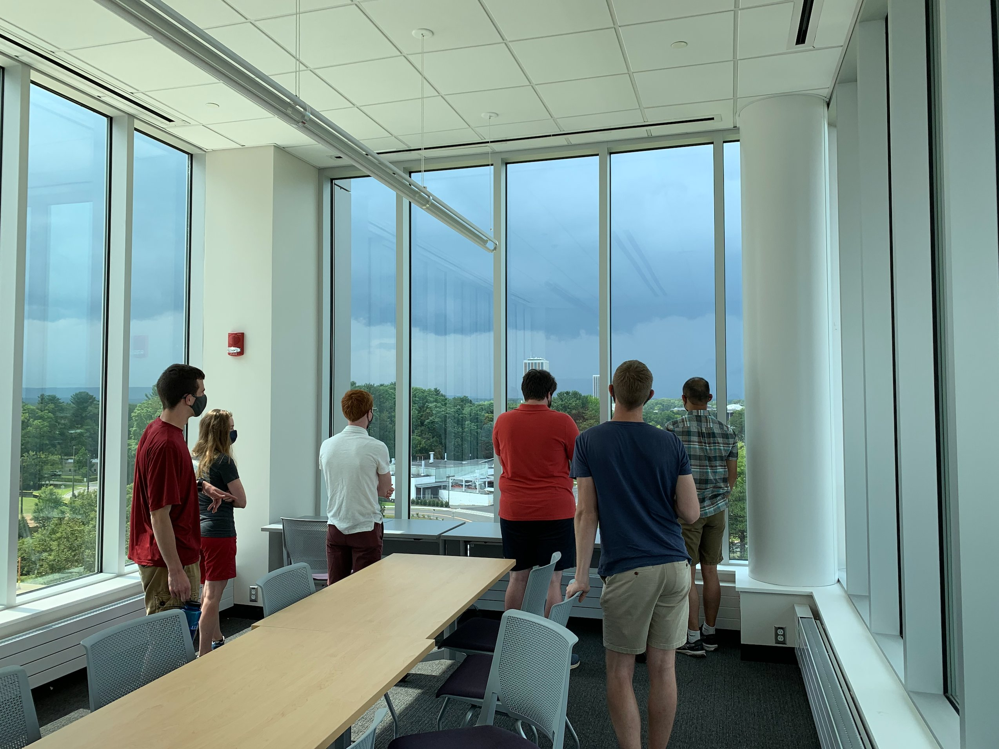
Questions?
DAES Director of Student Engagement and Recruitment: Ross Lazear – rlazear@albany.edu
Atmospheric Science undergraduate senior Sierra Liotta – sliotta@albany.edu

