Slide 1
Class #5
ATM 240 ~ Fall 2022
Robert Fovell
rfovell@albany.edu

Slide 2
“Cheat sheet”
Bookmark and visit this page for reminders regarding Python syntax and examples:
  http://www.atmos.albany.edu/facstaff/rfovell/ATM240/csheet.html
This is a “living document”

Slide 3
Class lab materials
Spawn a Terminal and type these after the prompt:
  cd /spare11/atm240/yournetid
  cp ../windplot.ipynb .
Then, type exit at the prompt and hit return
  When that’s done, you can close the tab
In your Files view, click on the atm240 link, then click on lin_chapter04.ipynb,the notebook we started last week and will finish today
[hit return]
[hit return]

Slide 4
Class roadmap
We’re going to finish the Chapter 4 walkthrough
We’ll then do the windplot demo (windplot.ipynb)
The next task (maybe not today) is to make a plot similar to windplot on your own, using a dataset I provide
Chapter 5 is on file I/O. Read it, but we’ll learn this material via practical examples instead…

Slide 5
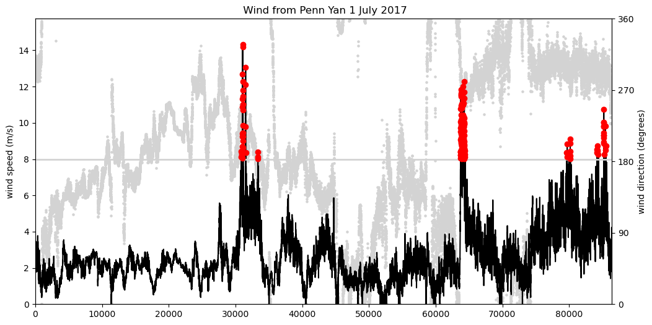
Final result of windplot.ipynb

