Slide 1
Class #6
ATM 240 ~ Fall 2022
Robert Fovell
rfovell@albany.edu

Slide 2
“Cheat sheet”
Bookmark and visit this page for reminders regarding Python syntax and examples:
  http://www.atmos.albany.edu/facstaff/rfovell/ATM240/csheet.html
This is a “living document”

Slide 3
Class lab materials
Spawn a Terminal and type these after the prompt:
  cd /spare11/atm240/yournetid
  cp ../WARMUP02.ipynb .
Then, type exit at the prompt and hit return
  When that’s done, you can close the tab
In your Files view, click on the atm240 link, then click on WARMUP02.ipynb,the notebook we started last week and will finish today
[hit return]
[hit return]

Slide 4
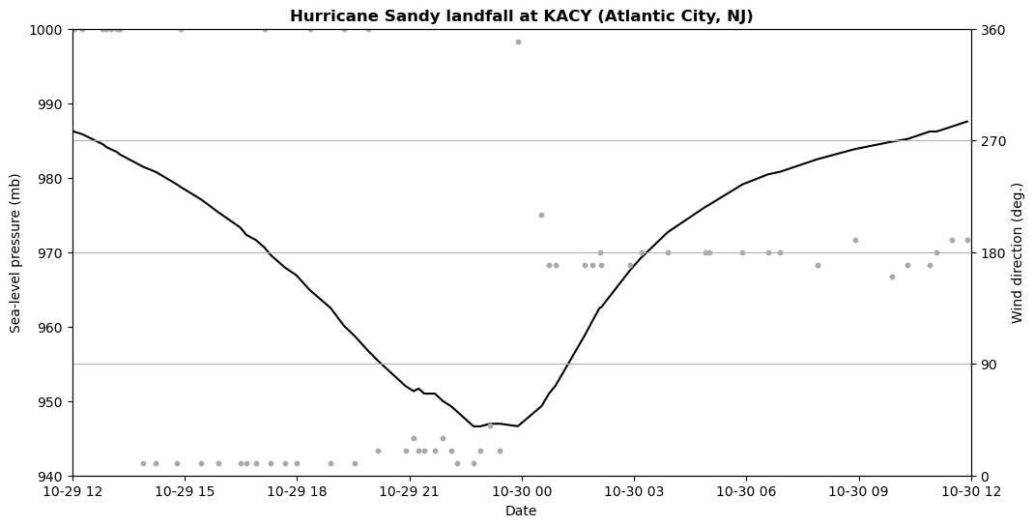
Next, we will make this plot…

Slide 5
Plotting Hurricane Sandy at landfall
You should be in your /spare11/atm240/yournetid directory
In the Files view, create a new notebook via the New menu on the upper right side.. and select “Python 3 August 2022 Environment”
See following slides for more information
Open and use your windplot.ipynb notebook for examples and sample code

Slide 6
My openers [same as windplot.ipynb]
%matplotlib inline
import numpy as np
import matplotlib.pyplot as plt
import pandas as pd
from matplotlib.ticker import MultipleLocator
# datetime
import datetime
from datetime import datetime

Slide 7
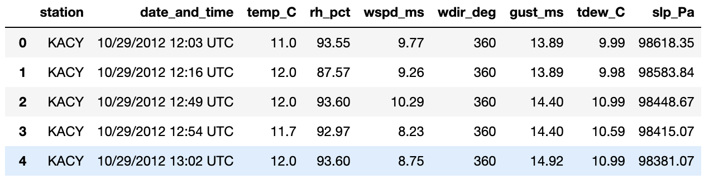
Dataset
case-sensitive name
File to read is /spare11/atm240/Sandy_KACY.csv
This is a CSV (comma-separated values) file with a header line identifying variable names and has dates
Read this file with pandas and inspect its contents
  ff = pd.read_csv(filename,parse_dates=True) # helps read date variables

Slide 8
Datetime package
Datetime makes manipulating dates/times relatively straightforward
  In my openers, I have
    import datetime
    from datetime import datetime
You can create a date variable by calling the datetime method
  start_date = datetime(2012,10,29,12) # 29 October 2012 at 12 UTC
  end_date = datetime(2012,10,30,12)
You can convert a variable read in via Pandas into a datetime variable by using pd.to_datetime
  date_temp = ff['date_and_time’] # reads in ‘date_and_time’ column
  date = pd.to_datetime(date_temp)

Slide 9
Task
Make a plot with date as the horizontal axis, SLP as the left y-axis, and wind direction as the right y-axis
Format the x-axis (using plt.xlim) between start_date and end_date, and label the axis
Format left y-axis (using plt.ylim) between 940 and 1000 mb, inclusive, and label the axis
  Note pressure in file is Pascals. I divided by 100 to get mb (hPa)
Twin the x-axis to create the 2nd y-axis (as in windplot.ipynb)
Format right y-axis (using plt.ylim) between 0 and 360 degrees, inclusive, and label the axis
Place title
Show me the result

Slide 10
MultipleLocator
Sometimes, matplotlib will not give you the axis tick labels or positions you request. MultipleLocator may help cajole matplotlib into giving you what you want
In my openers, I have
  from matplotlib.ticker import MultipleLocator
Using this for the 2nd y-axis to force tick labeling between 0 and 360 with 90 degree increments. My 2nd y-axis is “ax2”.
  ax2.yaxis.set_major_locator(MultipleLocator(90))

Slide 11
[end]

