Slide 1
Class #7
ATM 240 ~ Fall 2022
Robert Fovell
rfovell@albany.edu
[No class Tuesday, October 11 – Fall Break]

Slide 2
“Cheat sheet” reminder
Bookmark and visit this page for reminders regarding Python syntax and examples:
  http://www.atmos.albany.edu/facstaff/rfovell/ATM240/csheet.html
This is a “living document”

Slide 3
Class roadmap
Make maps using the Cartopy package, developed by the UK Met Office
Create a Terminal window, move to your /spare11/atm240/yournetid space. Then create a new notebook, specifying “Python 3 August 2022 Environment”. Call your notebook “cartopy”.
Resources for this demonstration
  This powerpoint
  Cartopy home page: https://scitools.org.uk/cartopy/docs/latest/
  Relevant MetPy Mondays videos (from Unidata):
    https://www.youtube.com/watch?v=iPJjtU7OFSQ&list=PLQut5OXpV-0ir4IdllSt1iEZKTwFBa7kO&index=5
    https://www.youtube.com/watch?v=bSdAqiVmrhA&list=PLQut5OXpV-0ir4IdllSt1iEZKTwFBa7kO&index=26

Slide 4
Cell #1 - Openers
%matplotlib inline
import numpy as np
import matplotlib.pyplot as plt
import pandas as pd
import cartopy.crs as ccrs # cartopy coordinate reference system
import cartopy.feature as cfeat # features like color-shading for land, ocean, coastlines, state boundaries
# these interface with operating system
import sys
import os

Slide 5
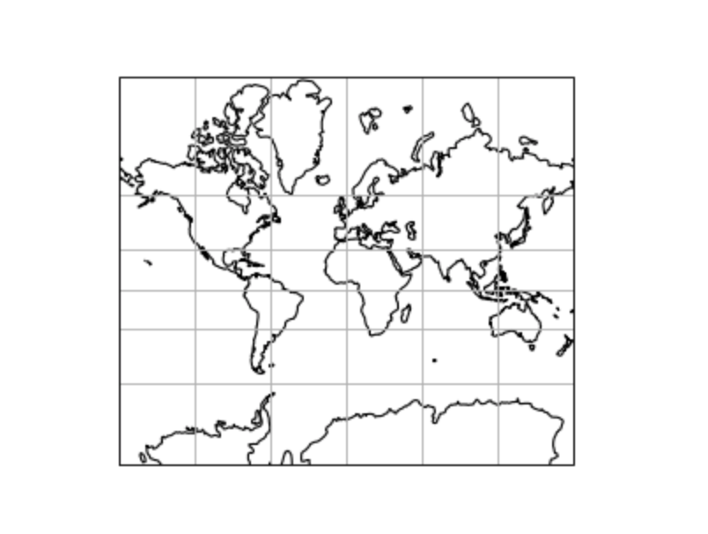
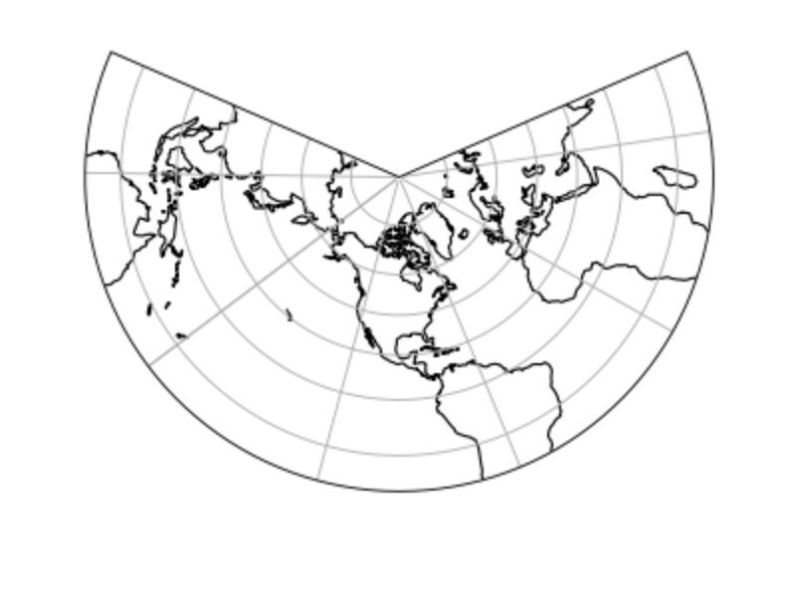
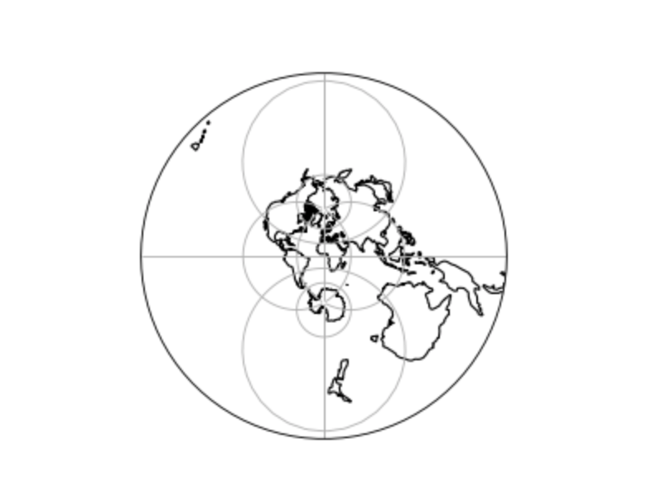
Map projections
https://scitools.org.uk/cartopy/docs/latest/reference/projections.html
Mercator – often used for the tropics
Lambert Conformal –
often used for midlatitudes
Stereographic –
often used for polar regions

Slide 6

Cell #2 – A basic plot
fig = plt.figure(figsize=(10,8))
ax = fig.add_subplot(1,1,1,projection=ccrs.LambertConformal()) # using LambertConformal projection
LambertConformal defaults to 39˚N 96˚W
[close to Topeka, KS]
but we don’t see any detail - yet

Slide 7
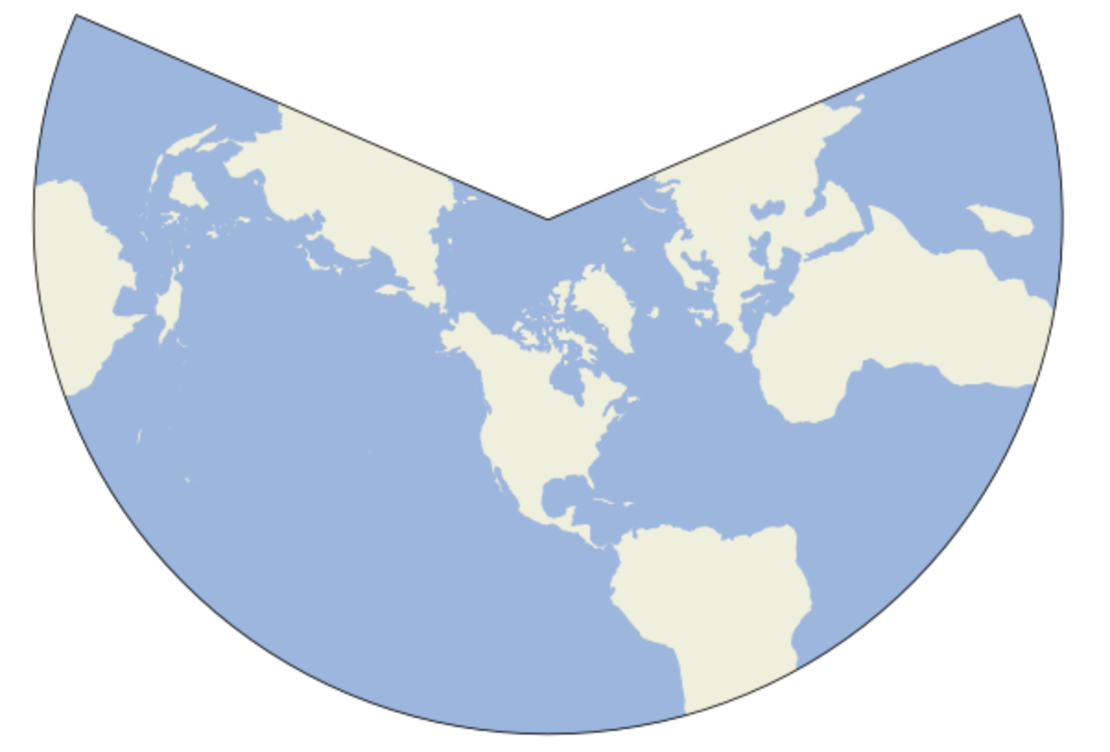
Cell #3 – Add land/ocean shading “features”
ax.add_feature(cfeat.LAND) # adds colorshading [yellowish] to land areas
ax.add_feature(cfeat.OCEAN) # adds colorshading [bluish] to ocean areas
fig
Invoking the figure object ‘fig’
again re-renders it, with new stuff added
Notes:
Havent done that before but that’s one reason we create objects like ‘fig’

Slide 8
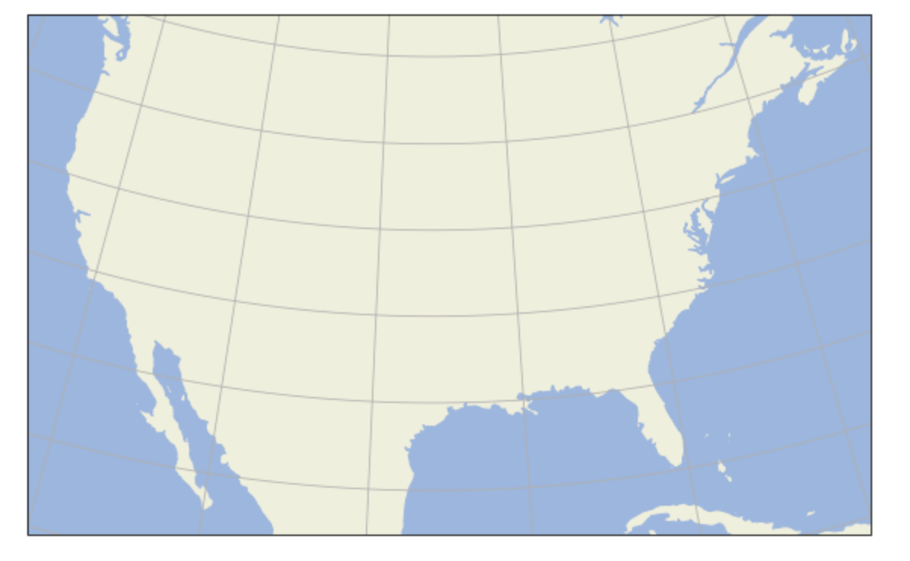
Cell #4 – Limit plot extent, add gridlines
ax.set_extent([-120,-70,20,50]) # west,east,south,north
ax.gridlines()
fig

Slide 9
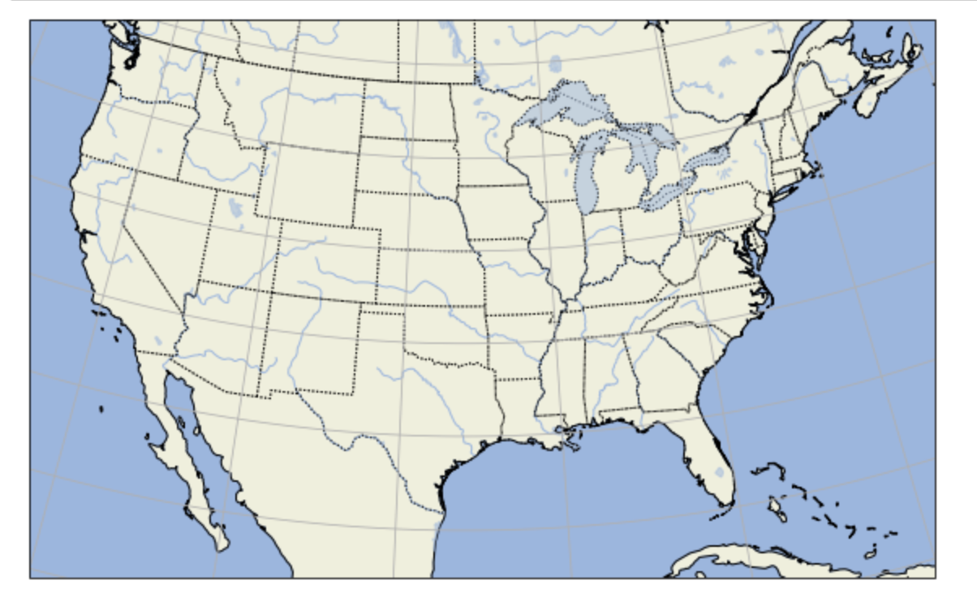
Cell #5 – Add more features
ax.add_feature(cfeat.COASTLINE)
ax.add_feature(cfeat.BORDERS,linestyle=':') # colon asks for dotted line
ax.add_feature(cfeat.LAKES,alpha=0.5) # alpha sets transparency level
ax.add_feature(cfeat.RIVERS)
ax.add_feature(cfeat.STATES,linestyle='dotted') # 'dotted' is equivalent to ':'
fig

Slide 10
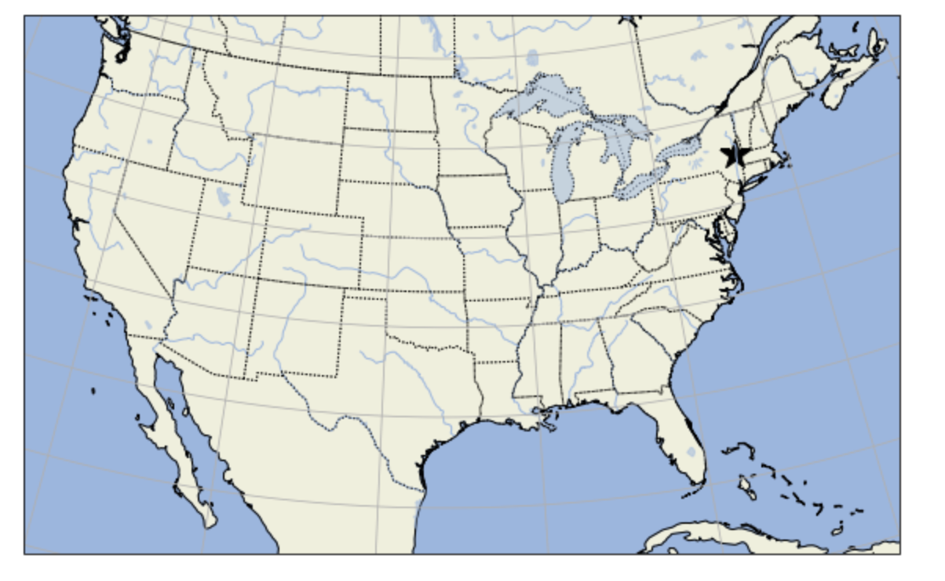
Cell #6 – Place a marker on the map
# we're specifying a lon/lat. Need a 'transform' to convert it to x/y coordinates.
# That is accomplished with PlateCarree() transform in ccrs (PlateCarree = French ‘flat square’)
ax.scatter(-73.8,42.7,marker='*',s=400,c='k',transform=ccrs.PlateCarree())
fig
We specified lon/lat of Albany,
marker type (* = star)
marker size ‘s=400’
marker color ‘k’
Notes:
Scatter plot with one point

Slide 11
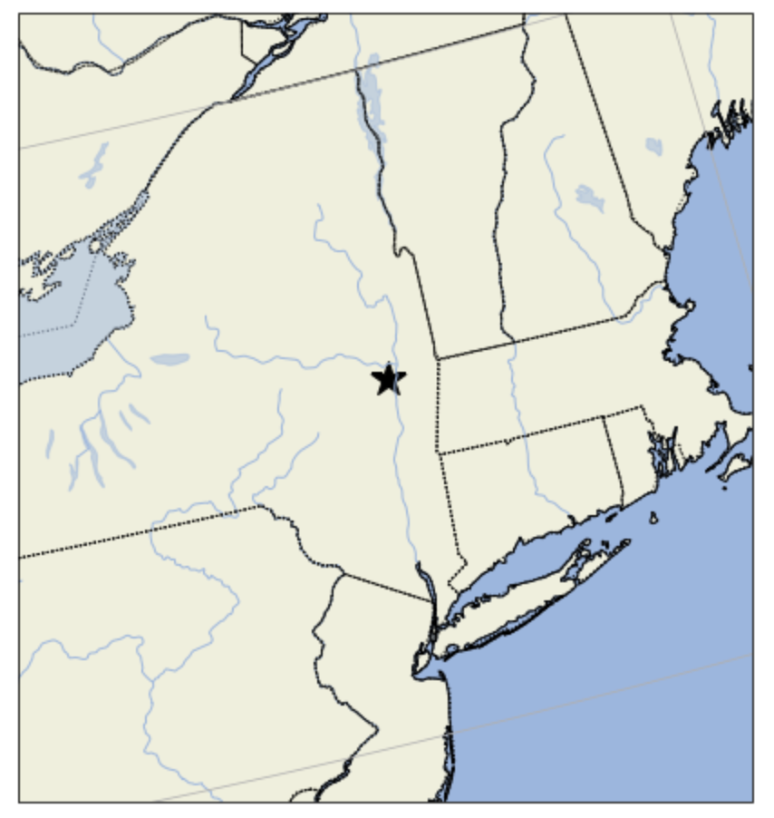
Cell #7 – Zoom in on our region
# zoom in on our region
# this could take a while to run
ax.set_extent([-77,-71,40,45])
fig
We specified lon/lat of Albany,
marker type (* = star)
marker size ‘s=400’
marker color ‘k’
Remember our standard longitude
defaulted to Topeka, KS… we’ll fix that soon
Notes:
Scatter plot with one point

Slide 12
Cell #8 – Read in NYS Mesonet location data
'''
stid,number,name,lat [degrees],lon [degrees],elevation [m]
ADDI,107,Addison,42.04036,-77.23726,507.614
ANDE,111,Andes,42.18227,-74.80139,518.282
BATA,24,Batavia,43.01994,-78.13566,276.12
BEAC,76,Beacon,41.52875,-73.94527,90.1598
BELD,90,Belden,42.22322,-75.66852,470.37
BELL,30,Belleville,43.78962,-76.11373,144.78
'’’
df = pd.read_csv('/spare11/atm240/NYSM.csv’)
print(' ready…')
Don’t type in these lines
… this is to show you what the data look like
First line (header) → variable names
This is a comma-separated-values (CSV) file consisting of:
stationid, station_number, station_name, latitude, longitude, elevation
We read it with Pandas, as before
Notes:
At this point, also introduce rest of PPT, then go back to this to work on it

Slide 13
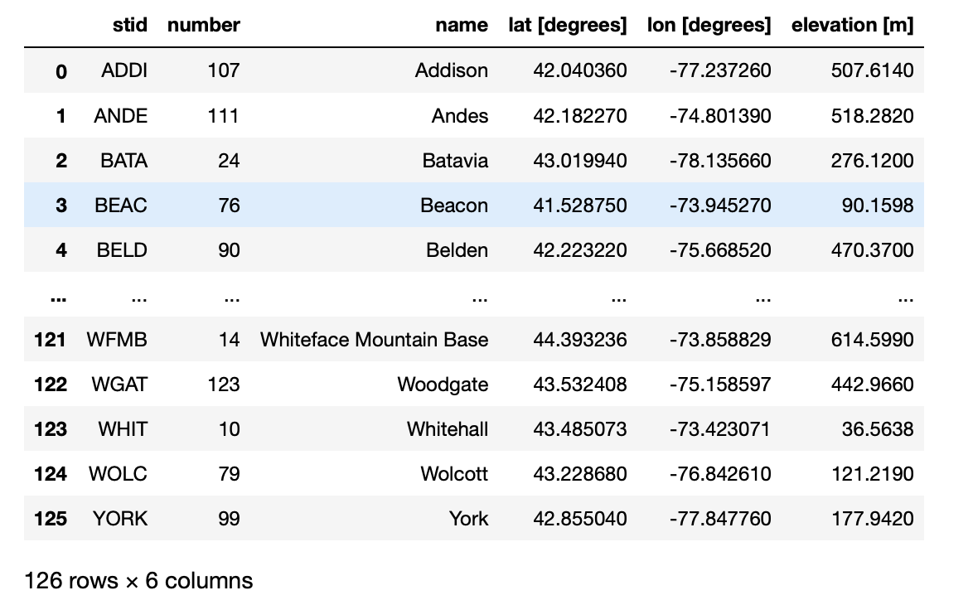
Cell #9 – Look inside the file
df
Useful for discovering
precisely what variable
(column) names are…
Notes:
At this point, also introduce rest of PPT, then go back to this to work on it

Slide 14
Cell #10 – Extract variables
lat=df['lat [degrees]'] # note there is a space embedded in these column names
lon=df['lon [degrees]']
elev=df['elevation [m]']
print(" number of stations ",len(lat))
Read in these data
You can read in only latitude, longitude, and elevation and skip the others
How many stations are there?
Notes:
At this point, also introduce rest of PPT, then go back to this to work on it

Slide 15
Cell #11 – Configure a new map
# Our map is using a default central latitude and longitude that aren't working well for the Northeast
# Let's make a new map, specifying more reasonable values, and set the extent to capture the entire state
# (watch out for Long Island)
lat_0 = 43 # central latitude for map (it defaulted to 39N)
lon_0 = -75 # central longitude for map (it defaulted to 96W)
fig = plt.figure(figsize=(10,8)) # reusing the fig object
ax = fig.add_subplot(1,1,1,projection=ccrs.LambertConformal(central_latitude=lat_0, central_longitude=lon_0))
To this new map [adding code to this cell]
Add features such as ocean and land, lakes, rivers, coastline, state boundaries, etc.
Select a set_extent that fits the entire state. Don’t cut off Long Island!
Plot NYS mesonet surface stations as dots on the map. Play around with marker style/size. Make it look nice!
https://matplotlib.org/stable/api/_as_gen/matplotlib.pyplot.scatter.html
Add a title [plt.title(“ Here is my title”)]
My plot is on the next slide
Notes:
Northeast is “tilted” w/r/t North

Slide 16
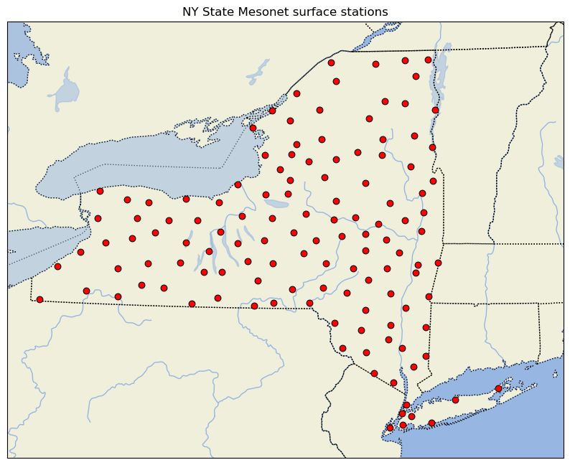
Notes:
I didn’t plot coastlines to help see stations on Long Island

Slide 17
Task
Create a map of the NYS Mesonet surface stations with station markers color-coded by station elevation
ax.scatter(lon,lat,color=statcolor,s=40,edgecolor='black',linewidth=0.75,zorder=2,
transform=ccrs.PlateCarree())
In this scatterplot call, color is set to an array called statcolor with same length as lon and lat, but containing colors
like ‘k’ (black), ‘w’ (white), ‘r’ (red), ‘y’ (yellow), ‘g’ (green)
Consider creating a numpy array, of dtype string, assigning colors based on elevation via an IF/ELIF/ELSE block
Put your name somewhere on the plot, save it as a PNG, and email or show it to me
My plot is on the slide after next
https://matplotlib.org/stable/gallery/color/named_colors.html ← Named colors (see next slide)

Slide 18
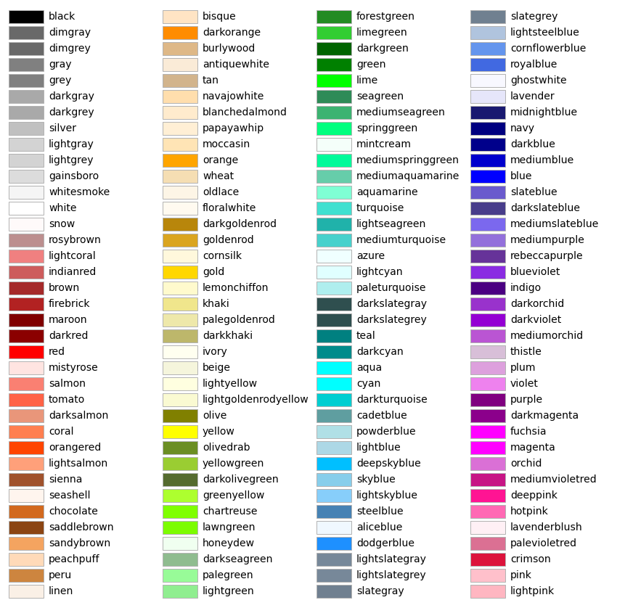
Matplotlib’s named colors

Slide 19
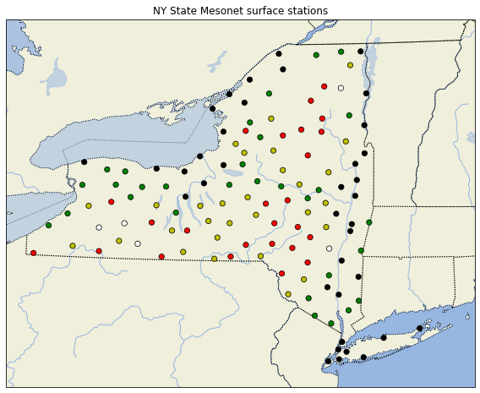
NY Mesonet sites color-coded by elevation MSL
My plot:
0 ≤ elev ≤ 150: black
150 < elev ≤ 300: green
300 < elev ≤ 450: yellow
450 < elev ≤ 600: red
600 < elev: white

Slide 20
Extra #1: adding a background image
Reference: http://earthpy.org/cartopy_backgroung.html
{not a typo, it’s “backgroung”}

Slide 21
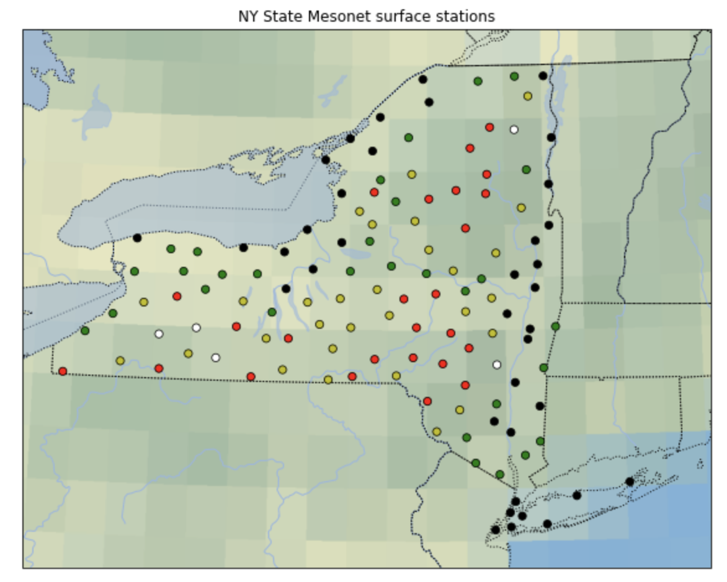
Background images - 1
You can add a default background image by invoking matplotlib’s stock_img() method in your code. At this writing, there’s only one image available and it’s not very high resolution
ax.stock_img()
Notes:
Works for CONUS but not regions

Slide 22
Background images - 2
You can add your own image via the technique described next. First, add these lines to your openers, or just before you need them:
Next, specify where your background images are. You can use the images already stored in this directory:
import sys
import os
os.environ["CARTOPY_USER_BACKGROUNDS"] = "/spare11/atm240/BACKGROUND/"

Slide 23
Background images - 3
Next, invoke your image using the background_img method
In this case, the keyword ‘topo’ refers to an entry in /spare11/atm240/BACKGROUND/images.json file, a plain text file representing the image catalogue
  In that file, ‘topo’ with resolution ‘high’ points to image ‘topo_hires.jpeg’
  If resolution ‘low’ is selected, the image ‘topo_lores.jpeg’ are used
  Images were from https://neo.gsfc.nasa.gov/view.php?datasetId=SRTM_RAMP2_TOPO
  At this writing, only low and high resolution images are included in my catalogue
ax.background_img(name='topo', resolution='high')

Slide 24
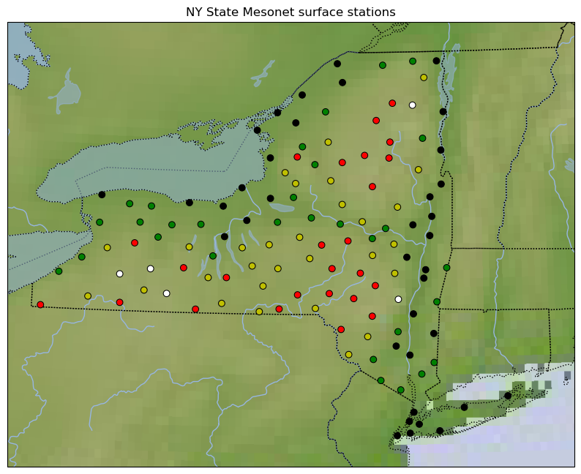
With ‘topo_hires.jpeg’ background image

Slide 25
Extra #2: using HRRR model topography
HRRR = High-Resolution Rapid Refresh model

Slide 26
HRRR topo - 1
We can read in the HRRR model’s topography and plot it beneath our Mesonet stations, to help us visualize the terrain better. The HRRR is based on the WRF model and uses a 3-km horizontal grid spacing.
First, we need to load some packages that help us manipulate NetCDF files and WRF model data. Then read in the HRRR topo file:
from netCDF4 import Dataset
from wrf import getvar
location = "/spare11/atm240/BACKGROUND/"
file = "geo_em.d01_HRRRV4.nc" # HRRR model’s ‘geogrid’ file
ncfile = Dataset(location + file)
hgt = getvar(ncfile,"HGT_M") # terrain height (m)
latwrf = getvar(ncfile,"XLAT_M") # latitude
lonwrf = getvar(ncfile,"XLONG_M") # longitude

Slide 27
HRRR topo - 2
fig = plt.figure(figsize=(10,8)) # reusing the fig object
ax = fig.add_subplot(1,1,1,projection=ccrs.LambertConformal(central_latitude=lat_0,
central_longitude=lon_0)) # using LambertConformal projection
ax.set_extent([-80,-71.5,40.2,45.25])
ax.add_feature(cfeat.LAND) # adds colorshading [yellow] to land areas
ax.add_feature(cfeat.OCEAN) # adds colorshading [blue] to ocean areas
ax.add_feature(cfeat.COASTLINE,alpha=0.5)
ax.add_feature(cfeat.BORDERS,linestyle=':') # colon asks for dotted line
ax.add_feature(cfeat.LAKES,alpha=0.5) # alpha sets transparency level
ax.add_feature(cfeat.RIVERS)
ax.add_feature(cfeat.STATES,linestyle='dotted') # 'dotted' is equivalent to ‘:’
norm = plt.Normalize(0, 1500)
cm = ax.pcolormesh(lonwrf,latwrf,hgt,shading='auto',norm=norm,cmap=plt.cm.Greys,
transform=ccrs.PlateCarree())
plt.colorbar(cm, orientation="vertical",shrink=0.5,label='terrain height (m)')
ax.scatter(lon,lat,color=color,s=40, edgecolor='black',linewidth=0.75,zorder=2,
transform=ccrs.PlateCarree())
plt.title("NY State Mesonet surface stations (with HRRR topography)")
Notes:
Shading=‘flat’ no longer works when lonwrf, latwrf, hgt are all same dimensions

Slide 28
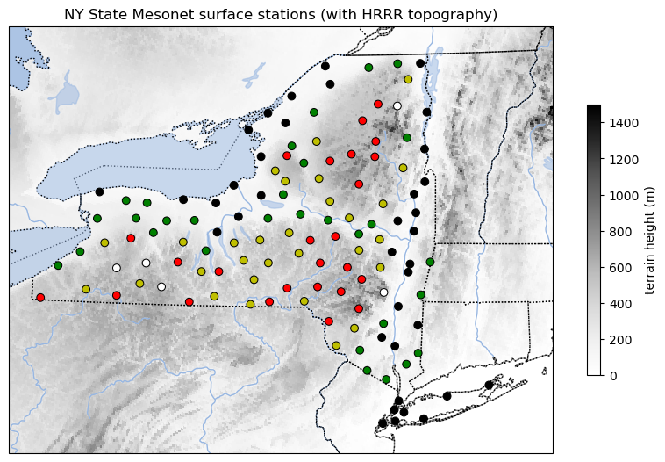

Slide 29
Extra #3: using Google tiles

Slide 30
Google tiles - 1
We can also put Google tiles imagery at a variety of resolutions beneath our plots. First, we need to load a package and define a function:
from cartopy.io.img_tiles import GoogleTiles
class ShadedReliefESRI(GoogleTiles):
# shaded relief
def _image_url(self, tile):
x, y, z = tile
url = ('https://server.arcgisonline.com/ArcGIS/rest/services/' \
'World_Shaded_Relief/MapServer/tile/{z}/{y}/{x}.jpg').format(
z=z, y=y, x=x)
return url
#
#

Slide 31
Google tiles - 2
fig = plt.figure(figsize=(10,8)) # reusing the fig object
ax = fig.add_subplot(1,1,1,projection=ccrs.LambertConformal(central_latitude=lat_0,
central_longitude=lon_0)) # using LambertConformal projection
ax.set_extent([-80,-71.5,40.2,45.25])
ax.add_image(ShadedReliefESRI(), 8) # 8 is the resolution (min 0, max 12)
ax.scatter(lon,lat,color=color,s=40, edgecolor='black',linewidth=0.75,zorder=2,
transform=ccrs.PlateCarree())
plt.title("NY State Mesonet surface stations (with HRRR topography)")
Notes:
Shading=‘flat’ no longer works when lonwrf, latwrf, hgt are all same dimensions

Slide 32
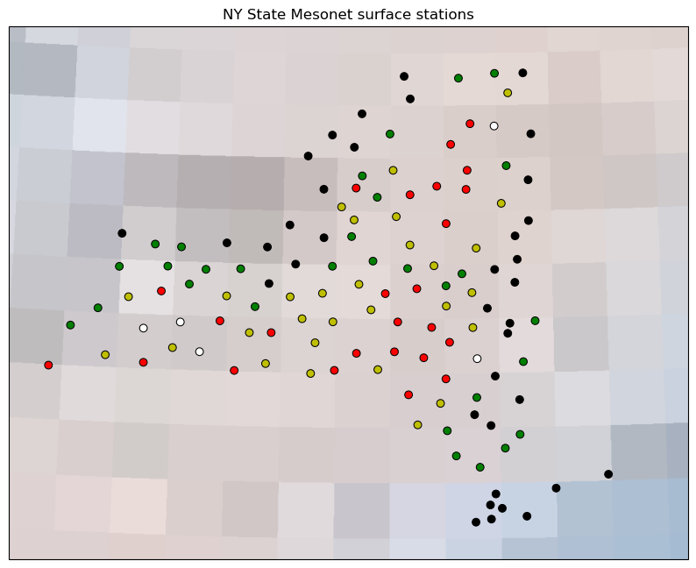
Resolution = 1
[very fast]

Slide 33
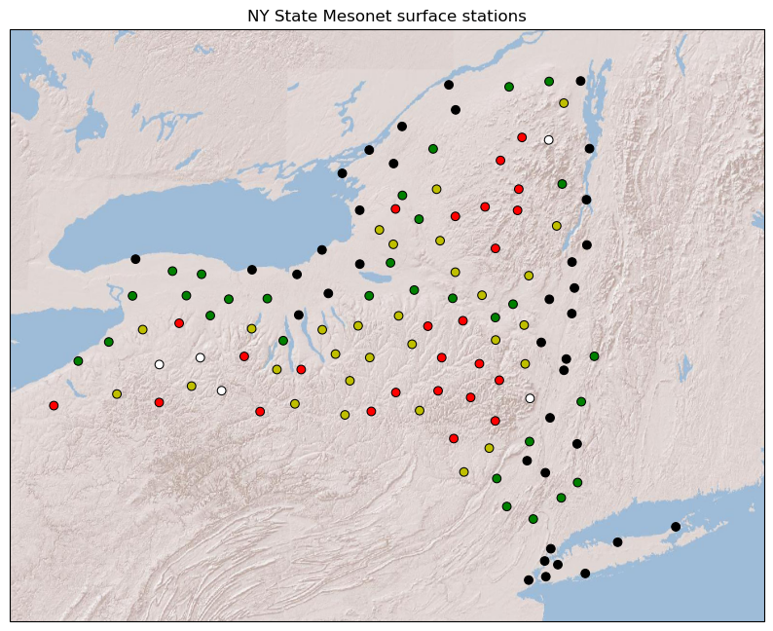
Resolution = 8

Slide 34
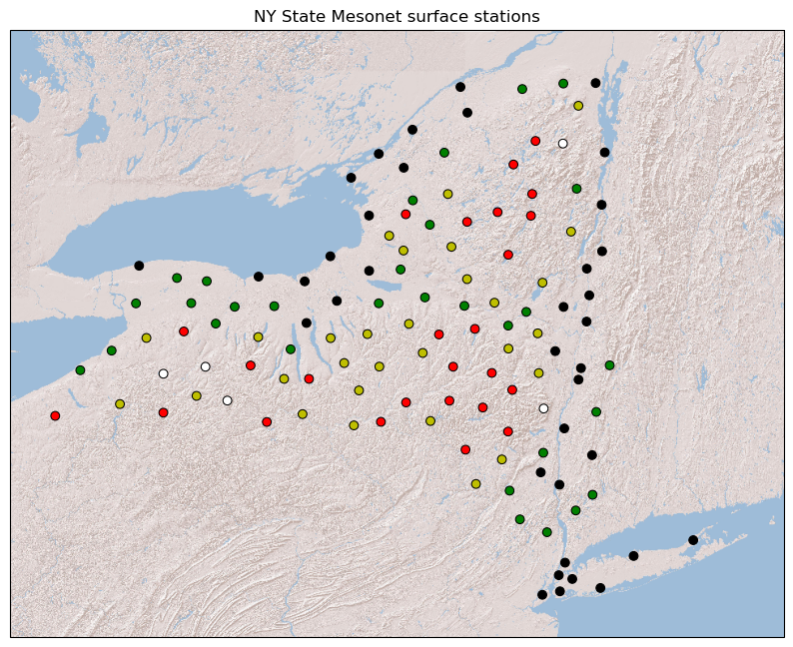
Resolution = 11
[took longer]

Slide 35
[end]

