Slide 1
Class #8
ATM 240 ~ Fall 2022
Robert Fovell
rfovell@albany.edu

Slide 2
“Cheat sheet” reminder
Bookmark and visit this page for reminders regarding Python syntax and examples:
  http://www.atmos.albany.edu/facstaff/rfovell/ATM240/csheet.html
This is a “living document”

Slide 3
Class roadmap
Today is primarily a demonstration of features of xarray, and a closer look at netCDF datasets
  xarray can be used to open structured datasets. Unlike numpy arrays, variables in xarray datasets can have coordinates and metadata (like units) attached
Create a Terminal window, move to your /spare11/atm240/yournetid space. Then copy and launch:
  cp ../irma_xarray_cartopy.ipynb .
Resources for this demonstration
  This powerpoint, and Cartopy demonstration cartopy_example.ipynb
  MetPy home page: https://unidata.github.io/MetPy/latest/index.html
  xarray basics:
    https://www.youtube.com/watch?v=_9j7Y1-lk-o&list=PLQut5OXpV-0ir4IdllSt1iEZKTwFBa7kO&index=46

Slide 4
Cell #1 - Openers
%matplotlib inline
import numpy as np
import matplotlib.pyplot as plt
import math
import os, sys
import glob
from matplotlib import cm
from matplotlib.colors import Normalize
from scipy.interpolate import interpn
import datetime
from datetime import datetime
import cartopy.crs as ccrs # cartopy coordinate reference system
import cartopy.feature as cfeat # features like color-shading for land, ocean, coastlines, state boundaries
import xarray as xr
import metpy.calc as mpcalc
from metpy.units import units
We’re not using these so they could be
removed to save some resources
The new stuff – run this and move on

Slide 5
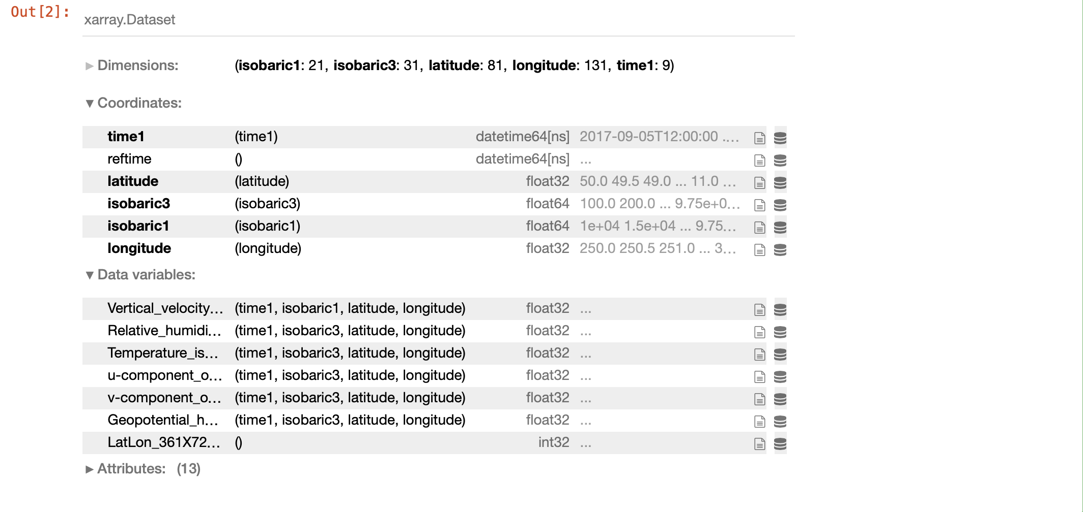
Cell #2 – Open dataset
ds = xr.open_dataset('/spare11/atm240/irma_gfs_example.nc')
ds
Use xarray to open the dataset
• This is a NetCDF dataset
Hover your cursor over variable
names to reveal partially
obscured information
Notes:
Metadata like descriptive terms and units

Slide 6
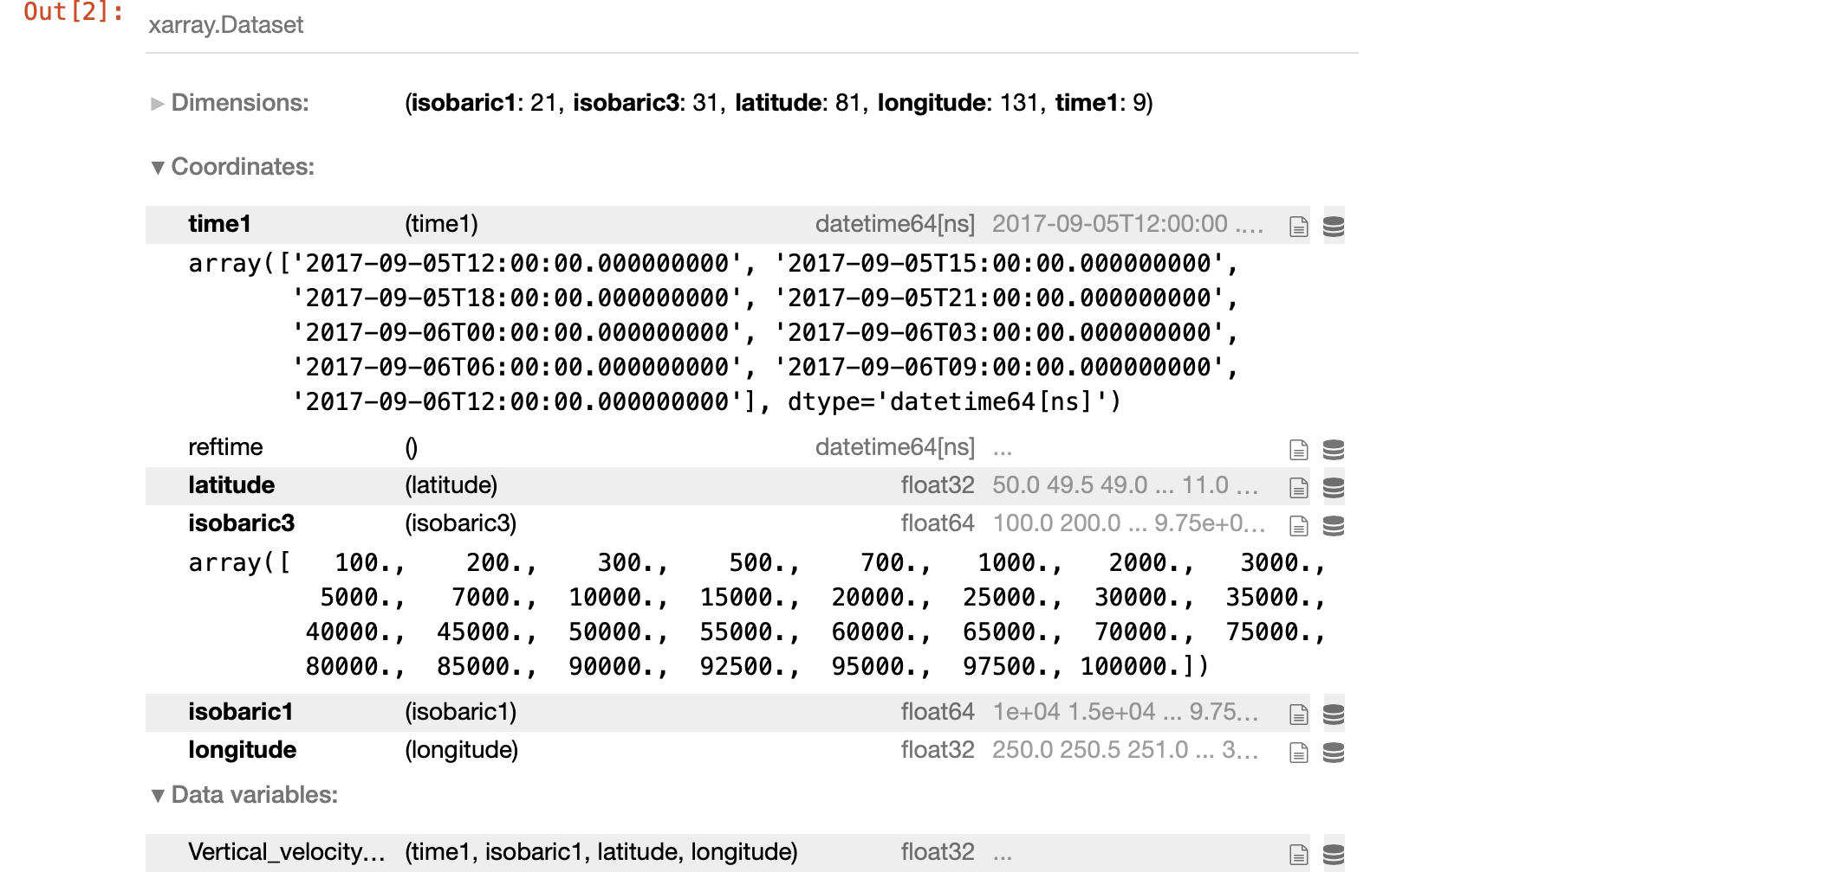
Click to expand for more information

Slide 7
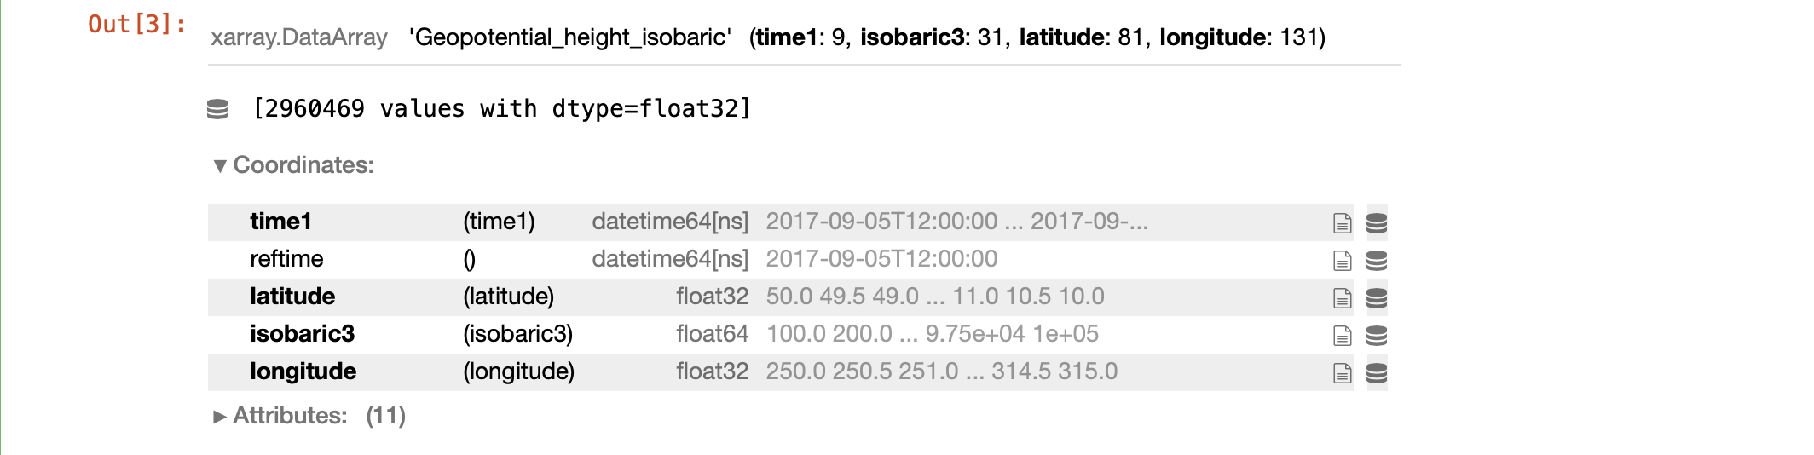
Cell #3 – Extract geopotential heights
heights = ds['Geopotential_height_isobaric']
heights
Coordinates for ‘heights’ include time1 and isobaric3.

Slide 8
Geopotential v. geometric height
Geometric height (km) | Geopotential height (km) | Gravity acceleration at 40˚N (m/s/s)
0 | 0 | 9.802
1.0 | 1.0 | 9.798
10.0 | 9.986 | 9.771
20.0 | 19.941 [0.3% error] | 9.741
30.0 | 29.864 | 9.710
Geopotential height is a gravity-adjusted height, measured above mean sea level.

Slide 9
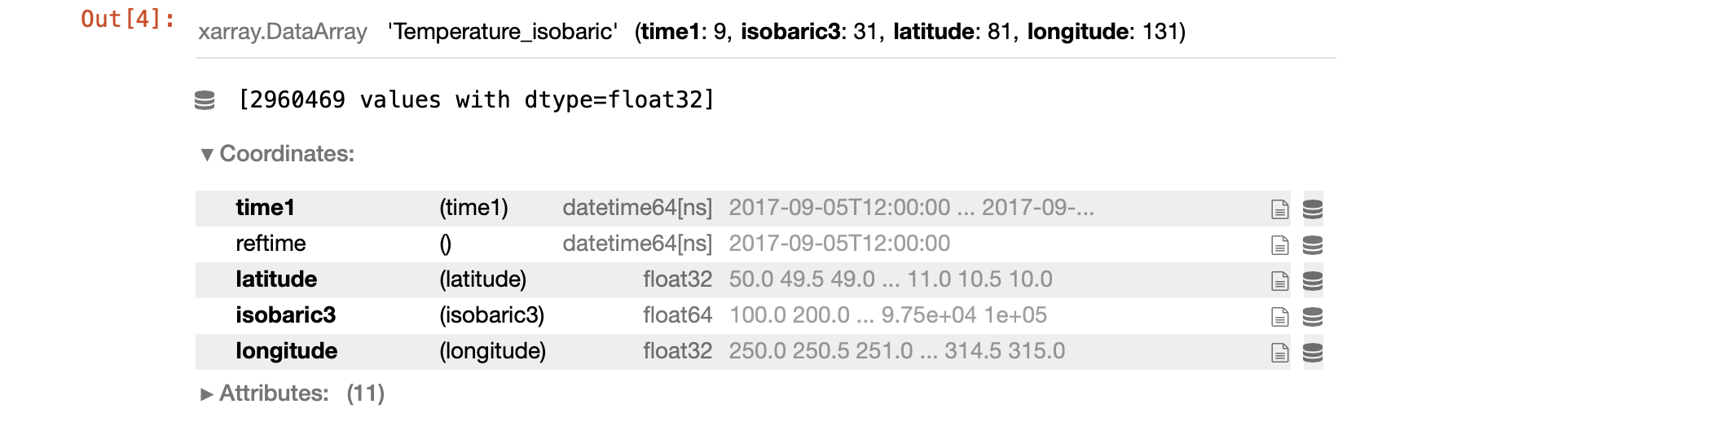
Cell #4 – Extract temperatures
temps = ds['Temperature_isobaric']
temps

Slide 10
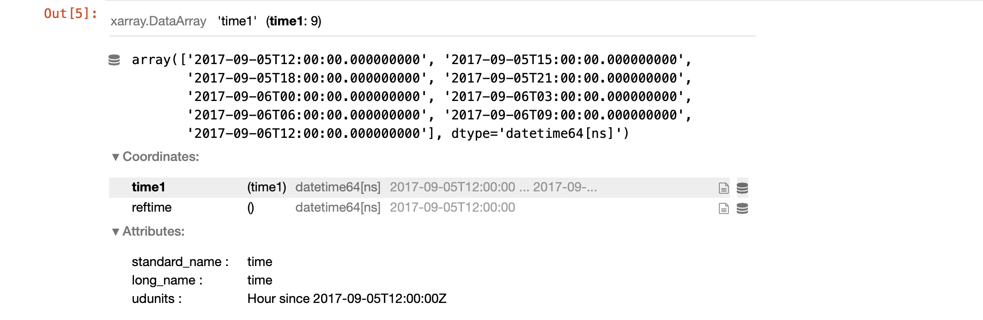
Cell #5 – Extract times
times = ds['time1']
times

Slide 11
Cells #6-8 – More coordinates being extracted
pressures = ds['isobaric3']
pressures
lats = ds['latitude']
lats
lons = ds['longitude']
lons
Notes:
Ended up not utilizing the pressures info directly but left that cell in the notebook

Slide 12
Cell #9 – Value of ‘values’ attribute
print(" max and min latitude ",np.max(lats.values), np.min(lats.values))
print(" max and min longitude ",np.max(lons.values), np.min(lons.values))
xarray arrays like lats and lons contain values, coordinates, and metadata.
Attaching ‘values’ extracts just the numeric data.
Our longitudes are clearly CCW (seen from above N Pole) from the prime meridian 0-360,
so 315˚ is east of 250˚.

Slide 13
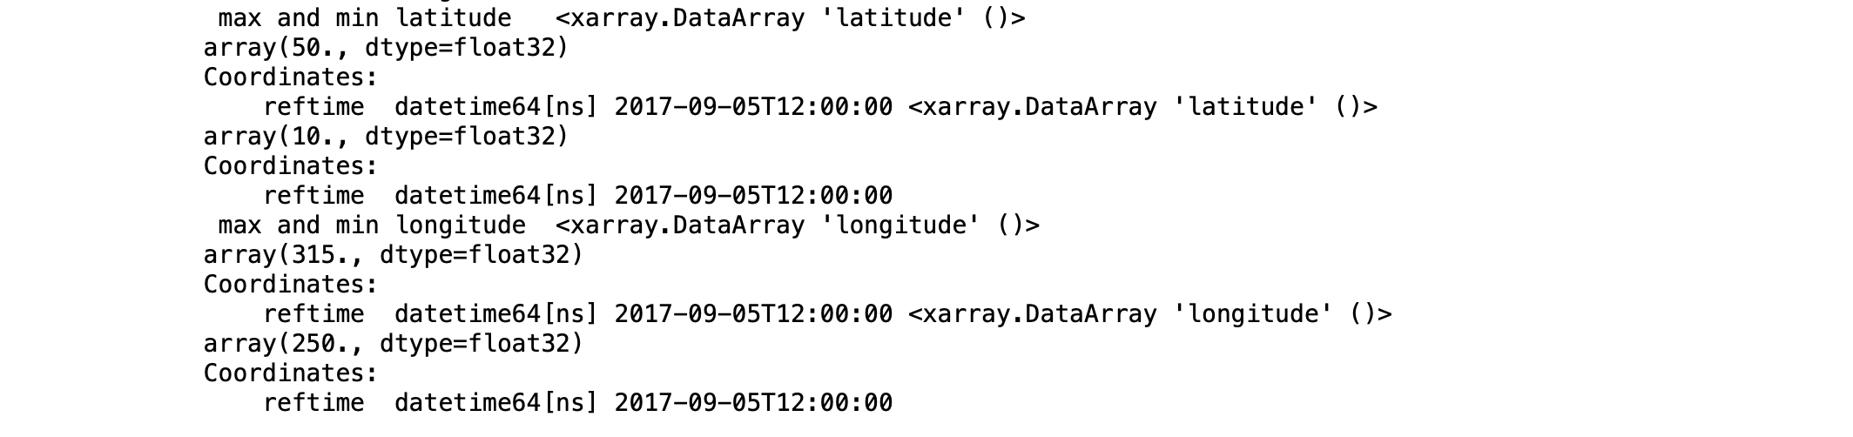
With & without ‘values’
print(" max and min latitude ",np.max(lats), np.min(lats))
print(" max and min longitude ",np.max(lons), np.min(lons))
Output with ‘values’
Without ‘values’ same information is there, just messier

Slide 14
Cell #10 – Get 850 mb height @ specific time
# Let's grab 850 mb heights for a single time
# I already extracted geopotential height and called it "heights"
# But "heights" contains multiple vertical (isobaric) levels and multiple times
# Here I select ["sel"] one specific level (850 mb = 85000 Pa) for one time, defined in datetime format
hgt_850_2017090606 = heights.sel(time1='2017-09-06T06:00',isobaric3=85000.)
# find the minimum 850 height
minheight=np.min(hgt_850_2017090606.values)
print(" min 850 mb height is ",minheight)

Slide 15
Cell #11 – Make a Cartopy plot [task]
# MAKE CARTOPY PLOT
# plot 850 mb height for the selected time
# REFER TO YOUR cartopy_example.ipynb NOTEBOOK FOR EXAMPLES AND POINTERS
# Create a figure and an axis and select a map projection
# Add some Cartopy features like LAND, OCEAN, etc.
# Use this plot extent
# Format is [west_long, east_long, south_lat, north_lat]
#ax.set_extent([250,315,10,45])
# My version (next slide) used projection=ccrs.PlateCarree()
# My version used height contour interval of 30 starting with 840 m
# My version added some gridlines with ax.gridlines

Slide 16
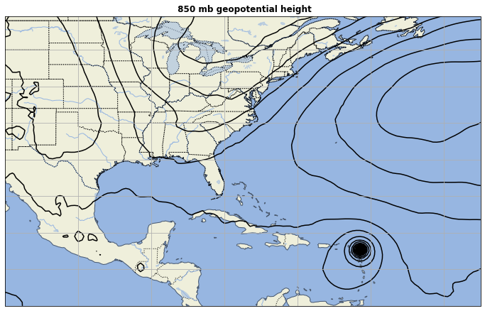

Slide 17
Cell #12 – Another Cartopy plot
# Make another Cartopy plot for the same plot area
# but first extract temperature for the same level and time
# Recall above we created the variable "temps", which includes all available levels and times
# My plot (next slide) used pcolormesh for 850 mb temperature with colormap cmap = plt.cm.RdBu_r
# and superimposed the same 850 mb height contours as the last plot
# the plt.cm.RdBu colormap runs red (for low values) to blue (for high values)
# adding “_r” at the end reverses the colormap

Slide 18
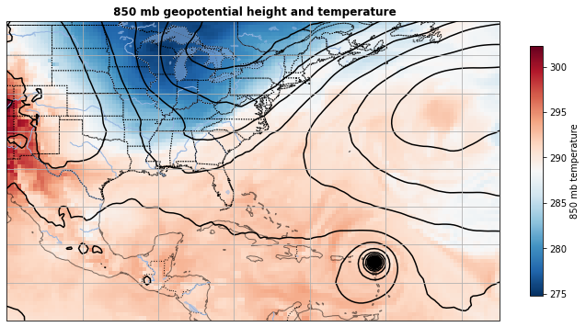

Slide 19
Cell #13 – Start a vertical sounding
# where (lat/lon) is that min 850 mb height located? This approach is inspired by Lin-2012 Chapter 3
# this is not the only way this could be accomplished
condition = np.equal(hgt_850_2017090606,minheight) # uses the logical function np.equal(x,y). Looks for x=y
print(condition)
answer_indices = np.where(condition)
print(answer_indices) # this yields a two-element array, 0th element being x and 1th being y
xx = answer_indices[0] # this is the x-coordinate of the location of minheight [i.e., latitude N-S]
yy = answer_indices[1] # and this is the y-coordinate
print(xx,yy)
# lat and lon corresponding to xx, yy
irma_lat = lats[xx]
irma_lon = lons[yy]
print(irma_lat.values, irma_lon.values)
Set condition where our 850 mb height variable equals the min value found in Cell #10
Extract the x and y coordinates where that min value occurs → [65] [97]
Find the latitude and longitude for those x, y coordinates → [17.5] [298.5]
Notes:
Could have used np.equal(hgt_850_2017090606.values,minheight) because hgt* has metadata/cords and minheight does not. That also works and makes output on next slide a little tidier
Note x coord is LATITUDE because it’s first in the dimension list

Slide 20
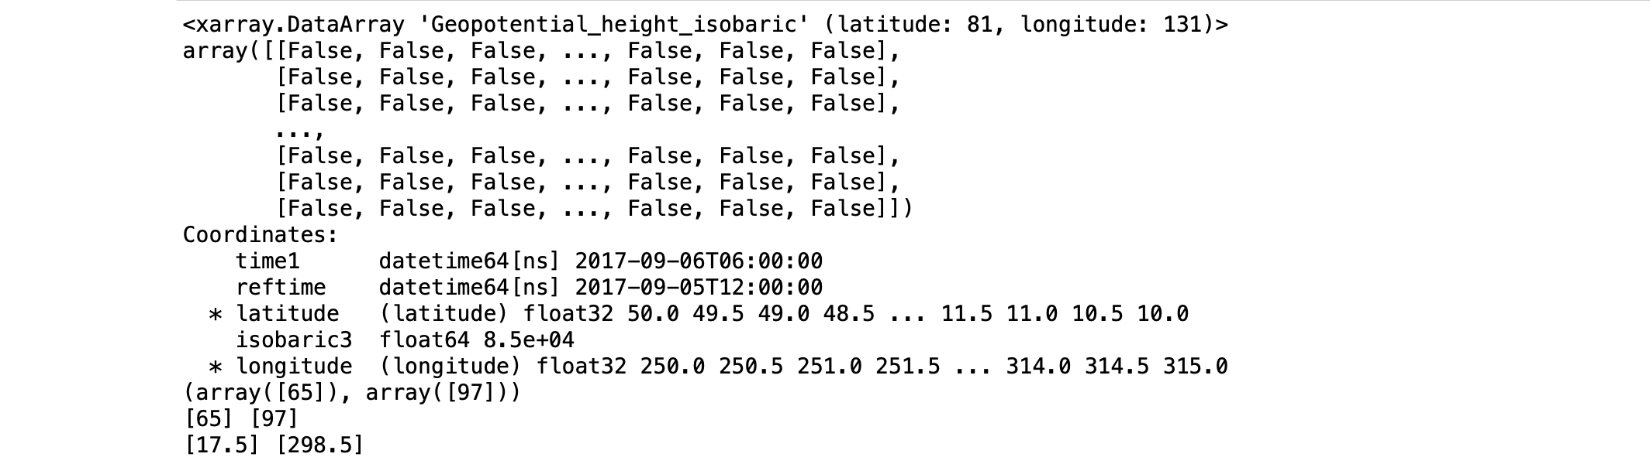
Output from Cell #13
The condition (850 mb height = minheight) is satisfied at
x = 65 and y = 97
And that corresponds to latitude 17.5˚N and
longitude 298.5 (61.5˚W)
Notes:
Printed out all values of condition. Only some shown. Only one will be ‘True’

Slide 21
Cell #14 – Extract 1D array of geop. height
# let's make a sounding through Irma's eye, or as close as we can get on this GFS grid
# pull out a 1D array of geopotential heights from our 'heights' variable, corresponding to Irma's location
# and corresponding to our time of interest
# 'nearest' finds nearest gridpoint
irma_ght = heights.sel(time1='2017-09-06T06:00',latitude=irma_lat,longitude=irma_lon,method='nearest')
irma_ght
# In the output below, click the 'Oreo' to collapse the display of data values
Now we’re selecting (with ‘sel’) based on time, latitude, longitude, via ‘nearest’ method.
Values written out when cell is executed.

Slide 22
Cell #15 – Examine 1D array of geop. height
# Let's print out these data
# First, recall what our pressures coordinate variable looks like.
# We are starting 8 pressure levels (-8) from the end and moving by single steps (1) to the end (-1).
# End of range (0) not included, as usual.
pressures.values
print('p (Pa) ght (gpm)')
for i in range(-8,0,1):
print(pressures.values[i],irma_ght.values[i])
#
Now we’re printing out the levels closest to the bottom of the sounding.
Note last three values are negative. Those heights are below sea level.
These heights are given on isobaric levels, including 1000, 975, and 950 mb (see Cell #6).
Given the surface pressure of Irma at this time, those isobaric levels are underground (underwater).
[They’re false data, created by extrapolation. See next slide.]

Slide 23
Geopotential heights above Irma’s center
p (Pa) ght (gpm)
75000.0 [[1908.0228]]
80000.0 [[1348.1184]]
85000.0 [[819.0325]]
90000.0 [[316.8714]]
92500.0 [[74.16223]]
95000.0 [[-163.30719]]
97500.0 [[-394.73145]]
100000.0 [[-620.2851]]
We know Irma’s center is over
the ocean. Note the 1000 mb
level is 620 gpm ~ 620 m below
the sea surface.
In this case, the 1000 (and 975 and
950) mb surface is fictional and
the data are not ”real”.
See next slide.
From coordinate isobaric3

Slide 24

Isobaric surfaces may be below ground or sea surface
Geopotential height is gravity-adjusted height above mean sea level (MSL).
Over land, an isobaric surface like 1000 mb may be underground. The geopotential height of the 1000 mb surface
may be above sea level, but also below ground level. To interpret this, you need to know your elevation.
In cyclones over the ocean, the 1000 mb level may be below the sea surface. Height relative to MSL will be negative.
Analyses on isobaric levels interpolate data to levels like 1000 mb, but this is very likely false information.

Slide 25
Cell #16 – Extract 1D array of temperature
# Please follow the same procedure to extract temperatures
##################################################################################################
# YOUR CODE BELOW
# YOUR CODE ABOVE
##################################################################################################
Keep in mind the last three values correspond to the false (underwater) points.

Slide 26
Cell #17 – Reshape and plot
print(" shape of pressure variable = ", np.shape(pressures))
print(" shape of temperature variable = ", np.shape(irma_tmp))
print(" shape of geop. height variable = ", np.shape(irma_ght))
# There are some vestigial dimensions there. Python does that.
# We need to 'squeeze' the unneeded dimensions from our plotting variables.
# You will probably do this fairly often in the future.
irma_tmp=np.squeeze(irma_tmp)
irma_ght=np.squeeze(irma_ght)
print(" NEW shape of temperature variable = ", np.shape(irma_tmp))
print(" NEW shape of geop. height variable = ", np.shape(irma_ght))
plt.plot(irma_tmp,irma_ght);
Pressure is 1D with 31 levels, as we expected.
But temperature and height are 3D even though we wanted 1D.
Those other two dimensions are vestiges of our selections, and
they will prevent us from (easily) plotting them.
But… we can put the np.squeeze on them!

Slide 27
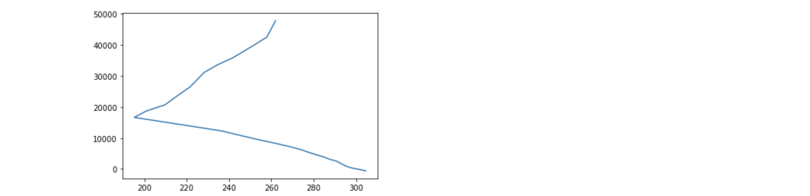
Cell #17 (continued) – Our initial plot
A quick plot of temperature vs. geopotential height
…it’s ugly for now but we can improve that.
Notice it’s plotting the entire atmosphere, up to the model top
(way up in stratosphere) AND includes the negative
heights associated with fake data (below sea surface)

Slide 28
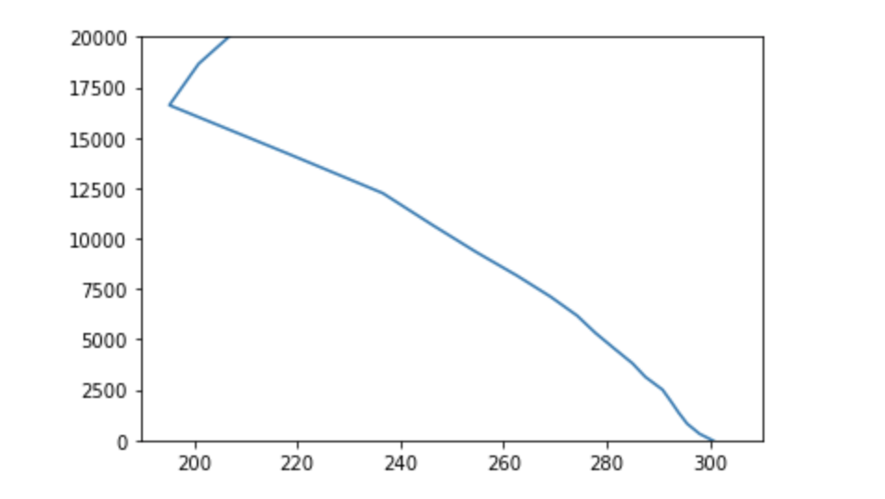
Cell #18 – A little improvement
# actually we noticed there are negative geopotential heights. This is because the isobaric levels nearest
# the surface have pressures > Irma's surface pressure.
# Let's cut those out with ylim
# Also let's cut out most of the stratosphere
plt.plot(irma_tmp,irma_ght)
plt.ylim([0,20000.])
That’s a little better. Now add labels and titles, etc..

Slide 29
Next: adding dewpoint temperature to sounding plot
Add cells at end of notebook {Insert menu}
Or use empty cells at bottom if they exist

Slide 30
Calculating dewpoint temperature (Td)
An atmospheric sounding usually consists of temperature and dewpoint plotted as a function of height or pressure.
  If dewpoint is not available, it can be computed from fields like temperature, relative humidity, specific humidity, and pressure
The task here will require the following steps:
  (1) Pull ‘Relative_humidity_isobaric’ field from our netCDF object ds. Call it relhum. See Cell #4 for an example.
  (2) Extract relative humidity for same selected time and lat/lon location that we defined irma_tmp, irma_ght at. Call it irma_rh. See Cell #14 for an example.
  (3) Squeeze irma_rh to get rid of vestigial dimensions. See Cell #17.
  (4) Calculate dewpoint from irma_tmp and irma_rh using MetPy function [next slide]

Slide 31
MetPy dewpoint calculation function
MetPy has many convenient calculation functions
However, MetPy requires variable units to be declared to operate
In our openers, we imported metpy.calc as mpcalc and metpy.units as units
In the call below, we attach the proper units to irma_tmp and irma_rh, call the mpcalc function, and convert the output to Kelvin
Sounding with both temperature and dewpoint on next slide
irma_tdew = mpcalc.dewpoint_from_relative_humidity(irma_tmp * units.K, irma_rh * units.percent).to(units('kelvin'))

Slide 32
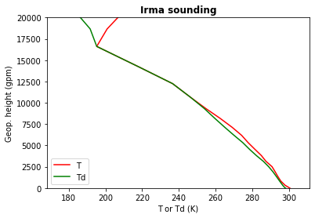
Hurricane Irma inner core nearly saturated (T = Td) below 17 km
I added title, axis labels, legend, and plotted T as red and Td as green

Slide 33
[end]

