Slide 1
Class #9
ATM 240 ~ Fall 2022
Robert Fovell
rfovell@albany.edu

Slide 2
“Cheat sheet” reminder
Bookmark and visit this page for reminders regarding Python syntax and examples:
  http://www.atmos.albany.edu/facstaff/rfovell/ATM240/csheet.html
This is a “living document”

Slide 3
Class roadmap
We’re going to plot flu cases and tests data for the United States between 2017 to present
This will involve
  Reading in a dataset using Pandas
  Creating a date variable
  Creating a 2-panel plot using subplots
In your Jupyter notebook files view, click on the shortcut to your /spare11/atm240/yournetid directory and create a new notebook. Call it flu_plot. Select the “Python 3 August 2022 Environment”.
Resources for this demonstration
  This powerpoint
  Class #6 powerpoint (Pandas, date axis formatting, etc.)
  Your Hurricane Sandy and windplot.ipynb notebooks

Slide 4
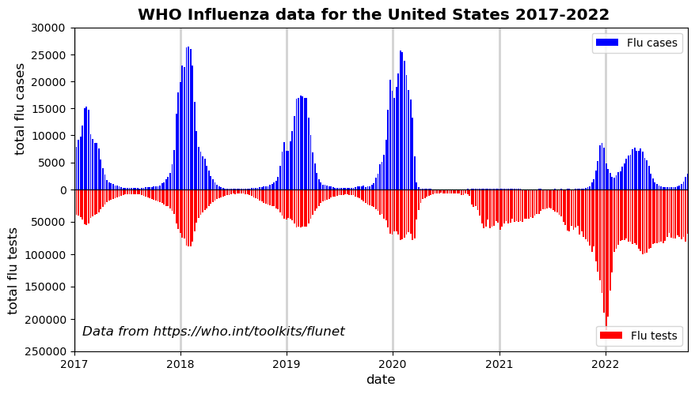

Slide 5
For this plot
Read in a CSV file using pandas
Extracted variables and created a datetime variable
Created a 2-panel plot using subplots
Made a bar plot instead of a line or scatter plot
Specified the x-axis as a date axis and prescribed start & end dates
Provided y-axis limits for top and bottom plots
Reversed the y-axis of the bottom plot
Suppressed the x-axis labels and ticks for the top plot
Squeezed out the vertical space between the 2 panels
Added an overall plot title and legends for both panels

Slide 6
Cell #1 - Openers
%matplotlib inline
# the usual suspects
import matplotlib.pyplot as plt
import matplotlib.cm as cm
import numpy as np
# datetime
import datetime
from datetime import datetime
# pandas
import pandas as pd

Slide 7
Cell #2 – Open dataset and inspect it
Dataset is located at /spare11/atm240/WHO_US_flu_data_23oct2022.csv
This is a CSV file with a header line. Use parse_dates=True as for the Sandy KACY station data
First part of data looks like
COUNTRY_CODE ISO_YEAR ISO_WEEK ISO_SDATE TESTS POSITIVE NEGATIVE
USA 2017 1 2017-01-02T05:00:00.000 38960 6933 32027
USA 2017 2 2017-01-09T05:00:00.000 39546 7850 31696
USA 2017 3 2017-01-16T05:00:00.000 41010 9250 31760
USA 2017 4 2017-01-23T05:00:00.000 42620 9782 32838
For a few records, TESTS ≠ POSITIVE + NEGATIVE, for unknown reasons (but discrepancies are small)
Notes:
Metadata like descriptive terms and units

Slide 8
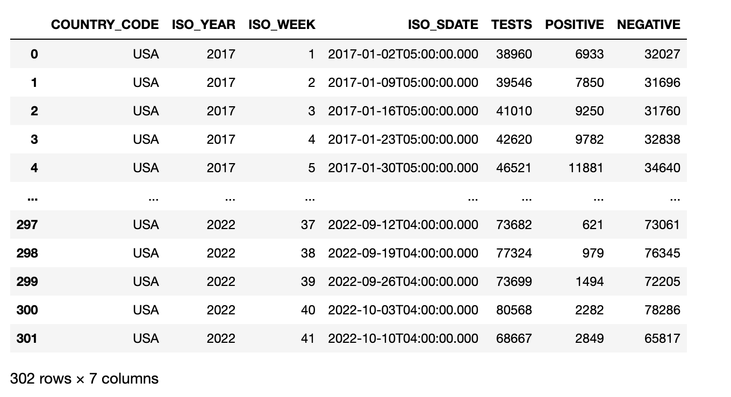

Slide 9
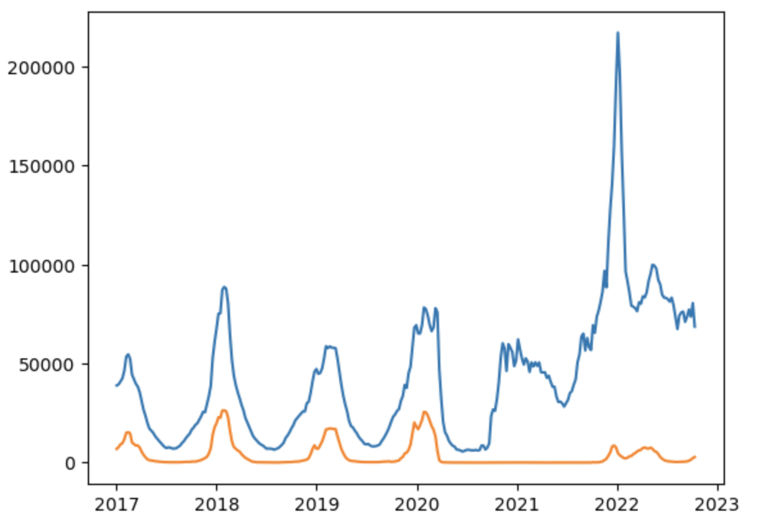
Read in and manipulate variables
Consult your Sandy notebook for a strategy for reading in the date information from the file [‘ISO_SDATE’] as a temporary variable and then using pd.to_datetime to create a true datetime variable
Read in the variables POSITIVE and TESTS. I am calling them cases and tests, respectively
Make a simple plot of dates v. tests and dates v. cases

Slide 10
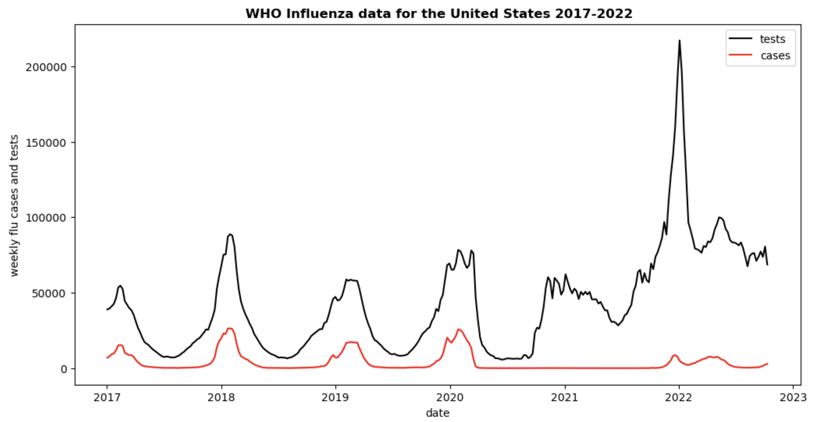
Create a figure object and include a legend
fig = plt.figure(figsize=(10,5))
# for each plot, we assign a color and attach a label
plt.plot(date,tests,c='k',label='tests') # black line
plt.plot(date,cases,c='r',label='cases') # red line
# now plot the legend, specifying the location
plt.legend(loc='upper right')
Also add x- and y-axis labels with plt.xlabel and
plt.ylabel. And a title (plt.title).
For my title, I selected fontweight=‘bold’

Slide 11
Start using subplots
For the next cell, copy the contents of your last cell, but start using subplots. This changes the syntax of the x- and y-axis labels.
fig = plt.figure(figsize=(10,5))
# Now add a subplot - but only one, so we still have only one plot.
# This is declaring an axis
ax = fig.add_subplot(1,1,1) # 1,1,1 = plot frame contains 1 row, 1 col, and this is plot 1
[more plotting code. You can call the line plots either ‘plt.plot’ or ‘ax.plot’]
ax.set_ylabel('weekly flu cases and tests',fontsize='large') # I also specified fontsize
ax.set_xlabel('date', fontsize='large')

Slide 12
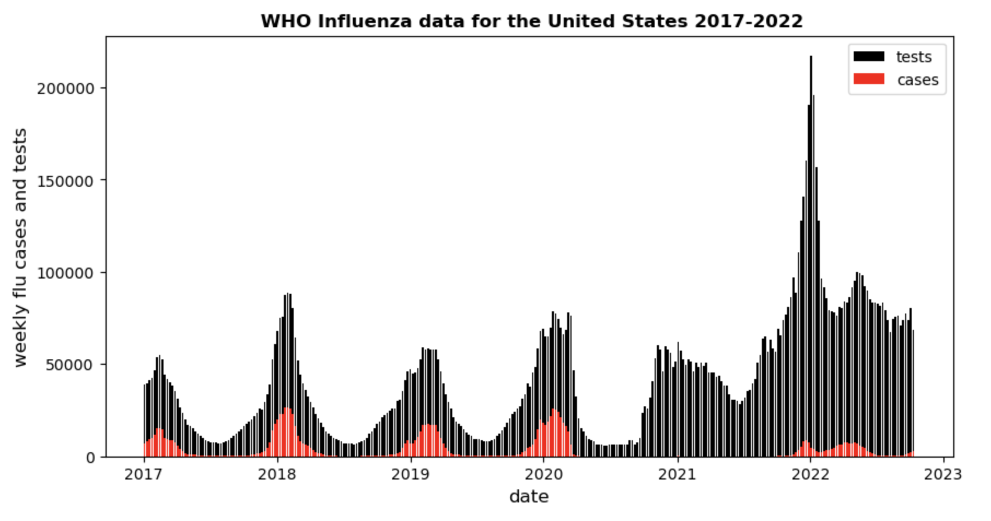
Bar charts v. line plots
We can make the chart using bars by using ax.bar instead of ax.plot

Slide 13
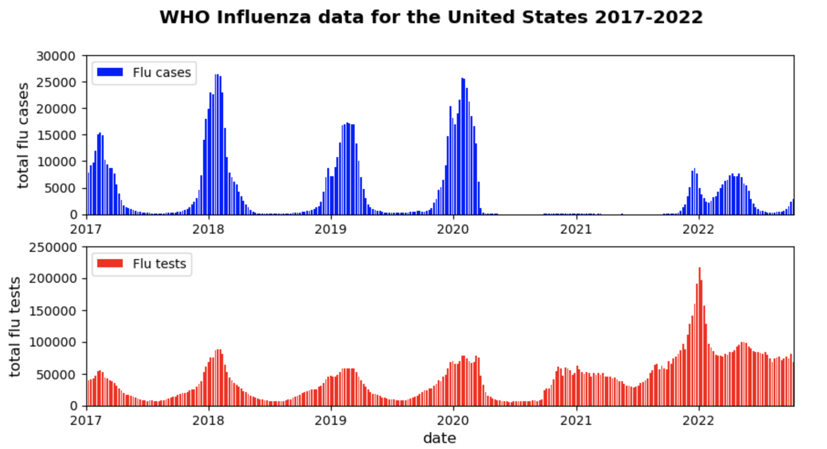
The next plot…

Slide 14
Details of that plot #1
I’m now creating 2 subplots. The subplot axes will be ’ax1’ and ‘ax2’.
fig = plt.figure(figsize=(10,5))
# -------------------------------------------------------------------------
# first plot: cases (ax1)
# -------------------------------------------------------------------------
ax1 = fig.add_subplot(2,1,1) # TWO rows, ONE column, PLOT NUMBER 1
ax1.bar(date,cases,color='b',width=5,label='Flu cases')
# note this is 'ax1'. Bars are blue. # ADD MORE ax1 INSTRUCTIONS
[The second axis will be ‘ax2’, declared with fig.add_subplot(2,1,2)

Slide 15
Details of that plot #2
For each axis, I call plt.legend to show the legend. If you call plt.legend only after creating the 2nd axis, you won’t get a legend on the top plot
For both axes (separately), I am setting y-axis limits with plt.ylim
For both axes (separately), I am prescribing x-axis limits by supplying datetime variables:
datemin=datetime(2017,1,1) # datetime(year,month,day)
datemax=datetime(2022,10,10)
ax1.xaxis_date() # tells matplotlib to treat x-axis for ax1 as dates
plt.xlim(datemin,datemax) # limit the x-axis to be between the specified dates
Notes:
For 2nd axis, that will be ax2 instead

Slide 16
The final plot

Slide 17
Tasks for the final plot
(1) Reverse the y-axis of the bottom (tests) plot
(2) Suppress the x-axis labels for the top plot
(3) Squeeze out the whitespace between the plots
(4) Add vertical lines highlighting January 1st of each year and controlling placement
(5) Tack on some text using 'figtext'
(6) Save a figure as a PNG file

Slide 18
Creating the final plot #1
I’d copy and paste the code making your 2-panel plot into a new cell and add new pieces step by step
First piece is reversing the y-axis of the bottom panel (ax2). This will do it. Note now your y-axis limits are also reversed!
ax2.invert_yaxis()
plt.ylim(250000,0)

Slide 19
Creating the final plot #2
We want to suppress the x-axis tick marks for the top panel. Thus, in the ax1 section, we can add one of the following commands
# suppress x-axis ticks for top plot
#plt.xticks([]) # this works
ax1.axes.xaxis.set_ticklabels([]) # but this is more general and flexible

Slide 20
Creating the final plot #3
We want to add an overall plot title. Can be done with suptitle.
We want to squeeze out whitespace between the 2 panels. This approach will do
plt.suptitle(" WHO Influenza data for the United States 2017-2022",
fontweight='bold',fontsize='x-large')
# Squeeze out whitespace between plots with subplots_adjust
plt.subplots_adjust(hspace=0.00)
# This next line helps position the suptitle in manner I like better
fig.subplots_adjust(top=0.93)

Slide 21
Creating the final plot #4
I used plt.figtext to add some text. The plotting coordinates were selected by trial and error
plt.figtext(0.135,0.15,'Data from https://who.int/toolkits/flunet’,size=12,
fontstyle='italic',zorder=30)

Slide 22
Creating the final plot #5
I want to place a vertical grey line marking each year’s January 1st.
I’m going to do that with [v = vertical axis]
plt.axvline(x=january1st,lw=2,c='lightgrey',zorder=0)
I can do this because I declared the x-axis to be a date axis
But I need first to define a new variable, called january1st, to represent January 1st of each year I want to highlight.
Think about how to do that. I would use a for loop using np.arange and use datetime to create a date variable.
Spoiler on next slide (don’t peek before thinking!)

Slide 23
Creating the final plot #6
This code sufficed to position the vertical grey lines, which were made using axvline [vertical line on axis]
for year in np.arange(2017,2023): # last year in range not included!!!
january1st=datetime(year,1,1)
plt.axvline(x=january1st, lw=2,c='lightgrey',zorder=0)
#

Slide 24
[end]

