Slide 1
Class #11
ATM 240 ~ Fall 2022
Robert Fovell
rfovell@albany.edu

Slide 2
“Cheat sheet” reminder
Bookmark and visit this page for reminders regarding Python syntax and examples:
  http://www.atmos.albany.edu/facstaff/rfovell/ATM240/csheet.html
This is a “living document”

Slide 3
Class roadmap
Make Skew-T/log p plots using the MetPy package, developed by Unidata, grabbing data from the University of Wyoming sounding archive and adding a hodograph as a plot inset
In your Files view, click on the symbolic link to move to your /spare11/atm240/yournetid space. Then create a new notebook, specifying “Python 3 August 2022 Environment”. Call your notebook “skewt”.

Slide 4
Resources
This powerpoint
MetPy home page: https://unidata.github.io/MetPy/latest/index.html
Relevant MetPy Mondays videos (utilized all or in part):
  MetPy Monday #13 https://www.youtube.com/watch?v=iveJCqxe3Z4&list=PLQut5OXpV-0ir4IdllSt1iEZKTwFBa7kO&index=8
  MetPy Monday #15 https://www.youtube.com/watch?v=OUTBiXEuDIU&list=PLQut5OXpV-0ir4IdllSt1iEZKTwFBa7kO&index=10
  MetPy Monday #16 https://www.youtube.com/watch?v=oog6_b-844Q&list=PLQut5OXpV-0ir4IdllSt1iEZKTwFBa7kO&index=11
  MetPy Monday #17 https://www.youtube.com/watch?v=b0RsN9mCY5k&list=PLQut5OXpV-0ir4IdllSt1iEZKTwFBa7kO&index=12
  MetPy Monday #18 https://www.youtube.com/watch?v=quFXzaNbWXM&list=PLQut5OXpV-0ir4IdllSt1iEZKTwFBa7kO&index=13
  MetPy Monday #19 https://www.youtube.com/watch?v=7QsBJTwuLvE&list=PLQut5OXpV-0ir4IdllSt1iEZKTwFBa7kO&index=14
  MetPy Monday #21 https://www.youtube.com/watch?v=kGljsludKtk&list=PLQut5OXpV-0ir4IdllSt1iEZKTwFBa7kO&index=16
  MetPy Monday #38 https://www.youtube.com/watch?v=c0Uc7imDNv0&list=PLQut5OXpV-0ir4IdllSt1iEZKTwFBa7kO&index=31
  MetPy Monday #39 https://www.youtube.com/watch?v=lUc8z8tLulE&list=PLQut5OXpV-0ir4IdllSt1iEZKTwFBa7kO&index=32
https://unidata.github.io/MetPy/latest/examples/plots/Hodograph_Inset.html

Slide 5
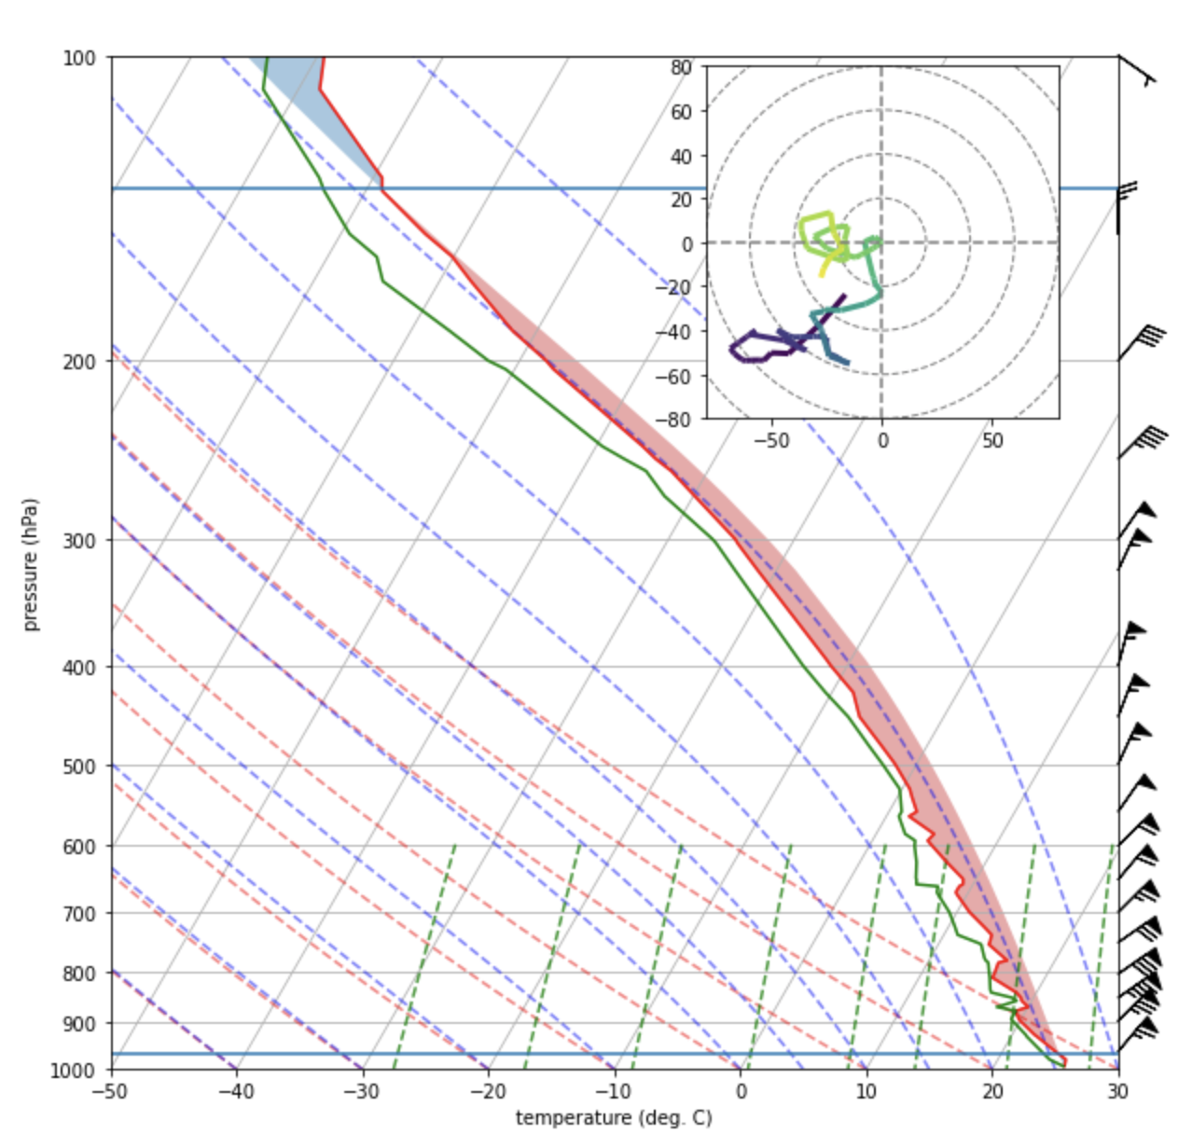
Our final product

Slide 6
Parts of the skew-T/log p plot

Slide 7
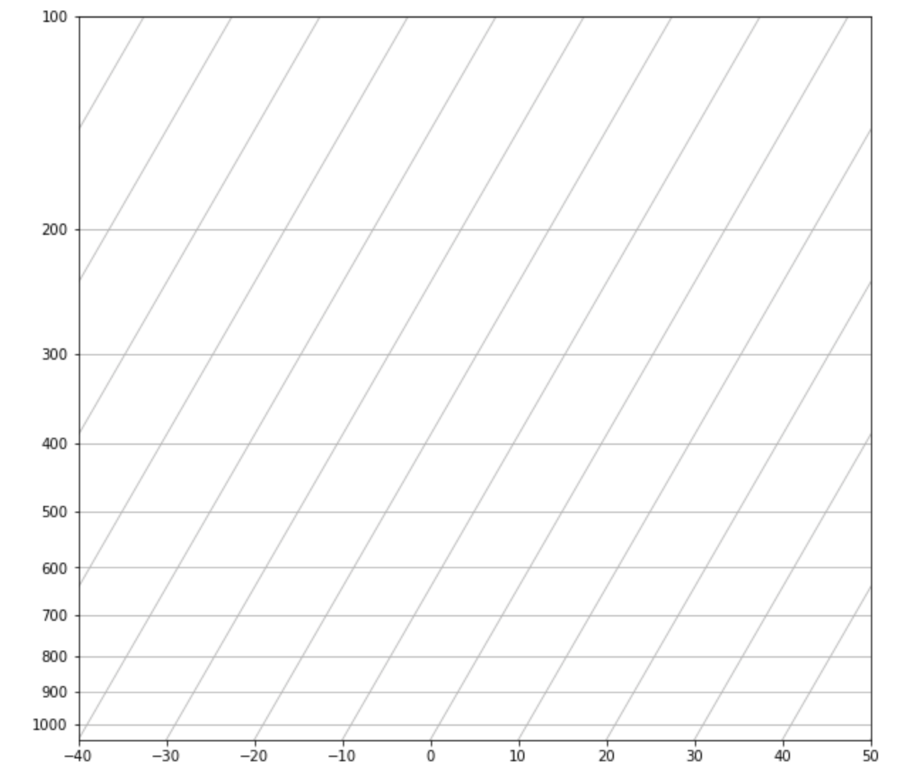
Isobars (equal pressure)
Isotherms (equal temperature)
Horizontal axis is T (˚C)
Vertical axis is log p
(hectopascals or mb)
Notes:
Skewing T helps with diagram compactness and helps make area on diagram proportional to energy

Slide 8
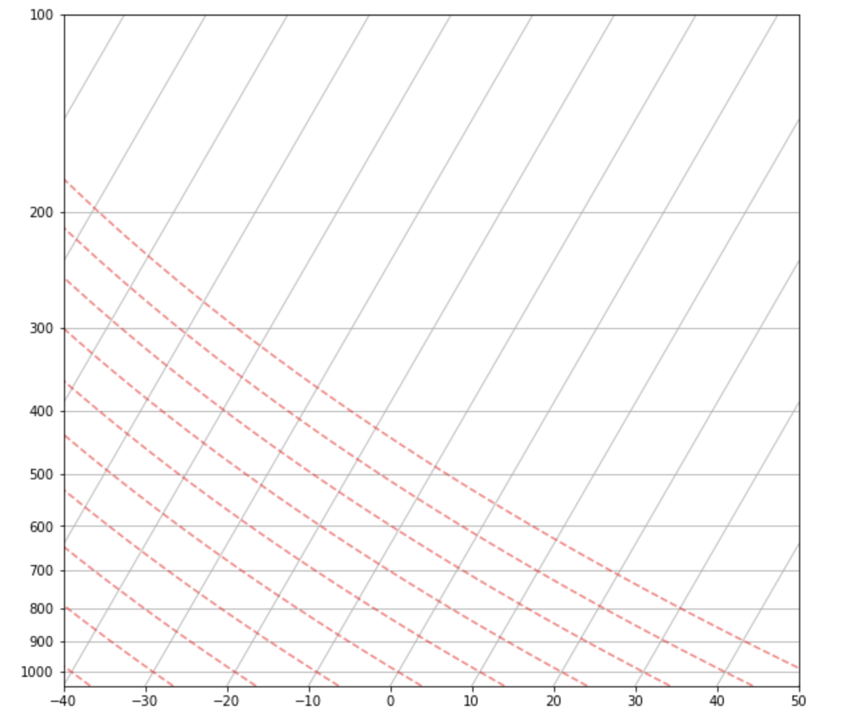
Dry (subsaturated) adiabats represent path
of a subsaturated air parcel.
If you lift a subsaturated parcel towards
lower pressure, it expands and cools rapidly
at the dry adiabatic lapse rate, the slope of
the dry adiabat.
If the parcel has moisture its relative humidity
is increasing…
Dry (subsaturated) adiabats

Slide 9
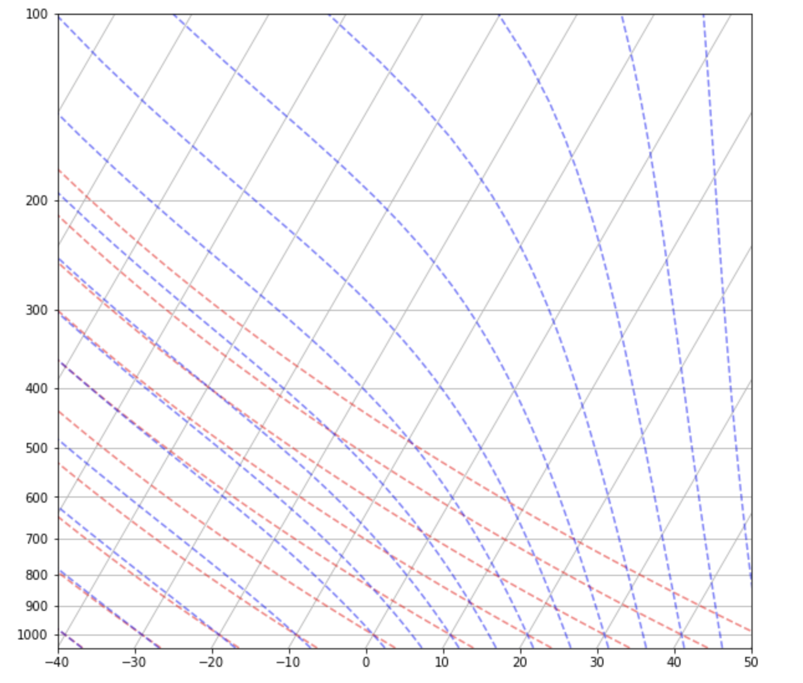
Moist (saturated) adiabats represent path
of a saturated air parcel.
Once the parcel is saturated, further
ascent causes condensation and warming,
resulting in a smaller & variable cooling
rate, the moist adiabatic lapse rate.
Moist (saturated) adiabats

Slide 10
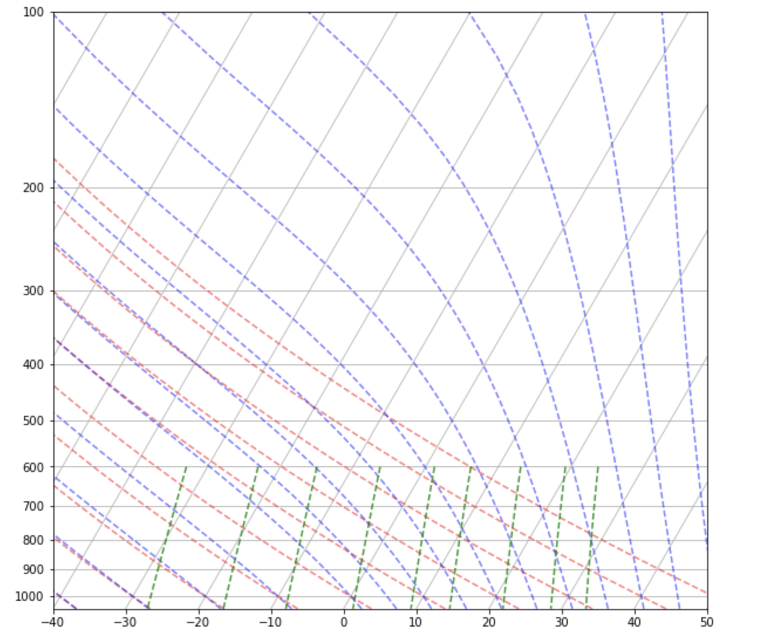
Mixing ratio lines represent fixed
values of water vapor mixing ratio.
Before saturation, parcel vapor content
is fixed. Dewpoint temperature (Td)
varies along the mixing ratio line.
Td is the temperature at which a
parcel becomes saturated via isobaric
cooling so Td ≤ T.
Mixing ratio lines

Slide 11
Cell #1 - Openers
%matplotlib inline
from datetime import datetime
import pandas as pd
from siphon.simplewebservice.wyoming import WyomingUpperAir
from metpy.units import units
import metpy.plots as plots
import metpy.calc as mpcalc
from metpy.plots import Hodograph
from mpl_toolkits.axes_grid1.inset_locator import inset_axes # for hodograph inset
import matplotlib.pyplot as plt
import numpy as np

Slide 12
Cell #2 – Using MetPy units capability
# Example of using units in calculations (MetPy Monday #13)
a = 25 * units.km
b = 5 * units.miles
a-b
MetPy allows you to attach/assign units to variables, which facilitates conversions.
In this example, a is in km and b is in miles, which are automatically converted to km before subtraction

Slide 13
Cell #3 – Declare station and date
date = datetime(2017, 9, 10, 0)
station = 'EYW' # Key West, FL
df = WyomingUpperAir.request_data(date, station)
This cell retrieves sounding data for 9/10/2017 at 00Z for station EYW from the Wyoming sounding archive
‘df’ is a Pandas dataframe

Slide 14
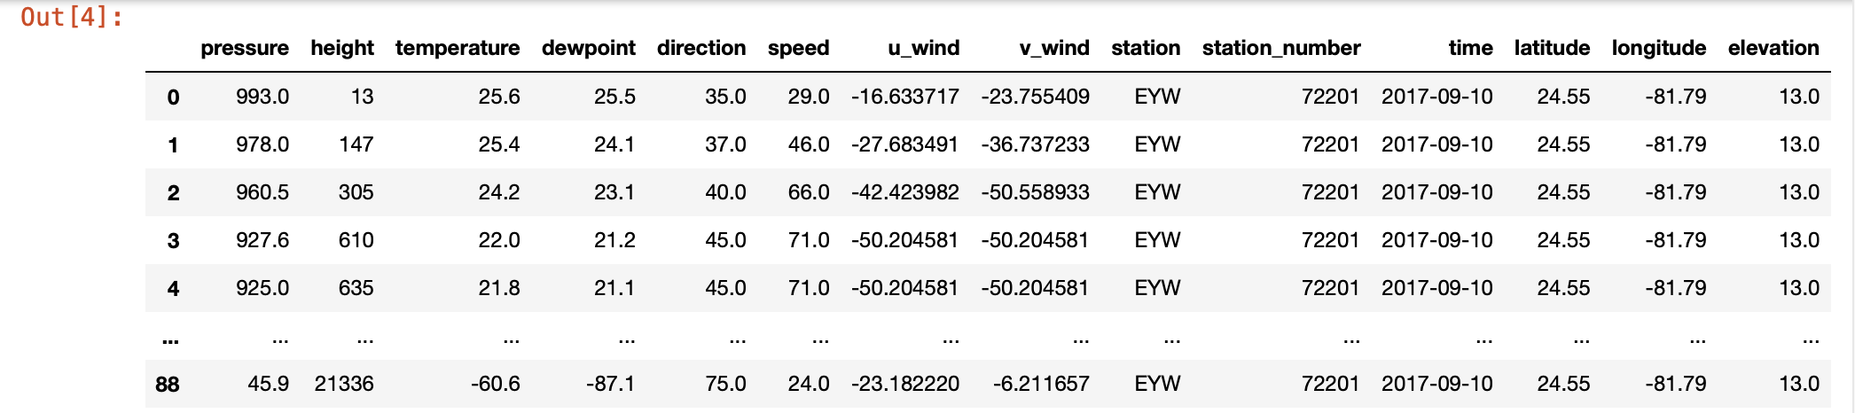
Cell #4 – Examine contents
df
scroll →
This cell retrieves sounding data for 9/10/2017 at 00Z for station EYW from the Wyoming sounding archive

Slide 15
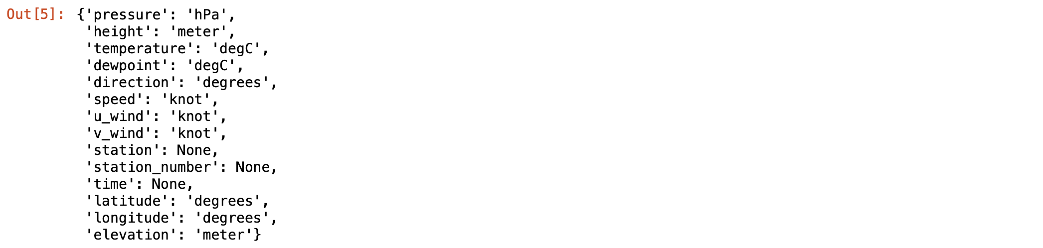
Cell #5 – Examine contents
df.units # reveals a dictionary of variable units - key is variable, value is unit of variable
1 kt = 1.1508 mph
= 0.5144 m/s
= 1.8520 km/h
Note winds are in knots (nautical mile per hour)
This cell retrieves sounding data for 9/10/2017 at 00Z for station EYW from the Wyoming sounding archive

Slide 16
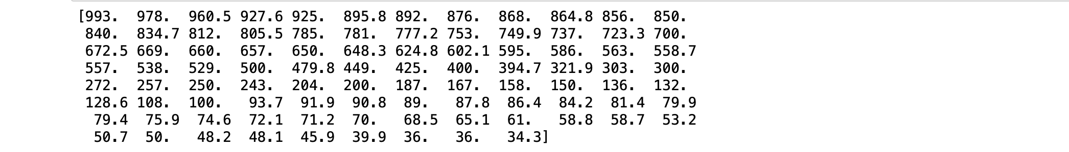
Cell #6 – Display pressure values
p = df['pressure'].values # this is an xarray with metadata. We just want the numbers
print(p)

Slide 17
Cell #7 – Display pressure values with units
p = df['pressure'].values * units('hPa') # Now numbers with units also attached. [ * units.hPa also works]
print(p)

Slide 18
Cell #8 – Display pressure values with units as specified in dataset
# use units actually defined in dataset instead of hardcoding
p = df['pressure'].values * units(df.units['pressure'])
print(p)
If the variable (as here) is provided the units declared in the dataset, use those to avoid possible mistakes

Slide 19
Cell #9 – More variables
T = df['temperature'].values * units(df.units['temperature'])
Td = df['dewpoint'].values * units(df.units['dewpoint'])
u = df['u_wind'].values * units(df.units['u_wind’]) # u is west-east wind, positive from west
v = df['v_wind'].values * units(df.units['v_wind’]) # v is north-south wind, positive from south
height = df['height'].values * units(df.units['height'])
print(T)
Extract more fields, using units as defined in dataset. If you don’t include “.values”, the units don’t get assigned.

Slide 20
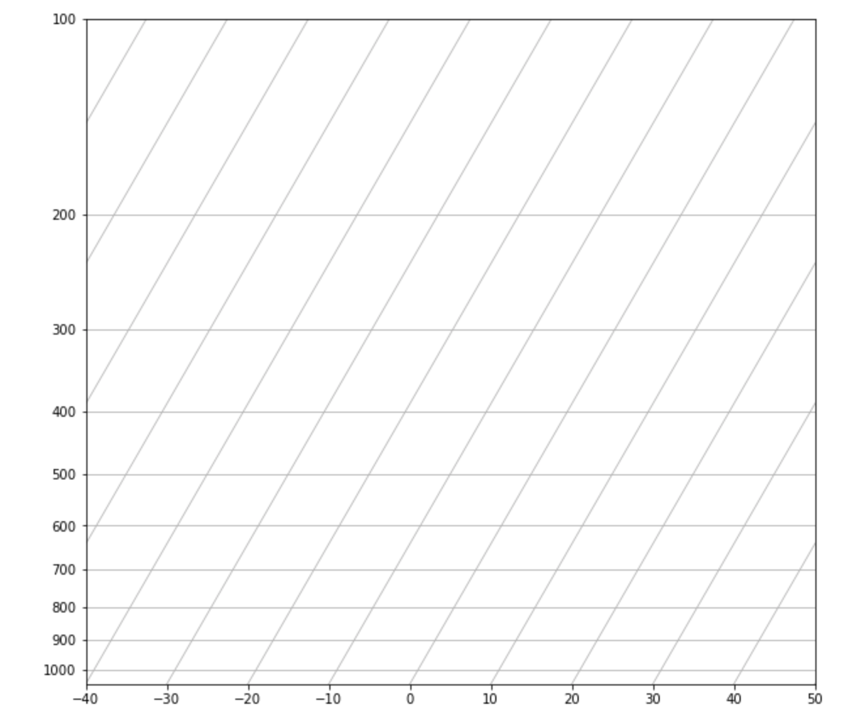
Cell #10 – Starting the skew-T plot
fig = plt.figure(figsize=(10,10))
skew = plots.SkewT(fig)
plt was from matplotlib
plots was from MetPy
[see openers]

Slide 21
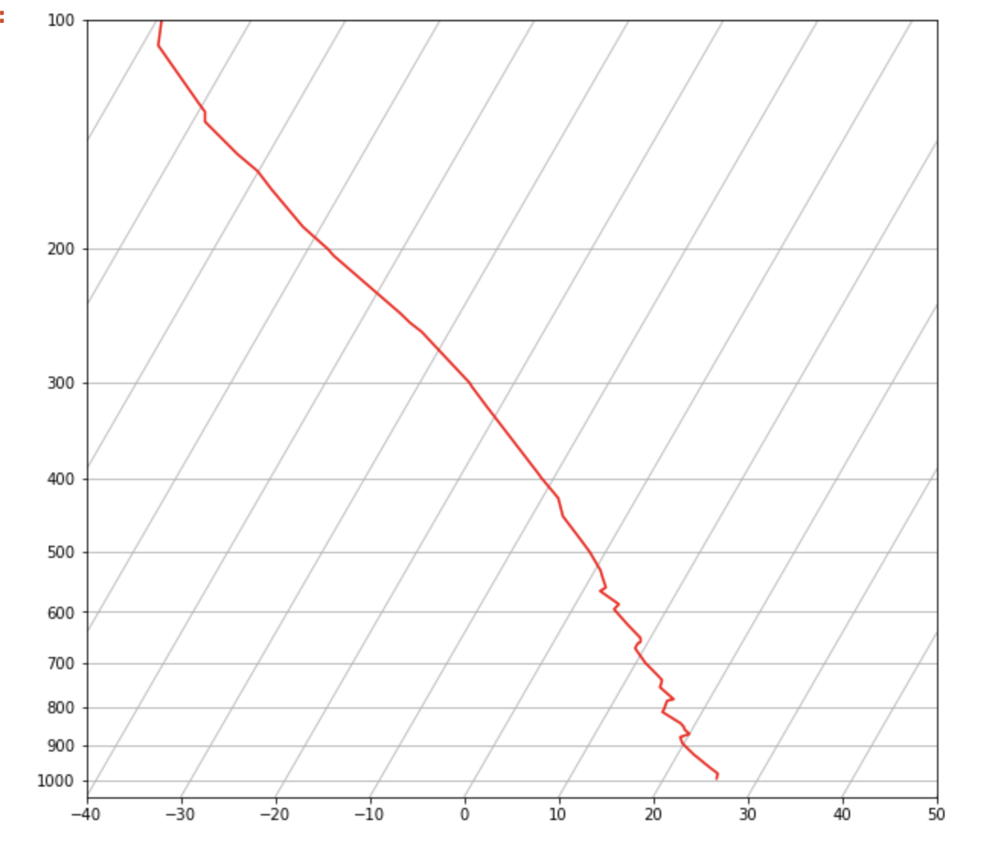
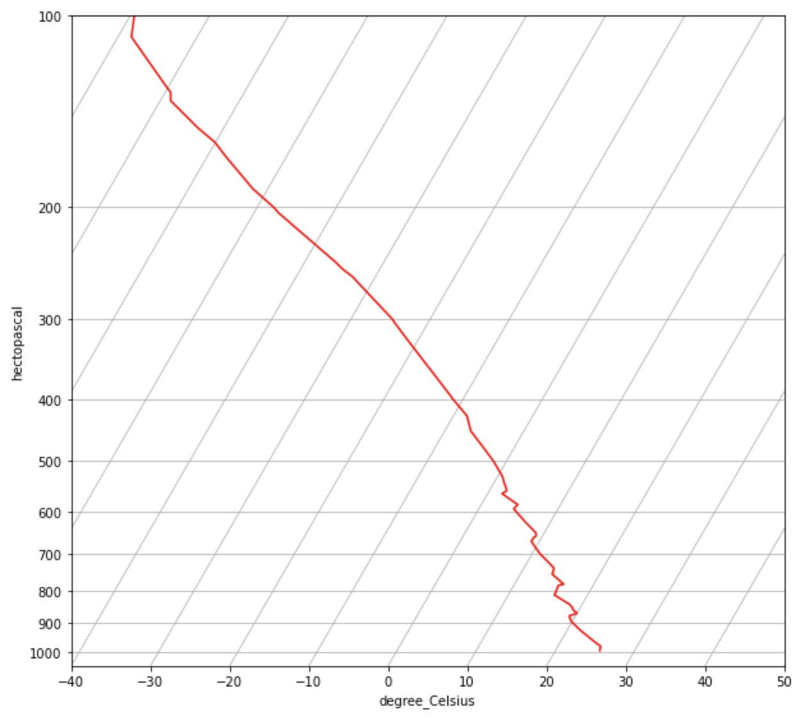
Cell #11 – Add T
skew.plot(p, T, 'red')
fig
Now units appear on axes, because we plotted a
variable with attached units!

Slide 22
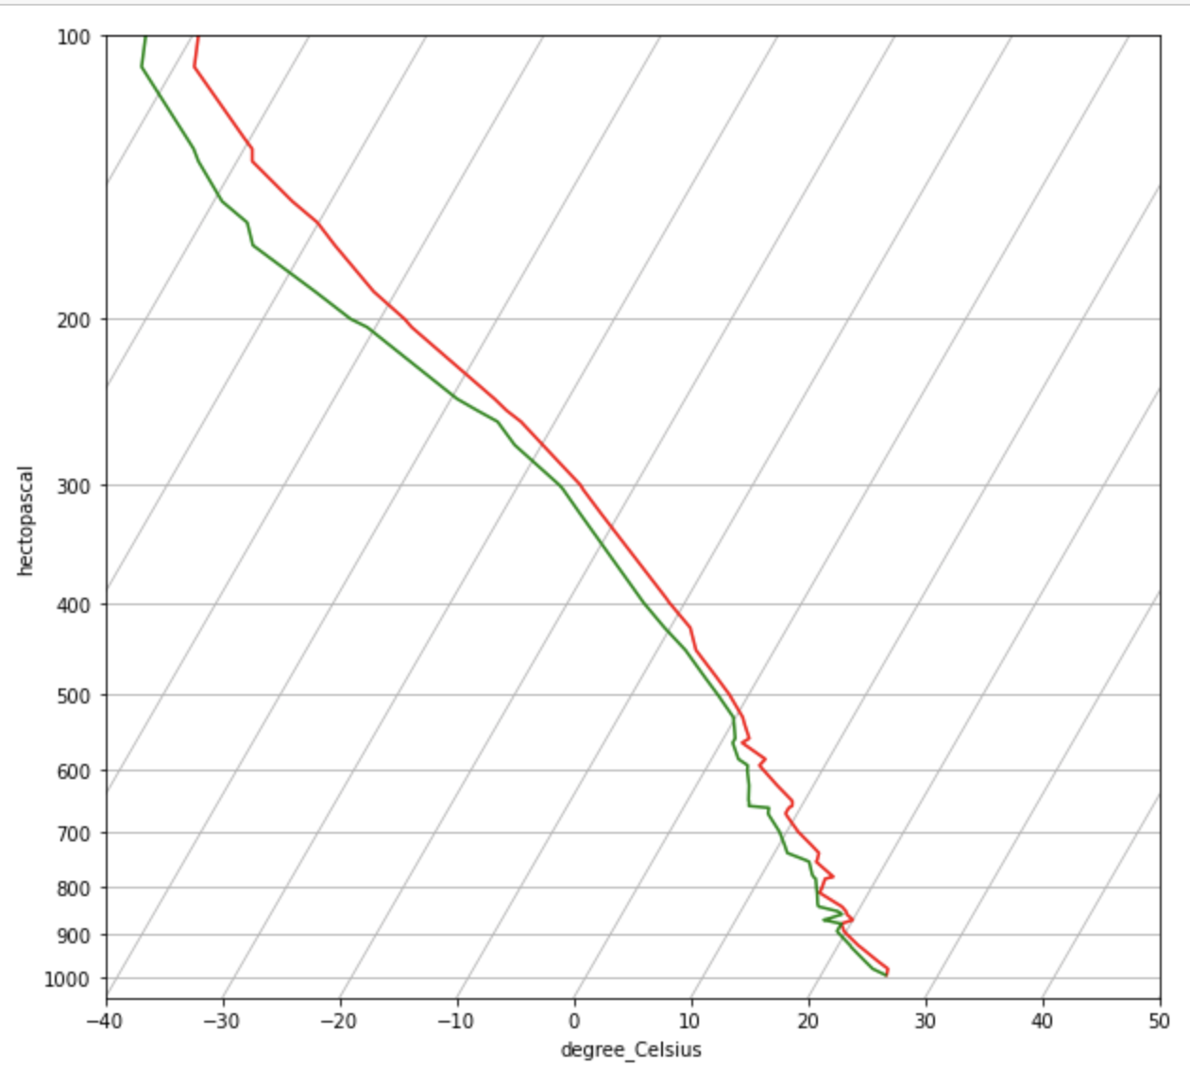
Cell #12 – Add Td
skew.plot(p, Td, 'green')
fig
Dewpoint is the temperature at which saturation
would be achieved via isobaric cooling (thus Td ≤ T)
Notes:
Very moist, all the way up to the tropopause

Slide 23
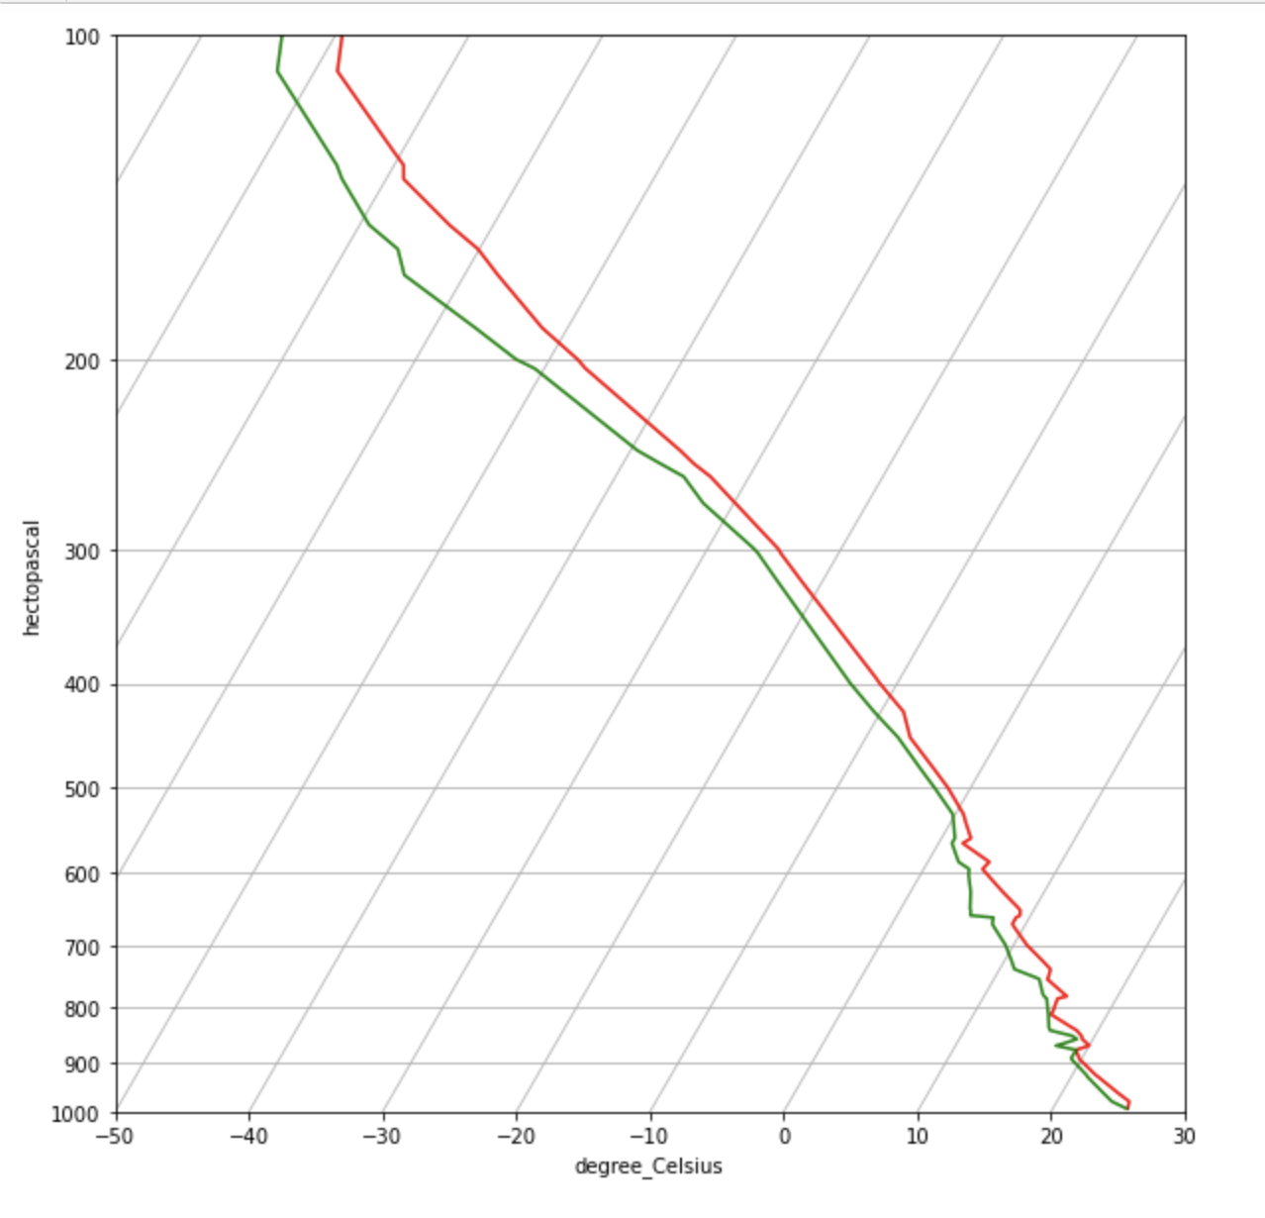
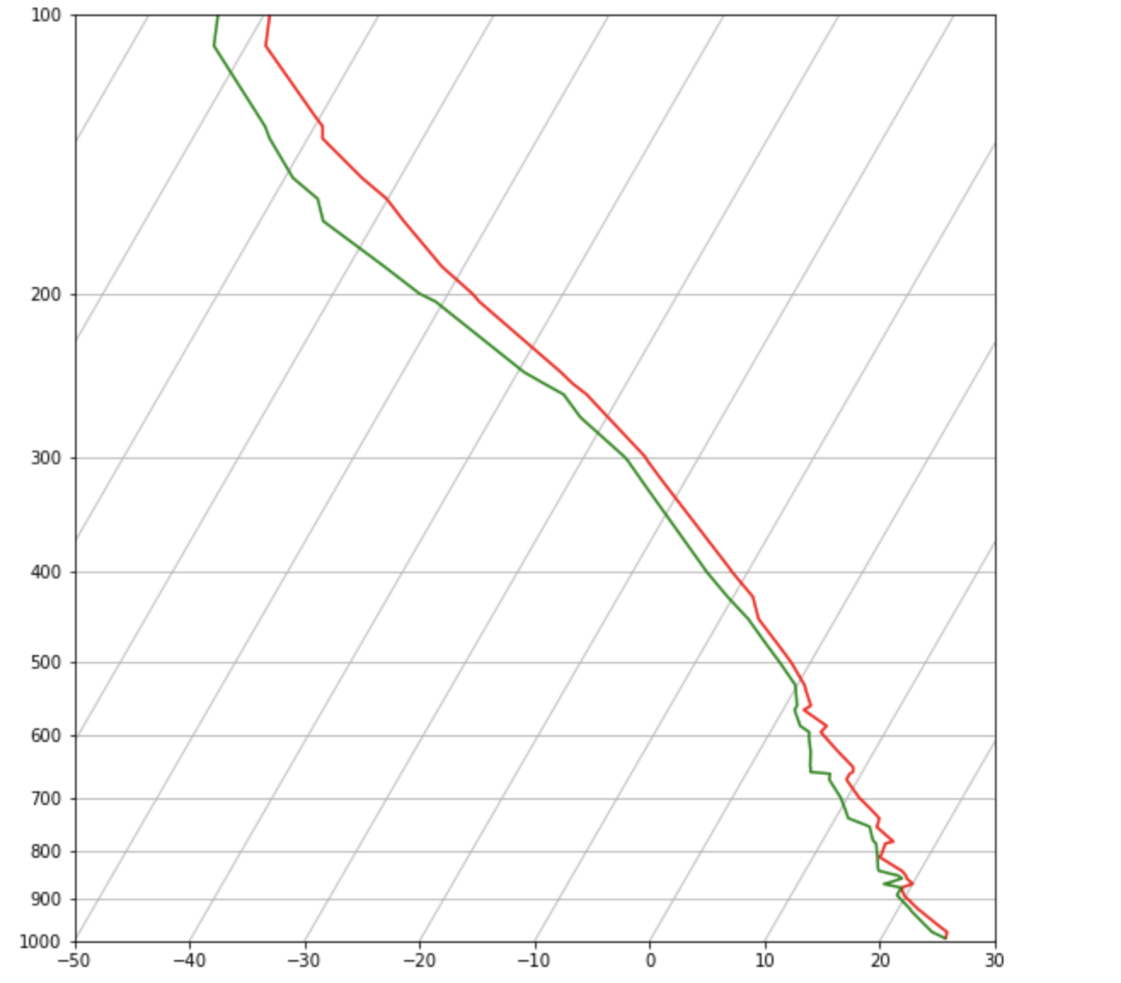
Cell #13 – Reformatting the plot ranges
# reformat plot window
# want ax.set_ylim, ax.set_xlim, but now acting on
# the 'skew' object, so it's skew.ax.set_ylim, etc.
# limit y-axis to 1000 to 100 mb
skew.ax.set_ylim(1000,100)
# limit x-axis to -50 to +30 C
skew.ax.set_xlim(-50,30)
fig

Slide 24
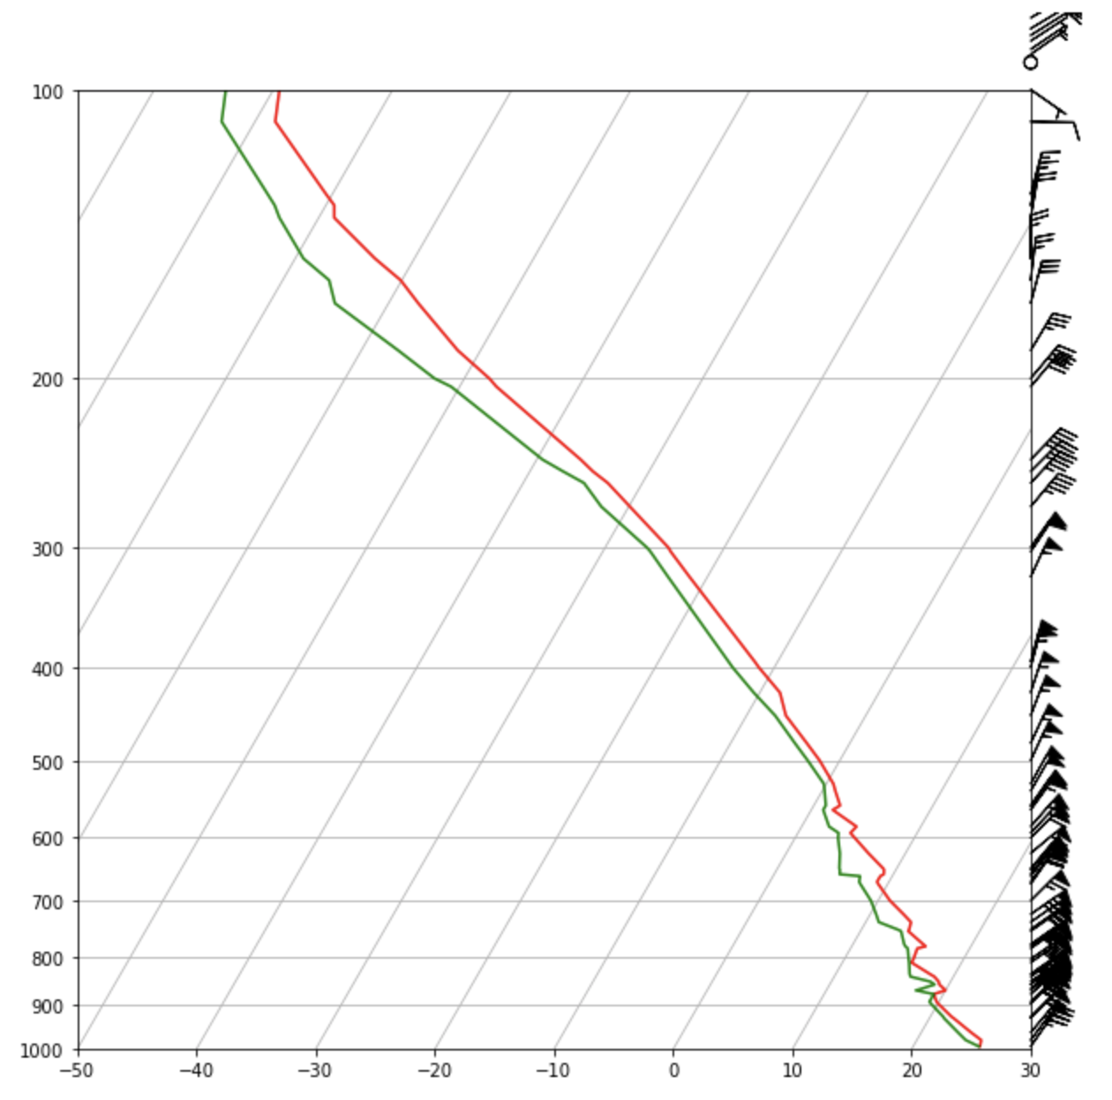
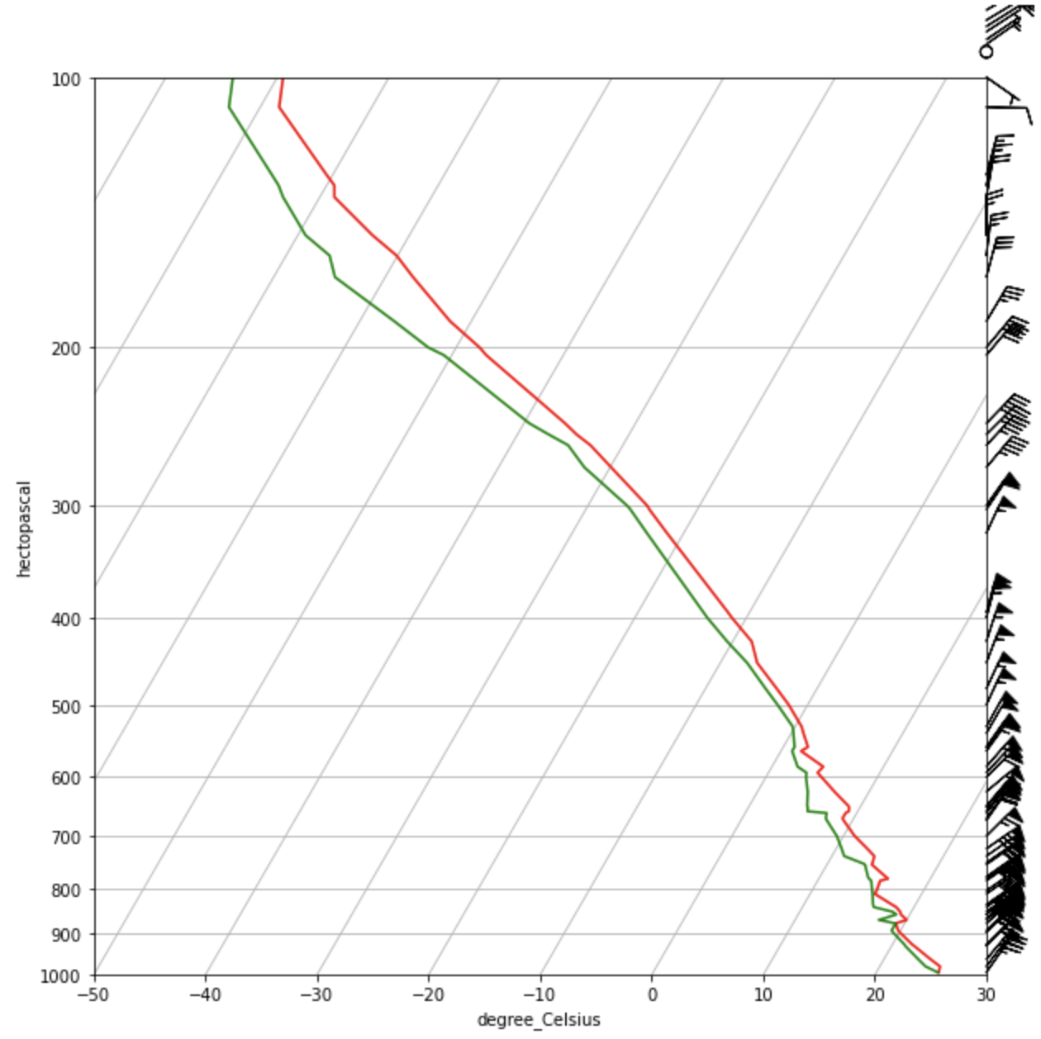
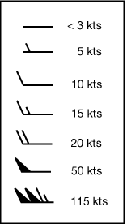
Cell #14 – Adding wind barbs
skew.plot_barbs(p, u, v)
fig
Too many barbs, too crowded
Plus, barbs are plotted at levels ABOVE the top of plot!!!

Slide 25
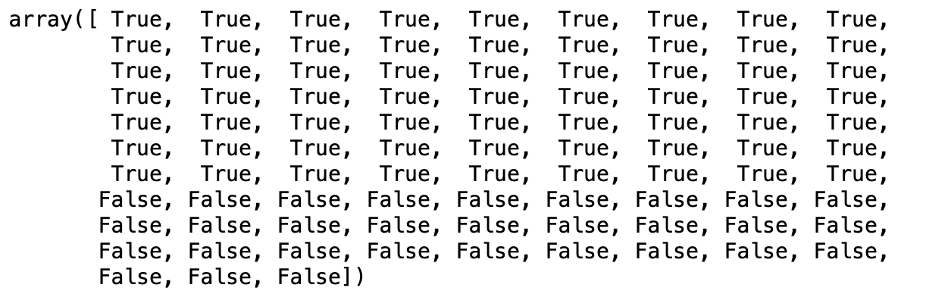
Cell #15 – Creating a Boolean mask
# Use Boolean masking to clean up wind barbs
mask = p >= 100 * units.hPa
mask # see it's a Boolean variable
Mask out pressure levels < 100 hPa
First of three methods for dealing with the wind barb problem

Slide 26
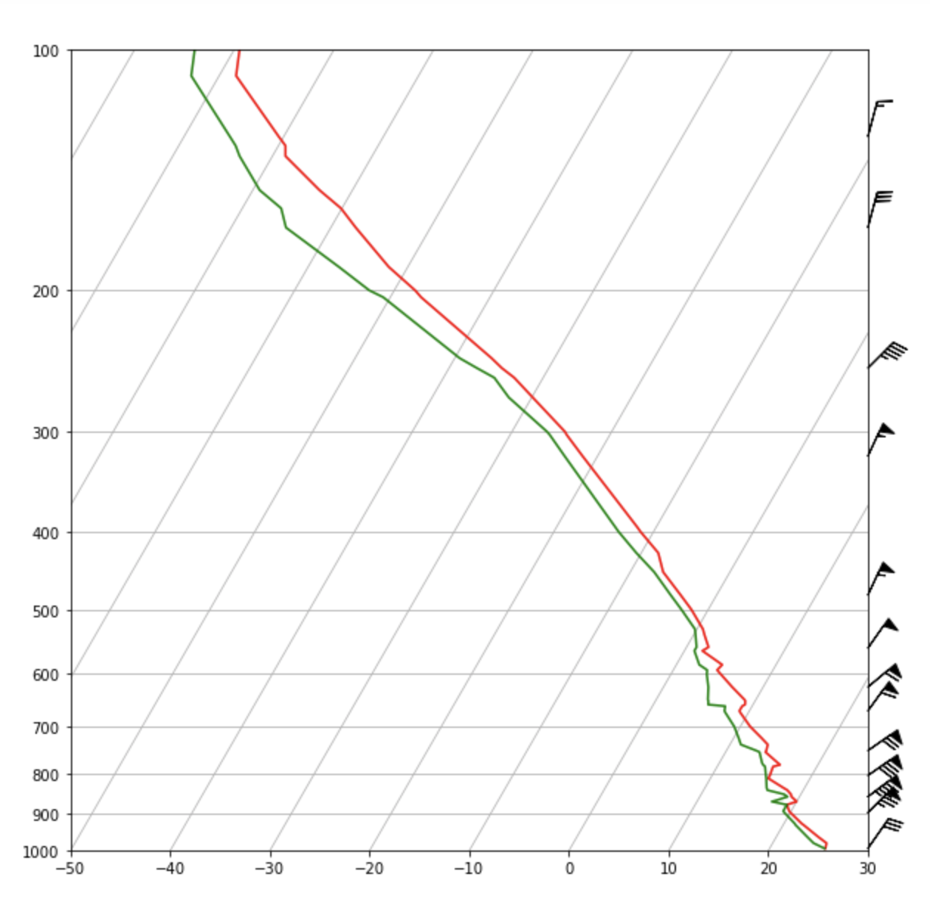
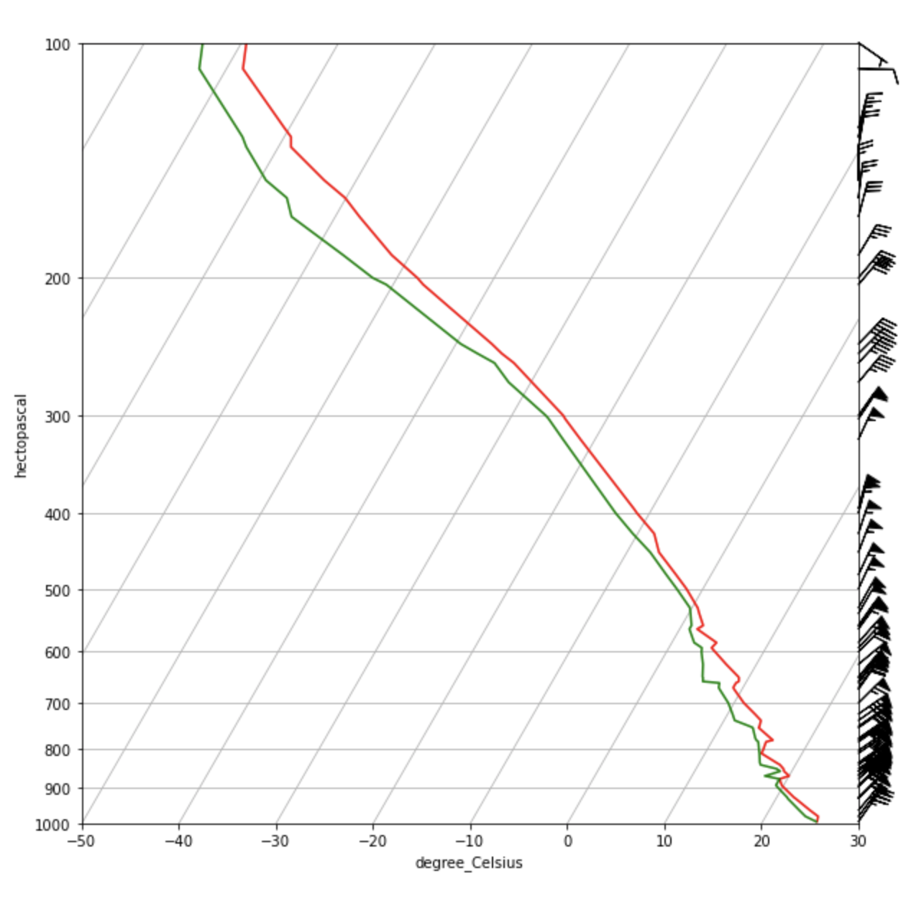
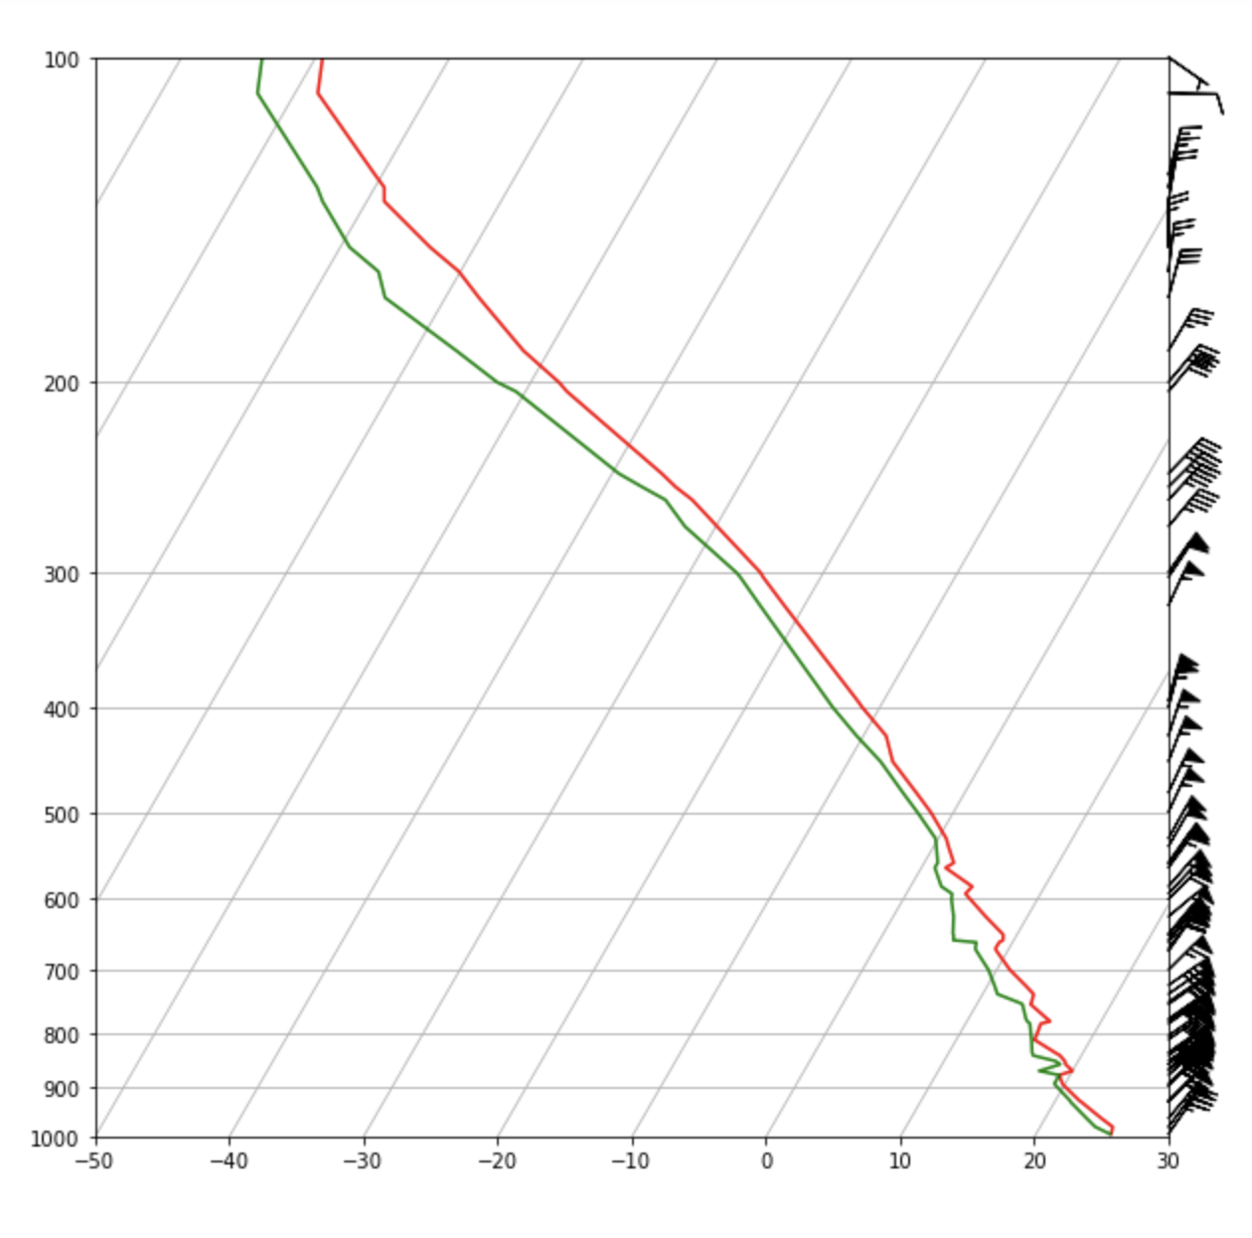
Cell #16 – Using the mask
# create new figure from scratch
fig = plt.figure(figsize=(10,10))
skew = plots.SkewT(fig)
skew.plot(p, T, 'red')
skew.plot(p, Td, 'green’)
skew.ax.set_ylim(1000,100) # limit y-axis 1000 to 100mb
skew.ax.set_xlim(-50,30) # limit x-axis to -50 to +30 C
skew.plot_barbs(p[mask], u[mask], v[mask])
# will only be plotted where mask = True
The barbs above the plot top are gone,
but still too crowded…

Slide 27

Cell #17 – Skipping values in a sequence
a = np.arange(10)
print(a)
print(a[::3])
This is slicing – start : end : stride. The notation [::3] means start at beginning
(default), and stop at the end (default), but keep only every 3rd item
Second of three methods for dealing with the wind barb problem
Notes:
B = np.arange(0,10,3) could have done same thing, but this is just demonstrating slicing.

Slide 28
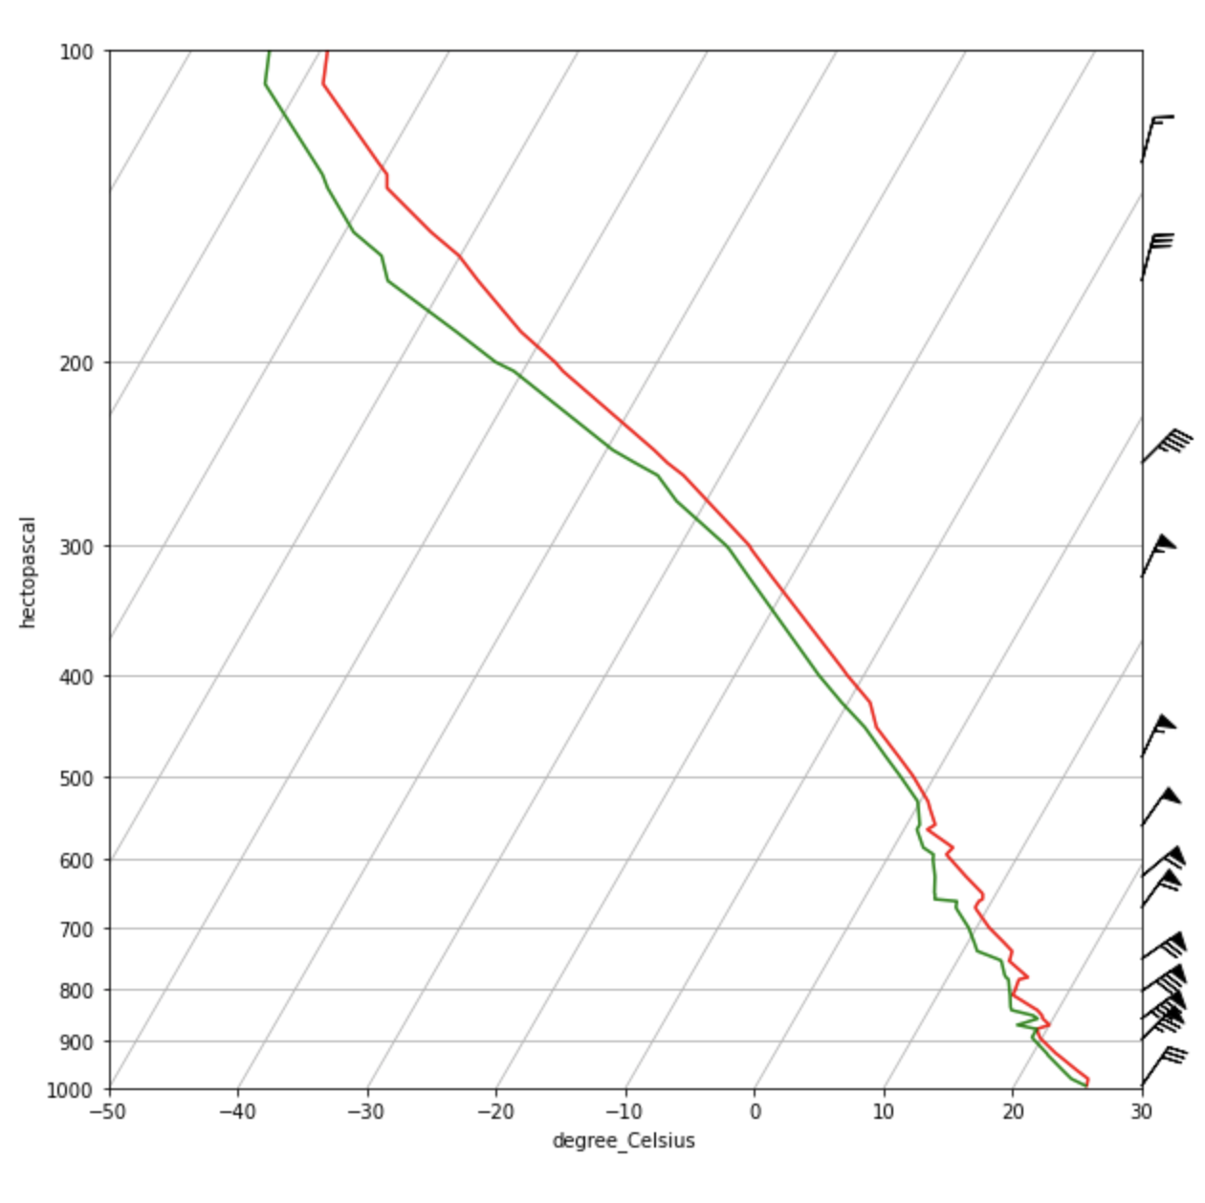
Cell #18 – Slicing to plot every 5th True level
# clean up some more - using a trick to skip some
# True values
# create new figure from scratch
fig = plt.figure(figsize=(10,10))
skew = plots.SkewT(fig)
skew.plot(p, T, 'red')
skew.plot(p, Td, 'green')
skew.ax.set_ylim(1000,100) # limit y-axis 1000 to 100 mb
skew.ax.set_xlim(-50,30) # limit x-axis to -50 to +30 C
skew.plot_barbs(p[mask][::5], u[mask][::5],
v[mask][::5])
# Now also only plot every 5th True value
Plotting every 5th level, but only for True levels.
The wind levels have been pruned
but we’d like more levels near the top of the plot…

Slide 29
Cell #19 – Define levels you want plotted
# define levels where we want barbs at, or close to. Attach units.
interval = np.arange(100,1000,50) * units.hPa
# remember it does not include the last value of range!!!!
interval
The pressure levels we have selected… but we’re not done…
Third of three methods for dealing with the wind barb problem
Notes:
So I wont get the 1000 mb wind, which I did have before. If I want that, need to change the range,

Slide 30
Cell #20 – Find the corresponding indices
That’s ”1d” not “ld”
idx = mpcalc.resample_nn_1d(p, interval)
# resample, using nearest-neighbor (nn), in 1 dimension (1d). Returns indices idx
idx
This uses the ‘calc’ method of MetPy to identify the array indices of the pressure variable ‘p’,
at the intervals defined in the previous cell. Interpolates for you when and where necessary.
https://unidata.github.io/MetPy/latest/api/generated/metpy.calc.resample_nn_1d.html?highlight=resample

Slide 31
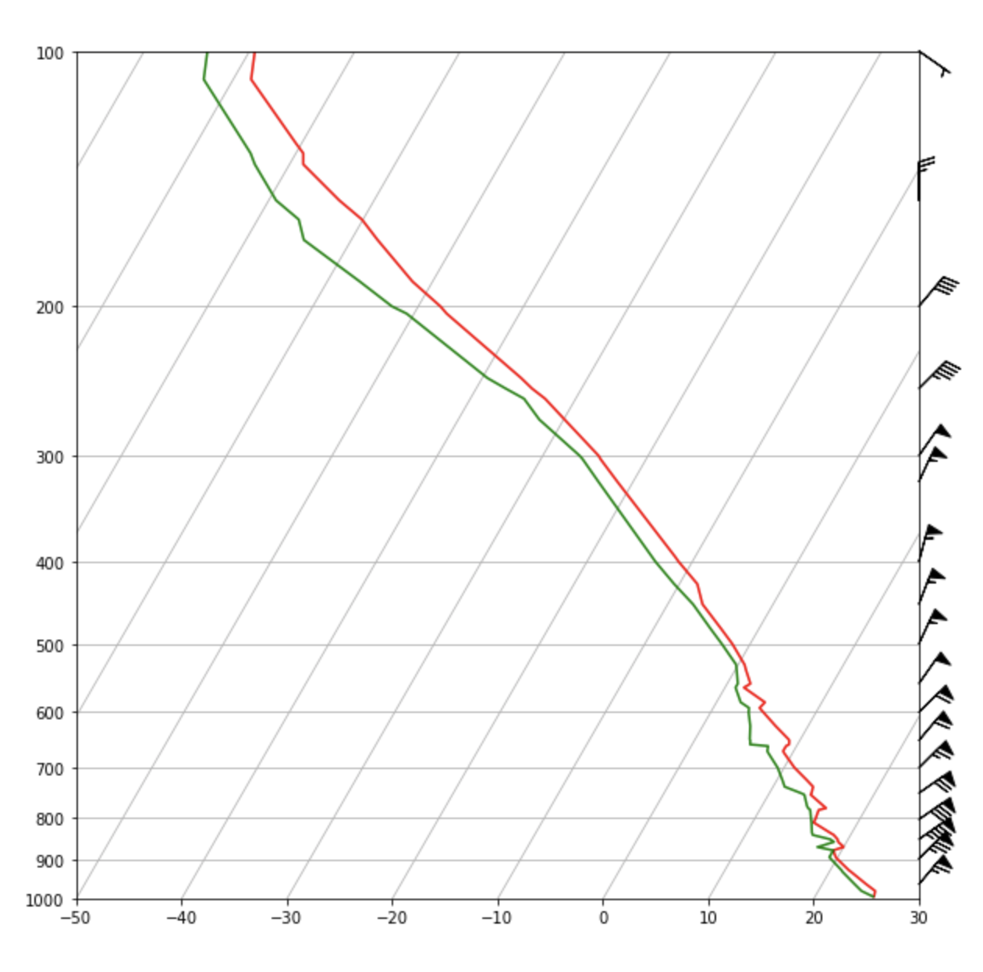
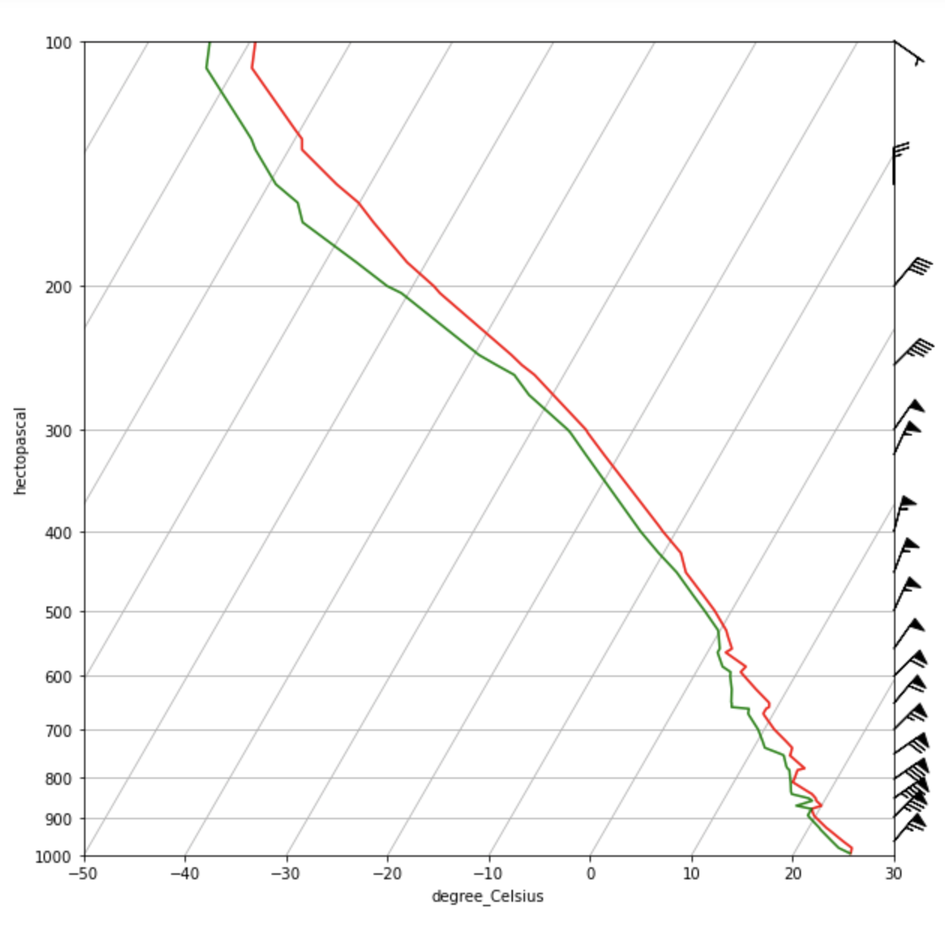
Cell #21 – Plotting winds at defined levels
fig = plt.figure(figsize=(10,10))
skew = plots.SkewT(fig)
skew.plot(p, T, 'red')
skew.plot(p, Td, 'green')
skew.ax.set_ylim(1000,100) # limit y-axis 1000 to 100 mb
skew.ax.set_xlim(-50,30) # limit x-axis to -50 to +30 C
skew.plot_barbs(p[idx], u[idx], v[idx])
# Now only for indices defined in last cell
Plotted at the pressure levels we’ve designated

Slide 32
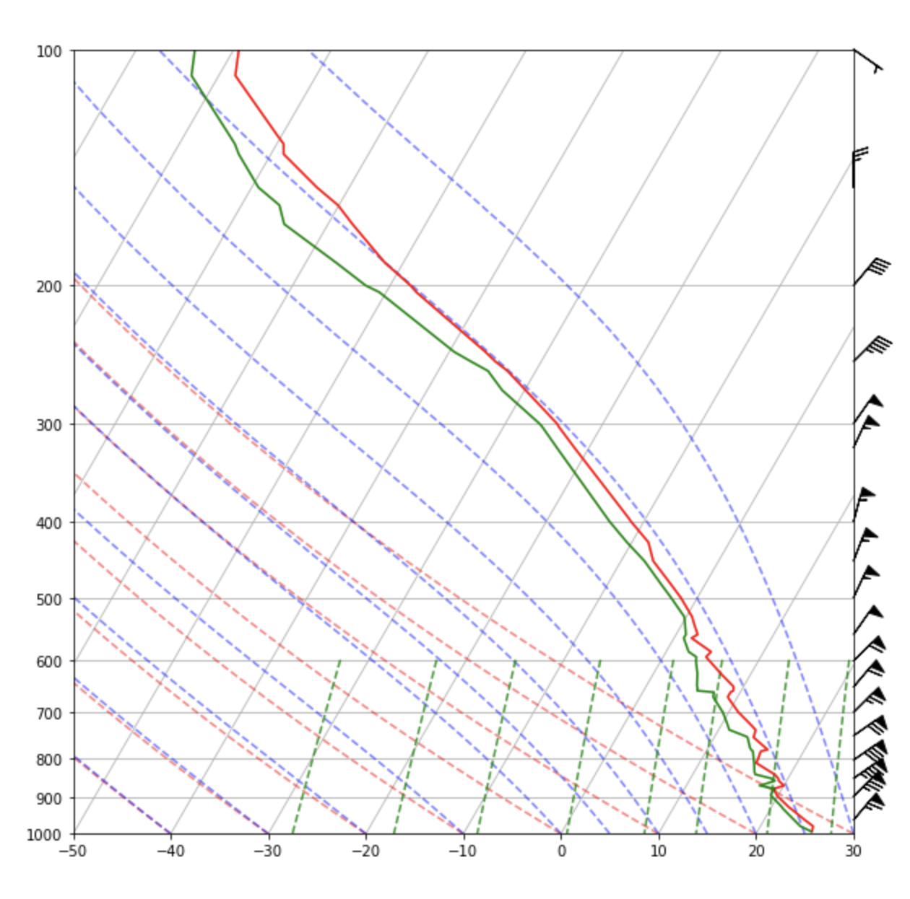
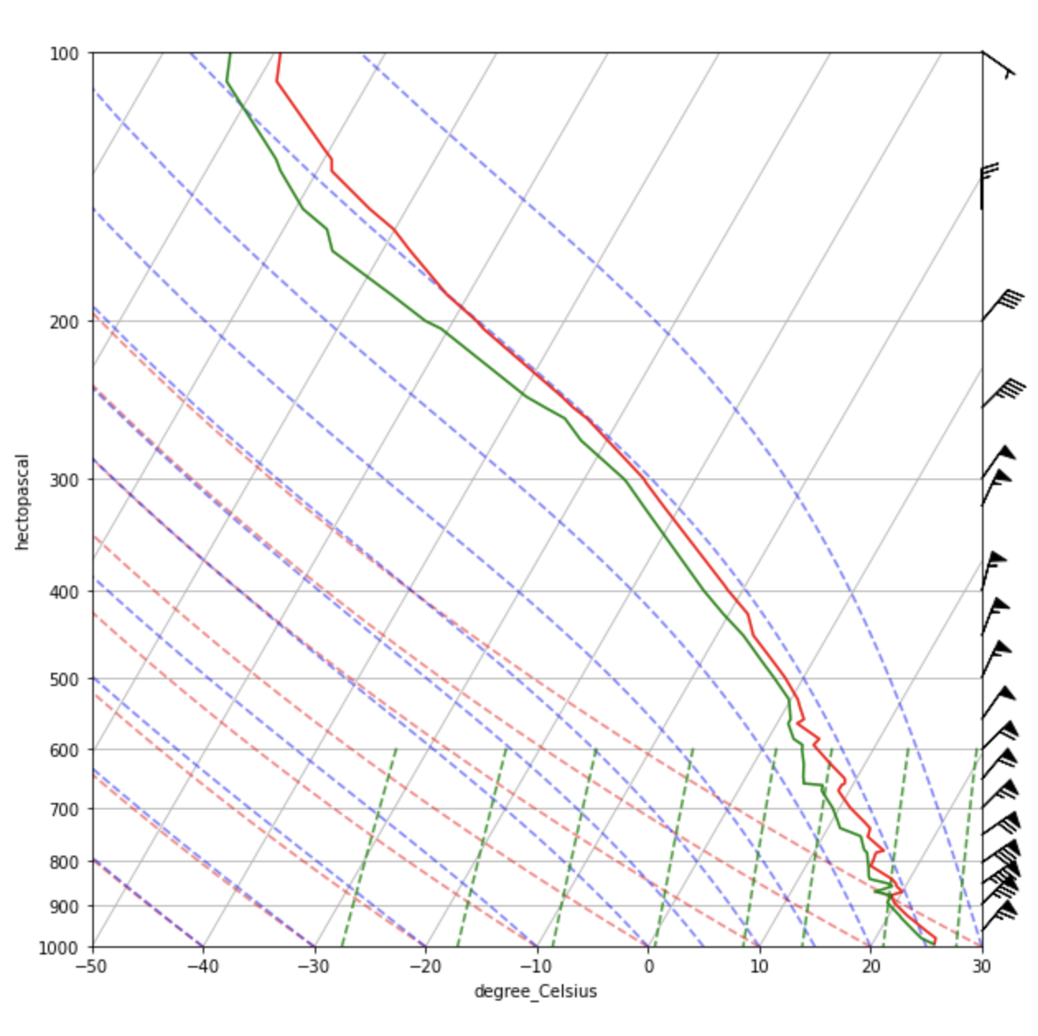
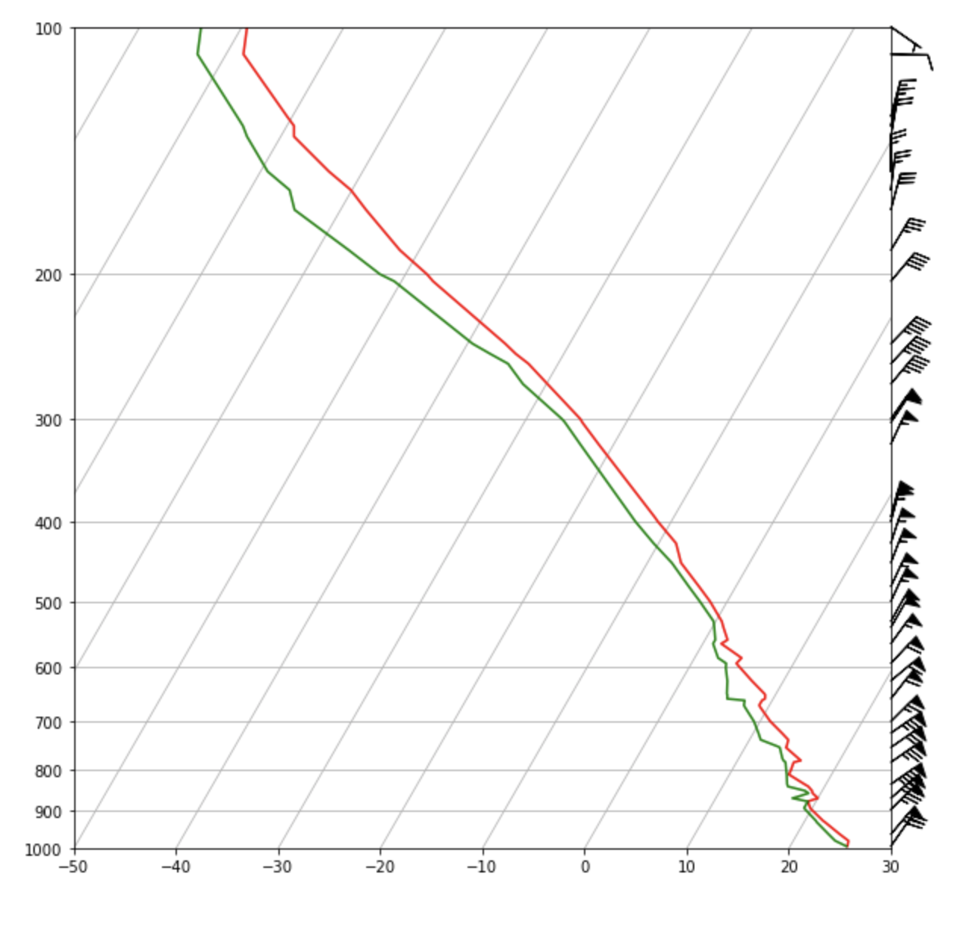
Cell #22 – Adding reference lines/curves
# after you start typing in the line, try hitting
# the TAB key to see autocomplete options
skew.plot_dry_adiabats()
skew.plot_moist_adiabats()
skew.plot_mixing_lines()
fig
Dry (subsaturated) adiabats: red dashed
Moist (saturated) adiabats: blue dashed
Mixing ratio lines: green dashed

Slide 33
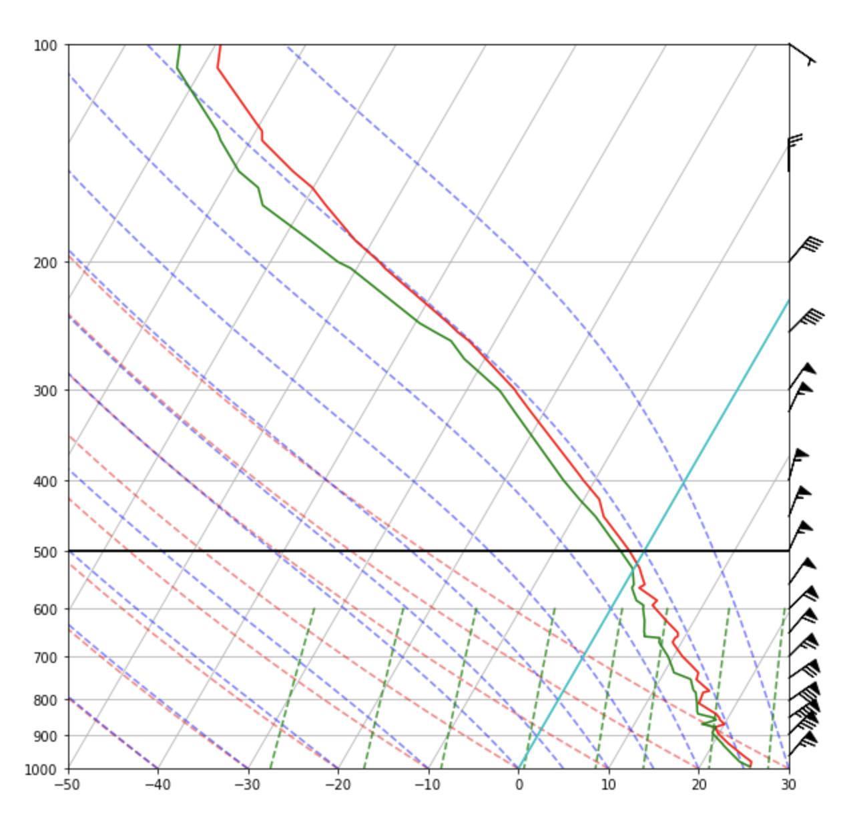
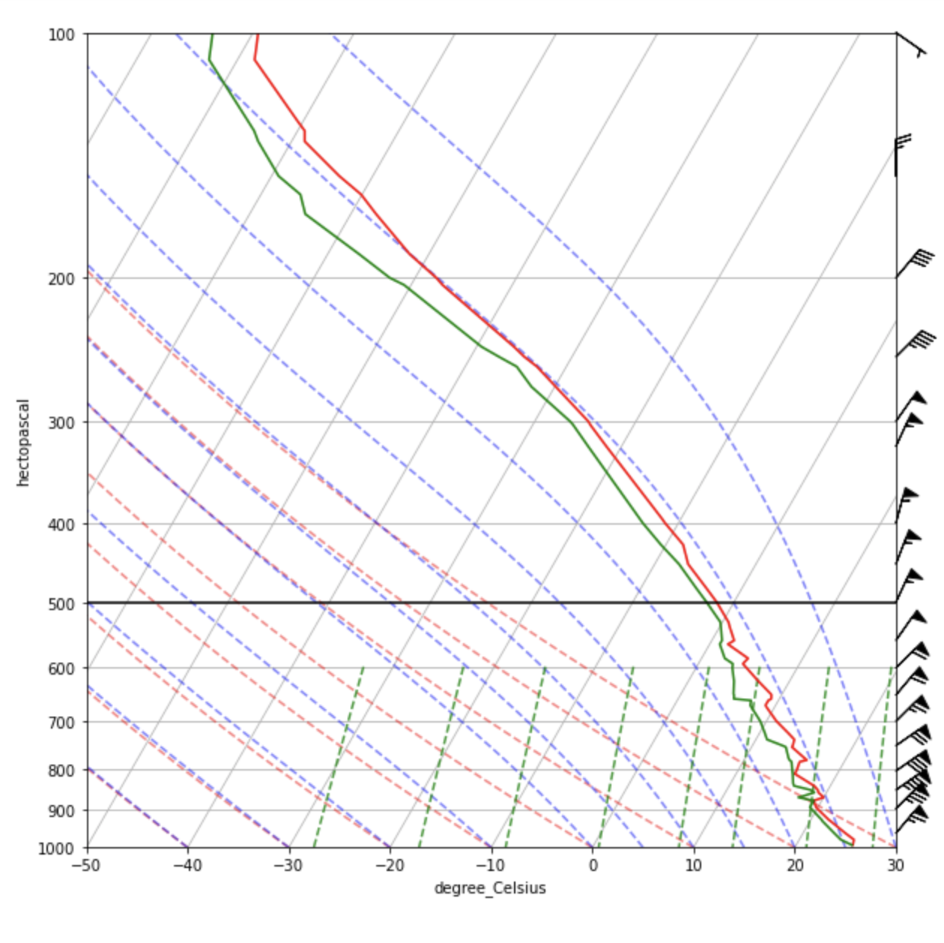
Cell #23 – Adding a horizontal reference line
# add a horizontal reference line at 500 mb
skew.ax.axhline(500 * units.hPa, color='k')
fig

Slide 34
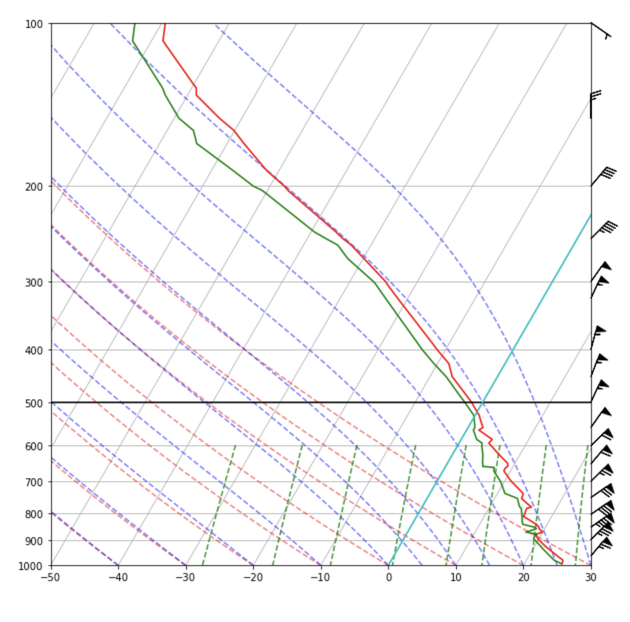
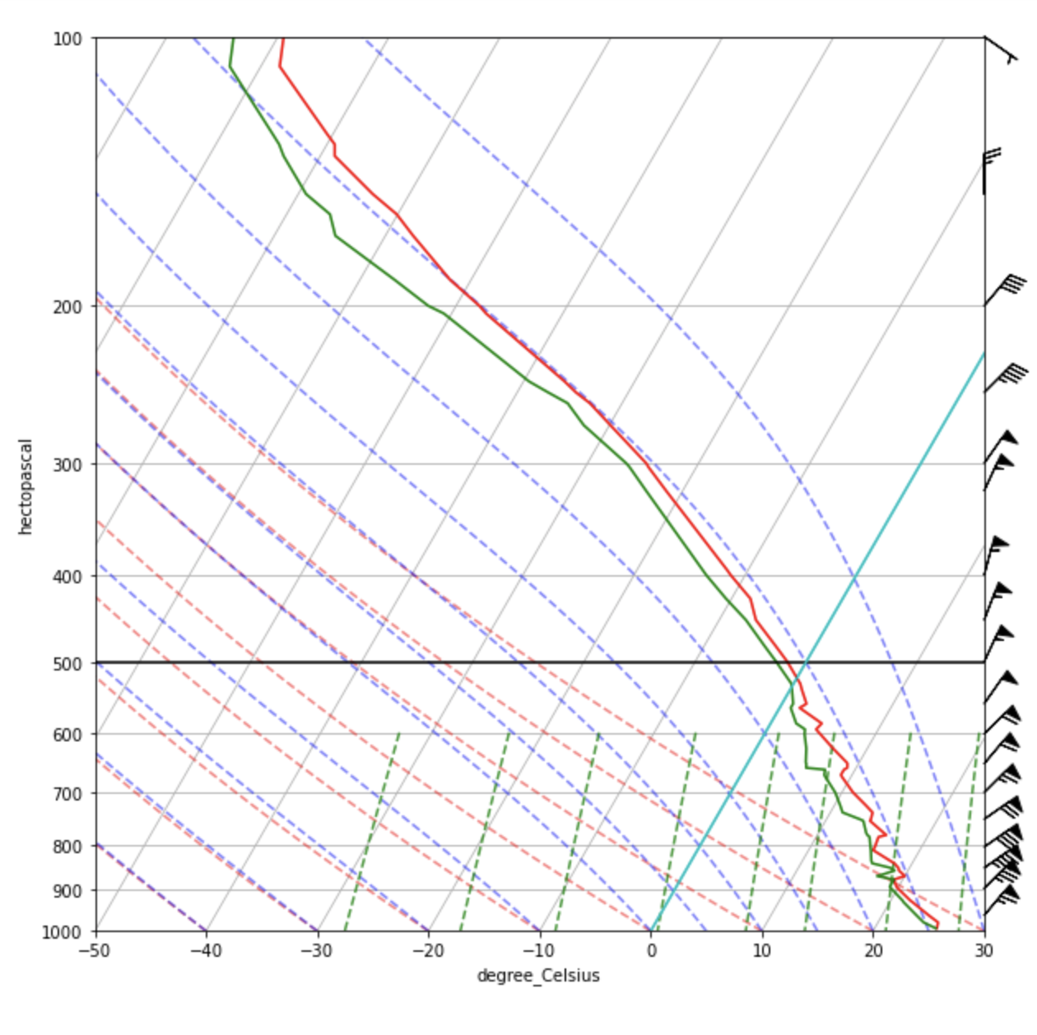
Cell #24 – Adding a “vertical” reference line
# emphasize the 0C isotherm. Not a true vertical line,
# but use axvline and the transformation is handled
# by MetPy
skew.ax.axvline(0 * units.degC, color='c')
# color is cyan
fig

Slide 35
Cell #25 – Calculating a parcel path
# Use built-in MetPy function to calculate and plot parcel paths, CAPE and CIN
# vertical coordinate is p
# parcel defined as first (zeroth) entries in the T and Td profiles: “surface parcel”
parcel_path = mpcalc.parcel_profile(p, T[0], Td[0])
parcel_path
scroll →
The parcel path is printed to screen… note you need to scroll to see all the values, and note its
unit is “kelvin” despite fact we gave the method T and Td in degrees Celsius. Because method
understood the units, it did the conversions for us. The result is a parcel T for each of our
pressure levels.
We specified the surface parcel. You could specify different parcel properties, of course
Notes:
You can define different parcel starting properties, of course

Slide 36
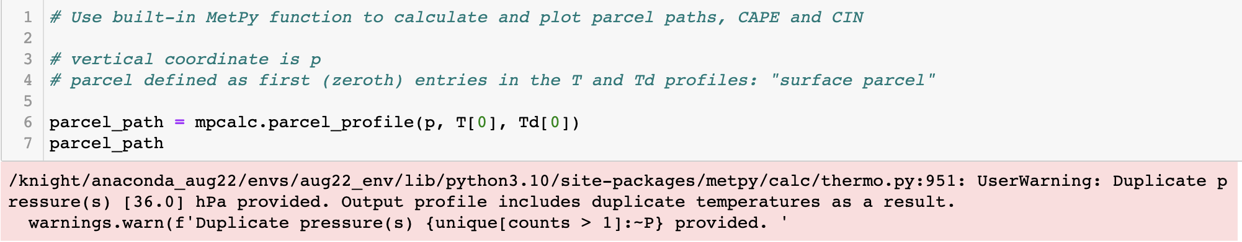
Cell #25 – Warning message…
Scroll back up to Cell #6, and note that there are indeed two levels defined with the same pressure, 36.0 mb.
MetPy is just alerting you to this.
Notes:
You can define different parcel starting properties, of course

Slide 37
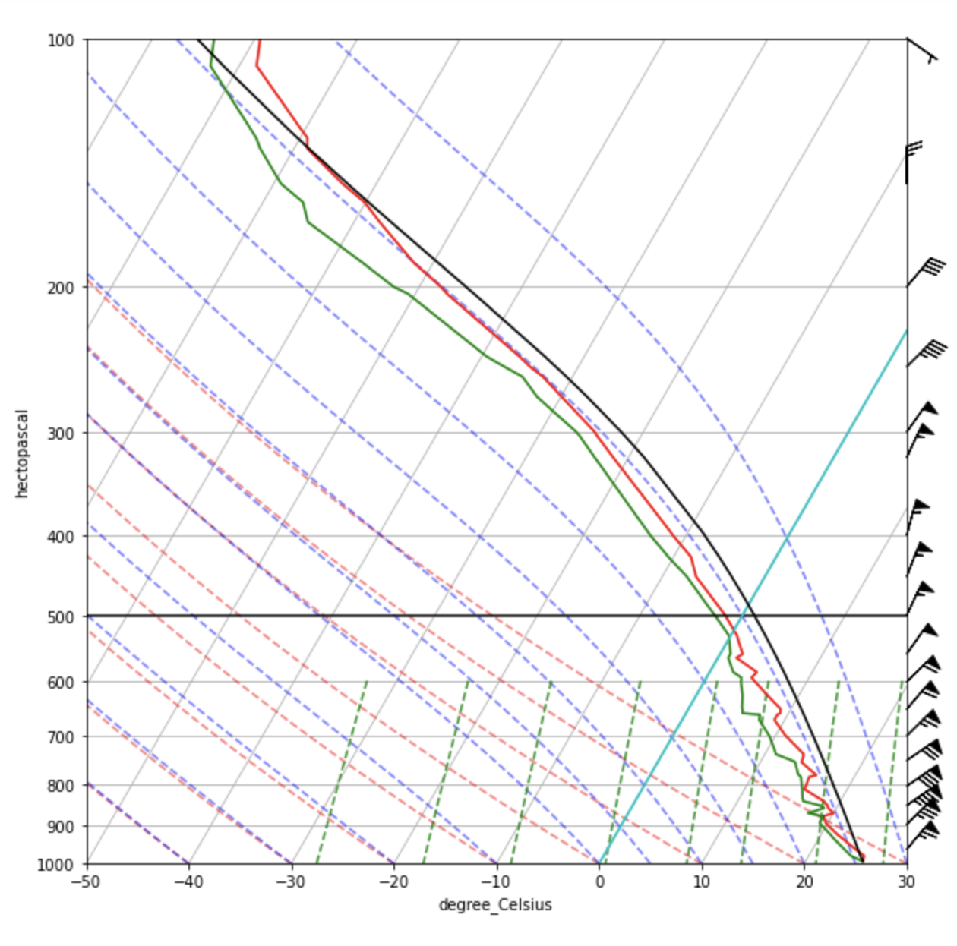
Cell #26 – Plotting the parcel path
# now add that parcel path to the figure
skew.plot(p, parcel_path, color='k')
fig
This parcel saturates almost immediately, and thus
rises parallel to a moist adiabat all the way up

Slide 38
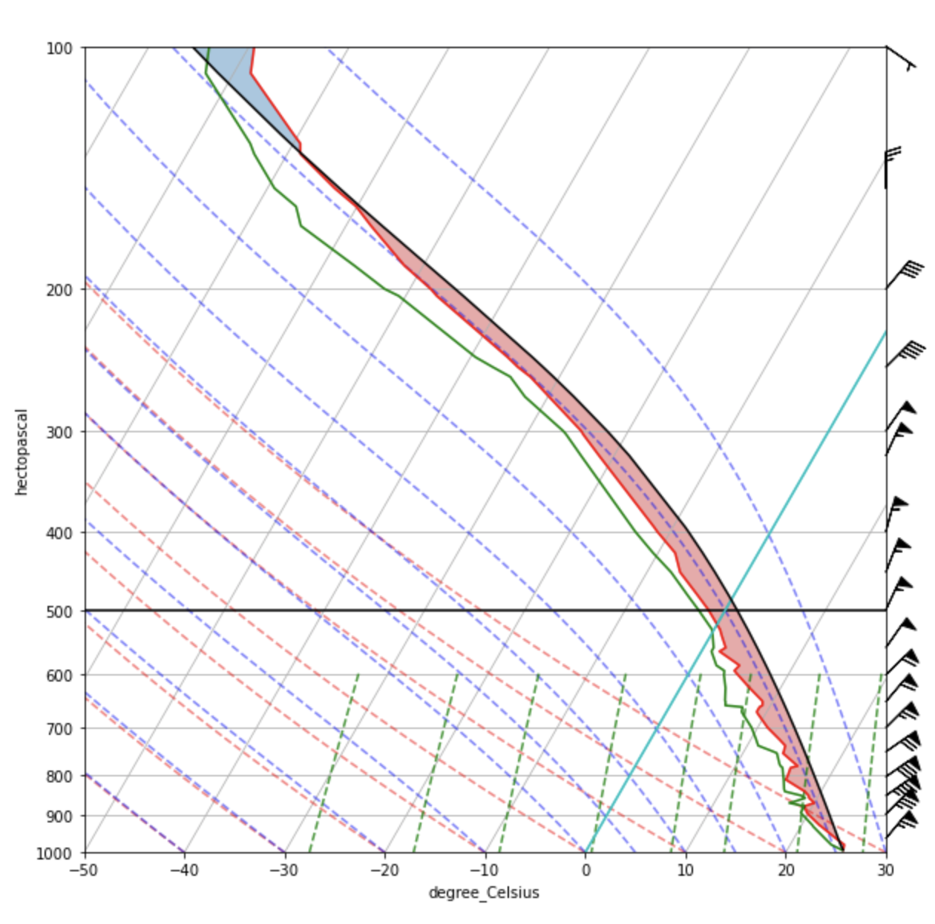
Cell #27 – Shading the CAPE and CIN
# calculate CAPE and CIN, and capture these values
cape, cin = mpcalc.cape_cin(p, T, Td, parcel_path)
print("CAPE is ",cape)
print("CIN is ",cin)
# now shade areas of CAPE (red) and CIN (blue)
# This also suffices to calculate CAPE and CIN
skew.shade_cape(p, T, parcel_path)
skew.shade_cin(p, T, parcel_path)
fig
CAPE (Convective Available Potential Energy): a measure
of energy available to a rising parcel = degree of instability.
Here, 1313 J/kg.
CIN (Convective Inhibition): a measure of energy that must
be supplied to overcome resistance to lifting. Here -1.4 J/kg.
Both have units of energy per mass (Joules per kg)
Notes:
Don’t have to explicitly calc CAPE, CIN because it was computed in the parcel_path. But this way I can extract the values.

Slide 39

Cell #28 – Calculating LCL
# Calc LCL for our parcel
# provide the parcel properties - we previously used lowest level info "surface parcel"
mpcalc.lcl(p[0], T[0], Td[0])
LCL (Lifting Condensation Level): pressure level
at which parcel would achieve saturation via lifting.
Units are pressure. Parcel T at LCL also provided.
Output is a tuple
If there is no LCL (unlikely), the method returns “NaN” (= nan)

Slide 40

Cell #29 – Calculating LFC
# Calc LFC for our parcel
# here we provide the profile - this DEFAULTS to surface parcel
# https://unidata.github.io/MetPy/latest/api/generated/metpy.calc.lfc.html?highlight=lfc
mpcalc.lfc(p, T, Td)
LFC (Level of Free Convection): pressure level
at which parcel would first become positively
buoyant. May not exist. Units are pressure.
Parcel T at LFC also provided.
Output is a tuple
You can provide a parcel path to the LFC method, but it defaults to surface parcel [zeroth elements in T and Td]
If you didn’t configure the parcel with surface values earlier, this would likely provide wrong values
If there is no LFC, method returns “NaN”

Slide 41

Cell #30 – Calculating EL (== EQL)
# Calc EL for our parcel
# again this defaults to surface parcel
# https://unidata.github.io/MetPy/latest/api/generated/metpy.calc.el.html#metpy.calc.el
mpcalc.el(p, T, Td)
EL (Equilibrium Level): pressure level at which
previously positively buoyant parcel again has
same temperature as environment. Only exists
if LFC does. Units are pressure, and parcel T at
EL also provided.
Output is a tuple
You can provide a parcel path to the LFC method, but it defaults to surface parcel [zeroth elements in T and Td]
If you didn’t configure the parcel with surface values earlier, this would likely provide wrong value
If there is no LFC, there is also no EL, and method returns “NaN”

Slide 42
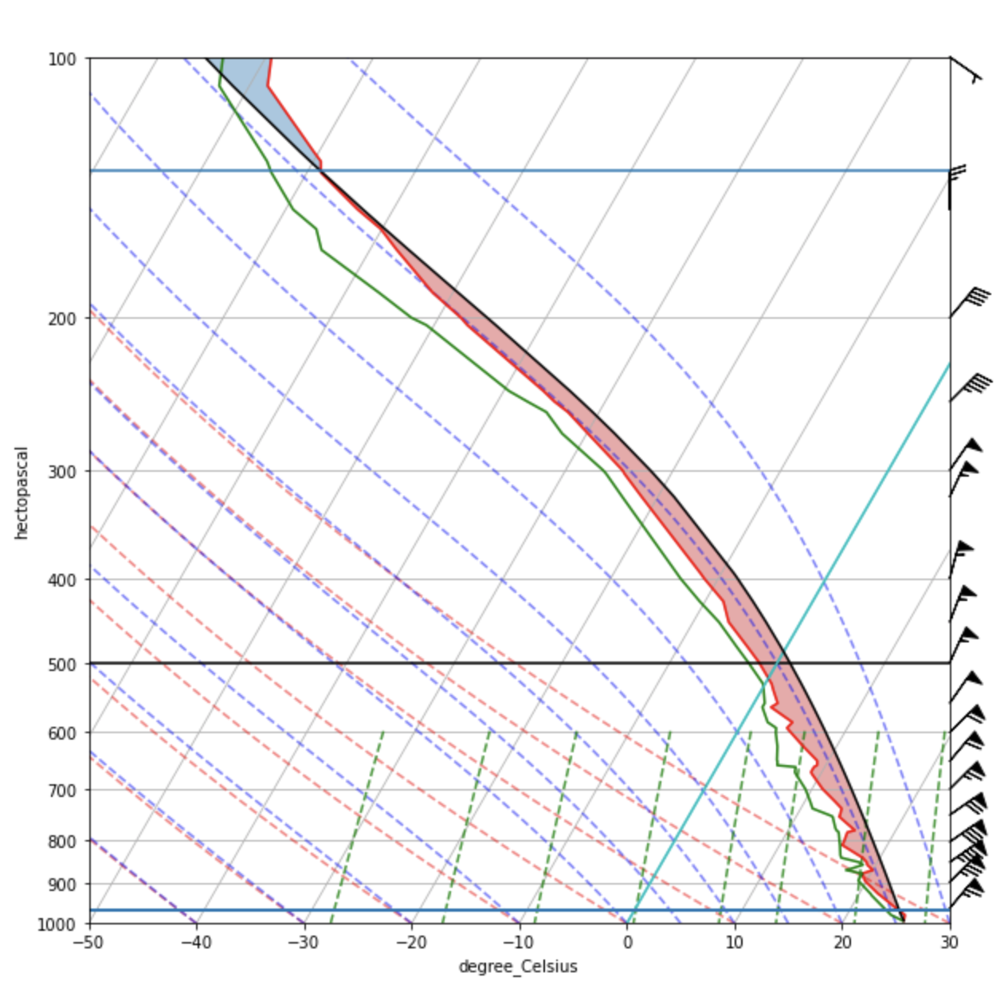
Cell #31 – Drawing the LFC and EL
# alternative approach to extracting info from lfc & el
# methods. This lets us capture the values
lfc_p, lfc_t = mpcalc.lfc(p, T, Td)
el_p, el_t = mpcalc.el(p, T, Td)
skew.ax.axhline(lfc_p) # highlight p level of LFC
skew.ax.axhline(el_p) # and same for EL
fig
mpcalc.lfc results in pressure and temperature values.
LFC pressure and temperature get assigned
to lfc_p and lfc_t, then plotted with axhline
Same for EL
However, if they do not exist, an error will be thrown

Slide 43
Cell #32 – Drawing the LFC and EL (cautious)
# more cautious approach to plotting LFC and EL:
# make sure they exist first!
lfc_p, lfc_t = mpcalc.lfc(p, T, Td)
el_p, el_t = mpcalc.el(p, T, Td)
if lfc_p:
skew.ax.axhline(lfc_p)
if el_p:
skew.ax.axhline(el_p)
fig
More cautious approach. Same plot since both LFC, EL
exist on plot
This works because “NaN” resolves to “False”

Slide 44
Cell #33 – Start from scratch and build in a hodograph inset (part 1)
# create figure and skew plot
fig = plt.figure(figsize=(10,10))
skew = plots.SkewT(fig)
# plot T and Td
skew.plot(p, T, 'red')
skew.plot(p, Td, 'green’)
# now the wind barbs, at selected vertical interval
interval = np.arange(100,1000,50) * units.hPa # remember it does not include the last value of range!!!
idx = mpcalc.resample_nn_1d(p, interval) # resample, using nearest-neighbor (nn), in 1d. Returns indices
skew.plot_barbs(p[idx], u[idx], v[idx]) # Now only for indices defined in last cell
# set axis limits
skew.ax.set_ylim(1000,100) # limit y-axis to 1000 to 100 mb
skew.ax.set_xlim(-50,30) # limit x-axis to -50 to +30 C

Slide 45
Cell #33 – Start from scratch and build in a hodograph inset (part 2)
# plot the reference curves/lines
skew.plot_dry_adiabats()
skew.plot_moist_adiabats()
skew.plot_mixing_lines()
# define parcel – it is a surface parcel
parcel_path = mpcalc.parcel_profile(p, T[0], Td[0])
skew.plot(p, parcel_path, color='k')
# shade CAPE and CIN
skew.shade_cape(p, T, parcel_path)
skew.shade_cin(p, T, parcel_path)
# calculate parameters for LFC and EL defaulting to surface parcel
# and plot if they exist
lfc_p, lfc_t = mpcalc.lfc(p, T, Td)
el_p, el_t = mpcalc.el(p, T, Td)
if lfc_p:
skew.ax.axhline(lfc_p)
if el_p:
skew.ax.axhline(el_p)

Slide 46
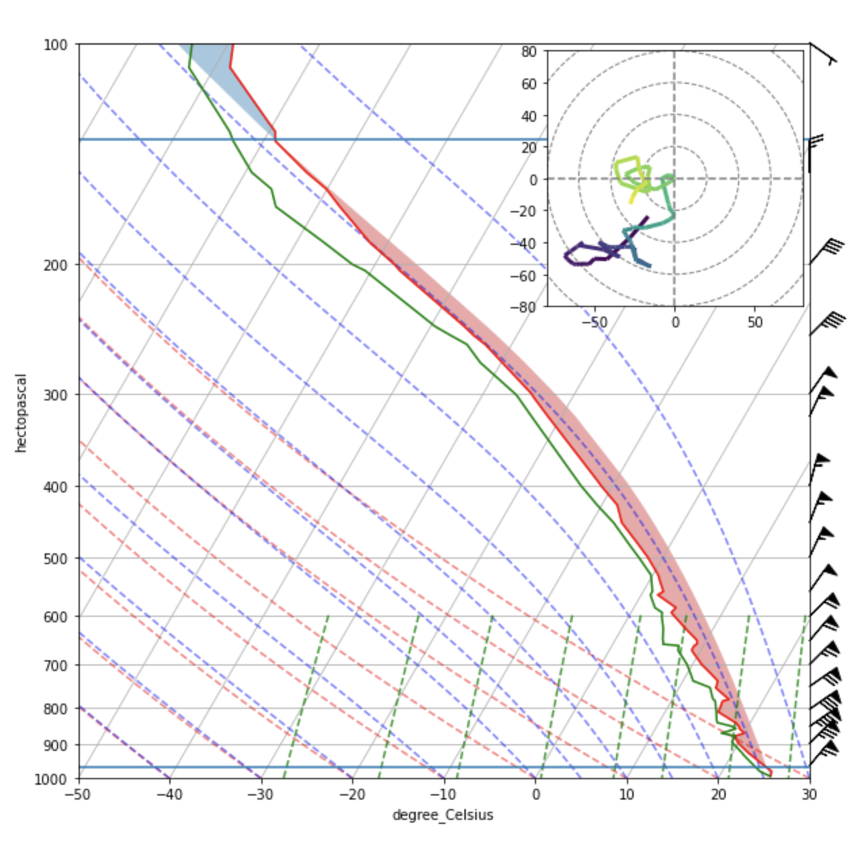
Cell #33 – Start from scratch and build in a hodograph inset (part 3)
# make the hodograph inset
ax_hod = inset_axes(skew.ax, '35%', '35%', loc=1)
h = Hodograph(ax_hod, component_range=80.)
h.add_grid(increment=20)
h.plot_colormapped(u, v, height)
Hodograph (‘path graph’) shows how wind components
vary with altitude.
On hodograph, altitude of wind observation is mapped
to color, with darker colors representing winds closer
to surface
The next slide moves the hodograph a little.

Slide 47
Cell #33 – Now modify and rerun
(part 4)
# make the hodograph inset
#ax_hod = inset_axes(skew.ax, '35%', '35%', loc=1)
# this new code shifts the hodograph to the left a bit
# so wind barbs are not obscured
ax_hod = inset_axes(skew.ax, '35%', '35%',
loc='upper right',
bbox_transform=skew.ax.transAxes,
bbox_to_anchor=(-0.05, 0., 1, 1))
h = Hodograph(ax_hod, component_range=80.)
h.add_grid(increment=20)
h.plot_colormapped(u, v, height)
Shifted the hodograph in case of strong westerly winds

Slide 48
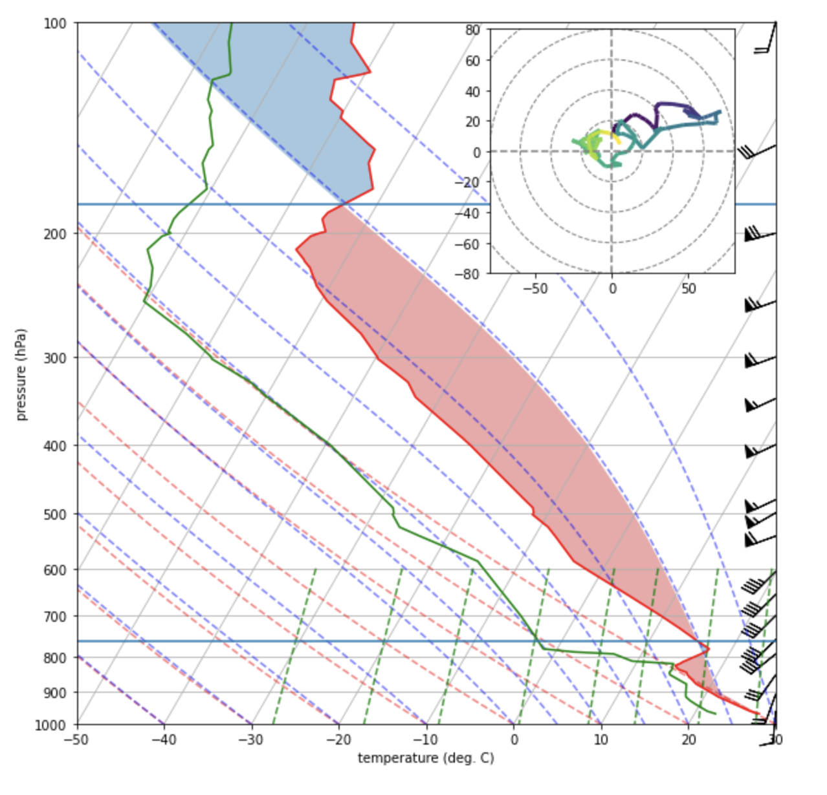
Extra
Rerun your notebook but instead request station OUN for May 20, 2013 at 18Z
Note there’s 4468 J/kg of CAPE and 0 J/kg of CIN, large vertical speed shear, and substantial, deep veering winds
What happened on this day?

Slide 49
[end]

