Slide 1
Class #12
ATM 240 ~ Fall 2022
Robert Fovell
rfovell@albany.edu

Slide 2
Class roadmap
Plot radar data from a historical archive and animate it. Our initial demonstration will be Hurricane Ida (2021) approaching landfall
Then we will reconfigure the demonstration to display radar reflectivity and radial velocity from the infamous 2013 Moore, OK EF5 tornado
If we have time, we will look at the radar reflectivity from the El Reno, OK EF3 tornado that occurred 11 days later, and is still the widest tornado on record
And we can plot the OUN sounding for the El Reno case on a Skew-T
Create a Terminal window, move to your /spare11/atm240/yournetid space. Copy the notebook RADAR.ipynb from the directory above
cp ../RADAR.ipynb .

Slide 3
Resources
This powerpoint
RADAR.ipynb
Your Skew-T script from last week

Slide 4
Radar information - 1
Radar was originally an acronym: RAdio Detection And Ranging
Radars come in a variety of types, but all send out pulses of radio waves of a specified wavelength and then listen for returned signal
  10-cm wavelength → weather radar ← sees larger particles; cloud droplets invisible
  Smaller wavelengths → cloud radar ← can see cloud droplets but cannot penetrate clouds
NOAA operates a network of NEXRAD (next-generation 10-cm radars, dating from 1988 or so) radars. Data are available in two types, from a variety of sources
  Level II data have higher resolution and are less processed
  Level III data have lower resolution and are more processed
  We will access Level II data from Unidata
  Most radar information found on the web is Level III

Slide 5
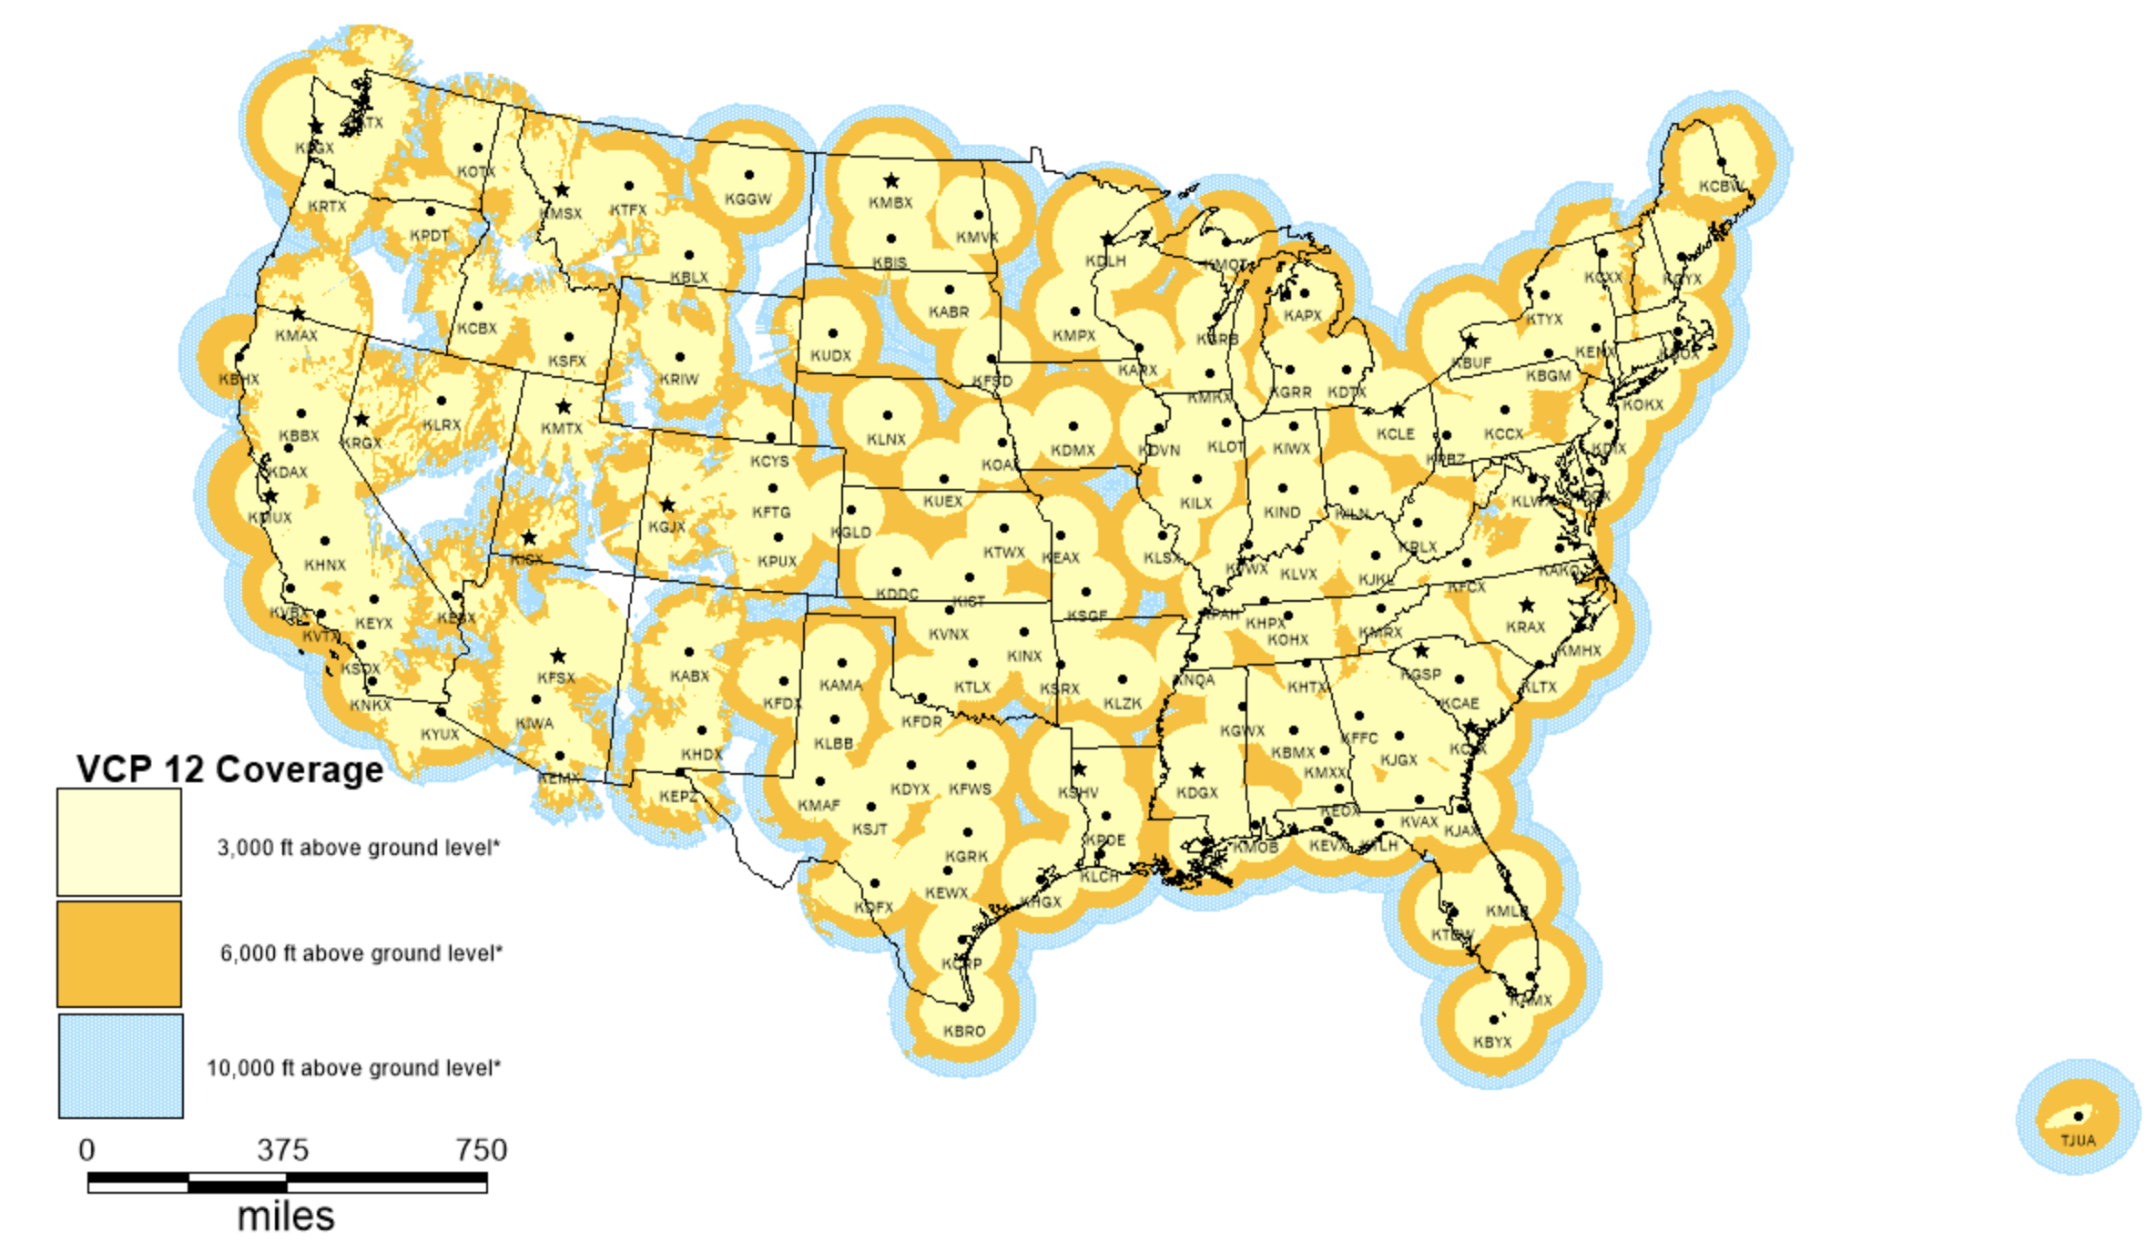
NEXRAD radars: https://www.roc.noaa.gov/WSR88D/Maps.aspx

Slide 6
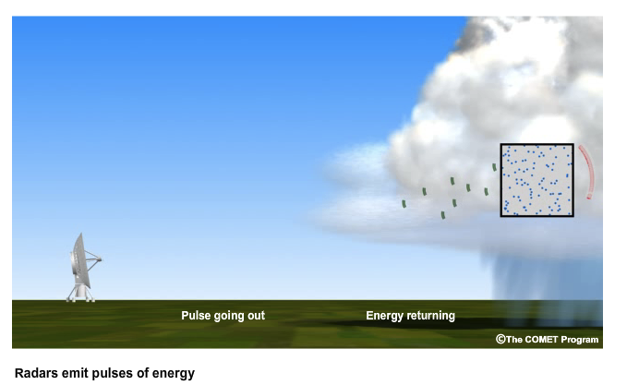
Radar information - 2
Radars send out pulses and
then go into “listening mode”
Only a small fraction of the
transmitted energy is returned
(backscattered or reflected)
Time lag for return signal reveals
target radial distance from radar
Signals reflected from large distance
may return after next pulse is sent
confusing the radar w/r/t location
(range folding)
targets
pulse
returning signal

Slide 7
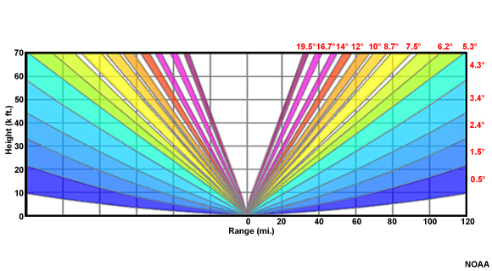
Radar information - 3
Radars execute a sequence of
elevation scans of various angles
relative to the radar platform
As a consequence, they cannot
detect information directly above
them (“cone of silence”)
Also, beams farther from radar are
both higher altitude and more
spread vertically (beam spreading)

Slide 8
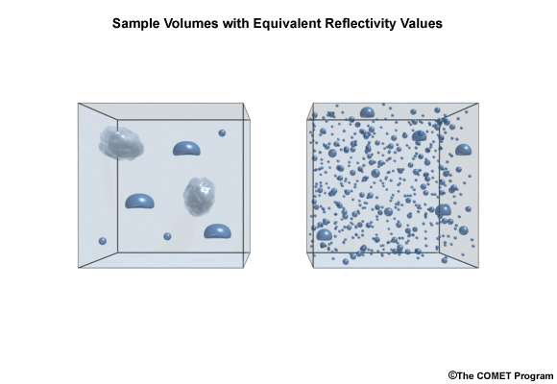
Radar information - 4
Reflectivity is a measure of the returned signal
  Units are dbZ (decibels, converted from equivalent reflectivity factor Z)
  Reflectivity in dbZ is logarithmic and dimensionless
  Z itself is proportional to 6th power of particle diameter (mm⁶) per cubic meter (m³)
    Many medium-sized particles and a few large particles --> same reflectivity
  Ice is less reflective than liquid & melting ice on radar can be very “bright”
  Typical color table goes from blue (low reflectivity) to red/pink (high reflectivity)
    Largest values: hail or debris

Slide 9
Radar information - 5
Radial velocity is component towards or away from the radar
  To interpret, you need to know where radar is located on the figure
  Typical color table consists of greens (towards) radar and reds (away from radar)
  Rotational signatures appear as green/red dipoles/couplets
  Purples are range-folded (spoiled) velocity data – radar cannot determine inbound from outbound
The farther from the radar, the higher the altitude being sampled and the larger the depth of atmosphere being seen (beam spreading)
  Look again at figure on slide 7

Slide 10
Radar information - 6
Radar data are provided in polar coordinates: radial distance & azimuth, and so needs to be converted
  We can convert to Cartesian (x,y) coordinates for plotting
  Or we can convert to lat/lon so we can superimpose topography, political boundaries, roads, etc.
  We are going to use Cartopy to plot map-projected data in this demo, and add some new features like roadways

Slide 11
[Tour of RADAR.ipynb]

Slide 12
The Moore, OK EF5 tornado
20 May 2013

Slide 13
Moore - 1
Via File menu, make a copy of your RADAR.ipynb notebook, and rename it “RADAR-Moore”
  Remember to close and halt RADAR.ipynb, please!
Change requested date/time to 20 May 2013 at 20 UTC
Specify radar KTLX instead of a lon/lat location
  Comment out ‘query.stations’ line specifying lat/lon and uncomment out version specifying specific radar location and edit for radar station call sign
Set an appropriate set_extent around Moore, OK. You can refine it later and rerun the notebook. Moore’s lat is 35.3˚N, lon is -97.5˚W
View your animation of base reflectivity (interval controls framerate)
  Last cell: ArtistAnimation(fig, meshes, interval=1250)
When you are happy with your plot, show it to me

Slide 14
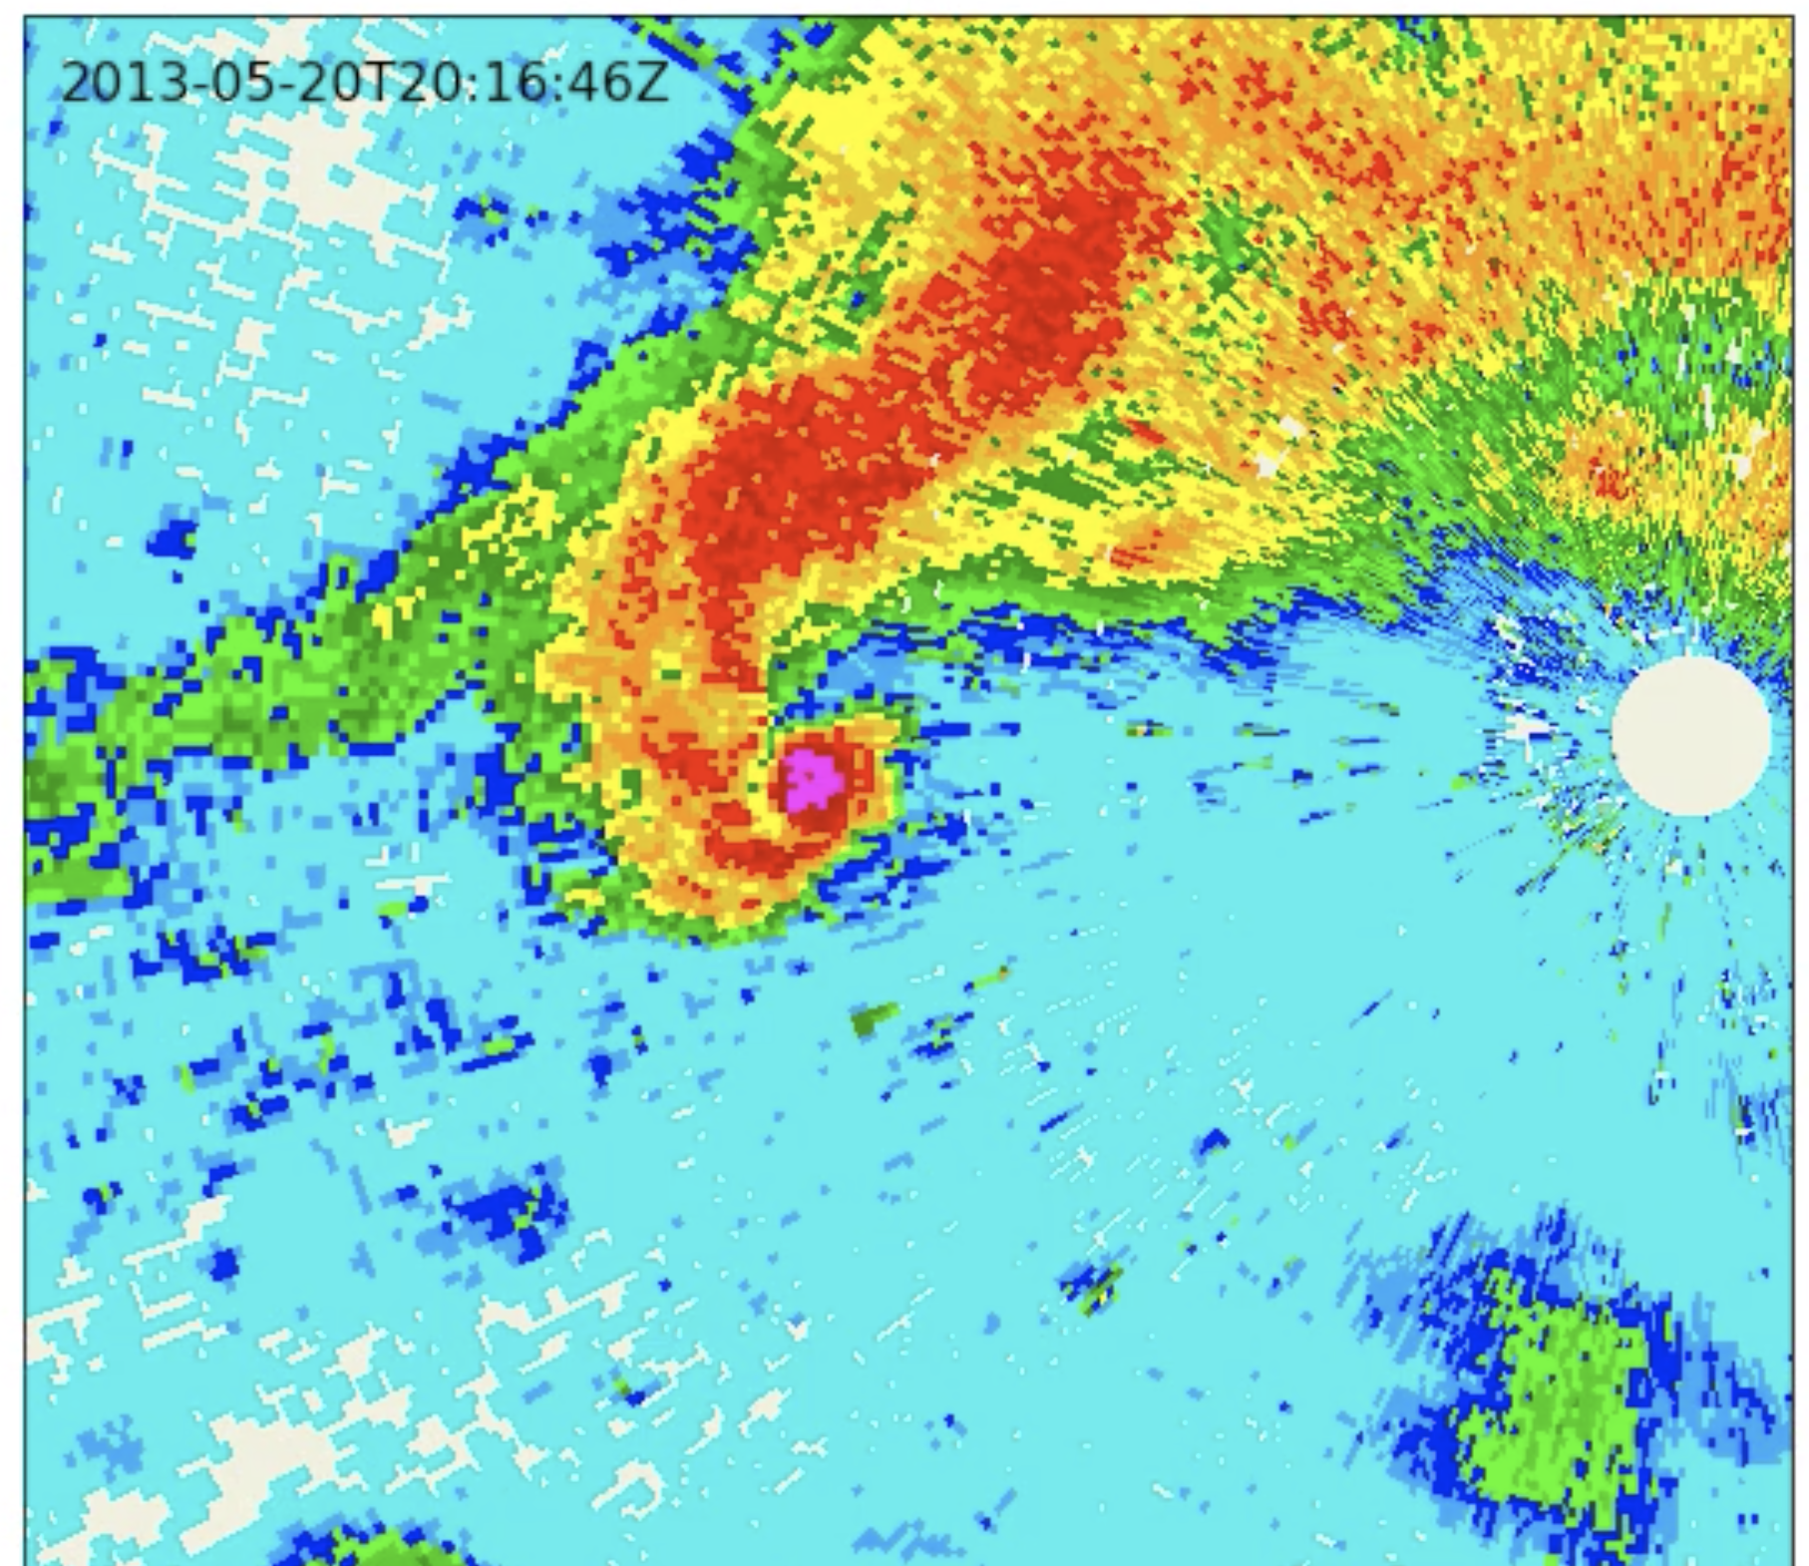
Reflectivity
for 2016Z
“hook echo”
Pink = highest
reflectivity =
hail and/or
debris lofted
by tornado
Radar location and
its cone of silence
Notes:
Reflectivity is very large. Not likely hail – it’s debris lofted by tornado

Slide 15
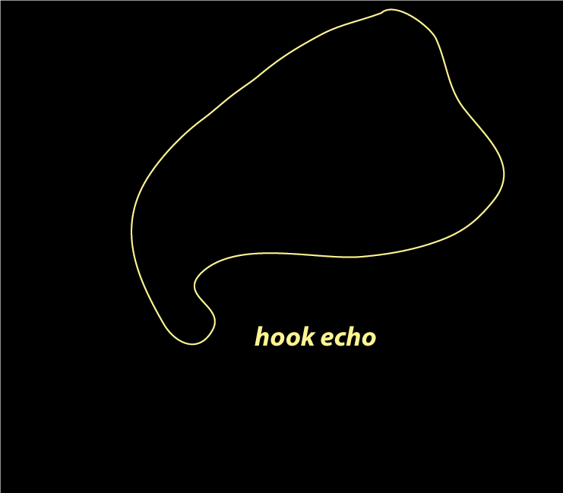
Basic shape of the
supercell ”hook echo”
on horizontal radar
display

Slide 16
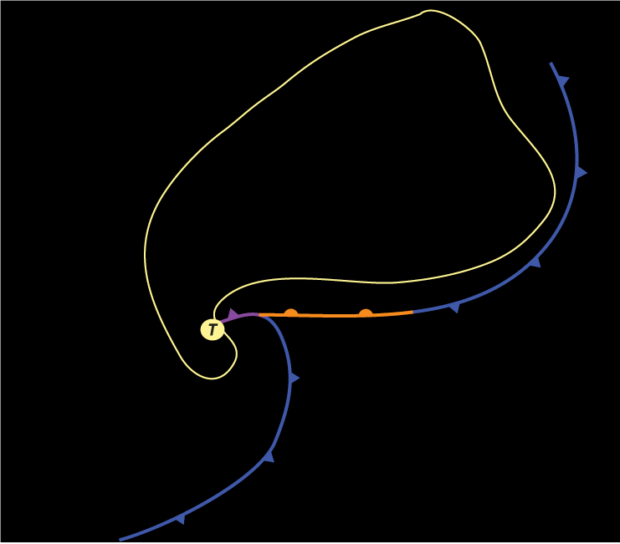
Mesoscale frontal
boundaries where
evaporatively cooled
air collides with
warm, moist
environmental air
Looks like a cyclone
but much smaller.
“Mesocyclone”
Tornado would form
at letter “T”

Slide 17
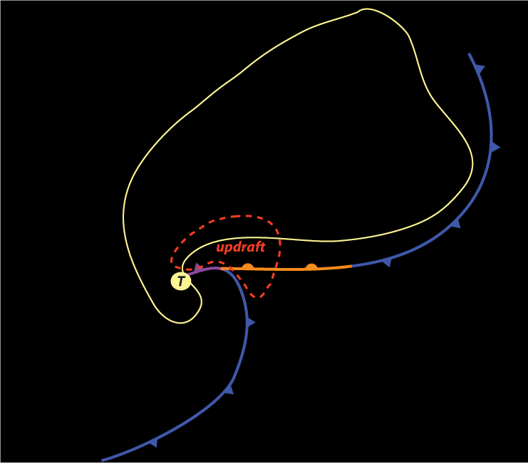
Main storm updraft
Hydrometeors are
being created in this
powerful updraft
but are too small to
see on radar (yet)
This and the horizontal
circulation leads to
the hook shape

Slide 18
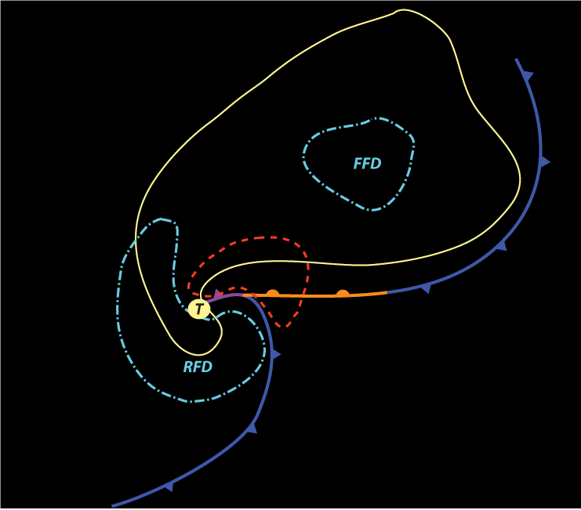
Two principal
downdrafts…
the forward-flank
(FFD) and rear-flank
(RFD) downdrafts

Slide 19
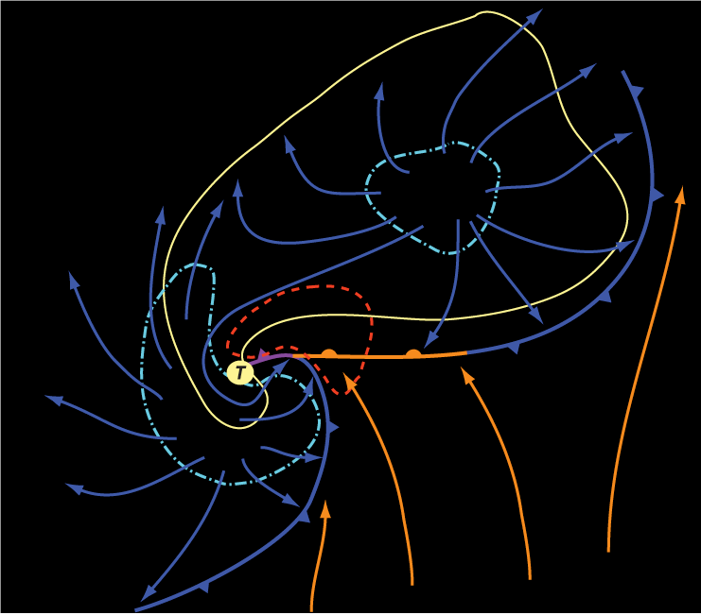
Storm-relative
airflow around
the supercell
Rotation is
concentrated at “T”

Slide 20
Reflectivity
for 2016Z
“hook echo”
Pink = highest
reflectivity =
hail and/or
debris lofted
by tornado
Radar location and
its cone of silence
Notes:
Reflectivity is very large. Not likely hail – it’s debris lofted by tornado

Slide 21
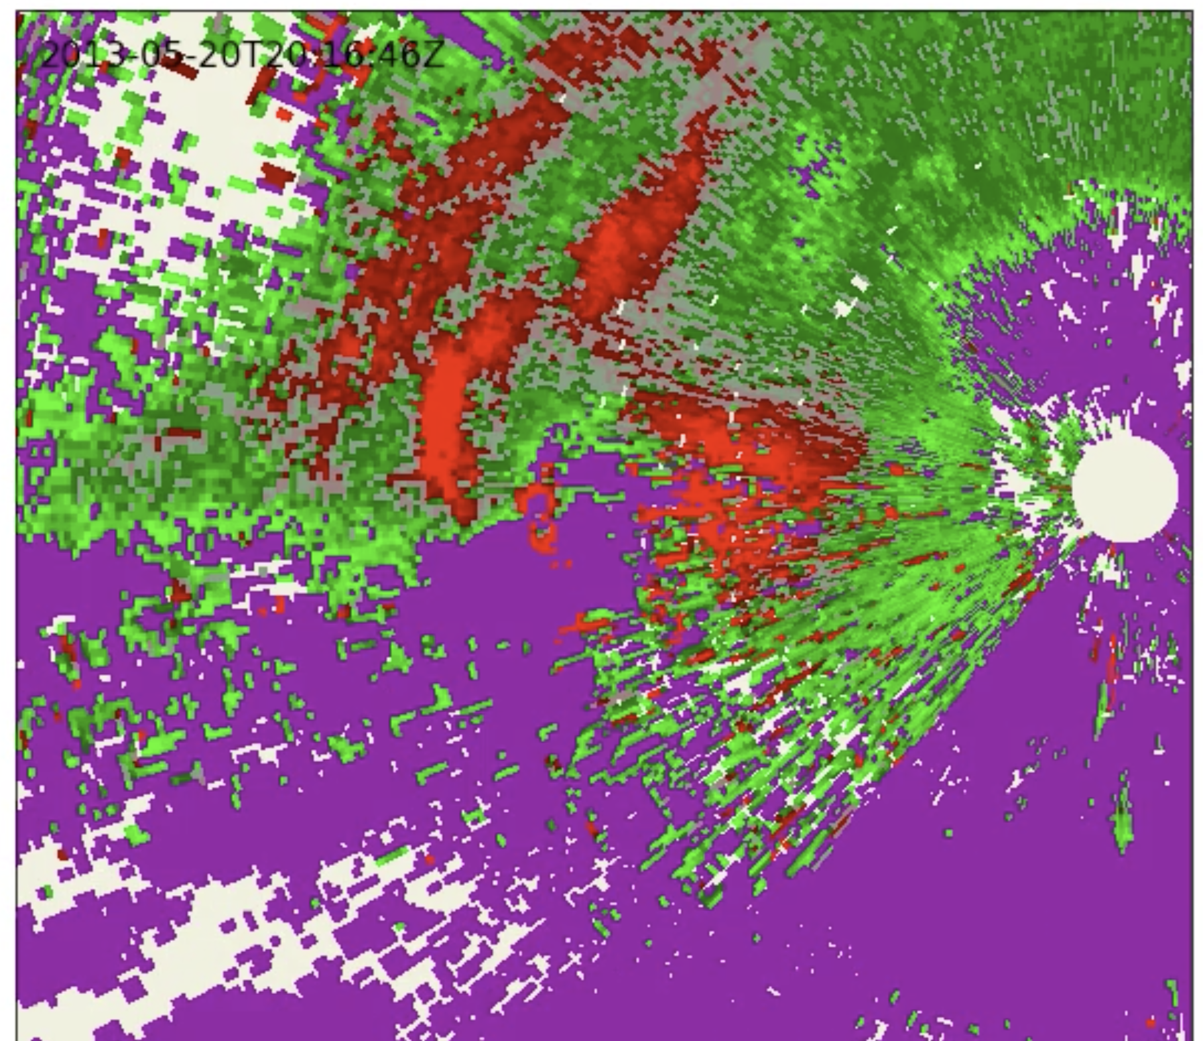
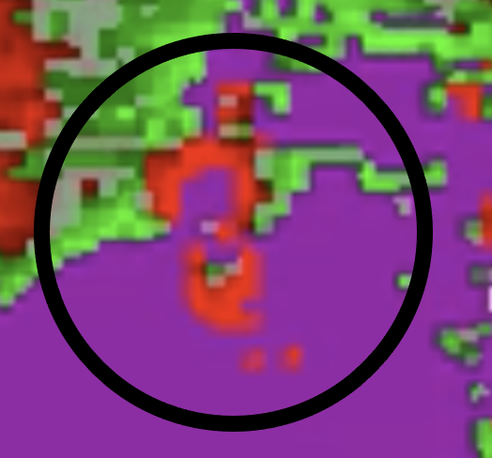
Radial velocity
for 2016Z
Cool colors =
towards radar
Warm colors =
away from radar
Note the velocity
dipole, indicating
cyclonic motion
(CCW) as seen
from above
Almost all US
tornadoes are
CCW
Purple = damaged
velocity data
[ignore]
In the circled area
(ignoring purples)
there is red to N
{away from radar}
and green to S
{towards radar}
→ CCW rotation
Notes:
Not the world’s best or cleanest example

Slide 22
Moore - 2
In the second cell from bottom, uncomment doplot = ‘velocity’ and run that and the subsequent cell again. This will refetch data and process radial velocity for the animation, including the still frame shown on previous slide
It’s not the cleanest example, but there is a suggestion of CCW rotation in the hook region, where a tornado would be expected

Slide 23
The El Reno, OK EF3 tornado
31 May 2013
11 days later… “only” EF3 but still widest tornado on record
Notes:
Velocity field not so good owing to range folding issues

Slide 24
El Reno - 1
Via File menu, make a copy of your RADAR-Moore.ipynb notebook, and rename it “RADAR-ElReno”
  Remember to close and halt RADAR-Moore.ipynb when done with it
Change requested date/time to 31 May 2013 at 23 UTC
We’re still plotting KTLX radar
Set an appropriate set_extent around El Reno, OK. You can refine it later and rerun the notebook. El Reno’s lat is 35.5˚N, lon is -98.0˚W
View your animation of base reflectivity
When you are happy with your plot, show it to me
If you want to plot velocity, go ahead, but know where the radar is located

Slide 25
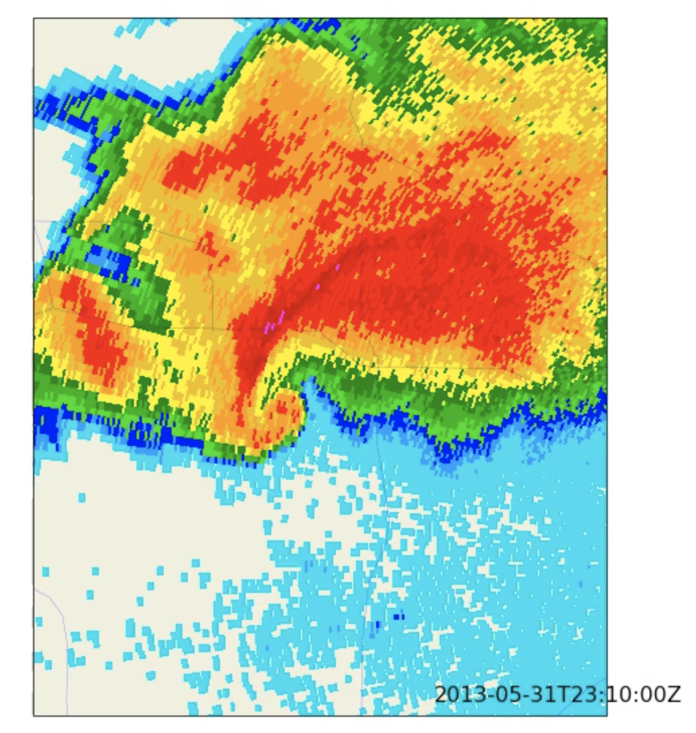

Slide 26
El Reno - 2
If we have time…
Fetch the OUN sounding for 31 May 2013 at 18Z
  It’s a “loaded gun” sounding with even more CAPE, lots of shear and warm advection
Clean up your Skew-T script – what you need should be in the first and last cells
Make a nice plot. See next slide for mine
When you are ready, show me your plot
plt.figtext(0.22,0.86,str(station)+' ' +str(date),size=12,fontweight='bold')
plt.figtext(0.22,0.82,'CAPE = ' + str(round(cape,2)),size=12)
plt.figtext(0.22,0.80,'CIN = ' + str(round(cin,2)),size=12)
I used these lines
to put info on plot

Slide 27
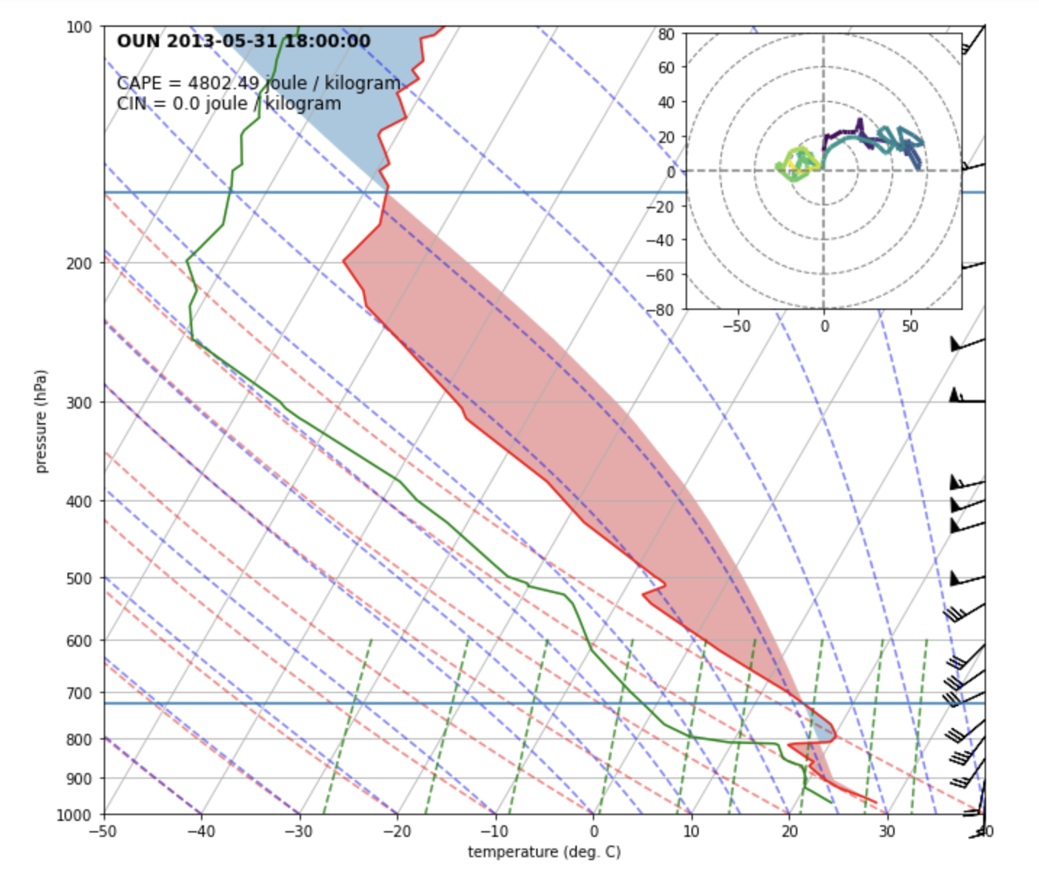
OUN sounding
18Z 5/31/13

Slide 28
[end]

