Slide 1
30 November 2016 12Z
500 and 200 mb maps
http://weather.uwyo.edu/upperair/uamap.shtml

Slide 2
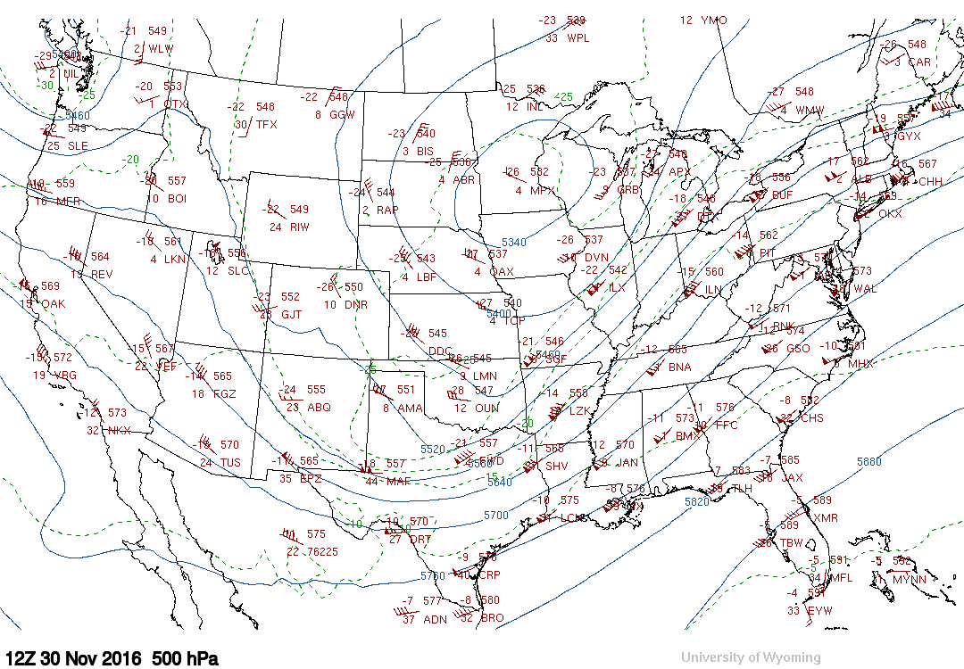
Isotherms (dashed)
L
COLD
Isoheights
(solid)

Slide 3
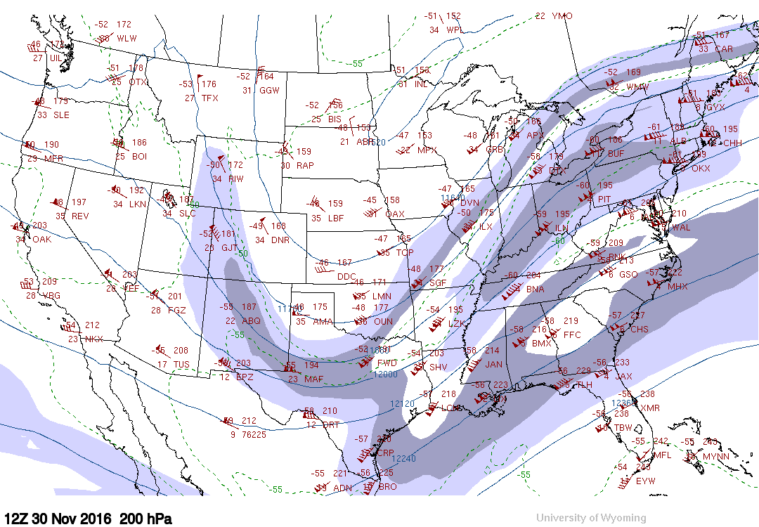
Fastest winds
shaded

Slide 4
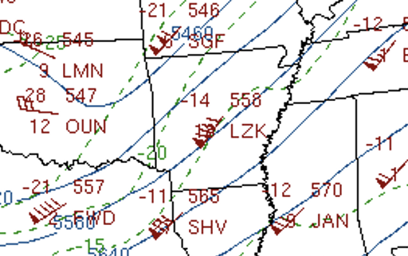
Little Rock, AR (LZK)
500 mb
COLD
Winds from SW @ 90 knots
[46 m/s, 167 km/h, 104 mph]
Temperature in ˚C: -14˚C
Dewpoint depression in ˚C: 18˚C
so Td = -14-18 = -32˚C
Geopotential height: 558 geopotential decameters
so height is 5580 gpm
Notice wind is not precisely parallel to the isoheights, as is expected at this altitude.
These contours are machine drawn and are smoothed, so not precise
Notice the isotherms. While we want layer mean temperature and not
temperature at a single height level, this is a big clue regarding how
the geostrophic wind is varying with height
So what does the shear vector look like?

Slide 5
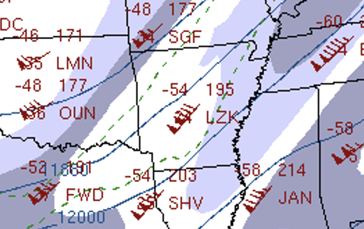
Little Rock, AR (LZK)
500 mb
200 mb
195 = 11950 gpm
Based on the isotherms we infer the shear vector.
Based on the shear vector we should have anticipated that the wind speed would
- increase with height (a lot) to 130 knots [67 m/s, 241 km/h, 150 mph]
[an increase of 40 knots]
- no change in direction

Slide 6
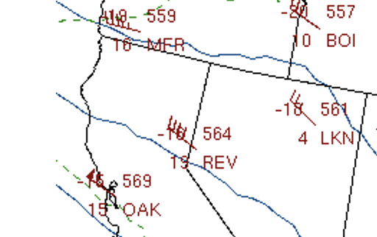
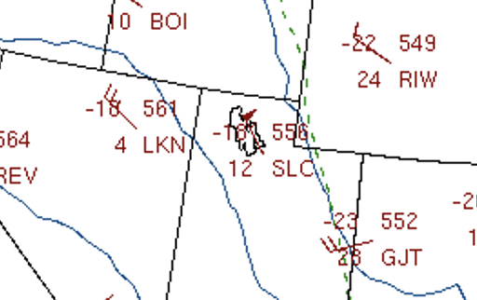
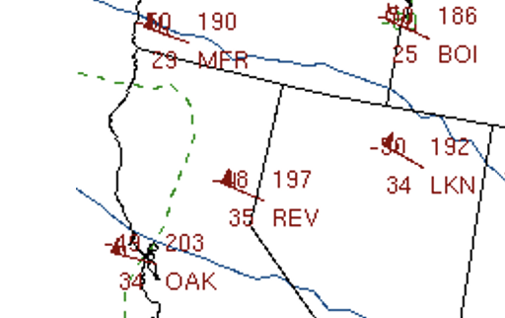
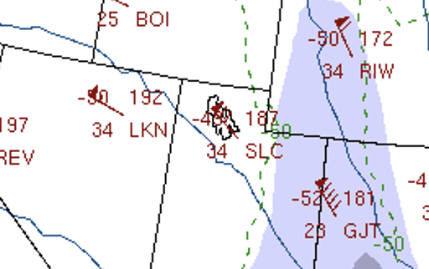
Reno, NV (REV)
500 mb
200 mb
At Reno at 500 mb: isotherm spacing is wider. So vertical shear is smaller.
Winds still roughly parallel to isotherms, with cold air now to NE.
Based on the smaller shear vector we anticipate that the wind speed would
- not much faster at 200 mb (increase only 20 knots)
- no change in direction

Slide 7
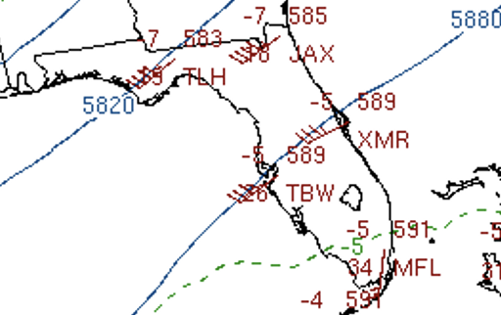
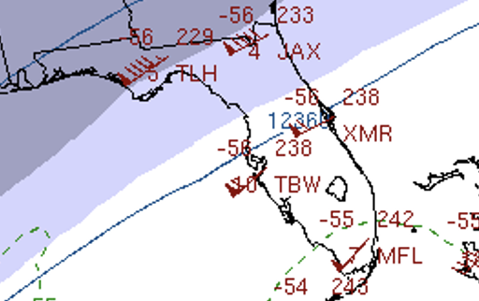
Tampa Bay, FL (TBW)
500 mb
200 mb
At Tampa at 500 mb: isotherm spacing is wide, but winds increase by 30 kts.
Winds are 30 kt at 500 mb but 60 kt at 200 mb
Keep in mind the thermal wind equations have Coriolis f in denominator
As f decreases 1/f gets larger, meaning more shear for a given temperature gradient
And, as you go farther south, geostrophic balance becomes less valid
Remember the Rossby number!

