Slide 1
Hurricane Rita
2005-09-24-1200Z
Maps from www.spc.noaa.gov

Slide 2
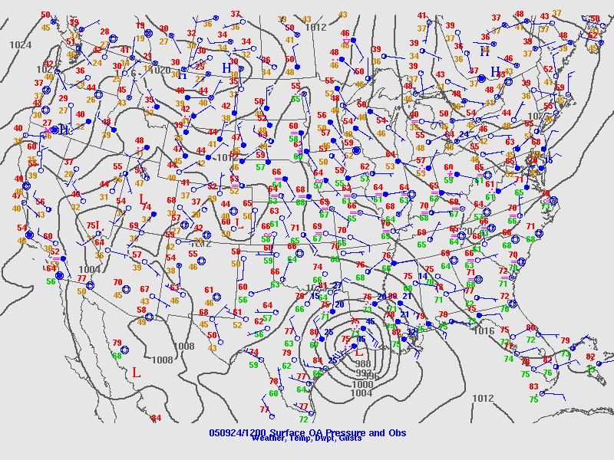

Slide 3
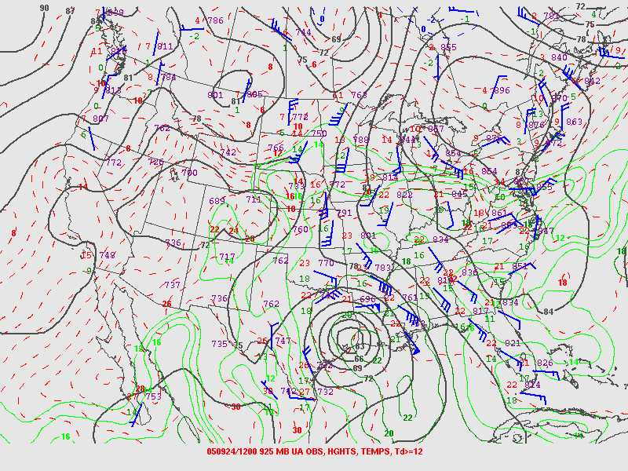
Hurricane (warm core low):
winds decrease with height (above friction layer)
925 mb
Notes:
Note component of wind towards L pressure around Rita.

Slide 4
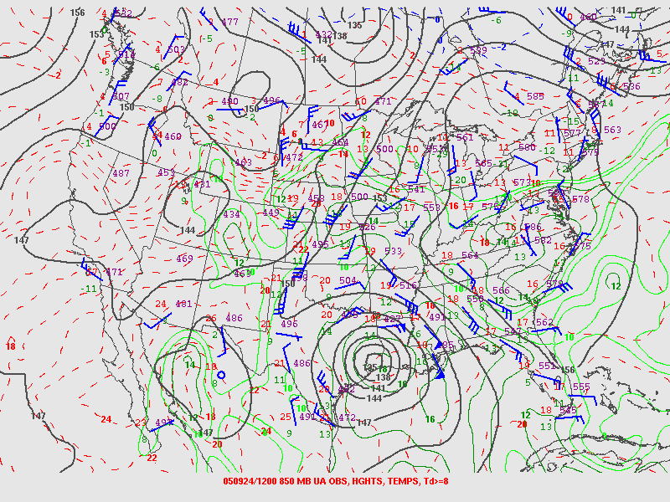
850 mb
Notes:
Most winds are stronger near hurricane. At 925, more influenced by friction

Slide 5
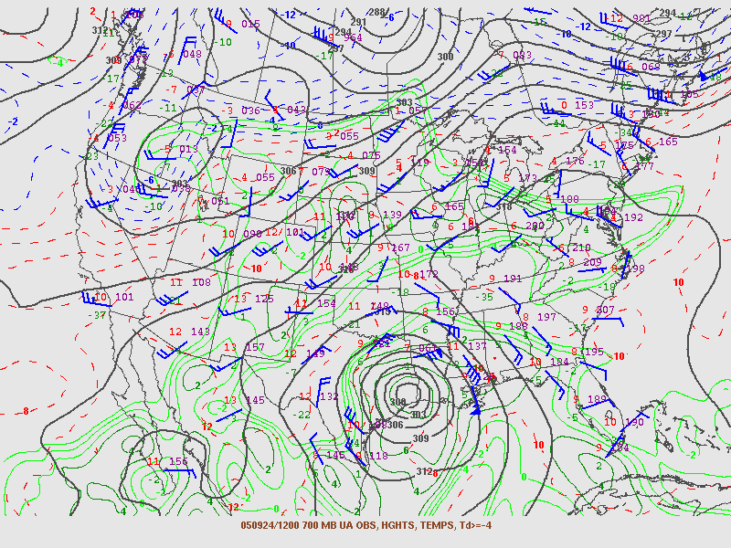
700 mb
Notes:
Note winds more parallel to isobars

Slide 6
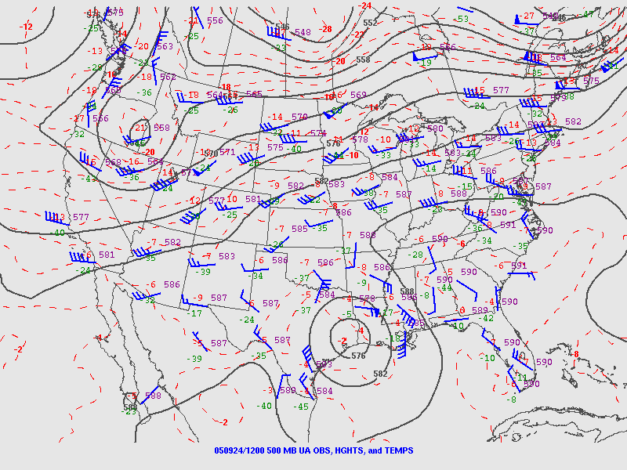
500 mb

Slide 7
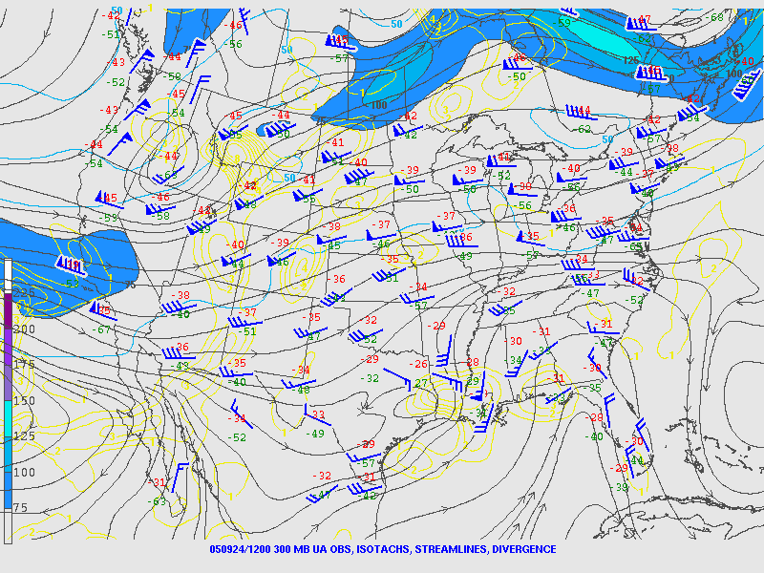
300 mb
Notes:
What happened to the hurricane?

Slide 8
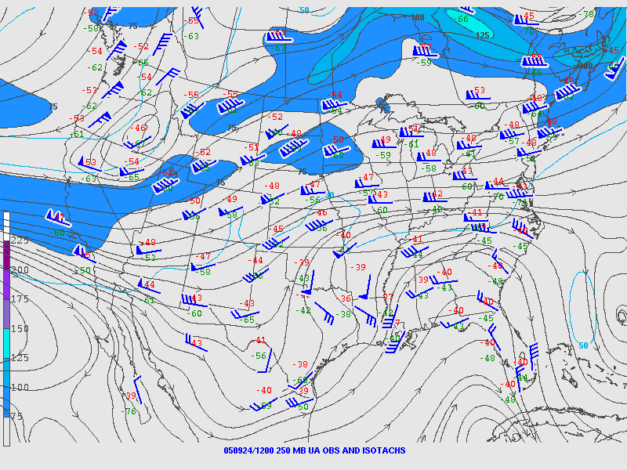
250 mb

