Slide 1
2024 squall line ensemble quick look
ATM 419/563
Spring 2024
Fovell
© Copyright 2024 Robert Fovell, Univ. at Albany, SUNY, rfovell@albany.edu

Slide 2
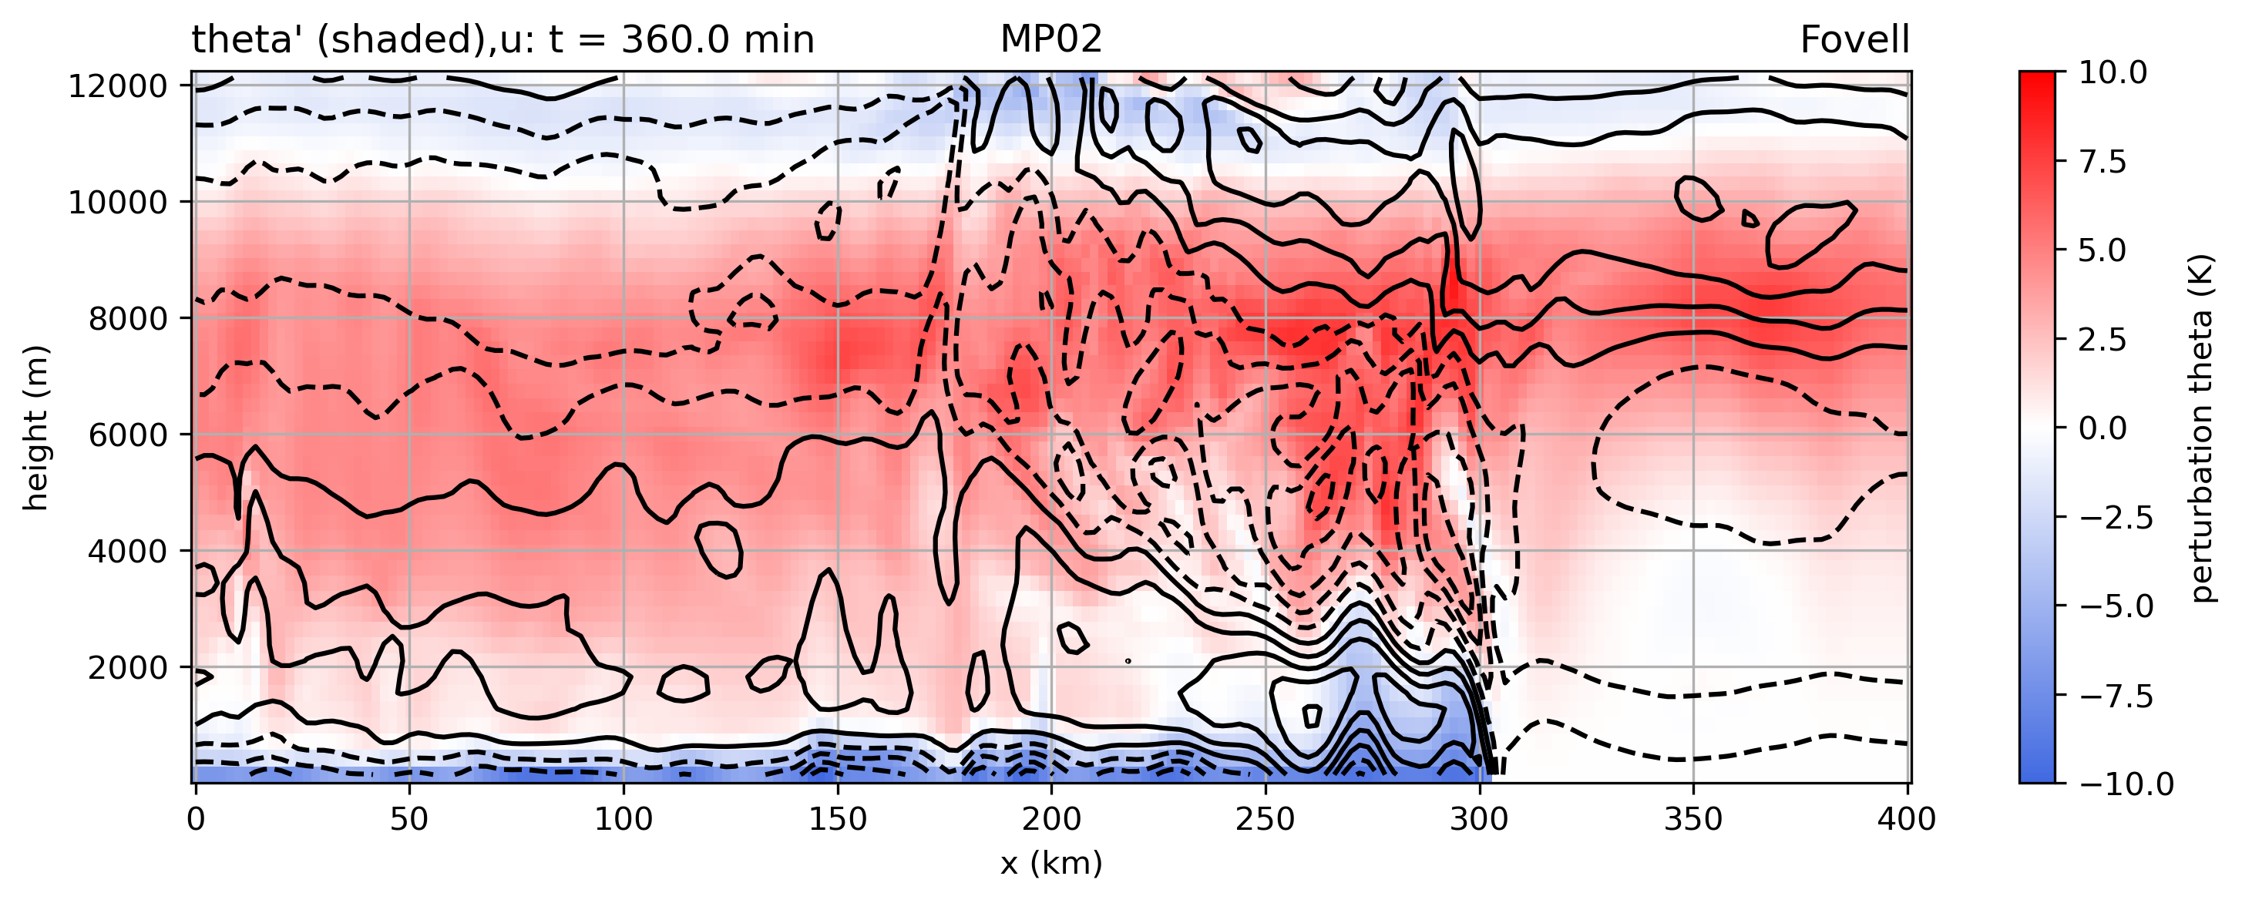
Control run

Slide 3
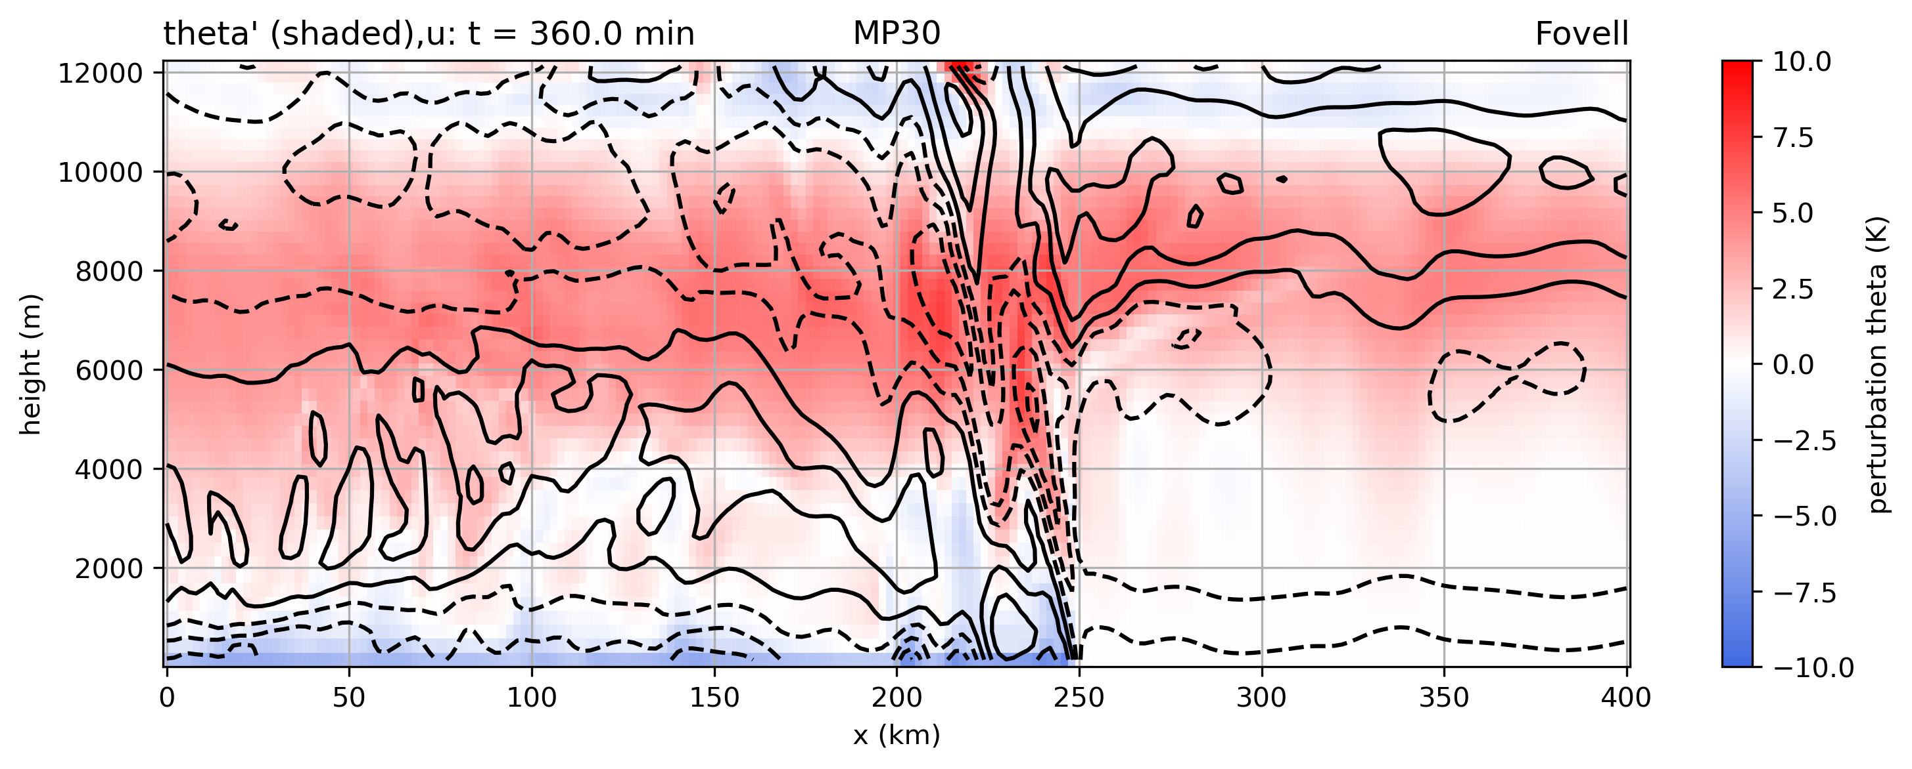
The very expensive bin scheme
Much weaker, shallower cold pool → slower propagation
Is this the “right” or “best” answer?

Slide 4
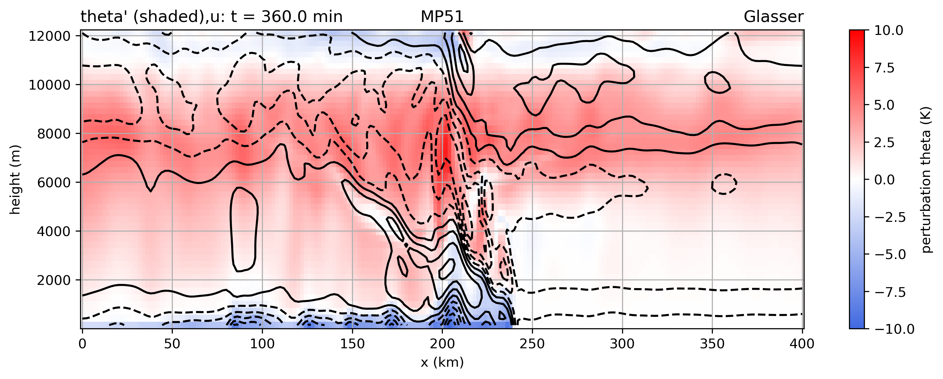
Slowest moving and/or slowest developing member
Also fairly weak cold pool

Slide 5
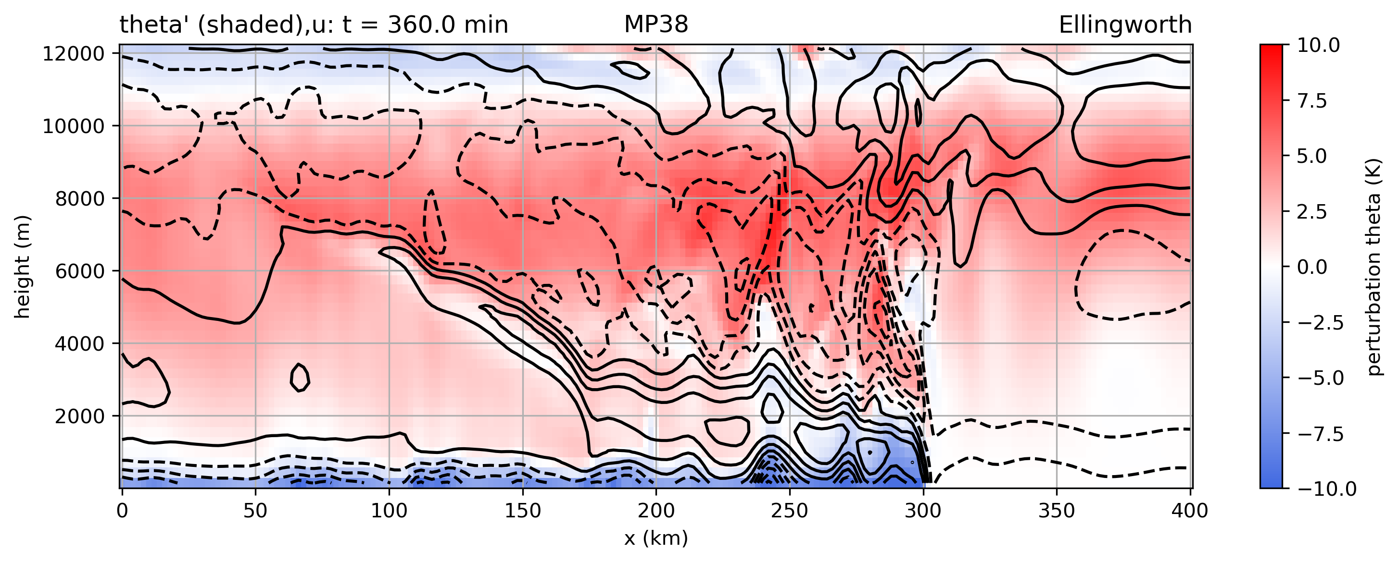
Fastest moving and/or developing member
Tied with control run for fastest moving squall line

Slide 6
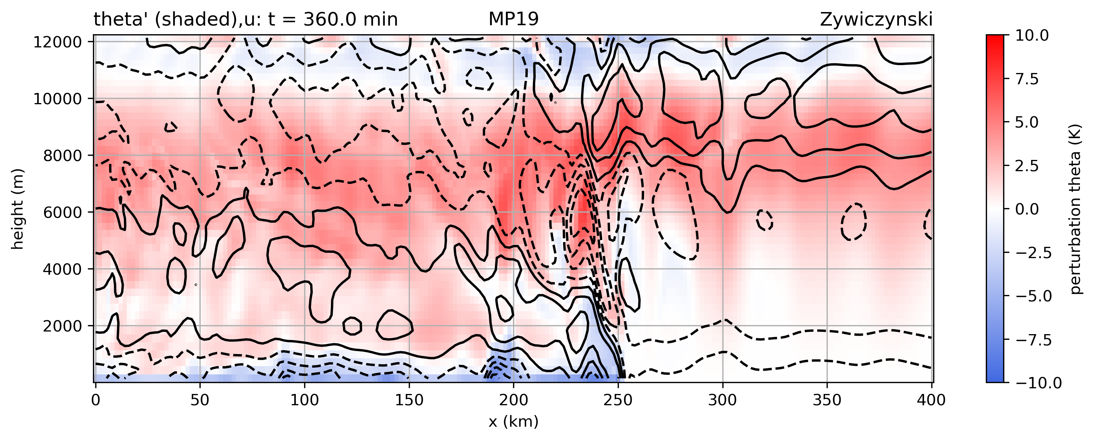
Evidence of trapped waves on forward side

Slide 7
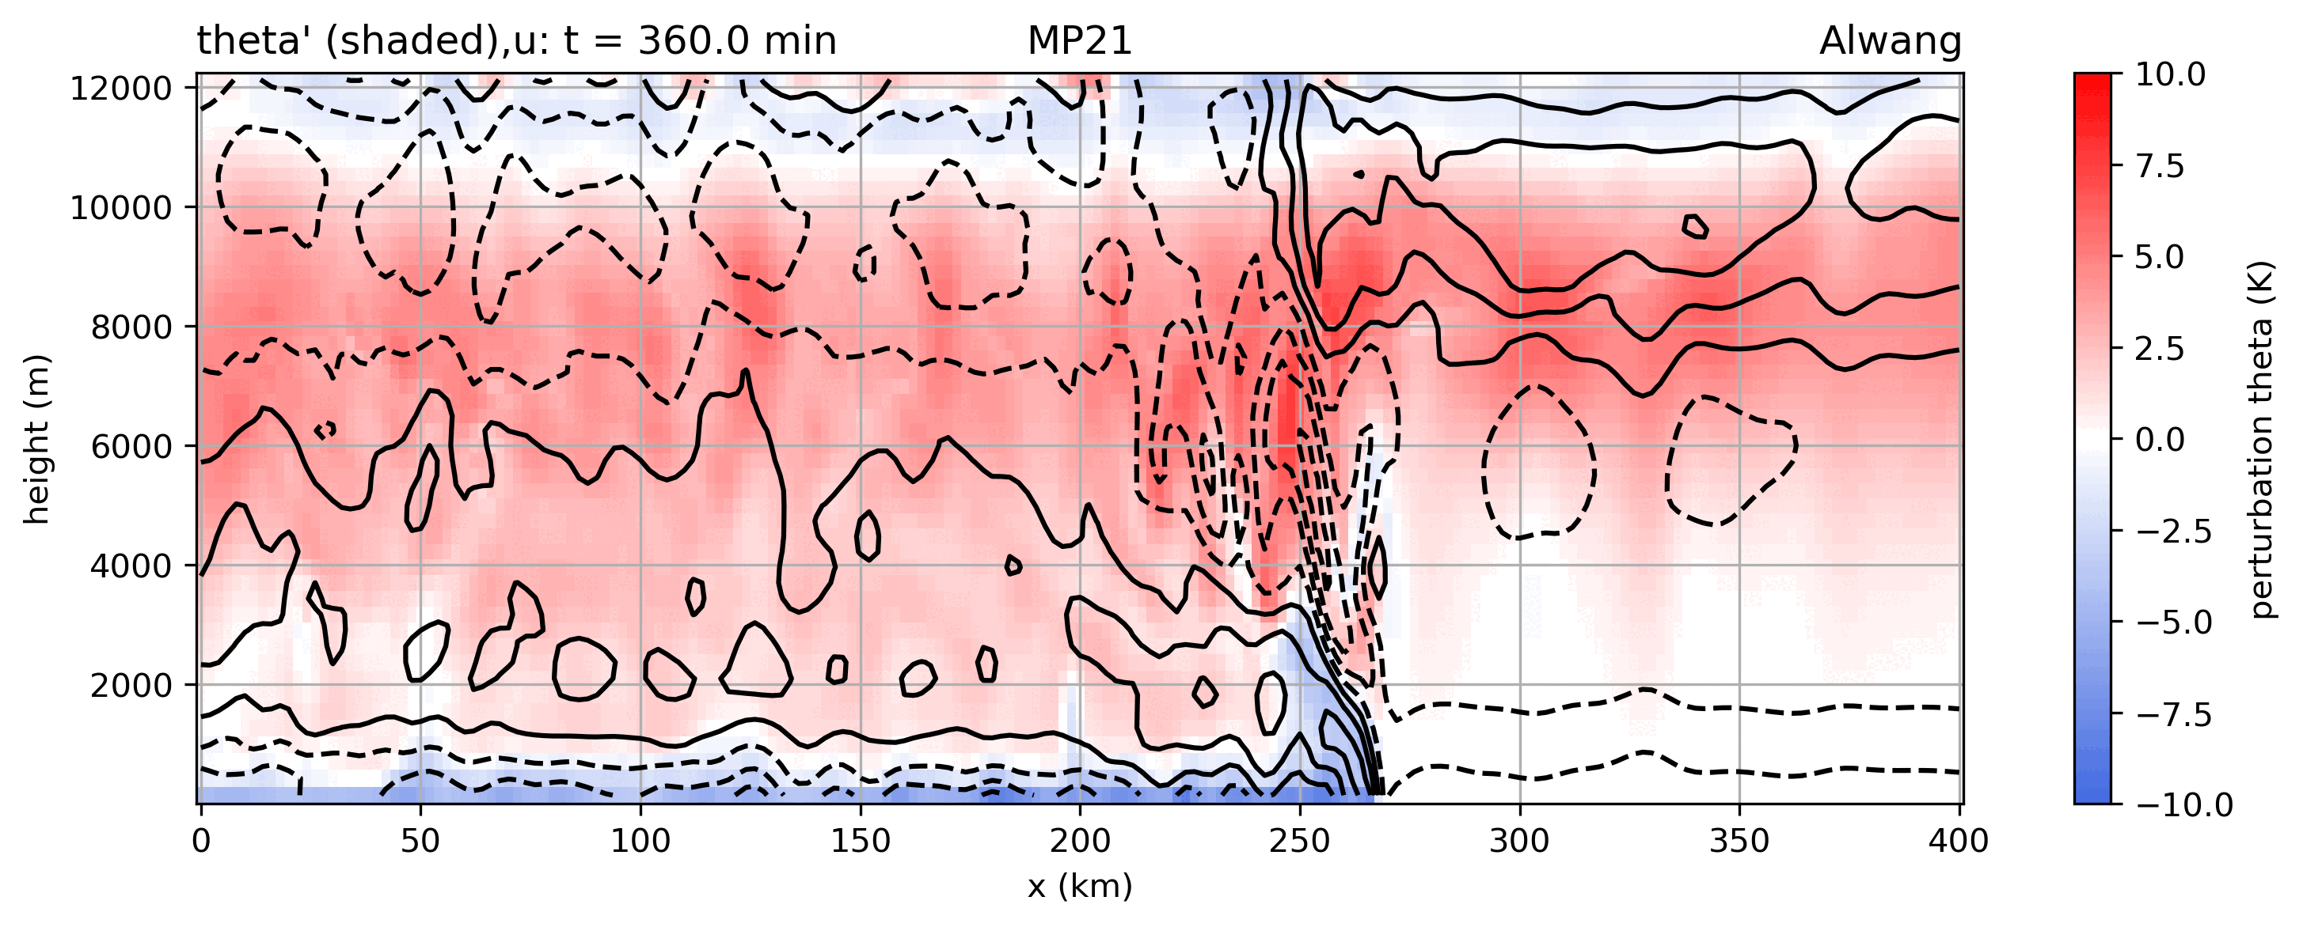
Animation

Slide 8
28 MP simulations ranked
bin
bin
Both max wind and total accumulated precip
vary by 100%

Slide 9
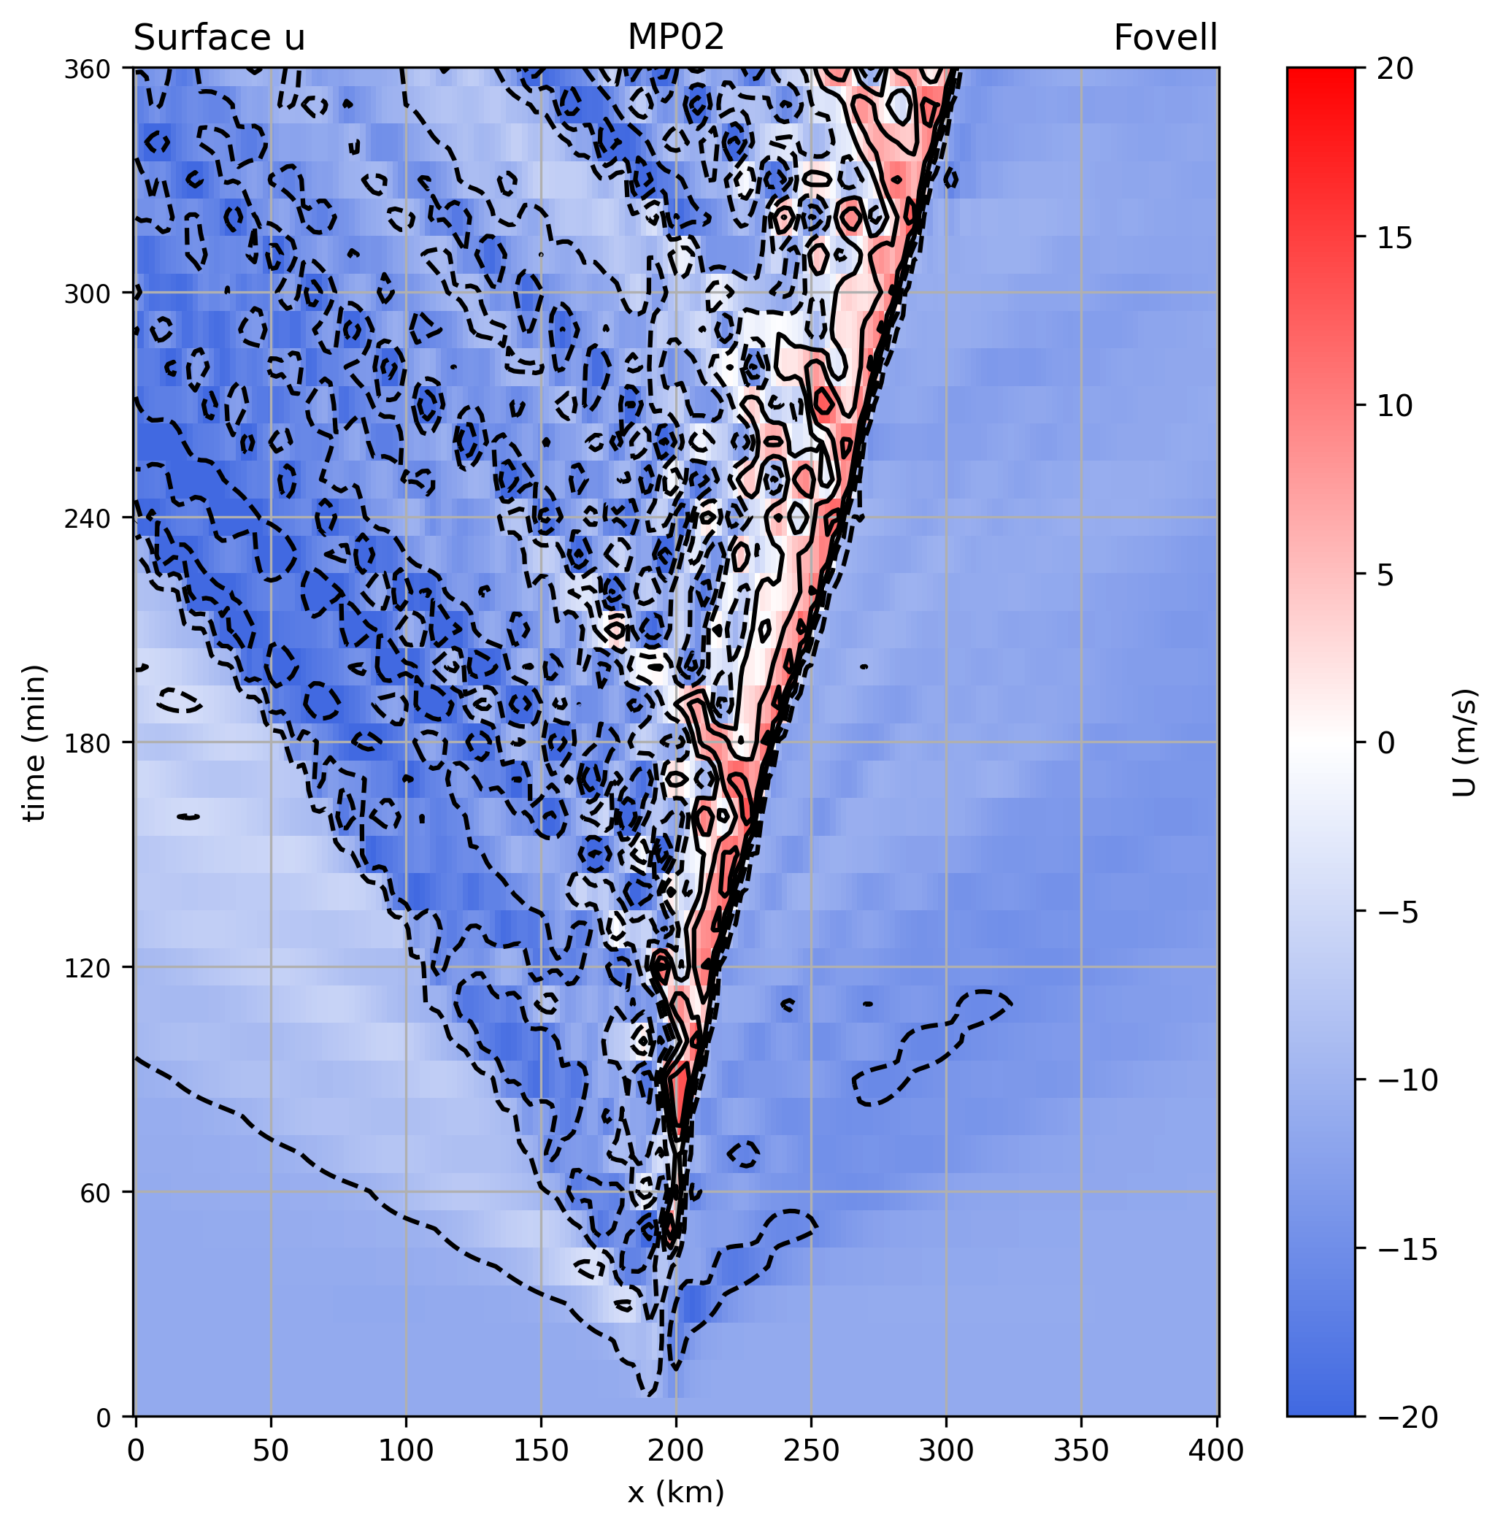
Control run

Slide 10
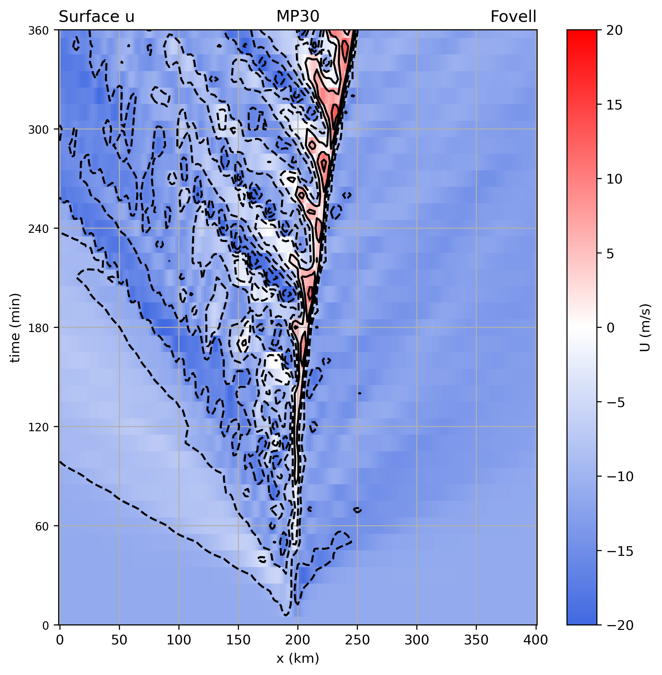
Bin scheme

Slide 11
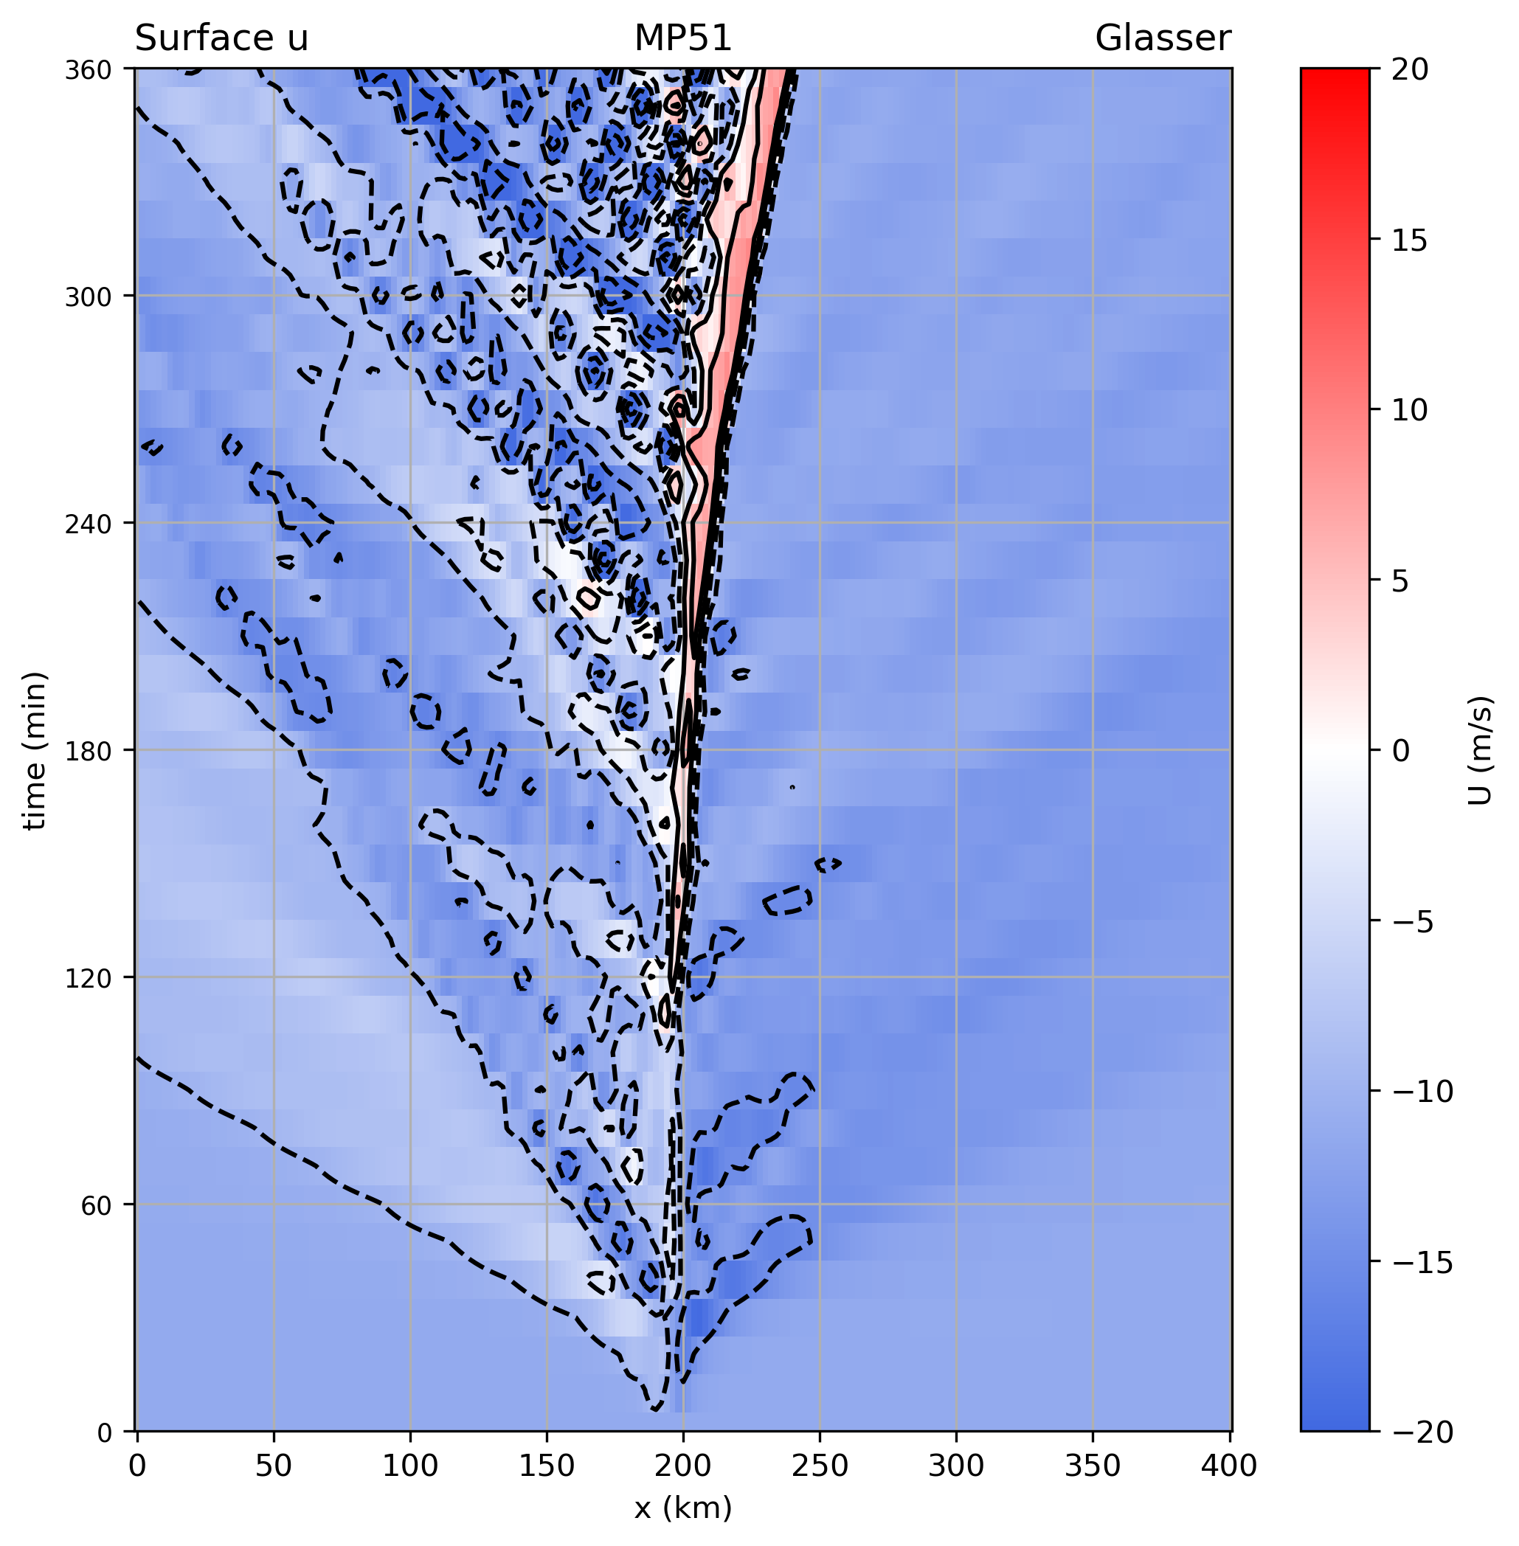
P3-nc

Slide 12
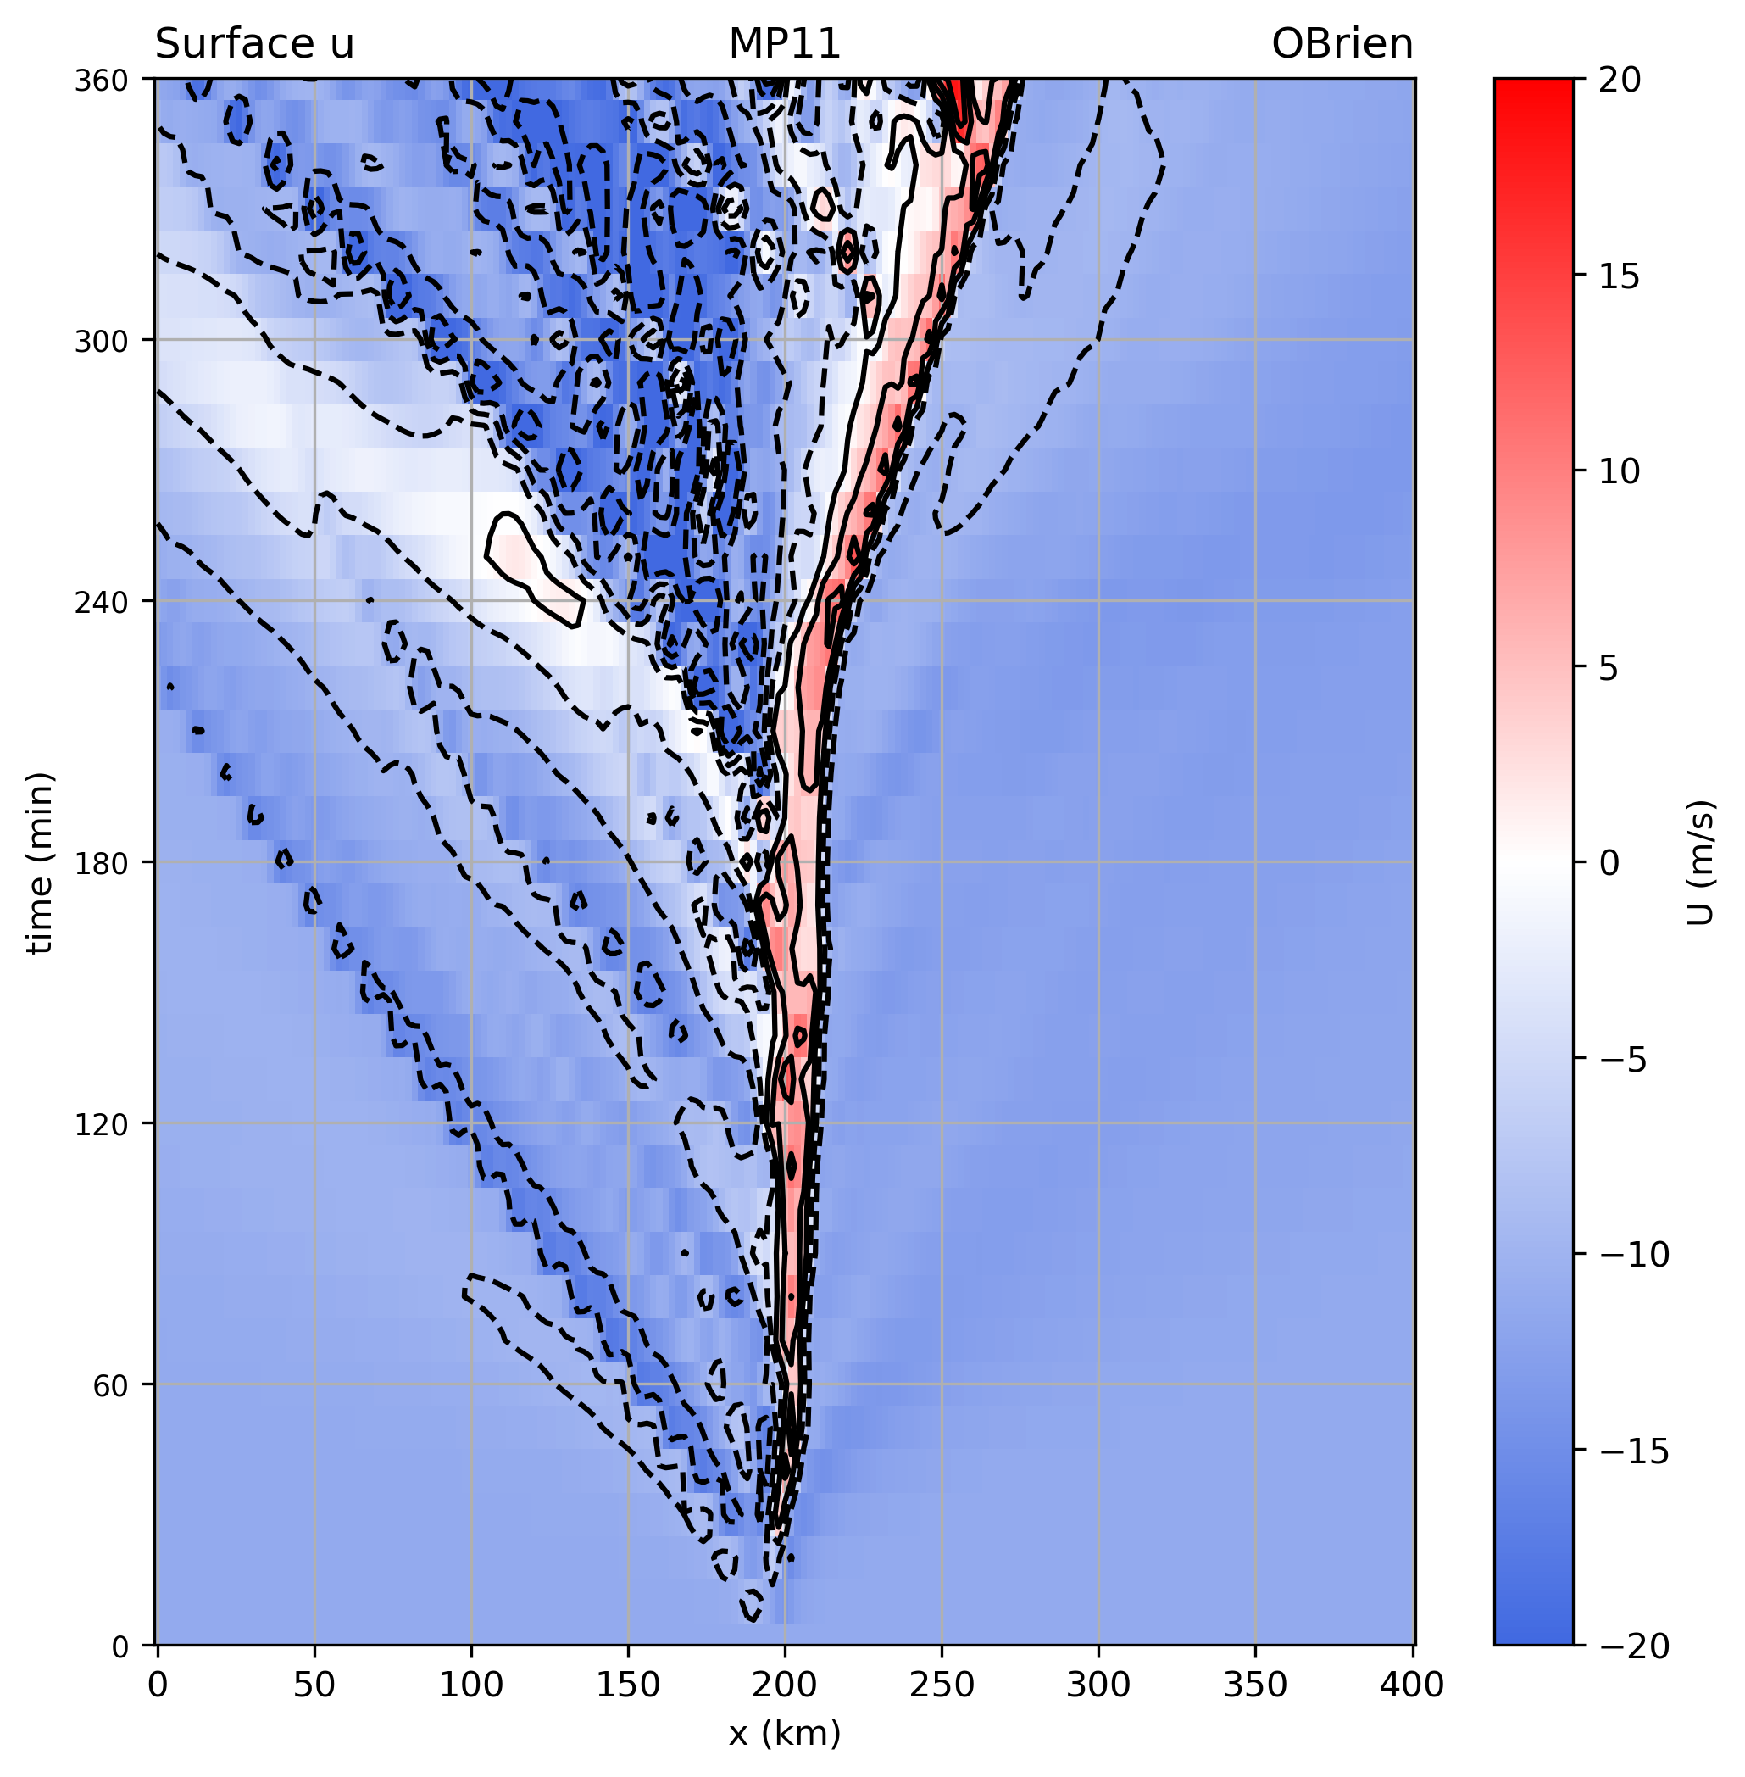
CAM 5.1

Slide 13
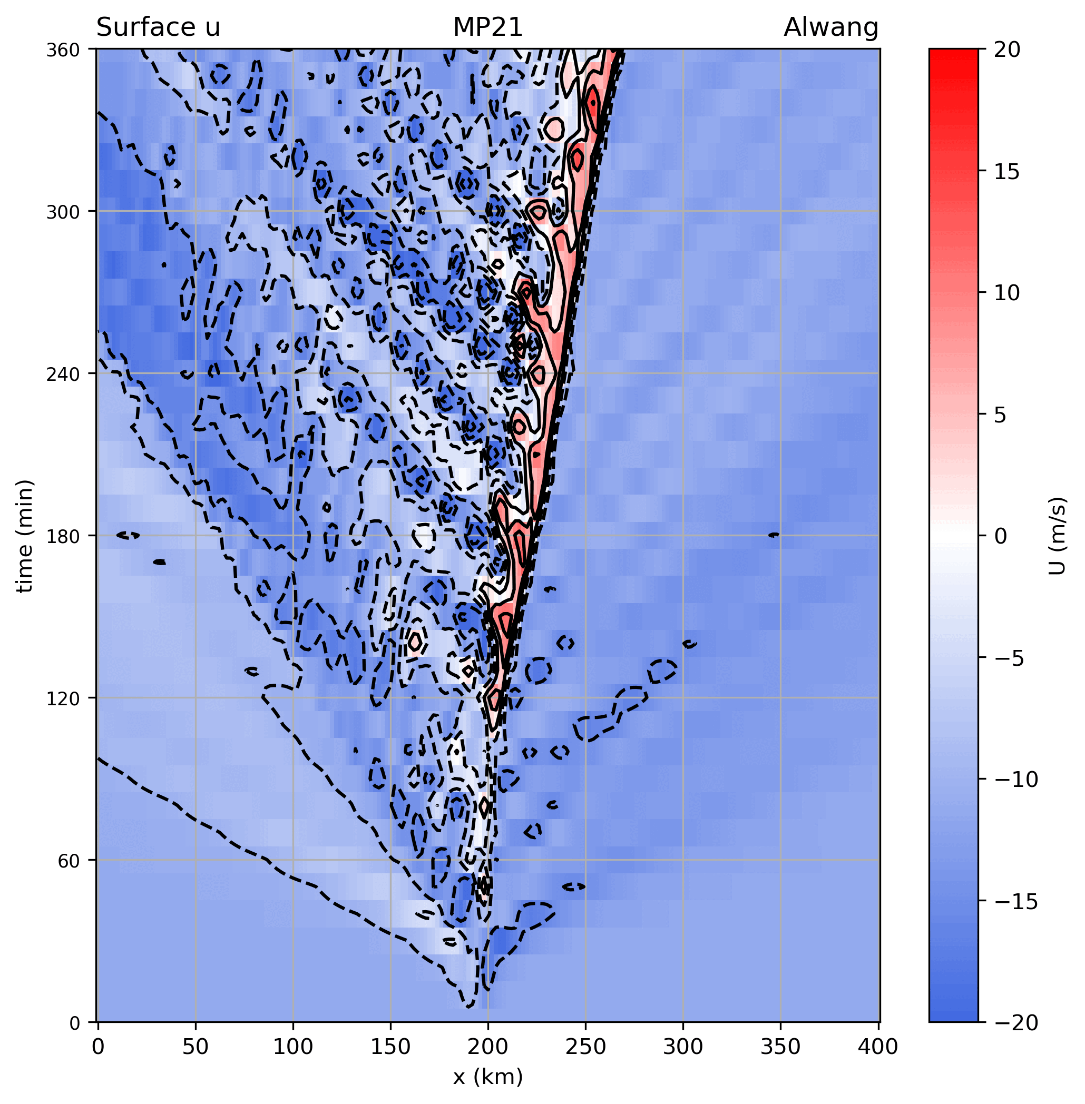

Slide 14
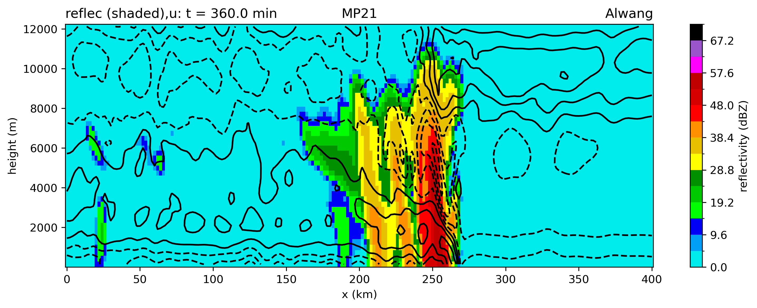
Reflectivity (subset)
A lot of variability in max reflectivity and also
development of bright band

