Slide 1
Cloud-radiative forcing influences on the tropical cyclone outer wind field
Robert Fovell
ATM 419/563 ~ Spring 2020
Example final project presentation (in terms of structure)
© Copyright 2020 Robert Fovell, Univ. at Albany, SUNY, rfovell@albany.edu

Slide 2
Outline
Background and motivation
Hypotheses
Experimental design
Results
Discussion and future work
Bibliography

Slide 3
Background & motivation
[Here I do some literature review, and introduce some concepts that are important to my hypotheses, analyses, and conclusions]

Slide 4
Background and motivation
Tropical cyclones (TCs) have weak near-surface winds in the eye, their strongest winds in the eyewall, and winds that diminish rapidly with radius in the “outer core” (Radius r > 150 km)
Although relatively weak, the outer core winds have been shown to be a controlling factor on TC motion, owing to the “beta drift” (e.g, Holland 1983; Fiorino and Elsberry 1989)
Cloud microphysical assumptions have been shown to influence outer core winds and, thus, beta drift-driven motions (Fovell and Su 2007; Fovell, Corbosiero, and Kuo 2009)
However, the primary reason microphysics influences outer core winds is owing to cloud-radiative feedback (CRF), the interaction of hydrometeors with longwave (LW) and shortwave (SW) radiation (e.g., Fovell, Corbosiero, Seifert, and Liou 2010)

Slide 5
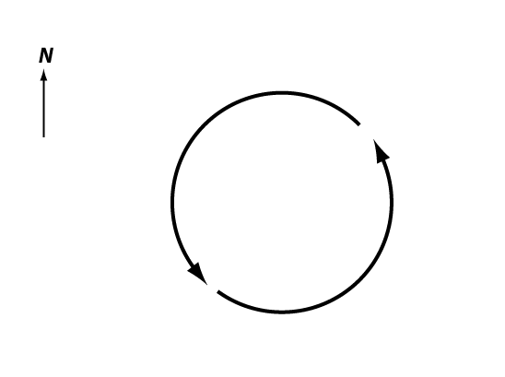
“Beta drift”
TC
ζ > 0
ζ = relative vertical vorticity
[In this sequence of slides, I am presenting an elementary discussion of
the beta drift concept. Instead of packing it into one, dense slide, I’m spreading
it over several slides, with a step-by-step explanation.]

Slide 6
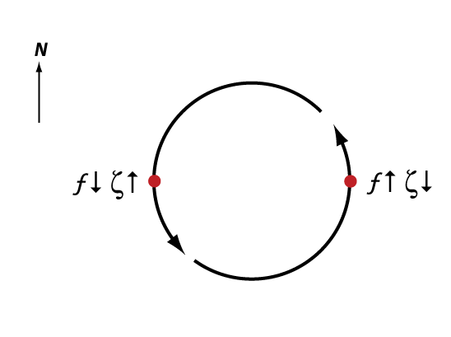
“Beta drift”
Initial
vortex motion
Conservation of absolute vorticity
f + ζ = constant

Slide 7
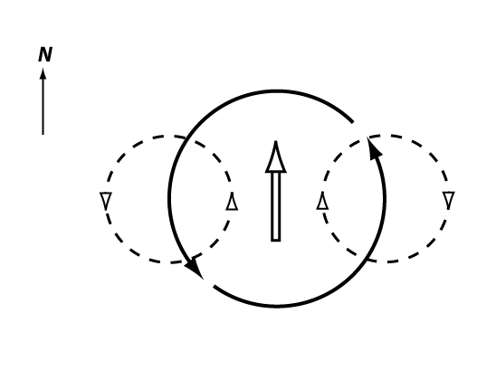
“Beta drift”
Relative vorticity increased on west side
decreased on east side, creating gyres.
“Ventilation flow” develops over vortex.

Slide 8
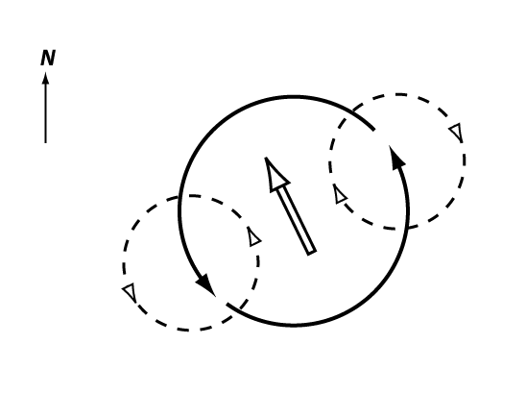
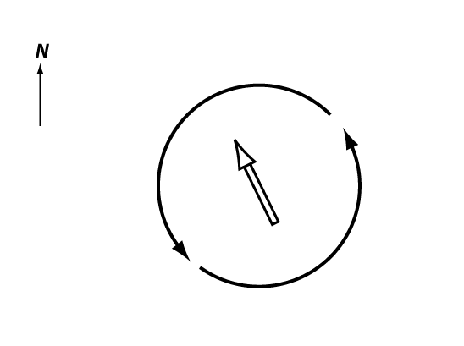
“Beta drift”
Ventilation flow is turned cyclonically
by the hurricane’s winds

Slide 9
“Beta drift”
Tropical cyclones naturally
tend to drift towards the northwest

Slide 10
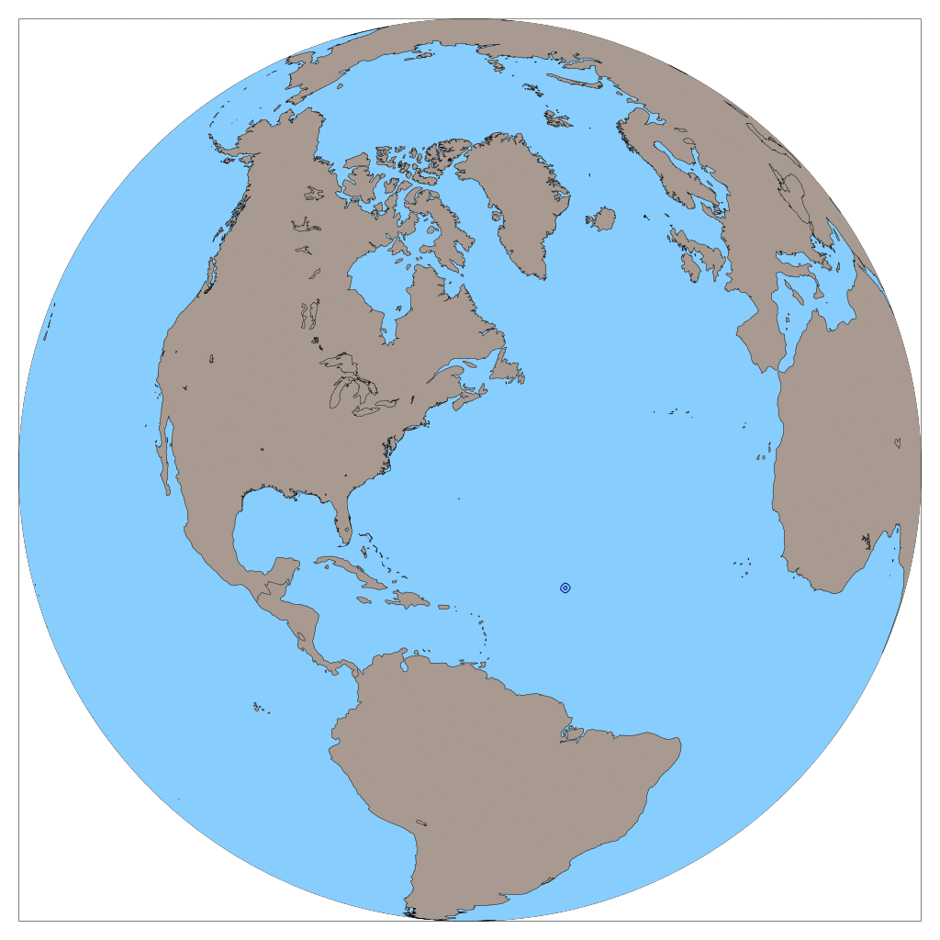
MPAS v. 2 semi-idealized
92 to 25 km mesh
NO LAND
NO INITIAL WIND
Sea-level pressure over 9 days

Slide 11
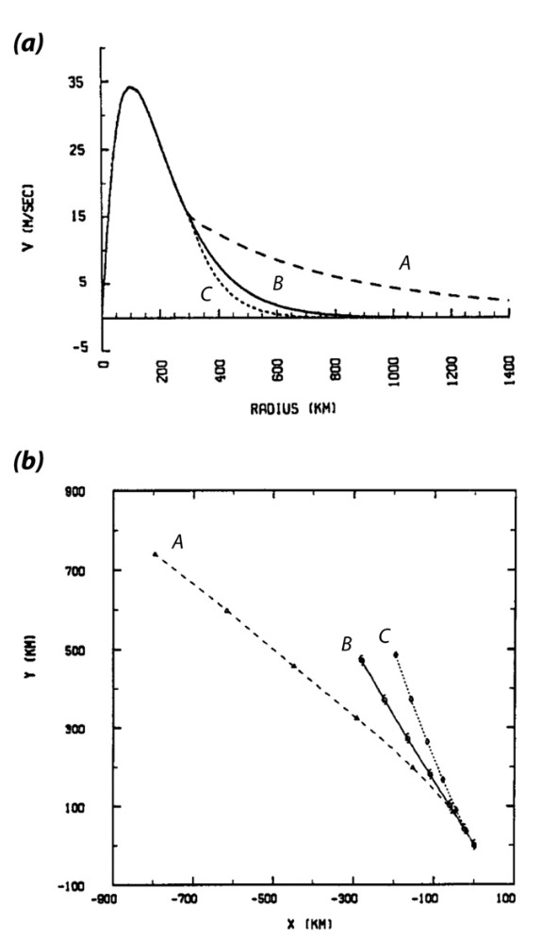
“Beta drift”
Fiorino and Elsberry (1989)
• Barotropic model initialized
with a TC vortex
• Three different wind profiles,
differing for r ≥ 300 km
• Stronger outer winds led to
faster and more NW-ward
motions
Averaged 10-m winds
800 km
Notes:
Different fallspeeds

Slide 12
“Beta drift”
very small part of domain shown
Fiorino and Elsberry (1989)
Averaged 10-m winds
800 km
Fovell and Su (2007)
Fovell et al. (2009, 2010)
Notes:
Different fallspeeds

Slide 13
“Beta drift”
very small part of domain shown
• WRF simulations with different
microphysics schemes but same
initial condition
• 4 km horizontal resolution,
72 h simulations
• Microphysics schemes produce
different amount of hydrometeors
having different growth and fall
speed characteristics
• Storms developed different
outer wind profiles and their
subsequent motions were
consistent with expectations
Fovell and Su (2007)
Fovell et al. (2009, 2010)
Notes:
Different fallspeeds

Slide 14
Cloud-radiative forcing
very small part of domain shown
CRF-on
CRF-off
Controlled by icloud in WRF namelist
Fovell and Su (2007)
Fovell et al. (2009, 2010, 2016)
Notes:
Different fallspeeds

Slide 15
Hypotheses

Slide 16
Hypotheses and justifications
  Cloud-radiative forcing causes broader outer wind profiles, resulting in different beta drifts and tracks (relative to CRF-off)
  Microphysics schemes differ with respect to the quantity of hydrometeors generated for different species (cloud ice, snow, graupel, etc.)
  The influence of radiation is inversely related to particle size, so smaller particles (cloud ice) interact more than larger ones (snow)
  Simulations that appear to produce a lot of cloud ice tend to result in broader wind fields than those that produce more snow
Hypothesis #1
  Altering the radiation schemes to treat cloud ice as snow will result in weaker outer winds and shift the track to the right
Hypothesis #2
  Making the radiation schemes ignore snow will also weaken outer winds and shift the track rightward

Slide 17
Experimental design

Slide 18
Setup
Real-data WRF model
  4 km horizontal resolution, 680 x 680 points (2700 km square)
  Lambert projection, centered at 20˚N and 50˚W
  Removed all land from domain
  Made SST constant at 29.5˚C
  Manufactured a parent data source from a single sounding (Jordan 1958 hurricane season composite) with calm winds
  Inserted a virtual temperature perturbation to establish a TC
Model physics (other than standard selections)
  Various microphysics schemes (next slide)
  RRTM LW radiation and Dudhia SW radiation (ra_lw = ra_sw =1)
  YSU PBL scheme
  Modifications to the radiation schemes will be made

Slide 19
Experiments
Control experiments using microphysics schemes:
  Lin (L) - primary control run
  WSM6 (W6)
  Seifert-Beheng versions 1 and 2 (S1 and S2) [I added these]
Further experiments with W6 and S2
  Neglecting CRF (icloud = 0): W6* and S2*
  Treating cloud ice as snow in RRTM LW: W6# and S2# (code mod)
  Ignoring snow in RRTM LW: W6^ and S2^ (code mod)
All experiments integrated 72 h
Experiments analyzed over final 24 h period

Slide 20
Additional tools used
Scripts to edit WPS-generated files to alter surface characteristics and initial conditions
Code to follow a vortex and average fields over a specified time period (here, 24 h) and also azimuthally around the vortex
Script to plot vortex tracks from w2g-produced GrADS files

Slide 21
Results
[Explain what you’re presenting]

Slide 22
Vertical velocity
480 km
• Vertical velocity averaged from
sfc to 500 mb and also averaged
over final 24 h of simulation
• This slide is illustrating the structure
of the primary control simulation
150 km
eyewall
outer core
Notes:
(This was an HWRF/YSU run from CRF-PBL paper)

Slide 23
Outer core ice fractions
• Computed the total ice in the
storm at r = 400 km, averaged
over time for 4 control runs
• Expressed ice species (cloud ice,
snow, graupel) as a fraction
of total ice
• Some schemes (S2) generate much
more cloud ice than others (L).
W6 also has a fair amount of
cloud ice. S2 has little snow.

Slide 24
Vortex tracks
* = CRF-off
# = ice treated as snow
^ = snow ignored
Result is broadly consistent with Hypotheses #1 and #2

Slide 25
Vortex tracks
* = CRF-off
# = ice treated as snow
^ = snow ignored
Treating ice as snow ~ neglecting CRF
Ignoring snow ~ including snow
Cloud ice is important
Snow is not
Result is broadly consistent with Hypotheses #1 and #2

Slide 26
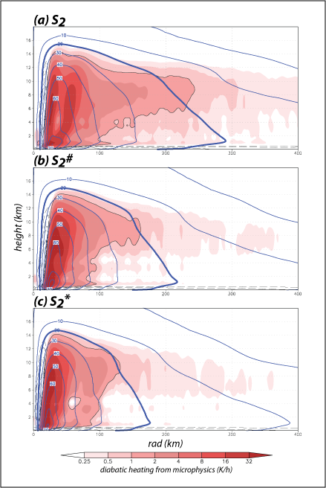
Temporally and azimuthally averaged
Storms with less active cloud ice
have narrower wind fields,
and track more to right
Blue contours: tangential wind
Color shading: H_DIABATIC

Slide 27
Temporally and azimuthally averaged
Storms with less active cloud ice
have narrower wind fields,
and track more to right

Slide 28
Discussion
Experimental results were consistent with both hypotheses
Neglecting snow in cloud-radiative forcing (W6^ and S2^) produced tracks that were somewhat to right of original tracks
  Little change occurred with S2 when snow was ignored because S2 generates little snow mass
Treating cloud ice as snow (W6# and S2#) also resulted in rightward shifts
  Larger shift occurred with S2 as it produces much more cloud ice
Rightward shifts occurred along with development of weaker outer core winds, as anticipated from prior research

Slide 29
Future work
Left unexplained by this experiment is why the radiative forcing associated with cloud ice results in a broader wind field
Is LW or SW more important?
Can test the impact of SW heating and CRF radiation by
  Modifying the model to neglect CRF in the SW scheme
  Modifying the model not to call SW radiation (perpetual night)
Can test the impact of LW radiation by
  Modifying the model to include only LW cooling or heating
  Modifying the model to neglect CRF in the LW cooling and/or heating in the LW scheme
Would other radiation schemes provide similar results?

Slide 30
Bibliography (use AMS format)
Fiorino, M. J., and R. L. Elsberry, 1989: Some aspects of vortex structure related to tropical cyclone motion. J. Atmos. Sci., 46, 975–990.
Fovell, R. G., and H. Su, 2007: Impact of cloud microphysics on hurricane track forecasts. Geophy. Res. Lett., 34, L24810.
Fovell, R. G., K. L. Corbosiero, and H.-C. Kuo, 2009: Cloud microphysics impact on hurricane track as revealed in idealized experiments. J. Atmos. Sci., 66, 1764-1778.
Fovell, R. G., K. L. Corbosiero, A. Seifert, and K.-N. Liou, 2010: Impact of cloud- radiative processes on hurricane track. Geophys. Res. Lett., 37, L07808,
Holland, G. J., 1983: Tropical cyclone motion: Environmental interaction plus a beta effect. J. Atmos. Sci., 40, 328–342.
Jordan, C. L., 1958: Mean soundings for the West Indies area. J. Meteor., 15, 91–97

Slide 31
Advice
Label your slides and plots – can I tell what I’m looking at?
More text on slides is OK as they are for reading, not presenting
Feel free to embed animations (make animated GIFs and place as photos; see the “Potpourri” PPT)
You may disprove your hypotheses, or at least fail to prove them = that’s OK
  The scientific literature suffers from a “positive-result” bias!
Show your slides to someone else, and solicit their feedback
Demonstrate that you learned something, from the experiment, and from the course

