Slide 1
GraphCast Machine Learning Weather Prediction Model
CAUTION: we will use lmm.rit.albany.edu for this demo
Execute the $ new command
See script
ATM 419/563
Spring 2024
Fovell
© Copyright 2024 Robert Fovell, Univ. at Albany, SUNY, rfovell@albany.edu

Slide 2
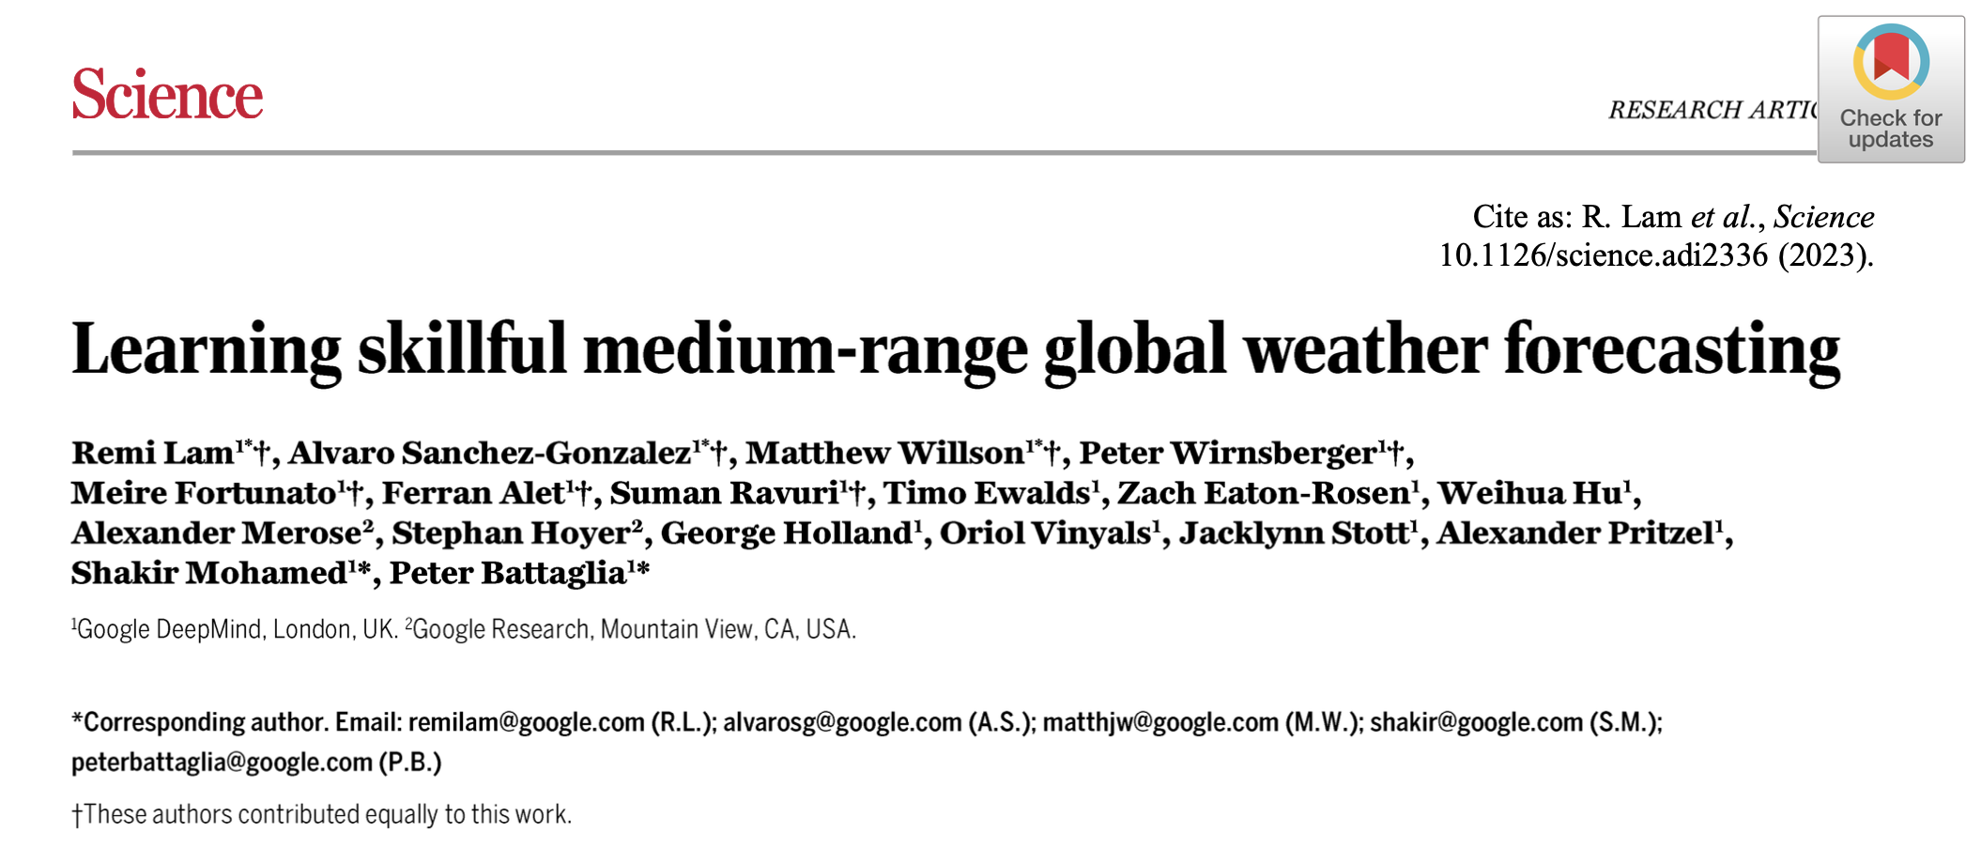
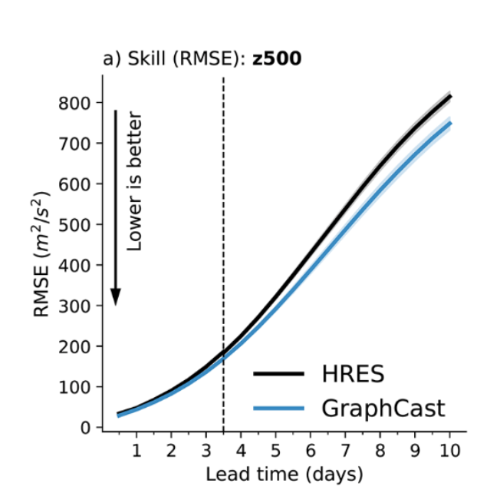
Machine Learning Weather Prediction (MLWP) models are now appearing that appear to rival or best
operational NWP models in some measure of skill
→ this includes GraphCast (Google), Pangu-Weather, FourCastNet
In particular, GraphCast (GC) was trained on 39 years (1979-2017) of the ERA5 reanalysis and
shares its 0.25˚ lat/lon grid. They show slightly higher skill than ECMWF’s HRES (see figure)
→ It can be initialized with ERA5 or (restricted access) HRES operational grids.
→ GC requires two sets of initialization fields, 6 h apart
→ GC produces forecasts every 6 h (cannot be changed)

Slide 3
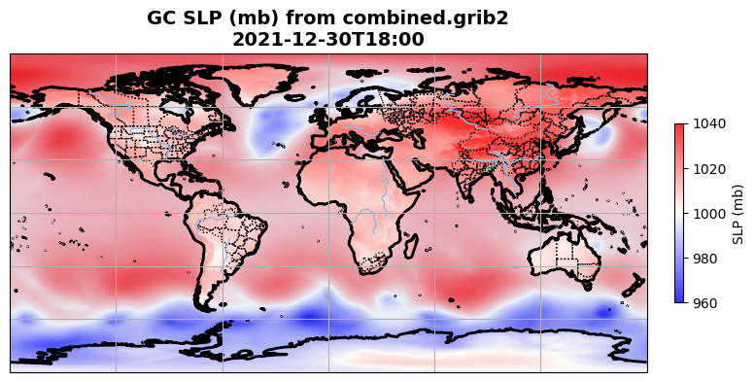
Plots made by GRIB_plot_GC.ipynb. Simulation started 12/30/2021 at 12 UTC. Forecast hour 6.

Slide 4
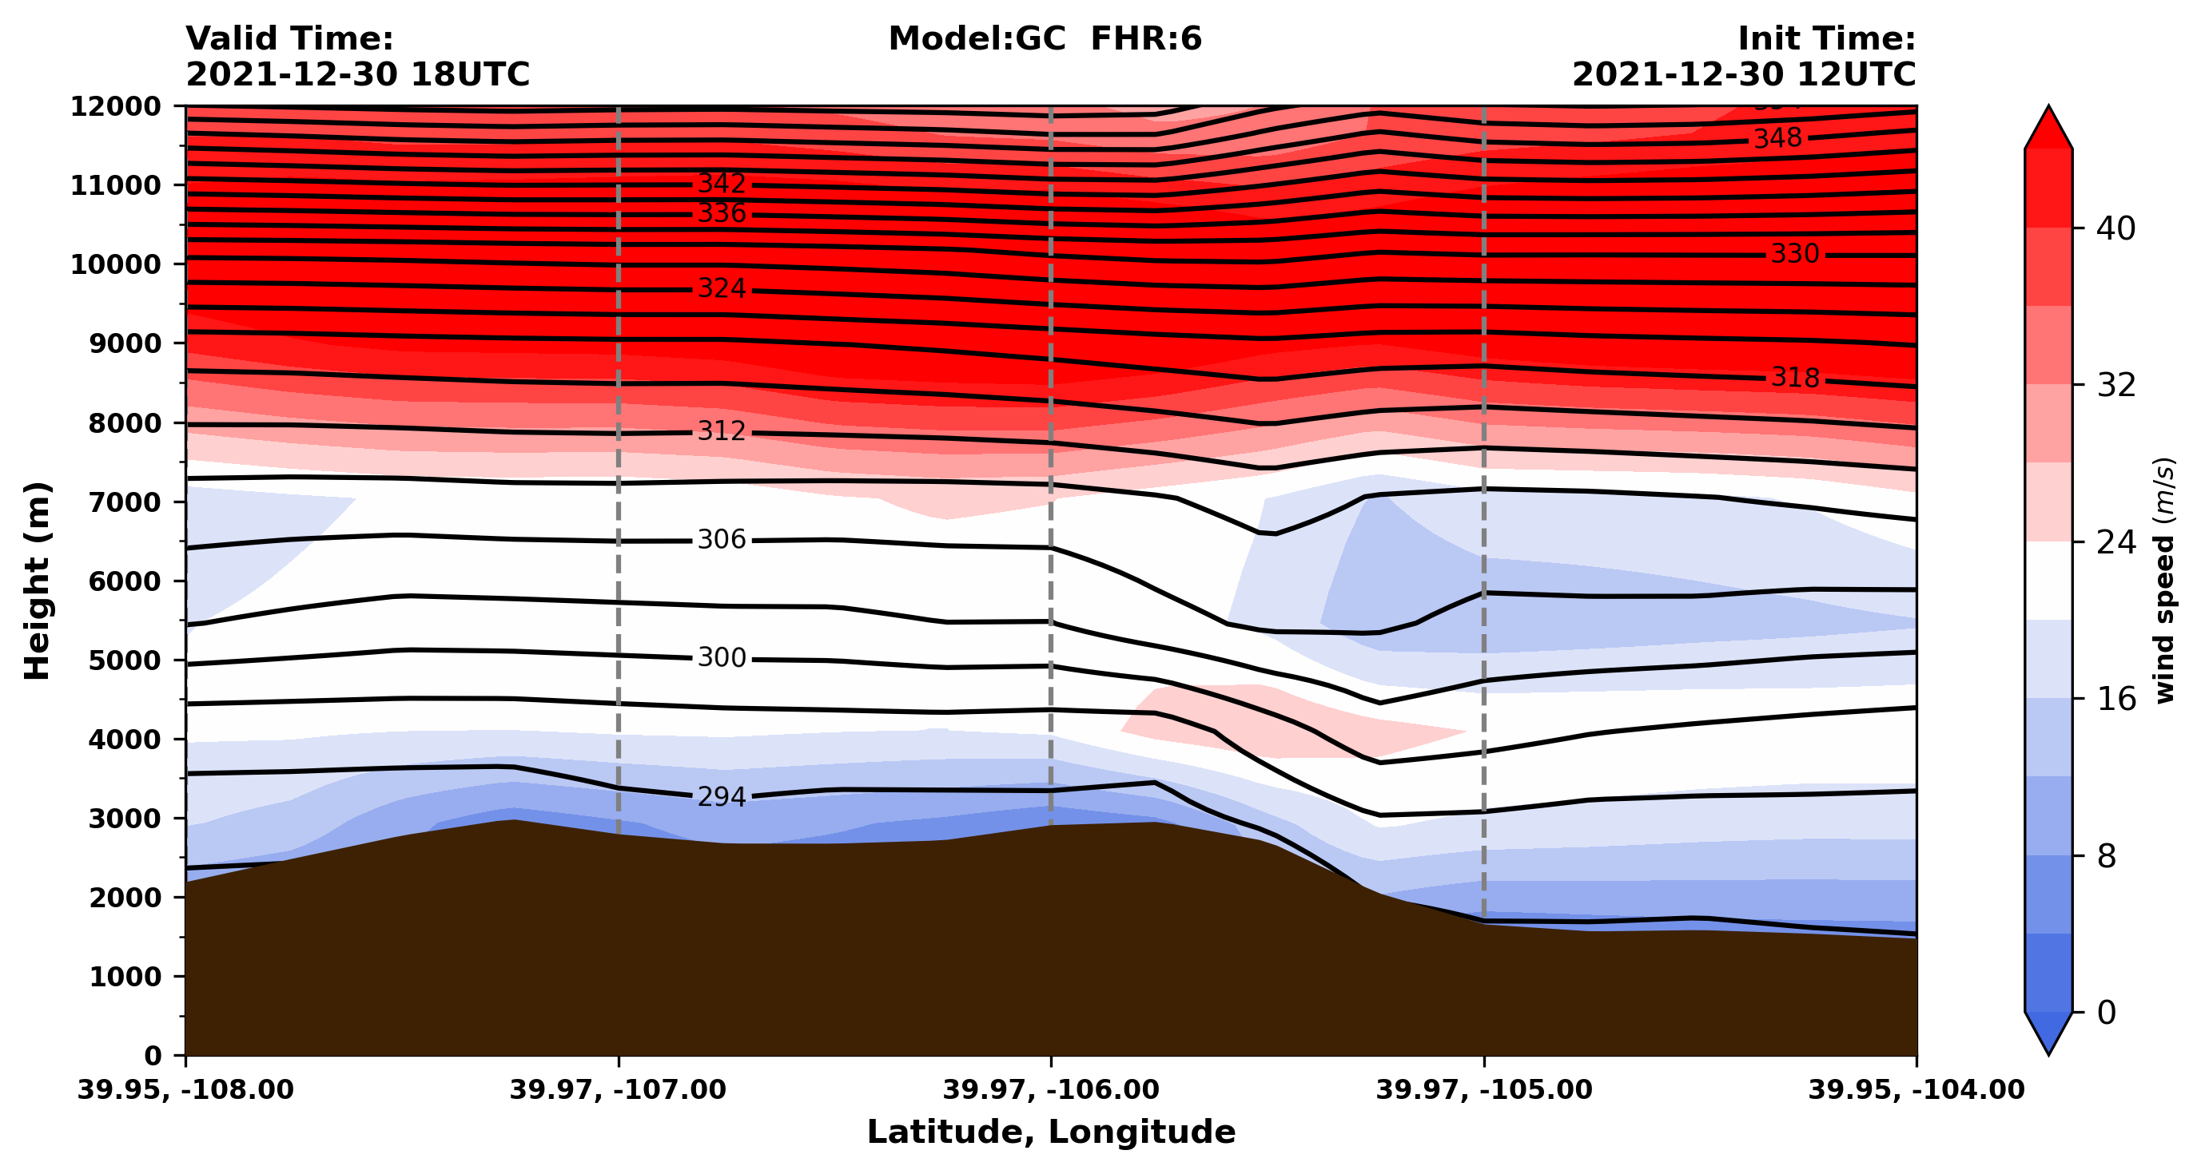
Plots made by GRIB_plot_GC.ipynb. Simulation started 12/30/2021 at 12 UTC. Forecast hour 6.

Slide 5
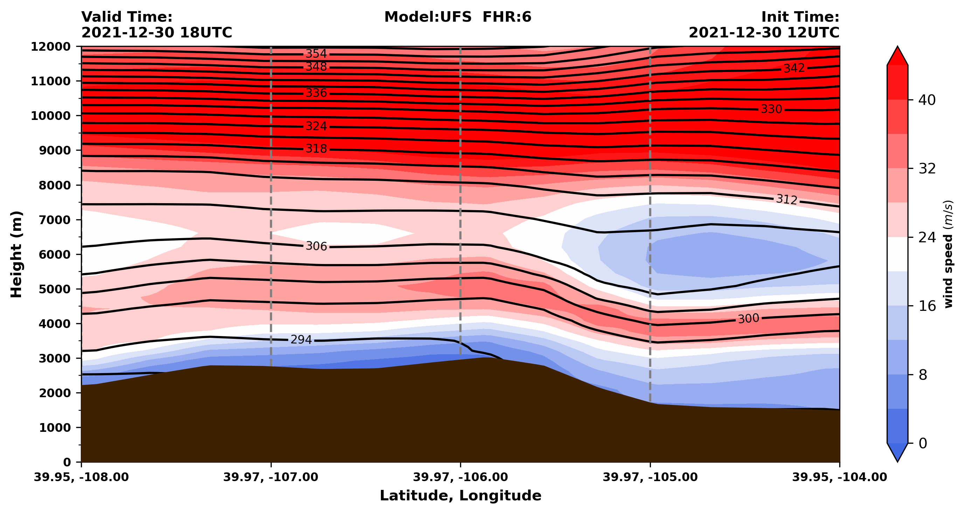
Our 25 km UFS SRW forecast

Slide 6
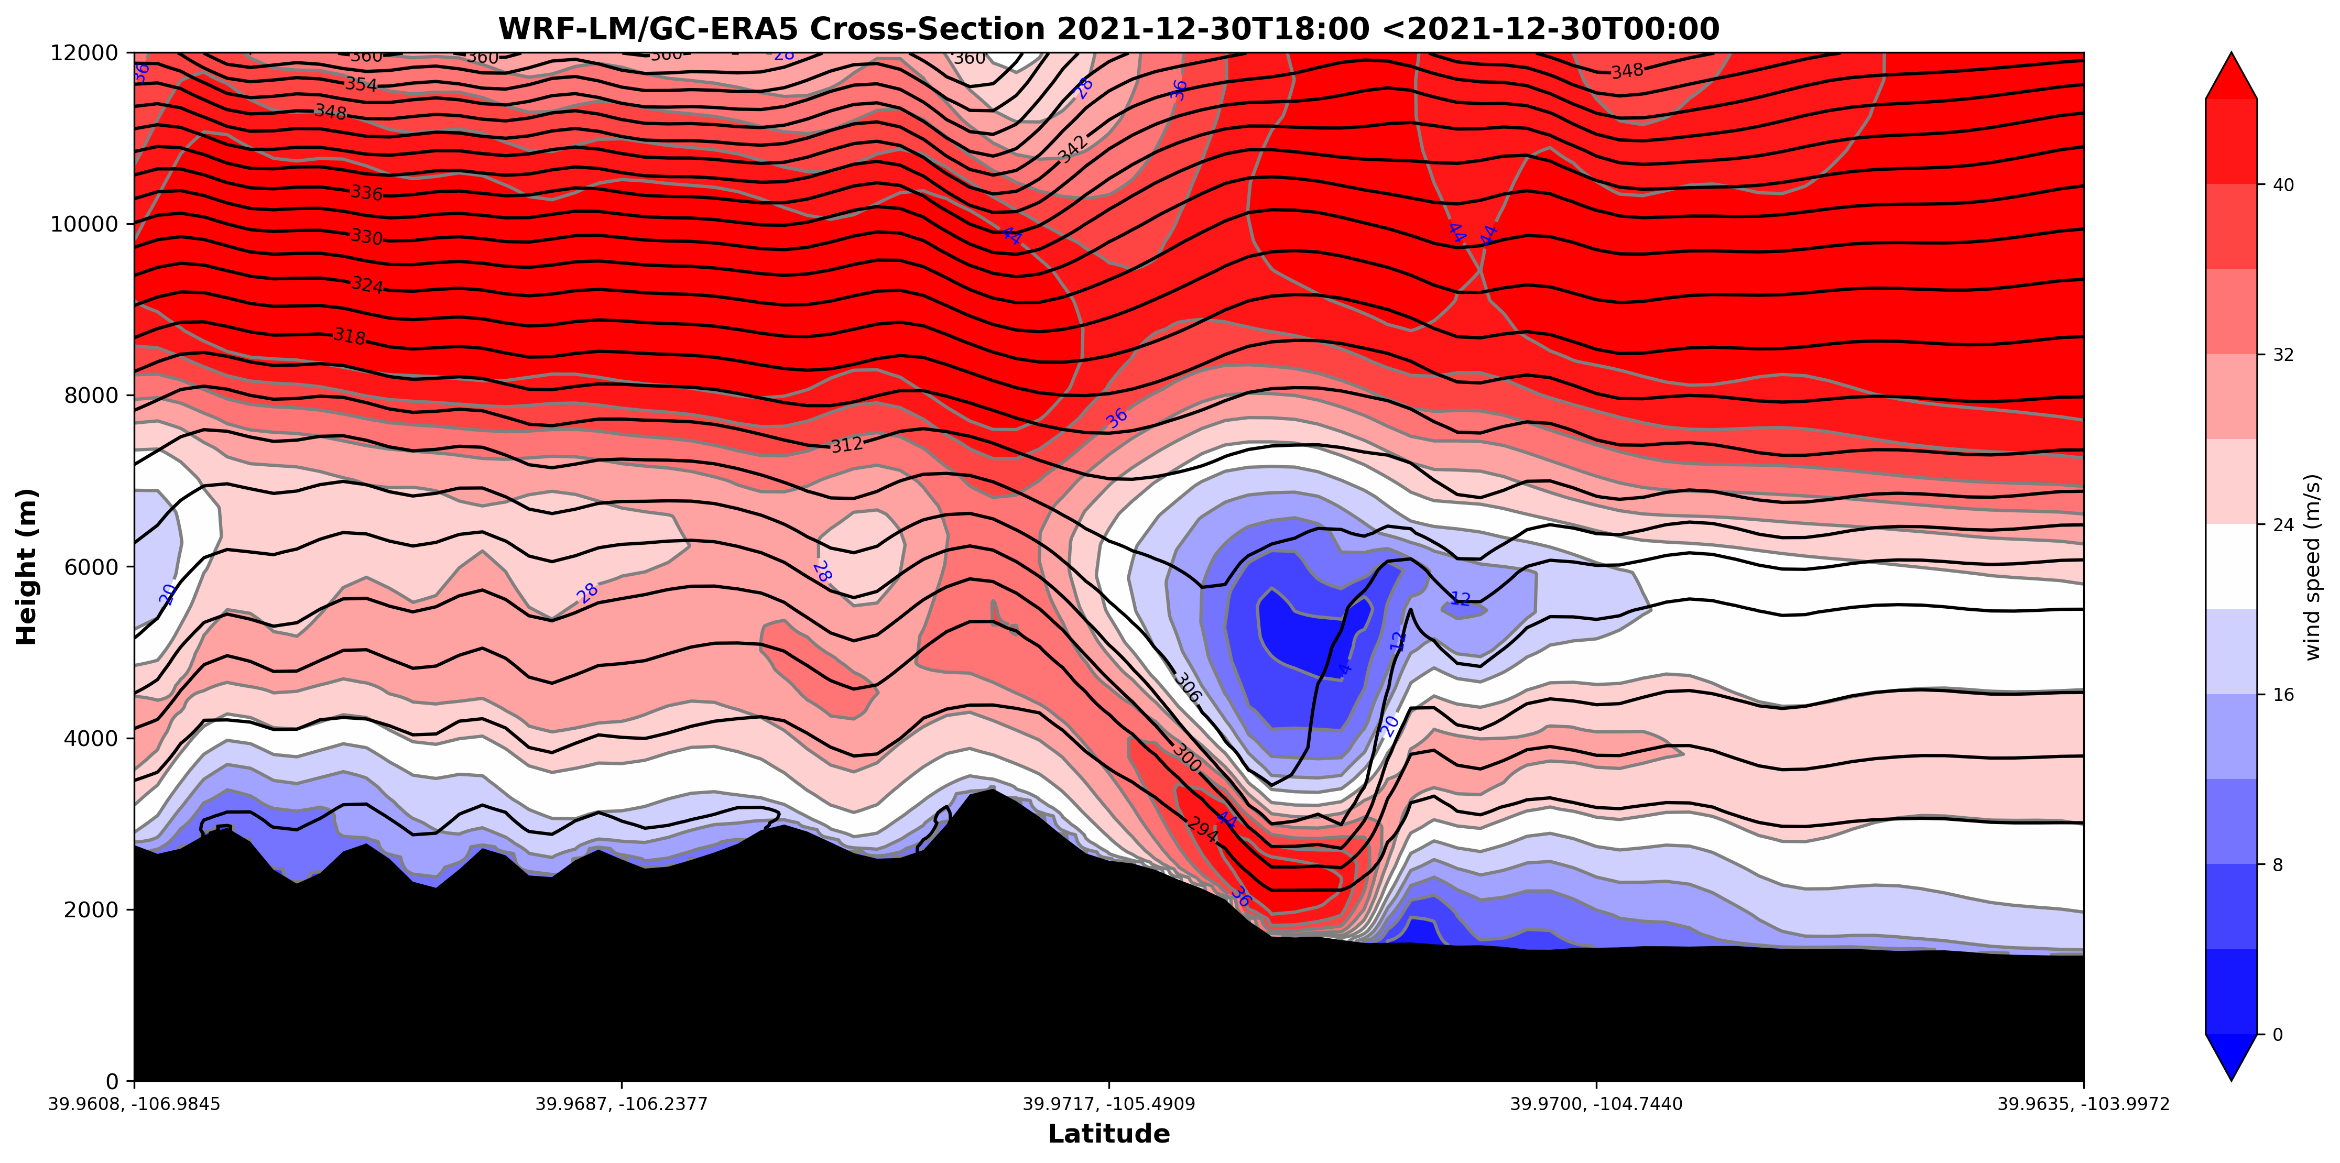
GraphCast forecast downscaled with WRF (Brewer, Fovell, Capps, submitted this morning)

Slide 7
[end]

