Slide 1
The Hurricane Milton ensemble
ATM 419/563
Fall 2024
Fovell
10/16/2024
© Copyright 2024 Robert Fovell, Univ. at Albany, SUNY, rfovell@albany.edu

Slide 2
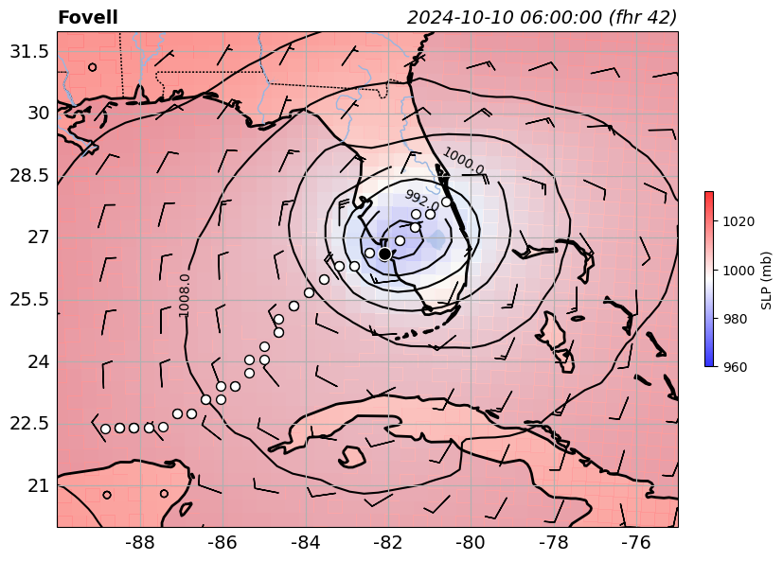
Milton ended up making landfall several hours earlier than forecast
White dots: min SLP
every hour
Black dot: landfall
My run: MYNN PBL and surface, WSM5 microphysics, KF cumulus, Noah LSM, RRTMG radiation

Slide 3
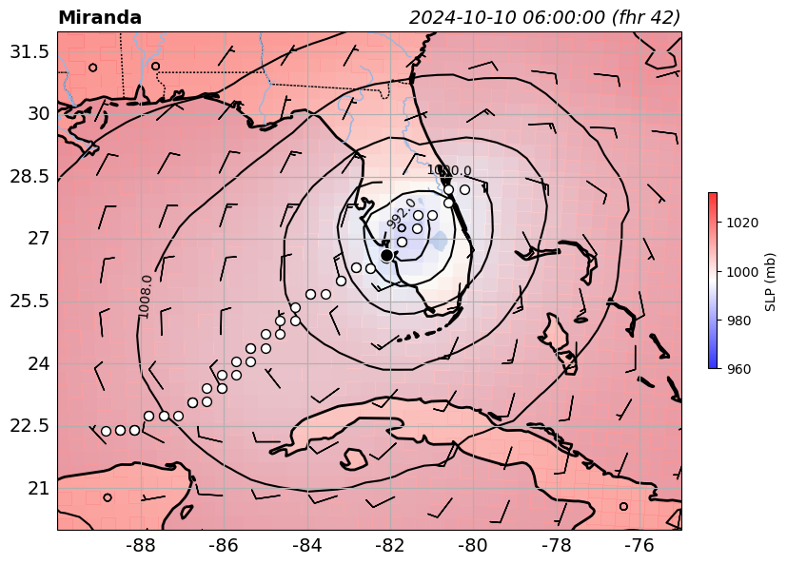
Fastest mover, earliest landfall, weaker intensity than mine

Slide 4
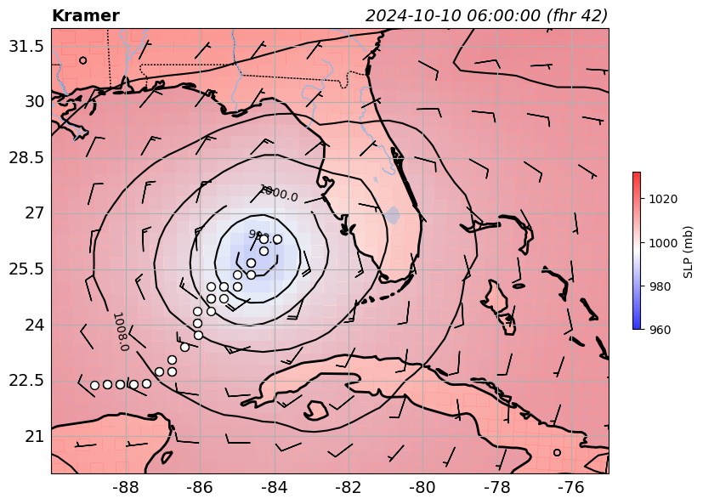
Slowest mover, weak

Slide 5
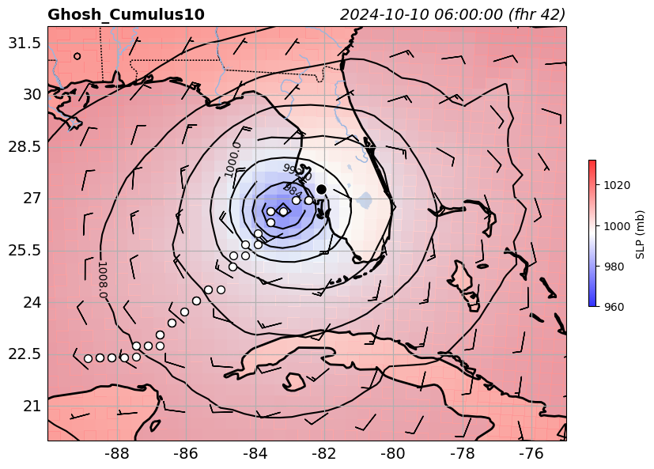
Deepest low prior to landfall: < 970 mb, later than average landfall

Slide 6
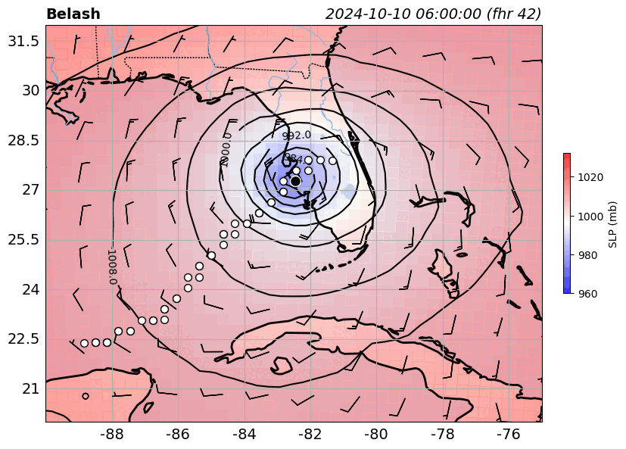
Animation
White dots: min SLP
every hour
Black dot: landfall
Model physics matters

Slide 7
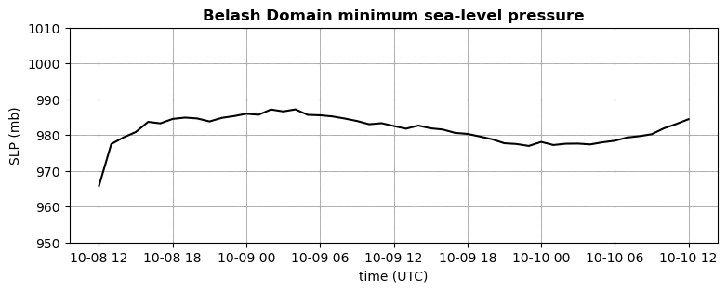
Animation

