Slide 1
Hurricane Milton
Simulations started from 10/8/2024 12Z GFS
Forecast hour 42 shown

Slide 2
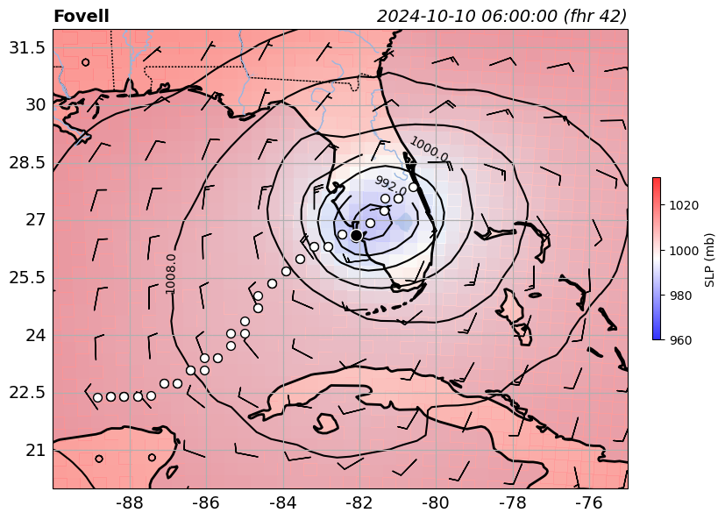
My WRF
“control run”

Slide 3
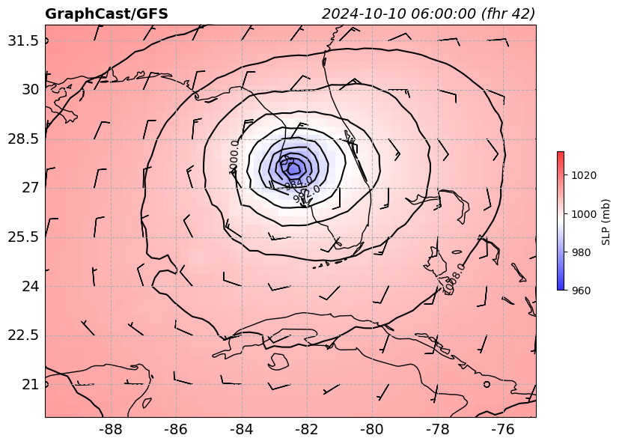
GraphCast
init w/ GFS

Slide 4
Can we do better with WRF?

