Slide 1
MPAS:
Model for Prediction Across Scales
ATM 419/563
Fall 2024
Fovell
© Copyright 2024 Robert Fovell, Univ. at Albany, SUNY, rfovell@albany.edu

Slide 2
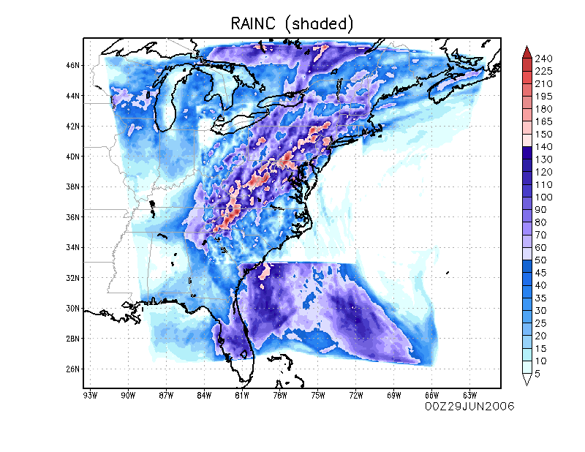
Problem statement
Total precipitation from 2-domain run
WRF is a great model, but there is
an irritating, and sometimes
important limitation:
To economically capture both
synoptic-scale fields and regional
fine resolution, we use nesting
Nesting can cause discontinuities
and distortions at the nest boundaries,
especially when model physics does
or must differ between parent and
child grids
An alternative is to smoothly vary the
grid spacing in space. That requires
a new and different approach to
grid generation…

Slide 3
Outline
A little bit of NWP history
MPAS vs. WRF and MPAS grid information
Example MPAS simulation, step by step
Visualizing MPAS output
Appendices: setting up the MPAS grid and using variable resolution meshes
This PPT uses material borrowed from MPAS tutorials created by NCAR

Slide 4
A very abridged NWP history
NAM now NMMB
HWRF → HAFS (based on UFS)
NAM, HWRF
GFS, RRFS1
NOAA/GFDL
NMM
UFS/FV3
NOAA/NCEP
MM4/
MM5
WRF
MPAS
NCAR
early
2000s
NCAR
RRFS2?
CCPP
ARW
???
RAP, HRRR
WRF is a wrapper for multiple cores. The core we have been using is WRF-ARW.
UFS = Unified Forecast System ← current GFS, based on FV3
CCPP = Common Community Physics Package
Future: UFS as a wrapper containing FV3 and MPAS?
HRRR → RRFS1 (FV3) → RRFS2 (MPAS?)

Slide 5
Resources
MPAS home page
MPAS V8.2.0 User’s Guide

Slide 6
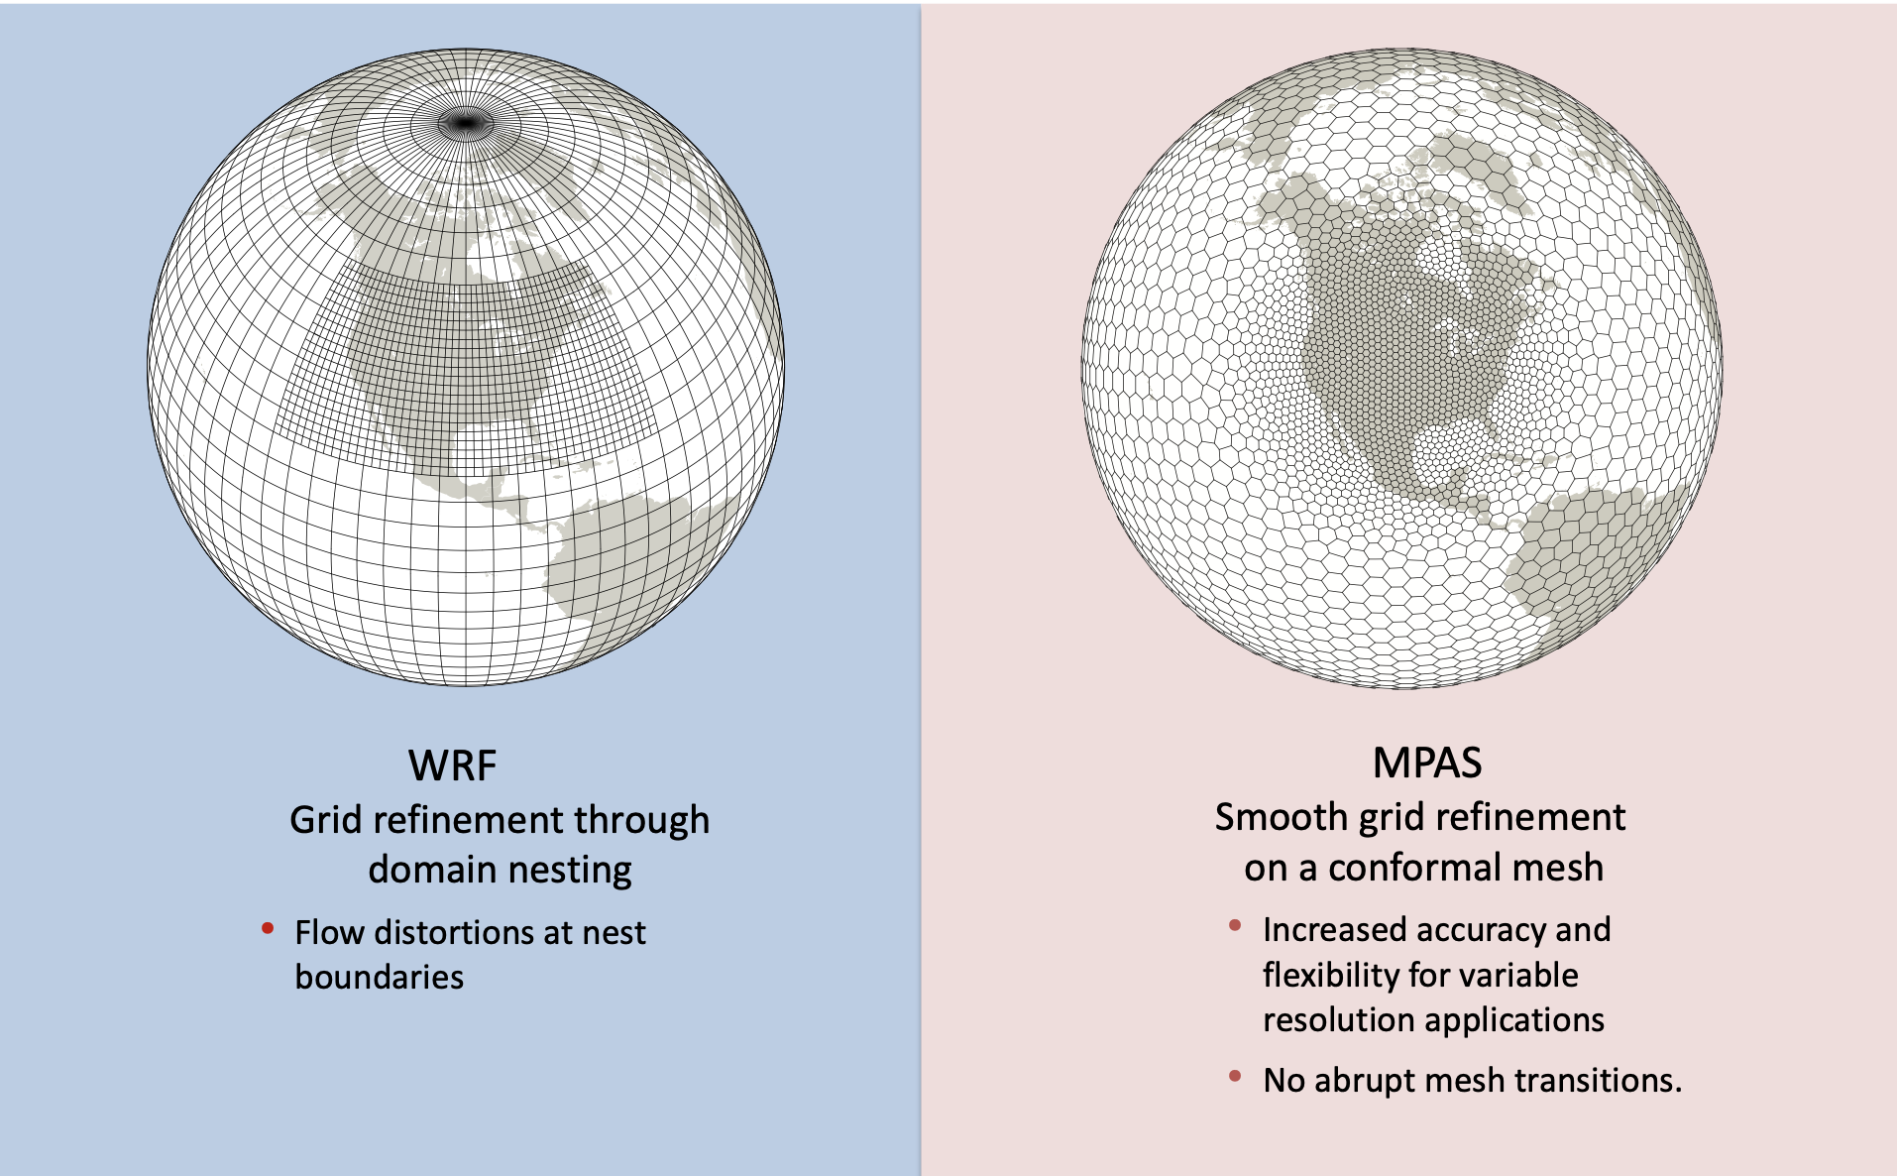
WRF v. MPAS
• Requires map projections
• Physics discontinuities
• No map projections!
Notes:
WRF gets locally higher res via nesting, creating discontinuities at nest boundaries. Map projections means issues at poles when using projections that handle midlatitudes well.

Slide 7
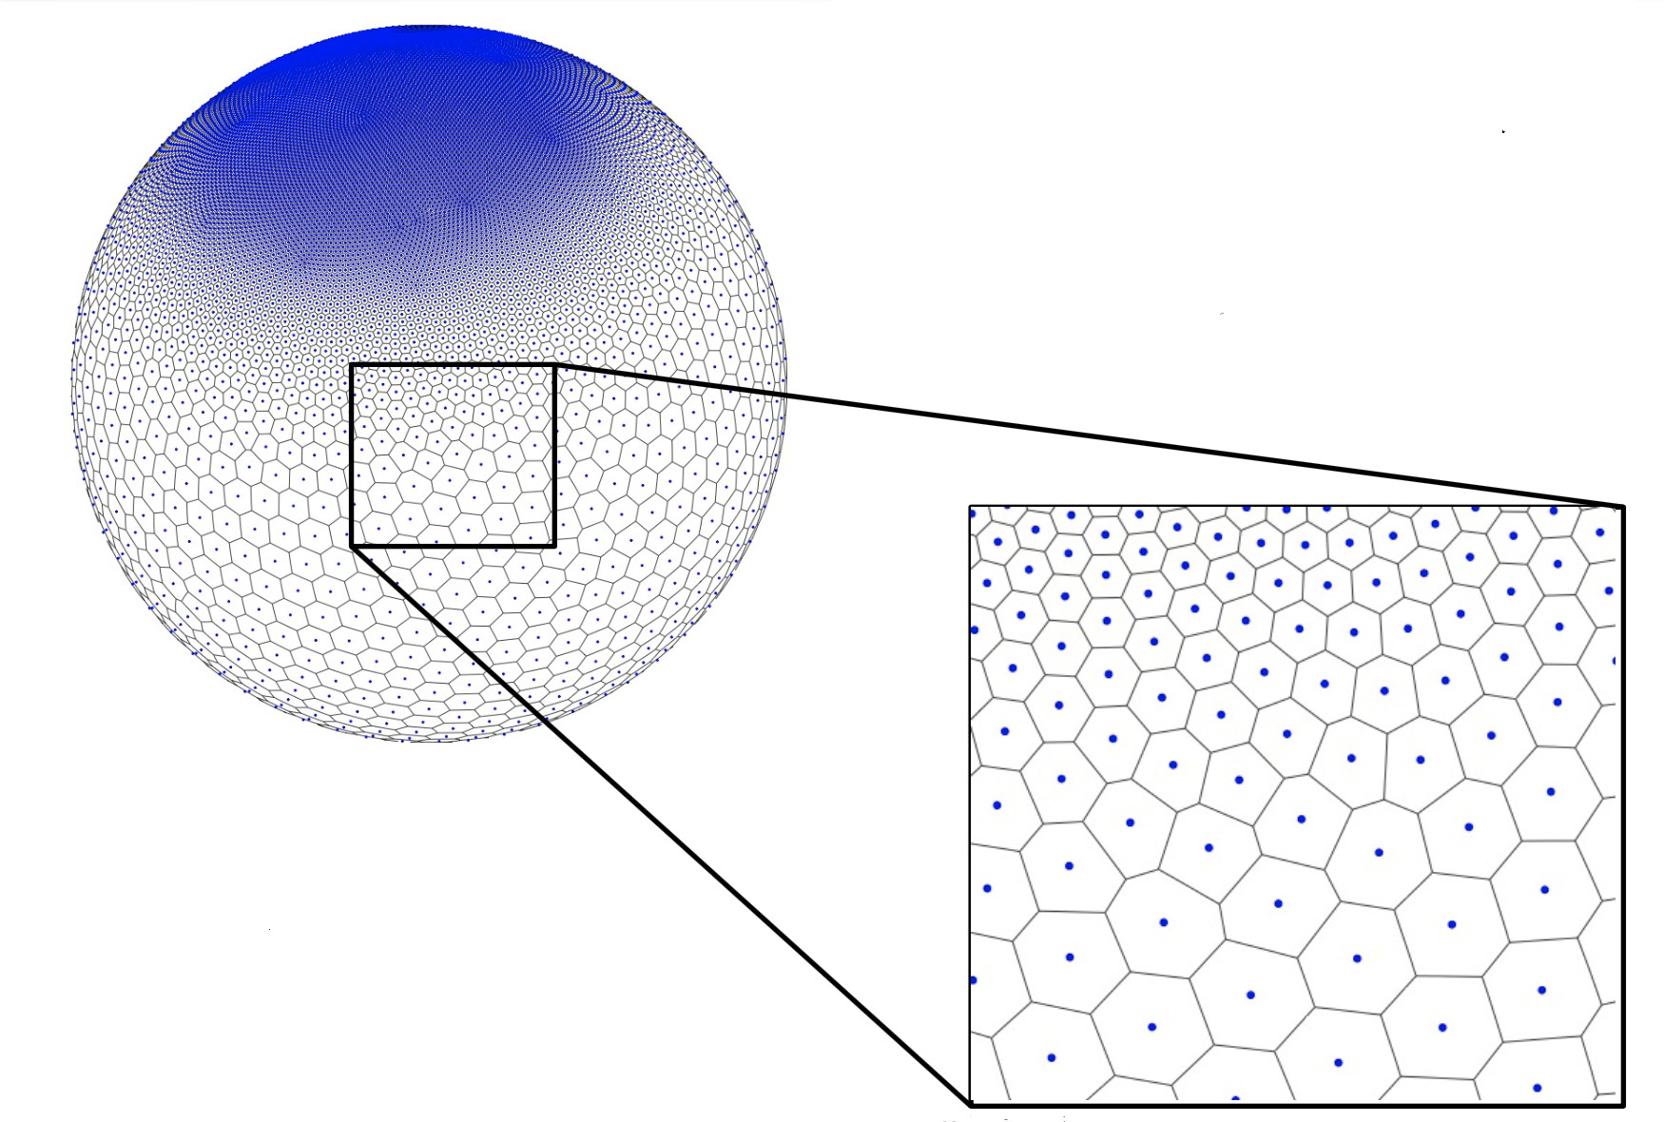
The horizontal MPAS grid uses cells that may
have 5, 6, 7, or more sides. The grid is unstructured.

Slide 8
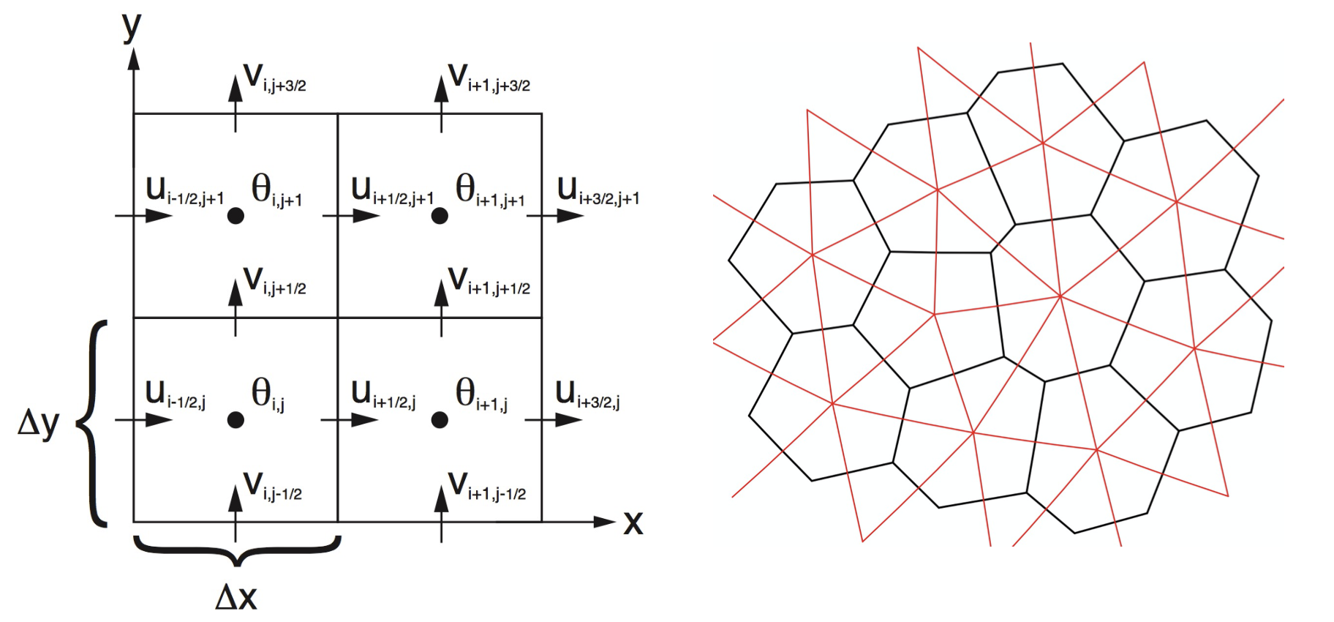
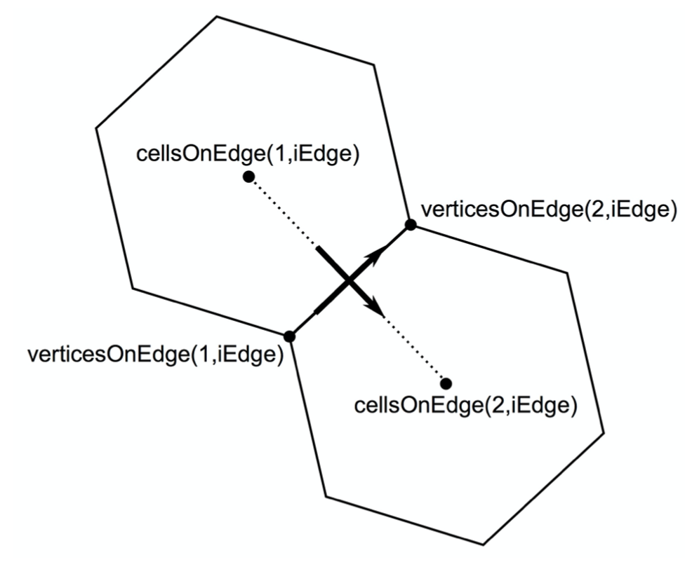
WRF staggered horizontal grid MPAS horizontal grid
MPAS velocity components are defined
relative to the cells, and then converted
in postprocessing to U and V components
we can interpret more easily

Slide 9
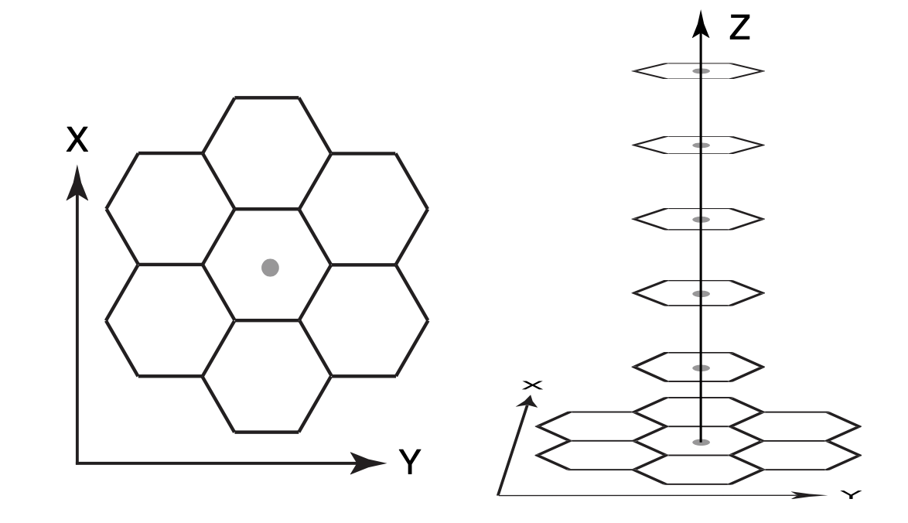
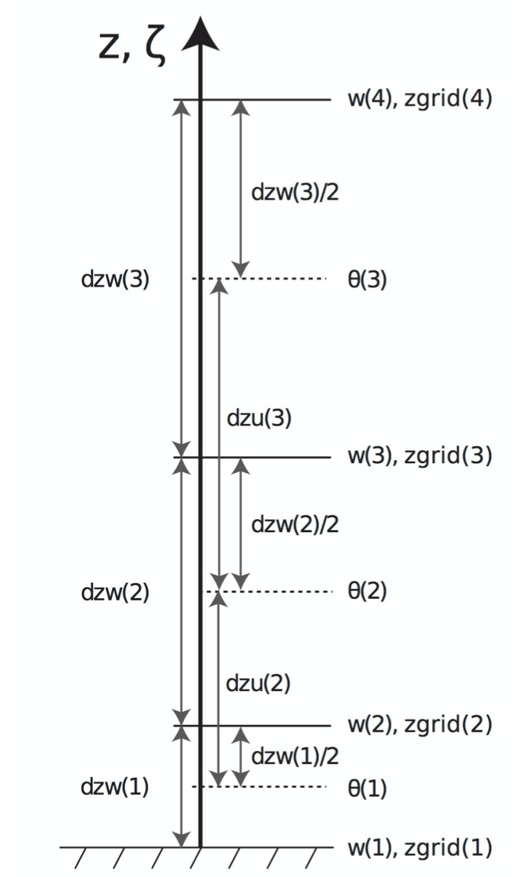
Vertical grid is structured
Vertical stretching is still used to
vary resolution with altitude
At present, cell area is constant in
vertical direction
The upcoming “deep atmosphere”
version will have grid cell areas
that increase with altitude

Slide 10
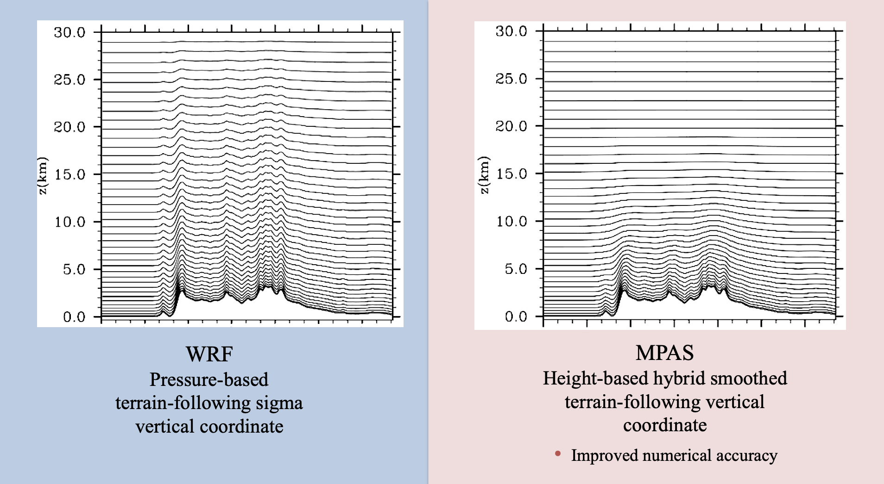
Mass (WRF) vs. height (MPAS) coordinate
V3
Notes:
I think this is the WRFV3 coordinate, not the newer hybrid coordinate

Slide 11
MPAS meshes
Can’t just make your own mesh (new mesh generation takes a very, very long time)
Download a mesh from the MPAS website and adapt it to your needs
Two kinds of meshes
  Fixed resolution
  Variable resolution
For fixed resolution, static (like geogrid) files are provided so you can skip a tedious step (but you can build your own, if needed; see Appendix)
For variable resolution, tools are provided to remap the higher resolution “refinement region” to location of your choice. Then, build the static file. (See Appendix)

Slide 12
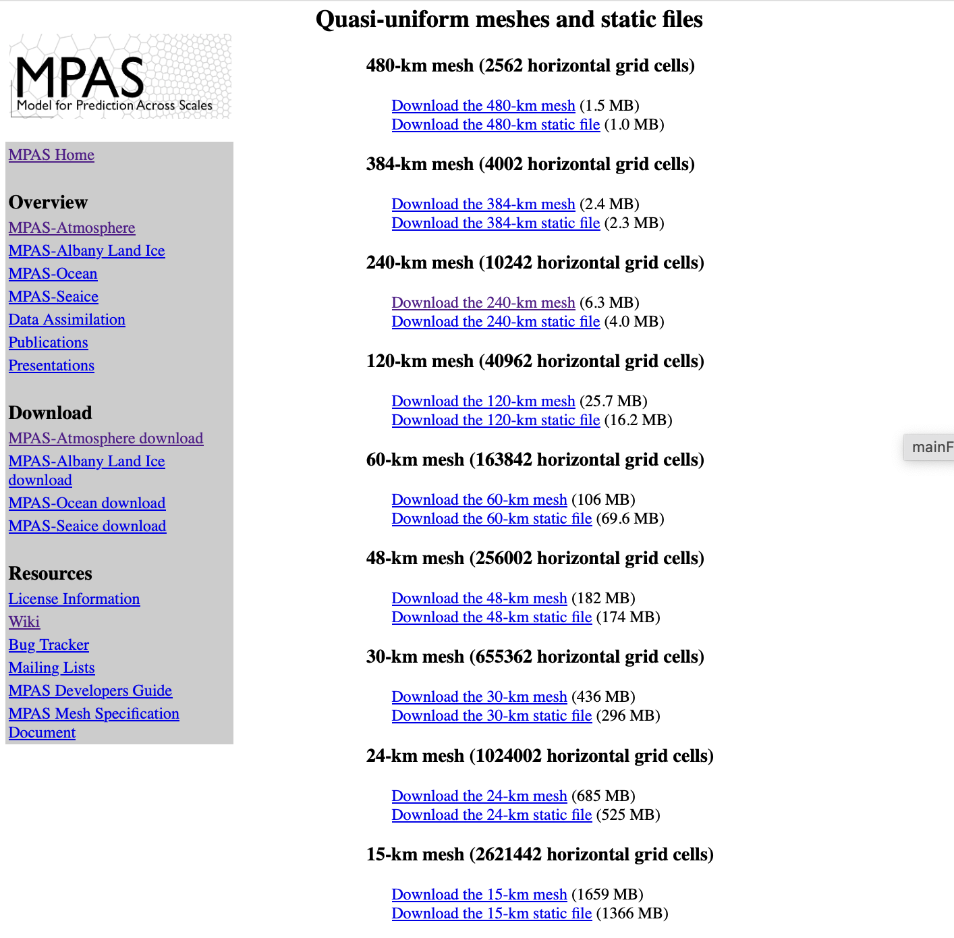
Get meshes from
MPAS page

Slide 13
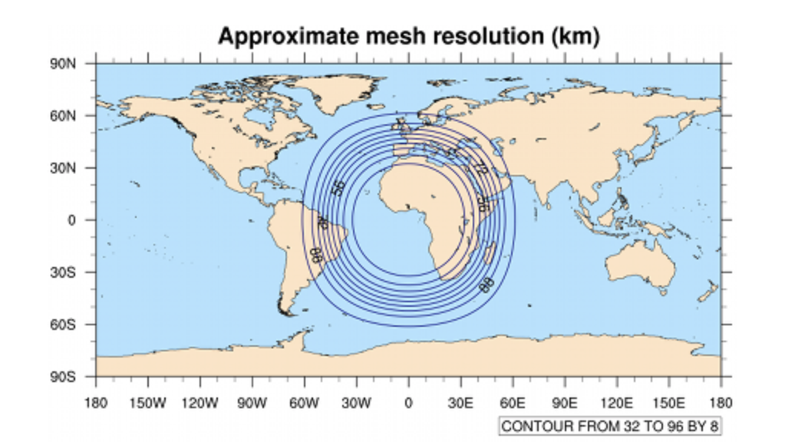
Variable resolution mesh
This example variable resolution mesh is 92 km resolution refining to 25 km
within a roughly 60˚ lat/lon area. It consists of 163,842 cells.
A tool called grid_rotate is used to move the refinement region to the location
of your choosing. See Appendix.

Slide 14
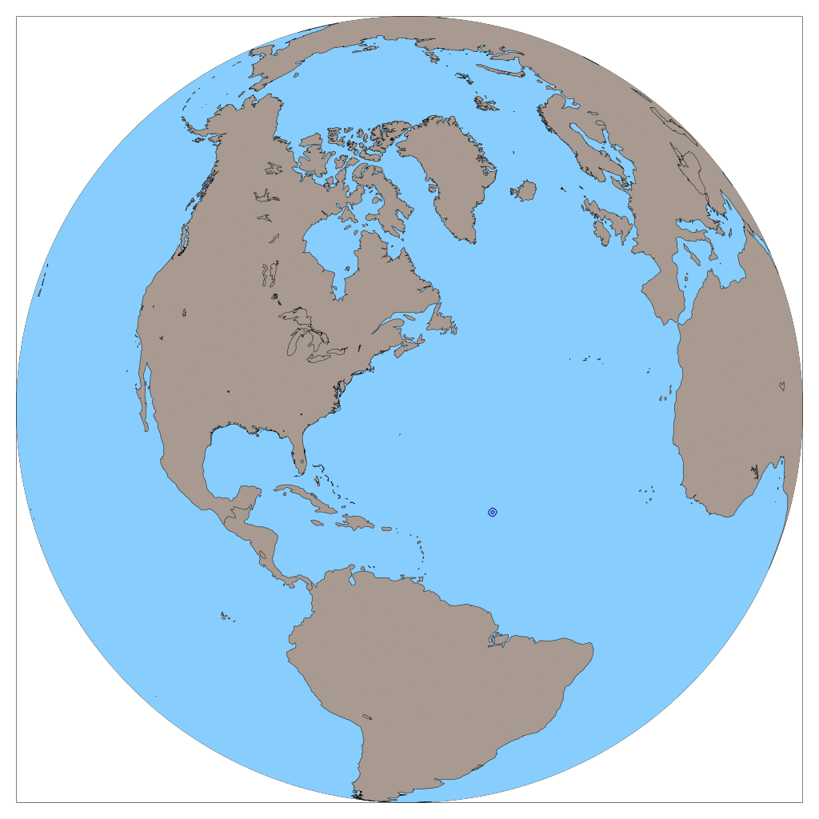
MPAS v.2 semi-idealized
92 to 25 km mesh
NO LAND
NO INITIAL WIND
NO LATERAL BOUNDARIES
Sea-level pressure over 9 days

Slide 15
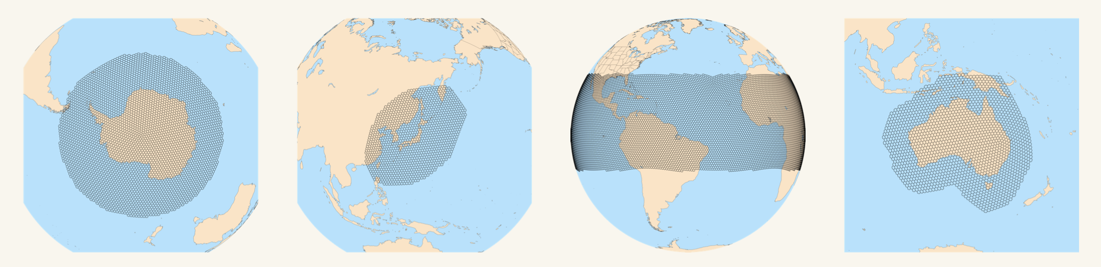
Regional MPAS is also now available

Slide 16
Postprocessing MPAS netCDF output
ncview does NOT provide quicklooks (owing to unstructured grid)
NCAR Command Language (NCL) can read, process, and plot raw MPAS output
  But… NCL is no longer being supported
  NCL-Python (PyNGL) exists but is not very mature
  Manipulating global MPAS outputs can be very time consuming
  NCL no longer natively available on head (see workaround)
The convert_mpas tool converts MPAS output to a regular latitude-longitude mesh for plotting with NCL or python
  You can designate interpolation resolution
  You can designate a specific region of interest to extract, which can speed up processing a lot
The MPASSIT package converts MPAS output to WRF format*
New Python tools for plotting unstructured grids are emerging, including uxarray and holoviews
* Not yet available on head.arcc

Slide 17
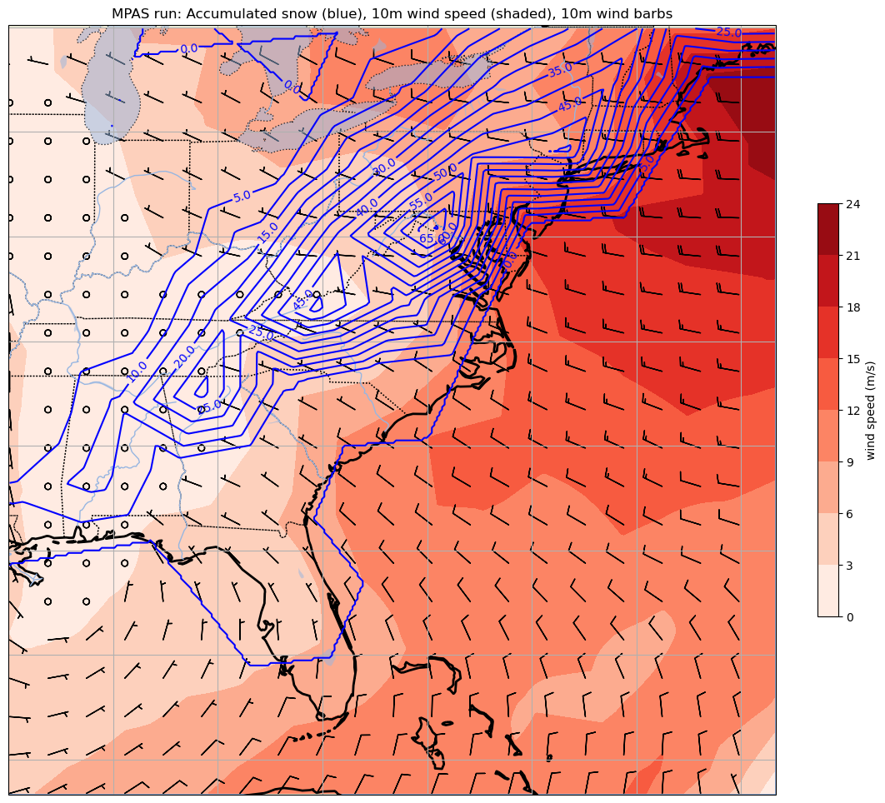
Snow liquid equivalent (mm)
using convert_mpas and
matplotlib

Slide 18
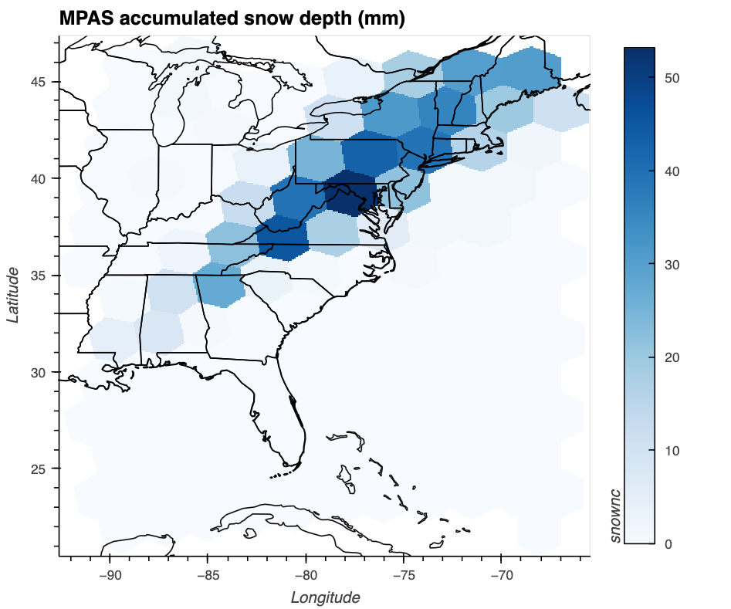
Snow liquid equivalent (mm)
using uxarray
(aspect ratio controlled by specifying plot width and height)

Slide 19
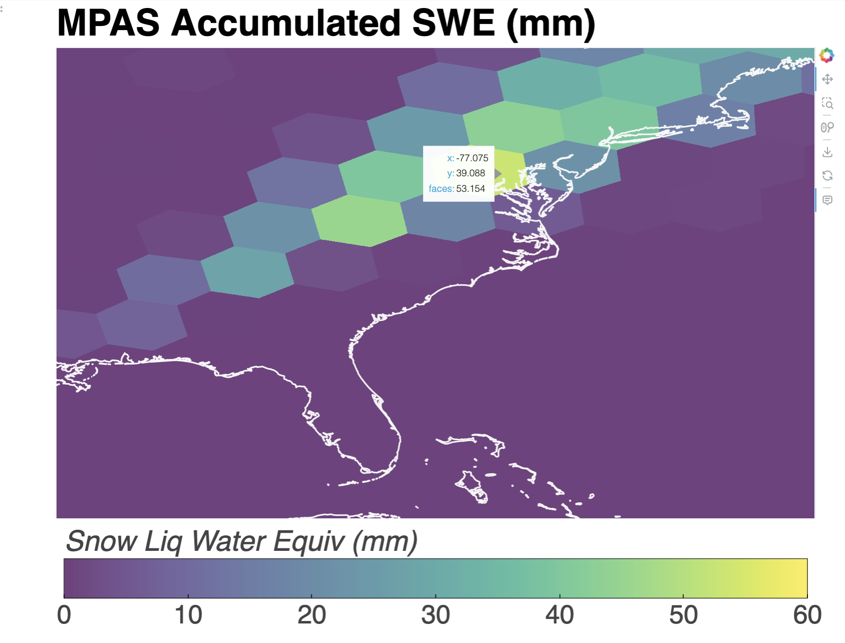
Snow liquid equivalent (mm)
using holoviews
(aspect ratio controlled by specifying plot width and height)

Slide 20
An example MPAS simulation
SOC simulation at 240 km resolution, initialized with NNRP
•• Requires output from ungrib ••

Slide 21
Overview
For this demo, we will skip steps #-1 and #0
Step #-1: Create static file (i.e., like geogrid)
  Reads in a grid file, creates static file
  Can be very time-consuming, can only use 1 cpu
  For fixed meshes, pre-made static files can be downloaded, so this step can be skipped. For other situations, see Appendix.
Step #0: Run ungrib (from WPS)
  For a global model only need one time (no lateral boundaries!)
  Here, we will use a pre-made, ungrib-processed file from the NNRP reanalysis for the model start time
Step #1: Run init_atmosphere_model (e.g., metgrid + real)
  Reads in static file, creates init file
Step #2: Run atmosphere_model (e.g., wrf)
  Reads in init file, creates history, diag, and restart files
Step #3: Postprocessing

Slide 22
Setup
In your lab space, make a directory called MPAS and move into it
Copy into it the contents of cp $LAB/MPASV8/FILES/* .
Execute make_mpas_links.sh
SEE SCRIPT

Slide 23
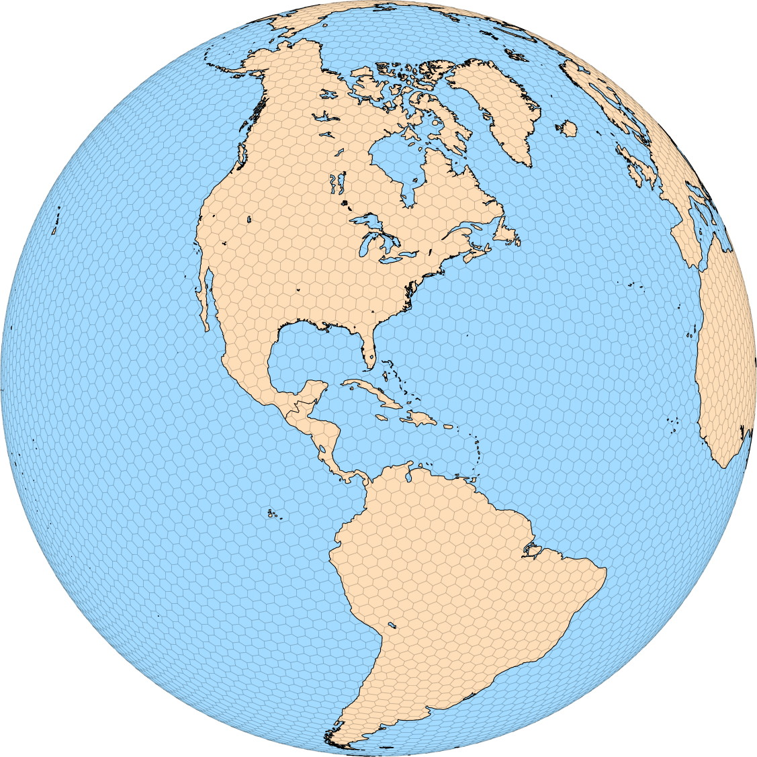
Our 240 km grid
Instructions on
next slide

Slide 24
Running NCL scripts [optional]
NCL is no longer supported and not natively available on head.arcc.albany.edu anymore
However, we can still access and use NCL through Anaconda python
Create a new terminal session (for safety) and in your MPAS directory:
  $ source doncl.sh
  $ export FNAME=x1.10242.grid.nc
  $ export T=0
  $ ncl mpas-a_mesh.ncl
  $ display atm_mesh.pdf
{‘source’ NOT ‘sh’}
{creates no output to screen}
Other NCL scripts for MPAS

Slide 25
Procedure
MPAS needs WPS’ ungrib.exe to prepare parent model grids for MPAS
MPAS model executables:
  init_atmosphere_model == geogrid.exe, metgrid.exe, real.exe
  atmosphere_model == wrf.exe
MPAS model input files
  namelist.init_atmosphere
  streams.init_atmosphere
  namelist.atmosphere
  streams.atmosphere
MPAS static file for our uniform 240 km mesh
  x1.10242.static.nc

Slide 26
Step #1: Creating initial conditions
(i.e., metgrid and real)
Edit namelist.init_atmosphere
Edit streams.init_atmosphere
submit submit_init to Burst
Check tail of log.init_atmosphere.0000.out
Namelists are pre-configured for this test case
For MPAS global, there are no lateral boundary conditions

Slide 27
&nhyd_model
config_init_case = 7
config_start_time = '1993-03-12_12:00:00'
config_stop_time = '1993-03-15_00:00:00'
config_theta_adv_order = 3
config_coef_3rd_order = 0.25
/
&dimensions
config_nvertlevels = 55
config_nsoillevels = 4
config_nfglevels = 38
config_nfgsoillevels = 2
/
&data_sources
config_geog_data_path = '/network/rit/lab/atm419lab/GEOG4.0/'
config_met_prefix = 'NNRP'
config_sfc_prefix = 'SST'
config_fg_interval = 86400
config_landuse_data = 'MODIFIED_IGBP_MODIS_NOAH'
config_topo_data = 'GMTED2010'
config_vegfrac_data = 'MODIS'
config_albedo_data = 'MODIS'
config_maxsnowalbedo_data = 'MODIS'
config_supersample_factor = 3
config_use_spechumd = false
/
&vertical_grid
config_ztop = 30000.0
config_nsmterrain = 1
config_smooth_surfaces = true
config_dzmin = 0.3
config_nsm = 30
config_tc_vertical_grid = true
config_blend_bdy_terrain = false
/
&interpolation_control
config_extrap_airtemp = 'linear'
/
&preproc_stages
config_static_interp = false
config_native_gwd_static = false
config_vertical_grid = true
config_met_interp = true
config_input_sst = false
config_frac_seaice = true
/
&io
config_pio_num_iotasks = 0
config_pio_stride = 1
/
&decomposition
config_block_decomp_file_prefix = ‘x1.10242.graph.info.part.'
/
used for SST, not NNRP
38 or larger should suffice
Because NNRP
See slide #30
used for SST, not NNRP
namelist.init_atmosphere
Pre-configured for this case
Check items in red
Note: I had to set config_nfgsoillevels = 2
for successful operation. Recall NNRP provides
only 2 soil levels. However (a) I did NOT have to
change config_nfglevels to the number of layers
NNRP provides (akin to num_metgrid_levels),
and (b) the setting appears to be completely ignored…
Notes:
Decomp so we can run this step on multiple nodes.
config_nfglevels does not need to be exact, just same or LARGER than number of levels in ungrib output.

Slide 28
<streams>
<immutable_stream name="input"
type="input"
filename_template="x1.10242.static.nc"
input_interval="initial_only" />
<immutable_stream name="output"
type="output"
filename_template="x1.10242.init.nc"
packages="initial_conds"
output_interval="initial_only" />
<immutable_stream name="surface"
type="output"
filename_template="x1.10242.sfc_update.nc"
filename_interval="none"
packages="sfc_update"
output_interval="86400" />
<immutable_stream name="lbc"
type="output"
filename_template="lbc.$Y-$M-$D_$h.$m.$s.nc"
filename_interval="output_interval"
packages="lbcs"
output_interval="3:00:00" />
</streams>
We obtained the static file from
the MPAS meshes page.
If we wanted to use the variable
resolution meshes, we’d have to
make our own (step #-1, see Appendix)
streams.init_atmosphere
Pre-configured for this case
Check items in red
Most of these lines are ignored at this stage
You are providing as input:
x1.10242.static.nc
You are creating as output:
x1.10242.init.nc

Slide 29
Successful completion of this step:
$ sbatch –p burst-daes submit_init
$ tail -f log.init_atmosphere.0000.out
-----------------------------------------
Total log messages printed:
Output messages = 405
Warning messages = 0
Error messages = 0
Critical error messages = 0
-----------------------------------------
Logging complete. Closing file at 2024/04/14 14:54:26
This should execute very quickly. Looking to see NO error messages.
You should now have a file called x1.10242.init.nc in your folder

Slide 30
Notes
This step can be executed on multiple nodes. However, your choice regarding number of nodes you can use is limited to the availability of the x1.10242.graph* files
In this case, you can select 24 or 32 cpus, but not 30, because you don’t have a graph.info file for that
  However, here is a tool (gpmetis) for crafting new graph files. See Appendix #4.
x1.10242.graph.info x1.10242.graph.info.part.36
x1.10242.graph.info.part.12 x1.10242.graph.info.part.4
x1.10242.graph.info.part.16 x1.10242.graph.info.part.48
x1.10242.graph.info.part.2 x1.10242.graph.info.part.6
x1.10242.graph.info.part.24 x1.10242.graph.info.part.64
x1.10242.graph.info.part.32 x1.10242.graph.info.part.8

Slide 31
Step #2: Run the model
(i.e., wrf)
Edit namelist.atmosphere
Edit streams.atmosphere
submit submit_mpas to Burst
tail –f log.atmosphere.0000.out to track progress

Slide 32
&nhyd_model
config_time_integration_order = 2
config_dt = 1200.0
config_start_time = '1993-03-12_12:00:00'
config_run_duration = '2_12:00:00'
config_split_dynamics_transport = true
config_number_of_sub_steps = 2
config_dynamics_split_steps = 3
config_horiz_mixing = '2d_smagorinsky’
config_visc4_2dsmag = 0.05
config_w_adv_order = 3
config_theta_adv_order = 3
config_scalar_adv_order = 3
config_u_vadv_order = 3
config_w_vadv_order = 3
config_theta_vadv_order = 3
config_scalar_adv_order = 3
config_u_vadv_order = 3
config_w_vadv_order = 3
config_theta_vadv_order = 3
config_scalar_vadv_order = 3
config_scalar_advection = true
config_positive_definite = false
config_monotonic = true
config_coef_3rd_order = 0.25
config_epssm = 0.1
config_smdiv = 0.1
/
&damping
config_zd = 22000.0
config_xnutr = 0.2
/
&limited_area
config_apply_lbcs = false
/
&io
config_pio_num_iotasks = 0
config_pio_stride = 1
/
&decomposition
config_block_decomp_file_prefix = 'x1.10242.graph.info.part.'
/
&restart
config_do_restart = false
/
&printout
config_print_global_minmax_vel = true
config_print_detailed_minmax_vel = false
/
&IAU
config_IAU_option = 'off'
config_IAU_window_length_s = 21600.
/
&physics
config_sst_update = false
config_sstdiurn_update = false
config_deepsoiltemp_update = false
config_radtlw_interval = '01:00:00'
config_radtsw_interval = '01:00:00'
config_bucket_update = 'none'
config_physics_suite = 'mesoscale_reference'
/
&soundings
config_sounding_interval = 'none'
/
namelist.atmosphere
See slide #30
Check the lines in
red but these
should already be
correctly set

Slide 33
<streams>
<immutable_stream name="input"
type="input"
filename_template="x1.10242.init.nc"
input_interval="initial_only" />
<immutable_stream name="restart"
type="input;output"
filename_template="restart.$Y-$M-$D_$h.$m.$s.nc"
input_interval="initial_only"
output_interval="1_00:00:00" />
<stream name="output"
type="output"
filename_template="history.$Y-$M-$D_$h.$m.$s.nc"
output_interval="6:00:00" >
<file name="stream_list.atmosphere.output"/>
</stream>
<stream name="diagnostics"
type="output"
filename_template="diag.$Y-$M-$D_$h.$m.$s.nc"
output_interval="3:00:00" >
<file name="stream_list.atmosphere.diagnostics"/>
</stream>
Check the line in
red but this
should already be
correctly set
streams.atmosphere
Most of these lines are ignored at this stage
You are providing as input:
x1.10242.init.nc
You are requesting as output:
daily restart files
6-hourly history files
3-hourly diagnostic “diag” files

Slide 34
Notes
Time step (config_dt) should be about 6x the finest resolution used for the mesh
  For 240 km uniform, that would be 1440 sec but I selected 1200 sec as it divides evenly into 3600
  For variable resolution meshes, use the smallest grid spacing in the mesh to determine the time step
MPAS employs physics “suites” and the mesoscale_reference suite is intended for grid spacings > 10 km. [see next 2 slides]
  For finer grid spacing, there is the convection_permitting suite
  You can override the suite’s defaults, in whole or in part
Remove existing output files (including history.*, diag.*, restart.*) before running the model, as [unlike WRF] the default is not to overwrite them and crash if they already exist. (This can be changed.)

Slide 35
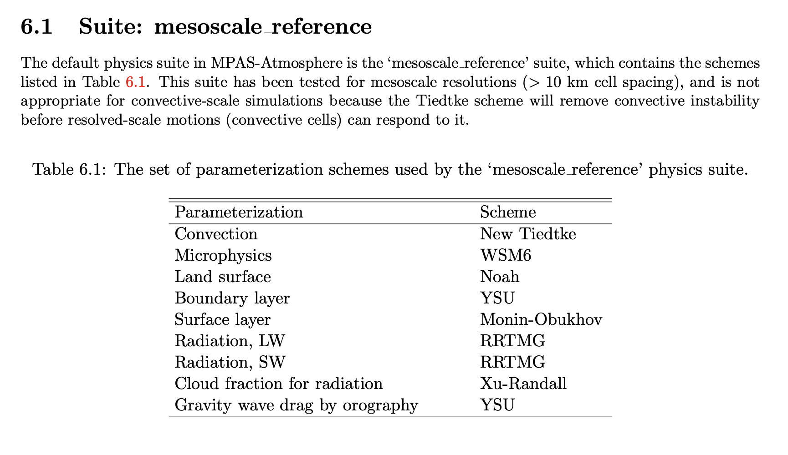
You can override one or more of these physics selections after invoking the suite
There is also config_physics_suite = ‘none’

Slide 36
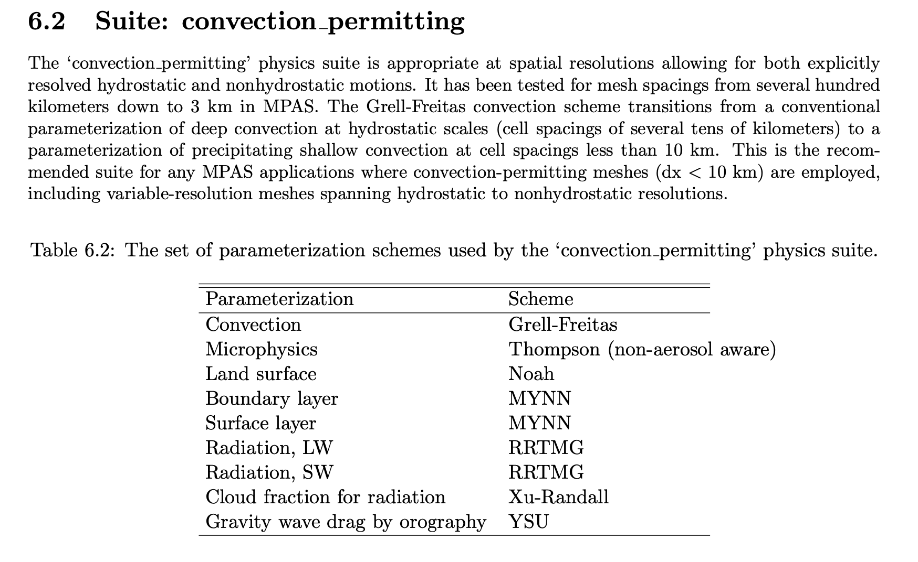
You can override one or more of these physics selections after invoking the suite
There is also config_physics_suite = ‘none’

Slide 37
Successful completion of this step:
$ sbatch –p burst-daes submit_mpas
$ tail -f log.atmosphere.0000.out
-----------------------------------------
Total log messages printed:
Output messages = 2899
Warning messages = 3
Error messages = 0
Critical error messages = 0
-----------------------------------------
Logging complete. Closing file at 2024/10/23 22:55:44
Files created:
history.1993-03-12_12.00.00.nc
history.1993-03-12_18.00.00.nc
history.1993-03-13_00.00.00.nc
history.1993-03-13_06.00.00.nc
history.1993-03-13_12.00.00.nc
history.1993-03-13_18.00.00.nc
history.1993-03-14_00.00.00.nc
history.1993-03-14_06.00.00.nc
history.1993-03-14_12.00.00.nc
history.1993-03-14_18.00.00.nc
history.1993-03-15_00.00.00.nc
+ diag.1993-03… files every 3 hours
+ restart.1993-03-13_12.00.00.nc
+ restart.1993-03-14_12.00.00.nc
Notes:
10 min on batch

Slide 38
Step #3: Postprocessing with convert_mpas
Edit target_domain
Execute convert_mpas from command line
I have my build of convert_mpas in your PATH

Slide 39
convert_mpas
Optionally provide a file called target_domain to specify lat/lon area of interest. Otherwise, global output is provided
Creates file latlon.nc. Remove existing latlon.nc file, if present, prior to running
No time information is written to the output. Also, sea-level pressure is not available
No terrain information is written to the output. Instead, the height of the lowest W level is used, which has been smoothed a bit
Home page
startlat=23
endlat=45
startlon=-90
endlon=-68
nlat=300
nlon=300
This will divide the area of interest
into nlat and nlon pieces

Slide 40
Plotting from the latlon.nc file
$ convert_mpas history.1993-03-15_00.00.00.nc
→ creates file called ‘latlon.nc’
→ Launch ARCC jupyterlab, execute notebook plot_mpas_latlon.ipynb
→ You can also view latlon.nc file using ncview

Slide 41
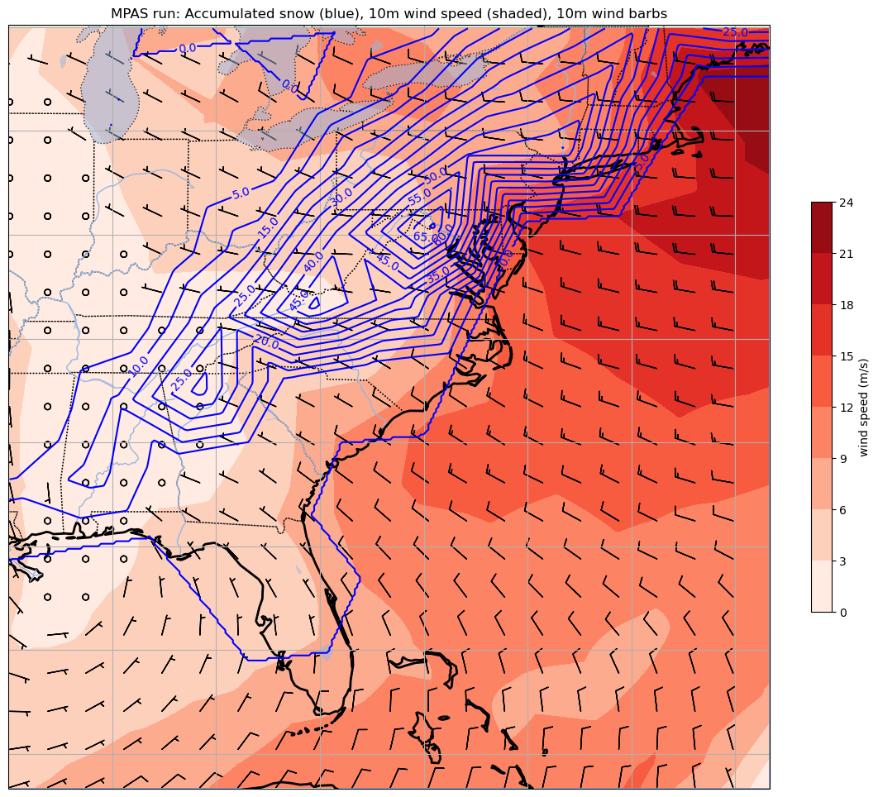
convert_mpas history.1993-03-15_00.00.00.nc

Slide 42
More on convert_mpas
The convert_mpas program can also operate on the diagnostic file outputs (diag.*) but these files do not contain mesh information, so that also has to be supplied
  convert_mpas x1.10242.init.nc diag.1993-03-15_00.00.00.nc
  This command gets mesh information from the init file and processes all of the available diag.* files
You can process more than one time at once…
  convert_mpas x1.10242.init.nc diag*.nc
…but to convert multiple history files, you also have to explicitly specify the mesh file or the first history time will be skipped¹
  convert_mpas x1.10242.init.nc history*.nc
¹Notebook plot_mpas_latlon.ipynb needs rewriting to accommodate more than one time

Slide 43
Using uxarray
The notebook plot_mpas_uxarray.ipynb provides an example of plotting directly from the MPAS files
Two files are opened: a mesh file and an MPAS output file
  In the example, the mesh file is x1.10242.grid.nc and the output file is a diag file
  Notebook works with the daes_jan24 environment

Slide 44
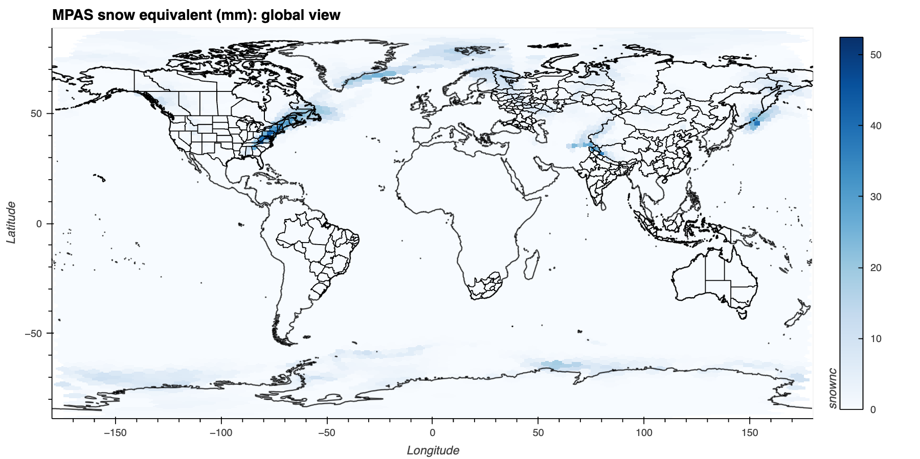

Slide 45
(aspect ratio controlled by specifying plot width and height)

Slide 46
[end]
{Coureurs des MPAS}
Appendices follow
Notes:
“courier du bois” = runner of the woods

Slide 47
Appendix #1: Making the static file

Slide 48
Step #-1: Creating static fields
(i.e., geogrid)
You do not need to do this step for the class demo
Edit namelist.init_atmosphere
Edit streams.init_atmosphere
submit submit_static to Burst
Check tail of log.init_atmosphere.0000.out

Slide 49
Creating static files
You do not need to do this step for the class demo
Reasons for creating your own static file
  You wish to modify the topography in some fashion
  You want to use one of the variable resolution meshes
From MPAS mesh page, obtain a mesh file (e.g., x1.10242.tar.gz)
If you want to create your own static file you use init_atmosphere_model with modified namelist.init_atmosphere and streams.init_atmosphere files, submit via submit_static, and be patient
  Creation of the static file runs on 1 cpu only
  Even for coarse meshes like 240 km it takes 30-45 minutes!

Slide 50
&nhyd_model
config_init_case = 7
config_start_time = '1993-03-12_12:00:00'
config_stop_time = '1993-03-15_00:00:00'
config_theta_adv_order = 3
config_coef_3rd_order = 0.25
/
&dimensions
config_nvertlevels = 55
config_nsoillevels = 4
config_nfglevels = 38
config_nfgsoillevels = 4
/
&data_sources
config_geog_data_path = '/network/rit/lab/atm419lab/GEOG42/WPS_GEOG/'
config_met_prefix = 'NNRP'
config_sfc_prefix = 'SST'
config_fg_interval = 86400
config_landuse_data = 'MODIFIED_IGBP_MODIS_NOAH'
config_topo_data = 'GMTED2010'
config_vegfrac_data = 'MODIS'
config_albedo_data = 'MODIS'
config_maxsnowalbedo_data = 'MODIS'
config_supersample_factor = 3
config_use_spechumd = false
/
&vertical_grid
config_ztop = 30000.0
config_nsmterrain = 1
config_smooth_surfaces = true
config_dzmin = 0.3
config_nsm = 30
config_tc_vertical_grid = true
config_blend_bdy_terrain = false
/
&interpolation_control
config_extrap_airtemp = 'linear'
/
&preproc_stages
config_static_interp = true
config_native_gwd_static = true
config_vertical_grid = false
config_met_interp = false
config_input_sst = false
config_frac_seaice = false
/
Edit namelist.init_atmosphere
Modify the lines in red
Many of these lines will need to be
modified again for Step 1
You do not need to do this step for the class demo

Slide 51
<streams>
<immutable_stream name="input"
type="input"
filename_template="x1.10242.grid.nc"
input_interval="initial_only" />
<immutable_stream name="output"
type="output"
filename_template="x1.10242.static.nc"
packages="initial_conds"
output_interval="initial_only" />
<immutable_stream name="surface"
type="output"
filename_template="x1.10242.sfc_update.nc"
filename_interval="none"
packages="sfc_update"
output_interval="86400" />
<immutable_stream name="lbc"
type="output"
filename_template="lbc.$Y-$M-$D_$h.$m.$s.nc"
filename_interval="output_interval"
packages="lbcs"
output_interval="3:00:00" />
</streams>
You do not need to do this step for the class demo
Edit streams.init_atmosphere
Lines in red will need to be modified
again for Step 1
You are providing as input:
x1.10242.grid.nc
[you obtained this from the mesh]
You are creating as output:
x1.10242.static.nc

Slide 52
Continuing Step #-1
You do not need to do this step for the class demo
Untar the mesh tar file
  tar –xvf x1.10242.tar
  Yields x1.10242.grid.nc and x1.10242.graph* files
sbatch –p burst-daes submit_static
  This must run on ONE CPU to work properly
  This takes A VERY LONG TIME (45+ minutes)
  Like geogrid, this step does not need to be repeated unless you change something (resolution, mesh configuration)
tail -f log.init_atmosphere.0000.out
  To follow the progress of building the static file
Creates x1.10242.static.nc

Slide 53
Appendix #2: Using variable resolution meshes
OPTIONAL
[The specific example requires a lot of time to prepare and run]

Slide 54
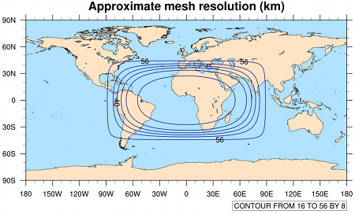
The 60-3 km mesh
OPTIONAL
The refinement region (with 3 km cell spacing) is easily remapped to any
desired location using grid_rotate tool

Slide 55
(1) Set up working directory
OPTIONAL
Create new working directory for this experiment
Copy over contents of $LAB/MPASV8/
Execute make_mpas_links.sh

Slide 56
(2) Obtain the desired mesh
OPTIONAL
Meshes at http://mpas-dev.github.io/atmosphere/atmosphere_meshes.html
Get the 60-3 km mesh
  File is x20.835586.tar.gz
  Unpack in your working directory (tar –zxvf x20.835586.tar.gz)

Slide 57
(3) Rotate the fine resolution region to desired area
Get grid_rotate materials
  cp $LAB/SOFTWARE/MPASV7/MPAS-Tools/mesh_tools/grid_rotate/namelist.input .
  ln -sf $LAB/SOFTWARE/MPASV7/MPAS-Tools/mesh_tools/grid_rotate/grid_rotate .
Edit namelist.input, changing these lines
config_new_latitude_degrees = 0
config_new_longitude_degrees = 0
to
config_new_latitude_degrees = 38
config_new_longitude_degrees = -82
Execute grid_rotate program [runs very quickly]
./grid_rotate x20.835586.grid.nc x20.835586.grid_ROTATED.nc
OPTIONAL
Output is x20.835586.grid_ROTATED.nc
Notes:
Using the MPASV7 version of grid_rotate - OK

Slide 58
(4) Build static file (step #-1)
OPTIONAL
Edit namelist.init_atmosphere
&preproc_stages
config_static_interp = true
config_native_gwd_static = true
config_vertical_grid = false
config_met_interp = false
config_input_sst = false
config_frac_seaice = false
&decomposition
config_block_decomp_file_prefix = 'x20.835586.graph.info.part.’
Edit streams.init_atmosphere
  <immutable_stream name="input"
  type="input"
  filename_template="x20.835586.grid_ROTATED.nc"
  input_interval="initial_only" />
  <immutable_stream name="output"
  type="output"
  filename_template="x20.835586.static.nc"
  packages="initial_conds"
  output_interval="initial_only" />

Slide 59
(4) continued…
OPTIONAL
sbatch -p burst-daes submit_static
tail -f log.init_atmosphere.0000.out
Takes a very long time (about 78 min)
Output is x20.835586.static.nc

Slide 60
(5) Initialize model
OPTIONAL
Presuming Step #0 (Ungrib) has been done. We’re using the NNRP outputs again in this example
Edit submit_init
  #SBATCH -n 36
    - Change in number needed to match one of the available x20.835586.graph.info.part.* files

Slide 61
(5) continued…
OPTIONAL
Edit namelist.init_atmosphere
&preproc_stages
config_static_interp = false
config_native_gwd_static = false
config_vertical_grid = true
config_met_interp = true
config_input_sst = false
config_frac_seaice = true
Edit streams.init_atmosphere
  <immutable_stream name="input"
  type="input"
  filename_template=" x20.835586.static.nc "
  input_interval="initial_only" />
  <immutable_stream name="output"
  type="output"
  filename_template="x20.835586.init.nc"
  packages="initial_conds"
  output_interval="initial_only" />

Slide 62
(5) continued…
OPTIONAL
sbatch -p burst-daes submit_init
Check tail of log.init_atmosphere.0000.out
Output is x20.835586.init.nc

Slide 63
(6) Prepare to run MPAS
OPTIONAL
Edit namelist.atmosphere
  Changes needed for finer resolution nest
  • config_dt = 20.0 [shorter time step needed]
  • config_radtlw_interval = '00:10:00’ [shorter radt]
  • config_radtsw_interval = '00:10:00’ [“]
  • config_physics_suite = 'convection permitting’
  [more appropriate for 3 km cell spacing]
  • config_block_decomp_file_prefix = 'x20.835586.graph.info.part.’
Notes:
config_dt - the model integration timestep; roughly six times the minimum grid distance in km is a reasonable first guess

Slide 64
(6) continued…
OPTIONAL
Edit streams.atmosphere
  <immutable_stream name="input"
  type="input"
  filename_template="x20.835586.init.nc"
Edit submit_mpas {144 matches one of the graph.info files. There are only 128 cpus/node}
  #SBATCH -n 144
  #SBATCH -N 2
sbatch -p burst-daes submit_mpas
tail –f log.atmosphere.0000.out
Outputs are diag*, history*, and restart*

Slide 65
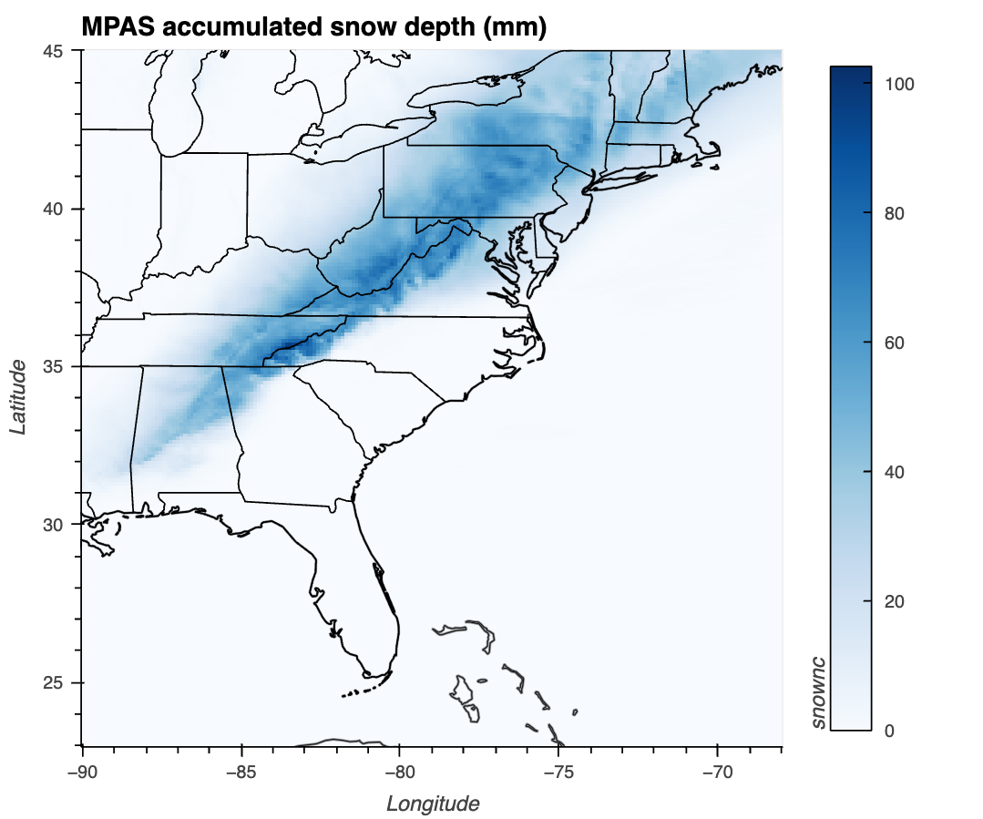
OPTIONAL
# make the regional plot
bbox_subset_nodes.plot.rasterize(method='point', pixel_ratio=0.5,
exclude_antimeridian=True,
title = "MPAS accumulated snow depth (mm)",
**plot_opts) * features

Slide 66
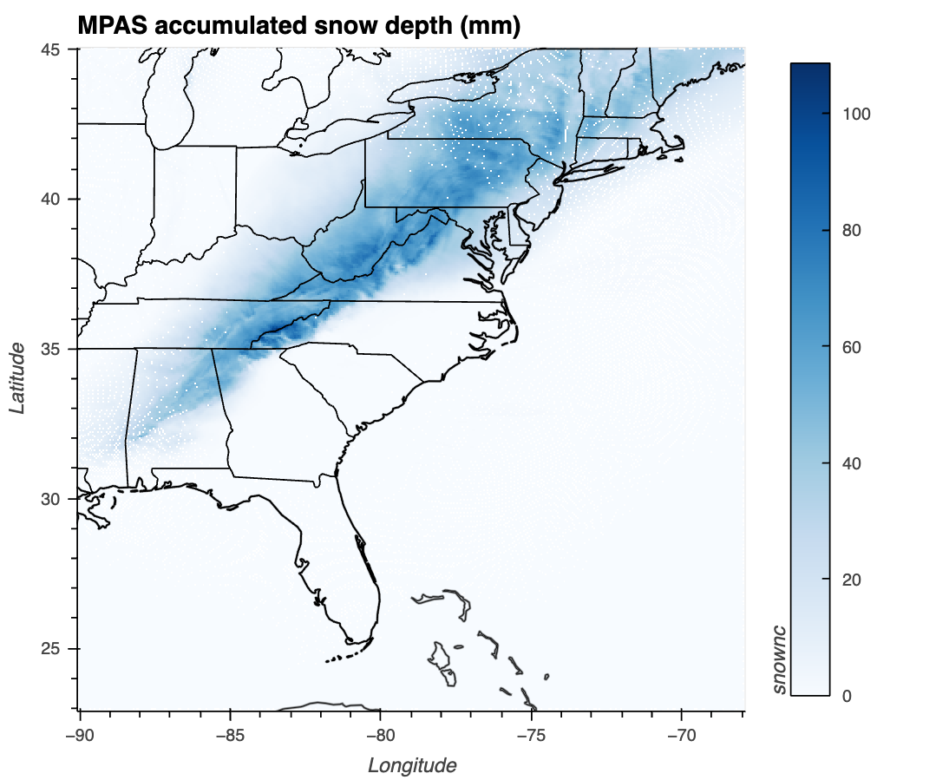
OPTIONAL
# make the regional plot
bbox_subset_nodes.plot.rasterize(method='polygon',
exclude_antimeridian=True,
title = "MPAS accumulated snow depth (mm)",
**plot_opts) * features
Notes:
Polygon works less well for hi-res field --<> results in fake missing data

Slide 67
Appendix #3: MPASSIT
OPTIONAL
[MPASSIT does not work particularly well for large meshes on our cluster]

Slide 68
MPASSIT
MPASSIT is a Fortran-based code to convert individual MPAS history or diag files into WRF-compatible outputs, so tools like wrf-python can be applied
It requires a namelist (I’m calling it namelist.mpassit) and files called histlist_2d, histlist_3d, and diaglist, listing fields to be extracted and written to the output file (which I am calling mpassit_out.nc)

Slide 69
Running MPASSIT
Copy these files from $LAB/MPASV8/:
  namelist.mpassit
  histlist_2d, histlist_3d, diaglist
  submit_mpassit
  Plot_MPASSIT_TSTORM.ipynb
Edit namelist.mpassit to include full-path information regarding the history and/or diag file you wish to operate on
Example notebook reading MPASSIT output file via wrf-python
grid_file_input_grid="/network/rit/lab/atm419lab/TESTING/TTTTM2/x4.655362.init.nc"
hist_file_input_grid="/network/rit/lab/atm419lab/TESTING/TTTTM2/history.2022-04-01_00.00.00.nc"
diag_file_input_grid="/network/rit/lab/atm419lab/TESTING/TTTTM2/diag.2022-04-01_00.00.00.nc"
output_file="/network/rit/lab/atm419lab/TESTING/TTTTM2/mpassit_out.nc"

Slide 70
More on namelist.mpassit
grid_file_input_grid="/network/rit/lab/atm419lab/TESTING/TTTTM2/x4.655362.init.nc”
→ your MPAS init file from init_atmosphere
hist_file_input_grid="/network/rit/lab/atm419lab/TESTING/TTTTM2/history.2022-04-01_00.00.00.nc”
→ an MPAS history file
diag_file_input_grid="/network/rit/lab/atm419lab/TESTING/TTTTM2/diag.2022-04-01_00.00.00.nc”
→ an MPAS diag file
output_file="/network/rit/lab/atm419lab/TESTING/TTTTM2/mpassit_out.nc”
→ your output file name. REMOVE/RENAME ANY EXISTING FILE BEFORE RERUNNING.
target_grid_type = 'lambert'
interp_diag=.false.
interp_hist=.true.
wrf_mod_vars=.true.
esmf_log=.false.
nx = 115
ny = 100
dx = 12000
dy = 12000
ref_lat = 42.6
ref_lon = -76
truelat1 = 42.6
truelat2 = 42.6
stand_lon = -76
is_regional=.true.
I’m operating on the history file but not on the diag file
This specifies our output grid information. I’m matching a WRF run

Slide 71
Running MPASSIT
MPASSIT uses one of your grid’s graph.info files for domain decomposition
You need to have a graph.info file available for the number of CPUs you are requesting in submit_mpassit
On our cluster, MPASSIT is very finicky. If you ask for “too many” CPUs, the code crashes with a floating point division by zero error. If you request “too few” it takes a very, very long time to run
  I’ve gotten it to run with a maximum of 16 CPUs, so you need a *graph.info.part.16 file. If you don’t, you can create one with gpmetis [see Appendix #4]
  It will still take minutes to an hour for more complex, finer resolution meshes

Slide 72
Appendix #4: gpmetis
OPTIONAL
[Making additional graph.info.part files]

Slide 73
gpmetis
Let’s say your MPAS grid mesh is x20.835586.* and you have a x20.835586.graph.info file.
You need a 16-partition file (x20.835586.graph.info.part.16) but you don’t have it
Procedure [all one line]:
$LAB/SOFTWARE/METIS/build/programs/gpmetis -minconn -contig -niter=200 x20.835586.graph.info 16
Result:
  x4.655362.graph.info.part.16

Slide 74
[end]

