Slide 1
WRF modeling:
Fundamentals, error sources, and troubleshooting
ATM 419/563
Fall 2024
Fovell
© Copyright 2024 Robert Fovell, Univ. at Albany, SUNY, rfovell@albany.edu

Slide 2
Insights on final project experiments
Grid spacing
  Trade off of detail vs. performance. Use largest grid spacing you can get away with. Nesting adds complexity but may improve performance.
  Strive to avoid grid spacings in parent domain or nests that fall between 5-10 km, especially for cases with convective precipitation. If you must use those grid spacings, use scale-aware cumulus schemes. Also avoid spacings between 100-600 m.
Time step
  Time step is explicitly set for outermost domain and implicitly for nests
    Default ratio for nests is 3:1, i.e., nest has 1/3 grid spacing of parent nest and 1/3 of parent’s time step. You can override.
  WRF recommends using a time step in seconds ~ 6 times the horizontal grid spacing in kilometers (e.g., 10 km grid spacing → 60 sec time step recommended)
    I strongly recommend using about 3x the grid spacing instead of 6x
    I strongly recommend making the time step divisible into or by 3600 (for hourly output)
Model physics most likely to provide improvement and/or variability in most cases:
  PBL scheme
  Microphysics
  Land surface model
  Cumulus parameterization (for ∆x > 10 km or so)
Most commonly used physics options [use same option for all domains EXCEPT possibly cumulus]:
  Radiation: ra_lw_physics = 4, ra_sw_physics = 4 (RRTMG). Set radt in minutes ~ grid spacing in km (e.g., radt = 12 or 12 km ∆x), and use same value for all nests. [Radiation is expensive.]
  Land surface model: sf_surface_physics = 2 with num_soil_layers = 4 (Noah LSM)
  Microphysics: mp_physics = 8 (Thompson)
  PBL and surface layer scheme: bl_pbl_physics = 5, sf_sfclay_physics = 5 (MYNN2). Leave bldt=0.
  Cumulus parameterization: cu_physics = 1 (Kain-Fritsch). Leave cudt = 0.
&dynamics section suggestions:
  w_damping = 1, damp_opt = 3 with dampcoef=0.2
  diff_opt = 2 and km_opt = 4 for every domain

Slide 3
Equations
(minimal set for moist air)
Navier-Stokes equations
  Newton’s 2nd law: real & apparent forces
  Turbulence and mixing terms
1st law of thermodynamics
Conservation equations for water substance
Ideal gas law
Continuity equation
Clausius-Clapeyron equation

Slide 4
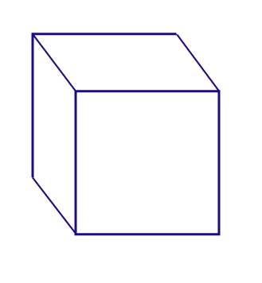
Domain
Local, regional or global in scale

Slide 5
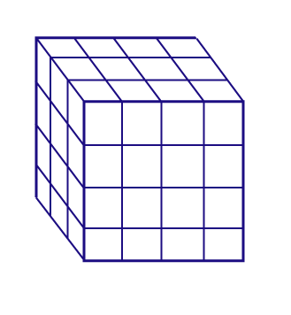
Domain
Local, regional or global in scale
Discretize into grid volumes
  virtual internal walls
  boundary conditions
Initialize each volume*
Make some forecasts…
* Note the model is primarily initialized with some other model’s rendition of reality
Notes:
Initial data from surface stations, upper air sondes, satellites, radar, ships, aircraft, and GUESSES
The model is primarily initalized with some other model’s rendition of reality

Slide 6
Extrapolation
Equations predict tendencies
  Initial forecasts may start with “observations” but subsequent forecasts based on prior forecasts
  Forecasts are used to recalculate tendencies
  Success depends on quality of initialization and accuracy of tendencies
Notes:
Forecast quality depends on quality of ICs and accuracy of tendencies
Forecasts degrade with time. Errors accumulate.

Slide 7
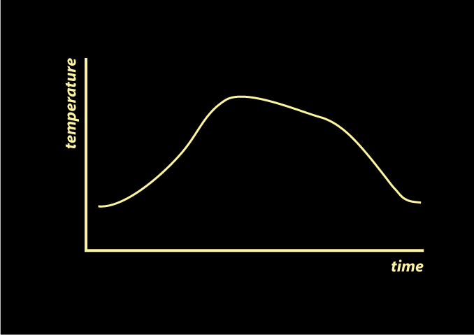
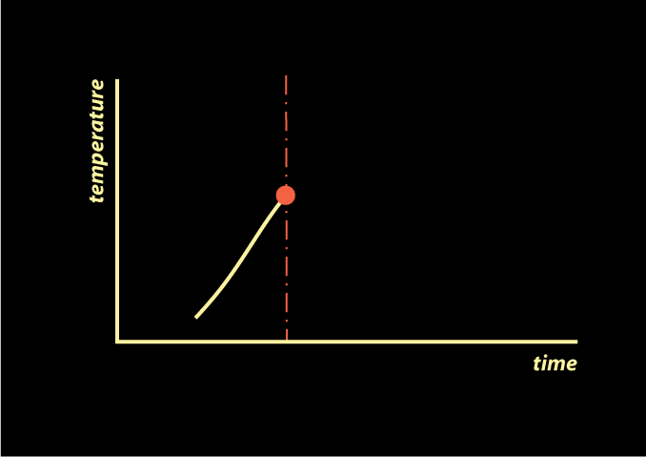
A simplistic example: temperature in your backyard

Slide 8
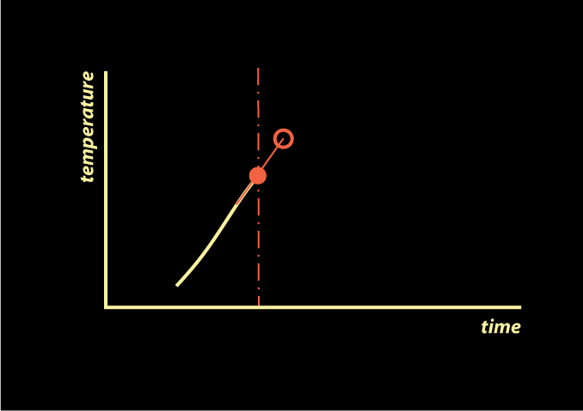
The model forecast will consider an enormous number of factors in estimating present tendency to project future value

Slide 9
In the absence of such information, you simply guess… and wait to see how good your guess was.

Slide 10
The model does not wait. It uses each forecast to recalculate the tendencies to make the next forecast
Notes:
After the initial time, new forecasts are built on previous forecasts. Think about that.

Slide 11
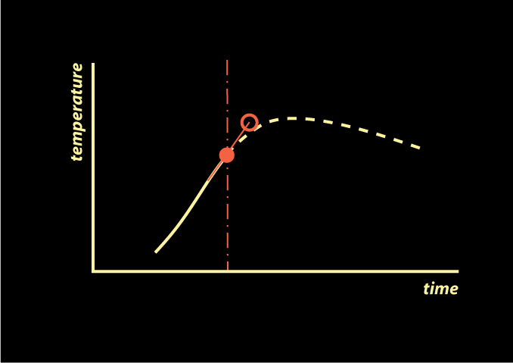
Verification of your forecast:
OK since you didn’t project out too far

Slide 12
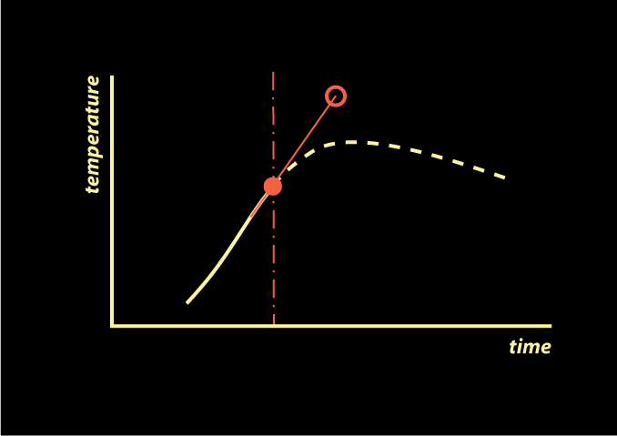
Forecast time steps cannot be too long.
Tendencies have the tendency to CHANGE.

Slide 13
Model forecasts will reflect…
Radiative processes
Surface and sub-surface processes
Boundary layer development and mixing
Cloud development and microphysics
Advection
Convergence and divergence
Ascent and subsidence
Sea-breezes, cold and warm fronts
Cyclones, anticyclones, troughs, ridges

Slide 14
Model resolution: from microscale to synoptic scale

Slide 15
Model resolution
Things to try to resolve
  Clouds, mountains, lakes & rivers, hurricane eyes and rainbands, fronts & drylines, tornadoes, much more
What isn’t resolved is subgrid
At least 2 grid boxes across a feature for model to even “see” it… and at least 6-8 to render it adequately → grid spacing vs. resolution

Slide 16
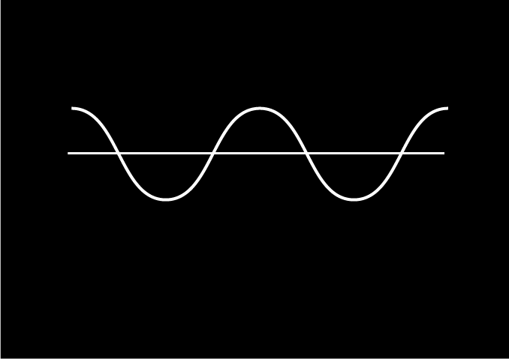
Wave-like features are ubiquitous, in space and time

Slide 17
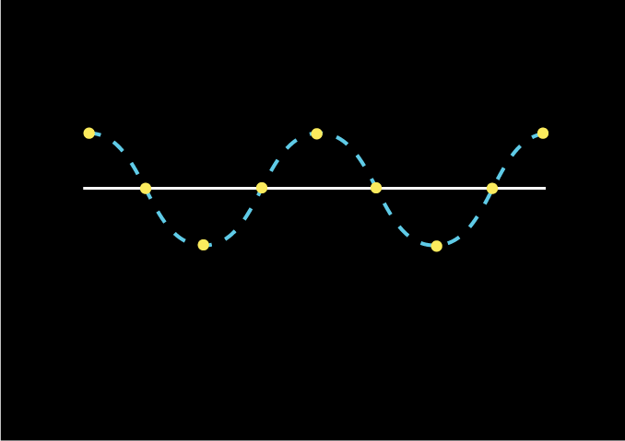
Models sample a wave only at grid points.
Example: 4 points across each wave.

Slide 18
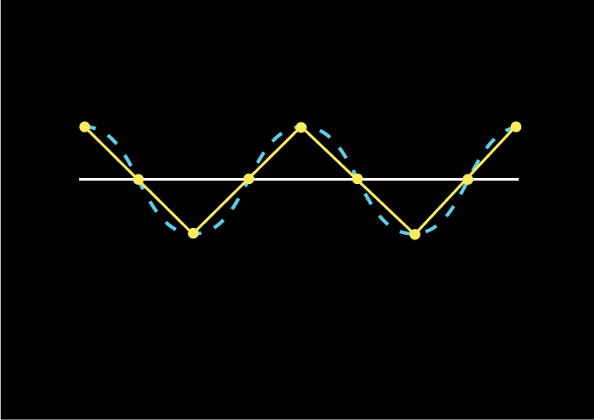
Models “connect the dots”.

Slide 19
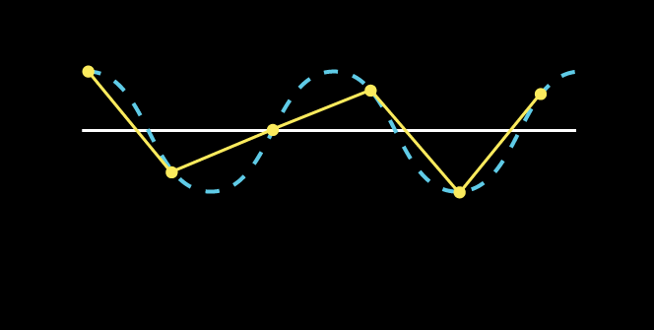
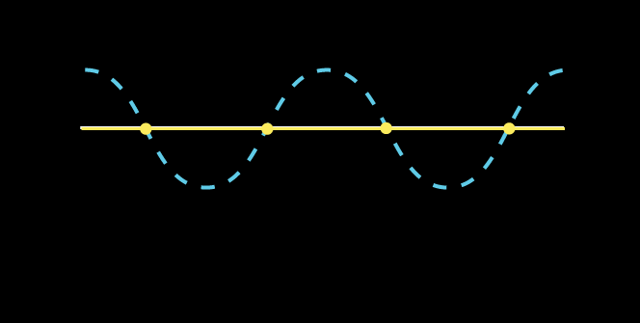
These do not look much like the actual wave at all.
2∆x is the smallest resolvable scale.
(With only 2 points, however, wave may still be invisible as in this example.)
3 points
across wave
2 points
across wave
Notes:
Could have arranged the 2∆x wave so it’s a sawtooth instead.
3∆x looks like Cassiopeia

Slide 20
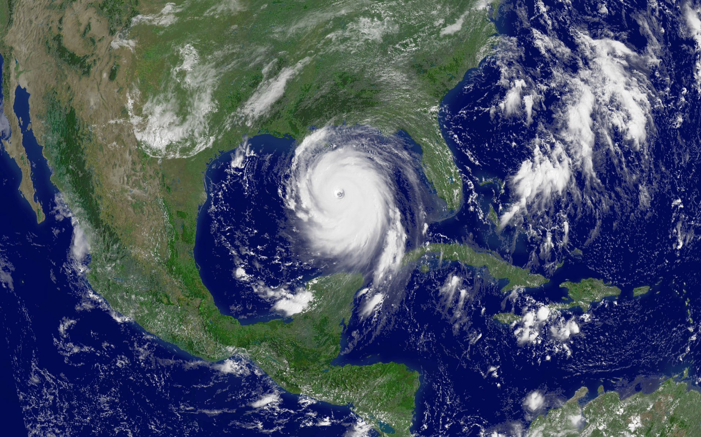
Hurricane Katrina satellite picture composed of 1 km pixels.
High resolution model = possibly accurate, definitely expensive, and extremely time-consuming
Notes:
Calculations take TIME and as resol improves TIME STEP gets smaller

Slide 21
As model resolution increases, we see more, but have to DO more.
Plus, the time step has to decrease, to maintain linear stability
Notes:
Calculations take TIME and as resol improves TIME STEP gets smaller

Slide 22
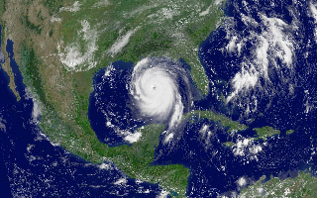
Compromising on the grid spacing – now it’s 10 km
Notes:
Largest degradation in small scale features, row clouds over land and sea breeze frontal clouds in FL

Slide 23

30 km grid spacing

Slide 24

At what point would we not be able to tell that’s a hurricane if we had not known it from the start?

Slide 25
This is the world as seen by global weather models not so long ago, and still many climate models today.

Slide 26
“My favorite story is about the model that perfectly predicts tomorrow’s weather, but it takes two days to run the program.”
- John C. Dvorak
Notes:
Calculations take TIME and as resol improves TIME STEP gets smaller

Slide 27
Resolution can affect forecasts
Downslope windstorm example
(Cao and Fovell 2016)
Notes:
Got to here 2021

Slide 28
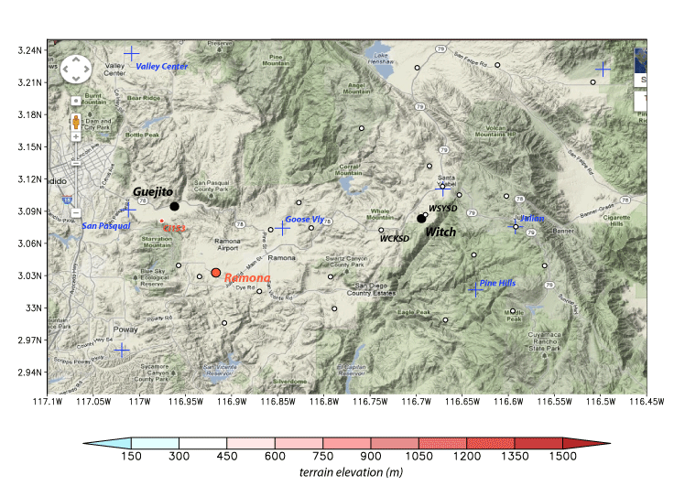
Eastern San Diego county terrain (Google Maps)
SIL
About 65 km
Distortions from map projection differences
Notes:
Witch = where Oct 2007 Witch Creek fire started, one of largest fires in CA history. Guejito fire started later, merged with Witch and other fires.
25+ fires in So Cal in late Oct 2007, during brutally strong Santa Ana wind event

Slide 29
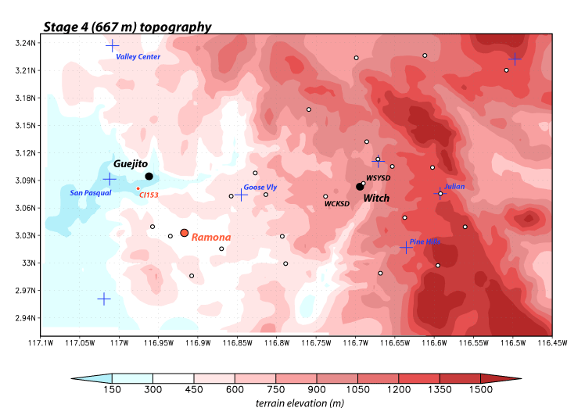
Eastern San Diego county terrain (WRF model)
667 m
SIL

Slide 30
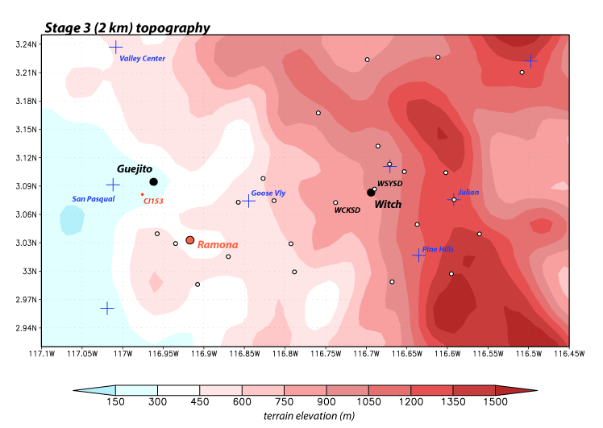
Eastern San Diego county terrain (WRF model)
2 km
SIL

Slide 31
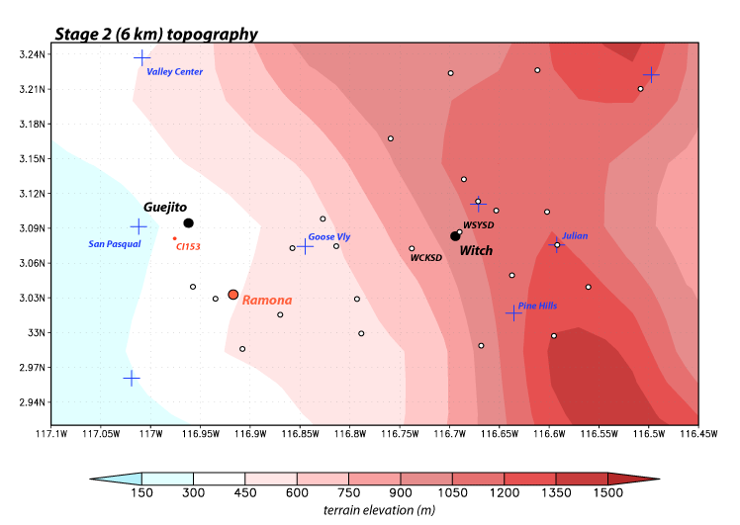
Eastern San Diego county terrain (WRF model)
6 km
SIL

Slide 32
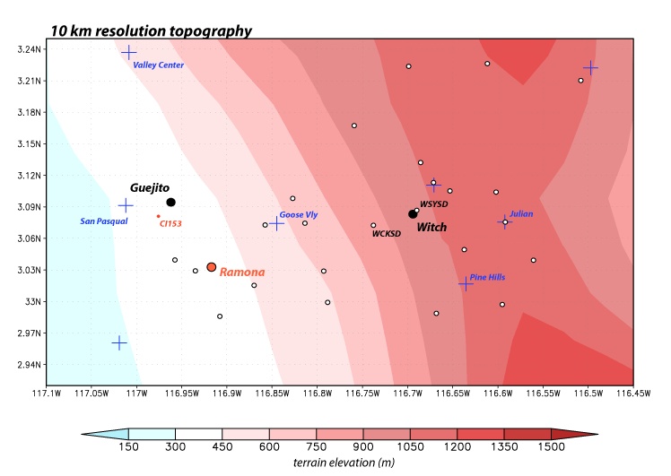
Eastern San Diego county terrain (WRF model)
10 km
SIL
Notes:
When does this become little more than a cartoon version of reality?

Slide 33
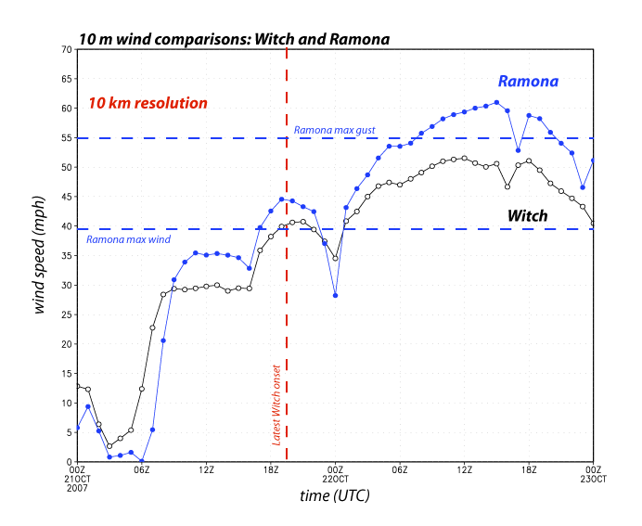
Oct 2007 event
Model reconstructed
sustained winds (not gusts)

Slide 34
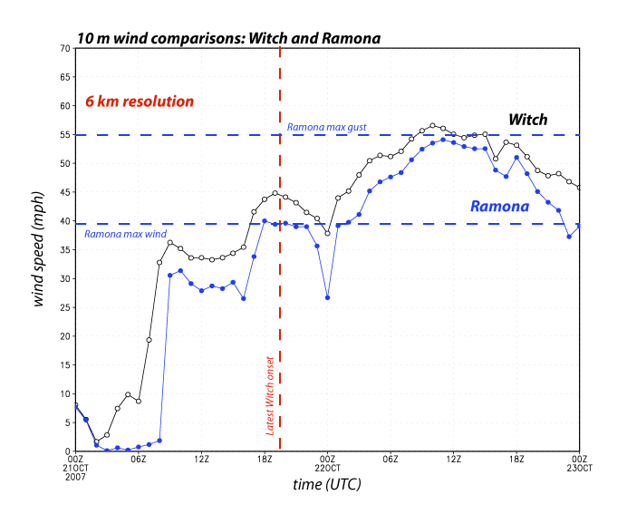
SR Fig. 6
Oct 2007 event

Slide 35
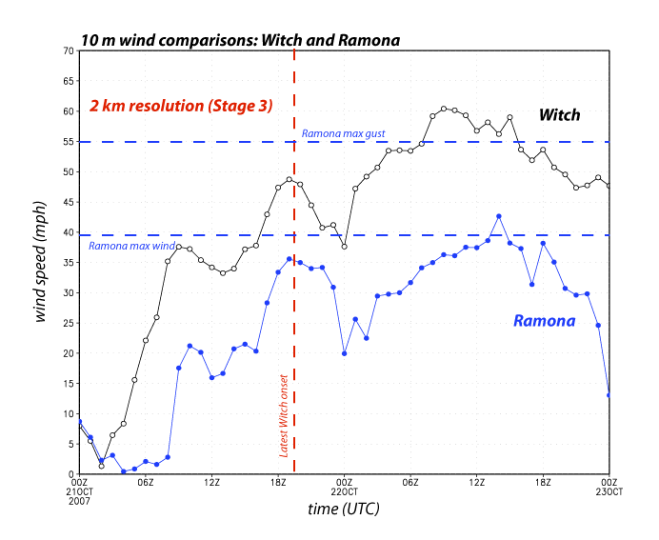
Oct 2007 event

Slide 36
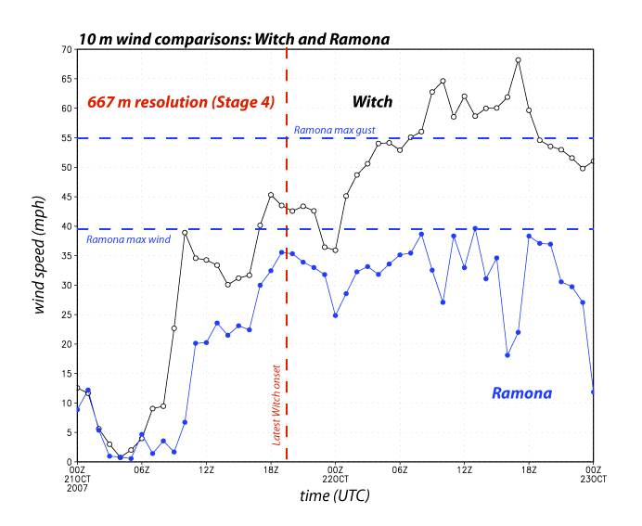
Oct 2007 event

Slide 37
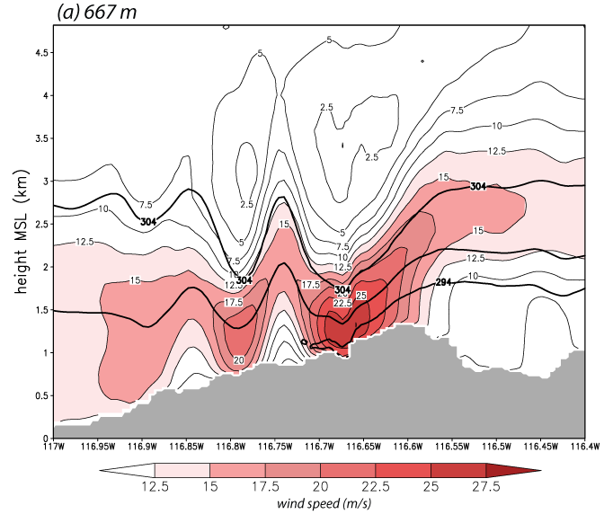
4-h average winds
56 km
Ramona
Witch
Feb 2013 event
Notes:
Vertical cross-section west-east across Witch

Slide 38
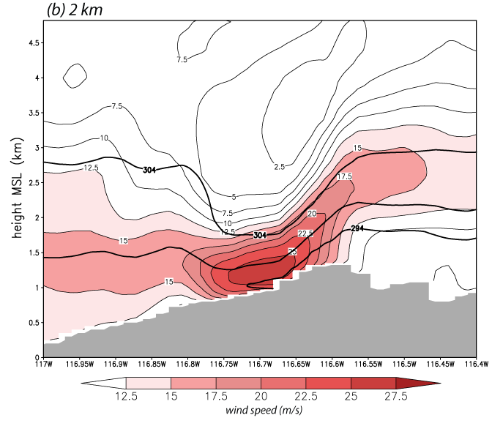
4-h average winds
Ramona
Witch
Feb 2013 event

Slide 39
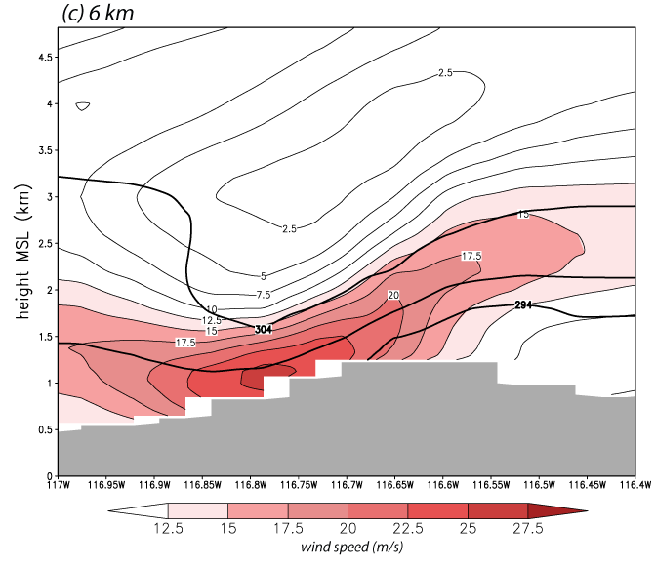
4-h average winds
Ramona
Witch
Feb 2013 event

Slide 40
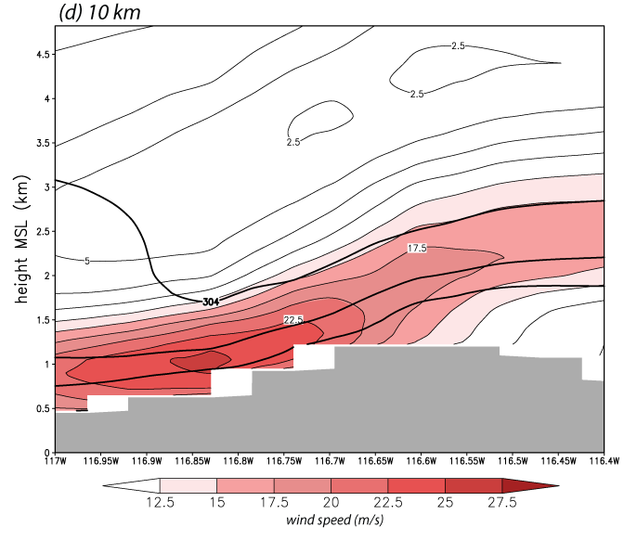
4-h average winds
X
Ramona
Witch
Feb 2013 event

Slide 41
4-h average winds
X
Ramona
Witch
Feb 2013 event

Slide 42
A “model” model equation

Slide 43
The 1D wave equation
• Simple 1D linear wave equation
(wave advected at speed c, to right if c > 0,
without change of shape)
• Discretize both time (n) and space (i), producing this
(quite poor) elementary numerical scheme
“Upstream scheme”
(Assumes c > 0)
• Write in explicit form (solve for the single unknown value):
- we know u at time n for all spatial locations i. Use that information
to get u at location i for time n+1
• Implicit equations: can’t solve one point at at time (more later)

Slide 44
Upstream scheme time integration
• Upstream scheme time integration:
Current time is time n
Compute advection at time n
Use this to push u forward by ∆t
Compute advection at new time n+1
Use this to push u ahead to time n+2
REPEAT

Slide 45
A Runge-Kutta 3rd order (RK3) time integration
• WRF uses an RK3 time integration
scheme (predictor-corrector type)
Current time is time n
Compute advection at time n
Use this to push u forward 1/3 step
Recompute advection, push u ahead
  farther from time n
Finally recompute advection at half-
  way point, push u ahead full ∆t
• MPAS uses a simpler RK2 scheme
• There is no single RK2 or RK3 scheme
Notes:
More work, but much better scheme

Slide 46
Numerical sources of error

Slide 47
Numerical error sources
Objects can be thought of as composed of waves, constructively and destructively interfering
A model attempts to propagate waves, which possess amplitudes, wavelengths, and phase speeds
Prediction of these waves subject to numerical errors:
  Amplitude error
  Phase error
  Dispersion error
    When advection error is a function of wavelength itself
Numerical schemes work better for longer wavelengths
  Also, when things “go wrong”, the shortest wavelengths are usually involved or even to blame
We need to think in terms of waves and combinations of waves
“advection error”

Slide 48
“Fourier thinking”

Slide 49
Fourier decomposition
A series of numbers, no matter how aperiodic in appearance, can be decomposed into a finite sum of sines and cosines of varying amplitudes and wavelengths
For N points, there will be N/2 wave pairs (a cosine & a sine) for a total of N waves
  The first pair has wavelength = length of series (N)
  Second pair has wavelength N/2 (so 2 waves in series)
  Third pair has wavelength N/3, and so on…
  Each sine and cosine has its own wave amplitude
Notes:
So N/2 sines and N/2 cosines

Slide 50
“When Fourier presented his first paper to the Paris Academy in 1807, stating that an arbitrary function could be expressed [as a finite sum of sines and cosines], the mathematician Lagrange was so surprised that he denied the possibility in the most definite terms.”
    Boyce and DiPrima, “Elementary Differential Equations”

Slide 51
1D series in space (or time)
• This results from a sum of 10 waves: 5 sines and 5 cosines of 5 different
wavelengths, and 10 different amplitudes (of a total possible 100 waves)
Notes:
fourier_example_NEW.xlsx

Slide 52
First wave pair
• Red curve shows combination of the sine and cosine with wavelength = domain width
(i.e., one sine and one cosine in domain)

Slide 53
Remove 1st wave pair

Slide 54
Identify 2nd wave pair
• Red curve now shows combination of sine and cosine wavelength = 1/2 domain width
(i.e., 2 sines and 2 cosines across domain)

Slide 55
Remove 2nd wave pair

Slide 56
Identify 3rd wave pair
• Red curve now shows combination of sine and cosine wavelength = 1/3 domain width
(i.e., 3 sines and 3 cosines across domain)

Slide 57
Remove 3rd wave pair

Slide 58
Identify 4th wave pair
• This wave pair represents 6 sines and cosines across domain

Slide 59
Remove 4th, identify final pair
• This wave pair represents 25 sines and cosines across domain (4∆x)
• I just used 10 waves. In reality, up to N (=100) waves could have been employed

Slide 60
…and they all sum to this
• All 10 waves combine to produce original series
• In the simplest case, all waves should be treated the same (same phase speed)
• In reality, advection error becomes worse as wavelengths become smaller

Slide 61
The original feature and its (paired) parts
Simple wave equation: feature is advected at speed c without change of amplitude or shape
Advection error: A wave’s amplitude not preserved and/or its speed is too fast or slow.
Dispersion error: Advection error varies with wavelength.
If error is dispersive, feature will unravel.

Slide 62
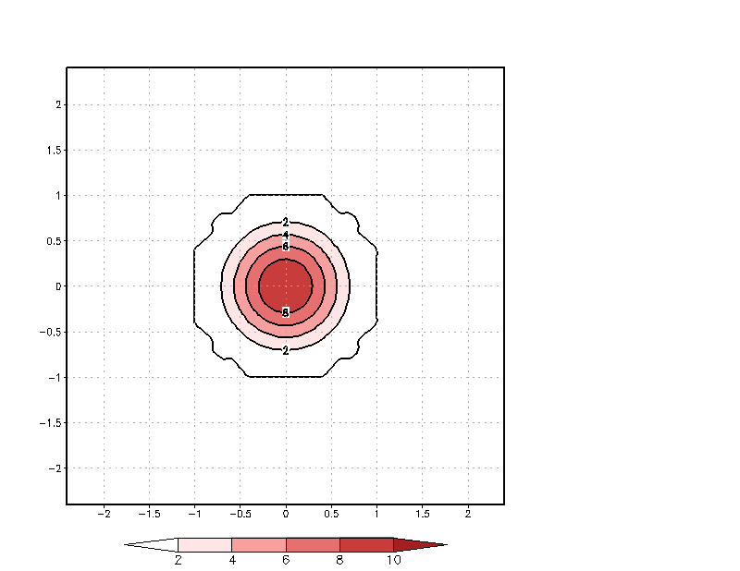
Advection of a cone
at constant speed
in doubly periodic domain
Shaded: true solution
Contoured: numerical solution
• amplitude error: cone height
not perfectly preserved
• phase error: cone lags slightly
behind true solution
• dispersion error: phase error is
worse for smaller wavelengths
(2∆x, 2∆y waves actually
move in wrong direction)
Notes:
Smallest scale waves are moving in the wrong direction!

Slide 63
Generally, we should
not take zero contours
too seriously – they
can be noisy and their
positions in a relatively
“flat” field are not
precise.
BUT, you may detect
emerging problems
first as small-scale
noise in contours like
the zero contour.

Slide 64
Linear and nonlinear instability
[How and why models “blow up”… and how to fix it]

Slide 65
Linear instability - 1
• Example: simple 1D wave equation
(wave advected at constant speed c)
• Many schemes cannot tolerate the wave moving
more than one grid point ∆x in one time step ∆t
• CFL ≤ 1 is not written in stone.
= criterion may be SMALLER because of grid
configurations (i.e., staggering) and forcings
= criterion may be LARGER when schemes have
some inherent damping (like WRF’s RK3)
or are implicit or semi-implicit
= WRF displays warnings when CFL ≥ 2
[if w_damping is used]
“CFL criterion”
In practice, c varies in space, time, and
with wavelength
Notes:
Got to here 2021 #2 and 2022 #1

Slide 66
Contents of rsl.out.XXXX
presumes w_damping = 1
Timing for main: time 0001-01-01_13:34:36 on domain 1: 0.03898 elapsed seconds
d01 0001-01-01_13:34:36 2 points exceeded cfl=2 in domain d01 at time 0001-01-01_13:34:36 hours
d01 0001-01-01_13:34:36 MAX AT i,j,k: 32 1 18 vert_cfl,w,d(eta)= 2.003050 16.71070 1.1111081E-02
d01 0001-01-01_13:34:36 10 points exceeded cfl=2 in domain d01 at time 0001-01-01_13:34:36 hours
d01 0001-01-01_13:34:36 MAX AT i,j,k: 32 1 18 vert_cfl,w,d(eta)= 2.036236 16.96239 1.1111081E-02
d01 0001-01-01_13:34:36 10 points exceeded cfl=2 in domain d01 at time 0001-01-01_13:34:36 hours
d01 0001-01-01_13:34:36 MAX AT i,j,k: 32 1 18 vert_cfl,w,d(eta)= 2.054908 16.97241 1.1111081E-02
Timing for main: time 0001-01-01_13:34:48 on domain 1: 0.03935 elapsed seconds
grep cfl rsl.out.*
WRF is warning you flow speeds are too
large given the time step you are using
Notes:
Up to 3 reports per time step owing to RK3

Slide 67
Linear instability - 2
In a model like WRF, c represents the fastest moving signal in the solution
  In theory, fastest signal is the sound wave (c ~ 350 m/s)
  In practice, sound waves are handled separately and specially so c represents gravity waves and high winds (~ 50+ m/s) and varies in space and time
Choose your time step based on the flow speeds you anticipate
  Don’t forget the vertical direction. Vertical velocities may be smaller than horizontal velocities, but ∆z << ∆x is typical
First (and usually sole) solution for linear instability: reduce ∆t
Notes:
Got to here 2019

Slide 68
Aside on sound waves
Two approaches to solving equations: explicit and implicit
  Explicit means you are solving for one point at a time (your equation has only one unknown) → our previous examples
  Vertically implicit schemes solve an entire column of points simultaneously (multiple unknowns) [akin to matrix inversion]
Explicit schemes are kept linearly stable by adjusting the time step ∆t
Implicit schemes are always stable!
  This is due to a trick: These schemes artificially slow down the waves to keep scheme stable (TANSTAAFL*)
WRF uses a vertically implicit scheme – keeps sound waves from making model unstable due to vertical propagation
WRF keeps horizontal propagation of sound waves stable via “time-splitting” (next slide)
*TANSTAAFL = There Ain’t No Such Thing As A Free Lunch
Notes:
TANSTAAFL = There Ain’t No Such Thing As A Free Lunch.

Slide 69
Time-splitting in WRF and RK3
Acoustically inactive time-stepping
• Equation terms are separated into
acoustically “active” and “inactive”
• Inactive terms are computed using the
RK3 steps (at left), using jumps of
∆t/3, ∆t/2 and ∆t as shown
• For each RK3 step, the active terms are
computed using even smaller time
steps, ∆τ, holding inactive terms fixed
• This is shown for the third step below

Slide 70
Developing linear instability
(provoked NaNs)
D = 1500 m
U = -17.5 m/s
∆t = 12 s
SLIDE HIDDEN
Linear instability often (not always)
appears first at the smallest scales
Notes:
Hovmoller diagram from a numerical experiment. See high-frequency wiggles appear and amplify near top of figure.

Slide 71
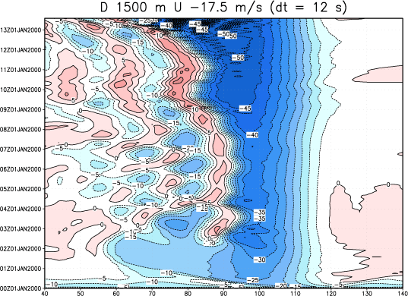
D = 1500 m
U = -17.5 m/s
∆t = 12 s
time
Downslope windstorm
example
space
• Hovmoller diagram from a numerical experiment. Time on vertical axis.
• Shaded/contoured: horizontal velocity (red westerly, blue easterly)
• Small wiggles in time and space appear and amplify
• Shortly after time shown, model “blows up” and produces NaNs
• This may represent linear instability or nonlinear instability
Notes:
About 14 h shown
Wider view of same HOV
The waves early on are not poorly resolved in time or space

Slide 72
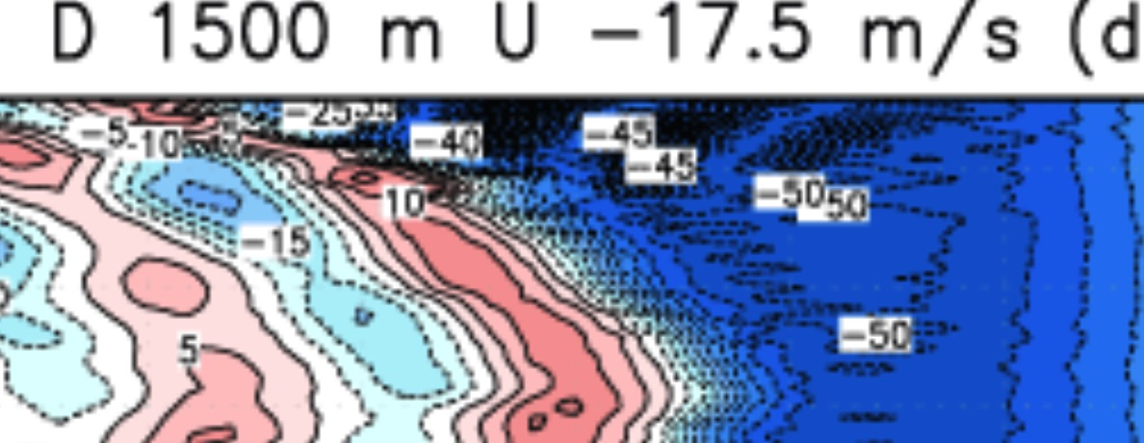
D = 1500 m
U = -17.5 m/s
∆t = 12 s
Zoomed view
• See small time and space scale features amplifying (“noisier”)
• Numerical schemes do not represent small-scale waves accurately
anyway, so this is undesirable even if model didn’t blow up
Notes:
Wider view of same HOV

Slide 73
D = 1500 m
U = -17.5 m/s
∆t = 12 s
• Linear instability results from an excessively large time step, so
test decreasing the time step. If the problem is resolved, the
instability was (likely to have been) linear
Notes:
Wider view of same HOV

Slide 74
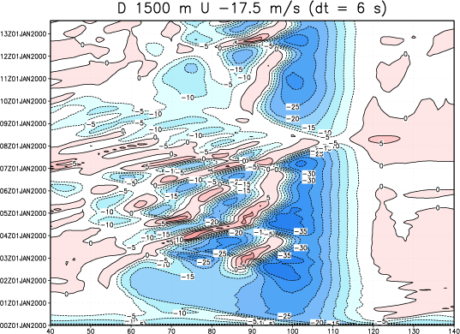
D = 1500 m
U = -17.5 m/s
∆t = 6 s
• But… choice of time step can sometimes influence results…
• (This is a pathological example; we’re in a part of the parameter
space that is very sensitive to small perturbations… and one is ∆t!)
• If the instability had been nonlinear, decreasing ∆t would have made
instability worse…
Notes:
Cut ∆t from 12 to 6 seconds. Good news: instability is gone. Bad news: results are very different. FLIP BACK AND FORTH WITH LAST SLIDE
Shift after about 3 h

Slide 75
Nonlinear instability - 1
Not constant advection anymore!
So 2k represents half the wavelength of wavenumber k
Nonlinear advection has shifted “energy” to smaller scales
Notes:
By itself, this sample equation is not stable. However, it is part of a more comprehensive, legitimate equation, and it is being used as an example of how and why nonlinear instability can occur

Slide 76
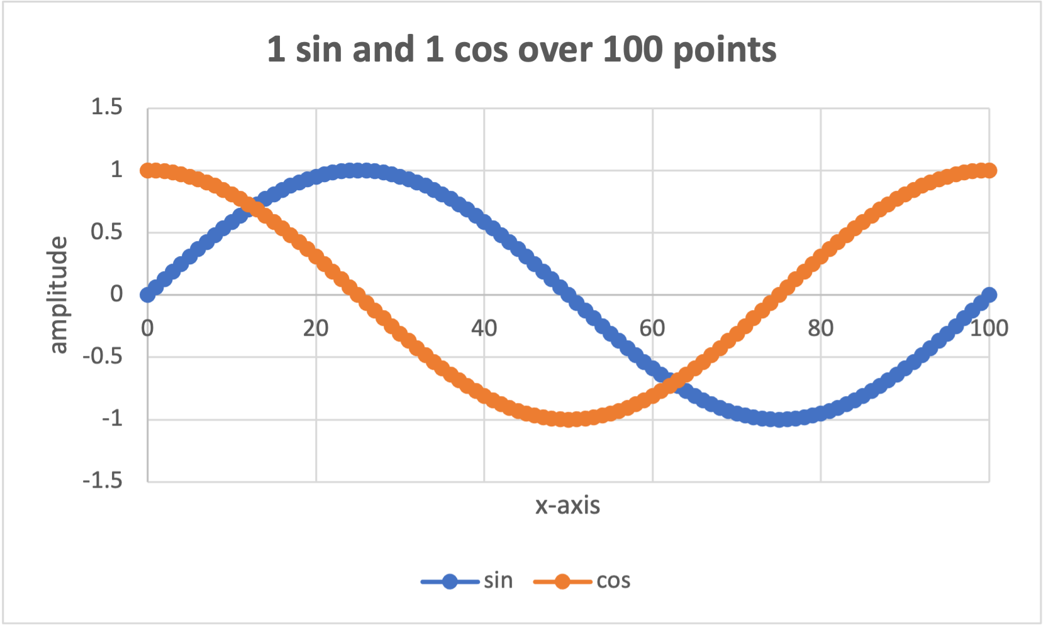
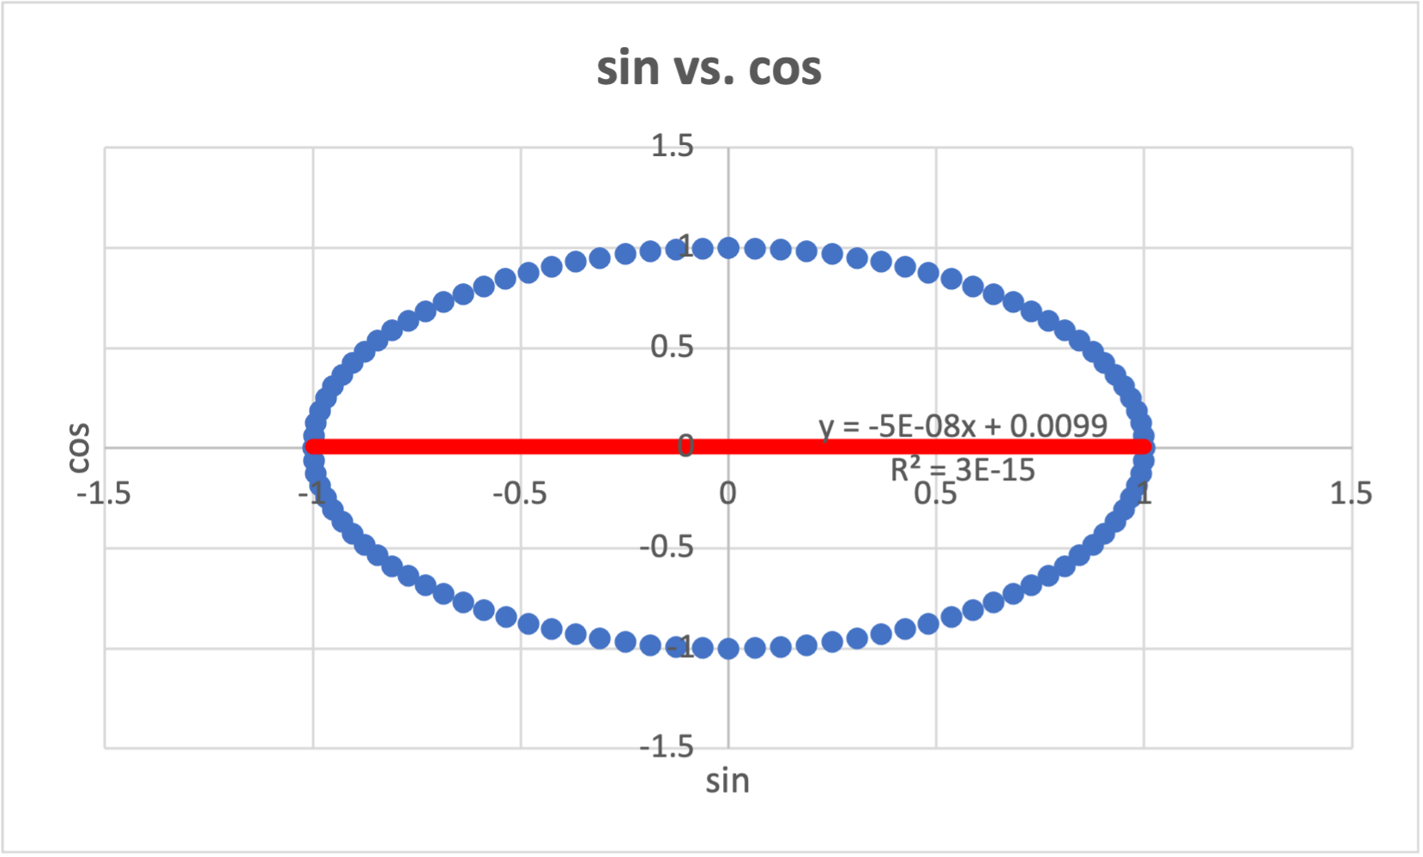
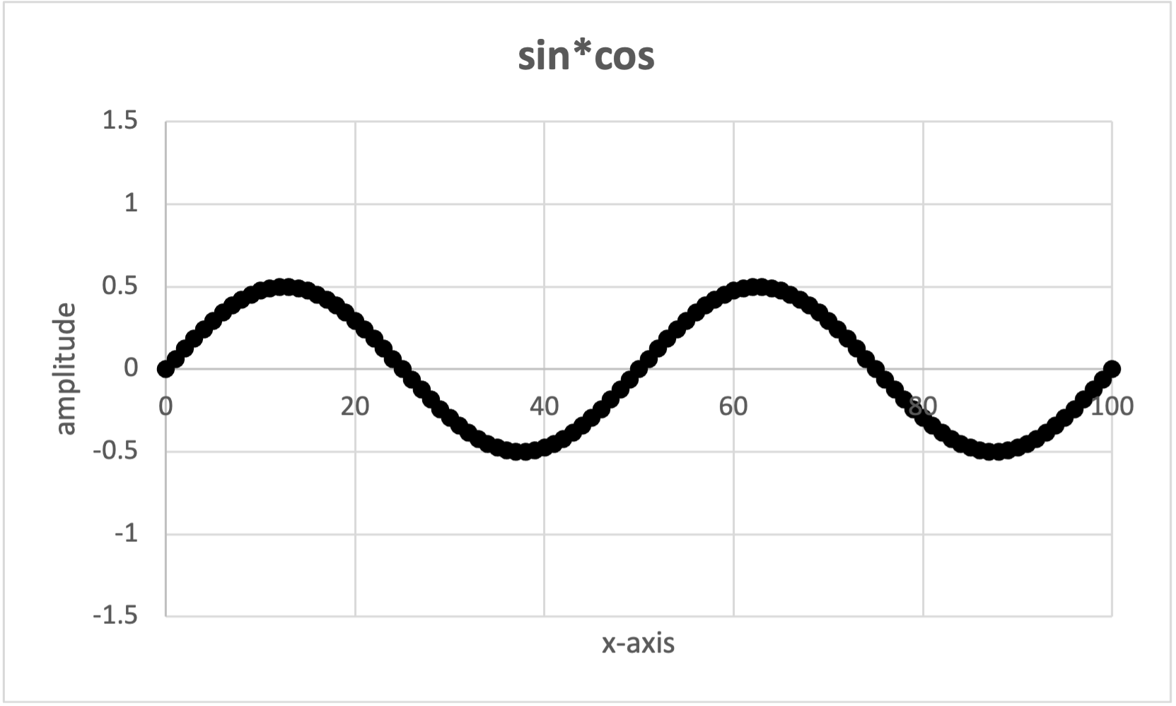
Sine-cosine interaction

Slide 77
Nonlinear instability - 2
Due to nonlinear terms (basically, advection), energy tends to move downscale
  In reality, this culminates in the molecular scale, where energy is dissipated by friction
    “Big whirls have little whirls that feed on their velocity. Little whirls have lesser whirls, and so on to viscosity.” (L. F. Richardson)
  In the model, energy becomes “stuck” and accumulates at the smallest resolvable scales
    Energy fails to drain away owing to “aliasing”
    This accumulation causes nonlinear instability

Slide 78
Nonlinear instability - 3
Aliasing occurs because smallest resolvable scale is 2∆x
A wave that has a wavelength < 2∆x actually appears on the grid as a wave between 2-4∆x
Recipe for nonlinear instability is:
  Nonlinear interaction means energy moves into the small scales
  Aliasing means the energy is not only NOT LOST but also “sticks” between 2 and 4∆x and grows even more

Slide 79
Nonlinear instability - 4
(what you see on the grid)
• Nonlinear interaction of two 8/3∆x waves produces a new 4/3∆x wave (solid)
• 4/3∆x < 2∆x and is therefore unresolvable
• the model “sees” this as 4∆x (dashed) on the grid
• so, instead of shunting off to be dissipated, the energy actually sticks around,
capable of participating in even more nonlinear interactions, resulting in
explosive growth of small-scale noise

Slide 80
Curing linear and nonlinear instability
Linear instability is caused by an excessively large time step
  Cure: decrease ∆t (or make ∆x and/or ∆z larger)
Nonlinear instability is caused by aliasing, which occurs every time step
  Decreasing ∆t actually causes the instability, if present, to emerge at an earlier forecast time
  Cure: smoothing fields to remove high-frequency oscillations in space and time
Problem: from model fields, it can be difficult to tell which instability it is (both can manifest as escalating small scale noise)
WRF model uses an odd-order advection scheme that contains some implicit damping (and permits longer time steps) that hit the smaller wavelengths hardest, making nonlinear instability somewhat more rare now than in the past. Thus, we should suspect linear instability first.
Notes:
We don’t encounter nonlinear instability so often anymore owing to advent of odd-order RK schemes.

Slide 81
namelist.input
Alter to address
linear instability
&domains
time_step = 12,
time_step_fract_num = 0,
time_step_fract_den = 1,
&dynamics
diff_opt = 1,
km_opt = 4,
diff_6th_opt = 2, 2, 2,
diff_6th_factor = 0.12, 0.12, 0.12,
Use to address nonlinear instability

Slide 82
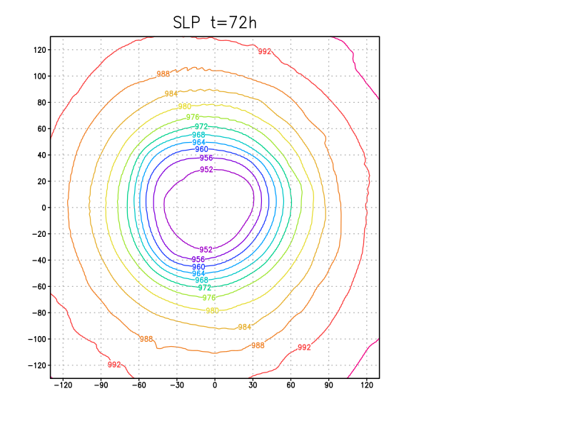
HWRF model
SLP field
y (km)
x (km)
Very small part of domain shown
Notes:
See a few wiggles. Nothing of concern – yet.

Slide 83
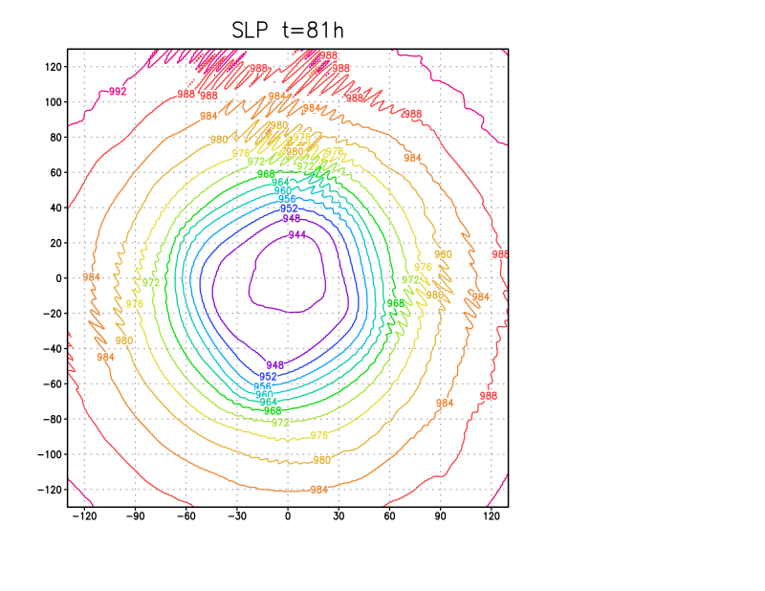
HWRF model
SLP field
y (km)
x (km)
Very small part of domain shown

Slide 84
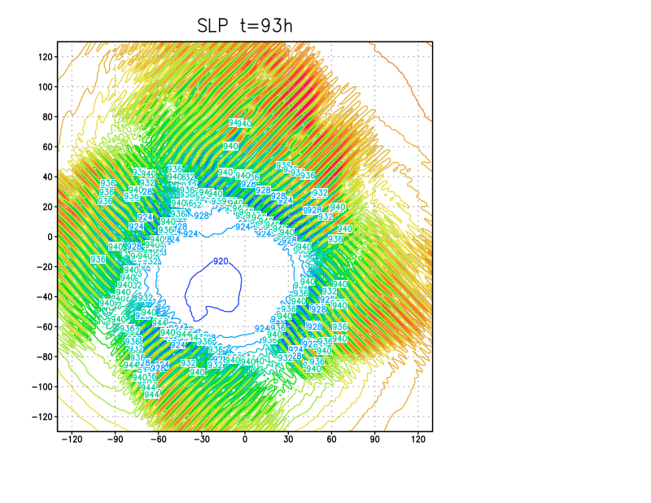
HWRF model
SLP field
y (km)
What went wrong?
How to fix it?
x (km)
Very small part of domain shown
Notes:
4 day simulation, ending at 96h. It didn’t blow up by that time, but it WOULD eventually do so if run longer.
What’s the cause? Linear or nonlinear instability? “Going to hell in a handbasket”

Slide 85
[end]

