Slide 1
Experiment #3 Results
SOC NNRP-based SKEBS runs
Fall 2024
Unperturbed:
NESIS = 11.63
RMSE SLP vs. NNRP = 2.02 mb/gridpoint
© Copyright 2024 Robert Fovell, Univ. at Albany, SUNY, rfovell@albany.edu

Slide 2
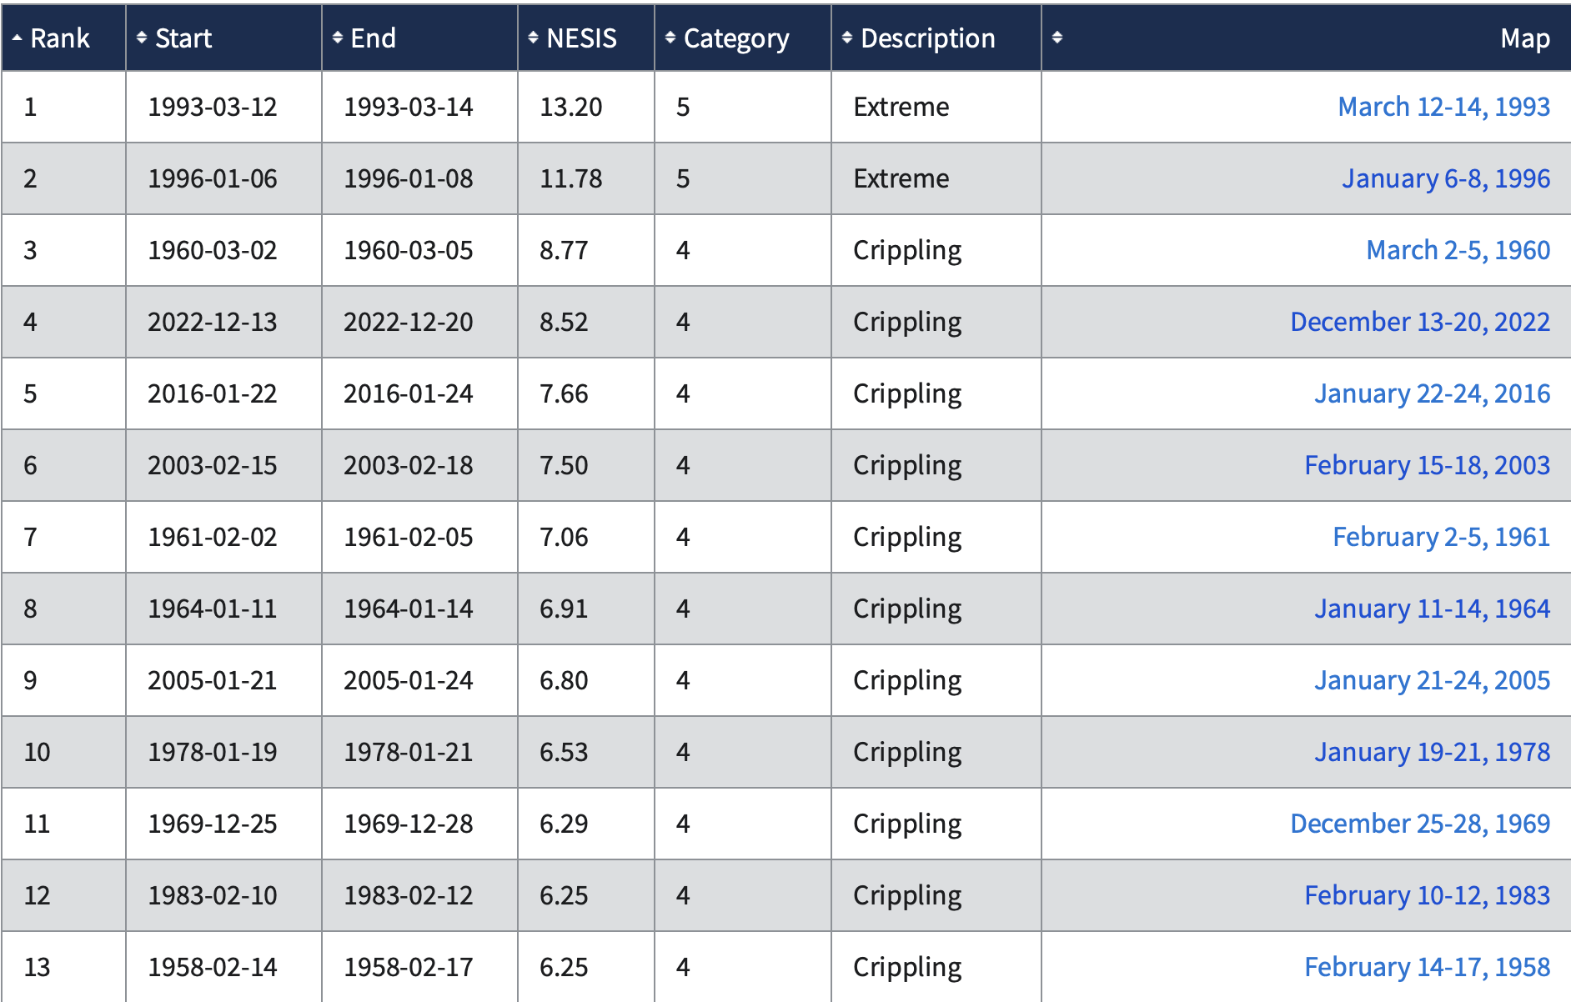
https://www.ncei.noaa.gov/access/monitoring/rsi/nesis
By NESIS metric, SOC event is #1. Is this because
It had the most favorable synoptic setup of all events?
It most fully realized its potential? (Luck)
Both?
Did event #2 have a more favorable setup but didn’t have as much “luck”?
12/2022 storm
Notes:
Did #2 case have even more favorable environ but didn’t achieve its potential for some reason?

Slide 3
Caveats
This analysis presumes:
  Initialization data source is correct and optimal and represents “truth”
  Model grid spacing is appropriate
  Model physics is well-configured
  SKEBS is the best way of incorporating randomness into the simulations and is optimally configured
  NESIS is computed correctly (esp. snow ratio)
The conclusions herein should be considered tentative and retested in an upgraded experiment
Notes:
4 of those 5 are pretty clearly “NO”. Keep that in mind

Slide 4
Hypotheses
Each storm has its own distribution with respect to NESIS, which may or may not be normally distributed (bell curve)
  Some NESIS values are more likely than others
A real past event is but one sample from the storm’s own distribution… so it could have fallen anywhere in the range
  Again, it’s most likely the sample would fall near the distribution peak… but it could have occurred in either tail… the distribution represents the storm’s potential
We elect to employ SKEBS as a means of applying perturbations, in an attempt to ascertain what the storm’s own distribution looks like
Hypothesis 1: the closer to the (high) tail the unperturbed run falls, the more likely that any perturbation of it would result with a smaller NESIS
  We surmise that the SOC was #1 among snowstorms because it falls in the high tail of its own distribution → it had the best luck, it realized most of its maximum potential
  Therefore: perturbed runs should tend to have smaller NESIS values than the unperturbed run, if the unperturbed run is “accurate” and hypothesis is correct
Hypothesis 2: the more accurate the model physics, the more likely that perturbations will increase, rather than decrease, SLP error
  Perturbations will shift the cyclone track and/or timing, resulting in more discrepancies with the parent model analysis (i.e., more error)
Notes:
Therefore, if by perturbing we get smaller NESIS, that means unpert run was in high tail

Slide 5
2020-2024 SKEBS ensemble results
353 perturbed simulations available
{some changes in WRF over time}

Slide 6
NESIS (or SLP error) distribution Hypothesis #1
unperturbed
Scenario #1: unperturbed run falls near peak of
its own distribution
Expected outcome from perturbations:
Equal chances of generating larger and
smaller NESIS or SLP error values
unperturbed
Scenario #2: unperturbed run falls near tail of
its own distribution [e.g., 1927 Yankees?]
Expected outcome from perturbations:
Much higher chances of generating smaller
NESIS or larger SLP error values
This hypothesis presumes that SKEBS provides a reasonable, and perhaps the most reasonable,
way of perturbing these simulations and could be used to reveal the storm distribution.
It also assumes the NNRP is a reasonable initialization and verification source, despite coarse
resolution.
Notes:
1927 Yankees: Babe Ruth, Lou Gehrig. What if perturbed that team? Mod batting order, schedule, pitch selection, baserunning strategy?
How does the real (control) roster compare to its perturbed members? Could the GOAT have been GOATier?

Slide 7
NESIS ranking: Hypothesis #1
unperturbed
MAX: 15.1
MIN: 8.22
Ctrl: 11.63
MEAN: 11.42
Of 353 perturbed members:
155 had larger NESIS than control (unperturbed)
0 were tied
198 had smaller NESIS than control
What does this imply for Hypothesis 1? What does it imply for predictability? For NESIS?
What does it imply for SKEBS?
Notes:
The first 8 runs seem different… and last 2 also. Unper NESIS value has changed among WRF versions/hardware changes

Slide 8
2020-2024 NESIS histogram
MAX: 15.1
MIN: 8.22
Ctrl: 11.63
MEAN: 11.42
control
A little bit of asymmetry…
but looks pretty ‘normal’
Total 353 perturbed runs
{Some changes in WRF/hardware over time}
Notes:
Same init. Although physics choices same, alterations may have been made to one or more physics schemes. Also, vert coord changed to hybrid

Slide 9
https://www.ncei.noaa.gov/access/monitoring/rsi/nesis
12/2022 storm
Even lowest NESIS value
would rank #5, but
Subject to our caveats
the SOC event could
have been worse
If Hypothesis 1 had been
valid, event could not
have been much worse
Notes:
3/12-3/15/2017 storm: rank #23, NESIS = 5.03, Cat. 3
Largest in 2018: 3/5/18-3/8/18 NESIS = 3.45, rank 41
Largest in 2020: 12/14/20 NESIS=3.21 rank 44
2021: 1/30-2/3 NESIS=4.93 rank 24

Slide 10
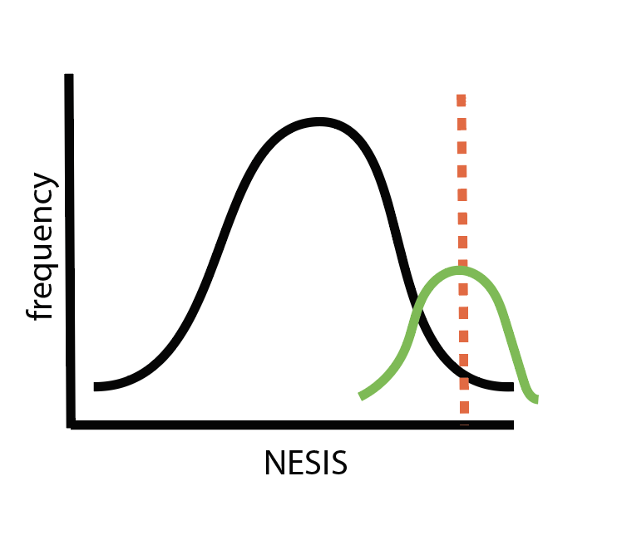
NESIS (or SLP error) distribution Hypothesis #1
unperturbed
Scenario #3: our distribution about the unperturbed
run (green) is not the same as the storm’s own
distribution (black) OR the black distribution
represents ALL storms and not versions of SOC…
unperturbed
all storms
unperturbed
SOC
Notes:
1927 Yankees: Babe Ruth, Lou Gehrig. What if perturbed that team? Mod batting order, schedule, pitch selection, baserunning strategy?
How does the real (control) roster compare to its perturbed members? Could the GOAT have been GOATier?

Slide 11
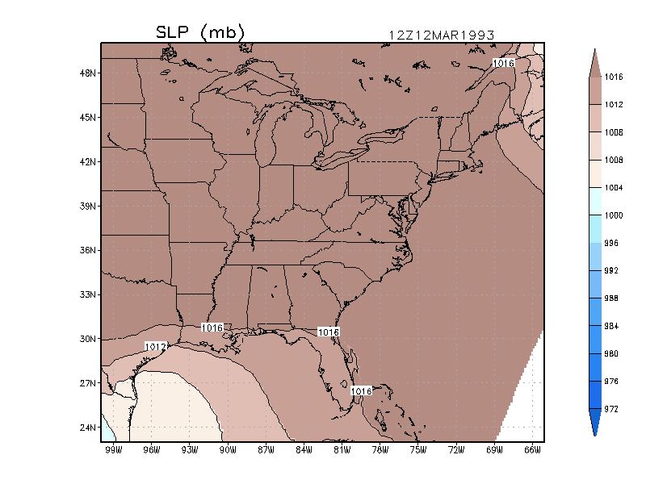
Animation of SLP field
(ECMWF reanalysis)
03/14/93 06Z
Storm Track
03/13/93 06Z
Hypothesis 2: the more accurate the model physics, the more likely that perturbations
will increase, rather than decrease, SLP error
Notes:
ecmwf_movie.GIF

Slide 12
SLP error ranking: Hypothesis #2
Hypothesis 2: the more accurate the model physics, the more likely that perturbations
will increase, rather than decrease, SLP error
unperturbed
MAX: 2.81
MIN: 1.74
Of 353 perturbed members:
63 (18%) had smaller SLP error than control (unperturbed) [max reduction 13.4%]
7 were tied
283 (80%) had larger SLP error than control [max increase 40%]
What does this imply for Hypothesis 2? What does it imply for skill, certainty, physics?
Alternative physics (unperturbed) was ALREADY at 1.6 mb/gridpoint – lowest of all

Slide 13
Recap
Perturbing the simulations tended to make them more different than the parent (w/r/t SLP RMSE) → supports Hypothesis #2
But perturbing the simulations yields many runs with larger NESIS scores than the unperturbed simulation → does not support Hypothesis #1

Slide 14
Is SLP error and NESIS correlated?
NNRP-based SKEBS ensemble
SLP error reflects differences in cyclone intensity, size, location, translation speed…
Alter track, size, intensity → alter where and how much snow falls → change NESIS…
Would/should change be systematic?

Slide 15
SLP error vs. NESIS for 2020-2024 SKEBS ensembles
R2 = 0.33 (fraction of variance explained)
r = 0.57 (correlation)
[R2 = (r)² for simple linear regression]
There is a moderately strong suggestion that higher SLP errors ←→ higher values of NESIS
Higher SLP differences from NNRP → differences in track and speed
Expectation: larger SLP error should be associated with both larger AND smaller NESIS
(e.g., a cone-shaped plot)
Does our initialization and model configuration yield the most realistic track for the
unperturbed run? Would our experiment conclusions differ if a better reanalysis used?
Notes:
Looks like two diff behaviors, below and above NESIS ~ 12. But higher error → larger NESIS. What made them different?
I can imagine deviations in track, intensity, speed resulting in BOTH larger and smaller NESIS. But larger is favored.

Slide 16
SLP error vs. NESIS for 2020-2024 SKEBS ensembles
Unperturbed SLP error: 2.02 mb/gridpt
AVERAGE SLP error: 2.19 mb/gridpt
[184 below average, 168 above average]
Higher the simulation NESIS, the more
likely its SLP error > AVERAGE
Larger SLP error → different track
→ higher NESIS
Notes:
Looks like two diff behaviors, below and above NESIS ~ 12. But higher error → larger NESIS. What made them different?

Slide 17
What if we used the lowest error member as the benchmark NESIS instead?
Unperturbed member:
  RMSE SLP 2.02 mb/gridpoint, NESIS 11.63
Lowest error member (== most accurate simulation???)
  RMSE SLP 1.74 mb/gridpoint, NESIS 9.41
lowest error member
333 of 354 simulations (94%) had larger NESIS
Notes:
Even worse for hypothesis 1

Slide 18
How do SLP errors vs. NNRP and NARR compare?

Slide 19
NNRP vs. NARR SLP error
typo
There is a very high correlation between SLP error against NNRP and NARR.
BUT, note that SLP error vs. NARR is higher when initialized with NNRP,
while you will find SLP error vs. NNRP is higher when initialized with NARR.
Does this make sense? That motivates using a better reanalysis.
Notes:
2 typos

Slide 20
Summary
Hypothesis 1: the closer to the (high) tail the unperturbed run falls, the more likely that any perturbation would result with a smaller NESIS
  Class SKEBS ensemble appears to refute Hypothesis #1 → wasn’t luck
  Next step: what made SOC case the GOAT (Greatest Of All Time?)
Hypothesis 2: the more accurate the model physics, the more likely that perturbations will increase, rather than decrease, SLP error
  Class SKEBS ensemble appears to support Hypothesis #2
BUT… we should revisit both hypotheses with a better initialization data source AND a better model physics configuration (especially microphysics) and higher resolution (so no cumulus scheme)
Also, should we reconsider SKEBS perturbation defaults?
Finally:
  How do large and small NESIS storms compare? What makes them different?
  How do large and small SLP error simulations compare?
  Larger SLP errors → larger NESIS… why?
  [This could be an interesting project or thesis.]
Notes:
Hyp 1 refutation also means control SOC run wasn’t lucky, didn’t luck itno a big NESIS. Something made that case different synoptically

Slide 21
[end]

