Slide 1
“Storm of the Century”:
Grid nudging & stochastic perturbations (and Experiment #3)
EXP 3 due date Monday, 11/18/24
ATM 419/563
Fall 2024
Fovell
© Copyright 2024 Robert Fovell, Univ. at Albany, SUNY, rfovell@albany.edu

Slide 2
New in this experiment
Simulation of the “Storm of the Century” (Superstorm 1993) snowstorm
Initialize with and verify against NNRP reanalysis (and NARR reanalysis)
We’ll look at parent model fields interpolated to the WRF grid at every available reanalysis time – so we can directly compare WRF runs to NNRP reanalysis fields on the same (WRF) grid
Perform analysis nudging (“FDDA”): regular and spectral versions
Explore using stochastic perturbations generated with SKEBS scheme and boundary condition perturbations
See SOC_EXP03_details.pdf

Slide 3
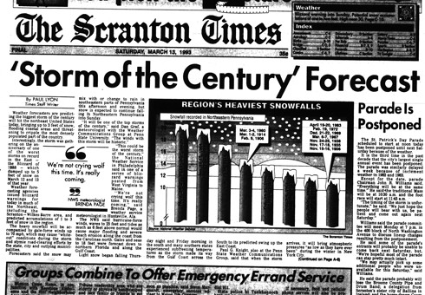

Slide 4
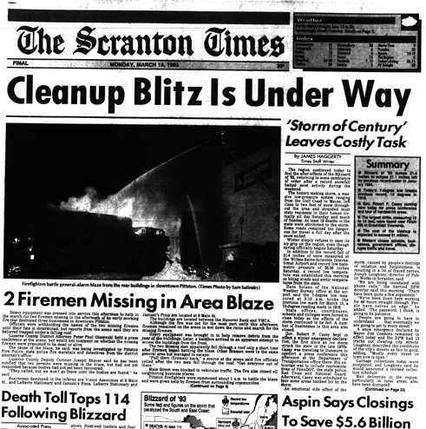

Slide 5
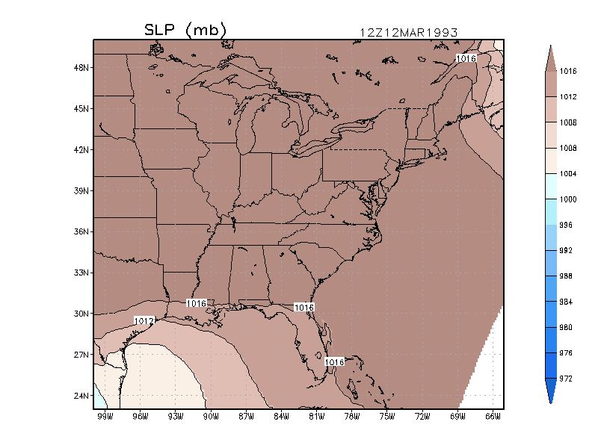
Animation of SLP field
(ECMWF reanalysis)
03/14/93 06Z
Storm Track
03/13/93 06Z
Notes:
ecmwf_movie.GIF

Slide 6
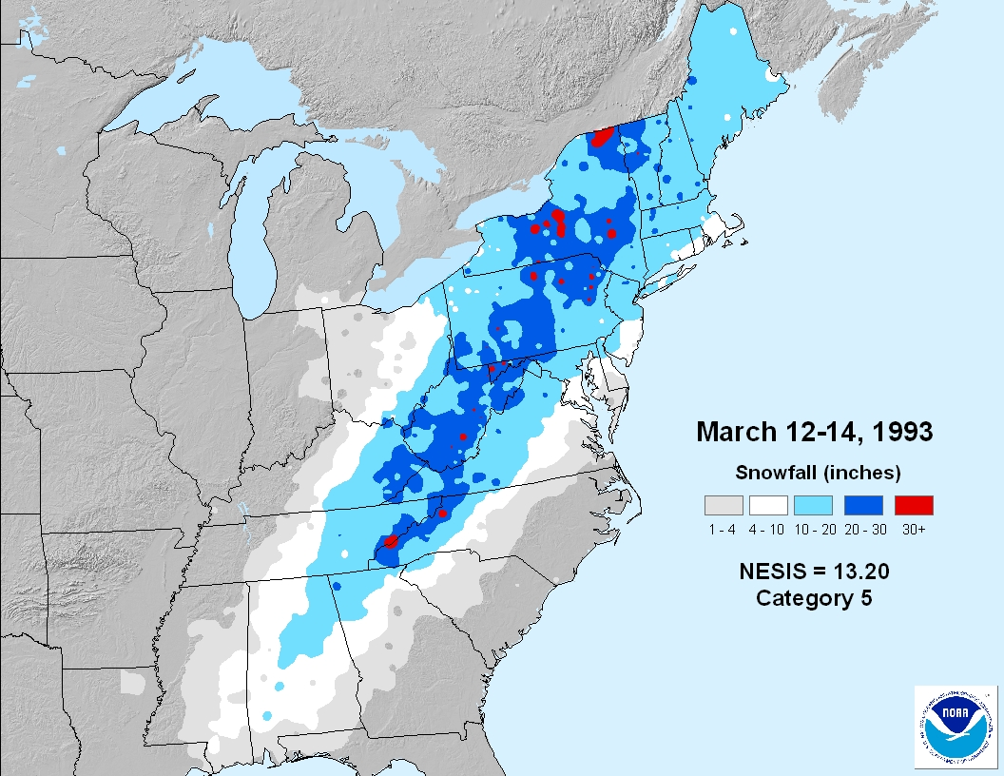
http://www.ncdc.noaa.gov/snow-and-ice/rsi/nesis
Notes:
The newer RSI, intended to succeed NESIS, is much more complicated. For the NE sector, it places 22 Feb 1969 #1, and SOC #2. Altho formula looks the same, values are different owing to the way normalization was done – in RSI each category’s A and P denominators are calibrated separately, and separately for each region. Snowfall thresholds also diff for each region. But it remains that the new scheme, for NE, effectively weights snowfall bins differently, and that makes values different, and lets 1969 “win”.

Slide 7
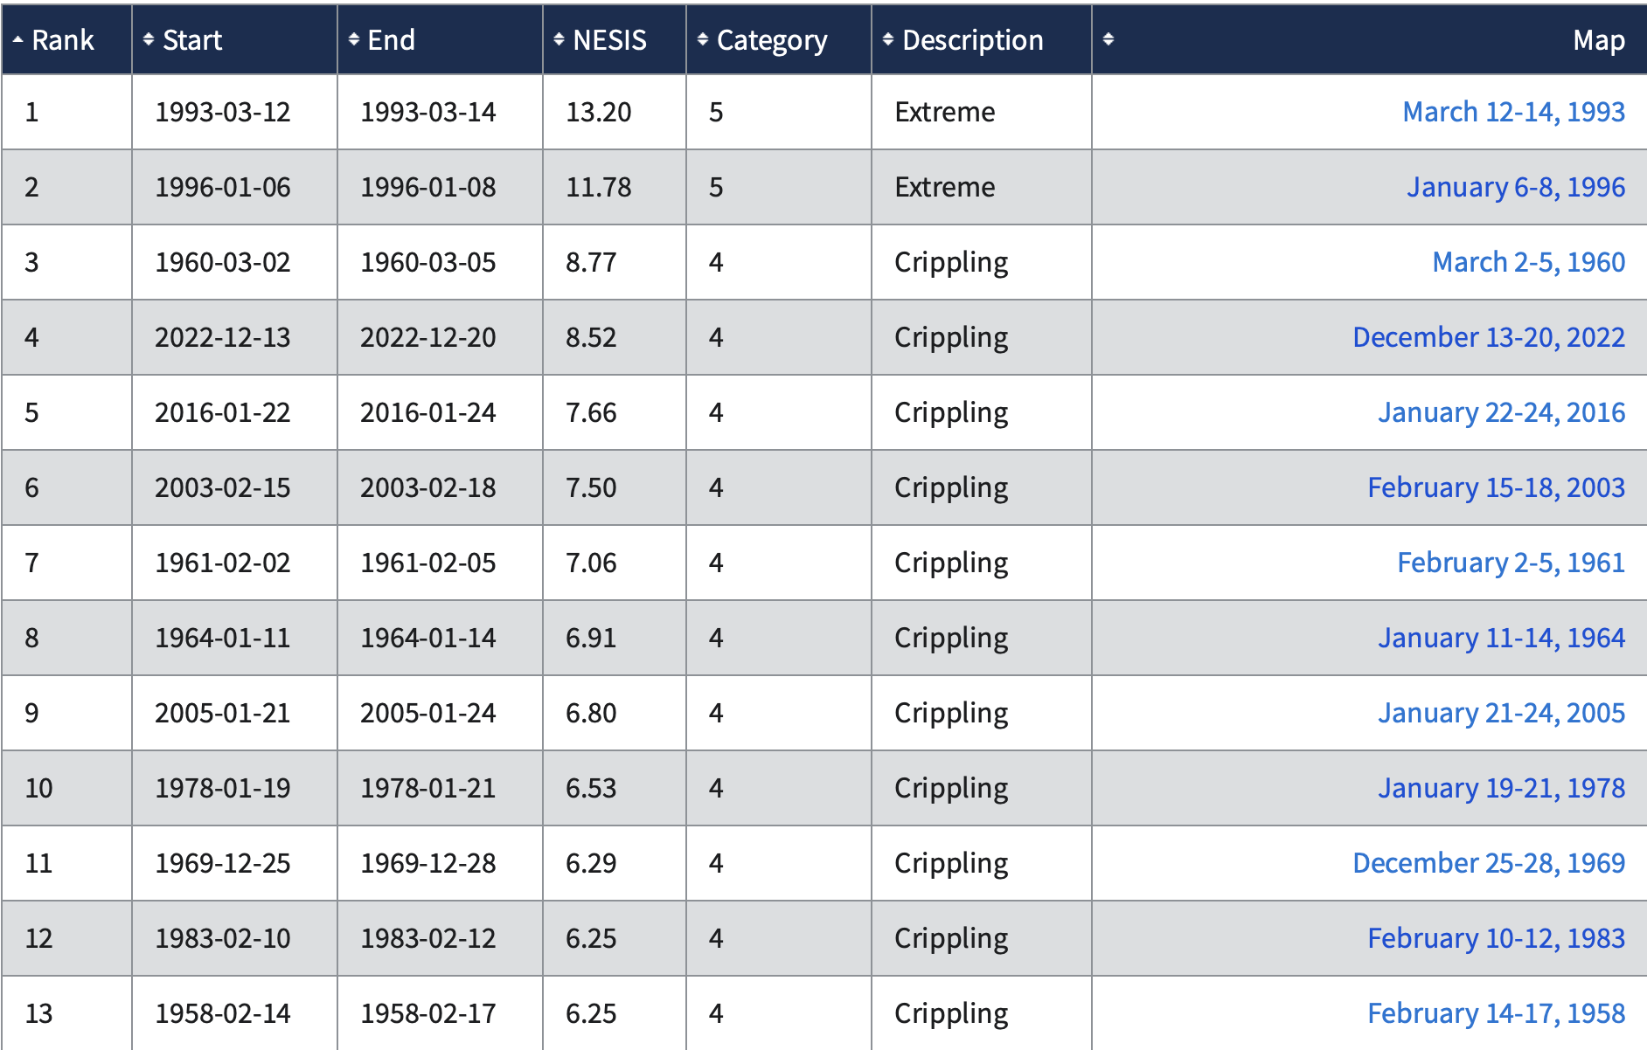
https://www.ncei.noaa.gov/access/monitoring/rsi/nesis
North East Snow Impact Scale (NESIS)
12/2022 storm
Notes:
3/12-3/15/2017 storm: rank #23, NESIS = 5.03, Cat. 3
Largest in 2018: 3/5/18-3/8/18 NESIS = 3.45, rank 41
Largest in 2020: 12/14/20 NESIS=3.21 rank 44
2021: 1/30-2/3 NESIS=4.93 rank 24

Slide 8
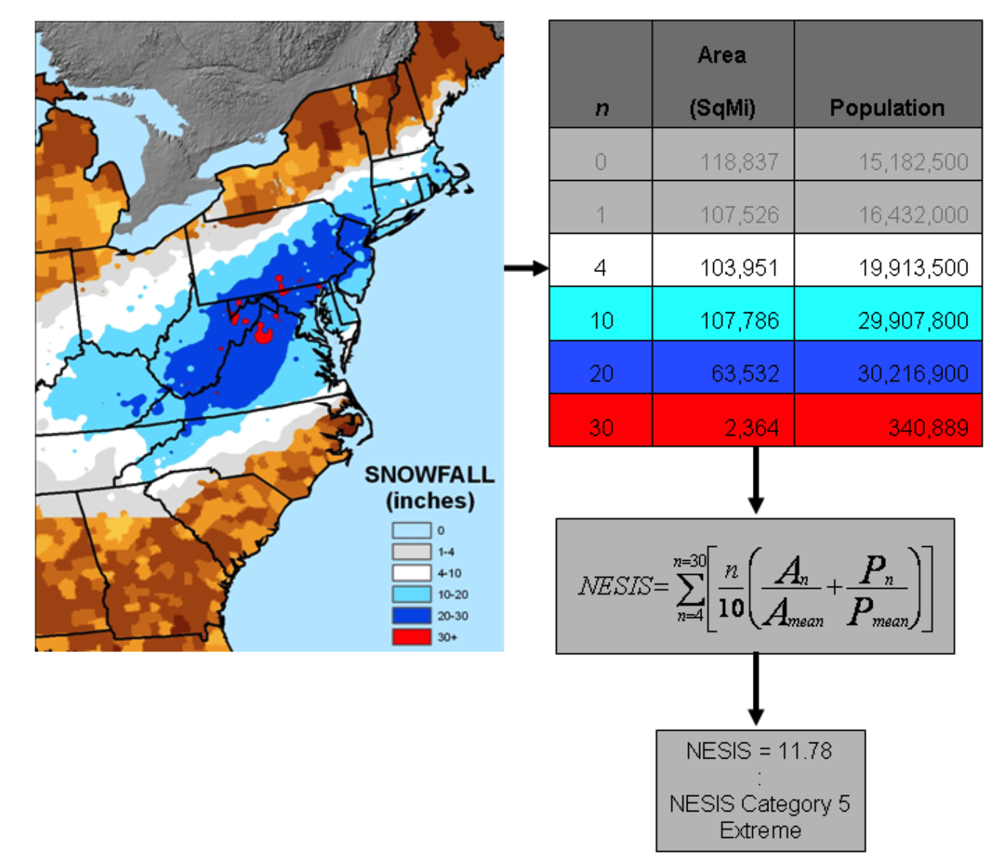
North East Storm Impact Scale (NESIS)
Snowfall totals
4”-9”
10”-19”
20”-29”
≥ 30”
• area-integrated AND
• population-weighted
http://www.ncdc.noaa.gov/snow-and-ice/rsi/nesis
Kocin and Uccellini (2004)
Notes:
NOTE: Example appears to suggest 10” area > 4” area, but formula would combine 10,20,30” areas into 4” category for NESIS computation. NESIS categories are “nested”.
“However, Equation (1) defines the area and population as “greater than” 4”, greater than 10”, etc. For example, the area for category 10 would include the areas for categories 10, 20, and 30. “ – Squires and Lawrimore (2006)

Slide 9
Initialization
NCEP/NCAR Reanalysis Project (NNRP)
  2.5˚ x 2.5˚ with 18 levels (but global and goes back to 1948), every 6 hours (21600 sec)
  Vtable.NNRP
Single 90 km domain
  See experiment script for details
Notes:
About 275 km grid spacing.

Slide 10
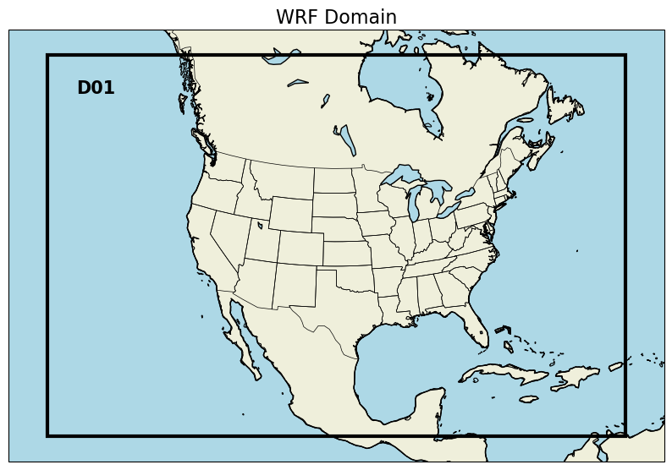
Domain configuration
Our 90 km domain
See script for details.
Do ungrib, geogrid
and metgrid as usual.
Check the map factors!
Notes:
Go to EXP03 script now. Map factors are going to start being a factor.
Dx_actual = dx_specified/m. Largest m = 1.13, so dx = 80 km (SW and SE corners), Smallest m = .966, so dx = 93 km.

Slide 11
namelist.wps
&share
wrf_core = 'ARW',
max_dom = 1,
start_date ='1993-03-12_12:00:00', '1993-03-12_12:00:00'
end_date = '1993-03-15_00:00:00', '1993-03-15_00:00:00'
interval_seconds = 21600,
io_form_geogrid = 2,
&geogrid
[…]
e_we = 85, 214, 772,
e_sn = 56, 196, 610,
geog_data_res = 'default', 'default', 'default',
dx = 90000.,
dy = 90000.,
&ungrib
out_format = 'WPS',
prefix = 'NNRP',
/
&metgrid
fg_name = 'NNRP',
io_form_metgrid = 2,
/

Slide 12
namelist.input
&time_control
all_ic_times = .true.,
run_days = 2,
run_hours = 12,
run_minutes = 0,
run_seconds = 0,
start_year = 1993, 1993, 1993,
start_month = 03, 03, 03,
start_day = 12, 12, 12,
start_hour = 12, 12, 12,
start_minute = 00, 00, 00,
start_second = 00, 00, 00,
end_year = 1993, 1993, 1993,
end_month = 03, 03, 03,
end_day = 15, 15, 15,
end_hour = 00, 00, 00,
end_minute = 00, 00, 00,
end_second = 00, 00, 00,
interval_seconds = 21600,
Produces a wrfinput_d01 file at initial time AND each interval_seconds thereafter

Slide 13
all_ic_times = .true.
WRF input files created by real.exe
wrfinput_d01
wrfinput_d01.1993-03-12_18:00:00
wrfinput_d01.1993-03-13_00:00:00
wrfinput_d01.1993-03-13_06:00:00
wrfinput_d01.1993-03-13_12:00:00
wrfinput_d01.1993-03-13_18:00:00
wrfinput_d01.1993-03-14_00:00:00
wrfinput_d01.1993-03-14_06:00:00
wrfinput_d01.1993-03-14_12:00:00
wrfinput_d01.1993-03-14_18:00:00
wrfinput_d01.1993-03-15_00:00:00
ncrcat wrfinput_d01* SOC_NNRP_reanalysis.nc
You will concatenate these into a single file and run w2g on it, to create
a file called “SOC_NNRP_reanalysis”. (See script.)
This permits us to compare WRF runs with NNRP fields interpolated to the WRF grid
at each available time.

Slide 14
RUN01
Do ungrib, metgrid as usual. Check num_metgrid_levels
  Notice NNRP has only 2 soil levels!
RUN01 namelist.input is pre-configured for
  max_dom = 1
  mp_physics = 3 (WSM3)
  ra_lw and ra_sw = 1 (RRTM LW and Dudhia SW)
  MYJ PBL and surface scheme (sf_sfclay = bl_pbl = 2)
  Noah LSM (sf_surface_physics = 2)
  cu_physics = 3 (Grell-Freitas)
  cudt = 0 (as recommended for Grell schemes)
After WRF finishes, run notebook plot_WRF_SOC.ipynb
  This will open your wrfout file and the SOC_NNRP_reanalysis.nc file
Notes:
Got here 2019

Slide 15
Cell #3
plot_WRF_SOC.ipynb
##################################################################################
# FIRST FILE location and filename of WRF model output. Look in current directory.
# Make sure wrfout file name is correct
location = './'
filename = 'wrfout_d01_1993-03-12_12:00:00'
runname='RUN01'
##################################################################################
# SECOND FILE. For SOC_NNRP_reanalysis.nc, we created this file with NNRP fields
# interp on WRF grid
# Make sure the filename is correct
second_location = './'
second_filename = 'SOC_NNRP_reanalysis.nc'
second_runname='NNRP'
This is set up for our common demonstration run.
It will need editing for future simulations.

Slide 16
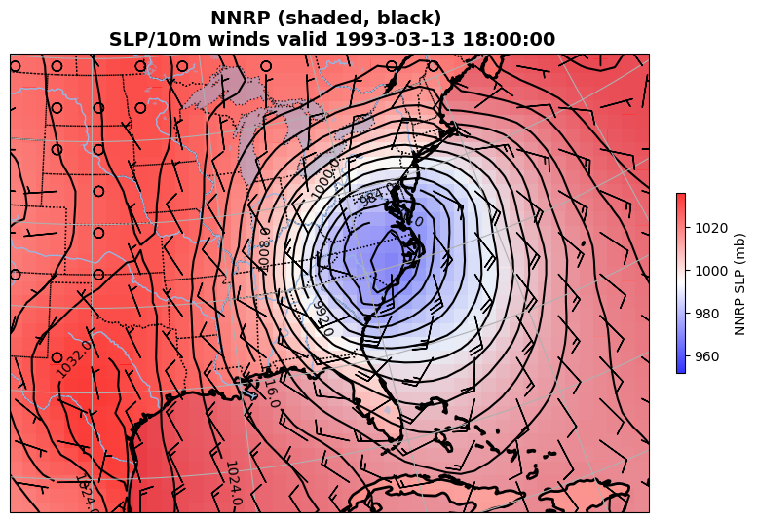
plot_WRF_SOC.ipynb
Cell #7

Slide 17
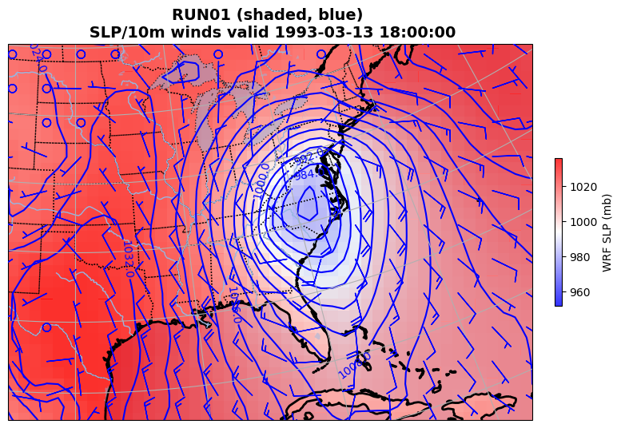
plot_WRF_SOC.ipynb
Cell #8
Notes:
WRF SLP not as low but has more frontal structure

Slide 18
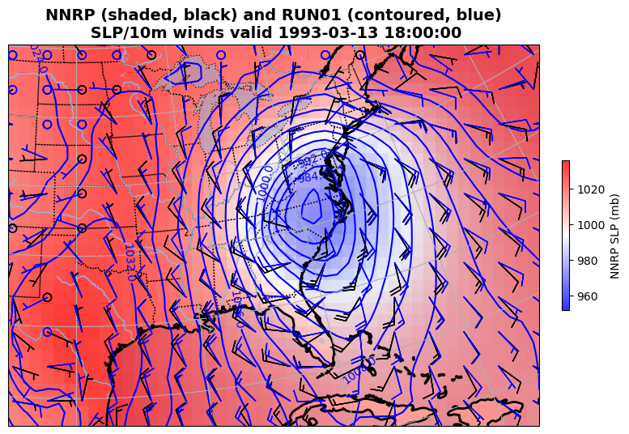
plot_WRF_SOC.ipynb
Cell #9

Slide 19
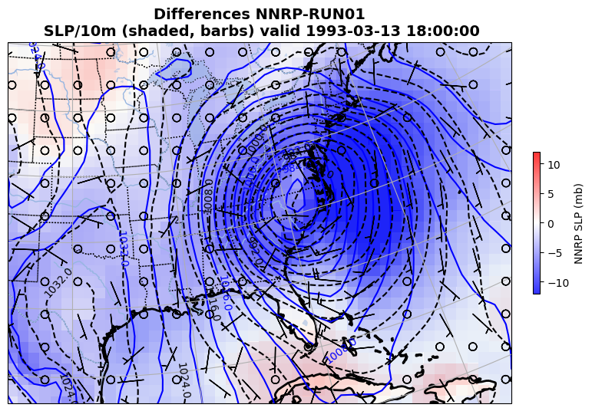
plot_WRF_SOC.ipynb
Cell #10
NNRP cyclone is spatially larger yet deeper
How much is NNRP low resolution, and how much is WRF error?

Slide 20
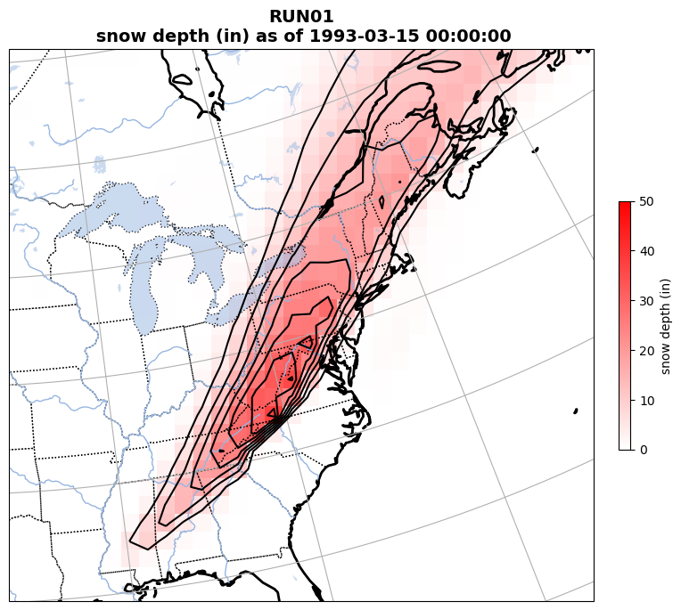
plot_WRF_SOC.ipynb
Cell #11

Slide 21
SLP root mean square error
(RMSE)
Computed relative to a reanalysis
(here, using NNRP)

Slide 22
Computing SLP RMSE
The provided script analyze.sh will use NCL scripts to compute RMSE SLP and NESIS. Record the values written to the screen.
  SLP is not a WRF output field. Previously, we used wrf-python to create it, and now we will use NCL
  SLP RMSE will be computed relative to the NNRP (and NARR) reanalysis fields, after interpolation to the WRF grid, every 6 hours, and summed over the simulation period.
    RMSE is computed w/r/t time at each grid point, then averaged across all grid points in domain 1
    Units: mb per gridpoint
  NESIS will be computed using SNOWNC and GRAUPELNC (snow and graupel precipitation received at the surface from microphysics scheme)
    More detail later

Slide 23
analyze.sh for RUN01
$ source doncl.sh [needs only run once in each terminal window]
$ analyze.sh
(0) NESIS = 11.63 (pop component= 3.27179 area component= 8.35517)
(0) RMSE SLP = 2.38 mb per gridpoint (vs. NARR reanalysis)
(0) RMSE SLP = 2.02 mb per gridpoint (vs. NNRP reanalysis)
• If something goes wrong, check contents of the file named “OUT”
that is generated by this script
• NESIS calculation is very sensitive to small numerical details, and running
real.exe and/or wrf.exe on machines with different chipsets can change the #s
(Actual storm NESIS = 13.2)
Notes:
Actual 13.2. Big difference, but not concerned with that (yet).
2023 version

Slide 24
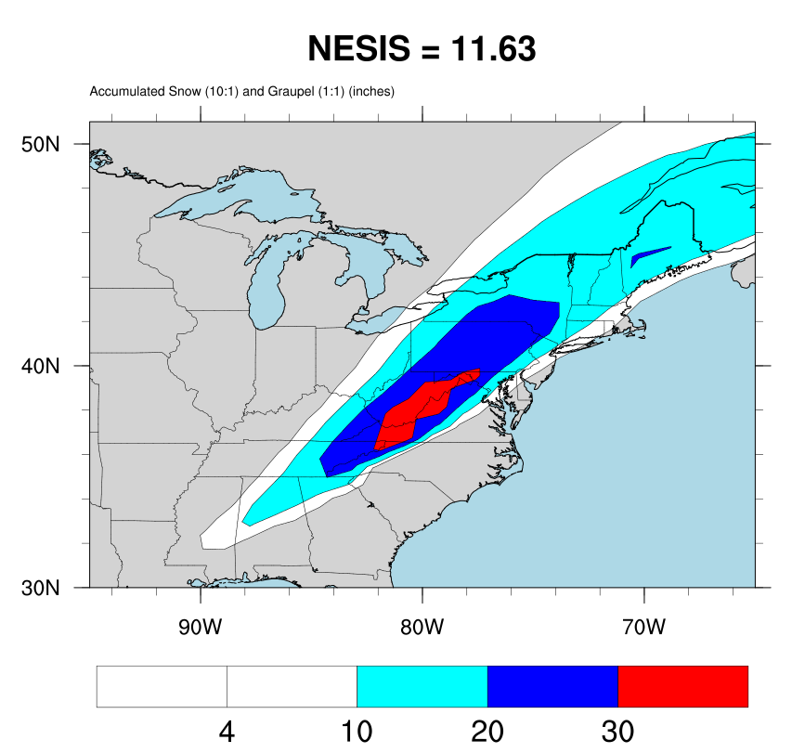
Actual NESIS =
13.2, but that
is also very
sensitive to
how we calculate
snow depth from
liquid water
equivalent
Notes:
Less snowfall on Long Island than in actual storm, which will make a big difference in the population component
Much too much snow in Appalachians, but that hardly affects population component. But did we have obs there?
2023 version

Slide 25
Analysis nudging “FDDA”
(four-dimensional data assimilation)
[WRF can also nudge to observations…]
Notes:
Lipstick on a pig

Slide 26
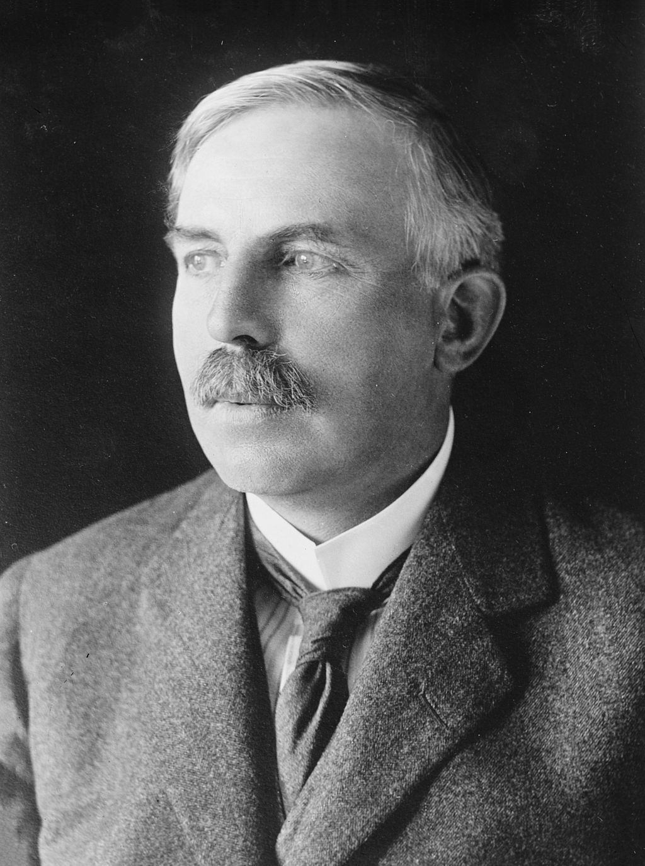
Ernest Rutherford (1871-1937)
Nobel Prize for Chemistry
“Father of nuclear physics”
Formulated concept of
radioactive “half-life”
[alleged to have said:]
“If your experiment needs statistics,
you ought to have done a
better experiment.”

Slide 27
Ernest Rutherford (1871-1937)
Nobel Prize for Chemistry
“Father of nuclear physics”
Formulated concept of
radioactive “half-life”
[if alive today he might say:]
“If your model needs nudging,
you ought to have done a
better model.”

Slide 28
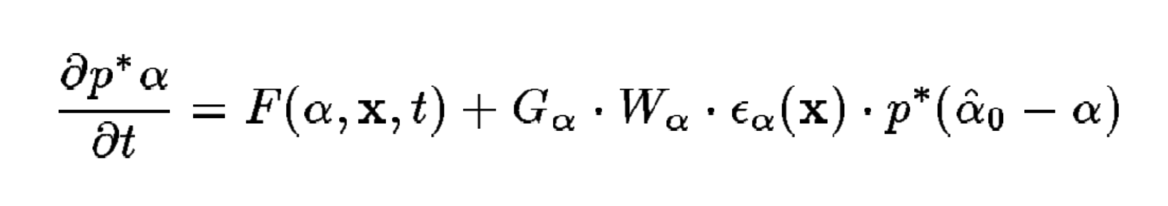
Nudging
Nudging adds terms like this to the model:
Tendency for Other RHS terms ------------------- Nudging term -------------------------
field α
Forcing α towards
analysis value
[zero-order diffuser]
Inverse time scale
Vertical weighting
function
We’ll use nudging
For 1st 6 hours ONLY…

Slide 29
grid_fdda = 1 turns on analysis
nudging (FDDA) in Domain 1.
Performed every 360 min
(= interval_seconds), or 6 h
Ceases after 6 h
Standard grid nudging
&fdda
grid_fdda = 1, 0,
gfdda_inname = "wrffdda_d<domain>",
gfdda_interval_m = 360, 360,
gfdda_end_h = 6, 6,
io_form_gfdda = 2
fgdt = 0, 0,
if_no_pbl_nudging_uv = 1, 1,
if_no_pbl_nudging_t = 1, 1,
if_no_pbl_nudging_q = 1, 1,
if_zfac_uv = 0, 0,
k_zfac_uv = 10, 10,
if_zfac_t = 0, 0,
k_zfac_t = 10, 10,
if_zfac_q = 0, 0,
k_zfac_q = 10, 10,
guv = 0.0003, 0.0003,
gt = 0.0003, 0.0003,
gq = 0.0003, 0.0003,
fgdtzero = 1, 0,
if_no_pbl_nudging_ph = 1, 1,
if_zfac_ph = 0, 0,
k_zfac_ph = 10, 10,
gph = 0.0003, 0.0003,
dk_zfac_uv = 1, 1,
dk_zfac_t = 1, 1,
dk_zfac_ph = 1, 1,
xwavenum = 7, 0,
ywavenum = 5, 0,
/
&fdda section of
namelist.input
Usually “nudge” only outer
domain, D1
Here, there is only one
domain anyway.
real.exe program creates file wrffdda_d01

Slide 30
Standard grid nudging
&fdda
grid_fdda = 1, 0,
gfdda_inname = "wrffdda_d<domain>",
gfdda_interval_m = 360, 360,
gfdda_end_h = 6, 6,
io_form_gfdda = 2
fgdt = 0, 0,
if_no_pbl_nudging_uv = 1, 1,
if_no_pbl_nudging_t = 1, 1,
if_no_pbl_nudging_q = 1, 1,
if_zfac_uv = 0, 0,
k_zfac_uv = 10, 10,
if_zfac_t = 0, 0,
k_zfac_t = 10, 10,
if_zfac_q = 0, 0,
k_zfac_q = 10, 10,
guv = 0.0003, 0.0003,
gt = 0.0003, 0.0003,
gq = 0.0003, 0.0003,
fgdtzero = 1, 0,
if_no_pbl_nudging_ph = 1, 1,
if_zfac_ph = 0, 0,
k_zfac_ph = 10, 10,
gph = 0.0003, 0.0003,
dk_zfac_uv = 1, 1,
dk_zfac_t = 1, 1,
dk_zfac_ph = 1, 1,
xwavenum = 7, 0,
ywavenum = 5, 0,
/
No nudging within PBL
(typical with coarse-resolution
analyses like NNRP)
Nudging coefficients
(default values, inverse seconds)
[about 1 hr]
&fdda section of
namelist.input
real.exe program creates file wrffdda_d01

Slide 31
Preparation for RUN02 (FDDA on)
Make a directory in your SOC folder called RUN01
Move into it your wrfout file
  $ mv wrfout* RUN01/
After running, store your FDDA run in new directory called RUN02 that you will make

Slide 32
FDDA procedure
Edit namelist.input to turn FDDA on
Run real again (to get wrffdda_d01 file)
Submit WRF batch job
Execute script analyze.sh
  NESIS = 10.94 [was 11.63]
  RMSE SLP = 1.74 mb per gridpoint [was 2.02]
    14% ‘improvement’ w/r/t NNRP reanalysis benchmark
Create RUN02 directory and move wrfout file there
In plot_WRF_SOC.ipynb, open RUN02 as second file in Cell #3 ← editing required
  Note RUN02’s cyclone is a little deeper and larger, extending a bit farther to east

Slide 34
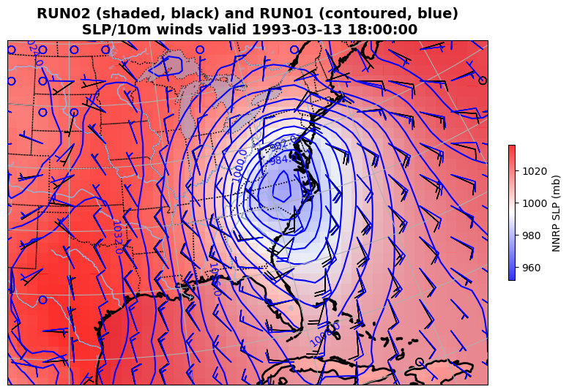

Slide 35
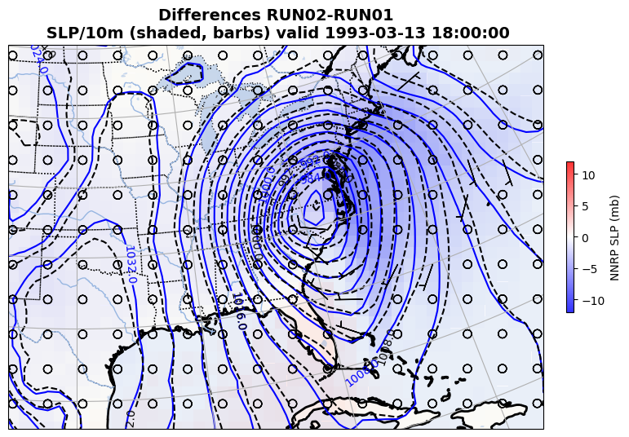
Notes:
FDDA slp lower on e side of cyclone, so diffs negative

Slide 36
Without FDDA
plot_WRF_SOC.ipynb
Cell #11

Slide 37
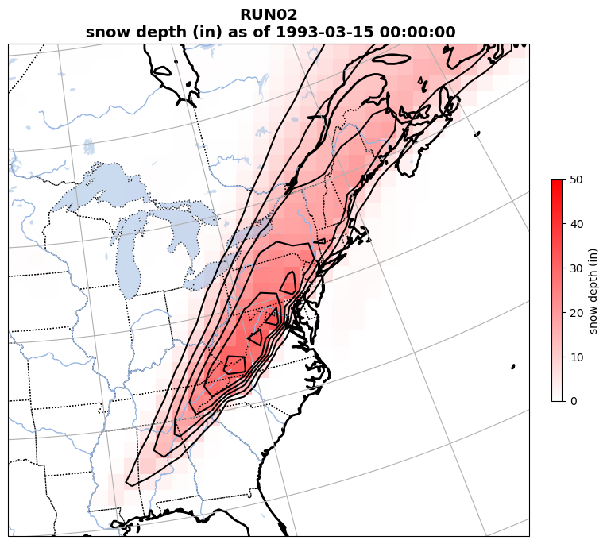
With FDDA
Subtle shift in track
appears to have increased
snow over NYC, Boston
but NESIS is smaller
plot_WRF_SOC.ipynb
Cell #11

Slide 38
OPTIONAL
grid_fdda = 2 turns on
spectral grid nudging in D1.
Spectral grid nudging
&fdda
grid_fdda = 2, 0,
gfdda_inname = "wrffdda_d<domain>",
gfdda_interval_m = 360, 360,
gfdda_end_h = 6, 6,
io_form_gfdda = 2
fgdt = 0, 0,
if_no_pbl_nudging_uv = 1, 1,
if_no_pbl_nudging_t = 1, 1,
if_no_pbl_nudging_q = 1, 1,
if_zfac_uv = 0, 0,
k_zfac_uv = 10, 10,
if_zfac_t = 0, 0,
k_zfac_t = 10, 10,
if_zfac_q = 0, 0,
k_zfac_q = 10, 10,
guv = 0.0003, 0.0003,
gt = 0.0003, 0.0003,
gq = 0.0003, 0.0003,
fgdtzero = 1, 0,
if_no_pbl_nudging_ph = 1, 1,
if_zfac_ph = 0, 0,
k_zfac_ph = 10, 10,
gph = 0.0003, 0.0003,
dk_zfac_uv = 1, 1,
dk_zfac_t = 1, 1,
dk_zfac_ph = 1, 1,
xwavenum = 7, 0,
ywavenum = 5, 0,
/
&fdda section of
namelist.input
Determines which
wavenumbers gets nudged
(see next slide)
real.exe program creates file wrffdda_d01

Slide 39
Spectral grid nudging
OPTIONAL
xwavenum and ywavenum determine which wavenumbers get nudged
Suggested target: select wavenumber such that domain extent/wavenumber ~ 1000 km in x and y directions separately
Here, D1 is 85 points x 90 km = 7650 km in x direction, so I chose xwavenum = 7, and 56 points x 90 km = 5040 km in y direction, so I chose ywavenum = 5.
Thus, we’re nudging wavenumbers 1-7 in x, and 1-5 in y directions, leaving smaller scale waves alone
If you do this, make sure to run real.exe AGAIN
My RUN03 using spectral nudging:
  NESIS = 11.00
  RMSE SLP = 1.72 mb per gridpoint (w/r/t NNRP) (15% ‘improvement’) [better improvement found in older WRF versions]

Slide 40
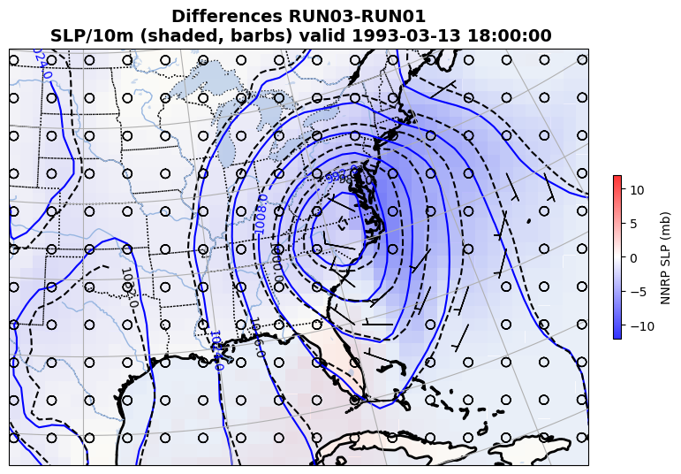
OPTIONAL

Slide 41
Nudging vs. good model physics
[i.e., fix the physics first]
KEEP IN MIND: this assumes NNRP fields are “truth”, but FDDA thinks so too!
SLP ERROR vs NNRP | Default setup | Alternate physics
No nudging (RUN01) | 2.02 mb/gridpt | 1.60 mb/gridpt
Regular nudging | 1.74 | 1.44
Spectral nudging | 1.72 | 1.43
…just nudging
first 6 h
So… how much of the difference above is due to random chance?
SLP ERROR vs NNRP | Default setup | Alternate physics
No SKEBS (RUN01) | 2.02 mb/gridpt | 1.62 mb/gridpt
nens = 1 | 2.34 | 1.94
nens = 2 | 2.23 | 1.83
nens = 3 | 2.04 | 1.81
SKEBS
experiment
(no nudging)
Because NNRP cyclone lacks frontal definition, nudging TOWARDS it may be moving you AWAY from a more realistic-appearing solution…
Notes:
Got to here 2021
Because NNRP cyclone lacks frontal definition, nudging to it may be moving you away from a more realistic-appearing solution

Slide 42
SKEBS perturbations
(stochastic kinetic energy backscatter scheme)
Berner et al. (2010)

Slide 43
SKEBS
SKEBS is an attempt to simulate the uncertainty associated with unresolvable turbulence by infusing some model fields with random noise where/when turbulence is anticipated
  Small perturbations are added to the potential temperature and rotational components of the horizontal wind
Activated by inserting &stoch namelist section and setting switch skebs = 1 for each domain you desire to use it in.
Lateral boundaries are also perturbed if perturb_bdy = 1.
WARNING: SKEBS is still switched ON, even if skebs = 0, as long as the perturb_bdy switch is set to 1.
  So, if you don’t want SKEBS on AT ALL, you need to make sure to switch BOTH options off (i.e., set them to 0).
Make sure grid_fdda = 0!

Slide 44
&stoch
Activates scheme (set BOTH to 0 to deactivate)
&stoch
skebs = 1, 0,
perturb_bdy = 1
nens = 1
tot_backscat_psi = 1.0E-05
tot_backscat_t = 1.0E-06
ztau_psi = 10800.0
ztau_t = 10800.0
rand_perturb = 1, 1,
gridpt_stddev_rand_pert = 0.03
stddev_cutoff_rand_pert = 3.0
lengthscale_rand_pert = 500000.0
timescale_rand_pert = 21600.0
/
IMPORTANT!
Set nens to a different
integer value for each run,
to generate different
perturbations!
Make sure grid_fdda = 0

Slide 45
EXP03: assigned nens values
Google Docs spreadsheet for Experiment 3 (click here)
EXP 3 due date, Monday 11/18/24
If you don’t have permission to add
your info to spreadsheet, let me know…
Redo RUN01 w/ no FDDA (fdda=0) but SKEBS ON (skebs=1, perturb_bdy=1) AND nens values assigned to you
You are responsible for three SKEBS simulations using 3 different nens values
See spreadsheet linked above for your assigned values [see also slide 40]
Report output of analyze.sh for each of your runs by email [example next slide]

Slide 46
Example: my analyze.sh output for nens = 1
(0) NESIS = 9.29 (pop component= 2.24753 area component= 7.04135)
(0) RMSE SLP = 2.67 mb per gridpoint (vs. NARR reanalysis)
(0) RMSE SLP = 2.34 mb per gridpoint (vs. NNRP reanalysis)
• Copy and paste this information, AND the nens values, for your runs to
us via email, and also enter it on the Google spreadsheet

Slide 47
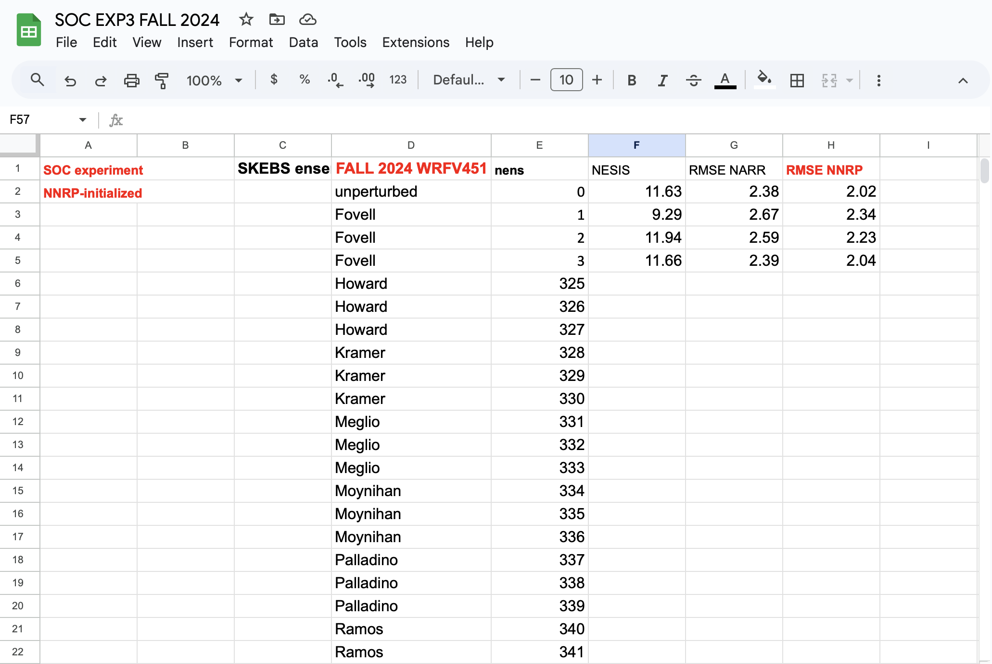

Slide 48
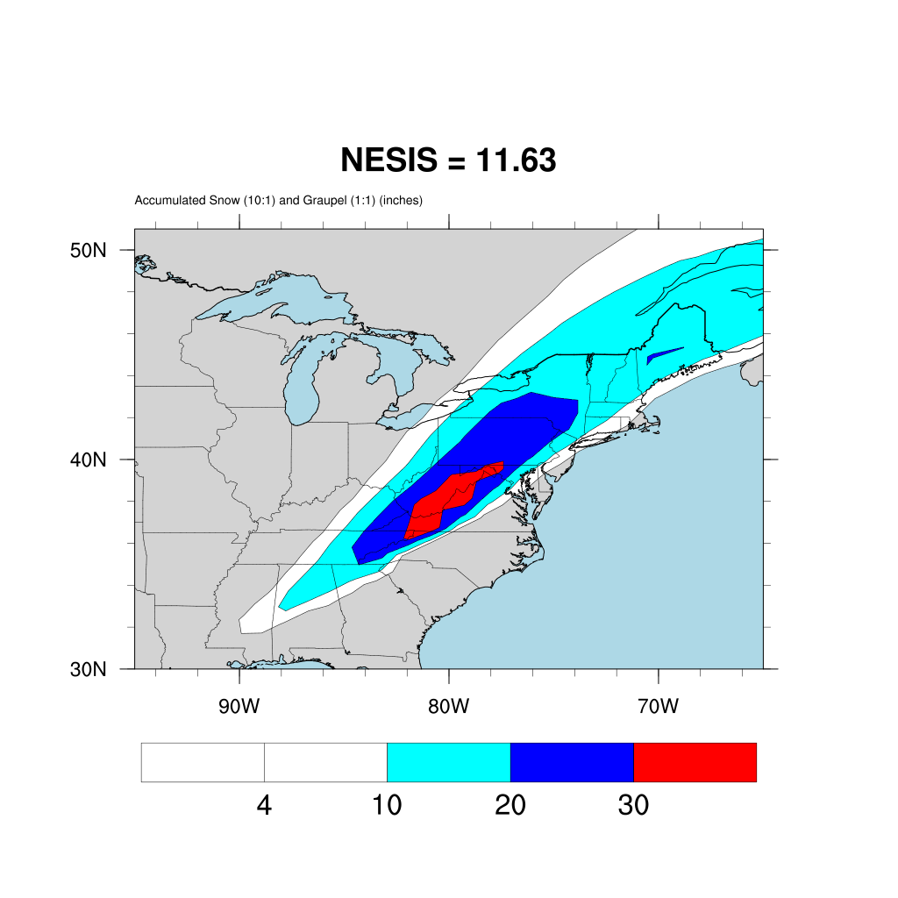
Default setup
Unperturbed
Notes:
2022

Slide 49
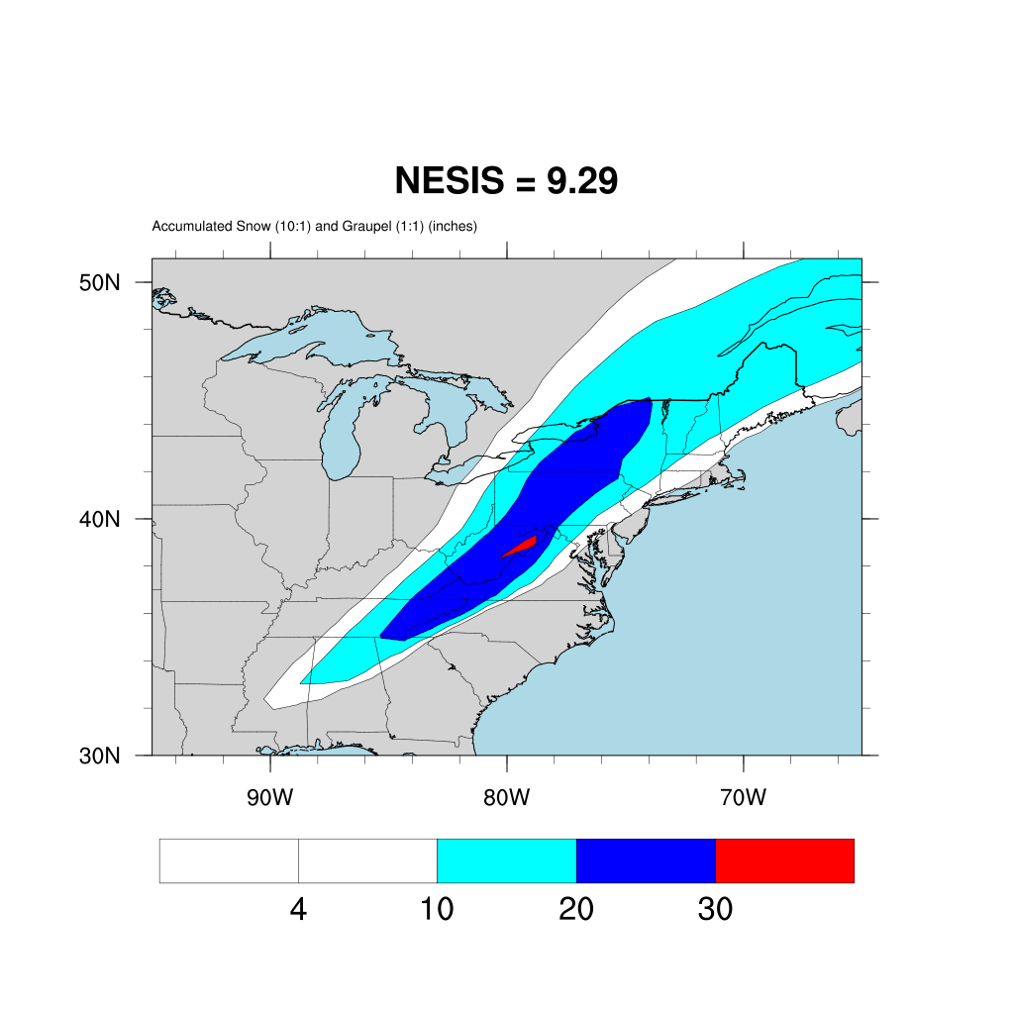
Default setup
nens = 01
Notes:
2022
E Penn: this run says 10-20, then next 20-30, and 30-40. Quite a range

Slide 50
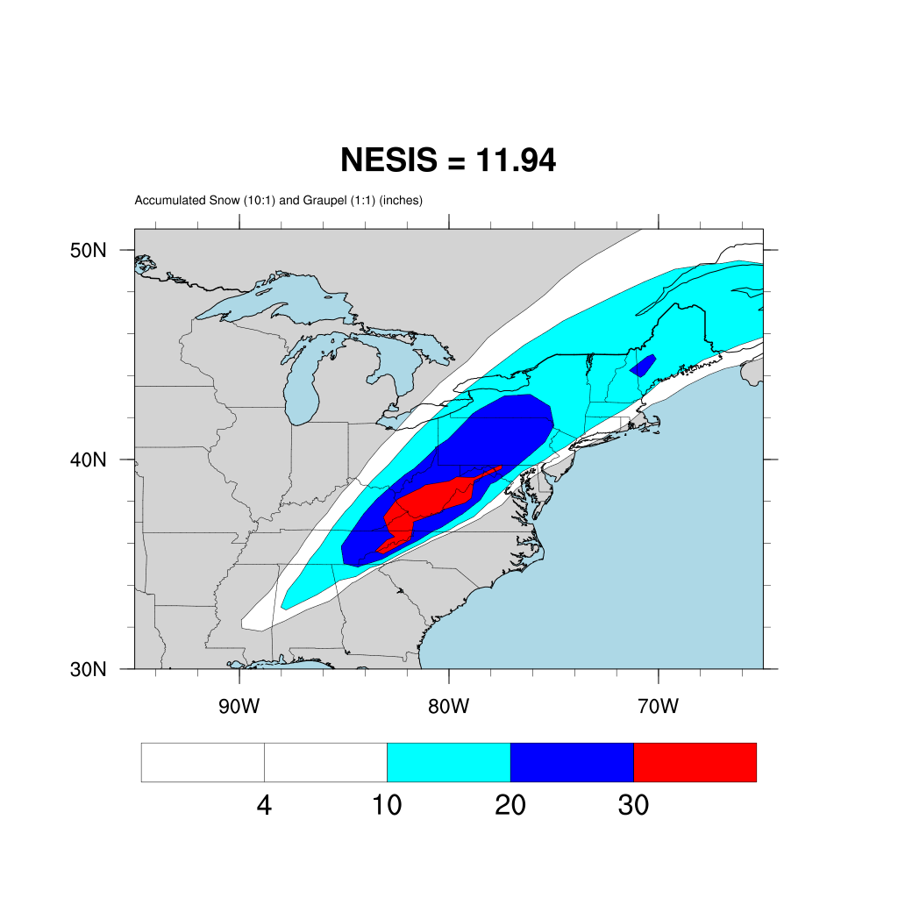
Default setup
nens = 02
Notes:
2022

Slide 51
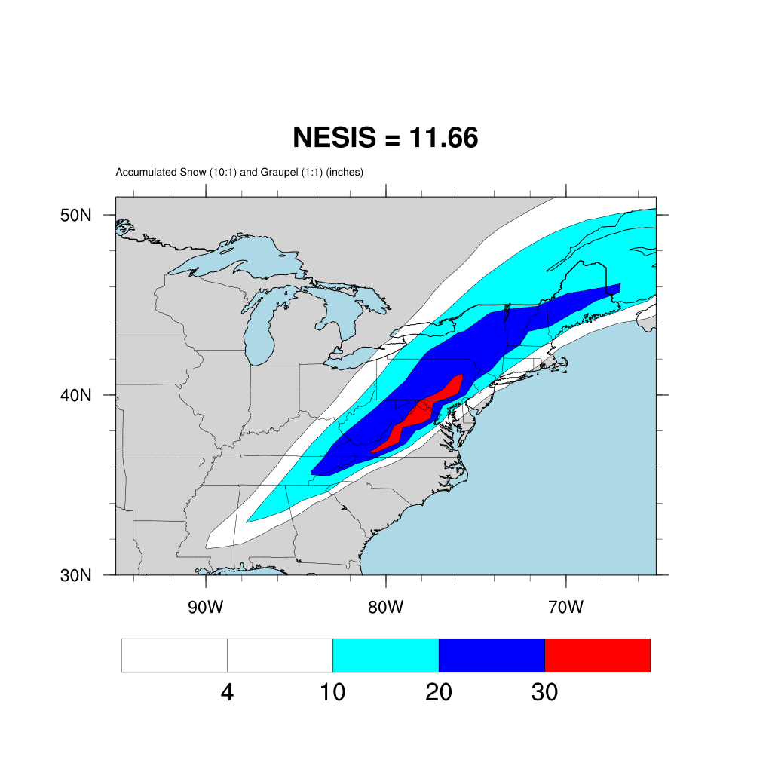
Default setup
nens = 03
Notes:
2022

Slide 52
Notes
Nudging, especially to a low-resolution analysis, really has to be questioned
  The low-resolution reanalysis is NOT “truth”
  At least spectral nudging can be confined to the longest waves, however
  That said, we’re going to move to a higher-resolution reanalysis – the NARR
It does not appear to make sense to use nudging and SKEBS simultaneously

Slide 53
[end of Part 1]

