Slide 1
Thunderstorm case demonstration and cumulus ensemble
Ensemble assignments will be made soon
ATM 419/563
Fall 2024
Fovell
WRF version
© Copyright 2024 Robert Fovell, Univ. at Albany, SUNY, rfovell@albany.edu

Slide 2
Objective
By completion of this demonstration, we will have covered:
  how and why some parameterizations work (and fail),
  what to check when creating a domain,
  how to create a parent domain with nests,
  how to initialize WRF using different data sets,
  how to visualize model output using Python,
  how parameterizations for subgrid-scale clouds (cumulus schemes) can vary and compete with microphysics,
  how the model is integrated in time and discretized in space,
  how to recognize, diagnose, and mitigate numerical difficulties,
Soon, we will also cover:
  how to verify forecasts against surface observations,
  how to perturb forecasts and modify model default levels
Notes:
As a result of the course to date…

Slide 3
March 2022 NY squall line

Slide 4
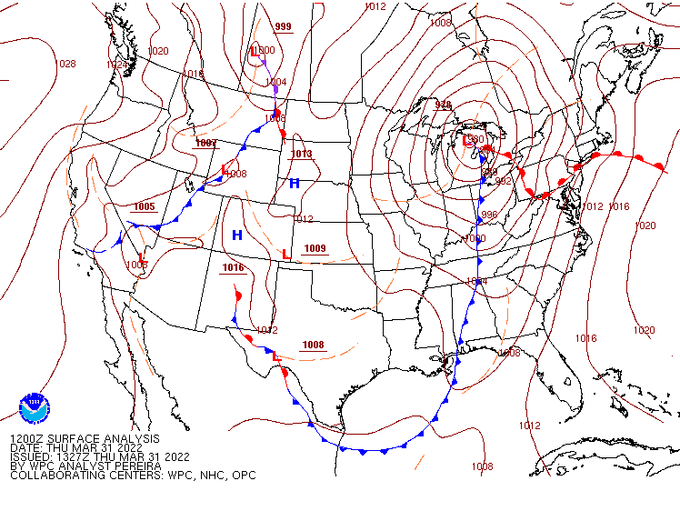
1200Z 31 March 2022

Slide 5
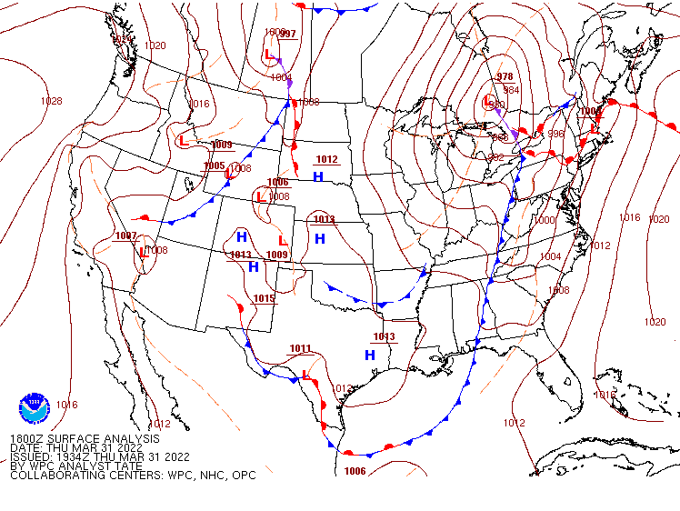
1800Z 31 March 2022

Slide 6
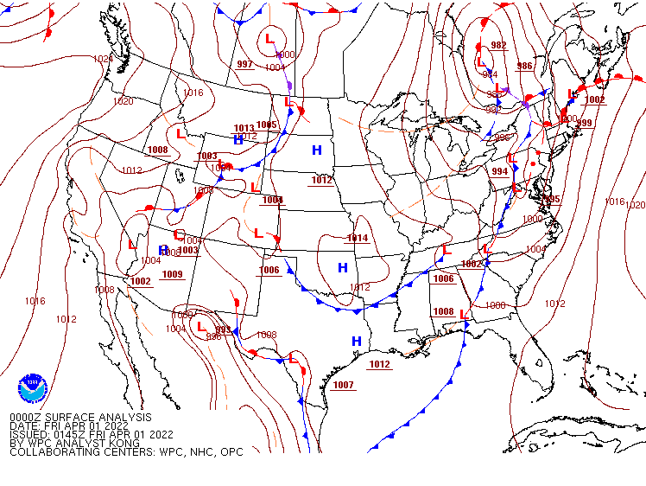
0000Z 1 April 2022
SQUALL

Slide 7
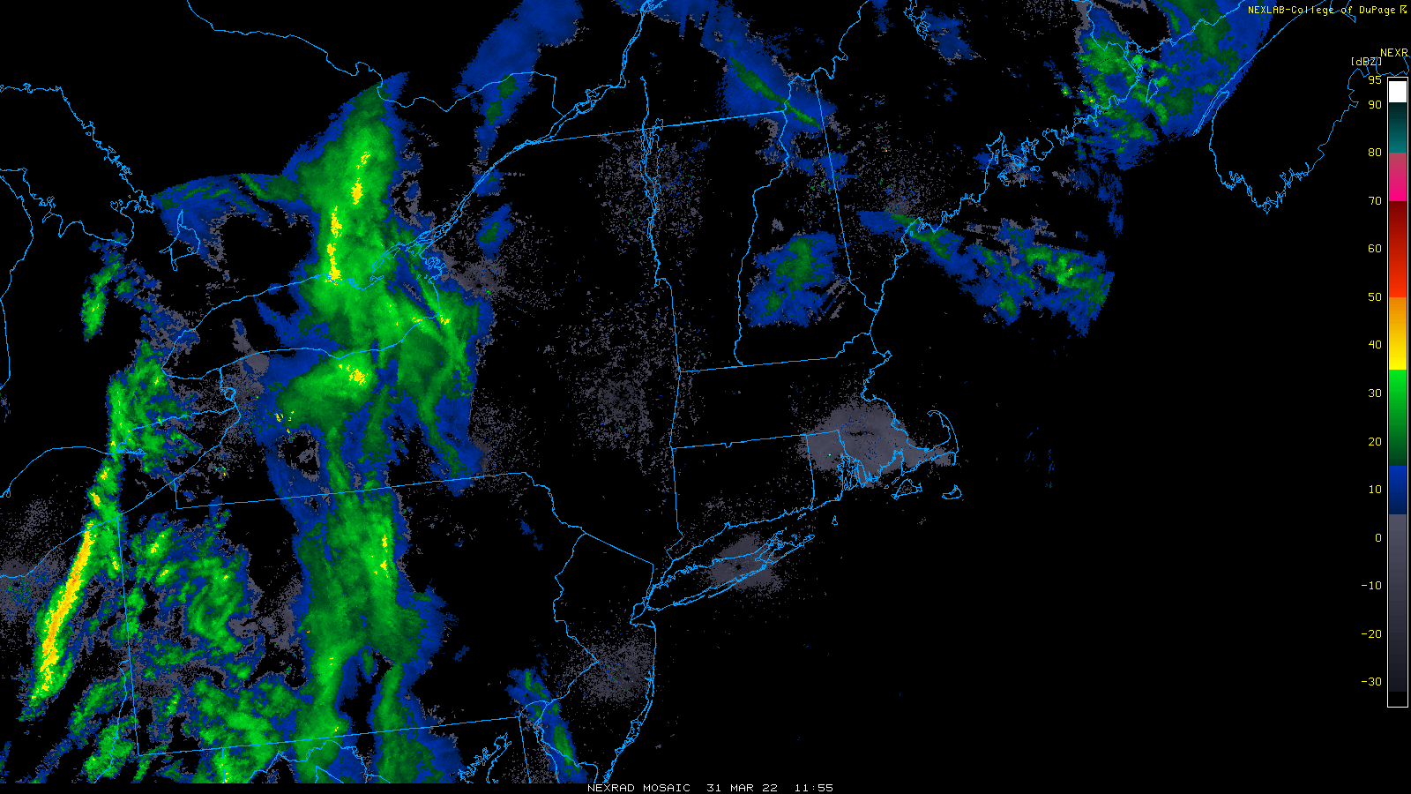
1155Z 31 March 2022
https://www2.mmm.ucar.edu/imagearchive/

Slide 8
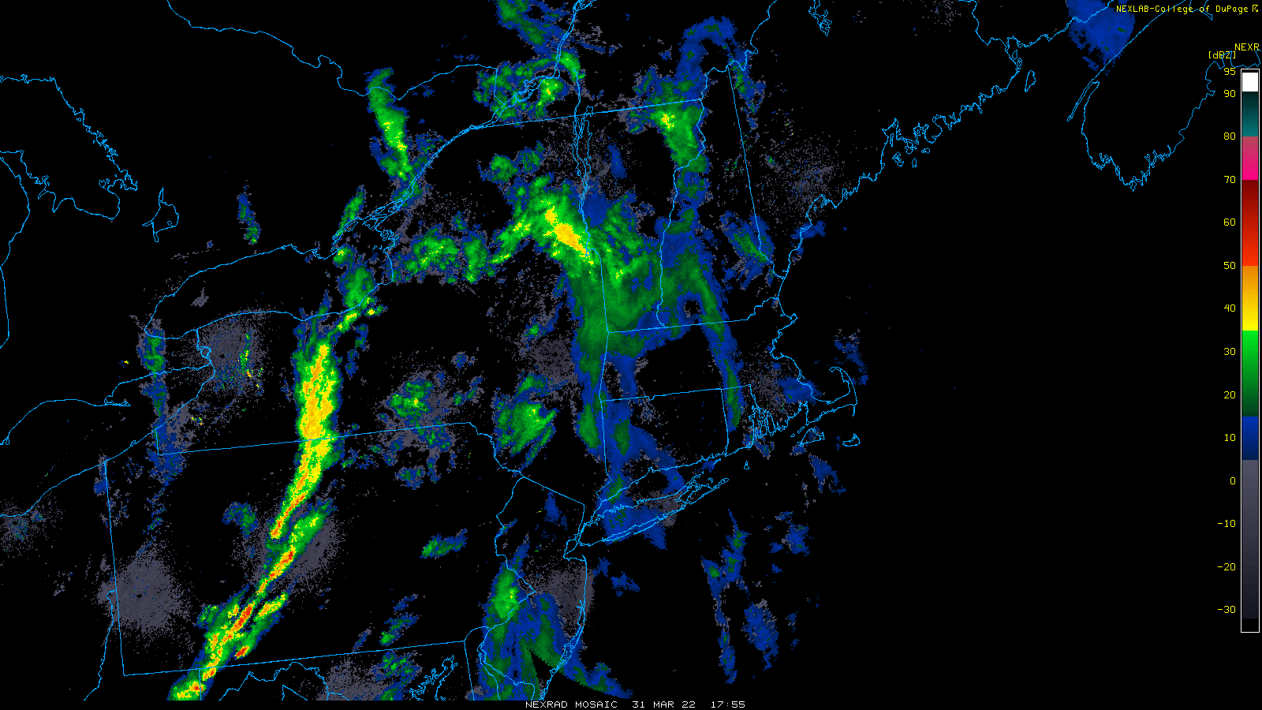
1755Z 31 March 2022
Pre-frontal squall line forms

Slide 9
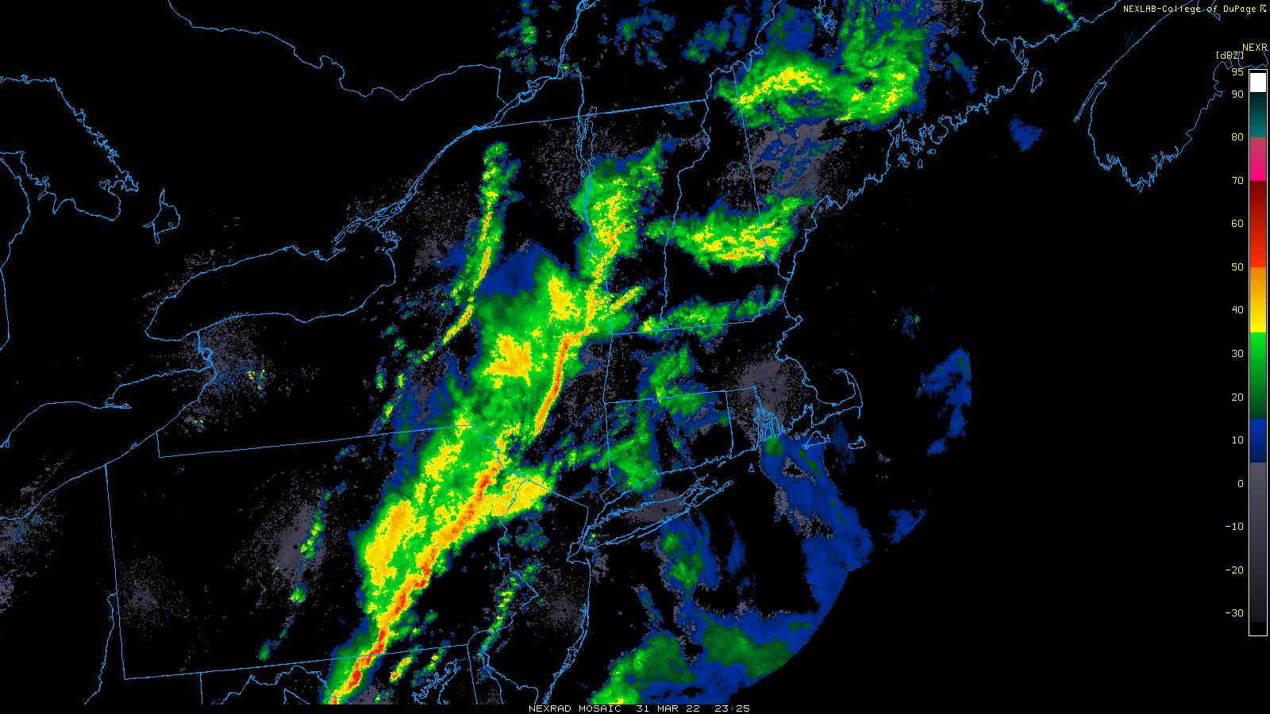
2325Z 31 March 2022
Trailing stratiform region now apparent behind squall. Convection also along cold front

Slide 10
WRF control run and “TRUTH” run
Control run: 12 km grid spacing, Thompson MP, Kain-Fritsch CU
TRUTH run: 4 km nest over NY area with no CU active

Slide 11
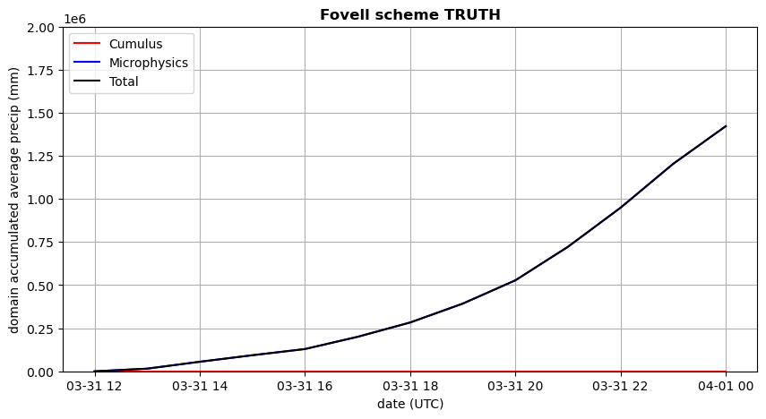
“TRUTH” – 2 domains, microphysics only in D2 (no cumulus)
Total precipitation in a defined subdomain

Slide 12
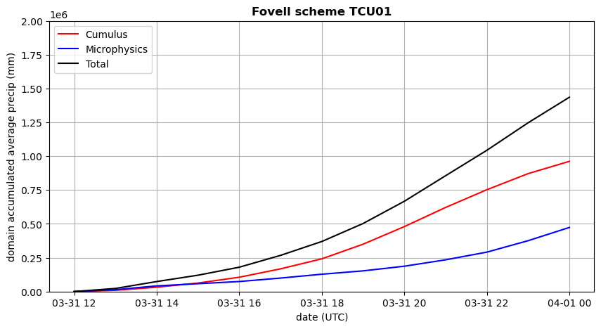
TCU01 [our common control run] – 1 domain, cu_physics=1
Total precip looks quite similar to “TRUTH”,
which is encouraging…
Total precipitation in a defined subdomain

Slide 13
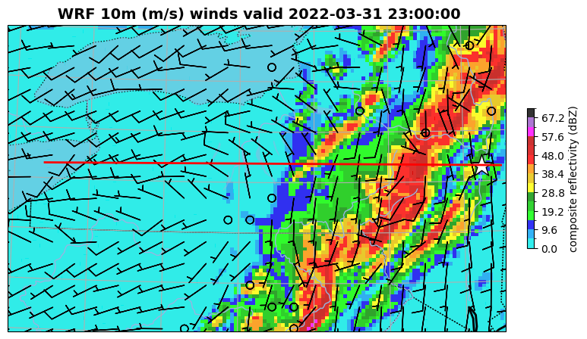
“TRUTH” – 2 domains, microphysics only in D2 (no cumulus) – forecast hr 11
4 km ∆x
Cumulus OFF
Wind barbs every 6 gridpoints
Notes:
Cold front maybe too far east.

Slide 14
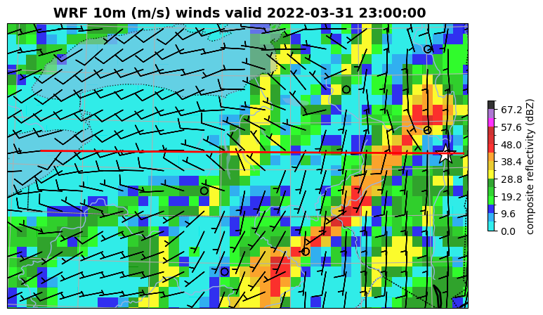
TCU01 [our common control run] – 1 domain, cu_physics=1 [our control run] - forecast hr 11
Thompson microphysics (T) + Cumulus (CU) scheme 1
12 km ∆x
Cumulus ON
Wind barbs every 2 gridpoints
Notes:
Convec along cold front seen in CU

Slide 15
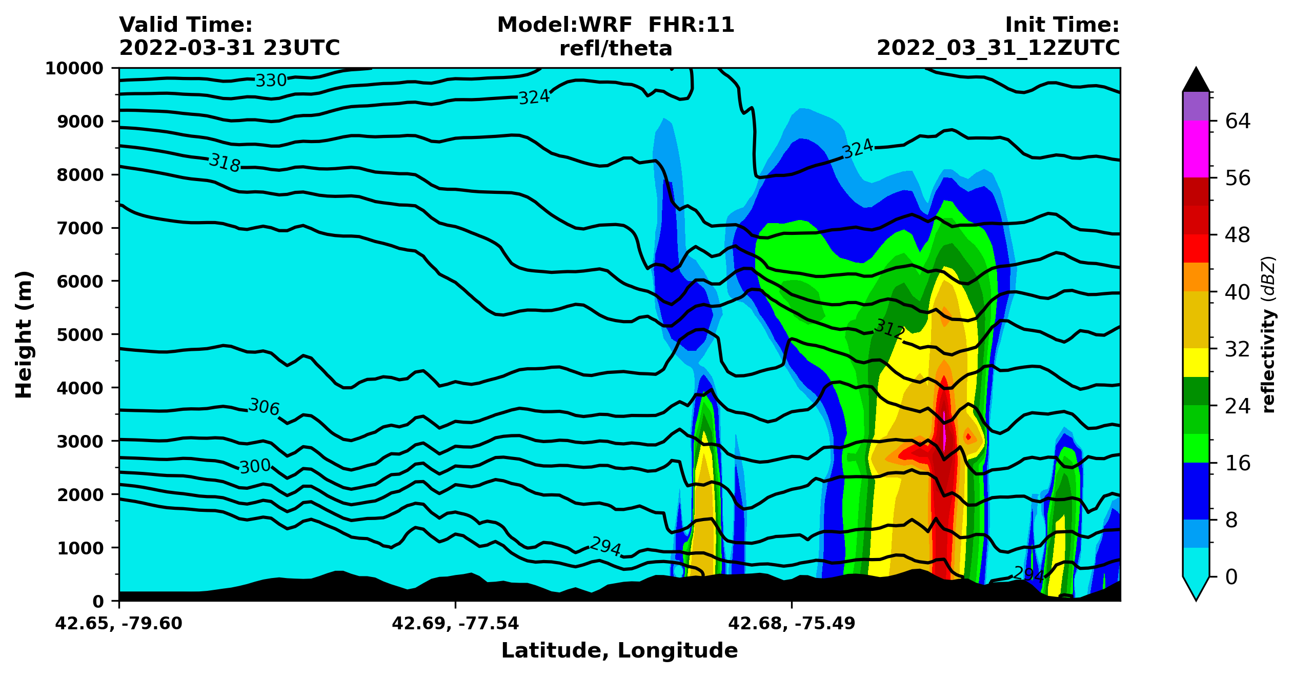
“TRUTH” – west east cross-section at 42N – forecast hour 11
4 km ∆x
Cumulus OFF
More realistic --> more correct?????
Made with plot_WRF_TSTORM.ipynb

Slide 16
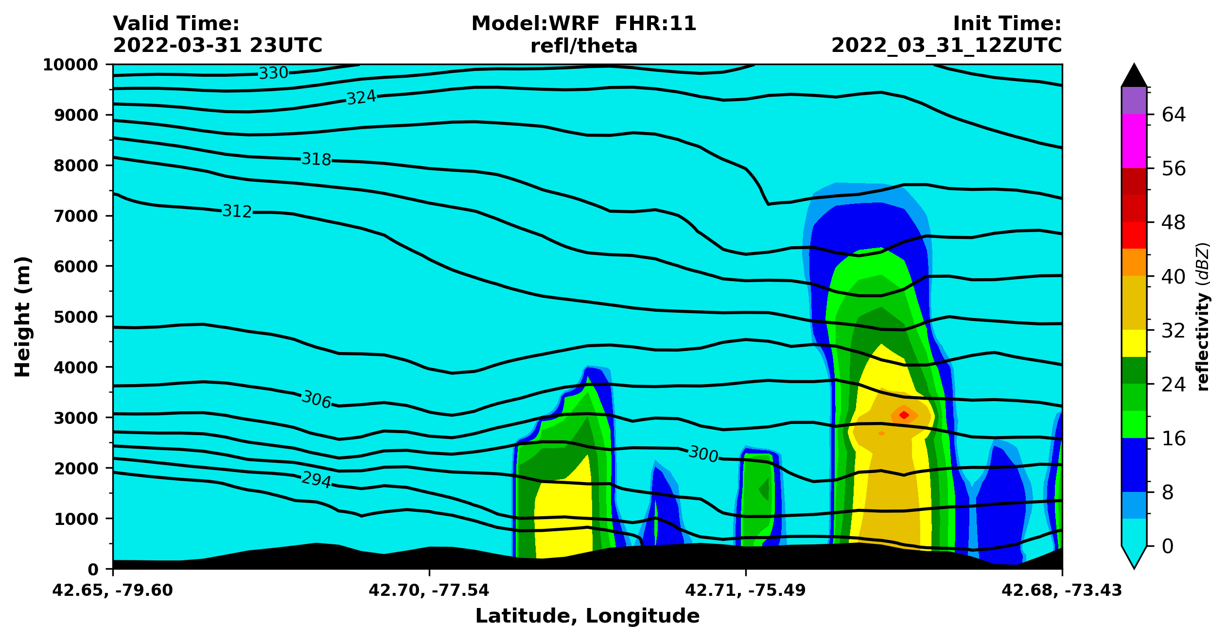
TCU01 – west east cross-section across Albany – forecast hour 11 [our control run]
12 km ∆x
Cumulus ON
Made with plot_WRF_TSTORM.ipynb
Notes:
We’re 42.75N

Slide 17
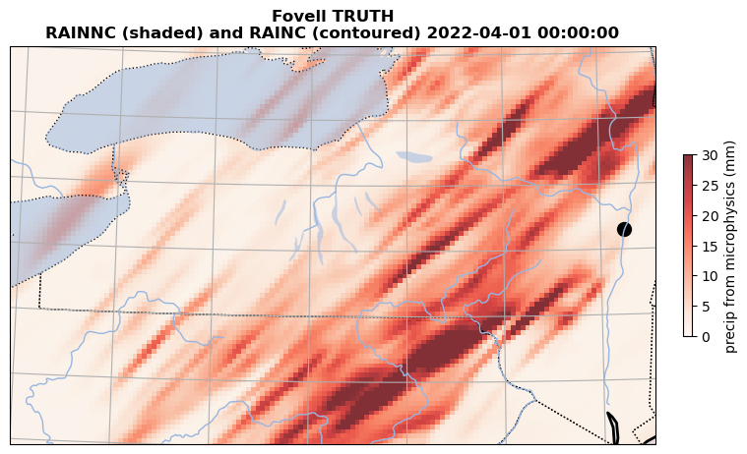
“TRUTH” – accumulated rain from microphysics (shaded)

Slide 18
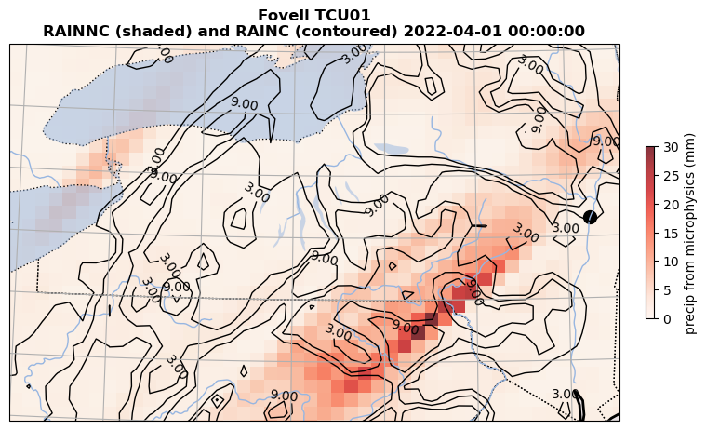
“TCU01” – accumulated rain from microphysics (shaded) and cumulus (contoured)

Slide 19
Outline (WRF)
Create and position an outer domain + nest
  D1 = Domain 1 (12 km)
  D2 = Domain 2 (4 km nest… 3:1 ratio standard)
Make a 12 h simulation using 1 domain initialized with GFS and using the Kain-Fritsch cumulus scheme
  Our common control run
Compare to simulation made with 2 domains without cumulus in inner nest (“TRUTH”); i.e.,
  D1 uses a cumulus parameterization and a microphysics scheme
  D2 relies on microphysics only
Contribute to a class cumulus scheme ensemble with some variation of microphysics after control run is complete
Please also refer to WRF REAL CHECKLIST

Slide 20
Resources (WRF experiment)
$LAB/SCRIPTS/WRF_REAL_SETUP.TAR
$LAB/TSTORM/plot_WRF_TSTORM.ipynb
  Output files created like
    TCU01_planview_Fovell.png
    TCU01_timeseries_Fovell.png
    TCU01_Fovell_precip.csv
Script: TSTORM_demonstration.pdf
WRF REAL CHECKLIST from class web page

Slide 21
WRF setup
(see also WRF setup script)
[Ungrib and Geogrid steps can be done simultaneously…]

Slide 22
NOW the second column – where it appears -- matters
namelist.wps
&share
wrf_core = 'ARW',
max_dom = 2,
start_date ='2022-03-31_12:00:00', '2022-03-31_12:00:00'
end_date = '2022-04-01_00:00:00', '2022-04-01_00:00:00'
interval_seconds = 3600,
Same start/end times for both domains
UNGRIB STEP
&geogrid
parent_id = 1, 1,
parent_grid_ratio = 1, 3,
i_parent_start = 1, 22,
j_parent_start = 1, 32,
s_we = 1, 1,
e_we = 115, 166,
s_sn = 1, 1,
e_sn = 100, 100,
geog_data_res ='default', 'default',
dx = 12000.,
dy = 12000.,
grey: never altered
Notes:
Grey = these are never altered.
Our WRF core is ARW

Slide 23
Ungrib step
[Consider opening TWO connections to head.arcc, so you can do the
ungrib and geogrid steps simultaneously]
cp Vtable.GFS Vtable
link_grib.csh $LAB/DATA/GFS_2022033112/gfs* .
sbatch –p burst-daes submit_ungrib
[you may need to wait for job to start]
tail –f ungrib.log
“*** Successful completion of program ungrib.exe ***”. THIS TAKES TIME.
{see also script. Follow real-data checklist.}

Slide 24
Geogrid step
[Consider opening TWO connections to head.arcc, so you can do the
ungrib and geogrid steps simultaneously]
2 domains maximum
D1: 115 e_we x 100 e_sn points, 12 km grid spacing
D2: 166 e_we x 100 e_sn points, 4 km grid spacing
  D2 lower left corner positioned at (22, 32) = (i_parent_start, j_parent_start) within D1 [see slide 26]
  D2:D1 grid ratio will be 3:1 (standard)
Lambert projection
  Reference latitude: 42.6˚
  Lambert true latitudes: both 42.6˚
  Reference and standard longitudes: -76˚
Edit namelist.wps as needed
Inspect domain using plot_WRF_domain.ipynb (don’t skip this; see slide 26)
Execute geogrid.exe somehow [see slide 28]
Make sure you have two new files: geo_em.d01.nc, geo_em.d02.nc
Run plot_WRF_terrain.ipynb to inspect terrain and map factors (slide 27)
{see also script. Follow real-data checklist.}
Notes:
Max map factor 1.00459, min 1.0

Slide 25
NOW the second column – where it appears -- matters
namelist.wps
&share
wrf_core = 'ARW',
max_dom = 2,
start_date = '2022-03-31_12:00:00', '2022-03-31_12:00:00'
end_date = '2022-04-01_00:00:00', '2022-04-01_00:00:00'
interval_seconds = 3600,
Same start/end times for both domains
Controls nest grid spacing
(D2 = D1/3)
[3:1 ratio is standard]
&geogrid
parent_id = 1, 1,
parent_grid_ratio = 1, 3,
i_parent_start = 1, 22,
j_parent_start = 1, 32,
s_we = 1, 1,
e_we = 115, 166,
s_sn = 1, 1,
e_sn = 100, 100,
geog_data_res ='default', 'default',
dx = 12000.,
dy = 12000.,
Controls location
(lower left corner) in parent
[see next slide]
D1’s grid spacing ONLY
grey: never altered
Notes:
Grey = these are never altered.
Our WRF core is ARW

Slide 26
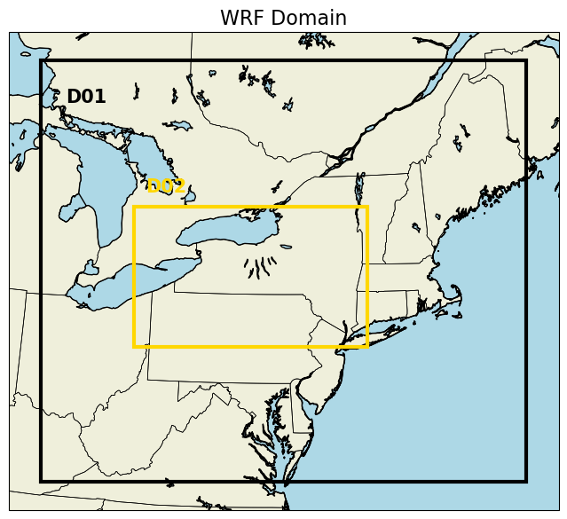
Output from plot_WRF_domain.ipynb
Make sure your domain looks like this before moving on!
(22,32)

Slide 27
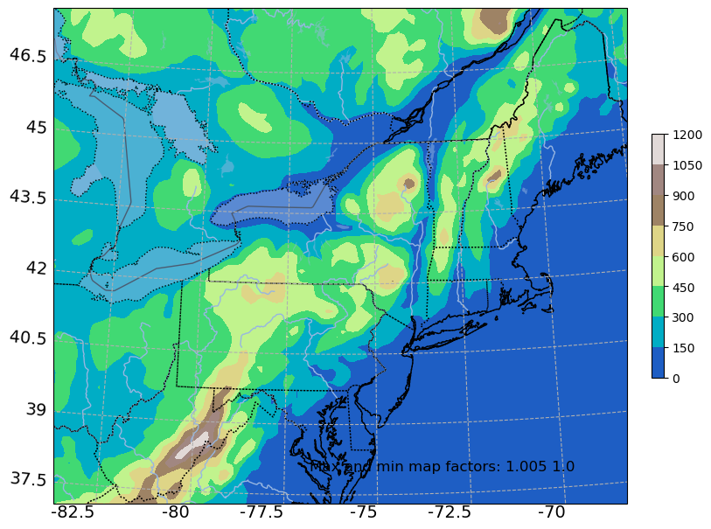
Terrain of D1
Output from plot_WRF_terrain.ipynb

Slide 28
Running geogrid.exe
The geogrid program can take some time, especially when generating large nests.
However, geogrid is also MPI-aware (all WPS/WRF programs are, except ungrib.exe and tc.exe)
Two options:
  (1) Ask for multiple cpus with srun. Example:
    srun –p burst-daes –n 8 geogrid.exe
  (2) Submit a batch job (submit_geogrid provided)
    sbatch –p burst-daes submit_geogrid
    tail –f geogrid.srun.out
Notes:
Mapfacs 1 to 1.00459

Slide 29
Metgrid step
[after ungrib AND geogrid are finished]
sbatch –p burst-daes submit_metgrid
tail –f metgrid.log.0000
“*** Successful completion of program metgrid.exe **”
Select one of the met_em.d* files generated, and dump the header (ncdump –h) to look for num_metgrid_levels, num_st_layers, num_sm_layers

Slide 30
Relevant to ungrib and metgrid steps
namelist.wps
Typical for ungrib outputs
== metgrid inputs to be
named “FILE”. You should
change this if manipulating
more than one data source
simultaneously
&ungrib
out_format = 'WPS',
prefix = 'FILE',
/
&metgrid
fg_name = 'FILE',
io_form_metgrid = 2,
/
constants_name = './TAVGSFC',
If a “constants file” is needed
[e.g., landmask or other
temporally invariant info]
it would be defined and placed ABOVE the / line
grey: very rarely altered
Notes:
Grey = these are never altered.
Our WRF core is ARW

Slide 31
Real and WRF steps
Edit namelist.input, as described in script
Make sure
  Start/end times, interval_seconds match namelist.wps
  num_metgrid_levels, num_metgrid_soil_levels are set correctly
  Domain size and resolution and nest location set as in namelist.wps
  max_dom = 1 for this demo
  Model physics and time step set as in script [lines 67-71]

Slide 32
NOW the second column – where it appears -- matters
namelist.input
&time_control
run_days = 0,
run_hours = 12,
run_minutes = 0,
run_seconds = 0,
start_year = 2022, 2022,
start_month = 03, 03,
start_day = 31, 31,
start_hour = 12, 12,
start_minute = 00, 00,
start_second = 00, 00,
end_year = 2022, 2022,
end_month = 04, 04,
end_day = 01, 01,
end_hour = 00, 00,
end_minute = 00, 00,
end_second = 00, 00,
interval_seconds = 3600,
input_from_file = .true., .true.,
history_interval = 60, 60,
frames_per_outfile = 99999, 99999,
Notes:
Check the stuff in red. All will need to change.

Slide 33
MAKE SURE INFO MATCHES namelist.wps!
namelist.input
&domains
time_step = 30,
time_step_fract_num = 0,
time_step_fract_den = 1,
max_dom = 1,
e_we = 115, 166,
e_sn = 100, 100,
e_vert = 57, 57,
p_top_requested = 5000,
num_metgrid_levels = ??,
num_metgrid_soil_levels = ?,
dx = 12000., 4000.,
dy = 12000., 4000.,
grid_id = 1, 2,
parent_id = 0, 1,
i_parent_start = 1, 22,
j_parent_start = 1, 32,
parent_grid_ratio = 1, 3,
parent_time_step_ratio = 1, 3,
For D1
1 domain (for demo)
Our choice but need
to be same for each domain
D2 has 1/3 the grid spacing of D1, and will use 1/3 the time step
Grid spacing of D2 is specified in 2 different ways: explicitly (dx, dy = 4000.) and implicitly (parent_grid_ratio = 3)
Notes:
Need to directly specify D2 grid spacing (4000 m) and indirectly (through parent_grid_ratio = 3)

Slide 34
Run real and WRF
sbatch -p burst-daes submit_real
tail -f rsl.out.0000: “real_em: SUCCESS COMPLETE REAL_EM INIT”
sbatch -p burst-daes submit_wrf
tail -f rsl.out.0000: “real_em: SUCCESS COMPLETE WRF”
This will take awhile and may not finish in today’s class. But, once you’re done…

Slide 35
Visualize output with plot_WRF_TSTORM.ipynb
Cell #3
############################################################################ set your surname and scheme name
###########################################################################
surname = 'Fovell'
scheme = 'TCU01'
print(" Hi ",surname,"! Your scheme is ",scheme)
You’ll modify the red lines for your ensemble contribution [later]

Slide 36
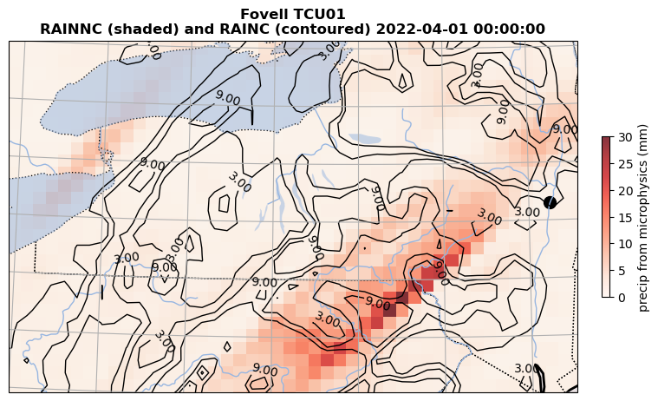
Cell #5

Slide 37
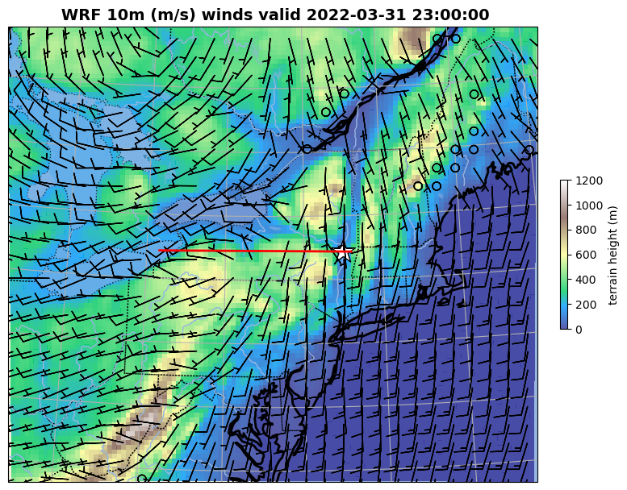
Cell #7
Barbs every
4 gridpts

Slide 38
Cell #8
Wind barbs every 2 gridpoints

Slide 39
Cell #9

Slide 40
Cell 10

Slide 41
Cumulus ensemble
Ensemble assignments will be made soon
Modify namelist.input as needed
Rerun real.exe and wrf.exe
Edit Cell #3 in plot_WRF_TSTORM.ipynb for your surname and your schemename
cp *schemename* $LAB/TSTORM_ensemble/.

Slide 42
[end]

