Slide 1
Thunderstorm case ensemble evaluation
ATM 419/563
Spring 2024
Fovell
SNOW cluster version
© Copyright 2024 Robert Fovell, Univ. at Albany, SUNY, rfovell@albany.edu

Slide 2
Our experiment
Domain 1 (12 km) ← cumulus scheme recommended
Domain 2 (4 km) ← cumulus scheme not recommended (unless “scale aware”)
Cumulus ensemble in Domain 1, for comparison w/ Domain 2 (“TRUTH”) results

Slide 3
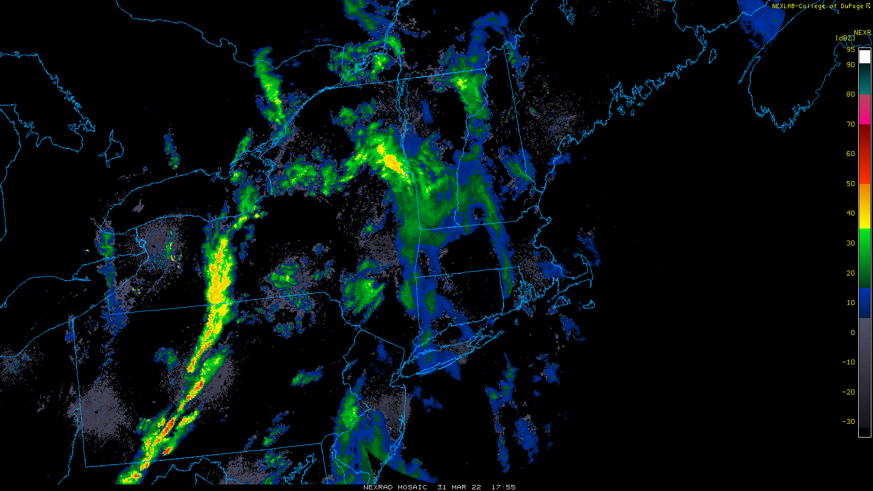
1755Z 31 March 2022
Pre-frontal squall line forms

Slide 4
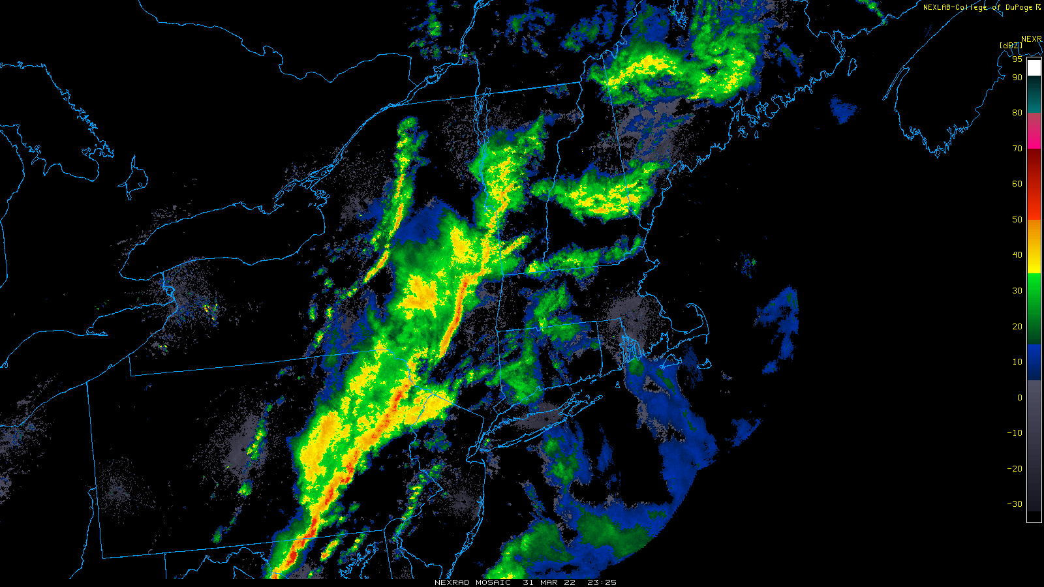
2325Z 31 March 2022
Trailing stratiform region now apparent behind squall. Convection also along cold front

Slide 5
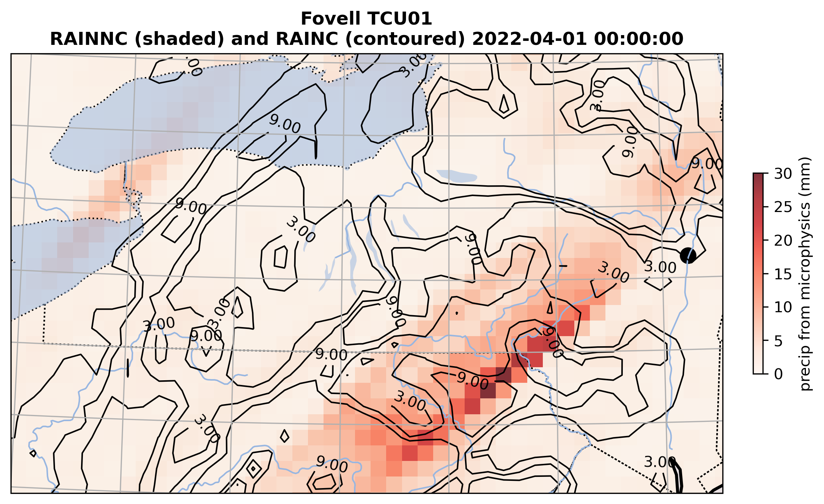
Control run: Kain-Fritsch, Thompson MP
Notes:
Cumulus responding to forced lifting at ADK south edge

Slide 6
Control run: Kain-Fritsch, Thompson MP
Microphysics alignment
Cumulus alignment
Cumulus precip ahead of
main line
Notes:
Cumulus responding to forced lifting at ADK south edge

Slide 7
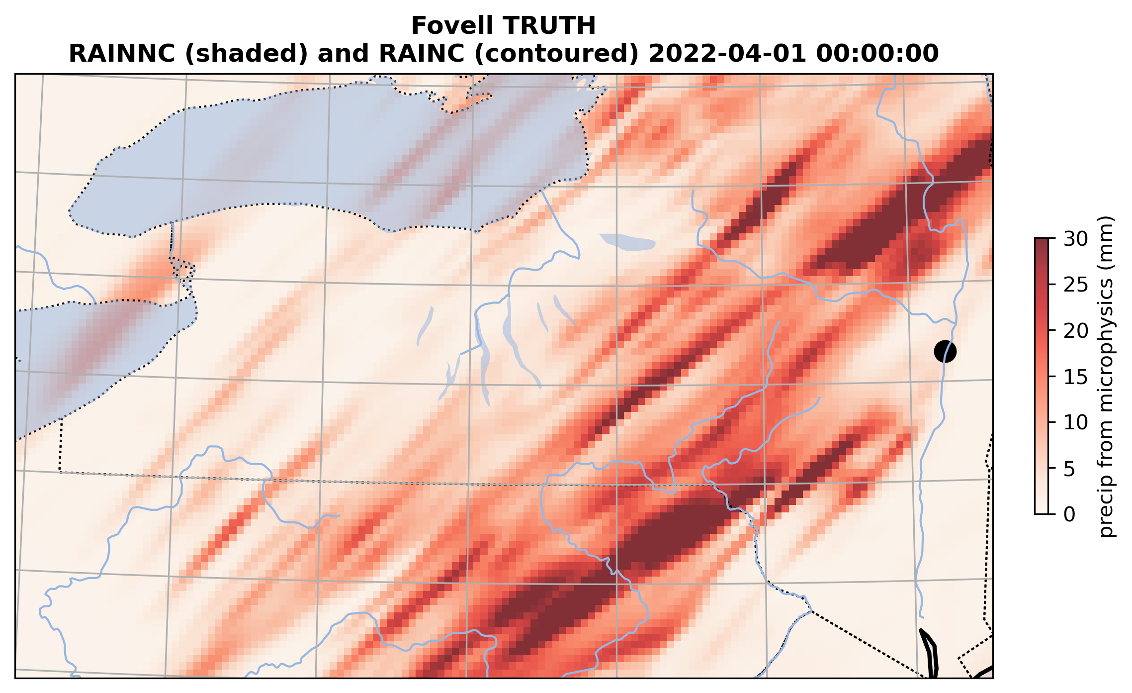
“TRUTH” 2 domains, no cumulus, Thompson
Notes:
Looks more like microphysics structure only, not like what CU scheme did in D1
There is precip along S ADK edge but not as smeared out as in CU

Slide 8
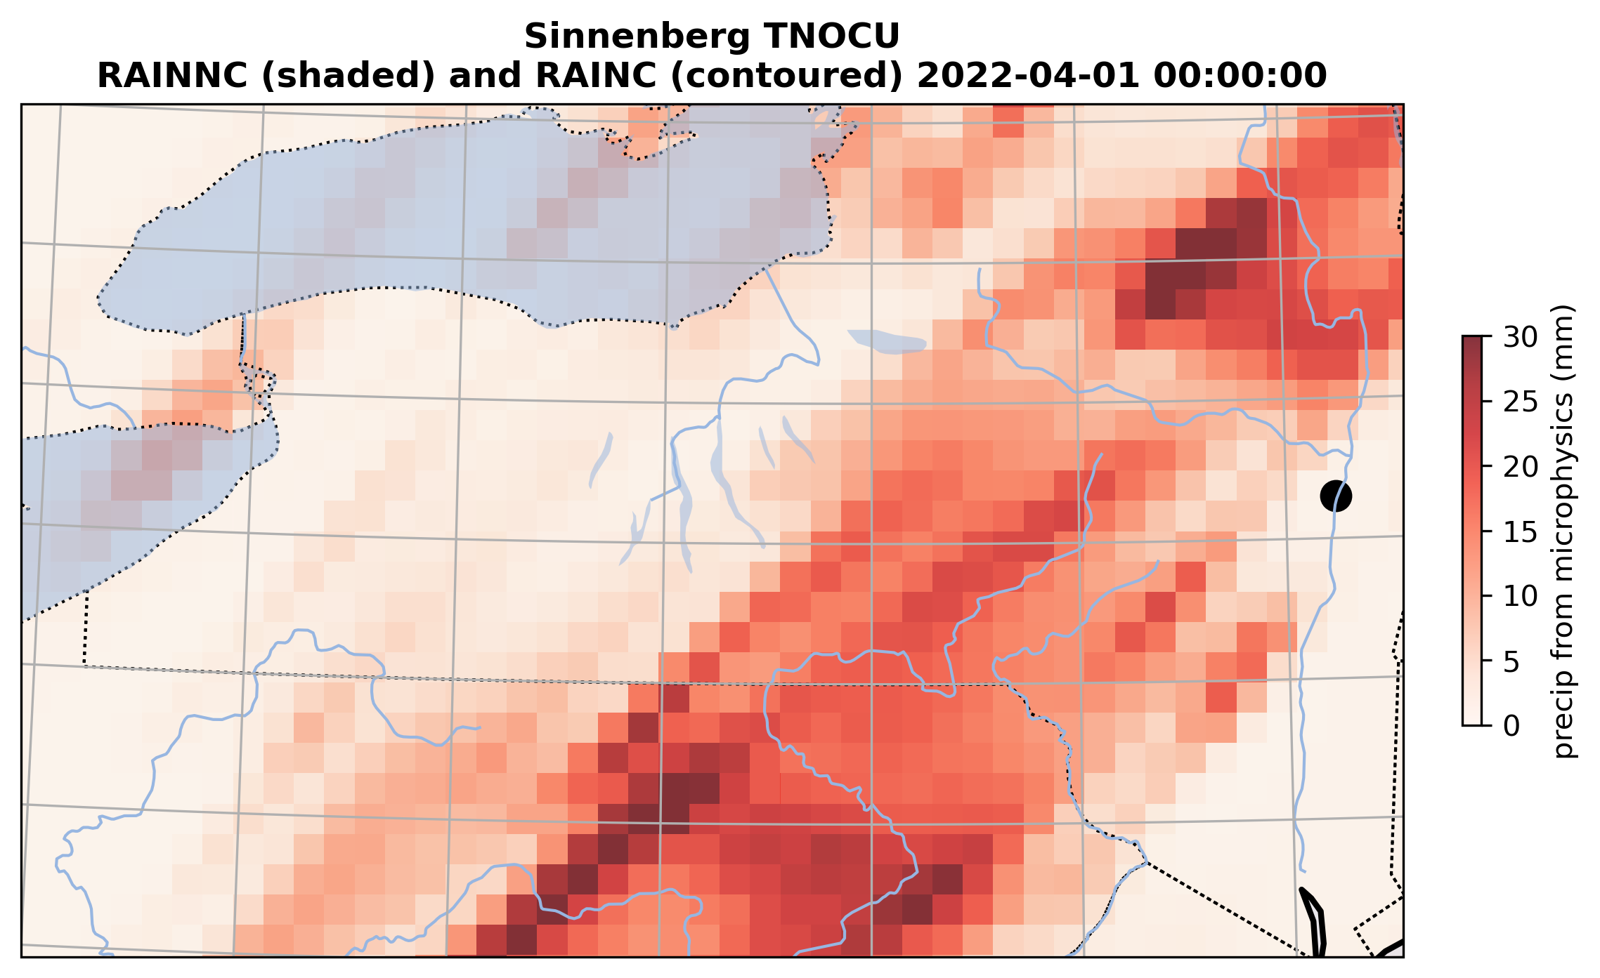
1 domain, no cumulus (Thompson MP)
Notes:
Not so bad!

Slide 9
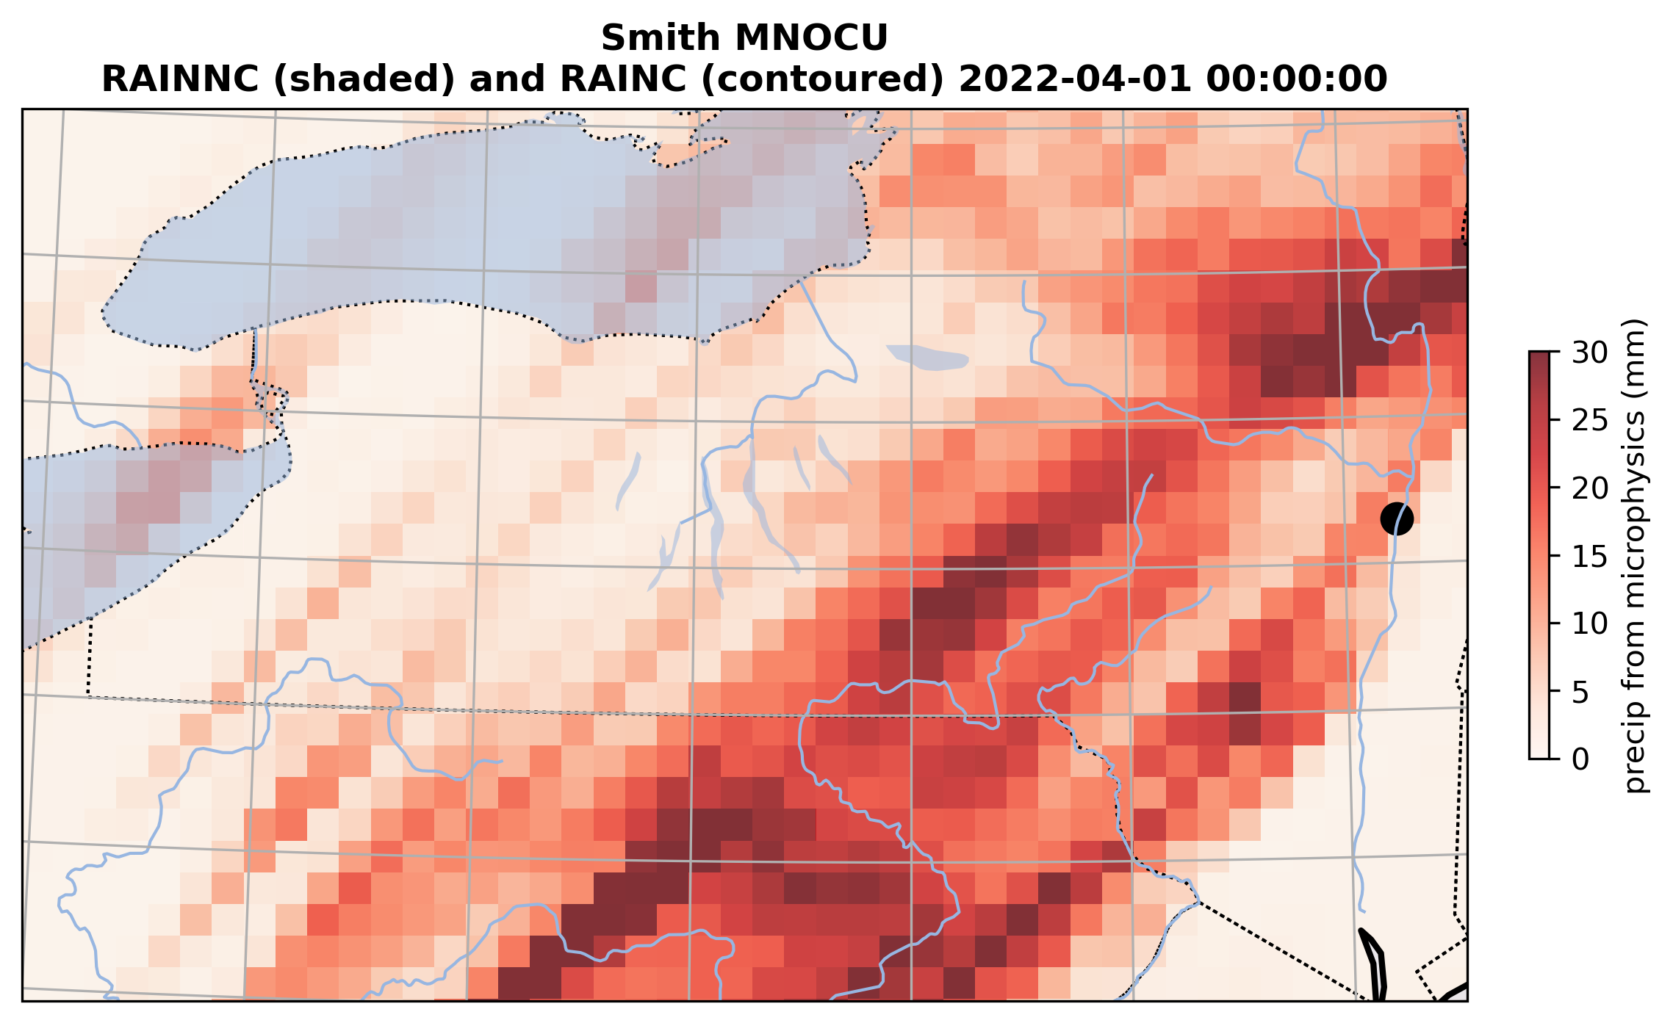
1 domain, no cumulus (Morrison MP)
Notes:
Diff MP, not so diff

Slide 10
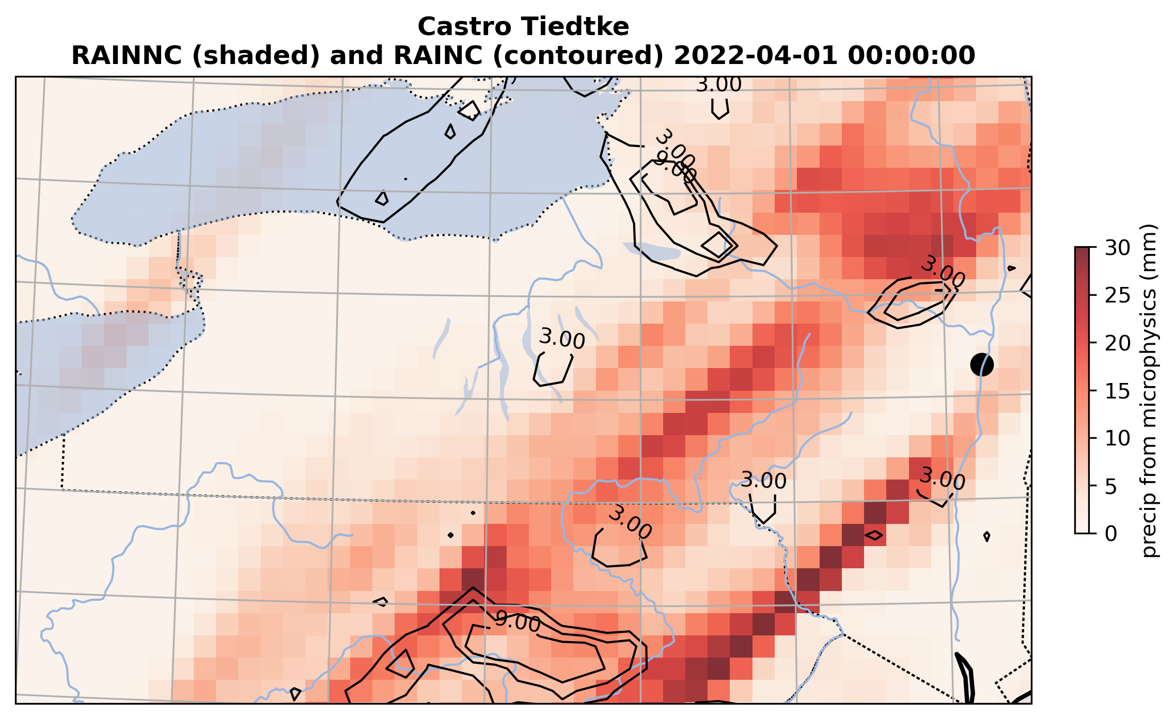
TCU06 (Tiedtke, Thompson MP)
Most inactive cumulus scheme

Slide 11
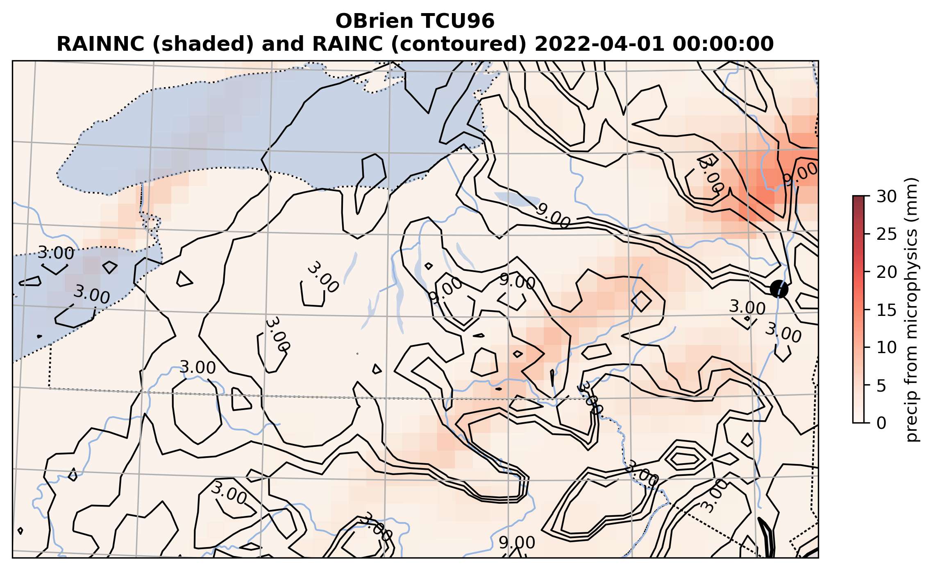
TCU96 (New SAS, Thompson MP)
Most active cumulus scheme ← very little microphysics precipitation, and pattern does not look encouraging
Notes:
This is bad. Basically it killed what MP was trying to do, and DID do in D2 “TRUTH”

Slide 12
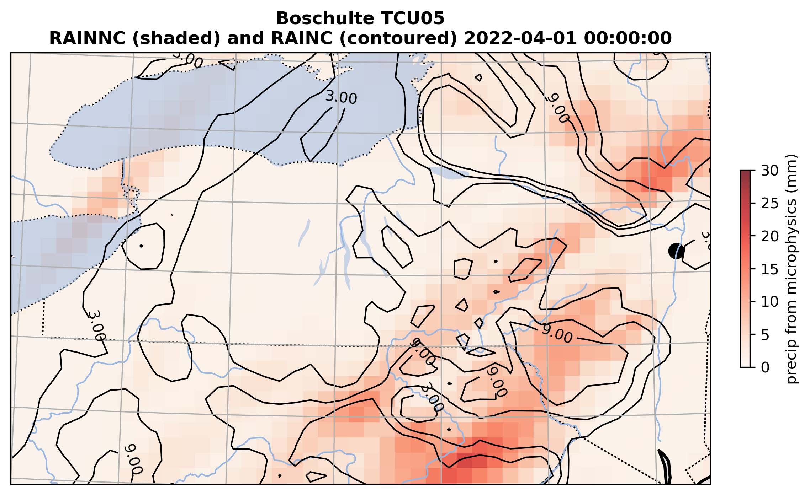
TCU05 (Grell3, Thompson MP)
Active cumulus but a little more microphysics precipitation

Slide 13
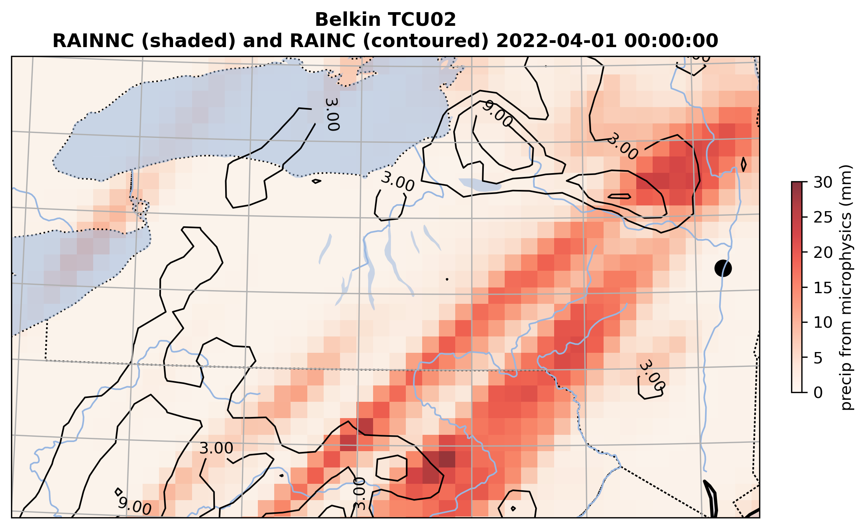
TCU02 (BMJ, Thompson MP)
NAM’s cumulus scheme

Slide 14
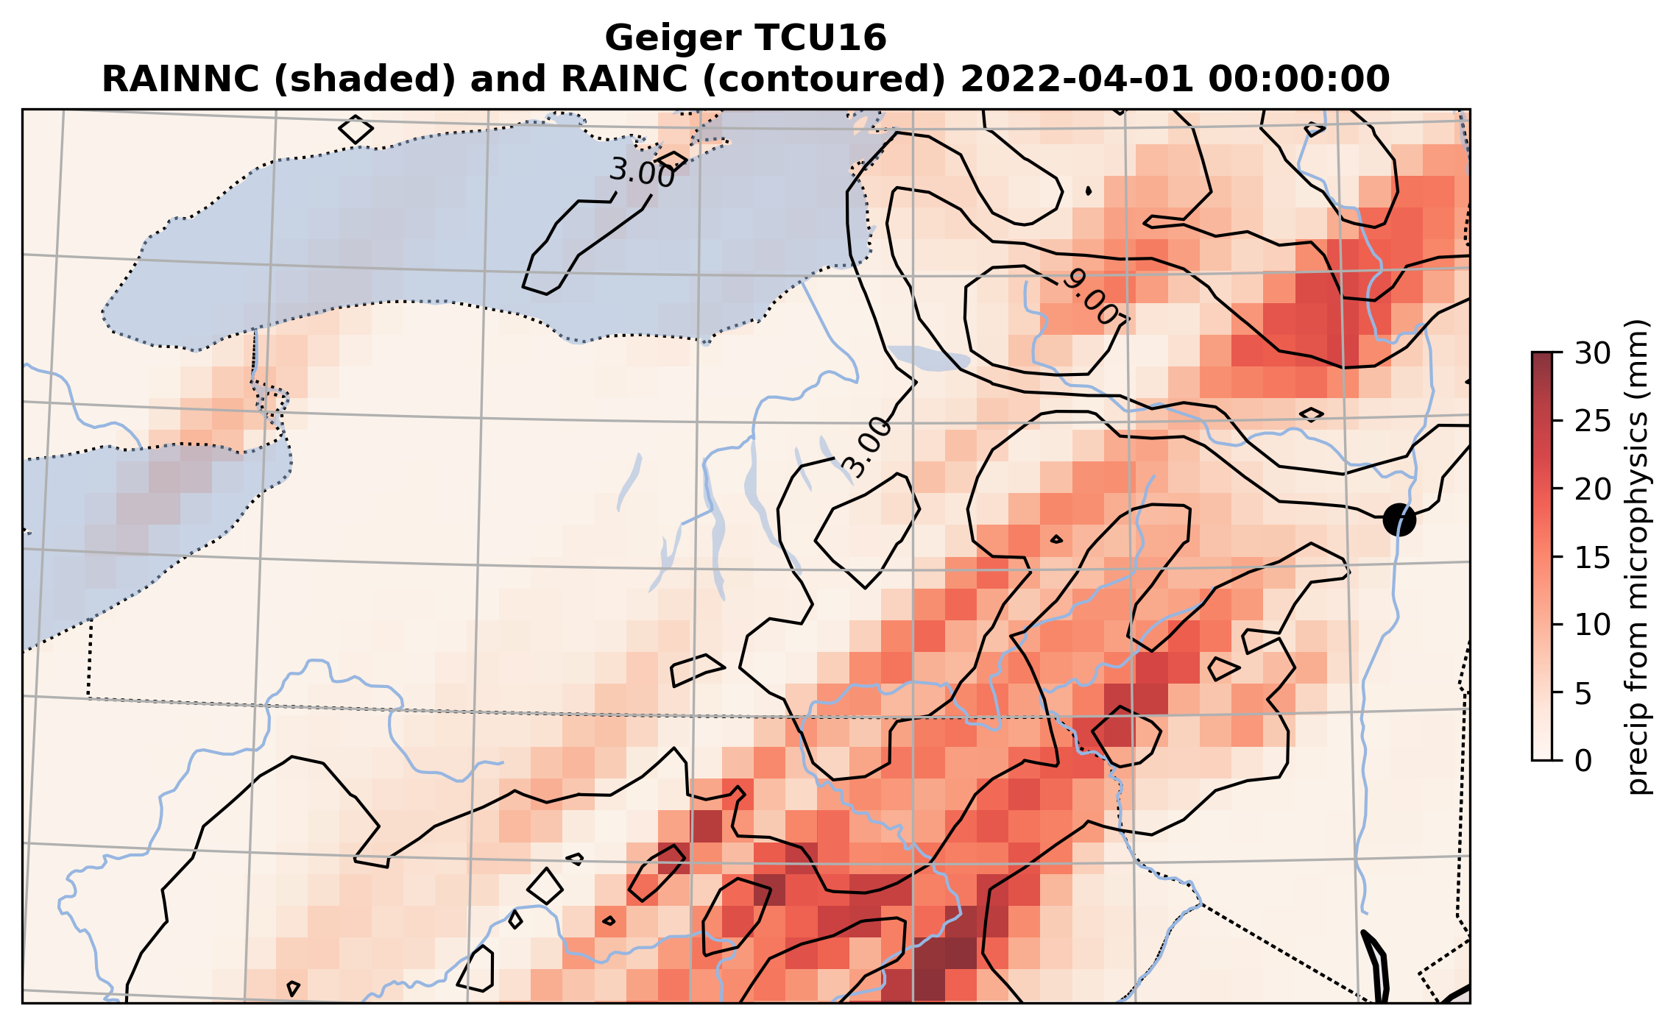
TCU16 (New Tiedtke, Thompson MP)
ECMWF’s cumulus scheme. A reasonable compromise?

Slide 15
Cumulus vs. microphysics

Slide 16
Control run (Kain-Fritsch, Thompson MP)
Notes:
Cumulus responding to forced lifting at ADK south edge

Slide 17
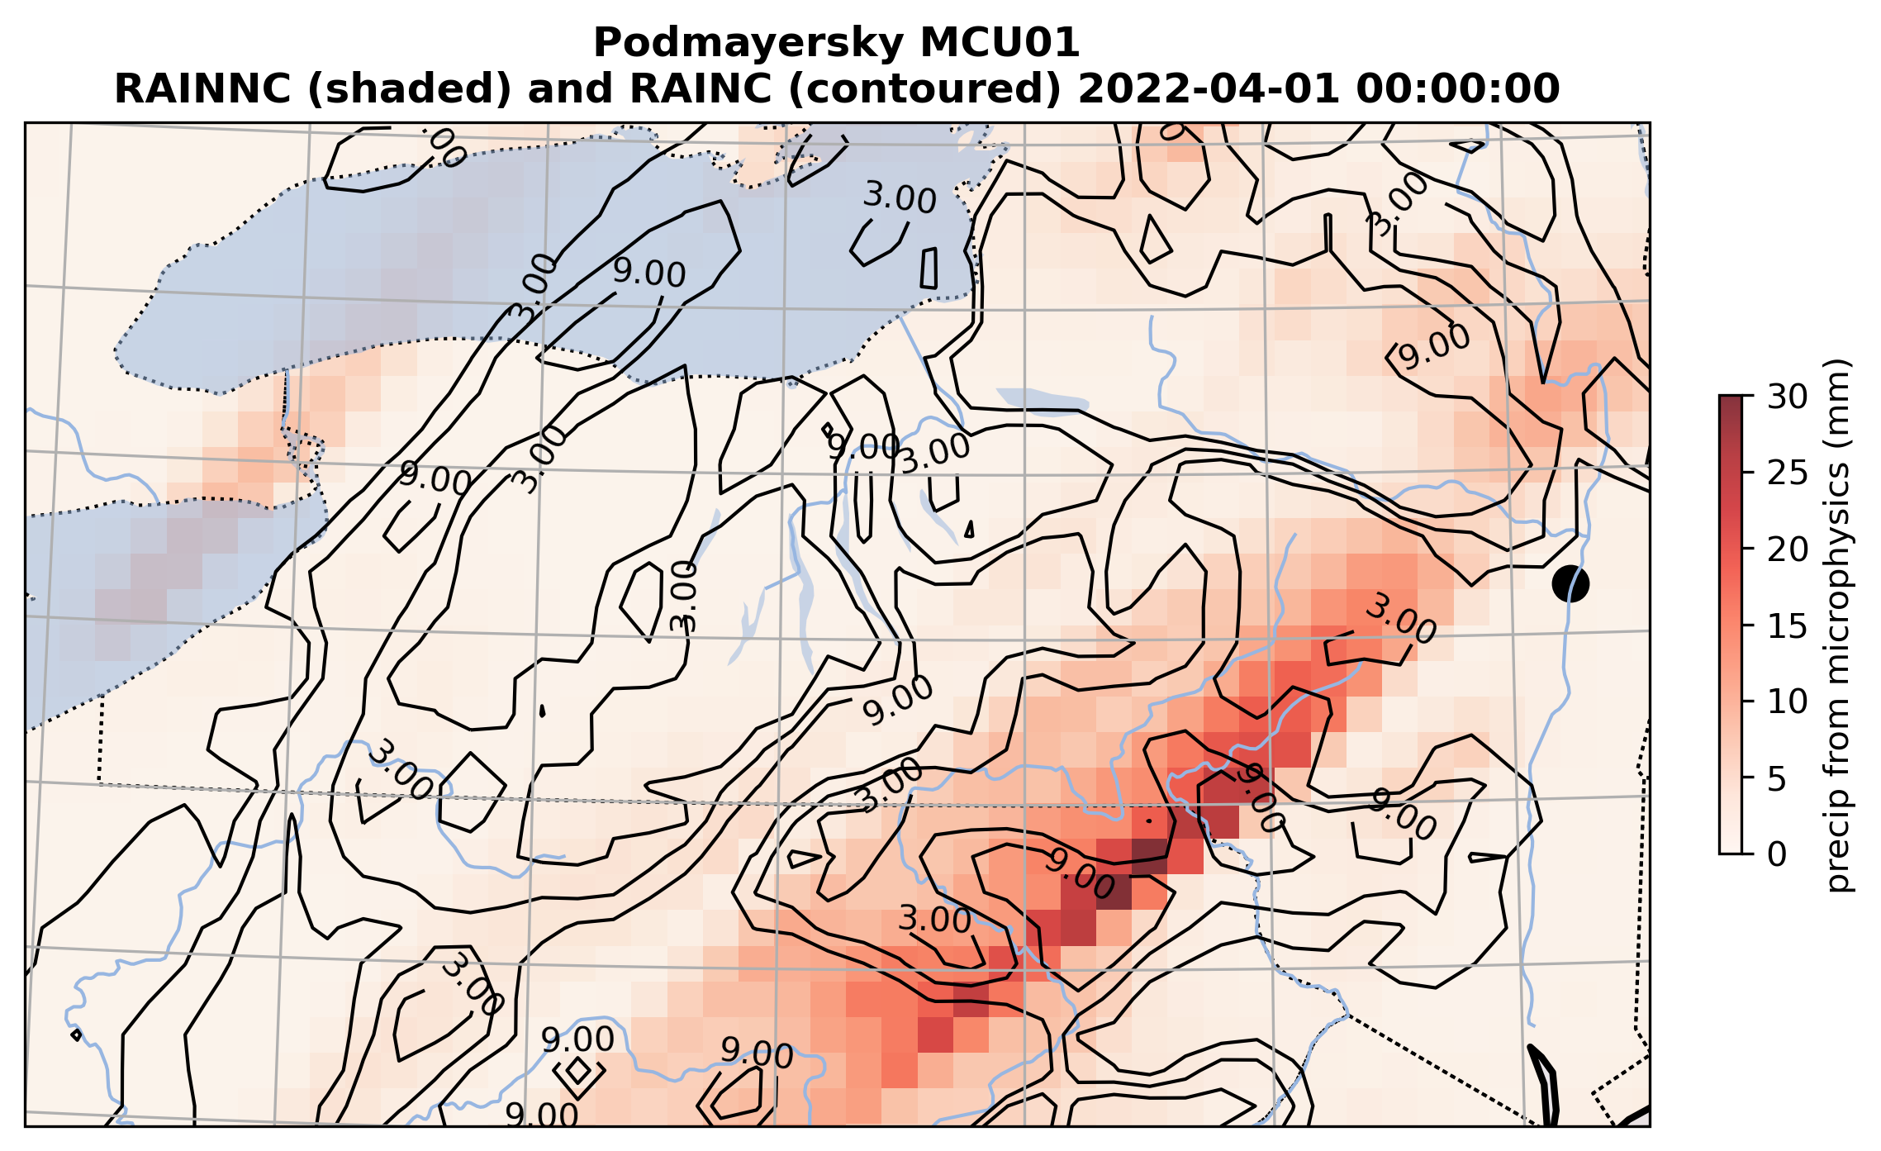
MCU01 (Kain-Fritsch, Morrison MP)

Slide 18
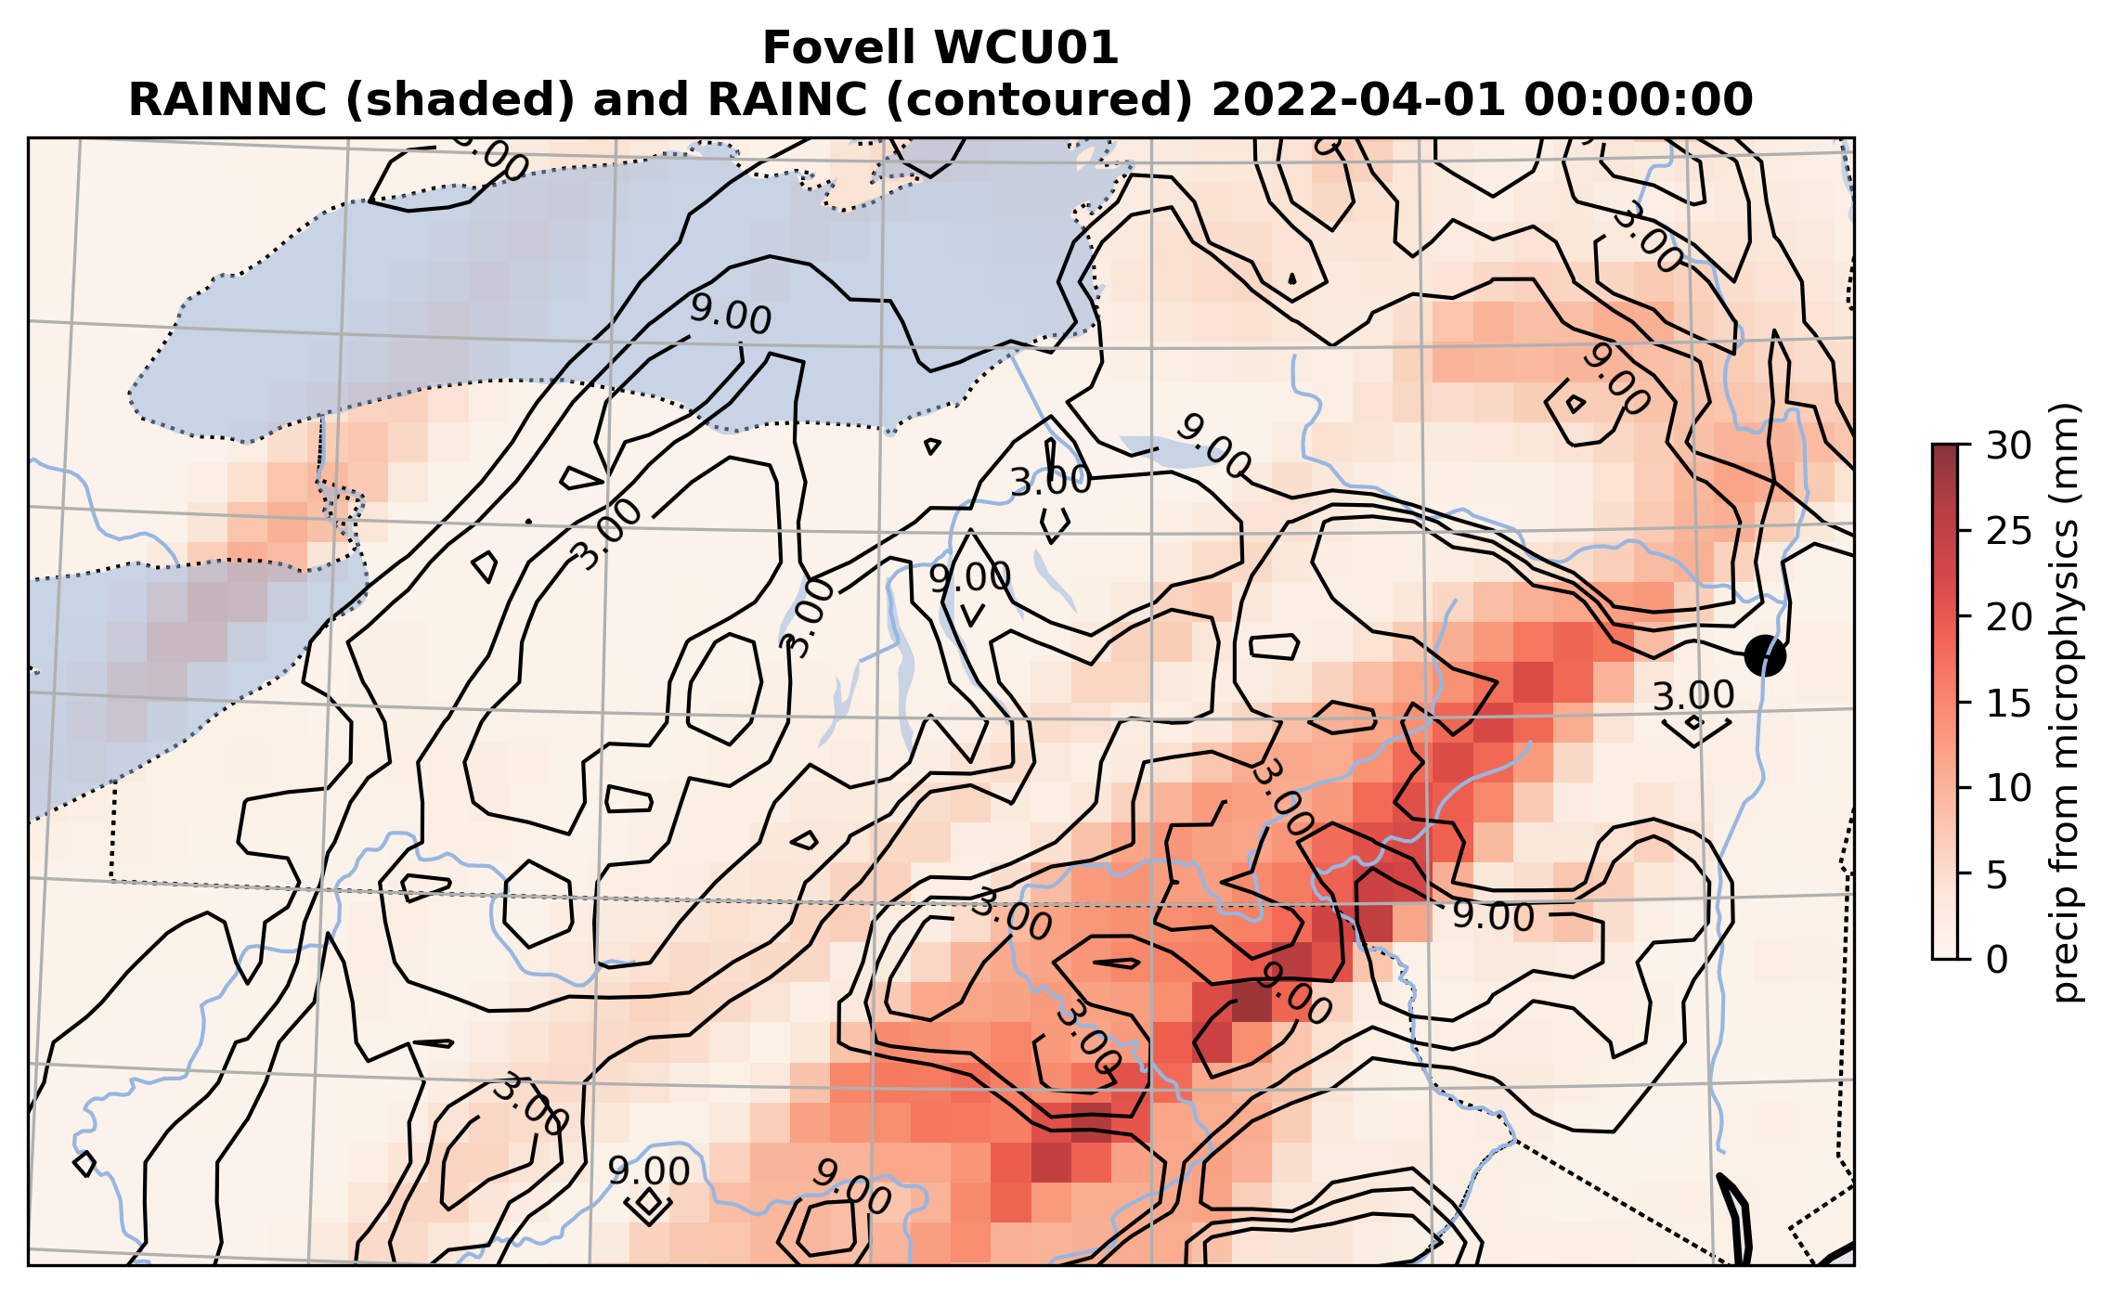
WCU01 (Kain-Fritsch, WSM5 MP)

Slide 19
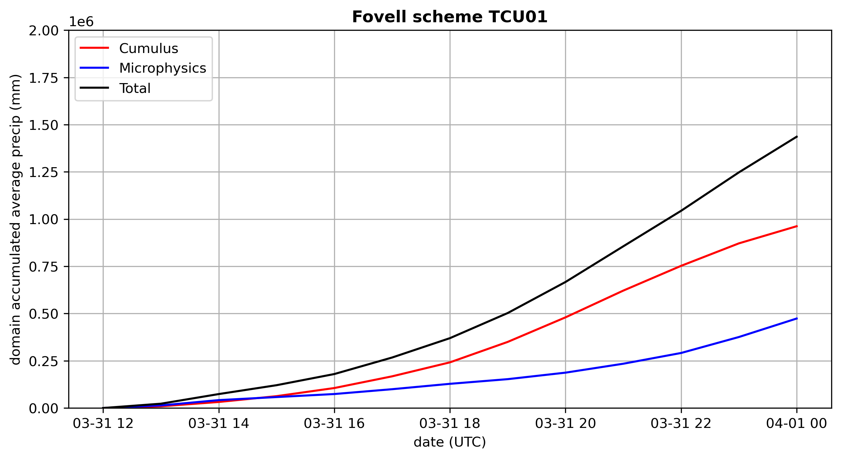
Kain-Fritsch + Thompson MP (Control run)
Next: same CU, different MP
Control run
Total precip
Cumulus precip
Microphysics precip

Slide 20
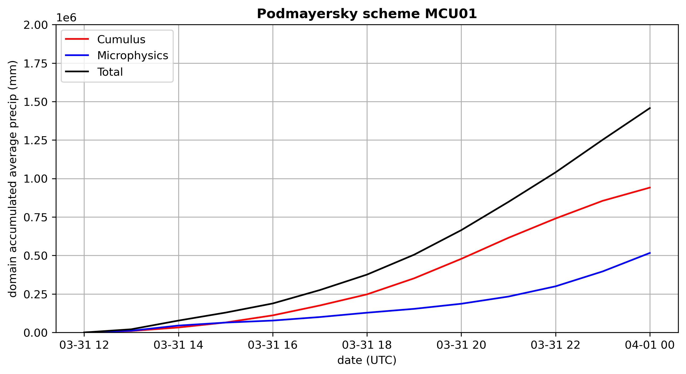
Kain-Fritsch + Morrison MP
Next: same CU, different MP
Control run
Total precip
Cumulus precip
Microphysics precip

Slide 21
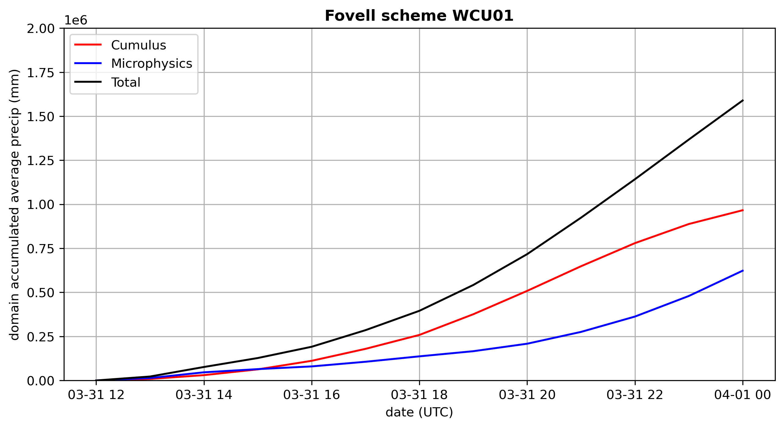
Kain-Fritsch + WSM5 MP
Next: same CU, different MP
Control run
Total precip
Cumulus precip
Microphysics precip

Slide 22
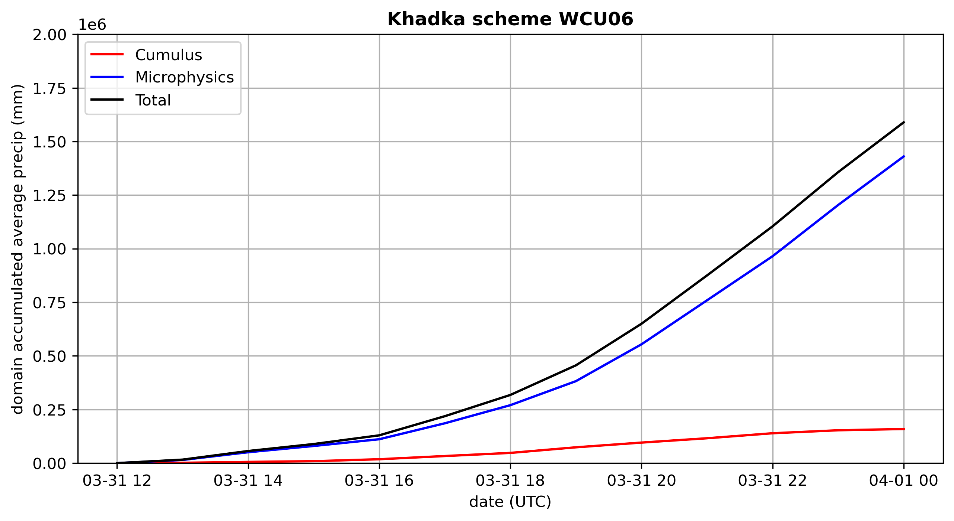
Tiedtke + WSM5 MP
Next: different CU, different MP
Control run
Total precip
Cumulus precip
Microphysics precip
When cumulus parameterization is used, cumulus makes more difference than microphysics
at least when the cumulus scheme is aggressive

Slide 23
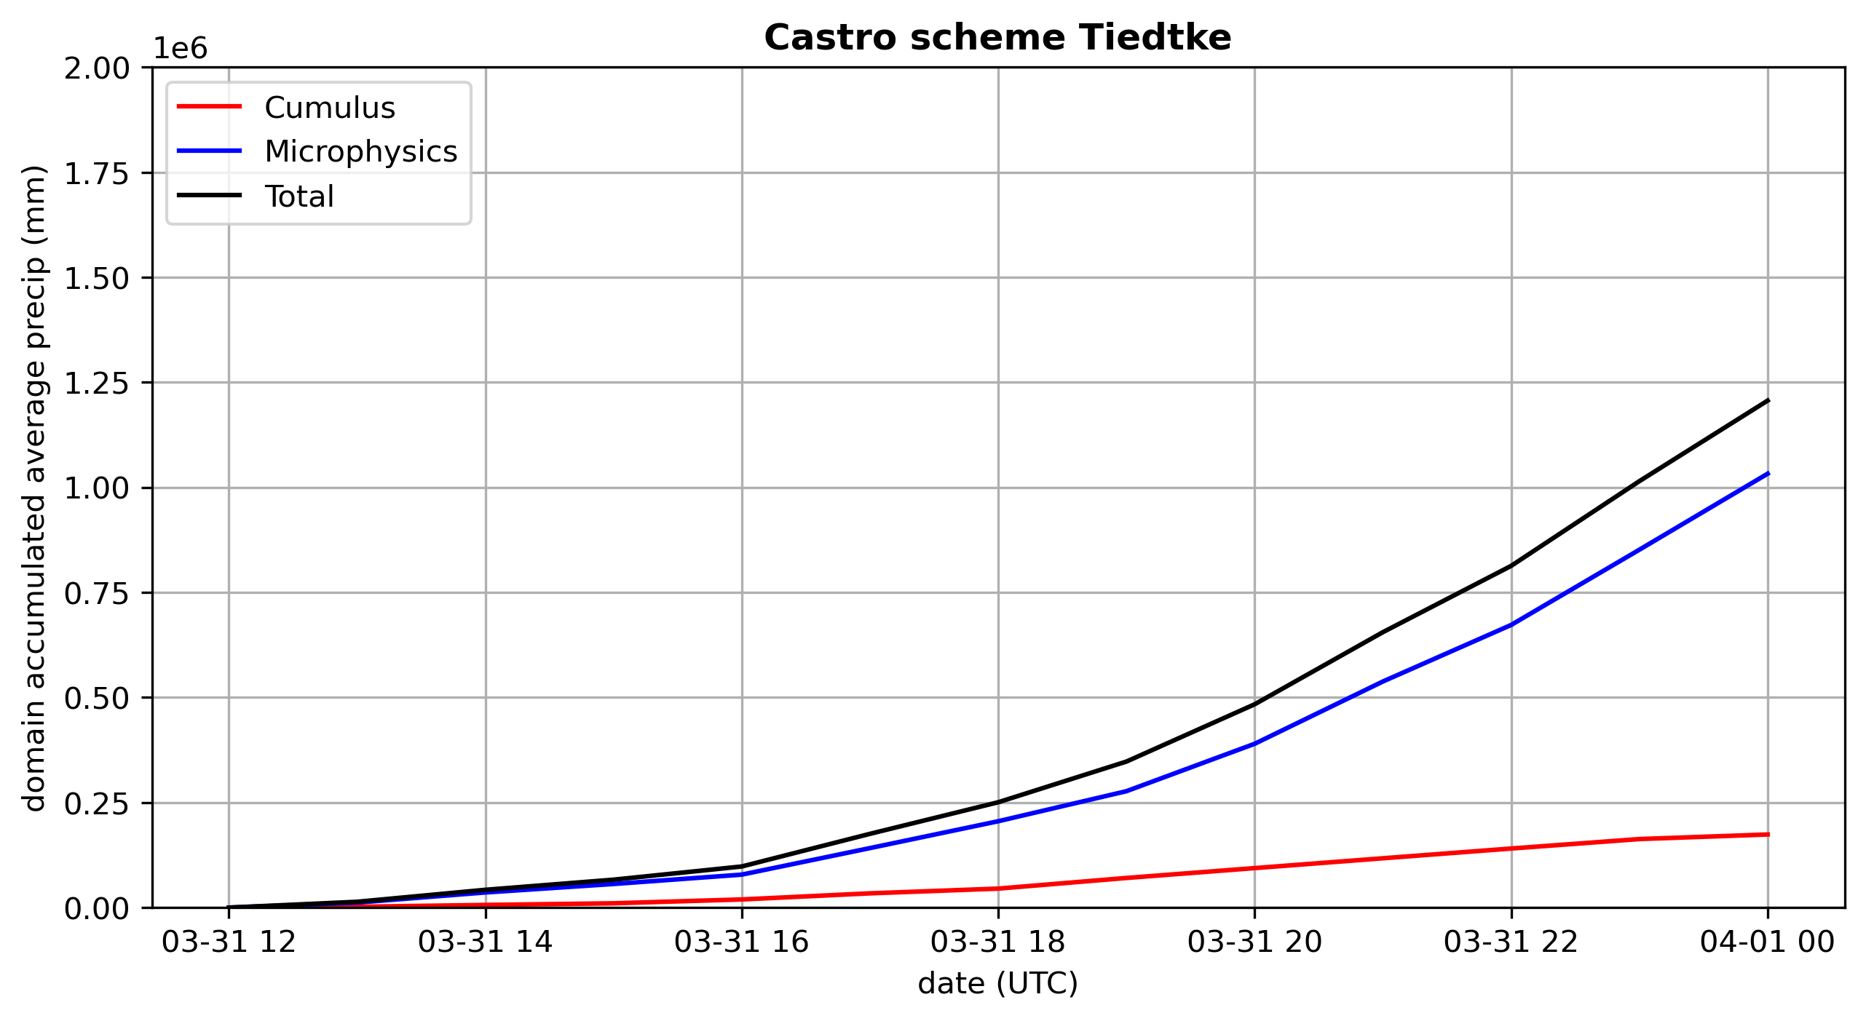
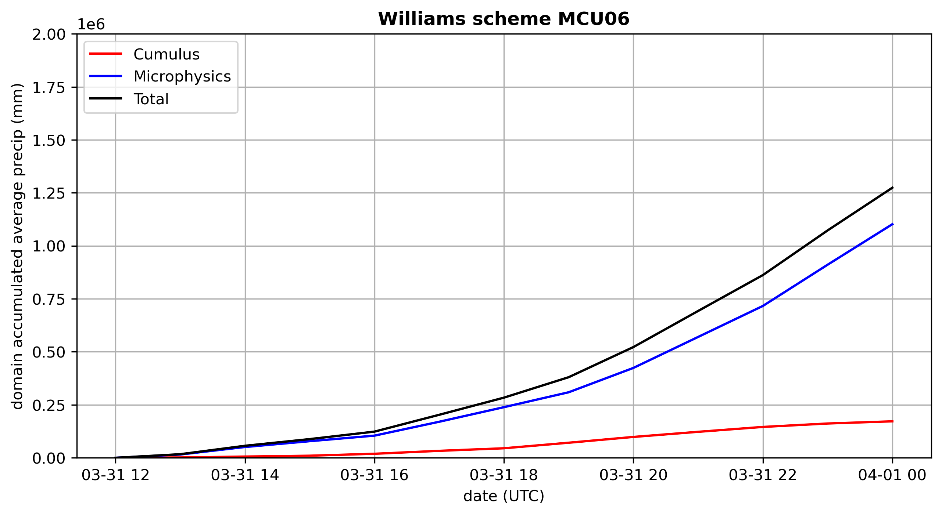
Tiedtke + Morrison MP
Next: same CU, different MP
Control run
Total precip
Cumulus precip
Microphysics precip
When cumulus parameterization is used, cumulus makes more difference than microphysics
at least when the cumulus scheme is aggressive

Slide 24
Tiedtke + Thompson MP
Next: same CU, different MP
Control run
Total precip
Cumulus precip
Microphysics precip
When cumulus parameterization is used, cumulus makes more difference than microphysics
at least when the cumulus scheme is aggressive
Notes:
40% less MP precip than Tiedtke+WSM5

Slide 25
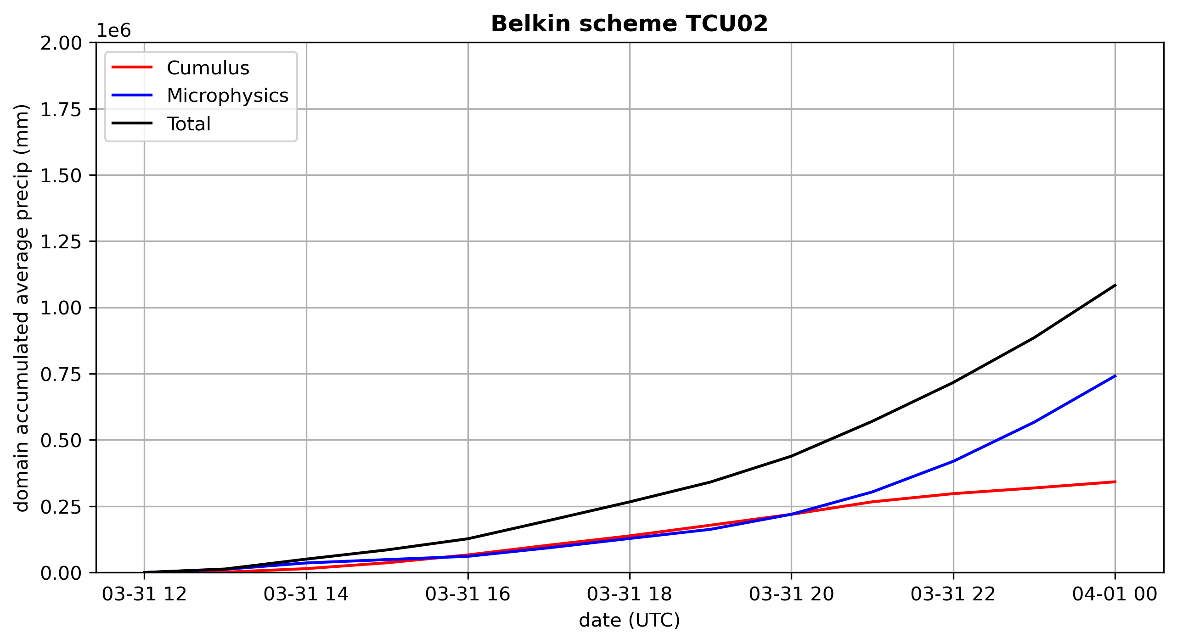
BMJ + Thompson MP
Next: different CU, same MP
Control run
Total precip
Cumulus precip
Microphysics precip
When cumulus parameterization is used, cumulus makes more difference than microphysics
at least when the cumulus scheme is aggressive

Slide 26
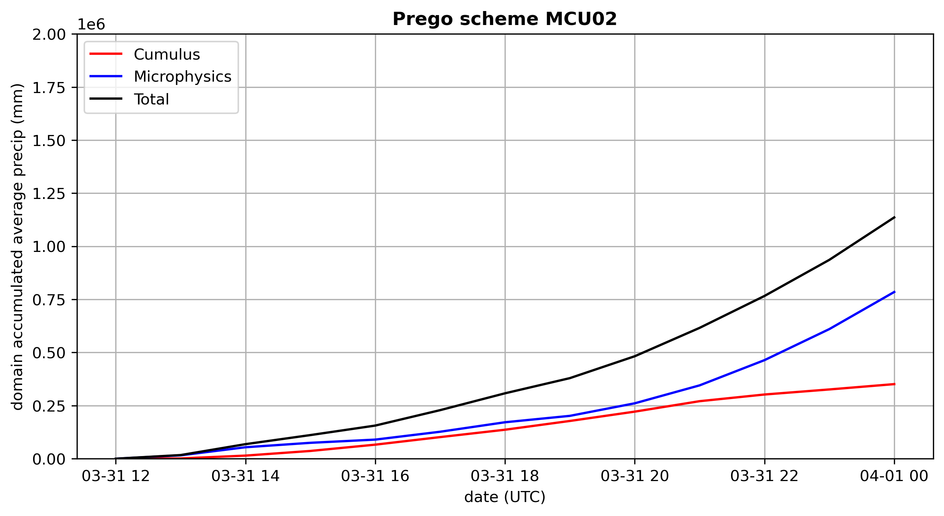
BMJ + Morrison MP
Next: same CU, different MP
Control run
Total precip
Cumulus precip
Microphysics precip
When cumulus parameterization is used, cumulus makes more difference than microphysics
at least when the cumulus scheme is aggressive

Slide 27
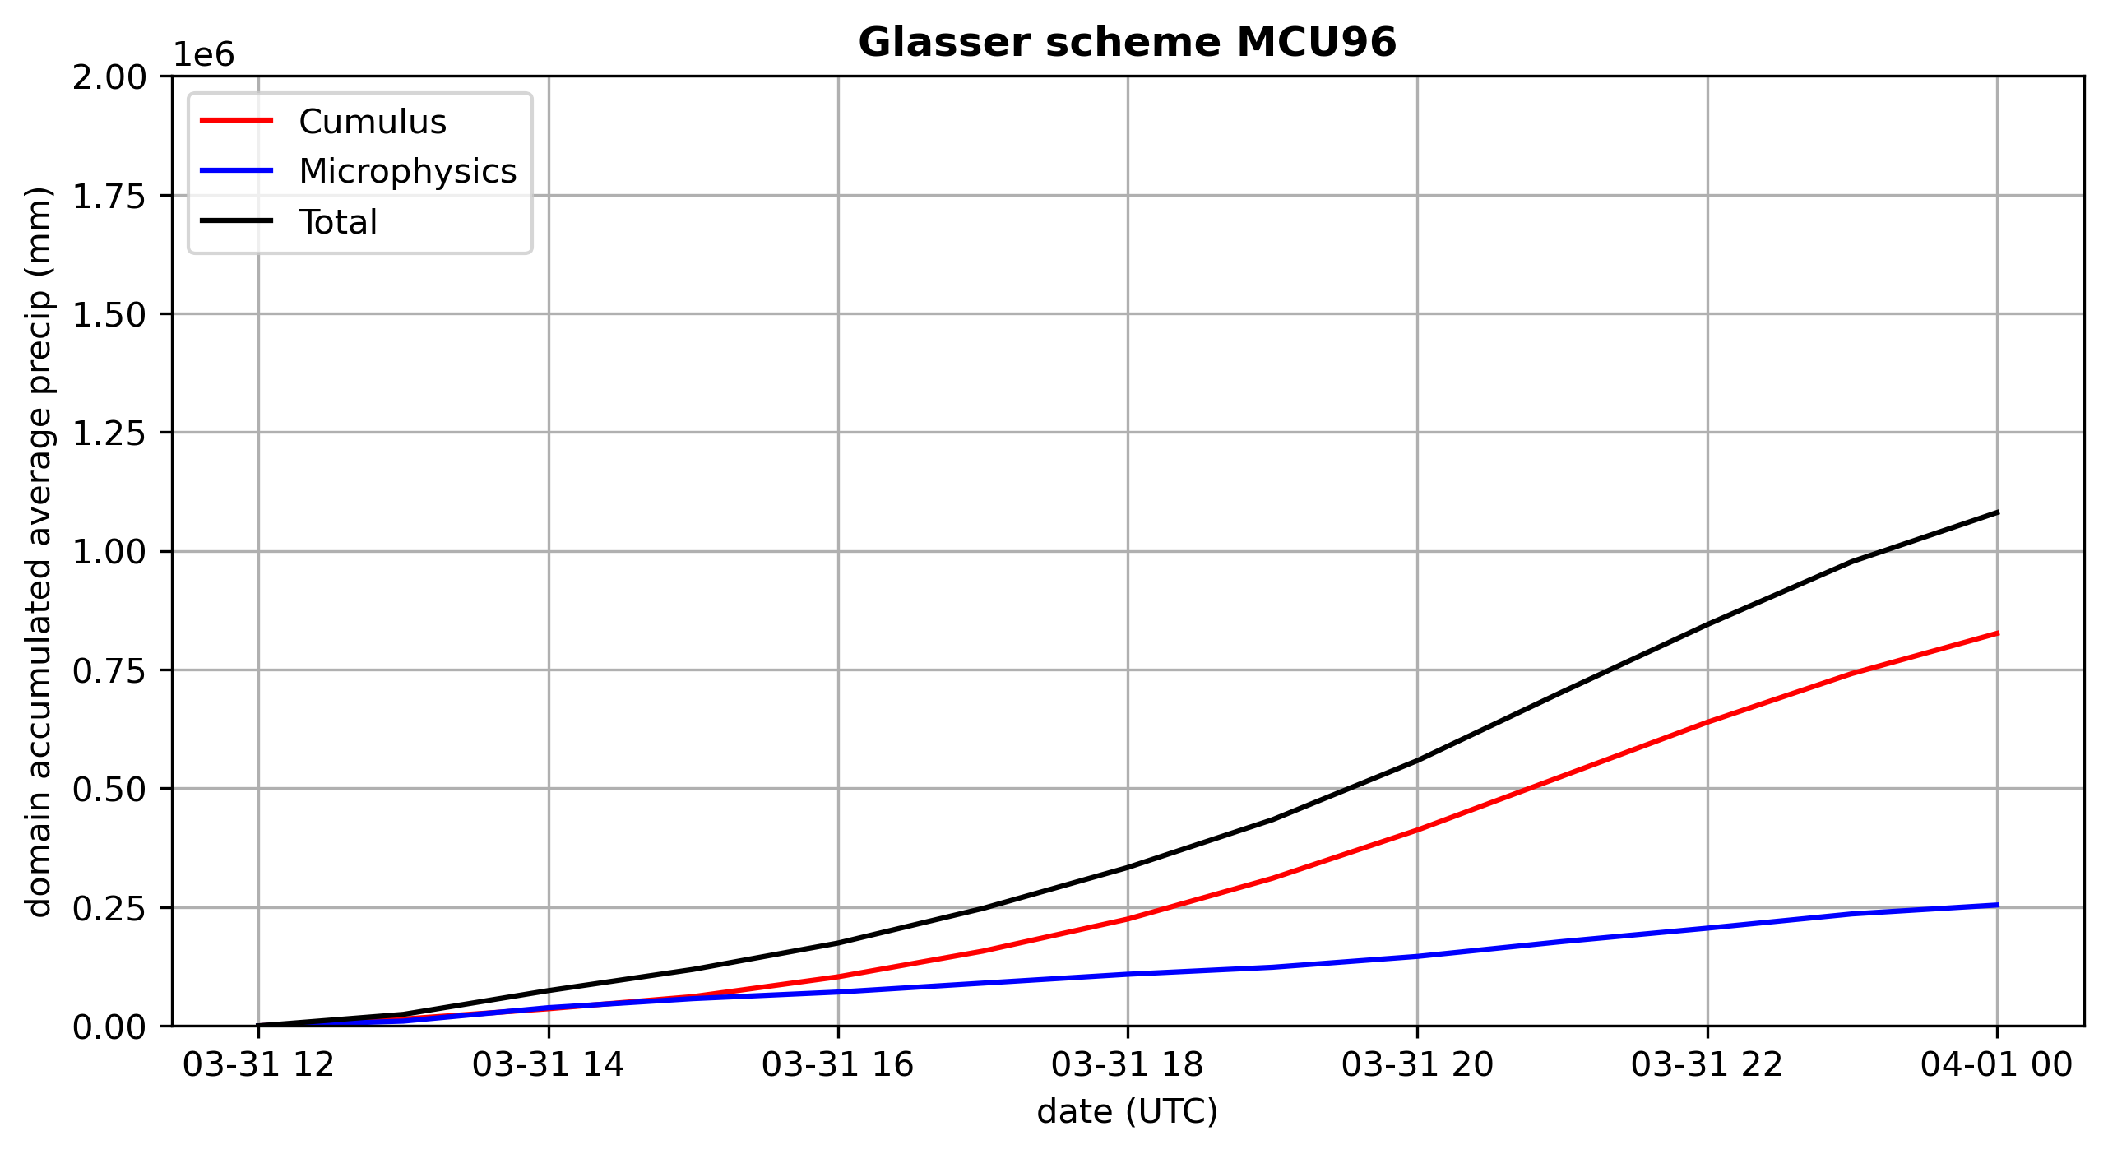
NSAS + Morrison MP
Next: different CU, same MP
Control run
Total precip
Cumulus precip
Microphysics precip
When cumulus parameterization is used, cumulus makes more difference than microphysics
at least when the cumulus scheme is aggressive

Slide 28
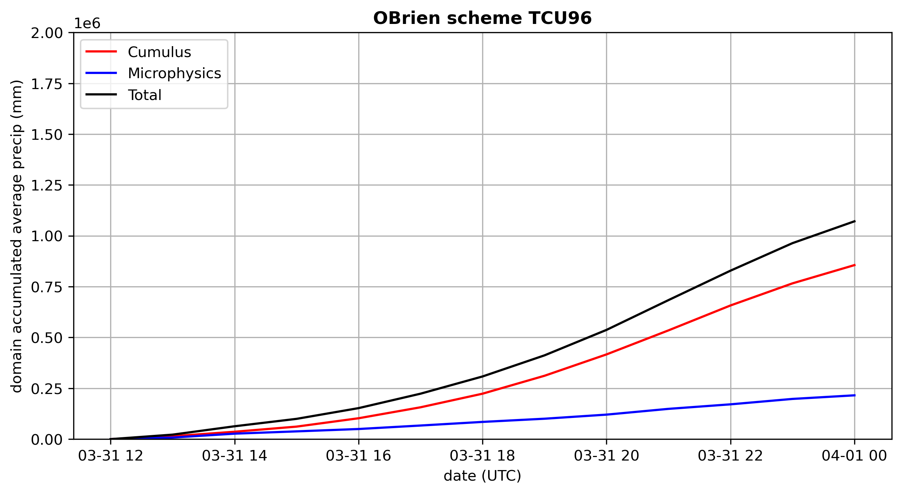
NSAS + Thompson MP
Next: same CU, different MP
Control run
Total precip
Cumulus precip
Microphysics precip
When cumulus parameterization is used, cumulus makes more difference than microphysics
at least when the cumulus scheme is aggressive

Slide 29
Conclusions
Cumulus schemes are recommended for ∆x ≥ 10 km, not for grid spacings ∆x ≤ 4 km or so [these are not hard thresholds]
Grid spacings between 4-10 km should be avoided unless a “scale-aware” cumulus scheme is used
But cumulus dramatically influences total precip and what’s left over for microphysics to deal with
Very active cumulus schemes don’t produce realistic-looking precipitation patterns, at least relative to observations and higher-resolution domains using only microphysics
Sensitivity to microphysics appears small when very active cumulus schemes are employed
Among the 12 km runs, the “no cumulus” simulations looked “best”, but this may be case-dependent

