Slide 1
UFS Short Range Weather App (SRW)
CAUTION: we will use derecho.hpc.ucar.edu for this demo
See script
ATM 419/563
Spring 2024
Fovell
Special thanks to Minghao Zhou
© Copyright 2024 Robert Fovell, Univ. at Albany, SUNY, rfovell@albany.edu
Notes:
2018 PROBLEM: for some persons, for some nodes, the supercell run STALLS at 20 min, and this appears to be a random glitch that happens when model data are being written to disk.

Slide 2
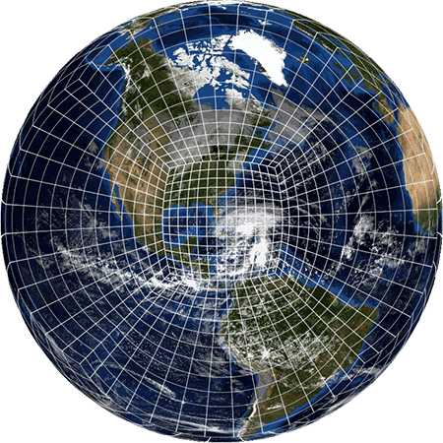
The Global Forecast System (GFS) model is
now based on the Finite-Volume Cubed-Sphere
dynamical core (FV3), developed at GFDL
https://www.gfdl.noaa.gov/fv3/
FV3 is a global model that permits grid spacing
to vary across the Earth
https://www.gfdl.noaa.gov/fv3/

Slide 3
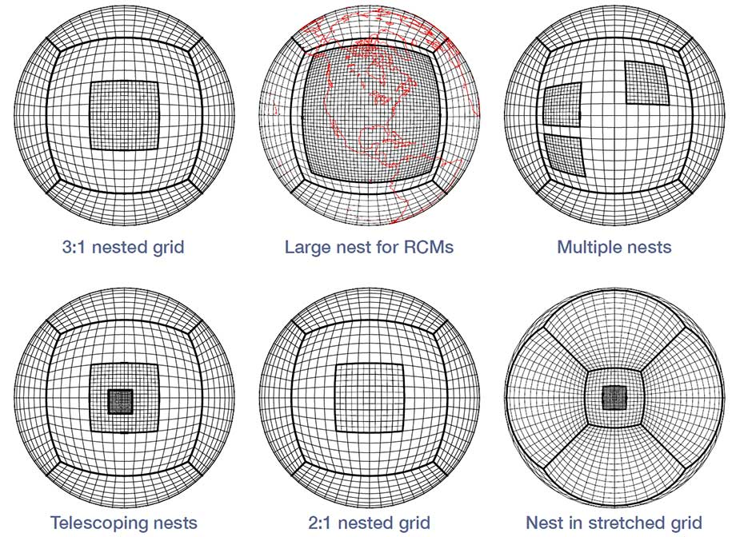
FV3 also permits nesting,
as illustrated here
The Short-Range Weather App
is a regional version of FV3,
being developed for the HRRR
replacement, RRFS (Rapid
Refresh Forecasting System)
https://www.gfdl.noaa.gov/fv3/fv3-grids/

Slide 4
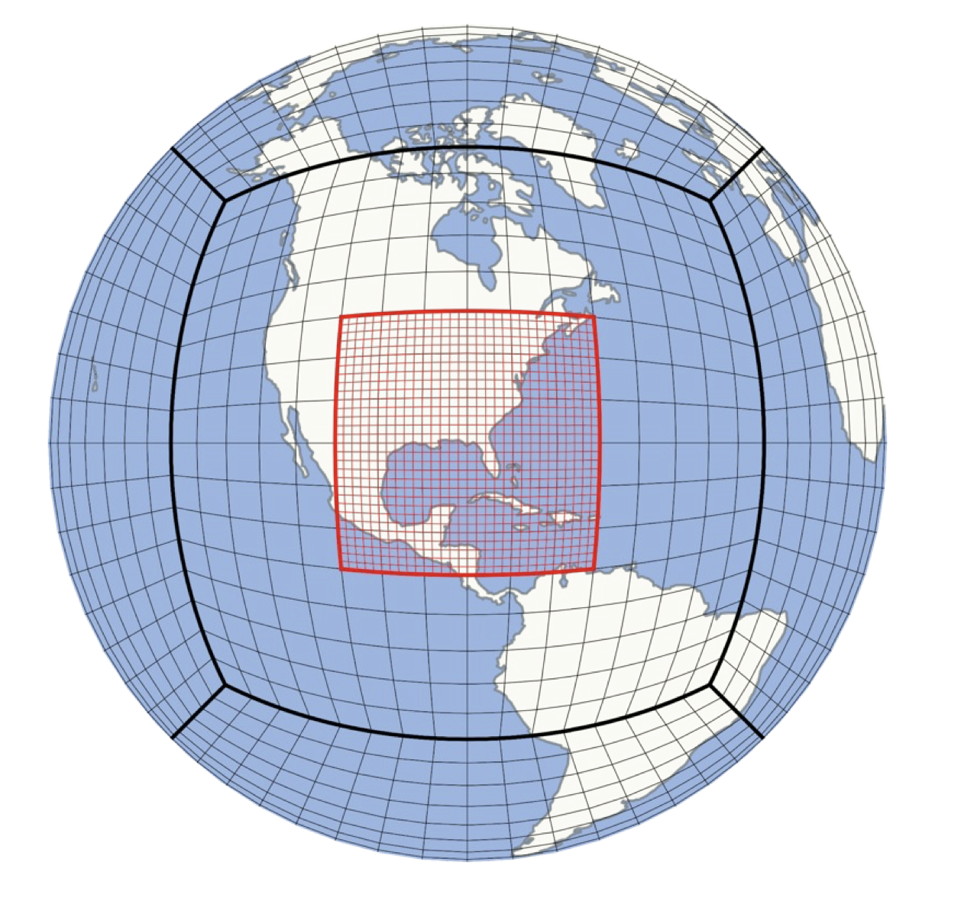
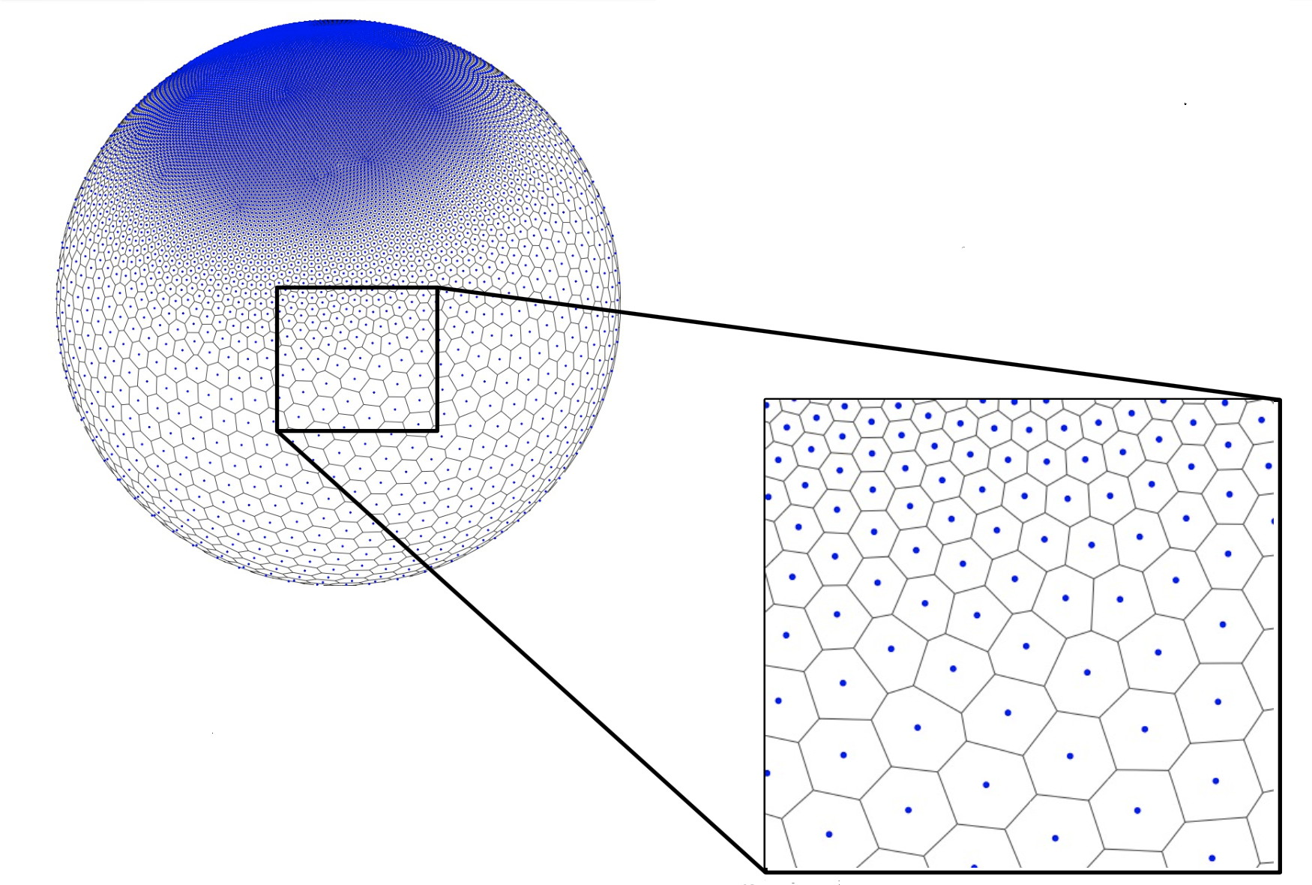
FV3 grid example
Cubed sphere advantages (relative to icosahedral MPAS):
Grid is easy to generate
Higher order numerics easier to implement
Cubed sphere disadvantages:
“Kinks” require special handling
[Harris et al. 2021]
MPAS grid example

Slide 5
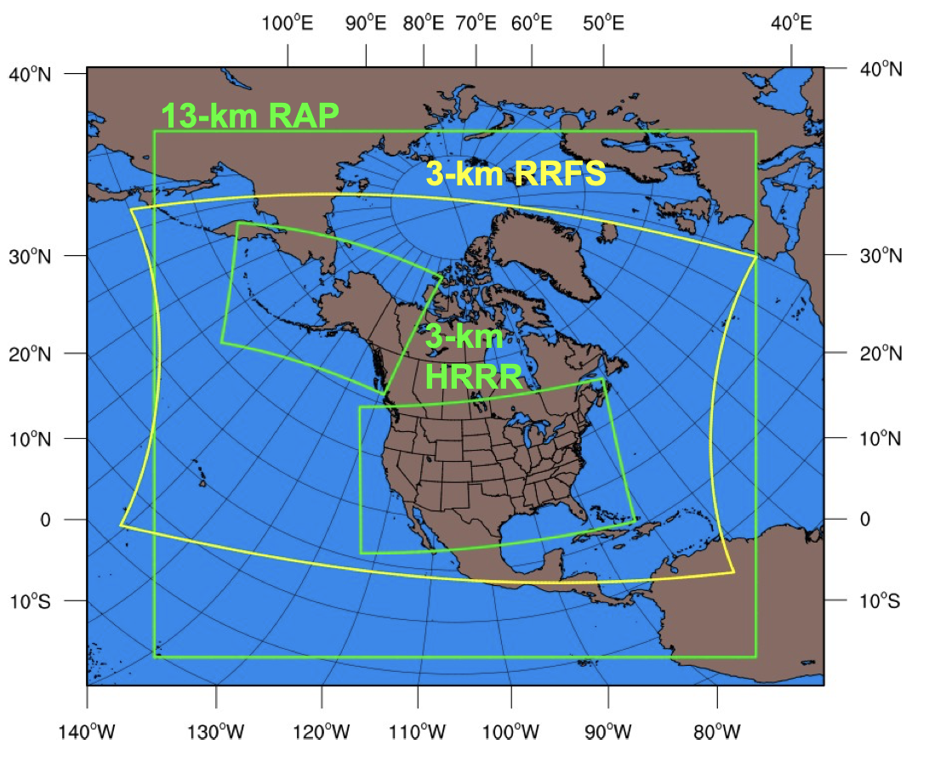
Intended RRFS 3 km grid compared to
current RAP and HRRR domains
https://epic.noaa.gov/wp-content/uploads/2023/08/UIFCW-2023-Tue-9.-Alexander_UFS_UIFCW_2023_Final-2.pdf

Slide 6
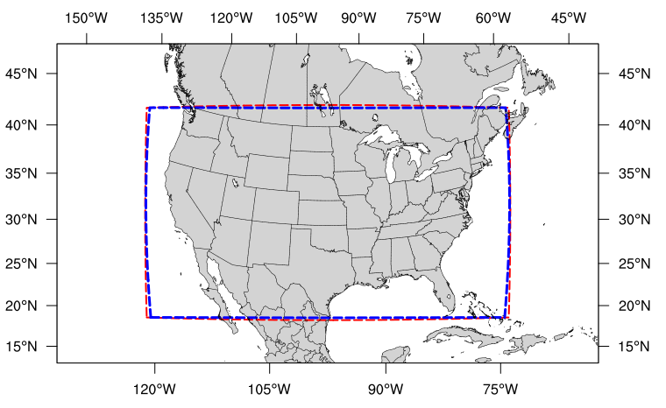
The pre-defined 25 km CONUS grid
“RRFS_CONUS_25km”
25 km version of RRFS grid that resembles current HRRR domain, and is one of SRW’s built-in options
We will use a spatially more extensive version of this grid for our demo we crafted for ourselves

Slide 7
UFS SRW on Derecho demonstration
See script
Run UFS SRW on Derecho on a 25 km grid
Boulder windstorm event
Start 2021123012, run 12 h, initialized from GFS
The workflow fetches GFS grids from AWS
Compile, build, run, postprocess, visualize output in GRIB2 format
Model outputs already stored locally here in $LAB/UFS/25KM
Optional: also run case on higher-resolution (6 km spacing), smaller domain, starting at different times [see script]
6 km, 24 h GFS-initiated run starting 2021123000 in $LAB/UFS/6KM
https://ufs-srweather-app.readthedocs.io/en/release-public-v2.2.0/

Slide 8
Demo case results
CONUS domain 25 km grid spacing
Simulation started 12/30/2021 at 12 UTC
Forecast hour 6 [around event peak]
See script

Slide 9
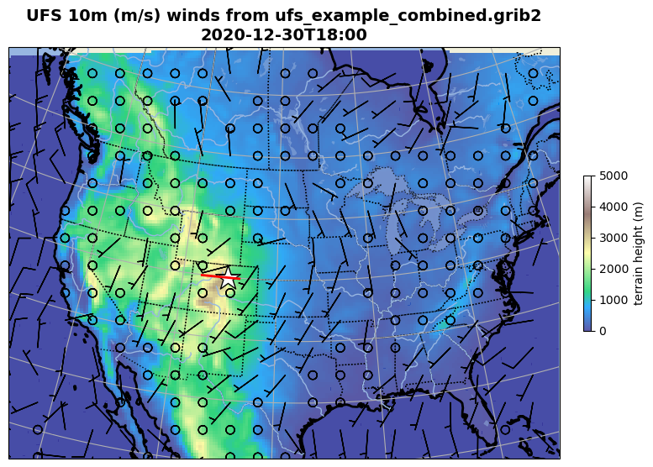
Forecast hour 6
Vertical cross-section

Slide 10
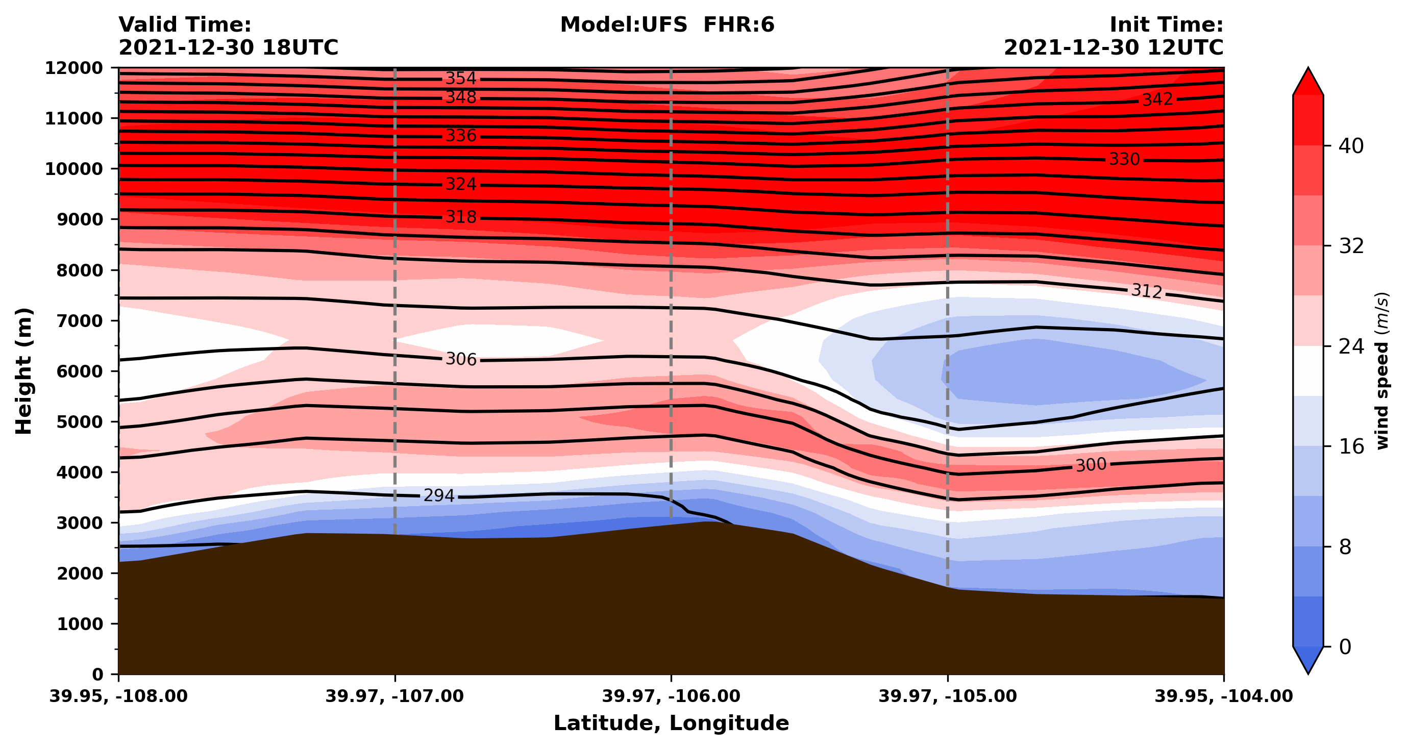

Slide 11
Higher resolution case results
Western US domain with 6 km grid spacing
Simulation started 12/30/2021 at 00 UTC
Forecast hour 18
See script

Slide 12
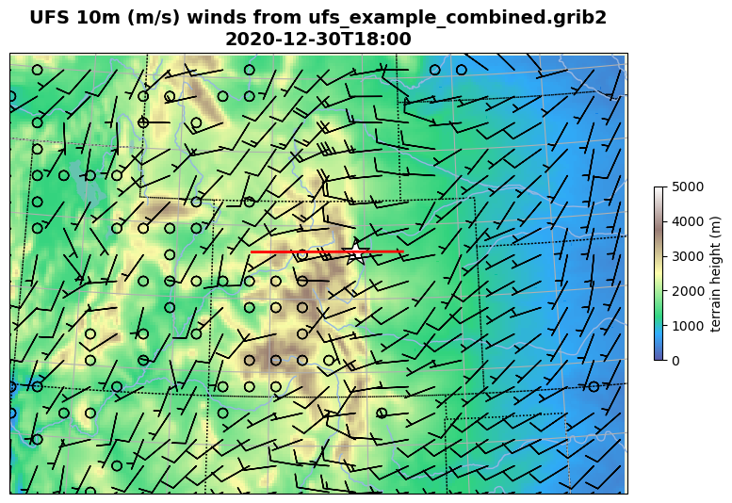
Forecast hour 18

Slide 13
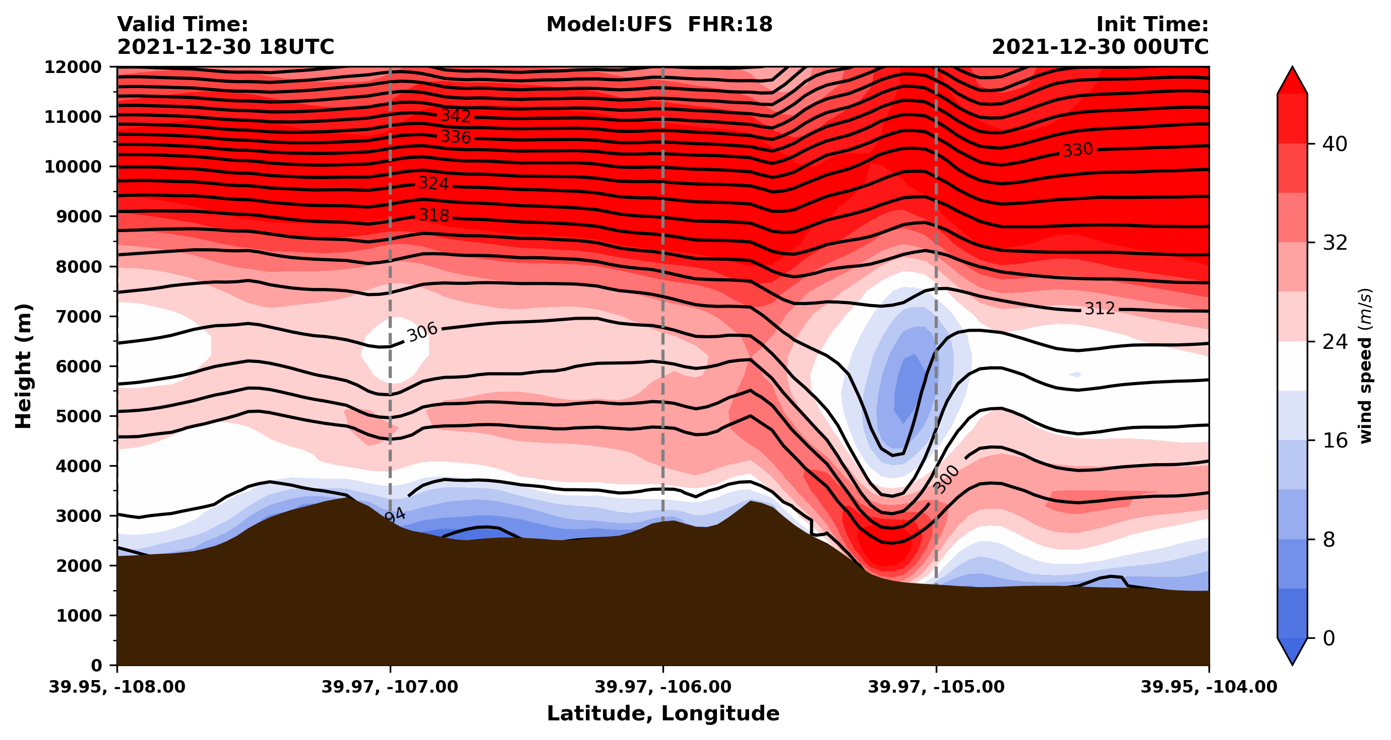

Slide 14
[end]
{Coureurs des UFS}
Appendix follows
Notes:
“courier du bois” = runner of the woods

Slide 15
Appendix 1: Inside the yaml file
config.yaml == namelist.wps, namelist.input from WRF

Slide 16
A config.yaml file #1
The yaml file for our 25 km demo
metadata:
description: >-
Sample community config
user:
RUN_ENVIR: community
MACHINE: derecho
ACCOUNT: UALB0046
platform:
CCPA_OBS_DIR: ""
MRMS_OBS_DIR: ""
NDAS_OBS_DIR: ""
workflow:
USE_CRON_TO_RELAUNCH: true
EXPT_SUBDIR: test_community
CCPP_PHYS_SUITE: FV3_GFS_v16
GRID_GEN_METHOD: ESGgrid
DATE_FIRST_CYCL: '2021123012'
DATE_LAST_CYCL: '2021123012'
FCST_LEN_HRS: 12
PREEXISTING_DIR_METHOD: rename
VERBOSE: true
COMPILER: intel
CRON_RELAUNCH_INTVL_MNTS: 3
EXPT_SUBDIR: ufs_srw_case_windstorm
UALB0046 - our account for this class [ends soon]
Start time: 2021123012 ← first cycle
We’re not cycling so last cycle = first cycle
Our experiment directory – change each run!

Slide 17
A config.yaml file #2
task_make_grid:
ESGgrid_LON_CTR: -97.5
ESGgrid_LAT_CTR: 41.25
ESGgrid_DELX: 25000.0
ESGgrid_DELY: 25000.0
ESGgrid_NX: 216
ESGgrid_NY: 156
ESGgrid_WIDE_HALO_WIDTH: 6
ESGgrid_PAZI: 0.0
task_get_extrn_ics:
EXTRN_MDL_NAME_ICS: FV3GFS
FV3GFS_FILE_FMT_ICS: grib2
USE_USER_STAGED_EXTRN_FILES: true
EXTRN_MDL_SOURCE_BASEDIR_ICS: "/glade/work/epicufsrt/contrib/UFS_SRW_data/develop/
input_model_data/FV3GFS/grib2/${yyyymmddhh}"
task_get_extrn_lbcs:
EXTRN_MDL_NAME_LBCS: FV3GFS
LBC_SPEC_INTVL_HRS: 6
FV3GFS_FILE_FMT_LBCS: grib2
USE_USER_STAGED_EXTRN_FILES: true
EXTRN_MDL_SOURCE_BASEDIR_LBCS: "/glade/work/epicufsrt/contrib/UFS_SRW_data/develop/
input_model_data/FV3GFS/grib2/${yyyymmddhh}"
Our requested grid, including:
central longitude and latitude
grid spacing
domain extent
We’re letting the workflow fetch the GFS grids
used for initial (ics) and boundary (lbcs)
conditions… [but you can provide your own]
{one single line}
{one single line}

Slide 18
A config.yaml file #3
task_run_fcst:
QUILTING: true
DT_ATMOS: 40
LAYOUT_X: 8
LAYOUT_Y: 12
BLOCKSIZE: 13
QUILTING: true
WRTCMP_write_groups: 1
WRTCMP_write_tasks_per_group: 12
WRTCMP_output_grid: lambert_conformal
WRTCMP_cen_lon: -97.5
WRTCMP_cen_lat: 41.25
WRTCMP_lon_lwr_left: -122.21414225
WRTCMP_lat_lwr_left: 22.41403305
WRTCMP_stdlat1: 41.25
WRTCMP_stdlat2: 41.25
WRTCMP_nx: 200
WRTCMP_ny: 150
WRTCMP_dx: 25000.0
WRTCMP_dy: 25000.0
Seems we have to repeat a lot of the grid/domain
information in this section
Some of this was determined iteratively
[see next slide]
There’s a little more, but we’re not using or needing to change that here, at least not yet…

Slide 19
Notes
The script is configured to fetch GFS outputs from AWS (Amazon Web Services), but the archive only goes back to early 2021, so if you’re interested in an older case you have to modify the two EXTERN_MDL_SOURCE lines
For constructing your own domain, selecting the correct values for WRTCMP_lon_lwr_left, WRTCMP_lat_lwr_left, WRTCMP_nx, and WRTCMP_ny appears to be a very iterative process. You could end up with “dead” space in the domains if not set correctly
To use one of the pre-configured grids, change GRID_GEN_METHOD to something like RRFS_CONUS_25km and remove all the ESGgrid lines

Slide 20
Appendix 2: Some more UFS information

Slide 21
Information on Vertical Levels
UFS SRW uses a hybrid vertical coordinate system*, which moves from purely sigma levels near the surface to purely isobaric levels near the top of the atmosphere (TOA). Default is 65 vertical levels.
pk=ak+bk*ps
pk: pressure value at a given level
ps: surface pressure
ak: contribution from the purely isobaric component of the hybrid vertical coordinate
bk: contribution from the sigma component
When ak = bk = 0, it is the TOA (pressure is zero).
When bk = 1 and ak = 0, it is the pressure at the first model level).
*also called the Lagrangian vertical coordinate and/or terrain-following pressure coordinate. See more at https://www.gfdl.noaa.gov/fv3/fv3-key-components/

Slide 22
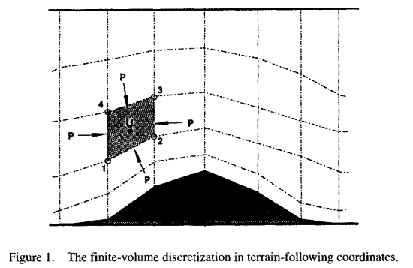
Information on Vertical Levels
Lin (1997)
https://www.weather.gov/media/sti/nggps/Lin_Pressure_Gradient_Force_General_Vertical_Coordinates_QuartJRoyMetSoc_1997.pdf

Slide 23
Information on Vertical Levels
To change the default vertical levels, refer to executable vcoord_gen under ufs-srweather-app/exec to generate a different set of ak and bk for each level.
$ ./vcoord_gen > vcoord_customize.txt
Enter levs,lupp,pbot,psig,ppre,pupp,ptop,dpbot,dpsig,dppre,dpupp,dptop
128,88,100000.0,99500.0,7000.0,7000.0,0.0,240.0,1200.0,18000.0,550.0,1.0 (e.g.)
In ufs-srweather-app/parm/input.nml.FV3, set levp=128 (number of vertical levels) and npz=127 (number of vertical layers), and make sure external_eta = .true.
To use the customized vertical coordinate, add in config.ymal:
task_make_ics:
VCOORD_FILE: ../exec/vcoord_customize.txt
task_make_lbcs:
VCOORD_FILE: ../exec/vcoord_customize.txt

Slide 24
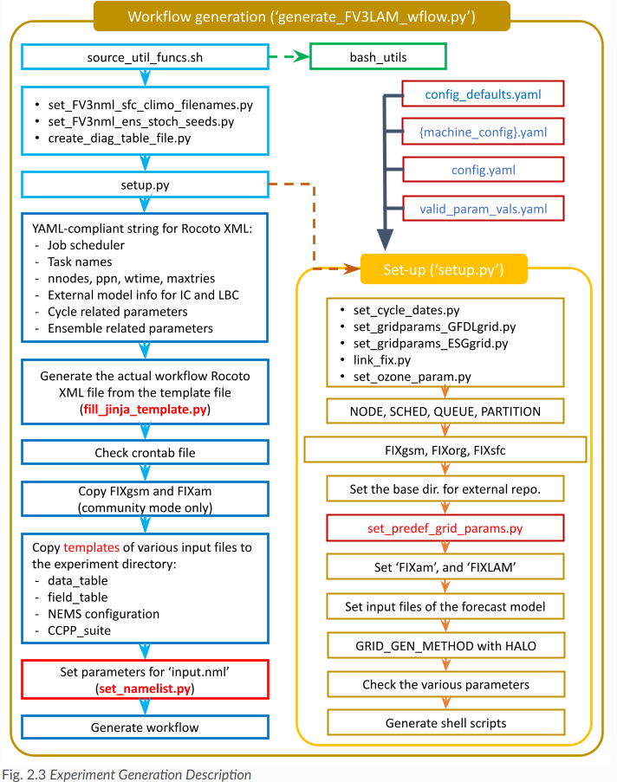
Paradigm of UFS-SRW
workflow generation
(from User’s Guide)

Slide 25
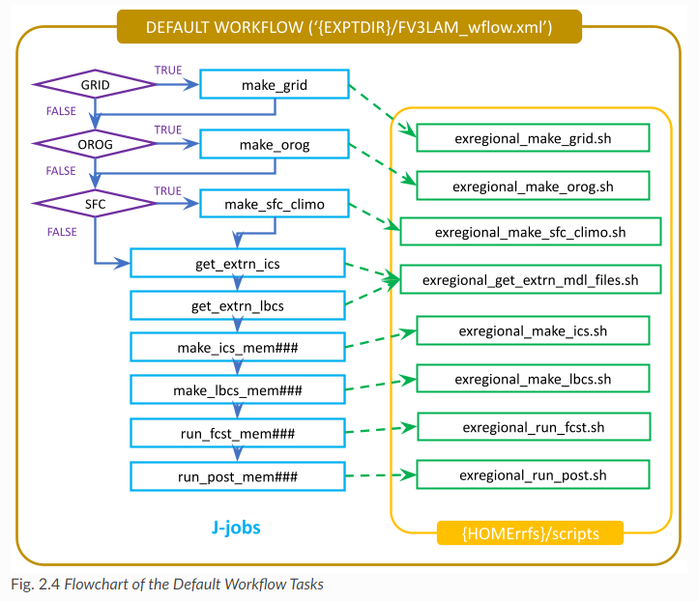
Paradigm of UFS-SRW
workflow tasks
(from User’s Guide)

Slide 26
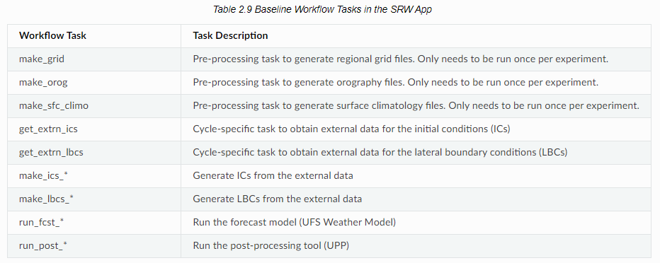
Paradigm of UFS-SRW
workflow tasks (continued)
(from User’s Guide)

Slide 27
Information on Rocoto (not complete...)
To change the number of nodes, CPUs, walltime, etc. for running the experiment, change nodes, nprocs, walltime in FV3LAM_wflow.xml, respectively.

Slide 28
[end]

