Slide 1
Boulder windstorm case
(Experiment #2, Parts 1, 2, and 3)
Part 1 DUE Monday, October 21, by start of class.
Part 2 DUE Wednesday, October 23, by start of class.
Part 3 will come later this semester.
ATM 419/563
Fall 2024
Fovell
© Copyright 2024 Robert Fovell, Univ. at Albany, SUNY, rfovell@albany.edu

Slide 2
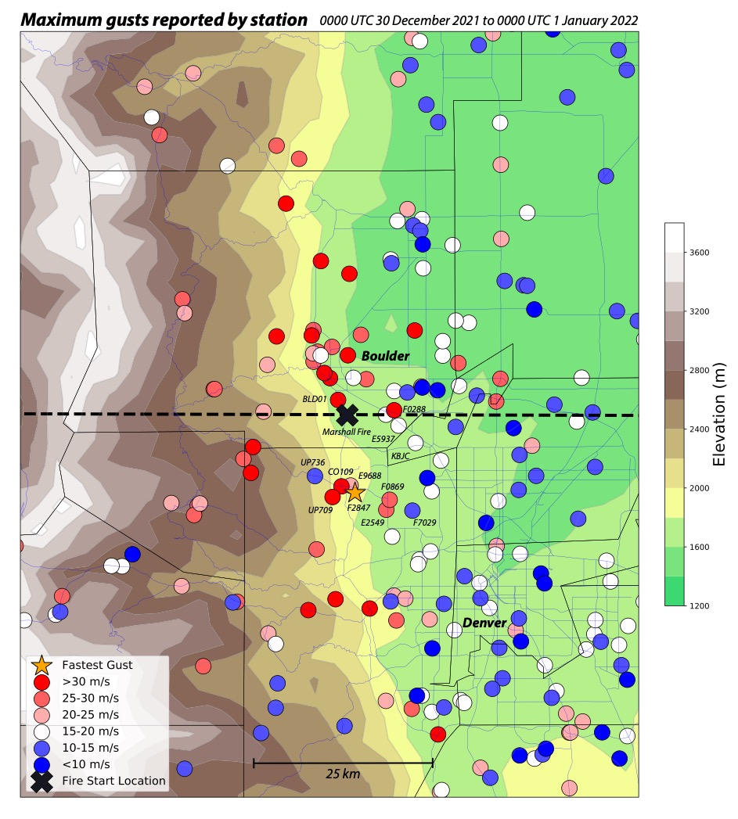
Marshall fire (X)
(2021) became
worst fire in
Colorado
history, driven
by drought and
high winds
HRRRv4
topography
with event
max gusts
(m/s)
during the
Marshall Fire
Event
Fastest gust
was 51.4 m/s
[115 mph] at
yellow star
Fovell et al. (2022)

Slide 3
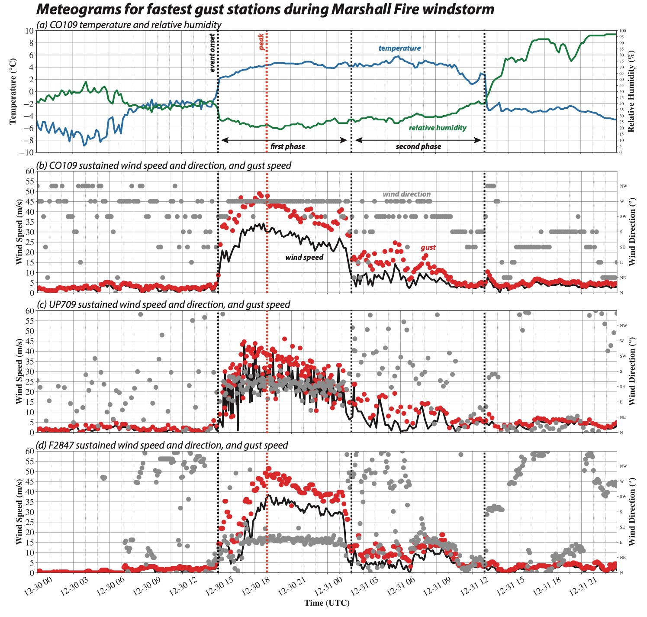
Windstorm
started about
15Z 12/30/21
[8 am MST],
peaked around
17-19Z, and
fell into a 2nd
weaker phase
after 2Z 12/31
[7 pm MST]
Fire started at
event peak (18Z,
11 am MST)
Fovell et al. (2022)

Slide 4
Instructions and Resources
YOU WILL NEED TO FINISH THIS OUTSIDE OF CLASS
In your lab space, create a directory called WINDSTORM and move into it
Copy the file $LAB/SCRIPTS/WRF_REAL_SETUP.TAR and unpack it (tar –xvf…)
Execute make_all_links.sh as per usual
Also follow the WINDSTORM script
Namelists will require extensive editing
Refer to the Real-data WRF Checklist on class website for detailed, step-by-step guidance

Slide 5
Python notebooks
[included in setup archive]
Edit namelist.wps for our experiment first
plot_WRF_domain.ipynb
  Reads your (modified) namelist.wps file and visualizes your domain
  Limited to Lambert projections at this time
plot_WRF_terrain.ipynb
  After running geogrid, plots your terrain in Domain 1, reading geo_em.d01.nc and namelist.wps
  Check your map factors
  Can be used for other domains (if they exist) with appropriate modifications
WRF_plot_example_V4.ipynb
  Requires editing. Plots plan maps and vertical cross-sections at time selected.

Slide 6
Our control run

Slide 7
Study area
Boulder-centered 200 x 200 gridpoint, 6 km grid spacing domain
  Lambert. Reference lat and lon: 40, -105. True latitudes: both 40. Standard lon: -105.
Make a simulation starting at 2021123012
  Initialized from 3-km NAM, available every 3 hours, located in $LAB/DATA/NAM_2021123012, using Vtable.NAM
  Run 12 h, ending 12/31 00Z
  See script for more information.

Slide 8
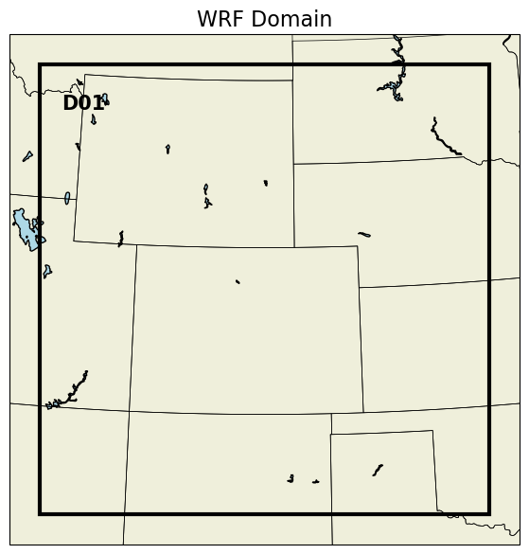
Produced by plot_WRF_domain.ipynb
[no topography since this notebook
just reads in the namelist.wps file]

Slide 9
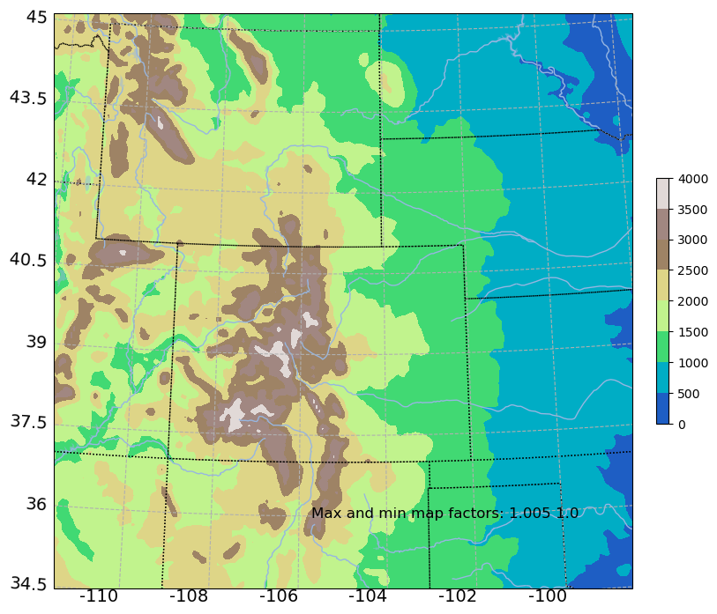
Produced by plot_WRF_terrain.ipynb
[You may need/want to tweak the
plt.Normalize command]

Slide 10
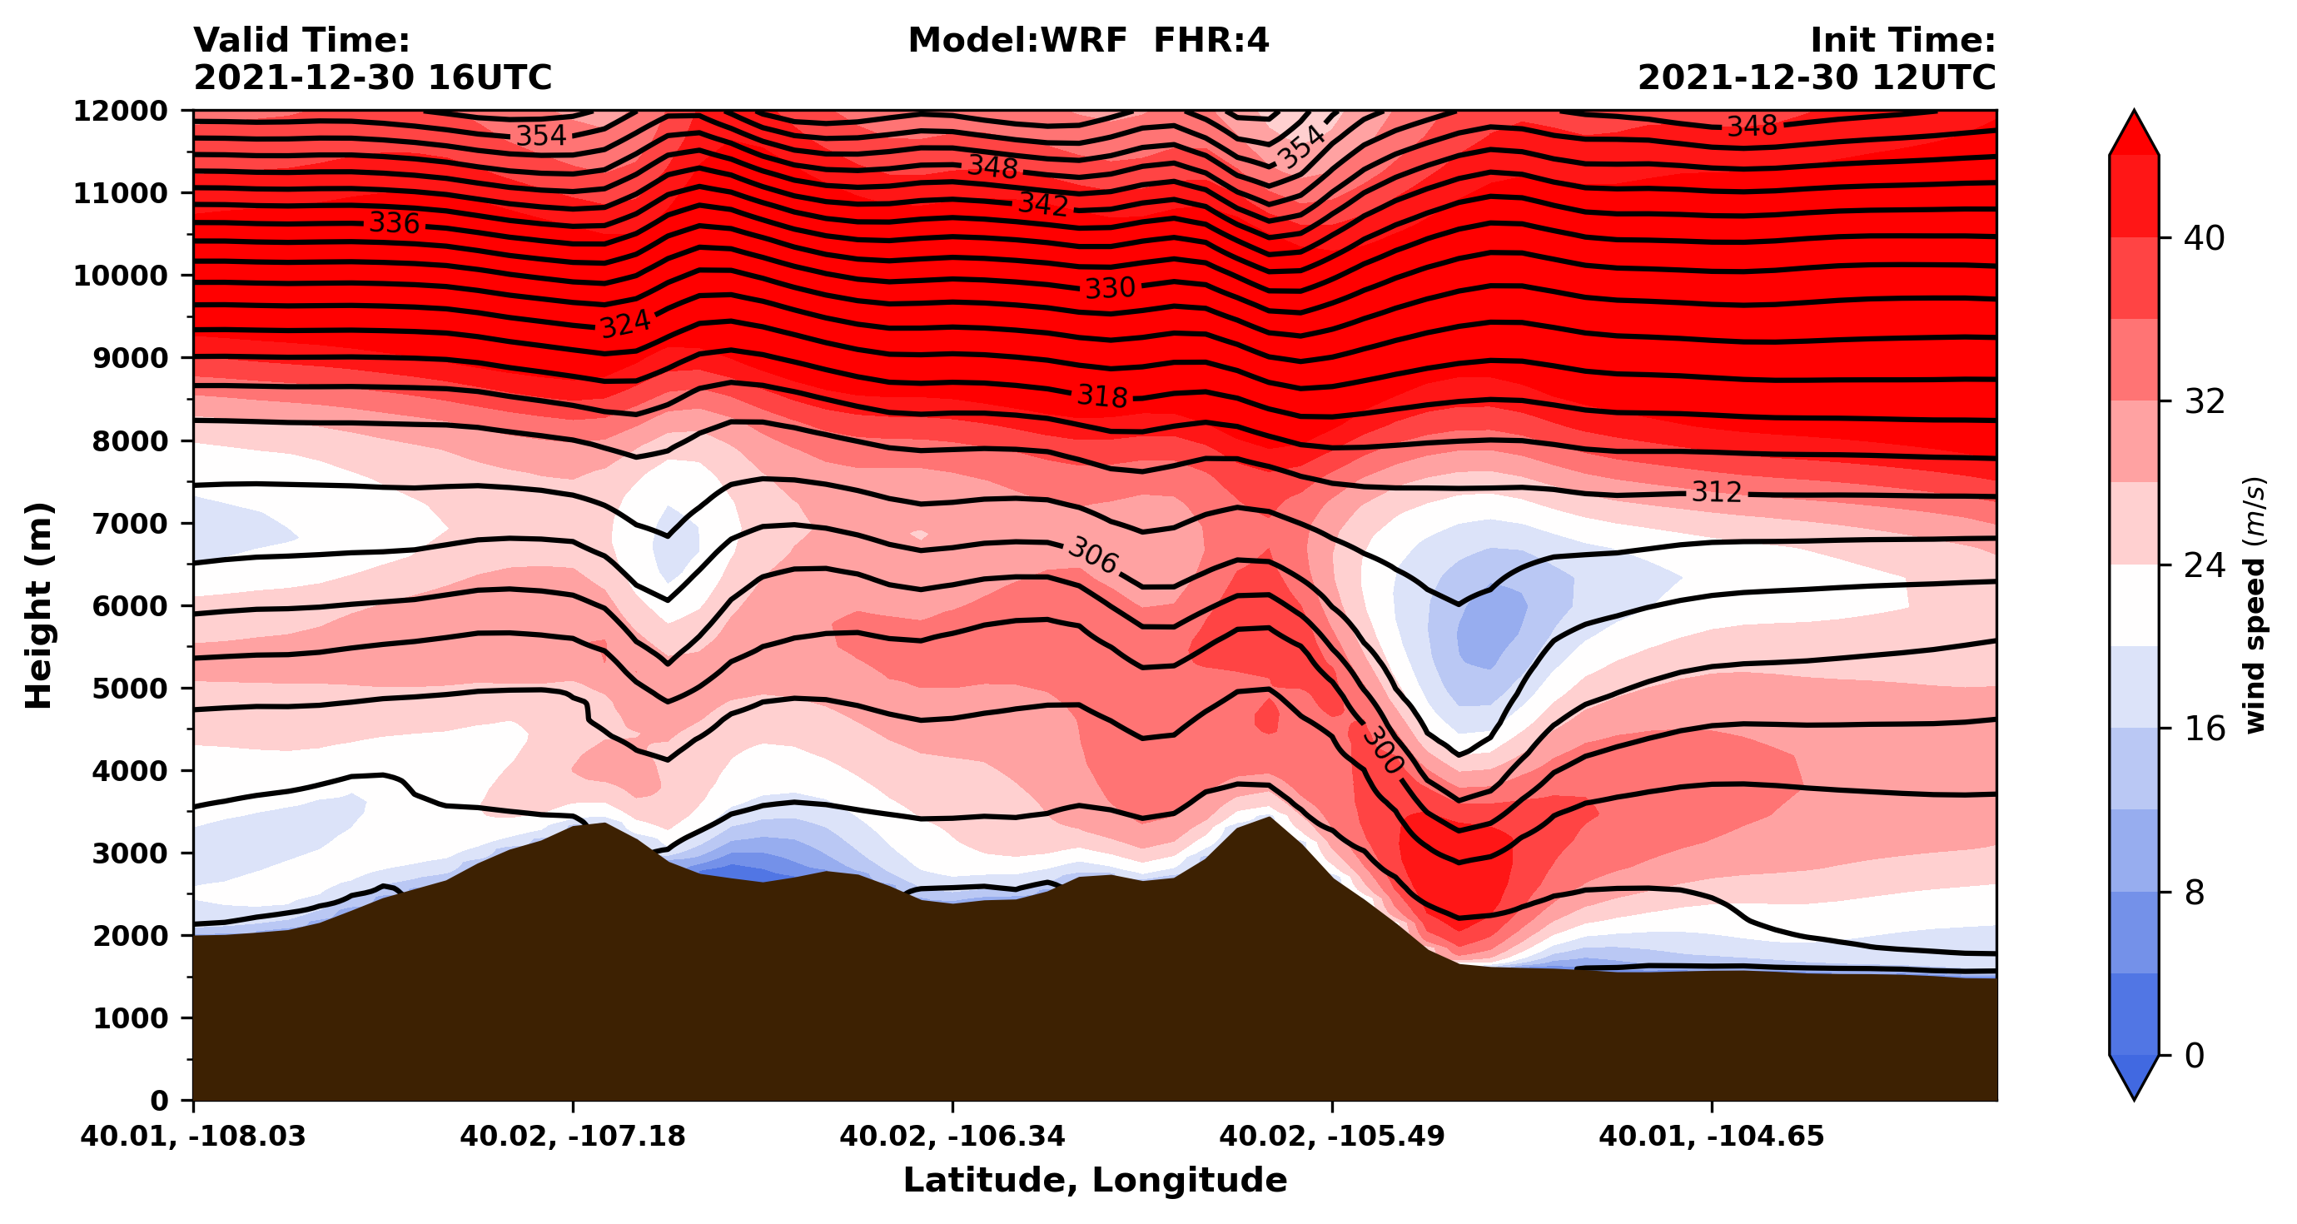
wind
West-east vertical cross section across Marshall fire ignition site, from -108 to -104 longitude
4 h forecast

Slide 11
Experiment #2, Part 1
Due Monday, October 21, 2024
by start of class

Slide 12
Experiment #2 Part 1
Make a time series plot of 10 m wind speed at the Marshall fire site for our control run
  We used WRF-Python’s ll_to_xy function in the SNOWSTORM case to plot a snow depth time series for Albany. Add something similar to this notebook for this task
  Marshall fire ignition site can be taken as 39.954871, -105.27055
  Cell #3 pulls 10 m wind speed and direction as “wspd10_w” and “wdir10_w”, respectively
  Put your name in the plot title.
  Email to Liam and myself.
  Grad students: plot wind direction on the second y-axis
Archive your Part 1 work. I would create a folder inside WINDSTORM called WIND01 and into it move the wrfout file and copy namelist.input, and namelist.wps

Slide 13
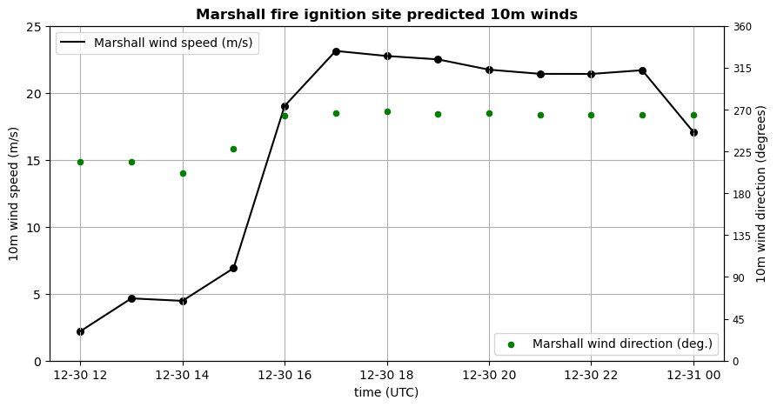
10 m winds for our simulation

Slide 14
Experiment #2, Part 2
Due Wednesday, October 23, 2024
by start of class

Slide 15
Experiment #2 Part 2
For Part 1, we all created the same simulation
For Part 2, do something different. You can consider [see following slides]:
  Initializing from a different parent model source
  Initializing at an earlier time (and running longer, so still ending 12/31 at 00Z)
  A combination of the foregoing
  Changing the resolution (making topography coarser)
  Changing the model physics
  Have a different idea? Consult with me.
Create a brief report (PowerPoint, Word, other document) comparing your Part 1 control run with your Part 2 simulation. What’s different? What’s similar?
Make it look nice.

Slide 16
Other parent model data available
In $LAB/DATA:
  NAM (use Vtable.NAM):
    NAM_2021123012 (We’re using these for Part 1)
    NAM_2021123000
    NAM_2021122912
  GFS (use Vtable.GFS):
    GFS_2021123012
    GFS_2021123000
    GFS_2021122912
  HRRR (Use $LAB/SCRIPTS/Vtable.HRRR.wrfprs)
    HRRR_2021123012
    HRRR_2021123000
    HRRR_2021122912

Slide 17
Changing model physics
Most likely candidates for physics sensitivity:
  PBL scheme bl_pbl_physics
  Surface layer sf_sfclay_physics
  Land surface model sf_surface_physics
Less likely candidates include microphysics (mp_physics), cumulus scheme (cu_physics), radiation (ra_lw_physics, ra_sw_physics), urban physics (sf_urban_physics), topographic and slope shading (topo_shading, slope_rad)

Slide 18
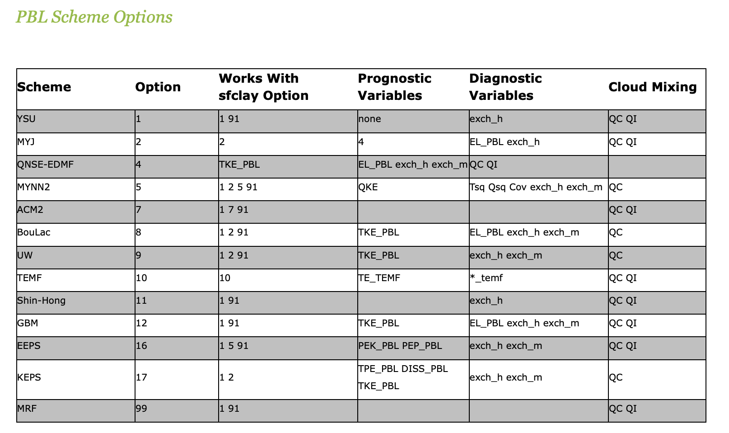
PBL and surface layer options
• PBL and surface layer options often paired
• Some combinations are optimized, others incompatible
• Names for the eddy mixing coefficients vary among schemes
bl_pbl_physics sf_sfclay_physics

Slide 19
Land surface models (LSMs)
Most common: Noah (sf_surface_physics = 2)
  Used in control run WIND01, and in GFS and NAM
  Set num_soil_layers = 4
Other reasonable options:
  sf_surface_physics = 3 (RUC LSM, used in HRRR and RAP)
    num_soil_layers = 6 or 9
  sf_surface_physics = 4 (NoahMP, related to Noah)
    num_soil_layers = 4
    Many additional options available [optional]
  sf_surface_physics = 7 (Pleim-Xiu)
    num_soil_layers = 2
Less desirable options:
  Thermal diffusion scheme (sf_surface_physics = 1): obsolete
  NCAR CLM4 LSM (sf_surface_physics = 5): very, very slow
num_soil_layers is not the same as num_metgrid_soil_levels

Slide 20
Experiment #2, Part 3

Slide 21
Model verification
Part 3 will be an in-class demonstration of how to use Model Evaluation Tools (MET) to perform a simple comparison of observed and forecasted wind, temperature, RH, dewpoint for ASOS stations in Colorado.
Coming later this semester.

Slide 22
[end]

