Slide 1
Real-data WRF: Forecast verification
(Boulder windstorm Part 3)
ATM 419/563
Fall 2024
Fovell
© Copyright 2024 Robert Fovell, Univ. at Albany, SUNY, rfovell@albany.edu

Slide 2
Overview
Surface station comparison: WRF forecasts v. observations
Data sources:
  Your WRF simulation of the Boulder windstorm of December 2021
  Surface observations from the NOAA MADIS archive
  Focus on near-surface temperature, wind speed, RH, dewpoint for this example
Tools:
  UPP (Unified Post Processor - unipost): converts WRF output to GRIB format for MET
  MET (Model Evaluation Tools): performs comparisons, computes statistics
  Python for charts and maps, with topo maps from Google
Goal:
  Assess how good WRF forecast skill is, and whether we need to reevaluate model configuration
  But also consider this question: are all surface observations created equal?

Slide 3
Verification for your final project would involve
Obtaining observations from MADIS and preparing them
Running UPP on your WRF model output
Running MET
Visualizing your results
Understanding limitations of both the model and the observations
Using the verification to evaluate and improve your experiment
(I can help)

Slide 4
Surface stations
[keep in mind WRF forecasts “2 m T” and “10 m wind”]
ASOS
  Primarily at airports
  Sonic anemometers, nominally mounted at 10 m AGL, usually flat and well-exposed (but not always)
AWOS
  Older installations, often non-sonic, at smaller and lesser used airports; many commingled with ASOS in MADIS
RAWS
  US Forest Service and other agencies, primarily sited on mountain slopes, often obstructed by trees
  Propeller or cup/vane anemometers nominally mounted at 6.1 m AGL, non-aspirated thermistors
MESOWEST
  An eclectic mix of stations, including many public utilities and highway and railroad mesonets
  Public utility mesonets often use propeller anemometers mounted at various heights, including 6.1 m AGL
APRSWXNET
  A real polyglot mix of citizen- and corporate-owned weather stations, many in people’s backyards
OTHER
  Include agriculture stations, avalanche stations, hydromet stations, etc. Some anemometers at 2 m AGL
There are differences in instrument type (sonic vs. non-sonic anemometer), mounting height, instrument
characteristics (aspirated vs. non-aspirated), characteristic placement and exposure – and reason for placement

Slide 5
Boulder windstorm simulation WIND01
Verification using MET against observations collected in Colorado and extracted from the NOAA MADIS public database
  Our domain extended beyond Colorado’s state borders
Our MET scripts compare a station to the nearest model grid point
  We could also interpolate model fields to station’s lat/lon location
  We’re also not filtering for elevation differences between model and station
We have hourly output. MET will find observations valid for as close to the top-of-hour that are available
  At an extreme, observations may be up to 30 min before or after model valid time. There are other options available
We start by verifying against ALL available observations. Follow script.
All of the choices in red can be revised/reconsidered

Slide 6
Network- and station- averaged results for WIND01
Using ALL available stations
SEE SCRIPT.
I am presuming you have a directory called WINDSTORM and a subdirectory called WIND01 with your wrfout file
from our common control run
If run_unipost_frames fails: (1) Did you create subdirectories postprd and wrfprd? (2) Did you move your wrfout file
into wrfprd?

Slide 7
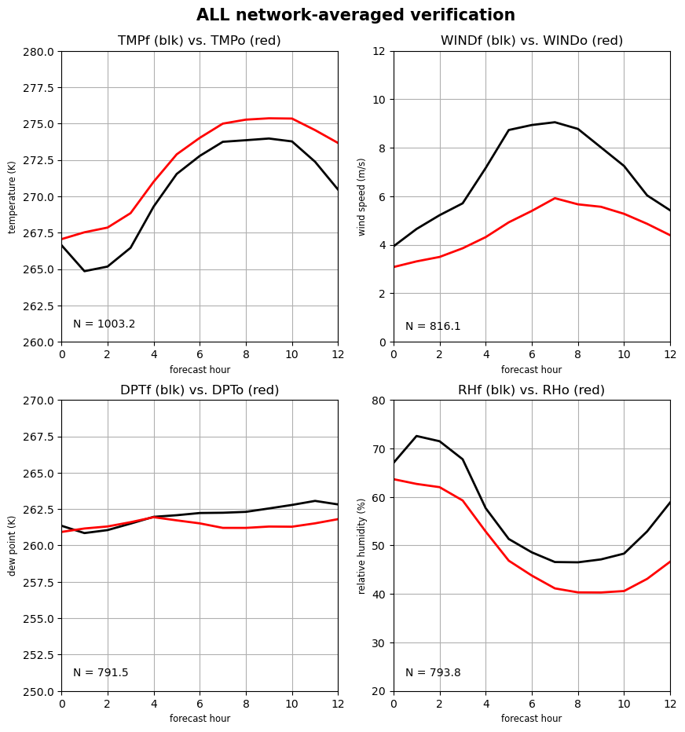
ALL STATIONS in COLORADO available in MADIS
Up to 1050 stations depending on variable and time
Network averages
obs
RED = observations
BLACK = forecast
N = avg number of stations available
forecast
T: cold bias
Td: wet bias
RH: high bias
Wind: very overpredicted,
especially at peak
MET6_ALL.sh
OBS_base=$MYLAB/DATA/MADIS/DEC2021_BOULDER_V2/
Notes:
How do you overpredict the wind during a windstorm?

Slide 8
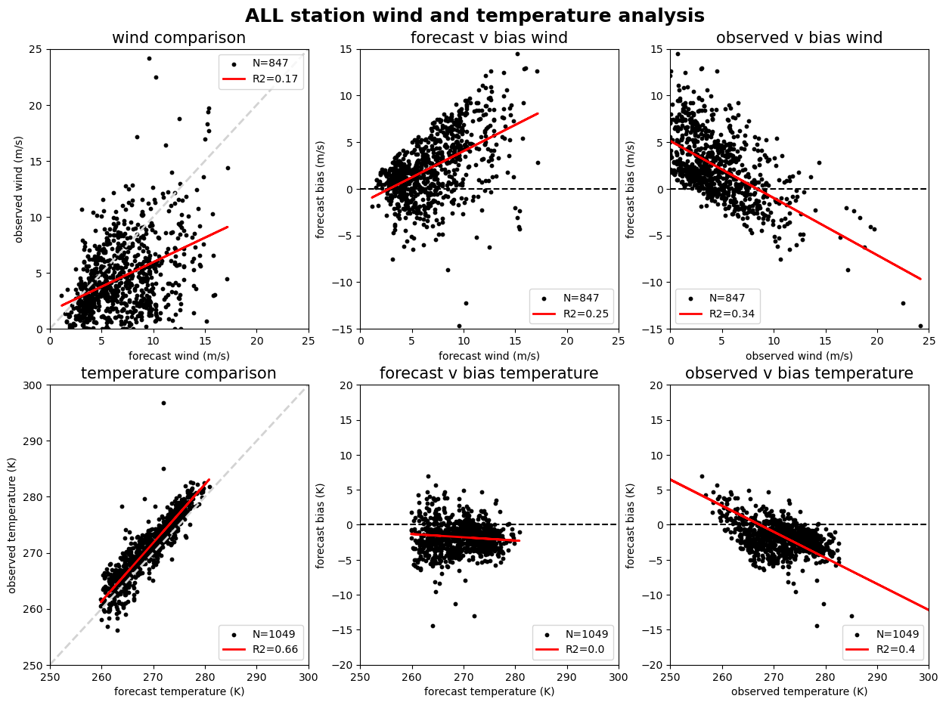
ALL
Is there
skill here?
Each dot is a
station averaged
over 13 h
The bias is
biased!
Bias = forecast
minus obs
Some of these
obs are outliers
and probably bad
but don’t change
basic result
→ Obs are dirty

Slide 9
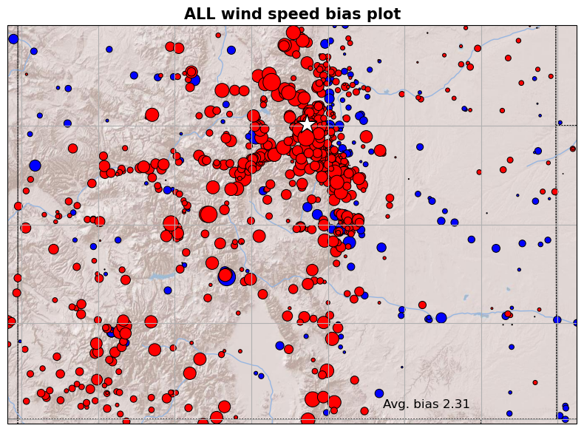
ALL
Star =
Boulder
Marker color:
red + bias
blue – bias
size ∝ bias size
MADIS state
filtering is
imperfect

Slide 10
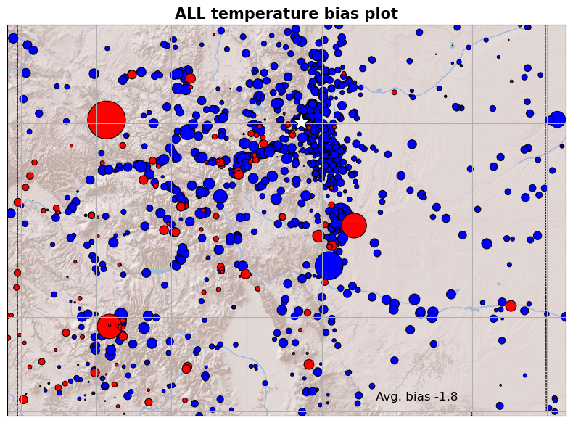
ALL
Star =
Boulder
Marker color:
red + bias
blue – bias
size ∝ bias size
MADIS state
filtering is
imperfect

Slide 11
Station subsets
Our ALL analysis used all stations, from all networks. You also have scripts to perform analyses on station subsets for these networks:
MET6_ASOS.sh ASOS stations (mainly airports)
MET6_RAWS.sh RAWS stations (many in hills, mountains, forests)
MET6_MESOWEST.sh MESOWEST stations (utilities, govt. agencies, etc.)
MET6_WXNET.sh APRSWXNET stations (obs mainly from the public)
MET6_COAGMET.sh Colorado Ag Meteorology stations
For each subset, run the script, one at a time, and visualize using the notebook. Let’s start with the ASOS script…

Slide 12
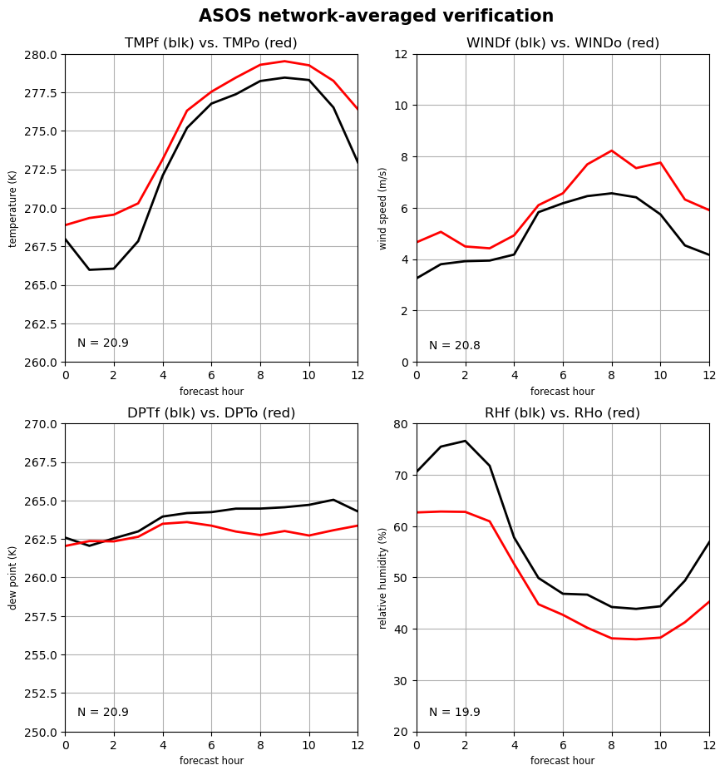
ASOS stations in COLORADO available in MADIS
21 stations max
Network averages
T: cold bias
Td: wet bias
RH: high bias
Wind: underpredicted
MET6_ASOS.sh
OBS_base=$MYLAB/DATA/MADIS/DEC2021_BOULDER_ASOS/

Slide 13
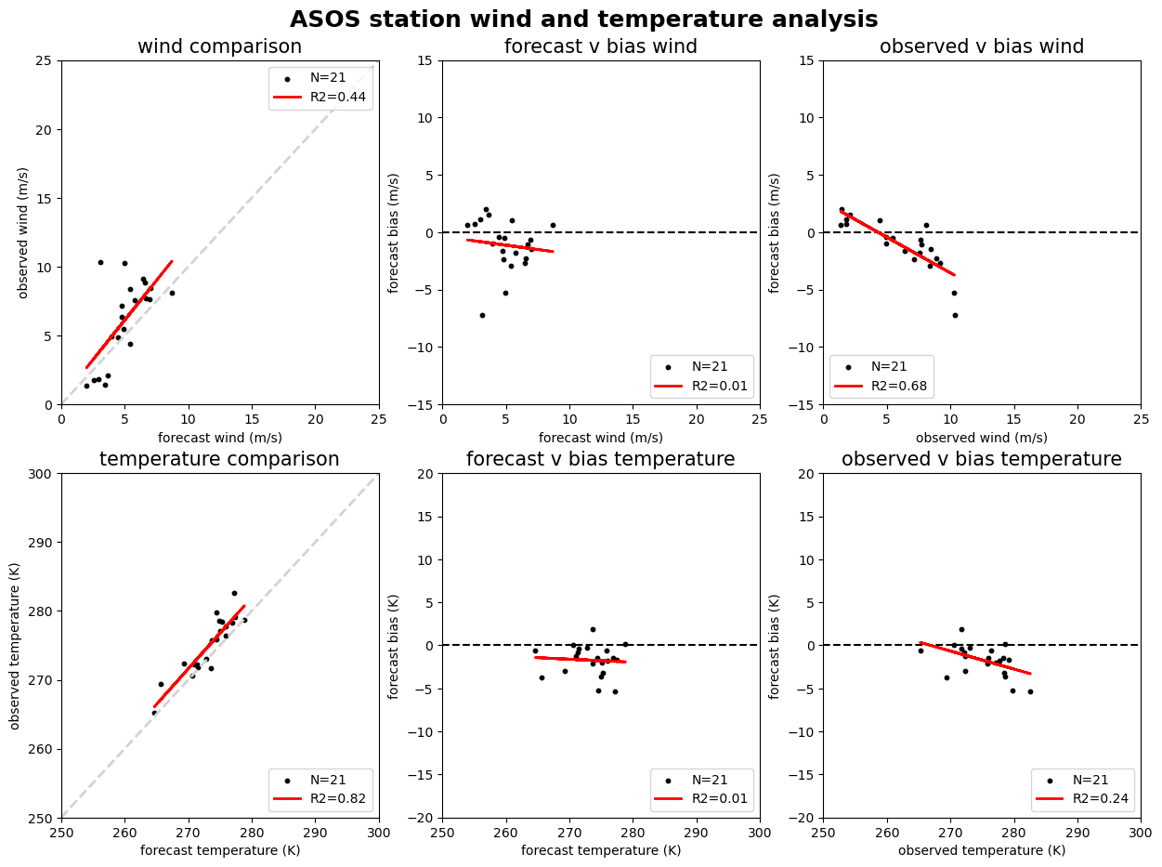
ASOS

Slide 14
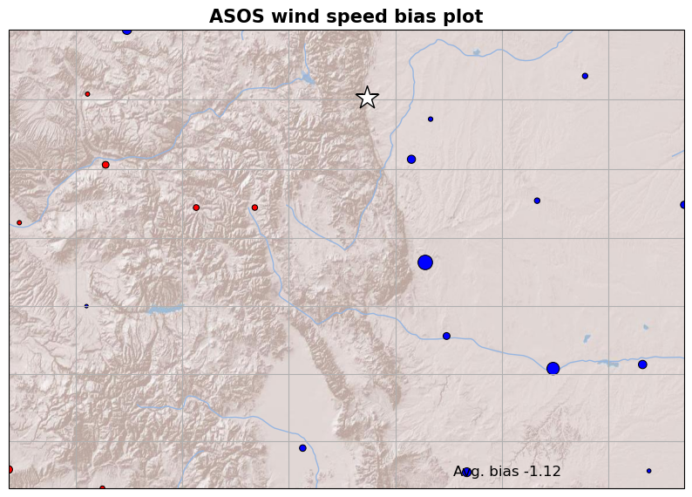
ASOS
Notes:
AWOS not included. Stations near Boulder are AWOS (KFNL is, KLMO is)

Slide 15
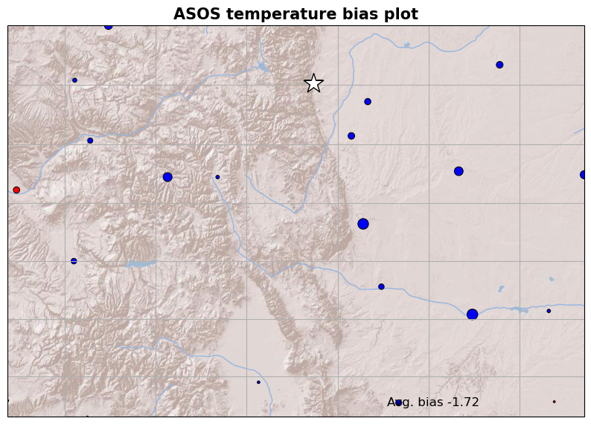
ASOS

Slide 16
Task: see ATM419_MET_assignment.pdf
For WIND01, finish running scripts for the station subsets
  For some variables, you are getting different answers and biases for different subsets. Which should you trust? Which should you not trust?
Do a similar analysis for your WIND02 simulation from the WINDSTORM experiment, and compare to WIND01 results
  Is one better than the other? For some variables? For all variables?
Identify the worst flaw in WIND01 and WIND02, propose a fix, and run a 3rd simulation (WIND03) and analyze it
See handout for report guidelines, and strategy outline on next slide

Slide 17
Analysis strategy
For each case you wish to analyze
Create a new folder for the analysis (e.g., WIND01)
Create the subdirectories postprd and wrfprd
Copy or move your wrfout file into wrfprd
Copy and unpack SETUP_MET.tar file in your analysis folder
Edit the scripts if necessary
Execute the dopython command
Run run_unipost_frames
Execute a MET6_xxx.sh script, then network_plots.sh, then do_surface_analysis.sh, then visualize with plot_MET_analyses.ipynb
Lather, rinse, and repeat as needed

Slide 18
[end]

