Slide 1
Real-data WRF: Setup and run and Geogrid assignment
Geogrid assignment is due by Wednesday, September 18. See slide 21.
ATM 419/563
Fall 2024
Fovell
© Copyright 2024 Robert Fovell, Univ. at Albany, SUNY, rfovell@albany.edu

Slide 2
References
WRFV4.5 users guide
  https://www2.mmm.ucar.edu/wrf/users/wrf_users_guide/build/html/index.html
Technical description of WRFV4 (PDF)
  https://www2.mmm.ucar.edu/wrf/users/docs/technote/contents.html
NetCDF operators (NCO) home page
WRF-Python documentation

Slide 3
Terms & facts
Parent model = gridded data used for WRF’s initialization and boundary conditions
  GFS/FNL, NAM, RAP/HRRR, reanalyses (NARR, CFSR, NNRP, ERA-interim, ERA5 etc.), other WRF runs
WPS = WRF Preprocessing System (consisting of geogrid, ungrib, and metgrid programs)
WRF simulations are almost always initialized with parent model datasets on isobaric levels in GRIB1/2 format, or WRF outputs in NetCDF format
WRF outputs are almost always NetCDF

Slide 4
Steps in real WRF experiment
Geogrid (geogrid.exe)
  Set up domain (and nests, if applicable)
  In this demo: creates geo_em.d01.nc
  Only redone if domain is altered
Ungrib (ungrib.exe)
  Unpacks GRIB1 & GRIB2 parent model data, almost always on isobaric levels
  Requires the correct variable table (“Vtable”) translator
  In this demo: creates a number of files called FILE:*
Metgrid (metgrid.exe)
  Interpolates unpacked parent model data to WRF model (horizontal) grid created with geogrid
  In this demo: creates a number of files called met_em.d01.*
Real (real.exe)
  Interpolates metgrid outputs from parent model’s vertical coordinate to WRF’s vertical coordinate
  Creates initial and boundary condition files on the terrain-following WRF vertical grid
  In this demo: creates wrfinput_d01 and wrfbdy_d01
WRF (wrf.exe)
  Compiled as em_real,reads in initial and boundary condition files from real
  In this demo: output file called wrfout_d01_2023-01-22_12:00:00

Slide 5
Task flowchart
geogrid
ungrib
metgrid
real
wrf

Slide 6
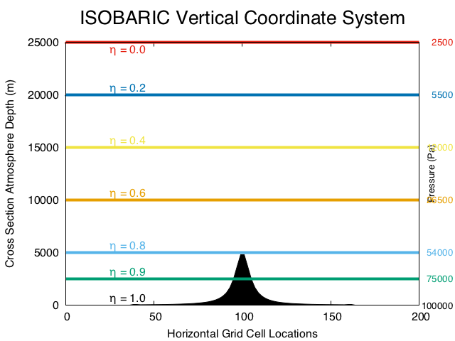
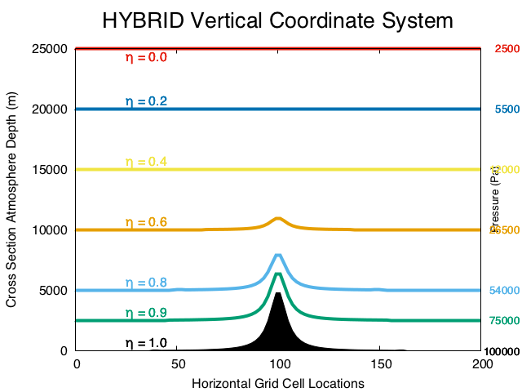
800 mb
Parent model data are almost always made available on isobaric levels (pictured at left).
Metgrid interpolates isobaric data onto the WRF horizontal grid.
Real interpolates the metgrid data onto the WRF vertical grid, which is a hybrid
terrain-following coordinate (pictured at right).
WRFV4 has further improved this coordinate relative to previous versions.
Notes:
Actually WRF vert levels strive to maintain same vertical height AGL, subject to variation wrt T as it’s a mass (hypsometric) coordinate, so what is shown at right is not really strictly accurate

Slide 7
SNOWSTORM case study
One 36-km grid spacing, 54 x 48 point domain centered over Albany, NY, simulated using WRF version 4.5.1
36 h simulation, initialized from GFS at 1/22/2023 at 12Z, with hourly outputs
See script ATM419_WRF_REAL_SNOW2023_script.pdf for implementing this case study
Notes:
Verify => later

Slide 8
Issues and workarounds
We’re generally using the srun command to execute programs on the batch or burst cluster. This command can execute single-threaded and MPI (multiple-cpu) jobs.
srun is aliased to srun --mpi=pmix. If this fails, do which srun. If the response is not the below, manually add --mpi=pmix
  srun srun --mpi=pmix
Ignore “There was an error initializing an OpenFabrics device” warnings.

Slide 9
Preliminaries
WRF-ARW has been compiled as em_real
Namelists are
  namelist.wps (used for geogrid.exe, ungrib.exe, metgrid.exe)
  namelist.input (used for real.exe, wrf.exe)
In your lab space, create a directory called SNOWSTORM,
move into it, and copy/unpack this file [see script]
  $ lab
  $ mkdir SNOWSTORM
  $ cd SNOWSTORM
  $ cp $LAB/SNOWSTORM/SETUP.TAR .
  $ tar –xvf SETUP.TAR

Slide 10
make_all_links.sh
This file is different and not interchangeable with versions supporting idealized runs
In addition to linking to needed programs and support files for WRF real, this shell script also:
  Creates directories called geogrid and metgrid and places the default *.TBL files in them.
    If those directories already exist, they are removed and replaced. We do not need to alter those files at this time.
  Copies variable translation tables, called Vtable.*, for commonly used parent model datasets

Slide 11
Namelists
Again, the real-data WRF modeling system uses two namelists: namelist.wps and namelist.input
  namelist.wps: geogrid, ungrib, metgrid
  namelist.input: real and wrf
These are pre-configured for this particular case, so no editing will be necessary

Slide 12
Visualize the domain defined in namelist.wps
Launch Jupyterlab on ARCC
  https://jupyterlab.its.albany.edu/hub/login
  One node on batch suffices
Click on LAB (if necessary), then your SNOWSTORM directory
Launch plot_WRF_domain.ipynb
  This notebook reads your namelist.wps and shows you what your domain looks like
  Output next slide

Slide 13
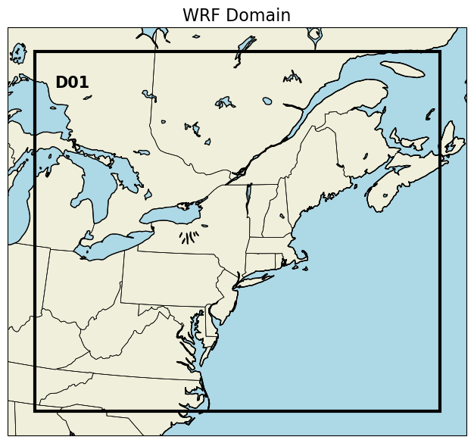
Output of plot_WRF_domain.ipynb

Slide 14
Geogrid
Do geogrid section of script
  Creates geo_em.d01.nc
  Outputs as shown in next 2 slides, visualized with plot_WRF_terrain.ipynb

Slide 15
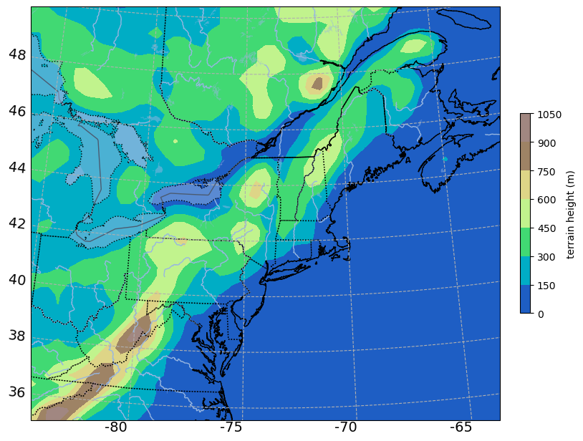
plt.contour version
Output from plot_WRF_terrain.ipynb
do_pcolormesh = False

Slide 16
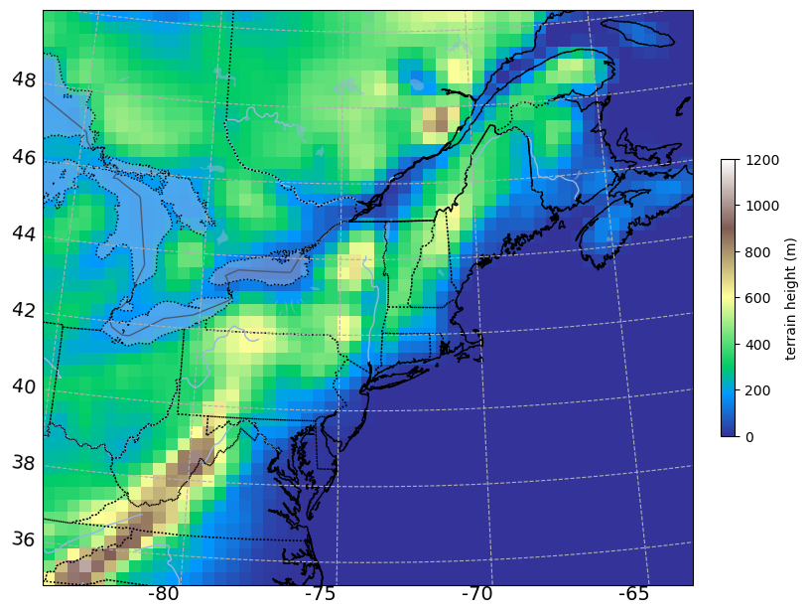
plt.pcolormesh version
Output from plot_WRF_terrain.ipynb
do_pcolormesh = True

Slide 17
&share
wrf_core = 'ARW',
max_dom = 1,
start_date ='2023-01-22_12:00:00', '2023-01-22_12:00:00'
end_date = '2023-01-24_00:00:00', '2023-01-24_00:00:00'
interval_seconds = 10800,
io_form_geogrid = 2,
opt_output_from_geogrid_path = './',
debug_level = 0
/
namelist.wps
NOTES:
• One domain (max_dom = 1) so second column of start_date
and end_date does not matter
• interval_seconds is time resolution of parent model data in seconds
(for GFS, we have 3-hourly data, so 10800 sec)
(NAM is hourly to 36 h, 3-hourly thereafter)
(HRRR is hourly to 36 h for 00Z/12Z runs, to 48 h after December 2020)
• Anything between / and the next & is ignored
• For geogrid step, only max_dom setting from this section matters at this time

Slide 18
&geogrid
parent_id = 1, 1, 2,
parent_grid_ratio = 1, 3, 3,
i_parent_start = 1, 82, 100,
j_parent_start = 1, 82, 36,
s_we = 1, 1, 1,
e_we = 54, 214, 772,
s_sn = 1, 1, 1,
e_sn = 48, 196, 610,
geog_data_res ='default', 'default', 'default',
dx = 36000.,
dy = 36000.,
map_proj = 'lambert',
ref_lat = 43.,
ref_lon = -74,
truelat1 = 43.,
truelat2 = 43.,
stand_lon = -74,
geog_data_path = '/network/rit/lab/atm419lab/GEOG4.0/',
opt_geogrid_tbl_path = 'geogrid/'
/
namelist.wps
center of domain
domain orientation rel. to north
NOTES:
• again, in this case, if multiple columns exist and are allowed, only first column matters
• our single domain is 54 x 48 and 36 km grid spacing
• We’re using the “default” landuse database… MODIS 21 category (others are available)
• Lambert projection is standard for modest-sized domains in midlatitudes.
Use polar stereographic for high latitudes, Mercator for tropical domains.
Notes:
38N 100W is very close to Dodge City, KS

Slide 19
Map factors
You specify ∆x (and ∆y) in namelist.wps
The map factor m determines actual grid spacing
  So when m > 1.0, your actual grid spacing is smaller than specified ∆x. This puts stress on your time step.
  When m < 1.0, you have less resolution than you thought you had.
  Map factor varies through the domain, so take note of largest and smallest values (and where they are)
  Stay as close to 1.0 as practical.

Slide 20
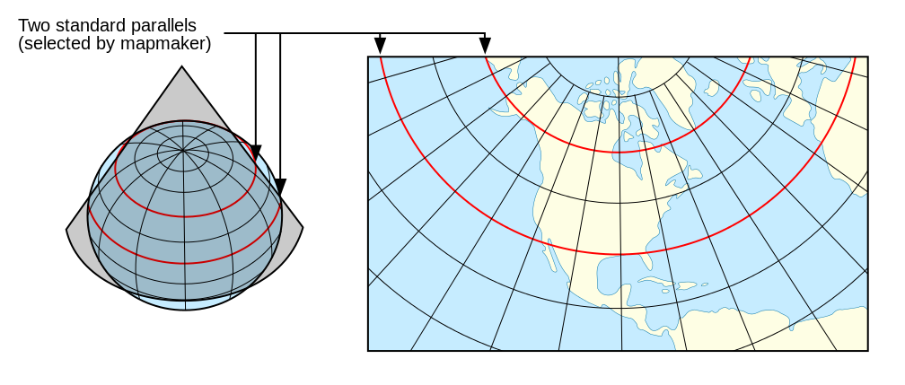
Lambert conformal projection (from Wikipedia)
- shape and accuracy depend somewhat on “true latitudes” (standard parallels)
At a “true latitude”, there is no map distortion;
i.e., map factor is 1.0. Defaults to 30 and 60˚.
For relatively small domains, true latitudes can be equal (as here) and set to center latitude
Map factor = (horizontal grid size)/(actual distance)
so when factor > 1 your real grid size < ∆x, ∆y
ref_lat = 43.,
ref_lon = -74,
truelat1 = 43.,
truelat2 = 43.,
stand_lon = -74,

Slide 21
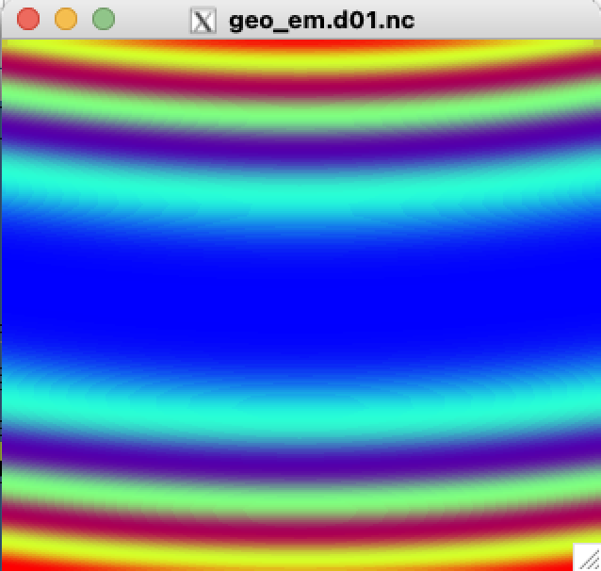
• Use NetCDF operators (NCO) in max.csh to look in geo_em.d01.nc file
csh max.csh MAPFAC_M geo_em.d01.nc
the max is
1.00928
the min is
1
• Use ncview to peek at geo_em.d01.nc file
ncview geo_em.d01.nc
[plot 2D variable MAPFAC_M]
[see also next slide]
ref_lat = 43.,
ref_lon = -74,
truelat1 = 43.,
truelat2 = 43.,
stand_lon = -74,
[i.e., smallest ∆x is 35.7 km]
1.009
1.0
MAPFAC_M increases
from ~ 1 to 1.01 away from
central (true) latitude.
You need to keep the map
factors “close” to 1.0.
Notes:
1.009 = actual grid spacing FINER than expected.

Slide 22
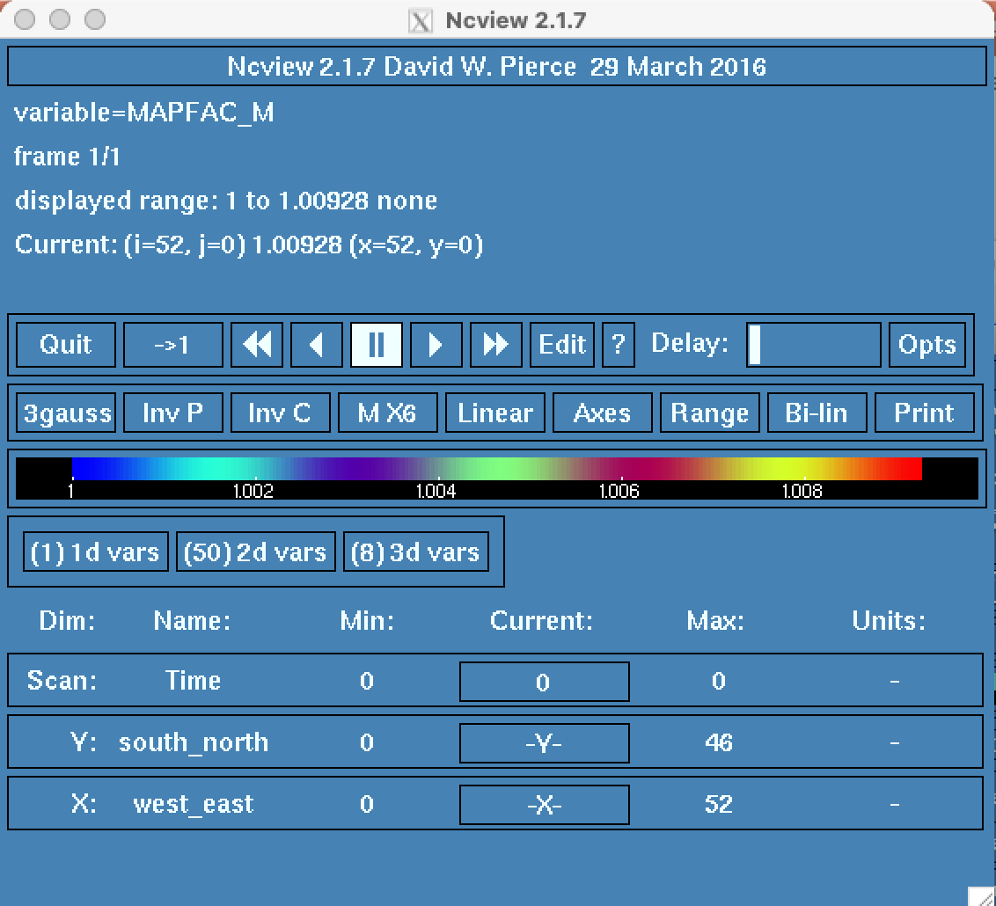
Using ncview

Slide 23
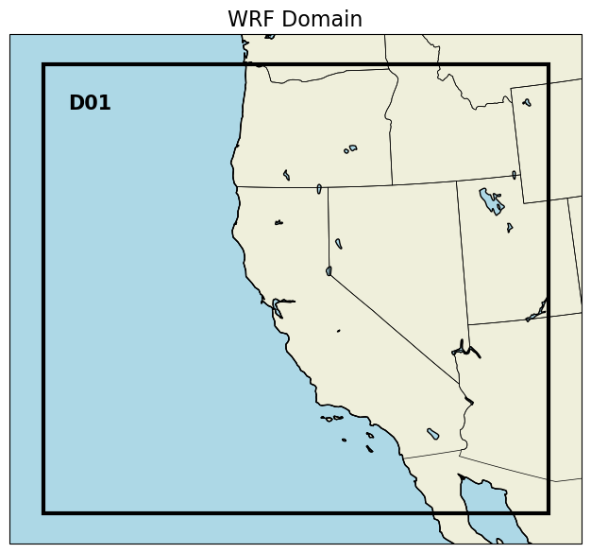
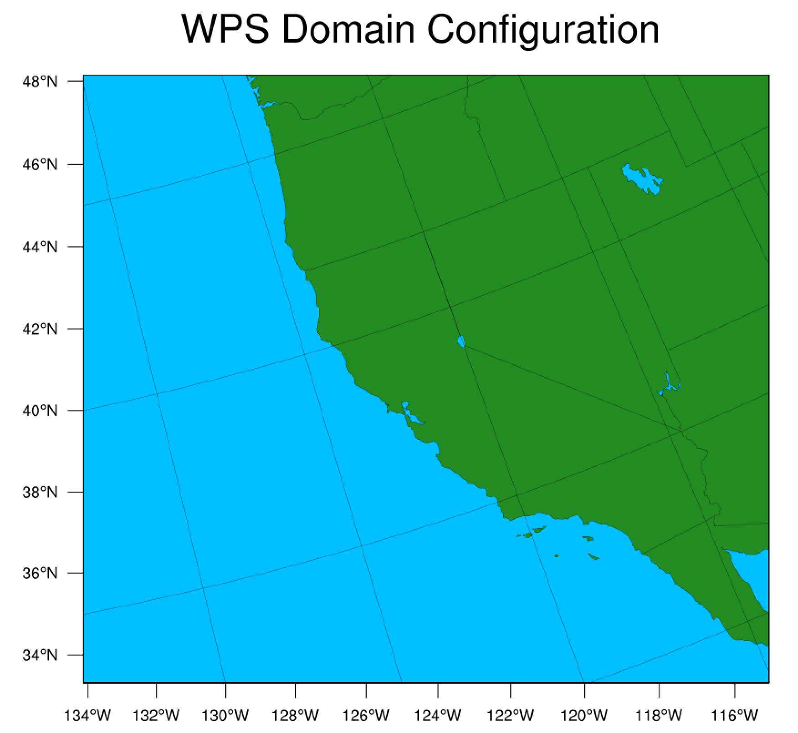
ref_lat = 38.5,
ref_lon = -121.5,
truelat1 = 38.5,
truelat2 = 38.5,
stand_lon = -121.5,
Example of ref_lon ≠ stand_lon
ref_lat = 38.5,
ref_lon = -121.5,
truelat1 = 38.5,
truelat2 = 38.5,
stand_lon = -151.5,
Used plotgrids.ncl, which does not work on head.arcc

Slide 24
Geogrid assignment
Posted on class web page
  ATM419_geogrid_assignment.pdf
  Explores different projections and map factors
  Choose a domain relevant to your final project simulations
  Use GEOGRID_assignment_example.pptx as a template for your results
  Due Wednesday, September 18, 2024

Slide 25
Ungrib
In this step, we link to the parent model gridded data in GRIB1 or GRIB2 format and unpack them into “intermediate format” files
IT IS CRUCIAL TO SELECT THE CORRECT VARIABLE TABLE (Vtable)
  There is a different Vtable for each parent model
  make_all_links.sh copies a few commonly used Vtables over
  The file used must be named “Vtable” alone
  Other variable tables found in $LAB/SOFTWARE/VTABLES
UNGRIB CAN BE VERY SLOW AND CAUSE RESOURCE CONTENTION
  Also, unlike other WRF/WPS programs, ungrib is not designed to utilize more than one processor simultaneously. [Unfortunately, you can actually do this anyway, and it makes a complete mess.]
Follow ungrib part of script – note there are 3 options – I’ll tell you which one we’re using

Slide 26
Option (B): ungrib in a batch script
To possibly avoid contention for resources, we may execute ungrib in a batch job:
$ sbatch –p burst-daes submit_ungrib
$ tail –f ug.srun.out
• In the submit_ungrib batch script, I inserted the command #SBATCH –exclusive. This is an attempt to avoid resource contention on a cluster node.
• NEVER TRY TO RUN UNGRIB ON MORE THAN ONE CPU. It is not an MPI code.

Slide 27
/bin/wgrib2 GRIBFILE.AAA | more
1:0:d=2023012212:PRMSL:mean sea level:anl:
2:995474:d=2023012212:CLWMR:1 hybrid level:anl:
3:1088027:d=2023012212:ICMR:1 hybrid level:anl:
4:1413903:d=2023012212:RWMR:1 hybrid level:anl:
5:1640833:d=2023012212:SNMR:1 hybrid level:anl:
6:1740618:d=2023012212:GRLE:1 hybrid level:anl:
7:1790467:d=2023012212:REFD:1 hybrid level:anl:
8:2590676:d=2023012212:REFD:2 hybrid level:anl:
9:3391370:d=2023012212:REFC:entire atmosphere:anl:
10:4251225:d=2023012212:VIS:surface:anl:
11:5045469:d=2023012212:UGRD:planetary boundary layer:anl:
12:5638465:d=2023012212:VGRD:planetary boundary layer:anl:
13:6226699:d=2023012212:VRATE:planetary boundary layer:anl:
14:6539917:d=2023012212:GUST:surface:anl:
15:7148107:d=2023012212:HGT:0.01 mb:anl:
16:8169128:d=2023012212:TMP:0.01 mb:anl:
17:8743175:d=2023012212:RH:0.01 mb:anl:
GFS model grids in GRIB2
format, on pressure levels
/bin/wgrib2 looks into GRIB2 format files. For GRIB (GRIB1) files, use wgrib.
Notes:
More recent wgrib2 in path fails to diagnose many of the fields, but the really old version [/network/rit/lab/snowclus/bin/wgrib2] works?!
/bin/wgrib2 works and does not have library problems

Slide 28
&share
wrf_core = 'ARW',
max_dom = 1,
start_date ='2023-01-22_12:00:00', '2016-03-13_00:00:00'
end_date = '2023-01-24_00:00:00', '2016-03-15_00:00:00'
interval_seconds = 10800,
io_form_geogrid = 2,
opt_output_from_geogrid_path = './',
debug_level = 0
/
&ungrib
out_format = 'WPS',
prefix = 'FILE',
/
&metgrid
fg_name = 'FILE',
io_form_metgrid = 2,
/
namelist.wps
NOTES:
• Execution of ungrib.exe unpacks the parent model grids into
a set of files named by the prefix (here, ‘FILE:…’)
• Program looks for files between start and end dates, at interval
specified as interval_seconds.
• metgrid.exe is next and will look for files named ‘FILE:…’.

Slide 29
Metgrid
Follow metgrid portion of script
In this step, we place data from the intermediate format files onto the WRF horizontal grid
  Creates files called met_em*
Files may be viewed with ncview (poorly) or Python
Use ncdump on any of the met_em* files to get # of vertical levels and # of soil levels (see next slide)

Slide 30
ncdump -h met_em.d01.2023-01-22_12:00:00.nc | more
[remember TAB COMPLETION!!!]
[type ‘q’ to break out]
netcdf met_em.d01.2023-01-22_12\:00\:00 {
dimensions:
Time = UNLIMITED ; // (1 currently)
DateStrLen = 19 ;
west_east = 53 ;
south_north = 47 ;
num_metgrid_levels = 34 ;
num_st_layers = 4 ;
num_sm_layers = 4 ;
south_north_stag = 48 ;
west_east_stag = 54 ;
z-dimension0003 = 3 ;
z-dimension0132 = 132 ;
z-dimension0012 = 12 ;
z-dimension0016 = 16 ;
z-dimension0021 = 21 ;
This parent model data source
has 34 vertical atmospheric levels
and 4 soil temperature and soil
moisture layers (st and sm).
These vary among parent model
sources AND vary over time.
Notes:
Got to here 2022

Slide 31
Running real.exe and wrf.exe:
Batch scripts

Slide 32
Batch scripts
Running real-data WRF (real.exe and wrf.exe) is often too resource-intensive to execute with srun from the command line.
As an alternative, we’ll run them as jobs on the cluster. SETUP.TAR provided two files: submit_real and submit_wrf.
  Both are presently configured to request 8 cpus on a single node ← can be changed
  No need to edit these scripts at this time (except to change your job name, if you wish)
Notes:
WARNING: After creating my SETUP.TAR file, I changed control_file.3Dz for Exp 4, which reuses KANSAS domain

Slide 33
submit_real
#!/bin/bash
# Job name:
#SBATCH --job-name=atm419
#SBATCH -n 8
#SBATCH -N 1
#SBATCH --mem=131072
#SBATCH -o sbatch.out
#SBATCH -e sbatch.err.out
st_tm="$(date +%s)"
echo "running real"
srun -N 1 -n 8 --mpi=pmix -o real.srun.out ./real.exe
These need to match. (Do not need to change them now.)

Slide 34
Steps for running real.exe
Submit job to burst
  sbatch –p burst-daes submit_real
To check on your job status, use
  myjobs
When job disappears from queue, check tail of rsl.out.0000 file with ‘trsl’ command
  d01 2023-01-24_00:00:00 real_em: SUCCESS COMPLETE REAL_EM INIT
Result of real.exe: creation of files wrfbdy_d01 and wrfinput_d01.
  If those files already existed, they are overwritten
Notes:
Real.exe should run very quickly

Slide 35
Steps for running wrf.exe
Submit job to burst
  sbatch –p burst-daes submit_wrf
To check on your job status, use
  myjobs
When job disappears from queue, check tail of rsl.out.0000 file with ‘trsl’
  d01 2023-01-24_00:00:00 wrf: SUCCESS COMPLETE WRF
Result of wrf.exe: creation of wrfout_d01_2023-01-22_12:00:00 file
  If that file already existed, it is overwritten
[We can combine the real and wrf jobs in a single batch submission and will do so in the future.]. • The rsl files from the real.exe step are overwritten.

Slide 36
Batch job information
When you submit a batch job, it is assigned a JOBID. Keep a record of this.
  Example submission to burst-daes
  $ sbatch –p burst-daes submit_real
  Submitted batch job 774952 [e.g., JOBID = 774952]
Keeping track of your job
  $ myjobs
Killing a job if necessary
  $ scancel JOBID

Slide 37
Analyze WRF model output
See script lines 85-99
WRF_plot_SNOW2023_V3.ipynb

Slide 38

Cell #5 = model domain and topography
This uses plt.pcolormesh instead of plt.contour:
less smoothing; you can see pixels

Slide 39
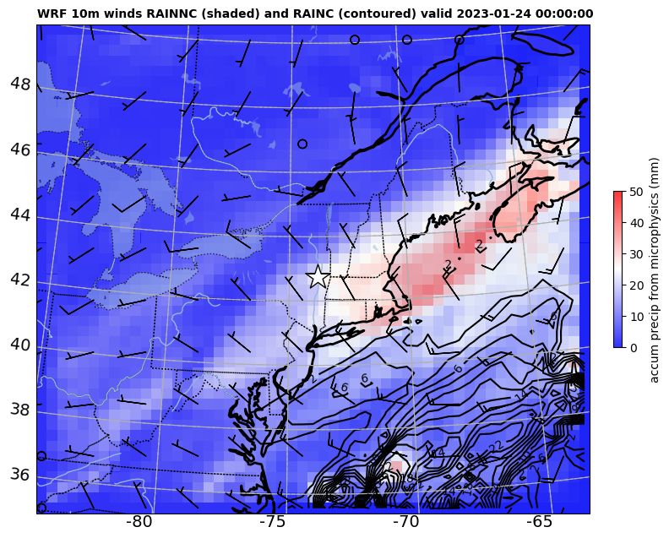
Cell #7 = 10m winds, total precipitation from microphysics and cumulus
Although called “RAIN”, this is total precipitation, including frozen

Slide 40
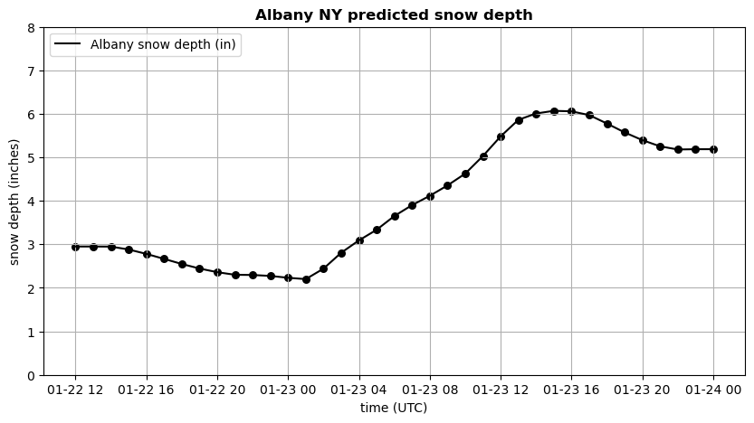
Cell #8 = Forecast snow depth time series for Albany, NY
Did we start w/ 3” on the ground at KALB as of 12Z 1/22/23? Why did snow depth then decrease?
From min to max, about 4” predicted at KALB.
https://www.weather.gov/wrh/climate?wfo=aly says 8” observed for this event.
How to improve?

Slide 41
Extracting fields for a specific lat/lon point (Cell #8)
# ------------------------------------------------------------------------------
# SNOWH variable in WRF is predicted snow depth (m) from NOAH land surface model
# Here we extract SNOWH for Albany and plot it in inches
# Albany is 42.74722, -73.79912
# -------------------------------------------------------------------------------
# get the xy coordinates corresponding to provided lat lon
x,y=ll_to_xy(ncfile,42.74722,-73.79912) # lat lon to x y coordinates
print(x.values,y.values)
print(np.shape(latwrf),np.shape(lonwrf))
print(latwrf[y,x].values,lonwrf[y,x].values)
# plot snow depth in inches as a function of time
fig = plt.figure(figsize=(10, 5))
plt.plot(times,snowh[:,y,x]*39.4,c='k',label="Albany snow depth (in)")
plt.scatter(times,snowh[:,y,x]*39.4,c='k',s=30,marker='o')

Slide 42
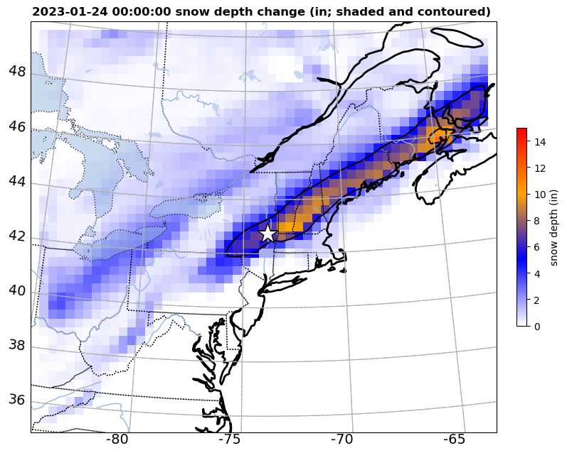
Cell #9 = Snow depth ∆ between
simulated max and min values
Notes:
Max and min to capture snow from this event, excluding the melting, compaction, and sublimation that also occurred for some hours

Slide 43
Look inside namelist.input
Determine run start/end times
Specify domain sizes, # of levels, time step
Select model physics options
…and more

Slide 44
WRF Namelist documentation
WRF version 4.5:
https://www2.mmm.ucar.edu/wrf/users/wrf_users_guide/build/html/namelist_variables.html

Slide 45
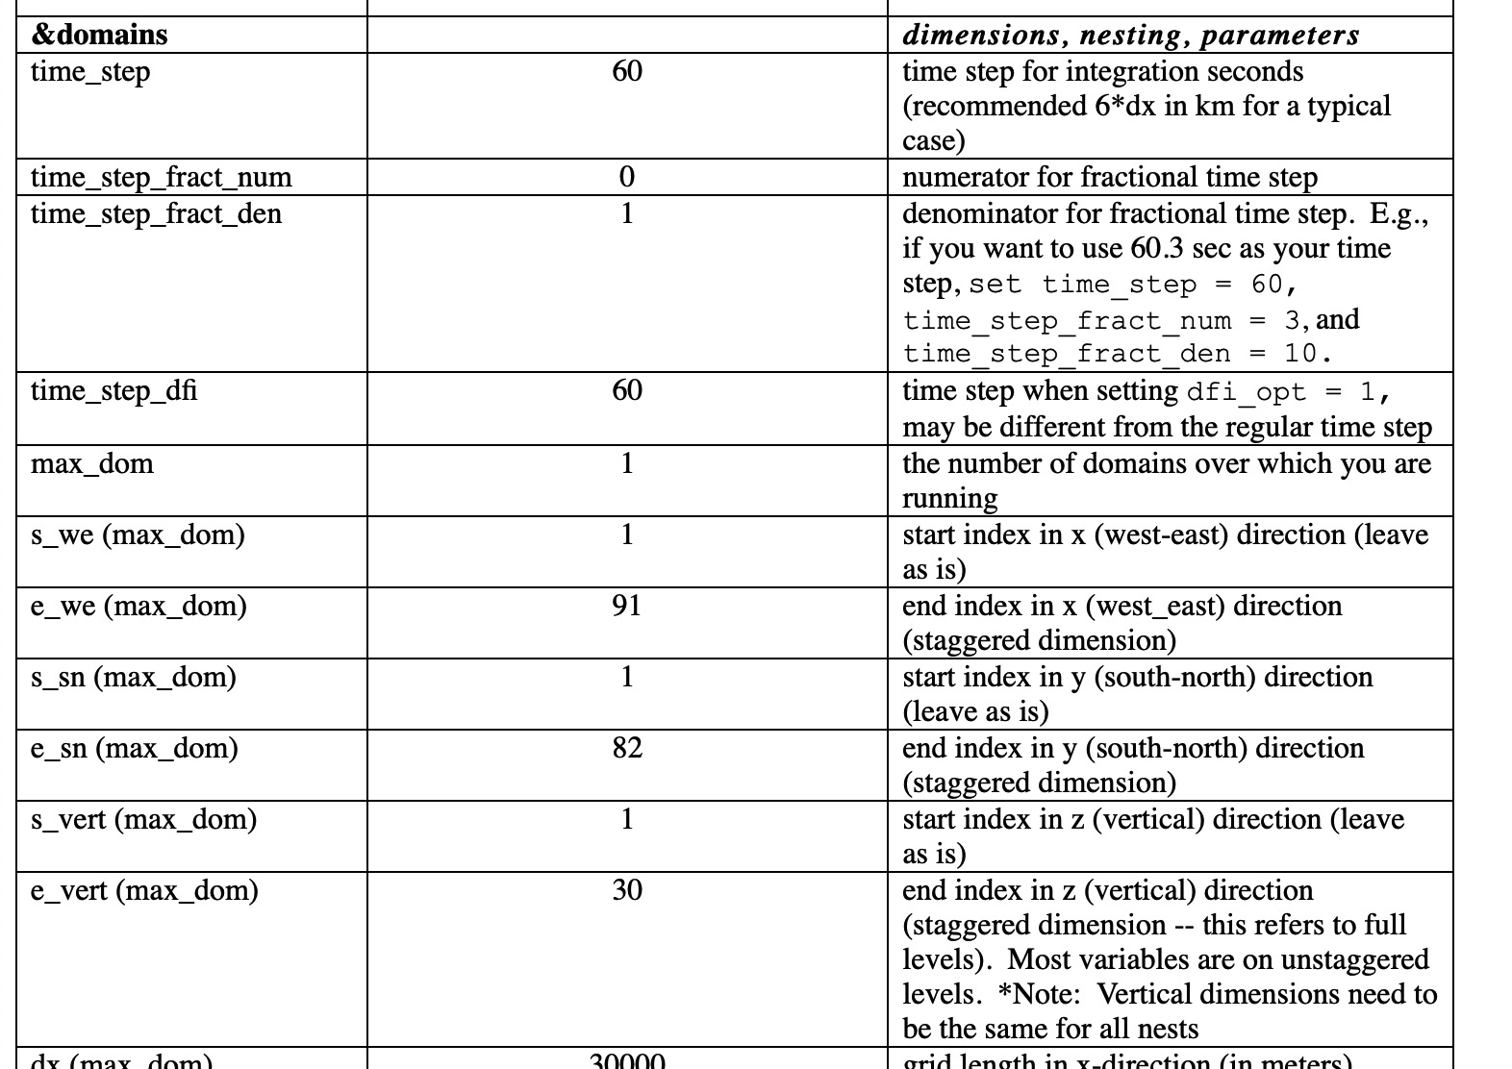
For multiple nest runs, time_step is for the outermost domain

Slide 46
&time_control
run_days = 0,
run_hours = 36,
run_minutes = 0,
run_seconds = 0,
start_year = 2023, 2023,
start_month = 01, 01,
start_day = 22, 22,
start_hour = 12, 12,
start_minute = 00, 00, 00,
start_second = 00, 00, 00,
end_year = 2023, 2023,
end_month = 01, 01,
end_day = 24, 24,
end_hour = 00, 00,
end_minute = 00, 00, 00,
end_second = 00, 00, 00,
interval_seconds = 10800,
input_from_file = .true., .true.,
history_interval = 60, 60,
frames_per_outfile = 99999, 1,
/
namelist.input
AGAIN, only first
column matters
since max_dom
is 1.
NOTES:
• We will run for 36 h, using starting and ending at times shown
• interval_seconds should match namelist.wps setting
• All history times in one file (frames_per_outfile = 9999)

Slide 47
&time_control
run_days = 0,
run_hours = 36,
run_minutes = 0,
run_seconds = 0,
start_year = 2023, 2023,
start_month = 01, 01,
start_day = 22, 22,
start_hour = 12, 12,
start_minute = 00, 00, 00,
start_second = 00, 00, 00,
end_year = 2023, 2023,
end_month = 01, 01,
end_day = 24, 24,
end_hour = 00, 00,
end_minute = 00, 00, 00,
end_second = 00, 00, 00,
interval_seconds = 10800,
input_from_file = .true., .true.,
history_interval = 60, 60,
frames_per_outfile = 99999, 1,
/
namelist.input
real.exe uses
this info to create
initial condition
(at start time) and
boundary conditions
(at interval_seconds
between start and
end times)
WHY we are specifying start and end times AND run length (run_days)

Slide 48
&time_control
run_days = 0,
run_hours = 36,
run_minutes = 0,
run_seconds = 0,
start_year = 2023, 2023,
start_month = 01, 01,
start_day = 22, 22,
start_hour = 12, 12,
start_minute = 00, 00, 00,
start_second = 00, 00, 00,
end_year = 2023, 2023,
end_month = 01, 01,
end_day = 24, 24,
end_hour = 00, 00,
end_minute = 00, 00, 00,
end_second = 00, 00, 00,
interval_seconds = 10800,
input_from_file = .true., .true.,
history_interval = 60, 60,
frames_per_outfile = 99999, 1,
/
namelist.input
wrf.exe uses
this info to
determine start
and end times
real.exe uses
this info to create
initial condition
(at start time) and
boundary conditions
(at interval_seconds
between start and
end times)
WHY we are specifying start and end times AND run length (run_days)

Slide 49
&domains
time_step = 180,
time_step_fract_num = 0,
time_step_fract_den = 1,
max_dom = 1,
e_we = 54, 214,
e_sn = 48, 196,
e_vert = 57, 57,
p_top_requested = 5000,
num_metgrid_levels = 34,
num_metgrid_soil_levels = 4,
dx = 36000., 4000.,
dy = 36000., 4000.,
grid_id = 1, 2,
parent_id = 0, 1,
i_parent_start = 1, 82,
j_parent_start = 1, 82,
parent_grid_ratio = 1, 3,
parent_time_step_ratio = 1, 3,
feedback = 1,
/
namelist.input
AGAIN, only first
column matters
since max_dom
is 1.
NOTES:
• Domain size must match namelist.wps!
• We are requesting 57 vertical levels in real.exe. (Our choice.)
• Get num_metgrid* info from met_em* files via ncdump.
Notes:
Stop 2020

Slide 50
The filename is wrfinput_d01
terrain height 713.9717 meters
----------------------------------------------------------------
model level 01 W height 0.00 S height 23.85
model level 02 W height 47.70 S height 78.12
model level 03 W height 108.54 S height 147.19
model level 04 W height 185.85 S height 234.67
model level 05 W height 283.49 S height 344.73
model level 06 W height 405.97 S height 482.11
model level 07 W height 558.24 S height 651.86
model level 08 W height 745.49 S height 858.92
model level 09 W height 972.36 S height 1107.48
model level 10 W height 1242.59 S height 1400.71
model level 11 W height 1558.83 S height 1740.36
model level 12 W height 1921.89 S height 2125.73
model level 13 W height 2329.57 S height 2553.61
model level 14 W height 2777.66 S height 3001.46
model level 15 W height 3225.25 S height 3446.17
model level 16 W height 3667.08 S height 3885.38
model level 17 W height 4103.67 S height 4319.62
model level 18 W height 4535.57 S height 4749.53
model level 19 W height 4963.48 S height 5175.76
model level 20 W height 5388.04 S height 5598.88
model level 21 W height 5809.73 S height 6019.21
model level 22 W height 6228.70 S height 6436.89
model level 23 W height 6645.07 S height 6852.06
model level 24 W height 7059.04 S height 7264.83
model level 25 W height 7470.63 S height 7675.11
model level 26 W height 7879.60 S height 8082.67
model level 27 W height 8285.74 S height 8487.49
model level 28 W height 8689.23 S height 8889.95
model level 29 W height 9090.67 S height 9290.66
model level 30 W height 9490.65 S height 9690.15
model level 31 W height 9889.65 S height 10088.67
model level 32 W height 10287.70 S height 10485.24
Heights above ground level (AGL), in meters
From headnode:
dopython
python read_wrfinput.py wrfinput_d01
This is the default WRF vertical coordinate generated by real.exe
Note levels are not equally spaced. Later, we will see how to modify this.
model level 33 W height 10682.78 S height 10878.88
model level 34 W height 11074.99 S height 11269.86
model level 35 W height 11464.73 S height 11658.51
model level 36 W height 11852.29 S height 12045.06
model level 37 W height 12237.82 S height 12429.65
model level 38 W height 12621.48 S height 12812.46
model level 39 W height 13003.43 S height 13193.45
model level 40 W height 13383.47 S height 13572.41
model level 41 W height 13761.34 S height 13949.29
model level 42 W height 14137.24 S height 14324.31
model level 43 W height 14511.38 S height 14697.66
model level 44 W height 14883.95 S height 15069.57
model level 45 W height 15255.19 S height 15440.23
model level 46 W height 15625.28 S height 15810.26
model level 47 W height 15995.24 S height 16180.36
model level 48 W height 16365.48 S height 16550.86
model level 49 W height 16736.23 S height 16921.97
model level 50 W height 17107.71 S height 17293.92
model level 51 W height 17480.14 S height 17666.93
model level 52 W height 17853.73 S height 18041.01
model level 53 W height 18228.29 S height 18416.06
model level 54 W height 18603.83 S height 18792.11
model level 55 W height 18980.39 S height 19169.19
model level 56 W height 19357.98 S height 19547.29
model level 57 W height 19736.60
----------------------------------------------------------------
We requested 57 levels
• that’s 57 W levels and
56 S [scalar/U/V] levels
[8 below 1 km AGL]
The precise heights of some of these levels will vary from case to case. WRF uses a mass coordinate. Layer thickness depends on temperature (think hypsometric).
Notes:
Got to here 2021

Slide 51
dx
WRF uses a horizontally
and vertically staggered
grid
u = east-west velocity
w = vertical velocity
s = scalar field
dz
One extra W point in vertical
One extra U point west-east
One extra V point north-south
u(i,k), w(i,k) and s(i,k)
do not represent same physical
locations (in wrfout files)!
[Some postprocessing tools
de-stagger the grid for you]
Notes:
ONE scalar number represents the entire volume. OK if volume is small. What if it’s not? And it should represent the average.

Slide 52
&physics
mp_physics = 4,
ra_lw_physics = 4,
ra_sw_physics = 4,
radt = 20,
sf_surface_physics = 2,
sf_sfclay_physics = 1,
bl_pbl_physics = 1,
bldt = 0,
num_soil_layers = 4,
num_land_cat = 21,
cu_physics = 1,
cudt = 5,
cugd_avedx = 1,
isfflx = 1,
ifsnow = 0,
icloud = 1,
do_radar_ref = 1,
surface_input_source = 1,
mp_zero_out = 2,
mp_zero_out_thresh = 1.e-8,
/
namelist.input
WSM5 microphysics
RRTMG radiation
(radiation called every 20 min)
Noah LSM,
Monin-Obukhov surface layer
YSU PBL
Determined by LSM (next slide)
Determined by geogrid
Kain-Fritsch cumulus (every 5 min)
AGAIN, only first
column matters
since max_dom
is 1.
REMINDERS:
• Many microphysics options available
• Many options available for surface, surface layer and PBL schemes
- surface layer (sfclay) and PBL (bl_pbl) usually come as pairs

Slide 53
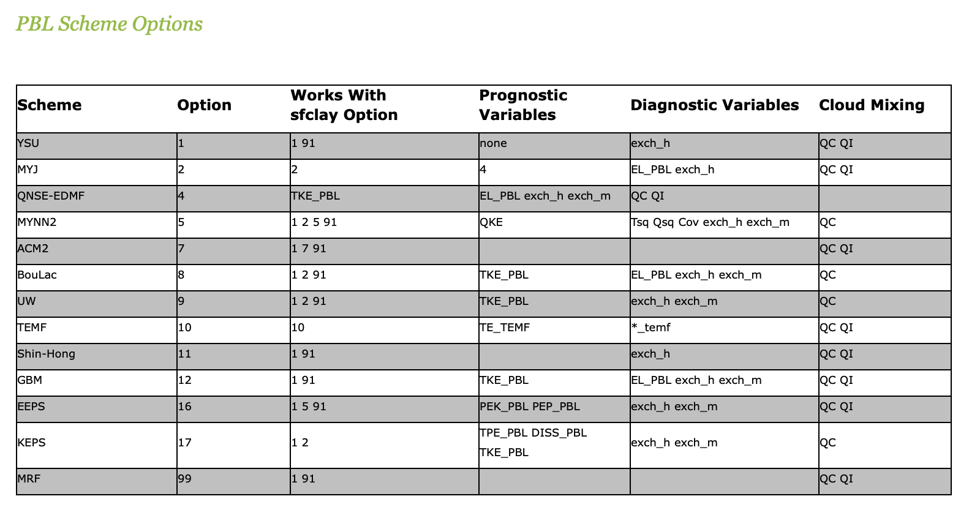
How PBL and surface layer schemes
can mix & match
Some available PBL schemes:
YSU: pbl = 1, sfclay = 1
MYJ: pbl = 2, sfclay = 2
MYNN: pbl = 5, sfclay = 1, 2, or 5
ACM2: pbl = 7, sfclay = 7
Some land surface models:
Noah: surface = 2, soil = 4
NoahMP: surface = 4, soil = 4
TD: surface = 1, soil = 5
RUC: surface = 3, soil = 6 or 9
PX: surface = 7, soil = 2
CLM: surface = 5, 10
pbl = bl_pbl_physics
sfclay = sf_sfclay_physics
surface = sf_surface_physics
soil = num_soil_layers

Slide 54
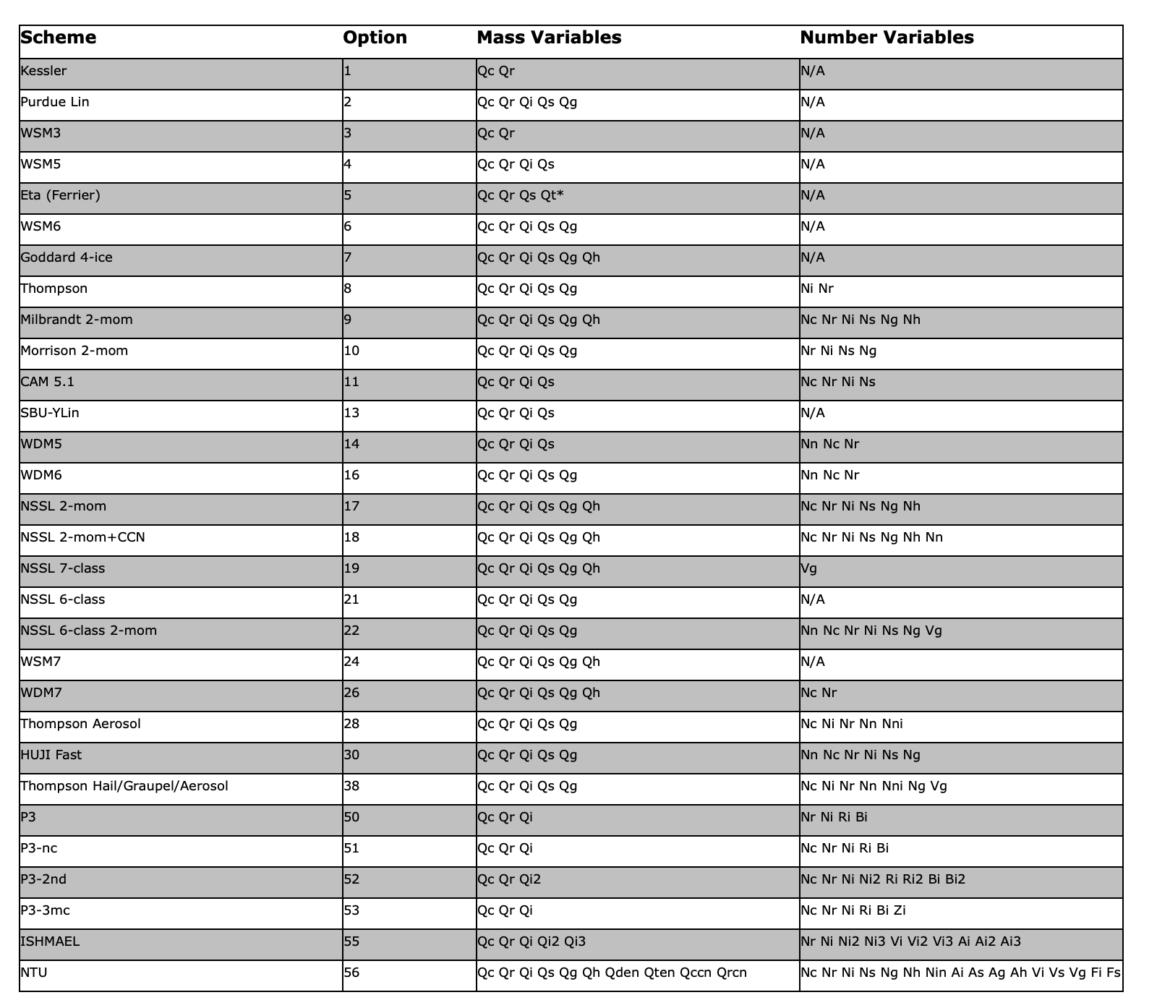
Microphysics options
in WRFV451.

Slide 55
[end]

