Slide 1
Real-data WRF: Experiment #1
Experiment #1 is due by Thursday, February 22nd.
New version of script: $LAB/SNOWSTORM/WRF_plot_SNOW2023_V2.ipynb
ATM 419/563
Spring 2024
Fovell
This version is configured for headnode7.rit.albany.edu
and the Snow cluster
© Copyright 2024 Robert Fovell, Univ. at Albany, SUNY, rfovell@albany.edu

Slide 2
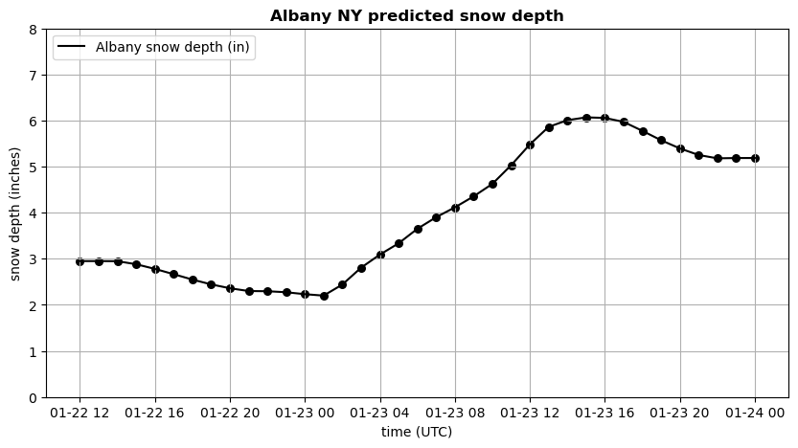
Time series of physical snow depth (inches) at Albany for our control run
This is predicted by the Noah land surface model

Slide 3
Experiment #1 - 1
Due Thursday, February 22nd
We could make a different, if not necessarily better, snow forecast by changing one or more of the following:
Model physics, including microphysics, boundary and surface layer, radiation, cumulus, and land surface parameterizations
Resolution (horizontal and vertical), so we can render topography and clouds better
Initialization data source, such as from the 3-km HRRR or NAM models
Data assimilation, nudging, and/or stochastic perturbation
Etc.
At this time, we will just vary microphysics

Slide 4
Experiment #1 - 2
Due Thursday, February 22nd
First, archive your WRF model output, since you will need it again. Whenever you re-run WRF, existing output files are overwritten. In your SNOW directory, make a folder called RUN01 and push your wrfout file into it
mkdir RUN01
mv wrfout_d01_2023-01-22_12:00:00 RUN01/.
Then make two more runs, archiving them in new folders called RUN02 and RUN03
For these two new runs, select a different microphysics scheme (within limitations; see next slide)
Edit the namelist.input to alter mp_physics line, changing the microphysics option from 4 to one of the other available schemes (see next slide)
Do not select schemes 1 or 30 as they either do not generate snow or they are far too resource intensive
Best ones to try are schemes 2, 3, 5, 6, 7, 8, 10. Try 13 for a shock.
For each new simulation, rerun real.exe, then wrf.exe. Use batch scripts as in the demonstration script.

Slide 5
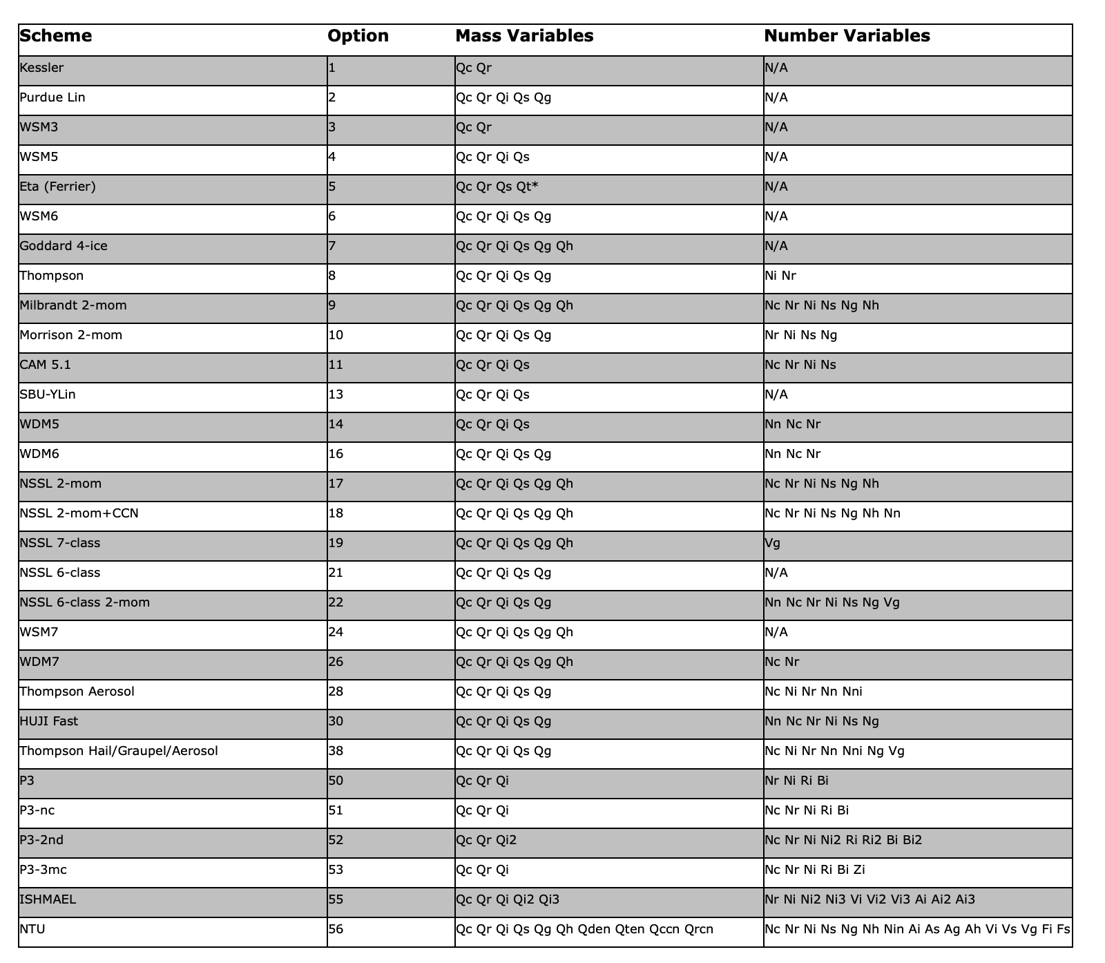
Microphysics options
in WRFV451. Some
are not viable for
this experiment.

Slide 6
Experiment #1 - 3
Due Thursday, February 22nd
Make a time series of SNOWH at Albany for the control run (RUN01) and your two new simulations
I would start with WRF_plot_SNOW2023_V2.ipynb and modify it to open multiple files
You are opening three wrfout files and plotting their snow depth fields on the same plot. Make sure you are plotting from three different files.
Your plot title should be your last name and the two scheme numbers you selected
Example: JONES, 8, 13
The notebook creates a plot “albany_snow.png”
Email that plot to Liam (lsheji@albany.edu) and myself (rfovell@albany.edu) by the due date

Slide 7
Keep in mind
We’re using headnode7 and WRF system executables built for the Snow cluster
After you log onto headnode7, issue the “old” command at the command prompt
$ old
The srun command is “srun –p snow executable.exe”

Slide 8
[end]

