Slide 1
Cumulus parameterizations
ATM 419/563
Fall 2024
Fovell
© Copyright 2024 Robert Fovell, Univ. at Albany, SUNY, rfovell@albany.edu
Notes:
2022: already did cumulus ensemble w/ TSTORM

Slide 2
Microphysics vs. cumulus schemes
Microphysics schemes
  Clouds can be resolved but hydrometeors are subgrid. The creation, growth, and settling of hydrometeors have to be parameterized. This is accomplished with particle size distributions (or bins).
  Condensation occurs explicitly on the grid, (generally) when grid-scale saturation is reached. Precipitation occurs as hydrometeors reach the model surface. Microphysics is applied grid volume by grid volume.
  Also called “explicit” or “stratiform” (no longer appropriate term).
Cumulus (convective) schemes
  Clouds cannot be resolved: they are subgrid. Their influence on the grid column they are embedded in must be parameterized. This is accomplished by adjusting the column sounding, column by column.
  Condensation and precipitation occur implicitly, as the column sounding is adjusted. Convection can occur when RH < 100% (grid-scale saturation is not necessary) if CAPE exists and trigger conditions are met… (that’s both advantageous and disadvantageous).
Notes:
Stratiform is no longer appropriate because we can resolve convective precip w/ microphysics alone, using sufficiently high resolution.
Advantageous: my hurricane example. Disadvantageous: our precip area in MO and AR and IL will be too wide, precip triggered over too wide an area

Slide 3
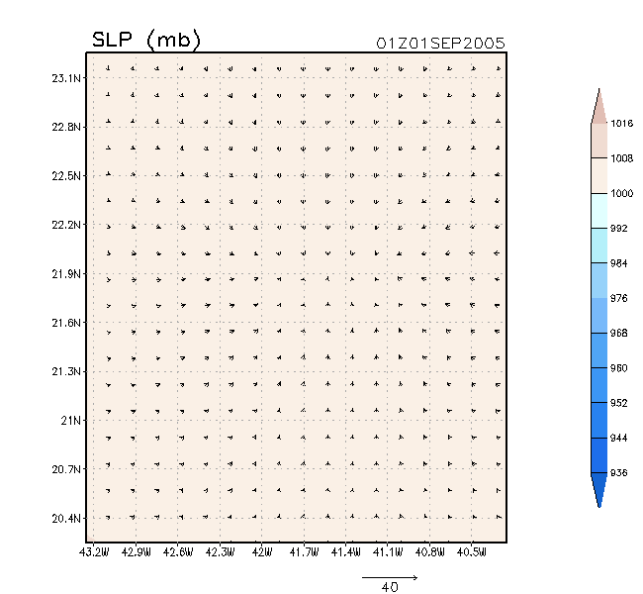
Aside: hurricane “bubble” initialization
Spin up of TC from
bubble, using
Kain-Fritsch cumulus
scheme (cu_physics=1)
30 km
Fovell and Su (2007) and subsequent papers
Only part of domain shown
Notes:
Faced with problem of creating a hurricane from scratch w/o predetermining its structure (as in bogussing). Tried using a bubble.
But w/ only MP, which needs grid scale saturation, initial TC was very very small. With CP, which does not need grid scale sat, TC larger.

Slide 4
Aside: hurricane “bubble” initialization
z
CP = cumulus parameterization
Fovell and Su (2007) and subsequent papers

Slide 5
Convective activity in a grid column
Deep convection occurs when conditions are favorable
  CAPE exists (i.e., instability and moisture)
  A source of lifting is available
Convection clearly modifies the air within the cloud(s)…
What specifically does convective activity do to its environment?
  That is, its environment in the SAME GRID COLUMN
  We can imagine it makes it warmer (latent heat release, compensating subsidence) overall and absolutely drier (moisture loss via precipitation)
So what does a post-convective environment look like?
  Within the deep convective cloud itself, you might guess the vertical lapse rate is moist adiabatic (constant θ_{e}) – but we cannot “see” that cloud
  We’re concerned with how the clouds modify their surrounding environment
  In a coarse-resolution model, a grid column may contain narrow deep clouds of various depths and widths… but most of the grid volume is expected to be cloud-free (between the clouds)
  What does this cloud-free environment look like (temperature, moisture, lapse rate, etc.)?
Notes:
Warmer overall – could be cooler near sfc owing to rain evaporation, say.

Slide 6
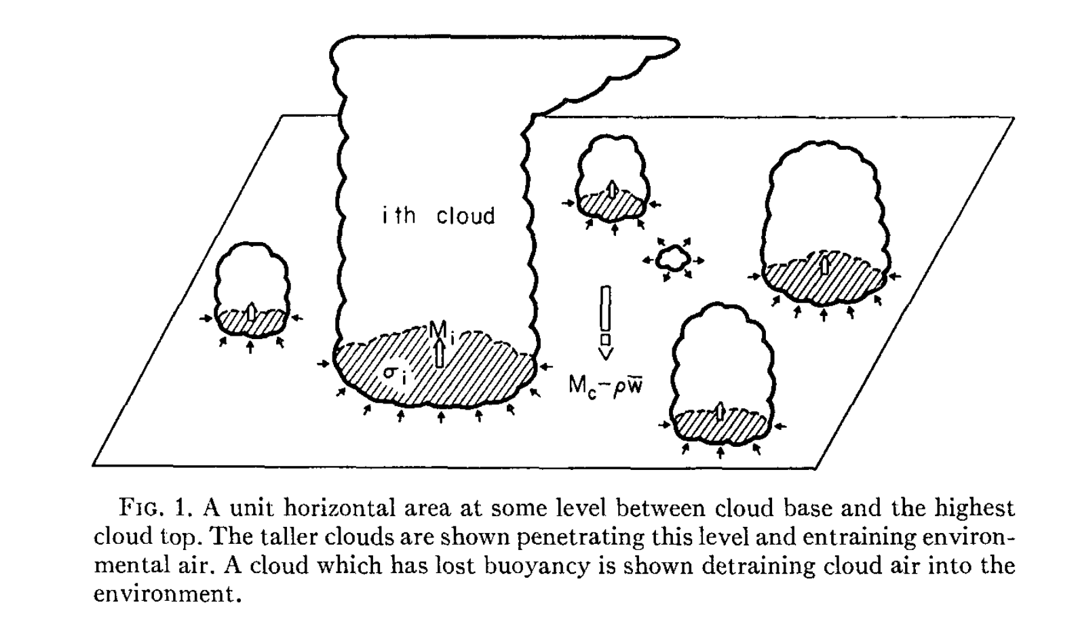
Start with a grid box.
Depicted is one level in a model column.
There are unresolvable clouds/updrafts of various depths within the grid box.
Note most of the grid box area is not occupied by updrafts.
grid box
Arakawa and Schubert (1974)

Slide 7
Using a cumulus parameterization
General recommendations:
  If your grid spacing in the domain or nest is > 10 km, you should use a cumulus scheme
  If your grid spacing in the domain or nest is ≤ 3 or 4 km, you probably should not use a cumulus scheme
  Strive to avoid grid spacings between 5-10 km, the cumulus “grey zone”
  “Scale aware” schemes that can “turn themselves off” or “tune themselves out” depending on grid spacing now do exist

Slide 8
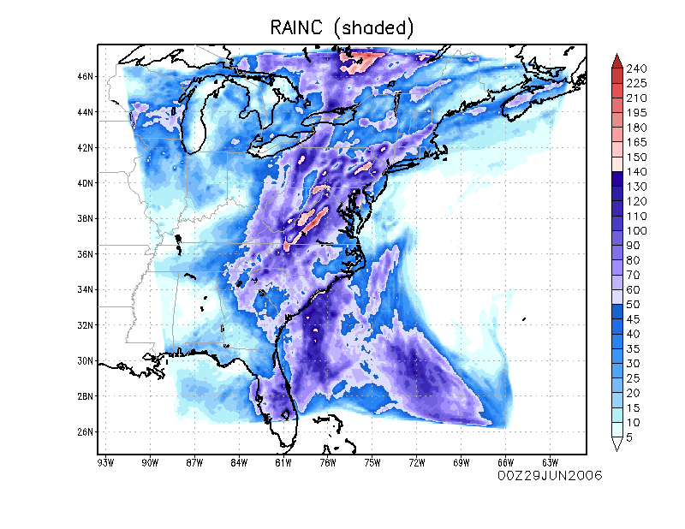
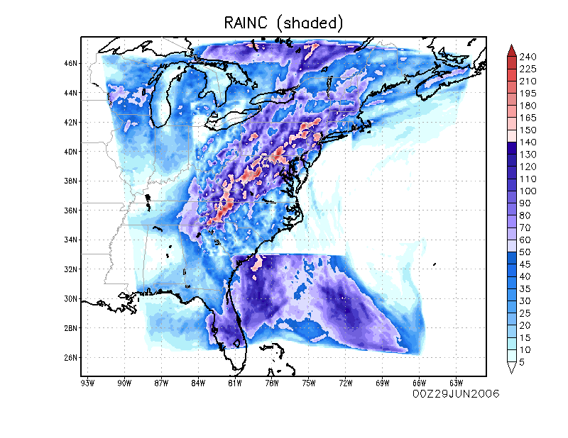
Heavy precipitation case: one vs. two domains
The present is telescoping grids
helps us avoid cumulus “grey zone”
BUT can (will) result in discontinuities at nest boundaries
Notes:
Conway & Gallagher 2016 – Heavy rain event, illustrates issues w/ nesting
A lot of times we want hi res but it’s expensive to use everywhere. SO – nesting. But nesting has consequences and unwanted features

Slide 9
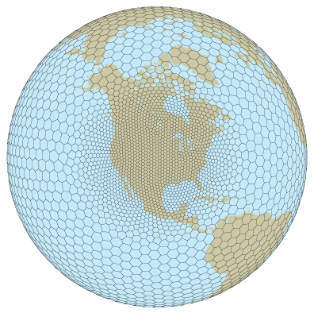
The future is continuously
variable grid meshes
→ need scale-aware physics
[especially cumulus schemes]
Want cumulus 100% off here
Want cumulus 100% on here
…and vary 0-100%
in between
An MPAS model grid

Slide 10
What does an active cumulus cloud do to its own grid box?
grid box
Arakawa and Schubert (1974)

Slide 11
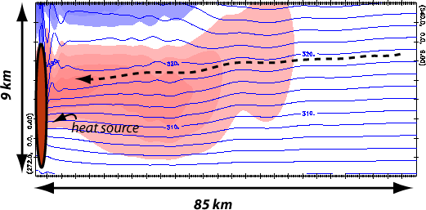
Convective cloud is influencing its own grid column
Consider this as one grid column within a coarser scale model
Which is more important: “direct” ∆T by condensation & advection, or “indirect” via compensating subsidence?
Blue contours: isentropes
Colored field: potential temperature change (red = increase)
Notes:
Heat source is an active cumulus cloud within the grid box. Entire domain can be thought of as one (coarse resolution) grid box, so everything you see is subgrid
Not a glide path. Parcels are not moving westward there

Slide 12
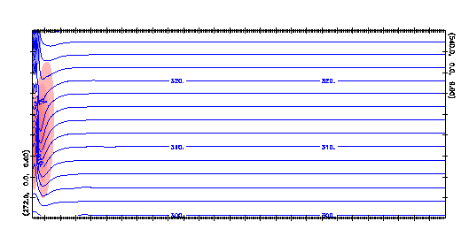
How a deep convective cloud modifies its surrounding environment
Consider this as one grid column within a coarser scale model
subgrid
convective cloud
response to subgrid cloud activity
Adjustment to convective heating is spread by gravity waves.
All of this is taking place within one grid column.
Net result: entire column is net warmer and drier than before.
Notes:
Parcel represents air w/ 320 K theta original elevation

Slide 13
Say each cloud entrains environmental (cloud-free) air at every level,
except at its top, where it detrains.
In this example, five clouds are entraining at this level,
while one (red arrow) is detraining.
grid box
Arakawa and Schubert (1974)
Notes:
Somehow the bulk consequence of all of this unresolvable, complex activity has to be parameterized

Slide 14
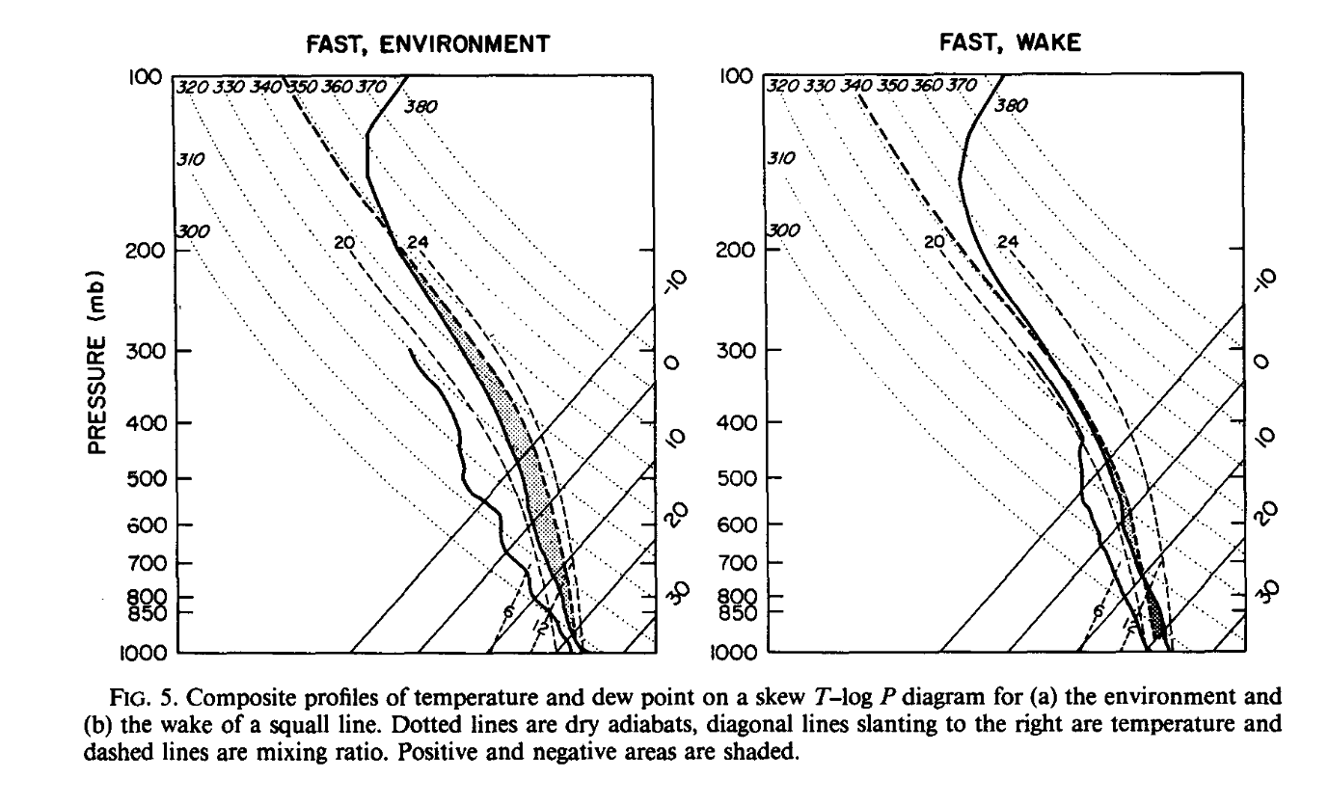
Environment ahead of squall line (at left) has a fair amount of CAPE (1000 J/kg).
Sounding in squall line wake has somewhat different structure, and much less CAPE (150 J/kg)
Convective activity
Convective activity converts one sounding into the other.
How can you accomplish this when you cannot resolve the clouds?
Barnes and Sieckman (1984)
Notes:
Convective activity turns one environment into the other. How to do this when you cannot resolve the clouds?
Barnes and Sieckman (1984) examined fast-moving and slow-moving tropical squall lines. These soundings are for the fast-moving cases.
Hmm… superimposing the two yields smaller warming in wake sounding than I expected.

Slide 15
Assessing the effect of convective activity in a given area
[a region of space or a grid volume/column containing cumulus clouds we cannot directly measure or see]
Notes:
With cumulus clouds within we cannot directly measure or see

Slide 16
Apparent heat source and moisture sink in observations
We cannot resolve subgrid clouds
But… these clouds are mixing and modifying the environment
Diagnose the net effect of convective activity in an area from observations via two quantities: Q₁ and Q₂
  Q₁ is the “apparent heat source”
  Q₂ is the “apparent moisture sink”
  Both have units J/kg/s
  Dividing by c_{pd} yields units of K/s – sensible and latent heating rates
Notes:
Energy rates

Slide 17
Deriving Q₁ and Q₂ #1
• s = dry static energy
(conserved for subsaturated
adiabatic processes)
• Change s following the motion
with net radiative forcing (Q_{R})
and water phase changes
(i.e., non-adiabatic processes)
• Continuity equation in isobaric
coordinates
c = condensation
e = evaporation
Notes:
S conserved for subsaturated adiabatic. But we can change it w/ diabatic forcings such as radiation, and phase changes

Slide 18
Deriving Q₁ and Q₂ #2
cancels due to continuity
Large scale quantities
(radiation and microphysics)
subgrid effects of
convection
= Q₁
• LHS is Q₁, representing the area-averaged quantities (overbars)
• blue box represents effects of subgrid eddies == convective activity
Notes:
Define LHS as Q1. It’s grid-scale averaged ds/dt in grid volume.
First part of RHS is diabatic forcings. Remainder is subgrid effects --- the subgrid convection! QR is radiation scheme. Lv(c-e) is microphysics. Rest is cumulus scheme

Slide 19
Deriving Q₁ and Q₂ #3
• Similarly for water vapor q_{v}:
microphysics
= -Q₂ / L_{v}
subgrid effects of
convection
• LHS is –Q₂/L_{v}
• Minus sign makes drying positive (“moisture sink”)
• Both Q₁ and Q₂ have units of J/kg/s. Divide by c_{pd} to get K/s.

Slide 20
Q₁ and Q₂ from observations #1
• Combine Q₁ and Q₂ equations, utilizing definition of moist static energy h. Then,
neglect the horizontal eddy transport term, yielding second equation below
subgrid effects of
convection
• If Q₁ – Q₂ – Q_{R} = 0 for an area, there’s no subgrid convection
• If there’s subgrid convection in an area,
then Q₁ – Q₂ – Q_{R} ≠ 0
• From observations, we can estimate Q₁, Q₂, Q_{R}… so
combination reveals what subgrid convection is doing,
solved as a residual
Notes:
Combining the Q1 and Q2 equations: the Lv term cancels out
If Q1 and Q2 = QR, there’s nothing for subgrid stuff to do
In the model, we need to forecast Q1 and Q2 – that’s how T and q are changing – and cant do that w/o estimating what subgrid convec is doing

Slide 21
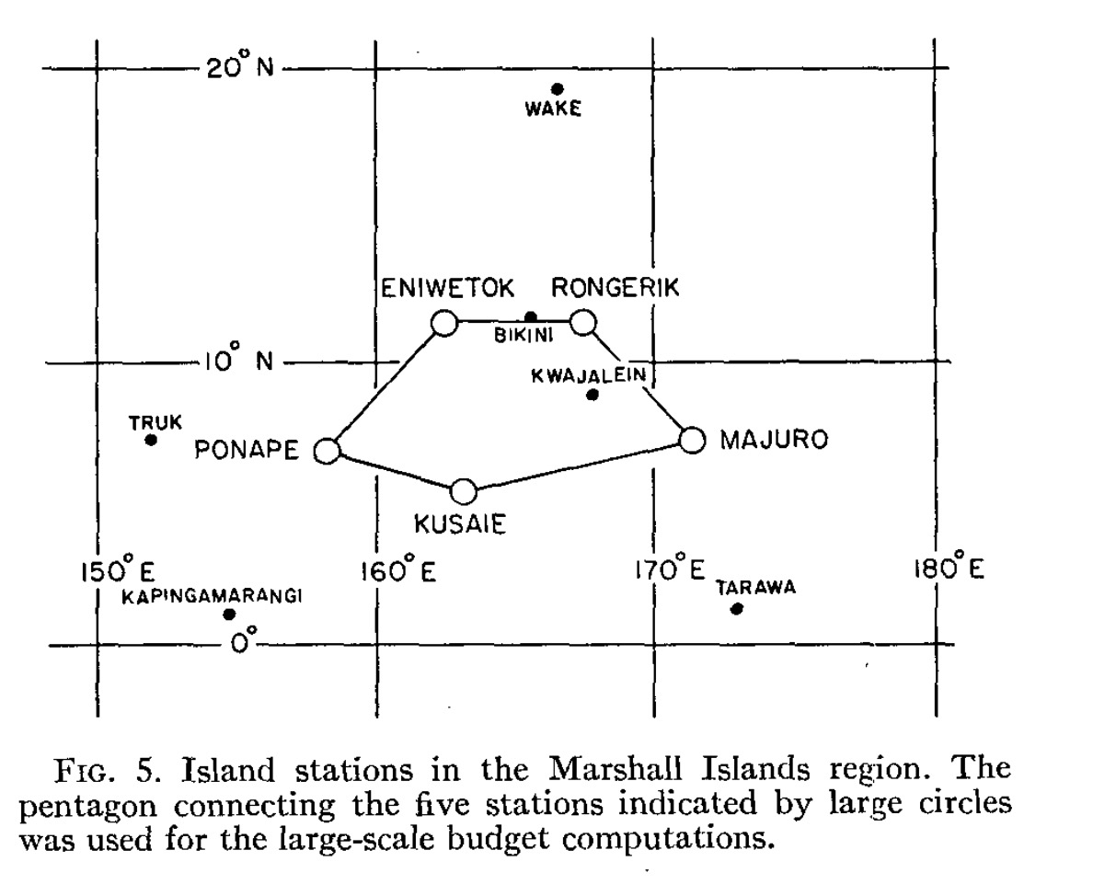
Q₁ and Q₂ from observations #2
• You can estimate Q₁ and Q₂ from
observations by using an array
of soundings around an area.
• You are estimating what’s going
in and out of the area – the area
means (terms with overbars)
• Q_{R} is obtained by other means.
• Then the convective activity in the
array is the residual of this equation
-- solving for right hand side
Yanai et al. (1973)
Notes:
Est Q1 and Q2 from obs, to demonstrate what the model should be producing w/ its cumulus scheme

Slide 22
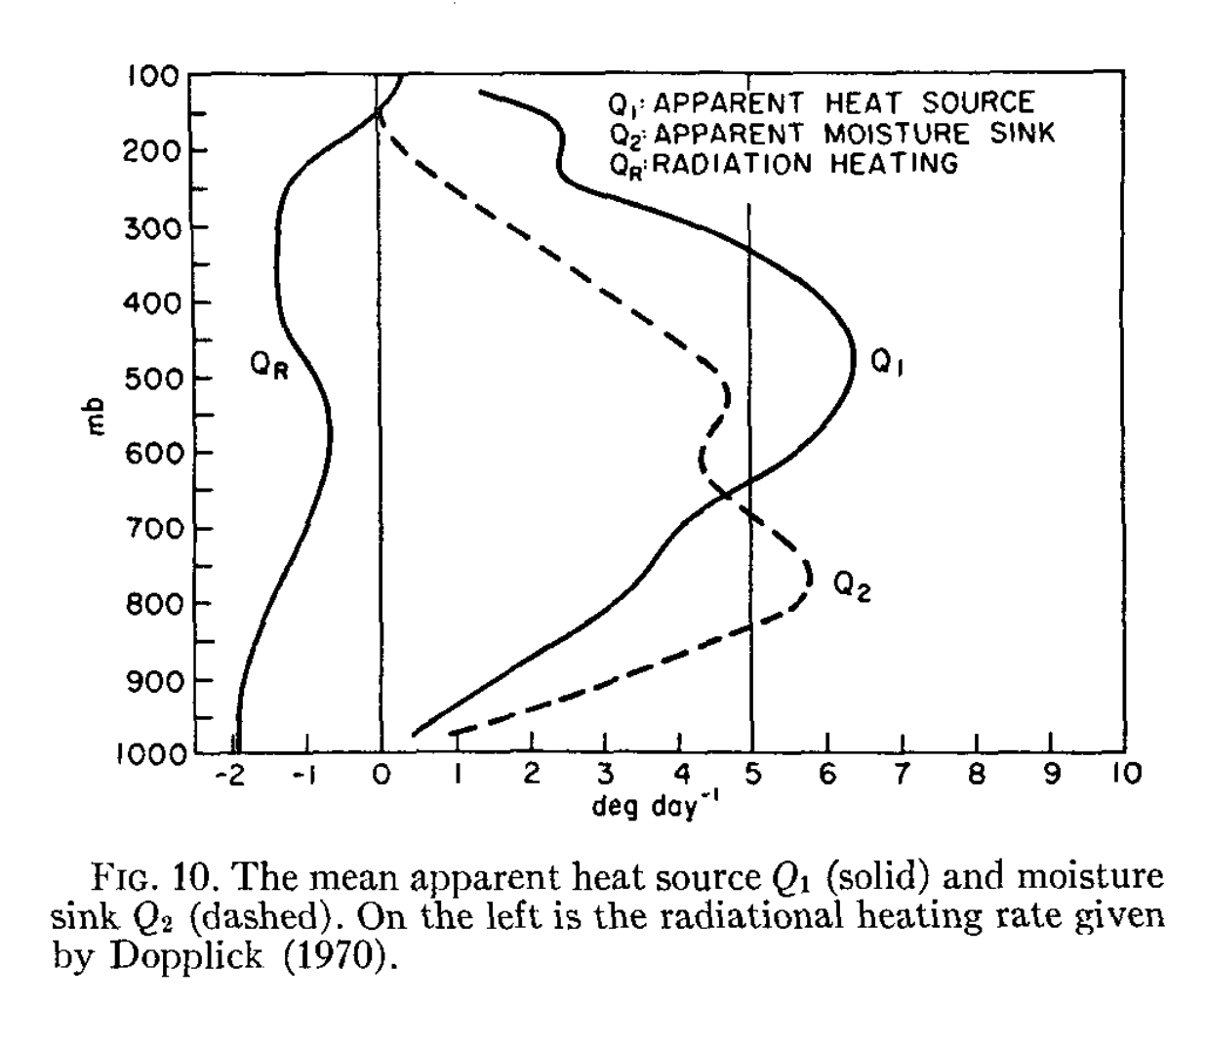
Q₁ and Q₂ from observations #3
Yanai et al. (1973)
• Net radiation (Q_{R}) cools the
troposphere.
• Q₁: convection warms the
troposphere everywhere,
with maximum around 500 mb,
making lower trop more stable.
• Q₂: convection dries the
troposphere everywhere,
more pronounced in lower
troposphere.
• Both have been divided by c_{pd}.
Shows what Q_{1,} Q₂, and Q_{R} look like in a tropical atmosphere. This includes what cumulus clouds in the area are doing to the atmosphere. In observations, we can obtain the contribution of subgrid convection (h’ω’) via the residual.
In models, we cannot. That’s the job of the cumulus parameterization.
Notes:
You can’t get these profiles w/o convection, much of which is subgrid in coarser models. Convective schemes attempt to produce these.

Slide 23
Now about the model #1
Recall from PBL: we want to predict grid volume means but needed to estimate subgrid terms to do so successfully. Same situation here.
Take the Reynolds-averaged s and q_{v} equations and rewrite in terms of grid volume tendency

Slide 24
Now about the model #2
Successful predictions for the LHS require
  (1) accurate calculation of advection
  (2) accurate calculations from the microphysics and radiation parameterizations
  (3) accurate estimations of the subgrid terms [the cumulus scheme]
• Ignoring horizontal subgrid terms, not unlike what we did in PBL

Slide 25
When to use a cumulus scheme revisited
Most cumulus schemes employ the assumption that subgrid clouds are narrow and most of the grid box is cloud-free
  The larger the grid spacing, the better this assumption is
  Some newer schemes are “scale-aware” and try to “turn themselves off” as ∆x, ∆y become smaller
Rule of thumb (microphysics scheme always presumed ON):
  >10 km grid spacing = use a cumulus scheme
  3-4 km grid spacing and smaller = don’t use cumulus (except scale-aware)
  Between 5-10 km: try to avoid using these spacings
Unlike most physics you can (and probably should) have the cumulus scheme active in some domains and switched off in others. Example:
  cu_physics = 1, 1, 0, 0, presuming ∆x = 36, 12, 4, 1.333 km

Slide 26
Some cumulus parameterizations
Kuo (1965) [not available in WRF]
  Relates convective activity to horizontal moisture convergence
  Criticism: moisture convergence itself does not cause convection
  (‘Planes need runways but runways don’t cause planes.’)
Arakawa and Schubert (1974)
  Convection rapidly consumes creation of CAPE by large-scale environment (“quasi-equilibrium” hypothesis)
  Original, very complex scheme simplified somewhat (Simplified Arakawa Schubert, or SAS, in WRF as OSAS, NSAS, and KSAS)
    Similar or related: Grell-Devenyi (2002), Grell-Freitas (2014)
  Criticism: The evidence that relates convective activity with CAPE generation is questionable at best (Mapes 1997)
Kain-Fritsch (Kain 2004)
  Convection activated by trigger function, governed by a time scale
  Similar or related: Tiedtke, New Tiedtke
Betts-Miller-Janjic (Janjic 1994)
  Creates post-convective environment motivated by observations
Notes:
Corr ≠ causation Chicken vs egg
Trenberth – move heating up a level, mult this other by 13 “worked better than 12” → lots of engineering. NWP class in those days was very very different.
“Cargo cult science”: WW2 pilots landed on runways on tropical islands. After the war, natives built runways to lure the pilots back. Planes need runways but runways don’t cause planes.

Slide 27
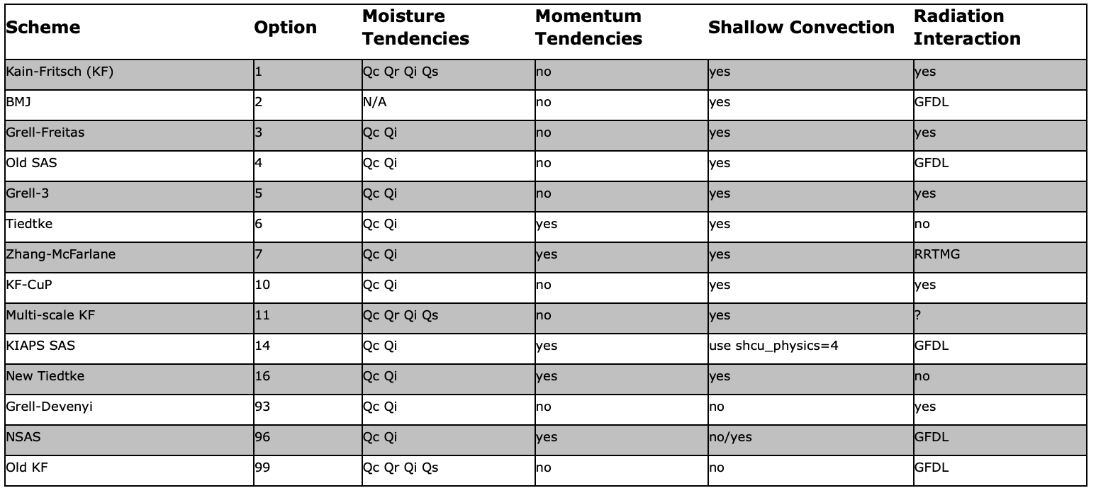
Cumulus schemes available
in WRF v4.2.2
Some of these schemes have
additional options
[see TSTORM experiment]
does not work
OSAS (cu=4) does not work
with WRF-ARW anymore
Zhang-McFarlane (cu=7) requires
specific PBL schemes
#94 HWRF NSAS is missing from list
#95 Old SAS for ARW is missing
#96 Old NSAS is missing from list
Cumulus schemes available
in WRF v4.5.1
Some of these schemes have
additional options
Notes:
2021

Slide 28
For most schemes, cudt = 0 (call
cumulus scheme every time
step) is recommended
KF schemes can use cudt = 5 (calls
cumulus every 5 min)
Your results may be sensitive
to your choice
Cumulus schemes available
in WRF v4.2.2
Some of these schemes have
additional options
[see TSTORM experiment]
does not work
OSAS (cu=4) does not work
with WRF-ARW anymore
Zhang-McFarlane (cu=7) requires
specific PBL schemes
#94 HWRF NSAS is missing from list
#95 Old SAS for ARW is missing
#96 Old NSAS is missing from list
Cumulus schemes available
in WRF v4.5.1
Some of these schemes have
additional options
Notes:
2021

Slide 29
[end]

