Slide 1
Identifying and controlling linear and nonlinear instability in WRF
ATM 419/563
Fall 2024
Fovell
© Copyright 2024 Robert Fovell, Univ. at Albany, SUNY, rfovell@albany.edu
Notes:
2018 PROBLEM: for some persons, for some nodes, the supercell run STALLS at 20 min, and this appears to be a random glitch that happens when model data are being written to disk.

Slide 2
Goals
Demonstrate potential examples of linear and nonlinear instability in WRF and how to address them
Demonstrate potential sensitivity of simulations to time stepping and diffusion
Show value of “new” schemes and approaches used by WRF (odd-order advection, RK3 time stepping)
Do this by revisiting our earlier supercell demo

Slide 3
Supercell thunderstorm demonstration #2
Reveal differences between odd- and even-order numerical schemes

Slide 4
Supercell recap
We previously simulated an idealized 3D supercell storm case for 1 h, writing output every 5 min
  Time step was 6 seconds
  No explicit diffusion was imposed
Storm was initialized with a bubble placed in a shear flow, resulting in a splitting storm (right- and left-movers)
Evaporation of rainwater established a subcloud cold pool that spread along the surface
You could expect sensitivity to microphysics, but we did not vary that for this demonstration

Slide 5
Supercell demo setup
Go to your SUPERCELL directory
Edit the namelist.input file to make these changes:
srun -p burst-daes ideal.exe
sbatch -p burst-daes submit_wrf
  trsl
While your simulation is running….
&dynamics
rk_ord = 2,
h_mom_adv_order = 4,
v_mom_adv_order = 2,
h_sca_adv_order = 4,
v_sca_adv_order = 2,
was 3
was 5
was 3
was 5
was 3
SEE SCRIPT
Notes:
OR HEADNODE7

Slide 6
Effect of diffusion and time stepping on squall line simulations
(while your supercell simulation is running…)
[SQUALL simulations made using WRFV3.7.1]

Slide 7
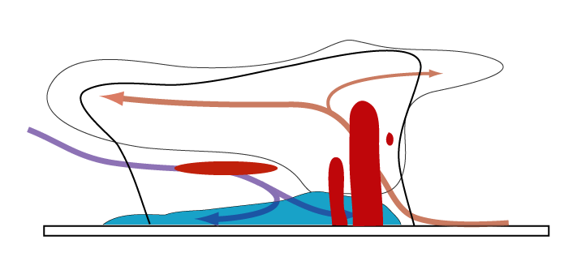
Squall line vertical x-section
Storm motion

Slide 8
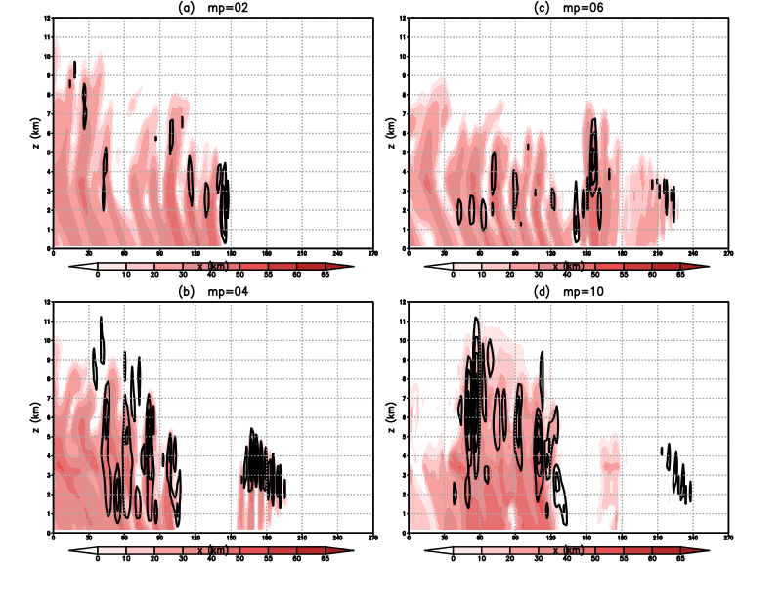
mp = 2
mp = 6
Our 2D squall line case
(but different wind profile)
mp = 4
mp = 10
Real or false?
Linear or nonlinear?
Different microphysics schemes: reflectivity (shaded) and vertical velocity at 6 h forecast
Notes:
What is going on here? We’ll return to this

Slide 9
Advection error: review
[see ATM419_modeling_fundamentals_and_errors.pptx]

Slide 10
A Runge-Kutta 3rd order (RK3) time integration
• WRF uses an RK3 time integration
scheme (predictor-corrector type)
Current time is time n
Compute advection at time n
Use this to push u forward 1/3 step
Recompute advection, push u ahead
  farther from time n
Finally recompute advection at half-
  way point, push u ahead full ∆t
• MPAS uses a simpler RK2 scheme
• There is no single RK2 or RK3 scheme
Notes:
More work, but much better scheme

Slide 11
“Fourier thinking” and its implications
Any series, no matter how aperiodic, can be decomposed into a finite set of sines and cosines of different wavelengths and amplitudes
When those Fourier components are recombined, the original feature is recovered

Slide 12
You see features, the model “sees” individual and separate waves
Simple wave equation: feature is advected at speed c without change of amplitude or shape
Advection error: A wave’s amplitude not preserved and/or its speed is too fast or slow.
Dispersion error: Advection error varies with wavelength.
If error is dispersive, feature will unravel.

Slide 13
You see a cone.
The model sees many
waves, constructively
and destructively
interfering that have
different advection
errors.
The model handles
the shortest wavelengths
the most poorly.

Slide 14
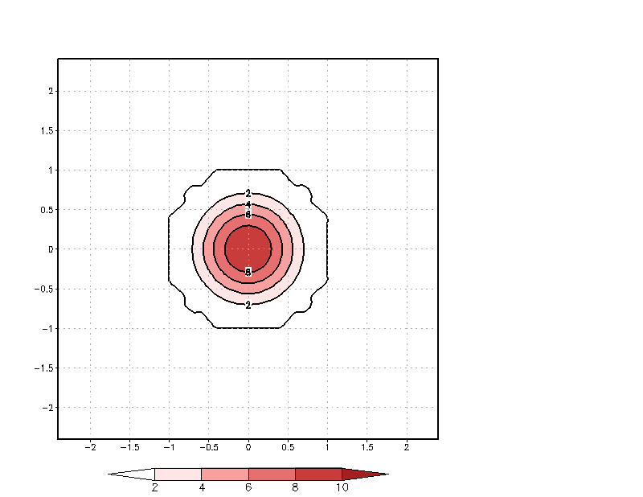
One of those ways things
can go wrong is improper
advection.
In this example, the shortest
waves are handled poorly
(and even moving in the
wrong direction!), but
they are not growing
When linear or nonlinear
instability appears, it may
be first apparent in the
unrestrained growth of the
smallest scale waves
GIF animation

Slide 15
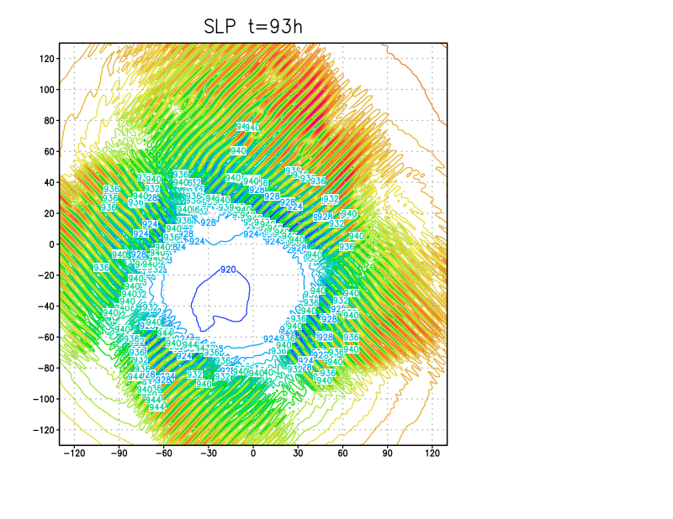
HWRF model
SLP field
Both linear and nonlinear
instability are
characterized by the
rapid growth of small-scale
waves
…but the cure for one
makes the other worse
because the growth
occurs for different reasons
That said, nonlinear
instability is not so common
in the WRF model
Let’s see why.
y (km)
x (km)
Very small part of domain shown
Notes:
4 day simulation, ending at 96h. It didn’t blow up by that time, but it WOULD eventually do so if run longer.
What’s the cause? Linear or nonlinear instability? “Going to hell in a handbasket”

Slide 16
Controlling linear and nonlinear instability: review
[see ATM419_modeling_fundamentals_and_errors.pptx]

Slide 17
Review of linear instability
Linear instability is caused, first and foremost, by using a time step that is too long or large
When linearly unstable, ALL wavelengths should grow exponentially with time
  However, the shortest waves typically grow fastest, so the linearly unstable solution may look “noisy” (contain a lot of large-amplitude, small-scale features) as it “blows up”
Solution: reduce the time step
Caveats (important!)
  Nonlinear instability also can manifest as small-scale noise, and reducing the time step can make nonlinear instability worse
  Changing the time step can change both simulation results and experimental conclusions, in pathological cases. Check to see if your time step matters.

Slide 18
Review of nonlinear instability
Nonlinear instability results when energy builds up at the smallest resolvable wavelengths (i.e., 2-3∆x)
  Wave-wave interaction causes energy to spread to smaller and smaller scales
  In reality, this energy cascade continues to microscales, where it is dissipated by friction
  In the model, the energy accumulates at the smallest resolvable scales because there is no natural sink and aliasing occurs
One test for nonlinear instability: decrease the time step… if the problem occurs earlier (in “real” time), then nonlinear instability is suspected
  Reason: wave-wave interaction occurs every time step. Reducing the time step means more possible interactions within a given “real” time period

Slide 19
Controlling nonlinear instability
(1) Apply an artificial, explicit diffusion term to remove energy at the smallest scales
  These are even-order derivatives in space, time (next slide)
  This is completely artificial, so you do not want to impact well-resolved components
  Thus, you want the filter to be as scale-selective and scale-specific as possible: Hit 2∆x waves hard with minimal impact waves longer than 4∆x
(2) Utilize “odd-order” advection schemes (like default WRF) which have implicit diffusion
  Odd-order schemes have even-order truncation errors, meaning advection error presents as artificial diffusion
(3) Do both (can be done in WRF)
Notes:
Got here 2021

Slide 20
Explicit diffusion terms
• φ = variable being predicted
• Diffusion terms added to RHS
• α_{n} is a dimensional diffusion coefficient ≥ 0
• Note derivatives are even order, starting with order 0 (φ itself)
• Note signs alternate
• You may (will) want diffusion in z direction as well…
Notes:
Dimensions… 1/s, m^2/s, m^4/s, etc.

Slide 21
Zeroth-order diffuser
The 0th order diffuser is a “flat tax” that reduces the amplitude of all waves equally
  Not scale-selective at all, so a very poor choice for controlling nonlinear instability
  Also called a “sponge”, Rayleigh damping (when applied to velocity components), and Newtonian cooling (when applied to temperature).
    Used when we need to damp everything out
    Tricky to implement, requires care
    We are using dampers in our real-data WRF runs
Notes:
Got to here 2019

Slide 22
Higher-order diffusers
Smoothing applied at grid point i
• Note symmetry
• Note denominator
• Note increasing order by two involves incorporating two additional points
• Each higher order scheme is more scale selective, targeting smallest wavelengths
(next slide), at the cost of increasing computational complexity
• These terms are multiplied by the time step and the diffusion coefficient α,
which can be combined and expressed as a nondimensional coefficient
Notes:
0th order – 1 point. 2st order – 3 points. 4th order – 5 points.
Points involved is order+1

Slide 23
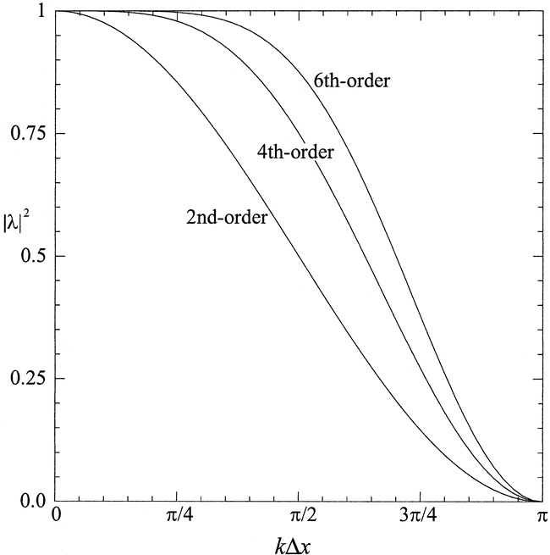
Amplitude factor vs. wavenumber
(and wavelength)
if
• Amplitude factor λ < 1 is amplitude preserved
per time step (per application)
and λ = 1 means no damping and λ = 0
means nothing remains
• Plots are normalized relative to complete
removal of 2∆x wave in 1 time step
(i.e., λ = 0), which is overkill
• Desire λ to be close to 1 for wavelengths
longer than 4∆x (“signal”)
∞∆x 4∆x 2∆x << wavelength
This is artificial. You want the smallest amount of diffusion that gets
the job done. You want diffusion targeted most precisely to small scales.
Xue (2000)
Notes:
artificial

Slide 24
WRF 6th order diffusion option
&dynamics
rk_ord = 3,
diff_opt = 2, 2, 2,
km_opt = 2, 2, 2,
diff_6th_opt = 2, 2, 2,
diff_6th_factor = 0.12,
• diff_opt = km_opt = 2: you are computing and applying eddy mixing (subgrid turbulence).
- this is intended to be physically realistic and reasonable diffusion, in all directions
- this is applied via 2nd derivatives in space (x, y, z)
- the mixing is intermittent in time and space and may not be generated
where and when nonlinear instability is growing
- in real-data WRF, using a PBL scheme, you select diff_opt=1, km_opt=4 instead
• rk_ord = 3 means we’re using an odd-order Runge-Kutta scheme
- this does have implicit numerical diffusion, which is larger for smaller-scale waves
- this may suffice to control nonlinear instability (but odd-order advection more relevant)
• diff_6th_opt = 2 means we’re requesting additional, highly-targeted 6th order diffusion
- the coefficient diff_6th_factor is nondimensional, and relative to 2∆x damping rate
diff_6th_factor = 1.0 would mean complete removal of 2∆x in one time step
(overkill!!!) [Using the recommended 0.12 is still very aggressive.]
Notes:
Diff_6th_factor = .12 means 2∆x killed in about 8 time steps. Still very aggressive.

Slide 25
Linear or nonlinear instability?
Example using our 2D squall line

Slide 26
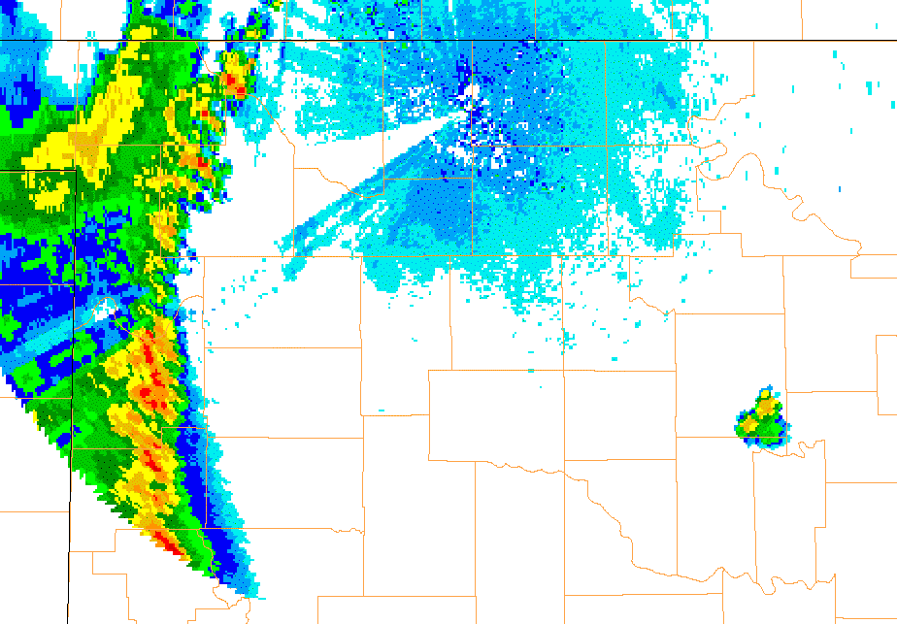
Observe new convective cells appearing
ahead of squall line – gust front visible
21 June 2003, VNX radar
Fovell et al. (2006)
Notes:
21jun2003_vnx_long_NEW.GIF

Slide 27
Squall line vertical x-section
New cells appearing
on radar
Storm motion

Slide 28
Vertical profile of horizontal wind
In input_sounding, can easily manipulate
vertical wind speed difference (∆u, m/s)
and shear layer depth (D, m). See next slide.
No shear above z = D.
Also specify domain translation speed (G, m/s).
[information only; you do not need to do anything]

Slide 29
input_sounding
(as in your SQUALL directory)
domain
translation
speed
G
[information only; you do not need to do anything]
∆u (m/s)
shear layer
depth D (m)
surface pressure, potential temperature and vapor mixing ratio
1000.0 300.5000 14.00000 6.0 3750. 16.0
125 300.5 14 -15.4 0.00E+00
375 300.565 14 -14.2 0.00E+00
625 301.0699 14 -13 0.00E+00
875 301.6293 14 -11.8 0.00E+00
1125 302.2307 14 -10.6 0.00E+00
1375 302.8666 13.11911 -9.4 0.00E+00
1625 303.5323 11.87561 -8.2 0.00E+00
1875 304.2242 10.742 -7 0.00E+00
ignore these
Configuration altered to ∆u = 6, D = 3750, G = 16.0

Slide 30
mp = 2
mp = 6
∆u = 6 D = 3750
WRFV371
mp = 4
mp = 10
Different microphysics schemes: reflectivity (shaded) and vertical velocity at 6 h forecast

Slide 31
Development of noisy features in a single case
mp=4, ∆u=6, D=3750, G=16 case
[WRFV371]

Slide 32
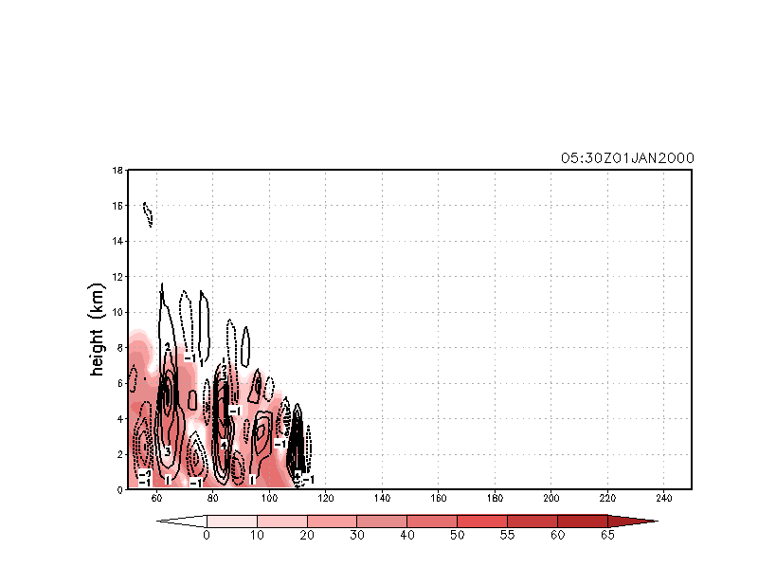
Shaded = reflectivity
Contoured = vertical velocity
Time t
This is what convective cells look like in our
2D squall line. Downdrafts and updrafts
have different magnitudes and altitudes
reflectivity (dBZ)

Slide 33

Time t + 10 min
Notes:
10 min later

Slide 34
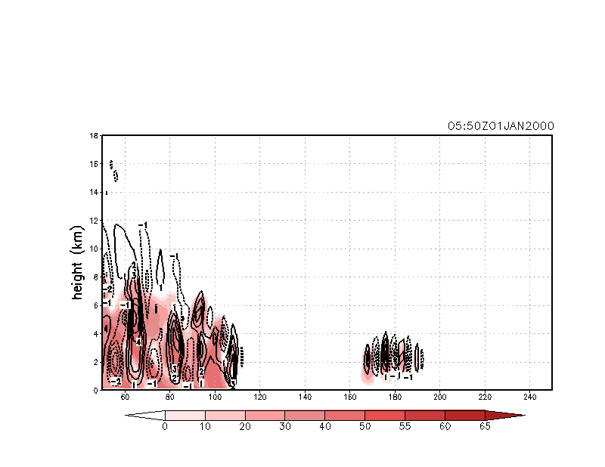
Time t + 20 min
These new features look different from
convective cells. Downdrafts and updrafts
have about same magnitude and altitude
Notes:
There’s something different about these new vert motion features. Instead of stronger updrafts with weaker downdrafts located below and behind, the new feature has updrafts and downdrafts of about same magnitude at same altitude.

Slide 35
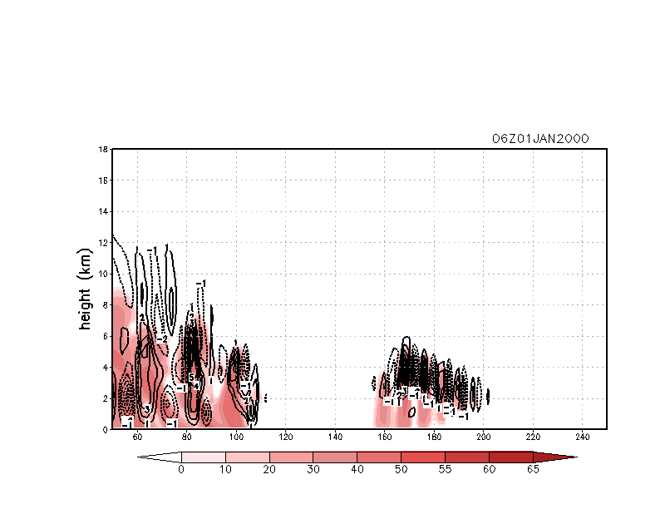
Time t + 30 min
mostly 3-4∆x
Cross-section at dotted line on next slide…

Slide 36
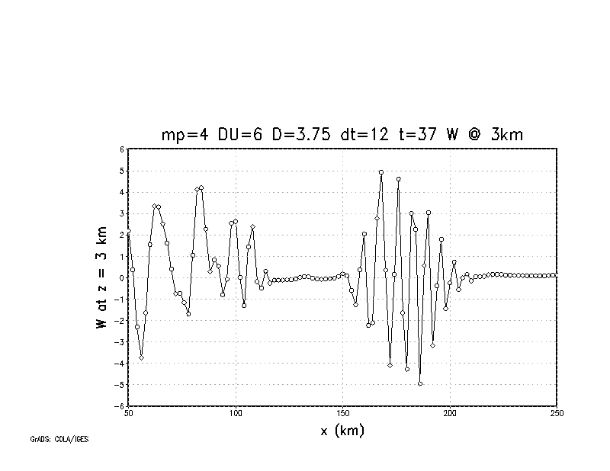
W at z = 3 km @ 6 h
cellular features
noise features
mostly 3-4∆x
Notes:
One feature at left is 11∆x. The new features are 3 and 4∆x.

Slide 37
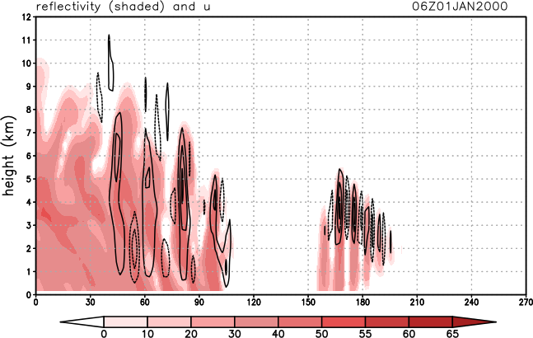
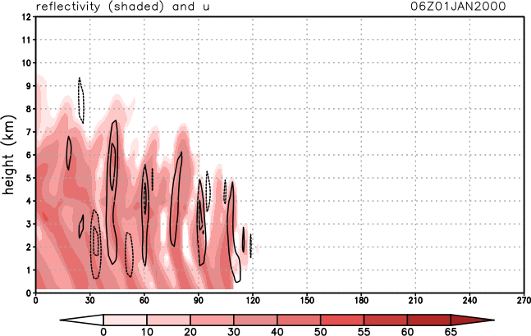
Shorten the time step
∆t = 12 sec
∆t = 6 sec
Issue disappears after reducing the time step.
Does this ensure the feature was linear instability?

Slide 38
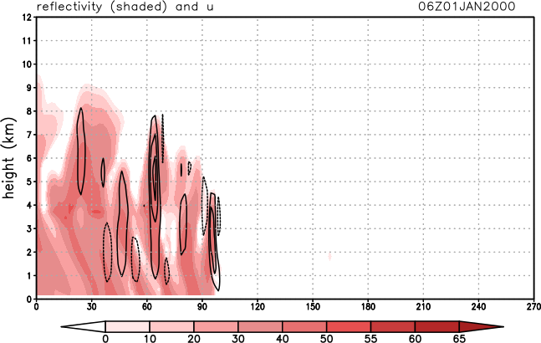
Add 6th order diffusion
∆t = 12 sec
No 6th order diffusion
∆t = 12 sec
Light 6th order diffusion
(diff_6th_factor = 0.06)
Issue disappears after adding some small scale diffusion.
Does this ensure the feature was nonlinear instability instead?
Notes:
Since small waves grow the fastest, and diffusion removed the smallest waves, it still could have been linear instability – if the longer waves were stable (or had very small growth rates).
If this was linear instab, theoretically should still be blowing up… but the longer waves have slower growth rates so it would take longer

Slide 39
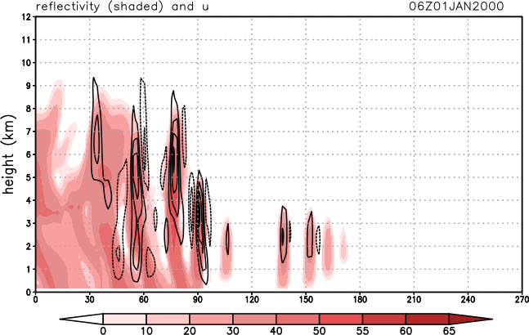
Do both
∆t = 12 sec
No 6th order diffusion
∆t = 6 sec
Light 6th order diffusion
(diff_6th_factor = 0.06)
Issue reappears. But, is it really the same phenomenon?
[These new cells actually do look realistic…]
Notes:
Original looks wrong. New looks possible. New cells look different, more like real convective cells.
That judge about porn = “I can’t define it, but know it when I see it”

Slide 40
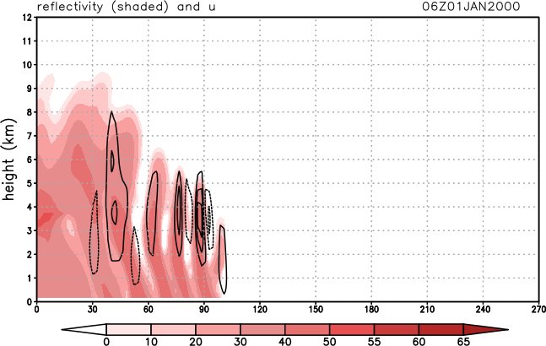
Do both, with larger diffusion
∆t = 12 sec
No 6th order diffusion
∆t = 6 sec
Standard 6th order diffusion
(diff_6th_factor = 0.12)
Issue disappears again. So, was it ever real?
Or are we now doing too much damping?
(Keep in mind: diffusion ALSO dampens signal, not just noise)
Notes:
There is no correct answer in this case.
Diffusion, however targeted, is still also hitting larger scale waves, and cut have nipped this in the bud before it could bloom.

Slide 41
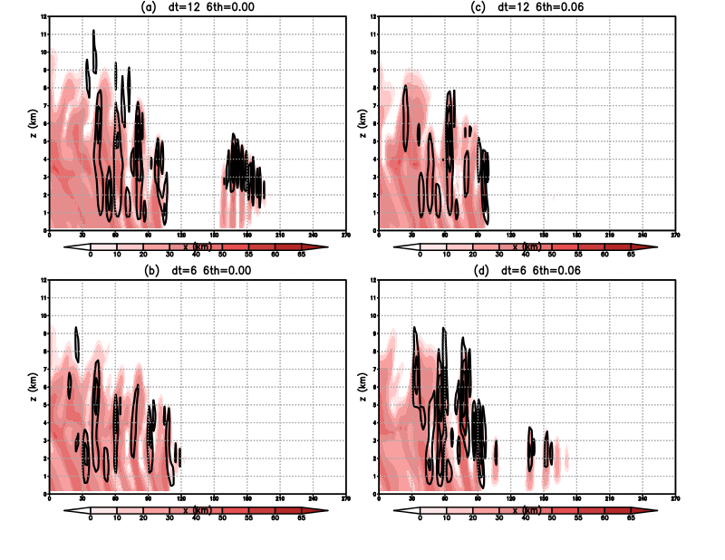
Add light diffusion
Reduce ∆t
Both

Slide 42
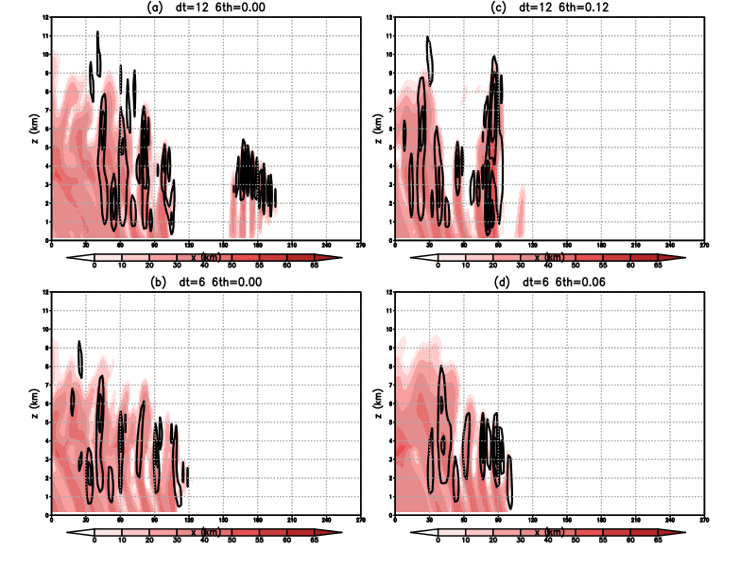
Add std diffusion
Reduce ∆t
Both
0.12

Slide 43
Caveats
Just because a feature disappears when the time step is reduced does not necessarily mean it represented linear instability
Just because the feature becomes more amplified when the time step is reduced (or artificial diffusion is reduced) does not necessarily mean it represented nonlinear instability
Reason:
  Small differences owing to physical and/or numerical causes can evolve into dramatic differences later
Keep in mind:
  “A difference is a difference only if it makes a difference”*
*Darrell Huff, How to Lie With Statistics

Slide 44
Escalation scenarios
• WRF simulation finishes. Nothing written to sbatch.err.out. No “cfl” warnings
in rsl.out.XXXX files. No NaNs encountered in python. You may be OK.
[grep cfl rsl.out.*]
• WRF simulation finishes. Nothing written to sbatch.err.out. A few “cfl” warnings
do appear in rsl.out.XXXX files. No NaNs encountered. You’re on the edge.
• WRF simulation finishes. Nothing written to sbatch.err.out. Many “cfl” warnings
in rsl.out.XXXX files OR anytime you get NaNs.
- The model actually did blow up, generating NaNs. Simulation is worthless
(except for debugging purposes). “SUCCESS COMPLETE” is a lie.
• WRF simulation stalls but remains in queue. sbatch.err.out file length is nonzero.
The model blew up, AND you need to remove it from the queue manually.
See next slide.
NaN = “not a number”

Slide 45
Removing a stalled job
• Look for sbatch.err.out. If it is nonzero length, your job bombed, and you
need to remove it manually
• To remove a job, first identify your WRF job with squeue –u YOURNETID
or myjobs
JOBID PARTITION NAME USER ST TIME NODES NODELIST(REASON)
538709 snow tcsh atm419 R 57:52 1 snow-02
538701 snow tcsh atm419 R 1:59:41 1 snow-10
538724 snow ATM419 atm419 R 0:29 1 snow-22
• Your WRF job is the one that doesn’t say “tcsh” or “bash”
• Remove it with scancel. Check your queue again to make sure it’s gone
$ scancel 538724
Notes:
This needs to be updated. Don’t see shell processes unless use ps –ef | grep [netid]

Slide 46
Trade-offs (TANSTAAFL!)
By default, WRF uses 3rd order RK time stepping, odd-order advection, and positive-definite methods for scalars (including moisture)
  These help prevent small-scale noise, which can lead to nonlinear instability, from emerging
  Odd-order advection “works” by causing implicit diffusion
&dynamics
rk_ord = 3,
h_mom_adv_order = 5,
v_mom_adv_order = 3,
h_sca_adv_order = 5,
v_sca_adv_order = 3,
moist_adv_opt = 1,
scalar_adv_opt = 1,

Slide 47
Return to supercell demo
[Assuming your simulation has finished successfully]

Slide 48
Launch new notebook
Copy this into your SUPERCELL directory $LAB/SUPERCELL/plot_SUPERCELL_DIFFUSION.ipynb
Launch ARCC Jupyterlab.
  Minimal resources suffice, batch or snow
In Cell #5 there are a few options
  trial = 1, 2, or 3 ← controls plot overlay
  mtime = 13 ← our final forecast time
  mlevel = 1 ← level 1 (closest to surface)

Slide 49
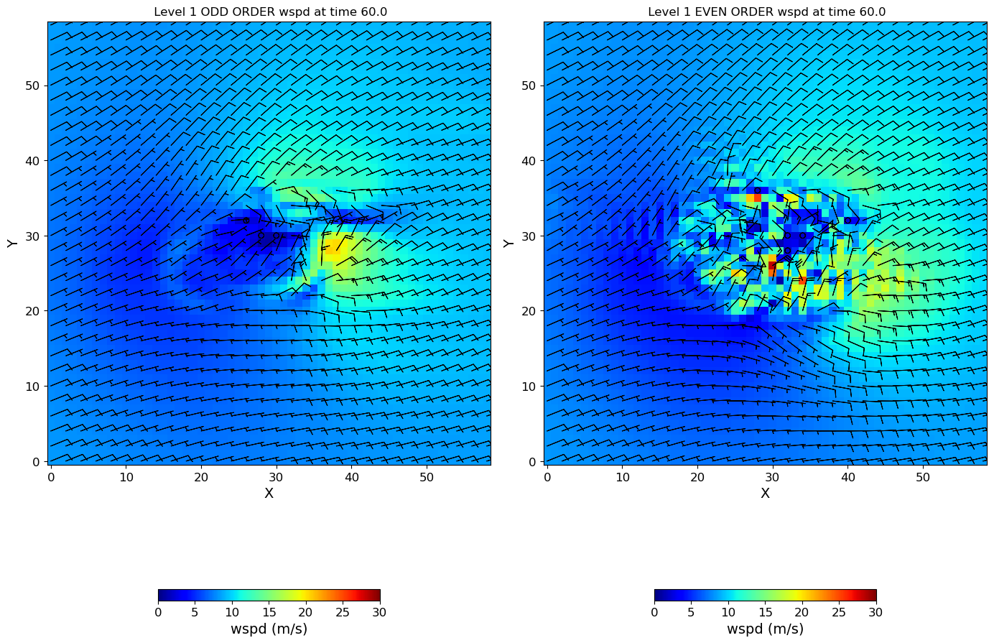
Cell #5 with trial=1 and mtime=13, mlevel=1
Shaded field and barbs = horizontal wind speed at lowest scalar level

Slide 50
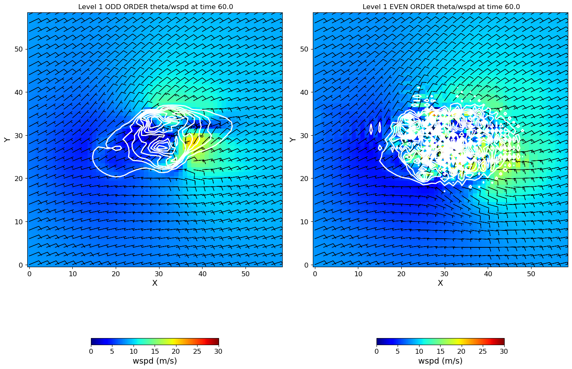
Cell #5 with trial=2 and mtime=13, mlevel=1 – contoured is theta at lowest scalar level

Slide 51
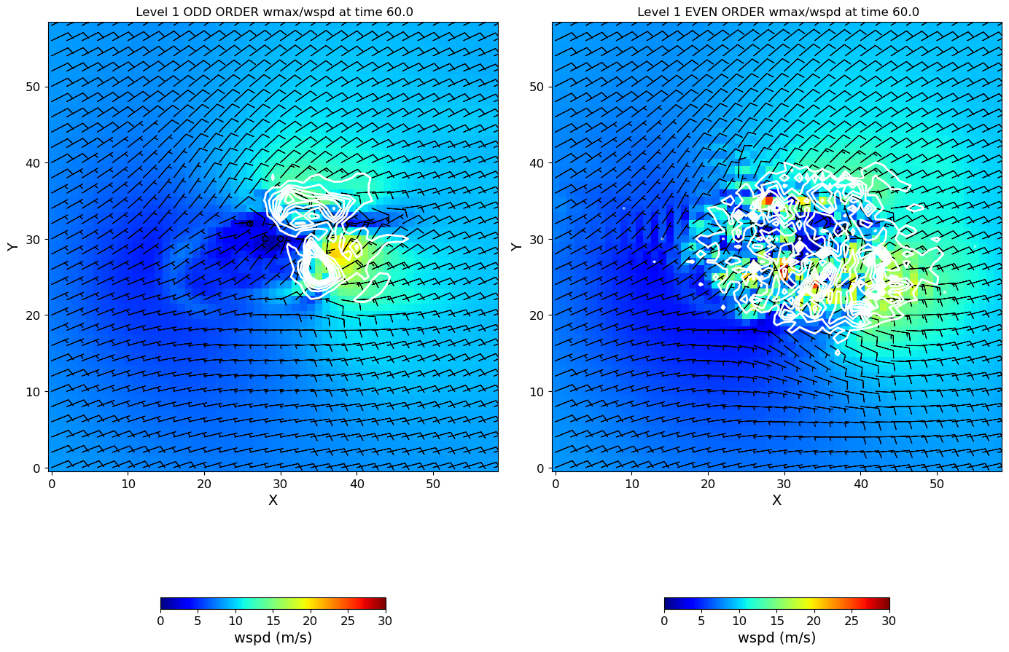
Cell #5 with trial=3 and mtime=13, mlevel=1 – contoured is column maximum vertical velocity
Let’s see how this noise developed…

Slide 52
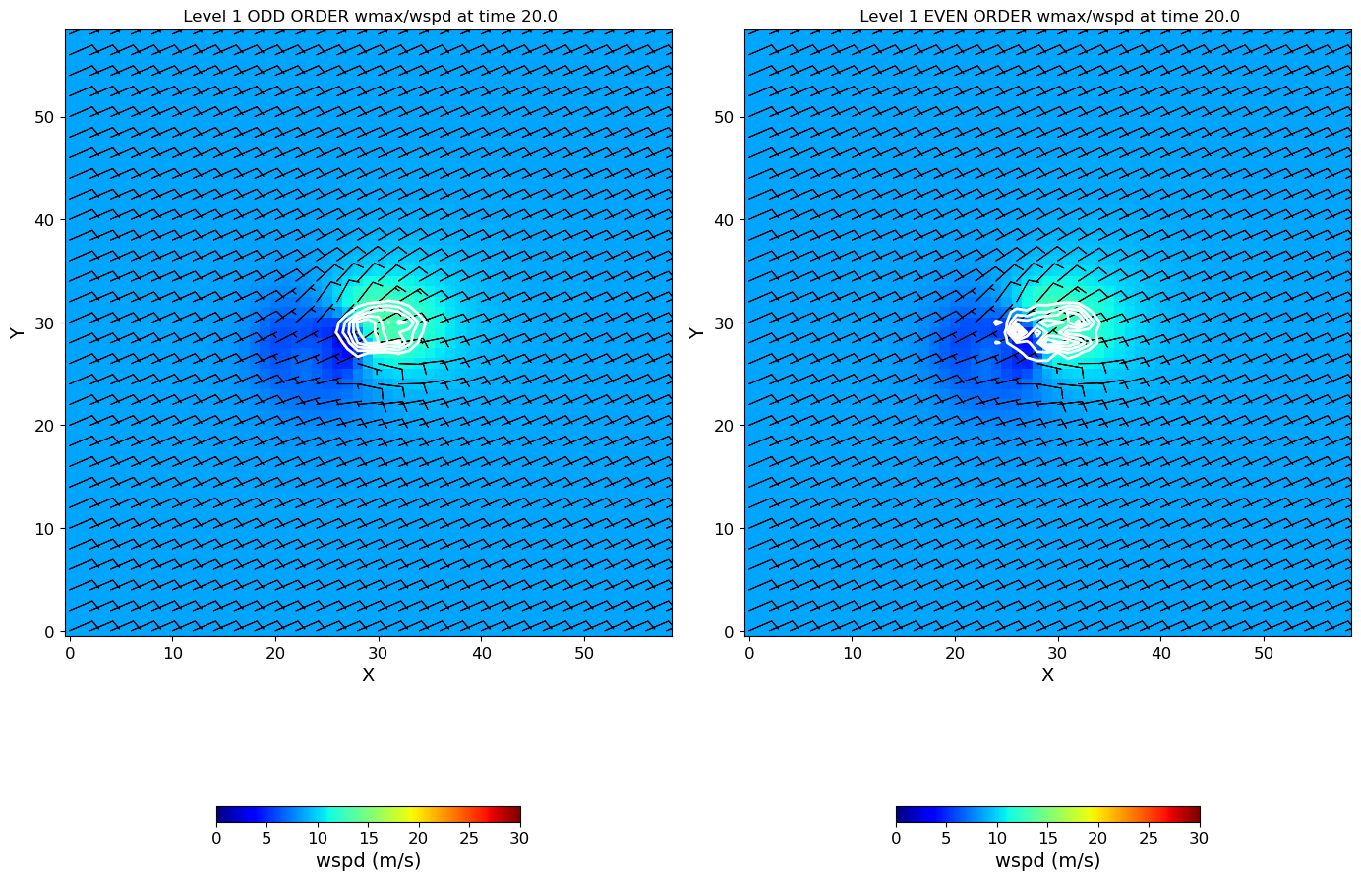
Cell #5 with trial=3 and mtime=5, mlevel=1 – contoured is column maximum vertical velocity

Slide 53
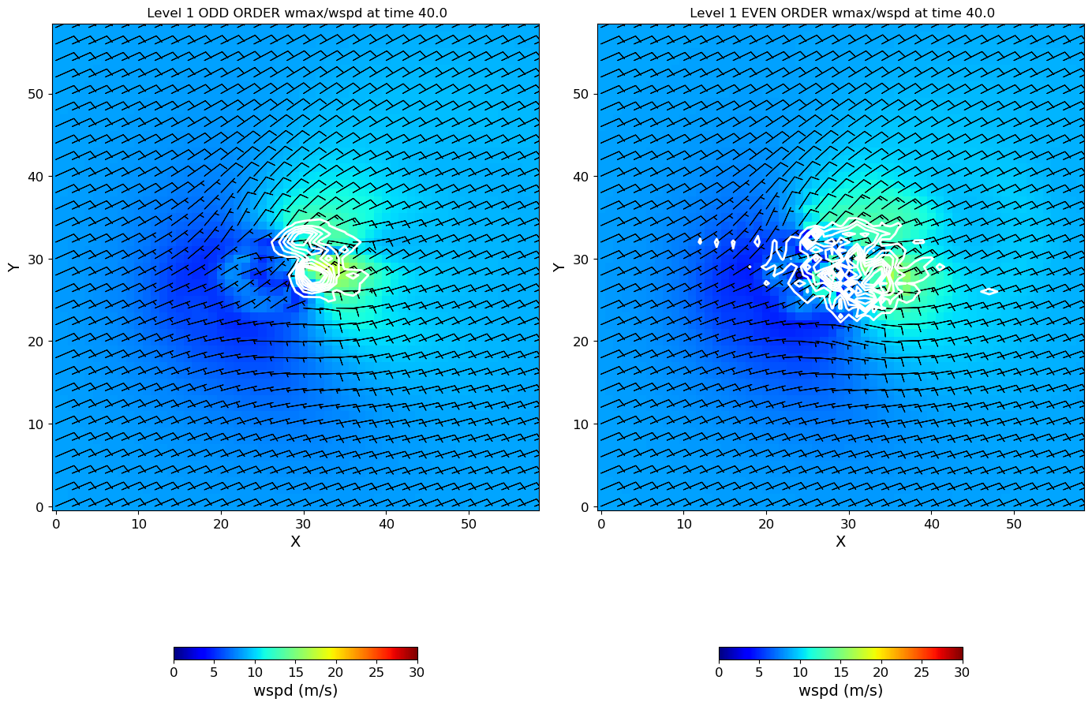
Cell #5 with trial=3 and mtime=9, mlevel=1 – contoured is column maximum vertical velocity

Slide 54
Cell #5 with trial=3 and mtime=13, mlevel=1 – contoured is column maximum vertical velocity
What happens if you run this simulation longer?
If it blows up, will shortening the time step help?
If it does not blow up, is this run of any value?

Slide 55
Summary
Models handle small-scale waves most poorly
  They are the “source” for linear AND nonlinear instability
  To us, this is “noise”
Diffusion, whether explicit or implicit, is used to constrain small-scale noise. We can’t avoid it.
WRF uses odd-order schemes with implicit diffusion to control noise
  Although it sometimes needs some extra help
You can use even-order schemes in WRF but you will need add explicit diffusion

Slide 56
Extra (optional)
Redo your simulation with the even-order scheme, but also select these settings and rerun. What happens?
[Reinitialize notebook before plotting…]
diff_opt = 2,
km_opt = 2,
diff_6th_opt = 2,
diff_6th_factor = 0.12,
Want to know more? Go to WRF physics page:
https://www2.mmm.ucar.edu/wrf/users/wrf_users_guide/build/html/physics.html
Notes:
Note namelist page is for V4.2

