Slide 1
Cloud microphysics
ATM 419/563
Fall 2024
Fovell
© Copyright 2024 Robert Fovell, Univ. at Albany, SUNY, rfovell@albany.edu

Slide 2
Water phase changes & hydrometeors
Heating and cooling and moistening and drying of air, as well as effects on momentum, owing to water substance phase changes are of overwhelming importance in atmospheric processes, and need to be handled appropriately in NWP models if we hope for skillful forecasts
We handle this in two complementary and yet antagonistic ways:
  Cloud microphysics – we can resolve the clouds on the grid but cannot track every hydrometeor.
    This approach parameterizes condensation, evaporation, deposition, sublimation, and hydrometeor evolution and interaction on a grid volume by grid volume basis and is based primarily on particle size distributions and geometric concepts.
  Cumulus parameterization – we cannot even “see” the clouds: they are subgrid.
    In this approach, we adjust entire model columns all at once to account for subgrid sources/sinks of heat, water, and momentum.

Slide 3
The C-C equation
The Clausius-Clapeyron (C-C) equation reveals how saturation vapor pressure (e_{s}) varies with temperature T:
  …where α₁ and α₂ are the specific volumes of water substance in phases 1 and 2, and L is the latent heat of the phase change
    For vapor to liquid, L = L_{v}, the latent heat of vaporization. For solid to liquid, L = L_{f}, the latent heat of fusion
This equation applies over a plane surface, say of liquid, in equilibrium (i.e., condensation and evaporation rates equal)

Slide 4
Curved (droplet) surfaces
If the liquid water surface is curved, like a cloud droplet or rain drop, an adjustment is needed. The saturation vapor pressure at the surface of a drop of radius r becomes
  …where e_{s}(∞) comes from the C-C equation, σ is the surface tension, ρ_{w} the liquid water density, and R_{v} is water vapor gas constant
As r decreases, e_{s}(r) gets much, much larger, making saturation harder to achieve

Slide 5
Saturation ratio
Rewrite this as the saturation ratio S:
• For large droplets, equilibrium occurs at S ~ 1
(RH = 100% relative to plane surface)
• For small droplets, S >> 1, so the required RH
for equilibrium becomes very large
(approaches 200%)
• The first droplets to appear are very small,
so this shows they cannot be composed of
pure water as the required RH is far too high
Notes:
Note plotted against ln(r)

Slide 6
CCN and the solute effect
Adding a cloud condensation nucleus (CCN) can drastically reduce the S needed to make a small droplet:
  … where b depends on the mass of the CCN, its molecular weight, and its chemical properties
Because of this solute effect, condensation can occur on some CCN for S < 1 (RH < 100%)!
  Especially salt (NaCL), leading to hazy conditions near seashores
Notes:
Salt at Malibu story

Slide 7
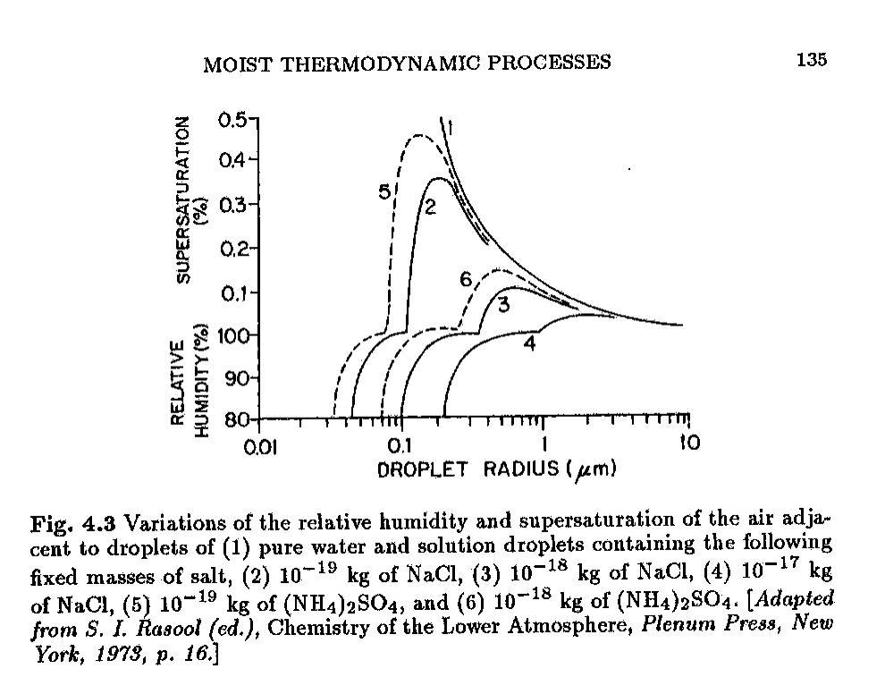
Köhler curve
• This information is captured by the Köhler
diagram.
• Vertical axis is a (discontinuous) function of S.
Horizontal axis is logarithmic in droplet
radius
• Curve (1) is pure water, as already seen.
The other curves are for various CCN.
(2), (3), and (4) = various masses of salt.
• See salt permits droplet formation at much
smaller RH values, even less than 100%
Note scale differs above and below 100%
[red line]
Emanuel’s text, p. 135

Slide 8
Köhler curve
• The peak of curve 2 is the critical radius r*
for a drop with a certain mass of salt
• For droplets with r < r*, the only way they
can grow is if S increases. This is why
haze particles may remain very small.
• Once a droplet radius passes r*, its growth
is much less restricted. However, it is
still very slow.
• The growth of cloud droplets to precipitation
size in a reasonable time requires a much
more efficient process…
Emanuel’s text, p. 135
Notes:
As S increases, the droplet moves up the path, attaining the size given by the horizontal axis.
Haze may remain small because there’s not enough S to permit them to grow.

Slide 9
Collision + coalescence
Once condensation particles acquire different sizes, they also possess different settling velocities (terminal velocity V_{T})
  Very small cloud droplets do not fall relative to still air because the drag force acting upon them is too great
  As particle size increases, V_{T} increases as drag becomes more easily overcome
  Fall velocity also increases as pressure decreases, owing to less air mass to cause drag
Because of different V_{T} (and turbulence in general), larger and smaller particles may collide

Slide 10
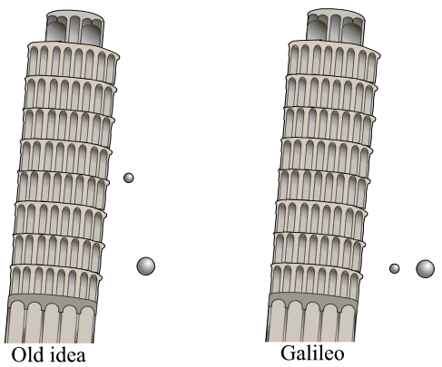
Didn’t Galileo prove that objects
of different weights fall at the same rate?
But… which would you rather get hit on the
head by: a snowflake or a hailstone?
Aerodynamic drag is important
and dependent on SIZE
Galileo actually considered objects made
of same material (density), so let’s do that
The downward force (weight) increases
with volume (cube of dimension)
The drag force increases with area (square
of dimension) → larger objects fall faster
Wikipedia
To the mouse and any smaller animal [gravity] presents practically no dangers. You can drop a mouse down a thousand-yard mine shaft;
and, on arriving at the bottom, it gets a slight shock and walks away. A rat is killed, a man is broken, a horse splashes. For the resistance
presented to movement by the air is proportional to the surface of the moving object. – J. B. S. Haldane
{It appears the illustration above is misleading, at least for our purposes}
Notes:
So the picture is wrong
vol increases faster than area

Slide 11
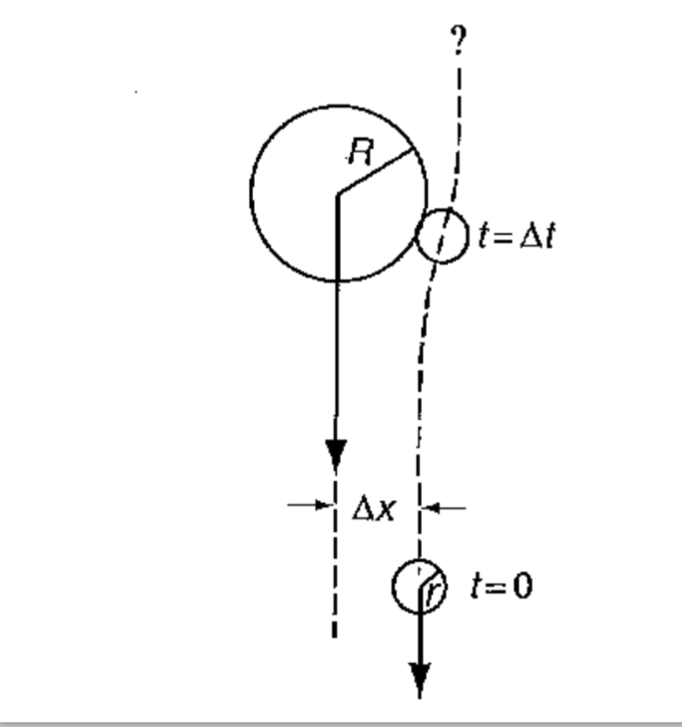
• Path of a small cloud droplet relative to a larger rain drop. If the droplet comes
sufficiently close to the drop, it may become collected, thereby increasing
the rain drop’s mass. (The larger rain drop will then fall even faster,
increasing its chances of colliding with more cloud droplets.)
• The total efficiency of this process
depends on:
- Collision efficiency = the fraction of
droplets that do collide (some
manage to escape)
- Coalescence efficiency = the fraction
of collided drops that remain
intact (some break up)
• Collection efficiency = collision
efficiency x coalescence efficiency.
• Although collection efficiency < 1, it
is still efficient enough to create
rain drops ~ 15 min after cloud
formation
Stensrud’s text, p. 269
Notes:
Got to here 2019

Slide 12
Microphysics schemes
We cannot follow every condensed water particle…
Two kinds: bulk and binned
  Bulk microphysics (currently, about 33 schemes) usually identify condensation species and handle particles of each species as a group (in bulk).
    Species may include cloud water, cloud ice, rain drops, snow crystals, graupel, and hail
    An individual species may take on a variety of particle sizes, represented by a particle size distribution (PSD) or drop size distribution (DSD)
    For each species, all particle sizes are handled simultaneously, as a group
    Some schemes explicitly include CCN aerosols
  Bin-based microphysics schemes (currently, 1 scheme in WRFV451¹) identify a discrete spectrum of particle sizes (bins) and model how particles move among the bins. Computationally very, very expensive.
¹ One of the bin schemes was recently removed
Notes:
Henceforth, just bulk schemes

Slide 13
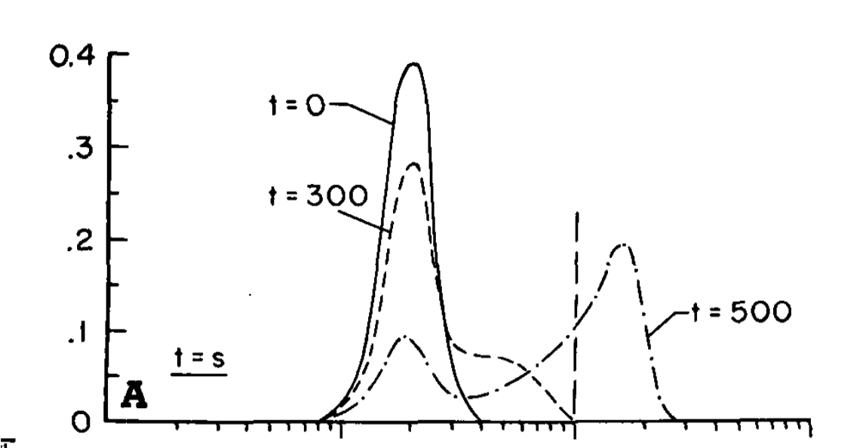
Developing rain drops from cloud droplets
cloud
• Results from Cotton’s (1972)
numerical experiment.
NOTE log scale for radius.
• A separation develops and is
maintained between cloud
and rain distributions.
• Range of cloud particle sizes
is quite small, justifying
assuming all same size.
(Keep in mind x-axis log scaled)
cloud/rain threshold
frequency
rain
0.01 0.1 1.0
t = 0: only cloud droplets exist
t = 500: bimodal separation between
cloud and rain
These raindrops are still quite small
ln(radius), in mm
Separation that develops between cloud and rain
particle size distributions justifies treating them separately
and differently
Cotton (1972), Fig. 1
Notes:
Here 2020
Spectral gap develops.
Horiz log scale obscures fact that cloud droplet size does not vary much, esp. rel to raindrop size variation.
Separation between distributions justifies handling them separately and differently.
These raindrops are actually quite small.
100 um = 0.1 mm = typical cloud/rain threshold

Slide 14
Simplest bulk scheme: “warm rain”
(WRF: Kessler scheme, mp_physics=1)
Two condensed water species: cloud water (q_{c}) and rain water (q_{r}), both expressed as mixing ratios (kg of condensate per kg of dry air)
  Usually assume no CCN shortage and condensation starts at 100% RH (no higher, no lower)
  Usually assume all cloud particles are the same size and do not fall relative to still air
  New rain drops are created by a process called “autoconversion”, which is handled simply (and very poorly) in models (e.g., Tripoli and Cotton 1980; Straka and Rasmussen 1997; Wakimoto et al. 2004)
  Raindrops are assumed to have a DSD consisting of relatively more smaller drops and fewer larger ones.
    The mass-weighted average particle size and mass can be computed, and plays a key role in bulk microphysics schemes.
    Fall speeds are proportional to that of the mass-weighted average particle.

Slide 15
Particle size distributions
(PSDs)
Also referred to as drop size distributions (DSDs)

Slide 16
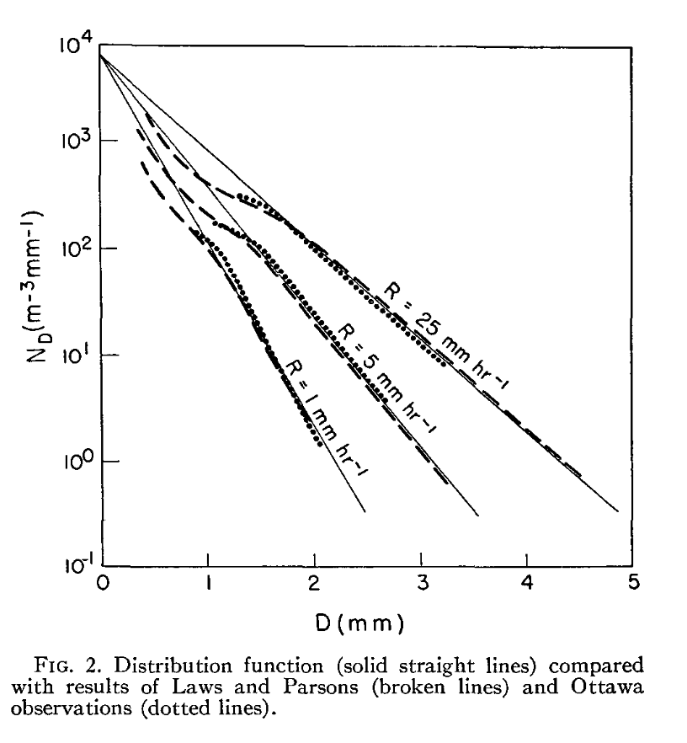
The Marshall-Palmer (M-P) or exponential size distribution
• Marshall and Palmer collected rain drops
reaching the surface and measured sizes.
- They found that as diameter size increased,
the number of particles exponentially
declined. Plotting ln(number) vs. diameter
made the plot linear
where N_{D} = the number of particles
per diameter D per unit volume
N₀ = the intercept (units 1/m⁴)
λ = slope > 0
• They found N₀ fixed but λ varied with
the rainfall rate R
Marshall and Palmer (1948)
Notes:
It also clearly didn’t work well for very small sizes
N(D) = # of particles per diam per vol = number/m^4 to make units work out on next slides

Slide 17
N: total number of drops in a volume
N₀ assumed constant
• We need to determine
both N₀ and λ
in some fashion
units 1/m³
Notes:
Larger the intercept and smaller the slope: more drops. Makes sense: area under curve is larger. Rise over run!
N is (1/m^4)/(1/m) = 1/m^3 = number per volume
Got to here 2022

Slide 18
• We need to determine
both N₀ and λ
in some fashion
Marshall and Palmer (1948)

Slide 19
Spherical raindrops
The mass M (in kg) of a raindrop of diameter D depends on the density of liquid water ρ_{l} and its volume V (by definition)
If the drops are spherical, then
The total mass per volume M in a grid volume (kg/m³) is the mass of a drop of diameter D x how many drops there are, summed over all diameters
Notes:
V = 4/3 \pi R^3 also
How did I get M = kg/m^3??? N(D) is number of particles PER UNIT VOL per DIAMETER, so it’s kg/m^4
(kg)*(1/m)(1/m^3)* m → kg/m^3

Slide 20
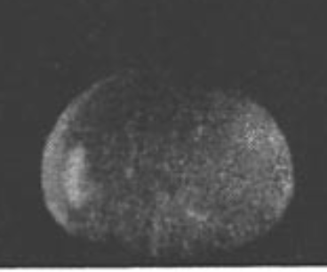
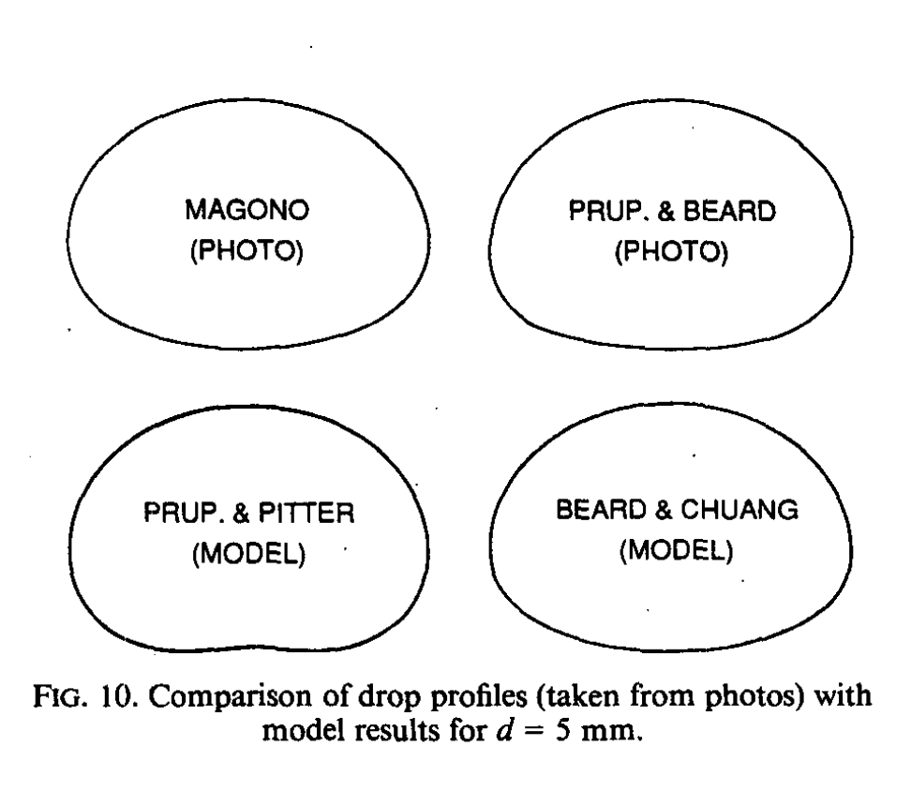
Neither spherical,
nor tear-shaped…
McDonald (1954)
Dr. Seuss
Beard and Chuang (1987)

Slide 21
Finding M
M = total mass per volume
Nasty integral – but a neat (Gamma) trick:
where
Notes:
n-1=3, so n=4, and Gamma(4)=3Gamma(3)=3*2Gamma(2)=3*2*1=6

Slide 22
Finding M
M = total mass per volume (kg/m³)
Notes:
This is total rain mass. Larger the intercept and smaller the slope, more mass because area under DSD is much bigger.
Looks like we want M but we are predicting M. We want N0 and Lambda.
Got to here 2021

Slide 23
Predicting M
We predict the rain water mixing ratio q_{r}, in kg_{w}/kg_{air}, for every grid volume
The total rain water mass per volume is
  …where is the air density
So… solve for the slope of the rain DSD
Something like this would be done for each species handled with particle size distributions
Notes:
Snow, graupel, hail… whether that is really reasonable or not

Slide 24
Next steps
We have an equation that relates the slope and intercept of the drop size distribution to the total amount of rain water in the grid volume
A single-moment microphysics scheme fixes either N₀ or λ, and solves for the other
  Many schemes fix N₀ (like Marshall and Palmer) for each species, whether that is reasonable or not, and this also assumes you know its value.
  Keep in mind M-P observed rain at the surface. Would rain sampled farther aloft have the same N₀?

Slide 25
Smaller drops/droplets less likely to get closer to the ground
• they fall more slowly
• they are more likely to evaporate (more surface to volume)
• they are more likely to become collected by larger particles
→ My guess is N₀ farther above the ground is larger… but we’re taking it to be constant??
• We need to determine
both N₀ and λ
in some fashion
Marshall and Palmer (1948)

Slide 26
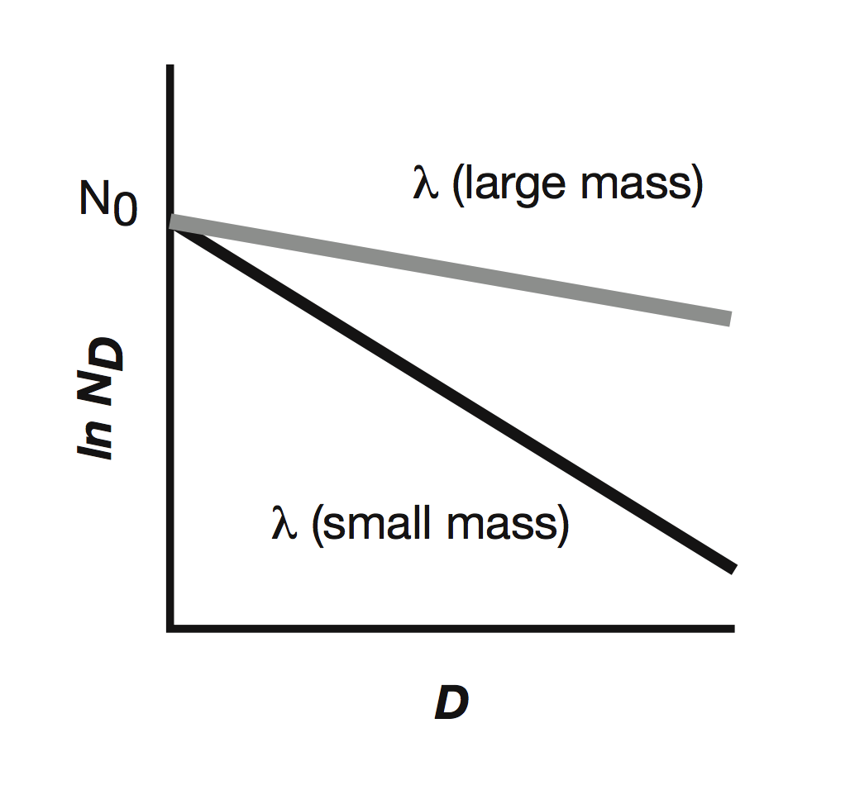
Consequence of fixing N₀
• If the intercept is held constant, then the
slope varies inversely with q_{r}
• This means that as the amount of rainwater
in a volume increases, the average particle
size is presumed to be getting larger

Slide 27
Consequence of fixing N₀
Mass-weighted average particle diameter
q_{r} increases →
λ decreases →
mass-weighted mean
diameter D grows
Notes:
Uses same tricks we saw before

Slide 28
Alternatives and advancements
Instead of fixing N₀, λ can be fixed instead (or either made a function of height or temperature)
  This has implications for average particle diameter (next slide)
Some schemes replace the exponential distribution with the “gamma” distribution (μ is a new shape parameter; same Gamma trick used)
Double-moment schemes try to predict two quantities for each species, such as q_{r} and N_{r} (the number concentration of rain drops per volume)
Notes:
Called gamma because it uses the same Gamma function trick we have already seen. Attempts to model larger sizes better than M-P.

Slide 29
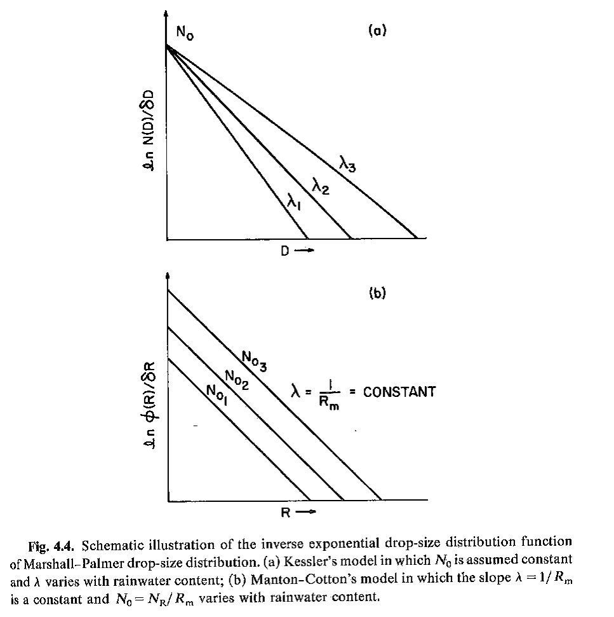
Fixing N₀ vs. fixing λ
Fixing intercept means average
drop size increases as total
rain water mass increases
Fixing slope means average
drop size does not change as
rain water mass increases
is increasing…
Cotton and Anthes text, p. 95

Slide 30
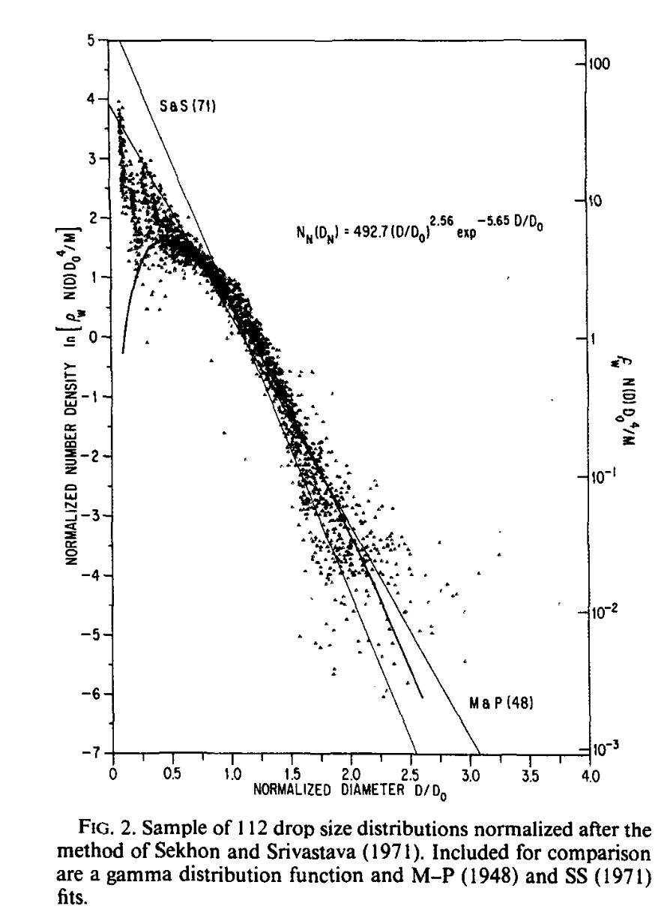
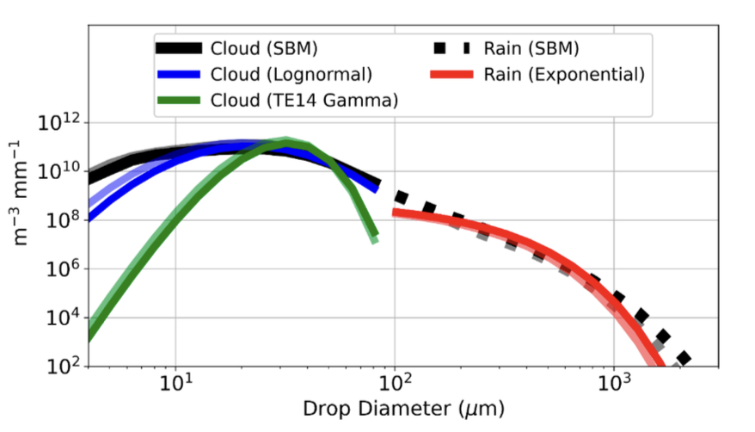
Gamma distribution (μ = 2.5) fits convex
shape of DSD at larger drop sizes better,
but discounts very small sizes.
Smith (2003): Differences between the
two DSDs “fall within the observational
uncertainties… so the extra effort
involved with the gamma distribution
is not often justified…”
Conrick et al. (2024): Gamma distributions
lead to underprediction of warm rain, and
lognormal is better
Willis (1984)
Conrick et al. (2024)
Notes:
Gamma (curved) does not fit very small particles well but handles convex shape of larger particles better than expon dists, which result in straight lines,

Slide 31
Terminal velocity

Slide 32
Terminal velocity
Particles are affected by gravity, which makes them fall relative to still air, subject to acceleration at 9.8 m/s per sec (32 ft/s per sec).
However, a falling particle also encounters resistance from the air it must pass through. The larger the particle, the greater the drag exerted.
This leads to a maximum fall speed, the terminal velocity when the gravity and drag forces balance.

Slide 33
Drag on small particles - 1
For spherical particles of small radius R, Stokes’ drag law provides an expression for the drag force F:
  where μ = air viscosity* and v = particle velocity
Gravity force acting on mass M is Mg, and for spherical water particles of radius R, mass is
*Not the gamma distribution shape parameter

Slide 34
Drag on small particles - 2
Equate the gravity and drag forces under the condition that velocity has reached its diameter-dependent terminal value v = V_{D}:
Now solve for V_{D}:

Slide 35
Drag on small particles - 3
Now take μ = 2x10⁻⁵ kg/m/s and a cloud droplet radius of 10⁻⁵ m (0.01 mm, 10 μm; see slide 13). With ρ_{l} = 1000 kg/m³, this yields a terminal velocity of only 1 cm/s
  Given a grid volume 50 m deep, a particle falling at 1 cm/s would take 1.4 h to fall from one box to the next
This is negligible in most if not all cases and is why we treat cloud particles as free-floating.
Notes:
Grid box 50 m deep, with 1 cm/s term vel, it takes 1.4 hours to fall from one box to the next

Slide 36
Drag on large particles - 1
Stokes’ drag law for small particles is a special case of its more general form:
  where C_{D} is a nondimensional drag coefficient and Re is the Reynolds number, a ratio between inertial and viscous forces.
At small Re (i.e., small particles with small inertia) viscosity dominates and C_{D} Re ~ 24, so it cancelled out from our previous expression
At larger Re, C_{D} tends to approach 0.4-0.6.

Slide 37
Drag on large particles - 2
The Reynolds number valid for when velocity has reached its terminal value V_{D} is
Now the equation of gravity and drag forces yields an expression for V_{D} like
  Note V_{D} depends on the square root of particle size.
Re numerator – inertial force → density • velocity • length
Re denominator – viscous force → dynamic viscosity

Slide 38
Drag on large particles - 3
After aggregating some constants and rewriting in terms of particle diameter D, we have
That’s the terminal velocity for a single particle. We want the mass weighted average particle terminal velocity
Terminal velocity proportional
to diameter

Slide 39
Drag on large particles - 4
With our assumed Marshall-Palmer PSD this integrates to
That was derived from first principles, and fallspeeds are often expressed in forms like this. However, empirically-determined fallspeed-diameter relationships like this are also often employed in the integration
  where a and b are empirically measured constants from sources such as Locatelli and Hobbs (1974). Also included is the air density fallspeed correction of Foote and du Toit (1969).
Γ(4.5) = 11.632

Slide 40
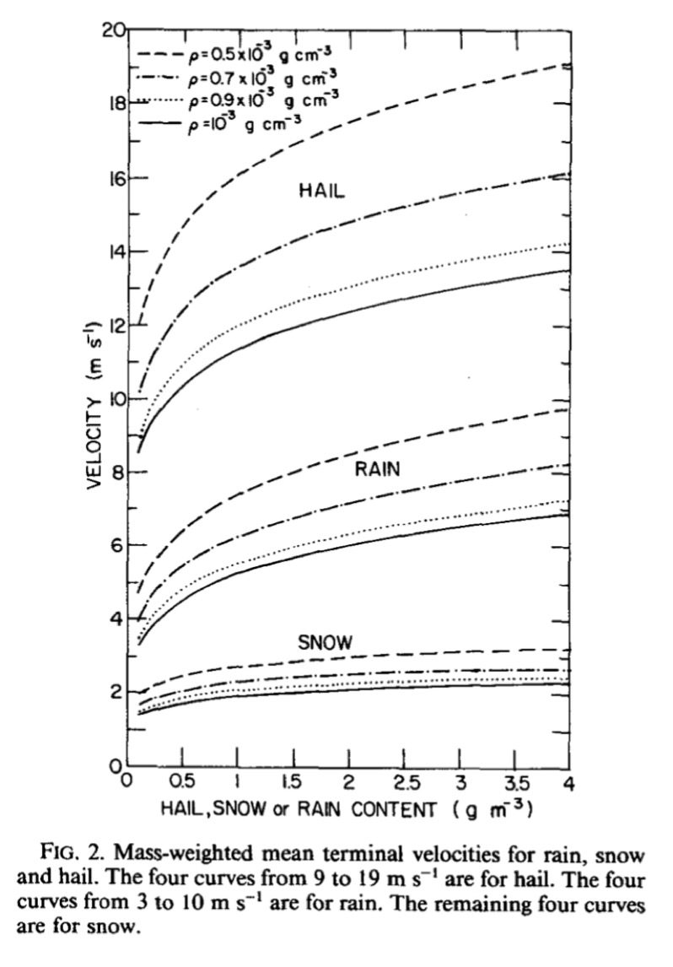
air densities
All of this results in terminal velocities
that vary by:
• species
• mass (mixing ratio) → mean particle diameter
• altitude (air density)
These curves depend on specifications of
PSD intercepts, fallspeed-diameter relationships,
particle densities (all vary among schemes),
and intercepts being presumed known and fixed
One consequence of this long chain of
approximations and assumptions:
Schemes that favor the fast development of
large particles don’t spread condensate as widely
ρq_{x}
Lin et al. (1983)

Slide 41
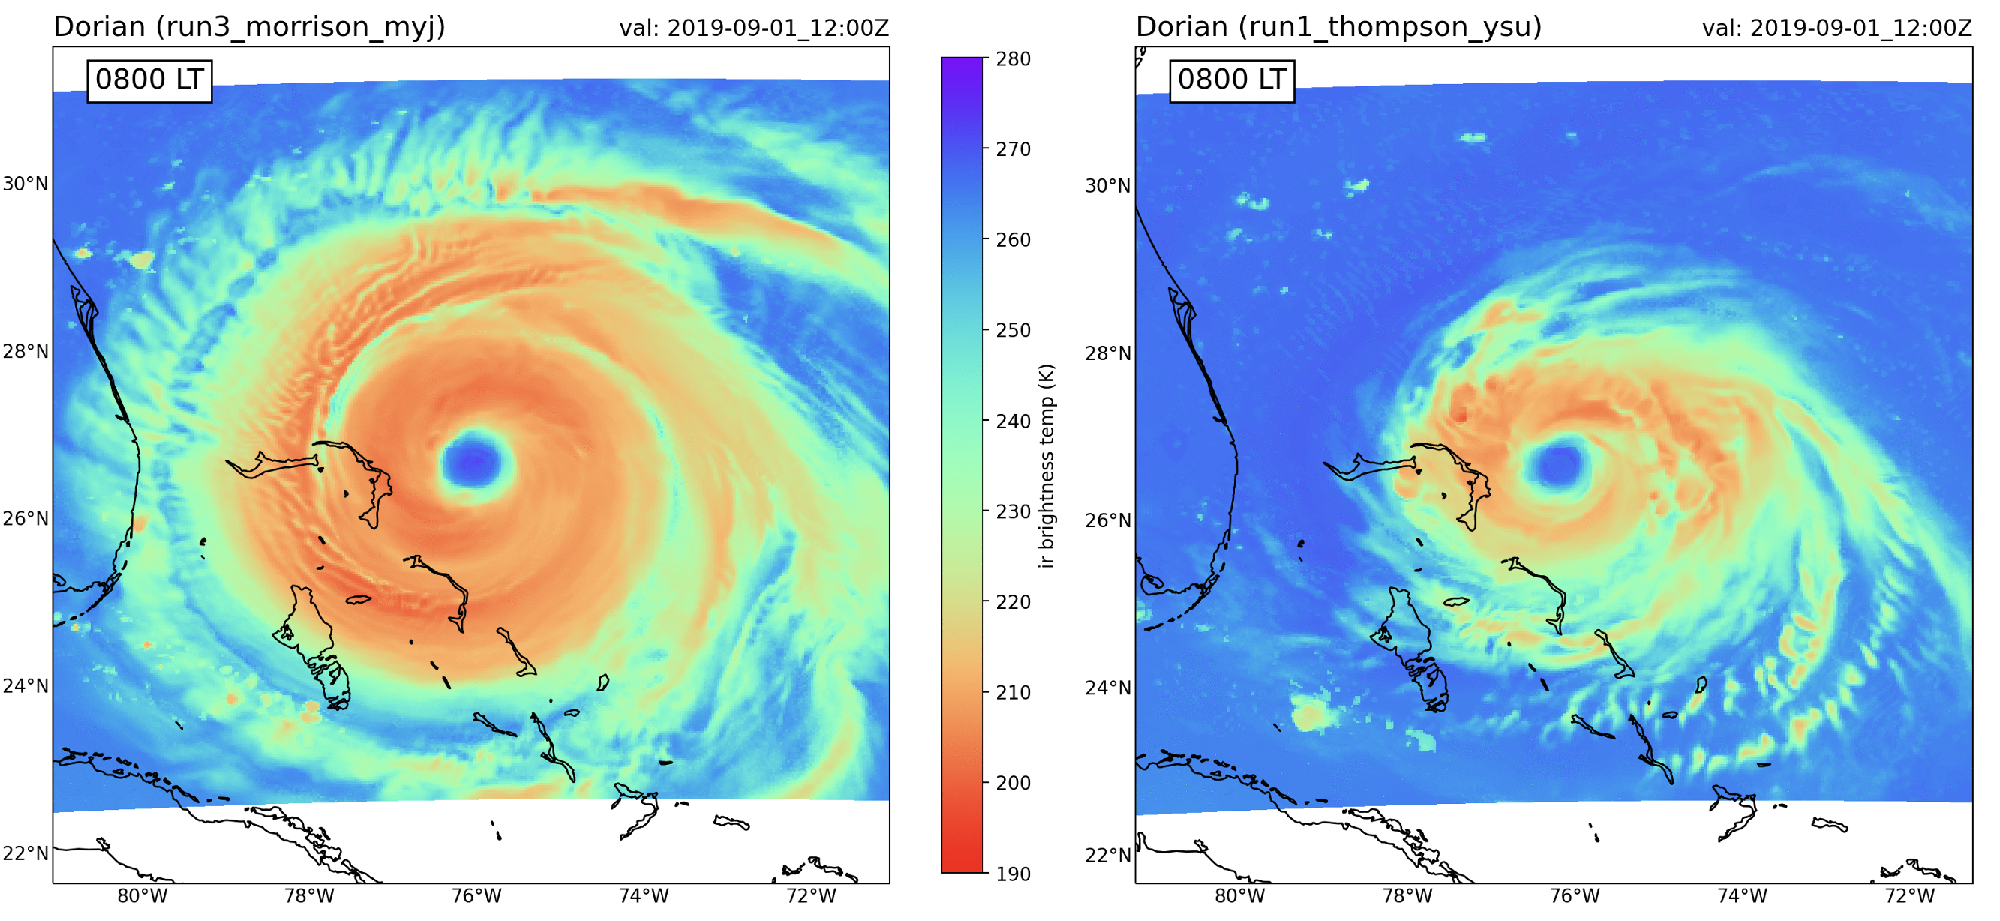
From a past NWP student final project
Two simulations of a TC that started with same initial condition
but differed with respect to microphysics
Is this a difference that can make a difference?

Slide 42
An example microphysical equation: accretion
Accretion (French: growth, increase, accumulation), related to accrue

Slide 43
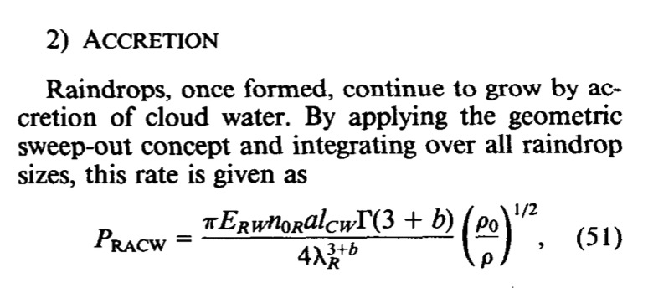
Collection equations
Microphysics consists of a large set of nasty-looking equations, many of them describing how particle A collects or accretes particle B.
This particular example is P_{RACW} (Production of Rain by ACcretion of cloud Water). Let’s derive it.
Lin et al. (1983)
Notes:
Some nomenclature changes

Slide 44
Accretion of cloud droplets by rain
Symbol changes…
A single raindrop of diameter D, falling relative to still air (and free-floating cloud droplets) at diameter-dependent velocity V_{D}, sweeps out a volume (with cloud water content ρq_{c}) based on its cross-sectional area (1/4)πD².
Upon colliding with a cloud droplet, the droplet may “stick”, depending on its collection efficiency ε_{D} that may or may not depend on diameter D.
The drop’s mass increase via accretion can be written as:
air density

Slide 45
Terminal velocity of a raindrop is diameter-dependent and can be written generically as
  In which a and b are suitably selected parameters
Integrate this expression over all raindrop sizes. For each size D, we have N_{D} drops. The result is P_{RACW}:
(see slide 37)
surface air density
[Assuming collection efficiency is constant, and not
diameter dependent]

Slide 46
Use the Gamma function trick again to solve for that nasty-looking integral
  Some minor nomenclature variations from paper to paper, but this is the basic idea
And we are done… with just one of potentially many, many terms (see next slide)
  Note that accretion rates are dependent on a large number of parameters. The assumptions and approximations really add up.
  Parameter settings and particle size distribution specifications are basically what makes a microphysics scheme unique
    …and since they control how much and how quickly precipitation forms, which determines where, when and how much latent heating and cooling occurs, they can have very large direct and indirect impacts on simulations
Notes:
And since they control how much and how quickly precip forms, which determines where, when and how much latent heating and cooling occurs, they can have very large direct and indirect impacts on simulations

Slide 47
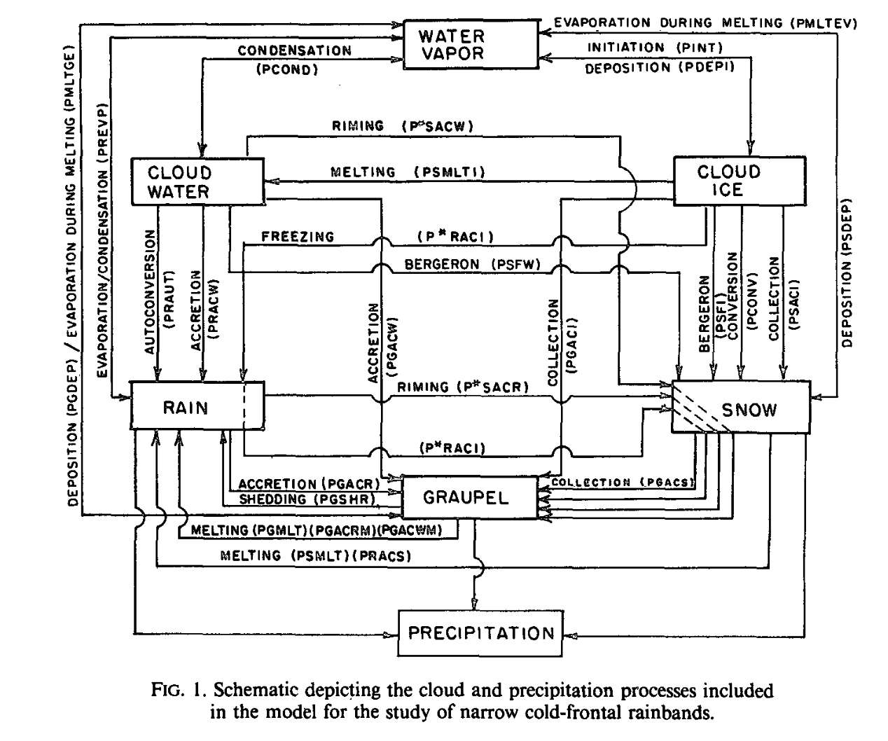
Rutledge and Hobbs (1984)
Notes:
As the number of species included increases, interactions can become much more complex.

Slide 48
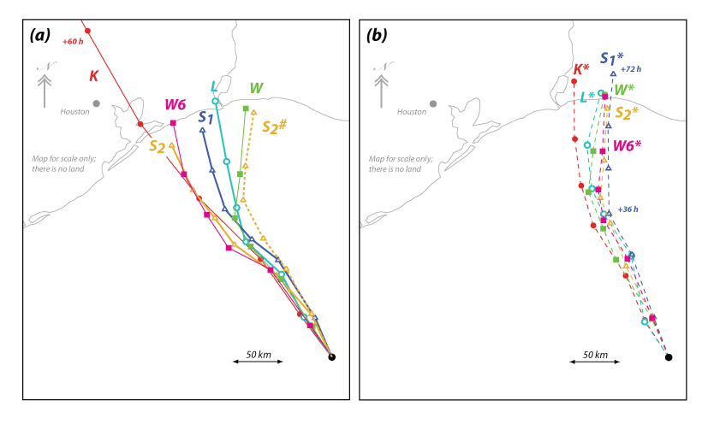
7 different microphysics schemes,
for idealized simulations starting
with same initial condition
The schemes generate different
amounts of various hydrometeor
species, with different fallspeeds
and accretion and evaporation rates
Primary (but not sole) impact of
microphysics was on storm width,
which influences motion due to
differential planetary vorticity advection
Hurricane tracks from 7 different microphysics schemes.
3-day simulations using WRF.
Fovell et al. (2016)

Slide 49
Hydrometeors influence radiation
Hydrometeors do NOT influence radiation
But microphysics only mattered because it modulated radiation.
More smaller particles == more cloud-radiative forcing (icloud in namelist.input).
The cloud-radiative forcing induced changes in storm size and track and speed
Fovell et al. (2016)

Slide 50
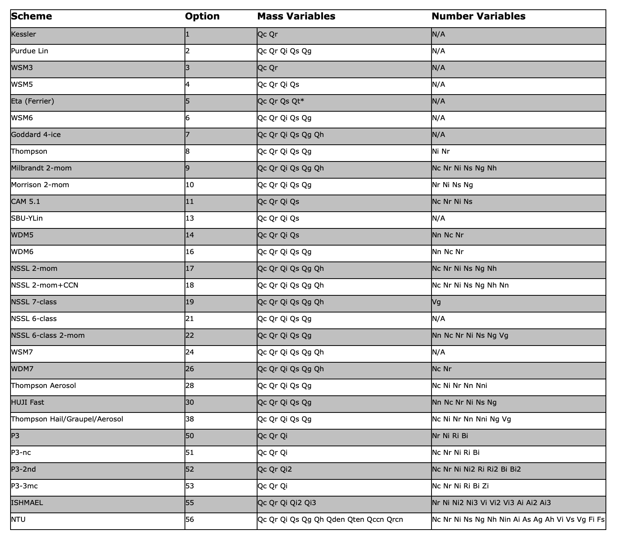
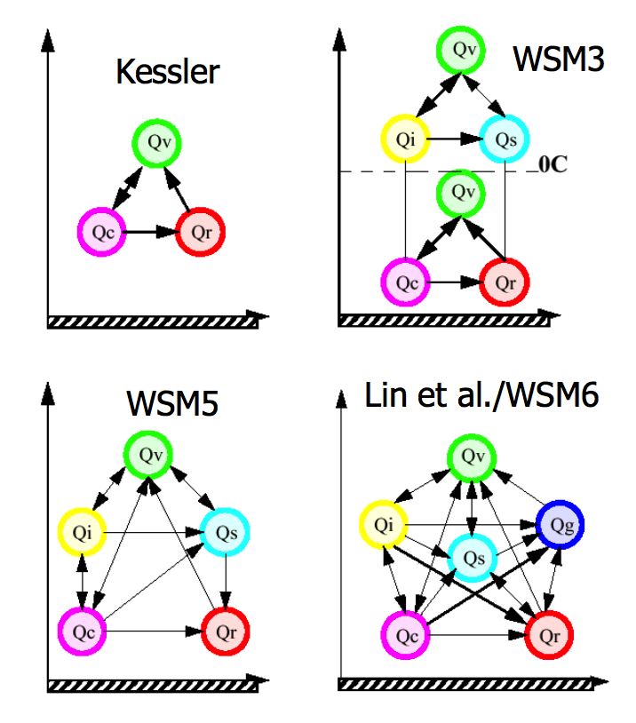
Schemes 1, 3, 5, 11, 13 do not produce radar reflectivity field
Microphysics schemes
in WRF
WSM7
Dudhia WRF tutorial presentation

Slide 51
[end]

