Slide 1
Cloud microphysics:
Squall line structure and in-class demo results
ATM 419/563
Fall 2024
Fovell
© Copyright 2024 Robert Fovell, Univ. at Albany, SUNY, rfovell@albany.edu

Slide 2
Definition of “squall line”
Glossary of Meteorology (2000):
“[A] line of active thunderstorms, either continuous or with breaks, including contiguous precipitation areas resulting from the existence of thunderstorms.”

Slide 3
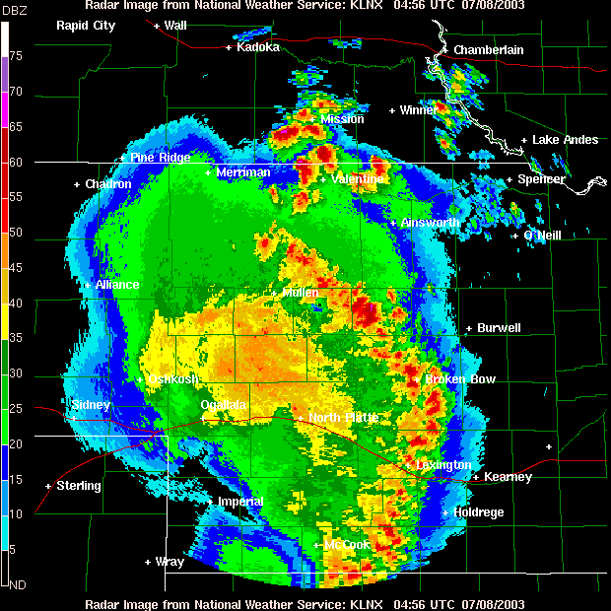
8 July 2003, Lincoln, NE
Notes:
08jul03-KLNX-multicell.GIF

Slide 4
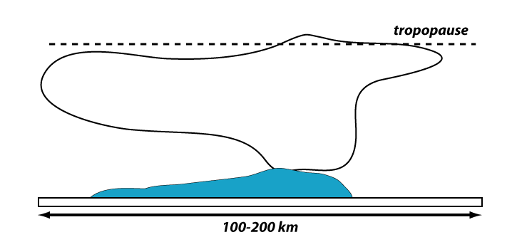
Squall line vertical x-section

Slide 5
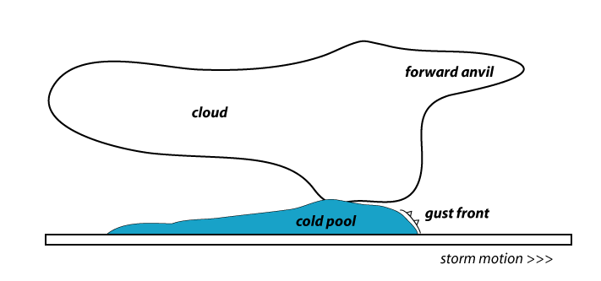
Squall line vertical x-section

Slide 6
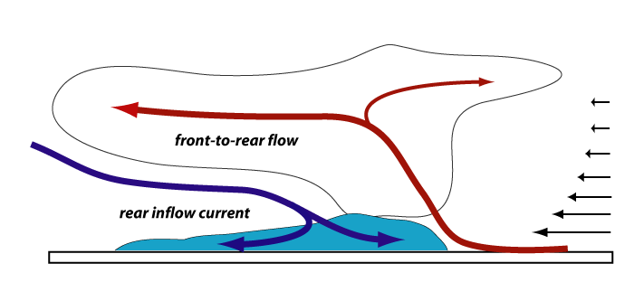
Squall line vertical x-section
Storm-relative flow in storm and far-field;
note vertical shear and upshear tilt

Slide 7
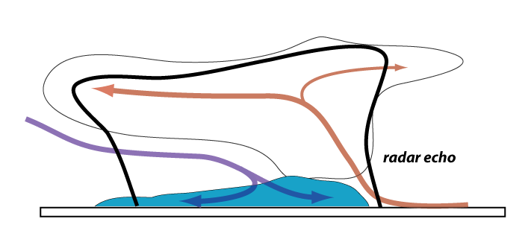
Squall line vertical x-section
Radar echo envelope

Slide 8
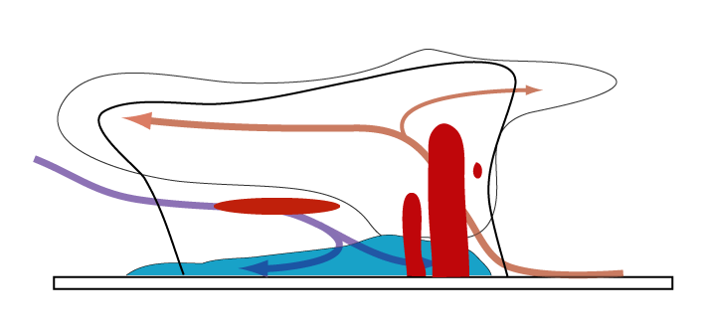
Squall line vertical x-section
Principal echo features, including “bright band”.
Implied multicellularity

Slide 9
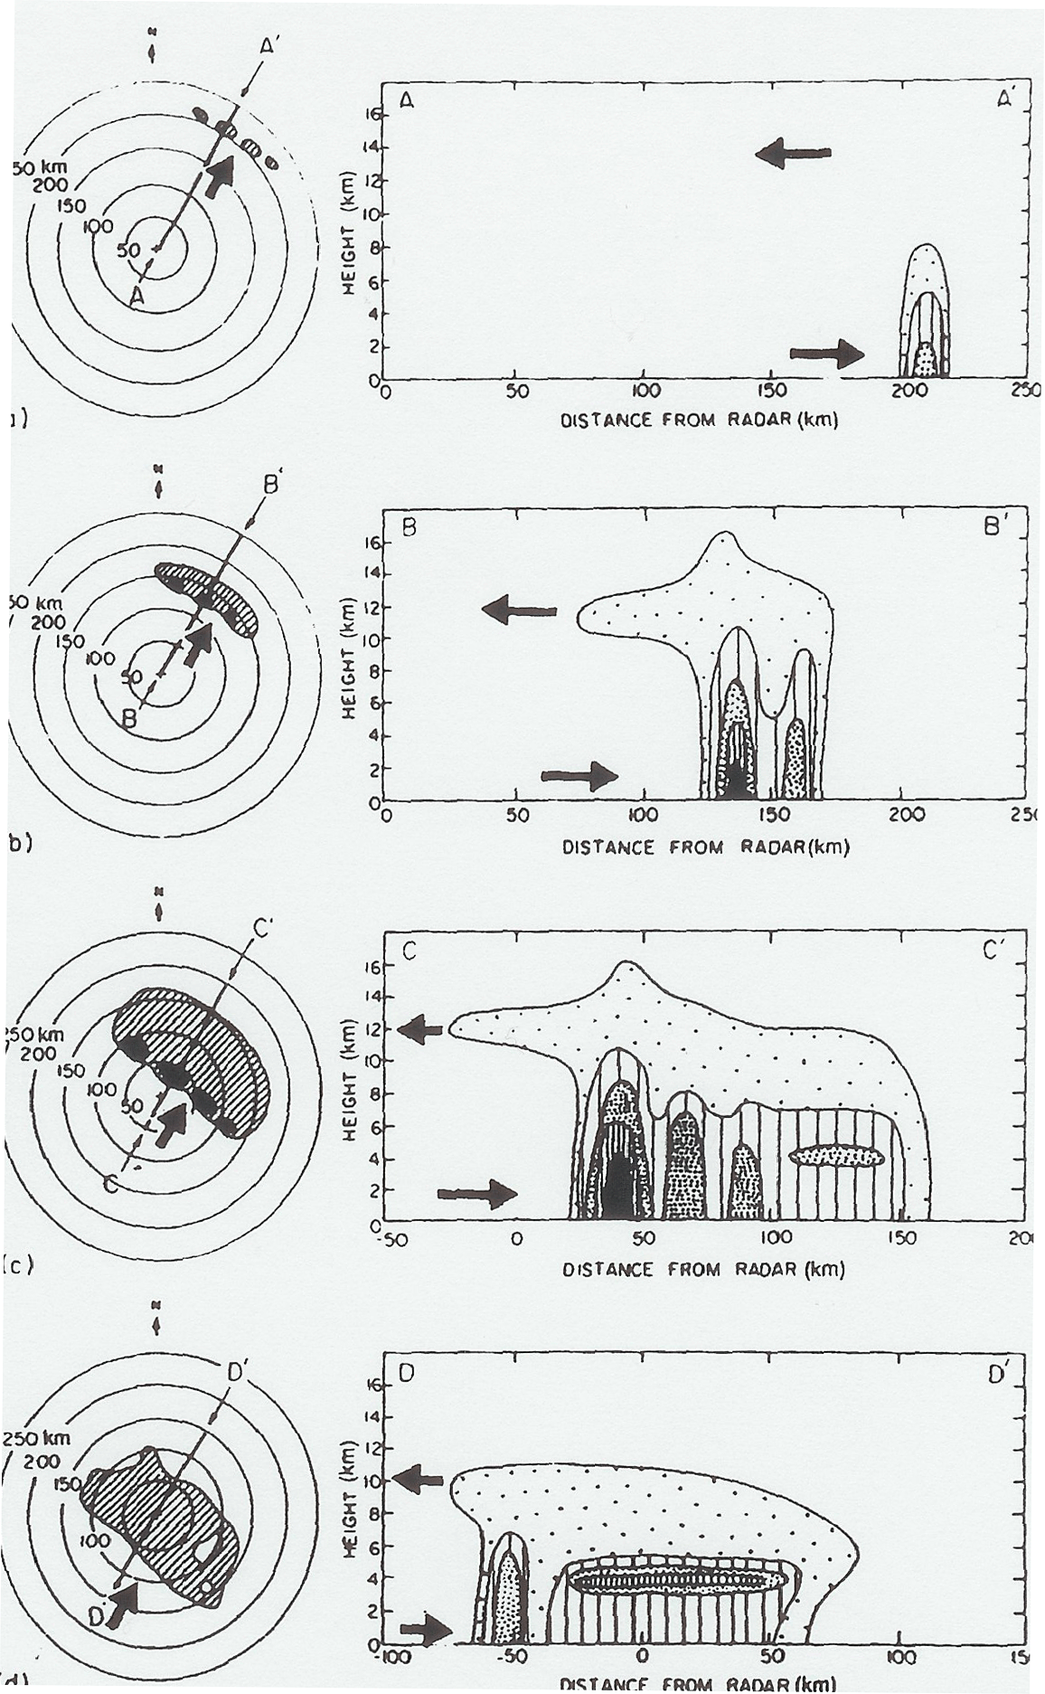
Life cycle of a tropical
squall line
(reversed for midlatitudes)
Leary and Houze (1979)
Notes:
Just looked at maturity up to now

Slide 10
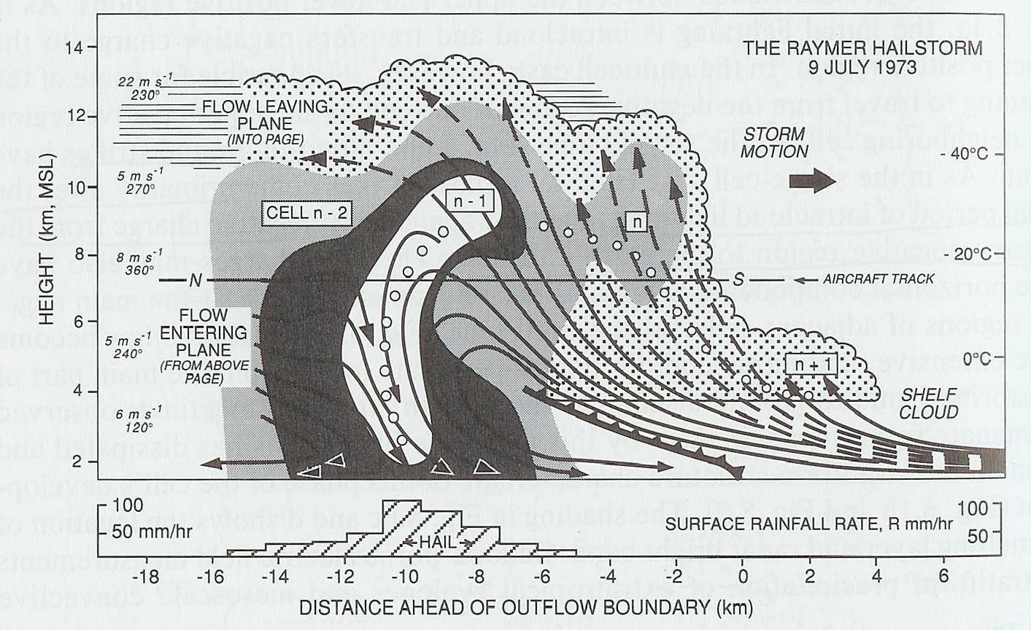
The multicell storm
Four cells at a single time
Or a single cell at four times
Browning et al. (1976)
Notes:
Also show multiple cells in conceptual model

Slide 11
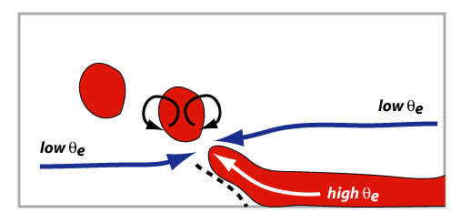
The multicell storm
Unsteadiness represents
episodic entrainment owing
to local buoyancy-induced
circulations.
Browning et al. (1976)
Fovell and Tan (1998)
Notes:
Also show multiple cells in conceptual model

Slide 12
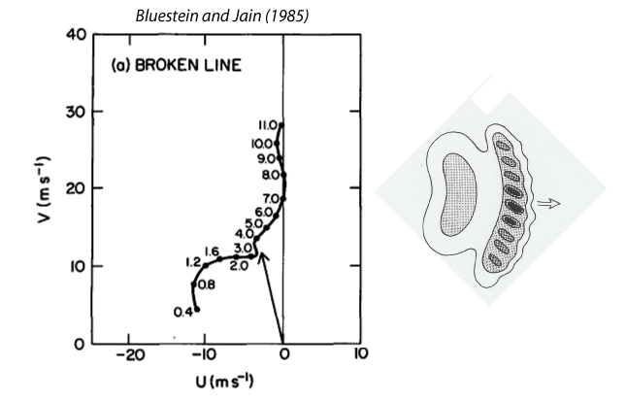
The severe squall line environment
“nothing succeeds like success”
Heights
km MSL
0.4 km is surface
in Oklahoma
From 10 years of severe spring Oklahoma storms
Bluestein and Jain (1985)

Slide 13
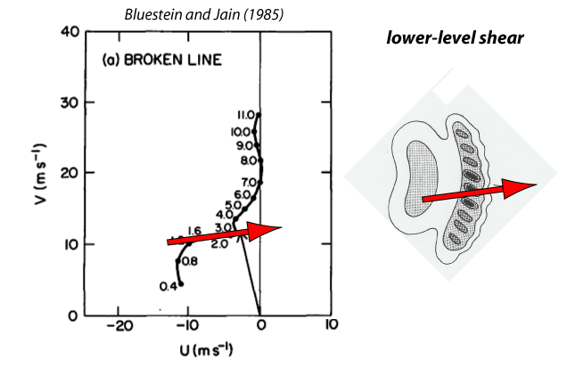
The severe squall line environment
“nothing succeeds like success”
(across-line)
Bluestein and Jain (1985)

Slide 14
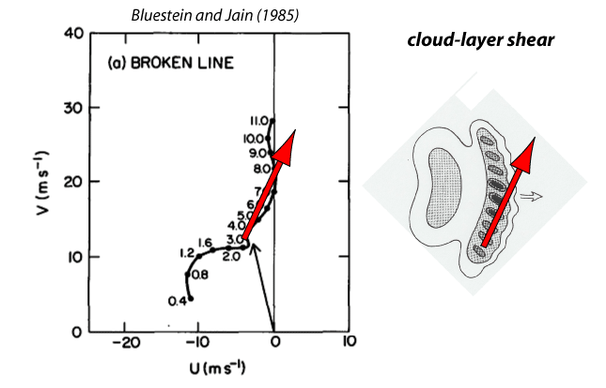
The severe squall line environment
“nothing succeeds like success”
(along-line)
Ground and storm
relative winds
Bluestein and Jain (1985)

Slide 15
WRF 2D idealized squall line experiment
Control run: mp_physics=2
(Purdue Lin scheme)

Slide 16
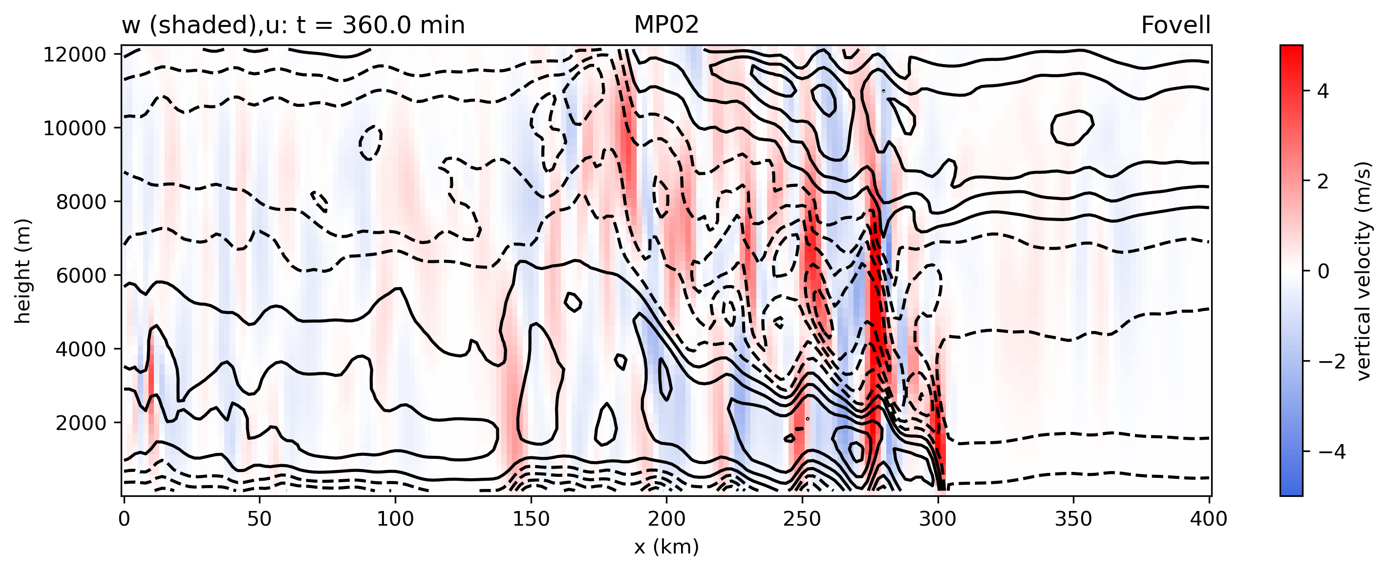
w and u
Fovell et al. (2006):
waves trapped beneath
forward anvil

Slide 17
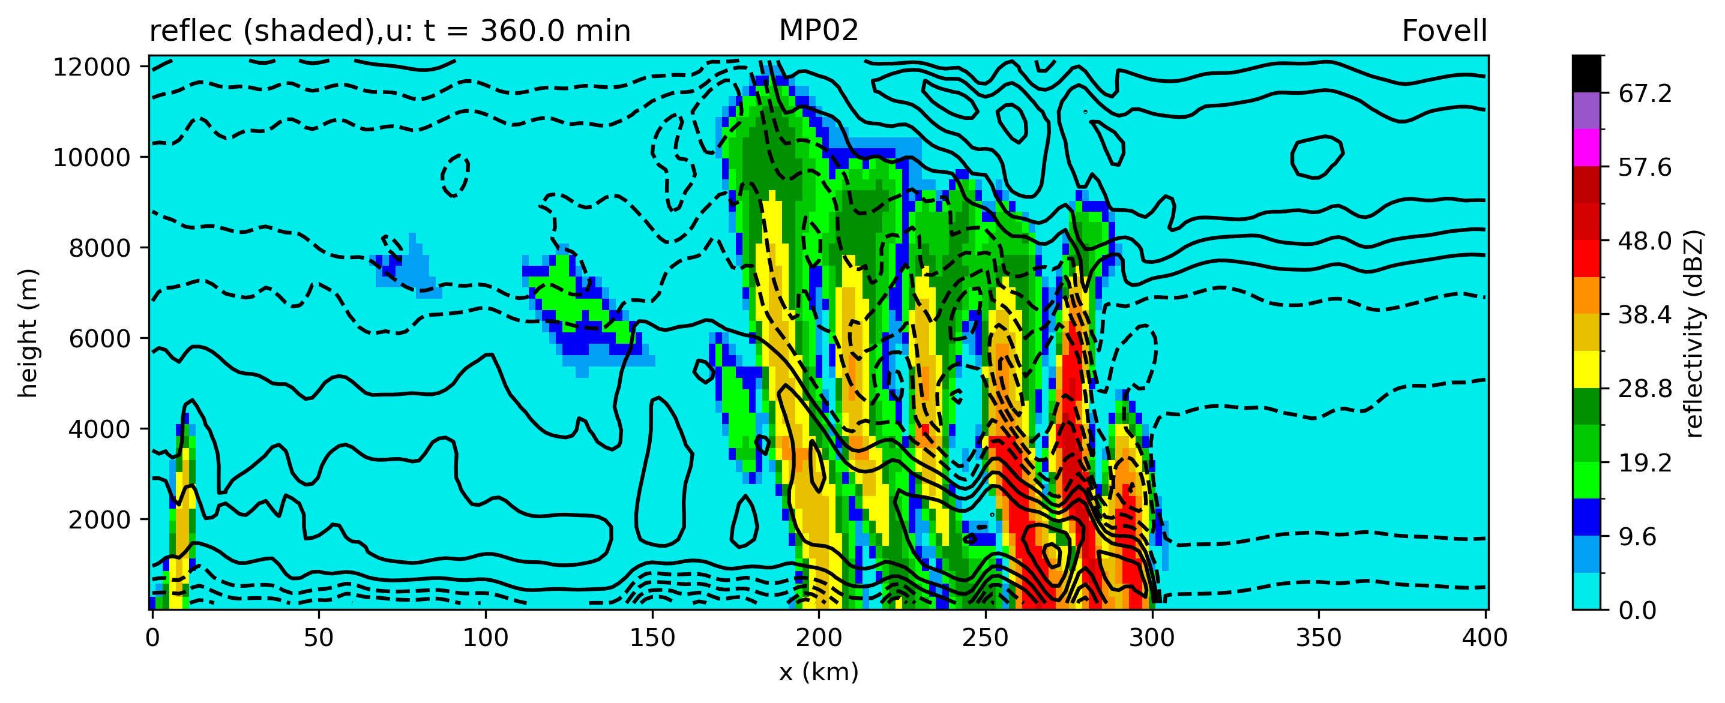
reflectivity and u
Not much of a prominent
bright band in stratiform region.
- too early in storm’s evolution?
- microphysics problem?
- reflectivity calculation issue?

Slide 18
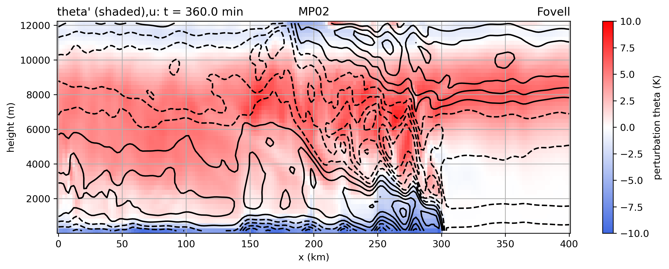
θ’ and u
How much of this warming is due to
latent heating and its advection,
and how much due to subsidence?

Slide 19
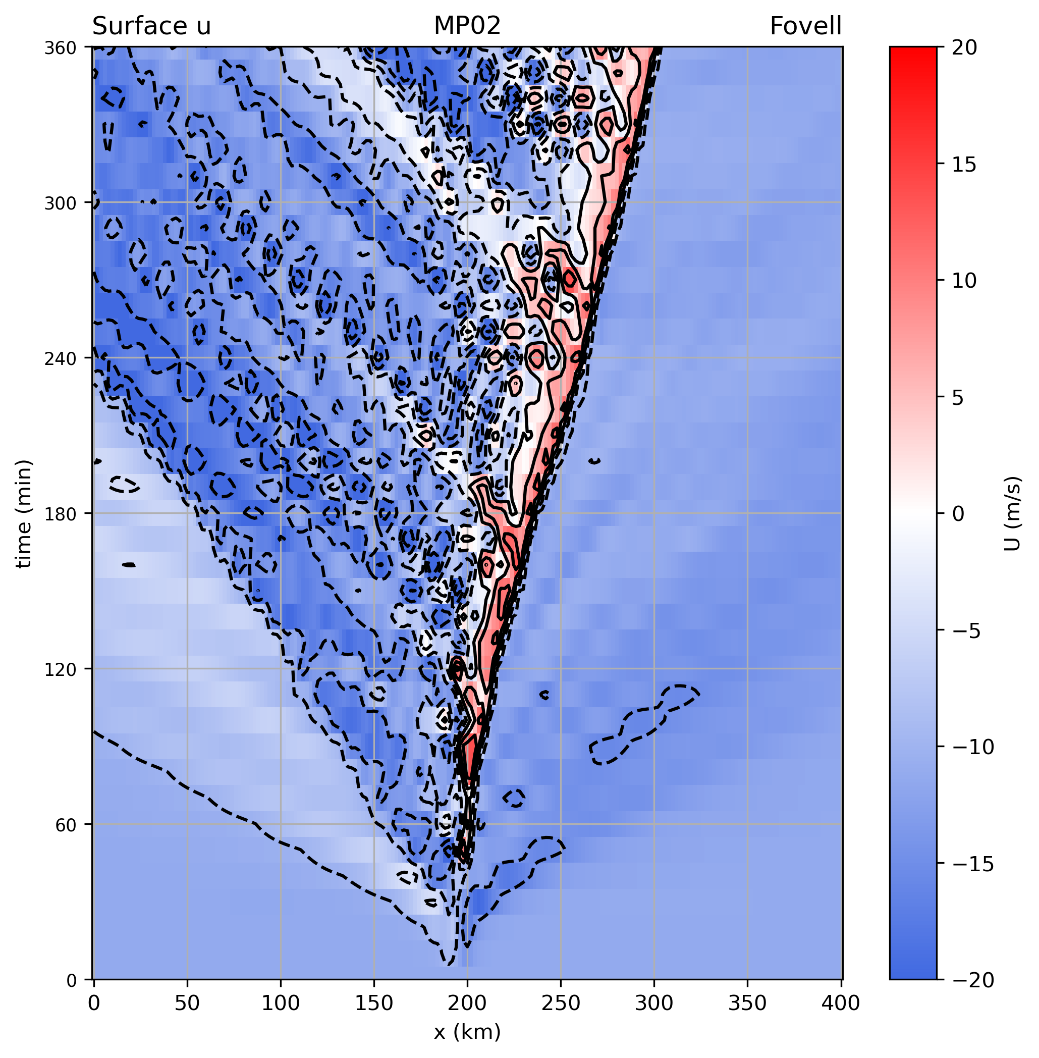
gravity waves

Slide 20
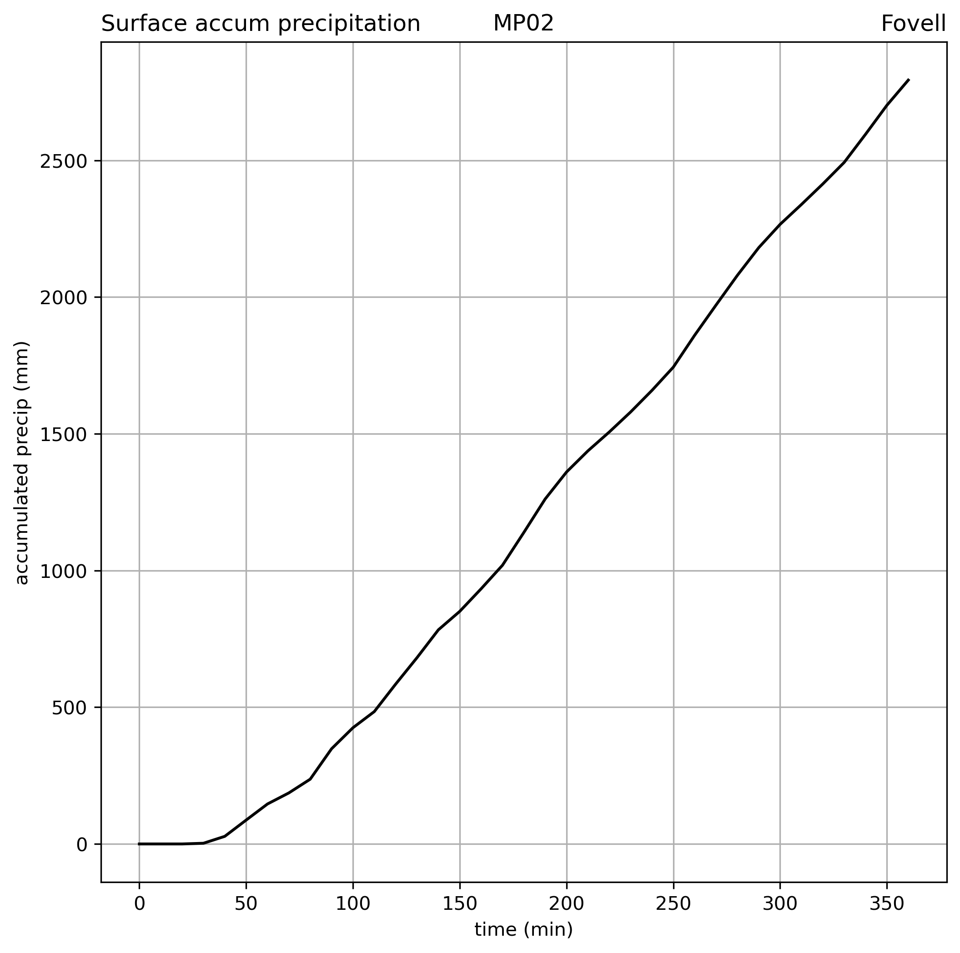
MAXIMUM NEAR-SURFACE WIND SPEED (m/s) 13.719600677490234
TOTAL SIMULATED PRECIPITATION (mm) 2793.663

Slide 21
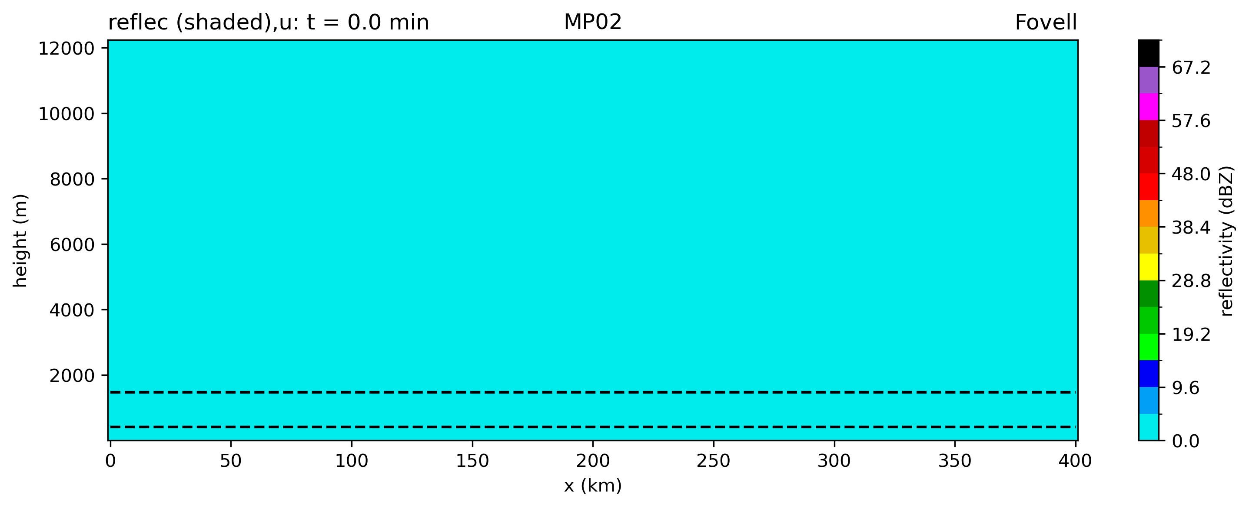
Animation of reflectivity
convert -delay 30 -loop 0 movie*png OUT.GIF
[this command is executed in the notebook’s last cell]
Notes:
Large reflectivity values appear rather quickly

Slide 22
Class ensemble
Good news: all the runs are squall lines
Bad news: there’s a lot of potentially important differences/variations

Slide 23
Control run
Deep, strong cold pool → fast propagation
vigorous lifting at gust front, strong front-to-rear flow

Slide 24
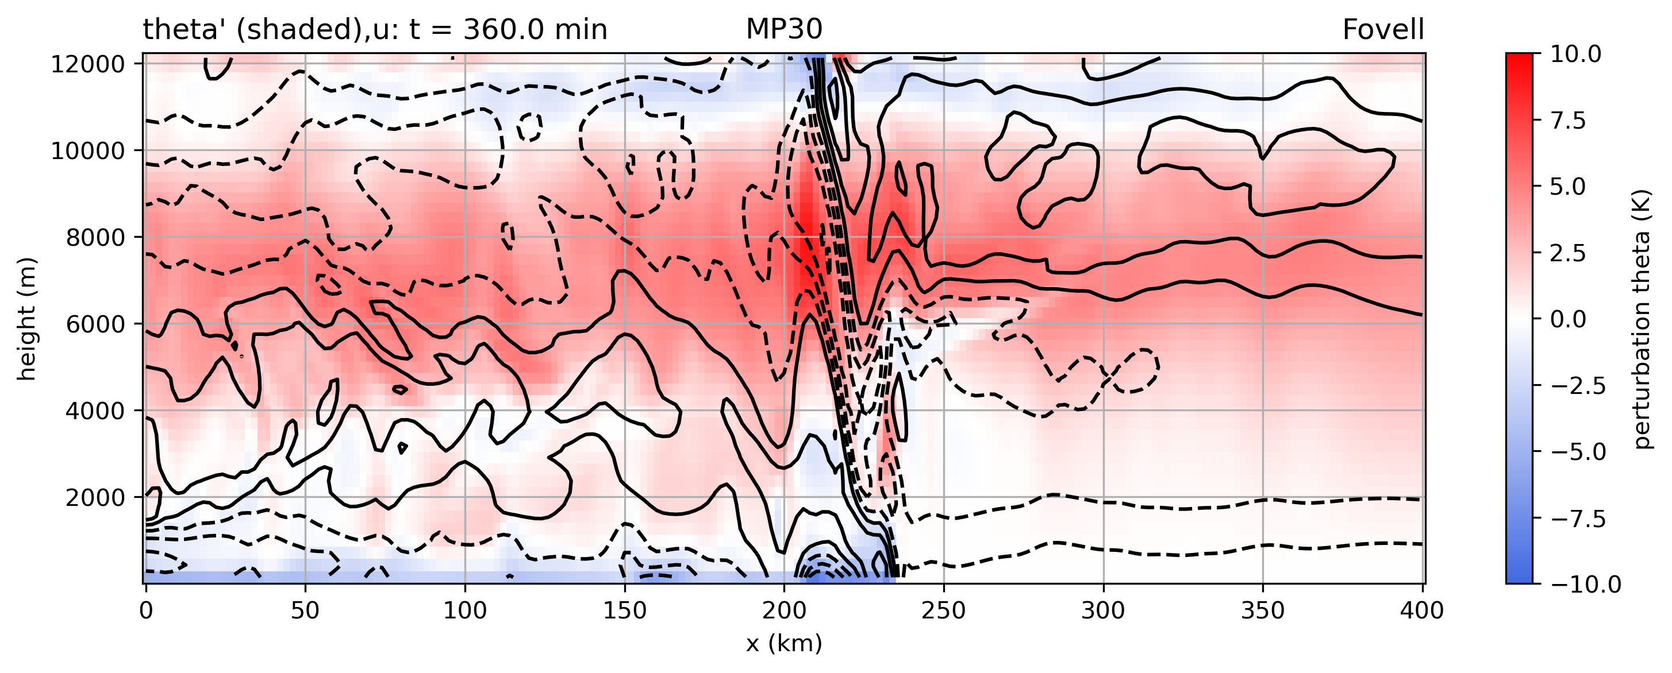
The very expensive bin scheme
Simulation took 40x more time to run
Much weaker, shallower cold pool → slower propagation
Slower to develop (did the bulk scheme produce rain too quickly?)
Is this the “right” or “best” answer?

Slide 25
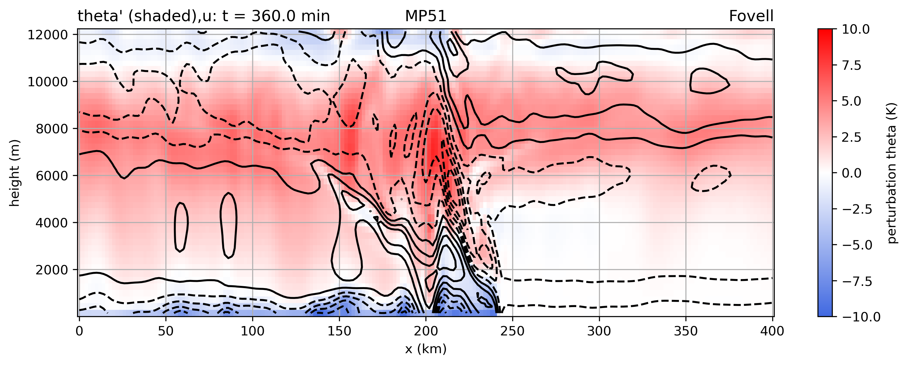
Slowest moving and/or slowest developing bulk scheme member
Also fairly weak cold pool
Most like the very expensive bin scheme?

Slide 26
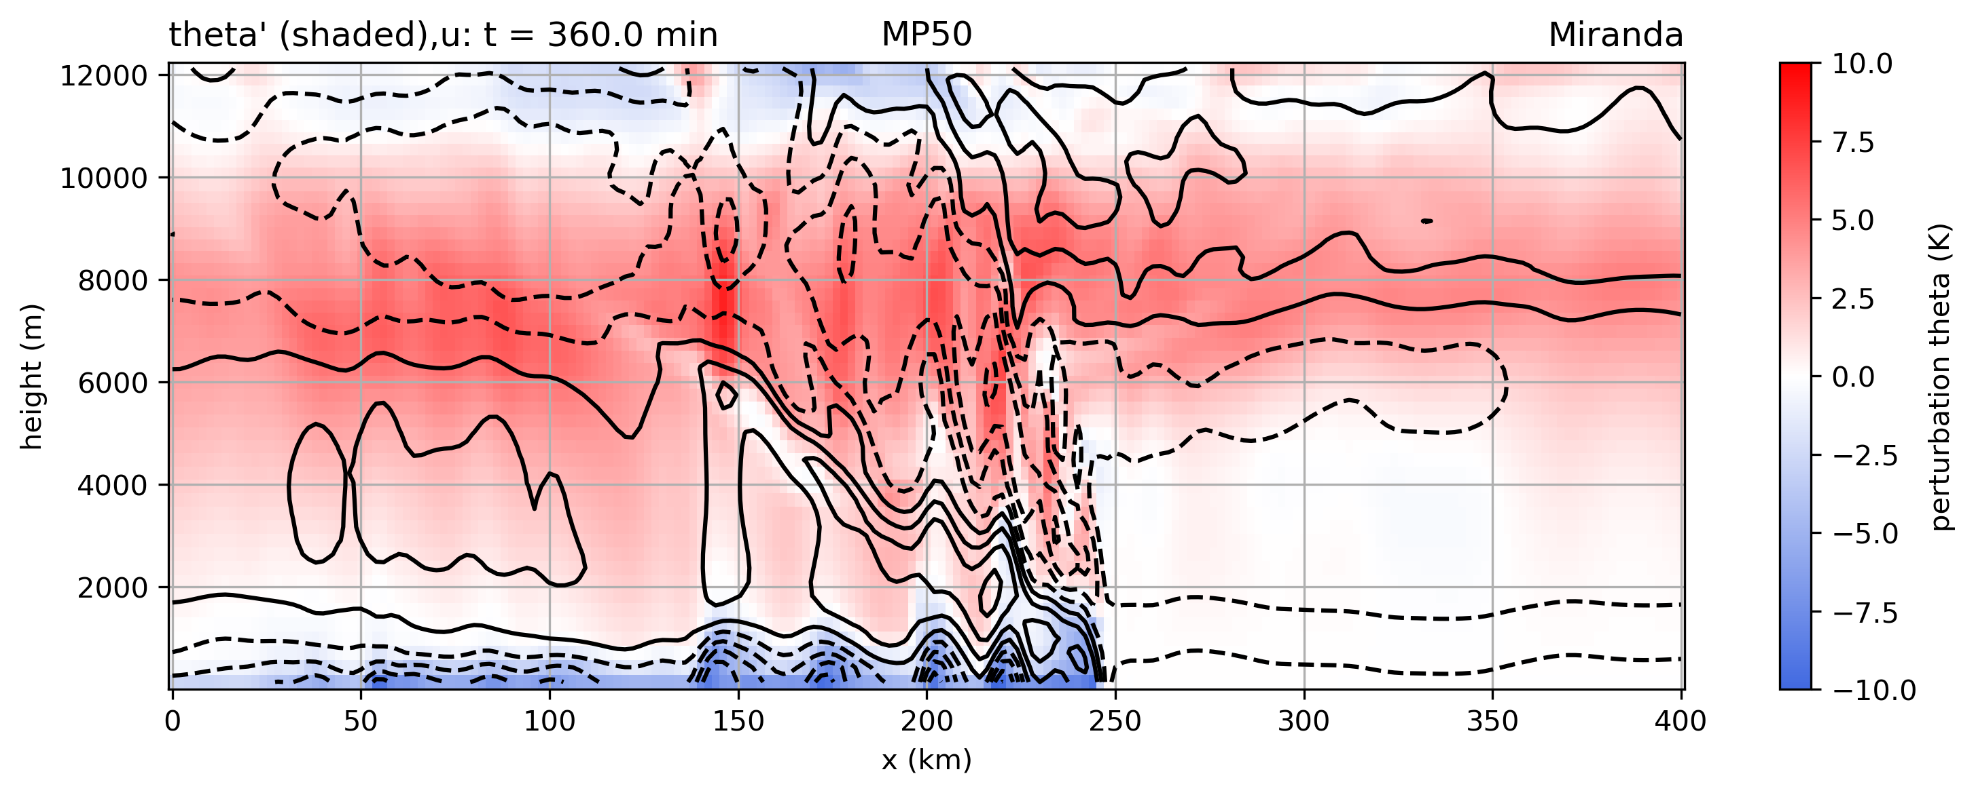
Another slowly moving member
Also fairly weak cold pool
Most like the very expensive bin scheme?

Slide 27
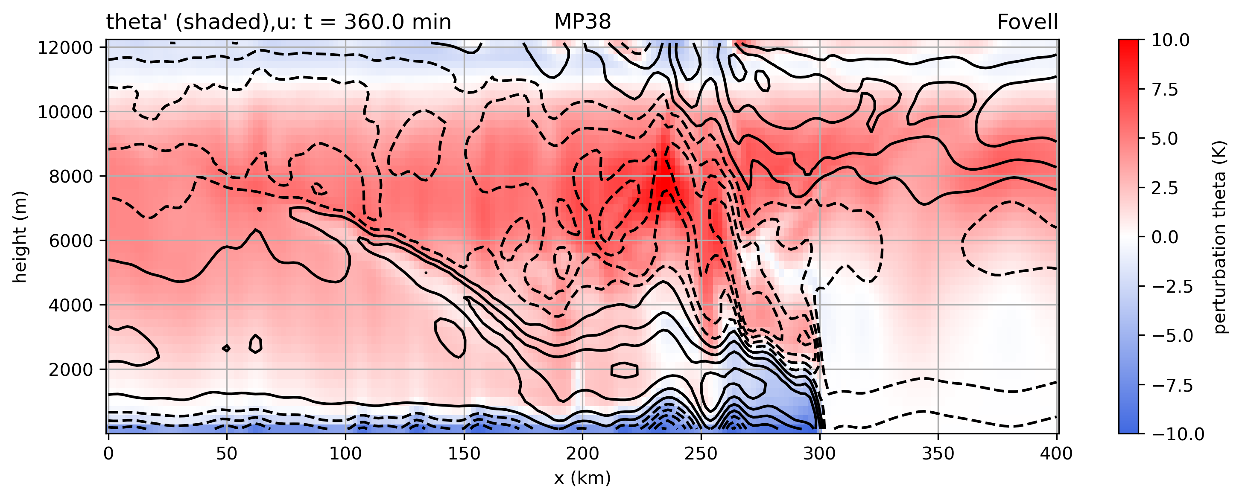
Fastest moving and/or developing member
Tied with control run for fastest moving squall line
Really well-defined rear inflow current

Slide 28
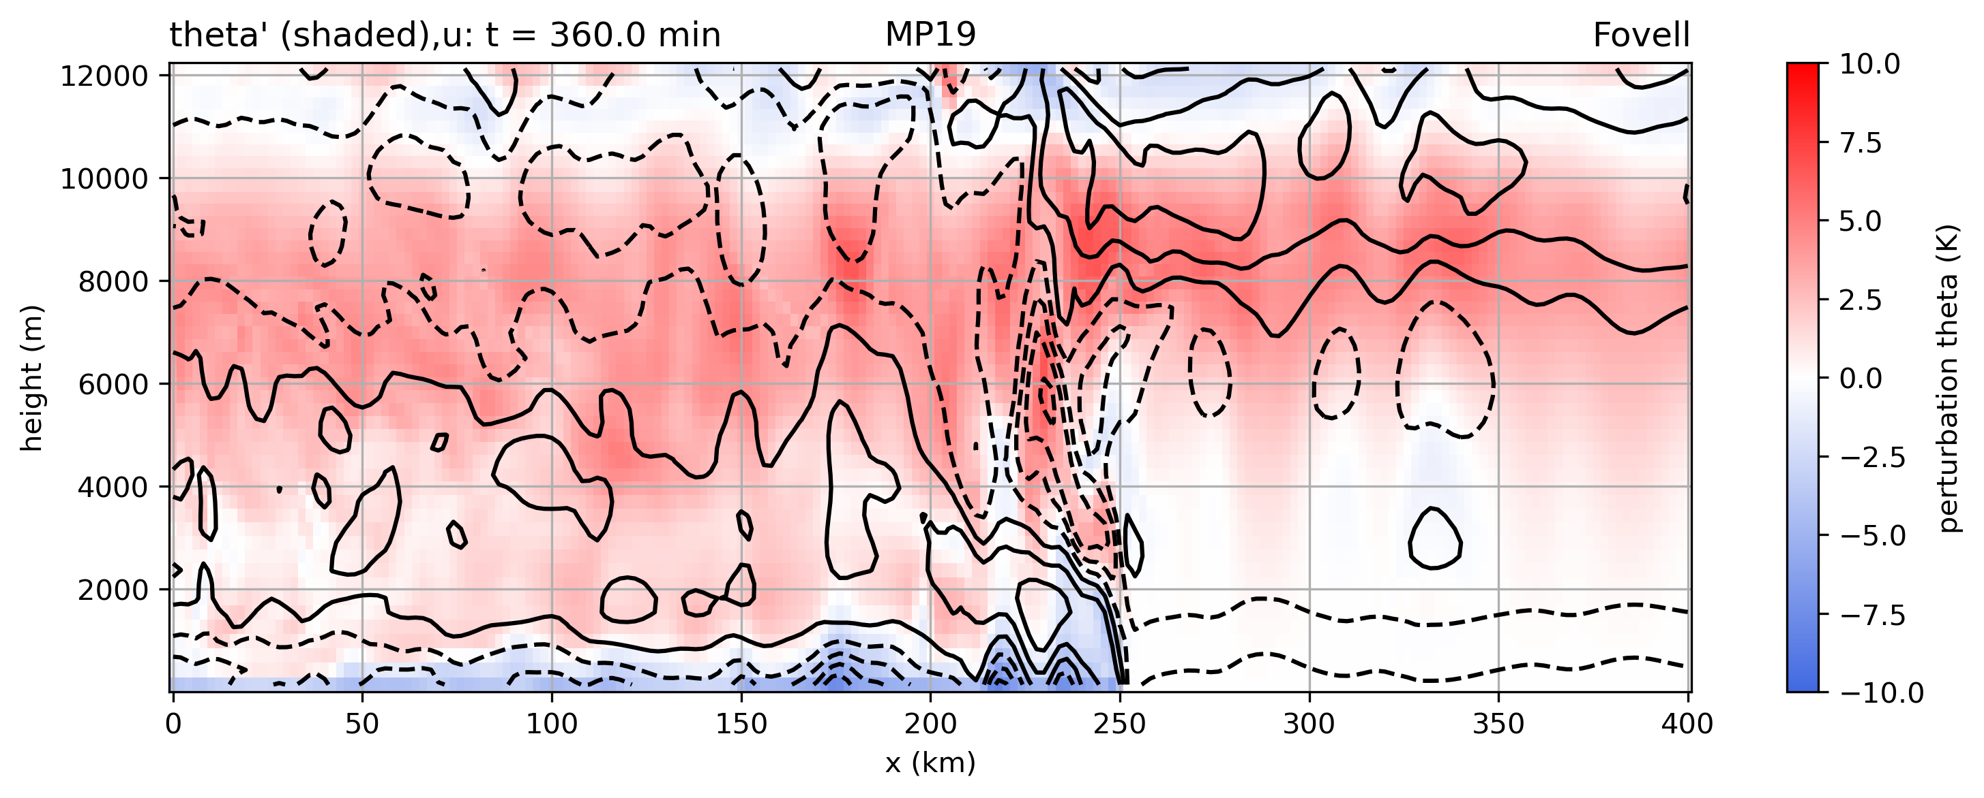
Evidence of trapped waves on forward side

Slide 29
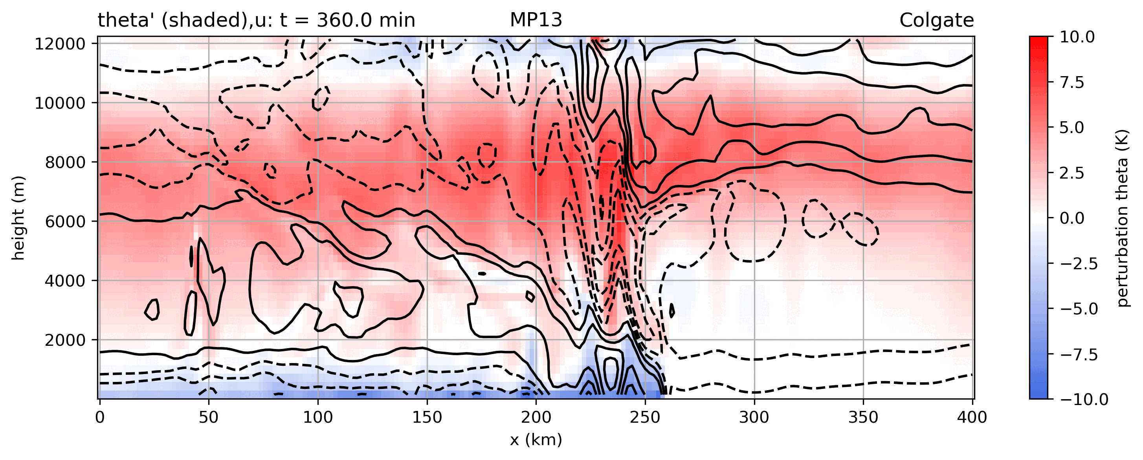
Animation
Notes:
43%

Slide 30
22 MP simulations ranked
bin
bin
Both max wind and total accumulated precip
vary by about 100%

Slide 31
Control run
Purdue-Lin
Notes:
Organizes quickly, propagates quickly, quickly develops strong westerly surface winds behind gust front

Slide 32
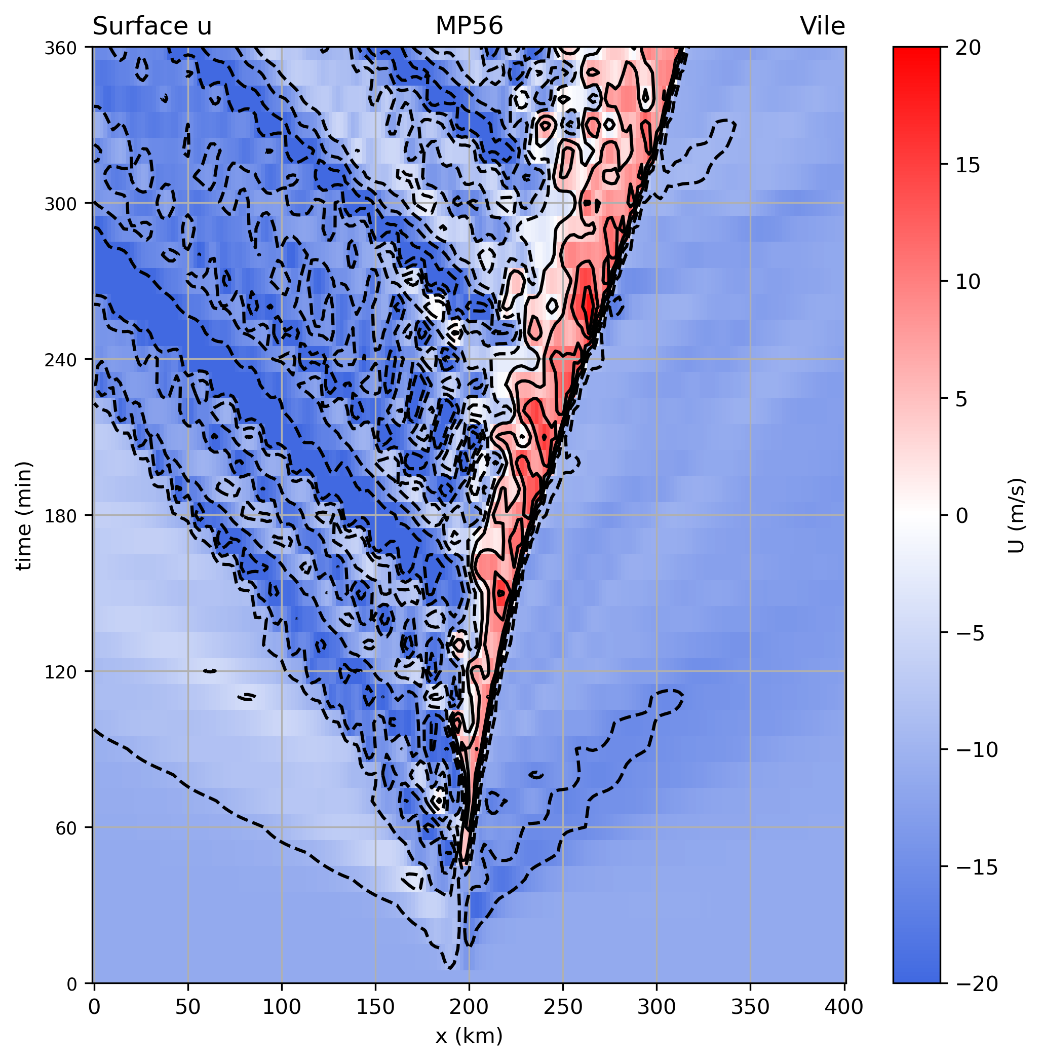
NTU

Slide 33
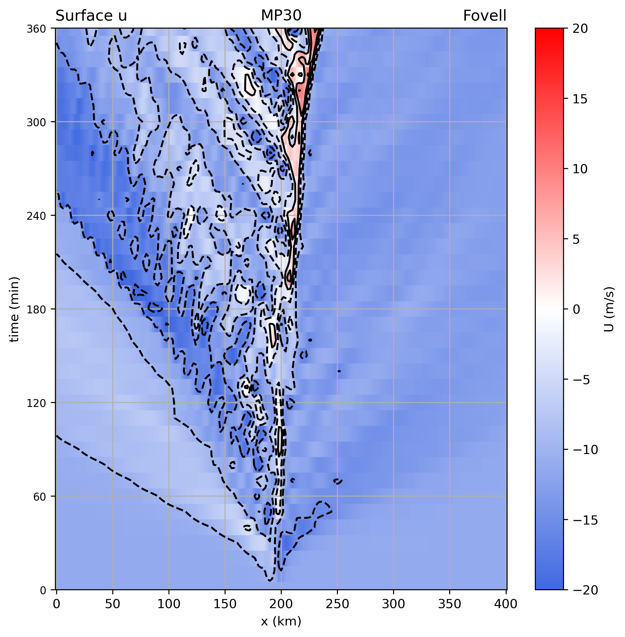
Bin scheme

Slide 34
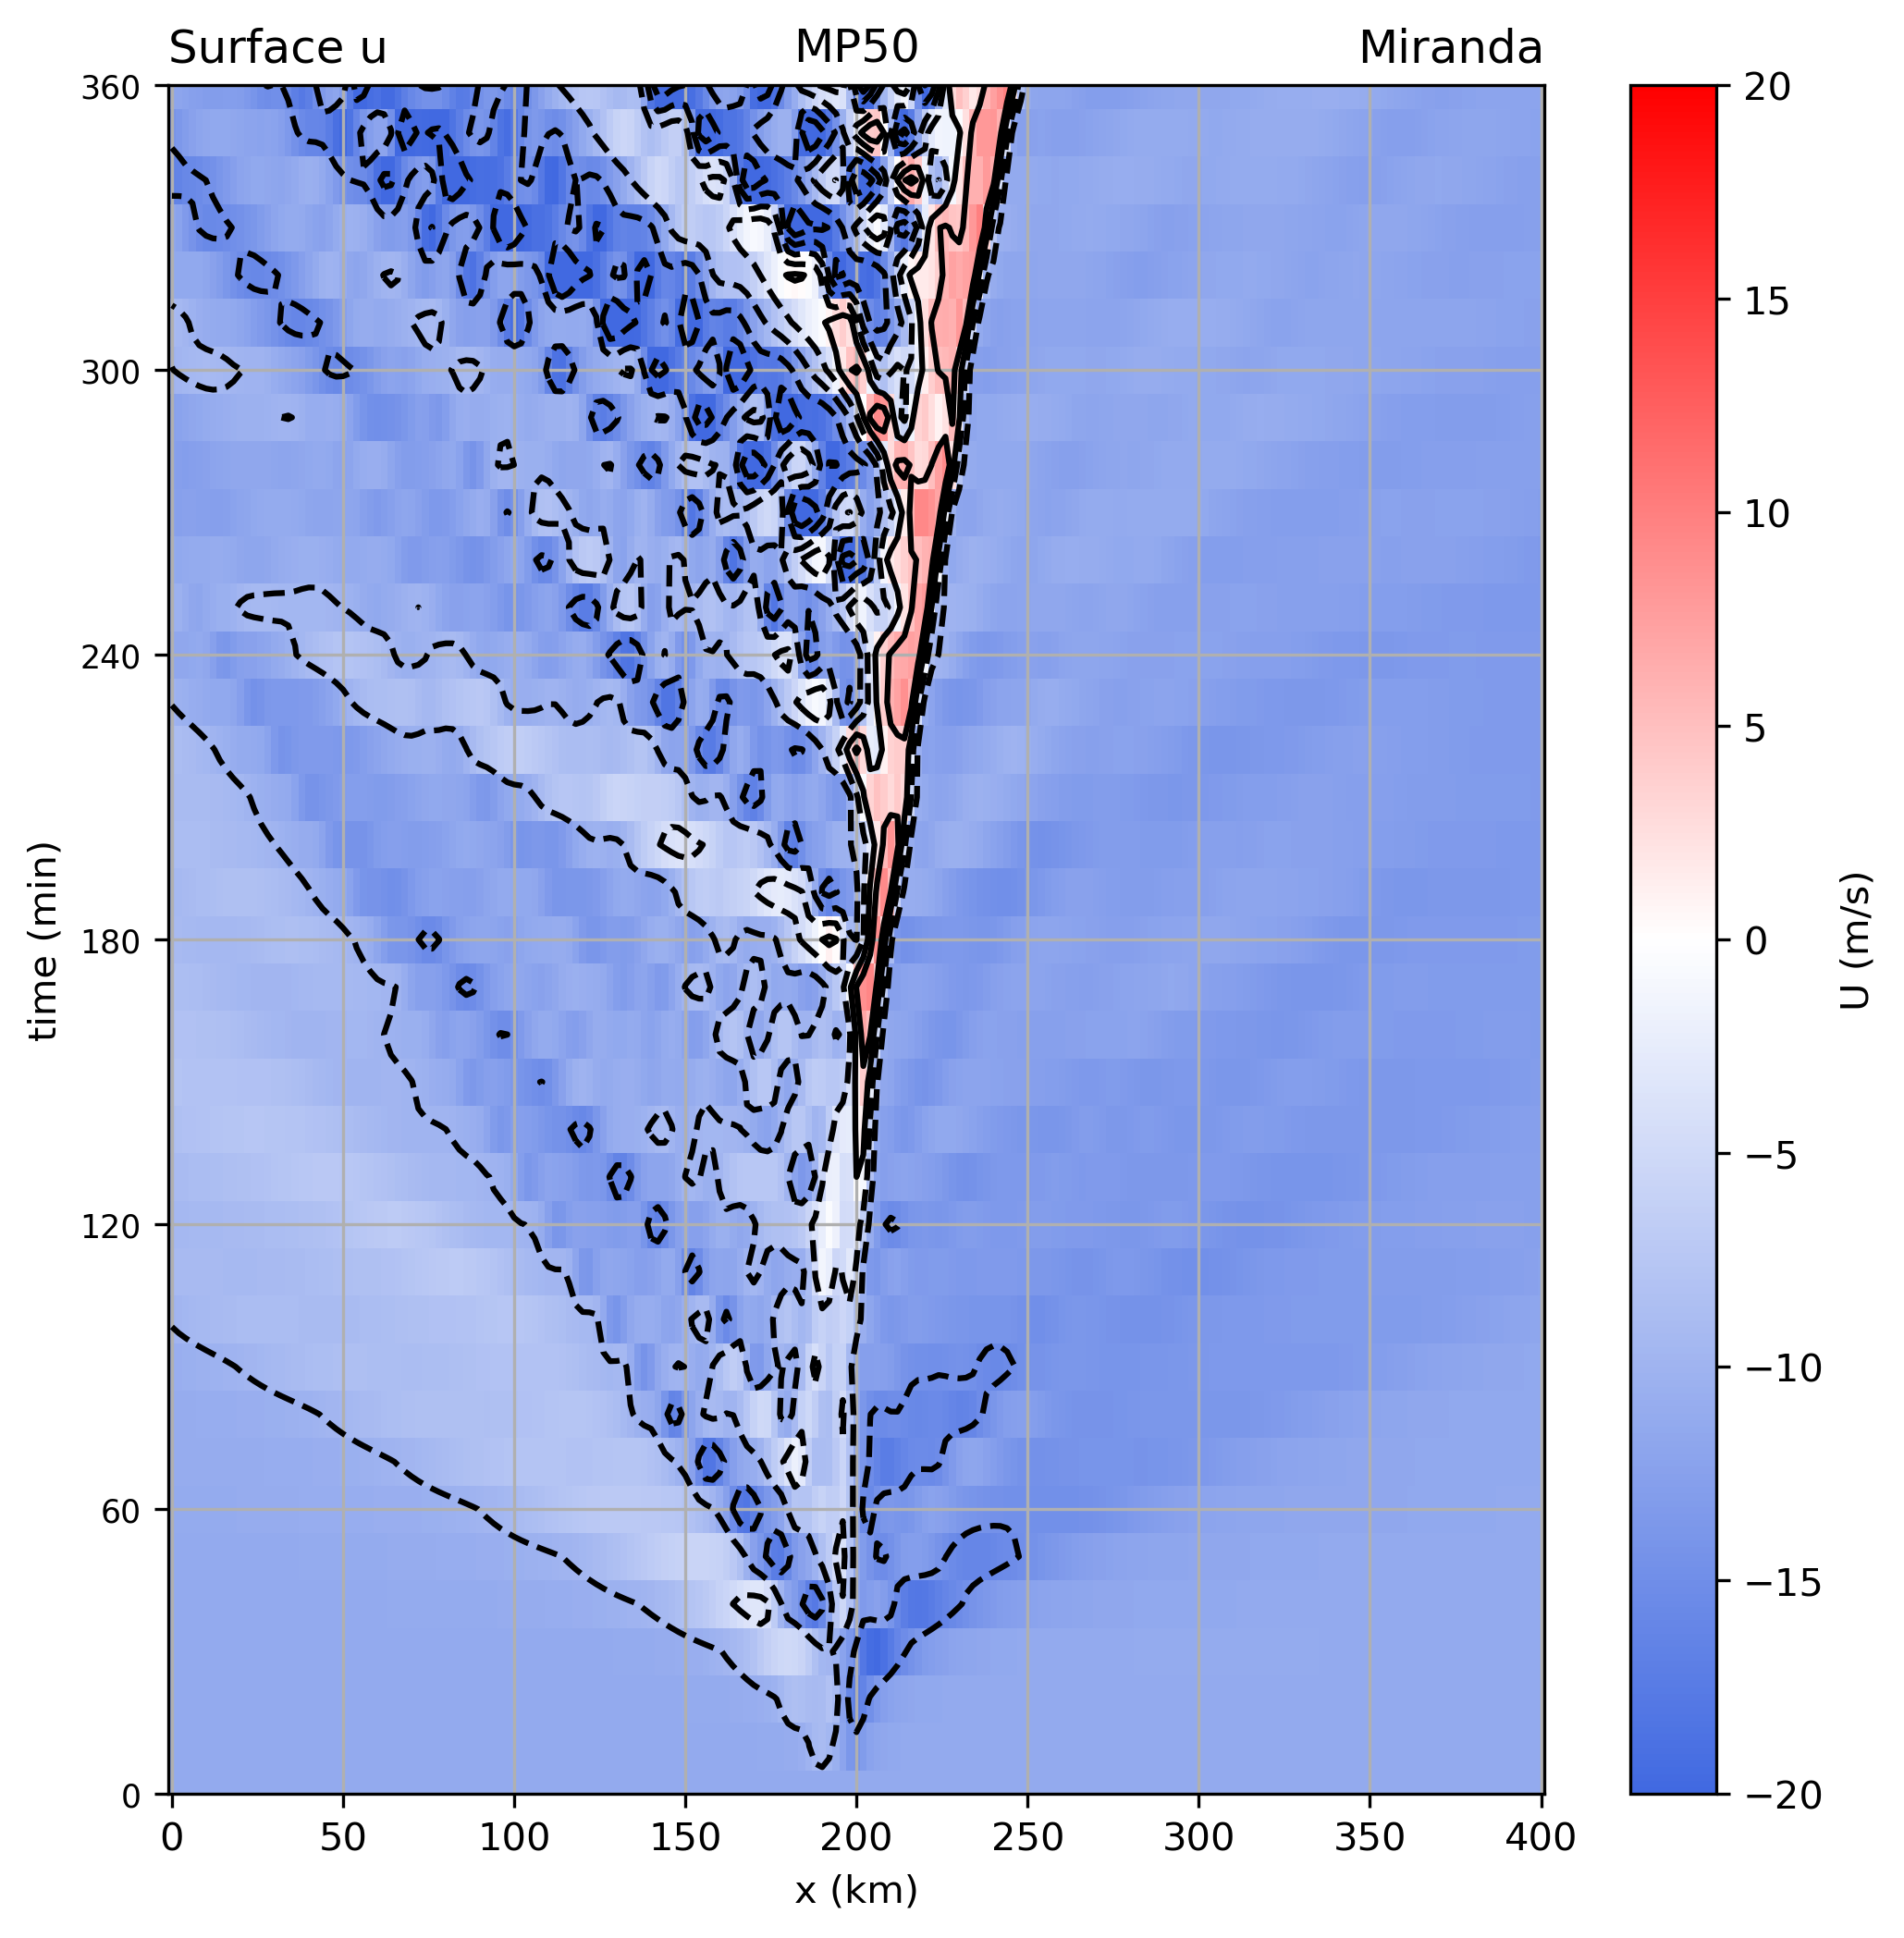
P3

Slide 35
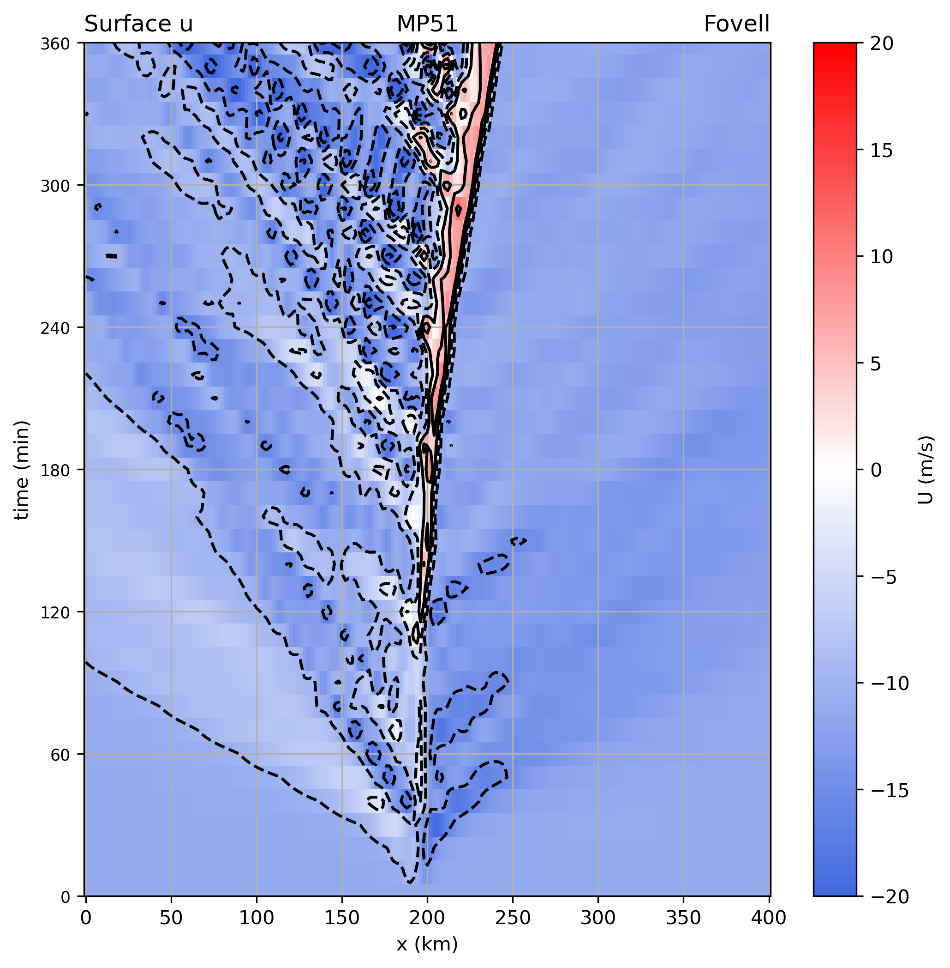
P3-nc

Slide 36
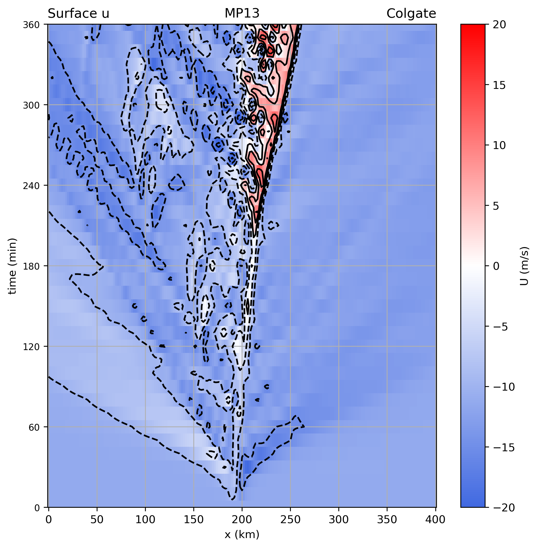
Stony Brook (SBU)
Notes:
Hard time organizing

Slide 37
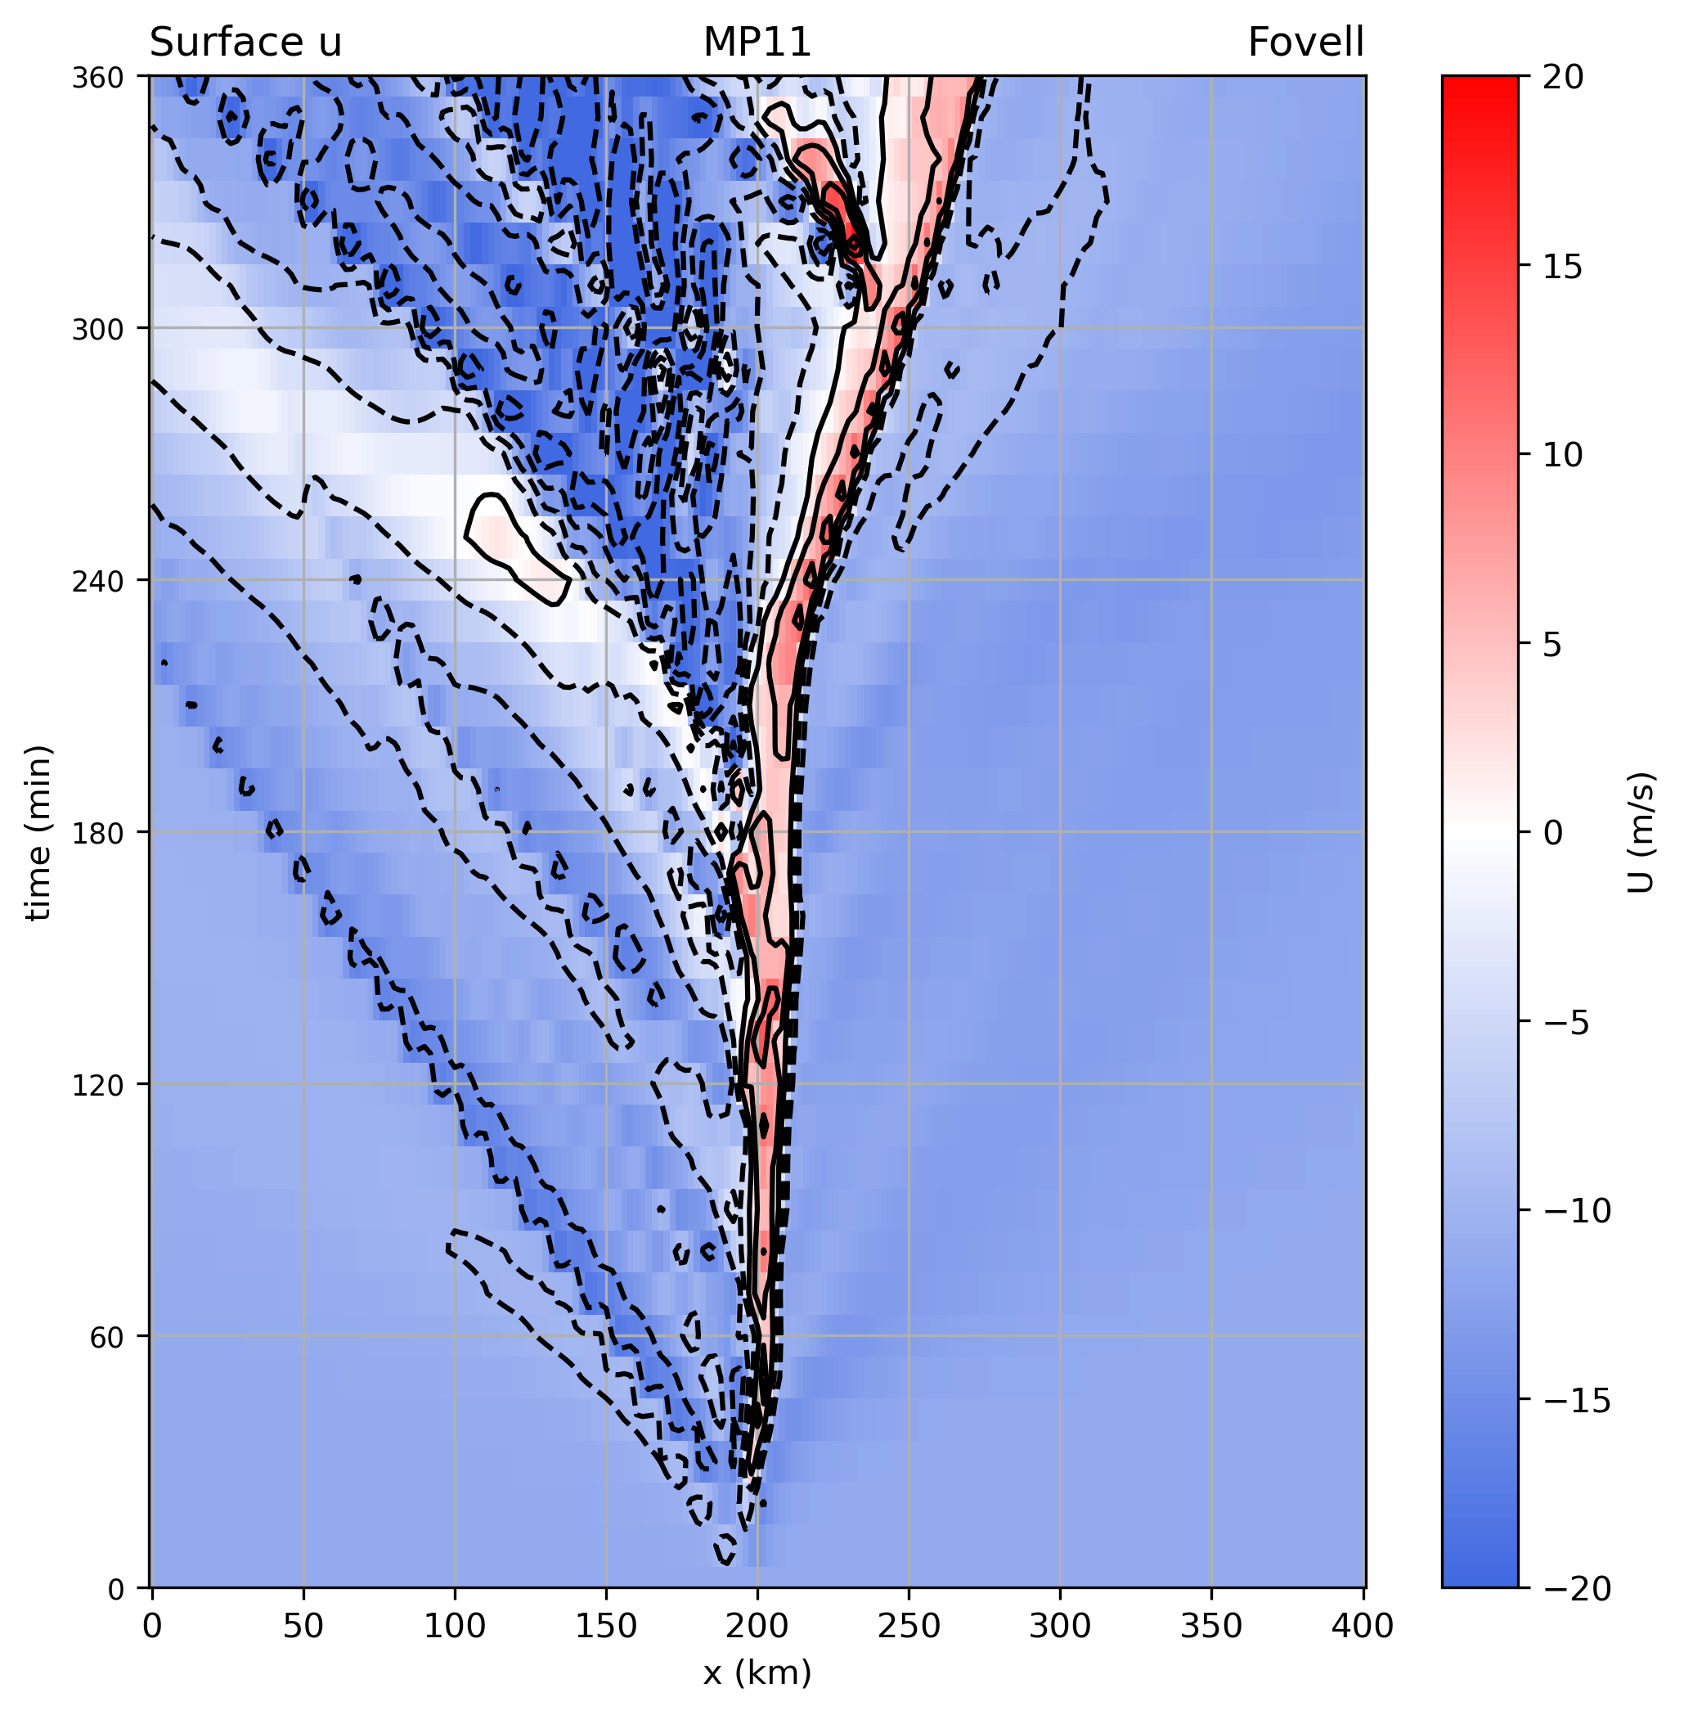
CAM 5.1

Slide 38

ANIMATION

Slide 39
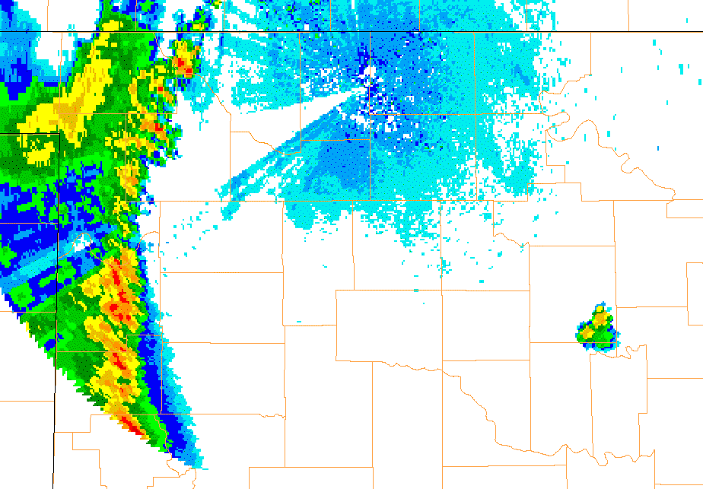
21 Jun 2003 (VNX)
Fovell et al. (2006):
waves trapped beneath
forward anvil
gravity waves

Slide 40

Reflectivity (subset)
A lot of variability in max reflectivity and also
development of bright band

Slide 41
[end]

