Slide 1
Plotting from GRIB files: including vertical cross-sections
ATM 419/563
Fall 2024
Fovell
© Copyright 2024 Robert Fovell, Univ. at Albany, SUNY, rfovell@albany.edu

Slide 2
Introduction
The WRF model will be initialized with some parent model data (e.g., GFS, NAM, HRRR, ERA5 reanalysis), almost always in GRIB1 or GRIB2 format
WRF model outputs almost always use NetCDF format (although GRIB outputs are possible)
You may want to compare your WRF model forecasts to those from the parent model
Possible strategies for accomplishing this:
  Plot WRF and GRIB data using different tools
    • Relatively straightforward but tools are different and plots may not look identical
  Interpolate GRIB forecasts to the WRF grid
    • Plots from the WRF and parent models will look the same but the parent model data are not being shown on its own grid
#2 requires more tools than we have at the moment, so we pursue #1 herein

Slide 3
Reading GRIB files
There are two editions of GRIB files: GRIB1 and GRIB2
Two ways of opening/reading both editions: pynio and cfgrib
pynio can easily access every variable in the GRIB file but variable names are ugly and the package is no longer being supported
  Some of our DAES-built kernels have pynio, others do not
cfgrib fashions much more readable variable names but cannot handle more than one time or vertical coordinate simultaneously
  You are apparently stuck with opening the GRIB file multiple times to fetch the variables you want
Other tools also exist

Slide 4
Two example notebooks
GRIB_plot_example_V4.ipynb
  Uses cfgrib to read in some HRRR forecast output in GRIB2 format
  Plots 10 m winds and terrain for a portion of the domain
  Uses MetPy to construct a west-east vertical cross-section
WRF_plot_example_V4.ipynb
  Uses wrf-python to read in some WRF model output in NetCDF format
  Plots 10 m winds and terrain for a portion of the domain
  Uses wrf-python to construct a west-east vertical cross-section

Slide 5
Preparation
$ lab
{go to your lab space}
$ mkdir PLOTTING
$ cd PLOTTING
$ cp $LAB/PLOTTING/*ipynb .
→ next command is all on one line. Use tab completion.
$ ln -s $LAB/DATA/BOULDER/20211230_12/hrrr.t12z.wrfnatf04.grib2 .
When you open a GRIB file, it creates an index (.idx) file in same location GRIB file resides.
This is why you have to link the GRIB file to a directory you have write permission for

Slide 6
Launch jupyterlab
https://jupyterlab.its.albany.edu/
If you are NOT given drop-down menu:
  Go to File > Hub Control Panel and then “Stop My Server”
  After the server is stopped, select the “Start My Server” button that appears
  From the drop-down menu, select batch – 4 cores, 16 GB, 8 hours [or config with even more memory]
[The minimum configuration does not have enough memory to execute the GRIB_plot_example_V4 notebook properly]

Slide 7
On jupyterlab
From your PLOTTING directory, launch GRIB_plot_example_V4.ipynb
You may see a lot of scary looking warnings and errors running the notebook but it should operate properly

Slide 8
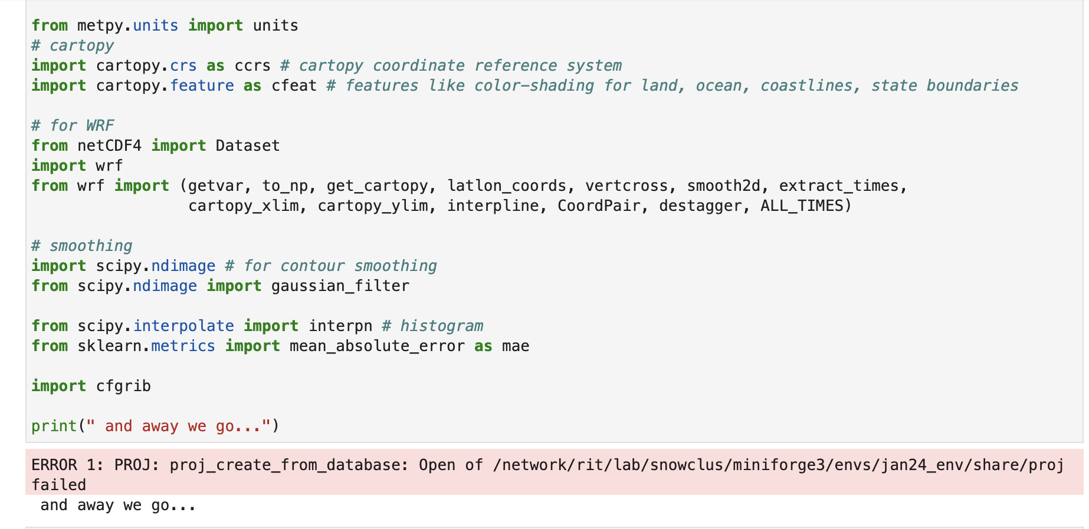
Cell #1
If you see this error, you can safely ignore it.
Example notebook text from older version

Slide 9
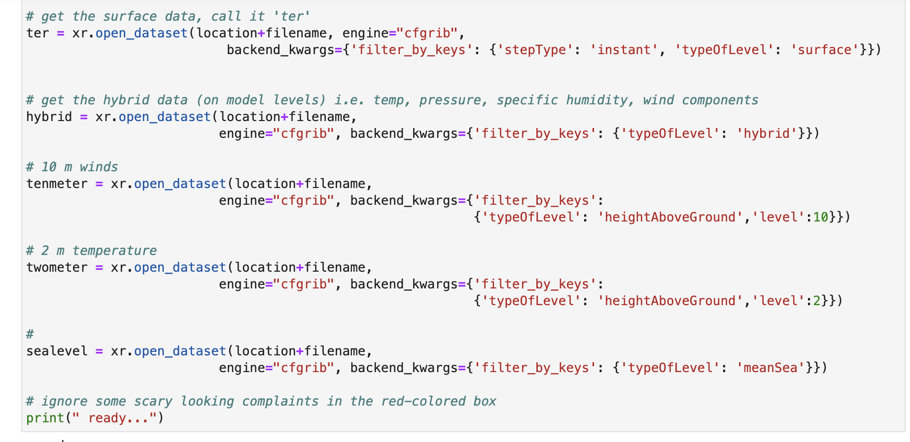
Cell #3
We are reopening the same dataset repeatedly to access variables having
different height and time coordinates. This is life with cfgrib.

Slide 10
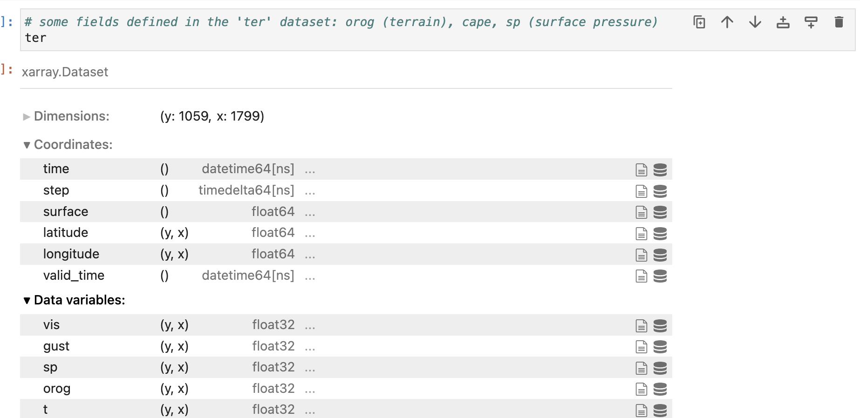
Cell #4
This looks inside the “ter” dataset. These are fields defined at the surface.
We will extract the model terrain (“orog”) from this dataset

Slide 11
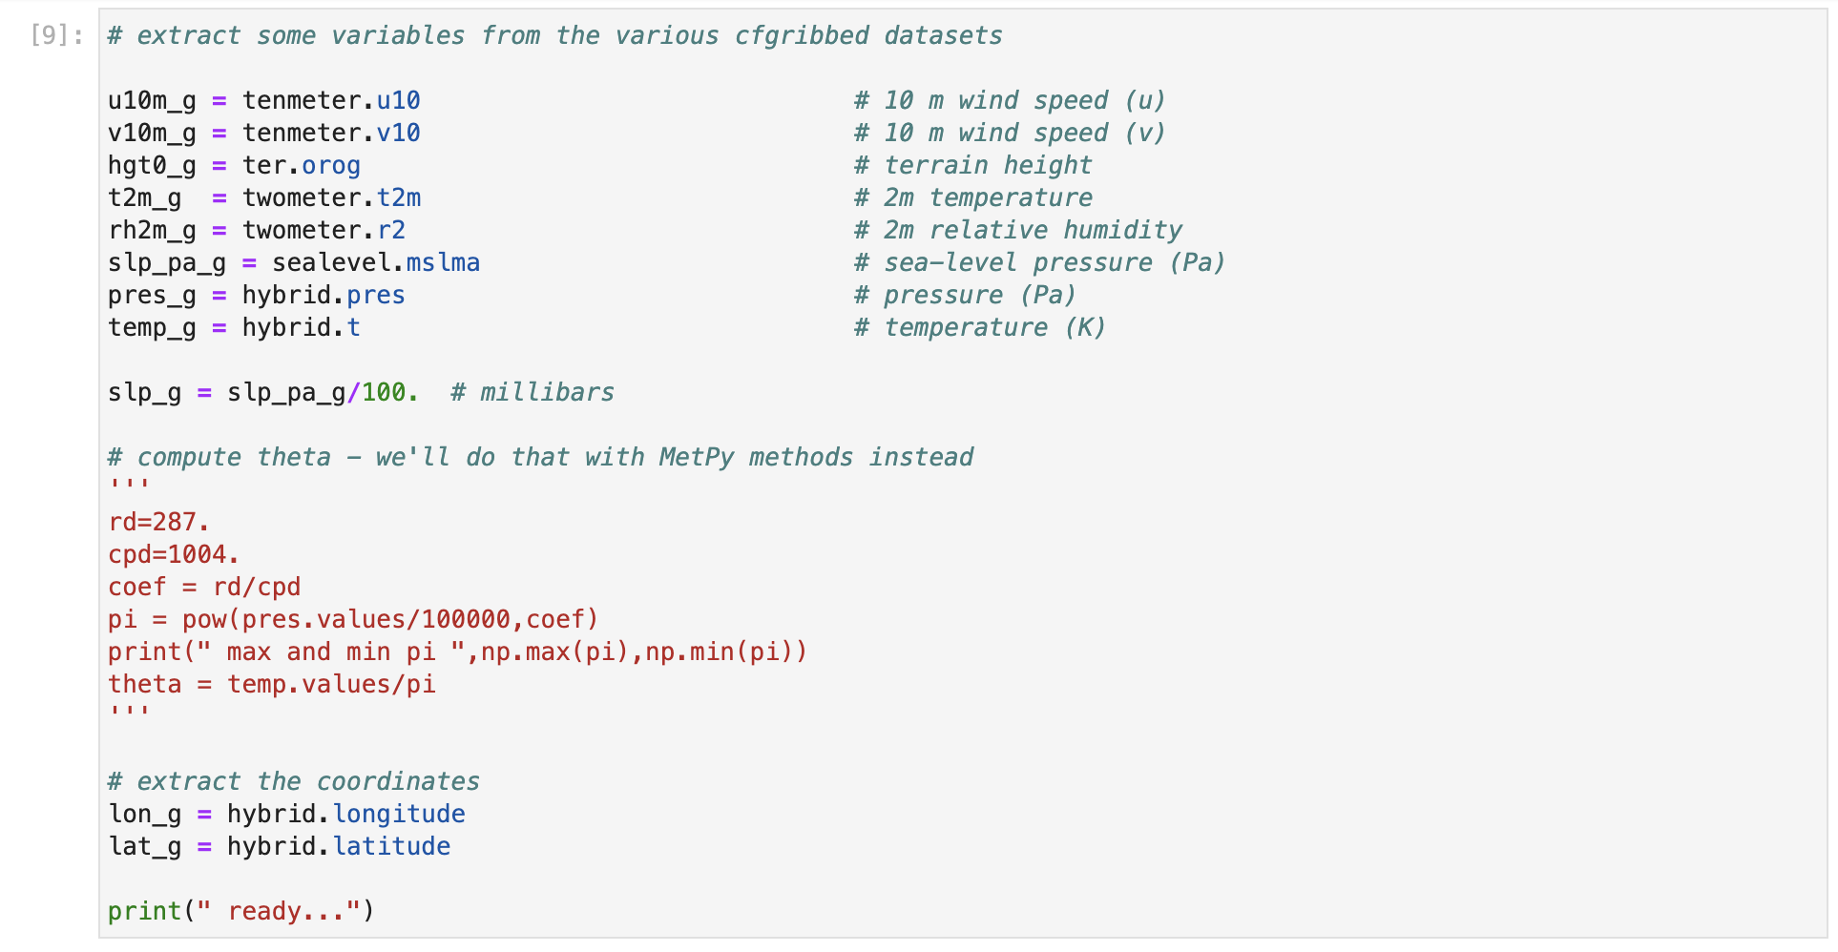
Cell #10
Extracting different variables from different datasets.
The “_g” is appended to indicate GRIB. You will probably want to open GRIB
and NetCDF files in the same notebook, and we don’t want their variables mixed up.

Slide 12
Cell #11
# make a spatial plot using cfgrib-opened files: plot 10m winds on topography
# should be same plot we got before!!!!
# first select our central latitude and longitude
centlon = -106
centlat = 39.96
fig = plt.figure(figsize=(9, 12))
# Select a projection
proj=ccrs.LambertConformal(central_latitude=centlat, central_longitude=centlon)
# create our axis object 'ax', specifying Lambert Conformal projection
ax = fig.add_subplot(1,1,1,projection=proj)
# set the plot bounds
plot_bounds = [-110,-102,39,41]
# terrain plot
norm = plt.Normalize(0,5000)
cm = ax.pcolormesh(lon_g,lat_g,hgt0_g,shading='auto',cmap=plt.cm.terrain, norm=norm,
alpha=0.8, transform=ccrs.PlateCarree())
# add a colorbar. This takes our 'cm' object, and asks for a certain orientation and size and scale
plt.colorbar(cm, orientation="vertical",fraction=0.02, pad=0.04, shrink=0.2, label="terrain height (m)")
# plot some barbs at interval spacing qq
qq=10
plt.barbs(to_np(lon_g[::qq,::qq]),to_np(lat_g[::qq,::qq]),to_np(u10m_g[::qq,::qq]),to_np(v10m_g[::qq,::qq]),color='k',
zorder=51,alpha=1,transform=ccrs.PlateCarree())
# add a title
plt.title(" HRRR 10m (m/s) winds from "+filename,fontweight='bold',fontsize=14)
# The features function we defined adds some cartopy features on. We pass it 'ax'
features(ax)
# enforce the plot bounds
print(plot_bounds)
ax.set_extent(plot_bounds)
# later we will make a vertical cross section. plot its extent on map
left_lon=-108
right_lon=-104
bot_lat=39.954871
top_lat=39.954871
plt.plot([left_lon, right_lon], [bot_lat, top_lat], color='red', linewidth=2,
zorder=900,transform=ccrs.PlateCarree())
# approximate Marshall fire location
ax.scatter(-105.27055,39.954871,marker='*',s=500,c='w',edgecolors='k',transform=ccrs.PlateCarree(),zorder=30) # Boulder
If you do not specify
”true latitudes” for lambert
they default to 30˚ and 60˚

Slide 13
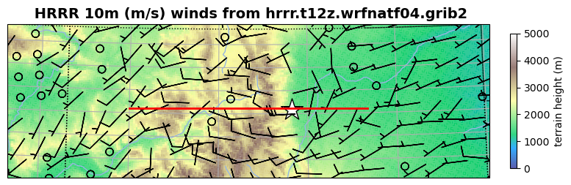
Output of Cell #11
Only a small portion of the domain is shown, specified with
plot_bounds = [-110,-102,39,41]
Only every 10th wind barb is plotted, specified with
# plot some barbs at interval spacing qq
qq=10
plt.barbs(to_np(lon_g[::qq,::qq]),to_np(lat_g[::qq,::qq]),to_np(u10m_g[::qq,::qq]),
to_np(v10m_g[::qq,::qq]),color='k',
zorder=51,alpha=1,transform=ccrs.PlateCarree())
The location and extent of the upcoming cross section marked with red line

Slide 14
Cell #12
# start working on vertical cross-section
# We are using MetPy to make cross-sections from GRIB files
# extract the projection information - needed for the cross-section
grib = pygrib.open(location+filename) ## read in the grib file
msg = grib.message(1) ## from this file we can pull out the projection information
print(" msg.projparms ",msg)
# create the coordinate system for the vertical cross-section from dataset 'hybrid'
data1 = hybrid.metpy.assign_crs(CRS(msg.projparams).to_cf()) #assigning proj
ds = data1.metpy.assign_y_x() #assigning x y's to allow for metpy cross section
# lots of scary red-filled text to ignore here
# our cross-section dataset will be 'ds'
ds
We are creating the dataset that will be used to make the cross-section, called “ds”
This cell can generate a lot of red-colored complaints that can be ignored

Slide 15
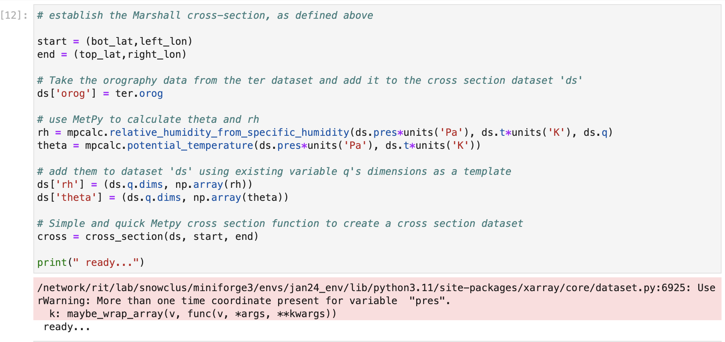
Cell #13
Using MetPy functions to compute potential temperature and RH
and add them to the cross-section dataset “ds”

Slide 16
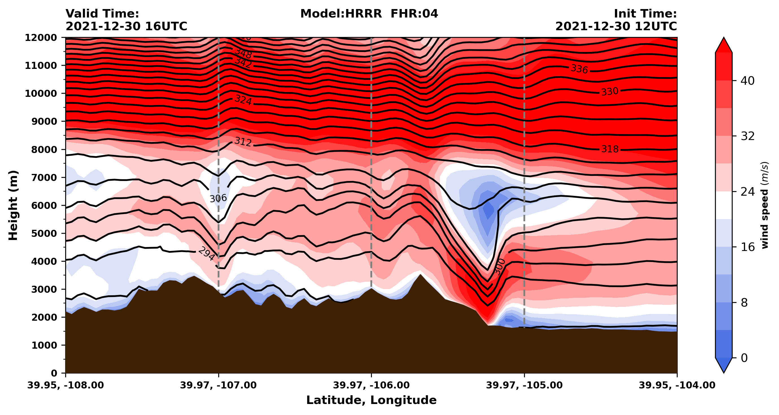
Cell #15

Slide 17
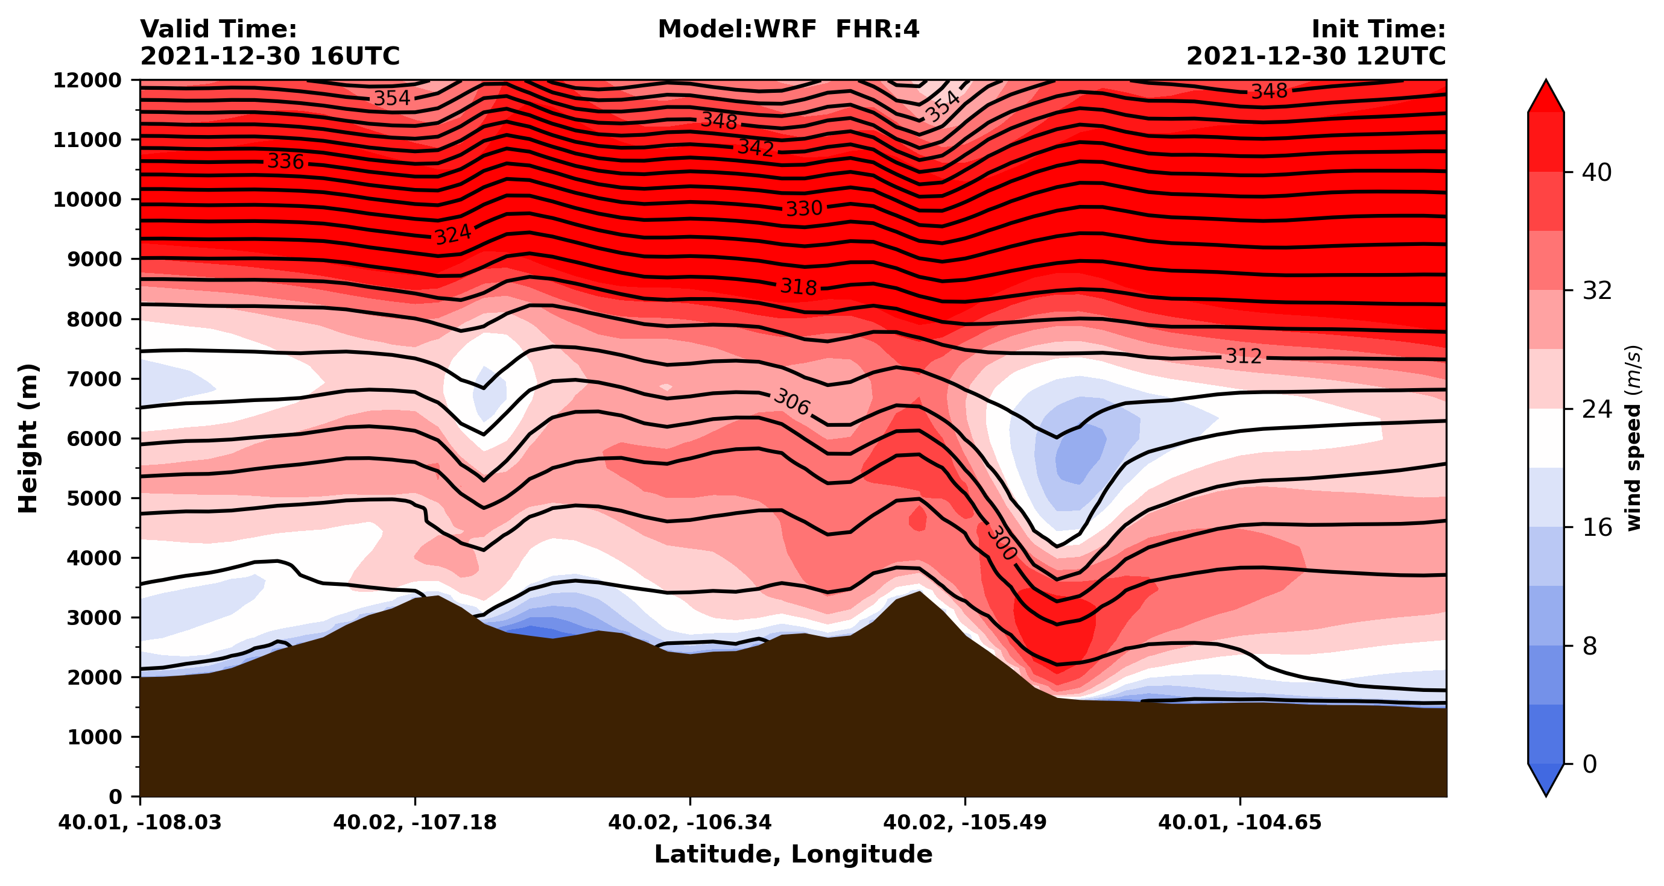
A WRF simulation version of this same forecast time

Slide 18
Next
We will simulate the same case, so we can compare our WRF model output to that produced by the HRRR

Slide 19
GRIB quick-looks
[horizontal plots]

Slide 20
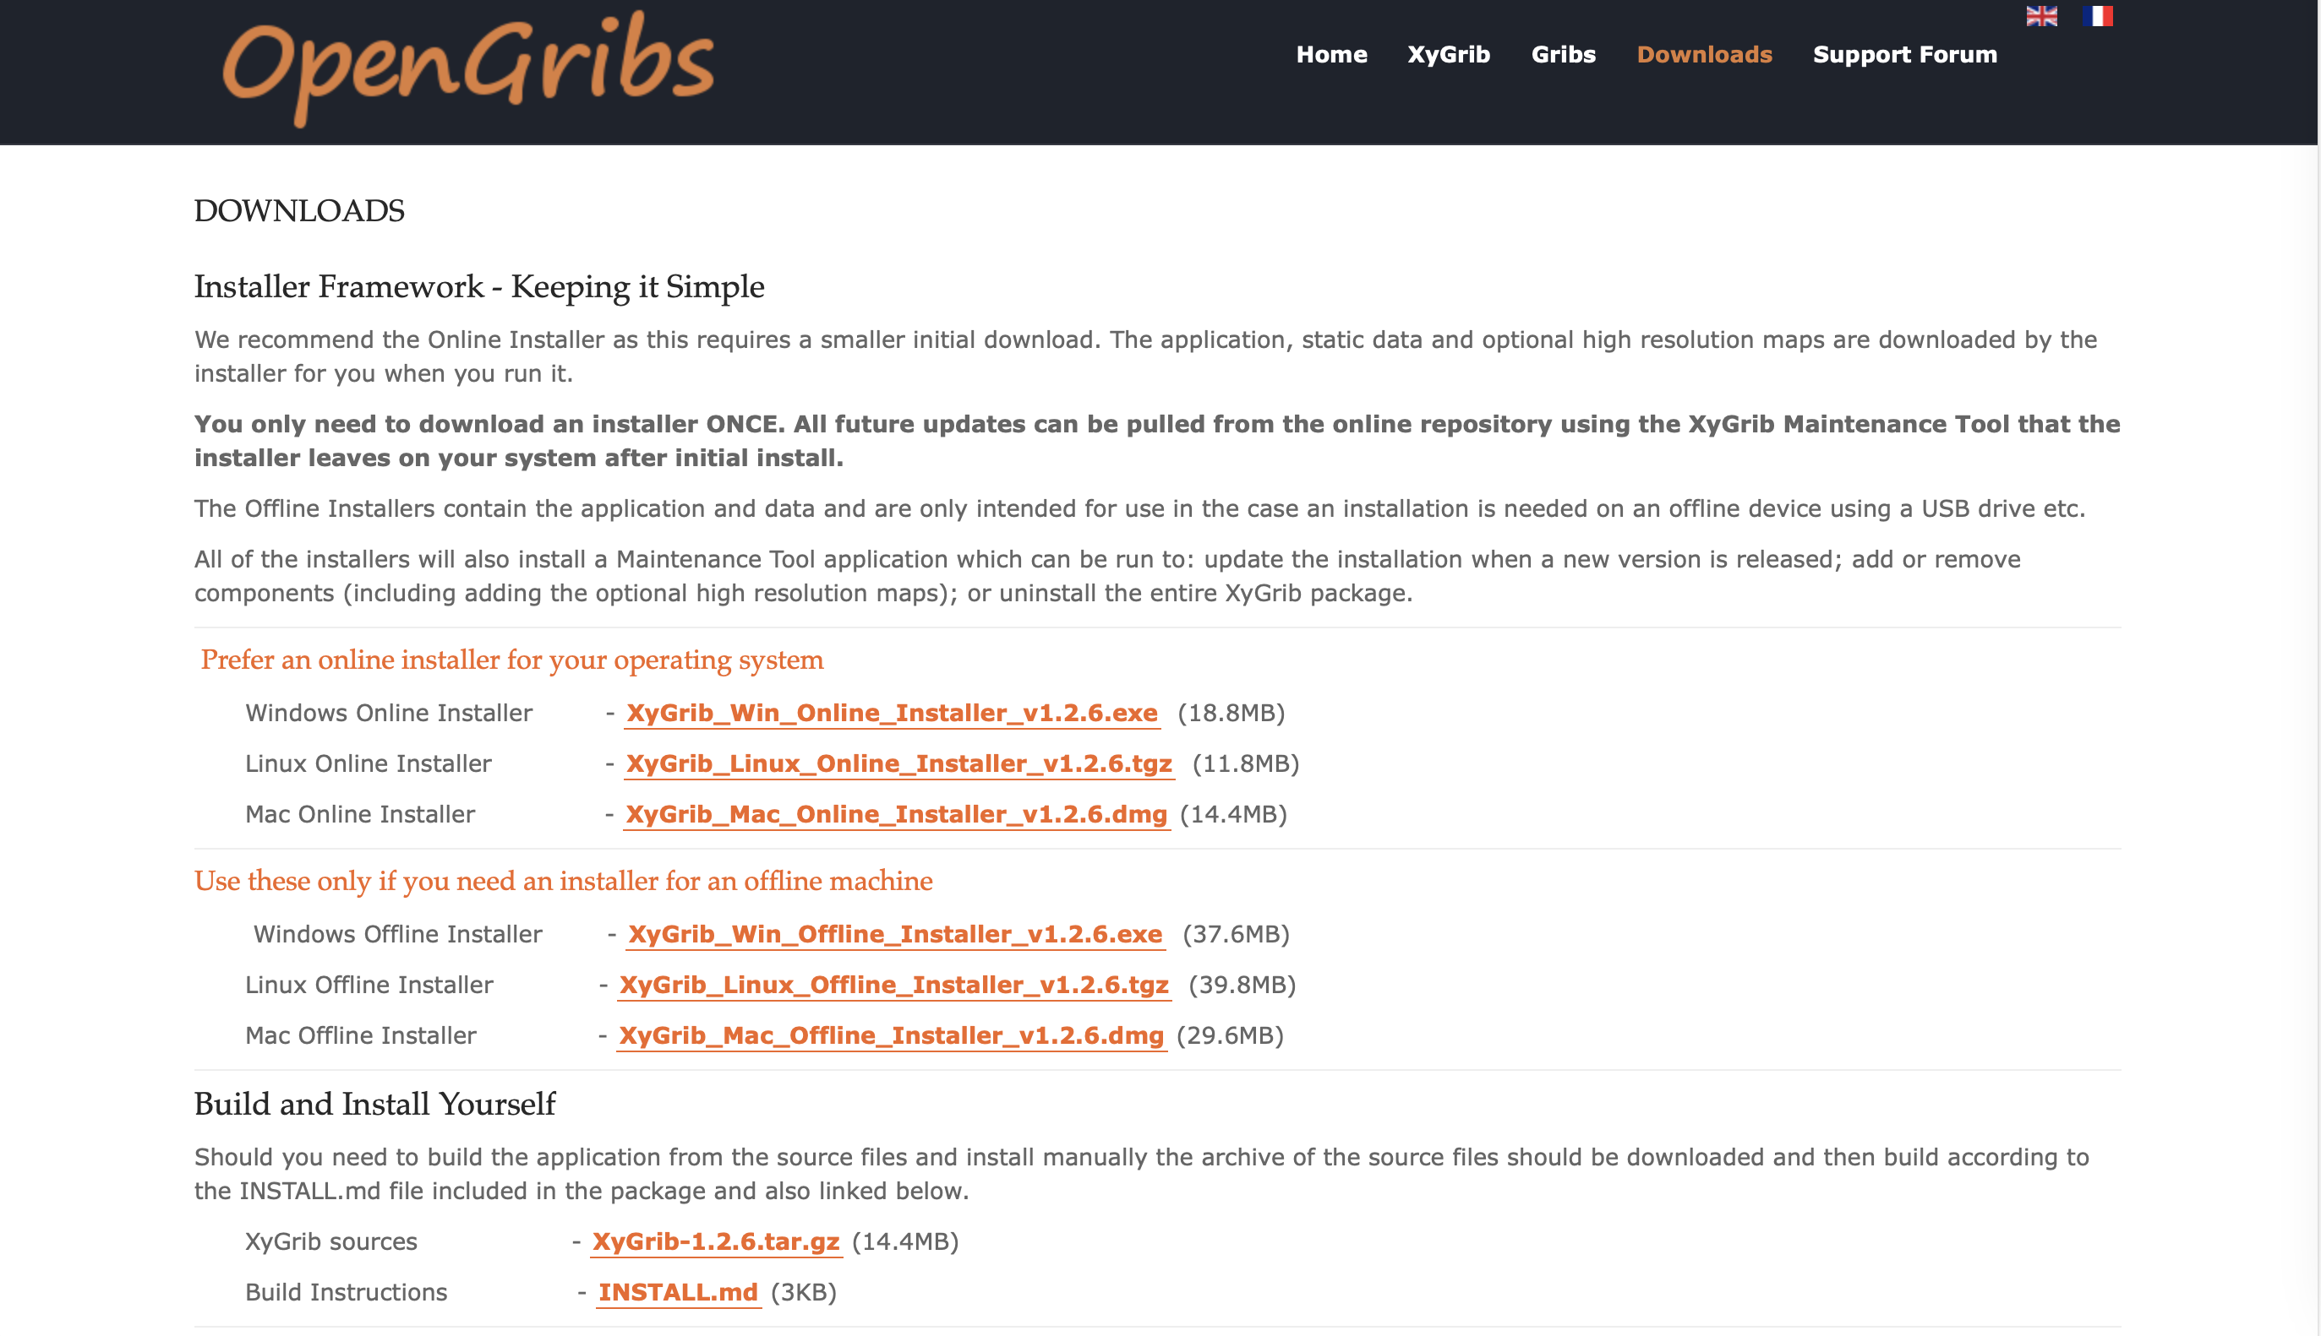
https://opengribs.org/en/downloads

Slide 21
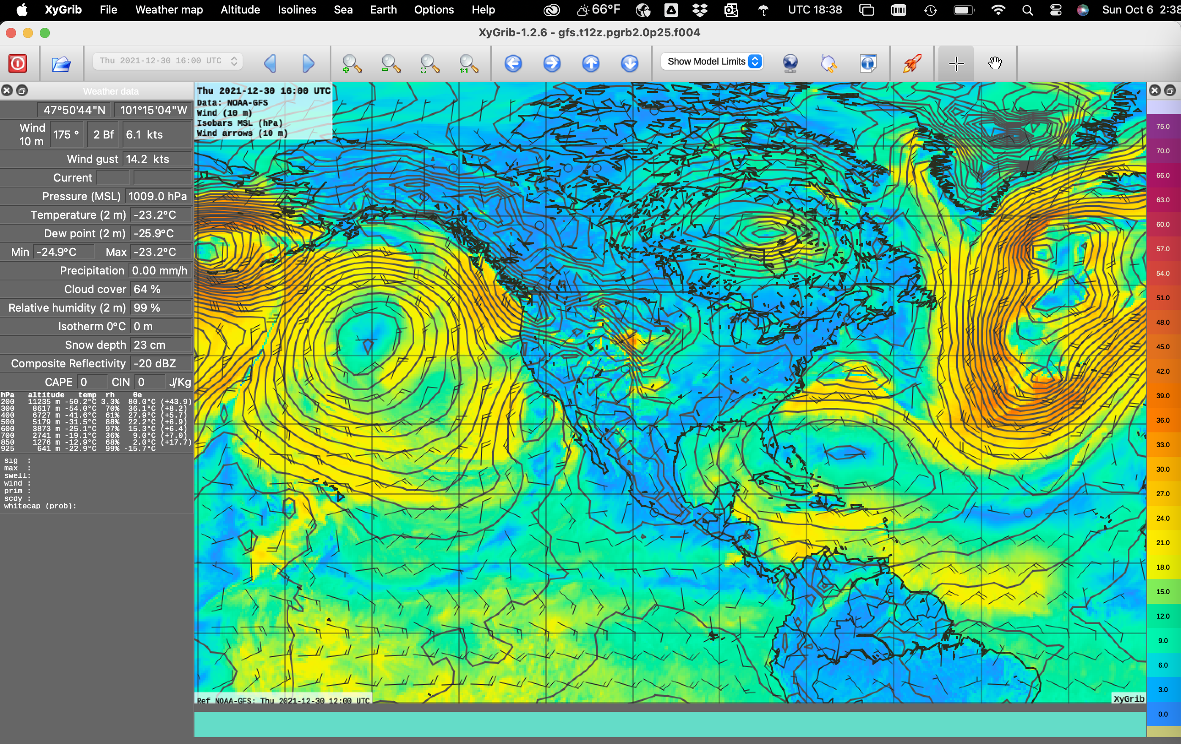
Does not appear to read HRRR grids properly
Can fetch real-time forecasts from remote server

Slide 22
[end]

