Slide 1
Plotting GRIB and NetCDF data
ATM 419/563
Spring 2024
Fovell
© Copyright 2024 Robert Fovell, Univ. at Albany, SUNY, rfovell@albany.edu

Slide 2
Introduction
The WRF model will be initialized with some parent model data (e.g., GFS, NAM, HRRR, ERA5 reanalysis), almost always in GRIB1 or GRIB2 format
WRF model outputs almost always use NetCDF format (although GRIB outputs are possible)
You may want to compare your WRF model forecasts to those from the parent model
Possible strategies for accomplishing this:
Plot WRF and GRIB data using different tools
• Relatively straightforward but tools are different and plots may not look identical
Interpolate GRIB forecasts to the WRF grid
• Plots from the WRF and parent models will look the same but the parent model data are not being shown on its own grid
#2 requires more tools than we have at the moment, so we pursue #1 herein

Slide 3
Reading GRIB files
There are two editions of GRIB files: GRIB1 and GRIB2
Two ways of opening/reading both editions: pynio and cfgrib
pynio can easily access every variable in the GRIB file but variable names are ugly and the package is no longer being supported
Some of our DAES-built kernels have pynio, others do not
cfgrib fashions much more readable variable names but cannot handle more than one time or vertical coordinate simultaneously
You are apparently stuck with opening the GRIB file multiple times to fetch the variables you want

Slide 4
Two example files
GRIB_plot_example.ipynb
Uses cfgrib to read in some HRRR forecast output in GRIB2 format
Plots 10 m winds and terrain for a portion of the domain
Uses MetPy to construct a west-east vertical cross-section
WRF_plot_example.ipynb
Uses wrf-python to read in some WRF model output in NetCDF format
Plots 10 m winds and terrain for a portion of the domain
Uses wrf-python to construct a west-east vertical cross-section

Slide 5
Preparation
$ lab
{go to your lab space}
$ mkdir PLOTTING
$ cd PLOTTING
$ cp $LAB/PLOTTING/*ipynb .
# next command is all on one line
# use tab completion as you are able
$ ln -s $LAB/DATA/BOULDER/20211230_12/hrrr.t12z.wrfnatf04.grib2 .

Slide 6
Launch jupyterlab
https://jupyterlab.its.albany.edu/
If you are NOT given drop-down menu:
Go to File > Hub Control Panel and then “Stop My Server”
After the server is stopped, select the “Start My Server” button that appears
From the drop-down menu, select batch – 4 cores, 16 GB, 8 hours
[The minimum configuration does not have enough memory to execute the GRIB_plot_example notebook properly]

Slide 7
On jupyterlab
If in your home directory, click on your LAB link
Click on your PLOTTING directory
Launch GRIB_plot_example.ipynb and WRF_plot_example.ipynb
You may see a lot of scary looking warnings and errors running GRIB_plot_example.ipynb but the notebook should operate properly

Slide 8
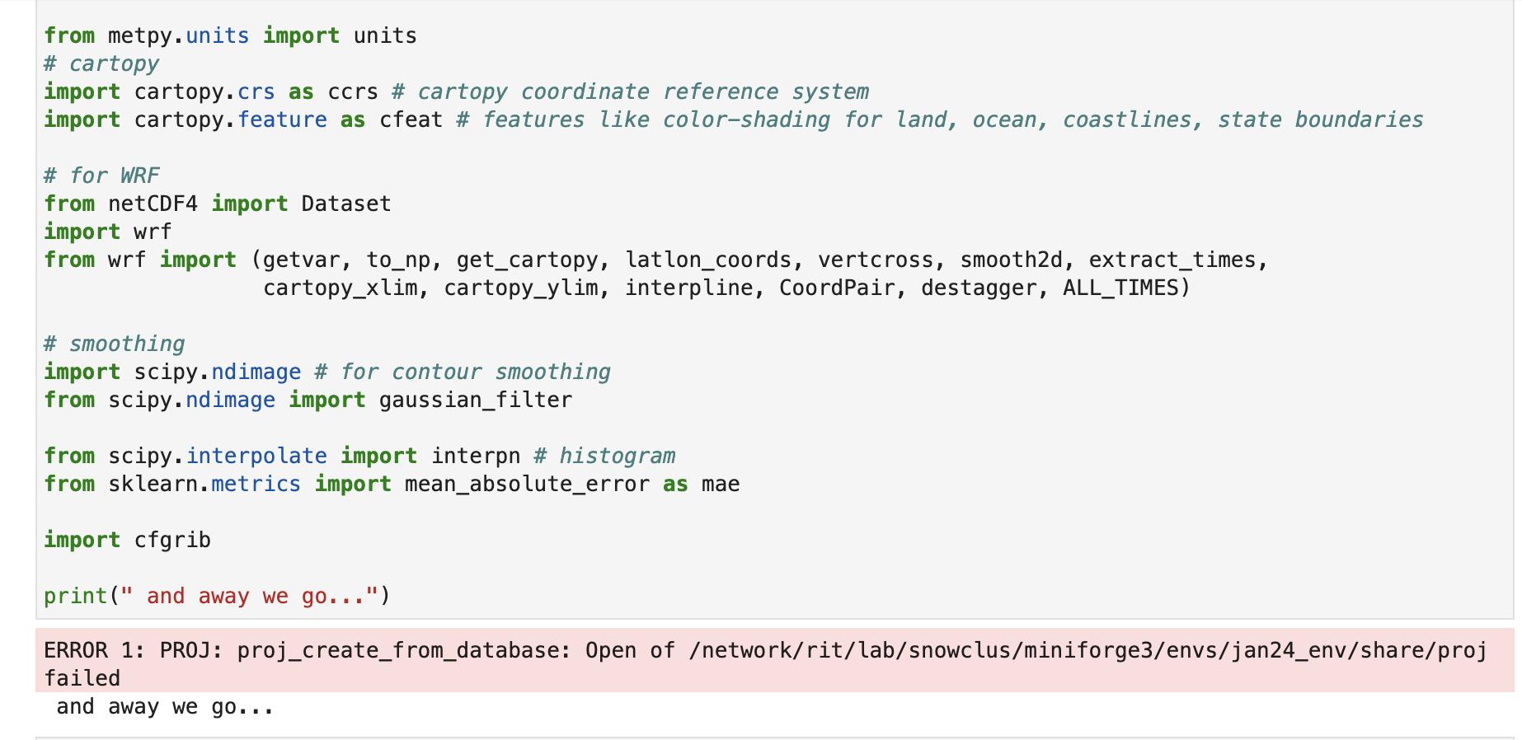
GRIB_plot_example.ipynb Cell #1
Apparently not a real error. You can rerun the cell and it disappears.
If you do not rerun the cell, nothing bad results.

Slide 9
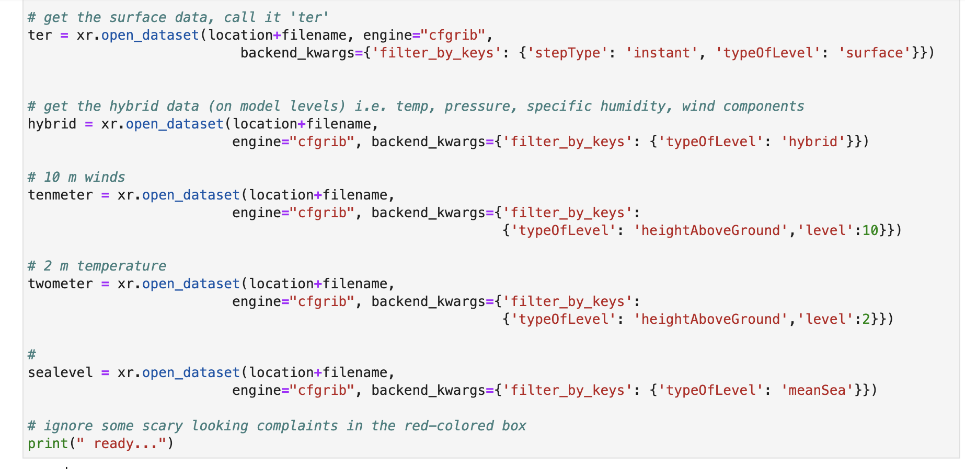
GRIB_plot_example.ipynb Cell #3
We are reopening the same dataset repeatedly to access variables having
different height and time coordinates. This is life with cfgrib.

Slide 10
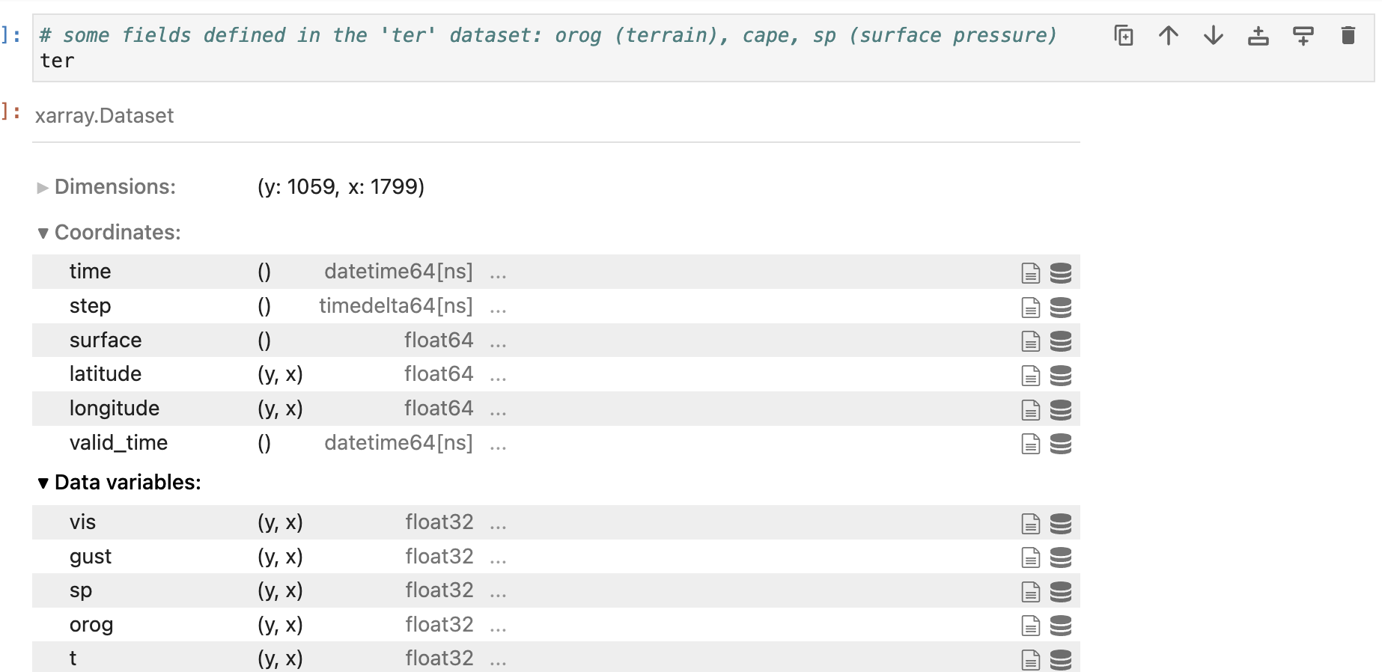
GRIB_plot_example.ipynb Cell #4
This looks inside the “ter” dataset. These are fields defined at the surface.
We will extract the model terrain (“orog”) from this dataset

Slide 11
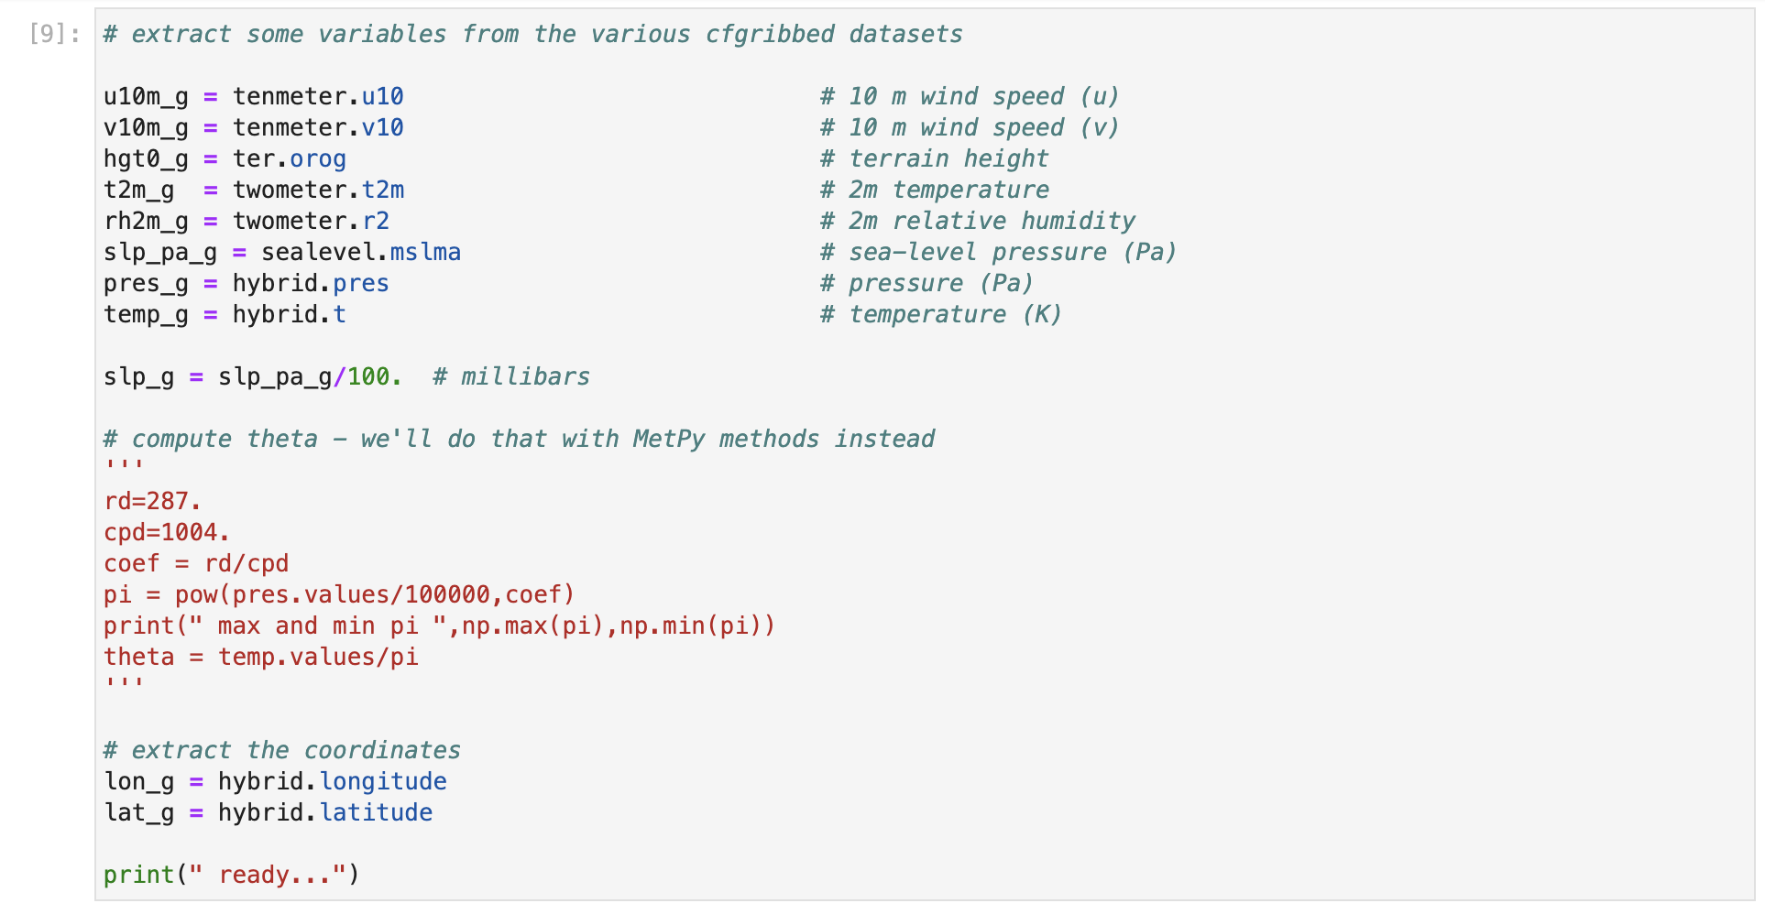
GRIB_plot_example.ipynb Cell #9
Extracting different variables from different datasets.
The “_g” is appended to indicate GRIB. You will probably want to open GRIB
and NetCDF files in the same notebook, and we don’t want their variables mixed up.

Slide 12
GRIB_plot_example.ipynb Cell #10
# make a spatial plot using cfgrib-opened files: plot 10m winds on topography
# should be same plot we got before!!!!
# first select our central latitude and longitude
centlon = -106
centlat = 39.96
fig = plt.figure(figsize=(9, 12))
# Select a projection
proj=ccrs.LambertConformal(central_latitude=centlat, central_longitude=centlon)
# create our axis object 'ax', specifying Lambert Conformal projection
ax = fig.add_subplot(1,1,1,projection=proj)
# set the plot bounds
plot_bounds = [-110,-102,39,41]
# terrain plot
norm = plt.Normalize(0,5000)
cm = ax.pcolormesh(lon_g,lat_g,hgt0_g,shading='auto',cmap=plt.cm.terrain, norm=norm,
alpha=0.8, transform=ccrs.PlateCarree())
# add a colorbar. This takes our 'cm' object, and asks for a certain orientation and size and scale
plt.colorbar(cm, orientation="vertical",fraction=0.02, pad=0.04, shrink=0.2, label="terrain height (m)")
# plot some barbs at interval spacing qq
qq=10
plt.barbs(to_np(lon_g[::qq,::qq]),to_np(lat_g[::qq,::qq]),to_np(u10m_g[::qq,::qq]),to_np(v10m_g[::qq,::qq]),color='k',
zorder=51,alpha=1,transform=ccrs.PlateCarree())
# add a title
plt.title(" HRRR 10m (m/s) winds from "+filename,fontweight='bold',fontsize=14)
# The features function we defined adds some cartopy features on. We pass it 'ax'
features(ax)
# enforce the plot bounds
print(plot_bounds)
ax.set_extent(plot_bounds)
# later we will make a vertical cross section. plot its extent on map
left_lon=-108
right_lon=-104
bot_lat=39.954871
top_lat=39.954871
plt.plot([left_lon, right_lon], [bot_lat, top_lat], color='red', linewidth=2,
zorder=900,transform=ccrs.PlateCarree())
# approximate Marshall fire location
ax.scatter(-105.27055,39.954871,marker='*',s=500,c='w',edgecolors='k',transform=ccrs.PlateCarree(),zorder=30) # Boulder
If you do not specify
”true latitudes” for lambert
they default to 30˚ and 60˚

Slide 13
Output of Cell #10
Only a small portion of the domain is shown, specified with
plot_bounds = [-110,-102,39,41]
Only every 10th wind barb is plotted, specified with
# plot some barbs at interval spacing qq
qq=10
plt.barbs(to_np(lon_g[::qq,::qq]),to_np(lat_g[::qq,::qq]),to_np(u10m_g[::qq,::qq]),
to_np(v10m_g[::qq,::qq]),color='k',
zorder=51,alpha=1,transform=ccrs.PlateCarree())
The location and extent of the upcoming cross section marked with red line

Slide 14
GRIB_plot_example.ipynb Cell #11
# start working on vertical cross-section
# We are using MetPy to make cross-sections from GRIB files
# extract the projection information - needed for the cross-section
grib = pygrib.open(location+filename) ## read in the grib file
msg = grib.message(1) ## from this file we can pull out the projection information
print(" msg.projparms ",msg)
# create the coordinate system for the vertical cross-section from dataset 'hybrid'
data1 = hybrid.metpy.assign_crs(CRS(msg.projparams).to_cf()) #assigning proj
ds = data1.metpy.assign_y_x() #assigning x y's to allow for metpy cross section
# lots of scary red-filled text to ignore here
# our cross-section dataset will be 'ds'
ds
We are creating the dataset that will be used to make the cross-section, called “ds”
This cell can generate a lot of red-colored complaints that can be ignored

Slide 15
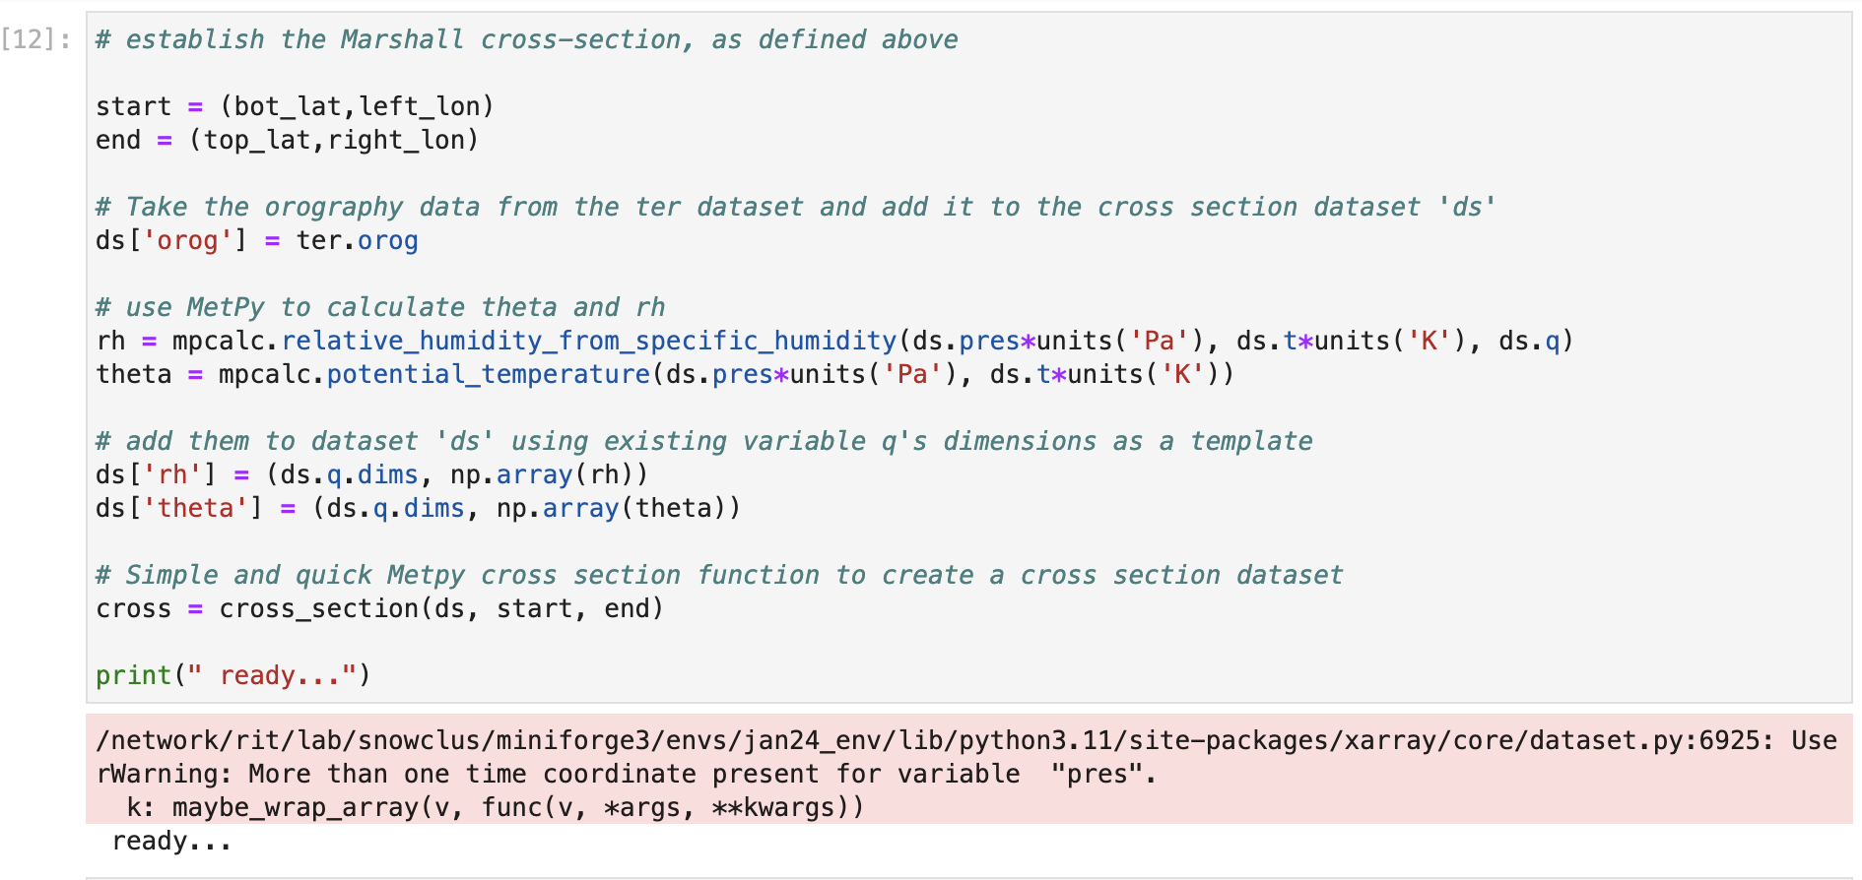
GRIB_plot_example.ipynb Cell #12
Using MetPy functions to compute potential temperature and RH
and add them to the cross-section dataset “ds”

Slide 16
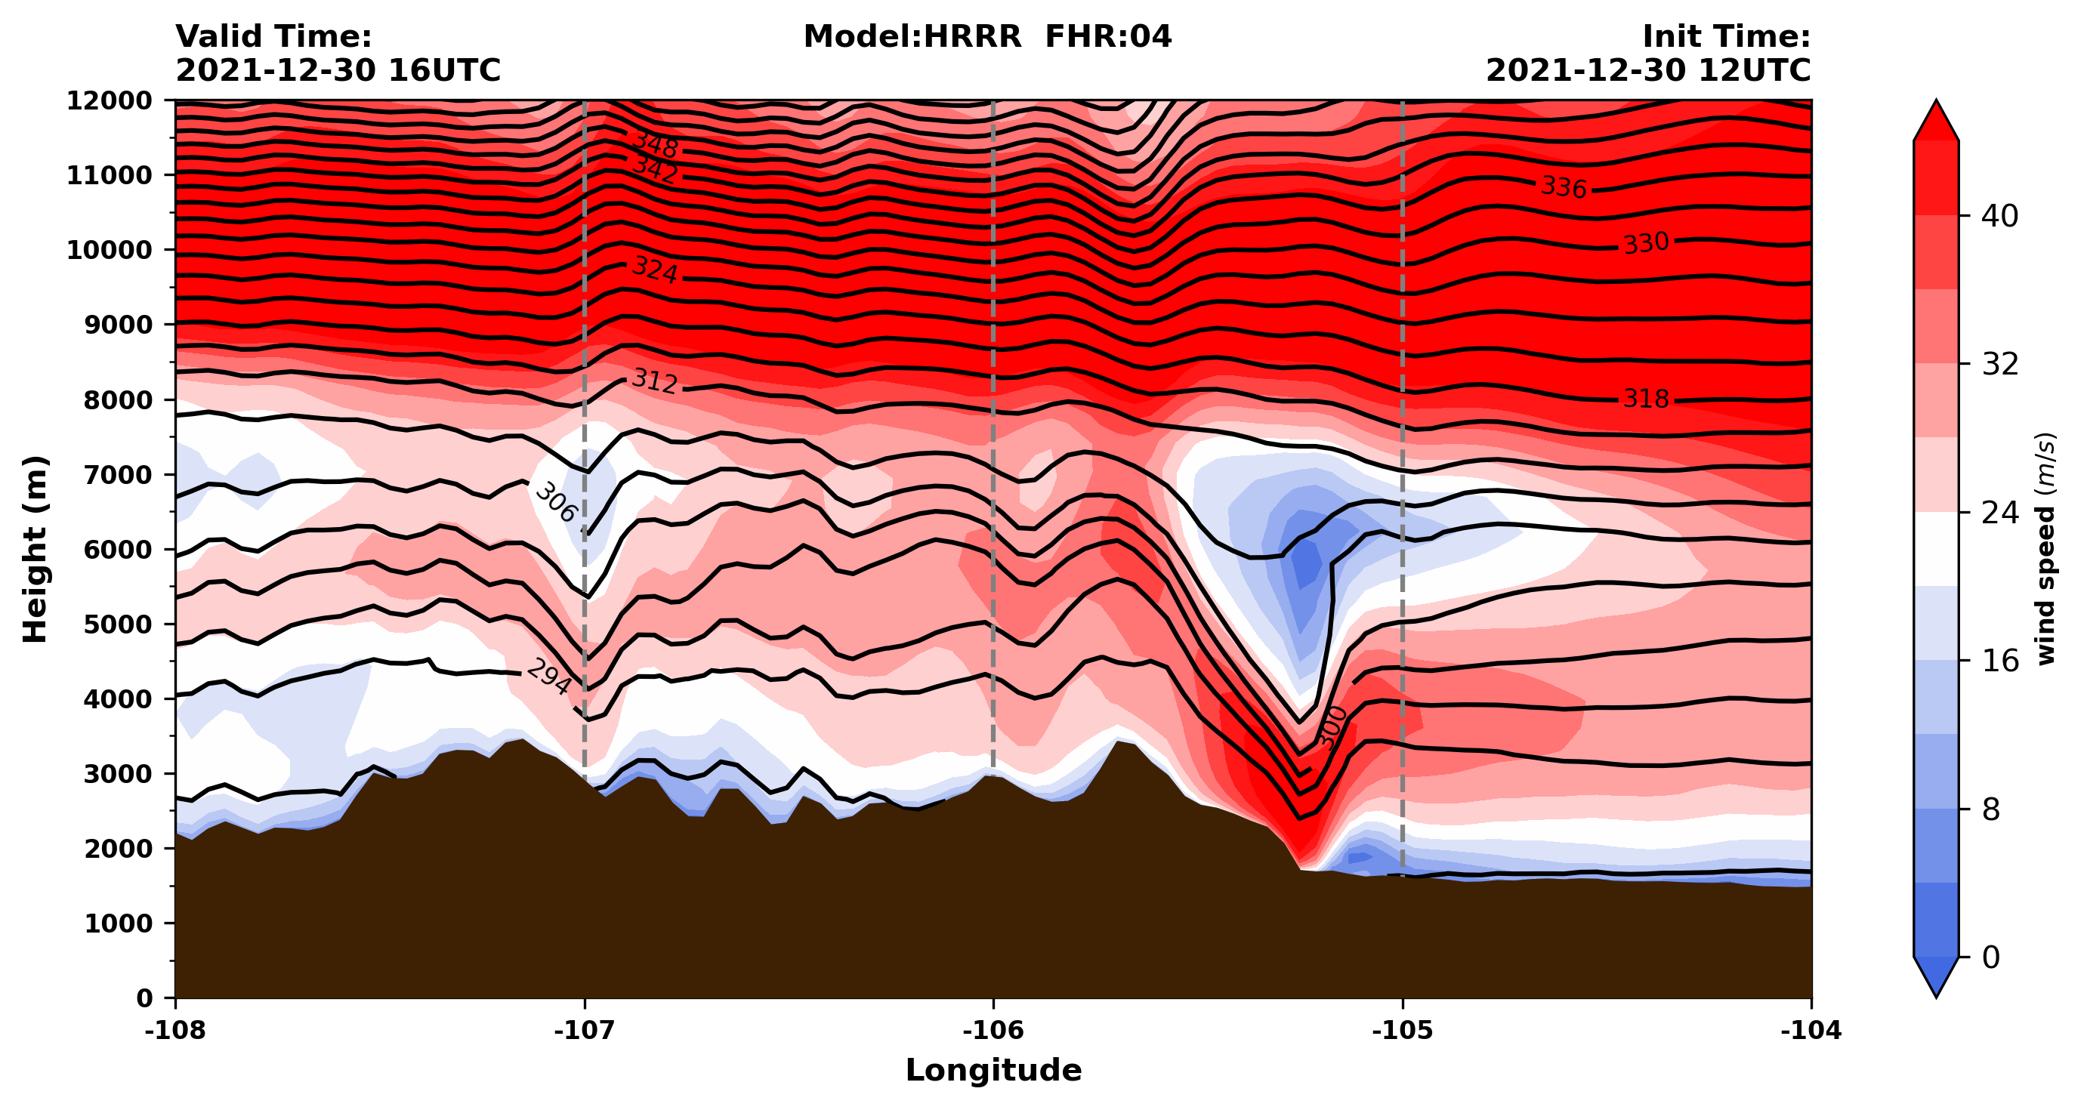
GRIB_plot_example.ipynb Cell #13
Be aware that the longitude labels and part of the title are hard-coded

Slide 17
WRF_plot_example.ipynb
This notebook reads in a wrfout file containing multiple output times
The first time is the initialization (0 h forecast) and successive forecasts are hourly
Some parts of the notebook assume a single wrfout file with multiple times with the first time being the 0 h forecast. That may need to be modified in the future

Slide 18
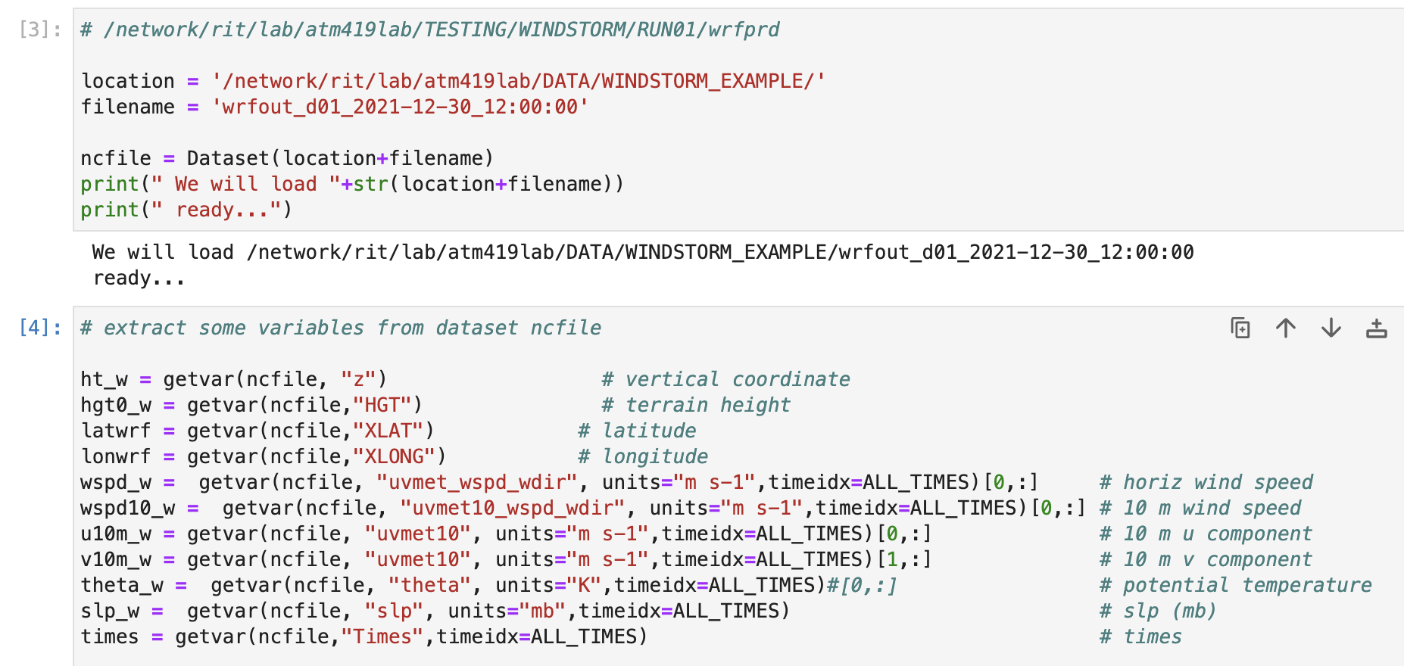
WRF_plot_example.ipynb Cells #3-4
Specifying location and name of wrfout file and extracting some variables.
In contrast to the GRIB file, this wrfout file has multiple forecast times
WRF predicts potential temperature so we do not need to compute it

Slide 19
WRF_plot_example.ipynb Cell #4
Our output times. We’re interested in the forecast valid 2021-12-30 at 16Z
so that’s time number 5 and time index 4 (since Python counts from zero)

Slide 20
WRF_plot_example.ipynb Cell #5
plot_time_index = 4
# define cross-section starting and ending points
cross_start = CoordPair(lat=39.954871, lon=-108.)
cross_end = CoordPair(lat=39.954871, lon=-104.)
[•••]
# extract wind speed and theta at the designated time,
# call the variables wspd_ and theta_, u10m_, v10m_
wspd_ = wspd_w[plot_time_index,:,:,:]
theta_ = theta_w[plot_time_index,:,:,:]
u10m_ = u10m_w[plot_time_index,:,:]
v10m_ = v10m_w[plot_time_index,:,:]
Defining bounds for vertical cross-section and extracting variable subsets
only for the desired time

Slide 21
WRF_plot_example.ipynb Cell #6
For comparison with the HRRR forecast valid at this same time
Again, only part of domain and not all wind barbs plotted

Slide 22
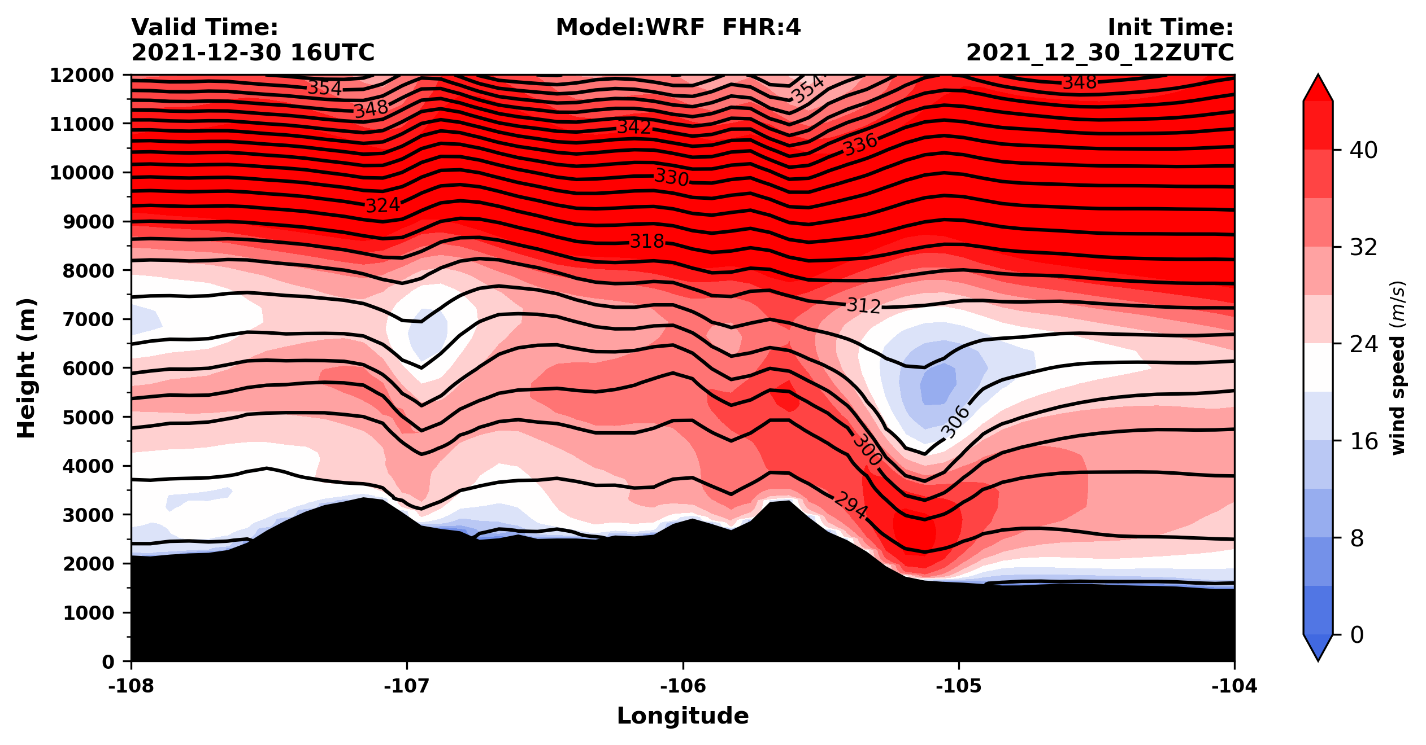
WRF_plot_example.ipynb Cell #7
Tried to make cross-section from WRF output look like the GRIB/MetPy plot as
much as possible, but it is not perfect

Slide 23
Task #1

Slide 24
Task #1
In either notebook, add a plan view contour plot of SLP on top of the map of terrain and 10m winds or in a new cell
For the WRF output, you’ll need to select SLP at a single time, like we did for wspd (etc.)
For either notebook, remember the map projection

Slide 25
Task #2

Slide 26
Next class
I will provide you with some GRIB and WRF outputs to plot. You may use these notebooks as a starting point to make some plots of your own
Start thinking about the case(s) you wish to examine for your final project. If you have an idea regarding a case, I may be able to get you some GRIB format data to use for this task. Please
Tell me what the case is
Let me know what time period you are interested in
Let me know what general spatial area is involved
Tell me if you have a preferred parent model (e.g., GFS, NAM, HRRR, reanalysis,…)
Get the information to me ASAP so I can make it available to you

Slide 27
[end]

