Slide 1
Potpourri
ATM 419/563
Fall 2024
Fovell
© Copyright 2024 Robert Fovell, Univ. at Albany, SUNY, rfovell@albany.edu
Notes:
Add GrADS on isobaric levels

Slide 2
Outline
Making animations
Downloading and processing MADIS data
Taylor diagrams
Verifying against radiosonde observations
Directly modifying WRF/WPS input and/or output files
Some sources of initialization data
Bypassing ungrib.exe!
Adaptive time stepping
Writing out extra fields to wrfout or other output files
Restarting WRF simulations
Reference is made to the “SCRIPTS” directory:
  $LAB/SCRIPTS

Slide 3
Making animations from PNG files

Slide 4
Merging PNG files into animated GIF
We have had some jupyter notebooks that created and displayed live animations via Matplotlib (e.g., plot_SUPERCELL.ipynb)
The notebook run_WRF_SQUALL.ipynb contained code for generating a PNG image at each model output time and combining them into an animation in GIF format using convert
  Change -delay to alter frame rate
  Loop “0” is endless loop; “1” plays only once
convert -delay 30 -loop 0 movie*png OUT.GIF

Slide 5
#------------------------------------------------------------------------
# Animate max column vertical velocity. Click on 'play' control to start
# from ATM419 plot_SUPERCELL.ipynb
# NOT map projected
#------------------------------------------------------------------------
import matplotlib.animation
import matplotlib.pyplot as plt
import numpy as np
plt.rcParams["animation.html"] = "jshtml"
plt.rcParams['figure.dpi'] = 150
plt.ioff()
norm = plt.Normalize(0, 50)
cmap=plt.cm.jet
# select model level
mlevel=1
# construct x and y axes
x=np.arange(0,np.shape(wspd)[3])
y=np.arange(0,np.shape(wspd)[2])
fig, ax = plt.subplots()
def animate(t):
plt.cla()
mtime=np.copy(t)
# extract fields at selected time and level
wspd_level = wspd[mtime-1,mlevel-1,:,:]
qr_level = qr[mtime-1,mlevel-1,:,:]*1000. # g/kg
ua_level = ua[mtime-1,mlevel-1,:,:]
va_level = va[mtime-1,mlevel-1,:,:]
wa_level = wa[mtime-1,mlevel-1,:,:]
wa_time = wa[mtime-1,:,:,:]
wmax = np.max(wa_time.values,axis=0)
current_time=xtimes[mtime-1].values
#print(" we're looking at model level ",mlevel," at time ",current_time)
# wspd as colormesh
cm = ax.pcolormesh(x,y,wmax,shading='auto',cmap=cmap, norm=norm)
# add a colorbar. This takes our 'cm' object, and asks for a certain orientation and size. DID NOT WORK WELL
#plt.colorbar(cm, orientation="vertical",shrink=0.5,label="wspd (m/s)")
# plot wind barbs, at interval q
q = 4
#plt.barbs(x[::q],y[::q],ua_level[::q,::q],va_level[::q,::q],length=6, color='k',lw=0.75) # BARBS
# and add a title
plt.title(" Max vertical velocity (m/s) at t="+str(current_time)[0:19]); # semicolon suppresses unwanted text printed to screen
# add axis labels
plt.xlabel("X")
plt.ylabel("Y")
# make sure plot is square - appropriate as we have square domain and no map projection
plt.axis('square')
#
#
matplotlib.animation.FuncAnimation(fig, animate, frames=13) # I knew I had 13 times
Matplotlib animation
Example from plot_SUPERCELL.ipynb
• idealized simulation, no map projection
• (version using map projection on next slide)
• colorbars mess up the animations…

Slide 6
# projected version
#---------------------------------------------------------------------------
# Animate SLP. Cartopy projected version. Click on 'play' control to start
# Helps to do these cell last
#---------------------------------------------------------------------------
import matplotlib.animation
import matplotlib.pyplot as plt
import numpy as np
plt.rcParams["animation.html"] = "jshtml"
plt.rcParams['figure.dpi'] = 150
plt.ioff()
norm = plt.Normalize(960, 1020)
levels = np.arange(960,1024,4)
cmap=plt.cm.jet
land_levels=np.arange(0,1)
# construct times
print(np.shape(slp))
ntimes=np.shape(slp)[0]
fig, ax = plt.subplots(subplot_kw={'projection': proj}) # proj previously defined
def animate(t):
plt.cla()
mtime=np.copy(t)
# extract field to be animated
slp_time = slp[mtime,:,:]
u10m_time = u10m[mtime,:,:]
v10m_time = v10m[mtime,:,:]
current_time=times[mtime].values
#print(" we're looking at time ",current_time,np.min(slp_time),np.max(slp_time))
# wspd as colormesh
cm = ax.pcolormesh(lonwrf,latwrf,slp_time,shading='auto',cmap=cmap, norm=norm, transform=ccrs.PlateCarree())
# add a colorbar. This takes our 'cm' object, and asks for a certain orientation and size
#plt.colorbar(cm, orientation="vertical",shrink=0.5,label="wspd (m/s)")
cs = ax.contour(lonwrf,latwrf,slp_time,colors='grey', levels=levels, linewidths=1, linestyles=':',transform=ccrs.PlateCarree())
ax.contour(lonwrf,latwrf,landmask,colors='k', levels=land_levels, linewidths=2,transform=ccrs.PlateCarree())
# plot wind barbs, at interval q. these need to be numpy arrays or get 'DataArray' object has no attribute 'flatten' error
q = 2
plt.barbs(to_np(lonwrf[::q,::q]),to_np(latwrf[::q,::q]),to_np(u10m_time[::q,::q]),to_np(v10m_time[::q,::q]),length=6, color='k',lw=0.75,transform=ccrs.PlateCarree()) # BARBS
# and add a title
plt.title(" SLP (mb) at t="+str(current_time)[0:19]); # semicolon suppresses unwanted text printed to screen
# add axis labels
#plt.xlabel("longtitude")
#plt.ylabel("latitude")
#
matplotlib.animation.FuncAnimation(fig, animate, frames=ntimes)
Matplotlib animation
This version is for a real-data simulation
that uses a map projection
• The secret appears to be coding the
projection in the keyword arguments
• Define ‘proj’ before this code block

Slide 7
Why animated GIFs?
Well-supported format, works in all browers
They work well with PowerPoint
  Linking external animations to PowerPoint presentations are prone to glitches, including broken links
  Trick: Insert an animated GIF as a “photo”, not as a “movie”. The animation then becomes incorporated into the presentation.

Slide 8
Computing domain-averaged and domain-total quantities
NCL example
$ source $LAB/SCRIPTS/doncl.sh
[execute this command first]
Notes:
2020

Slide 9
Domain quantities
Computing domain-averaged or domain-total quantities (e.g., of fields like microphysics or cumulus precipitation) requires some special handling:
  NCL can be used to extract fields from wrfout files. These fields are on the original WRF computational grid. In this case, map factors and staggering need to be considered. Non-scalars need destaggering.
  Same strategy can be implemented in Python

Slide 10
NCL (or Python)
Example from a past class ensemble
  NX = 72, NY = 48, so there are (NX-1)*(NY-1) = 3337 scalar points
The grid spacing ∆x = ∆y is constant across the WRF computational grid, but getting the distance on Earth requires applying the map factors.
  At any particular gridpoint i,j the grid distance on the Earth is ∆x/m_{i,j}, where m is the map factor
  NCL script on next slide extracts RAINNC, RAINC, and MAPFAC_M (map factor at scalar point), computes area of each grid box, and sums total precipitation over the WRF domain, expressed in mm m² or kg of water

Slide 11
load "$NCARG_ROOT/lib/ncarg/nclscripts/csm/gsn_code.ncl"
load "$NCARG_ROOT/lib/ncarg/nclscripts/csm/gsn_csm.ncl"
load "$NCARG_ROOT/lib/ncarg/nclscripts/wrf/WRFUserARW.ncl"
load "$NCARG_ROOT/lib/ncarg/nclscripts/wrf/WRF_contributed.ncl"
load "$NCARG_ROOT/lib/ncarg/nclscripts/esmf/ESMF_regridding.ncl"
load "$NCARG_ROOT/lib/ncarg/nclscripts/csm/shea_util.ncl"
load "$NCARG_ROOT/lib/ncarg/nclscripts/contrib/ut_string.ncl"
load "$NCARG_ROOT/lib/ncarg/nclscripts/csm/contributed.ncl"
begin
;---Open WRF output file
a = addfile("wrfout_d01_2016-03-22_12:00:00","r")
ntimes = dimsizes(wrf_user_list_times(a))
;---Get the rain field, grid size, and map factor
rainc = a->RAINC(ntimes-1,:,:)
rainnc = a->RAINNC(ntimes-1,:,:)
rain = rainnc+rainc
dx = todouble(a@DX)
mapfac = wrf_user_getvar(a,"MAPFAC_M",ntimes-1)
;Calculate WRF grid area and volume of rainfall
WRF_area = (dx*dx)/mapfac/mapfac
rain_vol_WRF = todouble(rain)*todouble(WRF_area)
;--Print
print(" WRF grid area is: "+sum(WRF_area)+" m^2")
print(" ")
print(" WRF grid rain volume is: " +sum(rain_vol_WRF)+" mm m^2")
end
$LAB/SCRIPTS/domain_total_precip.ncl
This NCL script opens a specified wrfout file, extracts RAINC and RAINNC for the final
forecast time, and computes & prints total WRF grid area and domain total precipitation
in mm*m² or kg. (Multiply by 0.001 to mm and then 1000 to get kilograms.)
(0) WRF grid area is: 4299570177127.188 m^2
(0)
(0) WRF grid rain volume is: 22334974217079.7 mm m^2

Slide 12
Downloading and processing MADIS surface data
See $LAB/SCRIPTS/

Slide 13
Scripts
MADIS_download.sh
MADIS2ASCII.sh (and MADIS2ASCII.pl)
ASCII2NC.sh
MET6_*.sh scripts from Verification demo
[There now is a MADIS2NC program that can skip the MADIS2ASCII/ASCII2NC step,
but there are useful data filtering options in the MADIS2ASCII step.]

Slide 14
MADIS_download.sh
By default, MADIS_download.sh will download ALL surface data for the entire world (see next slide), which takes time.
DIR=${PWD}
Date_base=20160313
Date_base_hour=00
run_hours=54
[…]
echo "will get data from "$date"_"$date_hr" to "$date2"_"$date2_hr
echo "Is this correct (y/n)?"
read input
• Downloads data to current directory
• Starting 3/13/2016 at 00Z
• …and for 54 hours additional hours

Slide 15
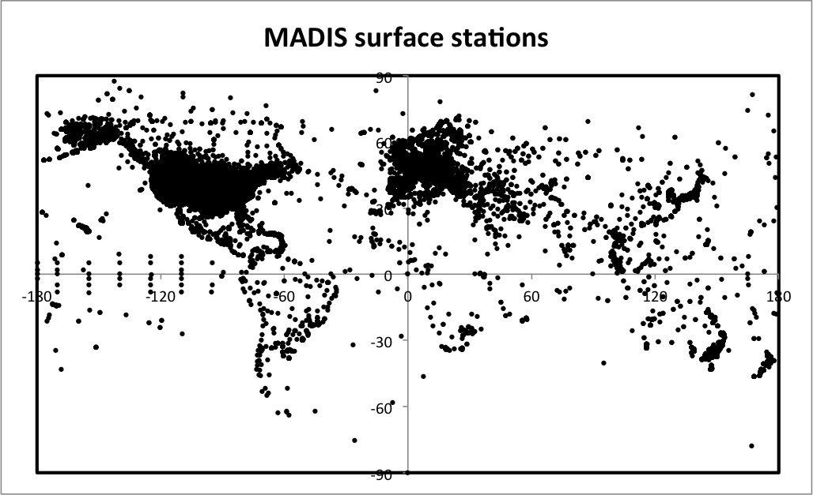
All available MADIS surface stations for a selected hour
N = 91,501 entries
20160306 00Z
Notes:
And since some obs report frequently, and report numerous variables, FAR MORE than 92000 data records…!!!!

Slide 16
MADIS_download.sh
The key line in the script may look like this:
As configured here, this will download ALL fields from ALL available stations, from ALL data providers, at the specified time AND over the previous 59 min, independent of quality control flag setting, for the entire world
Downloading can take a very, very long time!
site="https://madis-data.ncep.noaa.gov/madisPublic1/cgi-bin/
madisXmlPublicDir?rdr=&time="$date"_"$date_hr"00&minbck=-59&minfwd=0&
recwin=4&dfltrsel=2&latll=0.0&lonll=0.0&latur=90.0&lonur=0.0&
&state=&stanam=&stasel=0&pvdrsel=0&varsel=2&qcsel=0&xml=0&csvmiss=0”
The example script in $LAB/SCRIPTS may be configured somewhat differently

Slide 17
MADIS_download.sh
site="https://madis-data.ncep.noaa.gov/madisPublic1/cgi-bin/
madisXmlPublicDir?rdr=&time="$date"_"$date_hr"00&minbck=-59&minfwd=0
&recwin=4&dfltrsel=2&latll=0.0&lonll=0.0&latur=90.0&lonur=0.0
&state=&stanam=&stasel=0&pvdrsel=0&varsel=2&qcsel=0&xml=0&csvmiss=0”
• Time window extends ahead 0 minutes and behind 59 minutes (&minbck=-59 and &minfwd=0)
Alternative: &minbck=-30 and &minfwd=30 (requested time ± 30 min)
• All observations, irrespective of quality control flag (&qcsel=0)
Alternative: &qcsel=1, or 2, or 3
• Returns all records found in time interval requested (&recwin=4)
Alternatives:
&recwin=1 - return one record per station, closest to analysis time
&recwin=2 - return one record per station, closest to start of time window
&recwin=3 - return one record per station, closest to end of time window
Notes:
“Level 1 QC checks are considered the least sophisticated, level 3 the most sophisticated checks.” for surface data.
https://madis.ncep.noaa.gov/madis_sfc_qc.shtml
For radiosonde, only QC levels 1, 2.

Slide 18
MADIS_download.sh
site="https://madis-data.ncep.noaa.gov/madisPublic1/cgi-bin/
madisXmlPublicDir?rdr=&time="$date"_"$date_hr"00&minbck=-59&minfwd=0&
recwin=4&dfltrsel=2&latll=0.0&lonll=0.0&latur=90.0&lonur=0.0&state=
&stanam=&stasel=0&pvdrsel=0&varsel=2&qcsel=0&xml=0&csvmiss=0”
• More options (limiting data downloaded, to save time)
- Set latitude and longitude limits (&latll, &latur, &lonll, &lonur for
values at lower left (ll) and upper right (ur) of specific area
- &state=CA (if used, tries to limit request to stations in California, but it’s crude and
may [will] get get some data from neighboring states
- &pvdrsel=1 and &pvd=ASOS (would activate provider filter and
limit data obtained to ASOS stations)
- &varsel=1 and &nvars=T&nvars=TD&nvars=RH&nvars=DD&nvars=FF&nvars=FFGUST
(limit data obtained to temperature, dewpoint, RH, wind direction, wind speed
and gust)
Notes:
The state=NY draws a box around the state using LL and UR lat/lon, and as a consequence also got some stations iin neighboring states like PA, NJ, CT, MA, VT

Slide 19
MADIS quality control codes
https://madis.ncep.noaa.gov/madis_sfc_qc_notes.shtml
Automated QC checks: “QCD”
C - Coarse pass, passed level 1
S - Screened, passed levels 1 and 2
V - Verified, passed levels 1, 2, and 3
X - Rejected/erroneous, failed level 1
Q - Questioned, passed level 1, failed 2 or 3

Slide 20
MADIS2ASCII.sh, MADIS2ASCII.pl
These scripts do additional processing on the raw MADIS data
In particular, MADIS2ASCII.pl is currently configured to retain only ASOS station data, for a selection of fields (but can be edited)
Also contains optional code to filter by elevation, lat/lon
#station type filter
$typefilter=1;
if ( $station_type eq 'ASOS' ){
Notes:
There is a MADIS2NC tool now, untried – as my script does some potentially useful filtering

Slide 21
Sequence
Edit MADIS_download.sh
sh MADIS_download.sh
  Downloads files like 20160901_00.mtxt
Make sure MADIS2ASCII.pl is configured as you need
sh MADIS2ASCII.sh
  Creates files like 20160901_00.out
sh ASCII2NC.sh
  Creates files like 20160901_00.nc [NetCDF files]
Edit MET6_*.sh so OBS_base points to your MADIS NetCDF files and reflects time period of interest
  OBS_base=$MYLAB/MADIS/MADIS_20160313_ASOS

Slide 22
Taylor Diagrams
[WINDSTORM WIND01 example]

Slide 23
Problems with MAE #1
Mean absolute error (MAE) is not always the best error measure to use, as it can appear large even when the observations and forecasts are not that far apart
  Example: observed and forecast troughs that are slightly out of phase imply non-zero errors everywhere, and this can add up even if phase difference is functionally irrelevant
  Root mean square error (RMSE) can be even worse, as it exaggerates impacts of larger discrepancies

Slide 24
Problems with MAE #2
Worse still, sometimes imprecise forecasts can appear to be more accurate than more precise ones
  Example 1: Compare low- and high-resolution forecasts for precipitation. The high-res forecast may predict a sharply-defined and intense squall line at a particular location. The low-res forecast may predict a less intense, more diffuse blob of precip. If the position of the forecasted squall line is off a little bit, the low-res forecast may actually appear to have smaller error (the hi-res forecast goes “all in”).
  Example 2: Hurricane Jeanne (2004) did a looping track east of Florida as it headed westward. A simulation that failed to capture the loop, but traveled west more slowly than the actual storm, had less position error than one that actually got the loop correctly but was a bit too fast or slow. At any time, the looping forecast was always off, by enough for the absolute error to accumulate.

Slide 25
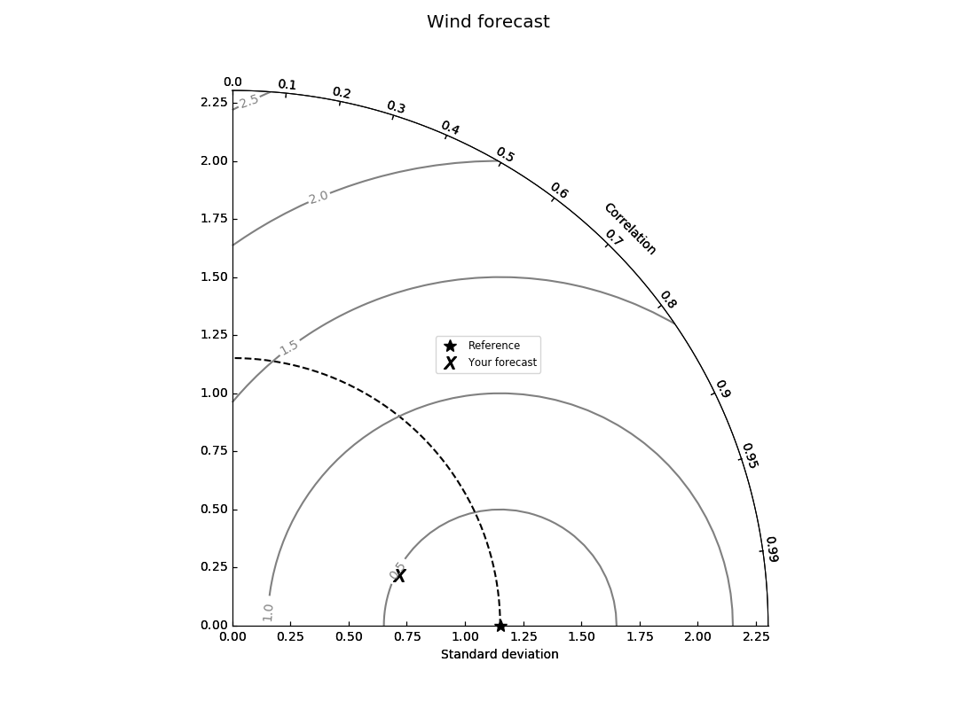
Alternative
Compute correlation between observed and forecast data, the standard deviations of the observed and forecast data, and the bias-corrected root-mean square error (BCRMSE)
Plot these on a “Taylor diagram” in which
  Horizontal axis is standard deviation. Vertical axis is, too.
  The rounded outer arc is forecast-observation correlation coefficient.
  The observed standard deviation is plotted along the horizontal axis (the "reference point").
  Contours of BCRMSE are plotted, centered on the reference point.
You are plotting two points: the observed standard deviation (along the horizontal axis), and a point defined by the forecast standard deviation and the correlation. (Add additional forecast points as desired.)
You want a high correlation with the observations, and a comparable standard deviation, so the (in this case) temporal variation of the observed and forecast time series are similar.
  In other words, you want to be as close to the reference point as possible.

Slide 26
Example: WINDSTORM verification for ASOS stations
You are in your WINDSTORM/WIND01 directory.
  I am presuming the last MET analysis you performed was MET6_ASOS.sh, and you have run the network_plots.sh script
Execute first:
  $ dopython
Copy $LAB/SCRIPTS/analyze_wind_taylor.sh and run it
  This script is configured to examine 10 m wind forecasts vs. observations; this can be changed

Slide 27
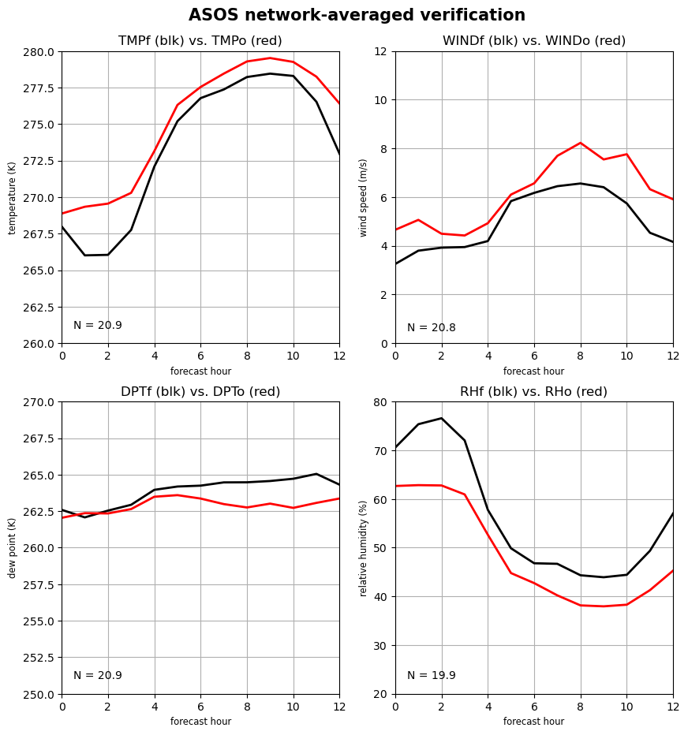
We anticipate a high correlation but a
forecast standard deviation smaller than observed

Slide 28

Output of analyze_wind_taylor.sh
---------------------------------------------------
Summed MAE for this run: 31.173000000000002
---------------------------------------------------
Correlation: 0.9004122170506883
Std deviation of forecasts: 1.15897313461366
Std deviation of observations: 1.3048171083902635
---------------------------------------------------
Taylor diagram
for
WIND01 ASOS
wind forecasts
Your simulation is at the “X”. You WANT it to be at the star (perfect correlation, same std. dev. as obs).

Slide 29
Details #1
In analyze_wind_taylor.sh, there is this line
  plot_met.sh 3 > out.tmp
The script network_plots.sh runs a script called plot_met.sh, which reads text files created by MET
  Variable number 3 is the WIND comparison
  Variable number #2 is 2 m TEMP, #4 is DPT (dewpoint), #5 is RH
The analyze_wind_taylor.sh script reads in the “out.tmp” file and creates ”wind.png” and “wind_forecast_taylor.png” when finished

Slide 30
Details #2
Note that we're plotting three quantities (standard deviation, BCRMSE, and correlation) in a 2D space. This is possible because BCRMSE is a function of the standard deviations and correlation (r):
https://pcmdi.llnl.gov/staff/taylor/CV/Taylor_diagram_primer.pdf
f = forecast, o = observation

Slide 31
Verifying against radiosonde data
{Not updated in a long time}
[KANSAS01 example]

Slide 32
Upper air data: PREPBUFR archive
Need a (free) account on NCAR’s Research Data Archive (http://rda.ucar.edu)
Direct link to PREPBUFR data:
  https://rda.ucar.edu/datasets/ds337.0/
You will obtain the data as tar files with names like prepbufr.20160707.nr.tar.gz. After unpacking (with tar –zxvf), they’ll have file extension “.nr”
  $ tar –zxvf prepbufr.20160707.nr.tar.gz
sh PREP2NC.sh will operate on .nr files, creating NetCDF files. This can take a long time.
There are more complete data available, but requires a lot more processing.

Slide 33
Example: KANSAS01 case
Move or remove KANSAS01/postprd/point_stat* files (created from analysis of ASOS surface stations)
Copy MET6_run_prepbufr.sh from SCRIPTS directory into KANSAS01
Edit and execute MET6_run_prepbufr.sh
  [script is preconfigured for KANSAS01 case]
  Compares T and wind speed at 925, 850, 700, and 500 mb
  1000 mb level skipped since it is not always represented in dataset
plot_met.sh NN
  NN={2,..5} for T at p={925,…,500 mb}
  NN={6,..,9} for wind speed at p={925,…,500 mb}

Slide 34
MET6_run_prepbufr.sh
Date_base=20160313
Date_hour=00
domain=1
MYHOME=/network/rit/lab/atm419lab/SOFTWARE
MET_base=$MYHOME/METV6G
OBS_base=/network/rit/lab/atm419lab/DATA/PREPBUFR/PREPBUFR_20160313
RUN_base=$PWD/postprd

Slide 35
Forecast Observ. N
$ sh plot_met.sh 2
0 20160313_000000 TMPf 285.97613 TMPo 286.20714 N 14 MAE 0.41023 BCMSE 0.13592
12 20160313_120000 TMPf 284.11043 TMPo 285.22143 N 14 MAE 1.54112 BCMSE 2.46193
24 20160314_000000 TMPf 286.92656 TMPo 286.35 N 13 MAE 1.52316 BCMSE 3.00807
36 20160314_120000 TMPf 287.23186 TMPo 286.35 N 14 MAE 1.60074 BCMSE 2.94989
48 20160315_000000 TMPf 291.44717 TMPo 290.90714 N 14 MAE 1.46878 BCMSE 2.81629
^^ Forecast hour
[remainder of the output lines shown above..]
MSE 0.18928 BIAS -0.2310 STDf 2.05248 STDo 2.27282 LVL P925f P925o
MSE 3.69624 BIAS -1.111 STDf 2.67884 STDo 2.24582 LVL P925f P925o
MSE 3.34048 BIAS 0.57656 STDf 4.86571 STDo 4.39318 LVL P925f P925o
MSE 3.72757 BIAS 0.88186 STDf 5.77761 STDo 4.63365 LVL P925f P925o
MSE 3.10792 BIAS 0.54003 STDf 5.73934 STDo 5.96254 LVL P925f P925o
Make sure forecast level
= observation level
(the script can get fooled by
problems in the output)
Check N and the fields being compared at each time.
Missing data can make for odd statistics.

Slide 36
2-m temperature averaged over up to 254 ASOS stations
Red: observed
Black: forecast
How does the model perform farther above the ground?
Two isues: many fewer sites, much lower temporal frequency…

Slide 37
925 mb temperature
(average of 13-14 radiosondes)
Red: observed
Black: forecast
Note there is nonzero MAE even at initial time, and it jumps to a higher value
afterward.
BUT…keep in mind the initial condition likely included the data you
are verifying against!
Notes:
Not just looking at surface data anymore, which is looking through the keyhole.

Slide 38
MAE by forecast hour and pressure level
hour 0
Notes:
MAE quickly jumps at 925 mb between 0-12 h and remains high. A LSM issue? PBL? Surface layer? Maybe microphysics and radiation, via incorrect cloudiness. How does this compare to what’s seen in the T2 field? Not just looking through the surface-based keyhole.

Slide 39
Modifying topography and SST
12/2024: The terrain modification NCL script and Python notebook are working
intermittently, for some users and not others. This is being diagnosed.
For the Python notebook, you may need to specify burst-daes as your server.
Using NCL or Python
$ source $LAB/SCRIPTS/doncl.sh
[execute this command first for NCL]

Slide 40
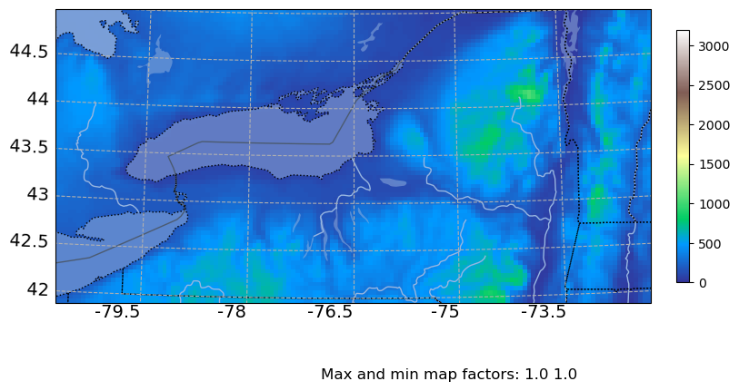
Original

Slide 41
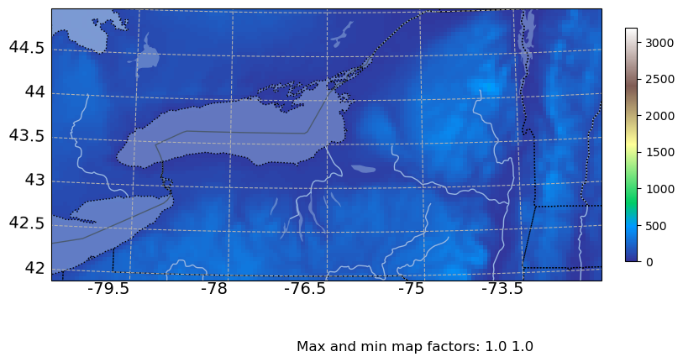
Terrain cut by 50%

Slide 42
NCL script for topography modification
; $LAB/SCRIPTS/mod_terrain.ncl
; a simple script to modify the topography in a geo_em file
load "$NCARG_ROOT/lib/ncarg/nclscripts/csm/gsn_code.ncl"
load "$NCARG_ROOT/lib/ncarg/nclscripts/csm/gsn_csm.ncl"
load "$NCARG_ROOT/lib/ncarg/nclscripts/wrf/WRFUserARW.ncl"
load "$NCARG_ROOT/lib/ncarg/nclscripts/esmf/ESMF_regridding.ncl"
a = addfile("geo_em.d01.nc","w") ; Open a file
f = wrf_user_getvar(a,"F",-1)
; reduce hgt_m by 50%
hgt_m = a->HGT_M
hgt_m = hgt_m*0.5
a->HGT_M = hgt_m
This script open geo_em.d01.nc, reads in topo height (hgt_m), modifies it by 50%,
and them writes it back to the file. The geo_em.d01.nc file is modified in this process
If you get an “HDF error” on opening the geogrid file, try the Python script instead

Slide 43
NCL topography modification recipe
Make sure to source doncl.sh first
Copy $LAB/SCRIPTS/mod_terrain.ncl and edit as needed
Run geogrid.exe
ncl mod_terrain.ncl
  Modifies geo_em.d01.nc
If you have multiple domains, edit NCL script for geogrid output file name (e.g., geo_em.d02.nc, etc.) and run for each domain
If you run geogrid.exe again, these changes are destroyed

Slide 44
Python notebook for modifying topography
Copy and modify $LAB/SCRIPTS/mod_WRF_terrain.ipynb
After you execute the script, the file geo_em.d01.nc has been modified
Try to plot the new terrain with plot_WRF_terrain.ipynb. Don’t skip this step.
  If you get an “HDF error”, your geogrid file may need fixing:
    mv geo_em.d01.nc broken.nc
    ncks --fl_fmt=netcdf4 broken.nc geo_em.d01.nc
  Try plotting again
Repeat for any nests

Slide 45
NCL script to modify SST
During the WPS steps, sea-surface temperature (SST) and ”skin temperature” (TSK) are read in from the parent model and used to initialize surface temperature over land and ocean
Say one wishes to alter surface temperature over the ocean but not the land
This involves
  Reading in a wrfinput_d01 file created by real.exe
  Accessing the TSK and SST variables, and the LANDMASK
  Altering TSK and SST where LANDMASK = 0 (ocean)
  Writing the modified fields back to wrfinput_d01

Slide 46
NCL script to modify SST
$LAB/SCRIPTS/sst.ncl
; change SST and TSK by fixed amount but only over OCEAN
[…]
a = addfile("wrfinput_d01","w") ; Open a file
f = wrf_user_getvar(a,"F",-1)
sst = a->SST
landmask = a->LANDMASK
tsk = a->TSK
do j=0,538
do i=0,718
if(landmask(0,j,i).eq.0) then
tsk(0,j,i)=tsk(0,j,i)+3
sst(0,j,i)=sst(0,j,i)+3
end if
end do
end do
a->SST = sst
a->TSK = tsk
This script
• opens wrfinput_d01 [AND WILL MODIFY IT
SO KEEP A PRISTINE COPY]
• loops over the entire domain [NEED TO CHANGE
TO YOUR DIMENSIONS. J IS NORTH-SOUTH
AND I IS WEST-EAST]
• adds 3 K to both SST and TSK, but only over
ocean, where LANDMASK = 0
• writes modified fields back to same wrfinput_d01
file

Slide 47
SST modification recipe
Make sure to source doncl.sh first
Copy $LAB/SCRIPTS/sst.ncl and edit as needed
Run real.exe
ncl sst.ncl
  Modifies wrfinput_d01
If you have multiple domains, edit NCL script for geogrid output file name (e.g., wrfinput_d02, etc.) and run for each domain
If you run real.exe again, these changes are destroyed

Slide 48
Input data sources
Get GRIB1 or GRIB2 data for use in ungrib
Make sure you have the correct Vtable(s)

Slide 49
Some sources for initialization data
NCAR RDA
  http://rda.ucar.edu
NCEP NOMADS server (for recent data)
  http://nomads.ncep.noaa.gov
  The get_gfs.csh script in $LAB/SCRIPTS is configured to fetch the most recent 00Z GFS 0.25˚ grids via FTP. It can be modified to fetch different datasets. You should seriously consider using AWS (below) instead.
NCDC NOMADS server (for older data)
  https://www.ncei.noaa.gov/products/weather-climate-models/numerical-weather-prediction
HRRR archives at U. Utah (obviated by AWS)
  http://hrrr.chpc.utah.edu
ERA5 reanalysis data from Copernicus
Amazon Web Services (AWS) [or Google Cloud] for archived NOAA model data (see upcoming slide)

Slide 50
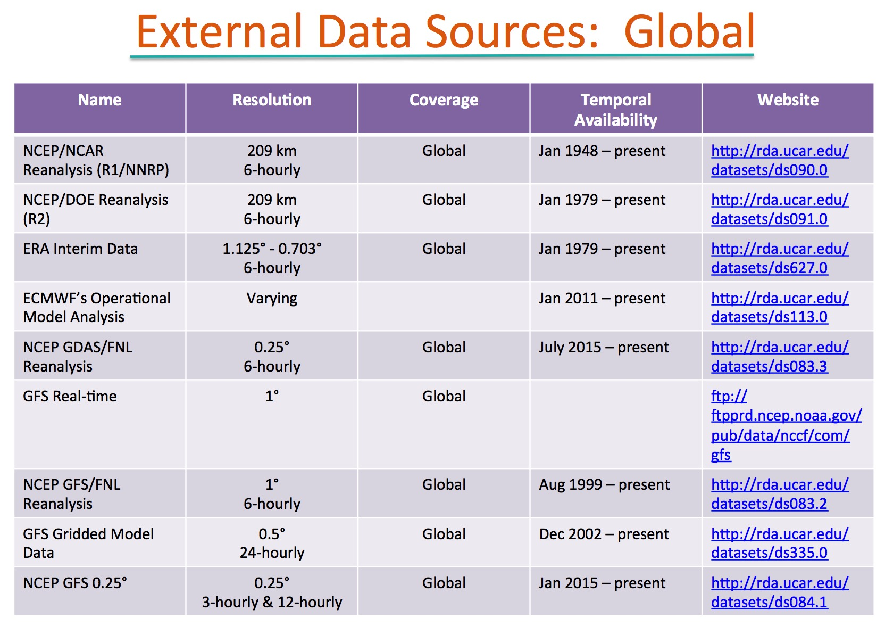
[superceded by ERA5]
(analysis)
(analysis)
2015
see slide 53
From WRF tutorial presentation

Slide 51
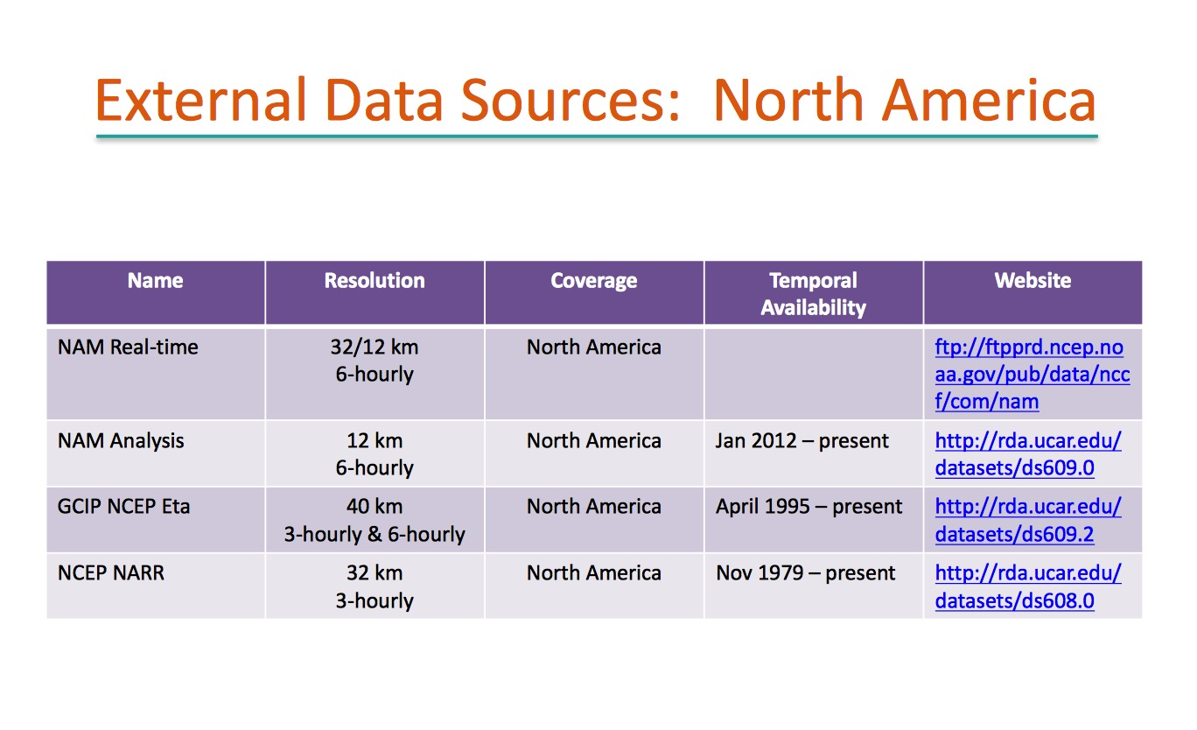
From WRF tutorial presentation

Slide 52
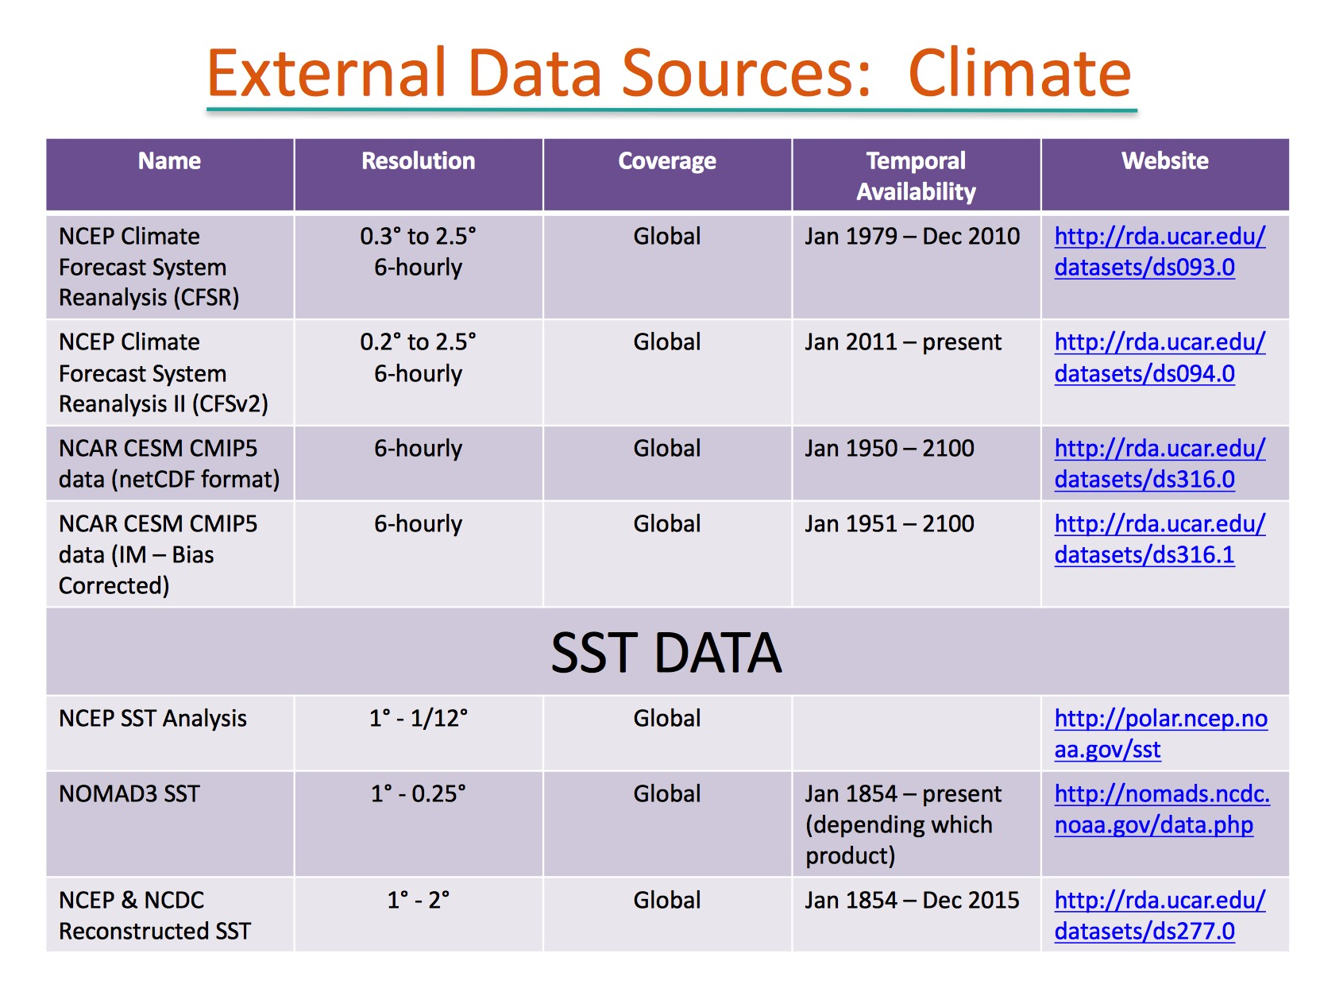

Slide 53
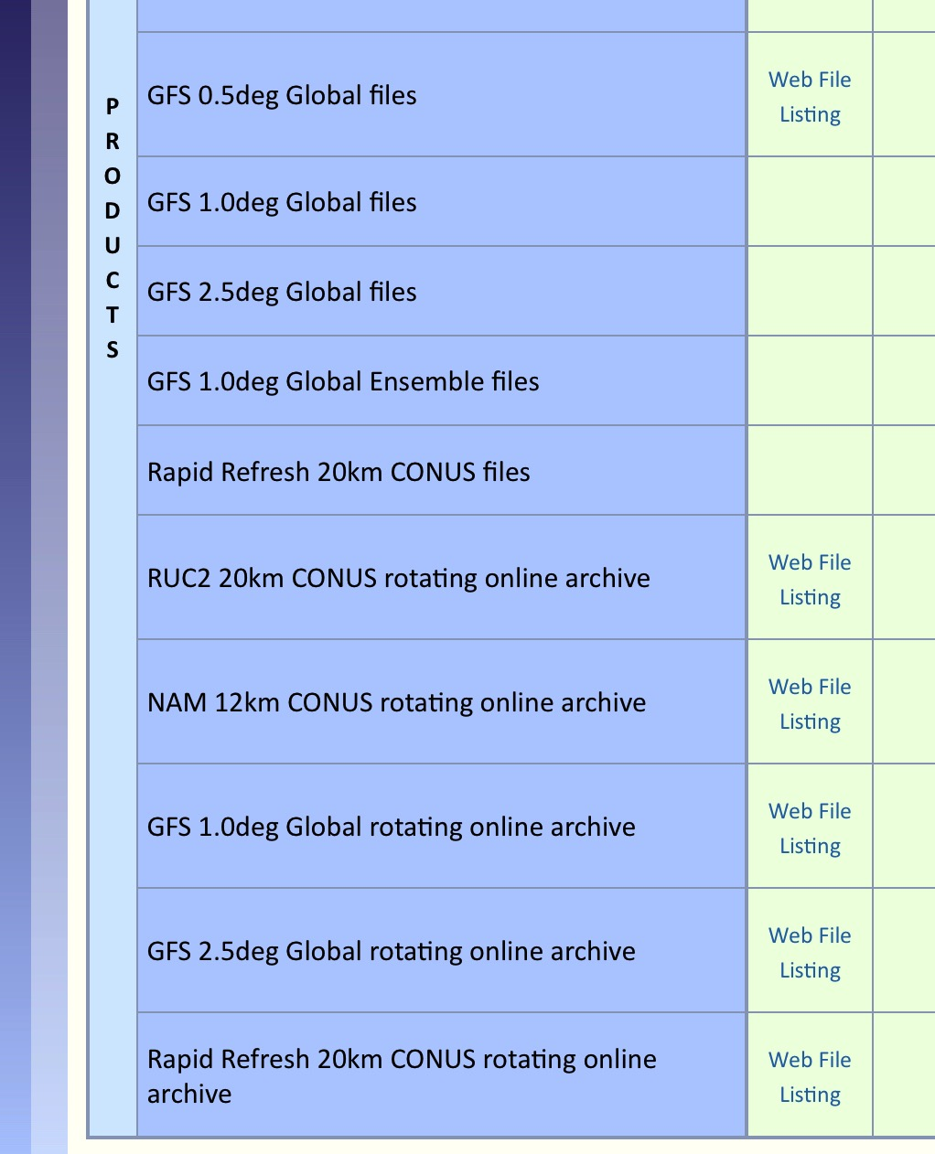
Unidata Internet Data Distribution (IDD) archive at rda.ucar.edu
ds335.0
• GFS 0.5˚ data are usable as-is in WPS
(tho they are 6-h analyses, not forecasts)
[see ds084.1 for 0.25˚ files for 2015-present]
• NAM 12km files need a lot of work
- analyses + forecasts combined
- soil information is missing
- ds609.0 is alternative, but analyses only
• RAP 20km are also problematic
- analyses + forecasts combined
- soil information is missing

Slide 54
Another catalogue of RDA links
http://www2.mmm.ucar.edu/wrf/users/download/free_data.html
  Links to datasets and Vtables

Slide 55
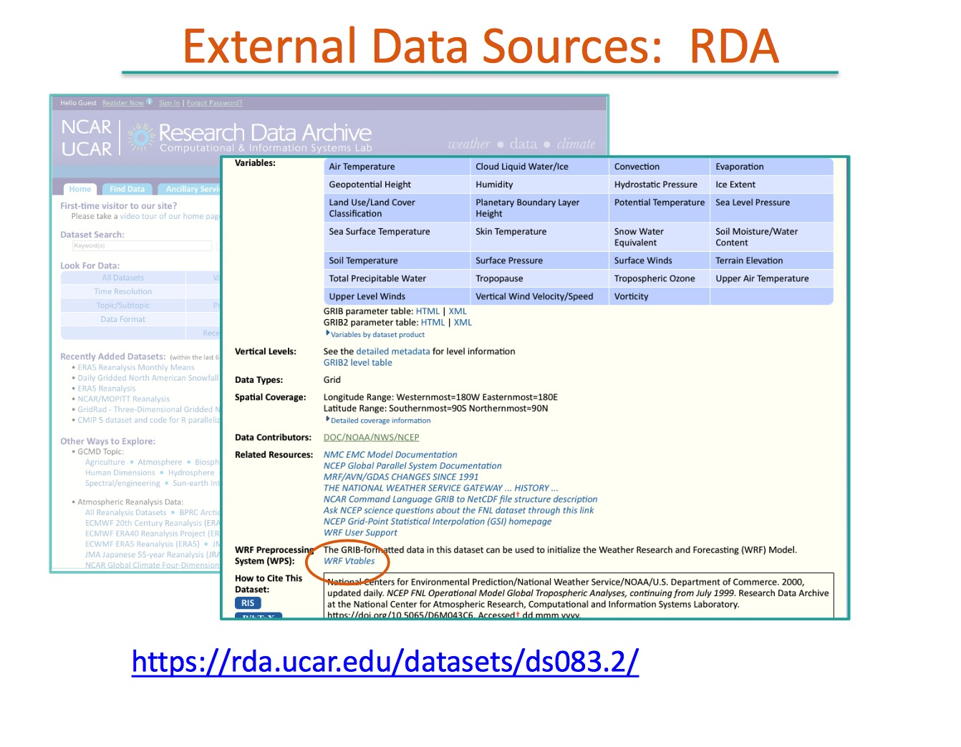

Slide 56
European Center datasets
(require permissions)
ECMWF operational model analyses (since 2011)
  https://rda.ucar.edu/datasets/ds113.0/
ERA-Interim Reanalysis (1979-2019)
  https://rda.ucar.edu/datasets/ds627.0/
ERA5 Reanalysis (GRIB format no longer available)
  https://rda.ucar.edu/datasets/ds633.0/
ERA 20th Century Reanalysis (1900-2011)
  https://rda.ucar.edu/datasets/ds626.0/
See http://www2.mmm.ucar.edu/wrf/users/download/free_data.html
for Vtables
Notes:
ERA5 available through present (2019) in netCDF4 format, but how to use those in WPS?

Slide 57
Amazon Web Services
NOAA Big Data Program at AWS: https://registry.opendata.aws/collab/noaa/
Model data available include
  HRRR (from 7/30/2014)
  NAM (from 9/16/2021)
  GFS (from 2/26/2021)
  RAP (from 2/22/2021)
  GEFS (from 1/1/2017)
  ERA5 reanalysis no longer available
See example downloading scripts $LAB/SCRIPTS/aws_hrrr_new.sh and aws_gfs_new.sh. Edit. Execute dopython first.

Slide 58
Initializing WRF with NetCDF source model files
[NEW. Feedback and bug reports welcome.]
Specifically, ERA5 reanalyses in NetCDF format
Sayonara, ungrib.exe!

Slide 59
Problem statement
The ungrib.exe program is used to read in GRIB1 or GRIB2 format files and produce outputs in an “intermediate format” for use by metgrid.exe
The NCAR RDA (rda.ucar.edu) has discontinued hosting GRIB-formatted ERA5 reanalysis files, in favor of NetCDF format. AWS has also discontinued hosting ERA5.
ERA5 GRIB files can be downloaded from Copernicus but access can be very slow.
A method is needed to create intermediate format files directly from NetCDF files is needed, bypassing ungrib

Slide 60
WPS_ERA5_PREPROCESSOR.ipynb
$LAB/SCRIPTS/WPS_ERA5_PREPROCESSOR.ipynb is a notebook-based replacement for ungrib
It is based on Luke Madaus’ wrf-preproc-intermediate-writer program with substantial modifications to work for ERA5 and can be run on ARCC Jupyterlab
Substantial preparation of the NetCDF files is needed prior to running the notebook. Part of that preparation involves editing and running ERA5_RH2m_computer.ipynb

Slide 61
Step #1
Download ERA5 files from NCAR RDA in NetCDF format.
  Isobaric level fields needed: z, t, u, v, r. (q is not needed)
  Surface fields needed: msl, sp, 2t, sstk, skt, 10u, 10v, 2d
  Subsurface fields needed: stl1, stl2, stl3, stl4, swvl1, swvl2, swvl3, swvl4

Slide 62
Step #2
For multiple day runs, combine isobaric level files by field. This can take a lot of time.
  ncrcat e5.oper.an.pl.128_129_z* era5_z.nc
  ncrcat e5.oper.an.pl.128_130_t* era5_t.nc
  ncrcat e5.oper.an.pl.128_131_u* era5_u.nc
  ncrcat e5.oper.an.pl.128_132_v* era5_v.nc
  ncrcat e5.oper.an.pl.128_157_r* era5_r.nc
The surface fields each encompass an entire month. For runs crossing months, you may need to combine surface files or run this notebook and do the following steps more than once

Slide 63
Step #3
ERA5 does not supply 2 m RH. Not having 2 m RH can also cause real.exe to also ignore U10 and V10 information, changing fields near the surface, because it forces use_surface to be set to False
  Run notebook ERA5_RH2m_computer.ipynb to read in 2t, 2d files, computing 2m RH via MetPy
  This generates a new NetCDF file called output_file.nc, which clones the file containing 2d
  Then change name of variable in output file:
    ncrename -v VAR_2D,VAR_2RH output_file.nc
  Change name of output_file.nc if needed:
    mv output_file.nc era5_rh2m_aug2019.nc
2t = 2 m T
2d = 2 m Td

Slide 64
Step #4
Have the invariant field SOILHGT available and expressed in meters (not surface geopotential in m2/s2).
  The file /network/rit/lab/atm419lab/DATA/ERA5/era5_SOILHGT.nc is ready for use
Modify Cell #2 in WPS_ERA5_PREPROCESSOR.ipynb for locations, names of files

Slide 65
Part of Cell #2: Declaring file locations
variable_paths = {
# Invariant
'SOILHGT' : '/network/rit/lab/atm419lab/DATA/ERA5/era5_SOILHGT.nc',
# Surface variables. VAR_2RH file created with ERA5_RH2m_computer.ipynb
'MSL' : '/network/rit/lab/atm419lab/DATA/ERA5_AUG2019_NETCDF/e5.oper.an.sfc.128_151_msl.ll025sc.2019080100_2019083123.nc',
'SP' : '/network/rit/lab/atm419lab/DATA/ERA5_AUG2019_NETCDF/e5.oper.an.sfc.128_134_sp.ll025sc.2019080100_2019083123.nc',
'VAR_2T' : '/network/rit/lab/atm419lab/DATA/ERA5_AUG2019_NETCDF/e5.oper.an.sfc.128_167_2t.ll025sc.2019080100_2019083123.nc',
'SSTK' : '/network/rit/lab/atm419lab/DATA/ERA5_AUG2019_NETCDF/e5.oper.an.sfc.128_034_sstk.ll025sc.2019080100_2019083123.nc',
'SKT' : '/network/rit/lab/atm419lab/DATA/ERA5_AUG2019_NETCDF/e5.oper.an.sfc.128_235_skt.ll025sc.2019080100_2019083123.nc',
'VAR_10U' : '/network/rit/lab/atm419lab/DATA/ERA5_AUG2019_NETCDF/e5.oper.an.sfc.128_165_10u.ll025sc.2019080100_2019083123.nc',
'VAR_10V' : '/network/rit/lab/atm419lab/DATA/ERA5_AUG2019_NETCDF/e5.oper.an.sfc.128_166_10v.ll025sc.2019080100_2019083123.nc',
'VAR_2RH' : '/network/rit/lab/atm419lab/DATA/ERA5_AUG2019_NETCDF/era5_rh2m_aug2019.nc',
# Upper air variables. Z is geopotential, not geopotential height
'T' : '/network/rit/lab/atm419lab/DATA/ERA5_AUG2019_NETCDF/era5_t.nc',
'R' : '/network/rit/lab/atm419lab/DATA/ERA5_AUG2019_NETCDF/era5_r.nc',
'U' : '/network/rit/lab/atm419lab/DATA/ERA5_AUG2019_NETCDF/era5_u.nc',
'V' : '/network/rit/lab/atm419lab/DATA/ERA5_AUG2019_NETCDF/era5_v.nc',
'Z' : '/network/rit/lab/atm419lab/DATA/ERA5_AUG2019_NETCDF/era5_z.nc',
# Soil variables
'STL1' : '/network/rit/lab/atm419lab/DATA/ERA5_AUG2019_NETCDF/e5.oper.an.sfc.128_139_stl1.ll025sc.2019080100_2019083123.nc',
'STL2' : '/network/rit/lab/atm419lab/DATA/ERA5_AUG2019_NETCDF/e5.oper.an.sfc.128_170_stl2.ll025sc.2019080100_2019083123.nc',
'STL3' : '/network/rit/lab/atm419lab/DATA/ERA5_AUG2019_NETCDF/e5.oper.an.sfc.128_183_stl3.ll025sc.2019080100_2019083123.nc',
'STL4' : '/network/rit/lab/atm419lab/DATA/ERA5_AUG2019_NETCDF/e5.oper.an.sfc.128_236_stl4.ll025sc.2019080100_2019083123.nc',
'SWVL1' : '/network/rit/lab/atm419lab/DATA/ERA5_AUG2019_NETCDF/e5.oper.an.sfc.128_039_swvl1.ll025sc.2019080100_2019083123.nc',
'SWVL2' : '/network/rit/lab/atm419lab/DATA/ERA5_AUG2019_NETCDF/e5.oper.an.sfc.128_040_swvl2.ll025sc.2019080100_2019083123.nc',
'SWVL3' : '/network/rit/lab/atm419lab/DATA/ERA5_AUG2019_NETCDF/e5.oper.an.sfc.128_041_swvl3.ll025sc.2019080100_2019083123.nc',
'SWVL4' : '/network/rit/lab/atm419lab/DATA/ERA5_AUG2019_NETCDF/e5.oper.an.sfc.128_042_swvl4.ll025sc.2019080100_2019083123.nc',
}

Slide 66
Step #5
In Cell #3, set the time range. Example:
  'time_range' : (datetime(2019,8,26,12), datetime(2019,8,27,0)),
In Cell #3, set the time interval (interval_seconds, but expressed in hours). Example:
  'time_freq' : '3h',
Run the notebook, creating ungrib-like outputs (e.g., named FILE:YYYY-MM-DD_HH:MM:SS)
  Existing files with these names are overwritten
In the metgrid step, do NOT include the ERA5 invariant file that you would use with GRIB data
  This appears to corrupt the soils information.

Slide 67
Adaptive time stepping
[can save a lot of time, but can also cause problems]

Slide 68
Modification to namelist.input (&domains section)
use_adaptive_time_step = .true.,
step_to_output_time = .true.,
target_cfl = 1.2, 1.2,
target_hcfl = .84, .84,
max_step_increase_pct = 5, 51,
starting_time_step = -1, -1,
max_time_step = 720, 720,
min_time_step = 240, 240,
adaptation_domain = 1,
Preserves requested output times
(for outermost domain anyway)
Starts with ∆t = 4∆x (∆x in km)
Often based on 8∆x and 3-4∆x
Domain to use to adjust ∆t
• CFL = (fastest wave speed)*∆t/(grid length)
• increase time step if vertical CFL < target_cfl and horizontal CFL < target_hcfl
• when use_adaptive_time_step = .true., time_step is ignored
• Typically use a larger max_step_increase in nests than in outer domain (as shown here)

Slide 69
Adaptive time stepping for SOC case
SOC experiment
time step
Created from information written to rsl.out.XXXX files
(Example from WRFV371-based simulation)

Slide 70
NNRP-based SOC runs sensitivity to time stepping
Time step | RMS SLP error (NNRP) | NESIS
adaptive | 2.01 mb/gridpt | 10.93
∆t = 720 sec | 2.04 | 11.09
∆t = 540 sec | 2.02 | 11.37
∆t = 240 sec | 2.00 | 11.35
∆t = 120 sec | 2.02 | 11.11
• Microphysics is more sensitive to time step than many other model physics
and numerics (such as advection)
• Example from WRFV371-based simulation

Slide 71
Outputting extra fields

Slide 72
Outputting extra fields
By default, a lot of fields computed or used by WRF are NOT written to the wrfout files
These can be added to the wrfout files by
  Editing the appropriate WRF Registry (e.g., Registry.EM_COMMON) file and recompiling from scratch (after clean –a)
  Using the “iofields” option in namelist.input
Example: Write out boundary layer tendencies RUBLTEN, RVBLTEN, RTHBLTEN, and RQVBLTEN

Slide 73
Modify namelist.input
(&time_control section)
Add these lines:
Contents of “my_file_d01.txt”:
For multiple domain runs, contents of the ”my_file” files can be the same or different, and you can use same filename for each nest
Presuming 3 domains used. One file for each domain.
iofields_filename = "my_file_d01.txt","my_file_d02.txt","my_file_d03.txt",
ignore_iofields_warning = .true.,
+:h:0:RUBLTEN,RVBLTEN,RTHBLTEN,RQVBLTEN
h:0 = wrfouts

Slide 74
Extra fields with more frequent outputs (&time_control section)
Add two more lines (→ output stream “24”):
Alter “my_file_d01.txt”:
Now these extra fields are written to a file called auxhist24_d01… instead, and at (possibly) its own history interval (here, 180 min)
iofields_filename = "my_file_d01.txt","my_file_d02.txt","my_file_d03.txt",
ignore_iofields_warning = .true.,
io_form_auxhist24 = 2,
auxhist24_interval = 180,
+:h:24:RUBLTEN,RVBLTEN,RTHBLTEN,RQVBLTEN

Slide 75
Restarting WRF

Slide 76
In namelist.input
Our SOC case started on 1993-3-12-12
Suppose you had restart_interval = 720. This would make restart files (called wrfrst_d…) every 720 minutes or 12 h.
To restart the model at 1993-3-13-00:
  Revise start_day, start_hour (to restart time)
  Revise run_days, run_hours (to be shorter)
  Set restart = .true.
Model will NOT write a wrfout file at restart time unless you also add this line:
  write_hist_at_0h_rst = .true.

Slide 77
[end]

