Slide 1
Experiment #1
(Hurricane Harvey)
Robert Fovell
ATM 419/563
Fall 2024

Slide 2
Domain setup
See script for experiment configuration
Plots shown here were made using the control run outputs and WRF_plot_HARVEY.ipynb notebook from $LAB/SCRIPTS/
You may want to reinitialize notebook for each run
  Kernel menu > Restart Kernel and Clear All Outputs

Slide 3
Control run

Slide 4
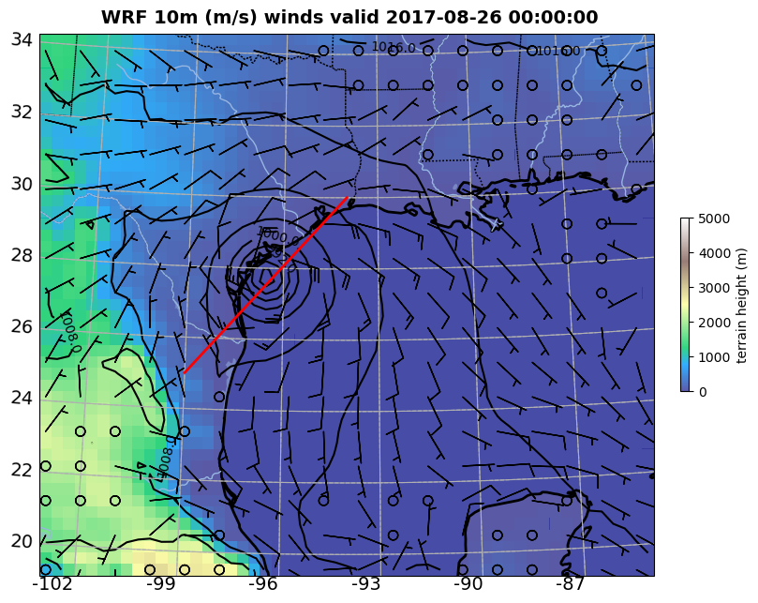
Cell #6
Plots at forecast
hour 12
SLP contoured
Position for
cross-section
was set in
Cell #3

Slide 5
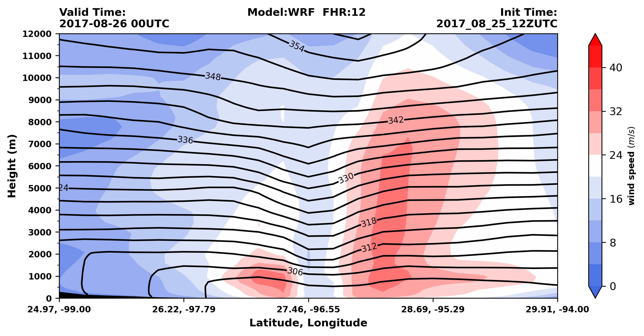
Cell #7: vertical cross-section along path shown in previous figure

Slide 6
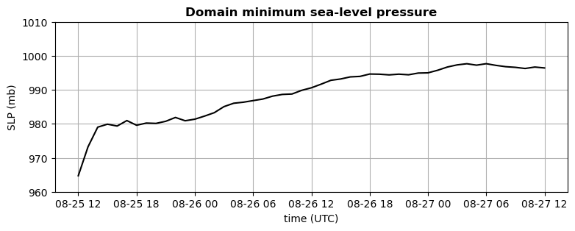
Cell #8: Domain minimum SLP for control run

Slide 7
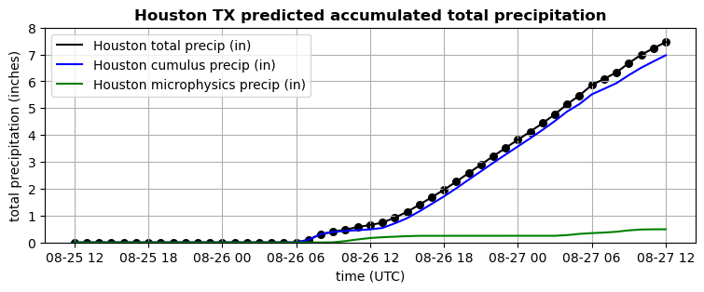
Cell #9: Accumulated total precipitation at Houston, and contributions from cumulus and microphysics

Slide 8
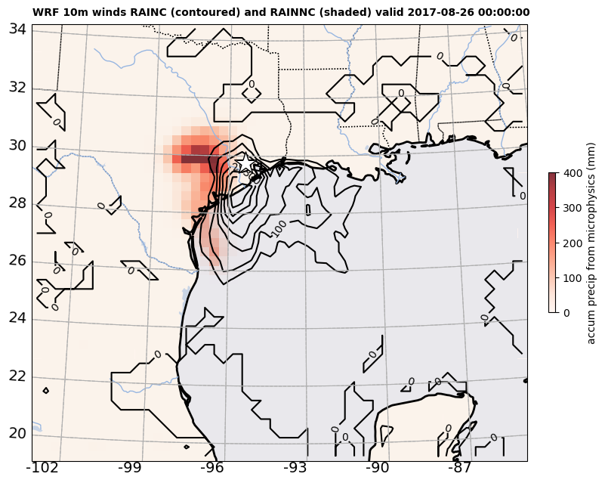
Cell #10
Total accumulated
precip
RAINC = cumulus
[contoured]
RAINNC
= microphysics
[shaded]
Star = Houston

Slide 9
Animations

Slide 10
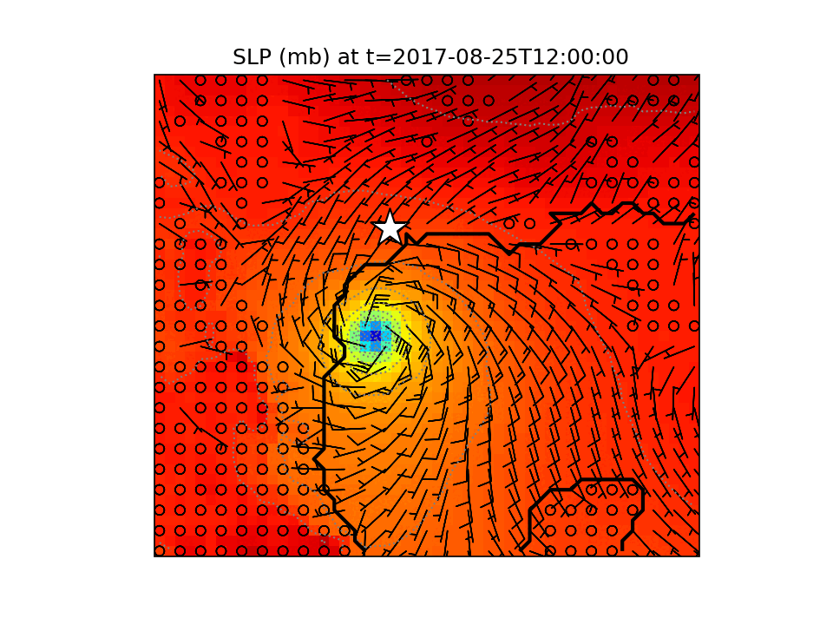
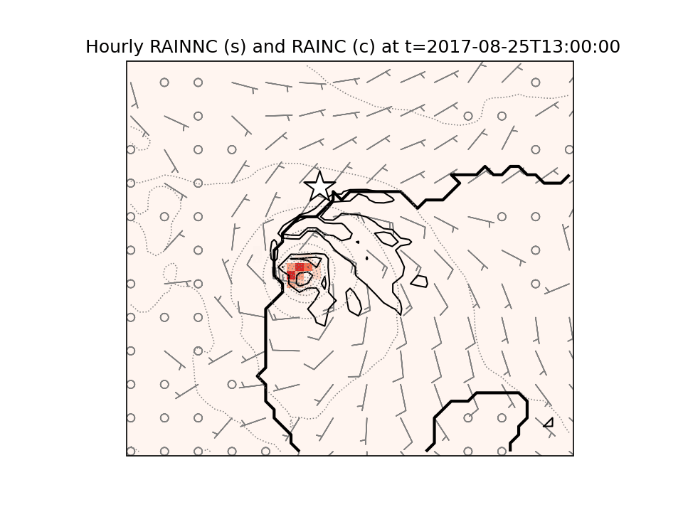

Slide 11
Experiment #1
Due on or before Sept 25 by start of class

Slide 12
Experiment #1 (see script)
Archive your control run
  Make a directory called CONTROL
  Move your wrfout file into it [$ mv wrfout* CONTROL/.]
  Copy your namelists into it [$ cp namelist* CONTROL/.]
Simulation MICRO:
  Edit namelist.input to set cu_physics = 0
  Redo real and wrf
  Rerun notebook.
    For cell that makes time series plot of Houston precipitation, change plot title to consist of your last name and “MICRO”
    Save/capture this image
  Archive this run. Make folder called MICRO, move wrfout into it, copy namelists
Simulation CUMULUS:
  Edit namelist.input to make cu_physics = 1 again but now mp_physics = 0
  Redo real and wrf
  Rerun notebook.
    For cell that makes time series plot of Houston precipitation, change plot title to your last name and “CUMULUS”
    Save/capture this image
  Archive this run. Make folder called CUMULUS, move wrfout into it, copy namelists

Slide 13
[end]

