Slide 1
Example Geogrid assignment
Robert Fovell
ATM 419/563
Fall 2024

Slide 2
Domain setup
60 x 60 grid points at 48 km grid spacing
Reference latitude: 40˚N
Reference longitude: -105˚ (W)
Standard longitude: -105˚ (W)
Intent: simulate a downslope windstorm along the front range of the Rocky Mountains in Colorado

Slide 3
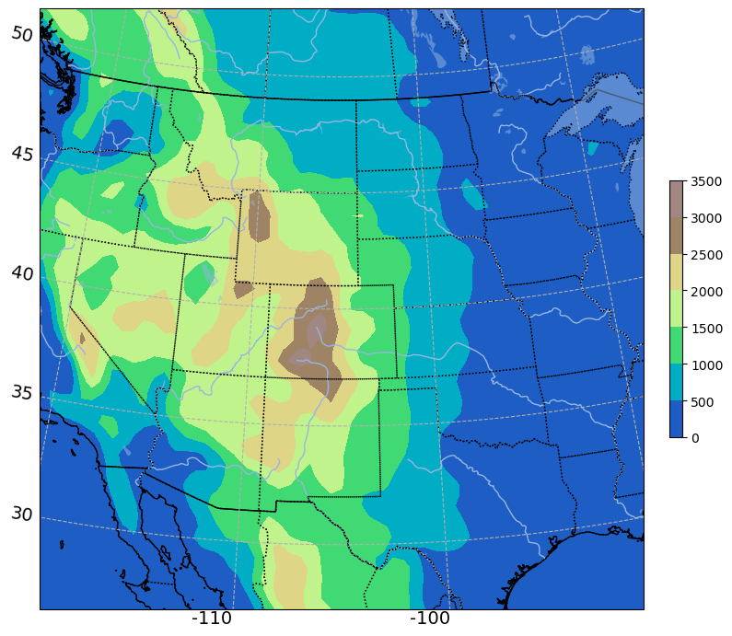
Visualized with
plot_WRF_terrain.ipynb
Lambert #1
map_proj = 'lambert',
ref_lat = 40,
ref_lon = -105,
truelat1 = 30.,
truelat2 = 60.,
stand_lon = -105,
Output from max.csh:
Max 1.01823
Min 0.965648
Grid spacing (km):
Min 47.13
Max 49.71

Slide 4
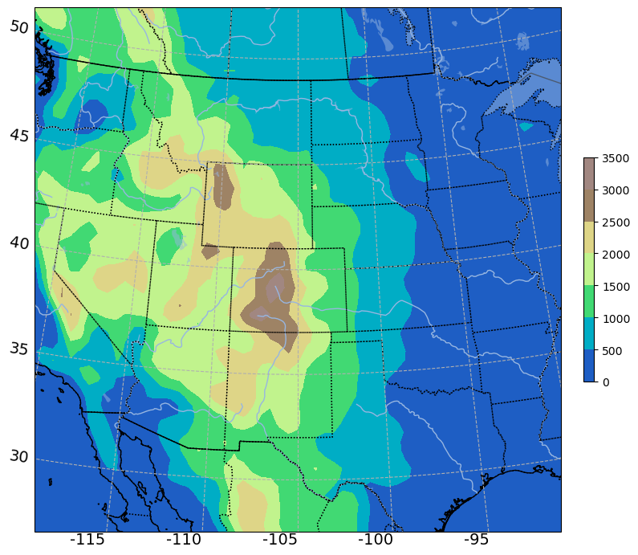
Lambert #2
map_proj = 'lambert',
ref_lat = 40,
ref_lon = -105,
truelat1 = 40.,
truelat2 = 40.,
stand_lon = -105,
Output from max.csh:
Max 1.0261
Min 1.00
Grid spacing (km):
Min 46.78
Max 48.00

Slide 5
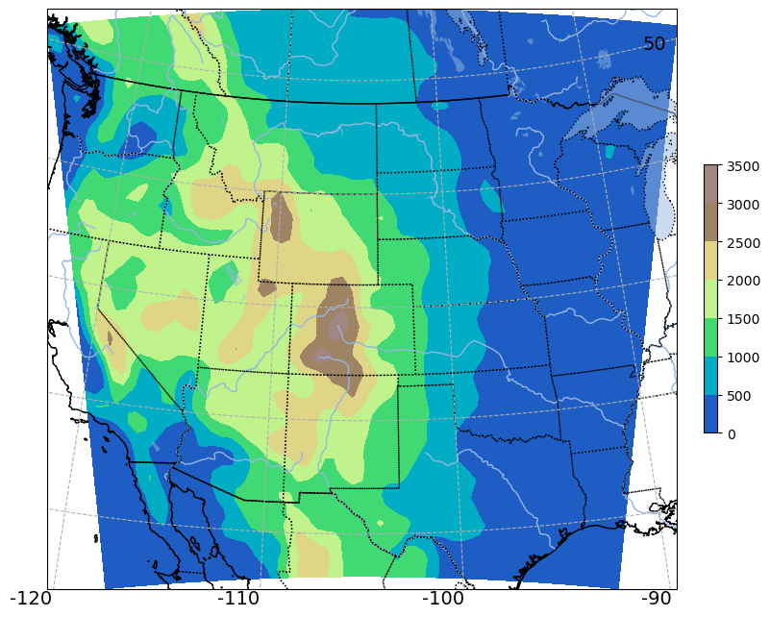
Polar Stereographic
map_proj = 'polar',
ref_lat = 40,
ref_lon = -105,
truelat1 = 40.,
truelat2 = 40.,
stand_lon = -105,
Output from max.csh:
Max 1.13097
Min 0.912634
Grid spacing (km):
Min 42.44
Max 52.60

Slide 6
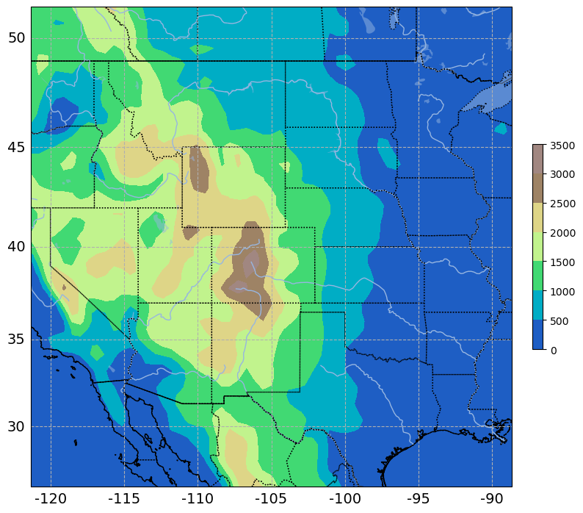
Mercator
map_proj = 'mercator',
ref_lat = 40,
ref_lon = -105,
truelat1 = 40.,
truelat2 = 40.,
stand_lon = -105,
Output from max.csh:
Max 1.22682
Min 0.855103
Grid spacing (km):
Min 39.12
Max 56.12

Slide 7
Grid spacing and map distortion
ref_lat = 40, ref_lon = -105, stand_lon = -105
Projection | Map factor maximum | Map factor minimum | Grid spacing smallest (km) | Grid spacing largest (km)
Lambert #1 | 1.01823 | 0.965648 | 47.13 | 49.71
Lambert #2 | 1.0261 | 1.00 | 46.78 | 48.00
Polar | 1.13097 | 0.912634 | 42.44 | 52.60
Mercator | 1.22682 | 0.855103 | 39.12 | 56.12
Nominal grid spacing is 48 km

Slide 8
Conclusions
Either Lambert #1 or Lambert #2 will work best for this domain
Polar and Mercator are not acceptable projections for this domain

