Slide 1
Visualizing the PBL with WRF-SCM
See also script PBL_demonstration.pdf
ATM 419/563
Fall 2024
Fovell
© Copyright 2024 Robert Fovell, Univ. at Albany, SUNY, rfovell@albany.edu

Slide 2
Introduction
The WRF single column model (SCM) is a useful tool for very quickly testing and comparing model physics
The environment for the SCM is defined in input_sounding and input_soil
We will run the notebook run_WRF_SCM.ipynb on ARCC Jupyterlab
This version runs on batch or burst/burst-daes

Slide 3
Setup [see script]
Create a directory in your lab space called SCM and move into it
Copy the notebook $LAB/SCM/run_WRF_SCM.ipynb
In ARCC Jupyterlab, spawn a process on batch or burst
  Minimal resources suffice – this run only uses 1 CPU
  Move to your SCM directory and launch the notebook

Slide 4
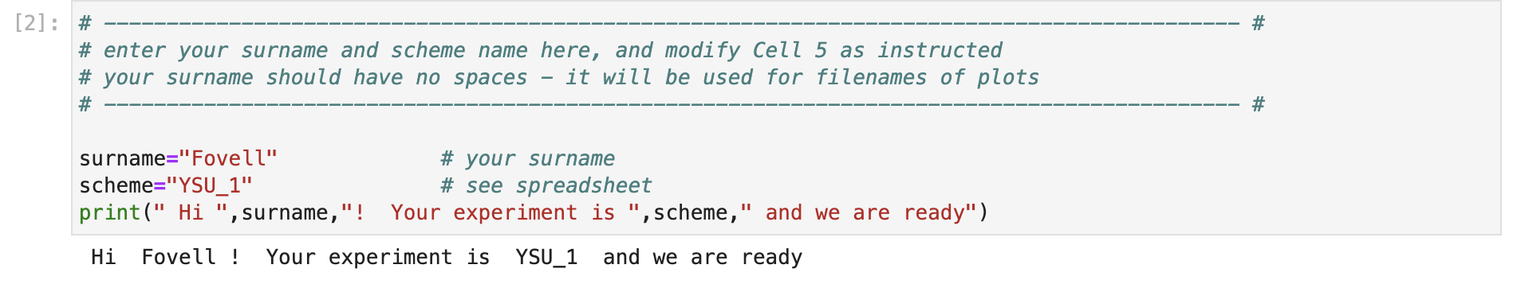
Cell #2 – Setting surname and experiment name
• For our demo, there is no need to modify this cell
• For the class ensemble, you will edit this cell with your surname and simulation (scheme) name
→ more details later

Slide 5
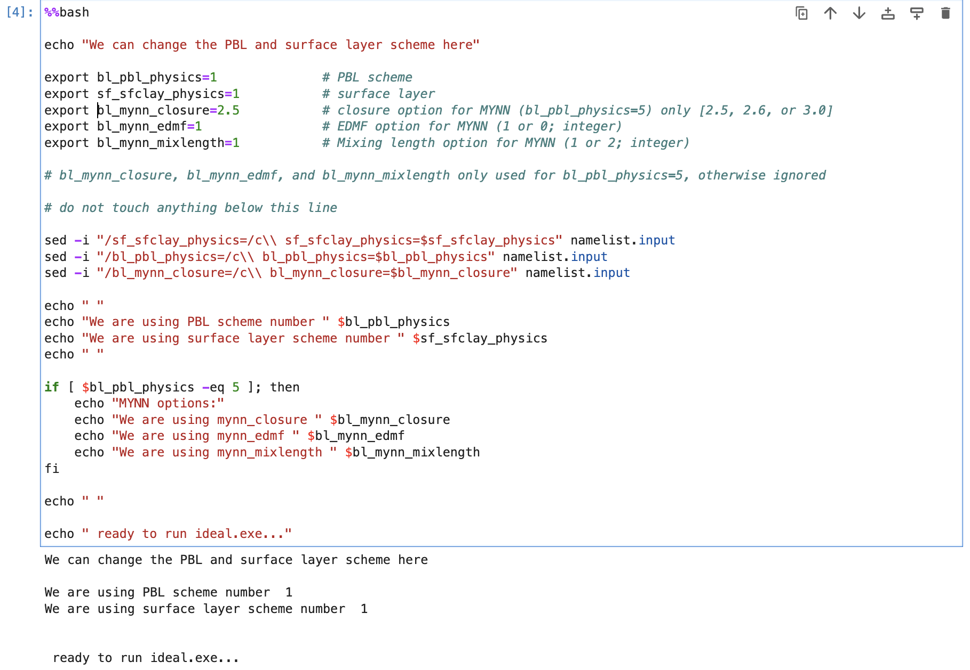
Cell #4 – Physics selection
• No editing needed for the demo
• For the class ensemble, you will modify
one or more of “bl_pbl_physics”,
“sf_sfclay_physics”, “bl_mynn_closure”,
“bl_mynn_edmf”, and “bl_mynn_mixlength”
• bl_mynn_closure is only relevant
if bl_pbl_physics = 5

Slide 6
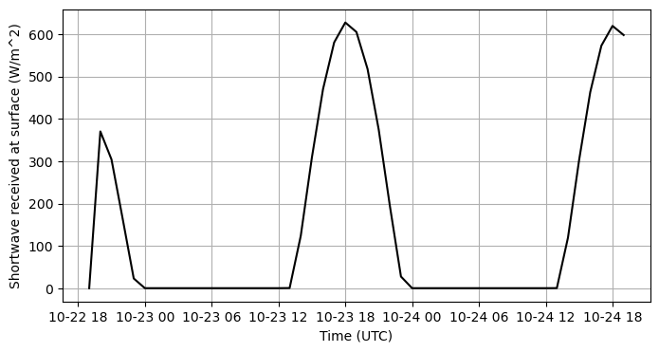
Cell #8 – Shortwave at surface (SWDOWN)
Sunrise is around 12Z
Noon is around 18Z [and simulation commenced at 19Z]
Sunset is about 00Z
• SWDOWN is not provided at first time (model start time), so is erroneously reported as 0

Slide 7
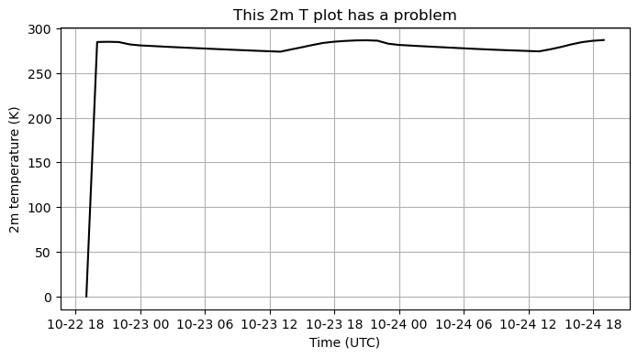
Cell #9 – Plot of 2m temperature (T)
• 2m T is not computed at the model start time, so it is erroneously treated as absolute zero [ouch!]

Slide 8
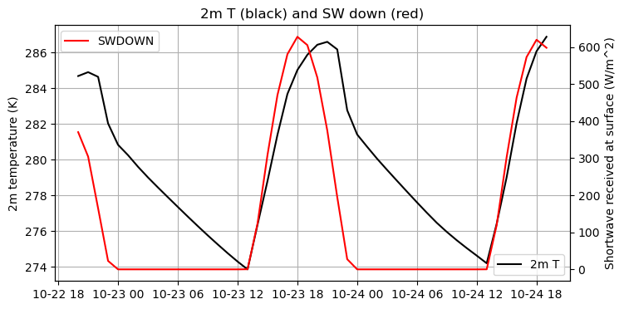
Cell #9 –2m T, SWDOWN
• We skipped the initial time in plotting 2m T and SWDOWN
• Observe the temporal behavior and phasing of these fields – especially 2m T at night

Slide 9
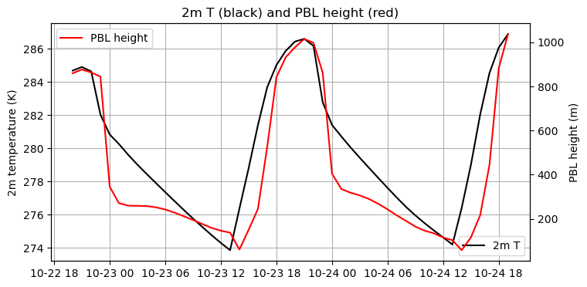
Cell #9 –2m T, PBL height
• We skipped the initial time in plotting 2m T and PBL height
• Observe the temporal behavior and phasing of these fields

Slide 10
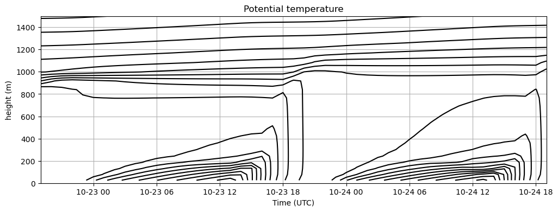
Cell #10 –Time-height potential temperature
• When is PBL stability largest and smallest?

Slide 11
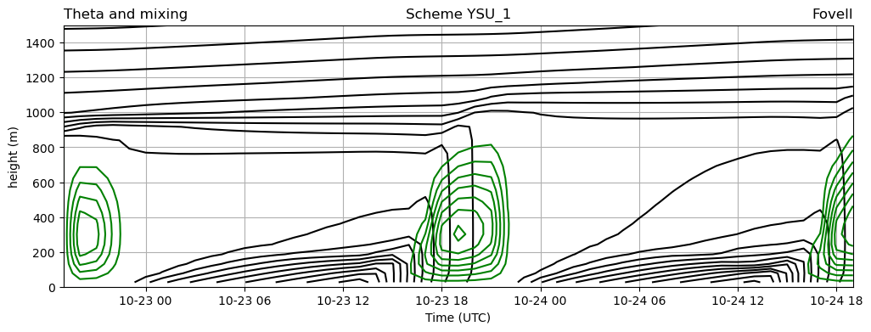
Cell #11 –Add PBL mixing K_{h}
• When is mixing largest and smallest?
• Optionally add Km contours. They’re slightly different.

Slide 12
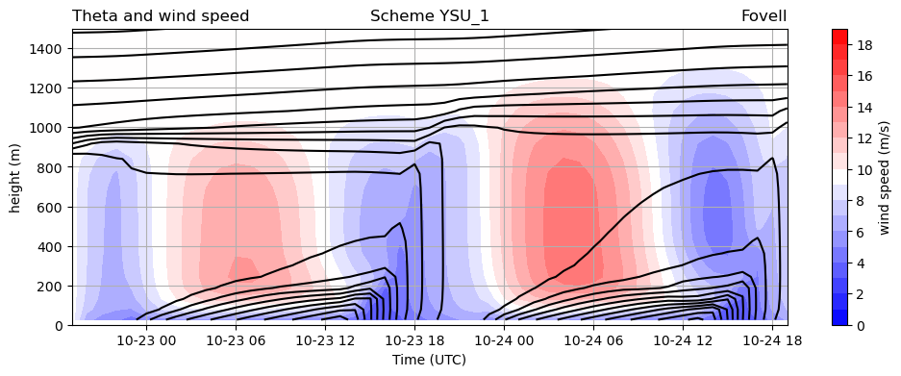
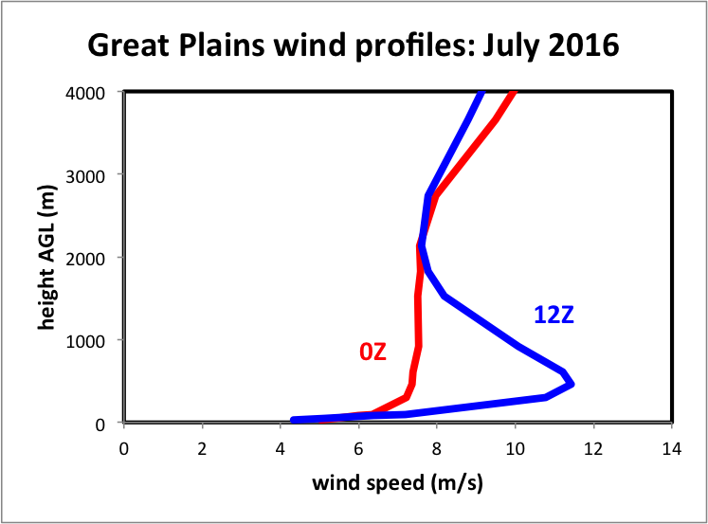
Cell #12 –Potential temperature and wind speed
• Large temporal pendular-like variation in PBL wind speed
• When is wind speed fastest and slowest?

Slide 13
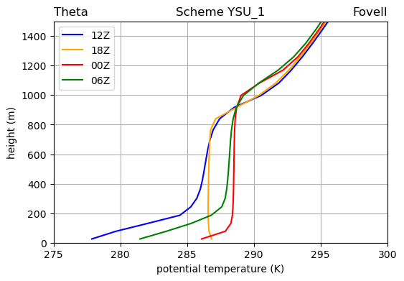
Cell #13 – Vertical profile of potential temperature
• Note 18Z profile is very nearly neutral through PBL except close to surface
• Surface inversions present at other three times

Slide 14
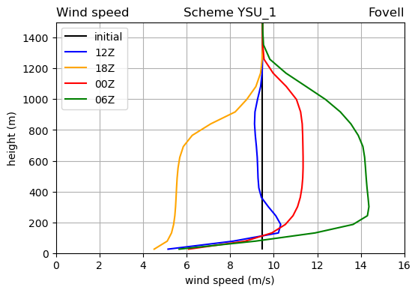
Cell #14 – Vertical profile of wind speed
• Very large amplitude pendular variation from nearly shearless to low-level jet

Slide 15
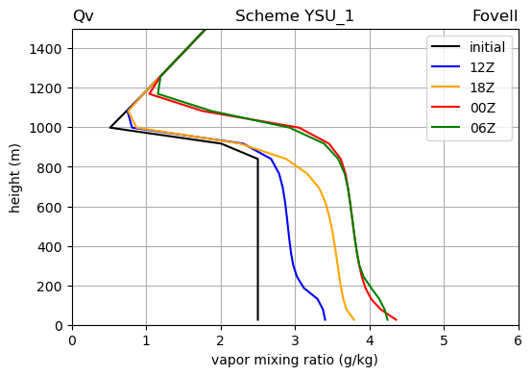
Cell #15 – Vertical profile of water vapor
• There is a secular trend owing to surface flux source plus a diurnal cycle

Slide 16
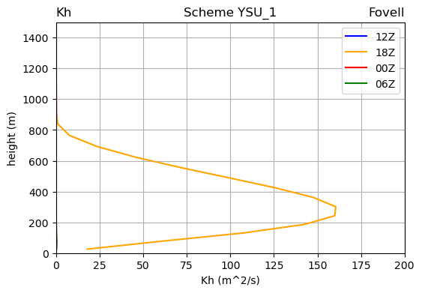
Cell #16 – Vertical profile of K_{h}
• K_{h} nonzero at only one of these 4 times plotted

Slide 17
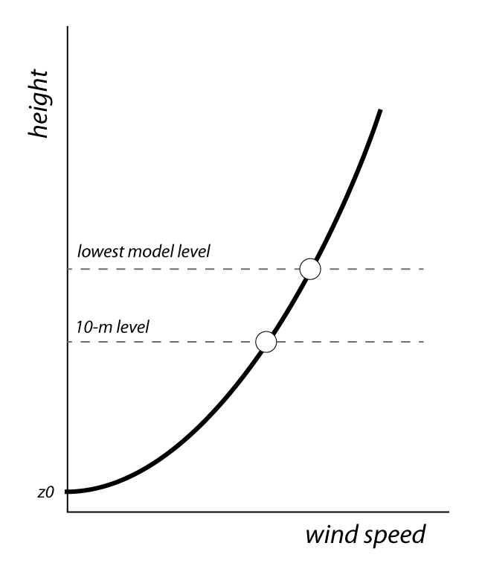
Finding the 10-m wind speed
• Very often, the lowest model
level is about 27 m above ground
level (AGL). (This is WRF default.)
• Many (not all!) wind observations
are taken at 10 m AGL.
• How do you compare model
winds to observations?
• Standard practice: employ log
wind profile to estimate 10 m wind

Slide 18
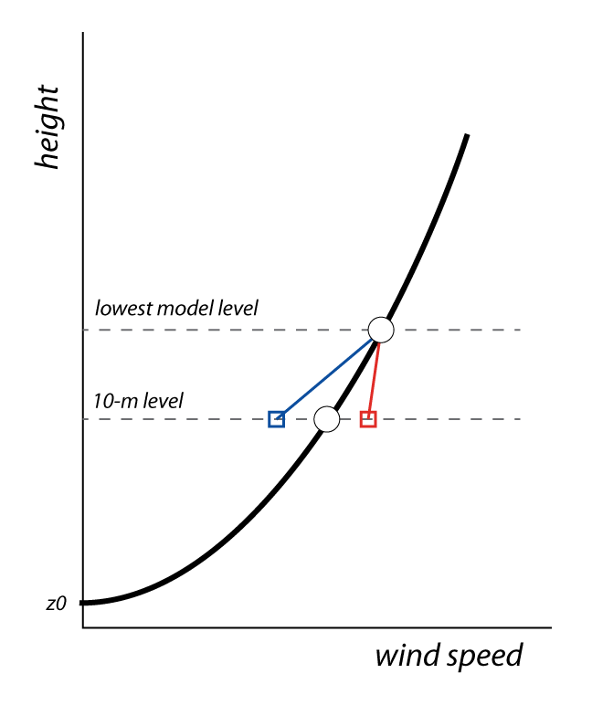
Finding the 10-m wind speed
• Recall the log profile assumes
neutral conditions, and requires
adjustment when not neutral
• An unstable surface layer has
less vertical shear, so log profile
would underestimate 10-m wind
• A stable layer has more shear, so
the unadjusted 10-m wind is too
large
• As wind speed increases, surface
layer often presumed neutral
Notes:
Got to here 2019, 2023

Slide 19
Finding the 10-m wind speed
If the log wind profile is valid at both the first model
level (z = Z_{a}) and at 10 m, then the 10-m wind (V₁₀) in
terms of the first model level wind V_{a} is:
Stability corrections
computed at 10m and Z_{a}
(Zero when neutral)
(divided two log wind profiles
for first model level and 10-m level)

Slide 20
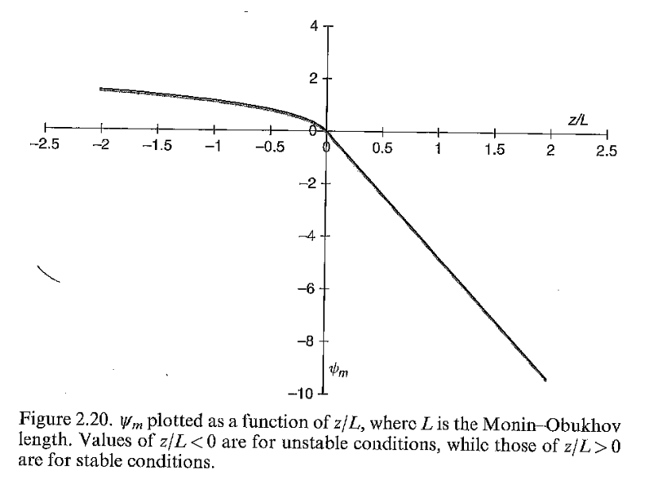
Stability function ψ
• In WRF, you call PBL & surface layer
schemes separately (and a
land surface model as well)
• A function similar to this is
employed in the surface layer
scheme, but varies among schemes
• A measure of stability is computed. Then ψ is
computed at lowest model U level Z_{a}
and at the 10 m level
• This is applied to log profile to get
10-m wind from the Z_{a} wind
unstable
stable
Stensrud’s text, p. 38

Slide 21
LANDUSE.TBL
Log wind profile
Surface roughness z₀, in centimeters
USGS SUMMER
ALBD SLMO SFEM SFZ0 THERIN SCFX SFHC ’
1, 15., .10, .88, 80., 3., 1.67, 18.9e5,'Urban and Built-Up Land'
2, 17., .30, .985, 15., 4., 2.71, 25.0e5,'Dryland Cropland & Pasture'
3, 18., .50, .985, 10., 4., 2.20, 25.0e5,'Irrigated Cropland & Pasture'
4, 18., .25, .985, 15., 4., 2.56, 25.0e5,'Mixed Dryland/Irrigated Crop'
5, 18., .25, .98, 14., 4., 2.56, 25.0e5,'Cropland/Grassland Mosaic'
6, 16., .35, .985, 20., 4., 3.19, 25.0e5,'Cropland/Woodland Mosaic'
7, 19., .15, .96, 12., 3., 2.37, 20.8e5,'Grassland'
8, 22., .10, .93, 5., 3., 1.56, 20.8e5,'Shrubland'
9, 20., .15, .95, 6., 3., 2.14, 20.8e5,'Mixed Shrubland/Grassland'
10, 20., .15, .92, 15., 3., 2.00, 25.0e5,'Savanna'
11, 16., .30, .93, 50., 4., 2.63, 25.0e5,'Deciduous Broadleaf Forest'
12, 14., .30, .94, 50., 4., 2.86, 25.0e5,'Deciduous Needleleaf Forest'
13, 12., .50, .95, 50., 5., 1.67, 29.2e5,'Evergreen Broadleaf Forest'
14, 12., .30, .95, 50., 4., 3.33, 29.2e5,'Evergreen Needleleaf Forest'
15, 13., .30, .97, 50., 4., 2.11, 41.8e5,'Mixed Forest'
16, 8., 1.0, .98, 0.01, 6., 0., 9.0e25,'Water Bodies'
These z0 are starting points;
Some schemes modify them
(see also VEGPARM.TBL,MPTABLE.TBL)
Aside: As of WRF v3.9, MODIS landuse database is now the default
Notes:
Water – 0.01 cm = very smooth (a problem when windy)
Urban area 80 cm (2.6 ft)
In between: shrubland (5 cm), grassland (12 cm), cropland (14-20 cm), forest (50 cm). Density and height of vegetation.

Slide 22
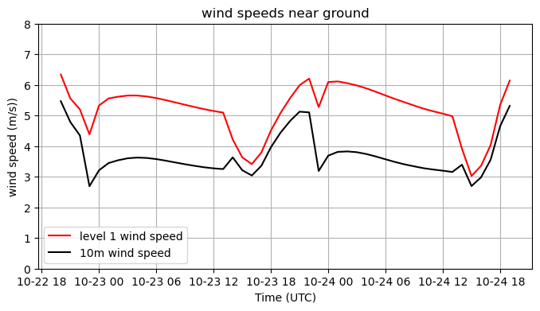
Cell #17 – 10m and lowest level wind speed
• The shear between the 10m and lowest model levels varies substantially with time
• This shear is also affected by surface roughness (expressed through z₀)

Slide 23
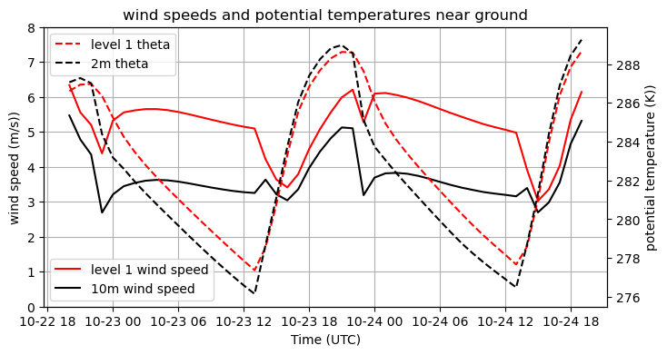
Cell #17 – adding 2m and lowest level theta
• Stability of the layer between 2m and lowest model level varies with time
• Under what conditions is the shear between 10m and the lowest level smallest?

Slide 24
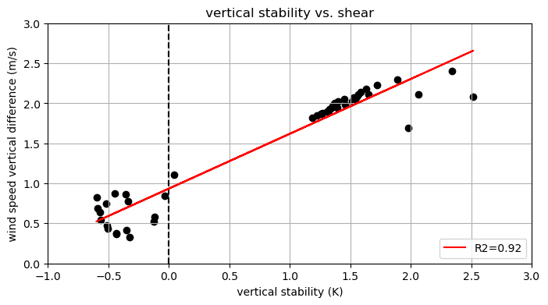
Cell #17 – stability vs shear
unstable
small shear
stable
large shear
• x-axis: stability (unstable when negative); y-axis: shear
• vertical shear largest when most stable
• this reveals the impact of the log wind profile’s stability corrector

Slide 25
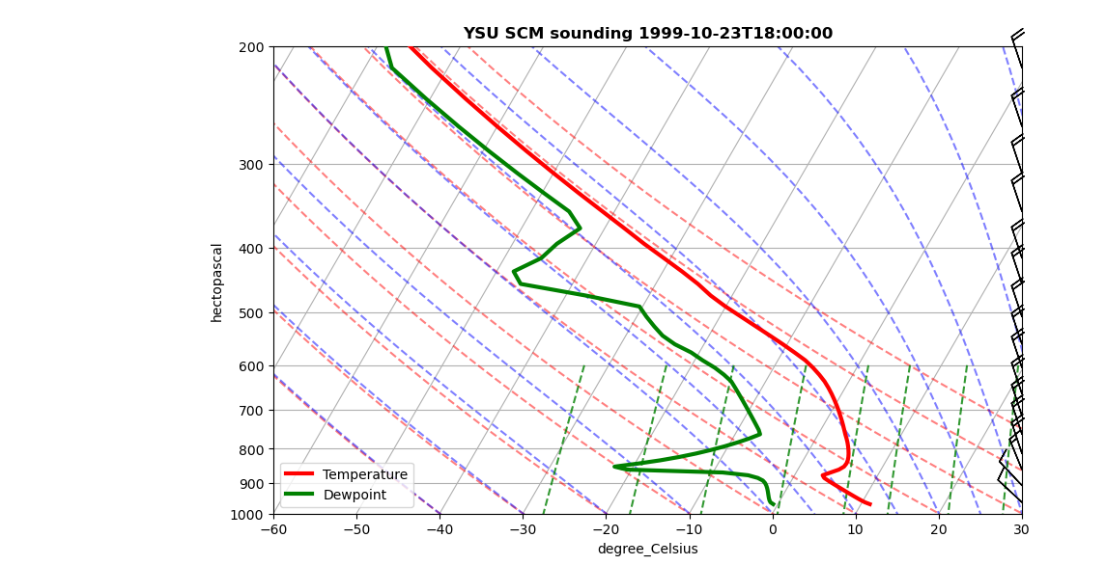
Cell #19 – Plot sounding at desired time
Set timeindex to valid value to plot sounding at that time

Slide 26
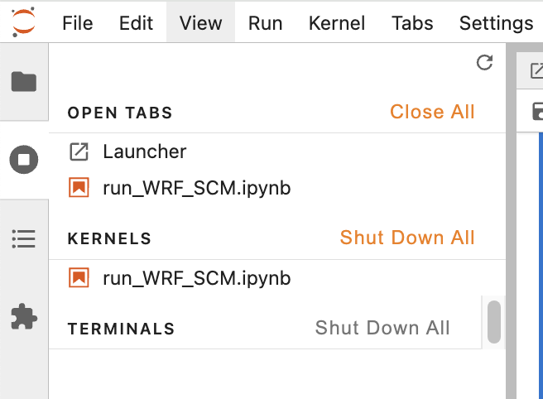
Finish up
Press the stop button at left, and make sure you close and halt your notebook job
From the File menu, select Hub Control Panel, and then Stop My Server
  This releases finite, shared resources

Slide 27
Class ensemble
You will be assigned a PBL physics configuration
Edit Cell #2 for your surname and experiment name, and re-run the notebook
The notebook will create figures named Surname_Experimentname_description.png
Copy these to $LAB/SCM_ensemble from your SCM directory
  $ cp *.png $LAB/SCM_ensemble/.

Slide 28
[end]

