Slide 1
PBL demonstration
See script PBL_demonstration.pdf
ATM 419/563
Spring 2023
Fovell
© Copyright 2023 Robert Fovell, Univ. at Albany, SUNY, rfovell@albany.edu

Slide 2
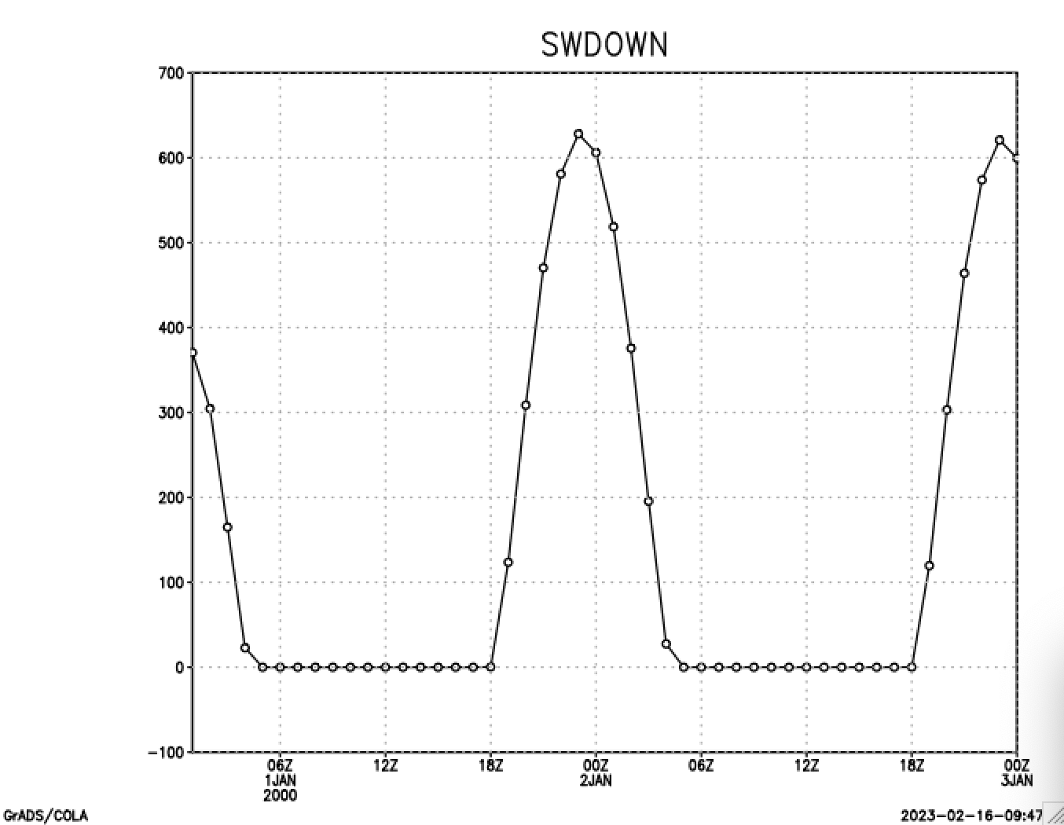
Line 22

Slide 3
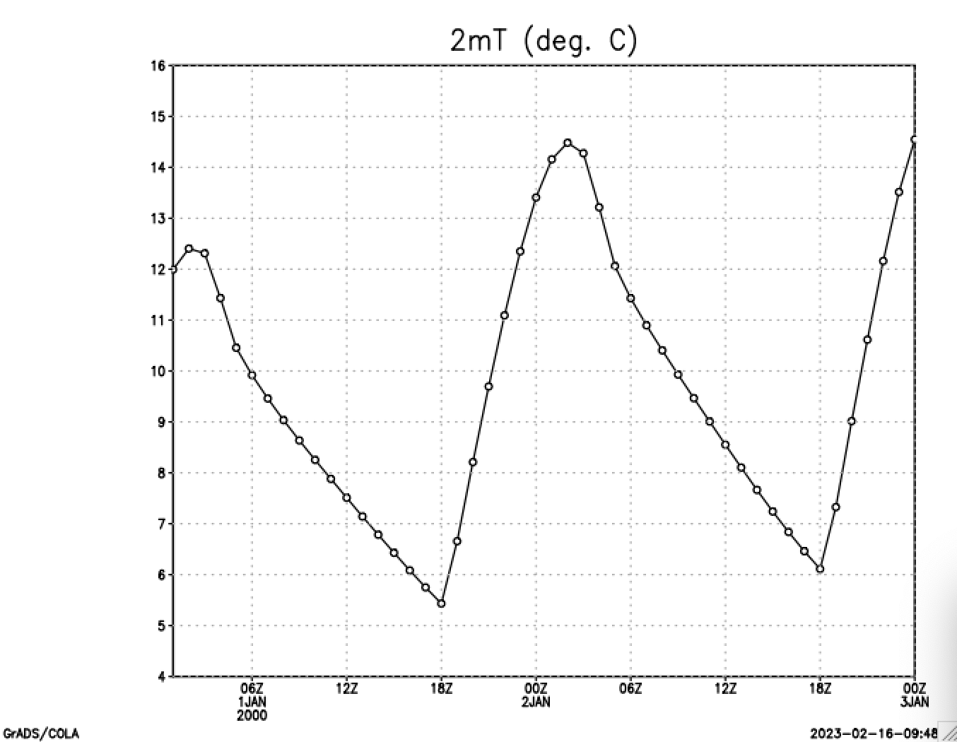
Line 26

Slide 4
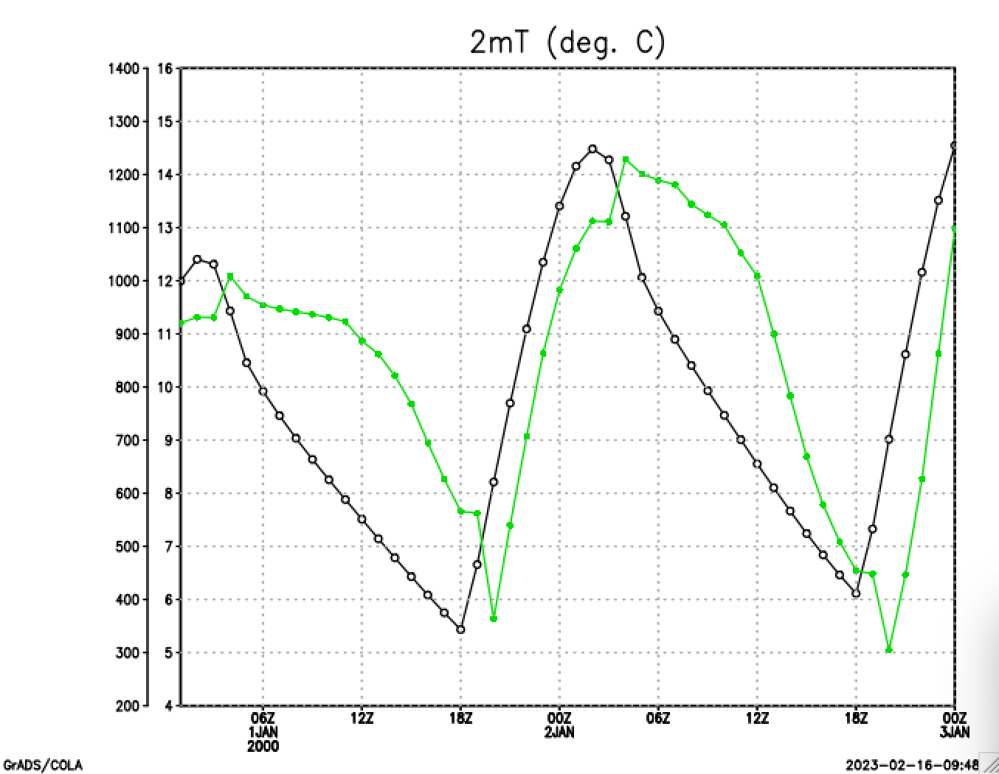
Line 29
pblh

Slide 5
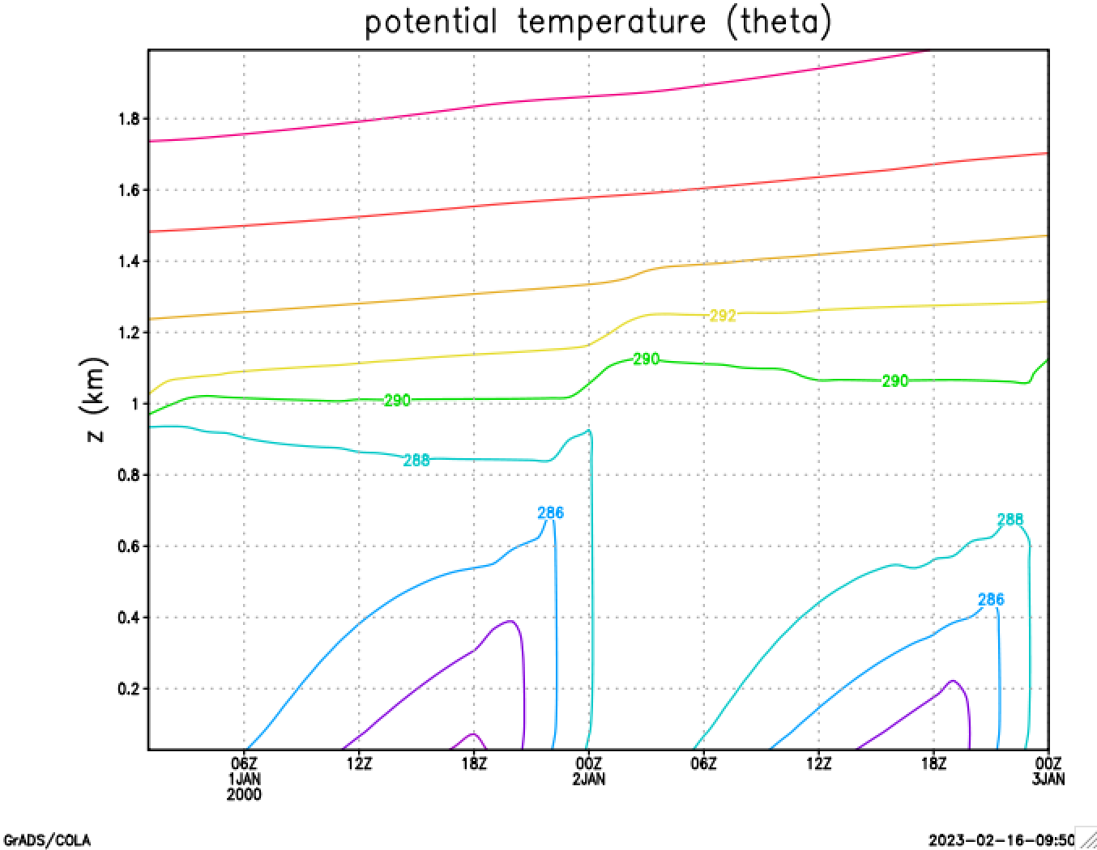
Line 34
When is the PBL least stable?

Slide 6
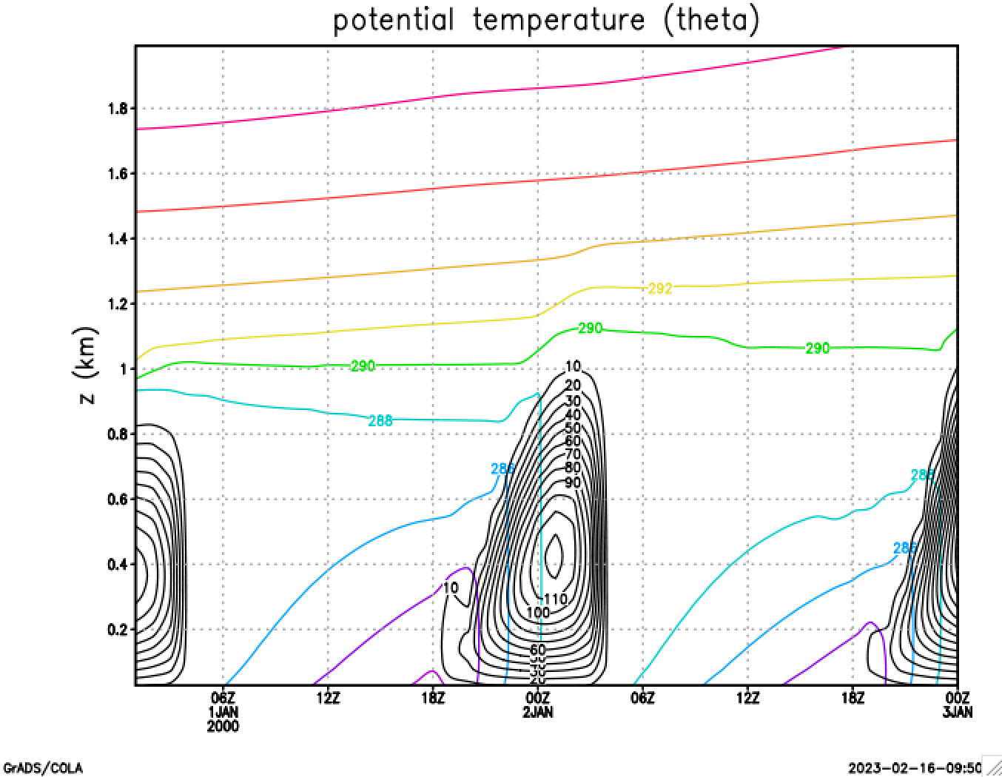
Line 38
dku3d

Slide 7
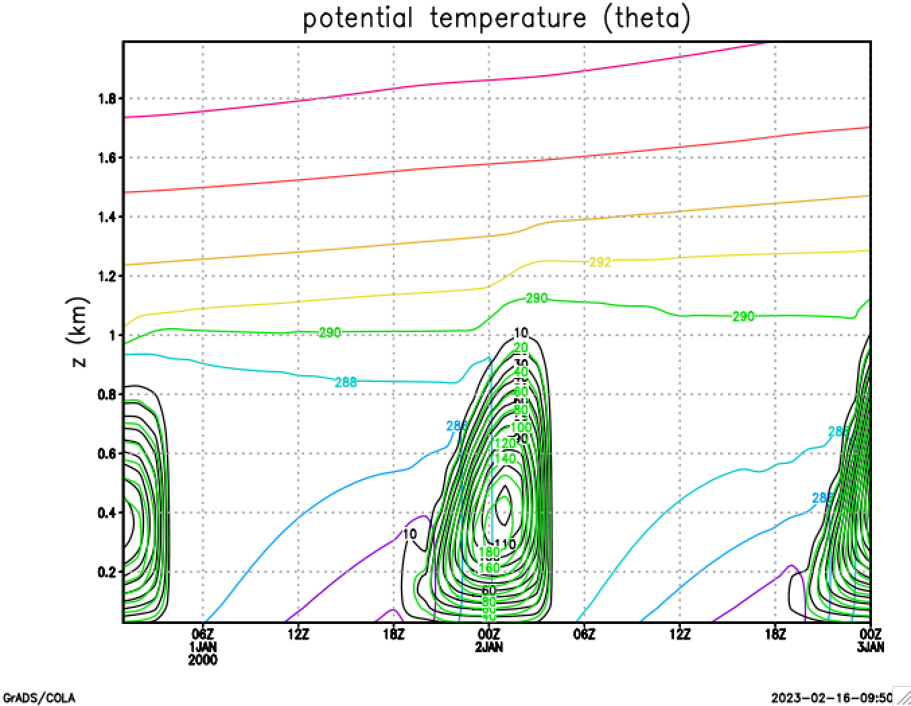
Line 42
dku3d
dkt3d
dku3d and dkt3d → similar but not the same

Slide 8
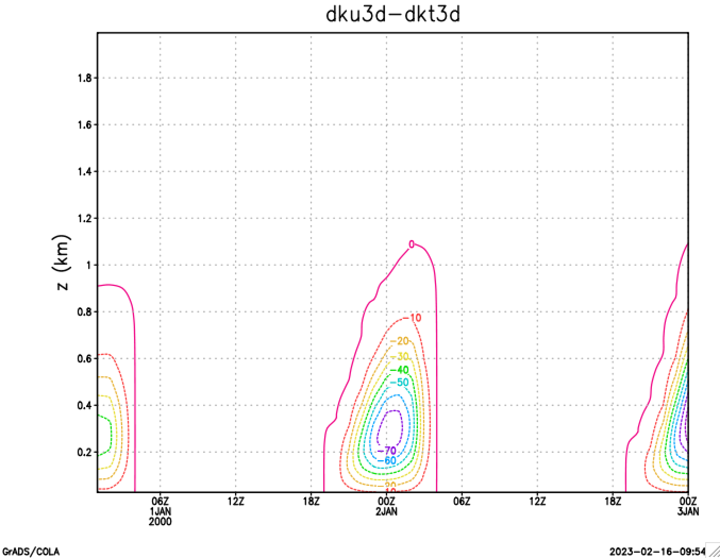
Line 46
dkt3d is a little larger (this is determined by the Prandtl number)

Slide 9
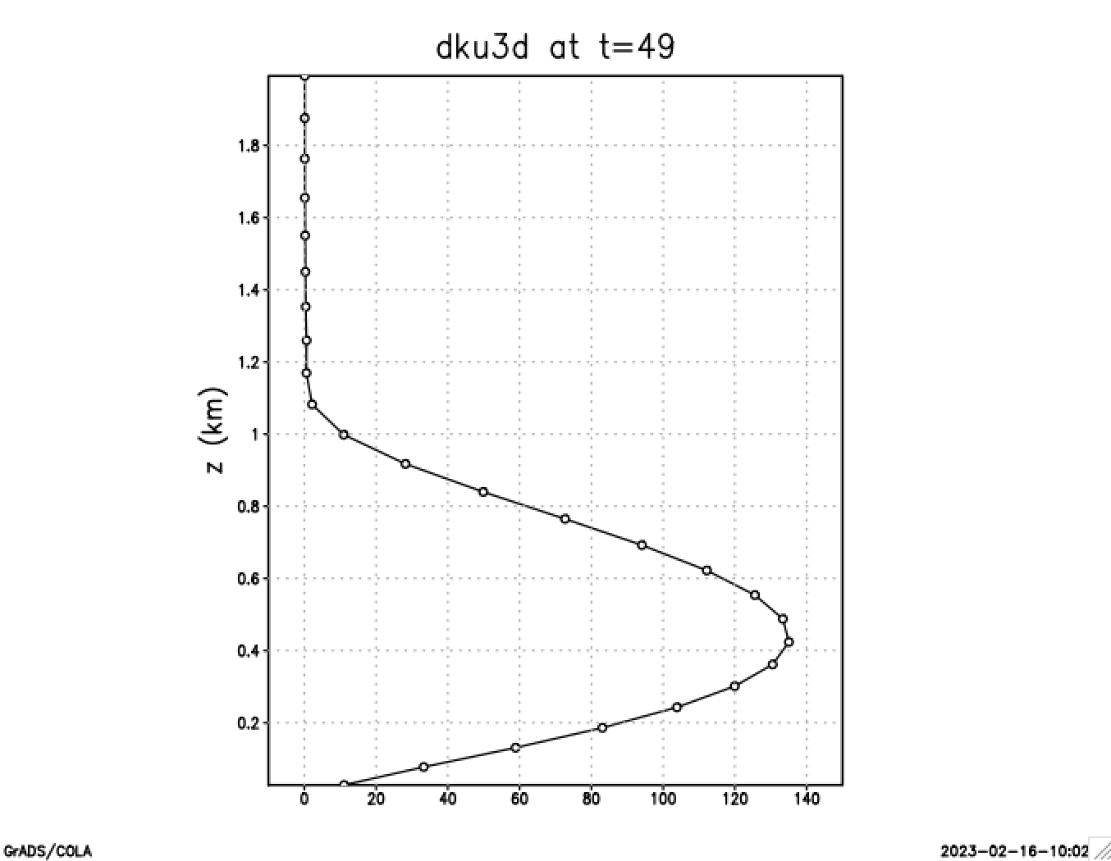
Line 51
dku3d during daytime. Note where Km → 0
pblh = 1097.76 [line 55]

Slide 10
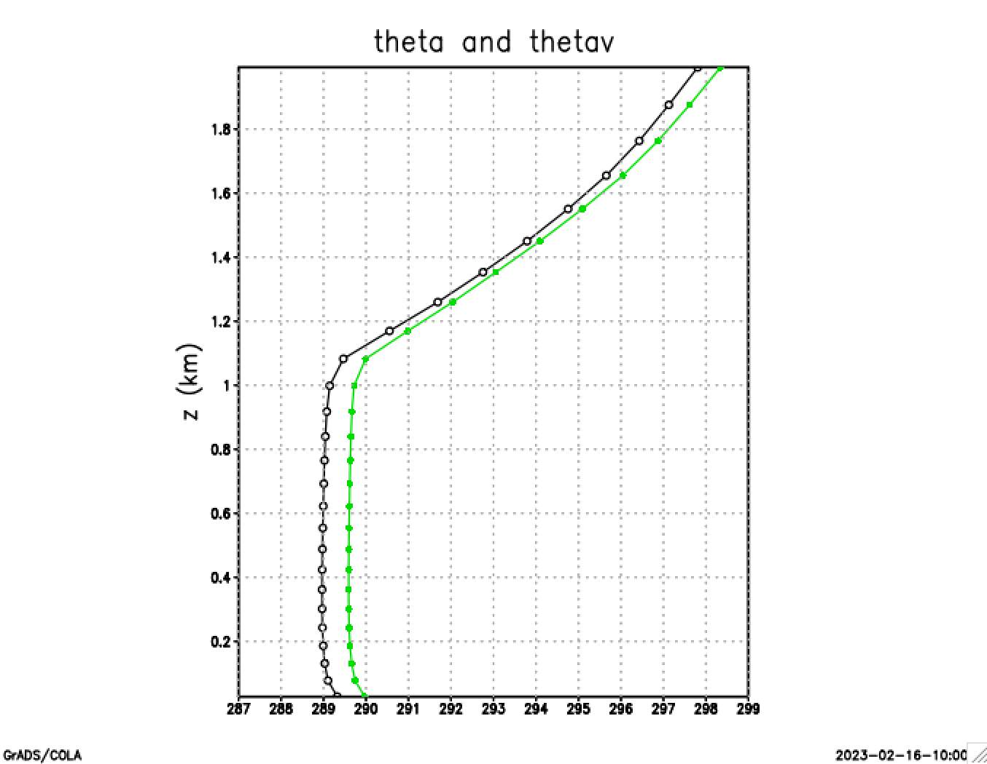
Lines 61, 62
thetav

Slide 11
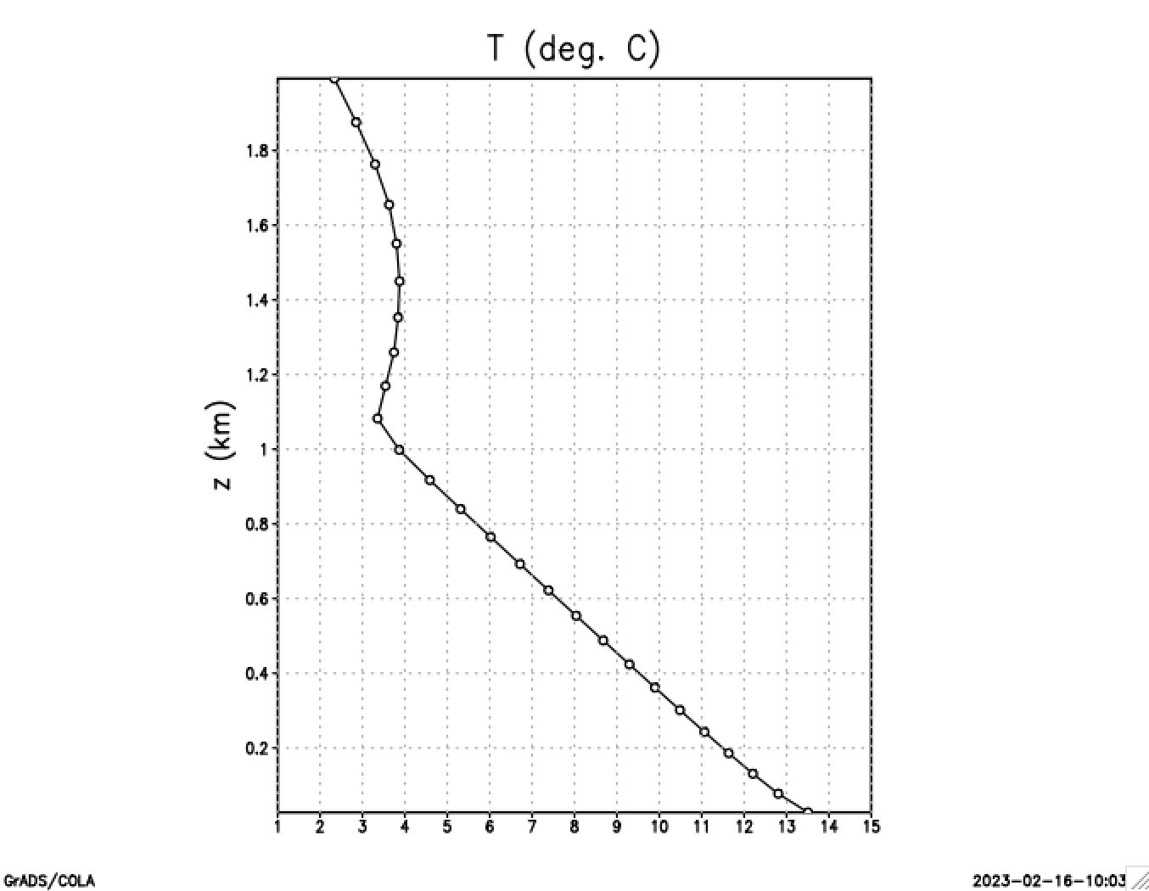
Line 66

Slide 12
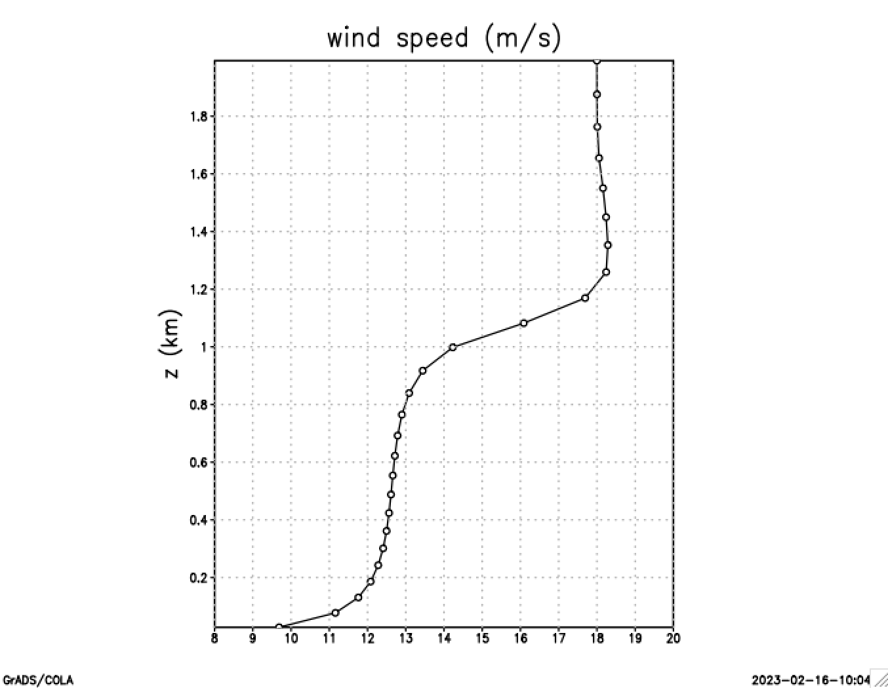
Line 66

Slide 13
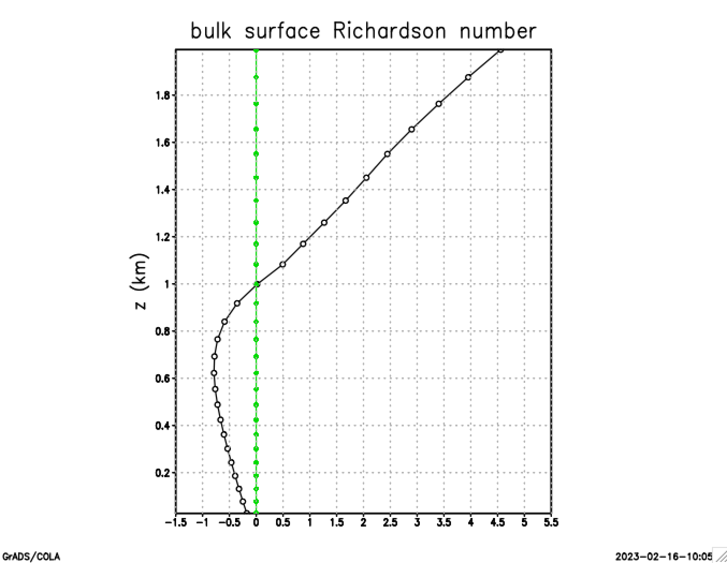
Lines 76-79
YSU uses this criterion to determine first guess
of PBL height (which was about 1.1 km)

Slide 14
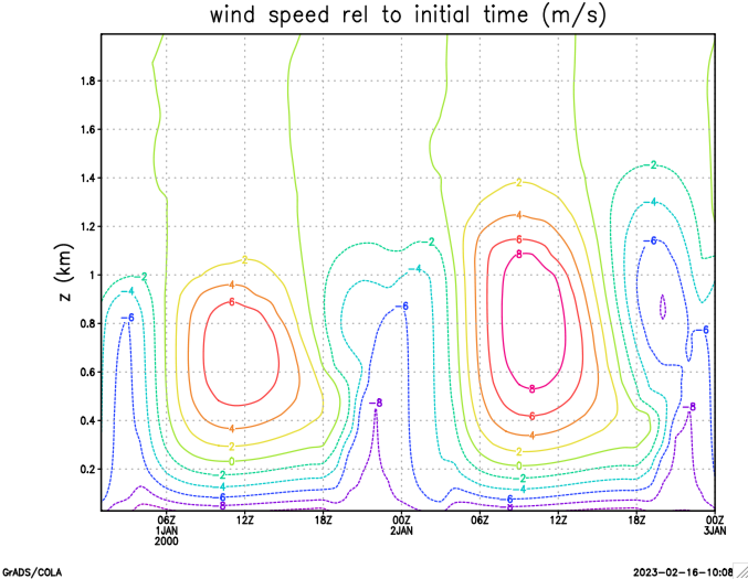
Lines 84-87
Recall sunrise 18Z, sunset 05Z, noon 00Z, midnight 12Z

Slide 15
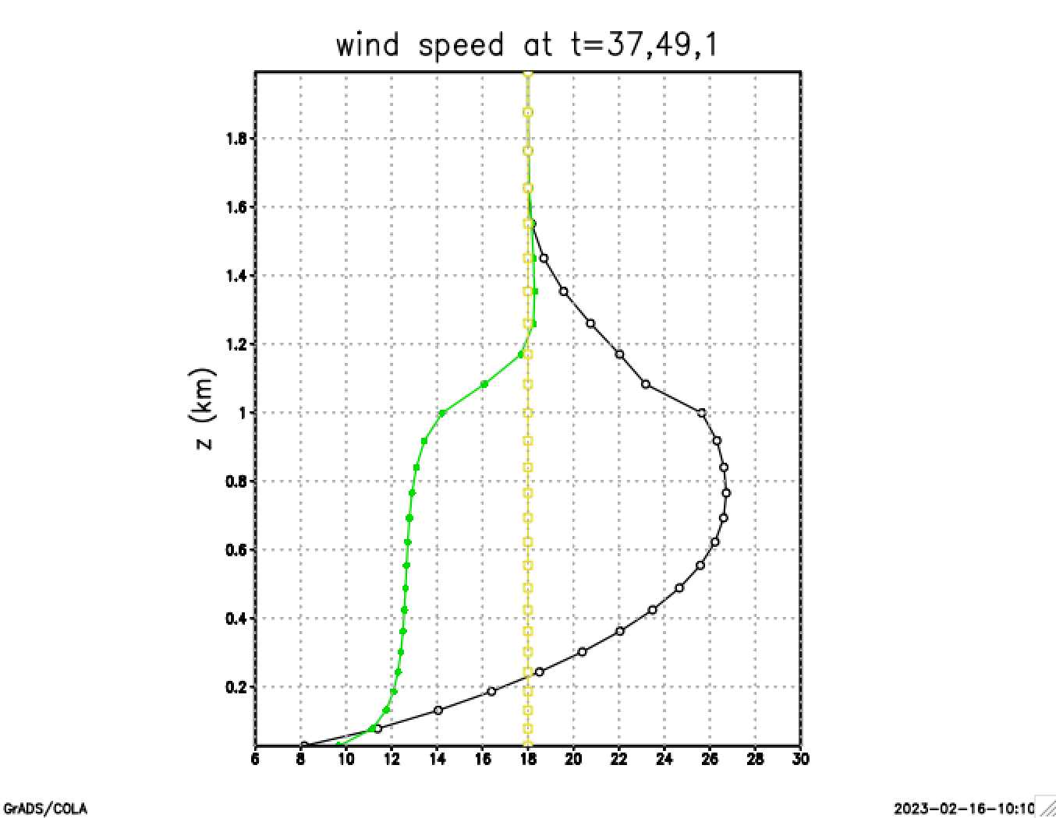
Lines 91-96
t=49
(noon)
t=37
(midnight)
initial

Slide 16
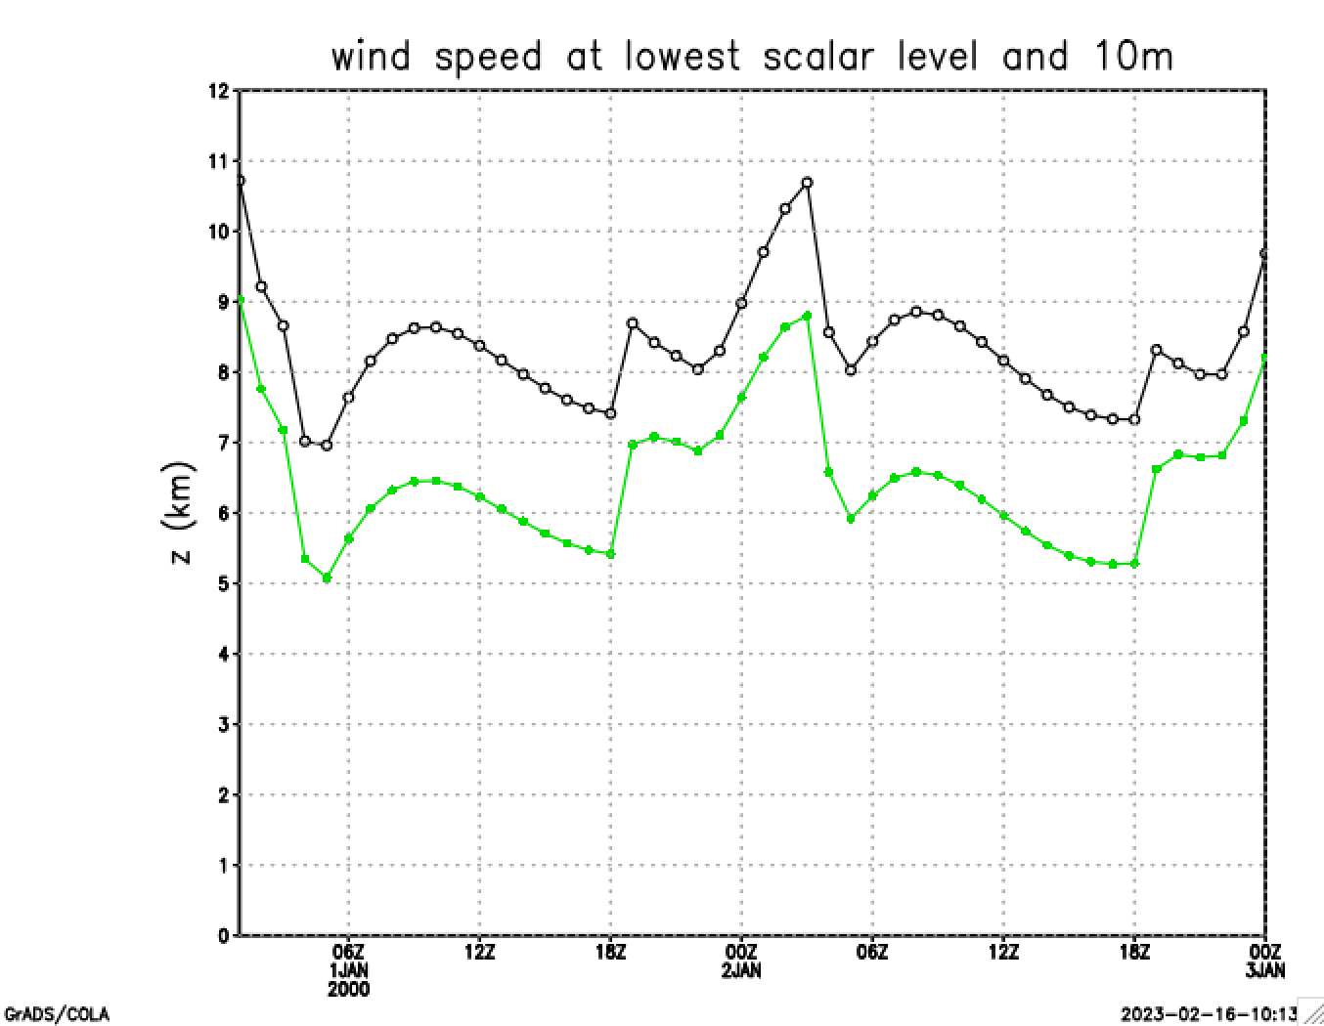
Lines 101-105
About 26 m AGL
10m wind
10m wind is diagnostic, computed using stability-adjusted log wind profile

Slide 17
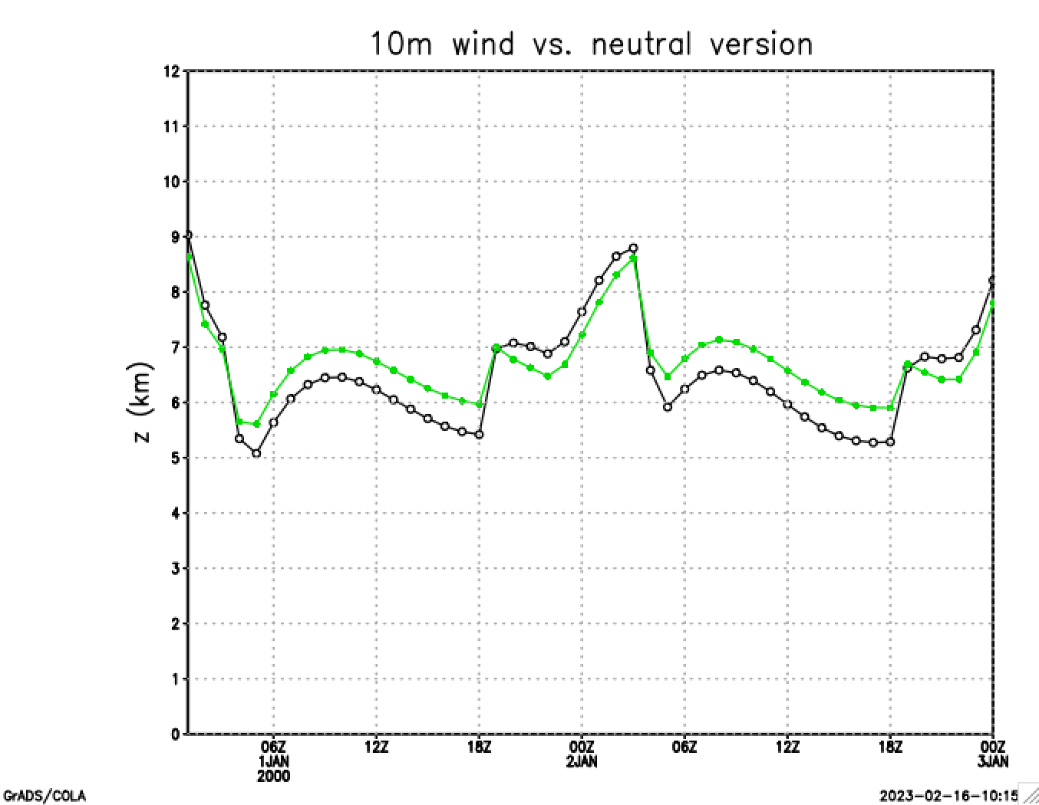
Lines 110-113
10m wind (neutral)
10m wind (stability-adjusted)

Slide 18
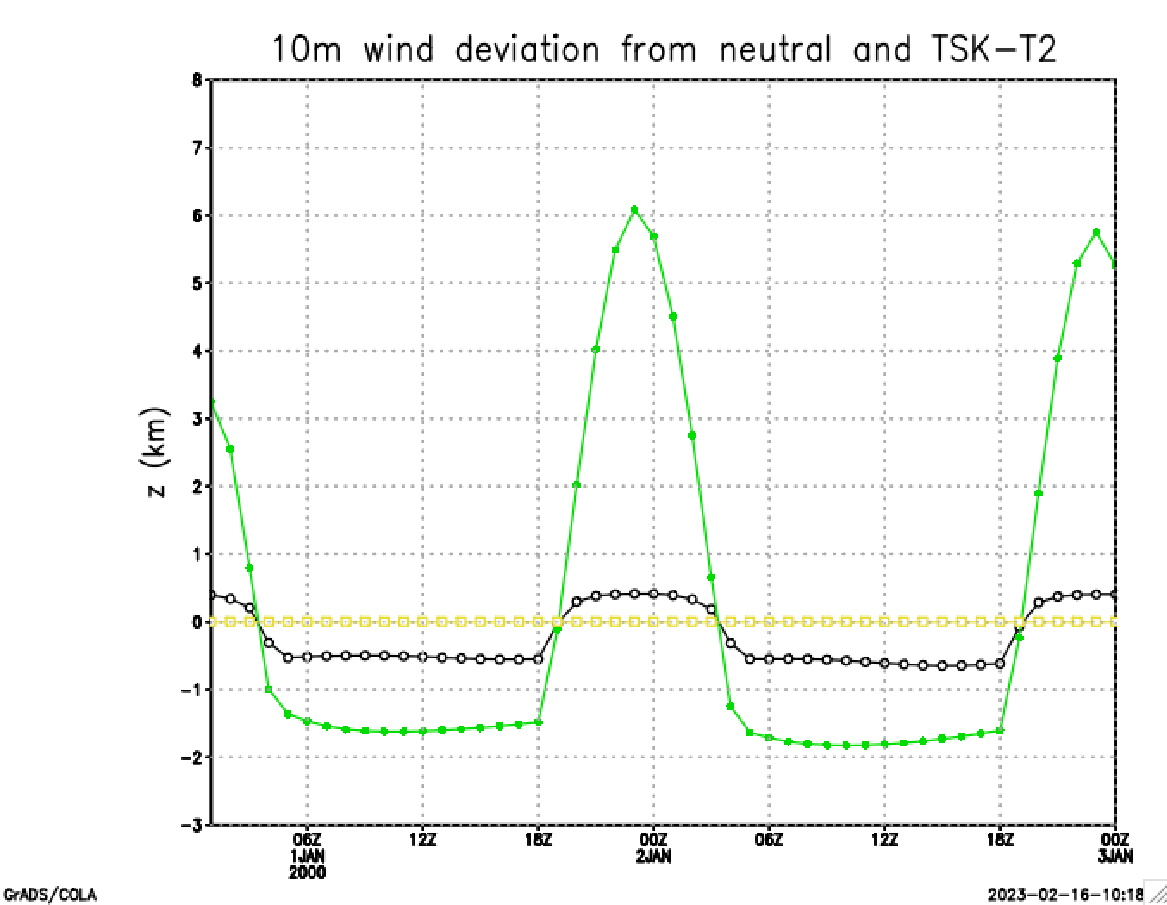
Lines 119-123
Near-surface stability
[unstable when positive]
Stability adjustment

Slide 19
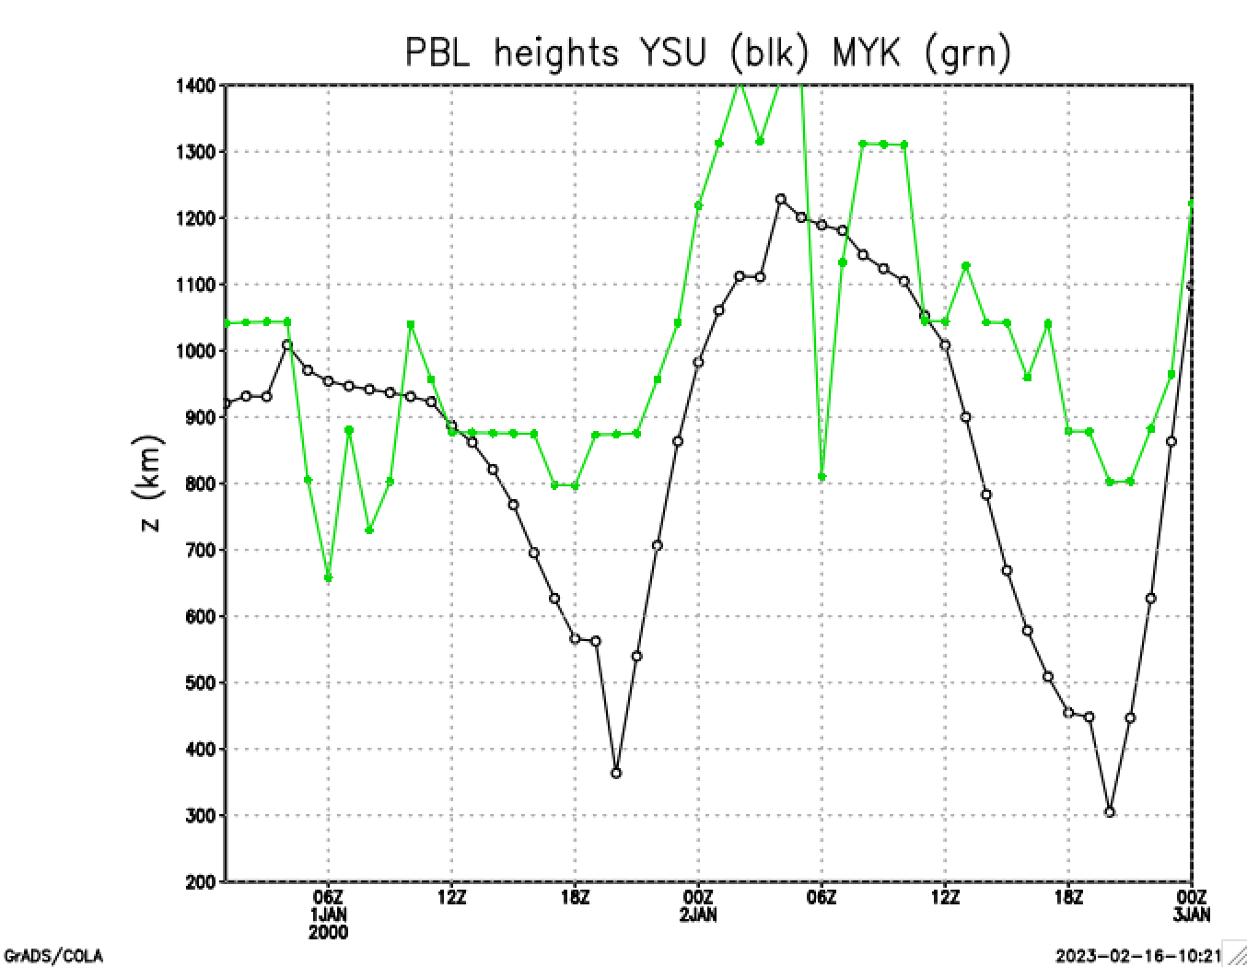
Lines 129-132
MYJ
YSU

Slide 20
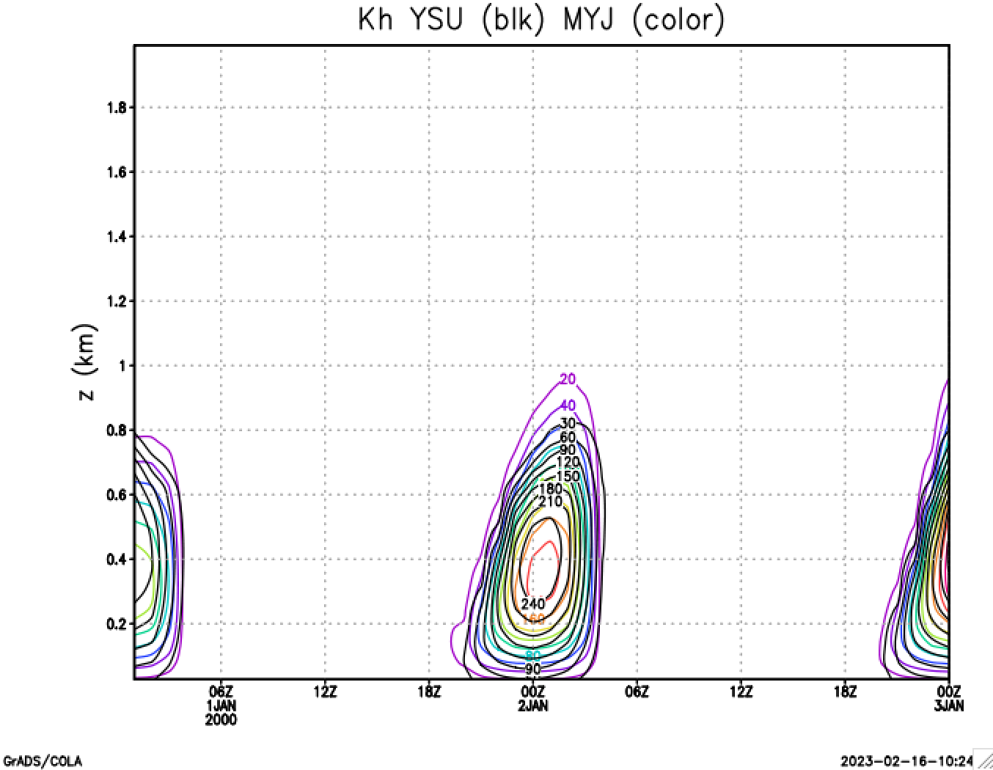
Lines 136-138
MYJ
YSU

Slide 21
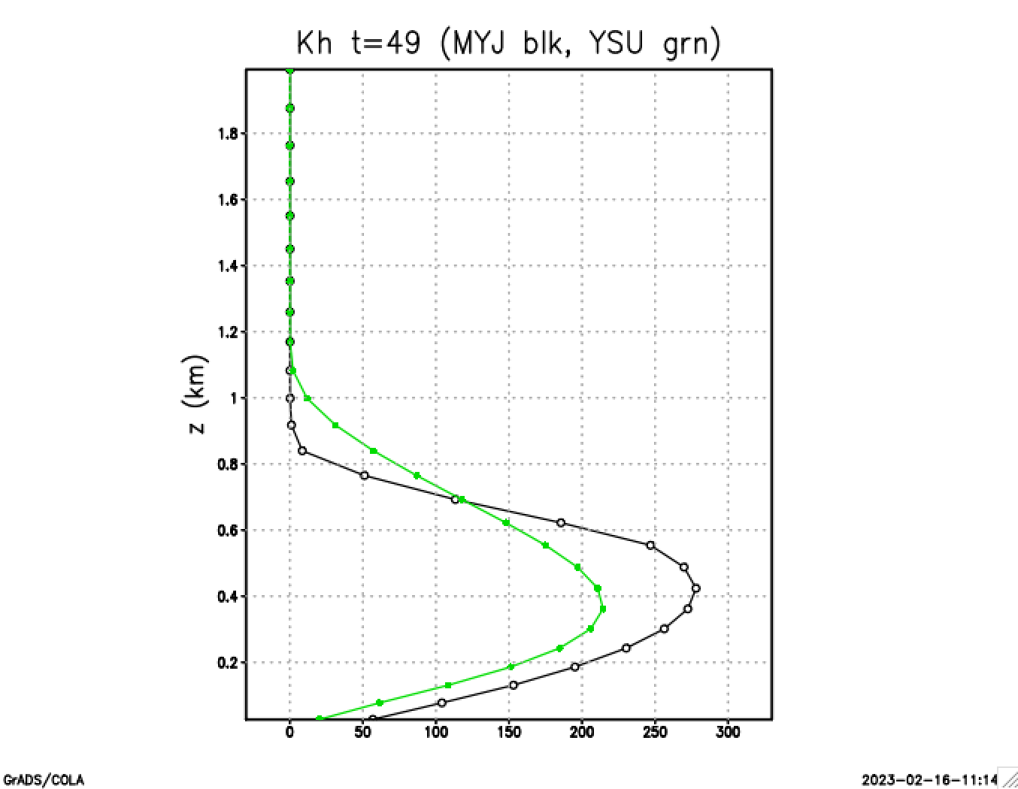
Lines 143-144
YSU
MYJ

Slide 22
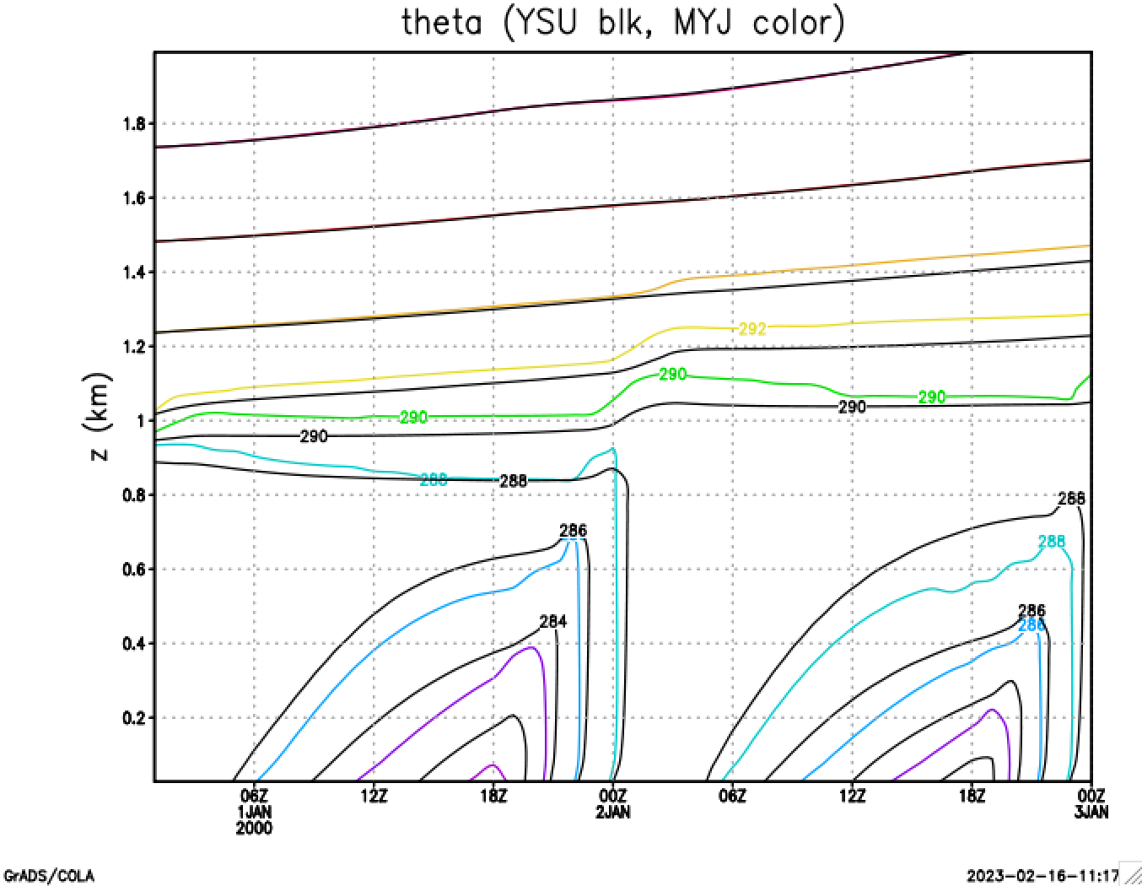
Lines 148-150

Slide 23
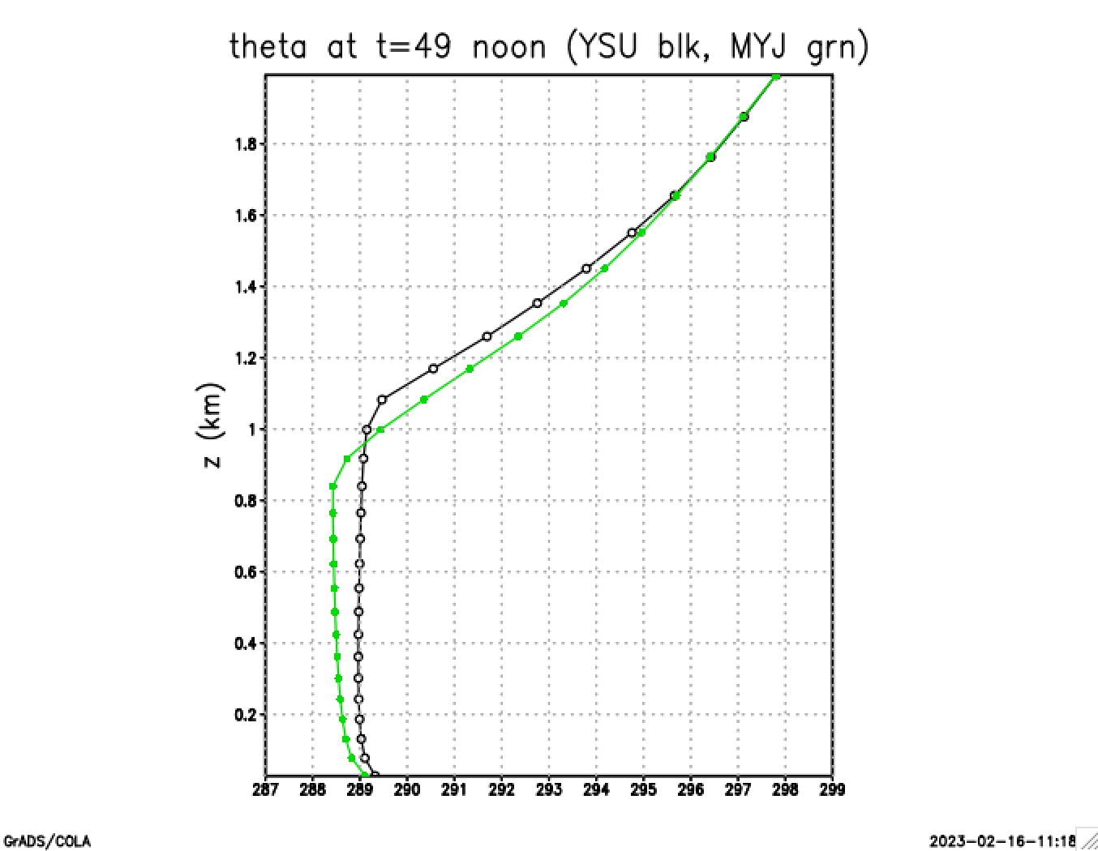
Lines 154-156
MYJ
YSU
MYJ is superadiabatic over a deep layer
YSU is neutral over a deep layer and only superadiabatic very close to the ground

Slide 24
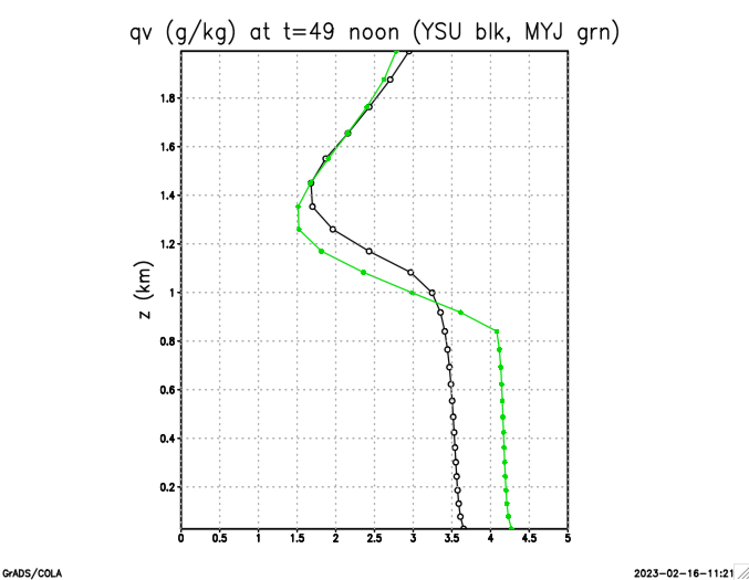
Lines 160-162
MYJ
YSU

Slide 25
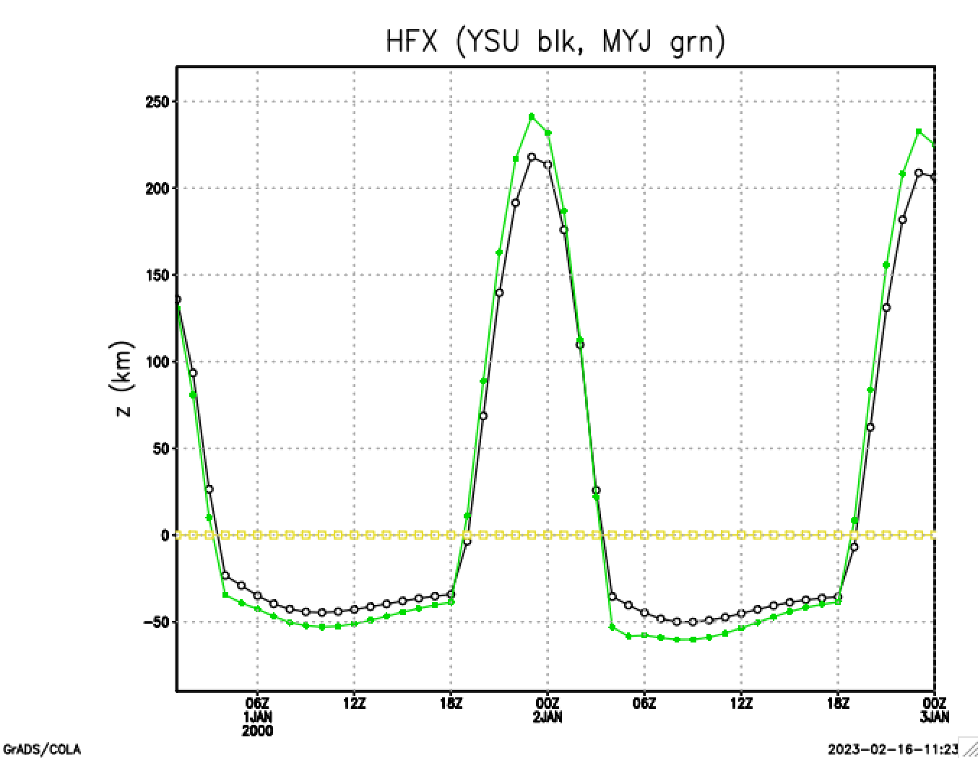
Lines 166-169
MYJ
zero
YSU

Slide 26
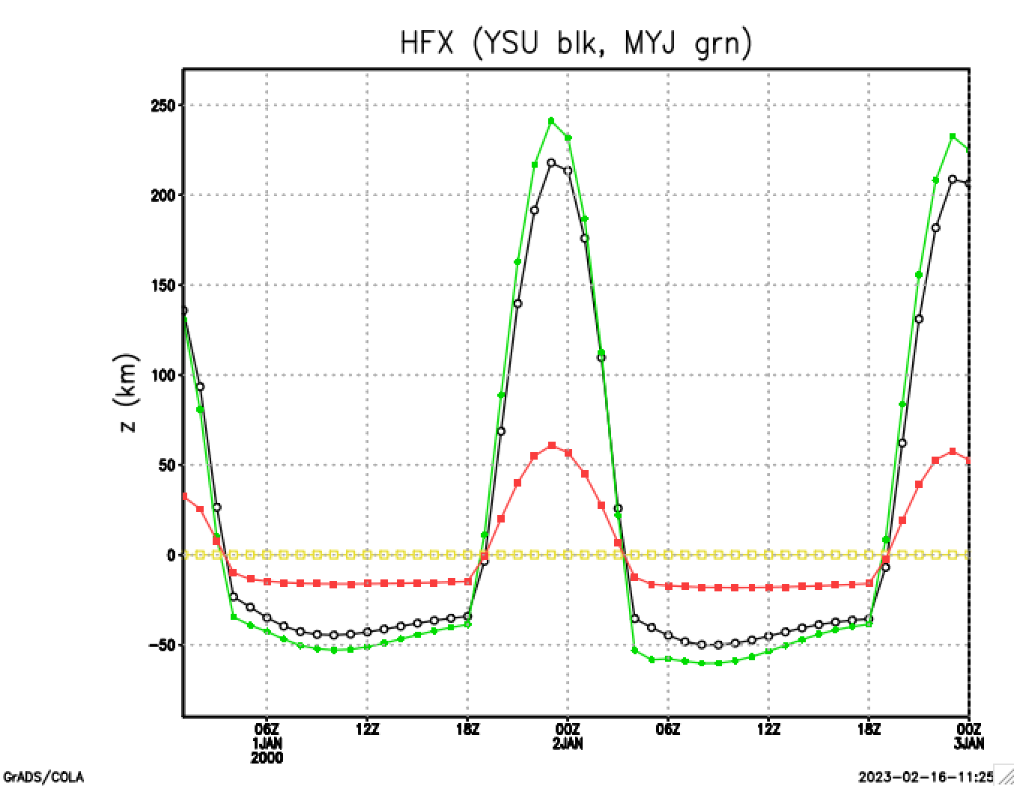
Line 174
MYJ
zero
YSU
TSK-T2 > 0 when surface layer is unstable (day)
TSK-T2 < 0 when surface layer is stable (night)

Slide 27
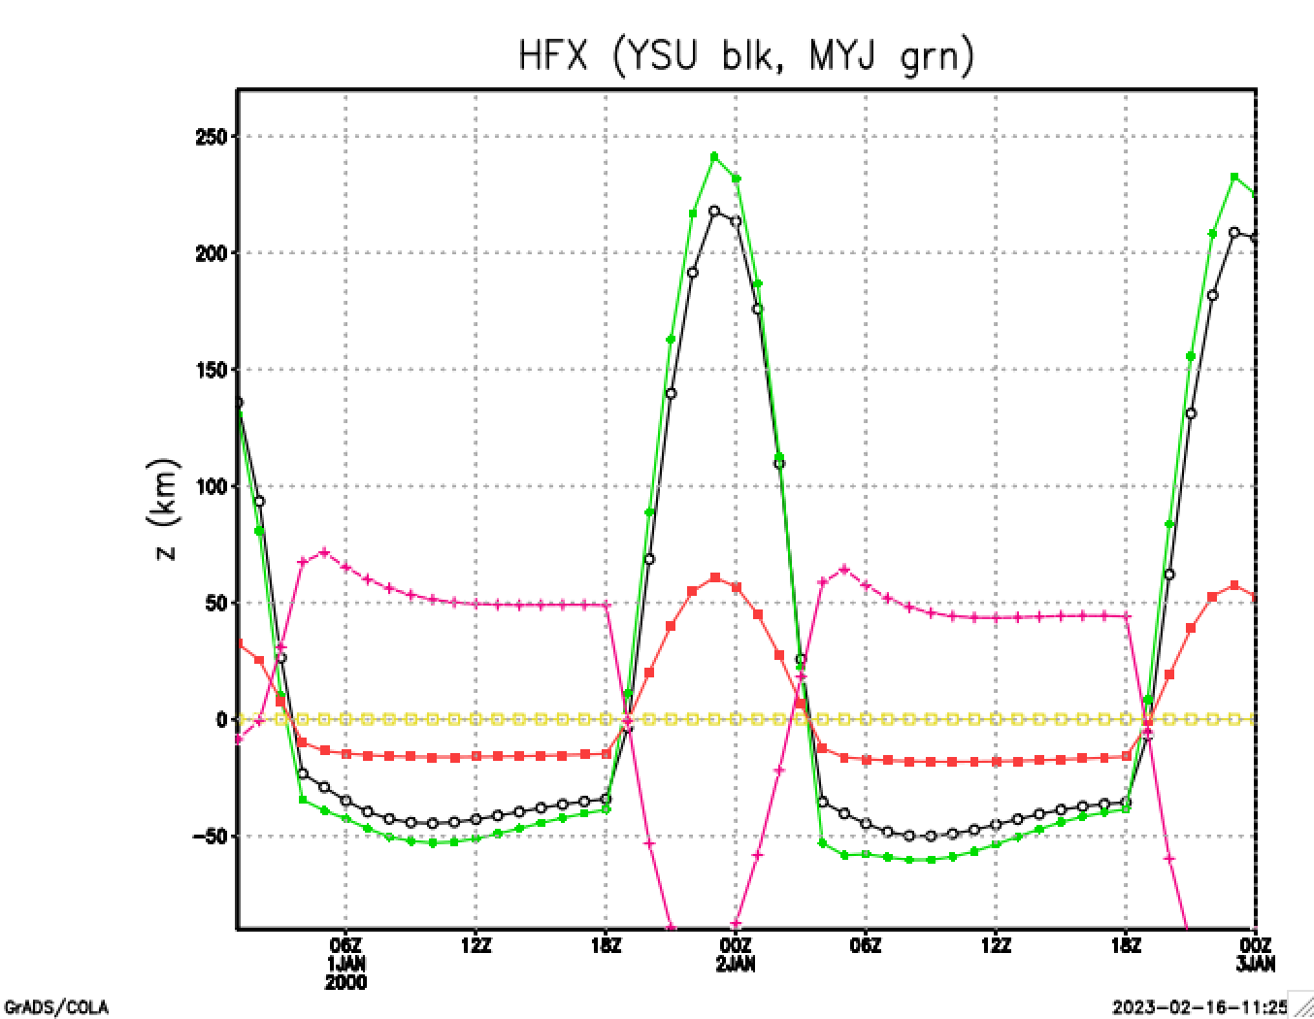
Line 177
MYJ
zero
YSU
GRDFLX > 0 when soil gives heat to surface (night)
GRDFLX < 0 when surface gives heat to soil (day)

Slide 28
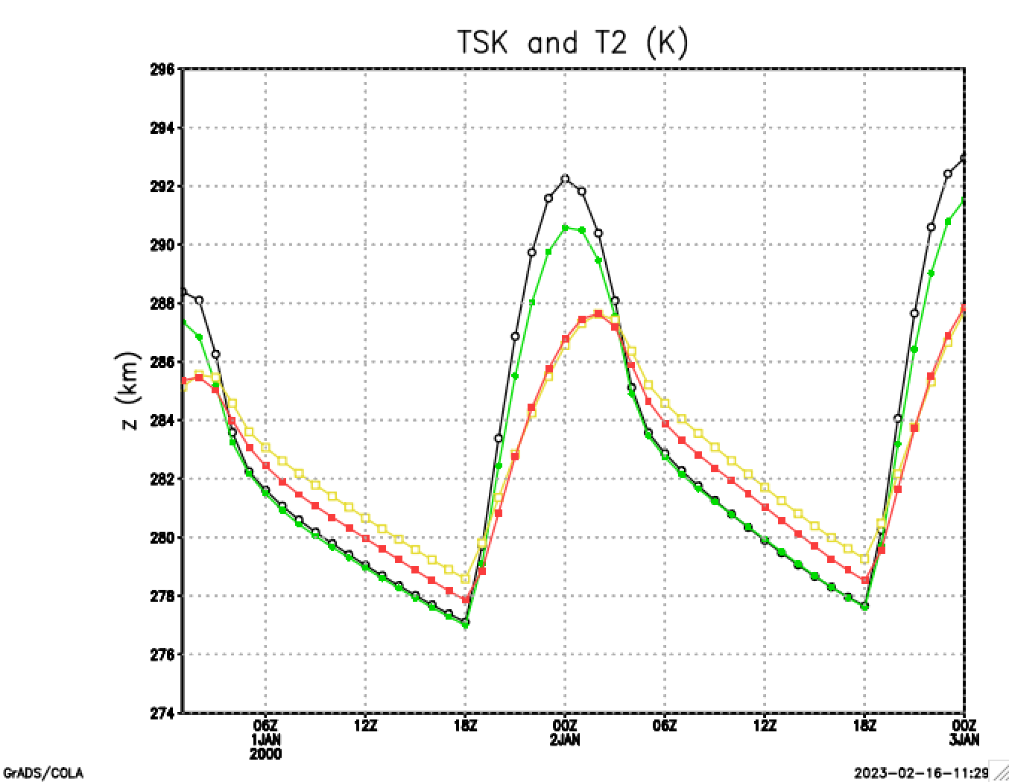
Lines 181-184
YSU TSK
MYJ TSK
YSU T2
MYJ T2

Slide 29
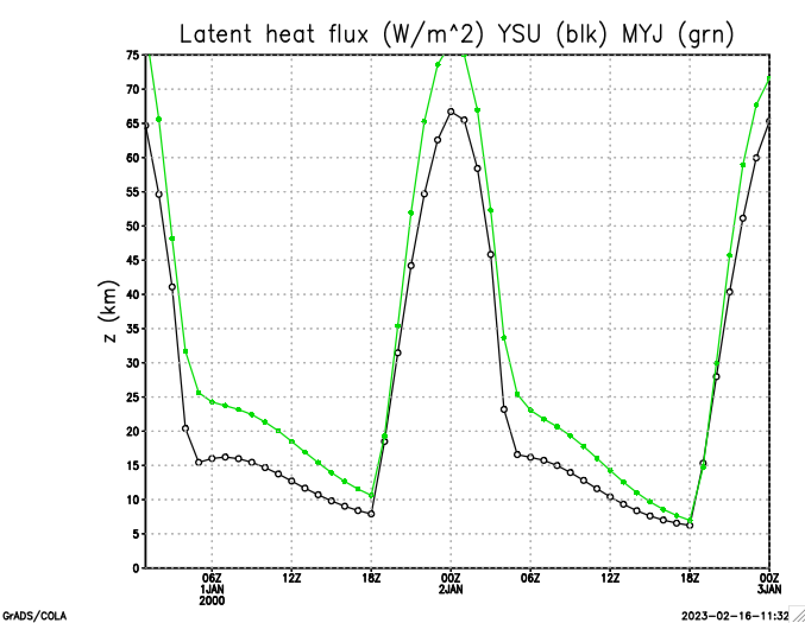
Lines 188-189
MYJ
YSU
Recall MYJ produced a more moist PBL near surface
Is this why?

Slide 30
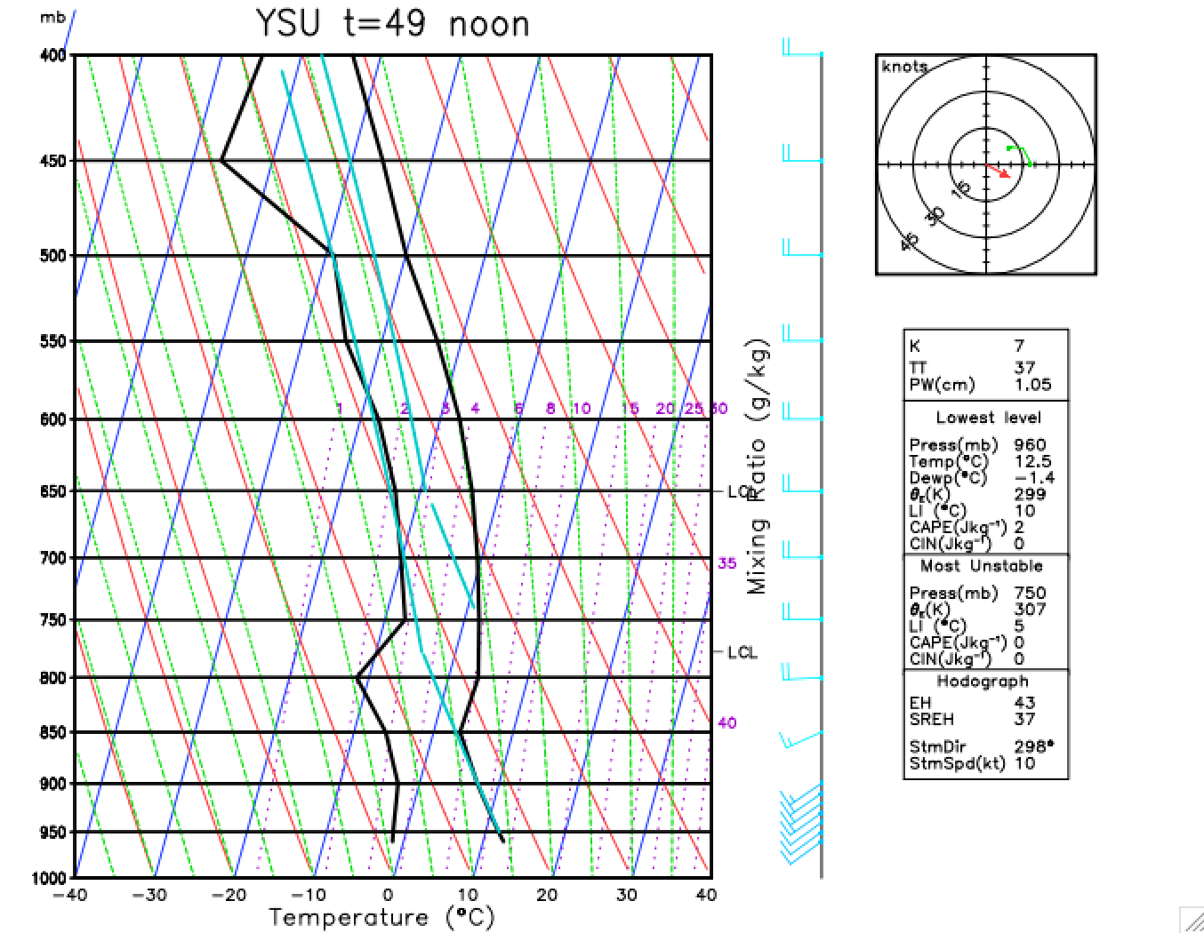
Line 200

Slide 31
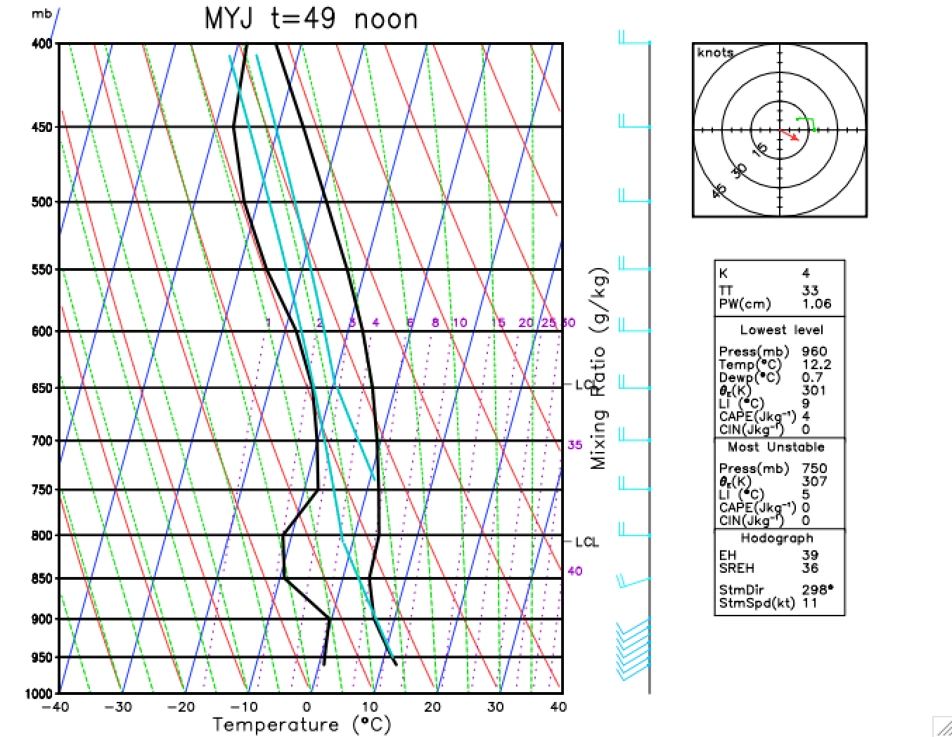
Lines 204-205
Differences in vertical moisture advection

Slide 32
[end]

