Slide 1
The PBL, Part 1:
Overview, tools and concepts
ATM 419/563
Fall 2024
Fovell
© Copyright 2024 Robert Fovell, Univ. at Albany, SUNY, rfovell@albany.edu

Slide 2
Motivation

Slide 3
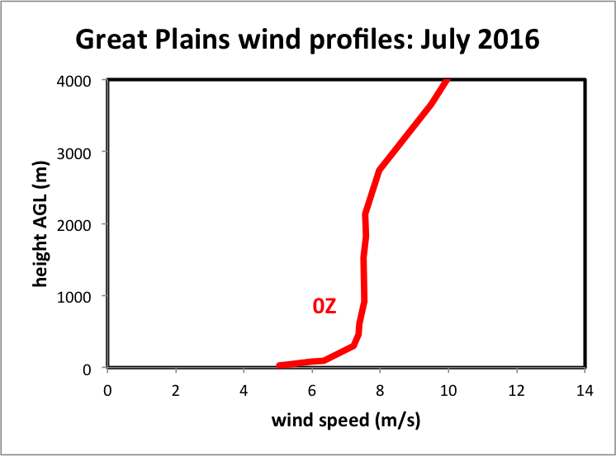
Composite late afternoon wind profile
Wind speed, not momentum
Averaged over 11 radiosonde stations and 31 days
Notes:
HIFREQ_July2016_analysis.xlsx
Is the mixed layer shearless? Basically, yes. Avg over large area, many days, many wx types, many PBL depths, so a lot of variability about this mean, but the mean stands out cleanly.
This is U, not rho*U,

Slide 4
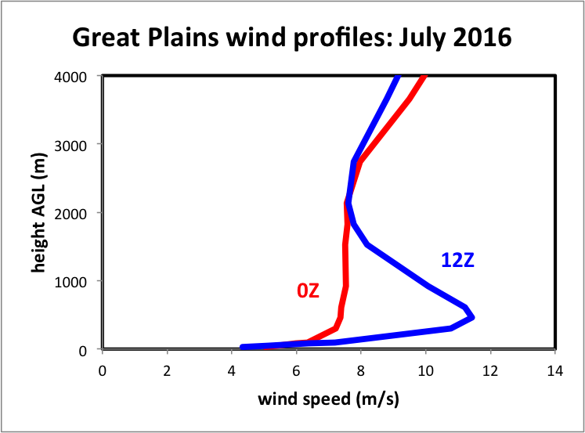
…add composite overnight profile
More in PBL Part II
about 450 m AGL
The difference is influenced by mixing, its magnitude, its presence, its absence. Mixing we cannot resolve.
Mixing we must parameterize. And parameterize it well so the forecasts can be accurate.
Notes:
HIFREQ_July2016_analysis.xlsx. LLJ. Implications for storm initiation, organization, longevity, intensity, moisture transport.
Again, lots of variability but this really sticks out. These are features our PBL scheme better be able to develop
Wind speed closest to sfc actually lower but not far above, speeds higher at NIGHT

Slide 5
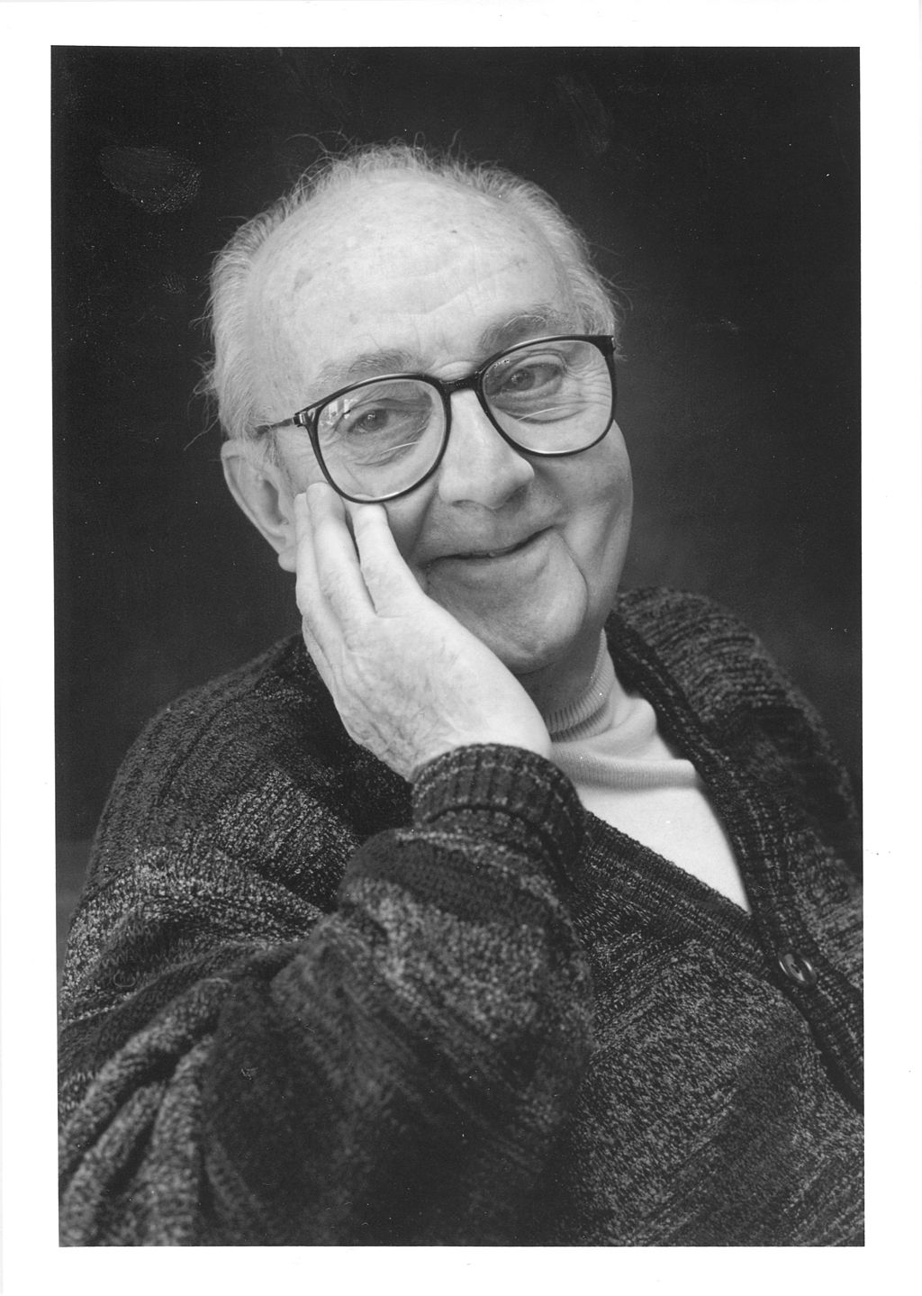
Theme #1
“All models are wrong,
but some are useful.”
-- George E. P. Box
(1919-2013)
A lot of details… but focus on the big picture
Wikipedia
Notes:
13 PBL schemes in WRF. They often help generate different forecasts. Not only cannot all be right, it is very likely all are wrong. Sometimes different schemes produce the same wrong forecast. In those cases, it may be that the schemes are all making the same poor assumptions.
FERMI PROBLEM, analogy to NWP – a chain of reasonable guesses.

Slide 6
Theme #2
“When creating a model, we have to start with assumptions. Indeed, all models
try to describe reality in such a way that it is not as cumbersome as reality,
but is useful to reflect reality. And to reflect reality, we start with some assumptions.”
-- Tom Tango, Tango on Baseball

Slide 7
The PBL
The planetary boundary layer (PBL) or atmospheric boundary layer (ABL) is the lowest part of the troposphere, where interactions with the surface are important.
  Turbulence is important in the PBL and is represented by fluctuations called eddies.
  Turbulence can be generated by buoyancy (convective turbulence) or shear (mechanical turbulence)
  PBL depth ranges from a few meters up to several kilometers (especially over strongly heated, dry land).
14 PBL schemes in WRF version 4.5
Part 1 will concentrate on some basic concepts and tools that will be used.

Slide 8
Outline
Reynolds averaging and eddy covariance
Prandtl’s mixing length theory
Friction velocity and roughness length
The logarithmic wind profile
Mixing of heat

Slide 9
Reynolds averaging
Take a variable of interest (say, u, w, θ_{v}, T, q) and partition it into a mean and perturbation part
  The mean represents the average over time and space
  The average of perturbations is assumed to be zero (Reynolds’ assumption)
Notes:
Instead of representing a base state that is usually fixed with time, NOW mean represents time/space avg that varies in space and time
Especially one GRID VOLUME

Slide 10
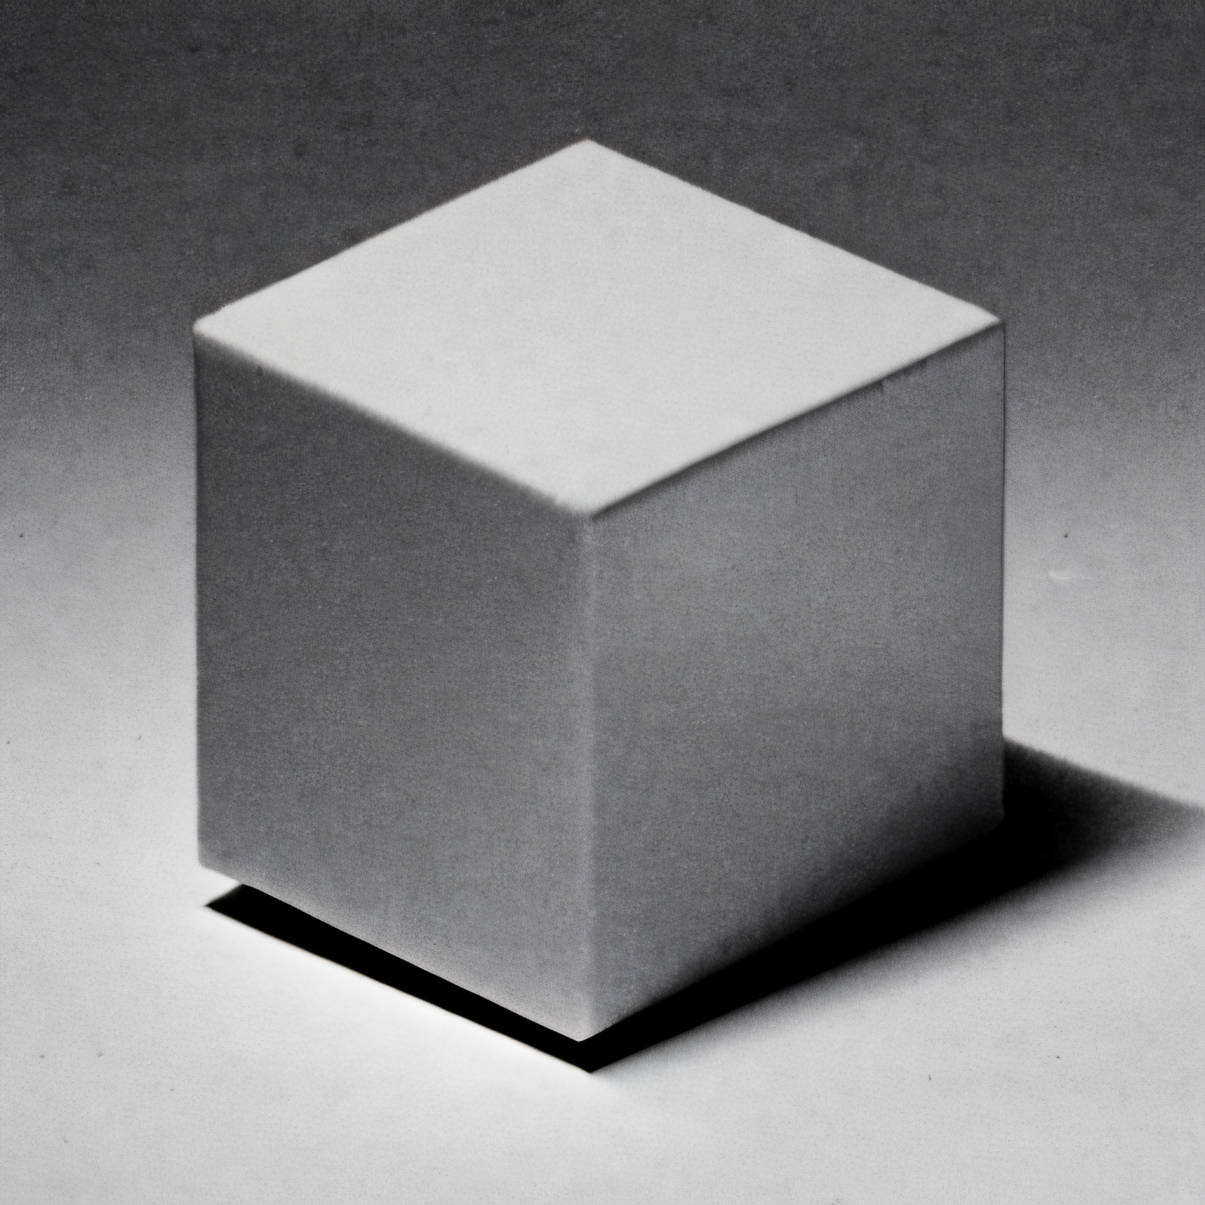
A single model grid box
• A single grid volume from our model
→ maybe 10 km x 10 km x 500 m
→ we’ll have thousands of them
• The model is predicting volume mean
temperature, wind, humidity, …
→ a single number for each field,
for each grid box and time step
• Deviations within each that volume from
that mean are our perturbations
→ they all average to zero, but…
• The deviations can combine to change
the volume mean

Slide 11
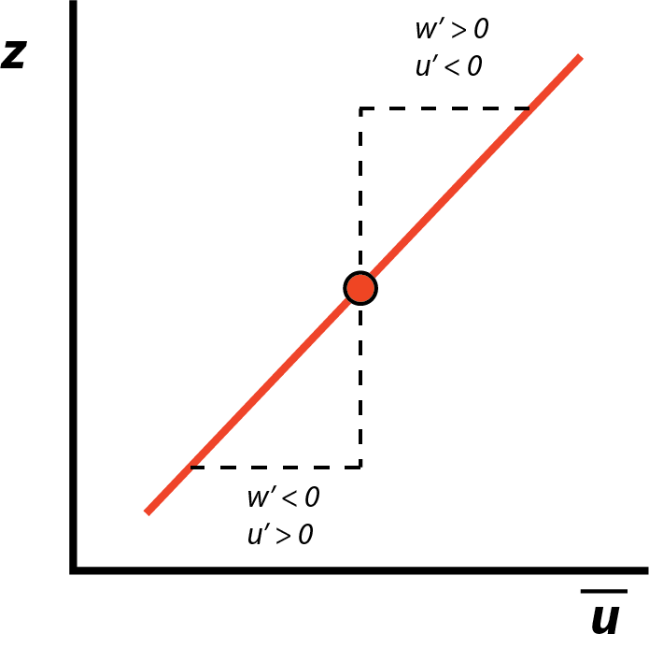
Eddy covariance
So, averaged over a grid volume, the mean
perturbations of w and u are zero, by definition.
BUT, the multiplication of w’ by u’ may not be zero
when averaged… if the perturbations are correlated
(i.e., they covary).
Example: Horizontal wind u has
positive shear. An eddy updraft
(w’ > 0) creates u’ < 0, and downdraft
(w’ < 0) creates u’ > 0, so w’u’ < 0,
even after averaging over time & space.
Notes:
How will that influence the mean vertical profile of U? (next slide)

Slide 12
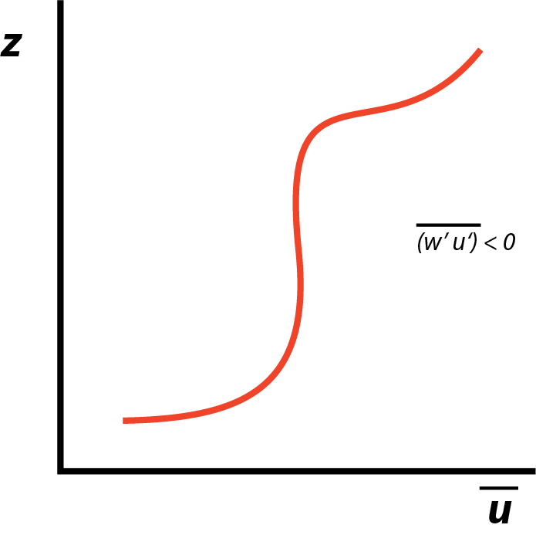
Eddy covariance
So, averaged over a grid volume, the mean
perturbations of w and u are zero, by definition.
BUT, the multiplication of w’ by u’ may not be zero
when averaged… if the perturbations are correlated
(i.e., they covary).
Result: reduction of vertical shear
where mixing is most effective.
This consequence of unresolved eddies
needs to be taken into account.
Notes:
I often say “parameterize” is Latin for “to make things up”. That is not true. But it should be.

Slide 13
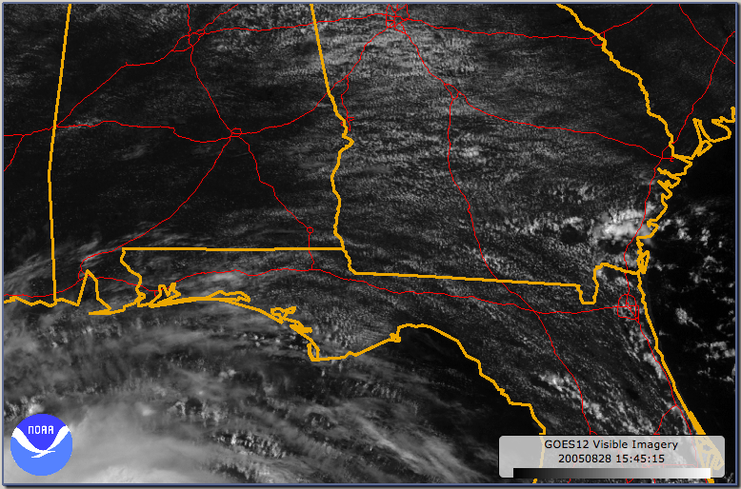
• We often see roll clouds
in the afternoon on
satellite pictures

Slide 14
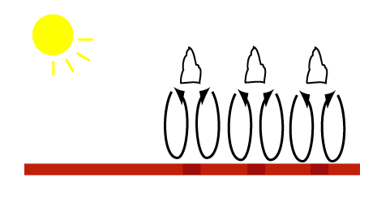
• We often see roll clouds
in the afternoon on
satellite pictures
• These rolls reflect PBL
eddy mixing organized by
vertical wind shear, and
made visible by saturation

Slide 15
• We often see roll clouds
in the afternoon on
satellite pictures
• These rolls reflect PBL
eddy mixing organized by
vertical wind shear, and
made visible by saturation
• The mixing accomplished
by these rolls is changing
the environment, affecting
the temperature, wind,
shear, moisture, stability,
and creating clouds… but
fine grid spacing (< 500 m)
is needed to resolve them

Slide 16
• We often see roll clouds
in the afternoon on
satellite pictures
• These rolls reflect PBL
eddy mixing organized by
vertical wind shear, and
made visible by saturation
• The mixing accomplished
by these rolls is changing
the environment, affecting
the temperature, wind,
shear, moisture, stability,
and creating clouds… but
fine grid spacing (< 500 m)
is needed to resolve them
• So we must parameterize
them – and if we do it
poorly, we get forecast
error

Slide 17
Decomposition
• expand this expression
• then average in space
and time
• average of mean =
mean itself
• average of perts =
zero, except possibly
when paired
Even if we wish to focus solely on how the large-scale fields vary,
the contributions of eddy covariances may be important
Notes:
AbarBbar is advection, etc., what WRF is giving us w/o the PBl scheme. ABbar on LHS is our forecast. If the eddies are important, and we don’t include them, the forecasts are wrong.

Slide 18
Decomposition
• expand this expression
• next average in the
grid volume
• average of mean =
mean itself
• average of perts =
zero, except possibly
when paired
Even if we wish to focus solely on how the large-scale fields vary,
the contributions of eddy covariances may be important
Notes:
AbarBbar is advection, etc., what WRF is giving us w/o the PBl scheme. ABbar on LHS is our forecast. If the eddies are important, and we don’t include them, the forecasts are wrong.

Slide 19
Decomposition
• expand this expression
• next average in the
grid volume
• average of mean =
mean itself
• average of perts =
zero, except possibly
when paired
Even if we wish to focus solely on how the large-scale fields vary,
the contributions of eddy covariances may be important
Notes:
AbarBbar is advection, etc., what WRF is giving us w/o the PBl scheme. ABbar on LHS is our forecast. If the eddies are important, and we don’t include them, the forecasts are wrong.

Slide 20
Decomposition
• expand this expression
• next average in the
grid volume
• average of mean =
mean itself
• average of perts =
zero, except possibly
when paired
Even if we wish to focus solely on how the large-scale fields vary,
the contributions of eddy covariances may be important
Notes:
AbarBbar is advection, etc., what WRF is giving us w/o the PBl scheme. ABbar on LHS is our forecast. If the eddies are important, and we don’t include them, the forecasts are wrong.

Slide 21
Decomposition
Subgrid activity we need to account for, for accuracy.
What our grid-scale model is giving us (after PGF, advection, etc..)
Our forecast. What we want.
Notes:
AbarBbar is advection, etc., what WRF is giving us w/o the PBl scheme. ABbar on LHS is our forecast. If the eddies are important, and we don’t include them, the forecasts are wrong.

Slide 22
Another example
• Given a grid volume.
• We are heating the volume from below,
creating an unstable lapse rate. Rising
parcels carry warmer air upward, and
sinking parcels draw cooler air downward.
• But, say the mean vertical velocity in the
volume is zero. Even then:
There is an upward flux of
heat due to eddy activity
Notes:
Eddy correlation nonzero because rising parcels are warmer than gridbox avg, and descending parcels are cooler. As a consequence, the gridbox averages will change over time.

Slide 23
Apply averaging to a model equation
Horizontal (u) equation of motion is selected
Presume for simplicity: 2D, Boussinesq, constant density ρ₀, no Coriolis, but keep vertical viscous shear stress (ν = kinematic viscosity)
Let
Keep in mind quantities with overbars are grid-volume averages.

Slide 24
Step 1
• Start with our equation, in flux form.
• Sub in for u, w, p. Expand.
Notes:
Do undergrads know flux form?

Slide 25
Step 2
• Now average this equation.
• Apply what we know:
averages of means = mean itself,
averages of perturbations = 0
(except possibly when multiplied together)
Notes:
Partial(ubar)/partial t is NONZERO since that’s how the gridvol avg changes w/ time – diff from pert analysis in ATM 316

Slide 26
Step 3
Turbulent eddy stresses

Slide 27
Simplification
In the PBL, |u’| ~ |w’|, but vertical gradients > horizontal gradients
So, we generally keep
  but not
(Not always a justifiable assumption)
Note and
are the same thing
Notes:
My picture really doesn’t “show” horiz gradients < vert gradients. But think of convective rolls – horiz dimension say 10 km, but vert dimen is depth of PBL, so on 1:1 aspect ratio plot, they’d look very squat
The one-dimensional approximation

Slide 28
Step 3A
X
Turbulent eddy stress
Notes:
Still have one new, important term to deal with

Slide 29
Now we have a set of equations possessing eddy stress terms like
How do we deal with them?

Slide 30
How to handle eddy stresses?
Vertical shear stress due to the viscous force gave us a term like:
Mimic this – presume turbulence behaves in an analogous fashion
  “flux-gradient theory”, “K-theory” or first-order closure
  turbulent eddy transport is related to gradient of the mean property via a mixing coefficient
  K_{m} ≥ 0 so minus sign required (see next slide)
ν = molecular kinematic viscosity (m²/s)
[diffusion by molecular motions]
Notes:
Got to here 2023

Slide 31
How to handle eddy stresses?
Vertical shear stress due to the viscous force gave us a term like:
Mimic this – presume turbulence behaves in an analogous fashion
  “flux-gradient theory”, “K-theory” or first-order closure
  turbulent eddy transport is related to gradient of the mean property via a mixing coefficient
  K_{m} ≥ 0 so minus sign required (see next slide)
ν = molecular kinematic viscosity (m²/s)
[diffusion by molecular motions]
K_{m} = “eddy viscosity” (m²/s)
[diffusion by eddy motions]
Molecular viscosity is small. Eddy viscosity may not be.
Notes:
This is kinematic viscosity. Dynamic (absolute) viscosity is kinematic viscosity divided by density.

Slide 32
Sign justification
• K_{m} ≥ 0 (diffusion, not confusion!)
• Here shear is positive. Updrafts create negative
horizontal velocity perturbations, so u’w’ < 0.
See minus sign is needed since K_{m} ≥ 0.
• Now shear is negative. Updrafts create
positive u’, so u’w’ > 0. Still need minus sign
since K_{m} is ≥ 0.

Slide 33
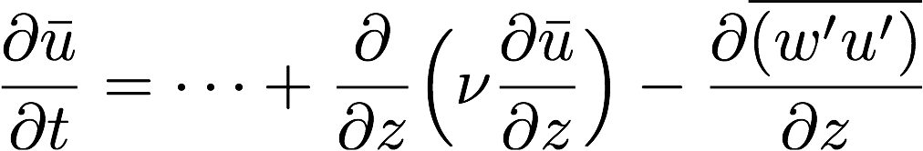
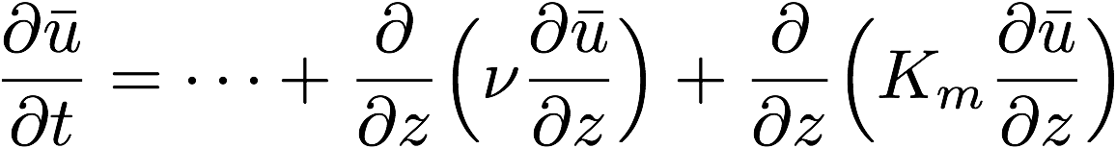
Return to Reynolds-averaged u equation
SMALL
ASSUMED
• for K_{m} ≥ 0, diffusion is downgradient
(from higher to lower values of u)
• We still need to quantify K_{m}
Notes:
WE have dubar/dz. Need Km.

Slide 34
At this point, it is useful to introduce the concept of the mixing length
The distance over which a parcel can travel before losing its original characteristics

Slide 35
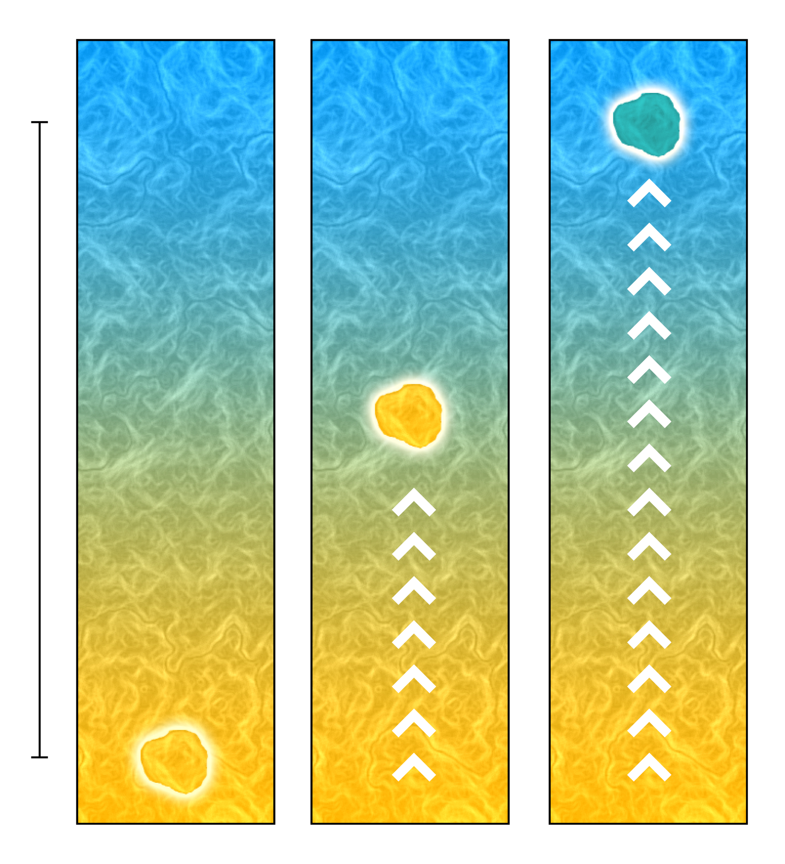
Temperature decreases with height
Make a parcel of warm air and
push it upwards
Wikipedia

Slide 36
Our parcel is now surrounded by
cooler air, and some mixing
has begun
Its properties have begun to change
Wikipedia

Slide 37
Our parcel has lost its original
characteristics, having
mixed with its surroundings
Wikipedia

Slide 38
Our parcel has lost its original
characteristics, having
mixed with its surroundings
The vertical distance it took to
accomplish this is the
vertical mixing length l_{v}
Sometimes it will take a longer
distance that this, other
times a shorter distance
We need to define a mean
mixing length
Wikipedia

Slide 39

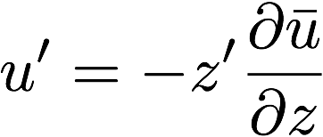
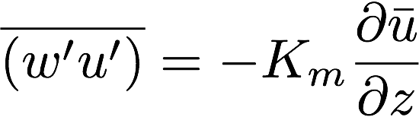
Prandtl’s mixing length theory
Assume…
z’ is a vertical displacement.
If shear is positive, an upward
displacement (z’ > 0) creates a
negative horizontal velocity
perturbation (u’ < 0), so need
minus sign
Notes:
Got to here 2022
This is how we will quantify Km. The perturbation you get depends on how far you displace and how U varies with height.
(1) Assume u’ = -z’ (dubar/dz). Minus sign needed
(3) Assumes w’ ~ z’|dubar/dz|, similar to u’ but absolute value needed

Slide 40
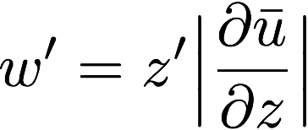
Prandtl’s mixing length theory
• In PBL, horizontal and vertical velocity
perturbations are similar in magnitude
- This more complex expression is needed
to make sure w’ > 0 when z’ > 0
Notes:
(1) Assume u’ = -z’ (dubar/dz). Minus sign needed
(3) Assumes w’ ~ z’|dubar/dz|, and prop to u’ but absolute value needed… so w’ > 0 when z’ > 0.

Slide 41
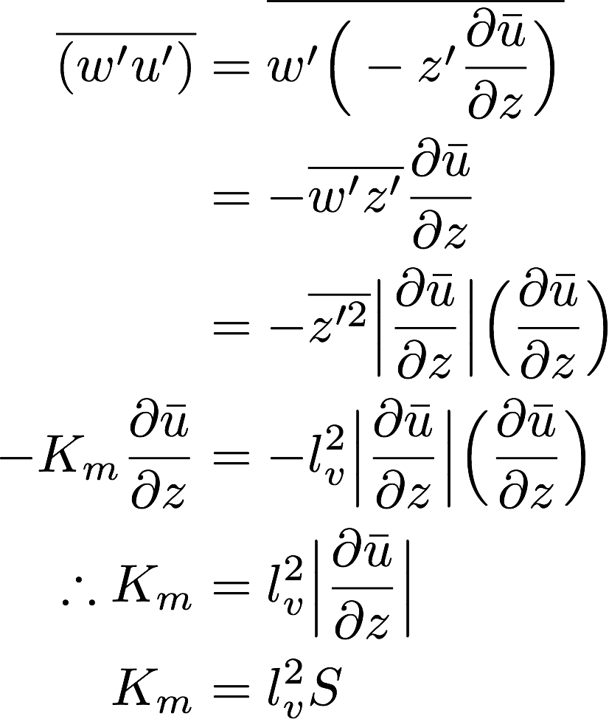
Prandtl’s mixing length theory
• Sub in for u’ and rearrange
• Sub in for w’
• Define a vertical mixing length l_{v}
(root mean square average parcel displacement)
(units = meters)
S = shear
Notes:
(1) Assume u’ = -z’ (dubar/dz). Minus sign needed
(3) Assumes w’ ~ z’|dubar/dz|, similar to u’ but absolute value needed
Identify \bar{z’}^2 as squared vertical mixing length l_v

Slide 42
Prandtl’s mixing length theory
plug in our assumption
S = mean shear absolute magnitude
Notes:
(1) Assume u’ = -z’ (dubar/dz). Minus sign needed
(3) Assumes w’ ~ z’|dubar/dz|, similar to u’ but absolute value needed
Identify \bar{z’}^2 as squared vertical mixing length l_v

Slide 43
S = mean shear
absolute
magnitude
This expression for eddy diffusion embodies the reasonable idea that larger parcel displacements (l_{v} ↑) result in more mixing (K_{m} ↑), but only if there’s something to mix (S ↑) in the first place.
But, what is a reasonable l_{v}?
In the surface layer, very close to the lower boundary, eddies are small, owing to the proximity of the surface. Farther above, eddies can be larger. So, with l_{v} ↑ height is expected.
Notes:
Also conveys the idea that Km is driven by shear. Shear results in mixing. When shear disappears, no more mixing? That’s a FLAW in K-theory.

Slide 44
S = mean shear
absolute
magnitude
This expression for eddy diffusion embodies the reasonable idea that larger parcel displacements (l_{v} ↑) result in more mixing (K_{m} ↑), but only if there’s something to mix (S ↑) in the first place.
But, what is a reasonable l_{v}?
In the surface layer, very close to the lower boundary, eddies are small, owing to the proximity of the surface. Farther above, eddies can be larger. So, with l_{v} ↑ height is expected.
Notes:
Also conveys the idea that Km is driven by shear. Shear results in mixing. When shear disappears, no more mixing? That’s a FLAW in K-theory.

Slide 45
This is why superadiabatic layers can form close to the surface
on days with strong surface heating. Eddy activity and size are
both restricted very close to the rigid surface.
Farther aloft, however, eddies can be larger in size and magnitude,
and thus more efficient vertical mixing is possible, which can lead to
a neutral lapse rate.
Notes:
Should actually show eddies as being even more “squat” – think convective rolls.
Got to here 2018

Slide 46
So we start with the hypothesis that l_{v} is proportional to height z:
where κ is an as yet unspecified proportionality*.
But, it is unreasonable to expect that vertical mixing length
continues to increase with height. Next expression bounds l_{v} by l∞:
Blackadar (1962, eq. 24)
l∞ ~ 50 m
*von Karman’s constant, empirically determined to be about 0.4 from lab experiments of flow near solid, no-slip walls

Slide 47
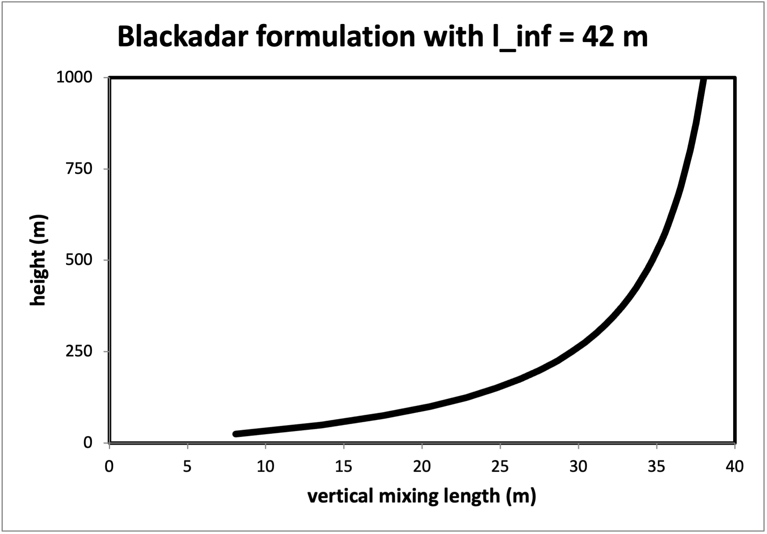
Blackadar mixing length formula
(l∞ = 42 m, κ = 0.4)
Blackadar (1962) used this to model Lettau’s (1950) wind data from Leipzig,
and inferred l∞ should be a function of geostrophic wind speed and latitude.
In many applications, larger l∞ values are used, which results in l_{v} increasing
with height over a much deeper layer than one might anticipate.
Businger et al. (1971): κ may be smaller than 0.4
Notes:
Lv=kz would have value of 40 m by z=100, so this profile is very very different

Slide 48
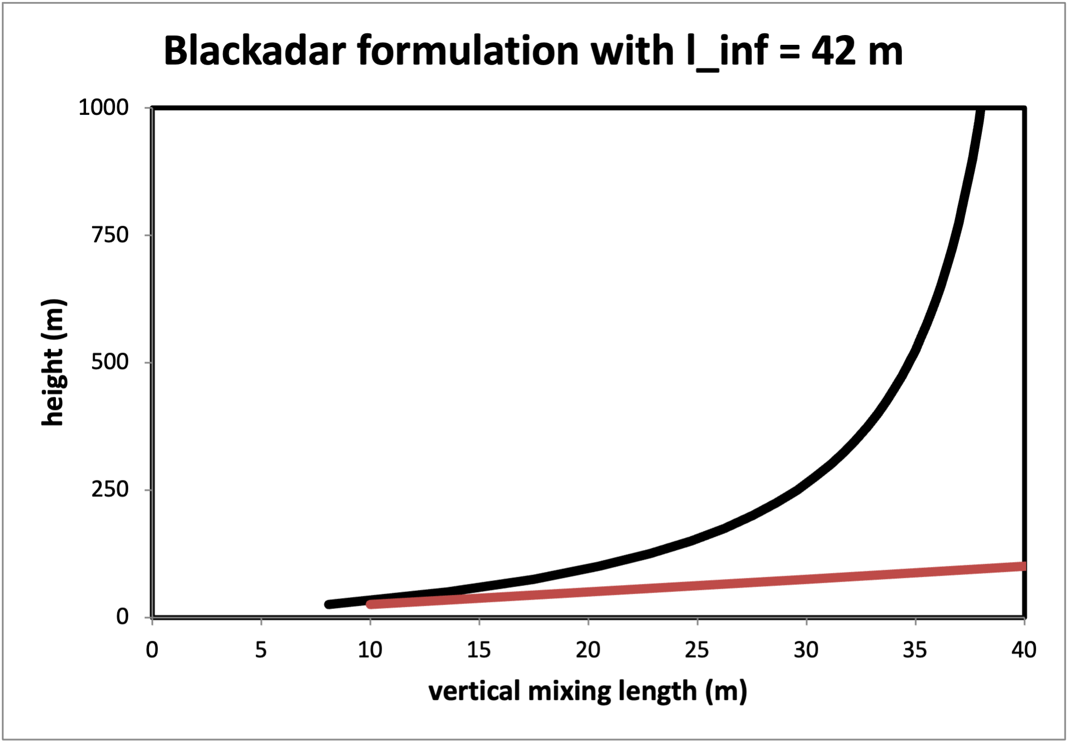
Blackadar mixing length formula
(l∞ = 42 m, κ = 0.4)
Assuming
l_{v} = κz and
constant
Blackadar (1962) used this to model Lettau’s (1950) wind data from Leipzig,
and inferred l∞ should be a function of geostrophic wind speed and latitude.
In many applications, larger l∞ values are used, which results in l_{v} increasing
with height over a much deeper layer than one might anticipate.
Businger et al. (1971): κ may be smaller than 0.4
Notes:
Lv=kz would have value of 40 m by z=100, so this profile is very very different

Slide 49
Application:
Horizontal wind speed near the ground
“Friction velocity” u*
Roughness length z₀
The logarithmic wind profile

Slide 50
“Friction velocity”
Now use the assumption*
Near the surface (subscript s)
use
use
*Because we’re staying very close to the ground
Notes:
Friction is the enemy of velocity!
Starting with something we had before.
Got shear twice, but one is in absolute value. Kind of awkward.
Using lv = kz, not something more complex, because we’re ONLY looking at sfc layer – it is NOT DEEP. Maybe 100m or so.

Slide 51
“Friction velocity”
Now use the assumption*
Near the surface (subscript s)
Take absolute value of each side
LHS is square of “friction velocity”
Units of u* is m/s
*Because we’re staying very close to the ground
Notes:
Friction is the enemy of velocity!
Starting with something we had before.
Got shear twice, but one is in absolute value. Kind of awkward.
Using lv = kz, not something more complex, because we’re ONLY looking at sfc layer – it is NOT DEEP. Maybe 100m or so.

Slide 52
“Friction velocity”
Now use the assumption*
Near the surface (subscript s)
Friction velocity u*² is a function
of wind shear very near surface,
a consequence of our assumptions.
Friction velocity is non-negative.
*Because we’re staying very close to the ground
Notes:
Friction is the enemy of velocity!
Starting with something we had before.
Got shear twice, but one is in absolute value. Kind of awkward.
Using lv = kz, not something more complex, because we’re ONLY looking at sfc layer – it is NOT DEEP. Maybe 100m or so.

Slide 53
Roughness length
Solve that last equation for the mean shear, using total derivative now since the only direction we’re interested in is the vertical:
Next, integrate this expression from z = z₀ (where u = 0) to some height z, somewhere in the surface layer (~lowest 100 m or so)
  z₀ is called the roughness length or roughness height
Everything is non-negative
Notes:
This really also says u* is something we can quantify, measure or estimate

Slide 54
Roughness length
The roughness length is the height above the surface where the wind has become calm.
Three points regarding z₀:
  (1) Roughness length embodies the idea that the wind becomes calm somewhere above the surface owing to surface friction and the drag it produces
  (2) This height/distance should depend on how rough the surface is
  (3) Still, this height is very close to the ground (a few cm to 1 m or so in the very roughest cases)
Notes:
See sheets of paper skipping across the ground… winds have to get very close to sfc

Slide 55
LANDUSE.TBL
Roughness lengths for various land surface types
as presumed in the WRF model (USGS database)
Surface roughness z₀, in centimeters
USGS SUMMER
ALBD SLMO SFEM SFZ0 THERIN SCFX SFHC
1, 15., .10, .88, 80., 3., 1.67, 18.9e5,'Urban and Built-Up Land'
2, 17., .30, .985, 15., 4., 2.71, 25.0e5,'Dryland Cropland & Pasture'
3, 18., .50, .985, 10., 4., 2.20, 25.0e5,'Irrigated Cropland & Pasture'
4, 18., .25, .985, 15., 4., 2.56, 25.0e5,'Mixed Dryland/Irrigated Crop'
5, 18., .25, .98, 14., 4., 2.56, 25.0e5,'Cropland/Grassland Mosaic'
6, 16., .35, .985, 20., 4., 3.19, 25.0e5,'Cropland/Woodland Mosaic'
7, 19., .15, .96, 12., 3., 2.37, 20.8e5,'Grassland'
8, 22., .10, .93, 5., 3., 1.56, 20.8e5,'Shrubland'
9, 20., .15, .95, 6., 3., 2.14, 20.8e5,'Mixed Shrubland/Grassland'
10, 20., .15, .92, 15., 3., 2.00, 25.0e5,'Savanna'
11, 16., .30, .93, 50., 4., 2.63, 25.0e5,'Deciduous Broadleaf Forest'
12, 14., .30, .94, 50., 4., 2.86, 25.0e5,'Deciduous Needleleaf Forest'
13, 12., .50, .95, 50., 5., 1.67, 29.2e5,'Evergreen Broadleaf Forest'
14, 12., .30, .95, 50., 4., 3.33, 29.2e5,'Evergreen Needleleaf Forest'
15, 13., .30, .97, 50., 4., 2.11, 41.8e5,'Mixed Forest'
16, 8., 1.0, .98, 0.01, 6., 0., 9.0e25,'Water Bodies'
Aside: As of WRF v3.9, MODIS landuse database is now the default
Some land surface models (notably Noah) use contents of VEGPARM.TBL instead
Notes:
Water – 0.01 cm = very smooth (a problem when windy, but this is why wind can get to the surface and kick up waves)
Urban area 80 cm (2.6 ft). Dryland 15 cm = 6 inches
In between: shrubland (5 cm), grassland (12 cm), cropland (14-20 cm), forest (50 cm). Density and height of vegetation.
This isn’t just an attempt to properly capture a true physical process – it also has to compensate for other errors and omissions!

Slide 56
The log wind profile
• Start with friction velocity
equation
• Integrate from z₀ to z
• z₀ depends on vegetation
• Assume u* constant with z
• κ is a constant
• wind at height z₀ is calm
• yields how u varies with z
based on u*, z₀, and κ
• Within the surface layer, the wind should vary logarithmically with height,
above height z₀ where the wind is calm, if assumptions reasonable.
• This is called the logarithmic wind profile.

Slide 57
The log wind profile
• Start with friction velocity
equation
• Integrate from z₀ to z
• z₀ depends on vegetation/
land
• Assume u* constant with z
• κ is a constant
• wind at height z₀ is calm
• yields how u varies with z
based on u*, z₀, and κ
• Within the surface layer, the wind should vary logarithmically with height,
above height z₀ where the wind is calm, if assumptions reasonable.
• This is called the logarithmic wind profile.

Slide 58
The log wind profile
• Start with friction velocity
equation
• Integrate from z₀ to z
• z₀ depends on vegetation/
land
• Assume u* constant with z
• Assume κ is a constant*
• Assume calm at height z₀
• yields how u varies with z
based on u*, z₀, and κ
• Within the surface layer, the wind should vary logarithmically with height,
above height z₀ where the wind is calm, if assumptions reasonable.
• This is called the logarithmic wind profile.
* κ is von Karman’s constant, empirically determined to be about 0.4 but may be smaller (Businger et al. 1971)

Slide 59
The log wind profile
• Start with friction velocity
equation
• Integrate from z₀ to z
• z₀ depends on vegetation/
land
• Assume u* constant with z
• Assume κ is a constant
• Assume calm at height z₀
• yields how u varies with z
based on u*, z₀, and κ
• Within the surface layer, the wind should vary logarithmically with height,
above height z₀ where the wind is calm, if assumptions reasonable.
• This is called the logarithmic wind profile.

Slide 60
The log wind profile
• Start with friction velocity
equation
• Integrate from z₀ to z
• z₀ depends on vegetation/
land
• Assume u* constant with z
• Assume κ is a constant
• Assume calm at height z₀
• Yields how u varies with z
based on u*, z₀, and κ
• Within the surface layer, the wind should vary logarithmically with height,
above height z₀ where the wind is calm, if assumptions are reasonable.
• This is called the logarithmic wind profile.

Slide 61
The log wind profile
(wind speed)
However, there are at least two complicating factors...
Notes:
ot to here 2020
Expect less shear, as vertical mixing will be more vigorous.
When stable, mixing is inhibited, so shear should be larger.
This implies a change in slope of the log wind profile.
Wind speed, not velocity

Slide 62
Problem #1: Obstructions
Densely packed vegetation and/or significant obstacles act to displace the zero-wind level upward. This might be treated by correcting height z by a displacement distance d.
for z > d
“zero-plane displacement”
“[S]ome roughness elements when packed close together, such
as forest canopies, act as a displaced ground surface.” – Stensrud, p. 36
Notes:
Basically says don’t start presuming the log profile until above a higher height

Slide 63
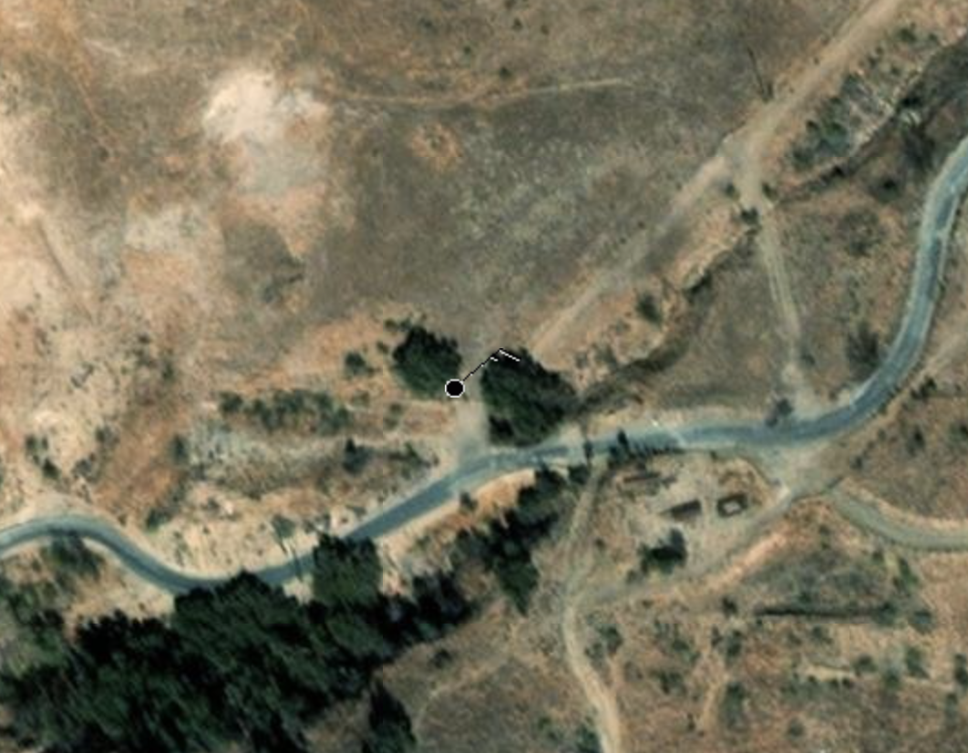
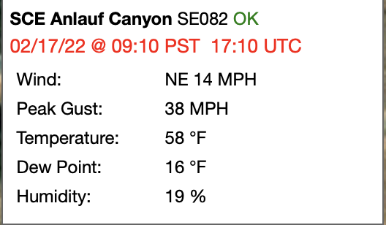
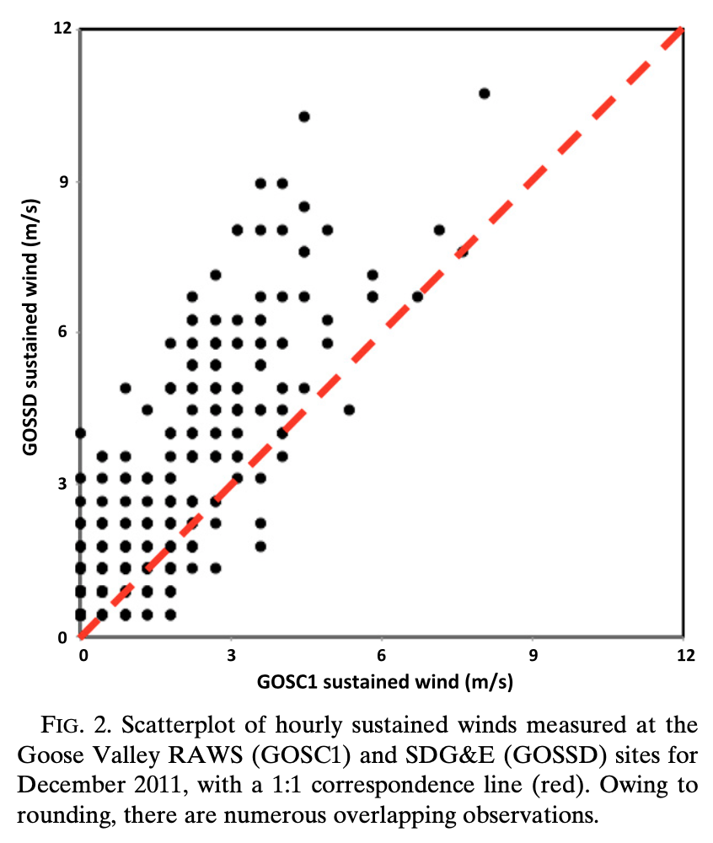
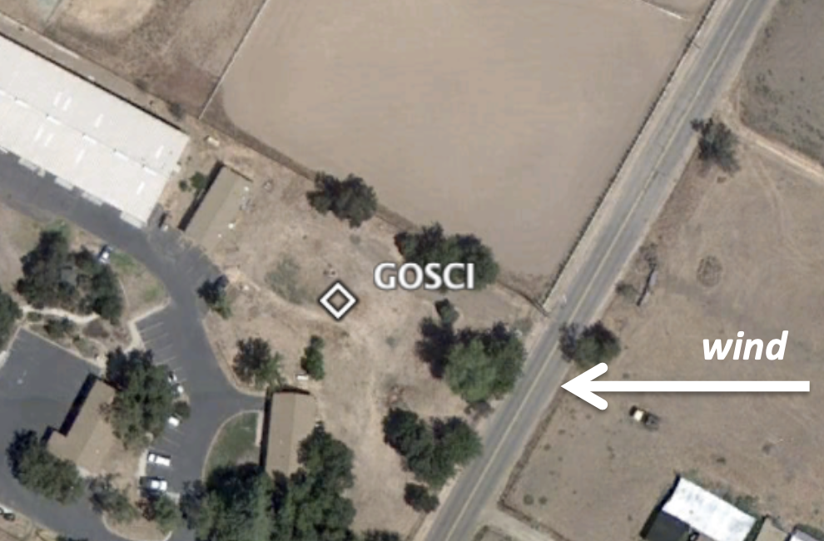
Obstructions in practice
GOSSD in
open area
Cao and Fovell (2016)

Slide 64
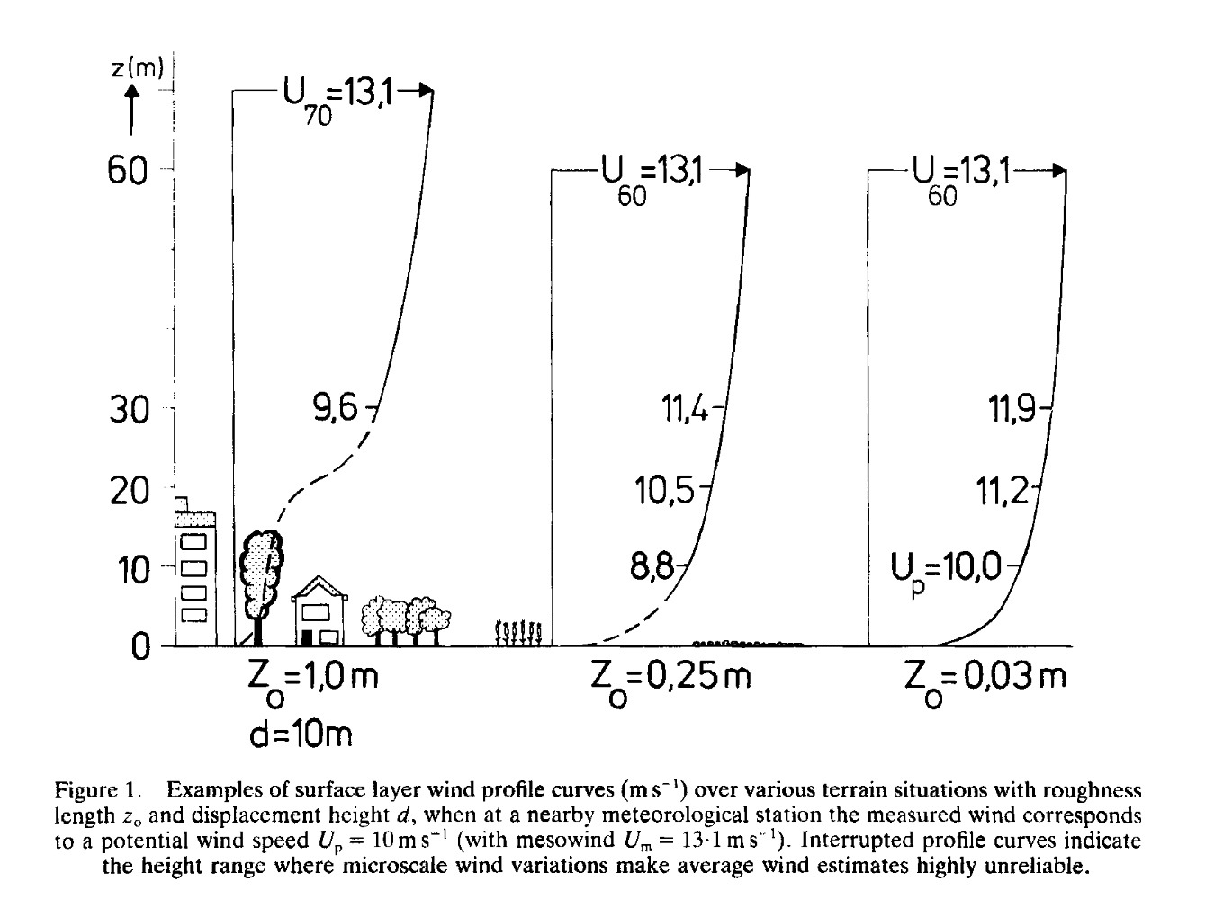
Wieringa (1986)
urban
cropland
shrubland
Our model cannot see those houses and trees but we want to forecast wind near the ground!
Notes:
Linear height, so not straight line.
Start from right to left: low roughness sfc, more rough sfc, high roughness + significant obstacles
Left: zero-wind level displaced upwards by 10m

Slide 65
Problem #2: Non-neutral stability
When near-surface atmosphere is not neutrally stratified, significant deviations from the log profile are found, but can be compensated for by stability adjustments.
Question: Do we expect more or less shear when the atmosphere is unstable?
Notes:
Got here Fall 2024
When stable, mixing is inhibited, so shear should be larger.
This implies a change in slope of the log wind profile.

Slide 66
Problem #2: Non-neutral stability
When near-surface atmosphere is not neutrally stratified, significant deviations from the log profile are found, but can be compensated for by stability adjustments.
Question: Do we expect more or less shear when the atmosphere is unstable?
Answer: Less shear when unstable owing to more mixing
Notes:
When stable, mixing is inhibited, so shear should be larger.
This implies a change in slope of the log wind profile.

Slide 67
Adjusting the log wind profile
When the near-surface atmosphere is unstable, we anticipate the vertical shear will be smaller… since mixing will be more vigorous and effective
When the atmosphere is stable, mixing is inhibited, so larger vertical shear can be supported
Either will change the slope of the log wind profile
Adjust the log profile with an experimentally-determined stability function φ_{m} that is > 1 when stable, < 1 when unstable
First, we need to define a new length scale, the Obukhov length L…

Slide 68
Obukhov length L
• Formulated by Obukhov (1946) and has units of meters.
• Represents the height above the surface at which buoyancy
production of turbulence exceeds shear production.
• L > 0 when atmosphere is stable, and L < 0 when it is unstable
• Numerator [with friction velocity cubed, a measure of shear]
always ≤ 0, since friction velocity and temperature non-negative
• Denominator contains vertical surface heat flux, which is negative
when atmosphere is stable and positive when unstable.
This sign controls sign of L. θ_{v} is virtual potential temperature.
Notes:
Got to here 2021
But before we do that, need to introduce another concept
Shear production is large near surface when stable because of friction caused shear
When atmosphere is unstable, L < 0
Ugliest equation in atmospheric science.
My grandfather used to dismantle and reassemble his Ford Model T or A on a Sunday afternoon. We’re disassembling and reassembling PBL concepts.

Slide 69
Obukhov length L
• Formulated by Obukhov (1946) and has units of meters.
• Represents the height above the surface at which buoyancy
production of turbulence exceeds shear production.
• L > 0 when atmosphere is stable, and L < 0 when it is unstable
• Numerator [with friction velocity cubed, a measure of shear]
always ≤ 0, since friction velocity and temperature non-negative
• Denominator contains vertical surface heat flux, which is negative
when atmosphere is stable and positive when unstable.
This sign controls sign of L. θ_{v} is virtual potential temperature.
Notes:
Got to here 2021
But before we do that, need to introduce another concept
Shear production is large near surface when stable because of friction caused shear
When atmosphere is unstable, L < 0
Ugliest equation in atmospheric science.
My grandfather used to dismantle and reassemble his Ford Model T or A on a Sunday afternoon. We’re disassembling and reassembling PBL concepts.

Slide 70
Obukhov length L
• Formulated by Obukhov (1946) and has units of meters.
• Represents the height above the surface at which buoyancy
production of turbulence exceeds shear production.
• L > 0 when atmosphere is stable, and L < 0 when it is unstable
• Numerator [with friction velocity cubed, a measure of shear]
always ≤ 0, since friction velocity and temperature non-negative
• Denominator contains vertical surface heat flux, which is negative
when atmosphere is stable and positive when unstable.
This sign controls sign of L. θ_{v} is virtual potential temperature.
Notes:
Got to here 2021
But before we do that, need to introduce another concept
Shear production is large near surface when stable because of friction caused shear
When atmosphere is unstable, L < 0
Ugliest equation in atmospheric science.
My grandfather used to dismantle and reassemble his Ford Model T or A on a Sunday afternoon. We’re disassembling and reassembling PBL concepts.

Slide 71
Obukhov length L
• Formulated by Obukhov (1946) and has units of meters.
• Represents the height above the surface at which buoyancy
production of turbulence exceeds shear production.
• L > 0 when atmosphere is stable, and L < 0 when it is unstable
• Numerator [with friction velocity cubed, a measure of shear]
always ≤ 0, since friction velocity and temperature non-negative
• Denominator contains vertical surface heat flux, which is negative
when atmosphere is stable and positive when unstable.
This sign controls sign of L. θ_{v} is virtual potential temperature.
Notes:
Got to here 2021
But before we do that, need to introduce another concept
Shear production is large near surface when stable because of friction caused shear
When atmosphere is unstable, L < 0
Ugliest equation in atmospheric science.
My grandfather used to dismantle and reassemble his Ford Model T or A on a Sunday afternoon. We’re disassembling and reassembling PBL concepts.

Slide 72
Closer look at L (1)
STABLE UNSTABLE NEAR
SURFACE
• Surface heat flux controls sign of L.
L < 0 when near-surface is unstable.
• L represents height above surface where
buoyancy-generated turbulence is
more important than shear-generated
turbulence.
• When L < 0, buoyancy always more
important than shear.
NEAR SURFACE
Notes:
The height at which shear is more important is “below the ground”
GOT HERE 2019

Slide 73
Closer look at L (2)
We had…
now
rewrite
as…
• L represents height above surface where
buoyancy-generated turbulence is
more important than shear-generated
turbulence.
• Friction velocity tells us something about
the vertical wind shear close to the surface.
• When L > 0, the larger the shear is, the greater
the depth over which shear-generated
turbulence is dominant.
• We now add adjustment factor φ_{m} to log wind
profile equation →
(no change if φ_{m} = 1)
Also, define new vertical coordinate
(dimensionless)
[not vorticity!]

Slide 74
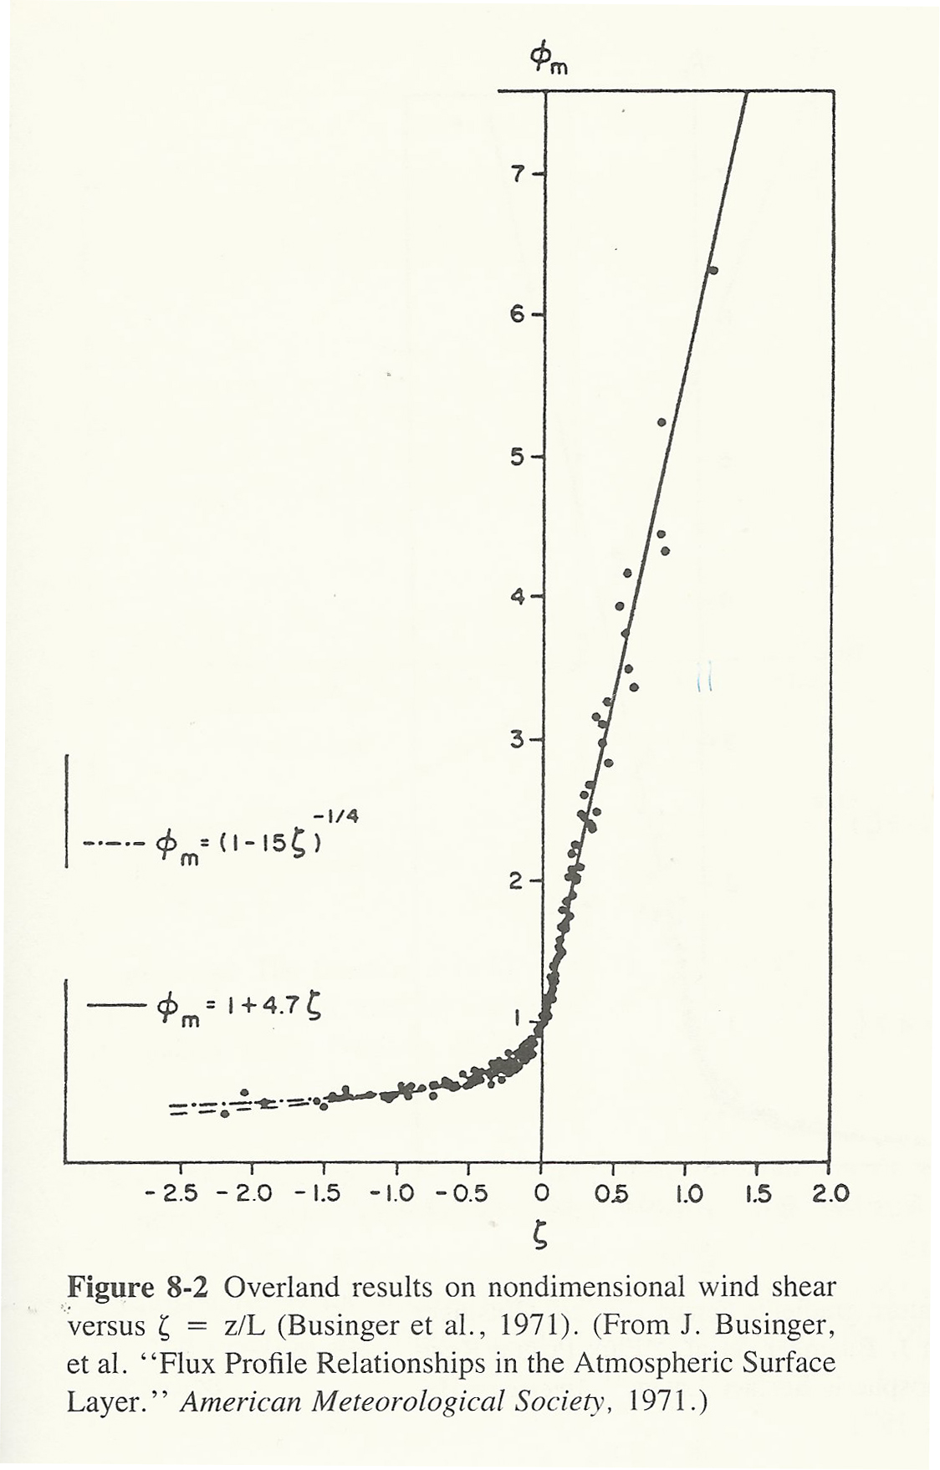
φ_{m} function will help log wind
function fit non-neutral
conditions
φ_{m} function plotted vs. ζ = z/L, as
determined from observations
(plotted as dots)
ζ = z/L > 0 when stable
Modification of log wind profile
is going to be larger when
atmosphere is stable.
unstable
stable
Haltiner and Williams (p. 279)
Notes:
Zeta becomes a nondimensional height, scaled by L.
When stable, magnitude of \phi_m larger. Very stable means a large amt of shear is supportable and expected.
As heat flux becomes more neg (stable), L becomes smaller, and zeta becomes larger, so \phi_m becomes BIG. Very stable, supports lots of shear.
For a given stable situation, tho, MORE shear (u* larger) means L larger, which means zeta SMALLER, and \phi_m SMALLER. Reason is likely: lots of shear induces mixing which works to REDUCE the shear!

Slide 75
When unstable, φ_{m} < 1. For the
same conditions, we expect
less shear, but the shear decrease
is not larger when more unstable
unstable
stable
Haltiner and Williams (p. 279)
Notes:
Got to here 2023
Zeta becomes a nondimensional height, scaled by L.
When stable, magnitude of \phi_m larger. Very stable means a large amt of shear is supportable and expected. For unstable not very sens to mag of instability. Mixing is mixing.
As heat flux becomes more neg (stable), L becomes smaller, and zeta becomes larger, so \phi_m becomes BIG. Very stable, supports lots of shear.
For a given stable situation, tho, MORE shear (u* larger) means L larger, which means zeta SMALLER, and \phi_m SMALLER. Reason is likely: lots of shear induces mixing which works to REDUCE the shear!

Slide 76
When unstable, φ_{m} < 1. For the
same conditions, we expect
less shear, but the shear decrease
is not larger when more unstable
When stable, φ_{m} > 1. For the
same conditions, we expect
more shear AND greater
sensitivity to stability since
making it a little more stable
means supporting a lot more
vertical shear
unstable
stable
Haltiner and Williams (p. 279)
Notes:
Got to here 2023
Zeta becomes a nondimensional height, scaled by L.
When stable, magnitude of \phi_m larger. Very stable means a large amt of shear is supportable and expected. For unstable not very sens to mag of instability. Mixing is mixing.
As heat flux becomes more neg (stable), L becomes smaller, and zeta becomes larger, so \phi_m becomes BIG. Very stable, supports lots of shear.
For a given stable situation, tho, MORE shear (u* larger) means L larger, which means zeta SMALLER, and \phi_m SMALLER. Reason is likely: lots of shear induces mixing which works to REDUCE the shear!

Slide 77
Adjusting the log wind profile
• We added the empirically-determined φ_{m} function. It increases
shear when stable (φ_{m} > 1) and reduces it when unstable (φ_{m} < 1)

Slide 78
Adjusting the log wind profile
• This just re-writes the equation and can collapse back to what we
had before. L is the Obukhov length, positive when atmosphere
is stable, and negative when unstable.
• Next, we integrate… again from z₀ to z

Slide 79
Adjusting the log wind profile
where
Stability-adjusted log wind profile
= neutral version + stability corrector
Notes:
Integrating is a little nasty, but redefining \phi_m into a new function \psi_m will make it easier to understand

Slide 80
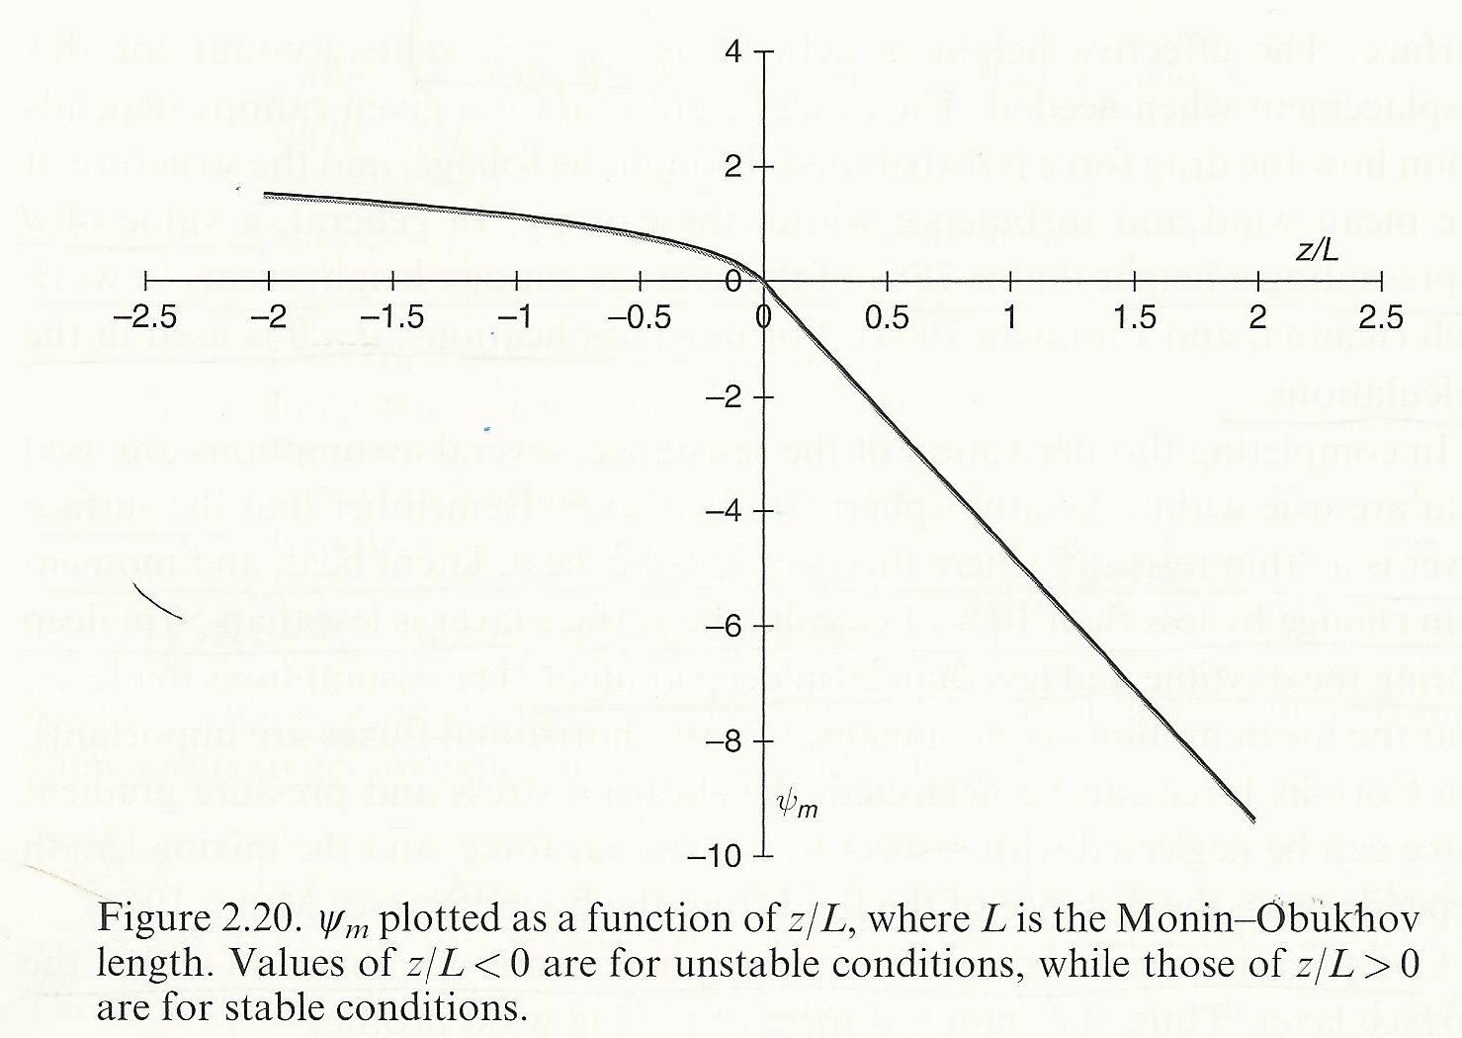
ψ_{m} function
• Horizontal axis is z/L, and
z/L > 0 is stable
• When atmosphere is unstable,
ψ_{m} > 0, so the corrector is
negative… thus wind speed
increases less quickly with
height (less shear) though
not very sensitive to degree
of instability
• When atmosphere is stable,
ψ_{m} < 0, so the corrector is
positive… thus wind speed
increases very quickly with
height (more shear)
• ψ_{m} is based on φ_{m} (slide 76)
= neutral version + stability corrector
stable
unstable
Stensrud, p. 38
Notes:
Psi_m empirical because derived from phi_m.
I am emphasizing ‘empirical’ to demonstrate the function has no theoretical, known value(s).

Slide 81
That was theory.
Does this work in practice?
WRF uses the log wind profile to compute u* and near-surface winds
“In theory, there’s no difference between theory and practice,
but, in practice, there is.”
Notes:
In practice: WRF uses the log wind profile to compute u* … !

Slide 82
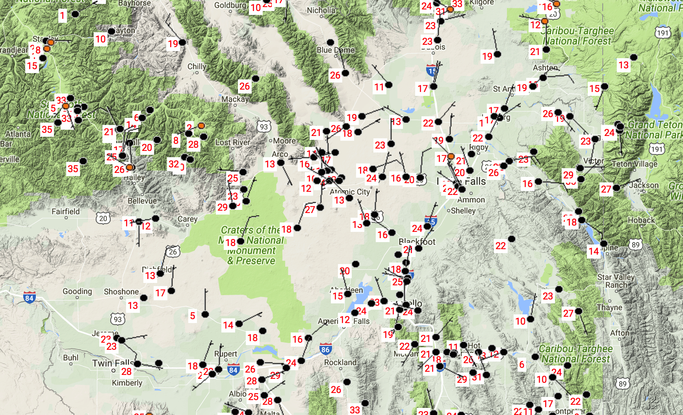
ARLFRD mesonet in SE Idaho
EBR

Slide 83
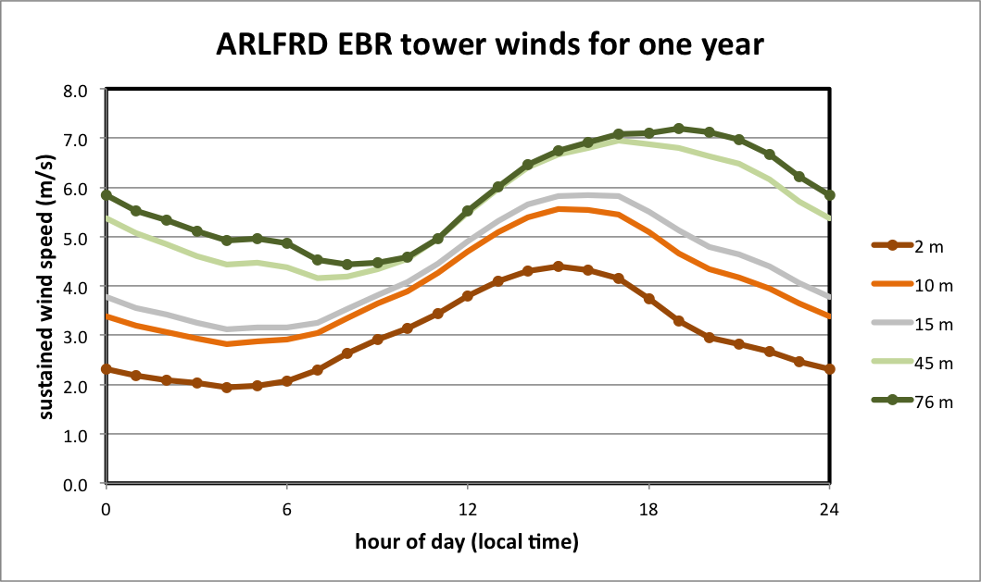
76 m
2 m
Wind speed increases with z.
Wind peaks later with z.
Vertical shear varies with time.
When is shear largest?
When is shear smallest?
ARLFRD mesonet (SE Idaho). Tower EBR.
Data averaged over one full year.
Sunrise ~ 06h and sunset ~ 18h local time.
Notes:
ARLFRD_EBR_tower.xlsx
When is vertical shear smallest? Around hour 12… midday. These aren’t isobars or isoheights!
Shear largest around 0000 – stable – resistance to mixing

Slide 84
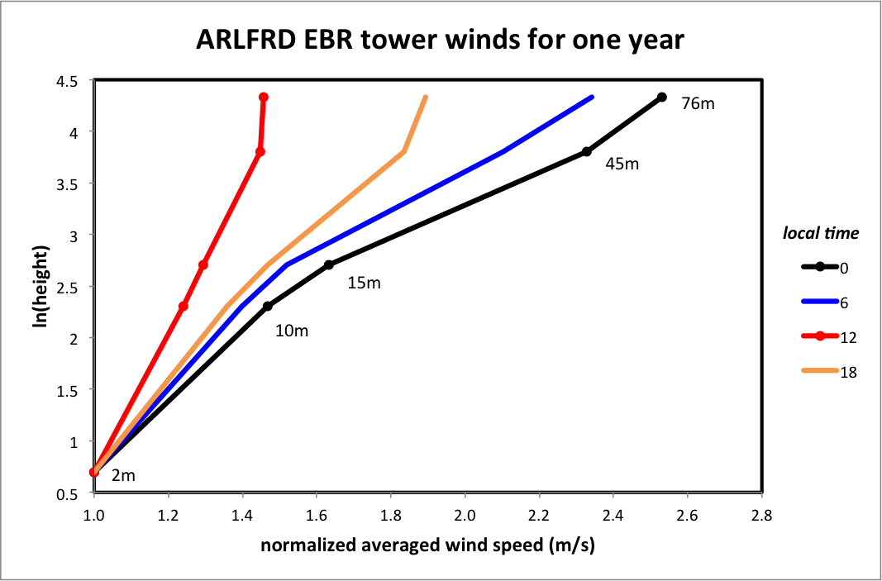
Wind analysis by Dr. Alex Gallagher
• 1 year of observations
at 2, 10, 15, 45, 76 m
above ground level
• Plotted against log z
• Winds plotted relative
to 2 m wind speed
[which varies with time]
• Wind profiles are
roughly logarithmic, BUT
• More shear at midnight
and less shear at noon
1200 local
[noon]
0000 local
[midnight]
We will utilize this information to predict winds near the surface
Notes:
Plotted against ln(z). Straight lines expected and roughly obtained. Shear larger when more stable.
Windspeed varies through day. We focus on the SLOPE (i.e., vert shear) by normalizing by wind at the lowest level (here 2m)

Slide 85
Wind analysis by Dr. Alex Gallagher
• 1 year of observations
at 2, 10, 15, 45, 76 m
above ground level
• Plotted against log z
• Winds plotted relative
to 2 m wind speed
[which varies with time]
• Wind profiles are
roughly logarithmic, BUT
• More shear at midnight
and less shear at noon
1200 local
[noon]
0000 local
[midnight]
We will utilize this information to predict winds near the surface
Notes:
Plotted against ln(z). Straight lines expected and roughly obtained. Shear larger when more stable.
Windspeed varies through day. We focus on the SLOPE (i.e., vert shear) by normalizing by wind at the lowest level (here 2m)

Slide 86
Recall Theme #2
“When creating a model, we have to start with assumptions. Indeed, all models
try to describe reality in such a way that it is not as cumbersome as reality,
but is useful to reflect reality. And to reflect reality, we start with some assumptions.”
-- Tom Tango, Tango on Baseball
What assumptions have we made?
Reynolds averaging and Reynolds’ assumption
Eddy mixing mimics molecular viscosity
Mixing length assumptions and von Karman constant
Roughness lengths
Absence of obstructions
Empirically-derived stability correctors
And we still need to implement this in the model!

Slide 87
Recall Theme #2
“When creating a model, we have to start with assumptions. Indeed, all models
try to describe reality in such a way that it is not as cumbersome as reality,
but is useful to reflect reality. And to reflect reality, we start with some assumptions.”
-- Tom Tango, Tango on Baseball
What assumptions have we made?
Reynolds averaging and Reynolds’ assumption
Eddy mixing mimics molecular viscosity
Mixing length assumptions and von Karman constant
Roughness lengths
Absence of obstructions
Empirically-derived stability correctors
And we still need to implement this in the model!
“A difference is a difference
only if it makes a difference”
-- Darrell Huff
How to Lie with Statistics

Slide 88
Eddy mixing of heat
For momentum, we mimicked molecular diffusion to get eddy mixing, and modified the vertical shear by a stability function
For heat, we do something similar:
Turbulent Prandtl number = K_{m}/K_{h} (but sometimes reversed!!)

Slide 89
[end of Part 1]

