Slide 1
The PBL, Part 2:
Structure as observed and modeled by WRF
(with in-class demonstration)
ATM 419/563
Fall 2024
Fovell
© Copyright 2024 Robert Fovell, Univ. at Albany, SUNY, rfovell@albany.edu

Slide 2
Outline
The PBL diurnal cycle
Visualization of diurnal cycle using WRF single-column model simulations

Slide 3
Mellor and Yamada’s depiction of the PBL diurnal cycle

Slide 4
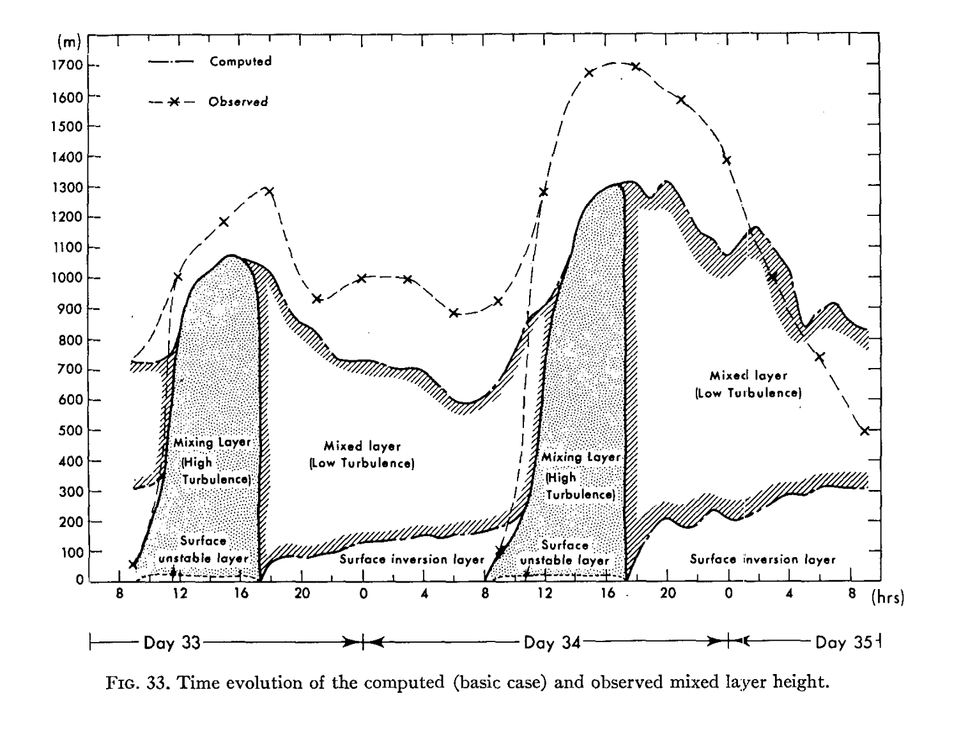
PBL height
Height (m)
[or Residual layer]
Local time
Yamada and Mellor (1975)
Notes:
PBL height computed vs observed

Slide 5
PBL height
Height (m)
Surface heating produces
unstable surface layer
[or Residual layer]
Local time
Yamada and Mellor (1975)
Notes:
PBL height computed vs observed

Slide 6
PBL height
Deep vigorous mixing
Height (m)
[or Residual layer]
Local time
Yamada and Mellor (1975)
Notes:
PBL height computed vs observed

Slide 7
PBL height
Height (m)
Late afternoon to evening:
surface layer stabilizes
[or Residual layer]
Local time
Yamada and Mellor (1975)
Notes:
PBL height computed vs observed

Slide 8
PBL height
Height (m)
Mixing rapidly vanishes,
leaving residual layer
Next day: do it again
[or Residual layer]
Local time
Yamada and Mellor (1975)
Notes:
PBL height computed vs observed

Slide 9
PBL height
PBL height varies with time
Height (m)
[or Residual layer]
Local time
Yamada and Mellor (1975)
Notes:
PBL height computed vs observed

Slide 10
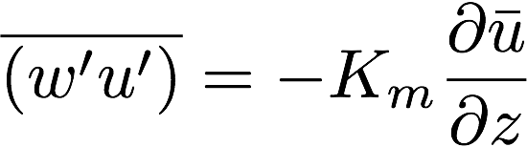
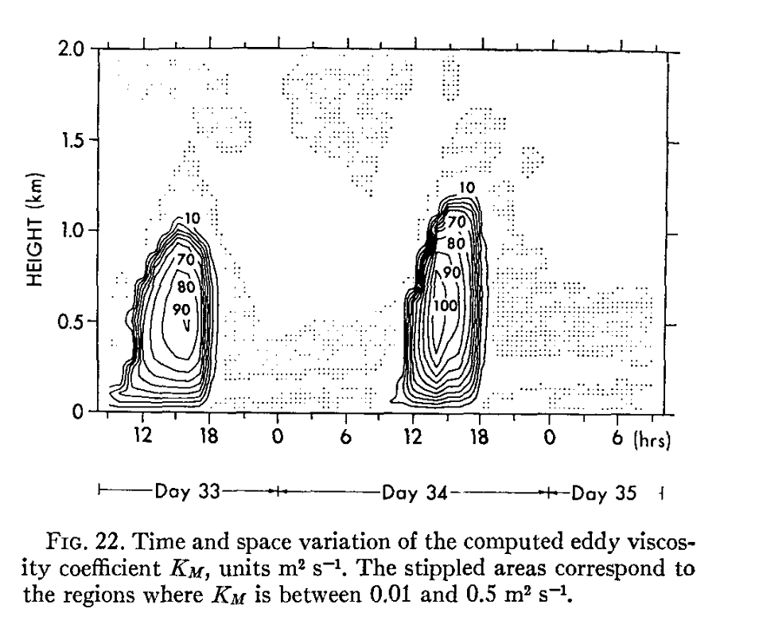
Estimates of eddy mixing (K_{m})
Max values ~ 100 m²/s
Max in afternoon
Abrupt disappearance
at night
Yamada and Mellor (1975)
Notes:
Emphasize very rapid collapse of mixing as sun goes down
What’s the big difference between afternoon and overnight? MIXING. PBL. SUBGRID MIXING. Need to param it right to get the forecast right.

Slide 11
PBL vertical structure

Slide 12
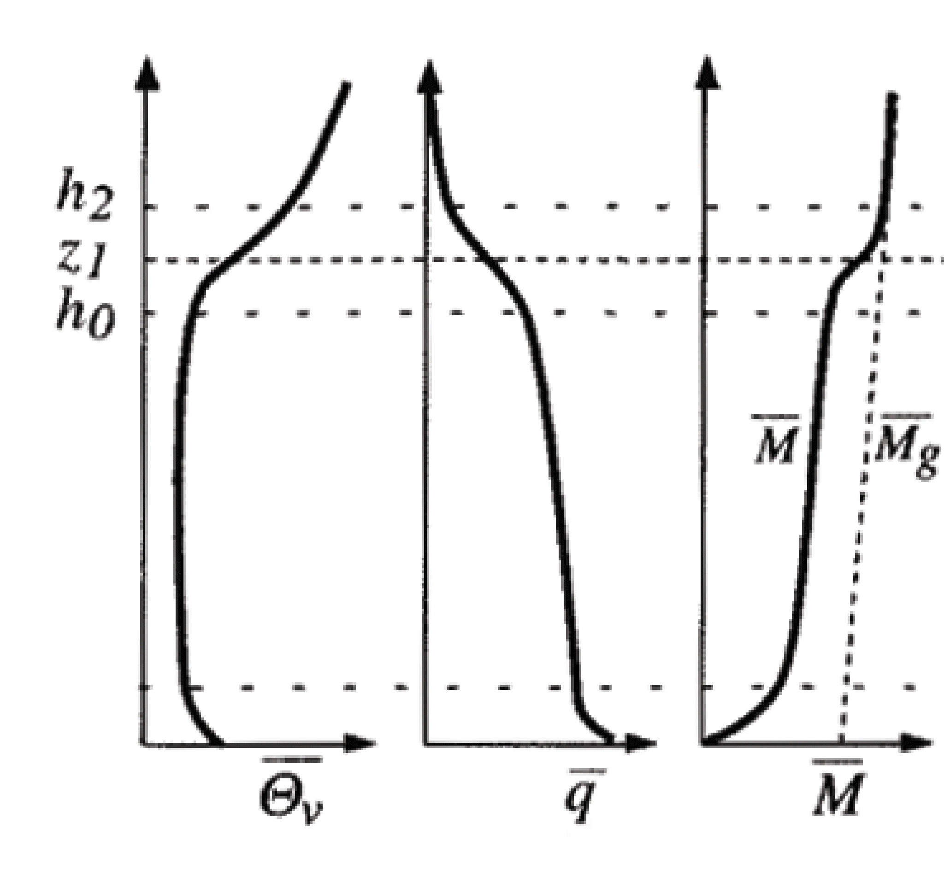
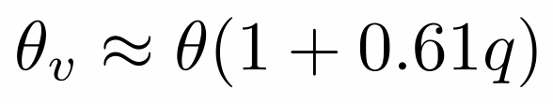
A strongly-heated afternoon PBL
Hartmann’s text Fig. 4.6
• Temporally averaged vertical profiles of virtual potential temperature (θ_{v}), vapor mixing ratio (q) and horizontal momentum (M)
• Strong surface heating, combined with surface friction that impedes vertical mixing, allows θ_{v} to decrease with height near the ground in the surface layer (superadiabatic)
• Farther above, convective turbulence (eddies) efficiently mixes the atmosphere and its conserved properties in the mixed layer
• For a dry adiabatic process, θ_{v} and q are conserved. If inviscid and unaccelerated, M is also conserved.
Virtual potential temperature contains a moisture influence:
q = water vapor mixing ratio (kg of water per kg of air)
Notes:
Virt PT because vapor content influences density via gas constant R
Surface layer is absolutely unstable but its shallowness and frictional drag makes it hard for eddies to form and “get a grip”

Slide 13
A strongly-heated afternoon PBL
• The entrainment zone (h₀ to h₂) separates the mixed layer from the free troposphere. Mixing between the PBL and free troposphere occurs intermittently there. Note that it is more stable there than the free troposphere above or the mixed layer below.
[entrain: French, to drag away]
• The q and M profiles are not as well mixed as θ_{v} due to entrainment of drier and higher momentum air from aloft
Notes:
What does the T-z profile look like?
Why does q decrease w/ z in mixed layer? I think it’s due to entrainment from above, which is larger closer to the free atmosphere (i.e., near PBL top). In case of potential temp, entrain from above brings high theta down, which helps maintain the neutral profile, but with vapor, it’s dry, so entrain erodes moisture at PBL top.
Also consider the countergradient term and what even theta looks like without it.

Slide 14
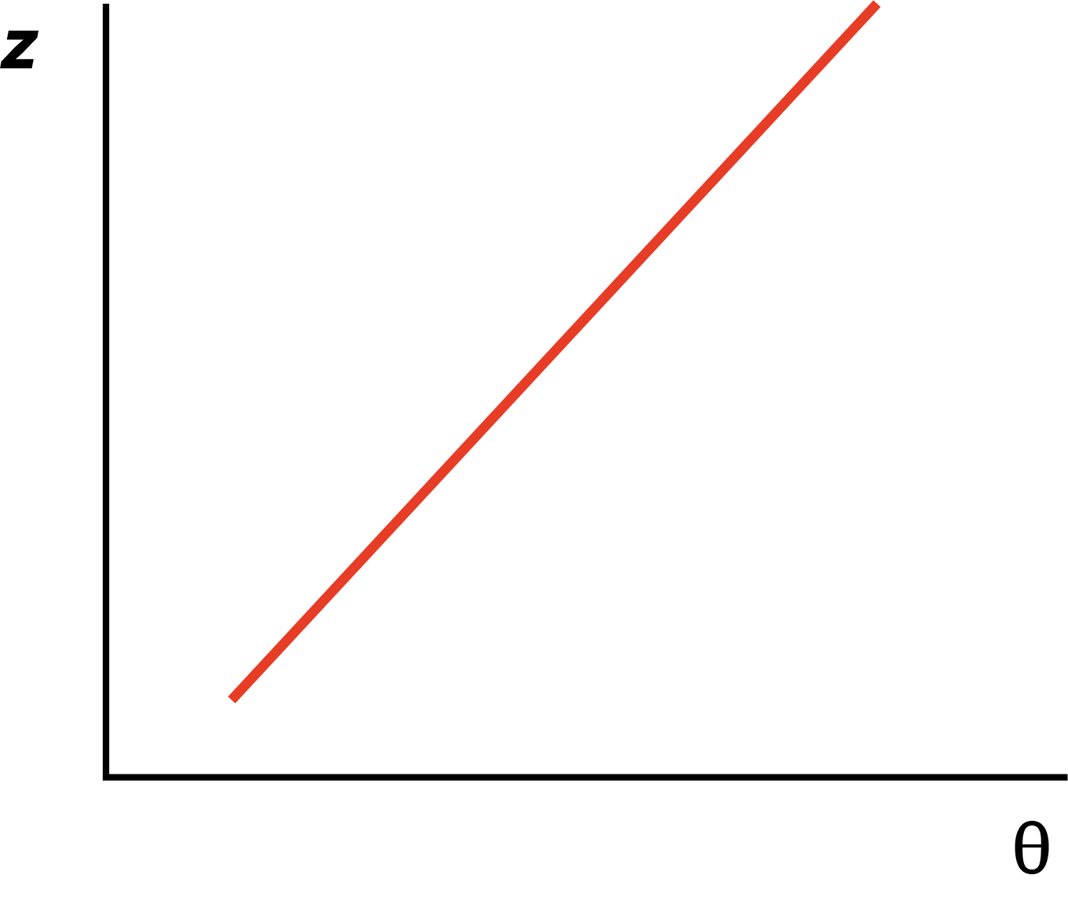
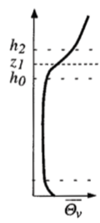
Evolution of well-mixed PBL #1
We start with a stable vertical profile
of potential temperature θ or θ_{v}

Slide 15
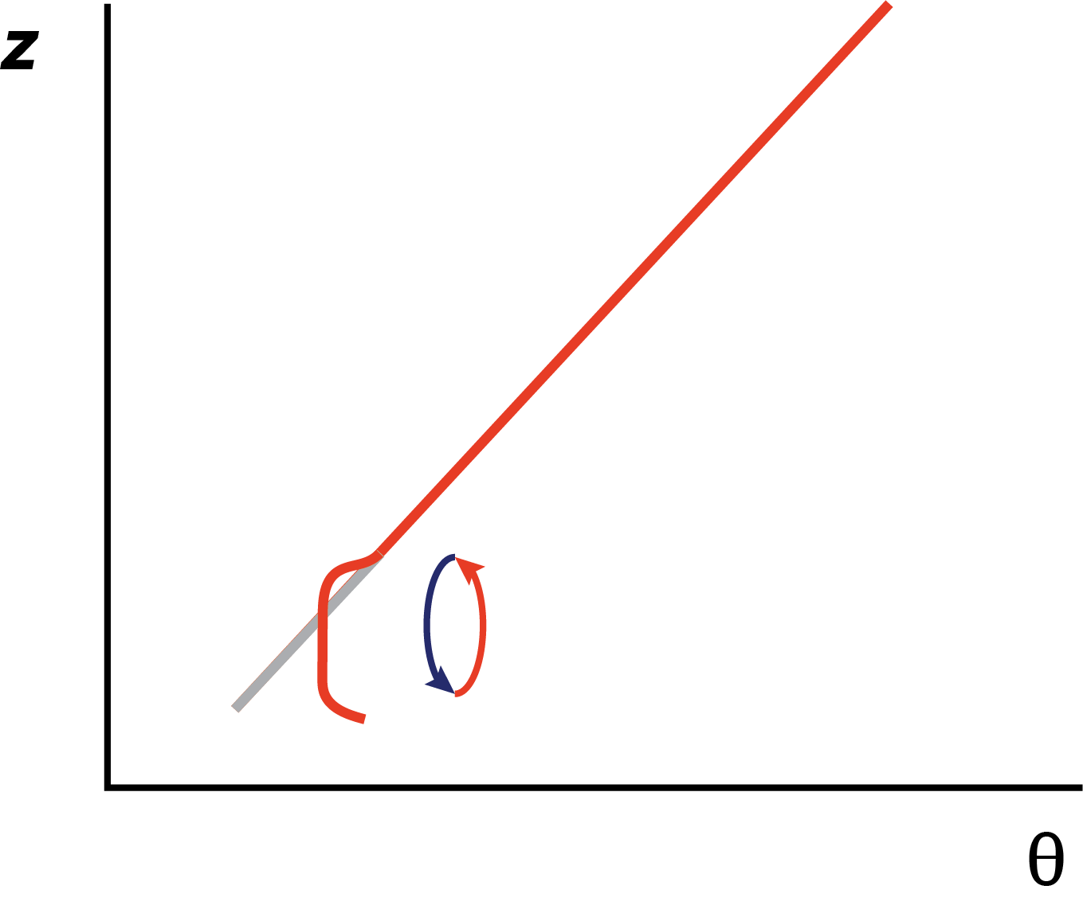
Evolution of well-mixed PBL #2
Daytime heating makes the surface layer unstable.
Mixing is restricted close to the ground, leaving
surface layer superadiabatic.

Slide 16
Evolution of well-mixed PBL #3
Above the surface layer, mixing makes θ profile neutral.
At top of PBL, air pushing from below establishes
the very stable PBL-top inversion.

Slide 17
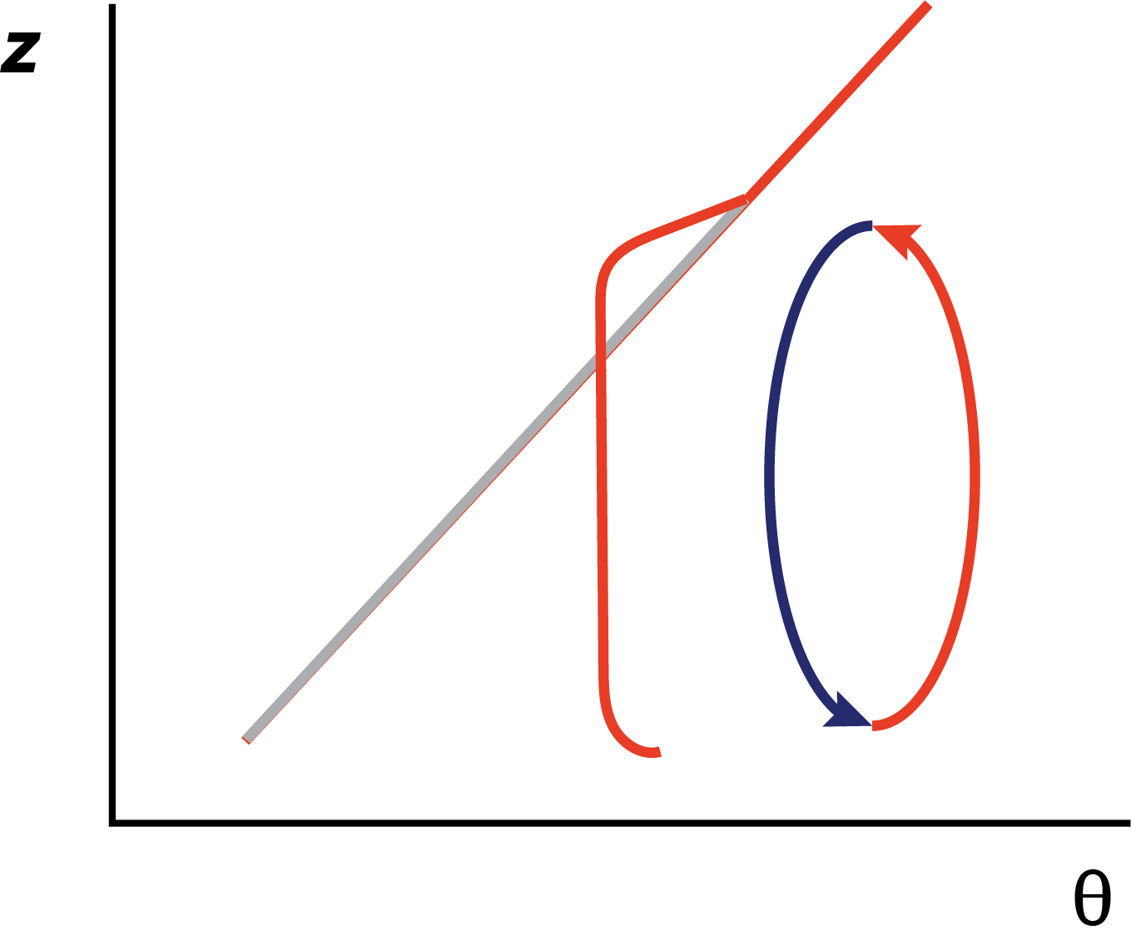
Evolution of well-mixed PBL #4
PBL top inversion
As heating continues, the surface temperature becomes warmer
and the PBL depth grows. Structure remains about the same.

Slide 18
A strongly-heated afternoon PBL
• Here, M is being compared to M_{g}, the geostrophic momentum
• The effect of surface drag can be seen in the M profile near the surface
• The straight-line large-scale wind comes into geostrophic balance
[geostrophic: Greek = Earth turns]
• However, the near-surface wind is slowed by friction. Upward mixing of slower air causes the wind to be subgeostrophic in mixed layer… during the day, anyway….
Notes:
Why does Mg increase with z? If for no other reason, mean density is decreasing with height, but that’s a pretty small effect over a 1km deep or so PBL. U itself will have less slope?

Slide 19
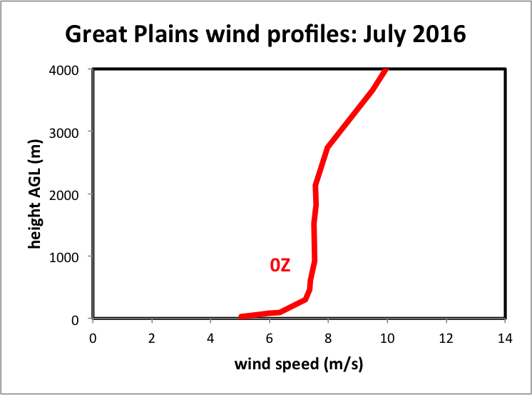
Great Plains wind profile: July 2016
next slide
Wind speed, not momentum
Averaged over 11 radiosonde stations and 31 days
Notes:
HIFREQ_July2016_analysis.xlsx
Is the mixed layer shearless? Basically, yes. Avg over large area, many days, many wx types, many PBL depths, so a lot of variability about this mean, but the mean stands out cleanly.
This is U, not rho*U,

Slide 20
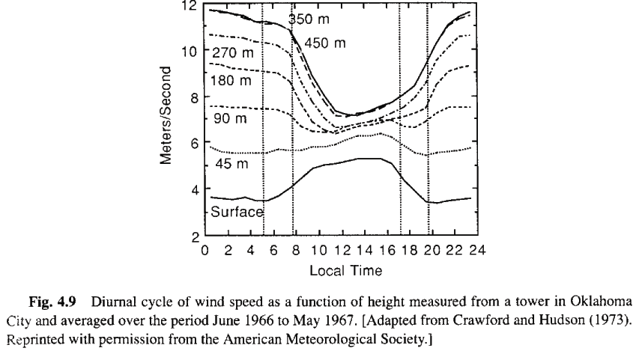
Diurnal variation of wind speed and shear with height
noon
midnight
Vertical wind shear varies through day owing to diurnally-driven mixing.
Do you see the vertical shear is larger at night, smaller in afternoon?
THIS IS MIXING WE ARE NOT RESOLVING… AND MUST PARAMETERIZE.
Hartmann’s text, p. 99
Notes:
So when is vertical shear largest? Plot can be deceptive. Largest at MIDNIGHT.
Actually, convective mixing during the DAY is mixing out the momentum, decreasing the wind at 350m and shear over the sfc-350m layer. But there’s another factor (next 2 slides)

Slide 21
PBL height
Now consider what happens with evening
Height (m)
…collapses into evening
surface inversion
Residual layer
Local time
Yamada and Mellor (1975)
Notes:
PBL height computed vs observed

Slide 22
Before evening…
PBL top inversion
Mixing layer
As heating continues, the surface temperature becomes warmer
and the PBL depth grows

Slide 23
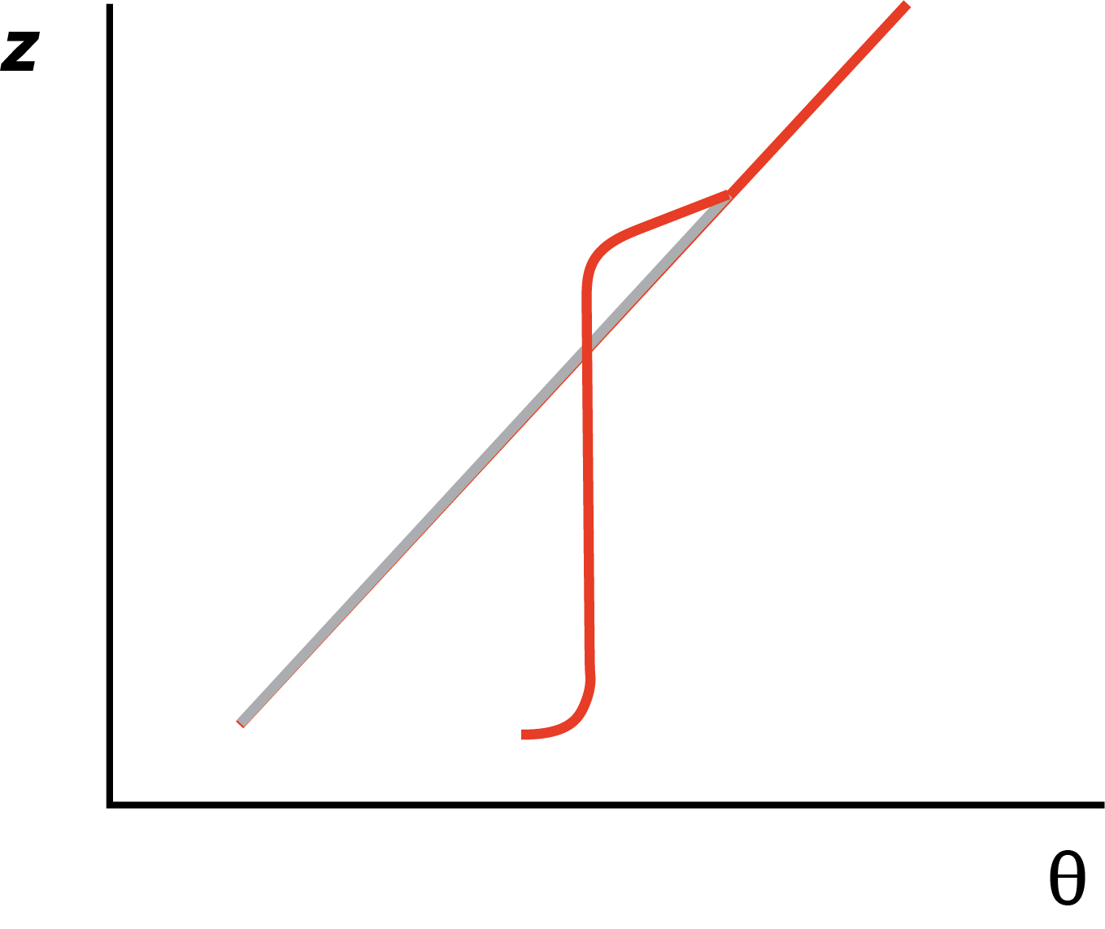
…the overnight residual layer
PBL top inversion
Residual layer
Surface inversion
Approaching evening, the surface layer stabilizes and
the surface inversion forms. Mixing vanishes but
the neutral residual layer remains.

Slide 24
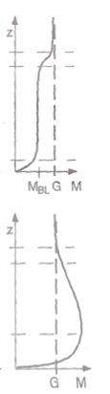
Momentum: day vs. night
Stull (2000)
• Momentum (M) during day is subgeostrophic
(M < G) owing to vertical mixing. Parcels are
brought down to the surface to get slowed by
friction
• Momentum at night is supergeostrophic (M > G).
The temporal variation of mixing influences a
pendulum-like effect on wind speed.

Slide 25
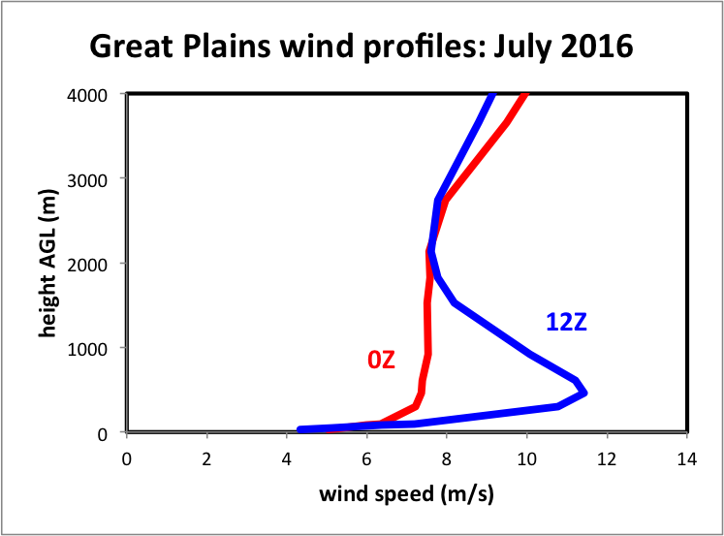
Great Plains wind profiles: July 2016
about 450 m AGL
Averaged over 11 radiosonde stations and 31 days
Notes:
HIFREQ_July2016_analysis.xlsx
Again, lots of variability but this really sticks out. These are features our PBL scheme better be able to develop
Wind speed closest to sfc actually lower but not far above, speeds higher at NIGHT

Slide 26
Visualizing the PBL diurnal cycle
Demonstration with
WRF single-column model (SCM)
Notes:
Got to here 2018, 2021, 2024 Fall

Slide 27
WRF SCM
1-D (vertical) single column
  Initialization employs input_sounding and input_soil
Many different PBL schemes in WRF, but most either prognose or diagnose eddy mixing
  Prognostic schemes predict turbulent kinetic energy (TKE) directly and use that to get K_{m}, K_{h} as functions of height
    Popular examples: MYJ and MYNN2
  Diagnostic schemes estimate the PBL layer depth and impose a vertical profile of K_{m}, K_{h} in the boundary layer [diagnostic = each time step essentially independent]
    Popular example: YSU
    Also called a “K-profile parameterization” (KPP)
TKE-prediction schemes are also generally “local schemes” (but not always)
  Local mixing is done between adjacent grid levels only
  They may struggle to accomplish deep PBL mixing
Diagnostic schemes are also usually “nonlocal schemes” (but not always)
  They include additional term(s) to accomplish deep mixing
Notes:
“local” and TKE and “nonlocal” and KPP often ised as synonyms. This is confusing.
The K profile parameterization parameterizes local mixing, so the K profile does not make the scheme non-local – the parameterized nonlocal term does
TKE schemes can also parameterize nonlocal mixig

Slide 28

Nonlocal mixing
Local mixing is from one grid volume
to adjacent grid volumes → slow
Nonlocal mixing involves deep flows
of fluid involving many grid volumes
quickly – like rising plumes → fast
https://tenor.com/view/lava-lamp-gif-14859421

Slide 29
u and v
(m/s)
theta (k)
z(m)
q_{v} (kg/kg)
sfc p (Pa)
0.0 18.00 0.000 288.0 0.0025 97200.0
200.0 18.00 0.000 286.0 0.0025
850.0 18.00 0.000 286.0 0.0025
900.0 18.00 0.000 288.0 0.0025
1000.0 18.00 0.000 292.0 0.0005
2000.0 18.00 0.000 300.0 0.0030
3500.0 18.00 0.000 310.0 0.0020
4000.0 18.00 0.000 312.0 0.0015
6000.0 18.00 0.000 312.0 0.0001
7000.0 18.00 0.000 312.0 0.0001
8000.0 18.00 0.000 312.0 0.0001
9000.0 18.00 0.000 312.0 0.0001
10000.0 18.00 0.000 312.0 0.0001
11000.0 18.00 0.000 312.0 0.0001
12000.0 18.00 0.000 312.0 0.0001
13000.0 18.00 0.000 312.0 0.0001
14000.0 18.00 0.000 312.0 0.0001
15000.0 18.00 0.000 312.0 0.0001
16000.0 18.00 0.000 312.0 0.0001
17000.0 18.00 0.000 312.0 0.0001
input_sounding
Initial wind is westerly at 18 m/s
at all height levels supplied
Starting with a little instability
near the surface
Constant θ above 4 km is not realistic
You do not have to edit this file at this time

Slide 30
TSK – skin temperature (K)
TMN – deep soil temperature (K)
input_soil
Z (depth)
0.0000000 288.0000000 288.0000000
0.0500000 288.0000000 0.2500000
0.2500000 288.0000000 0.2500000
0.7000000 288.0000000 0.2500000
1.5000000 288.0000000 0.2500000
SOILT – soil temperature(K) of each layer
SOILM – soil moisture fraction
(between 0 and 1)
The SCM model also makes use of a
large scale forcing file: force_ideal.nc
You do not have to edit this file at this time

Slide 31
Eddy mixing for momentum (K_{m})
Max values ~ 100 m²/s
Max in afternoon
Abrupt disappearance
at night
Yamada and Mellor (1975)
Notes:
Emphasize very rapid collapse of mixing as sun goes down
What’s the big difference between afternoon and overnight? MIXING. PBL. SUBGRID MIXING. Need to param it right to get the forecast right.

Slide 32
Eddy mixing for momentum (K_{m})
Vertical profile at time
of maximum mixing
Yamada and Mellor (1975)

Slide 33
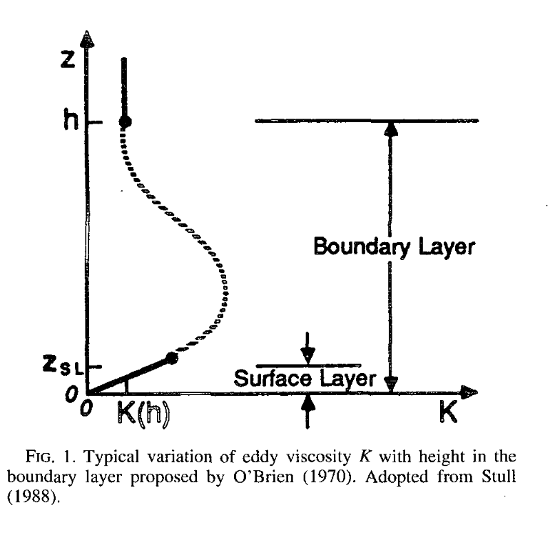
K_{m}, K_{h} profile with height
PBL depth
KPP (diagnostic schemes) impose this
TKE (prognostic schemes) try to develop it
Hong and Pan (1996)

Slide 34
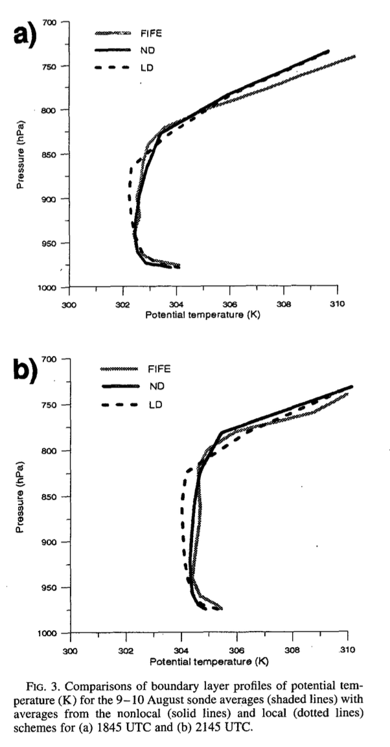
(obs)
non-local
local
obs
Hong and Pan Fig. 3
• Non-local schemes tend to do a
better job of developing an adiabatic
(constant θ or θ_{v}) mixed layer than
local schemes
• Shown are two different times during
the daytime heated boundary layer
In this study, “local” is TKE scheme,
and “non-local” is KPP+countergradient
[This will make sense later]
[Newer TKE schemes are trying to
incorporate non-local mixing]
obs
Hong and Pan (1996)
Notes:
Local scheme is superadiabatic through a much deeper layer

Slide 35
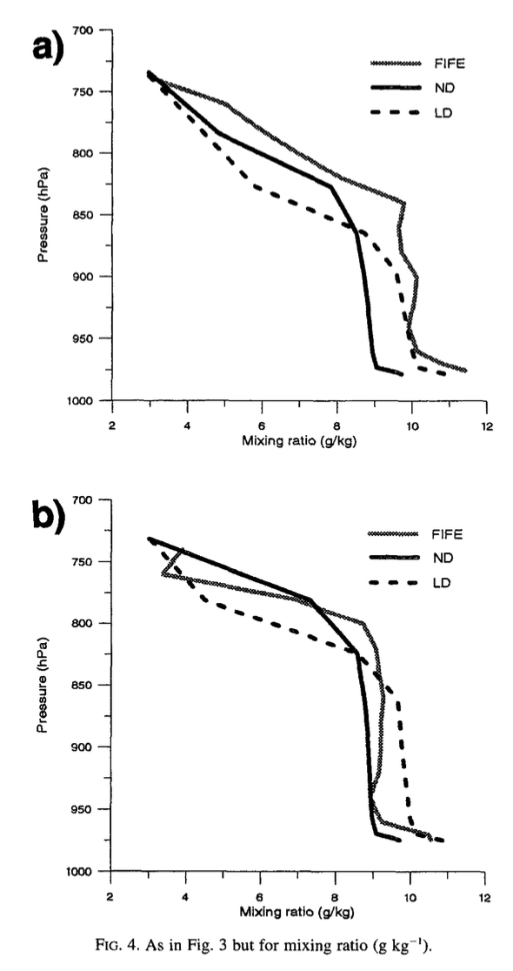
(obs)
non-local
local
Hong and Pan Fig. 4
• PBL schemes can differ with respect
to how well mixed water vapor gets.
This can influence CAPE and likelihood
of convective activity.
• Here, note non-local scheme is
drier near surface, more moist near
PBL top (too much mixing of vapor
likely)
• PBL scheme variability can be large
(see next slide)
obs
obs
Hong and Pan (1996)

Slide 36
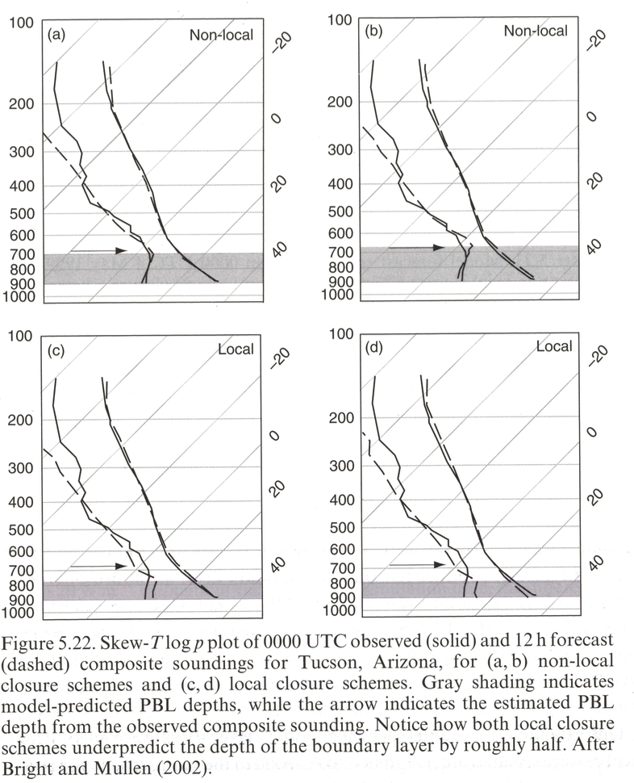
• Local schemes don’t always
do better with water vapor…
Grey shade: model PBL depth
Arrow: observed PBL depth
Stensrud’s text, p. 177; after Bright and Mullen (2002)

Slide 37
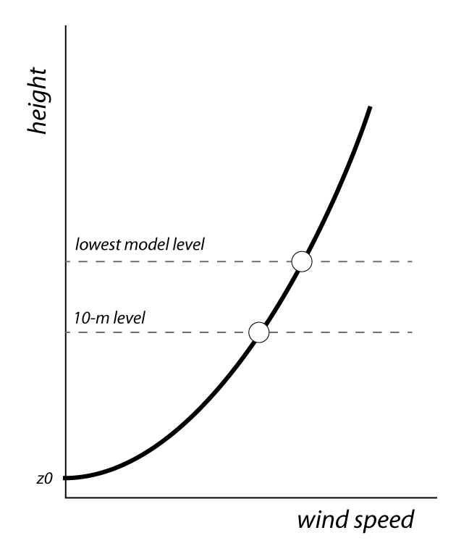
Finding the 10-m wind speed
• Very often, the lowest model
level is about 27 m above ground
level (AGL). (This is WRF default.)
- mass coordinate varies with T
• “Surface” wind observations
are taken at z ≤ 10 m AGL
• How do you compare model
winds to observations?
• Standard practice: employ log
wind profile to estimate 10 m wind
predicted
estimated

Slide 38
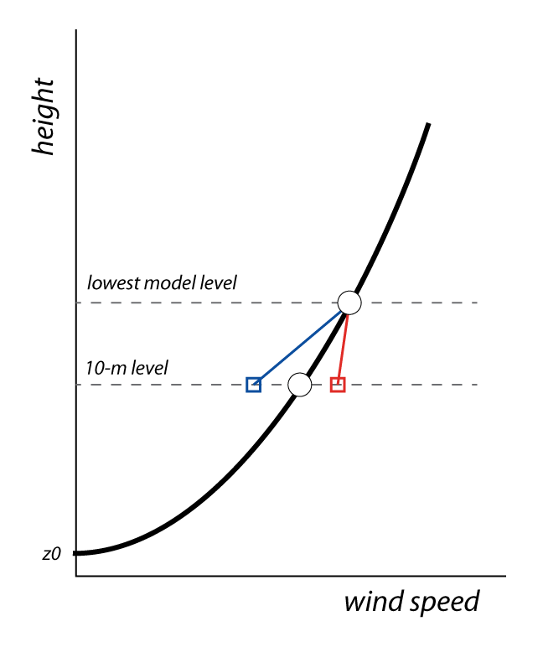
Finding the 10-m wind speed
• Recall the log profile assumes
neutral conditions, and requires
adjustment when not neutral
• An unstable surface layer has
less vertical shear, so neutral log
profile would underestimate 10-m
wind
• A stable layer has more shear, so
the unadjusted 10-m wind is too
large
• As wind speed increases, surface
layer often presumed neutral
Notes:
Got to here 2019, 2023

Slide 39
Finding the 10-m wind speed
If the log wind profile is valid at both the first model
level (z = Z_{a}) and at 10 m, then the 10-m wind (V₁₀) in
terms of the first model level wind V_{a} is:
Stability corrections
computed at 10m and Z_{a}
(Zero when neutral)
(divided two log wind profiles
for first model level and 10-m level)

Slide 40
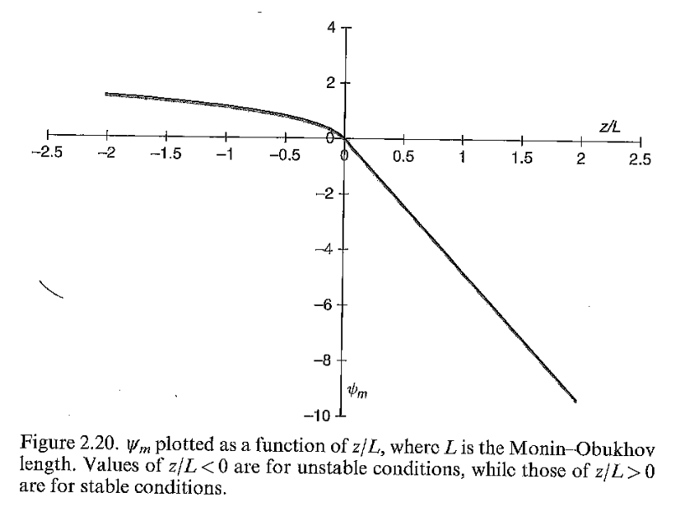
Stability function ψ
• In WRF, you call PBL & surface layer
schemes separately (and a
land surface model as well)
• A function similar to this is
employed in the surface layer
scheme, but varies among schemes
• L is computed. Then ψ is computed
at lowest model U level Z_{a} and at
the 10 m level
• This is applied to log profile to get
10-m wind from the Z_{a} wind
[equation on last slide]
unstable
stable
Stensrud’s text, p. 38

Slide 41
LANDUSE.TBL
Log wind profile
Surface roughness z₀, in centimeters
USGS SUMMER
ALBD SLMO SFEM SFZ0 THERIN SCFX SFHC ’
1, 15., .10, .88, 80., 3., 1.67, 18.9e5,'Urban and Built-Up Land'
2, 17., .30, .985, 15., 4., 2.71, 25.0e5,'Dryland Cropland & Pasture'
3, 18., .50, .985, 10., 4., 2.20, 25.0e5,'Irrigated Cropland & Pasture'
4, 18., .25, .985, 15., 4., 2.56, 25.0e5,'Mixed Dryland/Irrigated Crop'
5, 18., .25, .98, 14., 4., 2.56, 25.0e5,'Cropland/Grassland Mosaic'
6, 16., .35, .985, 20., 4., 3.19, 25.0e5,'Cropland/Woodland Mosaic'
7, 19., .15, .96, 12., 3., 2.37, 20.8e5,'Grassland'
8, 22., .10, .93, 5., 3., 1.56, 20.8e5,'Shrubland'
9, 20., .15, .95, 6., 3., 2.14, 20.8e5,'Mixed Shrubland/Grassland'
10, 20., .15, .92, 15., 3., 2.00, 25.0e5,'Savanna'
11, 16., .30, .93, 50., 4., 2.63, 25.0e5,'Deciduous Broadleaf Forest'
12, 14., .30, .94, 50., 4., 2.86, 25.0e5,'Deciduous Needleleaf Forest'
13, 12., .50, .95, 50., 5., 1.67, 29.2e5,'Evergreen Broadleaf Forest'
14, 12., .30, .95, 50., 4., 3.33, 29.2e5,'Evergreen Needleleaf Forest'
15, 13., .30, .97, 50., 4., 2.11, 41.8e5,'Mixed Forest'
16, 8., 1.0, .98, 0.01, 6., 0., 9.0e25,'Water Bodies'
These z0 are starting points;
Some schemes modify them
(see also VEGPARM.TBL,MPTABLE.TBL)
Aside: As of WRF v3.9, MODIS landuse database is now the default
Notes:
Water – 0.01 cm = very smooth (a problem when windy)
Urban area 80 cm (2.6 ft)
In between: shrubland (5 cm), grassland (12 cm), cropland (14-20 cm), forest (50 cm). Density and height of vegetation.

Slide 42
Nomenclature
Surface layer scheme handles interactions with the surface, computes friction velocity, log profile stability adjustment, 2-m T and q_{v} and 10-m winds. sf_sfclay_physics
PBL scheme uses surface layer scheme information and computes PBL height and mixing K_{m} and K_{h} (and maybe TKE). bl_pbl_physics
Land surface model (LSM) uses surface layer scheme information to compute surface fluxes of heat and moisture, interaction with soil, and effect of vegetation canopy. Provides z₀. sf_surface_physics
PBL and surface layer schemes often paired, and LSM selected independently, but not always. But, they’re all tied together, and strongly influence each other.

Slide 43
(not drawn to scale)
Z_{a}
10 m
2 m
0 m
LH = QFX•Lv
LH = W/m²
QFX = kg/m²/s

Slide 44
Do PBL_demonstration script
Notes:
Got to script line 125

Slide 45
[end of Part II]

